Slide 1
Aspects of realistic model building
Kang-Sin Choi
Ewha Womans University
Duality and Novel Geometry in M-theory
APCTP, Pohang, Jan. 29, 2016.

Slide 2
Contents
Supergraity in 12D
  Based on
  1409.2476 EPJC
  1504.00602 JHEP
Double Field Theory Standard Model
  Based on
  1506.05277 PRL with Jeong-Hyuck Park (Sogang)

Slide 3
Supergravity in 12D
Based on
1409.2476 EPJC
1504.00602 JHEP

Slide 4
Why higher dimension?
Simple principle
  Kaluza Klein
    5D pure gravity = 4D gravity + Maxwell A_{μ} + scalar
  N > 1 supersymetries
    A collection of multiplets = just a single multiplet in higher dim
  Flavor physics
    Couplings are overlap of wavefns in the internal dimensions.
Complicated 4D physics
= geometry of extra dimensions
String theory predicts extra dimensions

Slide 5

Kaluza and Klein
Pure 5D gravity
on a circle S¹: G_{mn} ~ (G_{μν}, G_{μ5}, G₅₅)
isometry = U(1) gauge symmetry
= 4D gravity + Maxwell + scalar
Consistent truncation

Slide 6
Supersymmetry
{Q,Q*} = P : P Poincare
[M,Q] = ½ Q : Q carries angular momentum ½.
Creation / annihilation
A⁺| λ > = | λ + ½>
N generators
(A⁺)^{N} | λ > = | λ + N/2 >
No consistent interacting theory with spin higher than 2.
Gravity multiplet -2 + N/2 = 2
N = 8

Slide 7
Supersymmetry from higher dimensions
Many N = 1 multiplets = a single multiplet in N ≥ 2 SUSY
Also understood as dimensional reduction of
the minimal SUSY of a higher dimensional theory.
  Isometry of extra dimensions = R-symemtry
vector
chiral₊
chiral
chiral₋

Slide 8
The maximal dimension
Maximal Poincare = 11D SUGRA [Nahm]
  Fermions are 32 component Majorana-Weyl.
Dimensional reduction on a circle gives
10D IIA supergravity (parity symmetric)
Any D ≥ 12 multiplet contains
λ > ½ state (in 4D language)
We know another 10D IIB supergravity: from where?
  Cf. 12D with Lorentz sign. (10,2). Cliff(10,2) ~ Cliff(9,1)
  We need compact torus. e.g. finite Newton constant.

Slide 9
IIB action
The action becomes very simple if we complexify
𝜏 = A₀ + i e^{φ}, B₂ - 𝜏 A₂,…
has typical form of dimensionally reduced form with two extra dimension of a torus,
with the complex structure 𝜏 ~ SL(2,Z).
  Cf. No Kahler (volume)
No-go: the maximal dimension is 11D.
Notes:
S_{\rm IIB} = \frac{M^8}{2} \int d^{10} x \sqrt{\det g} \left( R-\frac{2 \partial \tau \bar \partial \overline \tau}{(\tau - \overline \tau)^2 }+ \dots \right)

Slide 10
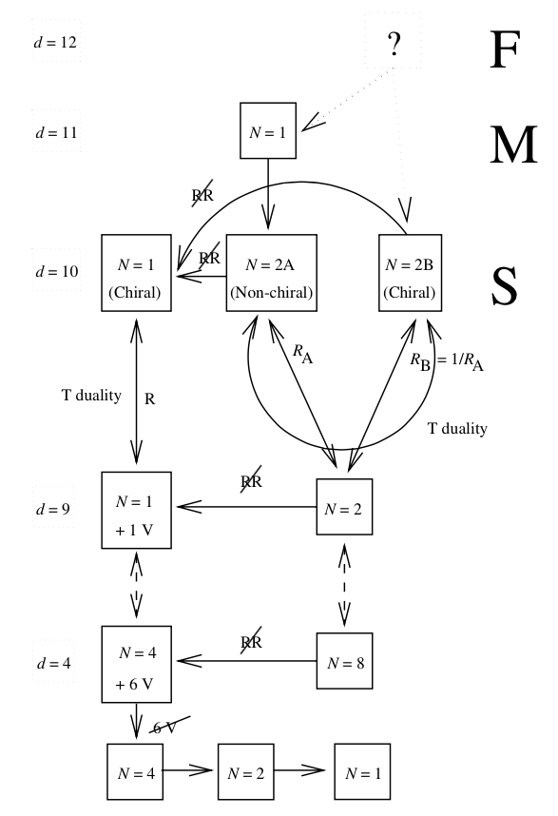
The highest dimensional theory
12D SUGRA?
Clue: M-theory on T²,
with Vol T² → 0
= F-theory
See also [Berman, Blair, Malek, Rudolph]
Berman’s, Blair’s, Malek’s talk
[Ortin]

Slide 11



12D SUGRA Formulation
circle
12D = (10+1)D Poincare + 1D circle
Graviton G_{mn}, G_{y’y’} = r²
M-theory three form – F-theory four form
Action
  Cf. essentially 11D SUGRA except r.
No-go theorem [Nahm] circumvented
M,N 12D indices
m, n 11D indices

Slide 12
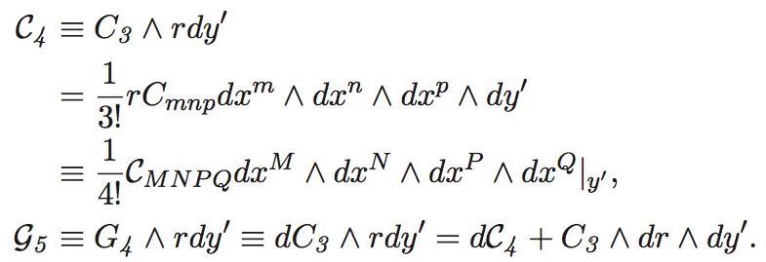
Field contents
Identical to 11D theory except G_{y’y’} = r²

Slide 13
Known compactification
circle
(9+1)D Poincare + circle + circle
Dimensional reduction of fields:
keeping the zero modes (KK tower)
Reproduces 11D SUGRA
Further compactification on S¹_{x}
Reproduces 10D IIA SUGRA (parity even)
another circle

Slide 14
Further compactification
circle
(8+1)D Poincare + circle + circle + circle
Compactification on S¹_{y’} gives 11D SUGRA
Further compactification on S¹_{x} gives 10D IIA SUGRA
Further compactification on S¹_{y} with angle
9D N=2 SUGRA
torus
Notes:
With KK
d s^2 = e^{4\phi/3} \left(d x + \tau_1 d y +(a_{\mu} - \tau_1 b_{ \mu}) d x^\mu \right)^2 + e^{4\phi/3} \tau_2^2 \left( d y - b_{\mu } d x^\mu\right)^2
+r^2 d y^{\prime 2} + g_{\mu \nu}' dx^\mu dx^\nu.

Slide 15

Unique 9D N = 2 SUGRA
[Bergshoeff, Hull, Ortin 95]
(8+1)D Poincare + circle + torus
The y-circle isometry KK U(1) b_{μ}
Fields reduction ex.
Looks like also dim reduction of IIB
with emergent graviton K_{μ} = C_{xyμ} (IIA) = G_{y’ μ} (IIB)
  Cf. T-duality
    Type IIA string on the y-circle = IIB string on the y’-circle
    IIA momentum = M2 wrapped on the torus.
circle
torus

Slide 16
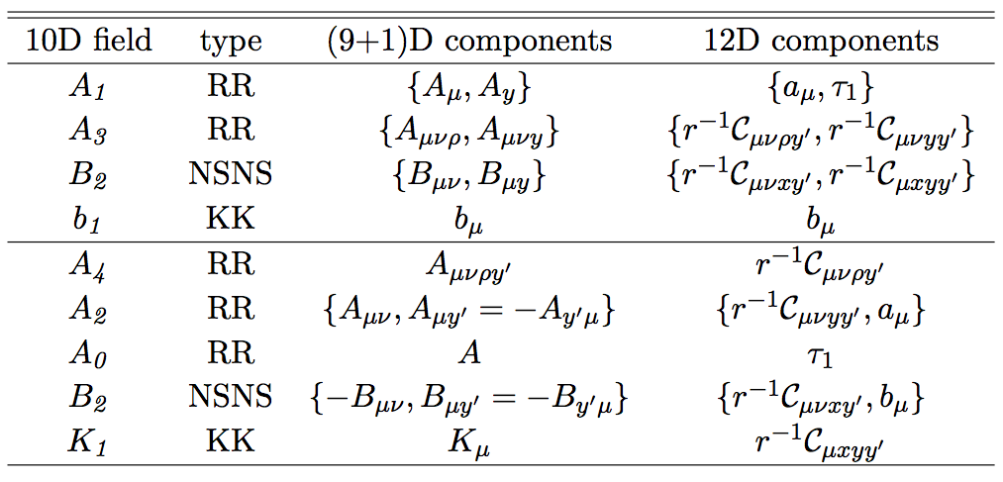
Field reduction
IIA
IIB

Slide 17

Decompactification
torus
circle
decompactified
10D IIA
10D IIB
Shrinking the torus decompactifies the y’
  We had KK towers in the y’ direction (12th direction)
Another 10D Poincare SUGRA: IIB
  Explicit IIB action from the dim reduction of 12D action.

Slide 18
Valve structure
Starting from 9D
Explicit metric in string frame
ϕ → ∞: x, y space decompactify, recovering 11D SUGRA
  Further compactification e^{ϕ} τ₂ → ∞ gives 10D IIA SUGRA
ϕ → 0: y’ space decompactifies, recovering 10D IIB SUGRA
torus
circle
11D
10D IIB
Notes:
String frame: ds^2 = e^{2 \phi} (dx + \text{KK})^2 + e^{2 \phi} \tau_2^2 (dy + \text{KK})^2 + e^{-2 \phi} \tau_2^{-2} dy^{\prime 2} + g_{\mu \nu}^{\text {9D,string}} dx^\mu dx^\nu

Slide 19


Self-duality
IIB SUGRA has RR fields with var rank A₀, A₂, A₄
A₄ satisfies self-duality
No covariant action satisfying this
  Constraint by hand to equation of motion
From 12D Hodge duality
Requiring 10D covariance in the index structure fixes

Slide 20
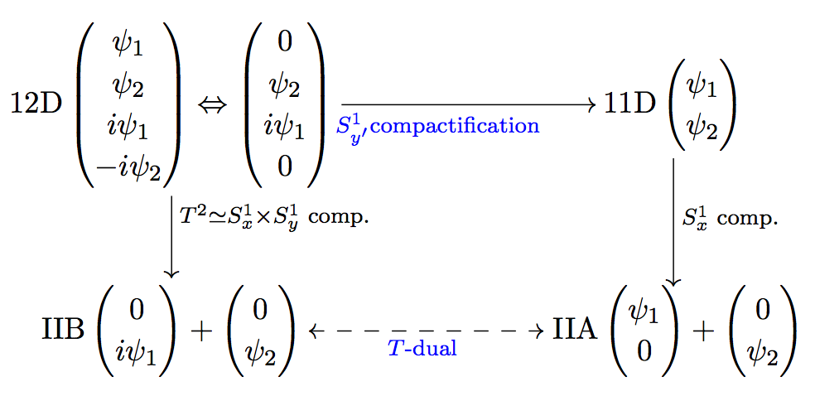
Fermions
32 SUSY gen: 11D Majorana embedded in 12D
In 12D (4D) we can convert 12D Majorana ↔ 12D Weyl
This Weyl can give 2x Majorana-Weyl in 10D
Chiral IIB

Slide 21

Emergent gravitino
The fermionic part is identical to that of IID SUGRA
without the y’-comp. Cf. No-go
Co-dependence
Supersymmetrizing the both sides
Decompactifying the y’-dir
it becomes a component of covariant gravitino.
10D IIB

Slide 22
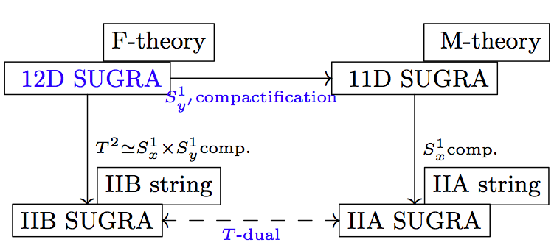
Summary 1: T-duality
11D SUGRA = 12D SUGRA on a circle.
T-duality is compactification.
Decompactification

Slide 23
Summary 2: Why 12D?
T-duality is a compactification.
  Decompactification requires KK towers of massive states.
Hodge duality in 12D, defining A₄ and F₅
self-duality.
IIB axion-dilaton = complex structure of the extra torus.
C_{mnpy’} suggests a 3-brane
A 3-brane wrapped along y’ = M2 brane
A 5-brane transverse to y’ = M5 brane
Spinors in 12D exchanges 10D Majorana and Weyl.

Slide 24
The Standard Model as Double Field Theory
Based on 1506.05277
In collaboration with Jeong-Hyuck Park (Sogang)

Slide 25
Introduction
Guiding principle beyond the Standard Model (SM)
What if the origin of the SM is string theory?
More restrictive symmetry of string theory: selection rules
If double field theory is correct framework, the SM should be embeddable.
Predictions?

Slide 26
SM as DFT
[KSC, J-H Park 15]
We require O(4,4,Z) T-duality invariance
Diffeomorphism invariance, generalized to O(4,4)
Symmetry
O(4,4) / [O(4) x O(4)]
  For “external” spacetime,
  we mean Lorentzian spaces with signatures (- +++) (+---).
  two spin groups Spin (1,3) x Spin (3,1) local symmetry.
We need to embed gravity, YM and chiral fermions,
under these more restrictive symmetries.

Slide 27
Warmup: covariant derivatives
To couple gauge field, from local U(1) transformation
  generalized to nonabelian gauge groups.
To couple graviton field, from diffeomorphism
To couple graviton field, from local Lorentz SO(D) transformation
The Christoffel connection obtained from metric compatibility
The spin connection obtained from vielbein compatibility .

Slide 28
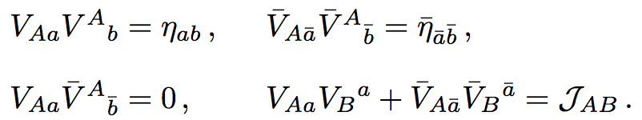
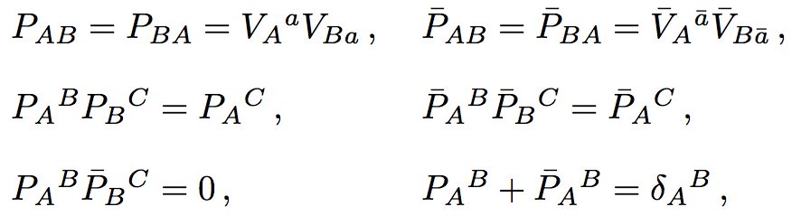
Double field theory
Vielbeins
  form frojectors
  and generalized metric

Slide 29

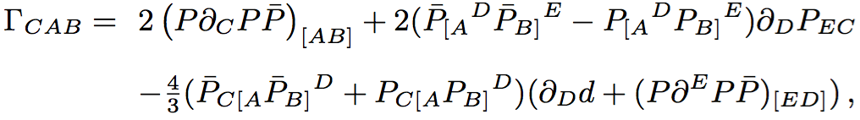
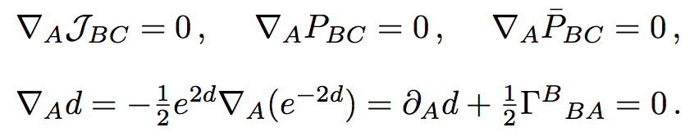
Semicovariant derivative
Semicovariant derivative [I. Jeon, K. Lee, J.-H. Park 11] I. Jeon’s talk.
  With the connection
    From O(D,D) metric compatibility

Slide 30
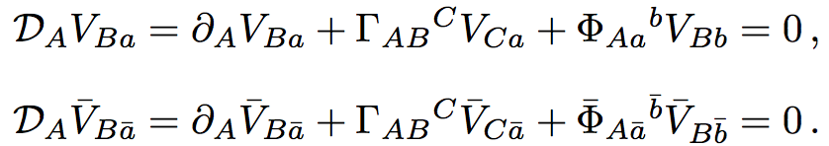
Inclusion of two spin connections
[I. Jeon, K. Lee, J.-H. Park 11, 12] I. Jeon’s talk.
Two spins from Spin(3,1) x Spin(1,3)
  The two spin connections from generalized vielbein compatibity and other fields

Slide 31
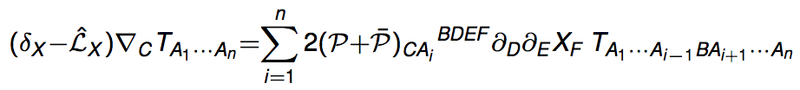

Full O(D,D) covariance
[I. Jeon, K. Lee, J.-H. Park 11, 12] I. Jeon’s talk.
Discrepancy between generalized diffeomorphism
Full diffeomorphic covariance by further projection
by at least one and one

Slide 32




Gauge field
We introduce Lie algebra-valued gauge field
with field strength
Gauge transformation
The section condition is also covariantized wrt A_{A}

Slide 33


The theta term
[KSC, J-H Park]
At-least-one-one index condition:
are not fully covariant.
The only allowed is
The Lagrangian including Higgs looks
In particular, we cannot form
  cf. the strong CP problem. cf. another phase from fermions.
[I Jeon, K Lee, JH Park 2011]
θ

Slide 34
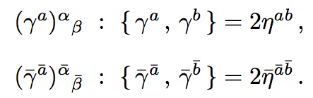
Two Lorentz symmetries
[Duff] [Siegel] [I Jeon, K Lee, JH Park]
For uncompact spacetime symmetry
O(4,4) / [O(4) x O(4)]
  we mean Lorentzian spaces with signatures (- +++) (+---).
Two spin groups Spin (1,3) x Spin (3,1)
  Two kinds of fermions and gamma matrices
Gauge symmetries: ‘covariant derivative’ spin connection

Slide 35

Fermion bilinears
[KSC, J-H Park]
Due to two Lorentz symmetries
with as many kinds gamma matrices,
Many fermion bilinears are forbidden
eg. , forbidden
From the Standard Model matter Lagrangian
q ~ u ~ d, but l ~ e can belong to different Lorentz group.

Slide 36
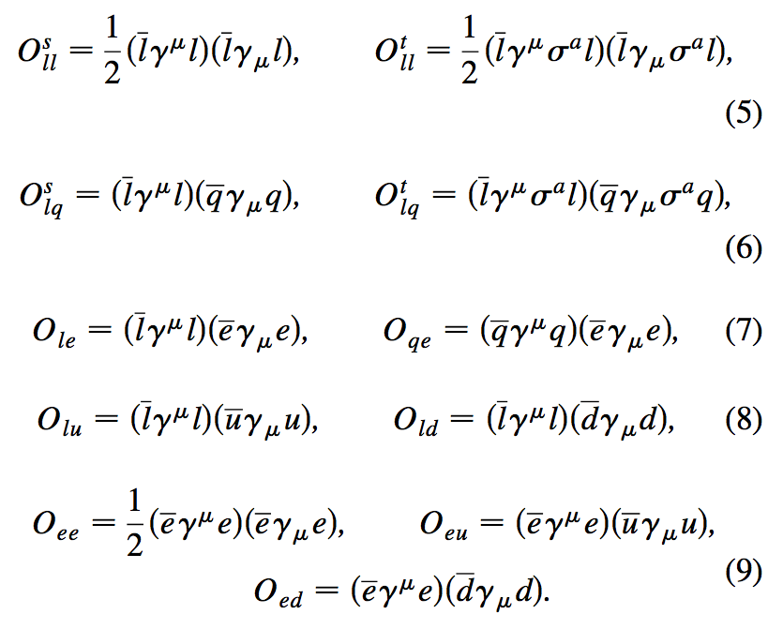
Higher dim. effective Ops.
Dimension 5 [Weinberg] lhlh
Many operators of dimension 6. ex. forbidden.
ex. [Han, Skiba 05]

Slide 37
Summary: SM DFT
The origin of gravity and the SM may be traced to string theory.
Double field theory can incorporate T-duality symmetry
  Gauge interaction: restriction from diff invariance of the doubled symmetry.
  We cannot have covariant theta term: strong CP problem.
  Fermion interactions: O(3,1)xO(1,3) gauge symmetry is very restrictive.

Slide 38
Thank you!

Slide 39
Supplementary

Slide 40
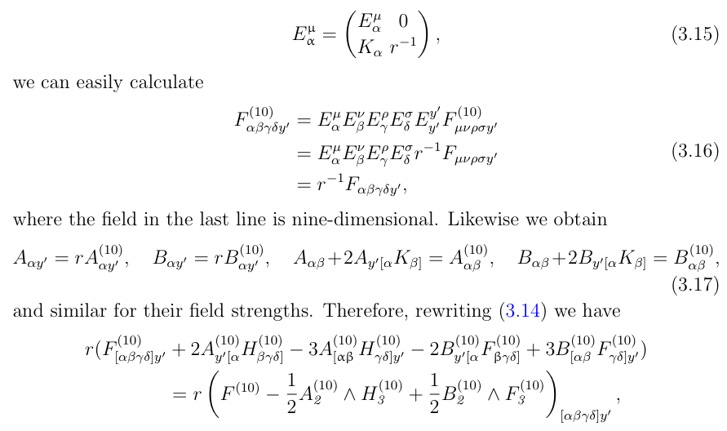
Decompactification

Slide 41
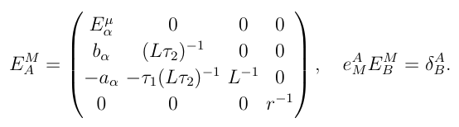
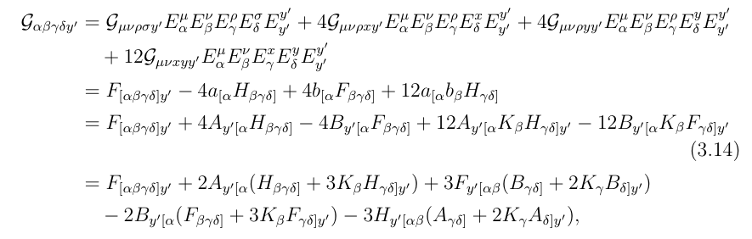

Slide 42
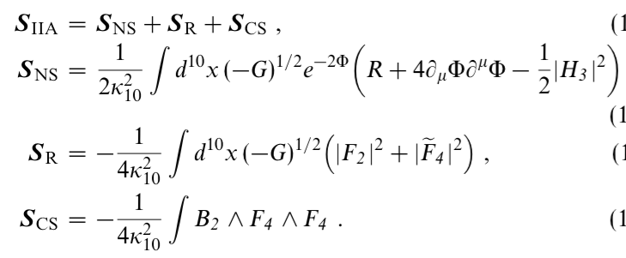
10D IIA action
We still use F4 instead of tilde F4

Slide 43
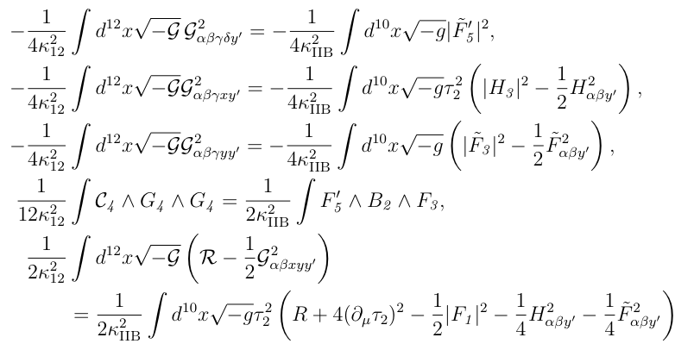
10D IIB action

Slide 44
Origin of gauge boson ‘closed’-style
Cf. Compactification of heterotic string on internal T⁶
Moduli space O(22,6) / [O(22) x O(6)]
  O(22,6): different compactification
  O(22) and O(6) gauge symmetries.
The net physical fields have d.f.
taking into account
  g_{mn}: 6•7/ 2 = 21
  B_{mn}: 6•5/ 2 = 15
  A_{m}^{I}: 16•6
  Enhancement to nonabelian

