Slide 1
Holography without Counter terms
Duality and Novel Geometry in M-theory Jan. 26-Feb. 04, 2016,
APCTP, Postech, Pohang, Korea
Based on arXiv:1512.09319 and a paper writing on
Kyung Kiu Kim(Yonsei Univ.)
With
Byoungjoon Ahn, Seungjoon Hyun, Sang-A Park, Sang-Heon Yi(Yonsei Univ.), Keun-Yung Kim(GIST) and Miok Park(KIAS)

Slide 2
Success of QM and GR(100 years old)
QFT + GR = ?
Black hole, Early Universe (Still we don’t know…)
We need the Quantum Gravity theory.

Slide 3

A hint for the Classical and Quantum Gravity – Thermodynamics of Black holes
Entropy of black holes = Area
Entropy
= Log ( number of Accessible states )

Slide 4
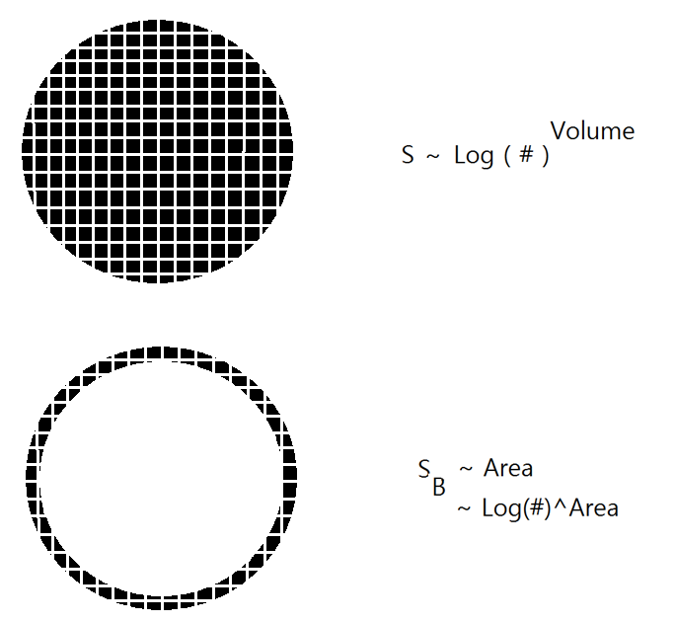
3+1 dimensional BH
~ 2+1 dimensional QFT system
This could be an important clue for the Quantum nature of Gravity

Slide 5
AdS/CFT
Two descriptions for D3 branes
Open string description -> Low energy limit -> N=4 super YM in 4 dimensions(S conformal gauge theory)
Closed string description : Black brane solution in 10 dimensions
-> Low energy limit -> Closed string theory on Near horizon geometry AdS_5 X S^5 ( Effectively 5 dimension )

Slide 6

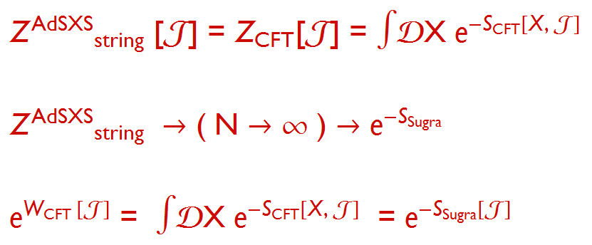
AdS/CFT
N=4 SYM theory in 4d
= gravity theory in AdS_5
There are many evidences…

Slide 7
Extension of AdS/CFT
Gauge/gravity correspondence
AdS/QCD
AdS/CMT
Fluid/gravity correspondence

Slide 8
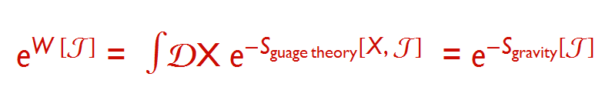
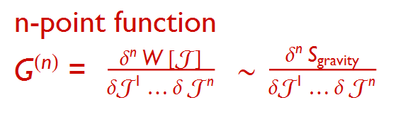
Gauge/gravity correspondence
This could be an effective description.
Model OK but As a theory ?

Slide 9
Let us remind the consistent construction of QFT.
Quantum field theory(Weak coupling)
1. Symmetry(Ward Identity,..)
2. Renormalization
3. RG( limit of perturbation )

Slide 10
Holgraphic principle
To obtain d+1 dimensional strongly coupled field theory, we may propose (d+1)+1 dimensional Gravity theory as another approach whose framework is similar to that of the QFT
1. Symmetry
2. Holographic renormalization
3. RG( validity of this method )

Slide 11
Let us remind the consistent construction of QFT.
Quantum field theory(Weak coupling)
1. Symmetry(Ward Identity,..)
2. Renormalization
3. RG( limit of perturbation )
To obtain d+1 dimensional strongly coupled field theory, we may propose (d+1)+1 dimensional Gravity theory as another approach whose framework is similar to that of the QFT
1. Symmetry
2. Holographic renormalization
3. RG( validity of this method )
This looks so plausible but there are many things we need to understand and check.
1. How do we identify the Bulk symmetries and the Boundary symmetries?
2. In some cases the holographic renormalization is not clear.

Slide 12
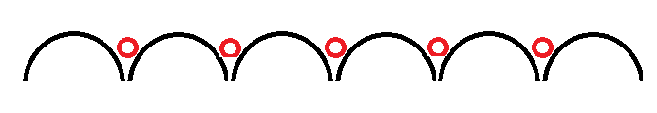
Boundary Symmetry to Bulk Geometry
Now we will show how a boundary symmetry can be encoded to bulk geometries.
An example : Recently holographers are interested in CMT.
In condensed matter theory the translational symmetry is broken. -> Finite DC conductivity, Drude model behaviors.

Slide 13


Translational sym. breaking is related to diffeomorphism invariance for a spatial direction.
Ex) Drude-Model
We have think about ways to break translational invariance.

Slide 14

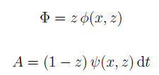
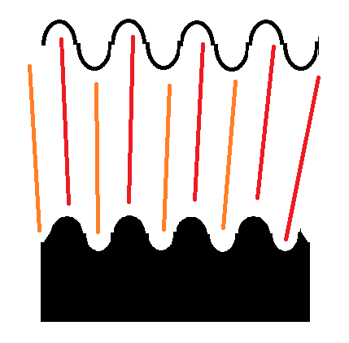
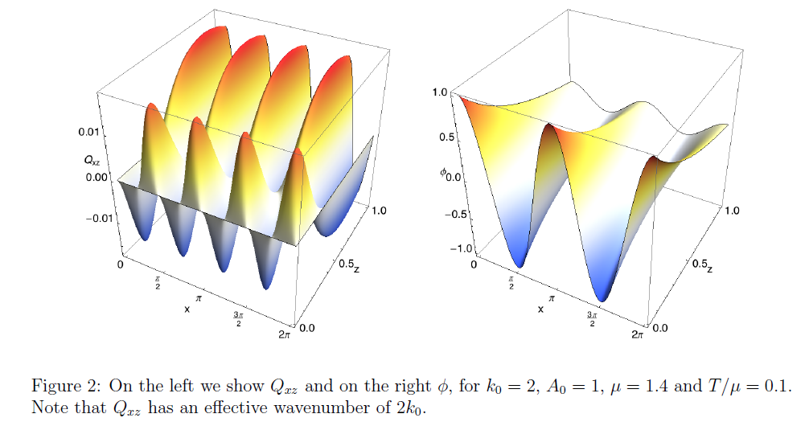
3 ways for broken translational symmtry
1. Giving spatial modulations (Santos Tong Horowitz 2012) -> solve PDE numerically

Slide 15



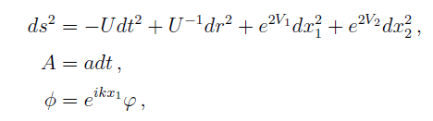
3 ways for broken translational symmtry
2. Axion Model or Q-lattice Model(Andrade and Withers 2013, Donos Gaumtlett 2013)
One can avoid PDE.

Slide 16


3 ways for broken translational symmtry
Translational Symmetry Breaking
-> Gravitational Higgs Mechanism
Graviton becomes massive..
3. Massive gravity Model (Vegh and Tong 2013)
Ex)
This shares a same black brane solution with the Axion model.

Slide 17
Boundary(Field theory side) symmetry can be described by Ward identities.
Let us consider WI related to diffeomorphism.

Slide 18
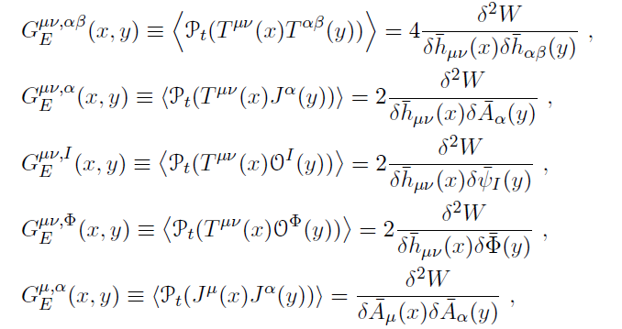
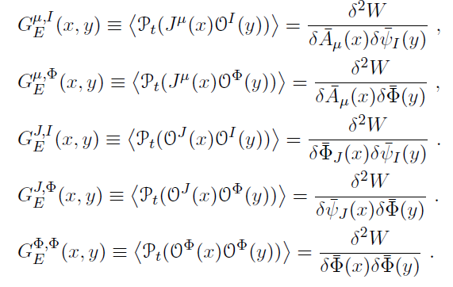
Derivation of the Ward identity
Corresponding operator expectation values
Two point functions

Slide 19

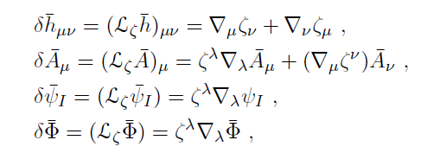
Derivation of the Ward identity
We assume that this system has diffeomorphism invariance and gauge invariance related to the background metric and the external gauge field.
The transformations

Slide 20


Derivation of the Ward identity
Variation of the generating functional
After integration by part, one can obtain a Ward identity( The first WI )
For gauge transformation

Slide 21
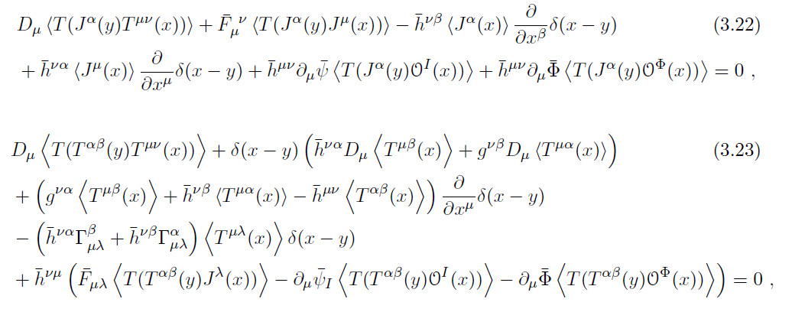
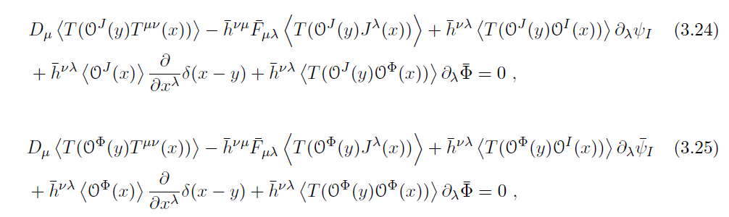
Derivation of the Ward identity
Taking one more functional derivative

Slide 22

Derivation of the Ward identity
More Assumptions:
Constant 1-pt functions and constant external fields
Then, we can go to the momentum space.

Slide 23
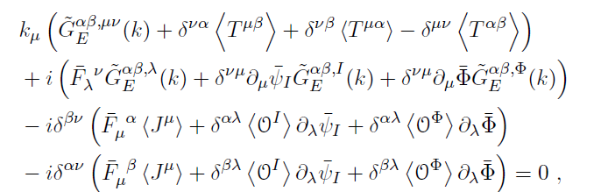

Derivation of the Ward identity
Euclidean Ward identities in the momentum space

Slide 24
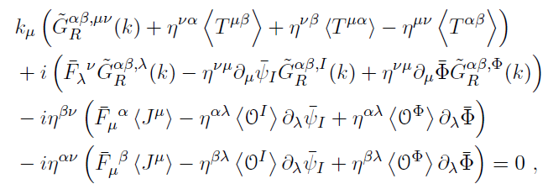
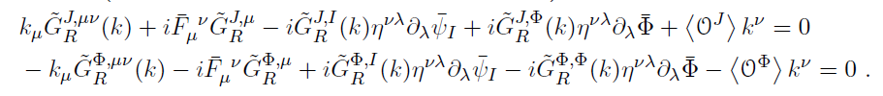
Derivation of the Ward identity
After the wick rotation
Ward identity with the Minkowski signature

Slide 25


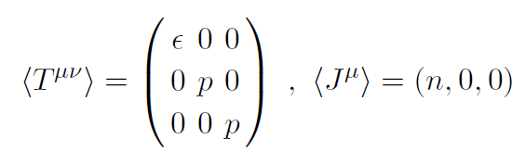

Derivation of the Ward identity
For more specific cases
Turning on spatial indices in the Green’s functions
i
0i
i
)

Slide 26
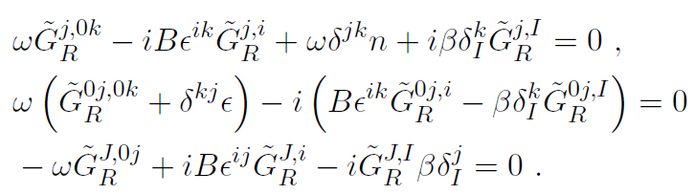



Derivation of the Ward identity
Practical form of the identity( The 2nd WI)
So far the derivation has nothing to do with holography.
Conditions
- 2+1 d, diffeomorphism invariance and gauge invariance
- Special choice of the sources
- non-vanishing correlation among the spatial vector currents

Slide 27
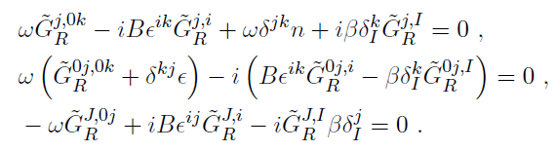

Derivation of the Ward identity
Let us consider the ward identity without the magnetic field
B=0 and i = x

Slide 28
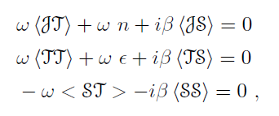

Derivation of the Ward identity
The Ward identity for the two point functions
Plugging thermo-electric conductivities into the WI,,,

Slide 29
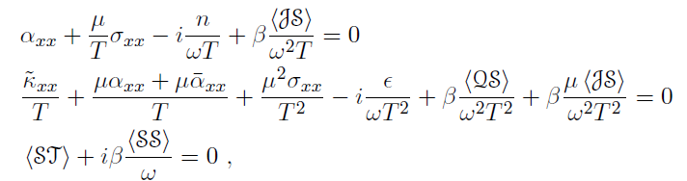


Derivation of the Ward identity
The Ward identity for the conductivities
We need subtraction

Slide 30
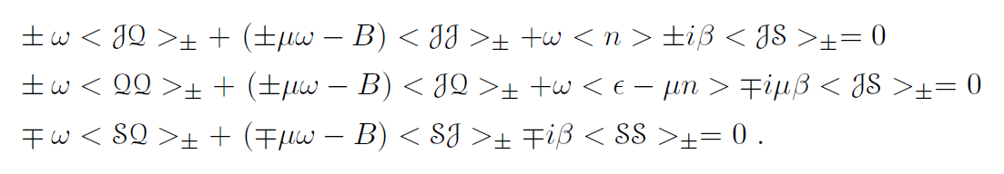

Derivation of the Ward identity
Let’s consider WI in the magnetic field
Previous form
of the W I
The ward identity in the magnetic field B
With

Slide 31
Test with a Holographic Model
Let us find consistent holographic models with the condition of the Ward Identity.
2+1 d, diffeomorphism invariance and gauge invariance
- special choice of the sources
- Non-vanishing correlations among only the spatial vector currents

Slide 32
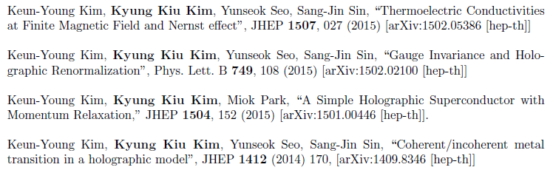




AC conductivity from Gravity
Two point functions in terms of frequency..
To apply to condensed matter theory

Slide 33
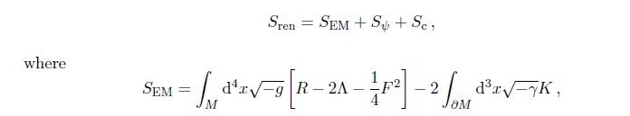


A Holographic model

Slide 34
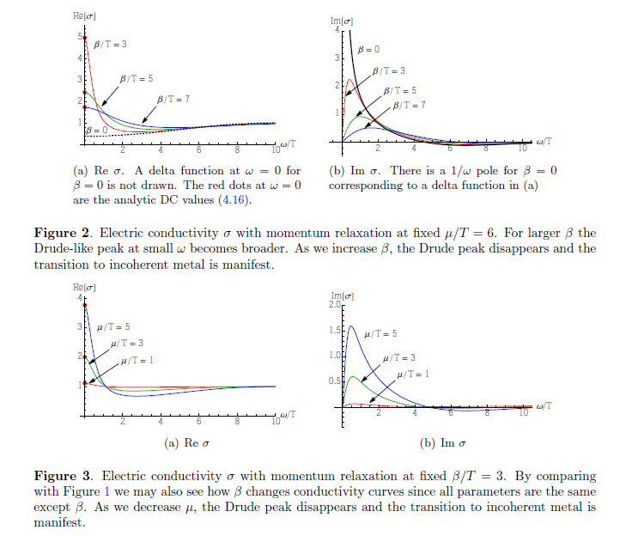
RN black hole modified by the Axion

Slide 35
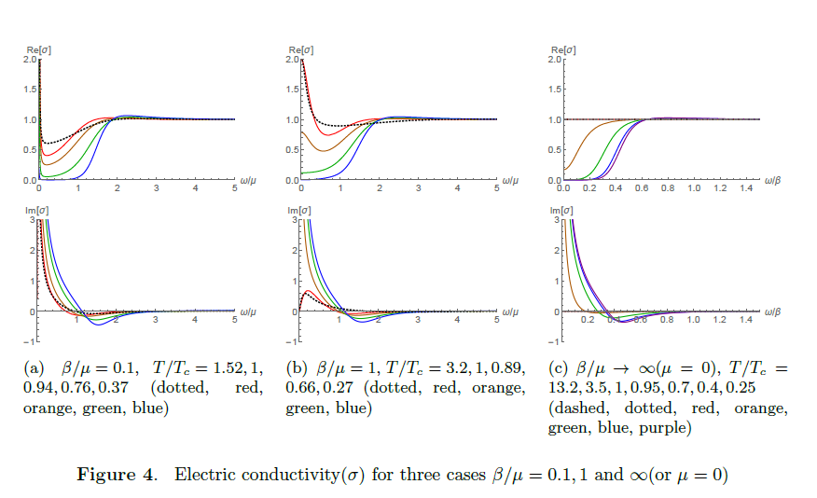
Holographic Superconductors

Slide 36
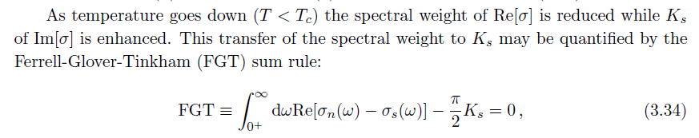
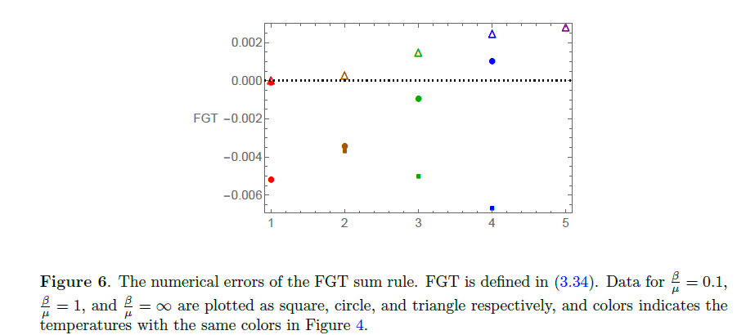
FGT sum rule

Slide 37
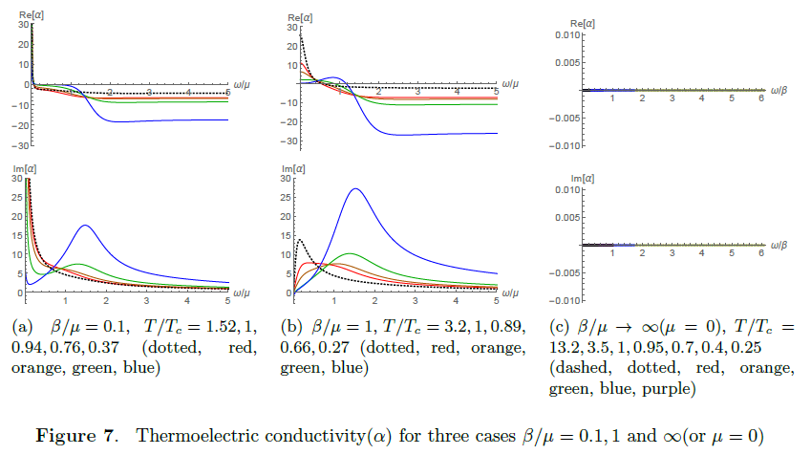
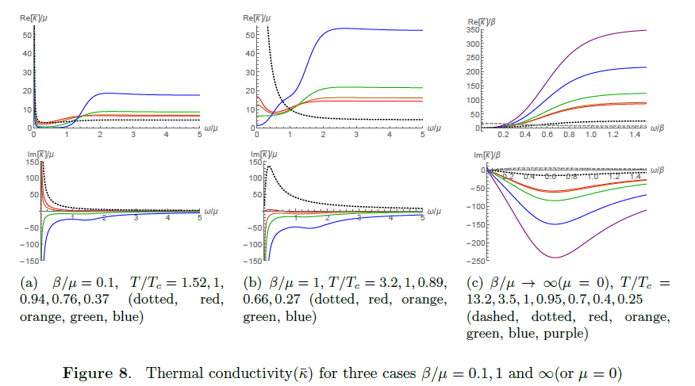

Slide 38


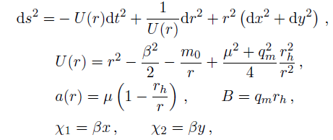
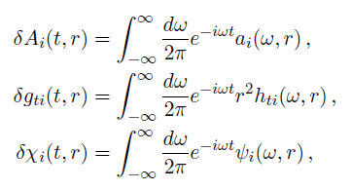
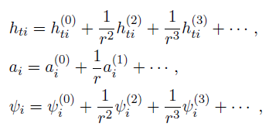
Dyonic Black brane

Slide 39

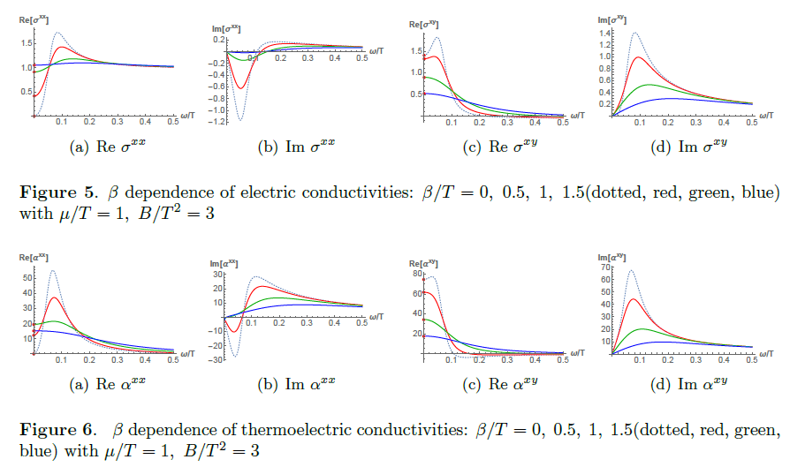
Thermoelectric conductivities from Dyonic black brane

Slide 40
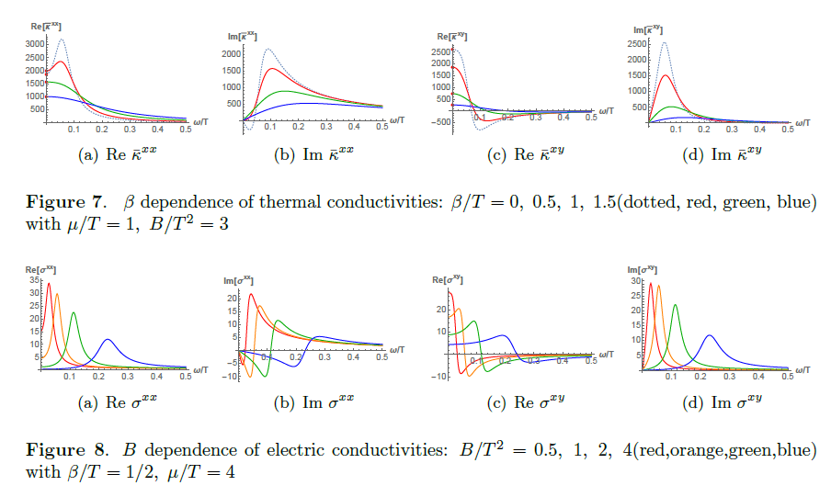

Slide 41

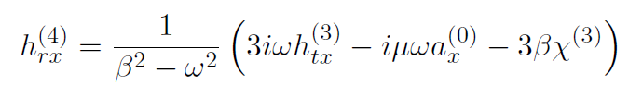
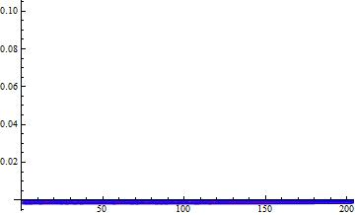
Axion model without magnetic field
The 1st Ward identity and numerical confirmation

Slide 42
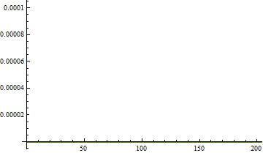
Axion model without magnetic field
The 2nd Ward identity
The numerical confirmation

Slide 43
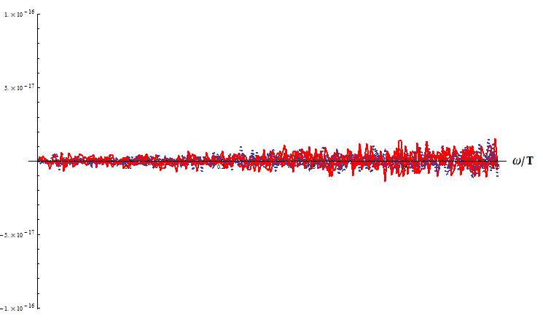
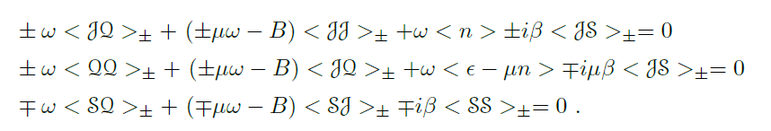
Test with Axion model in the magnetic field
Numerical confirmation < 10^-16

Slide 44
Axion model without magnetic field
What can we get from this?
Pole structure of the conductivity!
Contact terms, Superfluid density

Slide 45
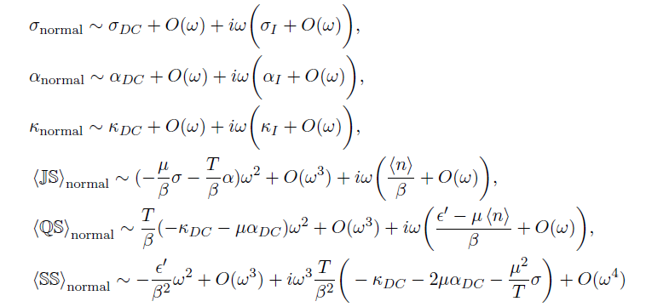
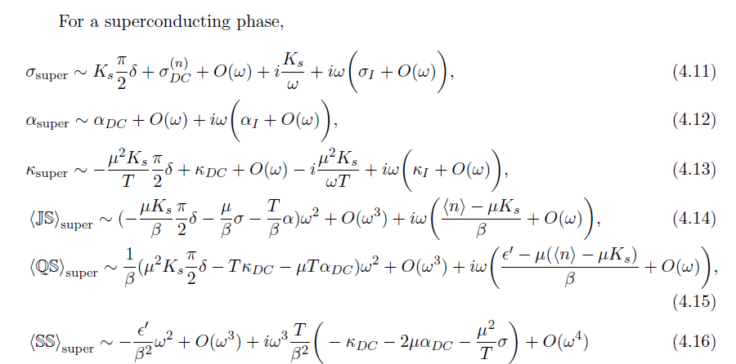

Slide 46
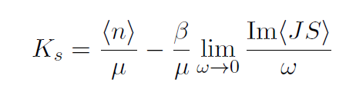


Superfluid density
By small frequency behavior of the Ward identity
We can identify the superfluid density with other correlation function.
If we define
The normal fluid density

Slide 47
Bulk Symmetry to Boundary System
We may take an opposite direction.
Can a bulk Symmetry tell us physics of the boundary theory?
Now we will provide an answer of this question.

Slide 48
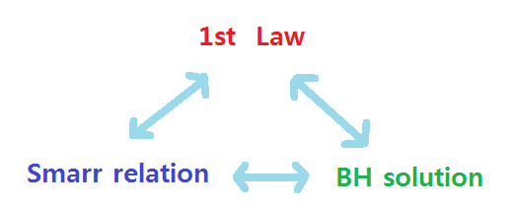
A Scaling Symmetry and the Smarr Relation
Banados and Theisen (05)
“ A scaling symmetry of an hairy BH in AdS3 induces the Smarr relation of BH.”
The Smarr relation, A BH solution and the 1st law of thermodynamics
The Smarr relation is the finite expression of the 1st law.
It is well known that two of these three gives the other one.

Slide 49


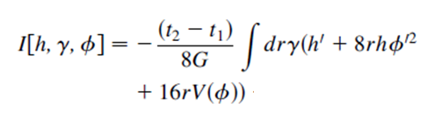
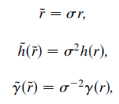
Model
Ansatz
The reduced Action
There is a scaling symmetry

Slide 50



The corresponding Noether Current
Thus this quantity is constant.
Plugging BTZ solution, C is ST at the horizon and 2M at the boundary of AdS space
We can obtain the Smarr relation.

Slide 51
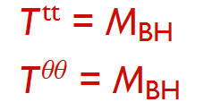

Holographic point of view : traceless Energy-Momentum tensor
The Smarr relation becomes the thermodynamic relation.
However, Banados and Theisen’s approach has a problem. Actually there is no hair in this case. BTZ is the only case for this approach.

Slide 52
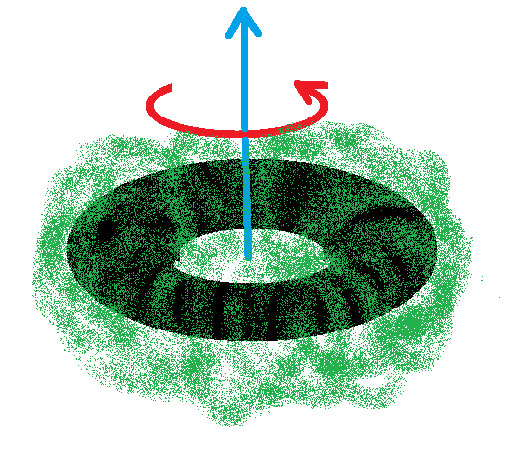
If there is a hairy black holes in AdS3, one can use this reduced action formalism.
There is a hairy-rotating black hole solution constructed perturbatively.
Iizuka, A. Ishibashi, K. Maeda (2015).
Rotating hairy BH in lumpy geometry

Slide 53
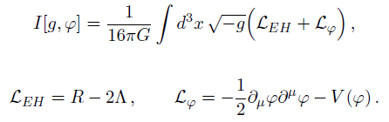


B. Ahn, S. Hyun, S. Park and S. Yi(2015)
Smarr relation for this hairy BH.
Reduced Action

Slide 54



There are additional time dependence and a paremeter transformation.
Conservation of Charge function should be modified.

Slide 55

This hairy BH has a modified Smarr relation by the time-dependent scalar configuration.
Does the scaling symmetry help us to understand boundary field theories?
- Yes!

Slide 56

1512.09319 (B. Ahn, S. Hyun, K. Kim, S. Park, S. Yi)
We considered various BHs in AdS4 which have some hairs. This can be generalized to more general class of BHs.
The Model is
This model contains Dyonic BH, Holographic Superconductor, massive gravity and a model for Anomalous Hall effect.

Slide 57




Ansatz
The reduced action
Scaling transformation

Slide 58




Spontaneous Magnetized System
- The Charge density function
- This model admits an exact solution
Y. Seo, K. Kim, K. Kim, S. Sin(2015)

Slide 59



Plugging the solution into this expression, we obtain
The BH mass and the holographic energy-monumtum tensor are given by
Then we arrive at a thermodynamic relation

Slide 60



The pressure
with magnetization
In the homogeneous system the pressure is same with the grand potential and on-shell action.

Slide 61




Massive gravity model
The charge function
Black brane in the massive gravity model
The pressure or – on-shell action and the magnetization

Slide 62




Modified holographic superconductor
The charge function
The pressure or on-shell action
The last term comes from the interaction between impurity and superfluid degrees of freedom.

Slide 63

On-shell Action
In order to obtain the on-shell action, we need to know the holographic renormalization and counter terms.
These are main difficulties of the holographic calculation.
Our reduced action formulation gives us the Universal thermodynamic relation without knowing the counter terms or the holographic renormalization.
If we have a prescription for the energy, we can get the on-shell action or pressure.

Slide 64


On-shell Action
Our prescription is that
Then the on-shell action is
This is valid for static configurations in general D-dimensions.

Slide 65




An ambiguity in the massive gravity model
Blake and Tong (2013) , Cao and Peng (2015)
They pointed out that there is an ambiguity in the boundary energy-momentum tensor.

Slide 66
Summary
We would like to construct the holographic theory through the similar procedure of QFT.
Symmetry -> Renormalization -> RG…
Bulk symmetry and the symmetry in the boundary theory are different from each other.
The symmetry in QFT is described by Ward Identity. We derived the WI s and show that the various holographic backgrounds are consistent with the WI s.
We develop the reduced action formalism by using a scaling symmetry for various holographic models.
This bulk symmetry gives us the universal thermodynamic relation.
We proposed a way to construct holographic models without knowing the counter terms.

Slide 67
Future Directions
We expect that consideration of fluctuations in our formalism could provide more efficient way for the holographic calculations for n-pt functions.
Our method can be easily extended to non-AdS, non-static and inhomogeneous backgrounds.
For the WI s, we may go to the next order.
It would be interesting to consider Ward Identities for the three point functions.
AdS Solitons, Higher spin BH geometry ?

Slide 68
Thank you!

