Slide 1

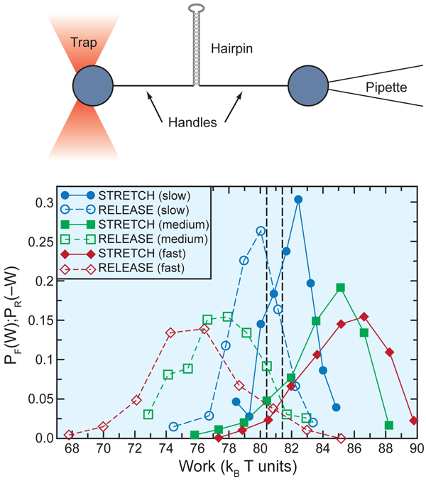
Hyunggyu Park
Stochastic thermodynamics
and Fluctuation theorems
Prelude & Brief History of Fluctuation theorems
Thermodynamics
Jarzynski equality & Crooks FT
Experiments
Stochastic thermodynamics
Entropy production and FTs
Summary $ Outlook
13th KIAS-APCTP winter school on statistical physics, Postech, Pohang (Jan. 18-19, 2016)
[Bustamante]

Slide 2
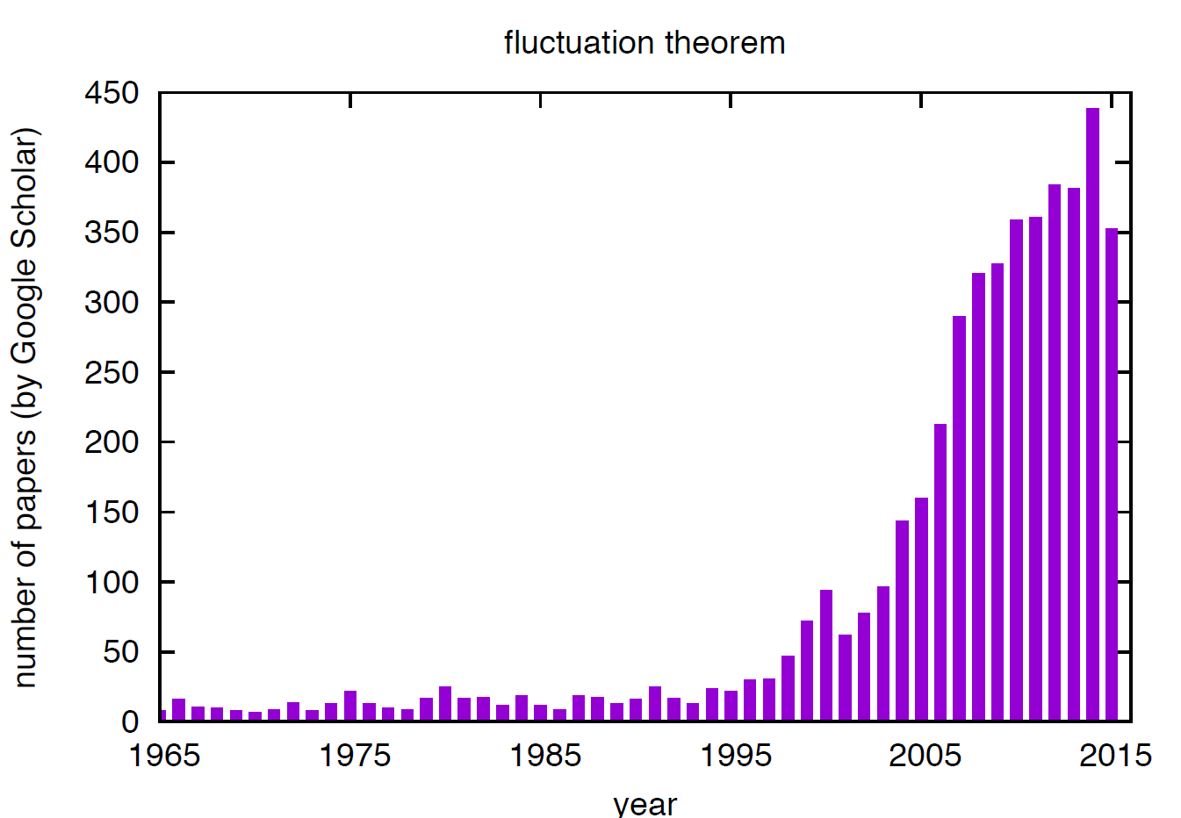
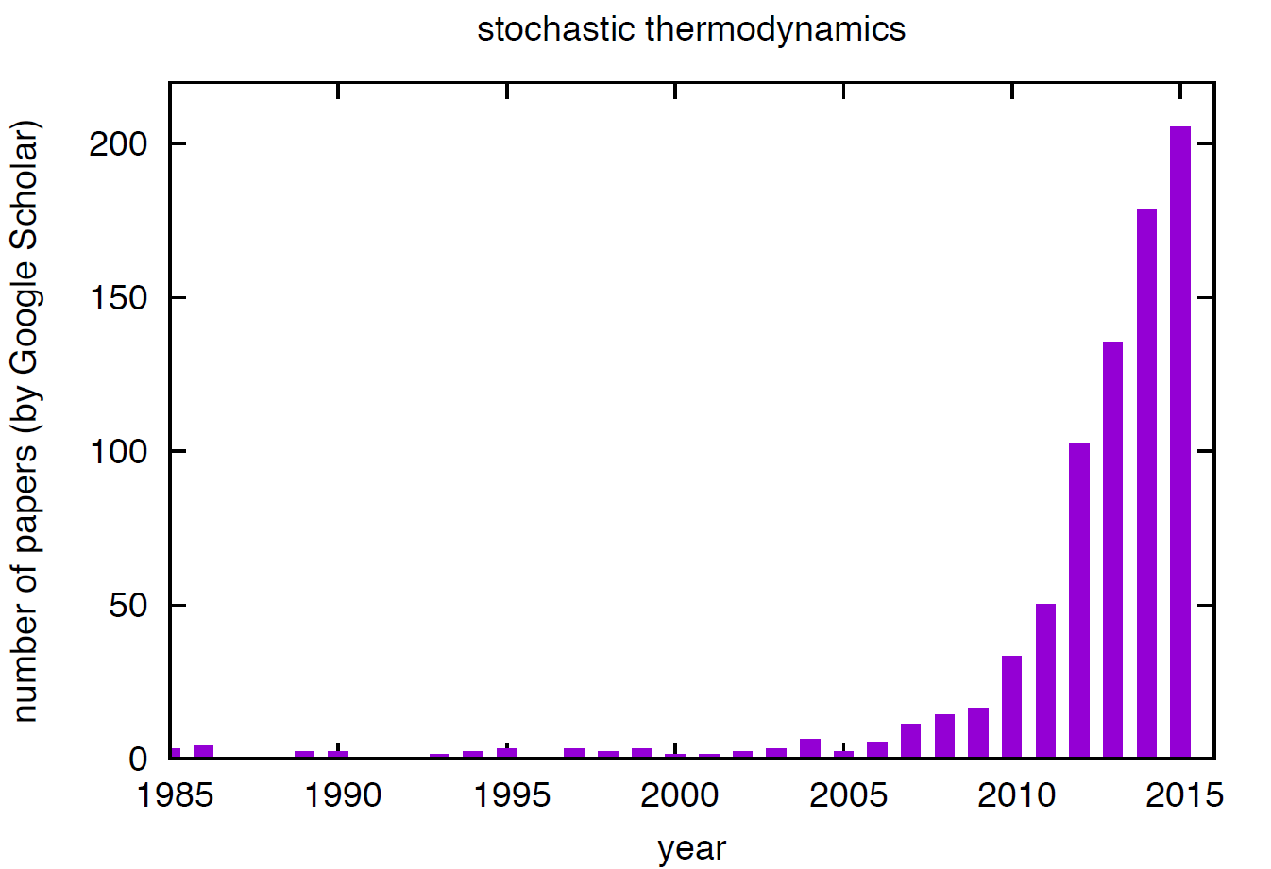
Outbursts of research activity

Slide 3

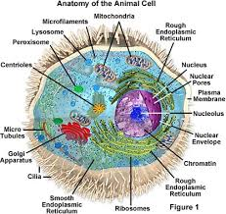
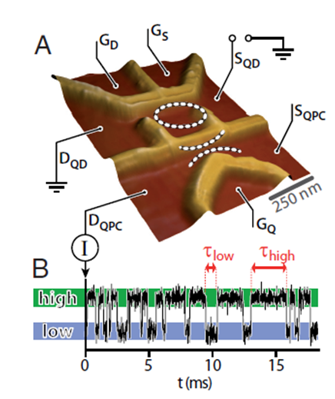
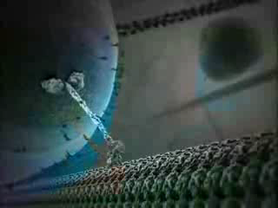
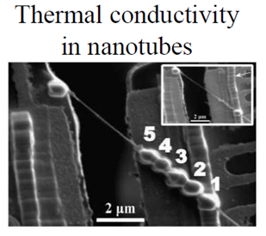
Nonequilibrium processes
Why NEQ processes?
- biological cell (molecular motors, protein reactions, …)
- electron, heat transfer, .. in nano systems
- evolution of bio. species, ecology, socio/economic sys., ...
- moving toward equilibrium & NEQ steady states (NESS)
- interface coarsening, ageing, percolation, driven sys., …
Thermodynamic 2nd law
- law of entropy increase or irreversibility
NEQ Fluctuation theorems
- go beyond thermodynamic 2nd law & many 2nd laws.
- some quantitative predictions on NEQ quantities (work/heat/EP)
- experimental tests for small systems
- trivial to derive and wide applicability for general NEQ processes

Slide 4
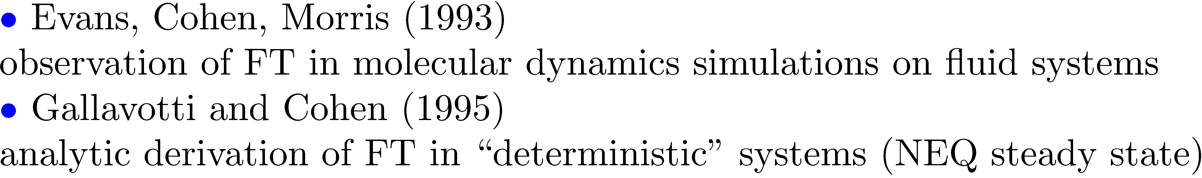
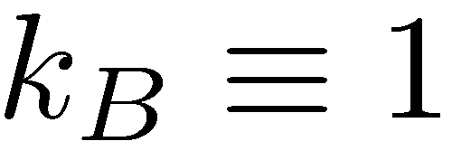
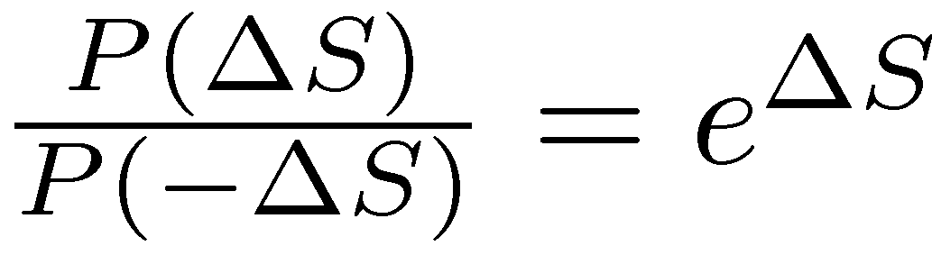
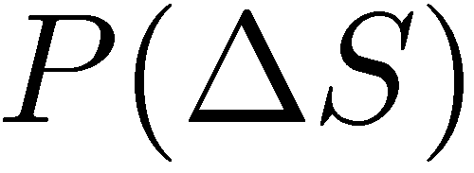
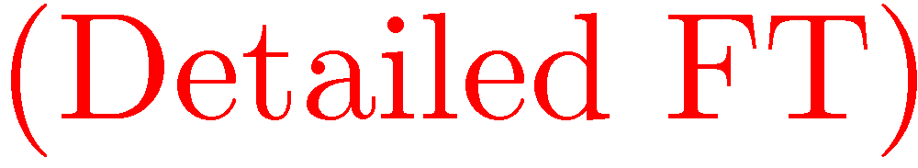
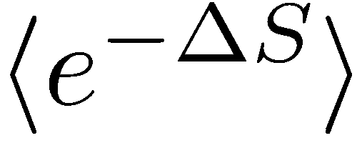


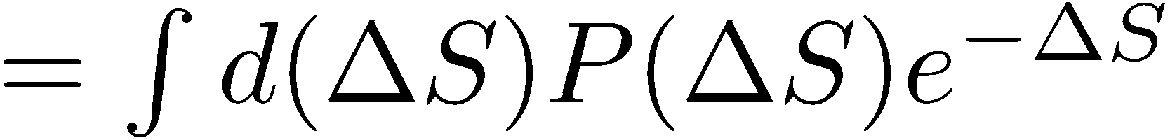
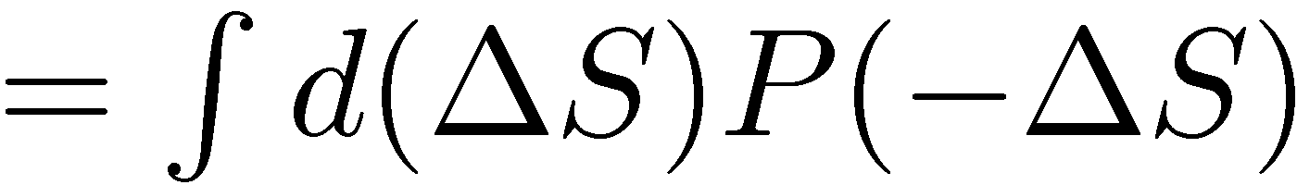

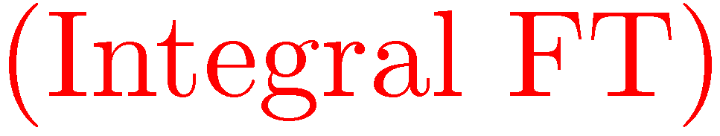
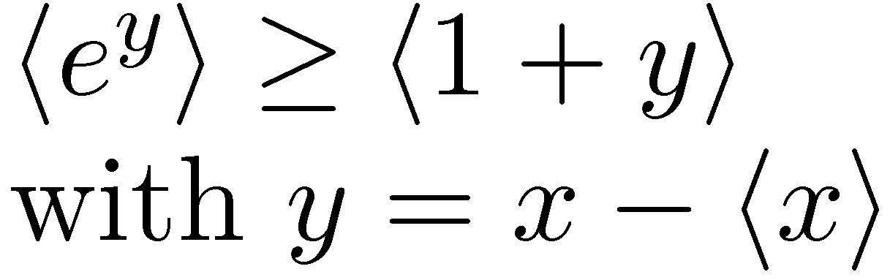
Brief history of FT (I)


Slide 5
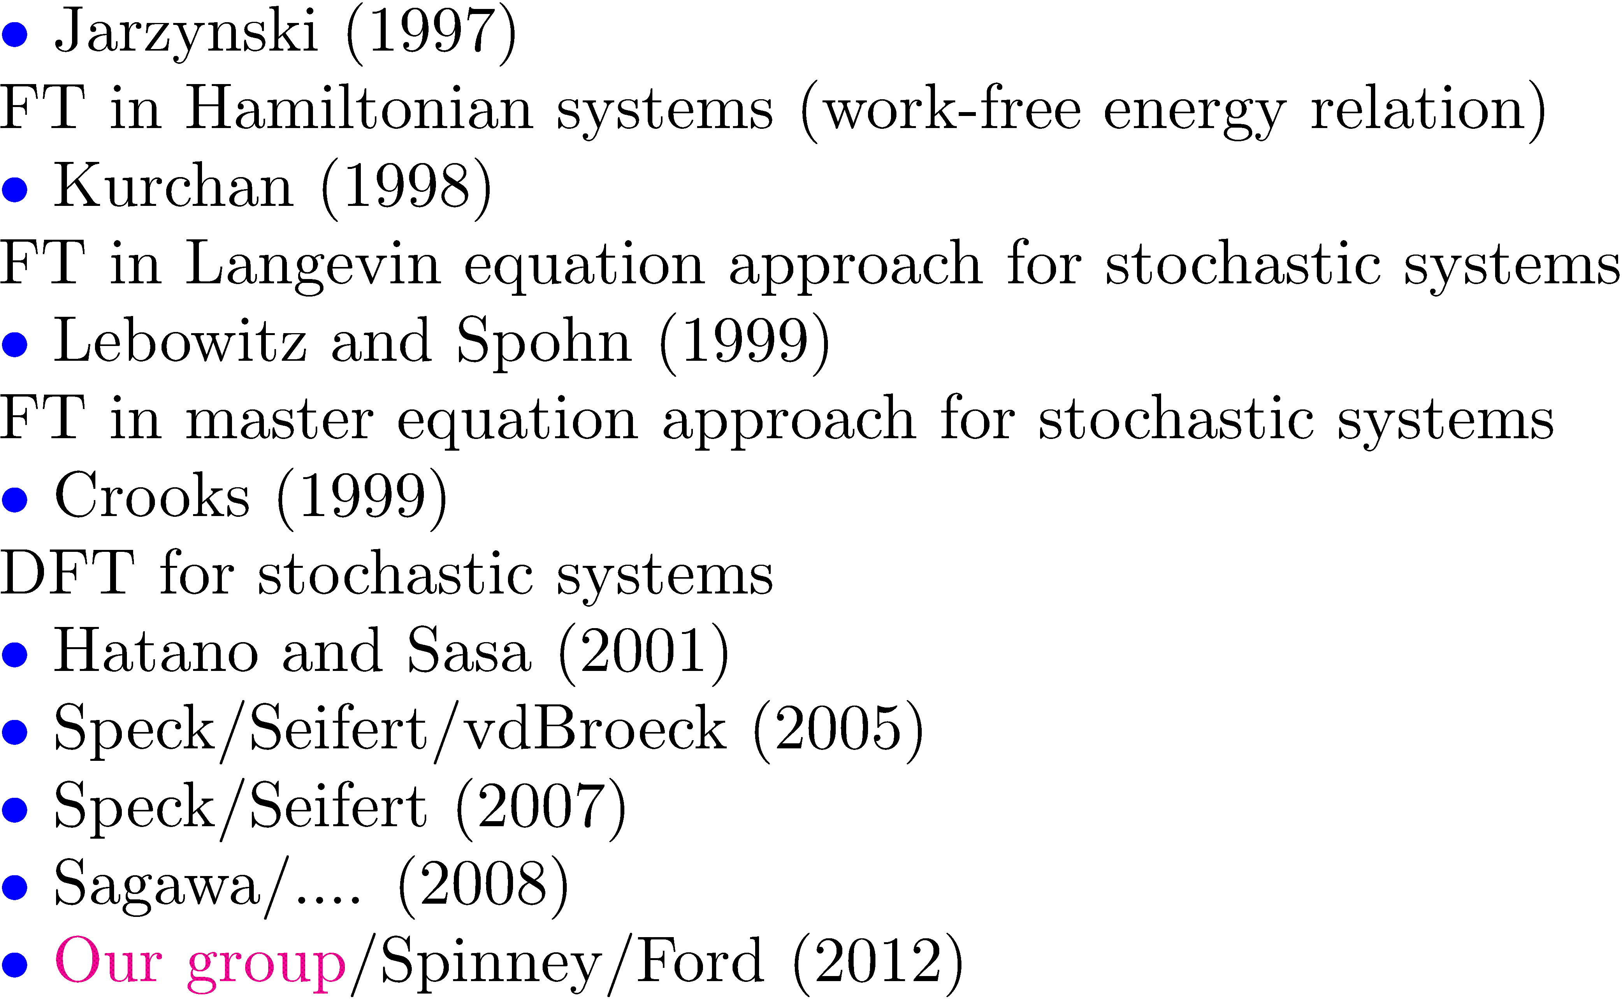
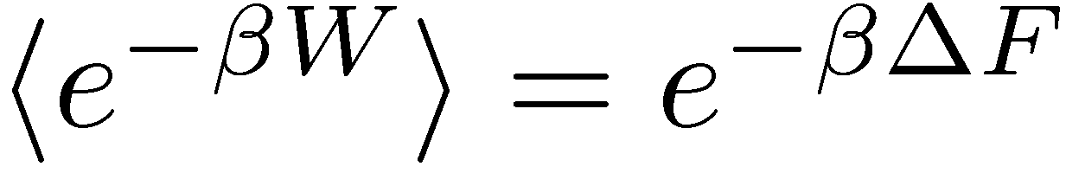
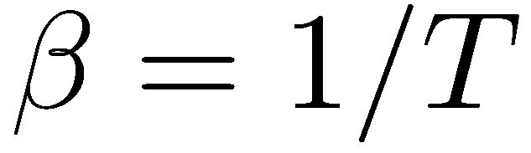
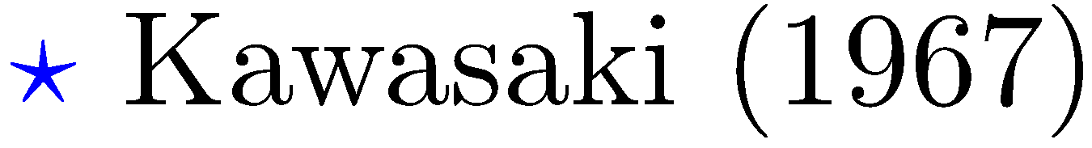
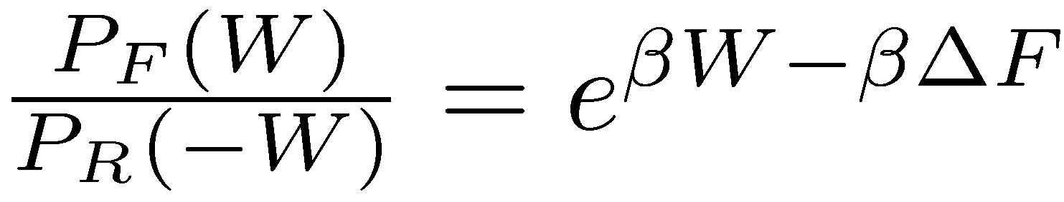
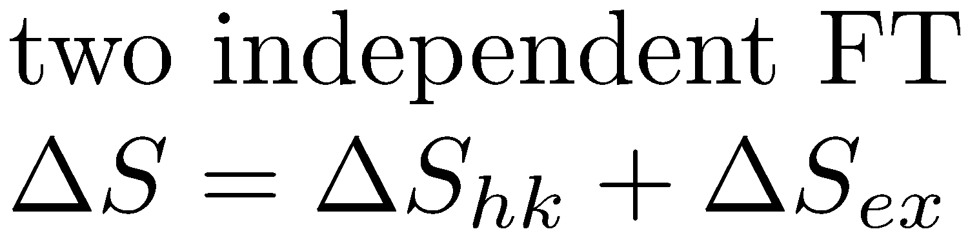

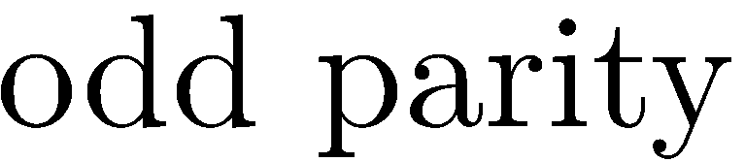

Brief history of FT (II)

Slide 6

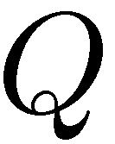
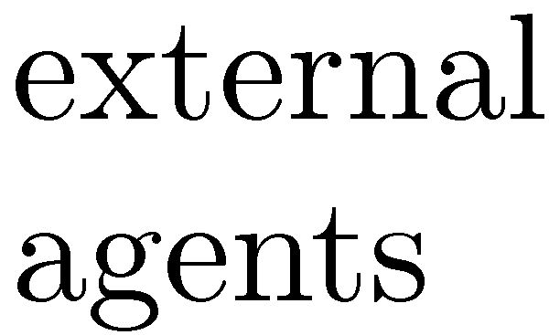
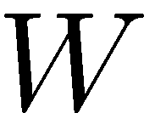

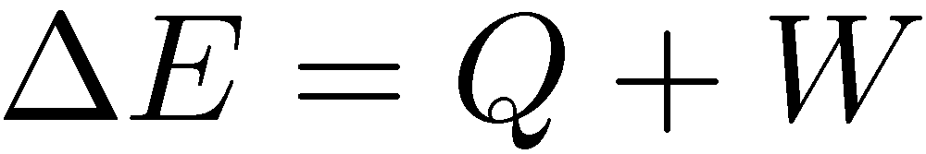

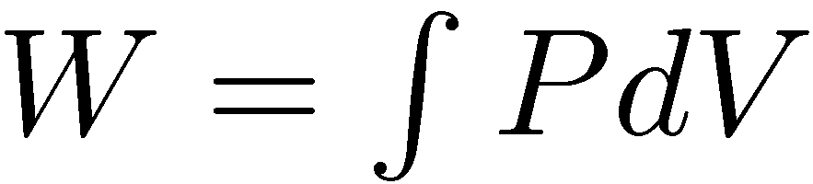
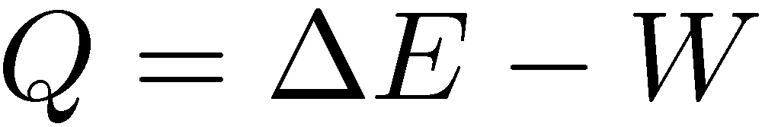
Thermodynamics
: heat absorbed by the system
: work done on the system
: internal energy of the system
System
Themodyn. 1st law
Quasi-static (reversible) process
- almost equilibrium at every moment
- path is well defined in the P-V diagram
- work : (path-dependent)
- heat : (path-dependent)
Irreversible process
- path can not be defined in the P-V diagram
- cannot calculate W with P and V (NEQ)
gas
heat reservoir
P
2
P
2
1
1
V
V

Slide 7
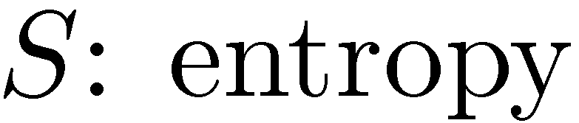
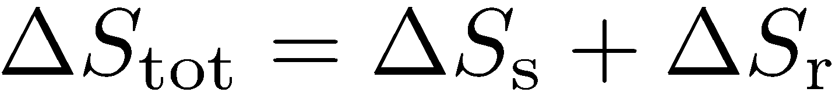
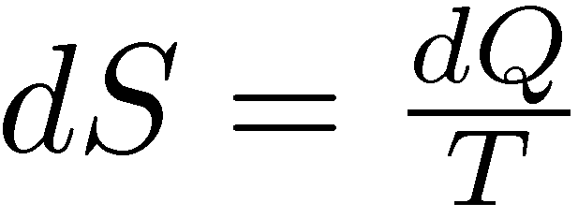
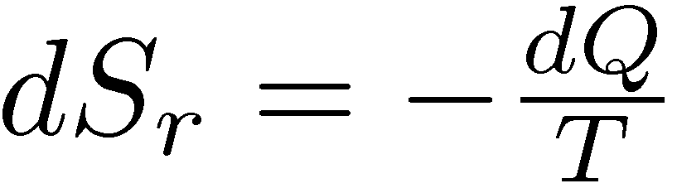
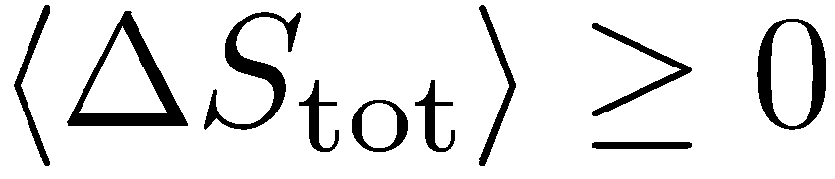
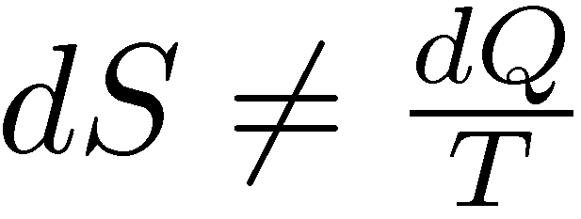
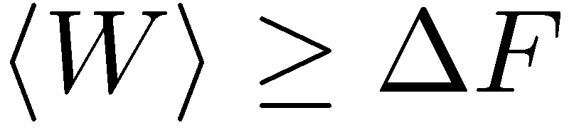
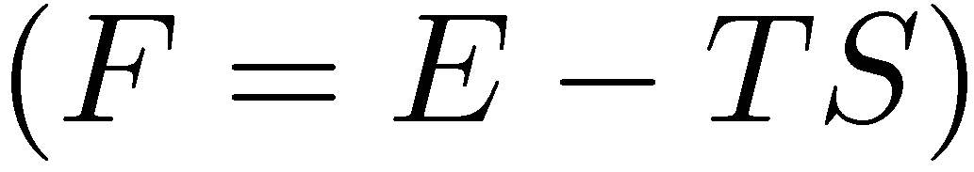
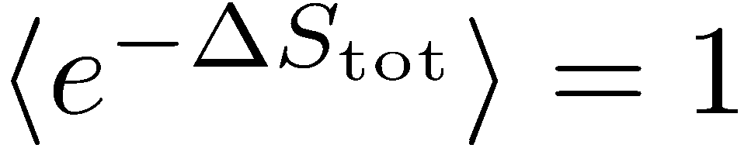
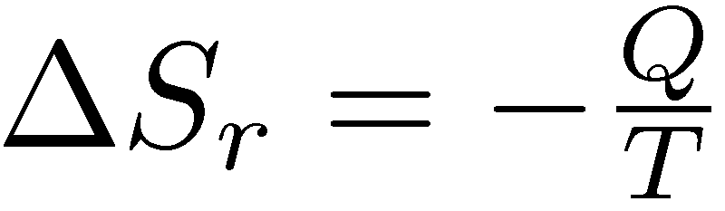
Thermodynamics
Thermodyn. 1st law
System
Thermodyn. 2nd law
Phenomenological law
Total entropy does not change during reversible processes.
Total entropy increases during irreversible (NEQ) processes.
▶ Work and Free energy
Jarzynski equality (IFT)
Crooks relation (DFT)

Slide 8
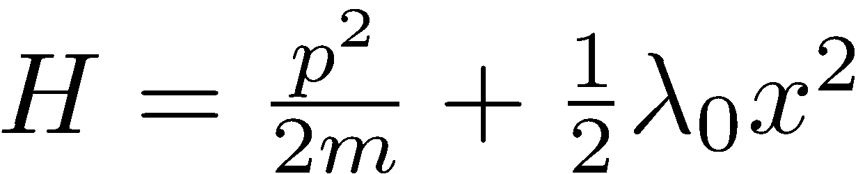
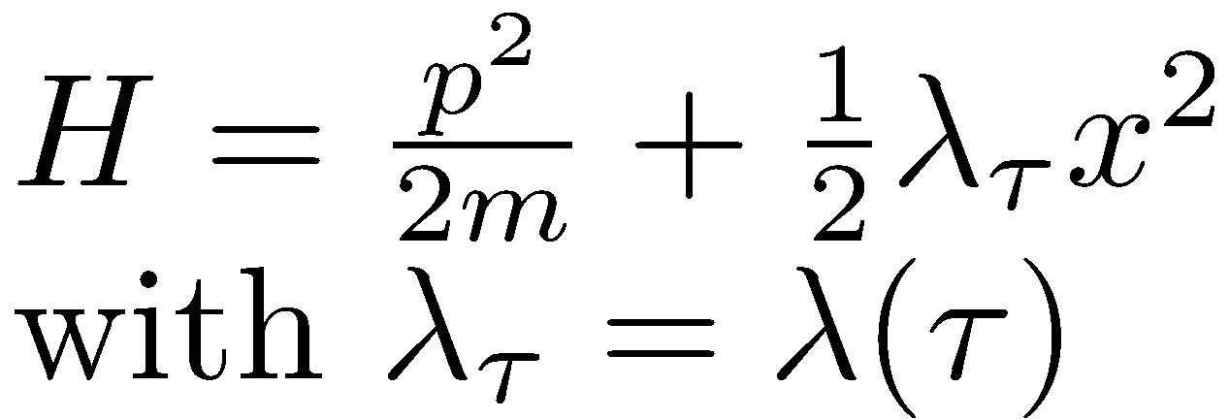
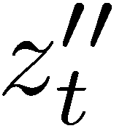
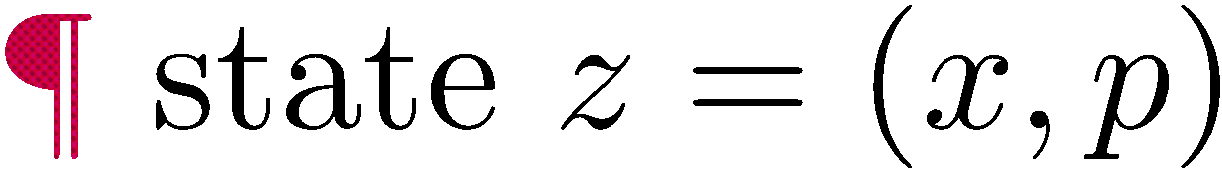
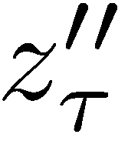
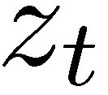
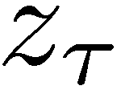
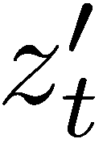
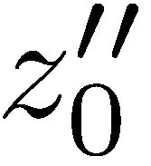
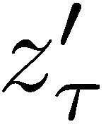





Jarzynski equality & Fluctuation theorems
Simplest derivation in Hamiltonian dynamics
state space
crucial
Intial distribution must be of Boltzmann (EQ) type.
Hamiltonian parameter changes in time. (special NE type).
In case of thermal contact (stochastic) ?
generalized
still valid

Slide 9





Jarzynski equality & Fluctuation theorems
Crooks ``detailed”fluctuation theorem
odd variable
time-reversal symmetry
for deterministic dynamics
Crooks detailed FT for PDF of Work
``Integral”FT

Slide 10






Experiments & Applications
DNA hairpin mechanically unfolded by optical tweezers
Collin/Ritort/Jarzynski/Smith/Tinoco/Bustamante,
Nature, 437, 8 (2005)
Detailed fluctuation theorem

Slide 11




Slide 12


PNAS 106, 10116 (2009)

Slide 13




Slide 14

arXiv: 1008.1184

Slide 15



Summary of Part I
Crooks relation
Jarzynski equality
: time-reverse path

Slide 16








Stochastic thermodynamics
Microscopic deterministic dynamics
Stochastic dynamics
Macroscopic thermodynamics

Slide 17


























Stochastic thermodynamics
System
Equilibrium
Nonequilibrium Process
trajectory
state space

Slide 18

















Langevin (stochastic) dynamics
state space
trajectory
System

Slide 19














Stochastic process, Irreversibility & Total entropy production
state space
trajectory
time-rev

Slide 20




Total entropy production and its components
System

Slide 21














Total entropy production and its components
System

Slide 22

Total entropy production and its components

Slide 23
Probability theory viewpoint
on Fluctuation theorems
Seifert, PRL 95, 040602 (2005)
Esposito/VdBroeck, PRL 104, 090601 (2010)

Slide 24






Fluctuation theorems
System
Integral fluctuation theorems

Slide 25



Fluctuation theorems
Integral fluctuation theorems
Thermodynamic 2nd laws
Detailed fluctuation theorems

Slide 26









Probability theory
Consider two normalized PDF’s :
state space
trajectory
Define “relative entropy”
Integral fluctuation theorem
(exact for any finite-time trajectory)

Slide 27







Probability theory
Consider the mapping :
Require
reverse path
Detailed fluctuation theorem
(exact for any finite t)

Slide 28


Dynamic processes & Path probability ratio
: time-reverse path

Slide 29





























Markovian jump dynamics
R
s

Slide 30


















Reservoir entropy change
Schnakenberg/Hinrichsen/Park

Slide 31









Langevin dynamics

Slide 32























Discretization scheme for a path integral

Slide 33









Langevin dynamics
: time-reverse path

Slide 34



Fluctuation theorems
reverse path
Irreversibility (total entropy production)

Slide 35




Fluctuation theorems
Work free-energy relation (dissipated work)
reverse path

Slide 36














Fluctuation theorems
reverse path
House-keeping & Excess entropy production
NEQ steady state (NESS)
for fixed

Slide 37






Dynamic processes with odd-parity variables?

Slide 38












If odd-parity variables are introduced ???

Slide 39

Summary and Outlook
Remarkable equality in non-equilibrium (NEQ) dynamic processes, including Entropy production, NEQ work and EQ free energy.
Turns out quite robust, ranging over non-conservative deterministic system, stochastic Langevin system, Brownian motion, discrete Markov processes, and so on.
Still source of NEQ are so diverse such as global driving force, non-adiabatic volume change, multiple heat reservoirs, multiplicative noises, nonlinear drag force (odd variables), information reservoir, and so on.
Validity and applicability of these equalities and their possible modification (generalized FT) for general NEQ processes.
More fluctuation theorems for classical and also quantum systems
Nonequilibrium fluctuation-dissipation relation (FDR) : Alternative measure (instead of EP) for NEQ processes?
Usefulness of FT? Efficiency of information engine, effective measurements of free energy diff., driving force (torque), ..
Need to calculate P(W), P(Q), … for a given NEQ process.

