Slide 1


Strong Disorder Renormalization Group
Ferenc Iglói
Wigner RC Budapest
Szeged University

Slide 2
Fluctuations
^{on the cube}
(It is the randomness rules)

Slide 3
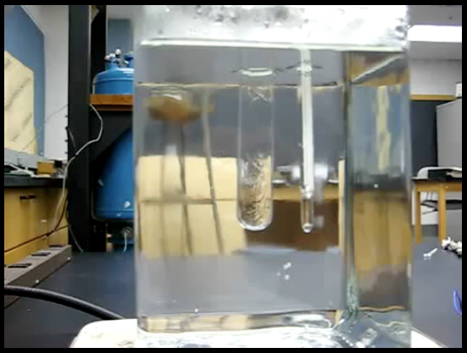
Thermal fluctuations
Critical opalescence

Slide 4
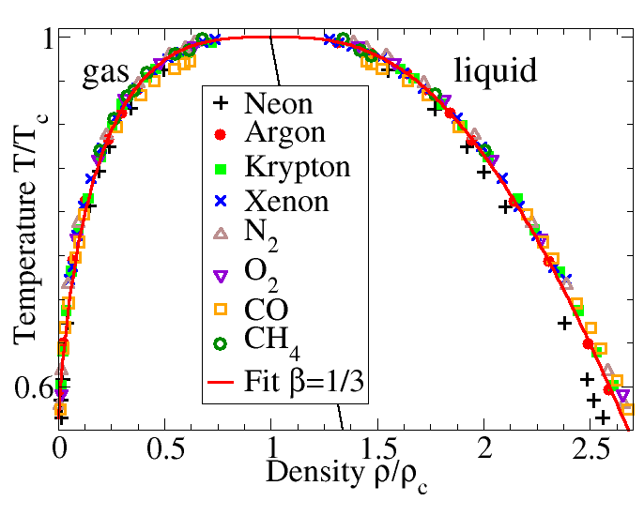
Critical behaviour: universality
Diverging
Correlation length:

Slide 5
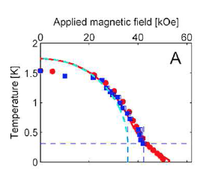
Thermal & quantum fluctiations
LiHoF₄ dipol-bonded
quantum Ising ferromagnet
Para
Ferro
(After Ronnow et al., 2005.)

Slide 6
Quantum-classical correspondence
(Feynman, Suzuki-Trotter)
(D+1)-dim. classical
T > 0 finite width
thermal criticality
imag. time
T = 0 infinite width
quantum criticality
z : dynamical exp.
z = 1, homogeneous
z ≠ 1, disordered
D-dim. quantum

Slide 7
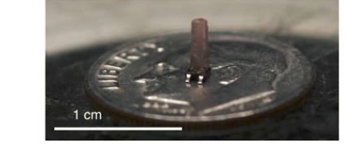
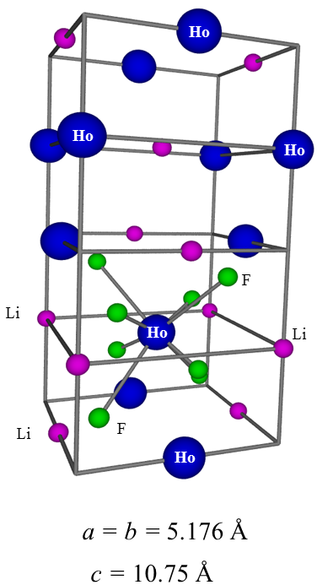
Thermal & quantum & disorder fluctuations
LiHo_{x}Y_{1-x}F₄ dipol-bonded diluted
quantum Ising ferromagnet
probability
probability
(After Ancona-Torres et al, 2008)

Slide 8
Quantum & disorder fluctuations
3D Anderson localisation with cold atoms
Palaiseau (Aspect group)
disorder
weak
strong

Slide 9
Quantum & disorder fluctuations
2D superconductor-insulator transition
width
magnetic field
insulator
superconductor
(Haviland, Liu and Goldman)
(Shahar)

Slide 10
Random quantum Ising model
random variables
nearest neighbours
In a finite system of linear size L :
Statics: magnetization [m]_{av}
O(1) L^{-x} exp(-L^{d})
ordered phase critical point disordered phase
Dynamics : exp(-L^{d}) exp(-L^{ψ}) L^{-z(δ)} O(1)
(energy gap)
Griffiths phase
Theoretical studies
expansion does not work
Strong disorder RG
recommended
quantum MC - possible

Slide 11
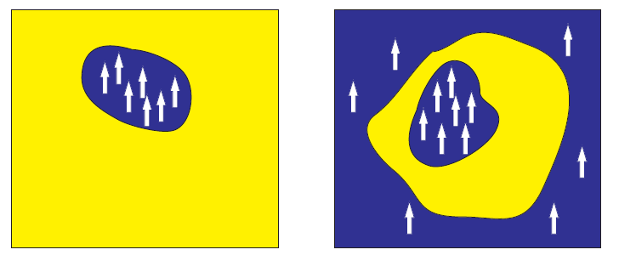









Griffiths-phases: rare regions
disordered ordered
Disordered Griffiths-phase:
Probability of rare region:
Excitation energy:
→ density of states:
Specific heat, susceptibility:
magnetization, entropy:
Griffiths phases and the stretching of criticality in brain networks
Paolo Moretti & Miguel A. Muñoz, Nature Communications, 2013

Slide 12
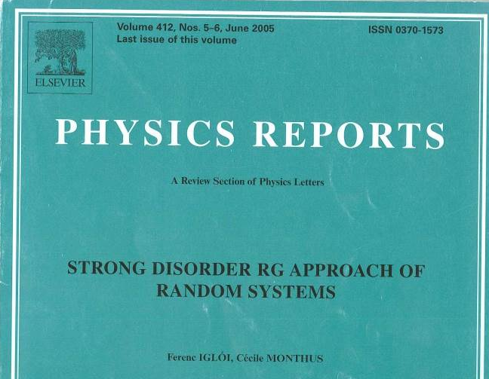
Basic ideas of strong disorder RG

Slide 13
1. Motivations for disorder-dependent RG procedures
Various descriptions of disordered systems
Approaches which start by averaging over the disorder
Replica method
Supersymmetric method
Dynamical method
Approaches which try to describe spatial heterogeneities of the disorder
Scaling arguments on disorder fluctuations
Real space renormalizations on the disorder

Slide 14
Scaling arguments on disorder fluctuations
a) Lifshitz arguments – density of states near spectrum edges
b) Griffiths phases – rare ordered regions induced singularities
c) The Harris criterion – relevance of weak disorder around a pure critical point
d) The theorem of Chayes et al -
e) The Imry-Ma argument – presence of domain walls in random-field systems
f) The theorem by Aizenman and Wehr
– rounding of first-order transitions by quenched disorder

Slide 15
Real space renormalizations on the disorder
Block renormalizations
Migdal-Kadanoff procedure
RG on hierarchical networks
Functional RG for interfaces in random media
Renormalization for disordered XY-models
Phenomenological RG for spin glasses – droplet theory
Ma-Dasgupta renormalization for quantum spin chains
Daniel Fisher’s results
i) Infinite disorder fixed points
ii) Explicit calculations

Slide 16
2. Principles of strong disorder RG
Dominance of disorder over thermal or quantum fluctuations
Pure systems: large degeneracy
Disordered systems: order through disorder
Example: ground state of a quantum system
S=1/2 AF Heisenberg chain
Pure: linear combination of all states composed from singulets
Random: one specific pairing of singlets
Example: classical (Ising) spin chain
Pure: domain-walls at all positions –
Random: domain-walls at fixed positions

Slide 17
Notions of infinite and strong disorder fixed points
Possible behaviour of disorder at large scales
a) Smaller and smaller without bound – pure fixed point
b) Larger and larger without bound – infinite disorder fixed point
c) Converge to a finite level – conventional finite disorder fixed point
Strong disorder RG concerns:
b) Infinite disorder fixed points – at the critical points
c) Strong disorder fixed points – in the Griffiths phases

Slide 18
How to know if the disorder dominates at large scale?
Via a priori theoretical arguments?
Via numerical studies?
Assumption of strong disorder and its check.

Slide 19
Essential features of infinite disorder fixed points
Strong dynamical anisotropy - length scale logarithm of the time-scale
Ultra-slow dynamics – dynamical processes in logarithmic time-scale
Broad distribution of physical quantities
Distribution of c.f. m (magnetization) – is logarithmically broad
Appropriate scaling combination:
( length)
Dominant effect of rare regions
Typical region, with probability 1, the value say :
Rare region, with probability, say ,the value O(1)
Average value :

Slide 20
Example: surface magnetization
with fixed end-spin,
The surface magnetization at site
involves a Kesten random variable.

Slide 21
at the critical point
In a typical sample with probability 1:
In a rare sample, in which:
as for a surviving walk

Slide 22
General features of Ma-Dasgupta RG rules
Pure systems: RG involves a few parameters
Random systems: RG involves distribution functions
What is a strong disorder RG rule?
The renormalization concerns the extreme value of a random variable
This sets the scale of the maximum of the variable:
The renormalization is local in space
New parameters are calculated perturbatively
is reduced during renormalization, at the fixed point

Slide 23
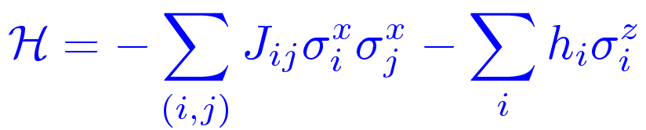
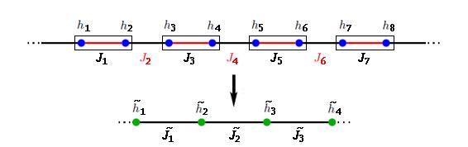


Block renormalization – uniform treatment
For a block of size b=2

Slide 24

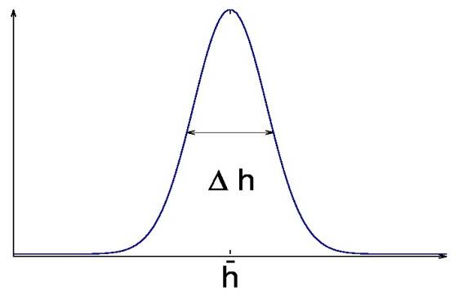

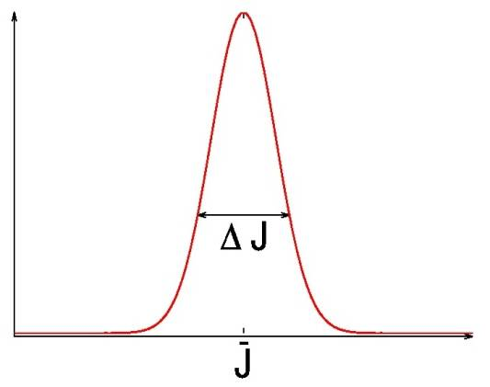

Transformation at the fixed point
Homogeneous system:
Fixed point:
Critical exponents:
z: dynamical exponent
Linearised transf. at the fixed point:
: correlation-length exponent
Disordered system:
: initially of Gaussian form
How it behaves after repeated use of the transformation?

Slide 25
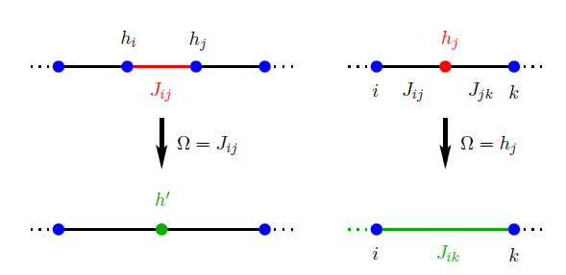
Example: RG rule for the random transverse Ising chain
Probability distributions for: and at RG scale
Due to local decimation rules one can write closed RG equations for
and

Slide 26
Classical example: RG rule for the Sinai model
The disorder consists of random forces at position i
Extrema of the associated random potential: .
Grouping the consecutive forces of the same sign:
Barriers of descending forces ascending forces
RG rule: choose the smallest barrier:
and eliminate it
Relation with the RG rules of the random transverse Ising model:

Slide 27
Iteration and convergence towards a fixed point
Numerically, for d>1
Analytically in some d=1 models
Infinite disorder fixed point (critical point)
This is the symmetric case:
Scaling variable:
Fixed-point distribution:
Strong disorder fixed point (Griffiths phases)
This is the biased case:
A parameter of solutions depending on

Slide 28
Auxiliary variables and scaling exponents
There are auxiliary variables, which are associated with bonds and/or sites
and follow specific RG rules
For lengths:
For the magnetic moments:
Generally:
At the fixed point:

Slide 29
Topics of the following lectures
Topic 2. Analytical solution of the SDRG equations
for 1d random quantum chains
Topic 3. Other 1d random (quantum) models
Topic 4. Random (quantum) systems in d›1 dimensions
Topic 5. Entanglement entropy of random quantum systems
Topic 6. Many-body localization transition

