Slide 1





2016 2nd HaPhy Meeting
Hadron Production: Theory and Experiment
Deeply Virtual and Production with CLAS:
Transversity GPDs
November 25, 2016
W. Kim
  (CLAS Collaboration)

Slide 2
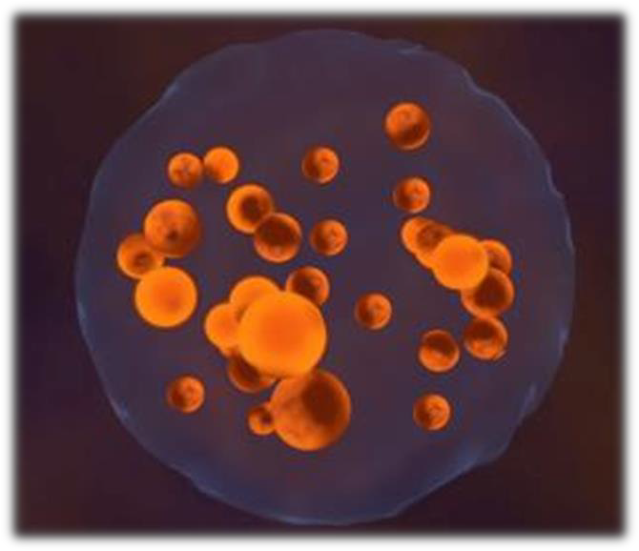
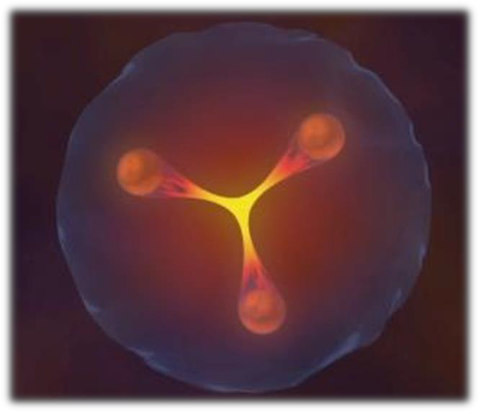
OUR GOAL: TO UNDERSTAND THE STRUCTURE OF THE NUCLEON
Degrees of freedom at high energy: quarks and gluons.
Perturbation theory
Bound states at low energy:
hadrons.
A unique laboratory to study QCD
The observed states are not the degrees of freedom but…
… factorisation allows us to relate them to degrees of freedom in some ‘hard’ processes

Slide 3
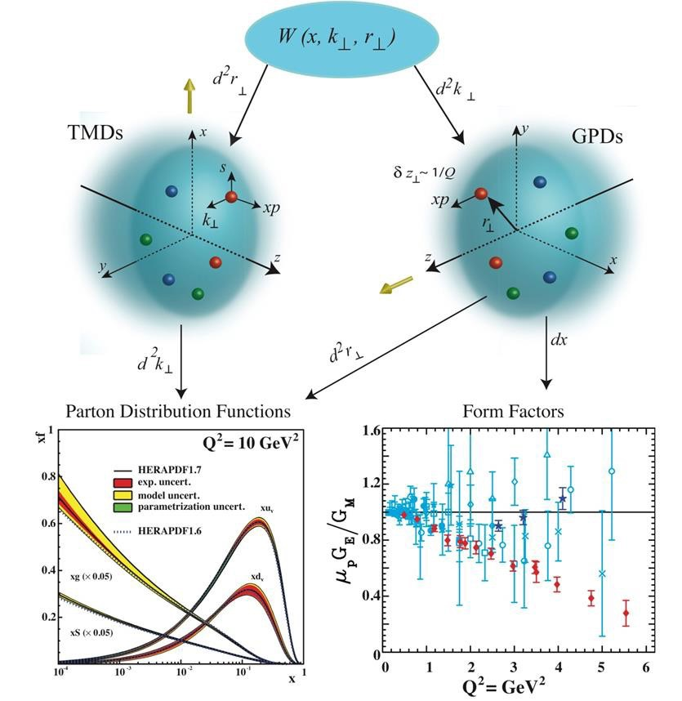


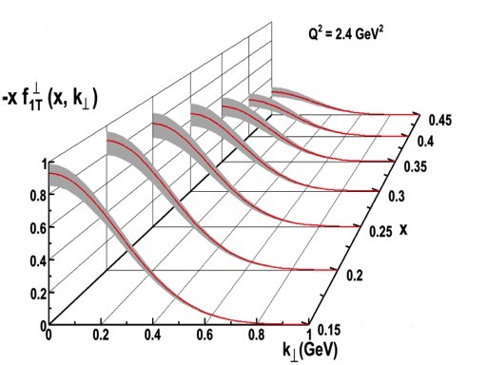
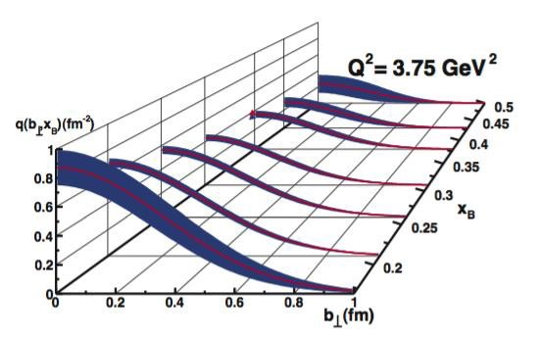
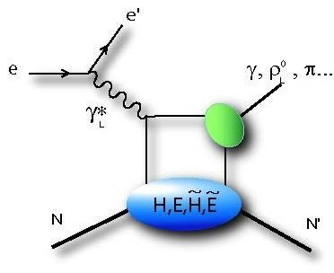
DISTRIBUTIONS ENCODING THE NUCLEON STRUCTURE
TMDs: Fraction of longitudinal momentum x et transverse momentum k
Scan in momentum
GPDs: Fraction of longitudinal momentum x et transverse position b
Scan in position
Q2
e
e’
γ∗
h
}
x + ξ
x − ξ
P
X
t
x ≠ x_{Bj}
ξ ~ x_{Bj}

Slide 4
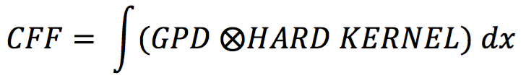
ACCESSING THE GENERALIZED PARTON DISTRIBUTIONS
The generalized parton distributions (GPDs) indirectly parametrize the cross sections of deep exclusive processes.
Q2
Hard kernel - High energy: perturbative computation
Factorisation
x + ξ
x − ξ
Nucleon structure - Low energy: Encoded by the GPDs
x ≠ x_{Bj}
ξ ~ x_{Bj}
t
The amplitude is a linear combination of complex integral of GPDs called Compton Form Factors (CFFs).
The GPDs are universal: Meson or photon electroproduction are
parametrized by the same GPDs.

Slide 5
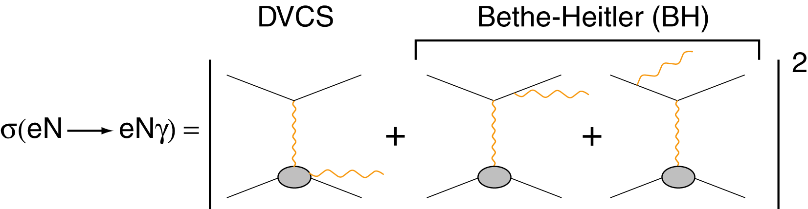
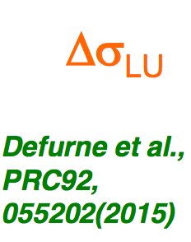
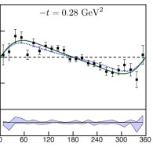
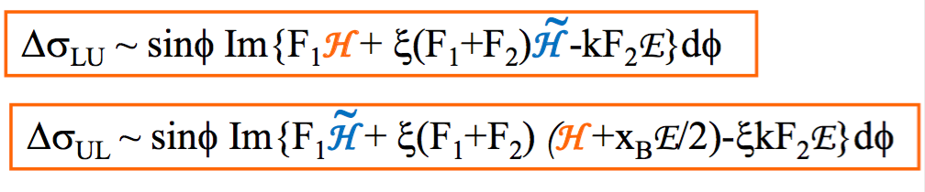
DEEPLY VIRTUAL COMPTON SCATTERING (DVCS)
DVCS is the process ep→epγ. It is a golden channel for GPDs since:
Unlike DVMP, no additional non-perturbative structure.
DVCS interferes with Bethe-Heitler process.
Bethe-Heitler:
-calculable
-dominates at low energies
-boosts signal via interference
Through the interference, we access the real and the imaginary part of CFFs. Method: Measure cross sections and asymmetries (beam, target, both) on proton
and neutron to disentangle all CFFs.
UL

Slide 6
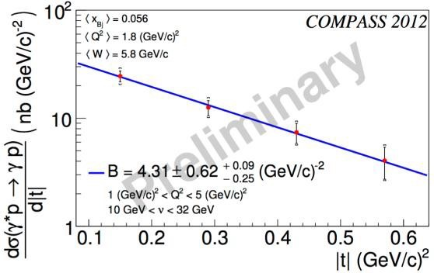
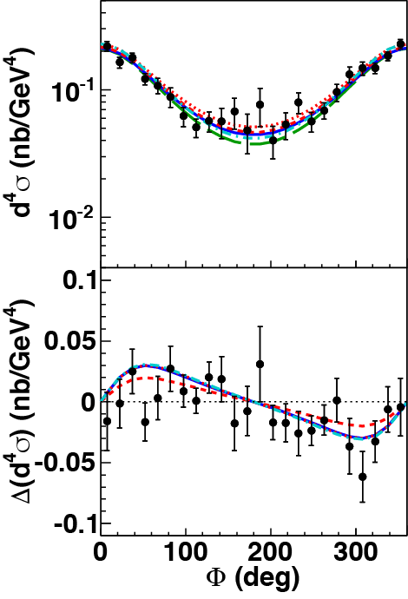
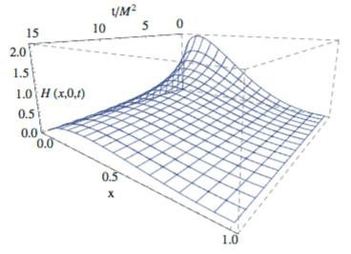
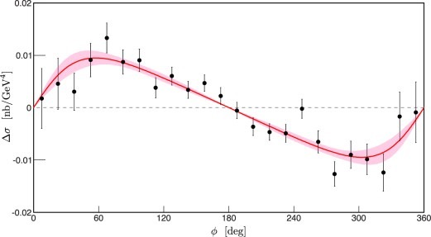


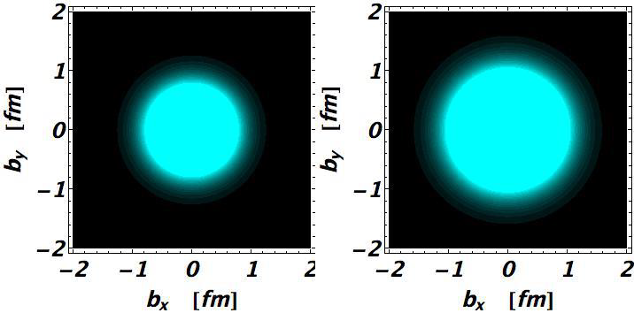
OUR STRATEGY: FROM DATA TO PHENOMENOLOGY
DVCS cross-section results from
Irfu/IPNO experimental teams
Generalized Parton Distributions Models, Parametrizations from Irfu/IPNO phenomenology teams
COMPASS
Jefferson Lab Hall B
PRL115 (2015) 21,
212003
Jefferson Lab, Hall A
PRC92 (2015) 5, 055202
PLB (2015) 190-196
arXiv:1512.06174
NSAC Long Range Plan (2015)
First 3D pictures of the nucleon
An ANR PARTONS result !

Slide 7
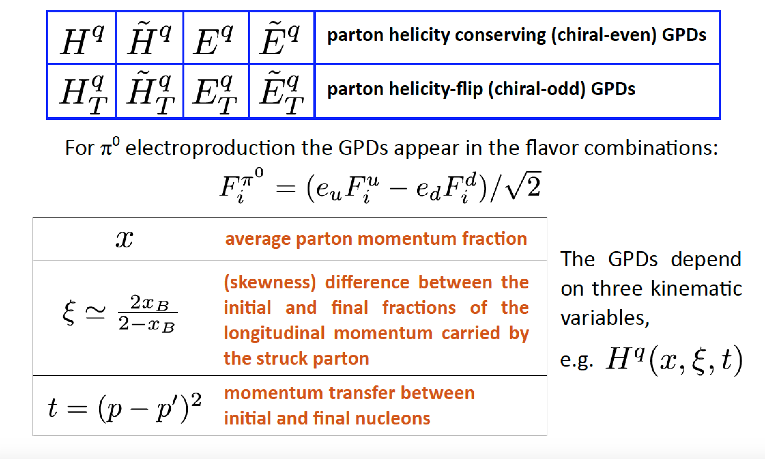
GENERALIZED PARTON DISTRIBUTIONS

Slide 8

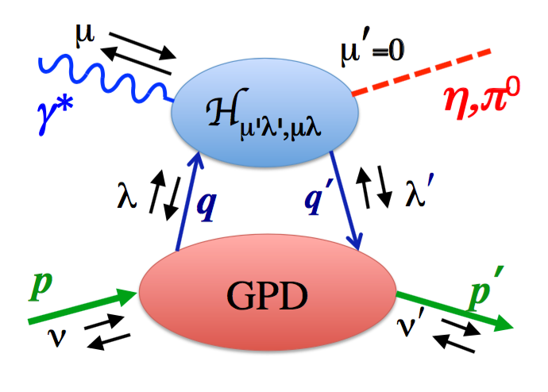



Accessing GPDs from DVπ⁰p

Slide 9

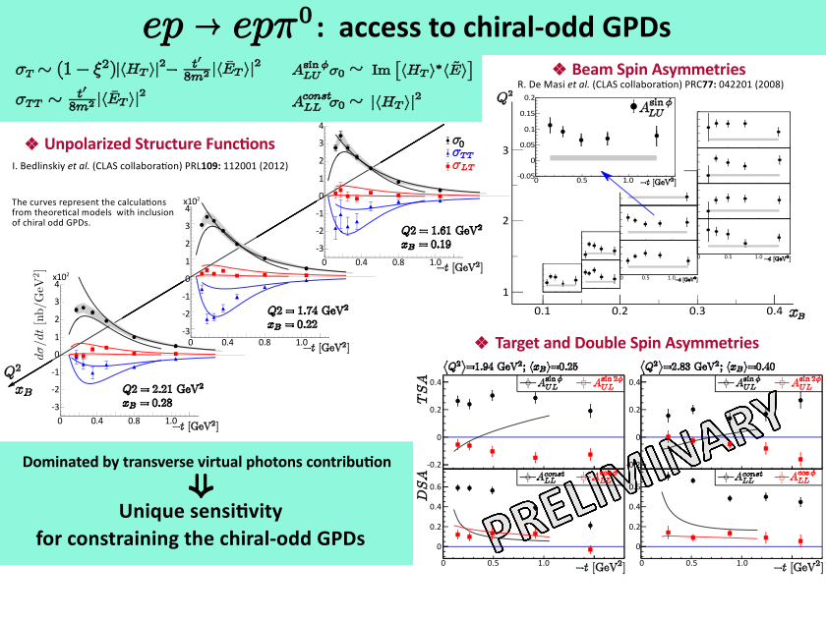
: access to chiral-odd GPDs

Slide 10
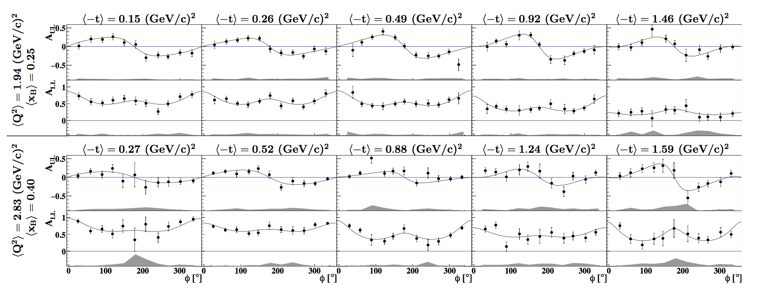
Target and Double Spin Asymmetry Moments of
Exclusive π⁰ Electroproduction as a Function of −t
  Target and double spin asymmetries for deep exclusive 𝝅⁰ production plotted as a function of ɸ for each kinematic bin in (𝑸², 𝓍B) space and -t range. The curves are simultaneous fit results. The shaded bands represent the overall systematic uncertainties.

Slide 11
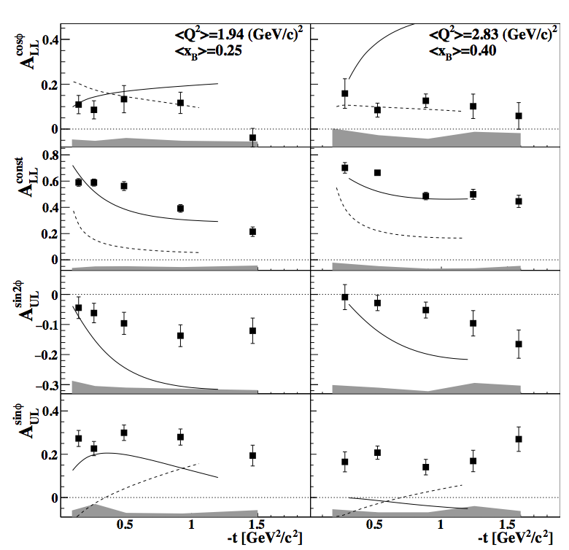

Target and Double Spin Asymmetry Moments of
Exclusive π⁰ Electroproduction as a Function of −t
Andrey KIM, Ph.D. Thesis KNU (2014)
        The target and double spin asymmetry moments of exclusive 𝝅⁰ electroproduction as a function of -t in 2 bins in (𝑸², 𝓍B) plane (left and right columns). The shaded bands represent the systematic uncertainties (including fit uncertainties), and the curves show the predictions from two GPD formalisms: GK (dashed) and GGL (solid). Note that
        moment is zero in the GK Model, and therefore is not shown.
        http://arxiv.org/abs/1511.03338

Slide 12
Goloskokov/Kroll(GK) Model and Goldstein/Liuti (GGL) Model
Both
Calculate the contributions from the transverse virtual photon amplitudes using chiral-odd GPDs with -t dependence, incorporated from Regge phenomenology.
The main difference between them is the GPD parametrization method.

Slide 13
Goloskokov/Kroll(GK) Model and Goldstein/Liuti (GGL) Model
GGL
Provides chiral-odd GPD parametrisation via linear relations to chiral-even GPDs under parity and charge conjugation symmetries in a Regge-ized diquark model.
This approach allows the model to overcome the issue that very few constraints on chiral-odd GPDs exist, while chiral-even GPDs can be relatively well-constrained using deep inelastic scattering, nucleon form-factor and DVCS measurements.
Reference
G.R.Goldstein, J.O.G Hernandez, S.Liuti, Phys. Rev. D. 91, 114013 (2015)

Slide 14
Goloskokov/Kroll(GK) Model and Goldstein/Liuti (GGL) Model
GK
Chiral-odd GPDs are constructed from double distributions and constrained using latest results from lattice QCD [1] and transversely parton distribution functions [2] with
the emphasis on 𝐻T and ĒT , while the contribution from the other chiral-odd GPDs are considered negligible.
Non-Perturbative double distribution 𝐹(𝑥,𝑦) used for Parametrizing GPDs. Specify Fraction of Initial Momentum & Longitudinal Part of Momentum Transfer carried by nucleon constituent.
Reference
      [1] M. Göckeler et al. (QCDSF and UKQCD Collaborations), Phys. Rev. Lett. 98 222001 (2007)
      [2] M. Anselmino et al., Nuclear Physics B - Proceedings Supplements 191, 98 (2009), proceedings of the Ring-berg Workshop New Trends in {Hera} Physics 2008.
      Theoretical Model of Goloskokov and Kroll, Euro. Phys. J. A 47, 112 (2011)

Slide 15
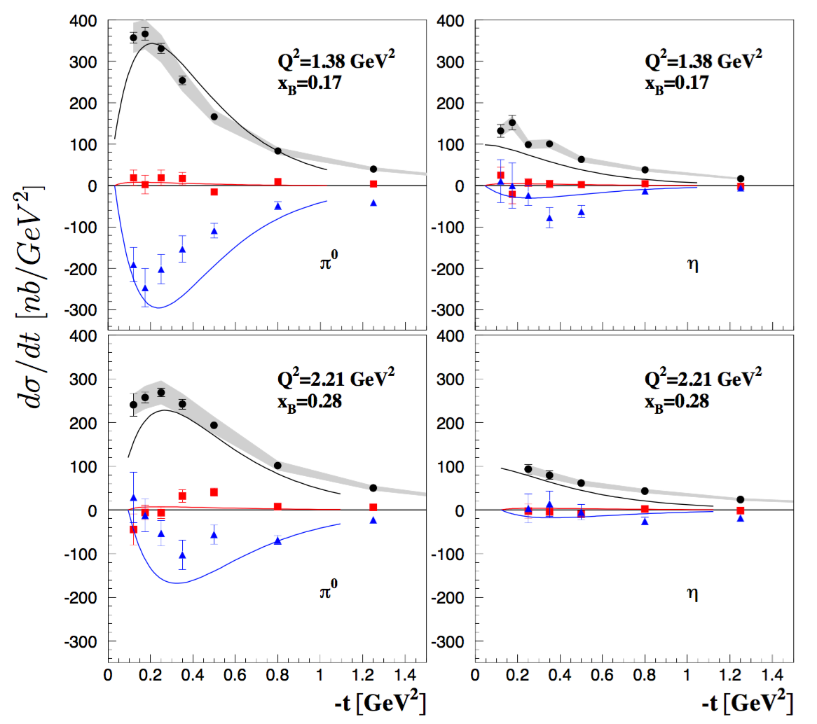



Exclusive electroproduction at W > 2GeV with CLAS I
Black
Blue
Red
Curves: Theoretical Model of
Goloskov and Kroll (Euro. Phys. J. A47 (2011)

Slide 16
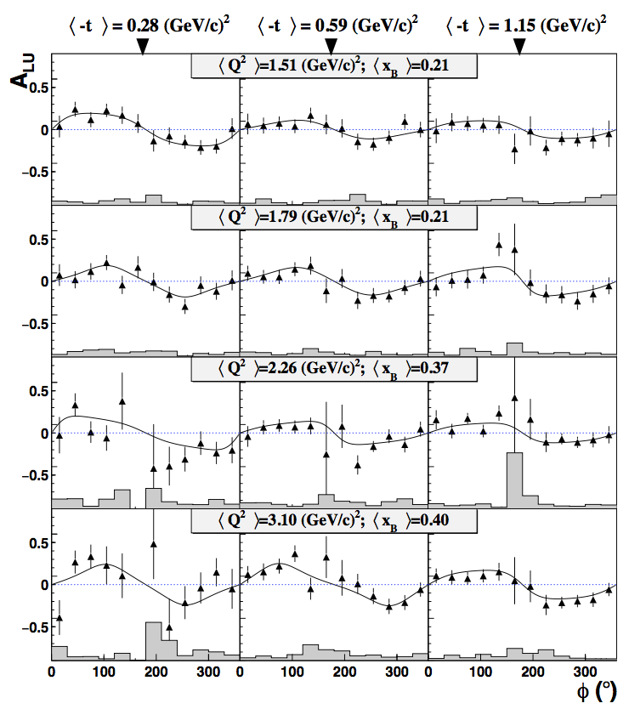
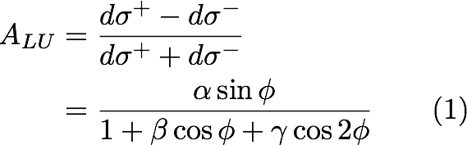
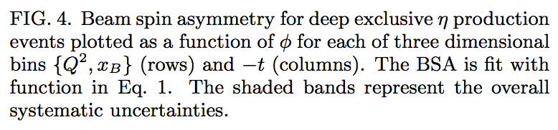
Beam spin asymmetry for deeply virtual production as a function of
A.Kim, K.Joo
(CLAS collaboration)

Slide 17

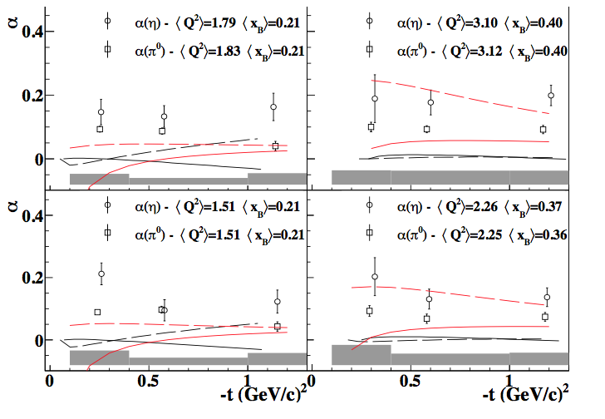
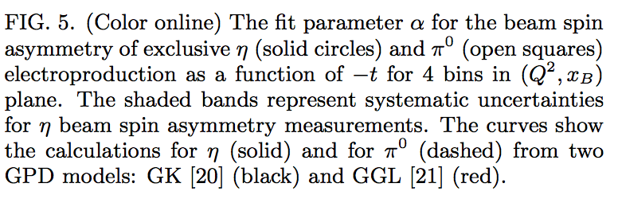
Beam spin asymmetry for deeply virtual and production as a function of -t
η (solid circles, solid line)
𝜋⁰: one squares, dashed lines

Slide 18
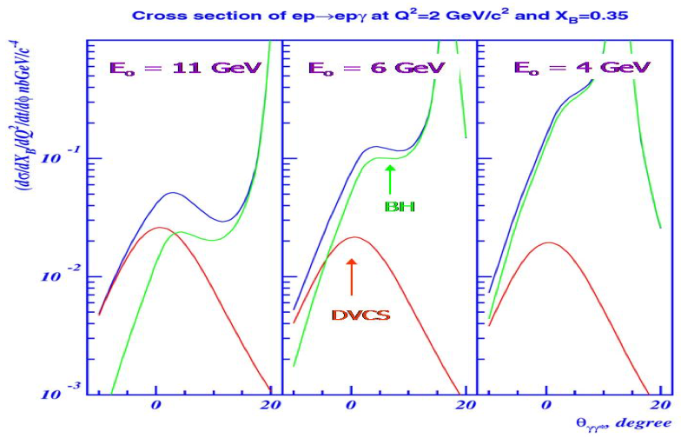
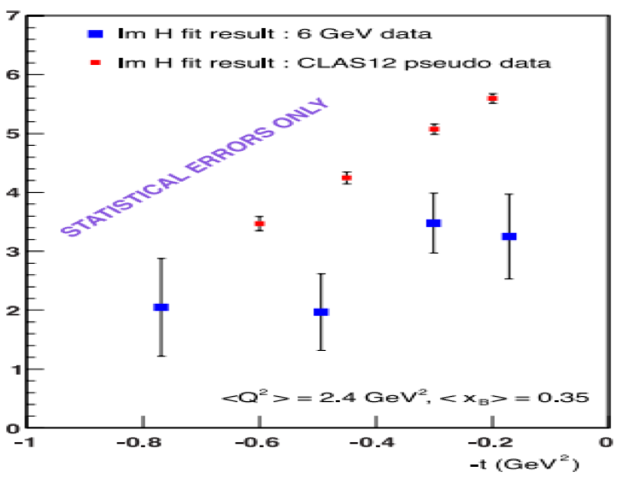
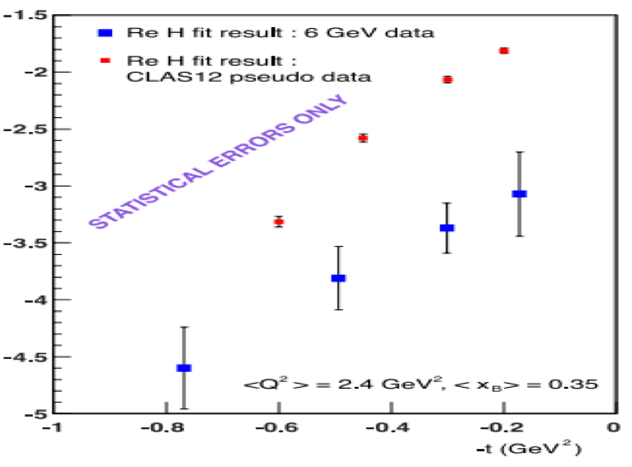
12 GeV Upgrade CLAS 12
Relative cross section ratio of contribution from DVCS and BH with increased electron beam energy
Fig.3: Imaginary part (left) and real part (right) of CFF H(t) extracted by H. Mourtarde for
existing JLab 6 GeV data (blue squares) with CLAS12 pseudo-data (red squares).

Slide 19
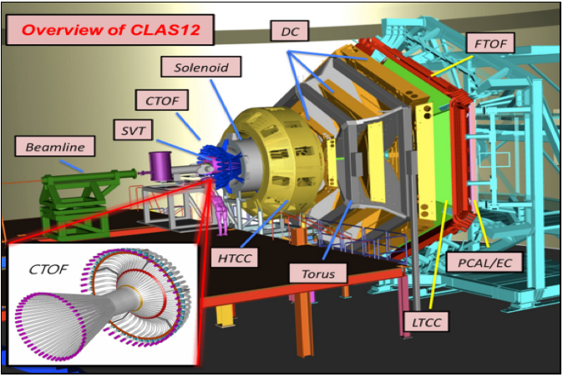
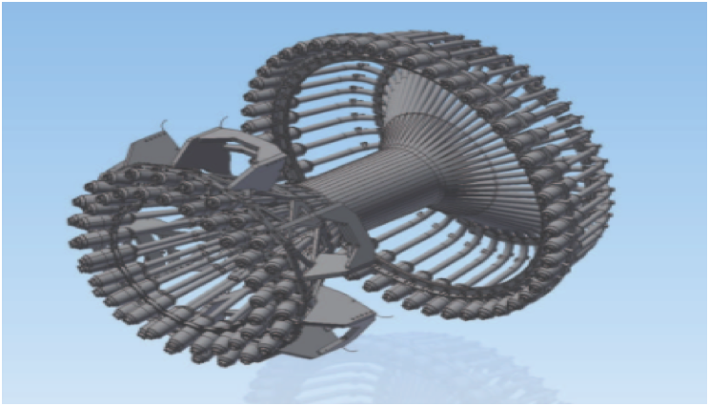
CLAS12 and KNU contribution
R&D, Testing, and Installation of the hardware.
CLAS12 Detector at JLAB HALL B
Central TOF Detector of CLAS12
CTOF readout PMTs enclosed by magnetic shielding.

Slide 20
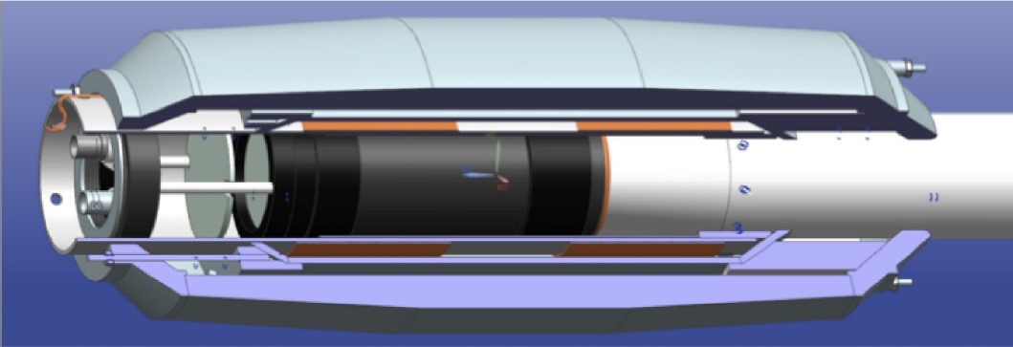
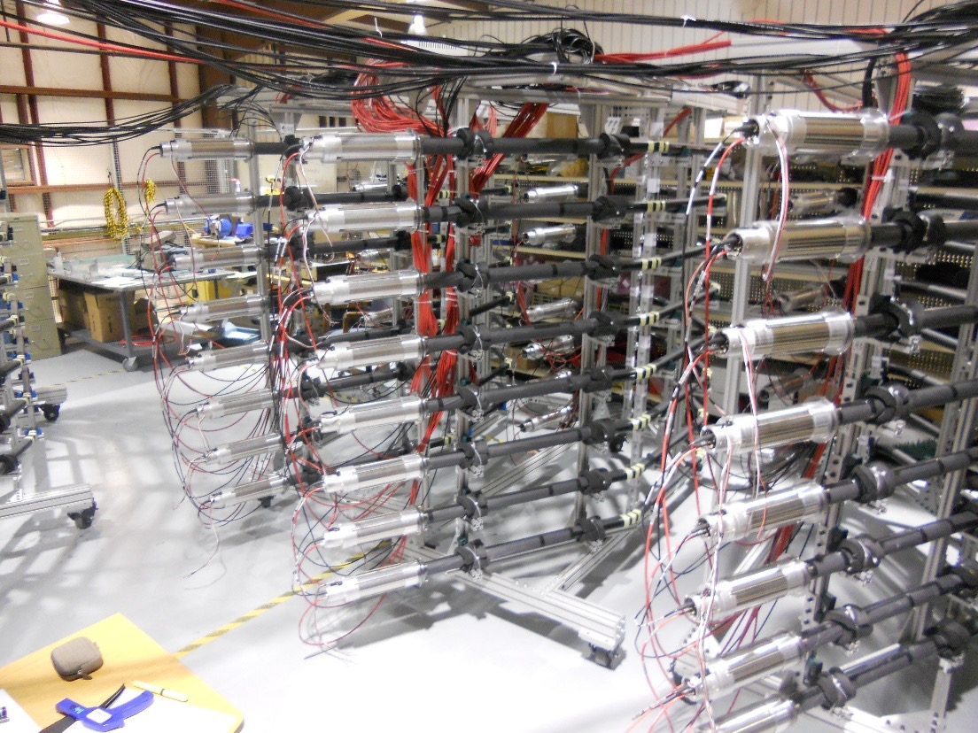
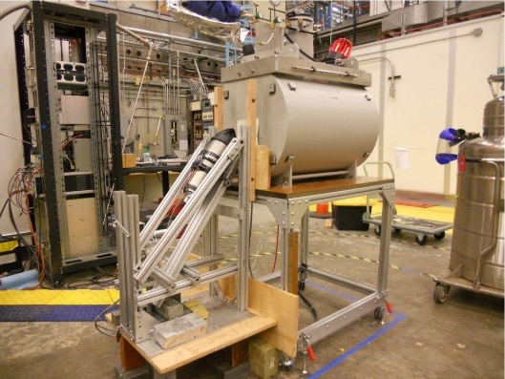
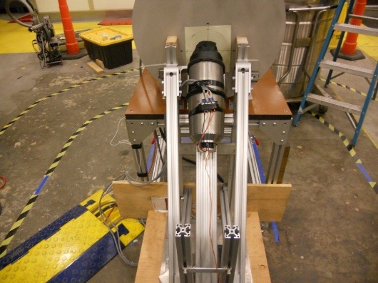
CTOF Magnetic Shield & Test
The CTOF shield as shown in a 3D cut-away view
Cosmic ray test of 48 counters at CTOF area of JLab
CTOF shield test with FROST superconducting magnet

Slide 21
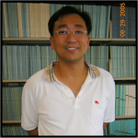
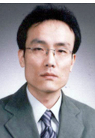

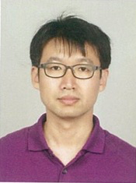
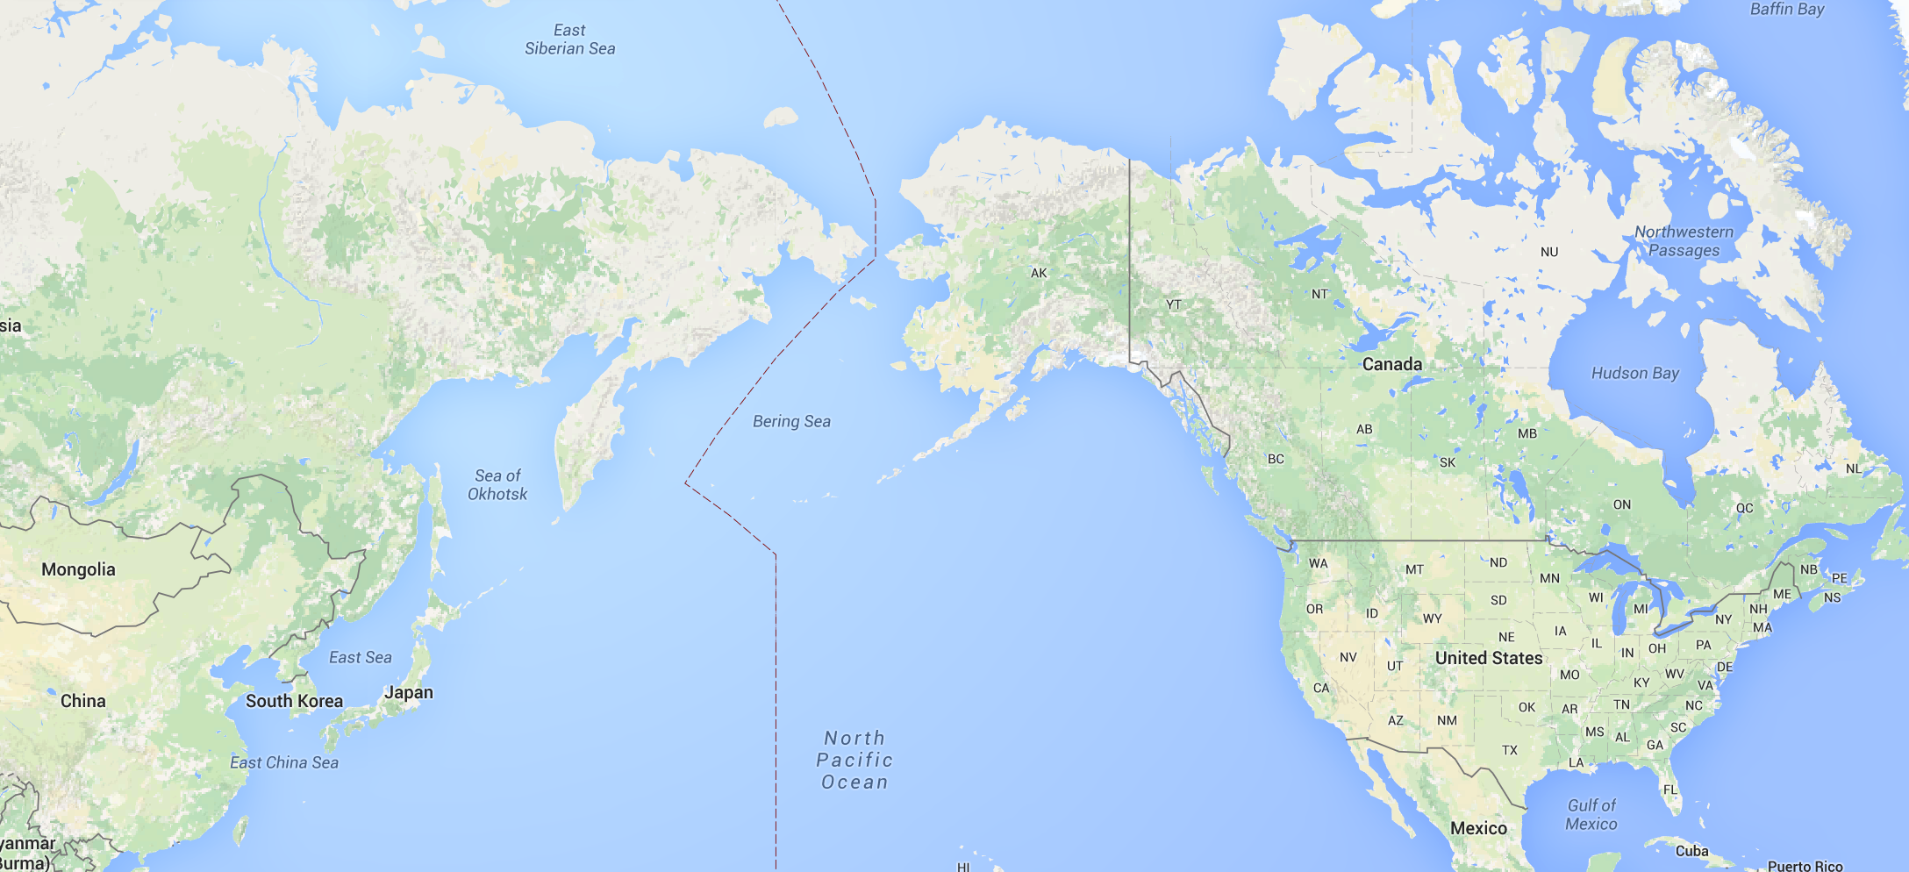
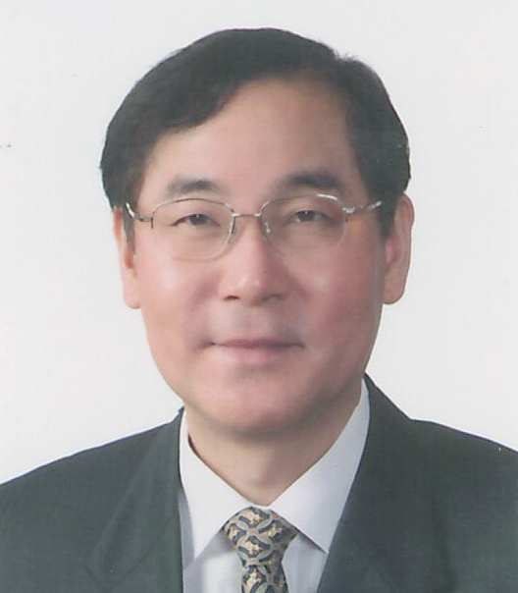
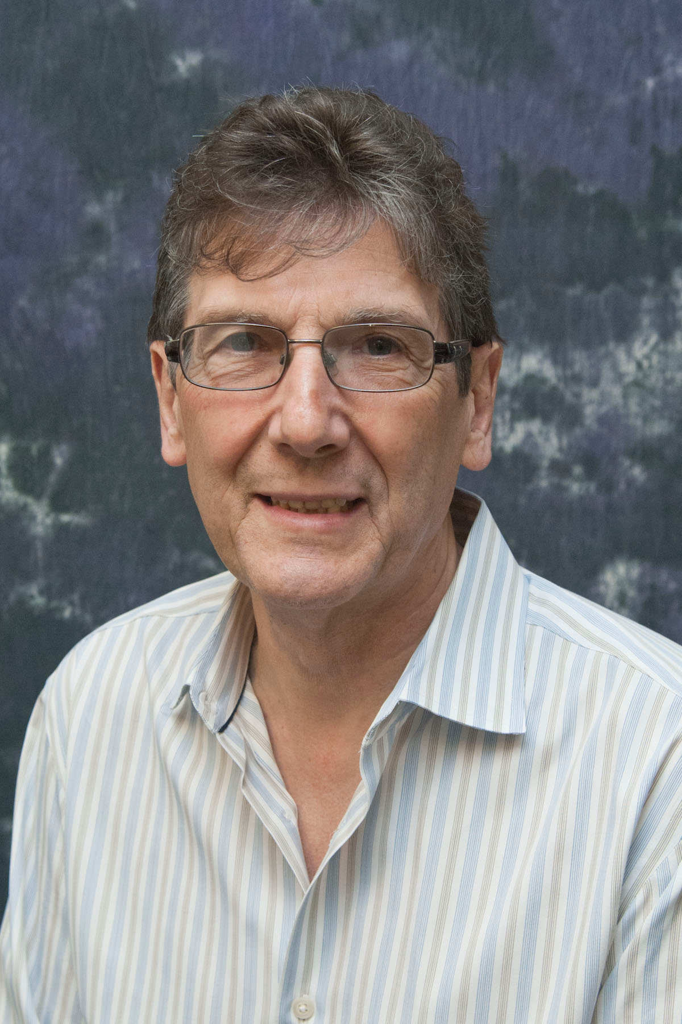
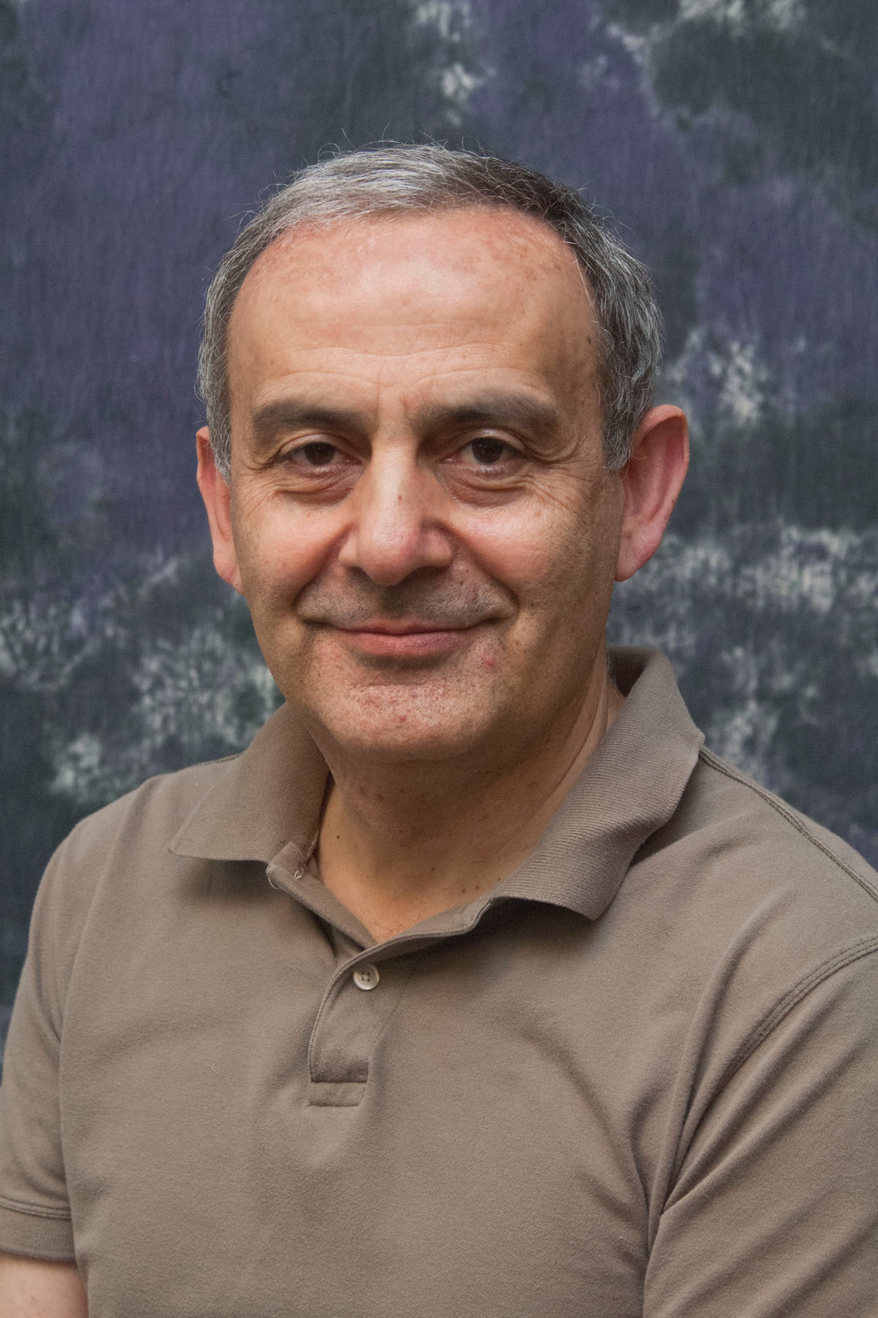
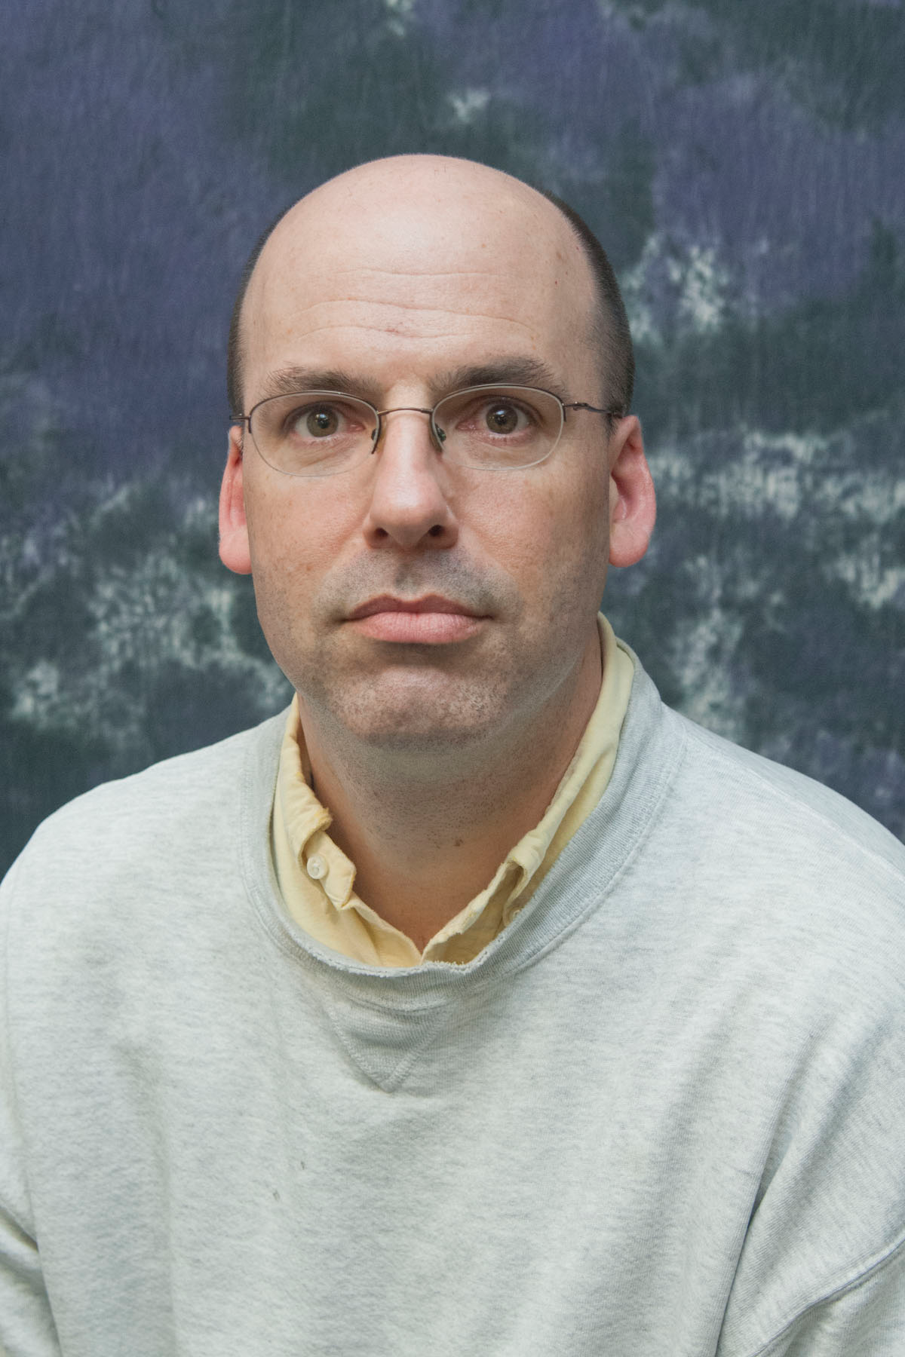
Korean Hadron Physics Group and Collaborators
KNU Theory Group
University of Connecticut
H. Choi
Y. Oh
H. Ryu
Y. Choi
K. Joo
A. Kim
KNU Physics Lab
Jefferson Lab
W. Kim
A. Ni
J. Tam
V. Burkert
H. Avagyan
D. Carman
  UCONN
  KNU
  J-LAB

Slide 22



Summary
and data, when taken together, can facilitate the flavour decomposition of the transversely GPDs.
Interpretation of the experimental data in terms of GPDs provides the first insight on the chiral-odd GPDs and , and complement unpolarised structure function data sensitive to the GPDs and
These data provide a crucial input for parameterizations of essentially unknown chiral-odd GPDs and will strongly influence existing theoretical calculations based on the handbag formalism
This will provide new constraints to existing GPDs models and will play an important role in the future GPDs quark flavor decomposition analysis.
12 GeV upgraded JLab with CLAS12, and polarized target will provide us with more accurate data and will enable us to tighten the theoretical models.

