Slide 1
Photoproduction of πΔ on the proton at E_{γ}=1.5-3 GeV, and near future LEPS and LEPS2 experiments at SPring-8
Nov/25/2016
RCNP, Osaka University, Japan
Hideki Kohri

Slide 2
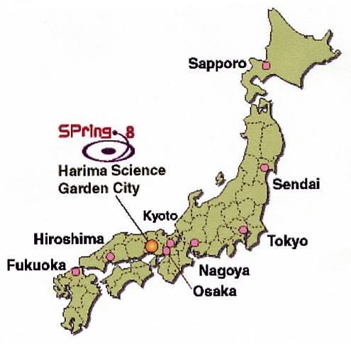
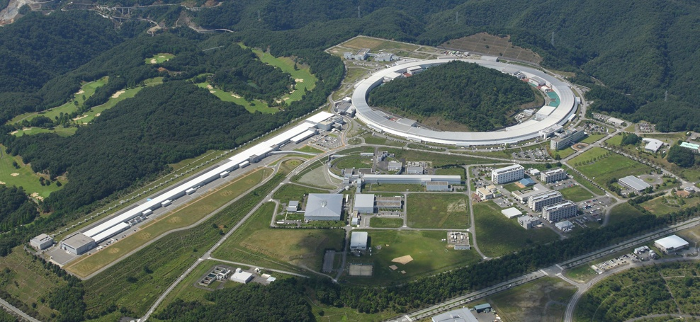
Super Photon ring ‐ ８ GeV
Electron storage ring
8 GeV electron beam
Diameter ≈457 m
RF 508 MHz
1‐bunch spread is
within σ＝12 psec．
Beam Current = 100 mA
120 km distant from Osaka

Slide 3
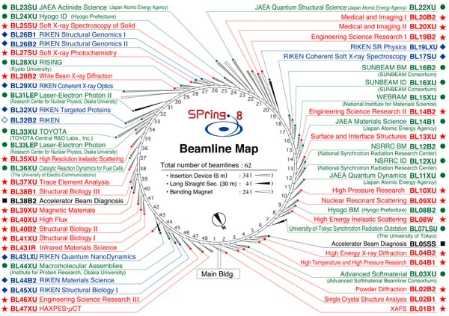
SPring-8 beamline map
LEPS

Slide 4
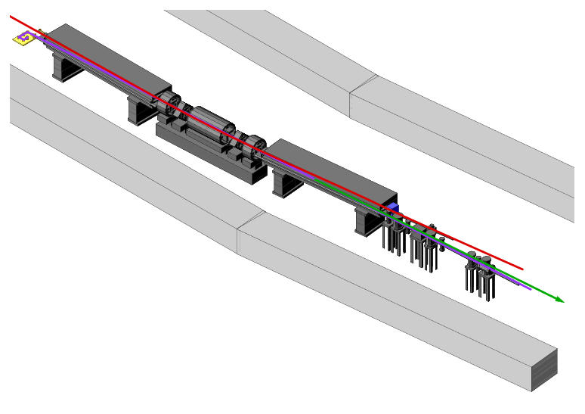
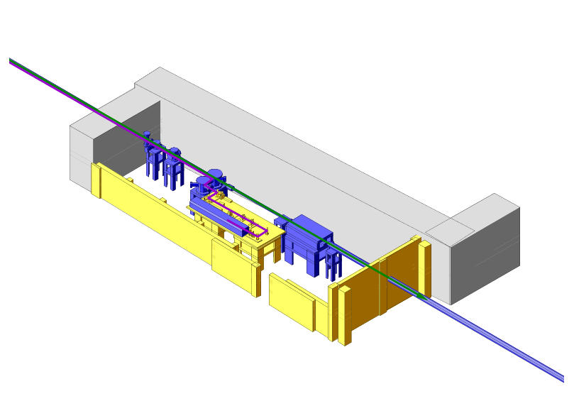
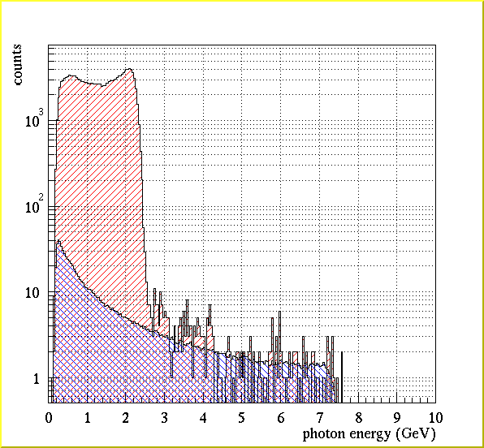
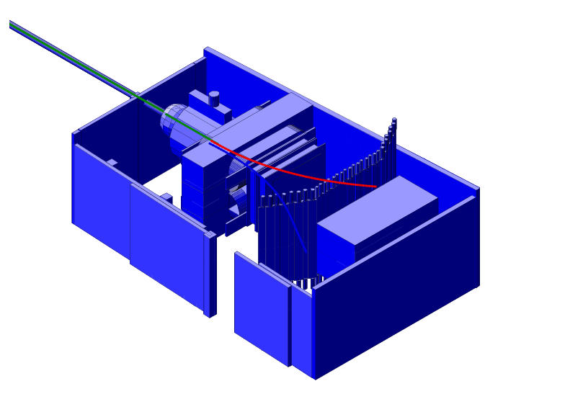
LEPS facility
LEPS experiment started in 2000
8 GeV electron
Backward-Compton scattering
Collision
Recoil electron
Tagging
counter
SSD + Sc hodoscope
ScFi + Sc hodoscope
Beam intensity
< 2.5 x 10⁶ for E_{γ} =1.5-2.4 GeV
(355 nm laser)
< 3.0 x 10⁵ for E_{γ} =1.5-3.0 GeV
(257 nm laser)
36m
70m
a) SPring-8
SR ring
Laser light
b) Laser hutch
Energy spectrum of
BCS photons
Bremsstrahlung
Inverse Compton γ-ray
c) Experimental hutch

Slide 5
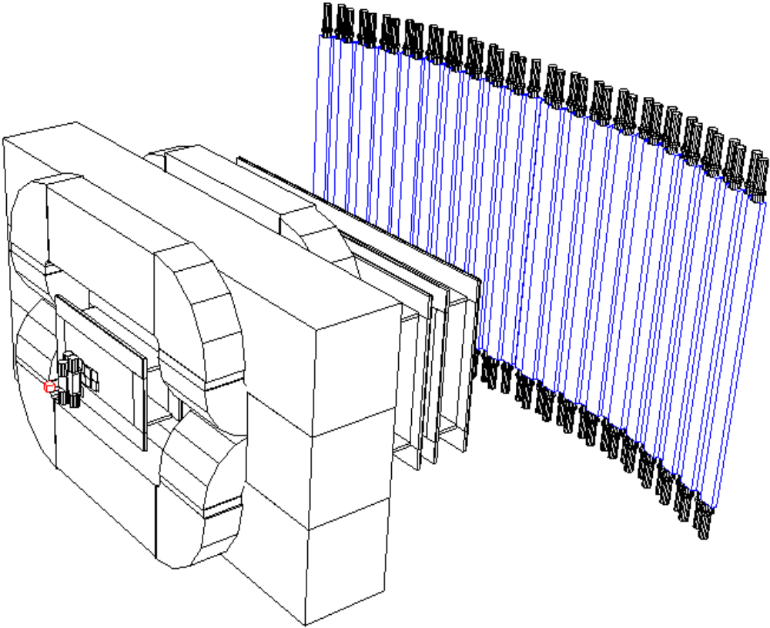
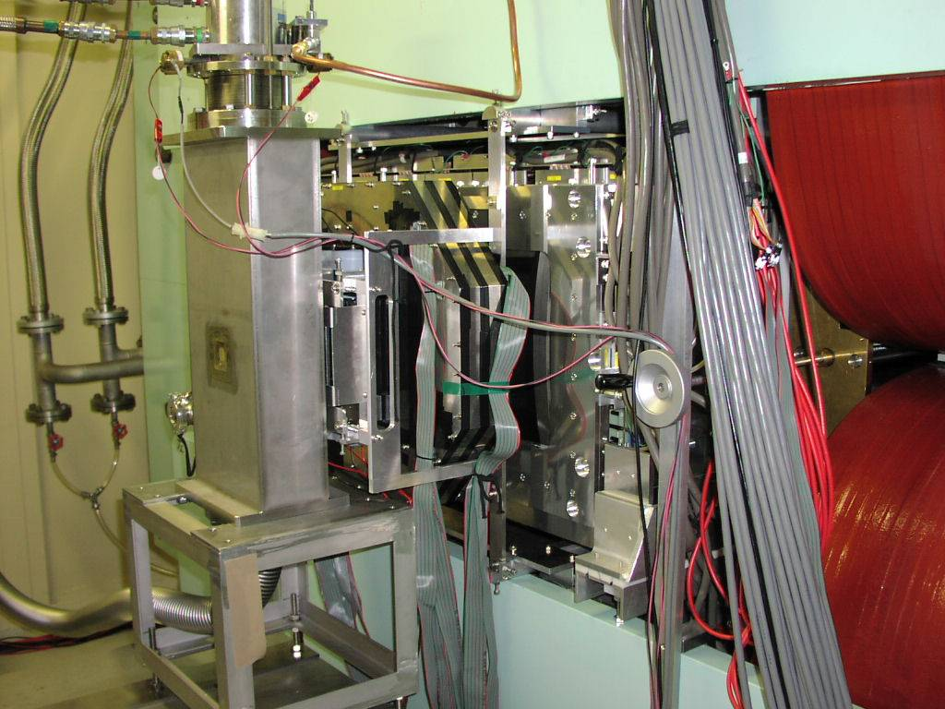
LEPS detector setup
LEPS detector was optimized to detect φ meson decaying to K⁺K⁻ at forward angles
TOF
wall
Aerogel
Cerenkov
(n=1.03)
Dipole
Magnet (0.7 T)
Start counter
Target
γ
MWDC 3
MWDC 1
1m
MWDC 2
Silicon Vertex
Detector

Slide 6
LEPS Physics Publications
(A) φ meson γ Li, C, Al, Cu T. Ishikawa et al. Phys. Lett. B 608 (2005) 215
γp −> φp T. Mibe et al. Phys. Rev. Lett. 95 (2005) 182001
γd -> φd W.C. Chang et al. Phys. Lett. B 658 (2008) 209
γn -> φn W.C. Chang et al. Phys. Lett. B 684 (2010) 6
γp, γd W.C. Chang et al. Phys. Rev. C 82 (2010) 015205
(B) Strangeness γp -> K⁺Λ γp -> K⁺Σ⁰ R.G.T. Zegers et al. Phys. Rev. Lett. 91(2003) 092001
γp -> K⁺Λ, γp -> K⁺Σ⁰ M. Sumihama et al. Phys. Rev. C 73(2006) 035214
γn -> K⁺Σ⁻ H. Kohri et al. Phys. Rev. Lett. 97 (2006) 082003
γp -> K⁺Λ K. Hicks et al. Phys. Rev. C 76 (2007) 042201(R)
γn -> K⁺Σ⁻(1385) K. Hicks et al. Phys. Rev. Lett. 102 (2009) 012501
γp -> K⁺Λ(1405), Σ⁰(1385) M. Niiyama et al. Phys.Rev. C 78(2008)035202
γp -> K⁺Λ(1520) N. Muramatsu et al. Phys. Rev. Lett. 103(2009) 012001
γp -> K⁺Λ(1520) H. Kohri et al. Phys. Rev. Lett. 104 (2010) 172001
γp -> K⁺Λ(1520). φp S.Y. Ryu et al. Phys. Rev. Lett. 116(2016)232001
γp -> K^{*0}Σ⁺ S.H. Hwang et al. Phys. Rev. Lett. 108(2012)092001
(C) Pseudoscaler meson
γp -> π⁰p M. Sumihama et al. Phys. Lett B 657 (2007) 32
γp -> ηp M. Sumihama et al. Phys. Rev. C 80(2009) 052201(R)
γp -> ω, η’ Y. Morino et al. Prog. Theor. Exp. Phys.(2015)013D01
(D) Exotic state Pentaquark search T. Nakano et al. Phys. Rev. Lett. 91 (2003) 012002
Pentaquark search T. Nakano et al. Phys. Rev. C 79 (2009) 025210
K⁻ pp search A.O. Tokiyasu et al. Phys. Lett. B 728 (2014) 616

Slide 7
LEPS Physics Publications
(A) φ meson γ Li, C, Al, Cu T. Ishikawa et al. Phys. Lett. B 608 (2005) 215
γp −> φp T. Mibe et al. Phys. Rev. Lett. 95 (2005) 182001
γd -> φd W.C. Chang et al. Phys. Lett. B 658 (2008) 209
γn -> φn W.C. Chang et al. Phys. Lett. B 684 (2010) 6
γp, γd W.C. Chang et al. Phys. Rev. C 82 (2010) 015205
(B) Strangeness γp -> K⁺Λ γp -> K⁺Σ⁰ R.G.T. Zegers et al. Phys. Rev. Lett. 91(2003) 092001
γp -> K⁺Λ, γp -> K⁺Σ⁰ M. Sumihama et al. Phys. Rev. C 73(2006) 035214
γn -> K⁺Σ⁻ H. Kohri et al. Phys. Rev. Lett. 97 (2006) 082003
γp -> K⁺Λ K. Hicks et al. Phys. Rev. C 76 (2007) 042201(R)
γn -> K⁺Σ⁻(1385) K. Hicks et al. Phys. Rev. Lett. 102 (2009) 012501
γp -> K⁺Λ(1405), Σ⁰(1385) M. Niiyama et al. Phys.Rev. C 78(2008)035202
γp -> K⁺Λ(1520) N. Muramatsu et al. Phys. Rev. Lett. 103(2009) 012001
γp -> K⁺Λ(1520) H. Kohri et al. Phys. Rev. Lett. 104 (2010) 172001
γp -> K⁺Λ(1520). φp S.Y. Ryu et al. Phys. Rev. Lett. 116(2016)232001
γp -> K^{*0}Σ⁺ S.H. Hwang et al. Phys. Rev. Lett. 108(2012)092001
(C) Pseudoscaler meson
γp -> π⁰p M. Sumihama et al. Phys. Lett B 657 (2007) 32
γp -> ηp M. Sumihama et al. Phys. Rev. C 80(2009) 052201(R)
γp -> ω, η’ Y. Morino et al. Prog. Theor. Exp. Phys.(2015)013D01
(D) Exotic state Pentaquark search T. Nakano et al. Phys. Rev. Lett. 91 (2003) 012002
Pentaquark search T. Nakano et al. Phys. Rev. C 79 (2009) 025210
K⁻ pp search A.O. Tokiyasu et al. Phys. Lett. B 728 (2014) 616

Slide 8
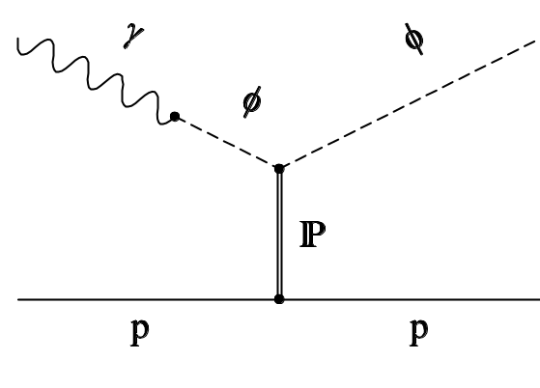
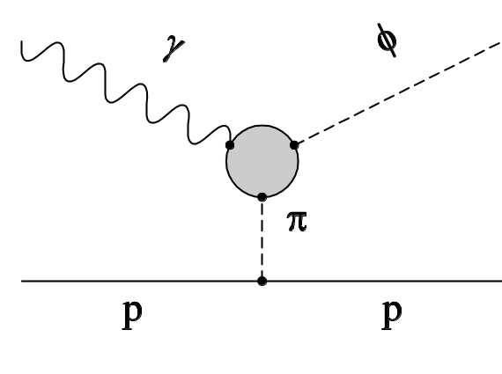
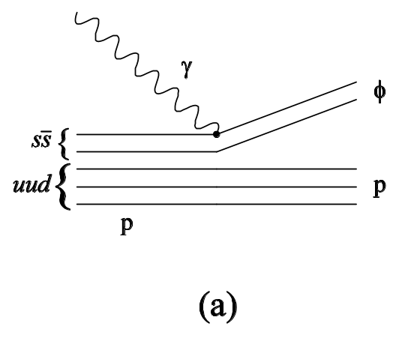
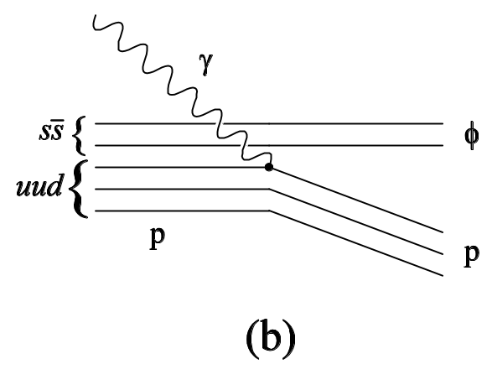
(A) φ meson photoproduction on proton
Reaction mechanism
Diffractive production within the
vector-meson-dominance
model through Pomeron exchange
One-pion-exchange
ss-knockout
uud-knockout
The meson exchange is suppressed by OZI rule.
We study the pomeron exchange, ss-knockout, and other effects
near the threshold.

Slide 9
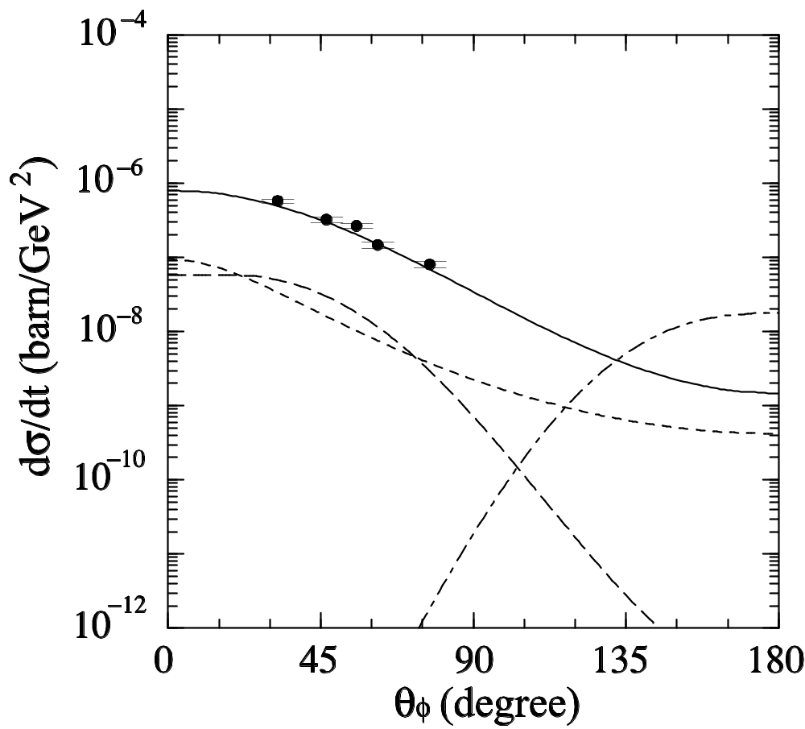
Theoretical prediction for the γp φp reaction
A.I. Titov et al. Phys. Rev. C58 (1998) 2429
Cross Section at E_{γ} = 2.0 GeV
Pomeron
Solid: Pomeron exchange
Dotted: One pion exhange
Dashed: ss knockout
Dotted-dashed: uud knockout
π
ss

Slide 10
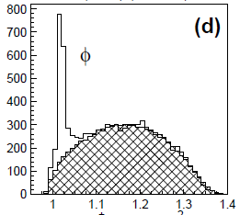
(A) φ meson photoproduction on proton
Invariant mass of K⁺K⁻
Counts
Invariant mass of K⁺K⁻ (GeV/c²)

Slide 11
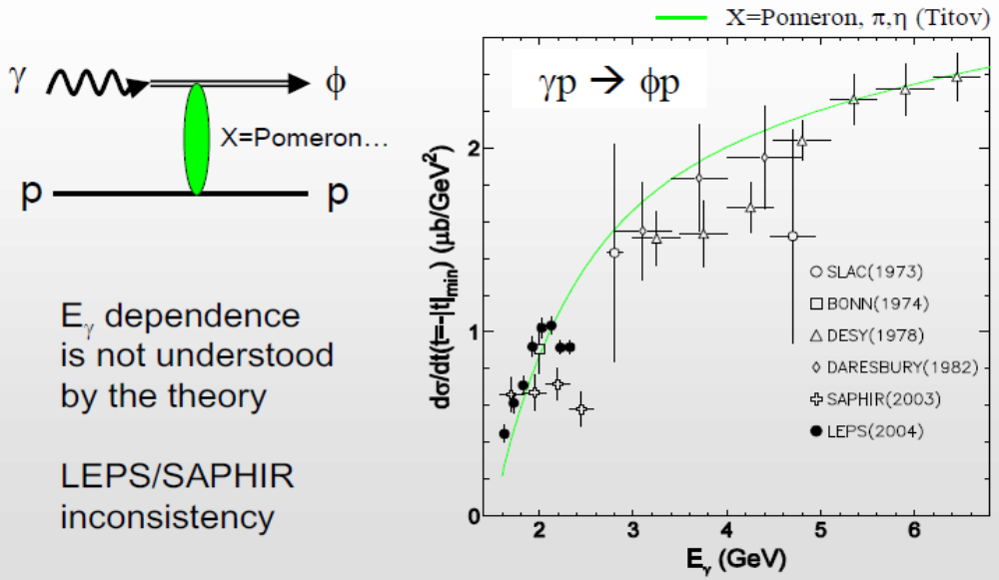
(A) φ meson photoproduction on proton
LEPS cross section data
Bump structure was found.
Diffractive φ meson photoproduction
on proton
T. Mibe et al. Phys. Rev. Lett. 95 182001 (2005)

Slide 12
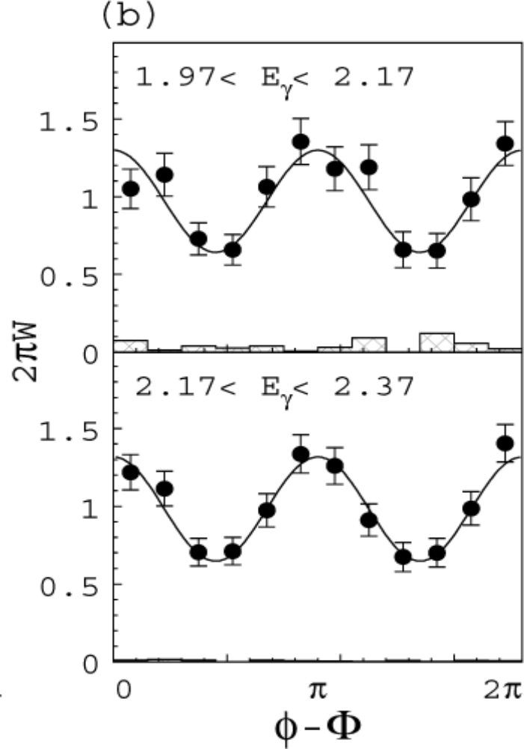
(A) φ meson photoproduction on proton
Decay asymmetry of φ meson
ρ¹₁₋₁>0 means that natural
parity exchange is dominant
Reaction mechanisms are not so
different between two energy regions.
ρ¹₁₋₁ = 0.197+-0.030
ρ¹₁₋₁ = 0.189+-0.030
T. Mibe et al. Phys. Rev. Lett. 95 182001 (2005)
Notes:
12

Slide 13
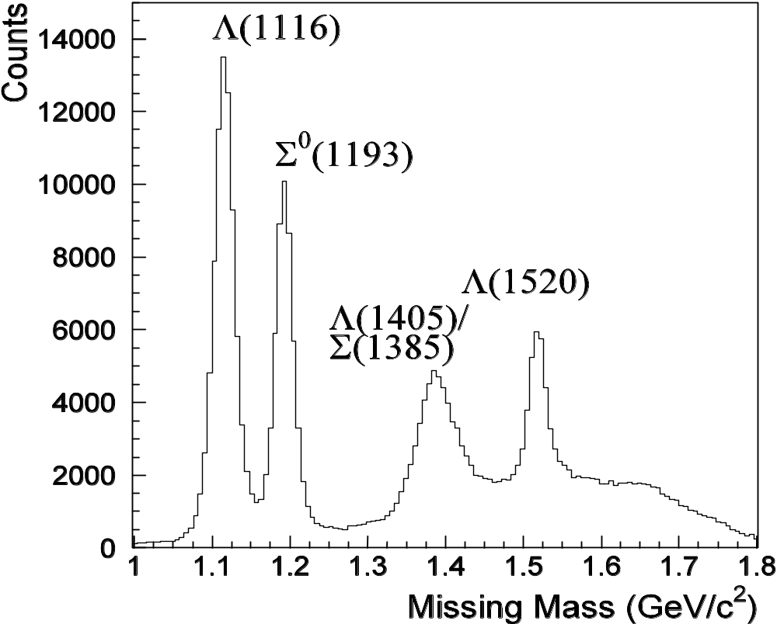
(B) Strangeness photoproduction
Missing mass spectrum of p(γ,K⁺)X
p(γ,K⁺)X
Eγ = 1.5-2.4 GeV

Slide 14
(B,C) K, π, η meson photoproduction
Physics motivation
Quark model predicts a lot of baryon resonances.
However, most of them are not identified experimentally.
These are called ‘Missing resonances’.
They are expected to decay not only to πN channel
but also to ηN, KΛ, KΣ, KΛ* and KΣ* channels.
Since only πN channel has been extensively studied so far,
new data for the other channels are very important.
Exotic baryon resonance search is also expected.
N*
Strong
N* may be an exotic baryon
resonance including ss.
Very weak
N
Κ
π
Λ

Slide 15
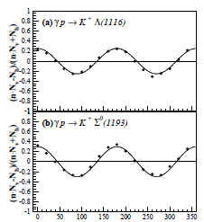
(B) Strangeness photoproduction
Photon beam asymmetry Σ for K⁺Λ and K⁺Σ⁰
dσ
dσ
Vertical = [ 1 + PγΣcos(2φ) ]
Horizontal = [ 1 - PγΣcos(2φ) ]
N = F_{acc}
= PγΣcos(2φ)
N : K⁺ photoproduction yield
φ : K⁺ azimuthal angle
Pγ : Polarization of photon
dΩ_{v}
dΩ_{unpol}
dσ
dσ
dΩ_{h}
dΩ_{unpol}
dσ
dΩ
N_{v} - N_{h}
N_{v} + N_{h}
Σ>0
Σ>0 means that K* exchange
in t-channel is strong in the
reaction mechanism.
Σ>0
M. Sumihama et al. PRC 73 (2006) 035214
Eγ = 1.5-2.4 GeV
φ (deg.)

Slide 16
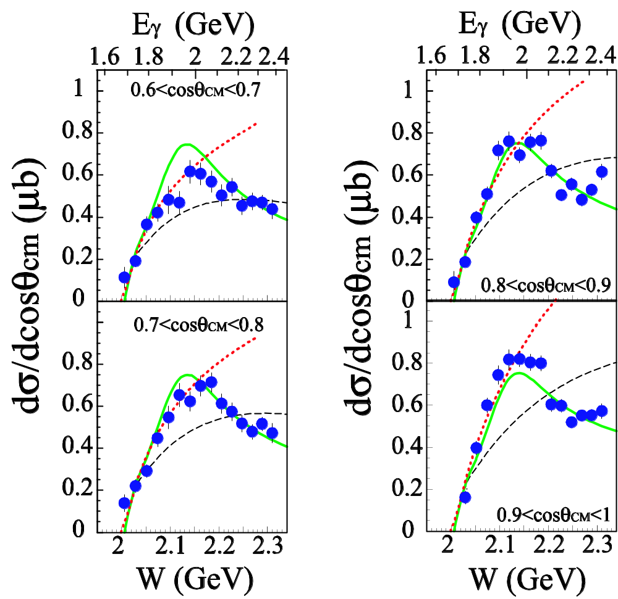
(B) Strangeness photoproduction
Bump structure was found in γp -> K⁺Λ(1520)
H. Kohri et al. Phys. Rev. Lett. 104 (2010) 172001
Differential cross sections
Result of fit
Bump energy 2.11 GeV
width 140 MeV
Observed width is narrower than
that of usual N*.
N* Status Mass Width
N(2080) D₁₃ ** ~2.08GeV ~300MeV
N(2090) S₁₁ * ~2.09GeV ~300MeV
N(2100) P₁₁ * ~2.10GeV ~300MeV
N(2190)G₁₇ **** ~2.15GeV ~500MeV
Bump
Bump

Slide 17
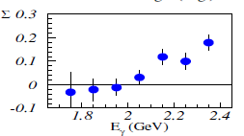
(B) Strangeness photoproduction
γp -> K⁺Λ(1520)
H. Kohri et al. Phys. Rev. Lett. 104 (2010) 172001
Photon beam asymmetry Σ
The asymmetry for K⁺Λ(1520)
is smaller than that for K⁺Λ.
The cause of the bump has not
been clarified by only
cross sections and Σ.

Slide 18
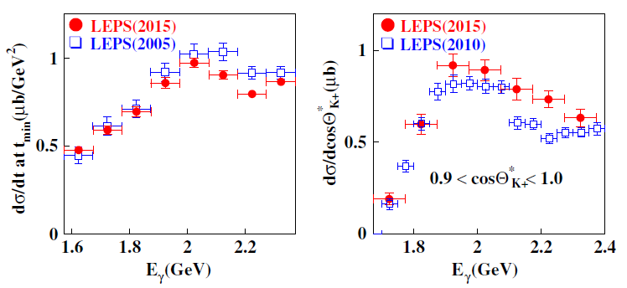
Interference effect cannot explain the bump
S.Y. Ryu, J.K. Ahn, T. Nakano et al. Phys. Rev. Lett. 116 (2016) 232001
γ p -> φ p γ p -> K⁺ Λ(1520)

Slide 19
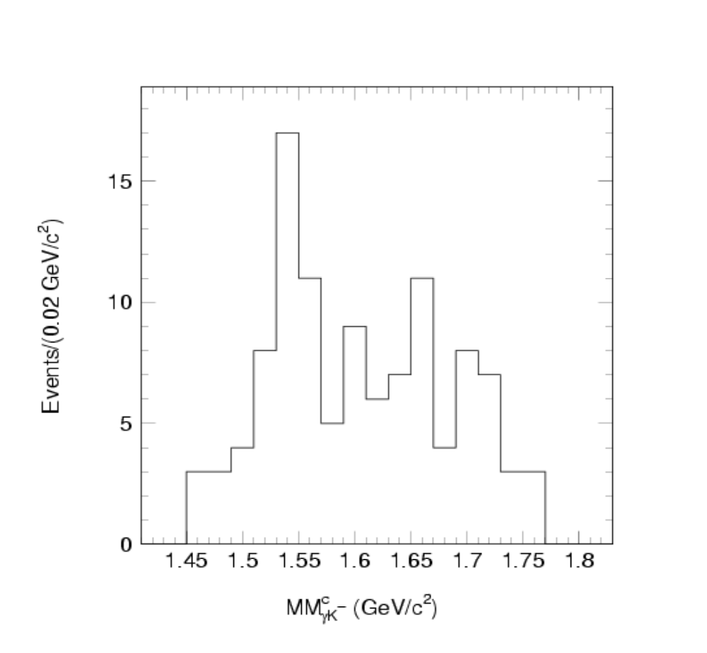
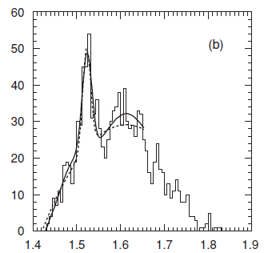
(D) Pentaquark (θ⁺ uudds ) search
Present status
Two papers were published.
(1) γC reaction T. Nakano et al. Phys. Rev. Lett. 91 (2003) 012002
(2) γd reaction T. Nakano et al. Phys. Rev. C 79 (2009) 0252
(1)
(2)
Counts
Counts
Mass (GeV/c²)
Mass (GeV/c²)

Slide 20
(D) Pentaquark (θ⁺ uudds ) search
Present status
Although the results are positive, statistics is not high enough in both data.
We introduced large scintillators to select neutron events and took high statistics data .
Data analysis is underway now.
γC PRL 91 (2003) 012002 γd PRC 79 (2009) 252
(1)
(2)
Counts
Counts
Mass (GeV/c²)
Mass (GeV/c²)

Slide 21
Step up of LEPS experiments
Old LEPS experiments Next experiments
Beam：Linearly polarized photon Beam : Circularly polarized photon
(E_{γ}=1.5-2.4 GeV) or E_{γ}>2.4 GeV
Target： Unpolarized LH₂、LD₂、LHe Target : Polarized nucleon target
Spectrometer: Forward spectrometer Spectrometer: Large solid angle
spectrometer

Slide 22
Weak point No charged pion data
(A) φ meson γ Li, C, Al, Cu T. Ishikawa et al. Phys. Lett. B 608 (2005) 215
γp −> φp T. Mibe et al. Phys. Rev. Lett. 95 (2005) 182001
γd -> φd W.C. Chang et al. Phys. Lett. B 658 (2008) 209
γn -> φn W.C. Chang et al. Phys. Lett. B 684 (2010) 6
γp, γd W.C. Chang et al. Phys. Rev. C 82 (2010) 015205
(B) Strangeness γp -> K⁺Λ γp -> K⁺Σ⁰ R.G.T. Zegers et al. Phys. Rev. Lett. 91(2003) 092001
γp -> K⁺Λ, γp -> K⁺Σ⁰ M. Sumihama et al. Phys. Rev. C 73(2006) 035214
γn -> K⁺Σ⁻ H. Kohri et al. Phys. Rev. Lett. 97 (2006) 082003
γp -> K⁺Λ K. Hicks et al. Phys. Rev. C 76 (2007) 042201(R)
γp -> K⁺Σ⁻(1385) K. Hicks et al. Phys. Rev. Lett. 102 (2009) 012501
γp -> K⁺Λ(1405), Σ⁰(1385) M. Niiyama et al. Phys.Rev. C 78(2008)035202
γp -> K⁺Λ(1520) N. Muramatsu et al. Phys. Rev. Lett. 103(2009) 012001
γp -> K⁺Λ(1520) H. Kohri et al. Phys. Rev. Lett. 104 (2010) 172001
γp -> K⁺Λ(1520). φp S.Y. Ryu et al. Phys. Rev. Lett. 116(2016)232001
γp -> K^{*0}Σ⁺ S.H. Hwang et al. Phys. Rev. Lett. 108(2012)092001
(C) Pseudoscaler meson
γp -> π⁰p M. Sumihama et al. Phys. Lett B 657 (2007) 32
γp -> ηp M. Sumihama et al. Phys. Rev. C 80(2009) 052201(R)
γp -> ωp, η’p Y. Morino et al. Prog. (2015)013D01
(D) Exotic state Pentaquark search T. Nakano et al. Phys. Rev. Lett. 91 (2003) 012002
Pentaquark search T. Nakano et al. Phys. Rev. C 79 (2009) 025210
K⁻ pp search A.O. Tokiyasu et al. Phys. Lett. B 728 (2014) 616

Slide 23
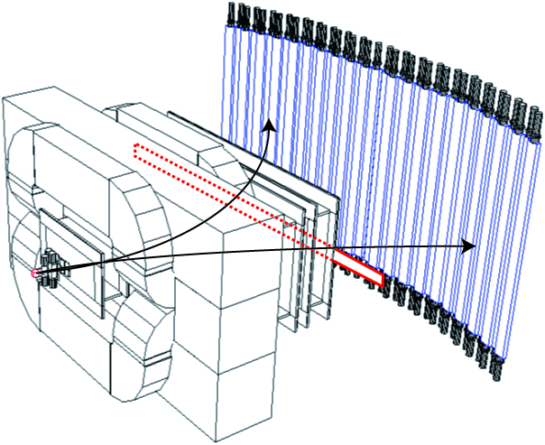
New experimental setup for high momentum π
Plastic counter for vetoing e⁺e⁻ was used
Dipole
Magnet (0.7 T)
No Aerogel
Cherenkov counter
TOF
wall
e⁻
Start counter
Target
e⁺
γ
MWDC 3
MWDC 2
MWDC 1
Silicon Vertex
Detector

Slide 24
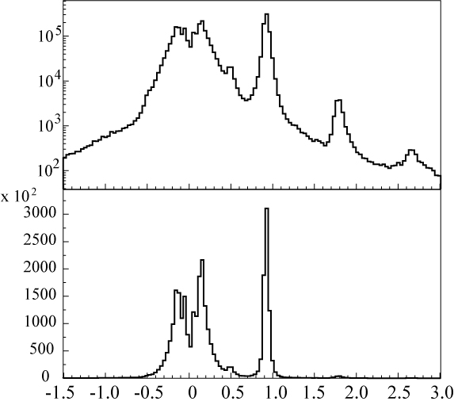
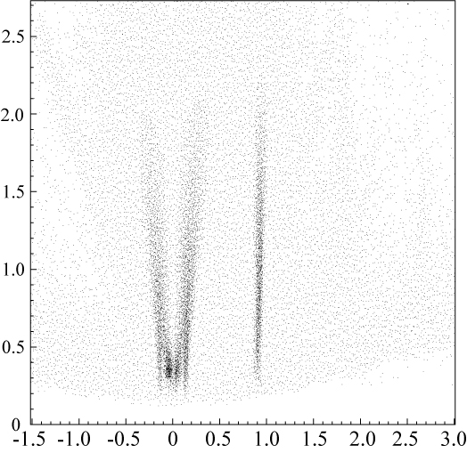
High momentum π data
Momentum (GeV)
Counts
π⁻
π⁺
p
K⁺
d
t
π⁻
π⁺
π⁺
p
p
π⁻
Momentum
range of previous
experiments
K⁺
d
e⁻ e⁺
Mass / Charge (GeV/c²)
Mass / Charge (GeV/c²)

Slide 25
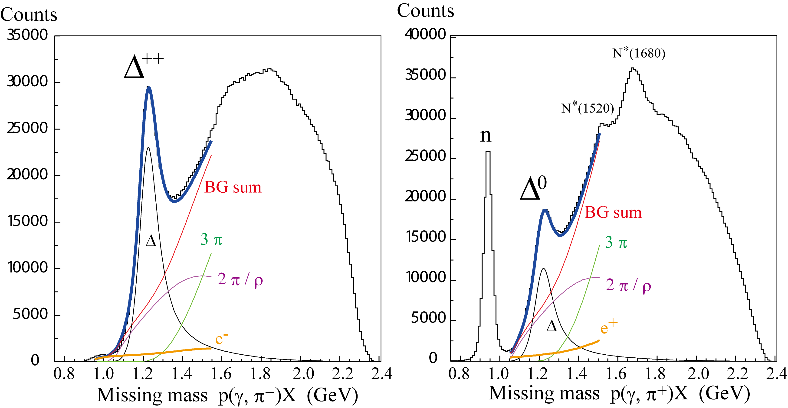
Missing mass of p( γ, π )X
p(γ, π⁻)X
p(γ, π⁺)X
0.7<cosθ_{π}<1
0.7<cosθ_{π}<1
E_{γ}=1.5-3.0 GeV
E_{γ}=1.5-3.0 GeV

Slide 26
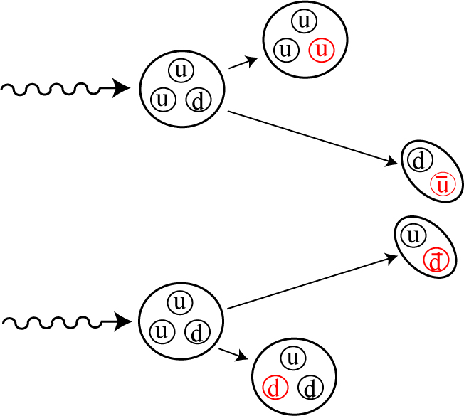
ūu and d̄d productions
ūu production is precisely compared with d̄d production
by the γp→ π⁻ Δ⁺⁺ and π⁺Δ⁰ reactions
Simultaneous measurements
Δ⁺⁺
γ
p
π⁻
Same proton target
Same
acceptance
p
π⁺
γ
Δ⁰

Slide 27
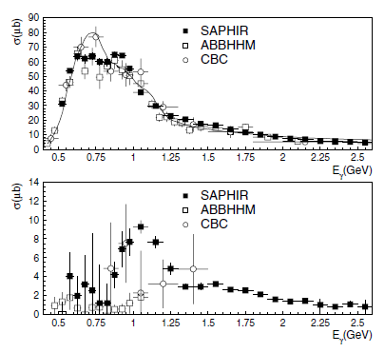
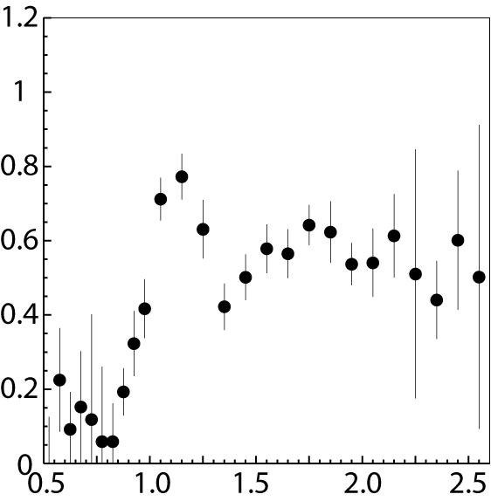
SAPHIR data published in 2005
σ(π⁻Δ⁺⁺)
LEPS energy
Clebsch-Gordan coefficients
π⁻Δ⁺⁺
N* -> 3 π⁻Δ⁺⁺ : 1 π⁺Δ⁰
Δ* -> 3 π⁻Δ⁺⁺ : 4 π⁺Δ⁰
Δ* favors π⁺Δ⁰ channel
Resonance effect
σ(π⁺Δ⁰)/σ(π⁻Δ⁺⁺)
t-channel
Δ∗ (?)
σ(π⁺Δ⁰)
No dσ/dcosθ
π⁺Δ⁰
-> pπ⁻
Resonance effect
t-channel
E_{γ} (GeV)
C. Wu et al. (SAPHIR collaboration) Eur. Phys. Jour. A 23 (2005) 317

Slide 28
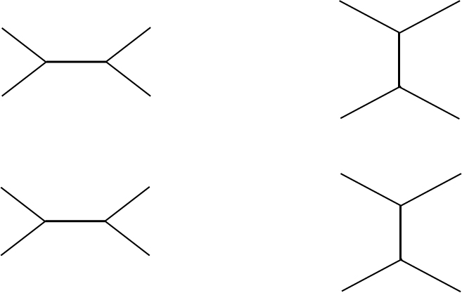
Reaction mechanisms of πΔ reactions at Eγ=1.5-3.0 GeV
Low energy ∼Eγ=1.5 GeV
Missing resonance search
s- channel
High energy ∼Eγ=3.0 GeV
Precision of isospin rule is checked
t- channel
γ
π
γ
π
N*
σ(π⁺Δ⁰)/σ(π⁻Δ⁺⁺)
= 1/3
σ(π⁺Δ⁰)/σ(π⁻Δ⁺⁺)
= 1/3
Isospin=1
π, ρ
Δ
p
p
Δ
π
γ
π
γ
Δ∗
σ(π⁺Δ⁰)/σ(π⁻Δ⁺⁺)
= 4/3
σ(π⁺Δ⁰)/σ(π⁻Δ⁺⁺)
= 3
Isospin=2
p
Δ
p
Δ

Slide 29
High momentum π data taken in 2007
p(γ, π⁻)X
p(γ, π⁺)X
0.7<cosθ_{π}<1
0.7<cosθ_{π}<1
E_{γ}=1.5-3.0 GeV
E_{γ}=1.5-3.0 GeV

Slide 30
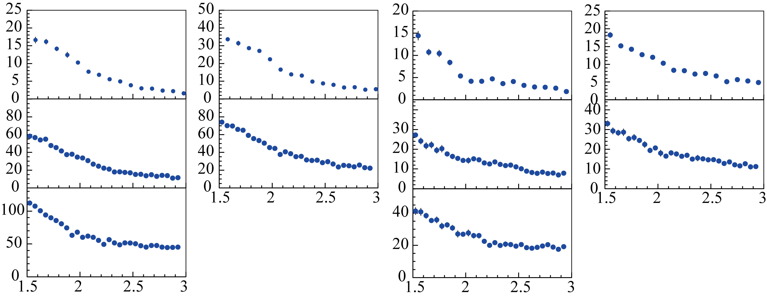
Preliminary differential cross sections for π⁻Δ⁺⁺ and π⁺Δ⁰
p(γ, π⁻)Δ⁺⁺
p(γ, π⁺)Δ⁰
dσ/dcosθ (μb)
dσ/dcosθ (μb)
0.7<cosθ<0.8
0.8<cosθ<0.9
0.7<cosθ<0.8
0.8<cosθ<0.9
0.9<cosθ<0.93
0.93<cosθ<0.97
0.9<cosθ<0.93
0.93<cosθ<0.97
0.97<cosθ< 1
0.97<cosθ< 1
Preliminary
Preliminary
E_{γ} (GeV)
E_{γ} (GeV)

Slide 31
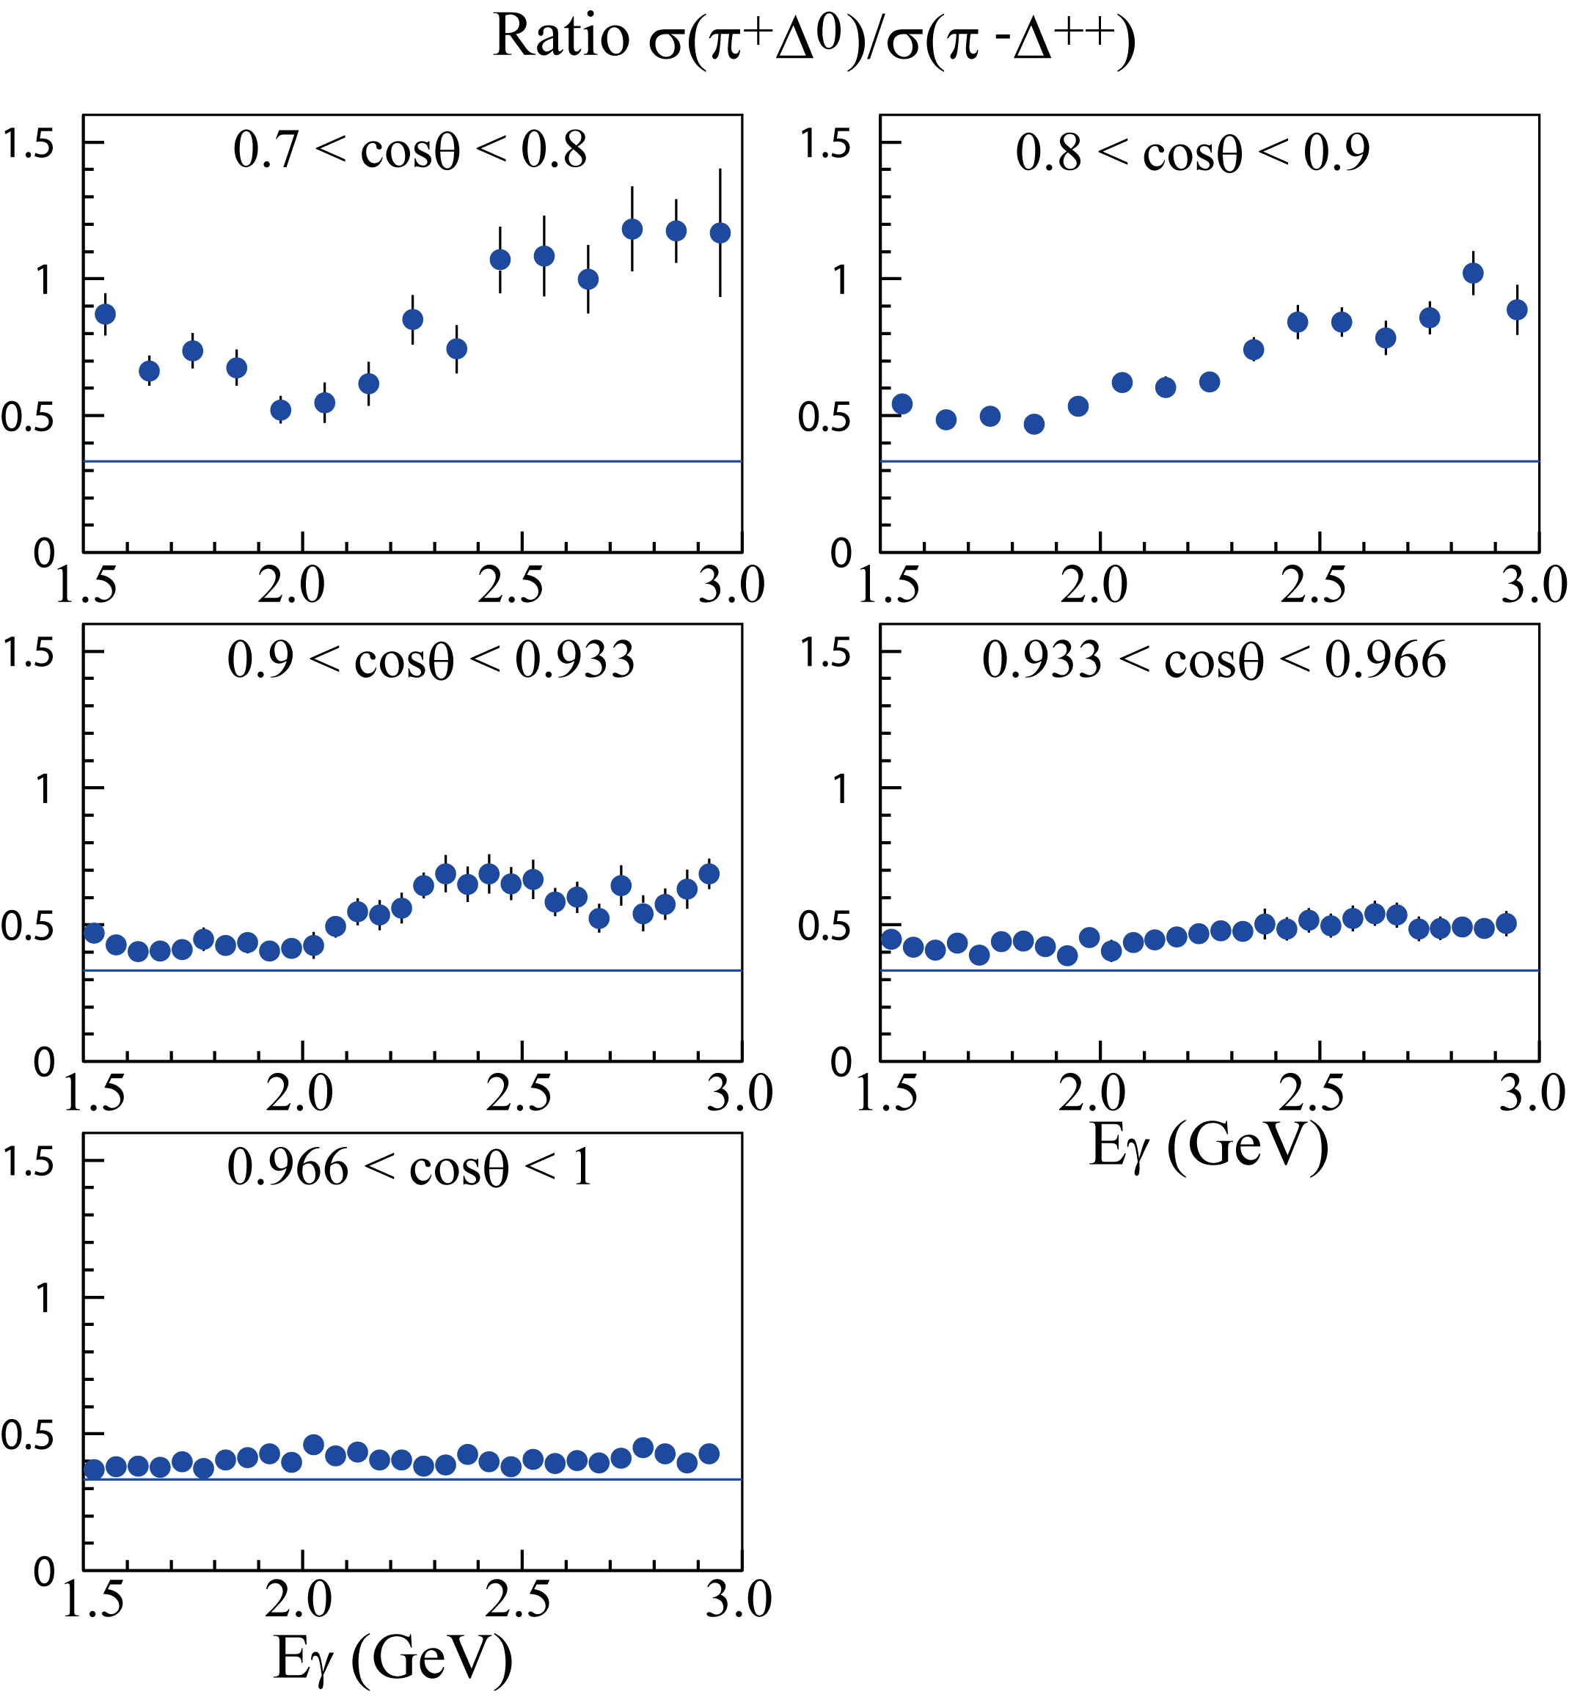
Preliminary ratio σ(π⁺Δ⁰)/σ(π⁻Δ⁺⁺)
(d̄d production / ūu production )
Preliminary
d̄d production is
enhanced
or
ūu production is
suppressed.
1/3 is expected from
isospin=1 exchange
in the t-channel

Slide 32
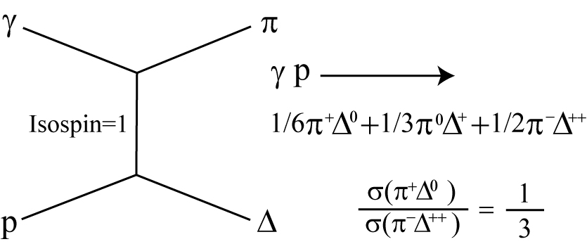
If interference between π and ρ exists, the ratio may be changed from 1/3
t-channel
π or ρ
Interference ?
The interference between π and ρ exchanges
may change the ratio of 1/3.

Slide 33
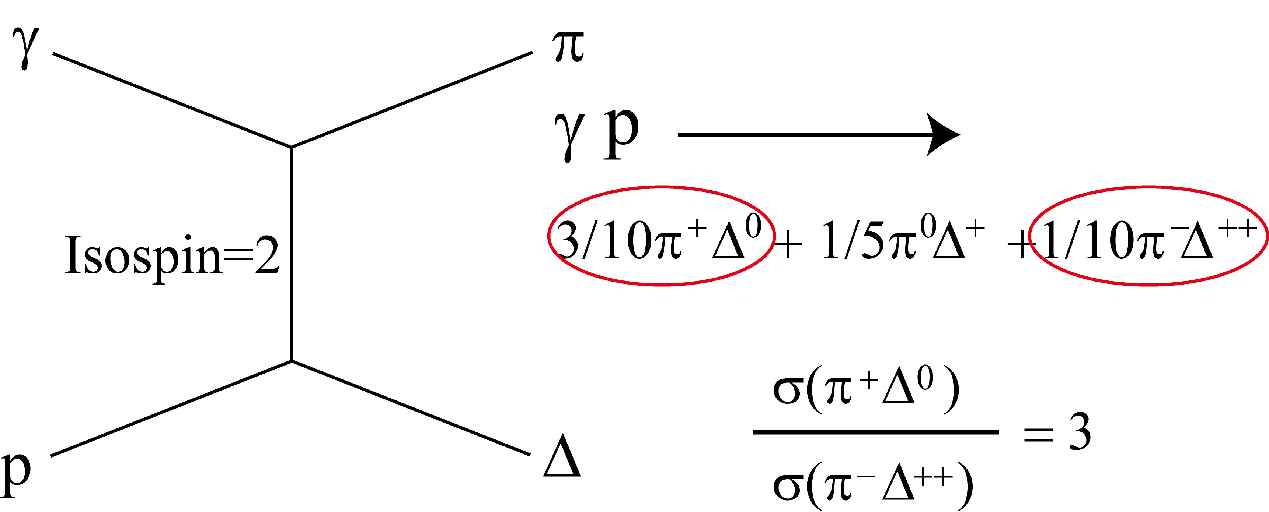
Isospin=2 exotic meson exchange in the t-channel may increase the ratio if it exists
t-channel

Slide 34
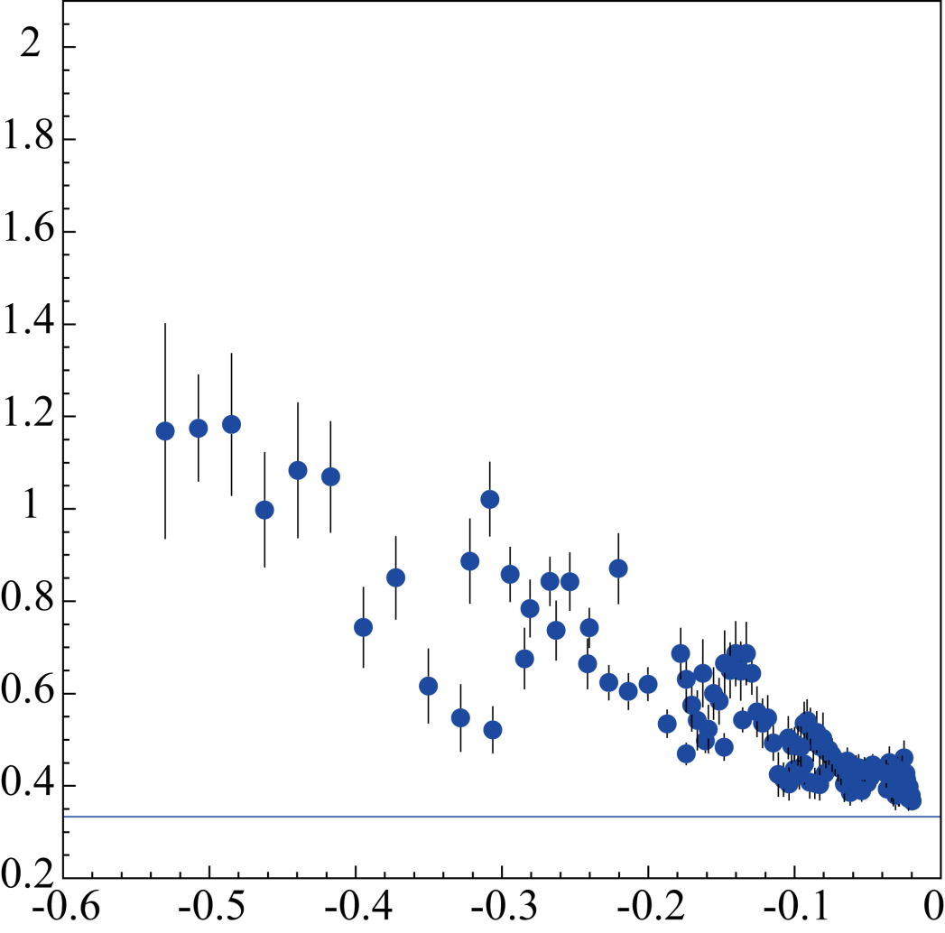
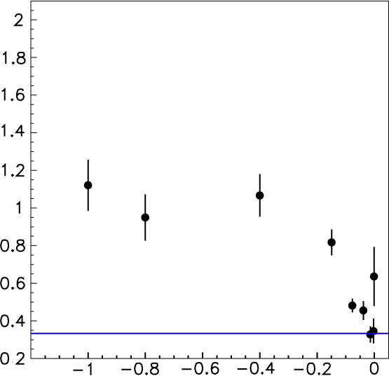
Comparison between LEPS and SLAC data
Preliminary
σ(π⁺Δ⁰)/σ(π⁻Δ⁺⁺)
σ(π⁺Δ⁰)/σ(π⁻Δ⁺⁺)
0.7 < cosθ_{π} < 1
SLAC data E_{γ} = 16 GeV
LEPS data E_{γ}=1.5-3.0 GeV
A.M Boyarski et al. PRL 25 (1970) 695
One conclusion
Isospin=2 exchange contributes to
the large cross section ratio.
Momentum transfer t (GeV²/c²)
Momentum transfer t (GeV²/c²)

Slide 35
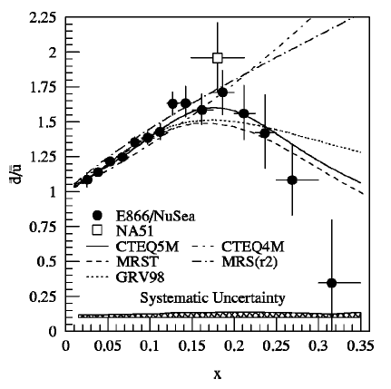
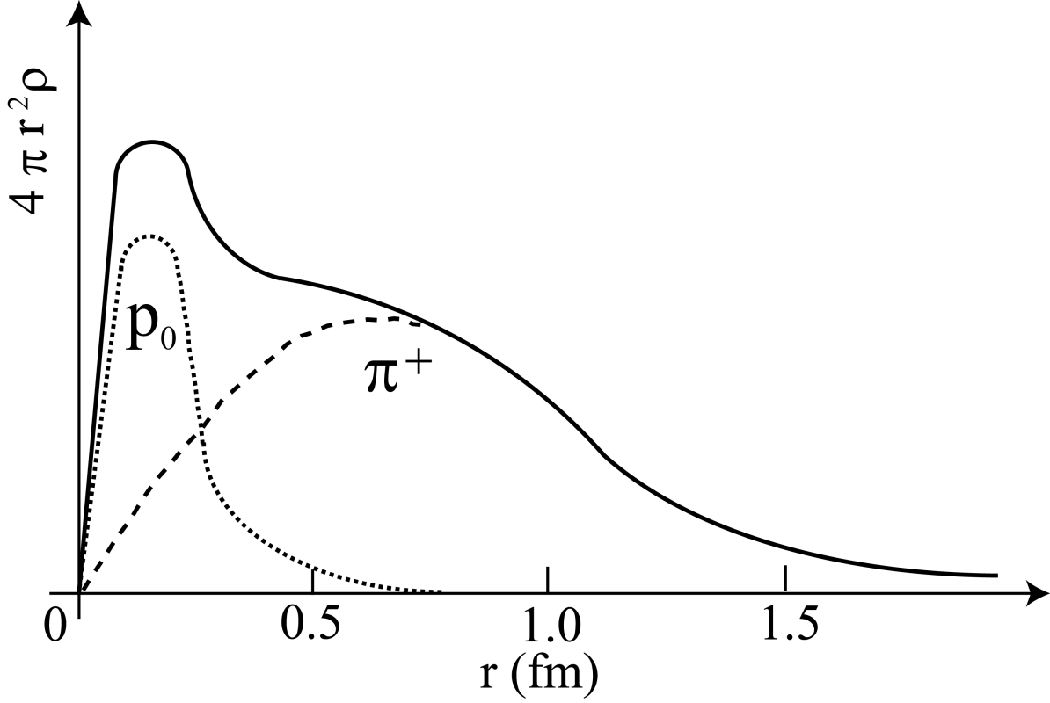

Another explanation
Proton charge distribution
Drell-Yan experiment
PRD 64 (2001)
052002
Bare proton
Pion cloud
d̄ / ū
(ud)
Pion cloud model
π⁺ (ud̄) may enhance π⁺Δ⁰ prodution(d̄d production)
−> Larger σ(π⁺Δ⁰)/σ(π⁻Δ⁺⁺)
(d̄d / ūu )

Slide 36
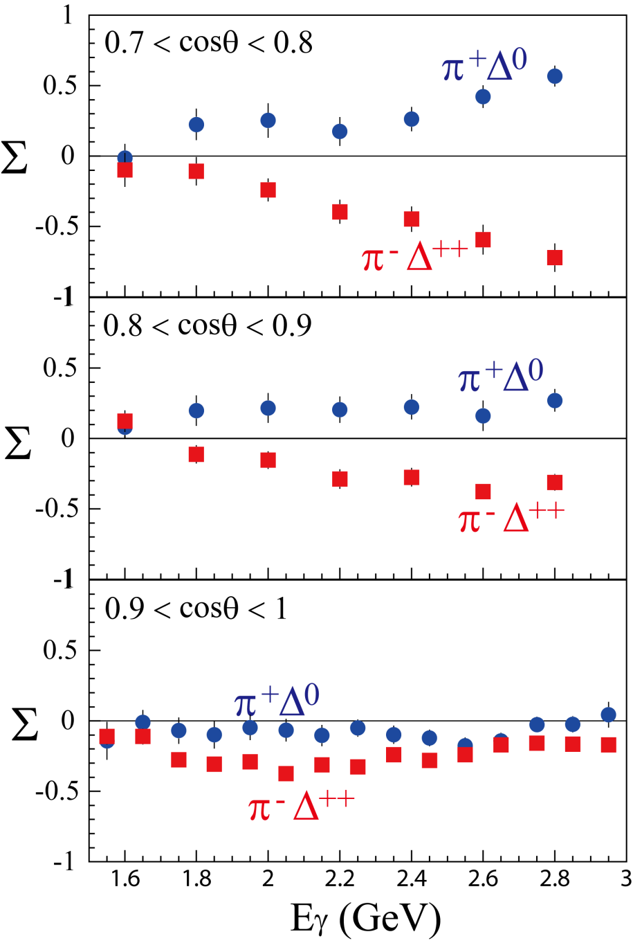
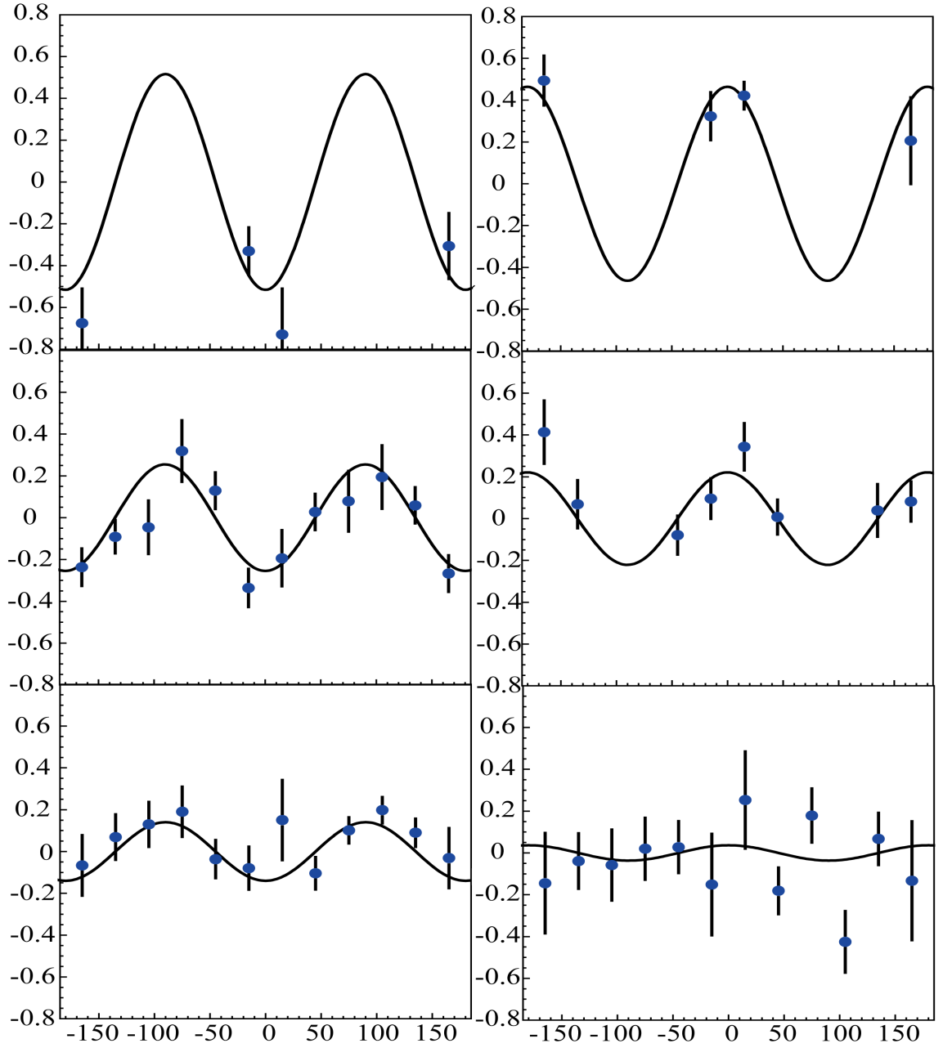
Photon beam asymmetry using linearly polarized γ beams
Nv-Nh
Nv+Nh
Nv-Nh
Nv+Nh
π⁻Δ⁺⁺ π⁺Δ⁰
0.7<cosθ_{π}=0.8
0.7<cosθ_{π}<0.8
Eγ=
2.8-3.0 GeV
Eγ=2.8-3.0 GeV
0.8<cosθ_{π}<0.9
0.8<cosθ_{π}<0.9
Eγ=2.8-3.0 GeV
Eγ=2.8-3.0 GeV
0.9<cosθ_{π}<1
0.9<cosθ_{π}<1
Eγ=2.9-3.0 GeV
Eγ=2.9-3.0 GeV
Azimuthal Angle φ (deg.)

Slide 37

Preliminary photon beam asymmetry for γ p -> π⁻Δ⁺⁺ and γ p -> π⁺Δ⁰ reactions
ρ exchange
π exchange
Preliminary

Slide 38
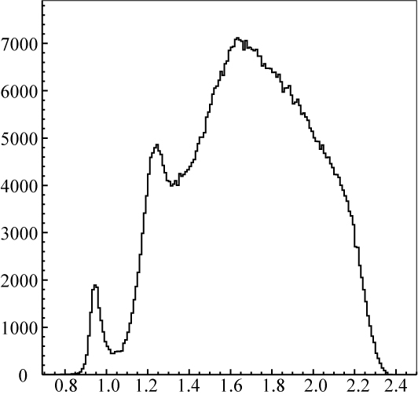
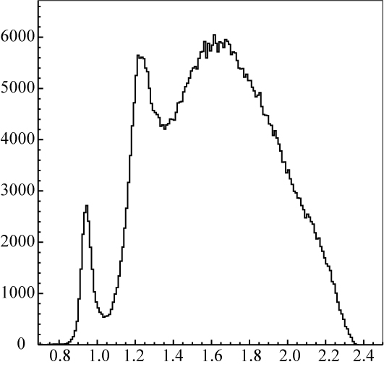
We are taking new data using LD₂ target
from Dec. of 2015
γ N → π⁻ X γ N → π⁺ X
Counts Counts
π⁺Δ⁰
π⁺Δ⁻
π⁻Δ⁺⁺
π⁻Δ⁺
New
New
π⁺n
π⁻p
Missing mass (GeV) Missing mass (GeV)

Slide 39
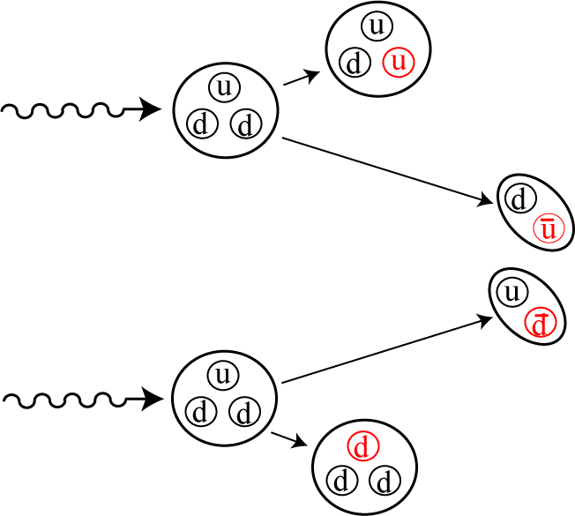
ūu and d̄d productions
by using neutron target
Simultaneous measurements
Δ⁺
γ
n
π⁻
Same neutron target
Same
acceptance
n
π⁺
γ
Δ⁻

Slide 40
Polarized HD target

Slide 41
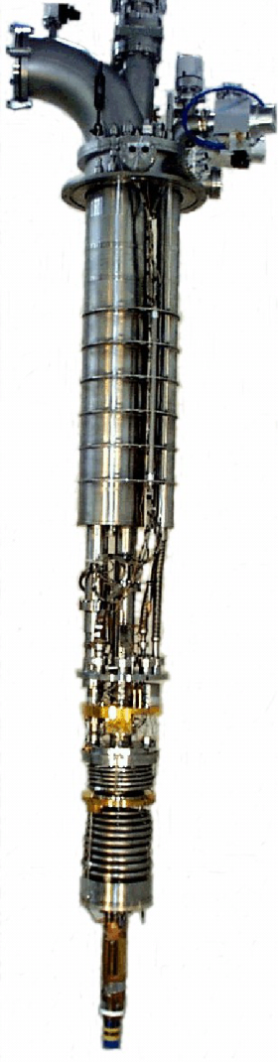
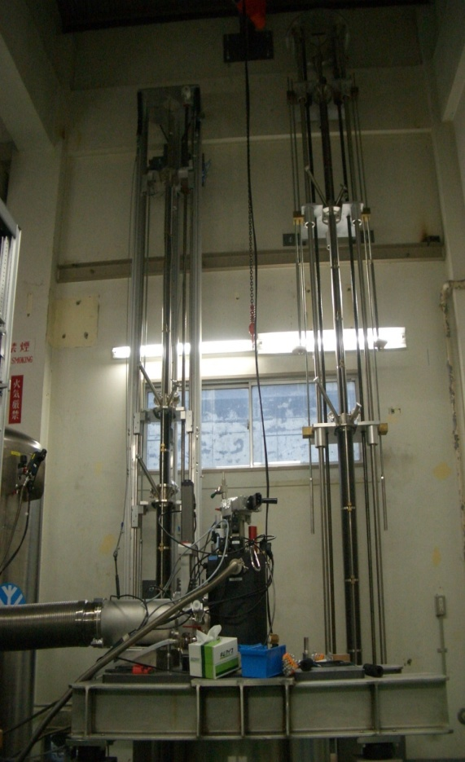
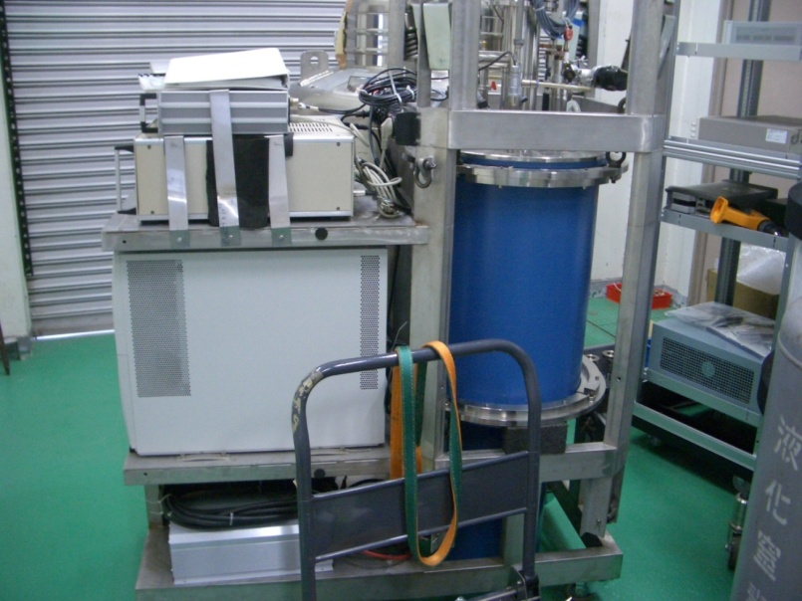
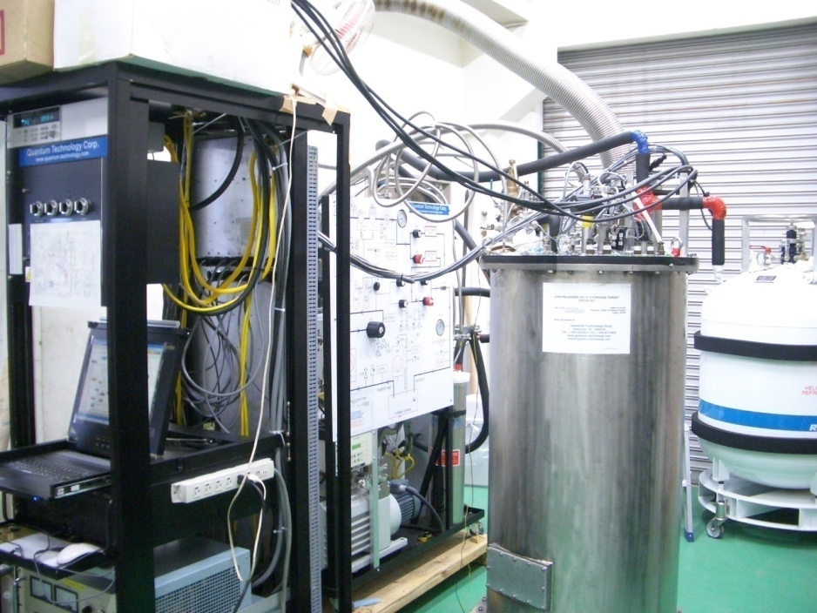
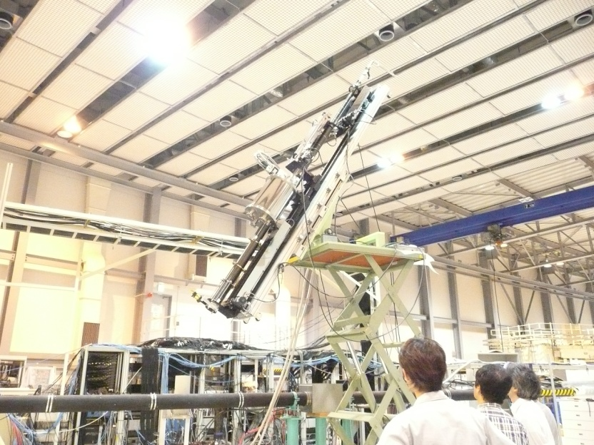
Refrigerators used for polarized HD target
RCNP
RCNP -> SPring-8
RCNP
We obtained
from
ORSAY GRAAL
SPring-8
SPring-8

Slide 42

Polarization degree of proton in HD
We carried out the 6th aging of HD in the beginning of 2015
NMR
Calibration data at T=4.2 K, B=0.9 Tesla
NMR
After aging HD for 3 months
H
H
Polarization
is grown up
by
~2000 times
Aging HD 1 2 3 4 5 6
Year 2008 2011 2012 2013 2014 2015
P_{H} (%) 40% -- 30% 18% 42% 44+-1%

Slide 43

Relaxation time of H polarization in the SPring-8 experimental condition
Polarization degree (%)
In 2015
T_{H}=239 +-66 days
T=0.3 K
B=0.9 Tesla
Time (day)
Aging HD 1 2 3 4 5 6
Year 2008 2011 2012 2013 2014 2015
T_{H} (days) 100 -- 70 60 --- 239+-66

Slide 44
LEPS2 beamline

Slide 45
SPring-8 beamline map
LEPS2
LEPS

Slide 46


LEPS2 experiment hutch was constructed in 2011
Experiment hall of SPring-8
LEPS2 experiment hutch
2010
August 2011

Slide 47


LEPS2 solenoid spectrometer system
We will start commissioning runs in this year
2.22 m
☆ Acceptance
5 – 120° (charged particle)
40 – 110° (photon)
☆ Momentum measurement
- sideway (30– 120°)
TPC Δp/p ~ 0.04 (1 GeV/c)
- forward (5 – 40°)
DC Δp/p ~ 0.01 (1 GeV/c)
☆ Particle Identification
3σ separation up to 2.7 GeV/c
- sideway (50 – 120°)
RPC (TOF)
- middle (30 – 50°)
AC, RPC
- forward (5 – 30°)
TOP, RPC(<11°)
Magnet (BNL-E949)
B=1 T
γ counter
RPC
TOP
γ
TPC
DC

Slide 48


BNL-E949 spectrometer was transported to SPring-8
Detectors are installed and
commissioning run will be
carried out in 2016
in 2011

Slide 49
Summary
We have been carrying out photoproduction experiments at
E_{γ}=1.5-2.4 GeV at the LEPS facility since 2000.
We newly took high momentum π data at E_{γ}=1.5-3.0 GeV.
Precise comparison between ūu and d̄d productions is possible
in γ p -> π⁻Δ⁺⁺ and π⁺Δ⁰ reactions.
Preliminary cross section ratio σ(π⁺Δ⁰)/σ(π⁻Δ⁺⁺) is found to be
larger than 1/3 expected from the I=1 exchange in the t-channel.
Preliminary photon beam asymmetry is typically found to be
negative for π⁻Δ⁺⁺ and positive for π⁺Δ⁰ reaction.
We are taking data for γ n -> π⁻Δ⁺ and π⁺Δ⁻ reactions now.
After this experiment, we plan to install a polarized HD target.
We are developing a large acceptance LEPS2 spectrometer
for the near future experiments at SPring-8.

Slide 50
LEPS/LEPS2 collaboration
RCNP, Osaka University, Ibaraki, Osaka 567-0047, Japan
Research Center for Electron Photon Science, Tohoku University, Sendai, Miyagi 982-0826, Japan
Kyoto University, Kyoto 606-8502, Japan
Korea University, Seoul 02841, Republic of Korea
Konan University, Kobe, Hyogo 658-8501, Japan
XFEL Project Head Office, RIKEN 1-1, Koto, Sayo, Hyogo 679-5148, Japan
Academia Sinica, Taipei 11529, Taiwan
Japan Synchrotron Radiation Research Institute, Sayo, Hyogo 679-5143, Japan
Japan Atomic Energy Agency, Kizugawa, Kyoto 619-0215, Japan
Nagoya University, Nagoya, Aichi 464-8602, Japan
Ohio University, Athens, OH 45701, USA
Japan Atomic Energy Agency (JAEA), Tokai, Ibaraki 319-1195, Japan
Yamagata University, Yamagata 990-8560, Japan
Chiba University, Chiba 263-8522, Japan
Wakayama Medical College, Wakayama, Wakayama 641-8509, Japan
Miyazaki University, Miyazaki 889-2192, Japan
National Defense Academy in Japan, Yokosuka, Kanagawa 239-8686, Japan
Tokyo Institute of Technology, Tokyo 152-8551, Japan
University of Saskatchewan, Saskatoon, SK S7N 5E2, Canada
University of Minnesota, Minneapolis, MN 55455, USA
Gifu University, Gifu 501-1193, Japan
Michigan State University, East Lansing, MI 48824, USA
University of Connecticut, Storrs, CT 06269-3046, USA
Joint Institute for Nuclear Research, RU-141980 Dubna, Russia
National Chung Cheng University, Taiwan

Slide 51
Thank you

Slide 53

σ(π⁺Δ⁰)/σ(π⁻Δ⁺⁺) ratio expected from
Clebsch-Gordan coefficients
Dominant
I=1 (π or ρ) exchange in the t-channel
should be dominant at forward
π angles.
Deviation from 1/3 might suggest
I=2 exotic meson exchange.

