Slide 1
Hysteresis Curves from 11 dimensions
Holography and Topology of Quantum Matter
August 22 (Mon), 2016 ~ August 29 (Mon), 2016
Kyung Kiu Kim(Yonsei University)
In collaboration with
Sang-Jin Sin(Hanyang Univ.), Yunseok Seo(Hanyang Univ.)
and Keun-Young Kim (GIST)

Slide 2
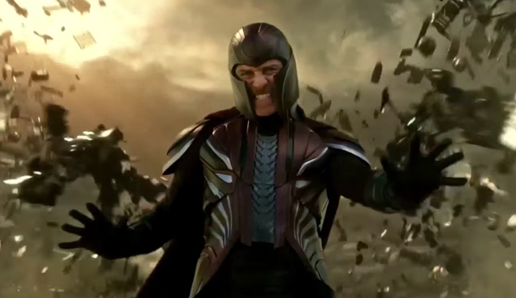
Motivation
Magnetic property is very interesting in realistic physics and theoretical physics.
Specifically, the ferromagnetism is one of most intriguing phenomena.
Ferromagnetism is a representative example of the Spontaneous symmetry breaking which is easily realized in a holographic model.
Spontaneous magnetization in holographic models ?
Hysteresis curves?
Is it possible to construct them from a supergravity theory ?

Slide 3
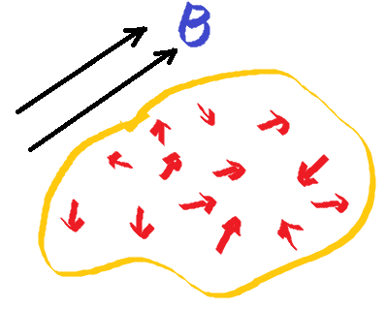
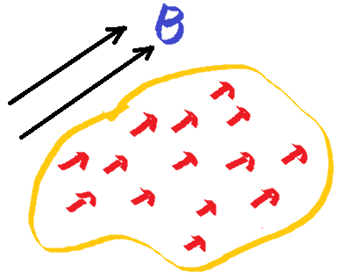
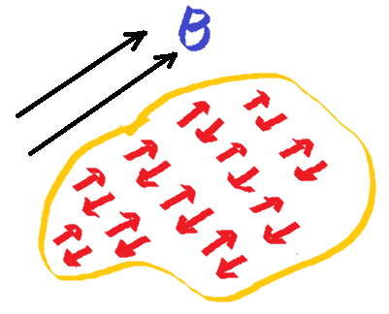
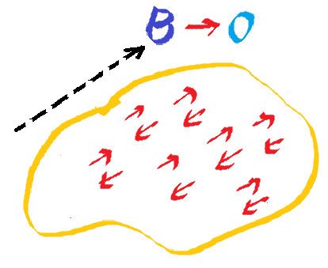
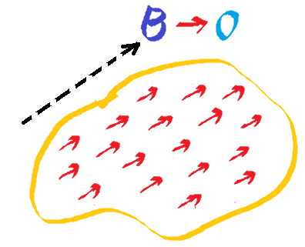
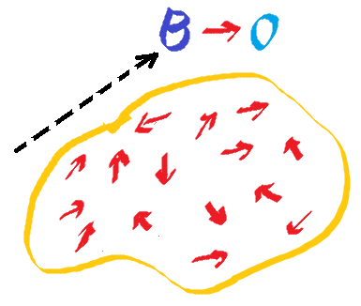
Ferromagnetism
An applied magnetic field classifies materials.
Turning off the magnetic field

Slide 4
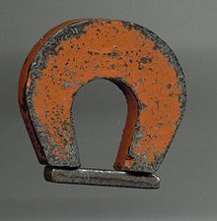
Ferromagnetism
Magnetization without External magnetic field ; order parameter!
< M > ≠ 0 with B = 0
Spontaneous Magnetization

Slide 5
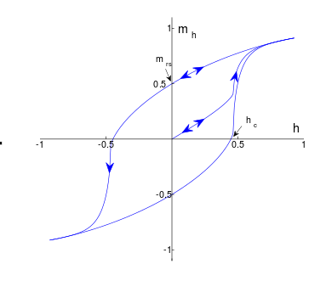
Typical property of Ferromagnetism
Hysteresis Curve
Important property for memories in devices.
How can we make the spontaneous magnetization and this curve through holographic way ?

Slide 6
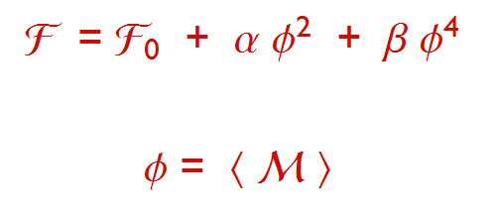

Ferromagnetism from phase transition
The phase transition can be descried by a model(LG) with a real scalar.
A simplest model is given by

Slide 7
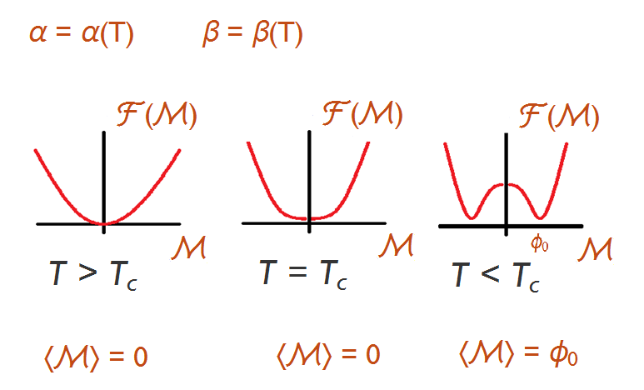
Phase transition with an effective model

Slide 8
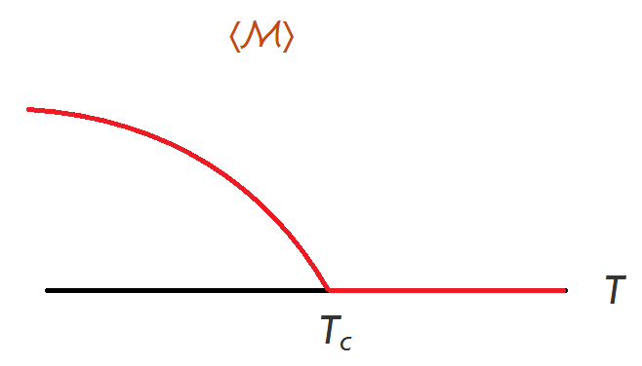
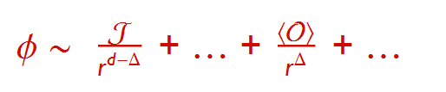
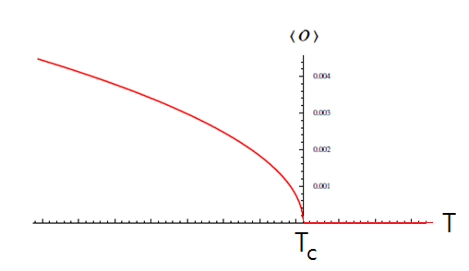
Holographic Model for spontaneous Z_2 symmetry breaking
Real scalar operator condensation
In a holographic model with a real scalar

Slide 9
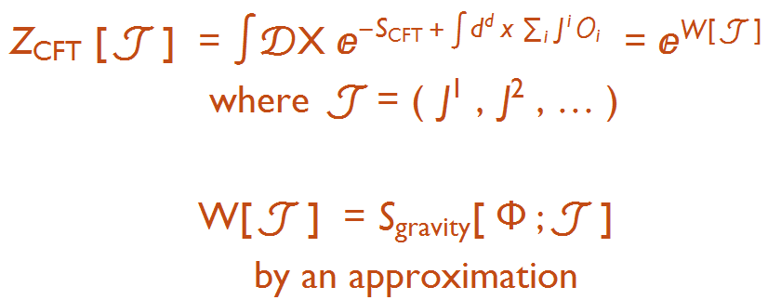

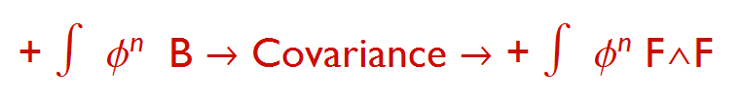

AdS/CFT
Previous gravity action
We want for the condensation to carry the magnetization.

Slide 10
For hysteresis curves
When B=0, we need positive and negative magnetizations.
n = odd

Slide 11
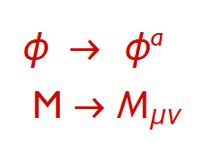

A comment on 2+1 dimension
In the real condensed matter:
2+1 dimension is not 2+1 dimension
▶ 2+1 dimensional materials in a 3+1 dimensional theory

Slide 12

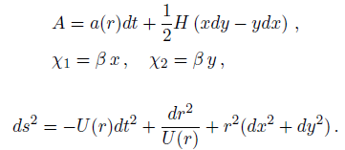
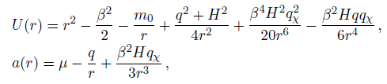
A model for ferromagnetism
Describing ferromagnetic materials by an analytic solution

Slide 13


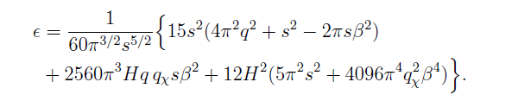

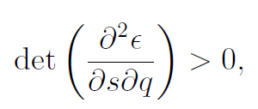
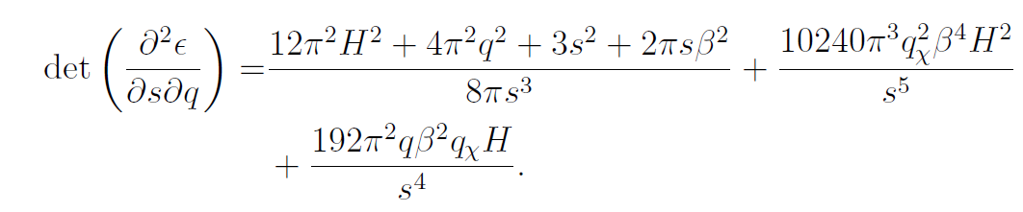
A model for ferromagnetism
Charge density
Magnetization
Energy
Thermodynamic stability is guaranteed for small

Slide 14
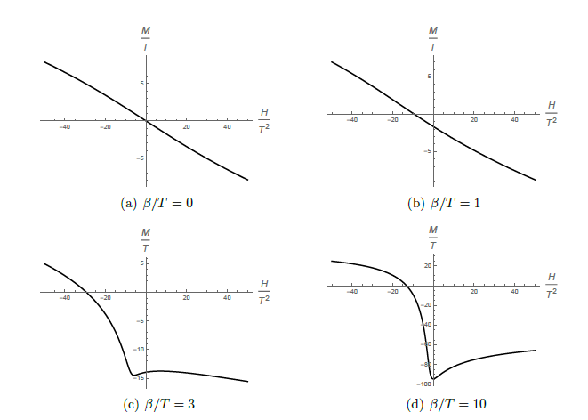
By the analytic solution and the holographic renormalization( the Smarr relation ), one can derive the 1st law of thermodynamics.
From the first law or the Smarr relation, one can find the magnetization.
Magnetization
In general it is not easy to obtain expression of the magnetization without analytic solutions.

Slide 15
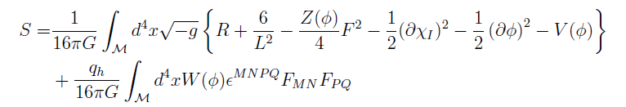


How to calculate magnetization
Magnetization
Model
Magnetization from the Smarr relation

Slide 16
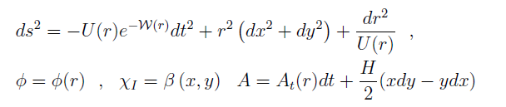
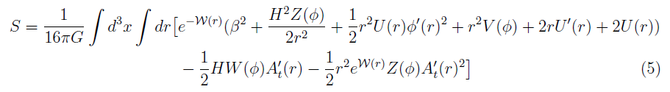

Reduced Action formalism
A scaling symmetry modified by transformation of parameters

Slide 17

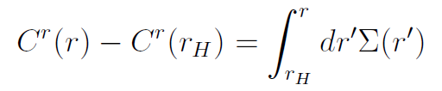

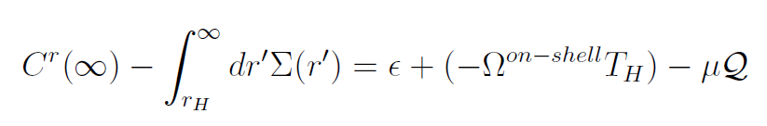

Relaxed Noether theorem
Integration form
One can find a Smarr like relation

Slide 18
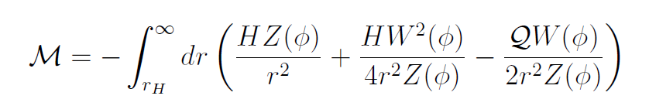
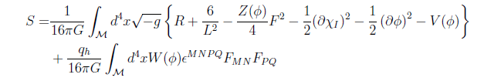

From the pressure or on-shell action
Magnetization

Slide 19
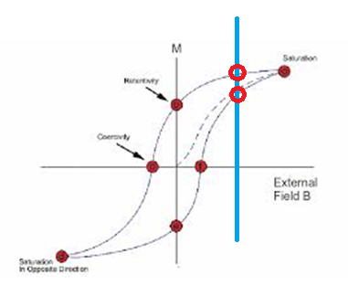
We choose odd powers to consider a system which have two solutions for a external magnetic field.
Gravity Dual for the Spontaneous Magnetization
➔ A hairy BH solution

Slide 20
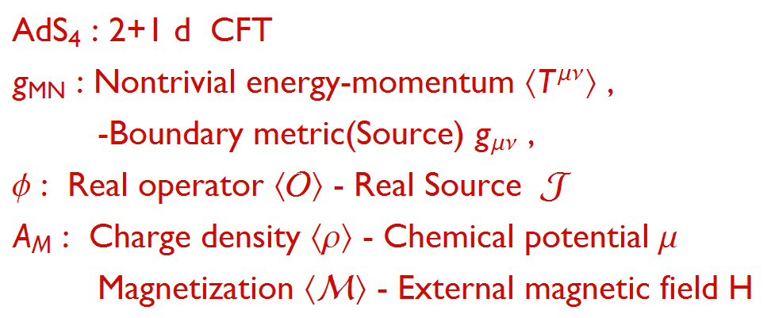
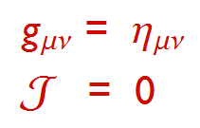
Dual system ?
Boundary condition of the bulk fields

Slide 21
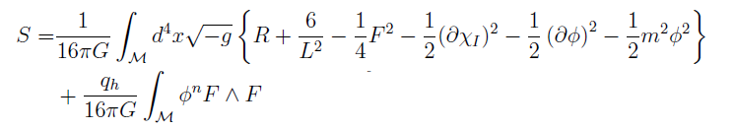
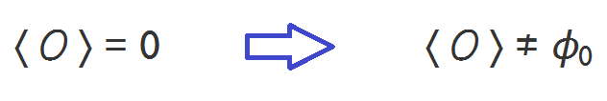
n=1
Without
Spontaneous Z_2 symmetry breaking
There is a transition from RN BH to a hairy BH which is dual to a phase transition related to a real order parameter.
This operator expectation value has nothing to do with the magnetization.

Slide 22
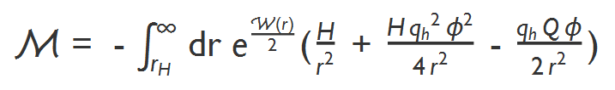
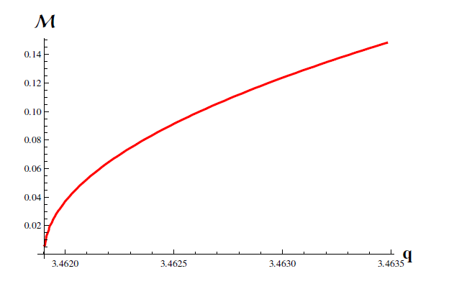
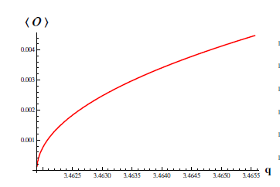
With
Solve the eoms numerically.
We obtained a spontaneous magnetization using real scalar condensation.

Slide 23
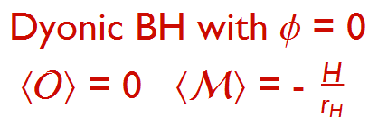
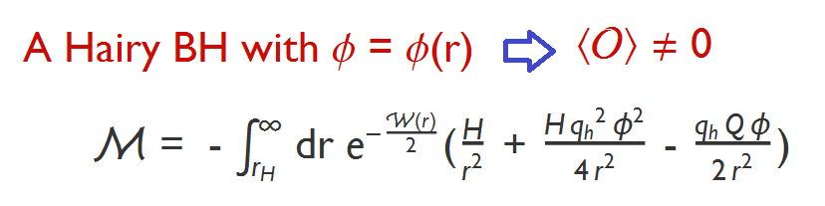
High temp.
Low temp.

Slide 24
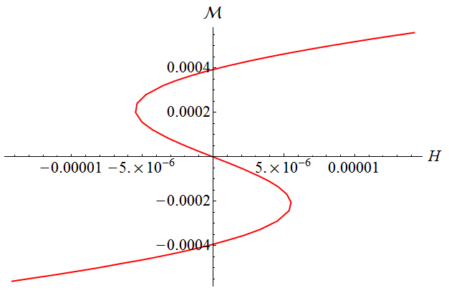
Hysteresis Curve in low temp.

Slide 25
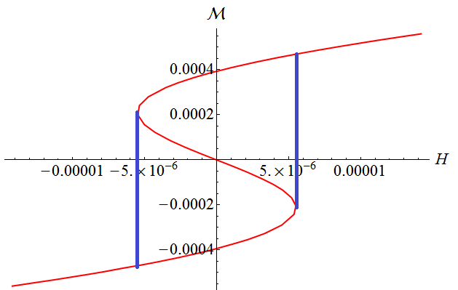
The hysteresis loop needs some magnetic work.

Slide 26
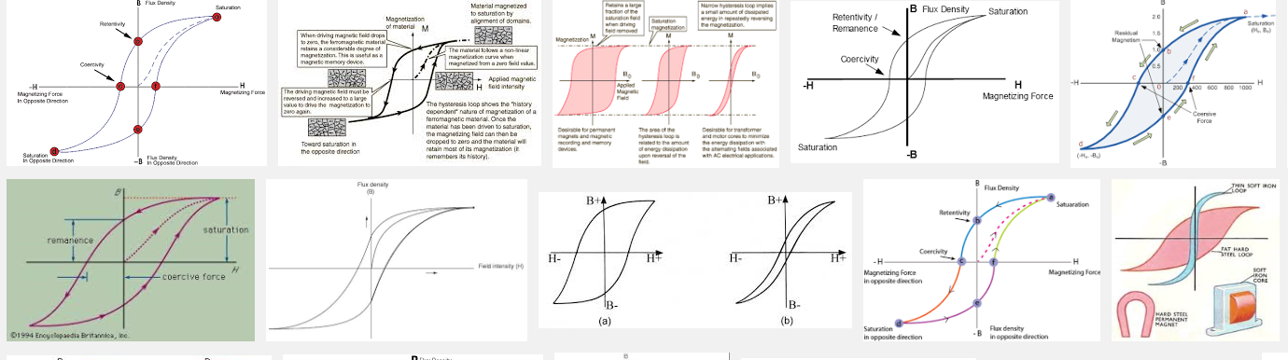
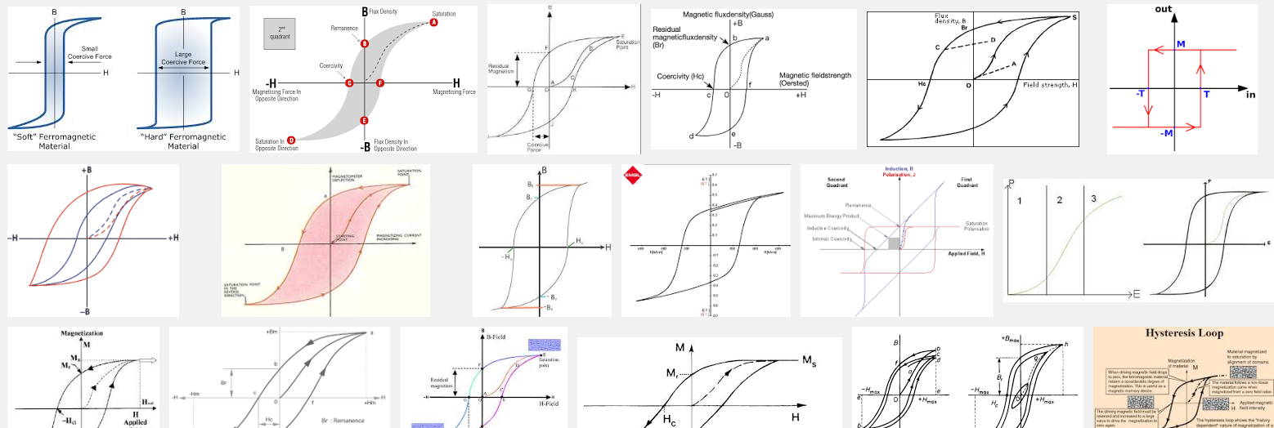
Experiments

Slide 27


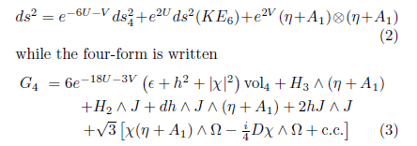
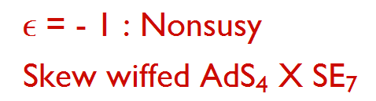
From the 11 dimensional Supergravity
Purterbatively stable

Slide 28
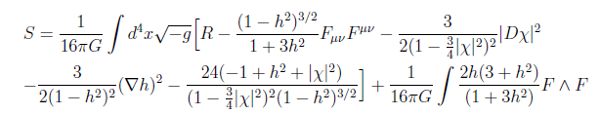
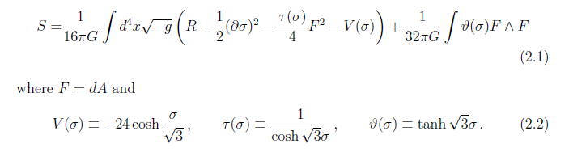
Without the complex scalar field
➔ A consistent truncation
For vanishing complex scalar field
The linearized action is similar to the previous action.
Qualitatively same physics ?
A solution of 11 dimensional SUGRA describes SM ?

Slide 29
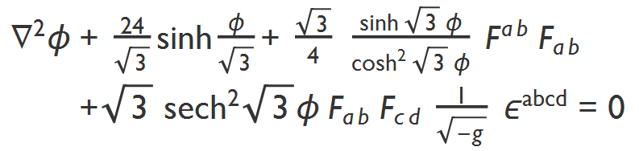
However
There is no spontaneous magnetization.
The dilaton type coupling obstructs the spontaneous magnetization.
Let us look at the eom for the scalar field.
The spontaneous symmetry breaking happens when the scalar field is very small in the RN BH background, i.e, with order 1 electric charge and without the magnetic field.

Slide 30

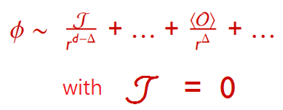
In this situation, the equation becomes as follows:
F^2 is much larger than the scalar field near the phase transition.
We check that there is no hairy black hole without the source mode in scalar field.
But there is always a solution with a non-vanishing source.
In addition, this case has a special physical meaning.

Slide 31




When the mass is negative, both modes are normalizable modes.
- Finite energy configuration in AdS4.
The mass of the scalar field and the modes
In fact, this generalized boundary condition corresponds to a special kind of relevant deformation.
Double trace deformation ( Witten 2001 )
Some nontrivial effect remains under the large N limit.

Slide 32


We found that there is a hairy black hole solution satisfying the generalized BC through a numerical method.
In the shooting parameter space

Slide 33

By applying the magnetic field

Slide 34

In a fixed charge system, there are three hairy solutions.

Slide 35


We obtained the magnetization as follows.
By some magnetic work, we could achieve a hysteresis loop.
We need to develop the result more.

Slide 36
Summary
By introducing F ^ F and a pseudo scalar, we can realize the spontaneous magnetization very.
And we found solutions which can be used to construct hysteresis curves
A skew-wiffed solution in11 dimensional supergravity is perturbatively stable, despite the absence of supersymmetry.
If we take a SE compactification based on the SWiffed solution, then we can obtain a 4 dimensional gravity model describing H superconductor with a pseudo scalar.
Turning off the complex field, the pseudo scalar describes nontrivial magnetization.
We found a family of solutions depicting a hysteresis curve.
Since we took a consistent truncation, the solutions are solutions of the 11 dimensional supergravity theory.
Therefore, 11 dimensional Sugra or M-theory contains solutions demonstrating hysteresis curves .

Slide 37
Thank you for your attention

