Slide 1
Toward a geometrical description based on real space renormalization group
Ki-Seok Kim (POSTECH) and Chanyong Park (APCTP)

Slide 2

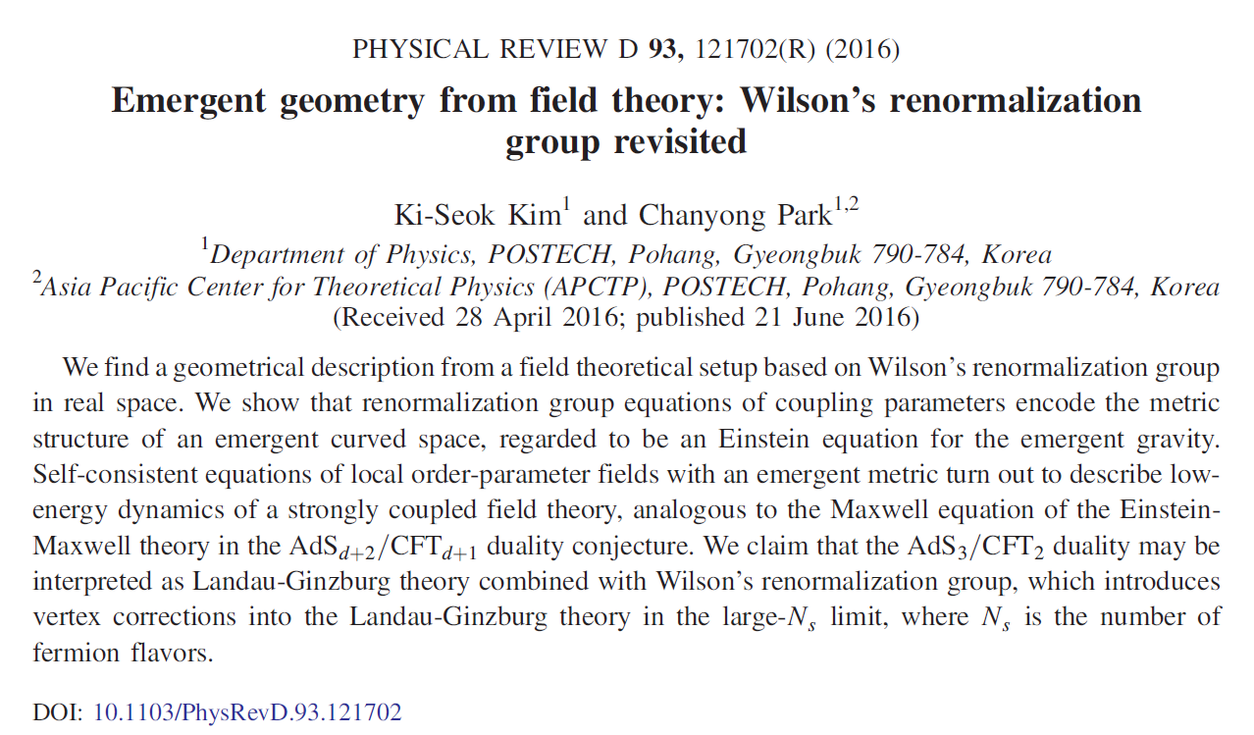

Slide 3

Landau-Ginzburg-Wilson’s theory
+
Real space renormalization group
=
$${GR}_{3}/QFT_{2}$$

Slide 4

Why do we care about the $AdS_{d+2}/CFT_{d+1}$ duality conjecture ?

Slide 5
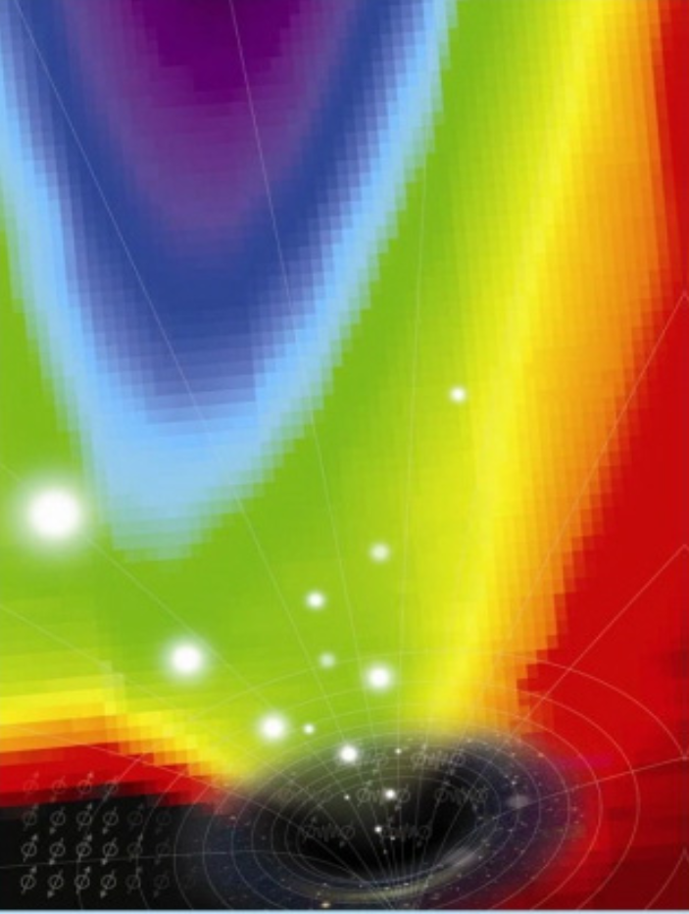
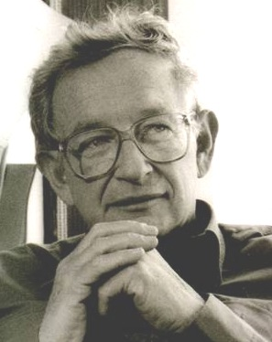
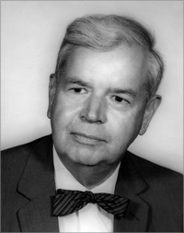
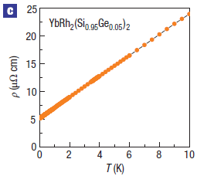


Quantum criticality in metals
Fermi-surface instabilities in the Landau’s Fermi-liquid state
Mott and Anderson metal-insulator transitions
Non-perturbative phenomena beyond the present perturbative theoretical framework
$$AF$$
$$FL$$

Slide 6

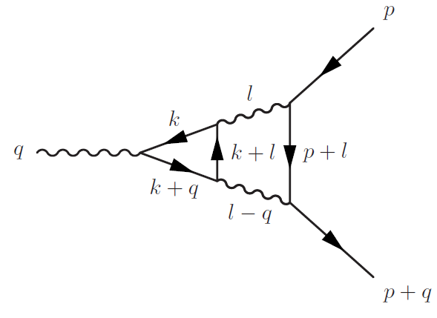
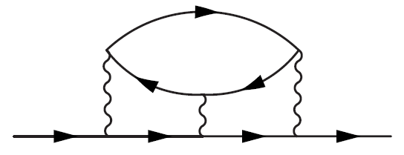
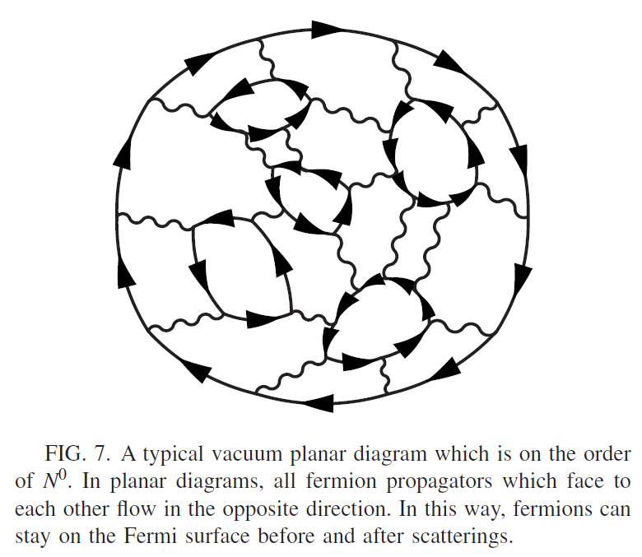
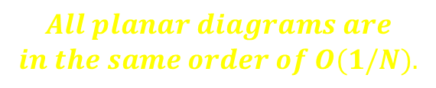
Strongly coupled field theories ?
Beyond the self-consistent random phase approximation (RPA) theory
$$All planar diagrams are$$
$$in the same order of O(1/N).$$
S.-S. Lee, Phys. Rev. B 80, 165102 (2009)

Slide 7
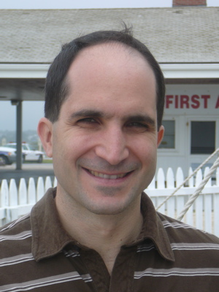
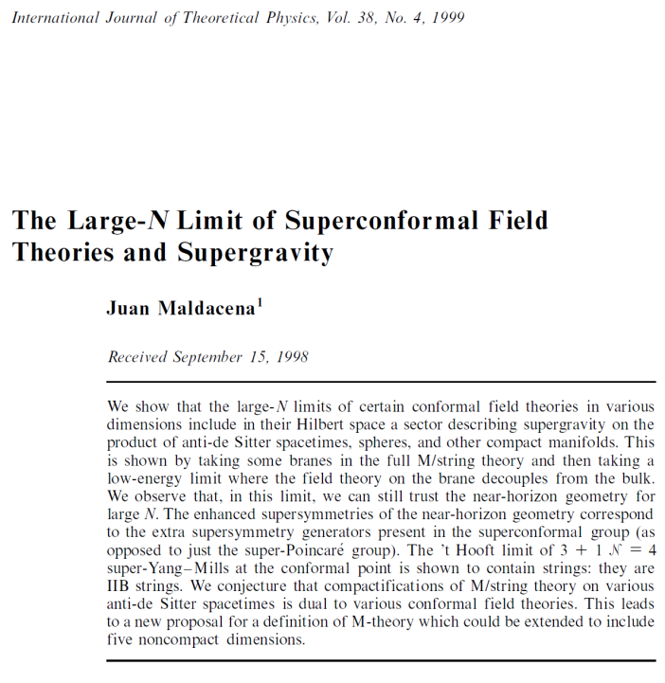
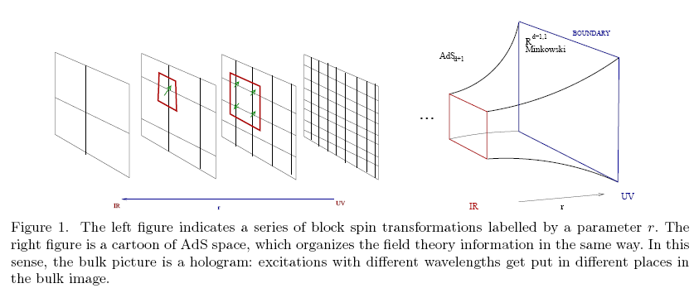
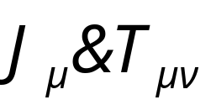
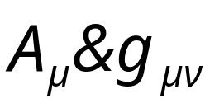

$AdS_{d+2}/CFT_{d+1}$ duality
Landau-Ginzburg-Wilson-type semi-classical field theory for strongly coupled quantum (conformal) field theories ??
(S.-J. Sin)

Slide 8
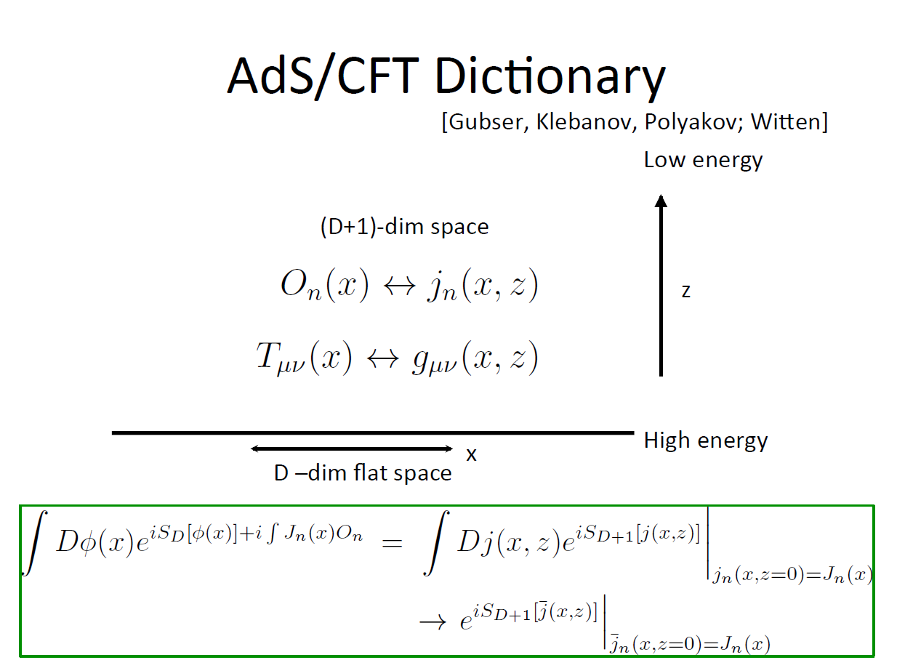
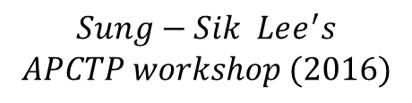
$$Sung−Sik Lee^{′}s$$
$$APCTP workshop (2016)$$

Slide 9
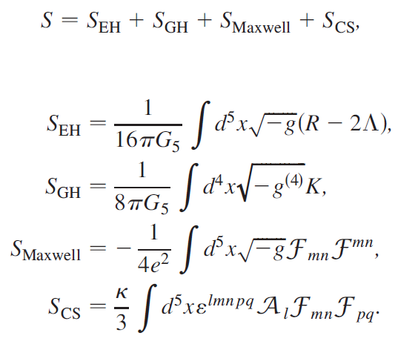
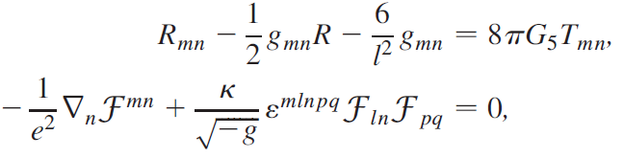
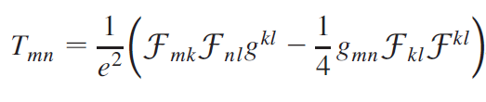
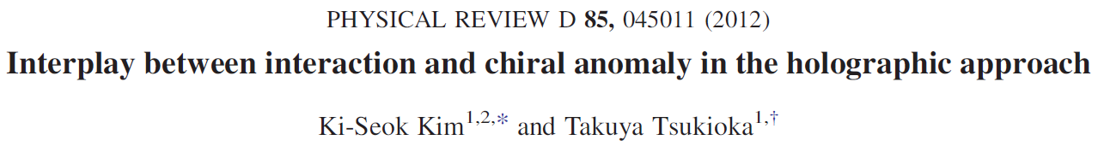

$$Dual to strongly coupled$$
$$Weyl metals ??$$

Slide 10
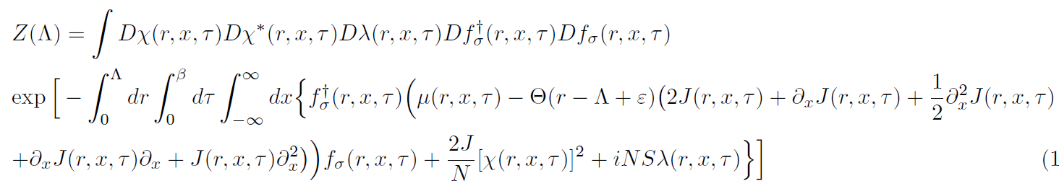
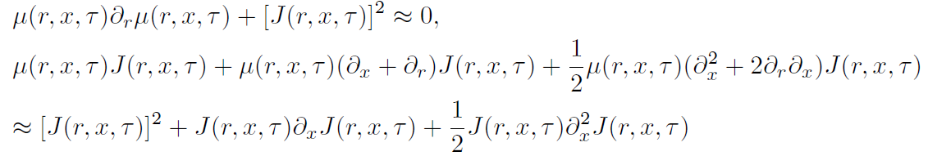

Slide 11
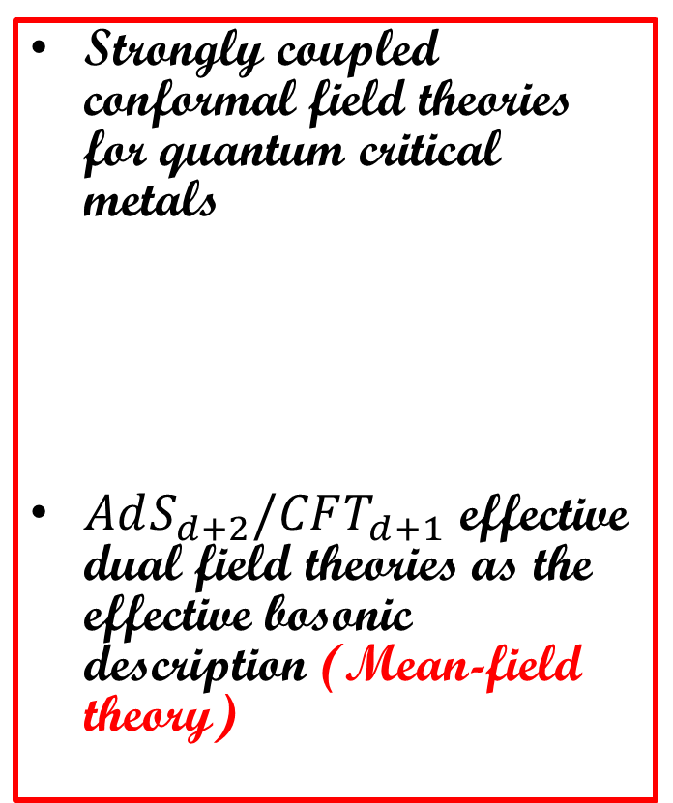
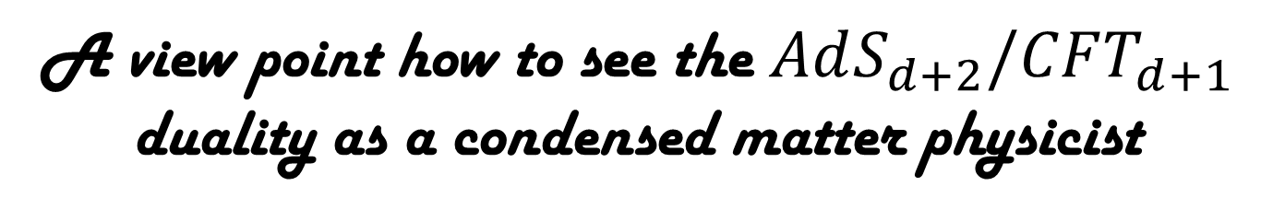
A view point how to see the $AdS_{d+2}/CFT_{d+1}$ duality as a condensed matter physicist
Landau’s Fermi-liquid theory for metals
Landau-Ginzburg-Wilson theory for symmetry breaking phase transitions in metals (Mean-field theory)
Strongly coupled conformal field theories for quantum critical metals
$AdS_{d+2}/CFT_{d+1}$ effective dual field theories as the effective bosonic description (Mean-field theory)
BCS theory
Wilson’s renormalization group

Slide 12
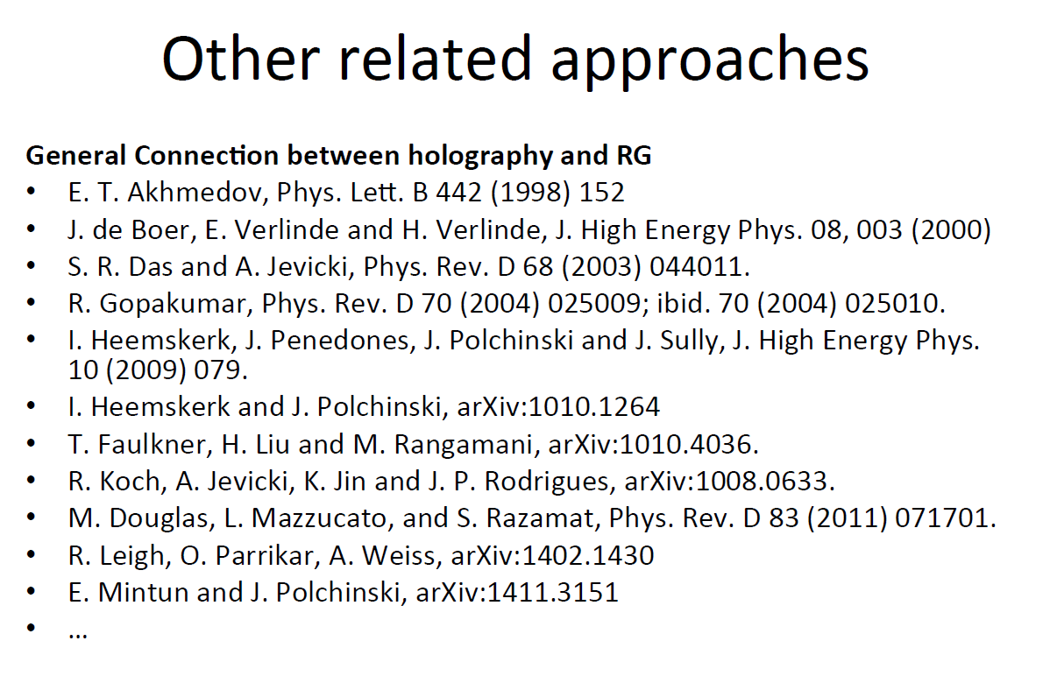

$$Sung−Sik Lee, arXiv:1305.3908 and 1603.08509$$
$$Sung−Sik Lee^{′}s$$
$$APCTP workshop (2016)$$

Slide 13
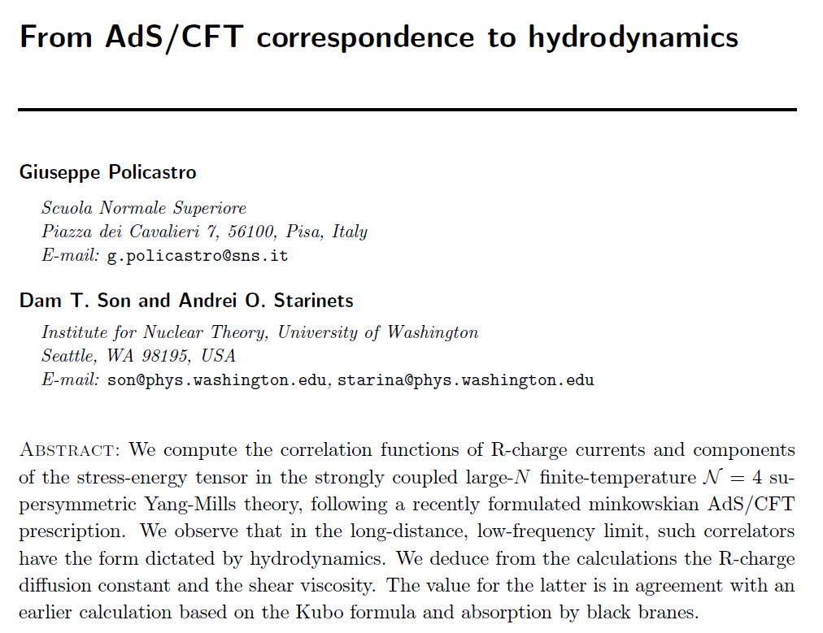


Hydrodynamics in “metals” ?
Strong inelastic scattering ➔ Fast thermalization ➔ Effective (approximate) hydrodynamics: $AdS_{d+2}$ classical dual field theory (Role of the conformal symmetry ?)

Slide 14
Hydrodynamic transport phenomena are quite difficult to realize in metals. However, ……

Slide 15
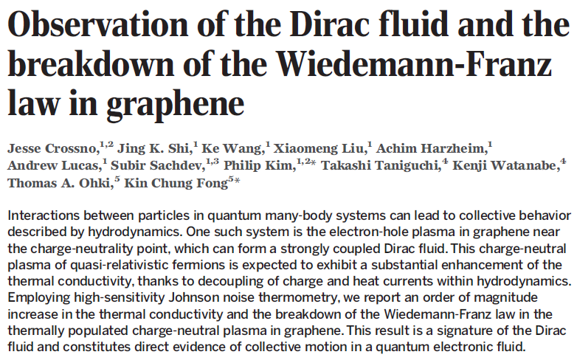
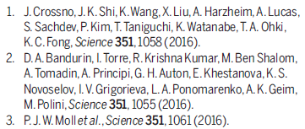
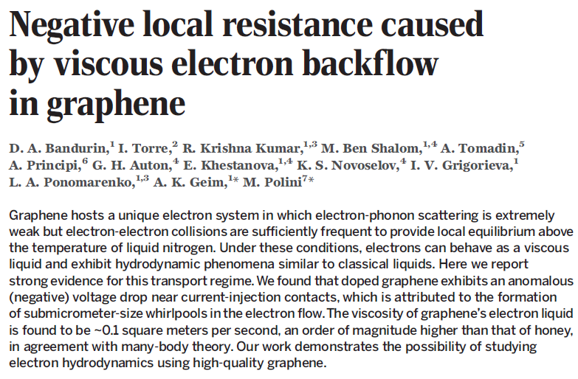
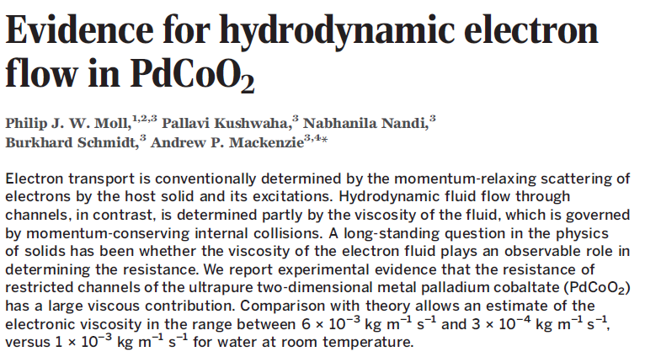

Hydrodynamics in the Dirac fluid ?: Realization of the $AdS_{d+2}$ semi-classical field theory ?

Slide 16
Toward an emergent geometry from renormalization group

Slide 17
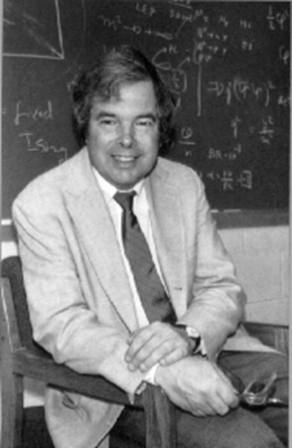
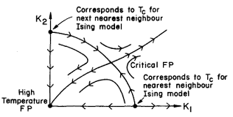
Renormalization group
Hiding infinities (regularization) and consistent re-summation of infinities via counter terms ➔ Renormalization group flow of coupling parameters depending on the energy scale
Wilson’s scheme of renormalization group: Integrating high-energy modes and rescaling (no infinities!) ➔ Low-energy effective field theories

Slide 18
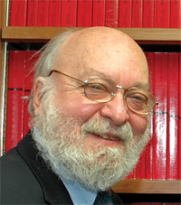
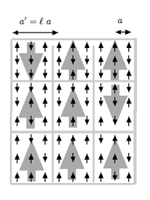





Renormalization group in real space
$$H=−J\sum_{i=1}^{N}{σ_{i}σ_{i+1}}−h\sum_{i=1}^{N}{σ_{i}}$$
$$K^{(1)}=\frac{1}{4}ln\frac{\cosh\left(2K+H\right)cosh⁡(2K−H)}{\cosh^{2}H}$$
$$H^{(1)}=H+\frac{1}{2}ln\frac{\cosh\left(2K+H\right)}{cosh⁡(2K−H)}$$
$$K=βJ$$
$$H=βh$$
$$H$$
$$K$$

Slide 19
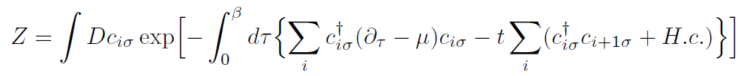




From $RSRG_{2}$ to an emergent geometry
$$Relativistic spectrum$$

Slide 20

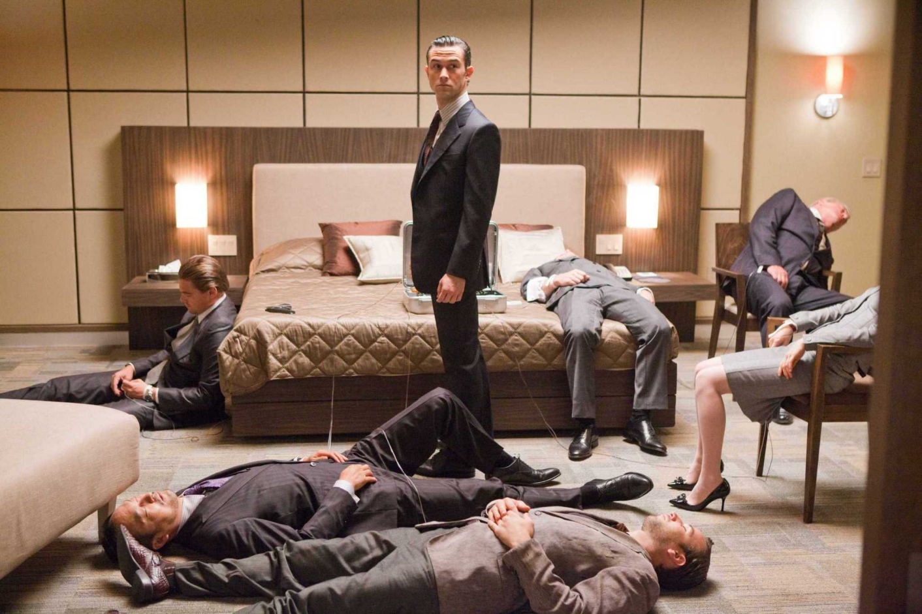
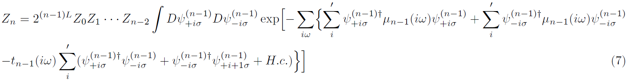
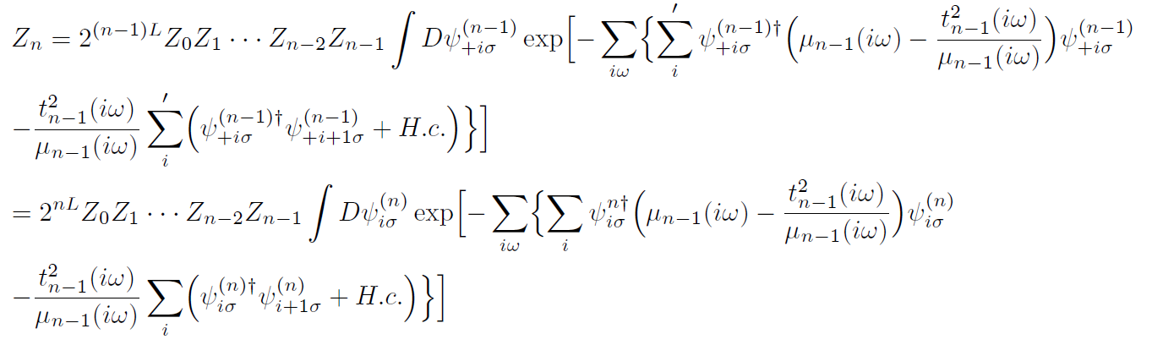



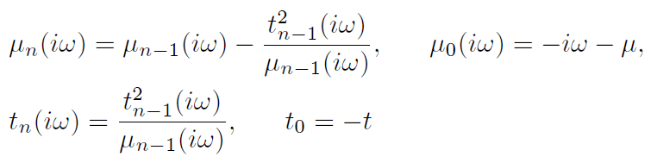
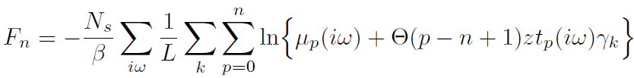


$$(n−1)$$
$$(n)$$

Slide 21

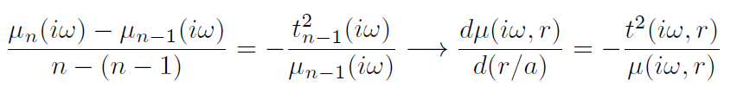
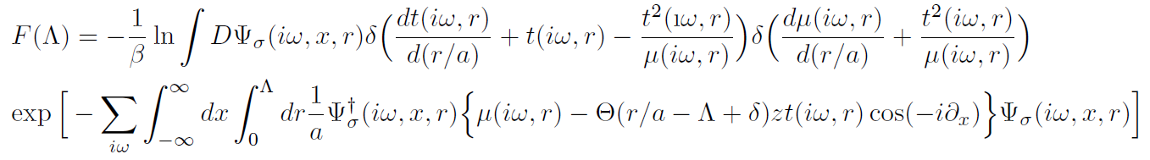
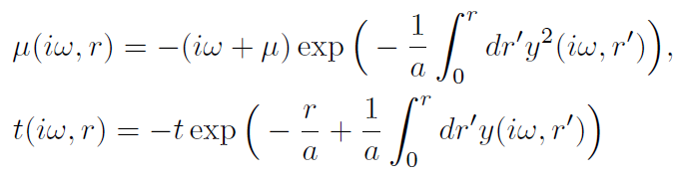



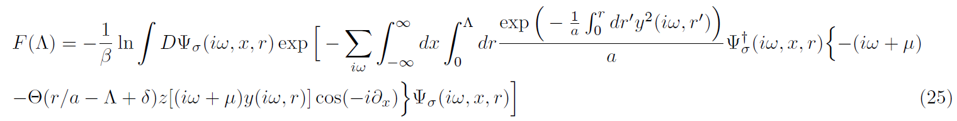

Slide 22

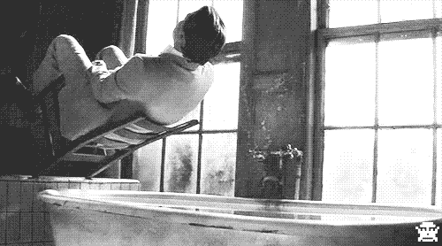







$$(0)$$
$$UV$$
$$(1)$$
$$(n−1)$$
$$(n)$$
$$IR$$

Slide 23
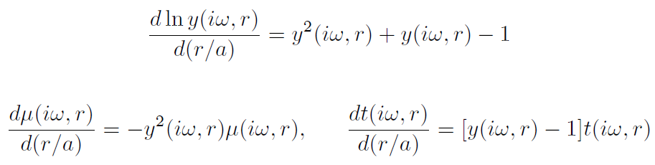
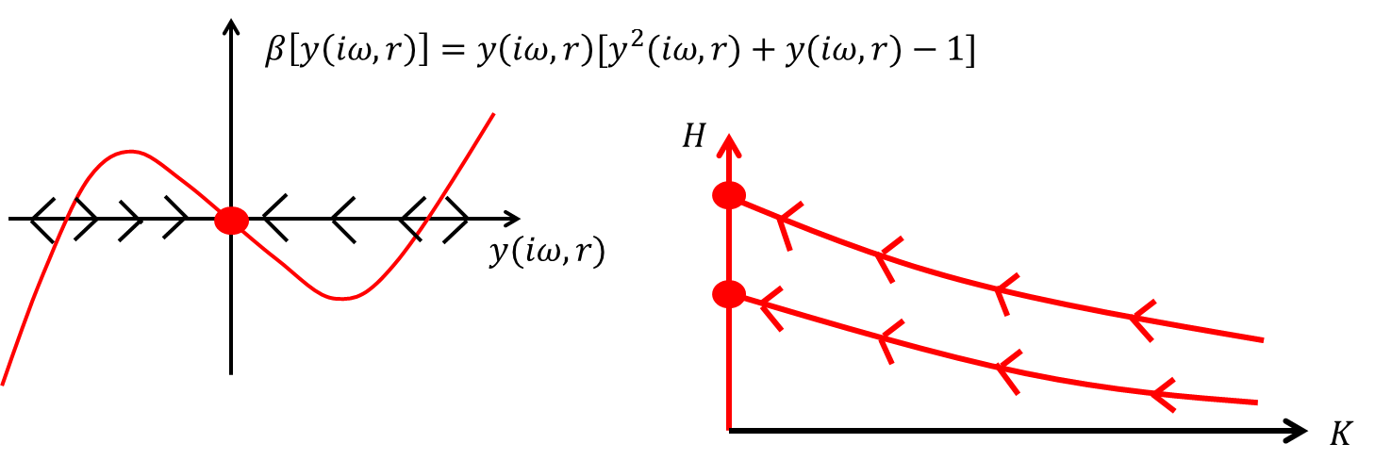

Slide 24


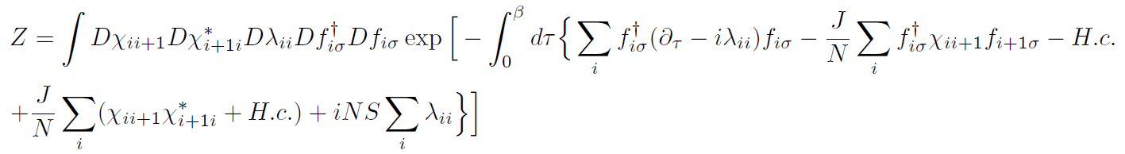
Large N limit?
$$(0)$$
$$(1)$$
$$(n−1)$$
$$(n)$$

Slide 25
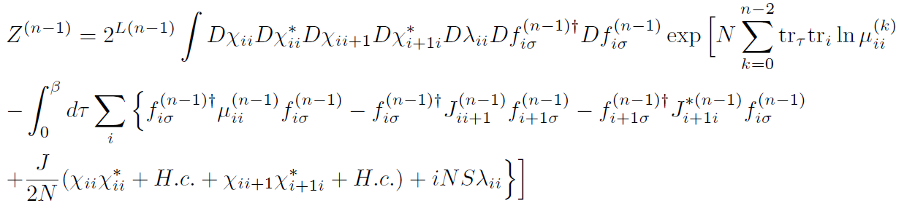
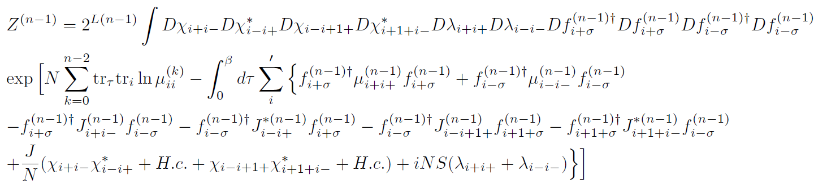


$$(n−1)$$

Slide 26



$$(n)$$

Slide 27



Slide 28




Slide 29




Slide 30






How to read the metric structure?
$$In progress$$

Slide 31
Hubbard model vs.
Heisenberg model
Hertz-Moriya-Millis theory vs.
Spin-liquid theory

Slide 32





Slide 34


Slide 35
Connection to MERA (multiscale entanglement renormalization ansatz)

Slide 36
AdS geometry is encoded into the ground-state wave function in the MERA representation.

Slide 37






Entanglement entropy
Von Neumann entropy of a reduced density matrix

Slide 38




Entanglement renormalization
Matrix product representations of a ground-state wave-function in one dimension (Ex. Transfer-matrix representation for the transverse-field Ising model)
JHEP 10, 193 (2012)

Slide 39








Entanglement renormalization
Multiscale entanglement renormalization ansatz (MERA) for critical systems
$$Ψ\left[σ\left(x,τ;u\right);u\right]=$$
JHEP 10, 193 (2012)

Slide 40









JHEP 10, 193 (2012)

Slide 41


Equivalence between the path-integral real-space renormalization group approach and the wave-function based real-space renormalization group approach (MERA)

Slide 42




$$Ψ\left[σ\left(x,τ;u\right);u\right]=$$

Slide 43





Entanglement entropy in $RSRG_{2}$

Slide 44




Slide 45


$$In progress$$

Slide 46





Toward ${GR}_{3}$ in $RSRG_{2}$
$$(0)$$
$$UV$$
$$(1)$$
$$(n−1)$$
$$(n)$$
$$S\left(r=0,x\right) S(r,x)$$
$$IR$$

Slide 47




Entanglement entropy in MERA vs. in the path-integral real-space renormalization group
$$S(r,x)$$
$$r$$
$$Ψ\left[σ\left(x,τ;u\right);u\right]=$$
$$S(0,x)$$
$$In progress$$

Slide 48



Slide 49



$$In progress$$

Slide 50

Summary
Landau-Ginzburg-Wilson’s mean-field theory
(local order parameter fields and large N limit)
+
Real space renormalization group
(vertex corrections ➔ emergent curved space)
= $AdS_{d+2}/CFT_{d+1}$
To solve coupled renormalization group equations and self-consistent equations for order parameters & To find the metric structure explicitly: Thermodynamics equivalent to SU(2) k=1 WZW theory ?
To calculate the entanglement entropy and to prove the c-theorem: The central charge equivalent to SU(2) k=1 WZW theory ?
Renormalized entanglement entropy: Ryu-Takayanagi formula vs. Field theoretic calculation in a curved space vs. c-theorem ?
Connection to the holographic renormalization approach ?
Higher dimensional generalization ? (cf. S.-S. Lee)

