Slide 1


Nuclear theory at RISP for RAON
Youngman Kim
Rare Isotope Science Project
Institute for Basic Science, Daejeon, Korea

Slide 2
・유효 이론을 이용한 핵반응/핵력 연구
・12C(d,p)13C, 14C(d,p)15C, 16C(d,p)17C 핵 반응의 DWBA 등
・새로운 Super heavy element 합성에 적합한 핵반응 연구
・대전16 핵력을 활용한 가벼운 핵들에 대한 계산
・2nd OLS 방법을 위해 작성한 기존 코드 점검 및 개선 및 sd-껍질 핵
종에 대한 계산
・Parity Doublet Model을 이용한 핵 구조 연구 수행
・Sn+Sn 실험에 대한 전산 모사 및 타 코드와 비교를 통한 검증.
전산 모사 결과를 실험 장치 설계를 위한 참고 자료로 제공.
・KIDS 밀도 범함수
・유효 핵력을 이용한 RPA 계산
・중성자 물질에서의 pairing
・scale invariant hidden local symmetry 이론을 이용하여 핵 물질의
특성 및 상태방정식 연구
・핵 물질의 위상적 구조를 시뮬레이션하는 코드개발
・델타 물질 연구
・비교적 작은 질량을 가지는 핵반응의 반응률 변화에 따른 빠른
중성자 잡힘 반응에 의한 핵 합성 과정의 민감도 조사

Slide 3
Ab initio No Core Shell Model for nuclear structure
Ab initio: nuclei from first principles using fundamental interactions without uncontrolled approximations.
No core: all nucleons are active, no inert core.
Shell model: harmonic oscillator basis
Point nucleons
p
n
p
n
π
p
π
n
n

Slide 4
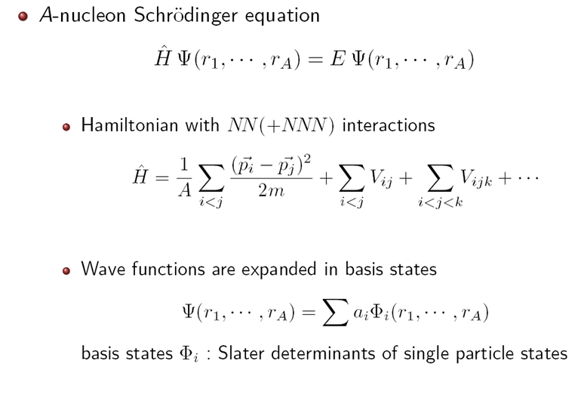

Slide 5
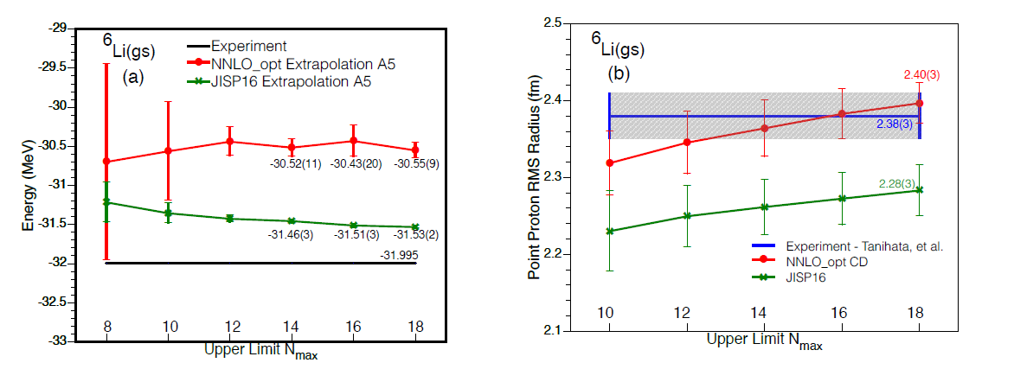
Ik Jae Shin, Y. Kim, P. Maris, J. P. Vary, C. Forssén, J. Rotureau, N. Michel, J.Phys. G44 (2017) 075103
Ab initio NCFC & ab initio GSM with a natural orbital single-particle basis

Slide 6
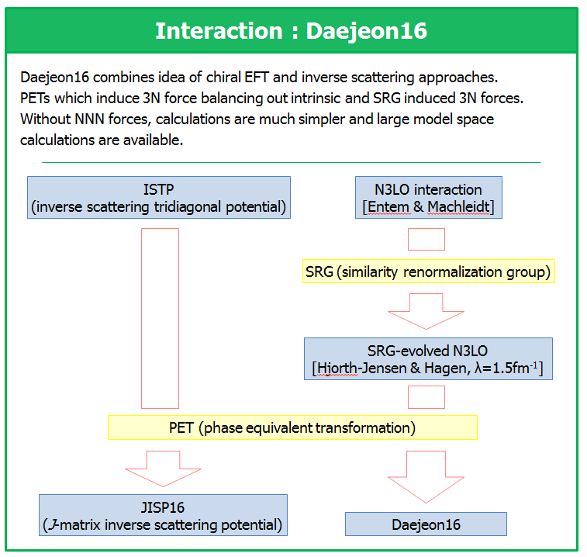
A.M. Shirokov, I.J. Shin, Y. Kim, M. Sosonkina, P. Maris, J.P. Vary, Phys. Lett. B761 (2016) 87

Slide 7
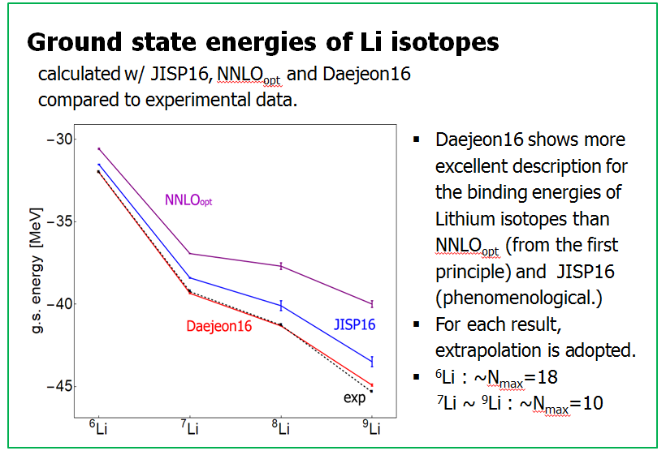

Slide 8
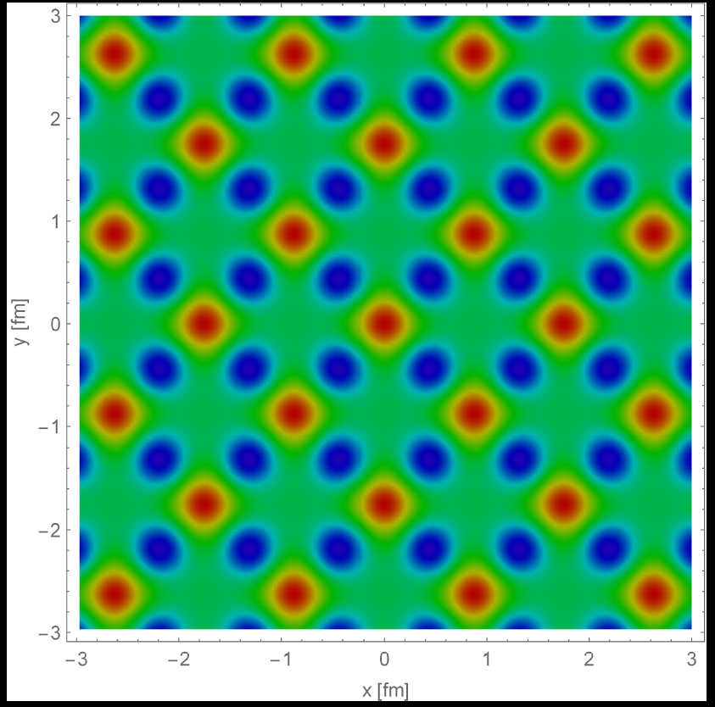
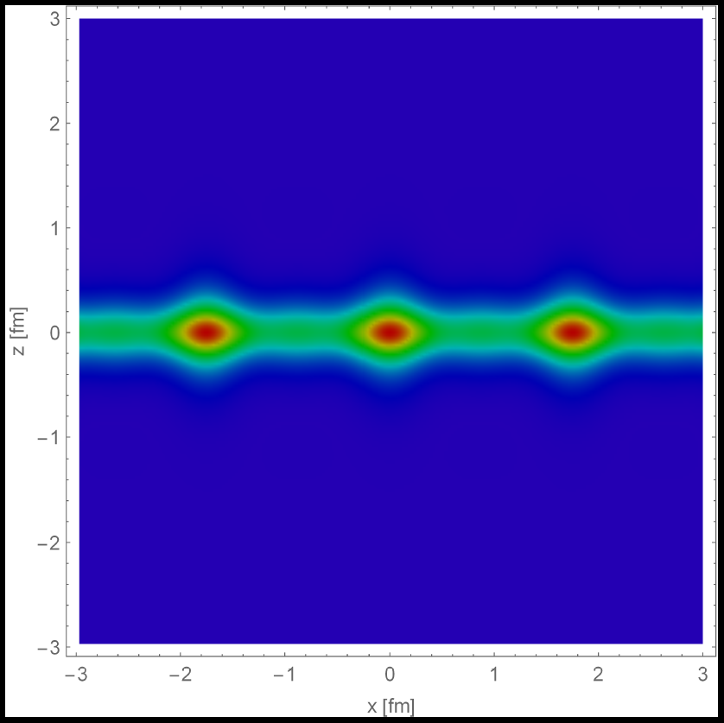
W. -G. Paeng, B. -Y. Park, et al
0.1

Slide 9
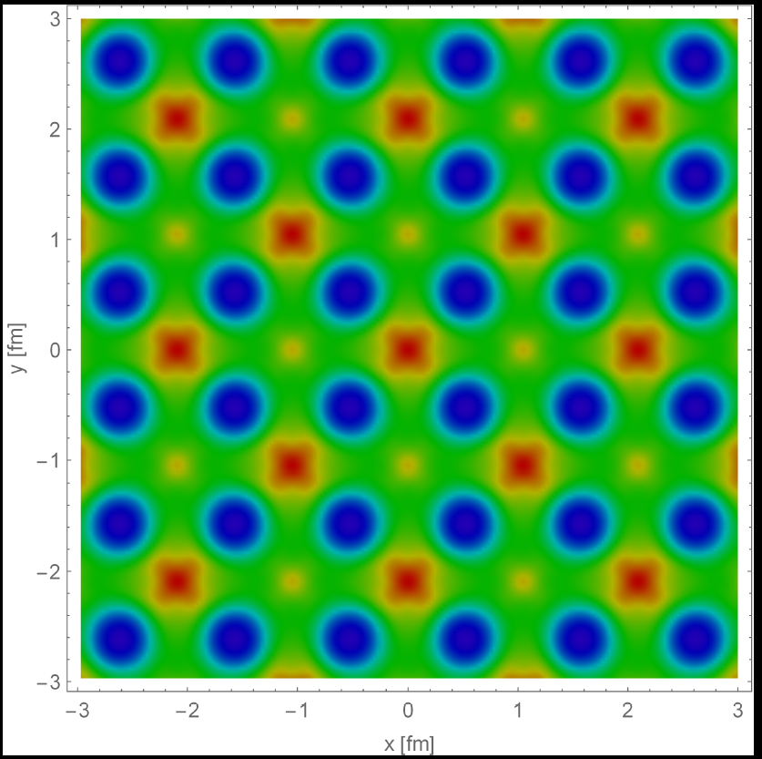
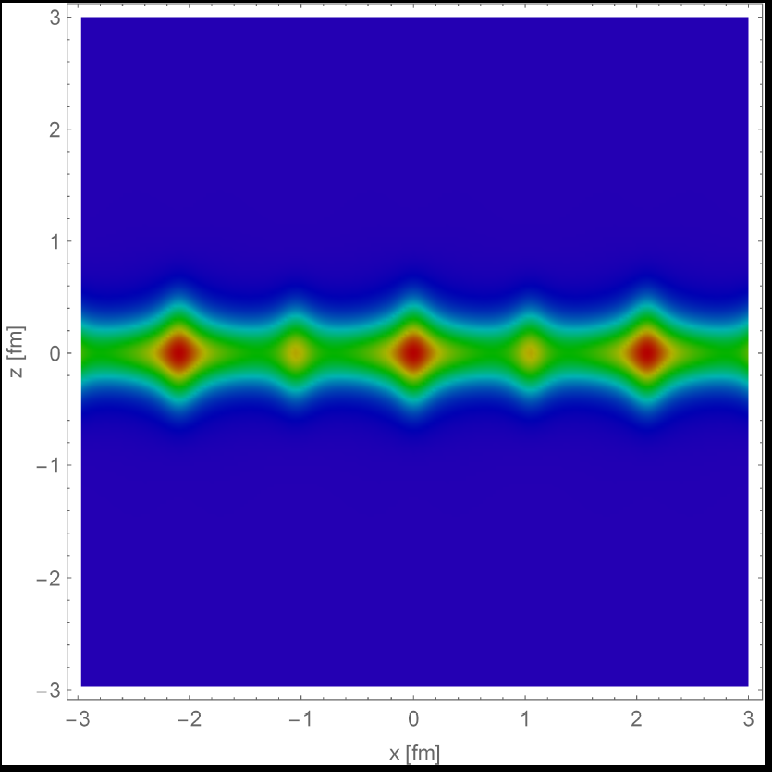
0.16

Slide 10
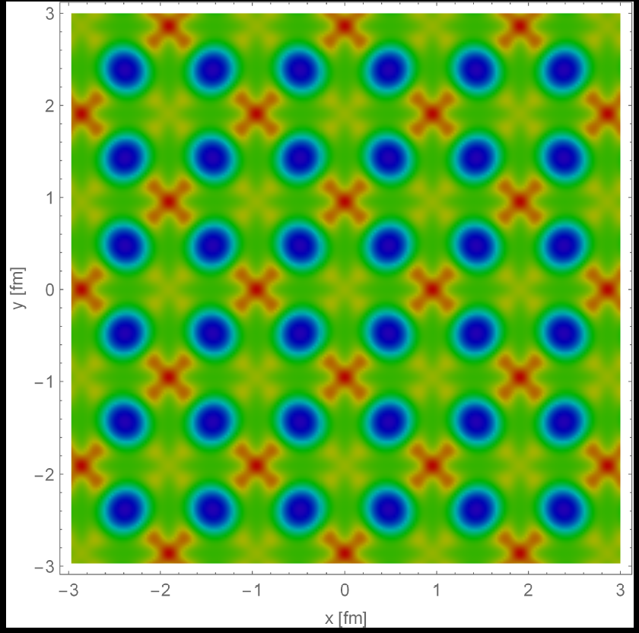
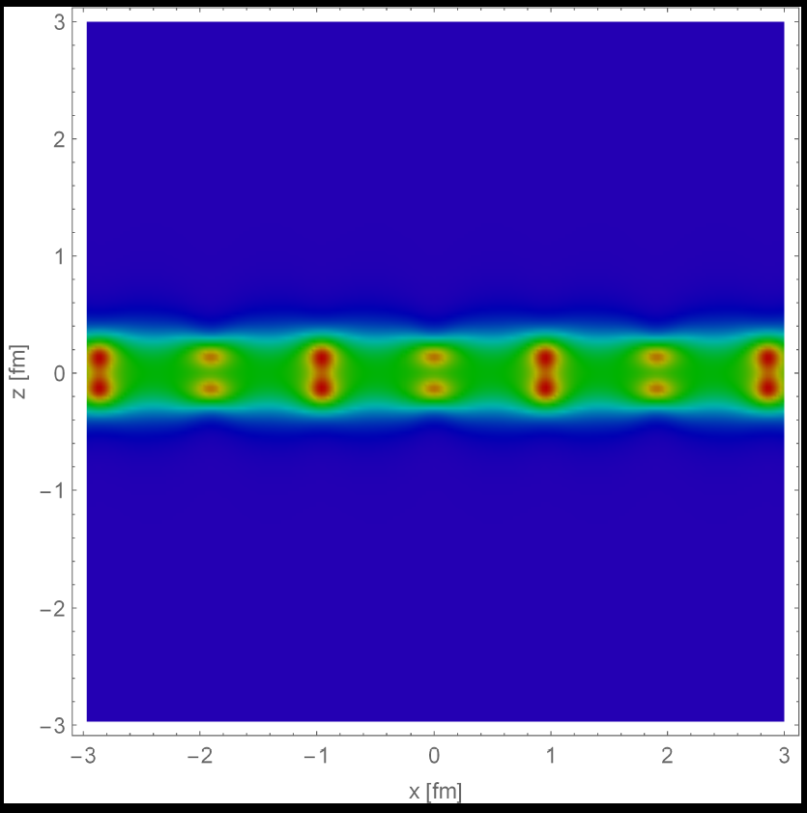
0.78

Slide 11
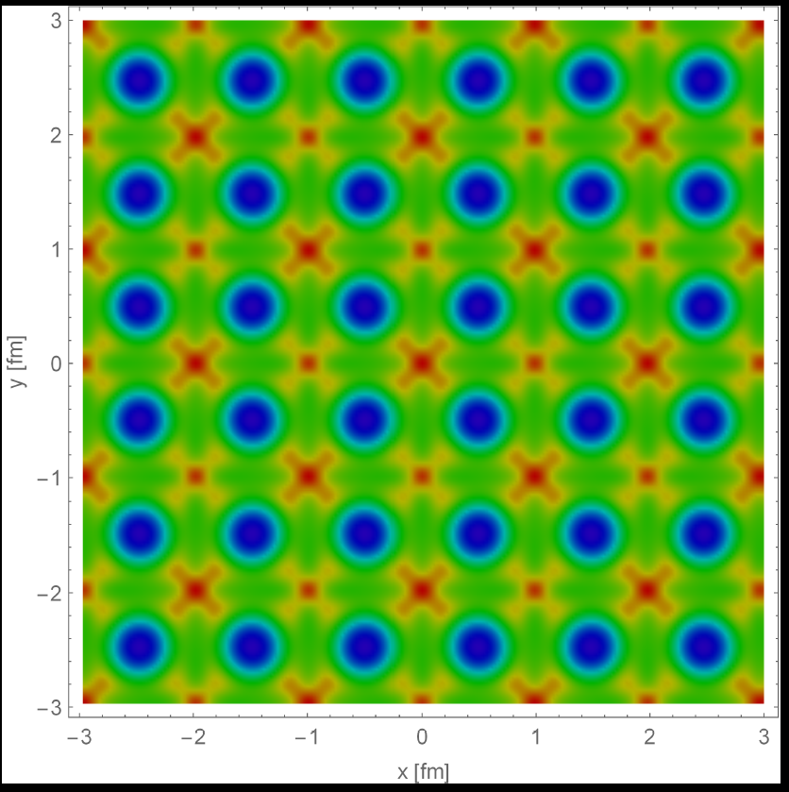
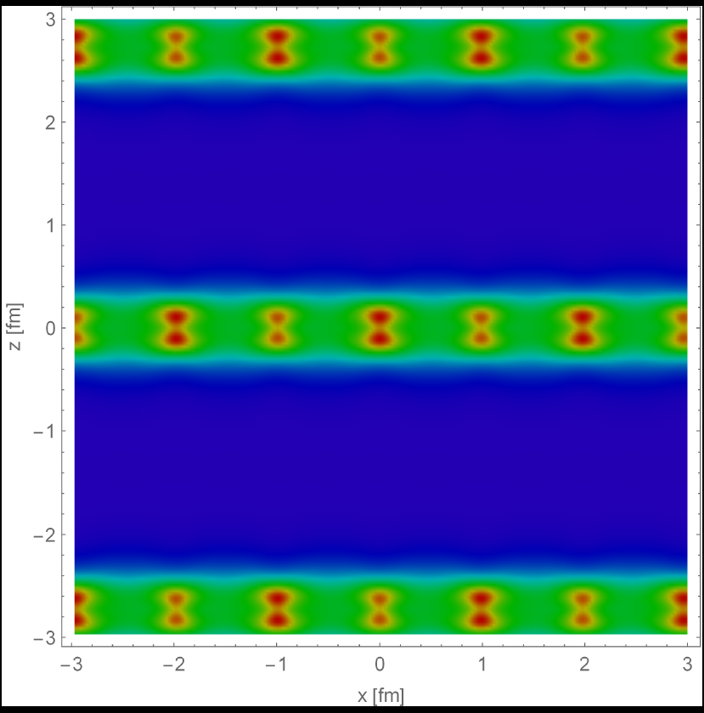
1.17

Slide 12
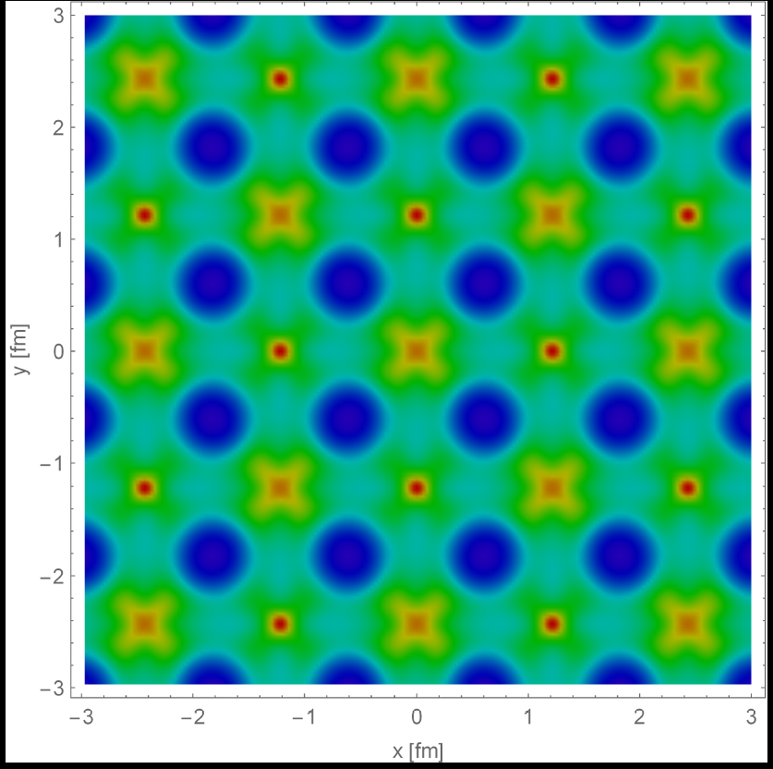
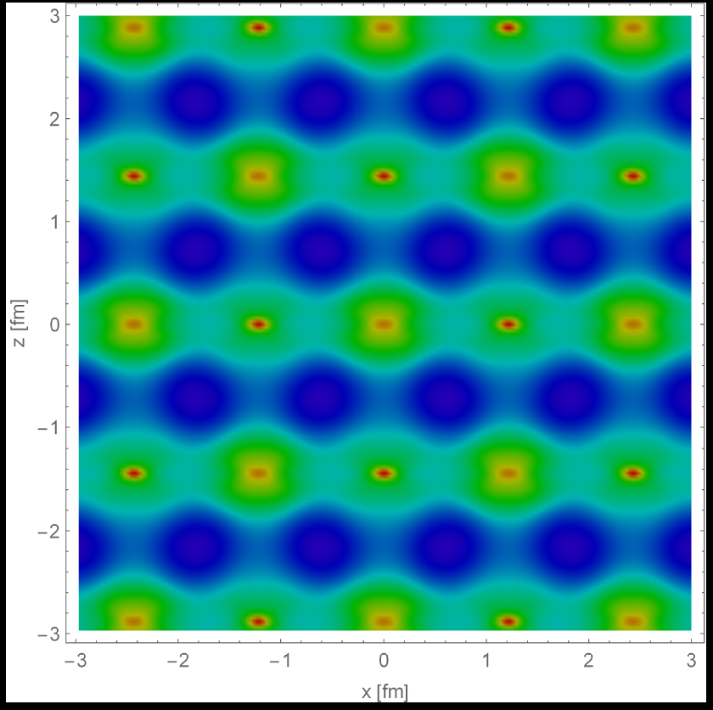
1.47

Slide 13
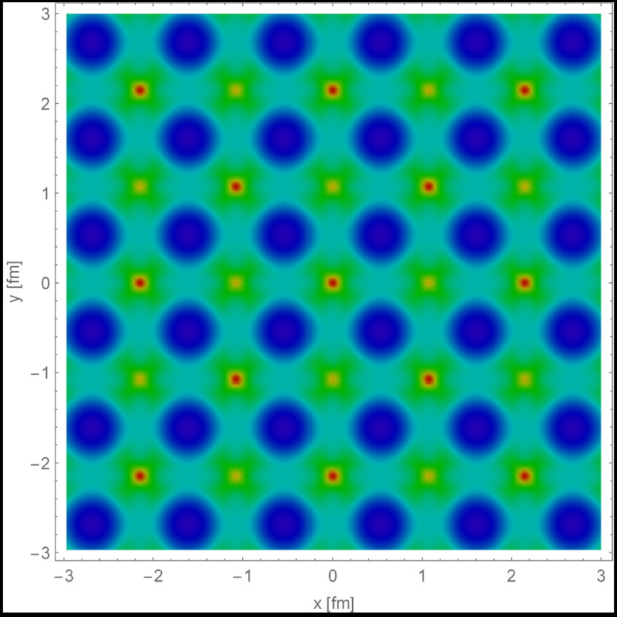
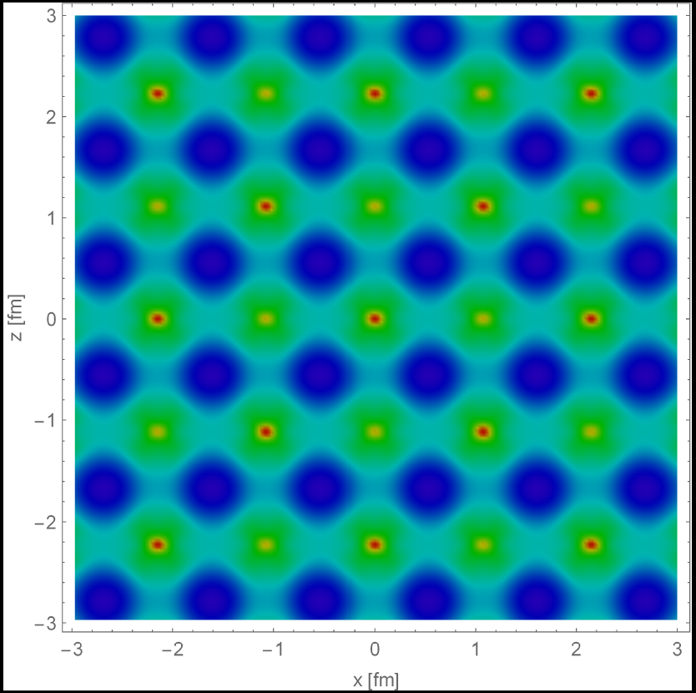
2.43

Slide 14
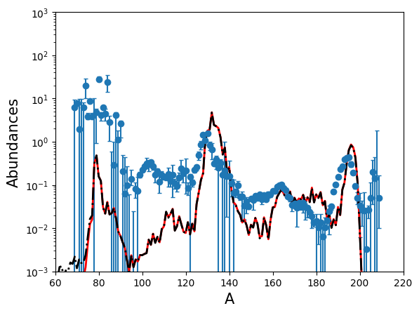
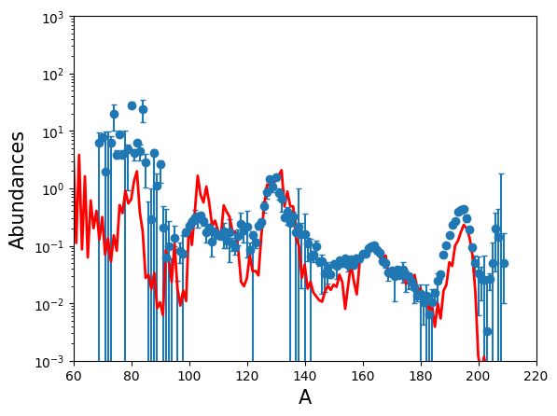
<r-Process in the Core-collapsed Supernovae>
Comparison between solar r-abundances and r-process abundance from two different scenarios
1) 𝛎-driven wind model
We compare abundances from our network calculations with the solar r-abundances in the reference, S.Goriely, Astron. Astrophys. 342, 881 (1999).
Here, the solar r-abundances are the relative amount of each element when the number of Si is 10⁶.
We obtain r-process abundances from two different scenarios and normalize our results to fix the abundance of ¹²⁹Xe=1.08, in order to compare with solar abundances.
In the 𝛎-driven wind model calculation, we use the exponential model with s/k=150.
The MHD jet trajectories which are obtained in the reference, S.Nishimura, et al., Astrophys. J. 642,410 (2006), are used.
s/k=150, T(0)=8.4 GK, Ye=0.45, tau_dyn=0.5ms
2) Magnetohydrodynamic (MHD) jet

Slide 15
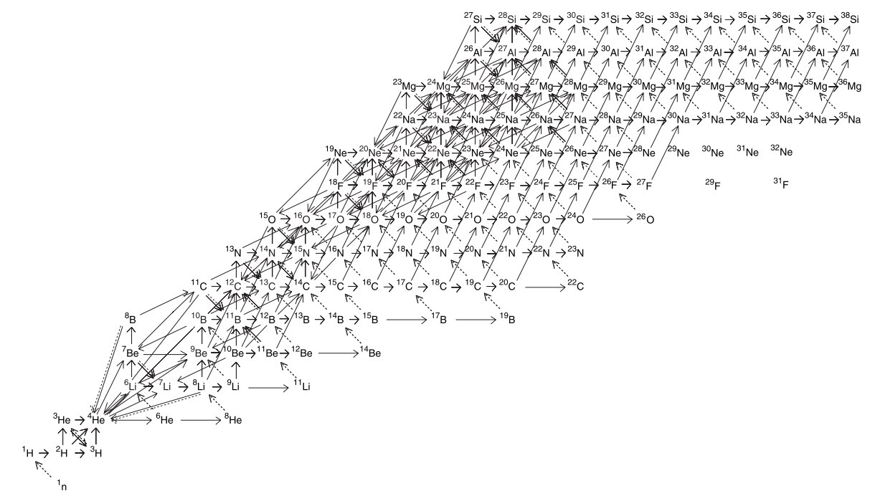
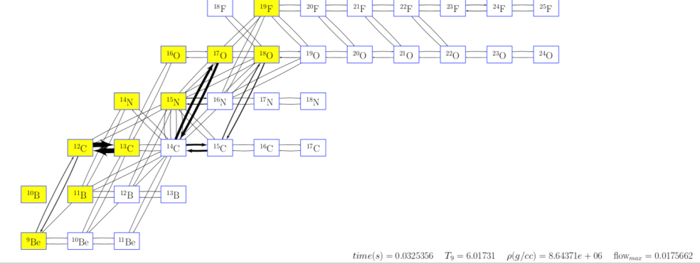
<r-Process and Reaction Network>
More than 2000 reactions are related to the network calculation!!
Reaction networks at low mass region
ref.) Terasawa et al. APJ 562, 470 (2001)
We change several reaction rates artificially and study the sensitivity of r-abundances in each scenario.
𝛂(𝛂n, 𝝲)⁹Be (x10)
⁸Li(𝛂, n)¹¹B (x10)
¹³C(𝛂, n)¹⁶O (x10)
¹⁴C(𝛂, n)¹⁷O (x10)
¹³C(n, 𝝲)¹⁴C (x10)
¹⁴C(n, 𝝲)¹⁵C (x10)
¹⁵C(n, 𝝲)¹⁶C (x10)
¹⁶C(n, 𝝲)¹⁷C (x10)
¹⁷C(n, 𝝲)¹⁸C (x10)
Reaction flows in the r-process

Slide 16
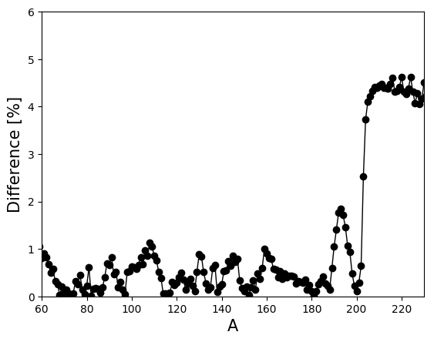
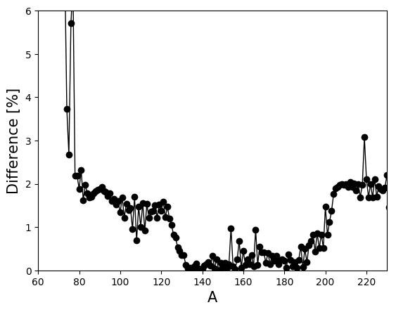
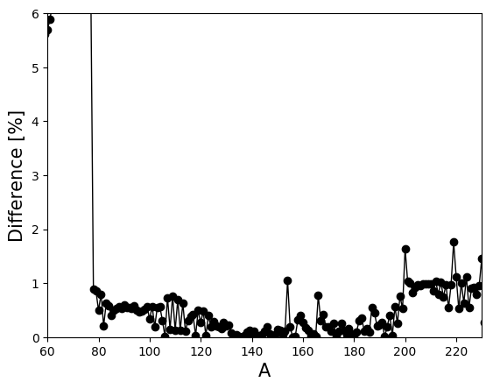
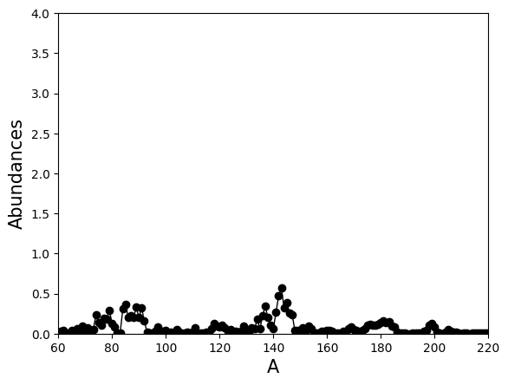
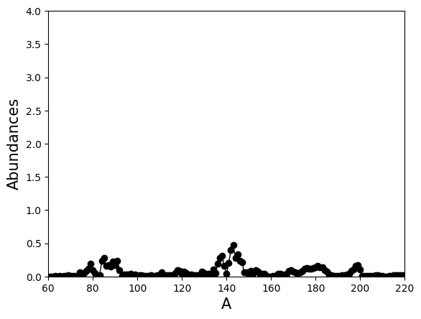
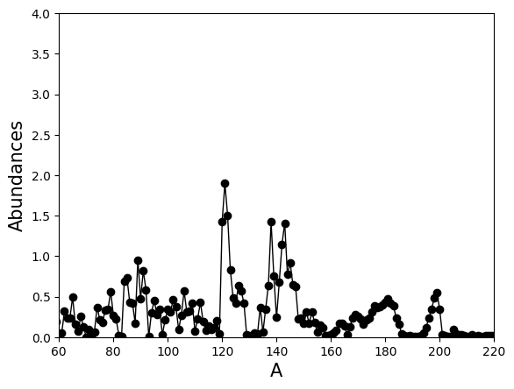
<Sensitivity of r-Abundances in the Artificial Change of Reaction Rates>
1) 𝛎-driven wind model
¹⁴C(n, 𝝲)¹⁵C (x10)
¹⁵C(n, 𝝲)¹⁶C (x10)
¹⁷C(n, 𝝲)¹⁸C (x10)
2) Magnetohydrodynamic (MHD) jet
¹⁴C(𝛂, n)¹⁷O (x10)
⁸Li(𝛂, n)¹¹B (x10)
¹³C(𝛂, n)¹⁶O (x10)
Difference [%]
Difference [%]
Difference [%]

