Slide 1
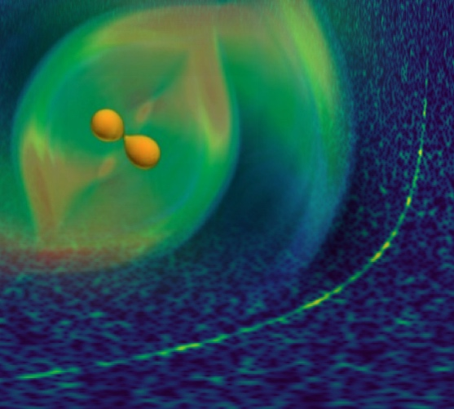
1st APCTP-TRIUMF Joint Workshop on “Understanding Nuclei from Different Theoretical Approaches”, Sept. 14-19, APCTP, Pohang, Korea
Messages from GW170817 on
Compact Star Matter
Hyun Kyu Lee, Hanyang University

Slide 2
I. Introduction
II. EOS and gravitational waves from binary neutron star
III. Dense hadronic matter under strong gravity
IV. GW170817
V. Pseudo-conformal equation of state
VI. Outlooks

Slide 3

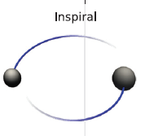


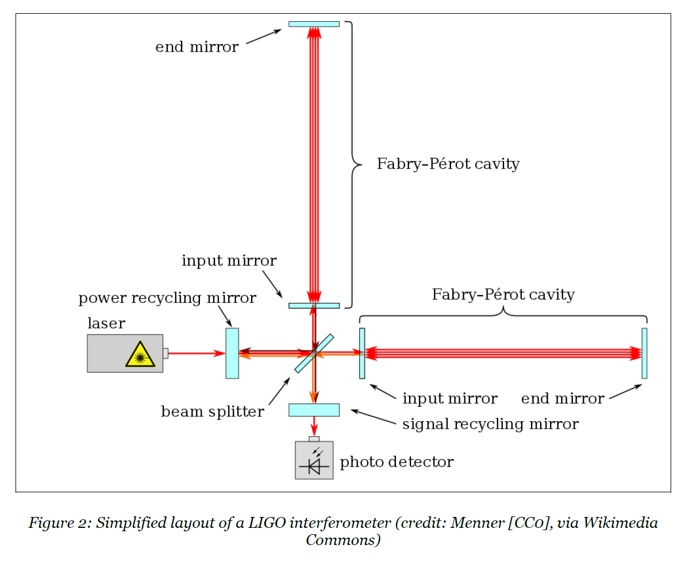
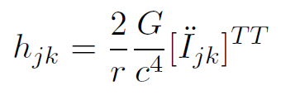

I. Introduction
Gravitational waves from binary neutron star (GW170817)
→ equation of state
LIGO – a gigantic interferometer
Notes:
Strain h

Slide 4
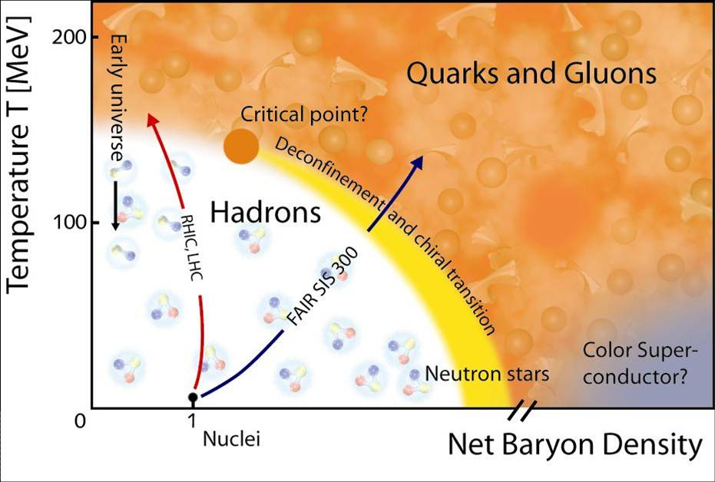
Strong(hadronic) interaction at high density
Density frontier
core of NS and/or final remnant (if not black hole)
Notes:
Present observations of neutron
stars mostly give us the information only on the masses of neutron stars not the radii such that it
Cannot fix the relevant EoS. However the above examples indicate that it can probe also the radii
as well as masses. New degre of freedom, interactions,…

Slide 5
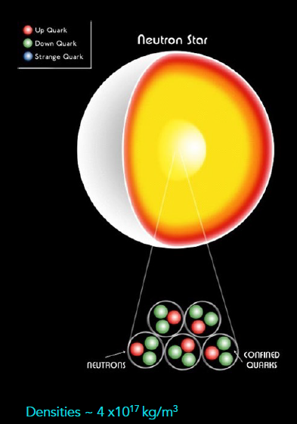
Dense hadronic matter
- Neutron star
neutron, proton (hyperon, quarks)
~ 1-2 solar mass
number of hadrons ~ 10^57
size of neutron star: ~ 10 km
Sathyaprakash(2017)

Slide 6
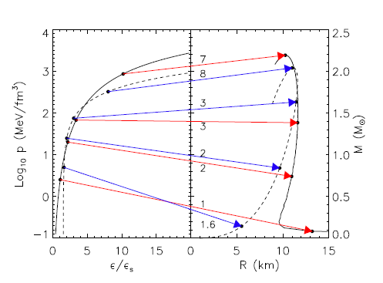
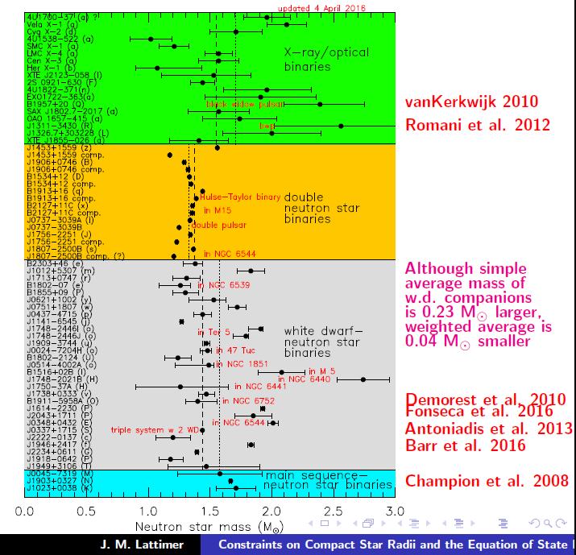


- Core density of neutron stars
Lattimer, arXiv: 1305.3510

Slide 7

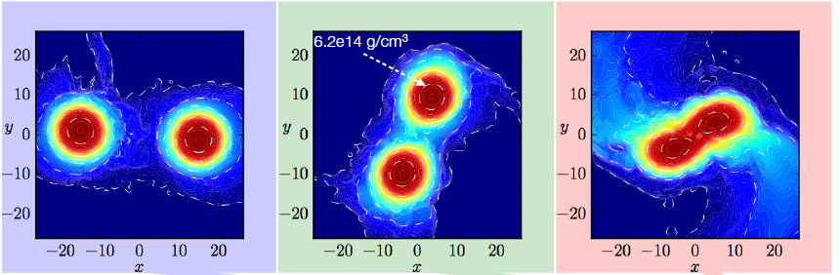
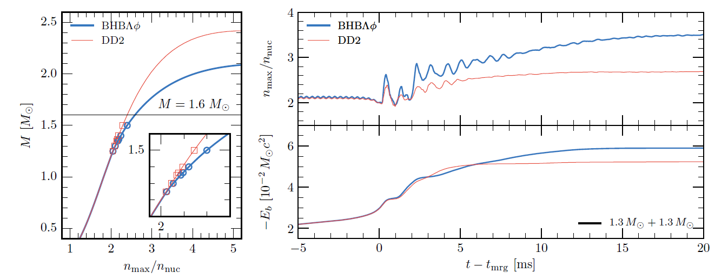
- Binary Neutron Star Merger Remnant
cosmic collider
n > 2 n₀
Radice et al. arXiv:1612.06429v2

Slide 8
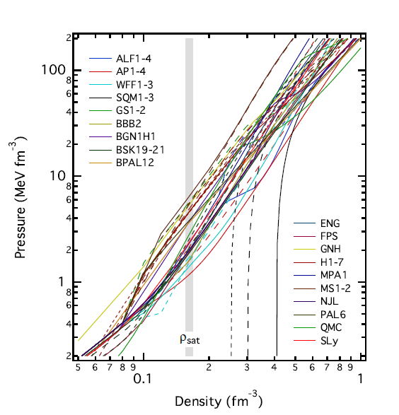
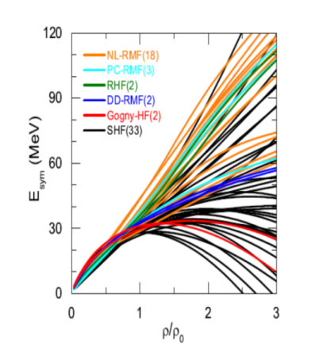

EoS in effective theories of hadronic degree of freedom
Ozel and Freire(2016)
- symmetry energy

Slide 9

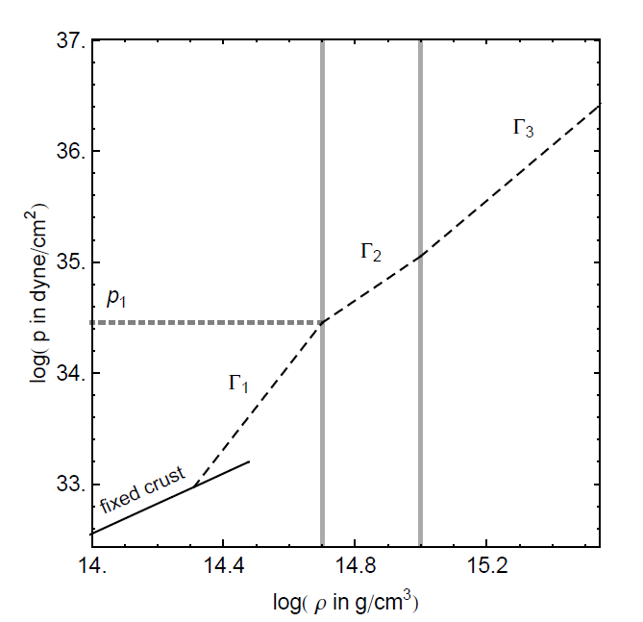
Piecewise EoS
Read et al.(2009)

Slide 10



Underlying basic interactions
a. QCD(hadrons)
effective theory of hadrons
b. Gravity(energy momentum tensor)
Einstein field equation
pressure and energy density :

Slide 11
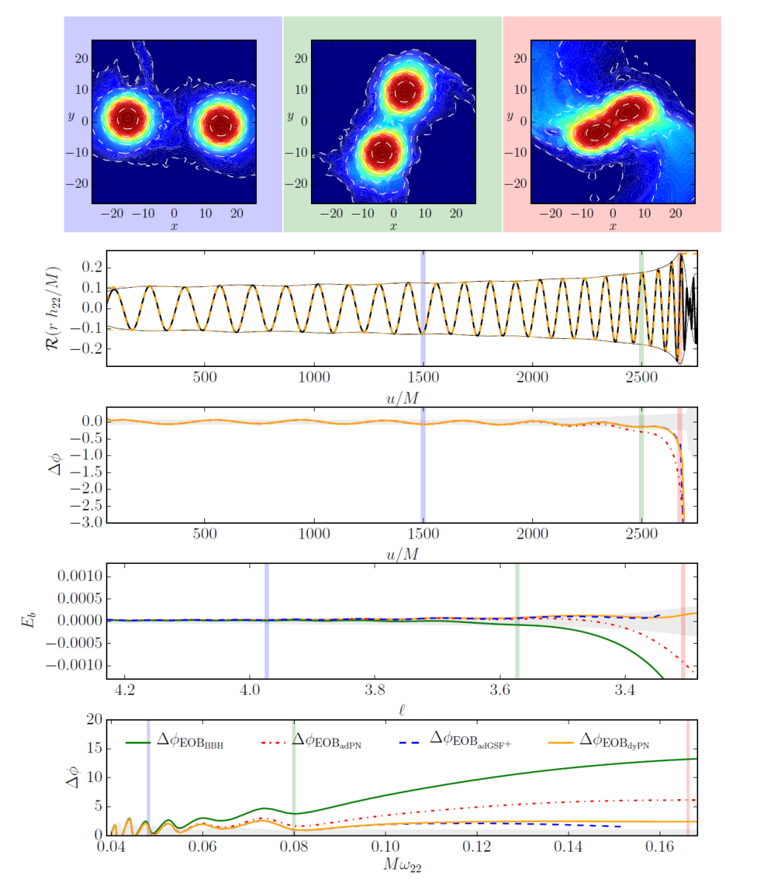
II. EOS and gravitational waves from neutron star binary

Slide 12
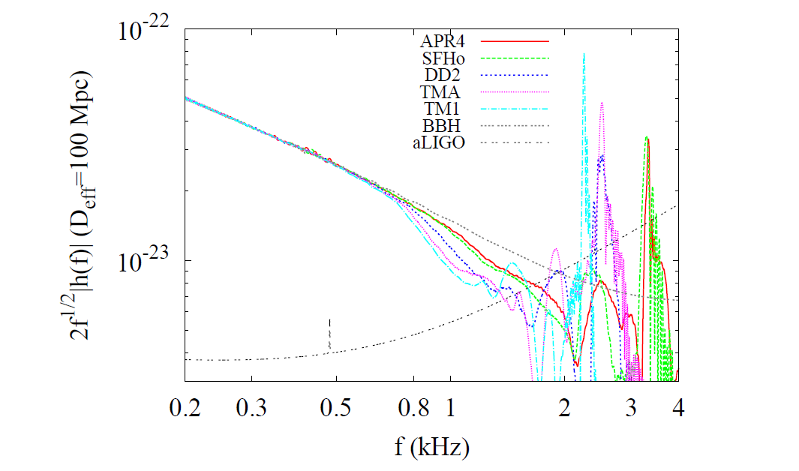
- Deviation from point particle approximation
Hotokezaka et al. Phys. Rev. D93, 064082(2016)
stiffer
stiffer
tidal deformation: inspriral
Peak frequency :merger remnant

Slide 13
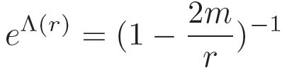

III. Dense hadronic matter under strong gravity
A. Tolman-Oppenheimer-Volkov(TOV) Equation
metric for a spherically symmetric(static, non-rotating) configuration
perfect-fluid stellar matter

Slide 14
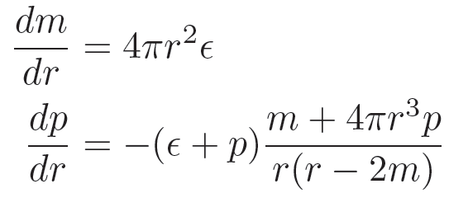
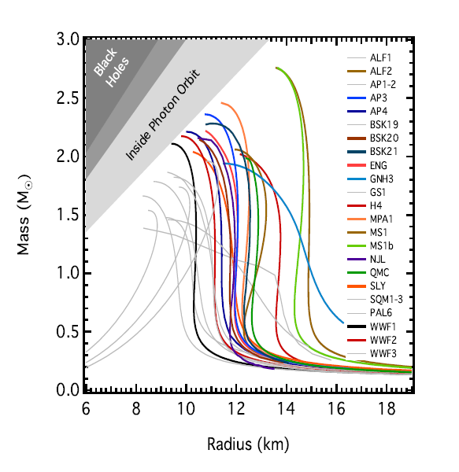
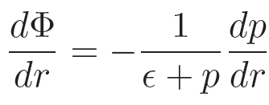
Tolman-Oppenheimer-Volkov(TOV) Equation
Ozel and Freire(2016)
→ Mass and radius

Slide 15
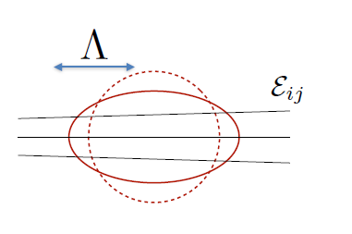



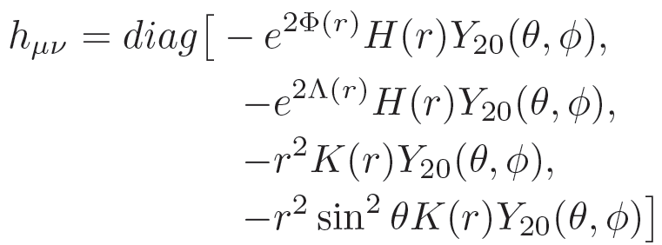
B. Tidal deformation
Einstein field equation for tidal perturbation
TOV Eqs.

Slide 16
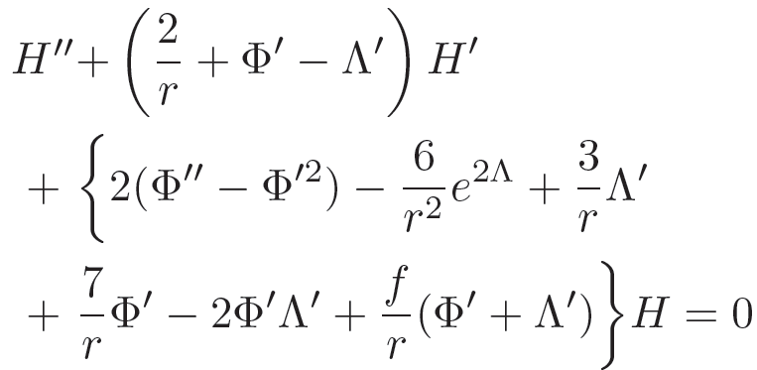
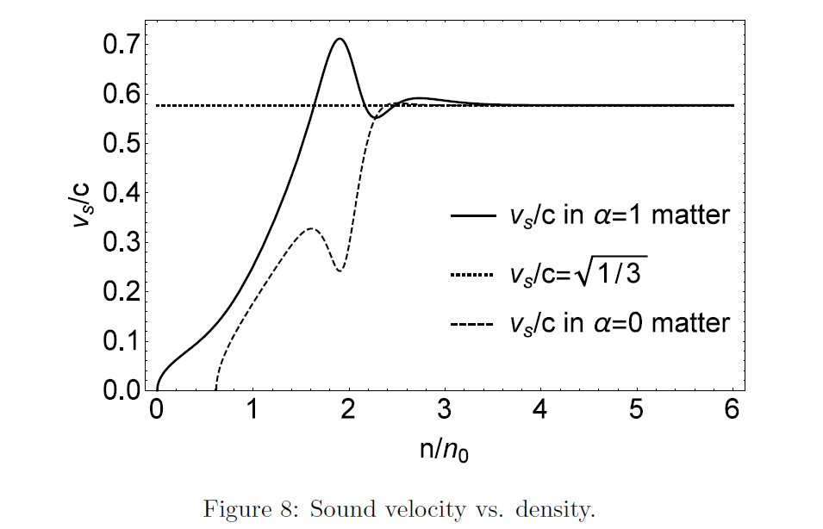
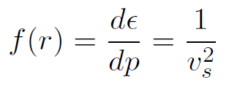
Speed of sound

Slide 17
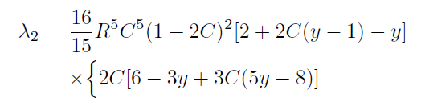


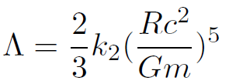
Deformability
dimensionless tidal deformation parameter

Slide 18
IV. GW170817

Slide 19
Large-scale Collision
Binary coalescence up-to merger
Cosmic distance ~ 40 Mpc
Bartos, Brady, Marka, Class.Quant.Grav. 30 , 123001(2013)

Slide 20
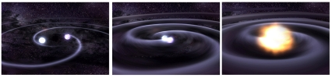
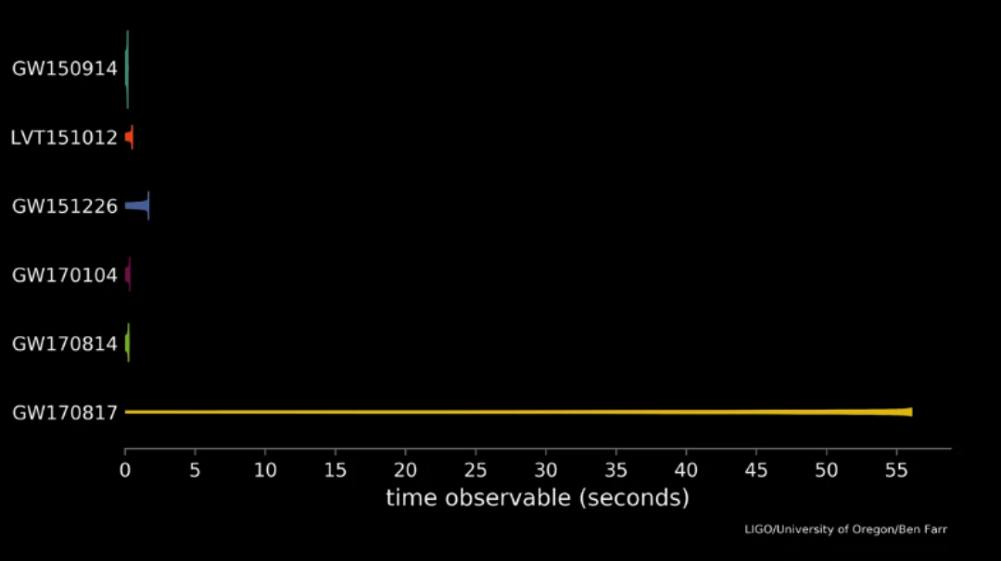

Slide 21
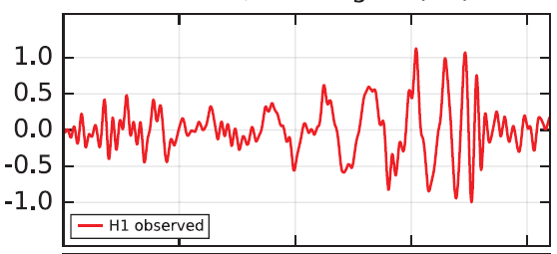



- Mass
GW 150914 (binary black hole)
Chirp mass: primary observable

Slide 22
- Tidal deformation

Slide 23


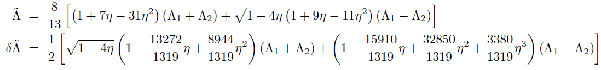

Phase change due to tidal deformation

Slide 24
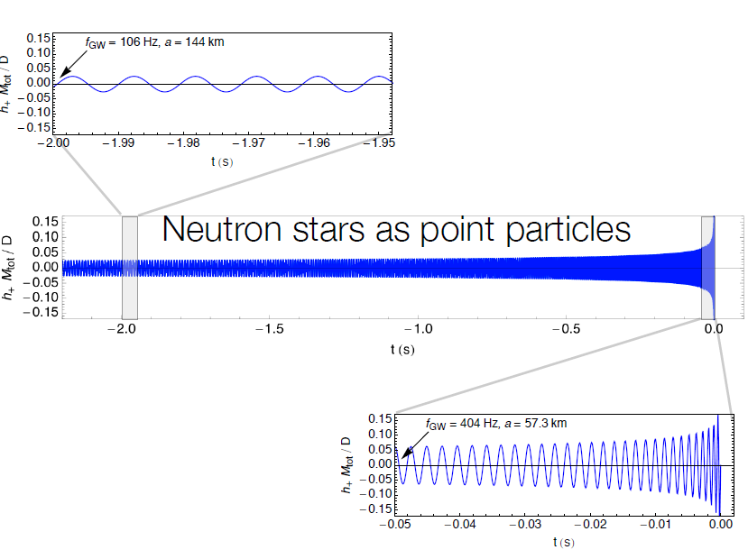
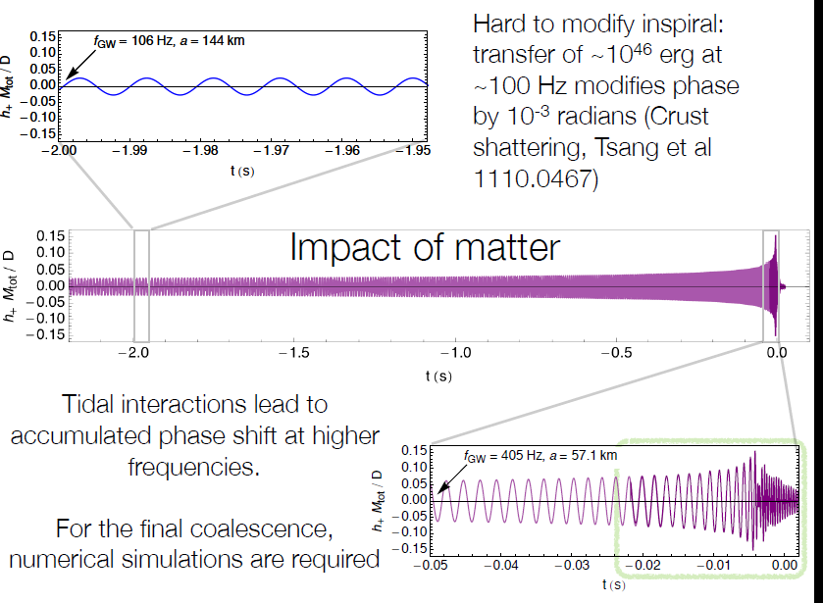
J. Read, Amaldi 2017

Slide 25
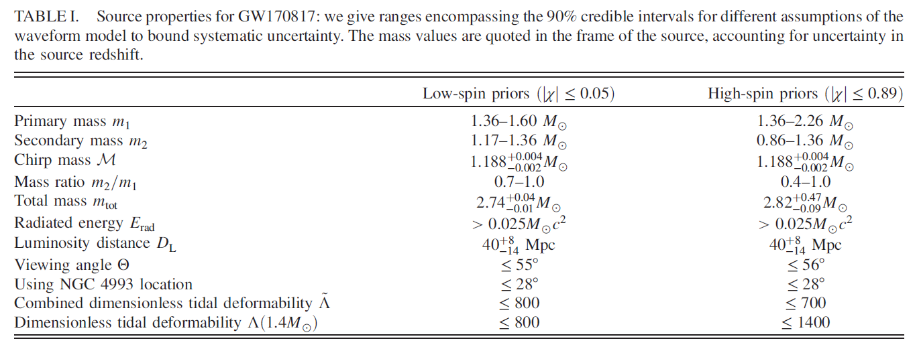
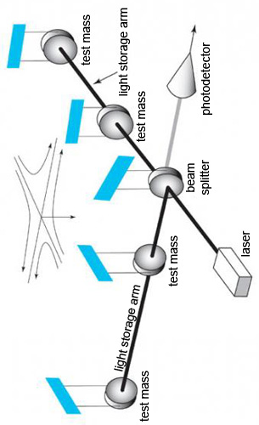

Slide 26

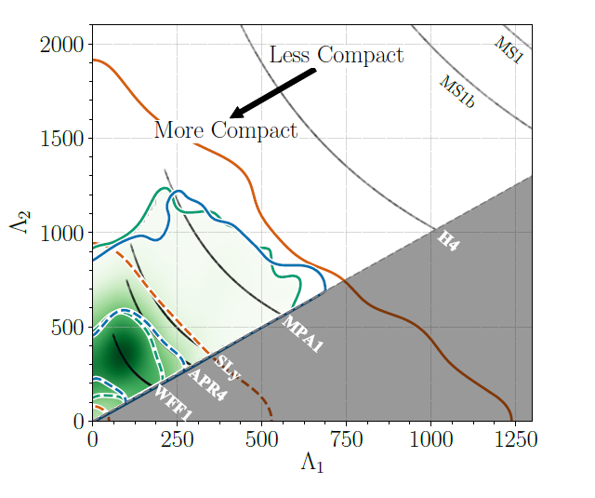

Constraints from GW170817
1805.11581
→ Some of EoS/effective models are not favored
- Tidal deformability
-

Slide 27
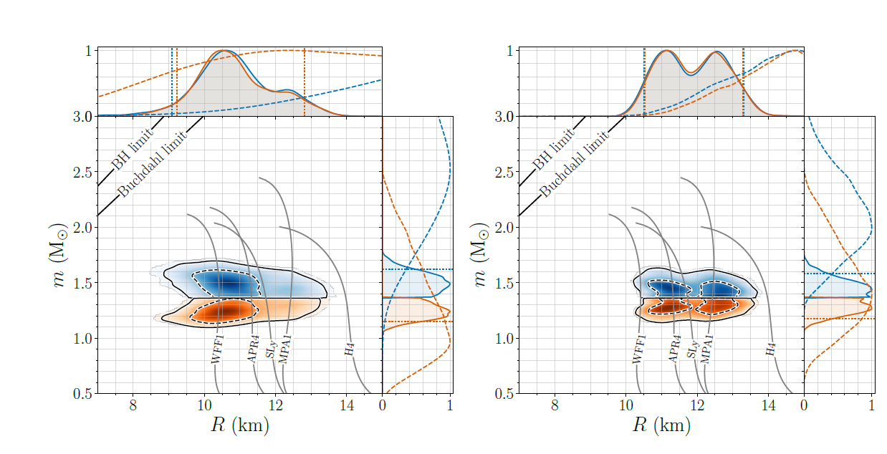




Radii and masses

Slide 28
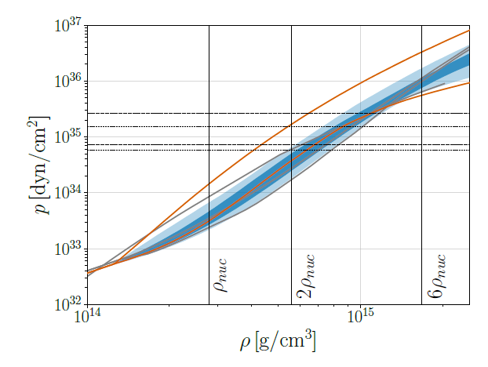
Pressure

Slide 29
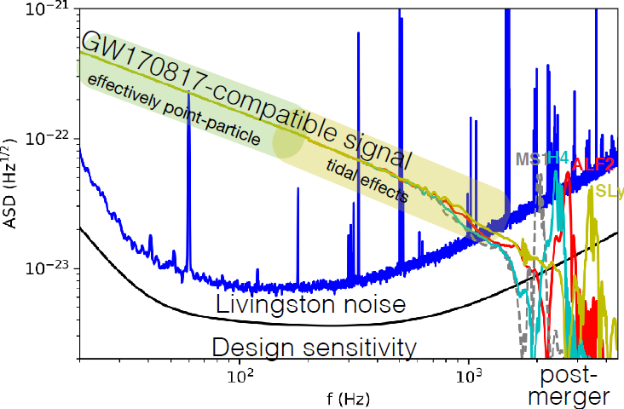
Merger remnant: peak frequency
J. Read, 2018
J.Read(2018)
hidden under LIGO sensitivity curve

Slide 30

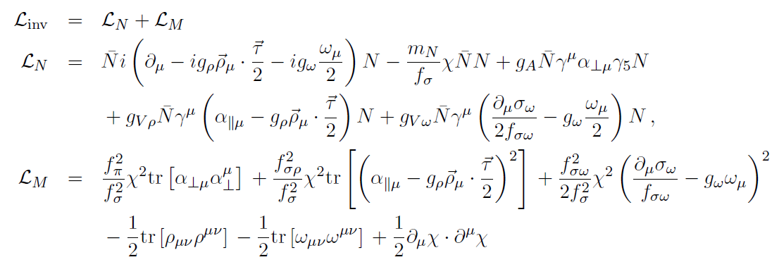

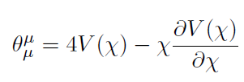
V. Pseudo-conformal model(PCM)
Paeng et al.(2017), Ma et al.(2018)
effective Lagrangian
trace of energy momentum tensor (TEMT)

Slide 31


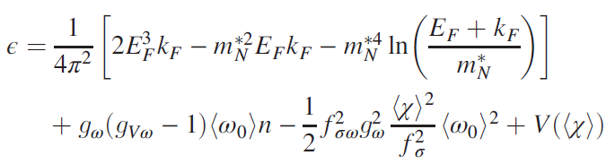



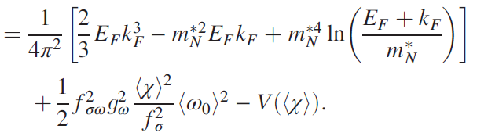

Trace of energy momentum tensor
- nucleon mass is introduced in a scale symmetric way !

Slide 32

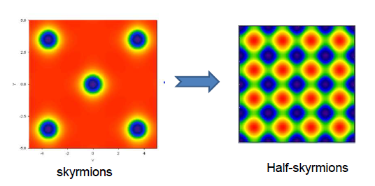
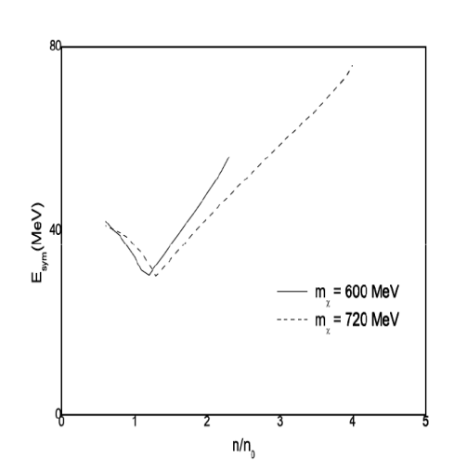

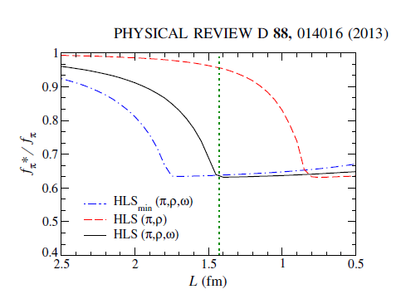

Topology change in skyrmion
Goldhaber & Manton(1987), Park et al.(2003) ,…..
1. Change of symmetry energy
HKL, Park and Rho, PRC 83,025206(2011)
2. homogeneous dilaton condensation
→ density independent

Slide 33

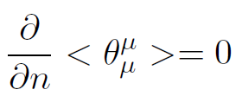
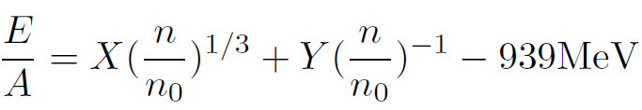
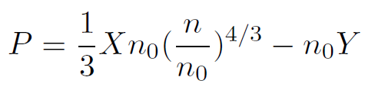
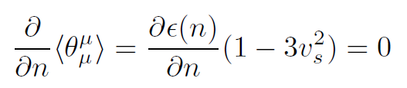

PCM
Pseudo conformal EOS
hadronic bag constant
conformal sound velocity
Paeng,Kuo,HKL,Ma,Rho, PRD96,014031(2017)

Slide 34
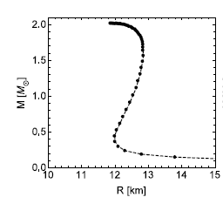





Ma, HKL, Paeng, Rho, arXiv:1804.00305
consistent with observed properties of compact stars
mass, radius : , ,
tidal deformability :
pressure: P

Slide 35




Slide 36


VI. Advanced LIGO/Virgo: O1,O2 → O3
D. Shoemaker,KIW, 2018
- GW(binary neutron stars) : 1-10/yr
- More on EoS : Mass, Radius, Tidal deformation, Spin, …
- More on EoS : GW peaks from merger remnants
- EM follow-up, Fermi(GRB) , Icecube(neutrino) , ….

Slide 37

Message from gravitational wave
→ equation of state(EoS) of dense hadronic matter
Mass, Radius, Deformation parameter, …
Mass -Radius
Deformation parameter
→ phase changes
new degrees of freedom
emerging symmetries, …
Notes:
Present observations of neutron
stars mostly give us the information only on the masses of neutron stars not the radii such that it
Cannot fix the relevant EoS. However the above examples indicate that it can probe also the radii
as well as masses. New degre of freedom, interactions,…

