Slide 1

Nuclear force at short distance:
A constituent quark model perspective
Su Houng Lee
Attempts to understand the static energy of the 6 quark (2-baryon) and 9 quark (3-baryon) configuration in a constituent quark model and their possible relation to nuclear force at short distance
Acknowledgement: Quark model group
Aaron Park, Woosung Park, Sungtae Cho, SHL

Slide 2
Few words on “Multiquark states”
Constituent quark model, Multiquark states and Short distance 2-N static energy
Tribaryons and short distance 3-N static energy

Slide 3
Few words on “Multiquark states”

Slide 4



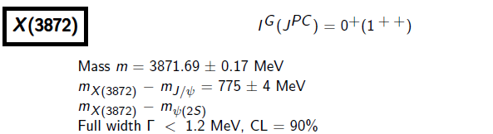






X(3872)
- 2003 -
Z(4430)
- 2007 -
- 2014 -
Spin parity = 1+
G=+ → will look at C=-

Slide 5








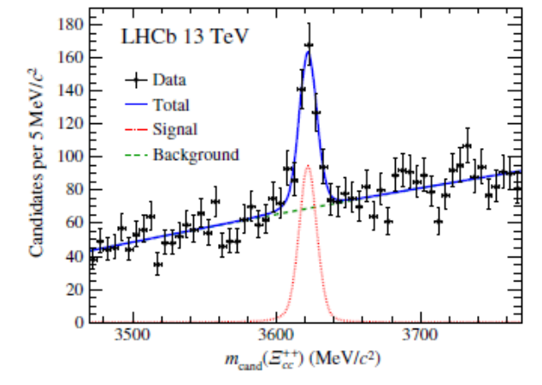
Pentaquark - Pc
- 2015 -
Baryon with ccu
PRL119 (2017)112001
- 2017 -

Slide 6


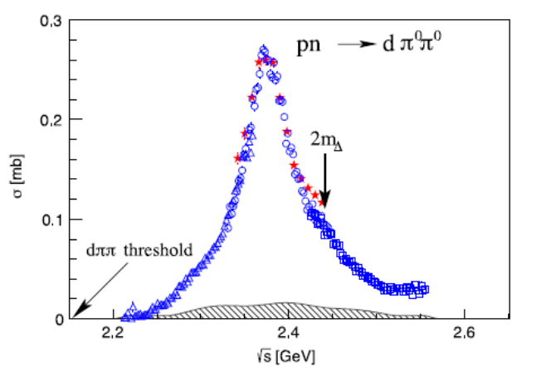
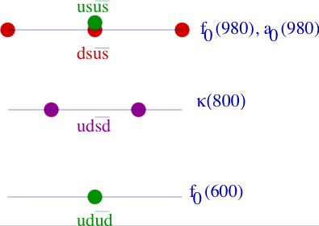
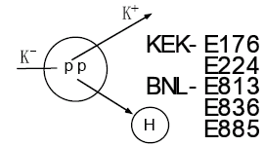
d*(2380)
- WASA-at-COSY [H. Clement]-
Revival of an old topic
Scalar tetraquark (Jaffe 76)
Search for H dibaryon

Slide 7
Normal meson, compact multiquark, molecules, resonances
 | Normal meson | Compact multiquark | Molecules | Resonance
Geometrical configuration
Examples | Nucleon, pion, kaon | ? | X(3872) | K*, rho meson
u
u
d
u
u
u
u
d
d
u
u
d
d
d
Pc, d*

Slide 8
II: Constituent quark model, Multiquark states and Short distance 2-N static energy

Slide 9
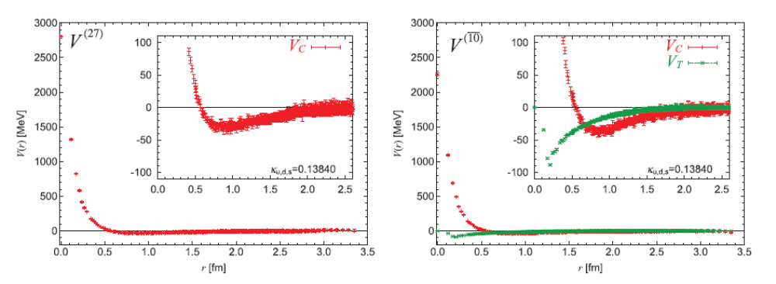



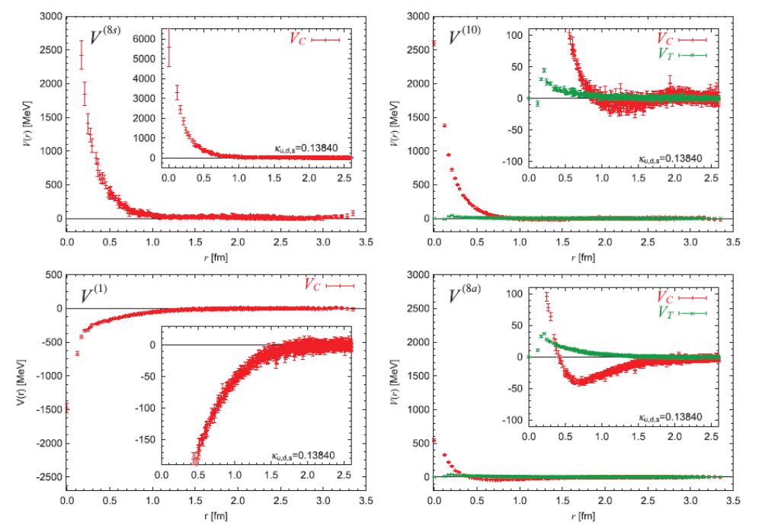




NN potential in SU(3) from Lattice: HAL QCD (PTEP 2012, 01A105)
Spin=0
Spin=1
Highly repulsive
Spin=0
Spin=1
Attractive
Weakly repulsive
Spin=0
Spin=1
Notes:
First could give compact configuration, the second may be resonance. So what does give the short distrance behavior ?

Slide 10

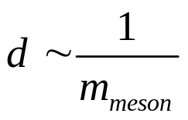


Compact dibaryon states and nuclear force at short distance
- Long distance nuclear force: meson exchange
1
2
q
q
4
5
3
6
Short distance dynamics could be understood using quark dynamics
M. Oka; quark cluster model
1
2
4
5
3
6

Slide 11
Quark wave function for multiquark states (W.Park, A.Park, S.Cho, SHL)
Pauli principle:
Totally antisymmetric (color x spin x flavor) wave function (s-wave quarks)
1
2
3
4
5
6
Can be use to understand
Compact dibaryon states
NN potential at short distance

Slide 12
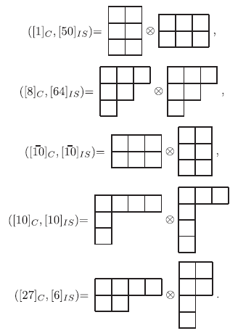
Quark wave function for light dibaryons (W.Park, A.Park, SHL15.)
- Choose the spatial part to be symmetric
- Choose the Color-Flavor-Spin part to be antisymmetric : SU(12)
Physical State

Slide 13





- Dibaryon: 5 Independent color singlet bases
1
2
3
4
5
6
1
3
2
4
5
6
1
2
3
5
4
6
1
3
2
5
4
6
1
4
2
5
3
6

Slide 14
Storng repulsion at short distance → Pauli forbidden 6 quark state
Example 1: ΩΩ in the Spin=3 channel is highly repulsive because
Flavor is totally symmetric
Spin is totally symmetric
Remaining part should be totally antisymmetric
But color singlet implies
Hence, short distance repulsion in this channel
Example 2: NN in spin 0, octet channel
Such forbidden configuration are highly repulsive at r→0 (Oka et al quark cluster model)
what about states that are allowed?

Slide 15
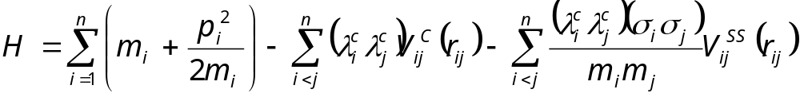



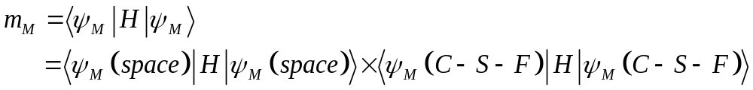
Constituent quark model
In Constituent quark model (Can fit experimental hadron spectrum well)
u
d
q
....
s
In this talk, Will concentrate on the Color-Spin-Flavor part

Slide 16
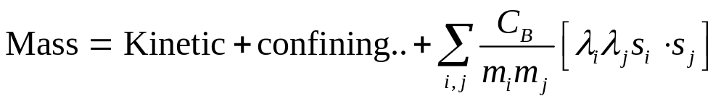
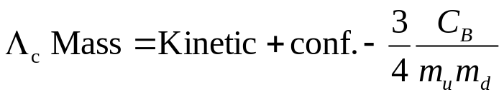

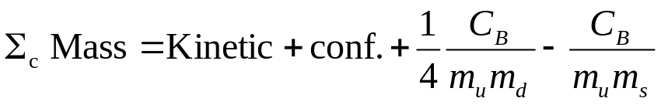

Baryon Mass splitting in a simplified version
Example
u
d
u
d
s
s
Mass diff | M_{Δ} –M_{N} | M_{Σ}-M_{Λ} | M_{Σc}-M_{Λc} | M_{Σb}-M_{Λb}
Formula | 290 MeV | 77 MeV | 154 MeV | 180 MeV
Experiment | 290 MeV | 75 MeV | 170 MeV | 192 MeV

Slide 17
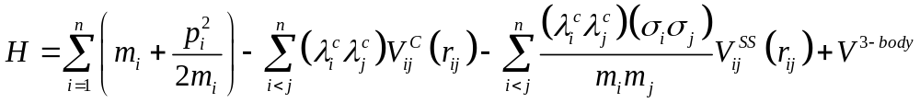
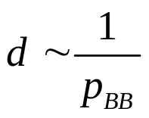
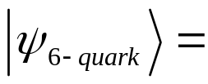
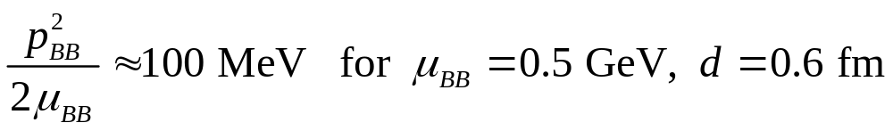
When allowed, Where are the Compact multiquark configuration?
Kinetic energy part
Compact state 6 quark state vs 2 separated baryons → Additional kinetic energy
1
2
4
5
3
6

Slide 18
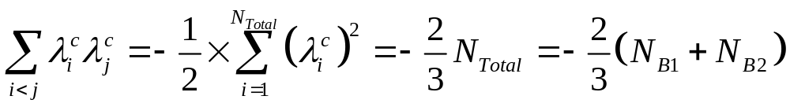
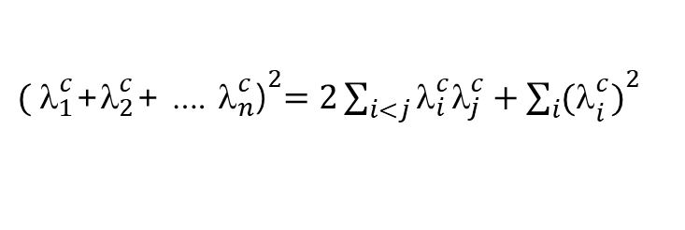
Color-Color interaction
Related to Casimir
${( {\text{l}}_{1}^{c}\text{+}{\text{l}}_{2}^{c}\text{+ …. }{\text{l}}_{n}^{c}\text{)}}^{2}=2\sum_{i<j}{{\text{l}}_{i}^{c}{\text{l}}_{j}^{c}}+{\sum_{i}{{(\text{l}}_{i}^{c})}}^{2}$
If color singlet
1
2
4
5
Sum of color-color interaction is additive
when the total number of quarks N_{Total}=N_{B1}+N_{B2}
3
6

Slide 19
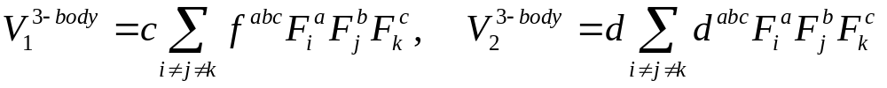
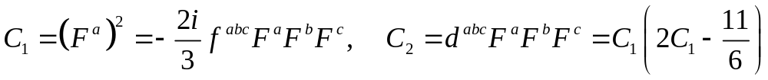

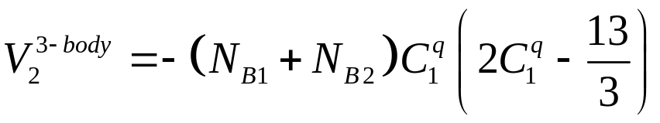
Quark 3-body force
Two types
- Note, related to 2 Casimir
→ 3-quark interaction are additive: For color singlet state composed of N_{Total}=N_{B1}+N_{B2} quarks

Slide 20
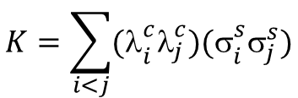
Color spin interaction
Color-spin interaction for quark-quark and quark antiquark
$$K=\sum_{i<j}{{\text{(}\text{l}}_{i}^{c}{\text{l}}_{j}^{c}){\text{(}\text{s}}_{i}^{s}{\text{s}}_{j}^{s})}$$
quark-quark and quark-antiquark
 | qq |  |  |  | qq
Color | A | S | A | S | 1 | 8 | 1 | 8
Flavor | A | A | S | S
Spin | A(1) | S(3) | S(3) | A(1) | 1 | 1 | 3 | 3
K | -8 | -4/3 | 8/3 | 4 | -16 | 2 | 16/3 | -2/3
u
d
u
d

Slide 21
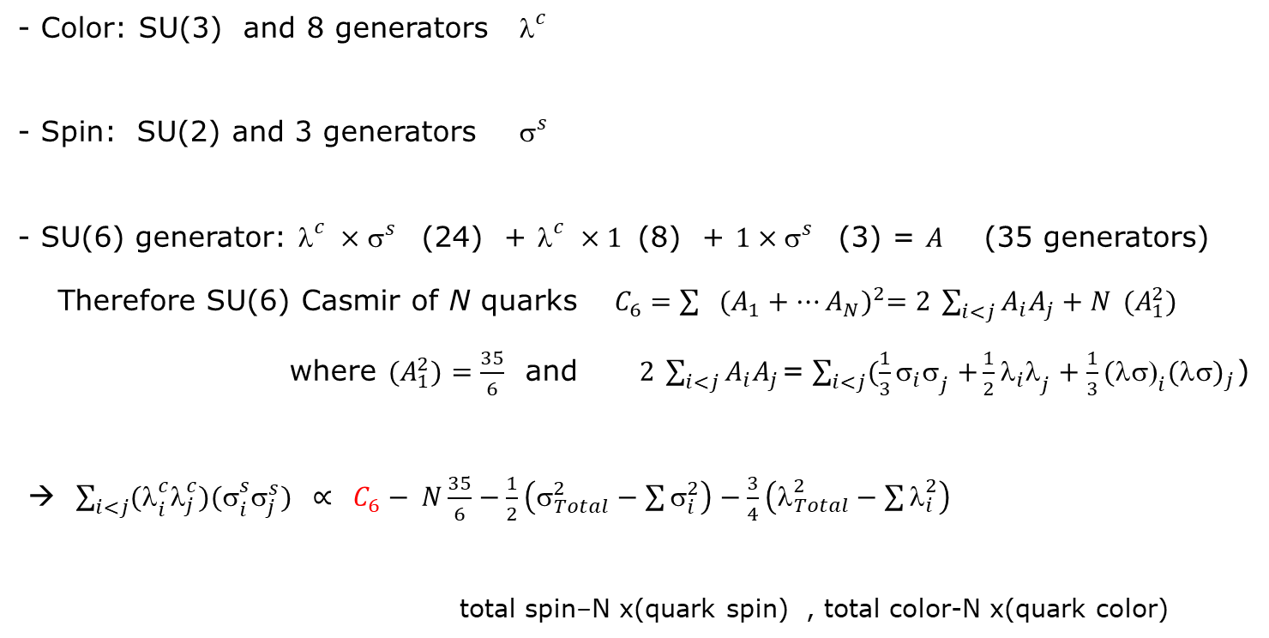
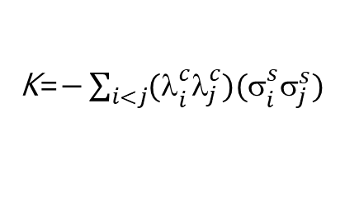
Color spin interaction - General remarks
K=$−\sum_{i<j}{{\text{(}\text{l}}_{i}^{c}{\text{l}}_{j}^{c}){\text{(}\text{s}}_{i}^{s}{\text{s}}_{j}^{s})}$
1) Part of a larger group
- Color: SU(3) and 8 generators${\text{l}}_{}^{c}$
- Spin: SU(2) and 3 generators ${\text{s}}_{}^{s}$
- SU(6) generator: ${\text{l}}_{}^{c}×{\text{s}}_{}^{s}$ (24) + ${\text{l}}_{}^{c}×1$ (8) + $1×{\text{s}}_{}^{s}$ (3) = $A$ (35 generators)
Therefore SU(6) Casmir of N quarks $C_{6}={\sum{{(A_{1}+…A_{N})}^{2}=2 \sum_{i<j}{A_{i}A_{j}}+N }{(A}_{1}^{2}) }^{}$
where ${(A}_{1}^{2})=\frac{35}{6}$ and $2 \sum_{i<j}{A_{i}A_{j}}$=$\sum_{i<j}{(\frac{1}{3}{{\text{s}}_{i}\text{s}}_{j}+}\frac{1}{2}{{\text{l}}_{i}\text{l}}_{j}+\frac{1}{3}{{\text{(}\text{ls}\text{)}}_{i}(\text{ls})}_{j}$)
→ $\sum_{i<j}{{\text{(}\text{l}}_{i}^{c}{\text{l}}_{j}^{c}){\text{(}\text{s}}_{i}^{s}{\text{s}}_{j}^{s})}$ $∝ C_{6}− N\frac{35}{6}−\frac{1}{2}\left({\text{s}}_{Total}^{2}−\sum{{\text{s}}_{i}^{2}}\right)−\frac{3}{4}\left({\text{l}}_{Total}^{2}−\sum{{\text{l}}_{i}^{2}}\right)$
total spin–N x(quark spin) , total color-N x(quark color)

Slide 22

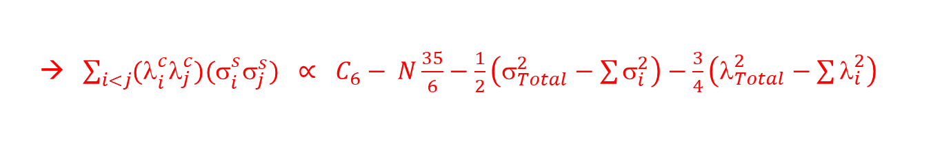
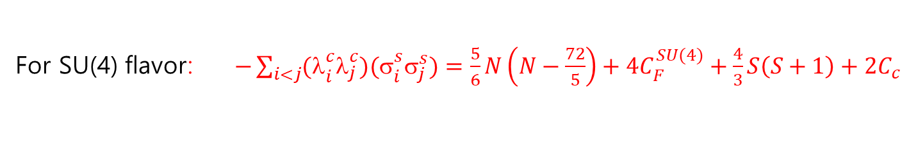
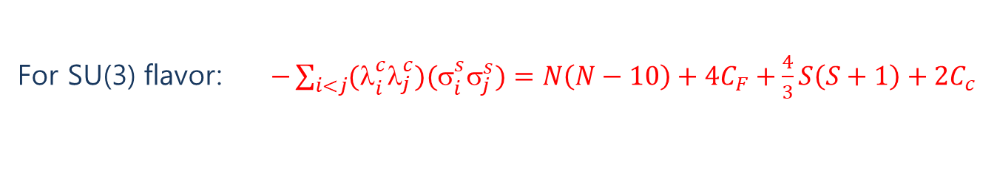
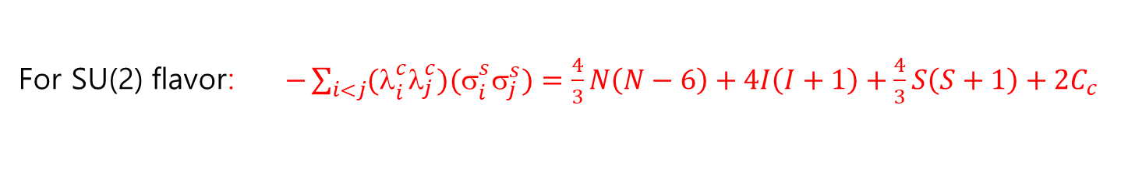
Color spin interaction - General remarks II
→ $\sum_{i<j}{{\text{(}\text{l}}_{i}^{c}{\text{l}}_{j}^{c}){\text{(}\text{s}}_{i}^{s}{\text{s}}_{j}^{s})}$ $∝ C_{6}− N\frac{35}{6}−\frac{1}{2}\left({\text{s}}_{Total}^{2}−\sum{{\text{s}}_{i}^{2}}\right)−\frac{3}{4}\left({\text{l}}_{Total}^{2}−\sum{{\text{l}}_{i}^{2}}\right)$
2) Color –flavor-spin wave function should be totally antisymmetric. (Aerts, Mulders, de Swart 78)
For SU(2) flavor: $−\sum_{i<j}{{\text{(}\text{l}}_{i}^{c}{\text{l}}_{j}^{c}){\text{(}\text{s}}_{i}^{s}{\text{s}}_{j}^{s})}=\frac{4}{3}N\left(N−6\right)+4I\left(I+1\right)+\frac{4}{3}S\left(S+1\right)+2C_{c}$
For SU(3) flavor: $−\sum_{i<j}{{\text{(}\text{l}}_{i}^{c}{\text{l}}_{j}^{c}){\text{(}\text{s}}_{i}^{s}{\text{s}}_{j}^{s})}=N\left(N−10\right)+4C_{F}+\frac{4}{3}S\left(S+1\right)+2C_{c}$
4$C_{F}=\frac{4}{3}\left(p^{2}+q^{2}+3p+3q+qp\right)$
q p using $p+2q=N$ → 4$C_{F}=\left(4I\left(I+1\right)+N(N+6)/3\right)$
For SU(4) flavor: $−\sum_{i<j}{{\text{(}\text{l}}_{i}^{c}{\text{l}}_{j}^{c}){\text{(}\text{s}}_{i}^{s}{\text{s}}_{j}^{s})}=\frac{5}{6}N\left(N−\frac{72}{5}\right)+4C_{F}^{SU(4)}+\frac{4}{3}S\left(S+1\right)+2C_{c}$

Slide 23
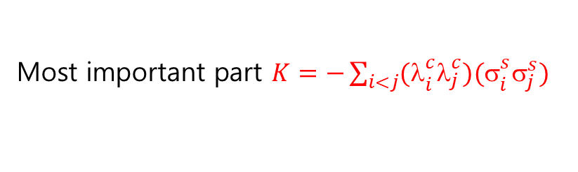
Short distance energy is dominated by color-spin interaction
1
2
4
5
3
6
Most important part $K=−\sum_{i<j}{{\text{(}\text{l}}_{i}^{c}{\text{l}}_{j}^{c}){\text{(}\text{s}}_{i}^{s}{\text{s}}_{j}^{s})}$

Slide 24

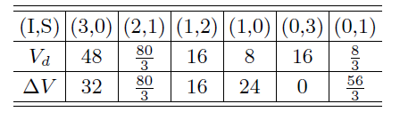



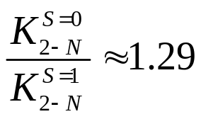
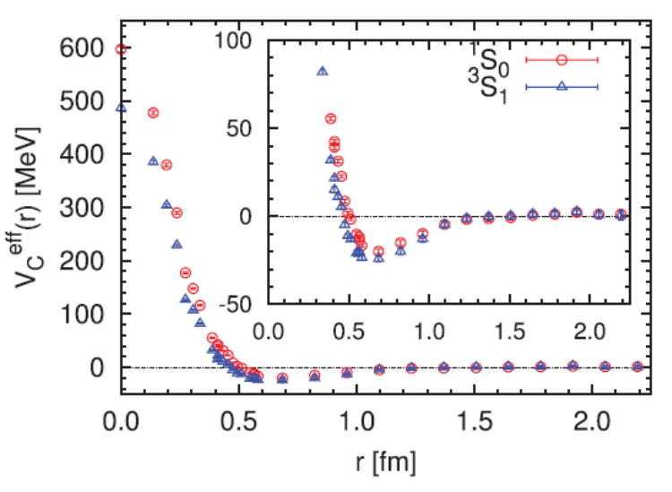

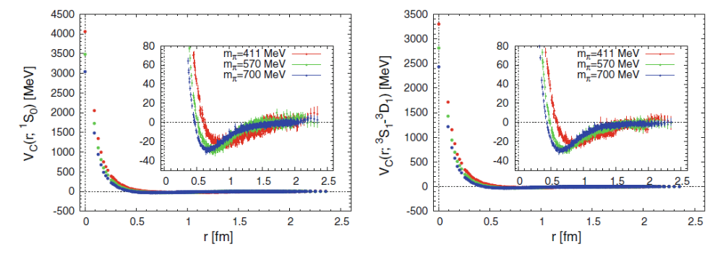
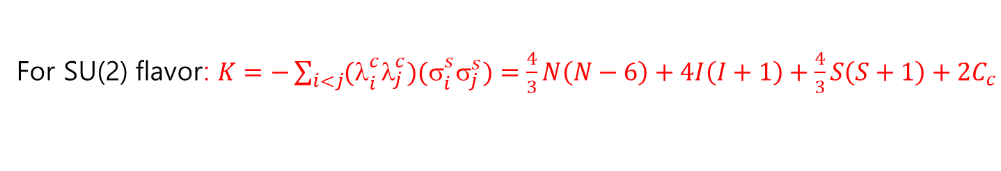
Comparison with lattice – NN interaction in SU(2)
For SU(2) flavor: $K=−\sum_{i<j}{{\text{(}\text{l}}_{i}^{c}{\text{l}}_{j}^{c}){\text{(}\text{s}}_{i}^{s}{\text{s}}_{j}^{s})}=\frac{4}{3}N\left(N−6\right)+4I\left(I+1\right)+\frac{4}{3}S\left(S+1\right)+2C_{c}$
K of 6 quark state and their decays (W Park, A Park, Lee 2015)
For P, N and Λ
Positive for all 6 quark configuration
→ comparison

Slide 25
Divide by V(1) part at short distance at look at ratios
Spin=0
Spin=1
Highly repulsive
Spin=0
Spin=1
Attractive
Weakly repulsive
Spin=0
Spin=1
Notes:
First could give compact configuration, the second may be resonance. So what does give the short distrance behavior ?

Slide 26
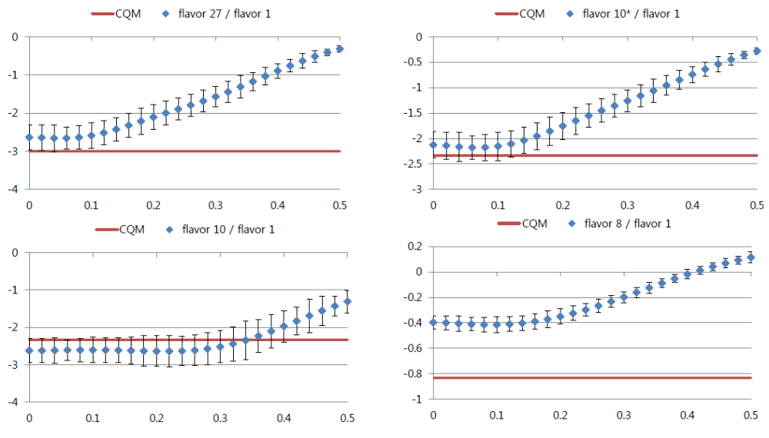
Comparison with lattice – HAL QCD SU(3) vs quark model-- preliminary
A. Park
y-axis: ratio
x-axis: fm

Slide 27
III. Tribaryons
and
Short distance repulsive three body nuclear force

Slide 28
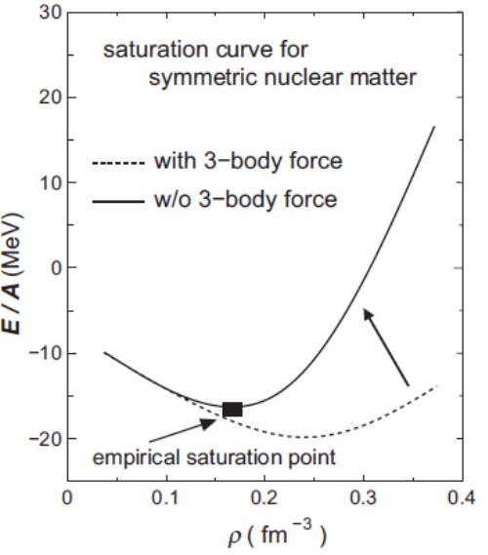
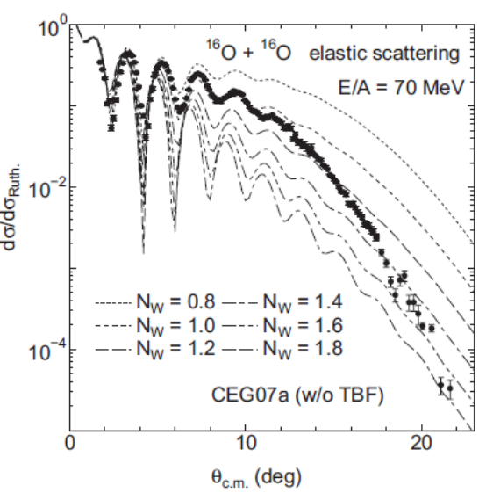
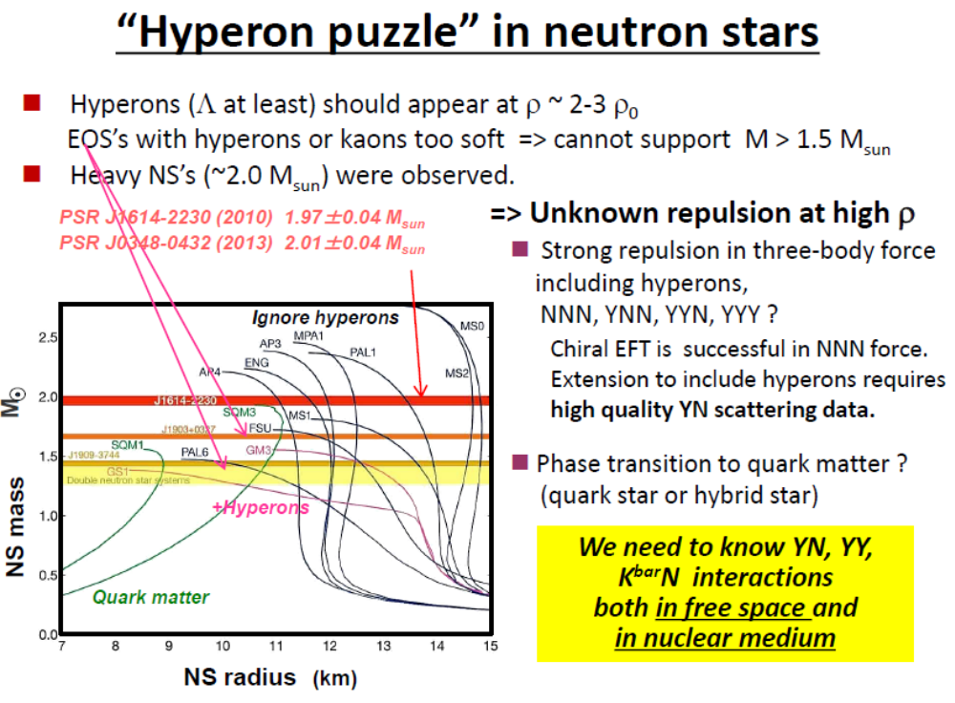
Three body nuclear force is repulsive at short distance
Review by Sakuragi
(PTEP 2016,06A106)
2) Hyperon Puzzle : slide by Tamura

Slide 29
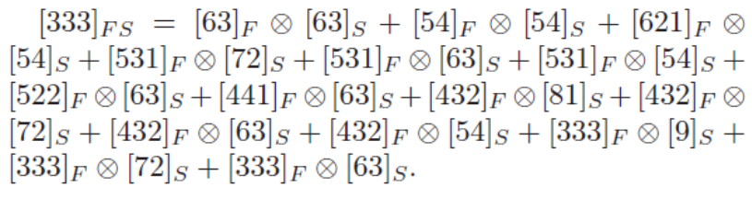
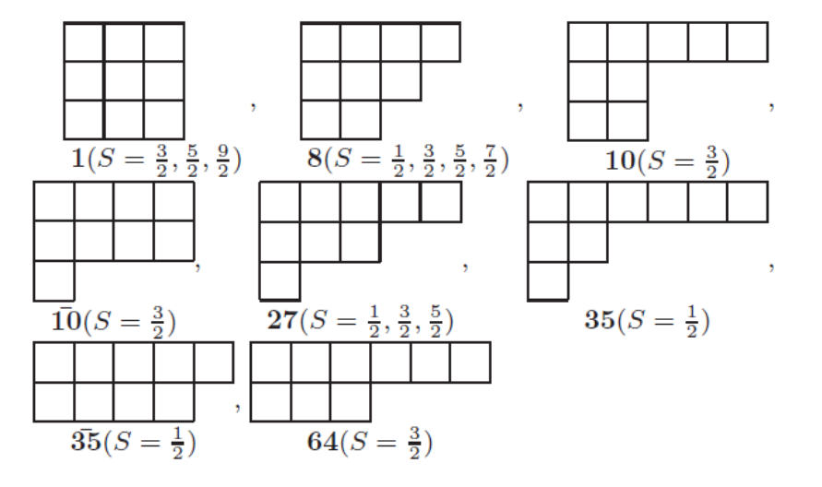
Tribaryon configurations (Aaron Park, W. Park, SH Lee PRD98(2018)034001)
1) Color singlet x Flavor spin state
2) Possible Flavor state

Slide 30
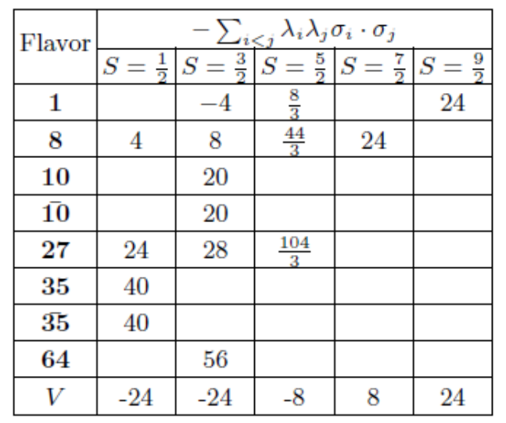


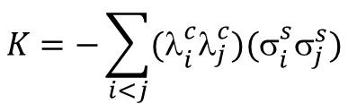

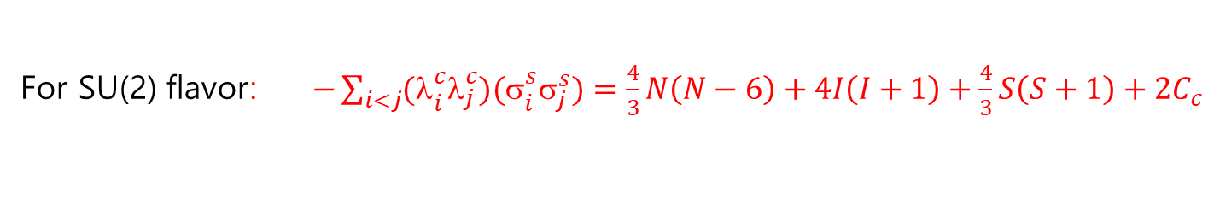
Color spin interaction - General remarks Tribaryon configuration (Aaron Park)
$$K=−\sum_{i<j}{{\text{(}\text{l}}_{i}^{c}{\text{l}}_{j}^{c}){\text{(}\text{s}}_{i}^{s}{\text{s}}_{j}^{s})}$$
1) SU(2): Three nucleons
For SU(2) flavor: $−\sum_{i<j}{{\text{(}\text{l}}_{i}^{c}{\text{l}}_{j}^{c}){\text{(}\text{s}}_{i}^{s}{\text{s}}_{j}^{s})}=\frac{4}{3}N\left(N−6\right)+4I\left(I+1\right)+\frac{4}{3}S\left(S+1\right)+2C_{c}$
For nucleon K= -8, But But Tribaryon (N=9) K>>0
2) SU(3): Including hyperons
For SU(3) flavor: $−\sum_{i<j}{{\text{(}\text{l}}_{i}^{c}{\text{l}}_{j}^{c}){\text{(}\text{s}}_{i}^{s}{\text{s}}_{j}^{s})}=N\left(N−10\right)+4C_{F}+\frac{4}{3}S\left(S+1\right)+2C_{c}$
All tribaryon channel is very repulsive
→ Three Baryon force should be repulsive with or without strangeness

Slide 31
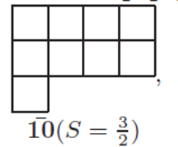
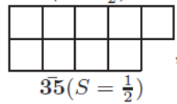
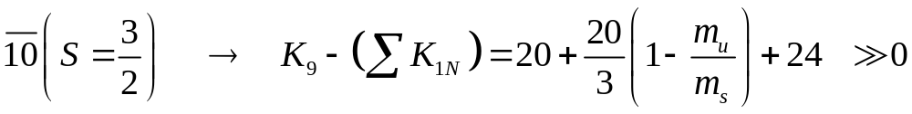
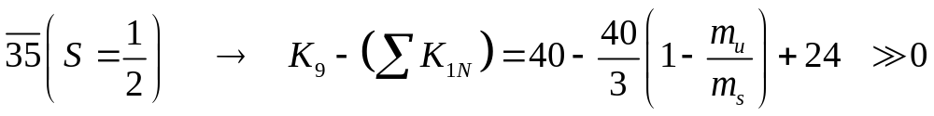
Color spin interaction - Tribaryon configuration with broken SU(3)
1) With one strangeness and isospin 0
With one strangeness: least repulsive state is S=3/2, Flavor antidecuplet

Slide 32
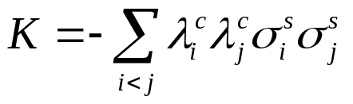




Purely three body repulsion
→ 2-Nucleon
→ 3-Nucleon
1) SU(2): Triton configuration (I,S)=(1/2,1/2)
2) Configuration with one strange quark
Intrinsic three nucleon forces are repulsive

Slide 33
Summary
Constituent quark model can be used to study multiquark configurations: d*, Pc, X(3872), Z are most likely molecular states
Qualitative features of the short distance Nuclear two-body repulsion from HAL QCD can be understood from a very simple constituent quark picture
Short distance Nuclear three-body interactions seems to be repulsive in the NNN and NNΛ configurations even in the SU(3) symmetry breaking case as required from phenomenology
→ more work in progress and looking forward to more lattice data on this

