Slide 1
Landau-Migdal Fermi-Liquid Fixed Point
Approach to Nuclear Dynamics
Complementary to
“Topology Change, Emergent Symmetry of QCD and Neutron Star Properties”
By Yong-Liang Ma
Mannque Rho
APCTP-TRIUMF 2018

Slide 2
Weinberg Folk Theorem
“What is quantum field theory, and what did we think it is?” 1997
“When you use quantum field theory to study low-energy phenomena, then according to the folk theorem you’re not really making any assumption that could be wrong, unless of course Lorentz invariance or quantum mechanics or cluster decomposition is wrong,
provided you don’t say specifically what the Lagrangian is.
As long as you let it be the most general possible Lagrangian consistent with the symmetries of the theory, you’re simply writing down the most general theory you could possibly write down.”
Folk Proof: “It’s hard to see how it can go wrong…”

Slide 3
Corollary to “Weinberg F-Theorem”
“The use of effective quantum field theories has been extended more recently to nuclear physics, where although nucleons are not soft they never get far from their mass shell, and for that reason can be also treated by similar methods as
the soft pions.
Nuclear physicists have adopted this point of view, and I gather that they are happy about using this new language because it allows one to show in a fairly convincing way that what they’ve been doing all along (…) is the correct first step in a consistent approximation scheme.”

Slide 4
Nuclear Physics Is a Chain of Connections
Reached by Tuning “Effective” Parameters
Hadrons ↔ quarks/gluons via topology
Quarks/gluons traded in for hadrons → “Cheshire Cat” phenomenon
NLσM ↔ LσM ↔ Scale-chiral invariant model
Nonlinear chiral theory tweaked by density to scale-invariant chiral theory
Skyrmions in ∞ tower of vector mesons ↔ BPS skyrmions
Holographic baryons tweaked to BPS skyrmions with ‘t Hooft constant

Slide 5

Chain of equivalences via topology in nuclear/hadron physics
Gauge equivalence Soliton/skyrmion
∞ tower
Cheshire Cat
Dilaton scalar by conformal compensator field χ= f_{σ} exp(σ /f_{σ})
“bsHLS”

Slide 6
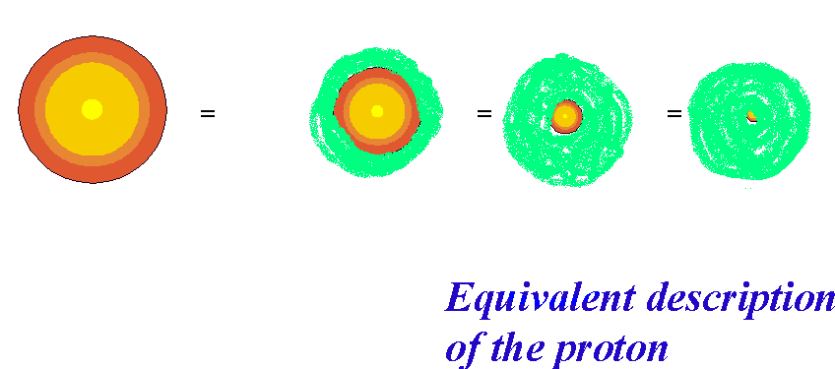
Cheshire Cat Principle:
Trading in topology for quarks/gluons
H.B. Nielsen, I. Zahed et al 1980’s
Pion Cloud
uud
MIT Bag Chiral Bag Skyrmion

Slide 7
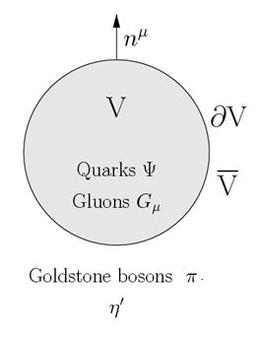

Evidence of Cheshire Cat
at low energy scale
Bag (or confinement) size is a “gauge artifact”: Damgaard, Nielsen, Sollacher 1997
E.g. the confinement size is not physical
θ(R=0)=0, θ(∞)=π
Protected by topology

Slide 8
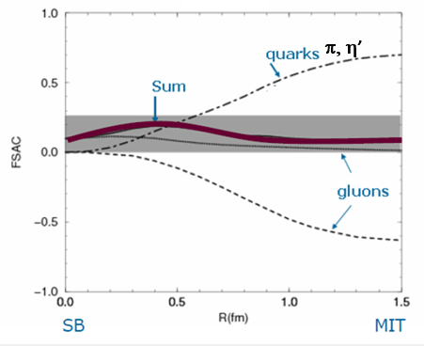
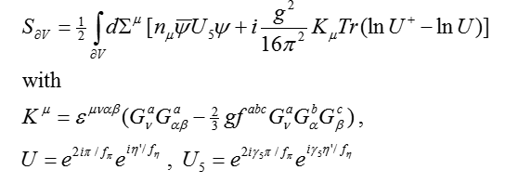
And flavor-singlet axial charge g_{A}⁰ (non-topological)
B.Y. Park et a 1991
Related to “proton spin” (EMC)
Δm=m_{N} – m₀ ≈ 0.3m_{N} ?

Slide 9
Effective Field Theory (EFT)
N: proton, neutron, Δ
π: pions, kaons (η’, U_{A} (1))
V: ρ, ρ’,..., ω, ω’, … ∞ tower HLS
s: σ (dilaton) ∝ ln(χ/f)
Relevant Degrees of Freedom
Length/Energy Scales
Λ_{chiral}: match EFT & QCD ∼ 1GeV
Λ_{eff} : ∼ m_{V,σ} ∼ 700 MeV
Λ_{data}: ∼ (400-500) MeV
k_{F} : Fermi momentum or density
χ: “conformal compensator”
→ EFT Lagrangian “bsHLS”

Slide 10
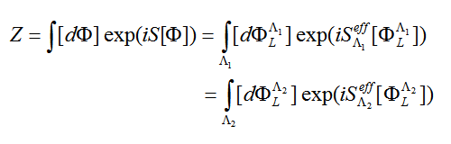
Scale Decimation and Renormalization Group Flow
E
RG flow
Strategy: Use symmetries and invariances to expand and truncate the series
with “NATURAL” coefficients C and the local operators Q.
Wilsonian RG flow
Weinberg “Folk Theorem”

Slide 11


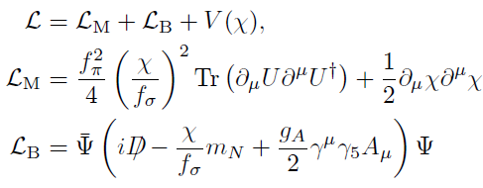
Effective Scale-Chiral Lagrangian
Won-Gi Paeng’s Thesis 2008 …
Construction
Start with nonlinear sigma model: N, π (→ S(tandard)χPT)
Put vector mesons ρ, ω as hidden local fields
Put dilaton σ via “conformal compensator”
Harada, Yamawaki
“bsHLS”
Crewther, Tunstall ….
QCD condensates
inherited from matching
Condensates follow vacuum change.
→ “intrinsic density dependence (IDD)”
Match
with
QCD
+ ...
+ ...

Slide 12
Hidden symmetries of QCD
Hidden flavor local symmetry (HLS)
Hidden scale symmetry (HSS)

Slide 13




Hidden Local Symmetry (HLS)
Bando, Kugo, Yamawaki et al 1985
Harada, Yamawaki 2013
NLσ:
Infinite Redundancy → ∞ tower of vector mesons. When elevated
to gauge fields by strong correlations ↔ Grassmannian à la Yamawaki
→ 5D Y-M gauge theory
(1) Bottom-up: “Moose diagrams” Son & Stephanov 2002
(2) Top-down: Gauge/gravity duality Sakai & Sugimoto 2005
In Nature, local symmetry, hidden, emerges when the gauge coupling g_{ρ} is dialed to 0
and the vector mesons made massless by e.g. density → “vector manifestation”

Slide 14








Hidden Scale Symmetry
Yamawaki 2016
(Catà, Crewther, Tunstall 2018)

Slide 15




Dialing coupling constant λ of linear sigma model
(Density)
à la Yamawaki 2016
Nonlinear sigma model (→ Standard χPT) ↔ hidden local symmetry (HLS)
and skyrmion→ baryons
Scale chiral symmetry → scale-χPT ↔ d(ilaton)HLS
and skyrmion→baryons
“Hidden scale & local symmetry”

Slide 16



Dialing ‘t Hooft constant λ_{t}
Bartolini, Bolognisi, Proto 2017
Consider the Sakai-Sugimoto holographic QCD (in 5D) Klein-Kluza-reduced to 4D
given in terms of infinite towers of hidden local vector mesons in ρ, ω and a₁ channels.
Valid in the limit N_{c}→ ∞ and λ_{t} =N_{c} (g_{QCD})² → ∞.
Forget this ‘t Hooft constant limit.
Suitably integrating out the infinite towers, the mass of the soliton is reduced to the form
Λ=8λ_{t}/27π
∼ Skyrme model (a.k.a current algebra)
∼ BPS model : à la Andrej Wereszczynski

Slide 17
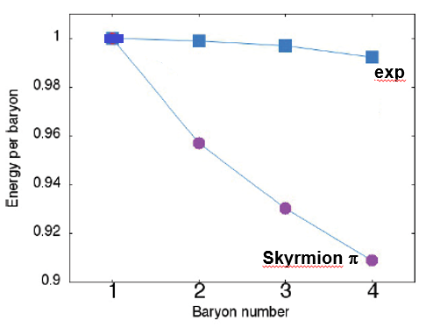
Problem with the Skyrme model
Nuclear binding energies come out totally wrong

Slide 18
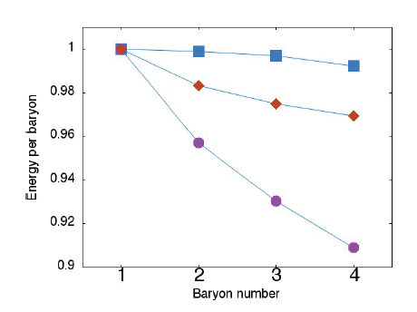
Working of ∞ isovector-vector mesons in flat spac
of Sakai-Sugimoto model (w.o. Chern-Simons term)
Sutcliffe 2011
In QCD, ground-state energies are a tough problem fighting with O(N_{c})
Infinite tower (↔ BPS)
exp
Skyrmion π, ρ, a₁
Skyrmion π

Slide 19
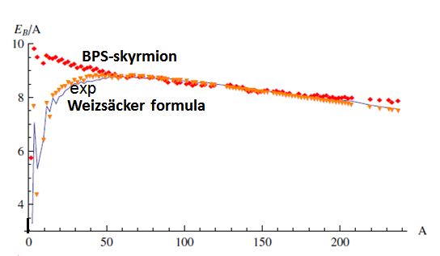
BPS skyrmions
Adam, Naya, Sanchez-Guillen & Wereszynski 2013
BPS skyrmion matter is relativistic perfect fluid. Standard RMF theory
may be obtained from “averaging” the BPS theory.
With 3 parameters and a small correction from Coulomb and
isospin breaking.
Connection to “soft pions”?
Less fundamental than “ab initio” EFT?
And compact stars?

Slide 20
Many-body problem: Doing RG (renormalization group)
with “bsHLS”
Single decimation ≈ Fermi-liquid fixed point (FLFP) approach:
Equivalent to Walecka’s RMF (Matsui 1981, Chaejun Song 1997)
→ Solution to proton δg_{l}, quenched g_{A} …
Double decimation ≈ V_{lowk} à la Stony Brook
Going beyond FLFP (Brown, Kuo et al) → Finite nuclei
→ EoS for massive neutron stars

Slide 21
Response to Axial Current
Solution to the “quenched” g_{A}
Long-standing mystery dating from 1970’s. D.H. Wilkinson 1973
g_{A}^{eff} ≈ 1 for GT transition in nuclei while g_{A} =1.274.. for neutron beta decay
→ Relevance to Fermi-liquid structure of nuclear matter
Crucial for neutrinoless double beta decay
Matrix element ∝ g_{A}², so extremely sensitive to g_{A}^{eff}
→ impact on beyond the Standard Model

Slide 22

Response Function: Soft Theorems For π (also photon, graviton etc)
J₅^{μ}
“Soft” pion
“Hard” pion
J₅⁰, J₅ª
Tae-Sun Park et al 1993
+
π,(ρ,ω,σ,..)
+ • • •
“LO”
“N^{n}LO”, n=1,2…
J₅⁰
n=1 NLO: Soft pions dominant, higher-order corrections suppressed
(Applies also to magnetic dipole (M1) operator)
J₅ª
n=3 N³LO: Soft pions are suppressd or chiral-filtered out.
Hence “hard pion” + vector mesons ρ, ω, a₁ & infinite tower…must all enter at n> 3.
∴ Chiral power expansion with pions only loses its predictive power!
(Applies also to electric charge operator)
Soft π theorem “Chiral filter mechanism”
Kubodera, Delorme & R 1978
Kubodera & R 1991

Slide 23




When Soft Pions Are Unsuppressed …
Axial charge transition:
← Deeply bound pionic systems
Kienle, Yamazaki 2004
also S(tandard) χPT
By far the largest and most accurate meson-exchange current known in nuclear physics!!
E. Warburton 1991
The “Folk Theorem” at work: χPT

Slide 24

When Soft Pions Are Suppressed
Gamow-Teller transitions:
Involving “hard pion” for the external field, the soft-pion exchange with
“hard” π + N→ “soft” π + N is suppressed by Adler zero.
What contributes is “hard” π + N → “hard” π + N which comes at N³LO.
Weinberg’s chiral expansion starts to lose power with ALL N^{n}LO for n>3 contributing.
Therefore infinite tower of vector mesons, excited baryons etc, contributing at n > 3
cannot be ignored in, e.g.,
microscopic calculations such as “ab initio” many-body approaches
using only calculable ( up to n<3) exchange currents.
Solution: Fermi-liquid fixed point approach with “bsHLS” Lagrangian
Initiated in Chajun Song’s thesis 1997

Slide 25
Landau-(Migdal) Fermi Liquid Approach
Matsui, Friman & R, Song, Paeng et al, Ma et al …
At Fermi-liquid fixed point with O(1/N_{c}) terms suppressed, the mean field
approximation with “bsHLS” Is equivalent to the EFT (Euclidean) action Z
defined on the Fermi surface - given in the next view graph -
treated in the (FLFP) limit
N_{FS} =k_{F}/(Λ^{eff} – k_{F})→ ∞ .

Slide 26






EFT for Fermi Liquid (à la Shankar, Polchinski, Fröhlich …)
Consider quasi-nucleons ψ on Fermi surface coupled to scalar φ
(and also to ω, ρ, π …)
Landau-(Migdal) Fermi-Liquid Parameters (denoted λ)

Slide 27




g_{A} at Fermi-liquid fixed point
The result is given entirely in terms of the fixed point quantities: Landau mass m_{L} and
Landau quasiparticle interactions F₁^{π,ω} involving π and ω exchanges;

Slide 28
g_{A} =1 Solves the Puzzle of Quenched g_{A}
Shell-model g_{A}^{eff} ≈ 1
1s0d-shell nuclei: 1.12 ± 0.05, 1.18 ± 0.05, 0.96 ± 0.03 …
1p0f-shell nuclei: 0.937 ± 0.019
16 < A < 40: ≈ 0.98, 60 < A < 80: ≈ 0.87 etc
For heavier nuclei, g_{A}^{eff} drops to ∼ 0.5-0.6
g_{A}^{L} ≈ 1 is precisely g_{A}^{eff} ≈ 1 observed in light nuclei in shell model.
Decrease for heavier nuclei could be explained by the role of Δ-hole
excitations at increasing density.
Wilkinson 1970’s

Slide 29
What does g_{A}^{L} = g_{A}^{eff} ≈ 1 mean?
It represents the full transition matrix element -- modulo O(1/N_{FS}) corrections –
given entirely by the non-interacting quasiparticle matrix element multiplied
by the effective constant ↔ simple (not no-core) shell-model matrix element.
It does not mean precursor to g_{A}^{Wigner-Weyl} =1 as was thought in 1970’s.
It is consistent with hidden scale symmetry but not with symmetry restoration.
g_{A}^{L} corresponds to the Landau(-Migdal) fixed point quantity, capturing full nuclear
correlations up to the effective cutoff scale Λ^{eff} ∼ (2-3) fm⁻¹.
This will include excitations of energies ∼ 200-300 MeV strongly connected by
the tensor force including Δ−hole states.
It subsumes many-body exchange currents involving hard-pion, (infinite tower of )
vector mesons, Δ excitations etc.

Slide 30
Implication on “ab initio” approaches
Since the leading GT exchange current involving hard pion comes at N³LO, it cannot
be justified to limit microscopic calculations to pionic N³LO. Such calculations, as
currently done in double beta decay calculations, “ab initio” or not, cannot be trusted.

Slide 31
Going to high density
(1) Topology change and (2) EFT with V_{lowk} à la Stony Brook
Topology: hidden and emergent
Nuclear structure:
Light nuclei Hoyle states: Skyrmion (Lau & Manton) vs. “ab initio” EFT (Epelbaum et al),
Medium nuclei: BPS (Adam et al) …
Dense matter: Trading-in quarks/gluons for skyrmion at high density
→ “bsHLS”: Cheshire Cat
V_{lowk} RG: hidden topology and symmetries
Wilsonian-type renormalization group approach to many-body problem
using V_{lowk} derived from potentials given by “irreducible” diagrams of bsHLS
and “ring diagrams” for “reducible” terms.

Slide 32
V_{lowk} RG with bsHLS
Bogner, Kuo et al, arXiv:nucl-th/0305035
There are roughly two decimations in
nuclear many-body EFT
First, decimate from Λ_{χ} to ~ (2-3) fm⁻¹ or ~ 400 MeV
up to which accurate NN scattering data are available,
say, E_{lab} ≤ 350 MeV. Call it Λ_{data}. Yields V_{lowK}
Second, decimate from Λ_{data} to Fermi surface scale Λ_{FS} using
V_{lowK} operative up to E_{lab}. This derives Fermi liquid
theory valid for nuclear matter going beyond the fixed point.
Fluctuate around Fermi surface; Many body technique

Slide 33


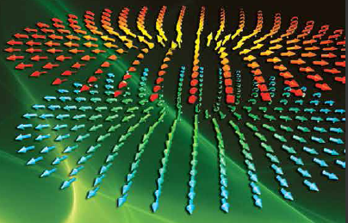
Topology change n_{1/2} =(2-4)n₀
Gravity
≈
1/2 skyrmions
Yong-Liang Ma’s Talk

Slide 34
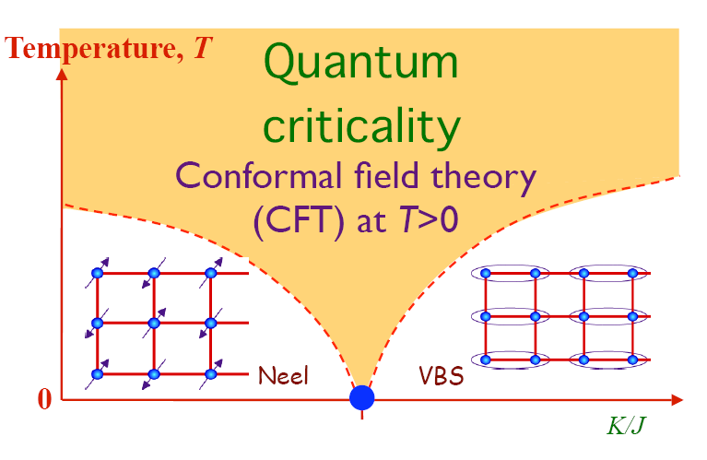
Half-Skyrmion Matter
Half-skyrmions in hadronic matter are confined:
Magneitc monopole ?
Gudnason and Nitta 2015
Y.M. Cho (with Zhang, Kimm, Zou) 2017
Contrast to (2+1)D condensed matter:
Néel-VBS “deconfined quantum critical” transition
Senthil et al 2004
Half-skyrmions are deconfined:
Berry phase
The phase transition is not
of Ginzburg-Landau-Wilson paradigm

Slide 35
Consequences in Dense Matter
Topology change at n_{1/2} impacts on “bsHLS” at high density
Makes quark condensate -- space averaged -- vanish but pion decay constant is not zero,
somewhat like pseudo-gap or quarkyonic.
Makes drastic modification to the tensor force and hence to the symmetry energy
in the EoS of compact star matter.
Parity doubling in nucleon spectrum, nucleon mass going to a chiral scalar
m₀ ∼ (0.6-0.9)m_{N} .
4. “... “Pseudo-conformal sound speed”
Claim: The pseudo-conformal sound speed is impossible unless there are non-hadronic degrees
of freedom emerging in the matter.
The topology change could represent such non-hadron degrees of freedom.

Slide 36
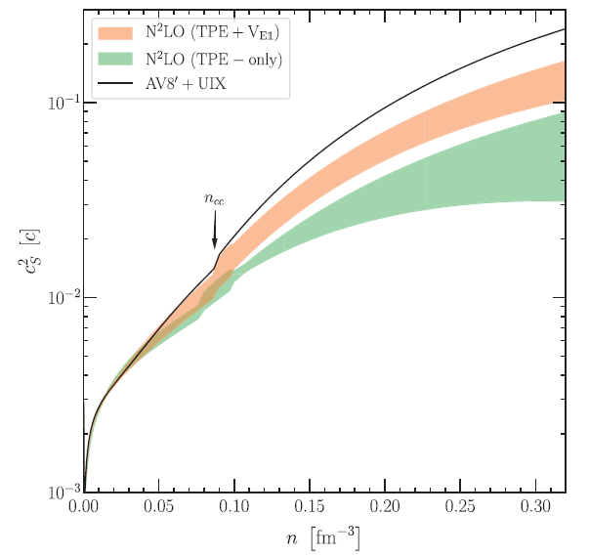
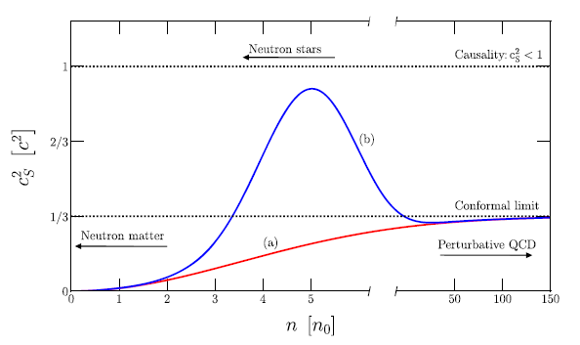
Sound Velocity v_{s}²
“Standard” Old
Tews et al 2018
2n₀
“Either QCD violates the conformal bound, or a chiral EFT-based description
breaks down at densities below 2n₀ due to new physical effects.”

Slide 37
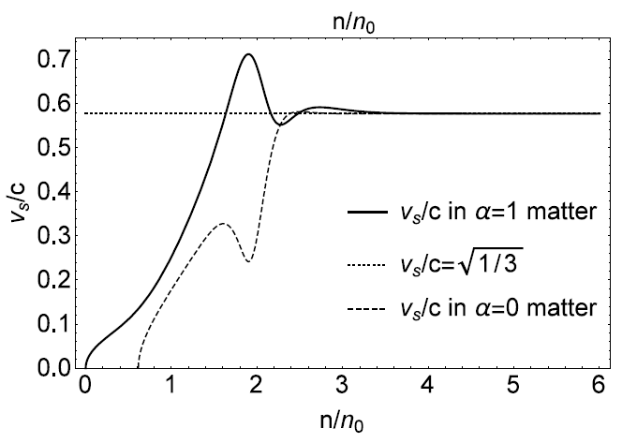
“Non-standard”: New
Paeng, Kuo, Lee, Ma, R. 2017
Ma, Lee, Paeng, R. 2018
Pseudo-conformal
Precocious: n > ∼ 3 n₀
Fully compatible with ALL observations including the tidal polarizability
Inferred from GW170817.

Slide 38
Is this pseudo-conformal structure
at odds with Nature?
NOT up to now

Slide 39
“Torpedoed” by critiques ? e.g., Tews et al. 2018
“The conformality (or PC) with v_{s}² =1/3 is in tension with
(a) current nuclear physics constraint
(b) observation of 2-solar mass neutron stars.”
The answer is NO
(a)
(b)
And GW170818?

Slide 40
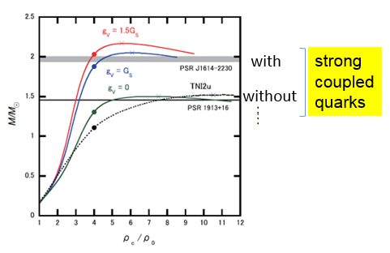
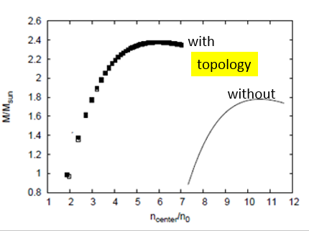
“If the conformal limit was found to hold at all densities this would imply that nuclear physics models breakdown below 2n₀.”
Yes for conventional models
But NOT for bsHLS: Trade in topology for quarks/gluons for n > 2n₀
Topology Change: Paeng et al
Hadron-SC Qarks: Baym et al.

Slide 41


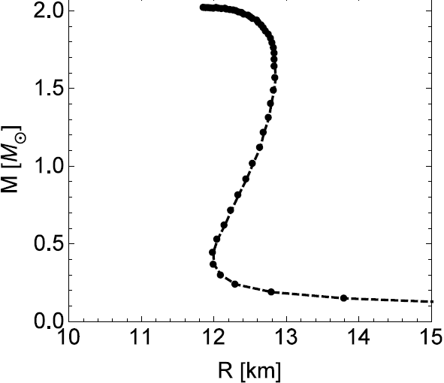
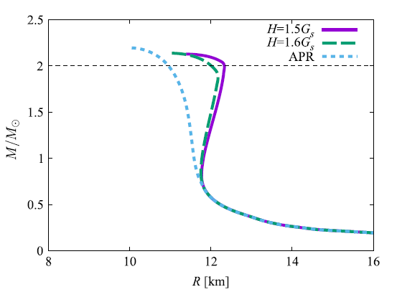
“Cheshire Cat” at Work
ss
Nadkarni, Nielsen, Zahed 1984
Topology
Change
½-skyrmions
Crystal
Hong, Zahed, R. 1999
Paeng, Ma et al 2018
(A)
Sigma
model
Sigma
model
duality
n_{1/2} ~ (2 -3)n₀
n
Baryons-to
SC quarks
Baryons → SC quarks → CFL
(quarkyonic?)
Fukushima, Kojo 2016
Baym et al, 2017
(A)
Massive stars
(B)

Slide 42
Conjecture:
Topology change ↔ Hadron-quark continuity
Proof either for or against would lead to
a window to the source of the proton mass
and related fundamental issues in nuclear physics

Slide 43
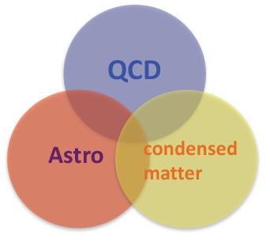
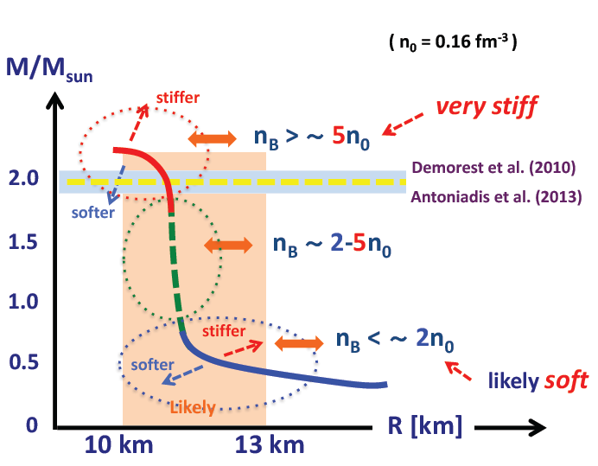
(B)
Gravity
≈
(A)
1/2 skyrmions
(C)

