Slide 1

Topology Change, Emergent Symmetry of QCD and
Neutron Star Properties
Yong-Liang Ma
Jilin University

Slide 2
Outline
    Introduction
    Skyrmion matter & topology change
    Hidden symmetries of QCD
    Emergent symmetry & neutron star properties
    Summary

Slide 3
I. Introduction

Slide 4
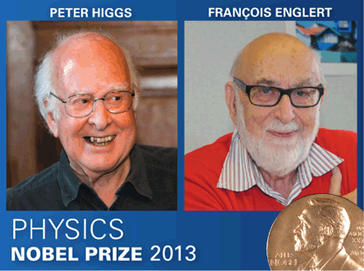
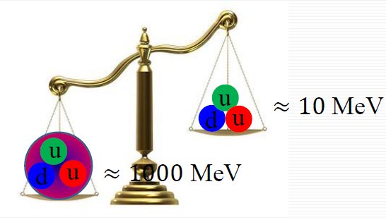
A challenge in particle and nuclear physics: Origin of nucleon mass
Nucleon mass in reality
Nucleon mass from Higgs mech.
The Standard Model of particle physics, mass is generated by Higgs mechanism；
From Higgs mechanism, nucleon mass ~ 10 MeV, in reality, ~1000MeV；100 times！
What is the origin of nucleon mass?

Slide 5
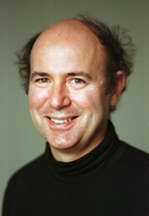
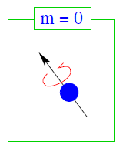
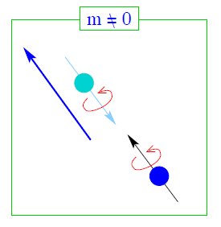

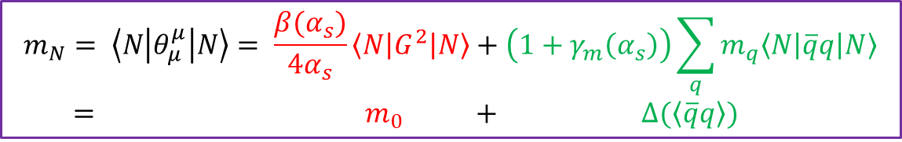
A challenge in particle and nuclear physics: Origin of nucleon mass
如何实现无中生有？
------------------- Frank Wilczek, Mod. Phys. Lett. A21, (2006) 701–712.
Scenario 1:
Scenario 2:
Patterns of symmetry:
Chiral symmetry
Scale symmetry
Mechanism?
$$m_{N} ∝ \left\langle \overline{q}q\right\rangle . Solely from \text{χ}\text{SB}\text{.}$$
Massless quark, Chiral symm. .
Massive quark, SB.
In metter-free space, these symmetries are broken/hidden.
$$m_{N}= \left\langle N\left|θ_{μ}^{μ}\right|N\right\rangle = \frac{β(α_{s})}{4α_{s}}\left\langle N\left|G^{2}\right|N\right\rangle +\left(1+γ_{m}\left(α_{s}\right)\right)\sum_{q}{m_{q}\left\langle N\left|\overline{q}q\right|N\right\rangle }$$
$= m_{0} + ∆(\left\langle \overline{q}q\right\rangle )$

Slide 6
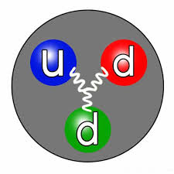
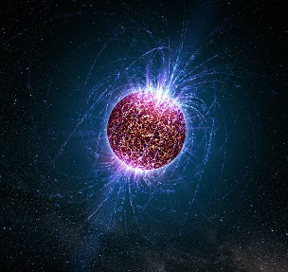
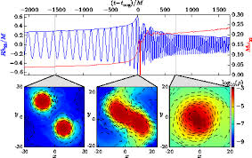



A challenge in particle and nuclear physics: Origin of nucleon mass
QCD at extreme condition, an environment to study the patterns of symmetries
Cold nuclear matter
Notorious sign problem,
Cannot be accessed by
lattice simulation
Experimental
measurement
or observation
$$ρ$$
0
$$\sim n_{0}$$
$${\sim \left(5 −7\right) n}_{0}$$
A new era of new nuclear physics.
Perspective & promising.
R. Muto et al, Phys. Rev. Lett. 98 , 042501 (2007). ,

Slide 7
What will I do in this talk
Dense baryonic matter properties based on chiral EFT implemented the lessons from skyrmion crystal approach;
Possible emergent symmetries in the nuclear matter;
Effects on neutron star properties.
Based on the work in collaboration with:
Masayasu Harada, Hyun-Kyu Lee, Yan-Ling Li, Yongseok Oh, Won-Gi Paeng, Byun-Yoon Park, Mannque Rho, ……

Slide 8
II. Skyrmion matter & topology change

Slide 9
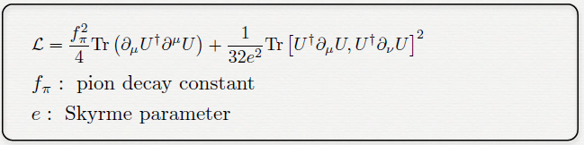


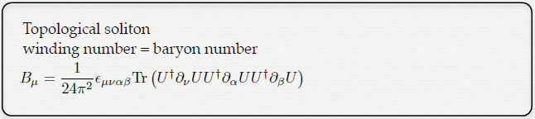
Skyrme model: Baryon as a topological soliton
T. R. Skyrme, 1960
For fixed time:
R³ can be compactified to S³ as all
points at infinity in R³ are mapped
into one fixed point in S³ .
Conserved winding num.  conserved baryon num. in QCD
With B.C.,
Trivial vacuum
In large $N_{c}$ limit, baryon in QCD goes to skyrmion. Witten 79’
Notes:
场变量U的参数化方式：$U=φ_{0}^{π}+iτ⋅φ^{π}$，由于U是幺正矩阵，于是 $φ^{π}$ 是一个单位四矢量，傅立叶展开比较困难，于是定义非正则场$\left({\overline{φ}}_{0}^{π},{\overline{φ}}_{1}^{π},{\overline{φ}}_{2}^{π},{\overline{φ}}_{3}^{π}\right)$。

Slide 10
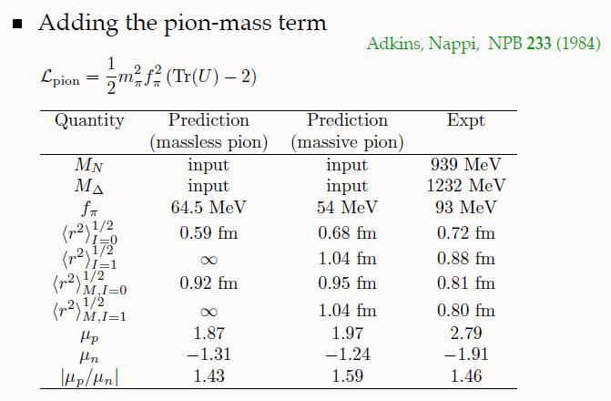
Skyrme model: results
Adkins, Nappi, Witten, NPB 228 (1983).
Jackson, Rho, PRL 51 (1983).
Adkins, Nappi, Witten, NPB 233 (1984).

Slide 11
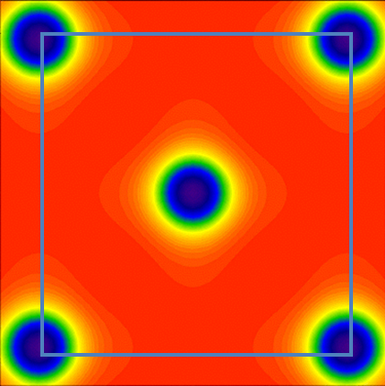

Nuclear matter from skyrmion crystal
Originally: I. Klebanov, Nucl. Phys. B262(1985) 133-143. CC
Kugler & Shtrikman, PLB208 (1988) 491; PRD40 (1989) 3421.
z
0
0
z
0
0
x
y
y
x
0
0
y
z
0
0
In the sense of $N_{c}→ ∞$;
More valid at high density!
x

Slide 12
What skyrmion crystal can do BUT χPT cannot do:
Topology
Topology changes at high density, with the skyrmion fractionizing into ½- skyrmions.
Drastic effect on the nuclear tensor forces.
Parity-doublet symmetry “emerges” at high density: Nucleon mass in medium has two components, i.e.,
m*_{N} =m₀ + Δ (Σ∗) → m₀ as Σ∗ → 0.
Could lead to Fermi-liquid-to-non-Fermi liquid transition, invalidating RMF theory at high density?

Slide 13
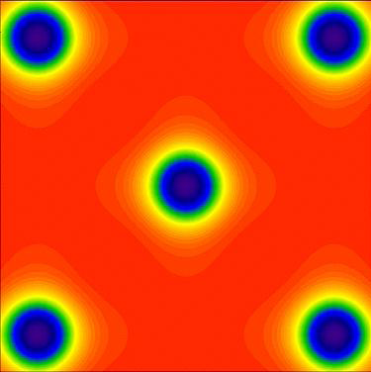
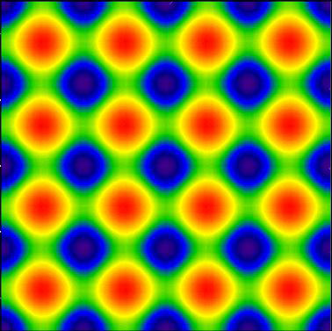


Topology change = Phase Change
Winding number $=$1
Winding number $=\frac{1}{2}$
Topology transition
An intrinsic mathematic properties of QCD at low energy.
Model and crystal independent.
Pseudo-gap.
YM and M. Rho, Sci. China Phys.Mech.Astron. 17’.
What is its effect? Dense nuclear matter.

Slide 14
    III. Hidden symmetries of QCD

Slide 15

Symmetries hidden in QCD
Symmetries are not visible in the matter free space:
Chiral anomaly;
  $U_{A}(1)$ symmetry is restored at high temperature even though the axial anomaly cannot be turned off, . Pisarski & Wilczek 89.
Chiral symmetry;
  At low energy region, chiral symmetry is broken to its vector channel.
Scale symmetry;
  Visible in the QCD at the classical level in the chiral limit but not present at quantum level due to the trace anomaly.
Local flavor symmetry (hidden local symmetry);
  Not apparent in QCD, low-lying vector mesons are massive.
  But restored at high scale, Harada & Yamawaki (2001); Georgi (1989)
The effective Lagrangian is constructed with respect these breaking symmetries.

Slide 16



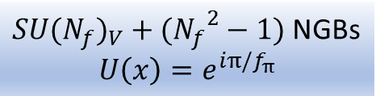
ChPT of pion and rho mesons, HLS
$${SU(N_{f})}_{L}×{SU(N_{f})}_{R}$$
Integrate out vector mesons, HLS gauge equivalent to ChPT.
Hidden flavor symmetry.
Absence of parity partner
${SU(N_{f})}_{V}+({N_{f}}^{2}−1)$ NGBs
$$U\left(x\right)=e^{iπ/f_{π}}$$
Chiral perturbation theory: power counting, derivative expansion
Weinberg, 79; Gasser and Leutwyler, 84
Redundancy in the decomposition
$$U\left(x\right)= ξ_{L }h\left(x\right) {h(x)}^{†}{ ξ_{R}}^{†}$$
Effective theory of vector mesons, Hidden local symmetry
Bando, et al 89; Harada & Yamawaki, 03
Dim. deconstruction: Son & Stephanov 04’
Gauge-gravity duality: Sakai-Sugimoto 05’

Slide 17
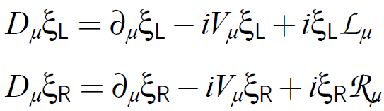
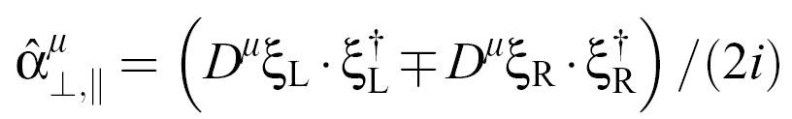


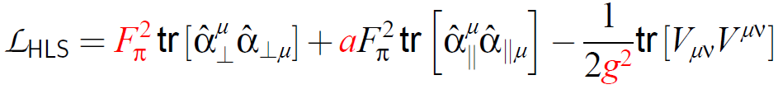
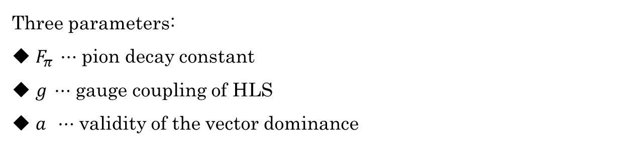
Maurer-Cartan 1-forms
Transformation:
Lagrangian
Three parameters:
$F_{π} ⋯$ pion decay constant
$g ⋯$ gauge coupling of HLS
$a ⋯$ validity of the vector dominance

Slide 18
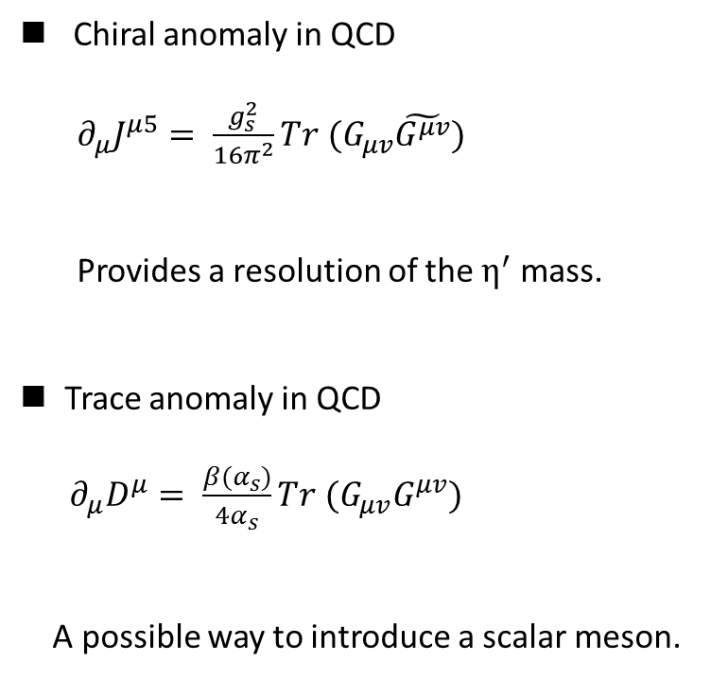
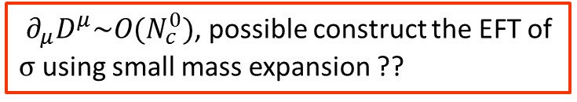
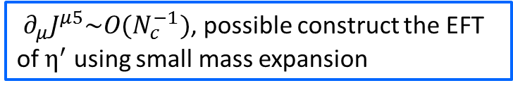
Explicit broken symmetries in QCD in chiral limit
Chiral anomaly in QCD
$∂_{μ}J^{μ5}= \frac{g_{s}^{2}}{16π^{2}}Tr (G_{μv}\tilde{G^{μv}})$
Provides a resolution of the $η^{′}$ mass.
Trace anomaly in QCD
$∂_{μ}D^{μ}= \frac{β(α_{s})}{4α_{s}}Tr (G_{μv}G^{μv})$
A possible way to introduce a scalar meson.
Anomaly matching
‘t Hooft, 80
$∂_{μ}J^{μ5}\sim O(N_{c}^{−1})$, possible construct the EFT of $η^{′}$ using small mass expansion
Anomaly matching
$∂_{μ}D^{μ}\sim O(N_{c}^{0})$, possible construct the EFT of σ using small mass expansion ??
How to include the sigma meson effect in ChPT?

Slide 19
Scale symmetry in EFT, 1970’s
Arising from explicit chiral symmetry breaking, irrelevant to the trace anomaly of QCD;

Slide 20
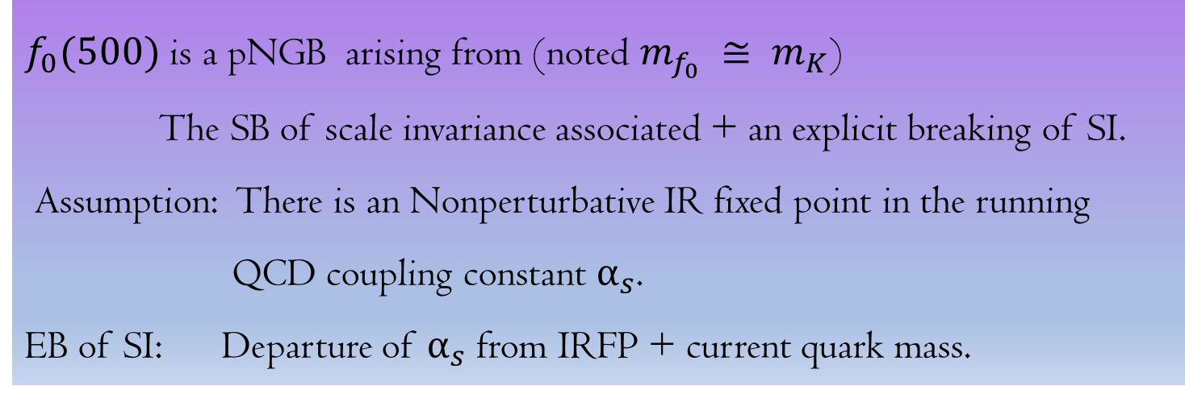
$f_{0}(500)$ is a pNGB arising from (noted $m_{f_{0}} ≅ m_{K}$)
The SB of scale invariance associated + an explicit breaking of SI.
Assumption: There is an Nonperturbative IR fixed point in the running
QCD coupling constant $α_{s}$.
EB of SI: Departure of $α_{s}$ from IRFP + current quark mass.
Crewther and Tunstall , PRD91, (2015) 034016

Slide 21
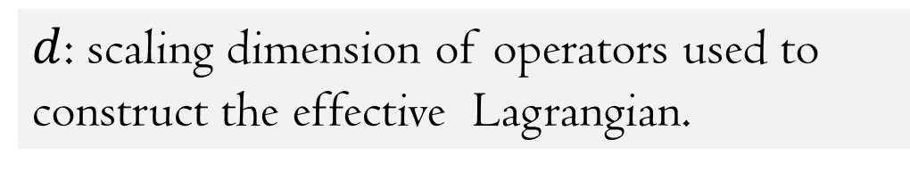


Chiral-scale hidden local symmetry
$$L_{χPT_{σ}}= L_{inv}^{d=4}+L_{anom}^{d>4}+L_{mass}^{d<4}$$
$d$: scaling dimension of operators used to construct the effective Lagrangian.
${L_{inv}^{d=4}}_{}$: Scale invariant term;
$L_{anom}^{d>4}$ : Account for gluonic interactions responsible for the strong
trace anomaly
$L_{mass}^{d<4}$ : Anomalous term arising from quark mass
Crewther and Tunstall , PRD91, 034016
Notes:
场变量U的参数化方式：$U=φ_{0}^{π}+iτ⋅φ^{π}$，由于U是幺正矩阵，于是 $φ^{π}$ 是一个单位四矢量，傅立叶展开比较困难，于是定义非正则场$\left({\overline{φ}}_{0}^{π},{\overline{φ}}_{1}^{π},{\overline{φ}}_{2}^{π},{\overline{φ}}_{3}^{π}\right)$。

Slide 22

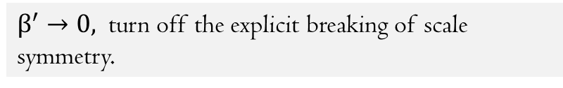
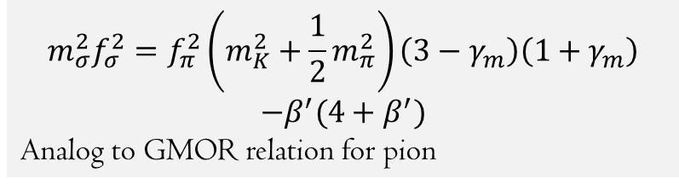
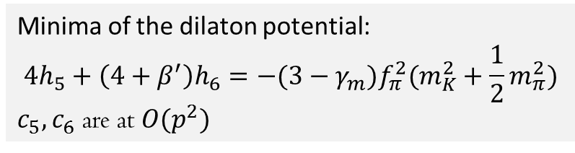
The leading-order HLS Lagrangian consists of three components:
Li, Ma and Rho, PRD95. 114011
Minima of the dilaton potential:
$$4h_{5}+\left(4+β^{′}\right)h_{6}=−(3−γ_{m})f_{π}^{2}(m_{K}^{2}+\frac{1}{2}m_{π}^{2})$$
$c_{5}, c_{6}$ are at $O(p^{2})$
$β^{′}→0,$ turn off the explicit breaking of scale symmetry.
$$m_{σ}^{2}f_{σ}^{2}=f_{π}^{2}\left(m_{K}^{2}+\frac{1}{2}m_{π}^{2}\right)\left(3−γ_{m}\right)\left(1+γ_{m}\right)$$
$$−β^{′}(4+β^{′})$$
Analog to GMOR relation for pion
Both $γ_{m}$ and $β^{′}$ are evaluated at $α_{IR}$

Slide 23
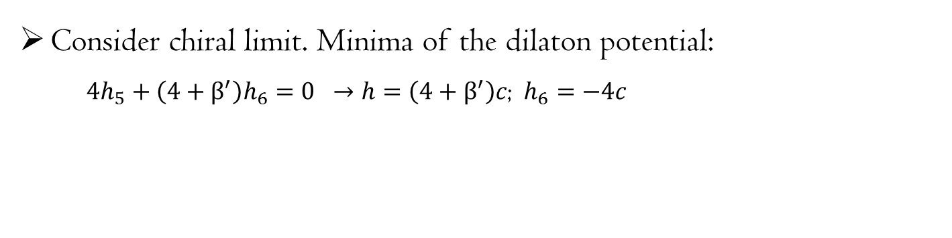
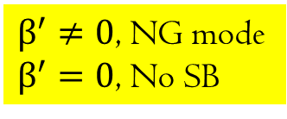

Chiral-scale hidden local symmetry: Discussion
Consider chiral limit. Minima of the dilaton potential:
${4h}_{5}+\left(4+β^{′}\right)h_{6}=0 →h=\left(4+β^{′}\right)c$; $h_{6}=−4c$
The SB of scale symmetry and EB of scale symmetry are correlated and the SB is triggered by EB which agrees with that, unlike chiral symmetry, SB of scale symmetry cannot take place in the absence of EB . Freund & Nambu,69 .
This implies that it is not possible to ``sit on" the IR fixed point with both scale and chiral symmetries spontaneously broken.
$β^{′}≠0$, NG mode
$β^{′}=0$, No SB
$β^{′}\left(α_{IR}\right)$ is a small quantity, i.e., $β^{′}\left(α_{IR}\right)≪1$:
Coleman-Weinberg type potential used in the literature. Goldberger, et al, 08
Notes:
场变量U的参数化方式：$U=φ_{0}^{π}+iτ⋅φ^{π}$，由于U是幺正矩阵，于是 $φ^{π}$ 是一个单位四矢量，傅立叶展开比较困难，于是定义非正则场$\left({\overline{φ}}_{0}^{π},{\overline{φ}}_{1}^{π},{\overline{φ}}_{2}^{π},{\overline{φ}}_{3}^{π}\right)$。

Slide 24
Scale invariant HLS with baryon octet: bsHLS
If EFT constructed in the matter-free space is applicable to medium, how to included the density effect?

Slide 25
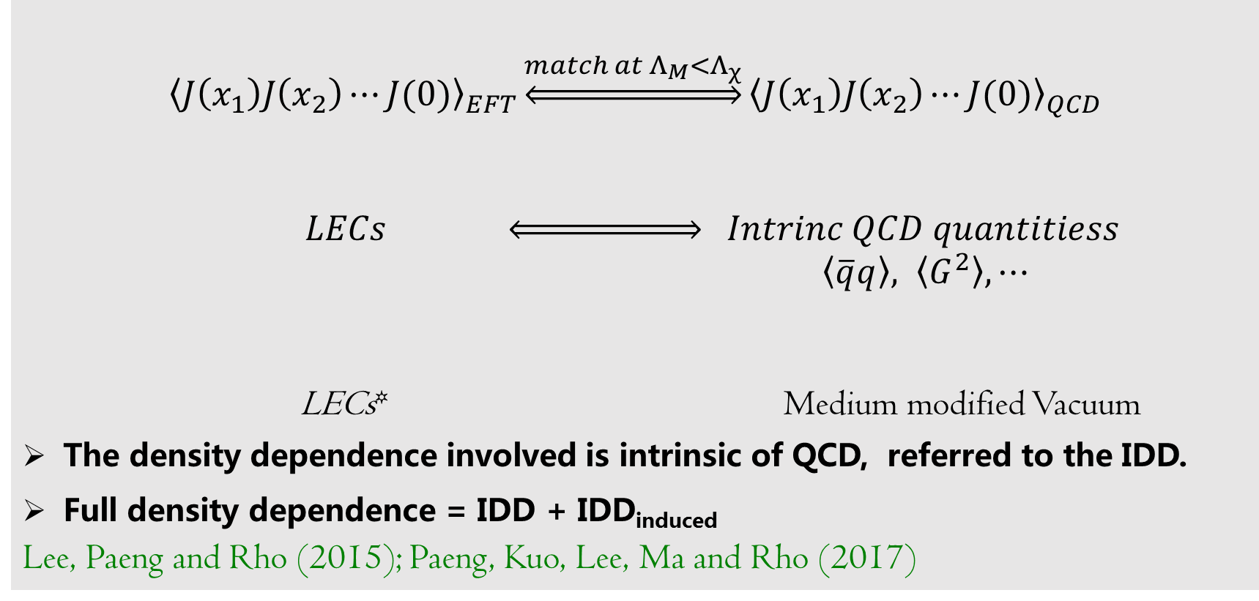
Intrinsic density dependence
$${\left\langle J\left(x_{1}\right)J\left(x_{2}\right)⋯J(0)\right\rangle }_{EFT}\underset{⇔}{{match at Λ}_{M}<Λ_{χ}}{\left\langle J\left(x_{1}\right)J\left(x_{2}\right)⋯J(0)\right\rangle }_{QCD}$$
$LECs \underset{⇔}{ } Intrinc QCD quantitiess$
$\left\langle \overline{q}q\right\rangle , \left\langle G^{2}\right\rangle , ⋯$
LECs* Medium modified Vacuum
The density dependence involved is intrinsic of QCD, referred to the IDD.
Full density dependence = IDD + IDD_{induced}
Lee, Paeng and Rho (2015); Paeng, Kuo, Lee, Ma and Rho (2017)

Slide 26
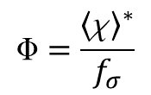
With respect to the present measurement and other theoretical approaches, we obtain:
$$=\frac{{\left\langle χ\right\rangle }^{∗}}{f_{σ}}$$
Affect the stability of nuclear matter,
further study is in progress.
Y. L. Li & Y. L. Ma, 17

Slide 27
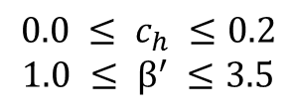
$$0.0 ≤ c_{h} ≤0.2$$
$$1.0 ≤ β^{′} ≤3.5$$
Chiral symmetry, scale symmetry and hidden local symmetry are restored at high density.
YM & M. Rho, PRD18

Slide 28
V. Emergent symmetry and neutron star properties

Slide 29
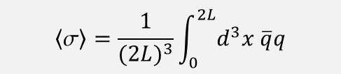
Nucleon mass and topology change
Y. L. Ma, et al, Phys. Rev. D88 (2013), 014016; Phys. Rev. D90 (2014) no.3, 034015.
$$\left\langle σ\right\rangle =\frac{1}{{(2L)}^{3}}\int_{0}^{2L}{d^{3}x \overline{q}q}$$
High density region(small L)： Quark condensate However Nucleon mass
vanishes is non-zero
Nucleon mass is not solely from chiral symmetry breaking, it include a chiral invariant part.  parity doubling structure.

Slide 30
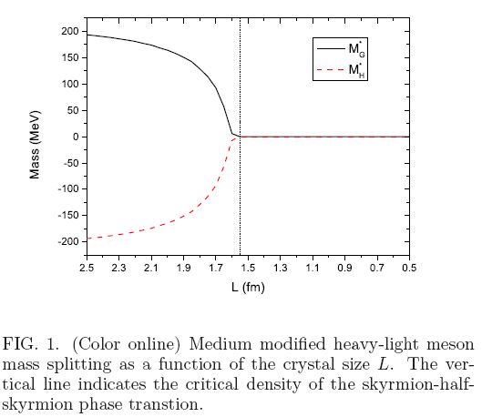
Emergency of chiral partner structure
Suenaga, He, YM, Harada, PRD(2015);

Slide 31
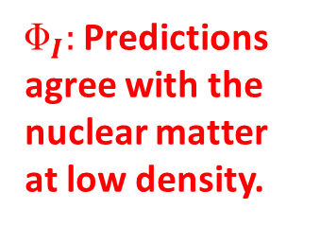
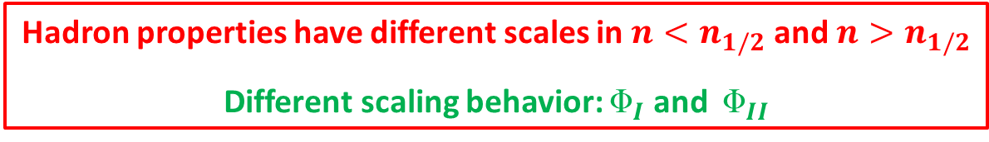

Implement topology transition to EoS
Hadron properties have different scales in ${n<n}_{1/2}$ and ${n>n}_{1/2}$
Different scaling behavior: $_{I}$ and $_{II}$
Imbed the quanlitative conclusion to bsHLS
$_{I}:$ Predictions agree with the nuclear matter at low density.
Calculate $V_{low k}$
EoS for nuclear matter with IDD

Slide 32

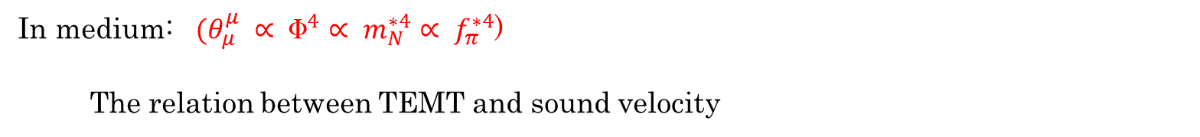

Emergent scale symmetry in medium
If scale symmetry is unbroken, then $\left\langle θ_{μ}^{μ}\right\rangle =0→ v_{s}^{2}=\frac{1}{3}$: “conformal sound velocity.“
Trace anomaly in matter free space, not present in QCD proper !
In medium: $(θ_{μ}^{μ} ∝ ^{4}∝ m_{N}^{∗4}∝ f_{π}^{∗4}$)
The relation between TEMT and sound velocity
Mean field and $V_{lowk}$
No extremum in energy density for $n>n_{1/2}$
Paeng, Kuo, Lee, Ma and Rho, PRD17’.

Slide 33
Emergent scale symmetry in medium
NOT the genuine conformal velocity, absent in QCD proper.
The trace anomaly is still non-zero there. Yet the velocity approaches conformal one as the system goes into a “phase" where the parity-doubling symmetry emerges.
Identify it as a “pseudo-conformal sound velocity" associated with a possibly emergent scale symmetry.
The viability was verified in in terms of a “pseudo-conformal EoS."
Paeng, Kuo, Lee, Ma and Rho, PRD17’.

Slide 34

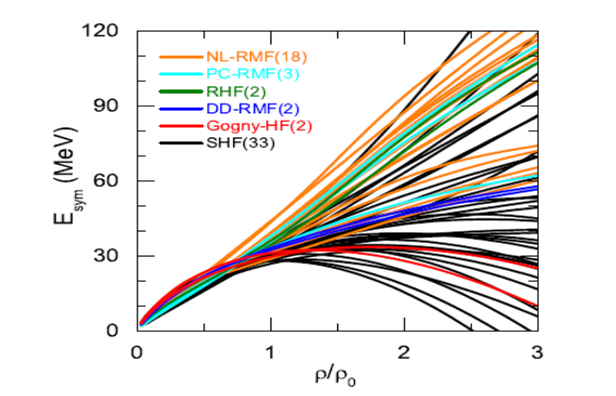
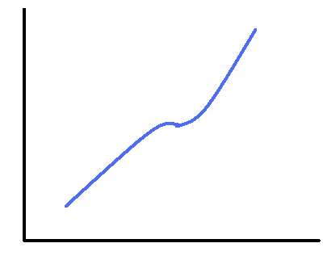
Symmetry Energy
“Symmetry energy is dominated by the tensor forces”:
Skyrmion
With nuclear correlations
The existence of cusp is model independent.
n_{1/2}
Lee, Park and Rho, PRC11’.
Liu, YM and Rho, in preparation.

Slide 35
Symmetry Energy
Supports the increasing of the Sym. E.
B. B. Zhang and B. A. Li, 1807.07698

Slide 36
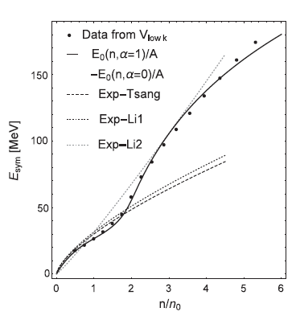

Emergent scale symmetry in medium
Paeng, Kuo, Lee, Ma and Rho, PRD17’.

Slide 37

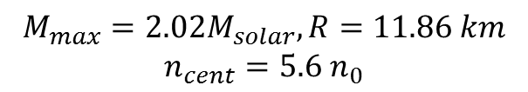
Massive star properties
Paeng, Kuo, Lee, YM and Rho PRD17’
$$M_{max}=2.02M_{solar}, R=11.86 km$$
$$n_{cent}=5.6 n_{0}$$
Independent of $n_{1/2}$?
Ma, Lee, Paeng and Rho, 18’.

Slide 38
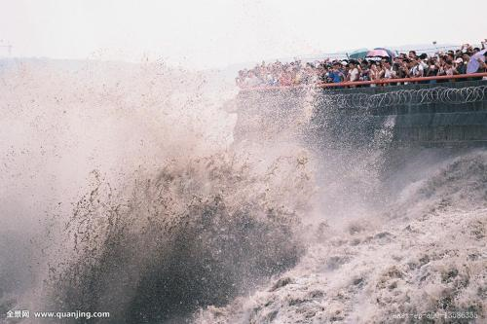
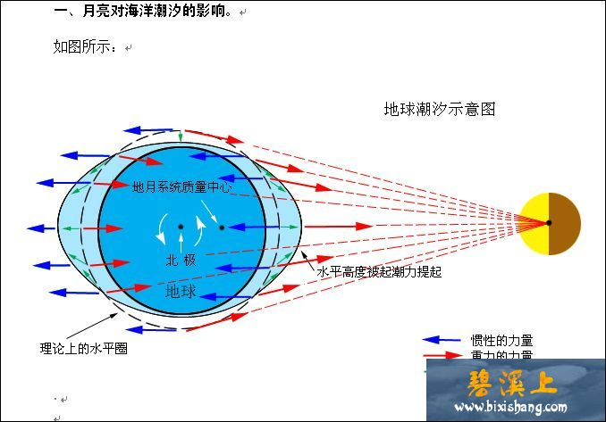
Tidal deformability
Contain the information of EoS

Slide 39
Tidal deformability
Ma, Lee, Paeng and Rho, 18’.

Slide 40
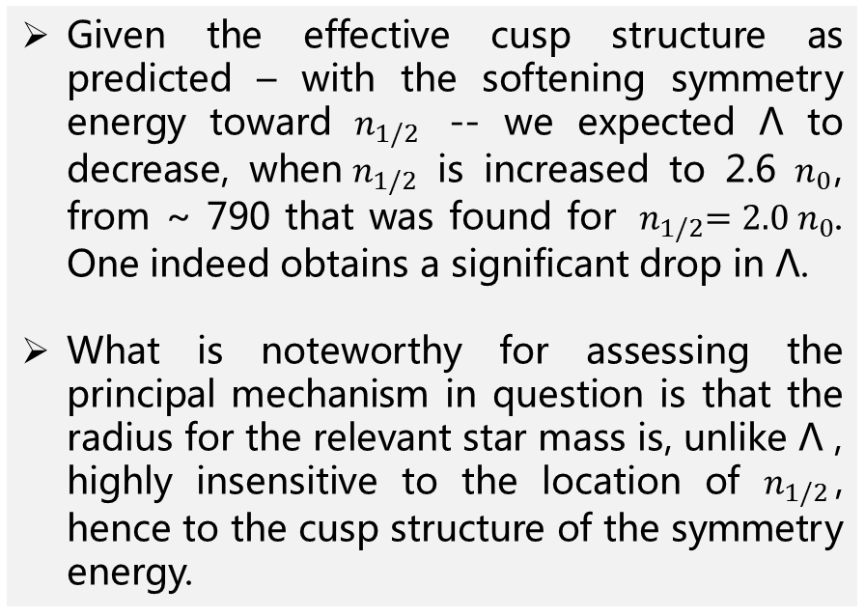
Tidal deformability
Location of the topology change density is found to strongly impact the tidal deformability.
Given the effective cusp structure as predicted – with the softening symmetry energy toward $n_{1/2}$ -- we expected Λ to decrease, when${ n}_{1/2}$ is increased to 2.6 $n_{0}$, from ~ 790 that was found for ${ n}_{1/2}=2.0 n_{0}$. One indeed obtains a significant drop in Λ.
What is noteworthy for assessing the principal mechanism in question is that the radius for the relevant star mass is, unlike Λ , highly insensitive to the location of $n_{1/2}$, hence to the cusp structure of the symmetry energy.
Ma, Lee, Paeng and Rho, 18’.

Slide 41
VI. Summary and duscussion

Slide 42
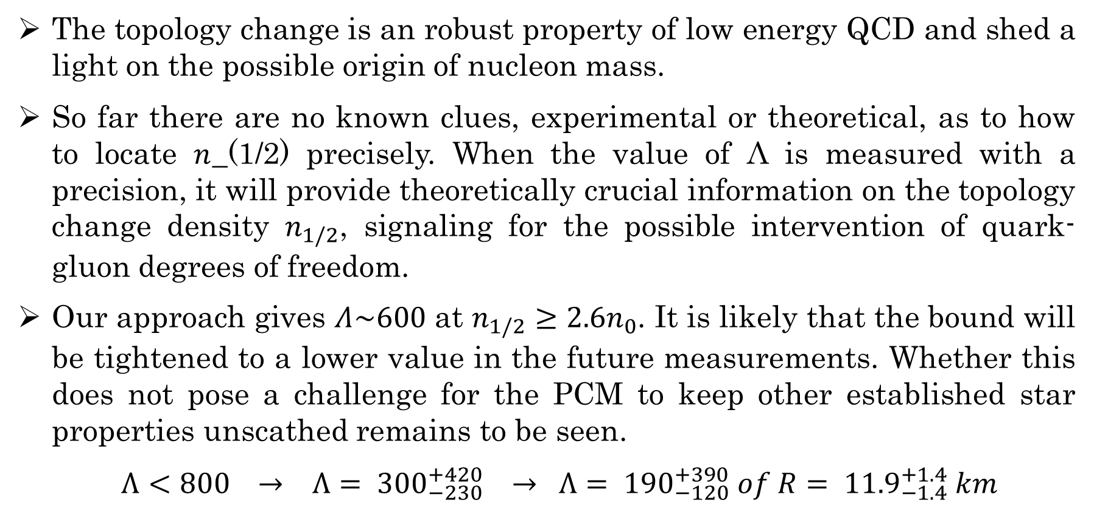
Summary and discussion
The topology change is an robust property of low energy QCD and shed a light on the possible origin of nucleon mass.
So far there are no known clues, experimental or theoretical, as to how to locate 𝑛_(1/2) precisely. When the value of Λ is measured with a precision, it will provide theoretically crucial information on the topology change density $n_{1/2}$, signaling for the possible intervention of quark-gluon degrees of freedom.
Our approach gives $Λ\sim 600$ at $n_{1/2}≥2.6n_{0}$. It is likely that the bound will be tightened to a lower value in the future measurements. Whether this does not pose a challenge for the PCM to keep other established star properties unscathed remains to be seen.
$Λ<800 → Λ= {300}_{−230}^{+420} → Λ= {190}_{−120}^{+390} of R= {11.9}_{−1.4}^{+1.4} km$
C. Y. Tsang, et al., 1807.06571

Slide 43
Summary and discussion
Perhaps more fundamental is the possible role of the tidal deformability in illuminating how scale symmetry figures in dense matter. The approach so far employed is anchored on what was referred to as LOSS. While the LOSS approximation is fairly consistent with nature at low density, it is however an open issue at high density. It may be that a precisely determined could provide valuable information on the validity of, or deviation from, LOSS at higher density relevant to compact stars.
It is important to understand the physical consequence of a half or nontopological charge of half (or fractional) skyrmions, such as the static of them and some phenomena in condensed matter physics.

Slide 44
Summary and discussion
Is this pseudo-conformal structure
at odds with Nature?
Not with what’s measured (or known)
up to now
Slide borrowed from M. Rho

Slide 45


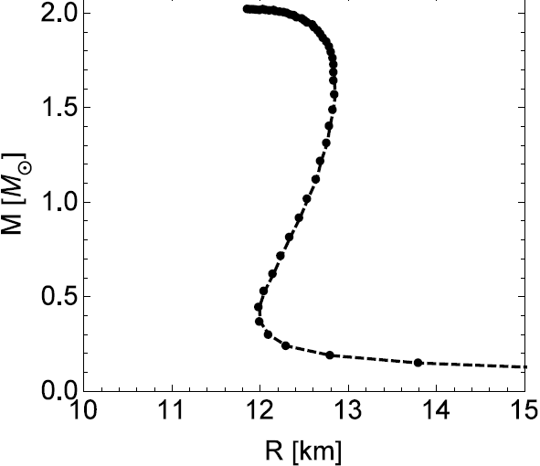
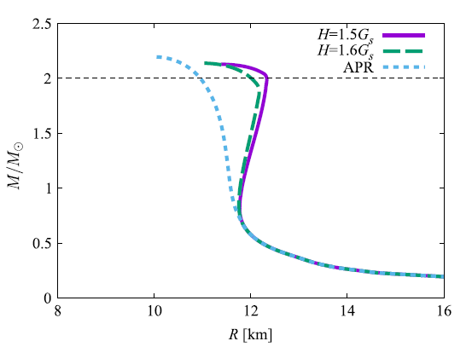
Hint: “Cheshire Cat” at Work
Nadkarni, Nielsen, Zahed 1984
ss
Topology
Change
½-skyrmions
Crystal
Hong, Zahed, R. 1999
Paeng, Ma et al 2018
(A)
Sigma
model
Sigma
model
duality
n_{1/2} ~ (2 -3)n₀
n
Baryons-to
SC quarks
Baryons → SC quarks → CFL
(quarkyonic?)
Fukushima, Kojo 2016
Baym et al, 2017
(A)
Massive stars
(B)
Slide borrowed from M. Rho

Slide 47
Thank you for your attention

Slide 48

The IR fixed point exists for three-flavor QCD in the matter-free space? Not yet established and remains highly controversial.
  Although there are no lattice indications or compelling theoretical arguments for the existence of IR fixed points for $N_{f}≤8$. But, none of the presently available lattice calculations can be taken as an unambiguous no-go theorem.
Light-front Holography calculation for 2-flavor QCD
There is even a tentative support from a stochastic numerical perturbation calculation in Pade approximant that indicates an IR fixed point for two-massless flavor quarks.
Brodsky, Teramond & Deur, PRD81,2010.
Horsley, et al, 14

