Slide 1
Blindfold Determination of Baryon Spectrum in Strangeness Production Reactions
Collaboration:
Justin Landay (GWU)
Maxim Mai (GWU)
Micheal Doering (GWU)
Helmut Haberzettl (GWU)
K. N. (UGA)
APCTP2018, July. 1-4, 2018

Slide 2
Resonance determination: issues one faces
Hadron Spectroscopy: integral part for understanding the
non-perturbative regime of QCD.
Jlab-12 GeV: strangeness baryon spectroscopy
Basic issues in resonance determination from data:
Resonance extraction from experimental data is non-trivial since the separation of the signal from background is model-dependent.
Many experimental data, especially, in hadronic reactions suffer from
large uncertainties. Some of them suffer from under- or over-estimation of
the systematical uncertainties. Furthermore, many data sets are often
inconsistent with each other, even for recent high-precision
photoproduction data (e.g., differential cross sections in η, η’ and ω
photoproduction from the CLAS and CBELSA/TAPS collaborations
[V. Crede, et al., PRC80’2009; A. Wilson et al., PLB479’2015] ).

Slide 3
Resonance determination: standard procedures
Resonances are determined from experimental data by fitting the data using
some model. Except for those models where the resonances are generated
dynamically (e.g., UχPT), one usually considers the resonances:
From some quark (or related) theoretical models
Known from PDG (1-, 2-, 3-, 4-star resonances)
Completely new resonances as needed

Slide 4
Resonance determination: standard procedures
Resonances are determined from experimental data by fitting the data using
some model. Except for those models where the resonances are generated
dynamically (e.g., UχPT), one usually considers the resonances:
From some quark (or related) theoretical models
Known from PDG (1-, 2-, 3-, 4-star resonances)
Completely new resonances as needed
Problem: Many potentially relevant resonances.

Slide 5
Resonance determination: standard procedures
S=-1 hyperon resonances listed in PDG (35 resonances):

Slide 6
Resonance determination: standard procedures
Resonances are determined from experimental data by fitting the data using
some model. Except for those models where the resonances are generated
dynamically (e.g., UχPT), one usually considers the resonances:
From some quark (or related) theoretical models
Known from PDG (1-, 2-, 3-, 4-star resonances)
Completely new resonances as needed
Problem: Many potentially relevant resonances.
It is impractical to consider all of them.
Which ones to consider is subjective.
Problem of overfitting.

Slide 7
Resonance determination: standard procedures
Resonances are determined from experimental data by fitting the data using
some model. Except for those models where the resonances are generated
dynamically (e.g., UχPT), one usually considers the resonances:
From some quark (or related) theoretical models
Known from PDG (1-, 2-, 3-, 4-star resonances)
Completely new resonances as needed
Problem: Many potentially relevant resonances.
It is impractical to consider all of them.
Which ones to consider is subjective.
Problem of overfitting.
In particular, if a flexible background with resonance terms on top of it is provided, the task consists of minimizing the number of resonances and only accepting them as physically significant if the background cannot provide a satisfactory description.

Slide 8
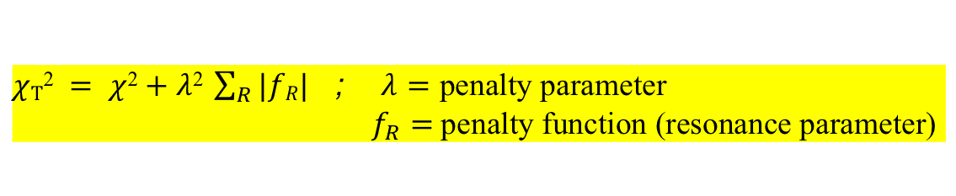
Resonance determination: a novel approach
A blindfold determination of the resonances based on the Least Absolute Shrinkage and
Selection Operator (LASSO) in combination with Information Theory Criteria (ITC)
R. Tibshirani, J. R. Stat. Soc. B 58, 267 (1996);
T. Hasti et al., The Elements of Statistical Learning: Data Mining, Inference, and Prediction (Springer-Verlag, N.Y., 2009);
G. James, et al., An Introduction to Statistical Learning (Springer-Verlag, N. Y., 2013).
applied in excited meson production experiments [B. Guegan et al., JINST 10, P09002 (2015)]
applied in pion photoproduction [J. Landay et al., PRC95’17]
LASSO : minimize
$χ\text{T}\text{2} = χ\text{2}+$ $λ\text{2} \sum_{R}{|fR|}$ ; $λ=$ penalty parameter
$f_{R}=$penalty function (resonance parameter)
as a function of λ.
ITC : selection of optimal value of λ based on Information Theory Criteria:
Akaike Information Criterion (AIC)
Bayesian Information Criterion (BIC)
& their variatiants
H. Akaike, IEEE Trans. Autom. Control 19, 716 (1974);
K. Burnham and D. Anderson, Model Selection and Multimodel
Inference: A Practical Information-Theoretic Approach
(Springer-Verlag, New York, 2003);
G. Schwarz, Ann. Stat. 6, 461 (1978);
J. E. Cavanaugh, Statist. Probab. Lett. 33, 201 (1997).
AIC/BIC attempt to resolve the overfitting problem by introducing a penalty term for the number of
parameters in the model. Detailed study of LASSO+ITC: J. Landay et al., in preparation.

Slide 9
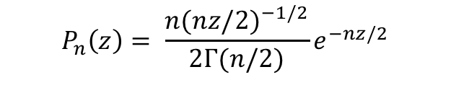
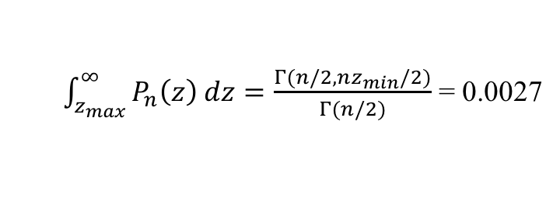
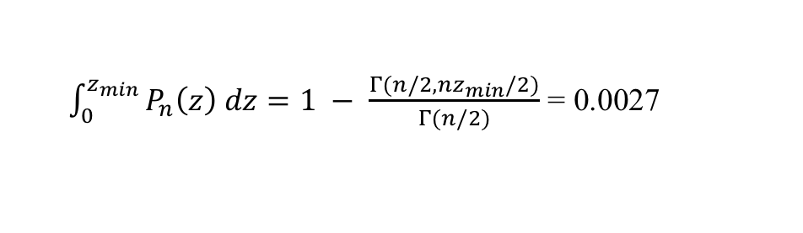
Resonance determination: expt. data prunning
Self-consistent 3σ criterion: [Perez, Amaro, Arriola, PRC88’13, 89’14]
For a set of n measurements with Gaussian distribution, the quantity z = χ² / n will satisfy
the normalized probability distribution:
$$P_{n}\left(z\right)= \frac{n(nz{/2)}^{−1/2}}{2Γ(n/2)}e^{−nz/2}$$
3σ criterion : a dataset is inconsistent with the rest of the database if z has a probability
smaller than 0.27%. Then, for every n, the allowed z is given by
z_{min} < z < z_{max} , where
$\int_{0}^{z_{min}}{P_{n}\left(z\right) dz=1 − \frac{Γ(n/2, nz_{min}/2)}{Γ(n/2)}}$ = 0.0027
$\int_{z_{max}}^{∞}{P_{n}\left(z\right) dz=\frac{Γ(n/2, nz_{min}/2)}{Γ(n/2)}}$ = 0.0027
self-consistency : fit the entire unpruned data → apply 3σ criterion & prune the data
→ fit the pruned data anew & apply 3σ criterion to the entire unpruned
data to get a new pruned data → repeat the process.

Slide 10
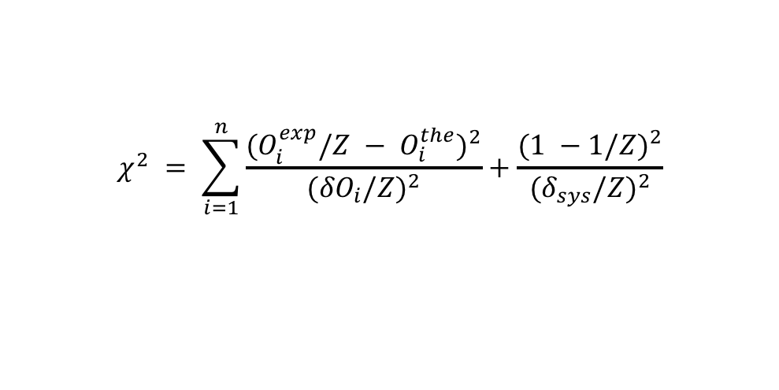
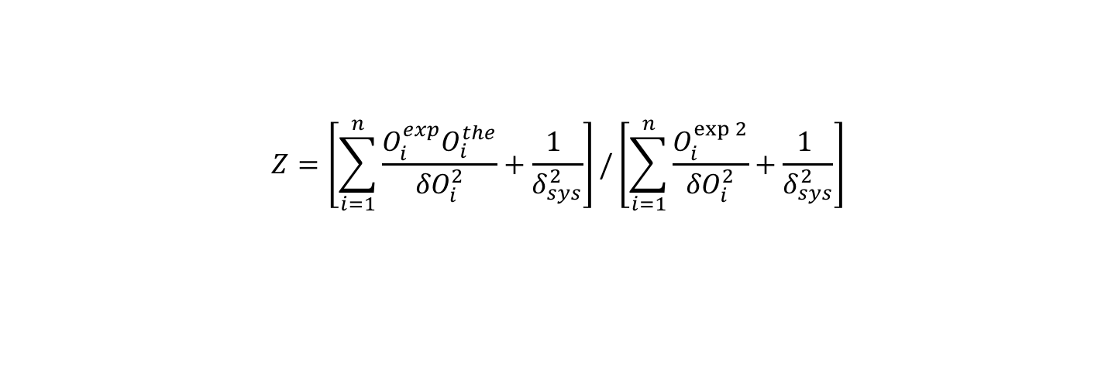
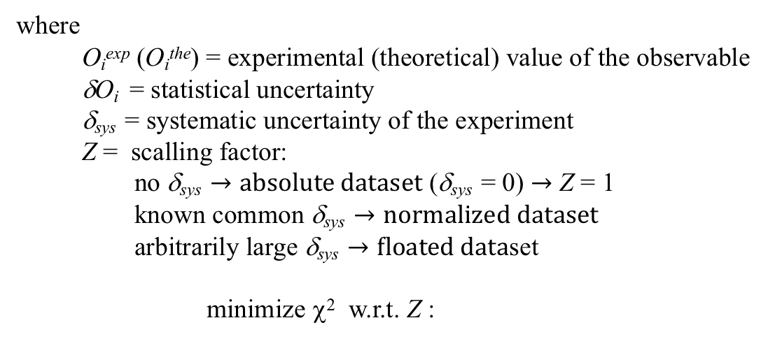
Resonance determination: χ² merit function
Theoretical description of a given experimental dataset with n data points is achieved by
fitting the model parameters through a minimization procedure of the χ² merit function :
$$χ^{2} = \sum_{i=1}^{n}{\frac{{(O}_{i}^{exp}/Z − O_{i}^{the})^{2}}{({δO}_{i}/Z)^{2}}}+\frac{(1 −1{/Z)}^{2}}{{(δ}_{sys}/Z)^{2}}$$
where
O_{i}^{exp} (O_{i}^{the}) = experimental (theoretical) value of the observable
δO_{i} = statistical uncertainty
δ_{sys} = systematic uncertainty of the experiment
Z = scalling factor:
no δ_{sys} $→absolute dataset$ (δ_{sys} = 0) $→$ Z = 1
known common δ_{sys} $→normalized dataset$
arbitrarily large δ_{sys} $→floated data$set
minimize χ² w.r.t. Z :
$$Z=\left[\sum_{i=1}^{n}{\frac{O_{i}^{exp}O_{i}^{the}}{{δO}_{i}^{2}}}+\frac{1 }{δ_{sys}^{2}}\right]/\left[\sum_{i=1}^{n}{\frac{O_{i}^{\exp{2}}}{{δO}_{i}^{2}}}+\frac{1 }{δ_{sys}^{2}}\right]$$

Slide 11
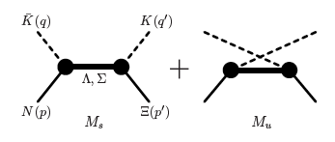
Illustration of the approach: KN → KΞ
1) Basic reaction mechanism:
hyperon exchanges
no t-channel exchange
(absence of S=2 exotic mesons)
2) existing data are of poor quality: does LASSO+ITC work?
for high-quality data (pion photoproduction): works [J. Landay et al., PRC95’17]

Slide 12
KN → KΞ : experimental data prunning
448 data points.
10 out of the
allowed range
of z .

Slide 13
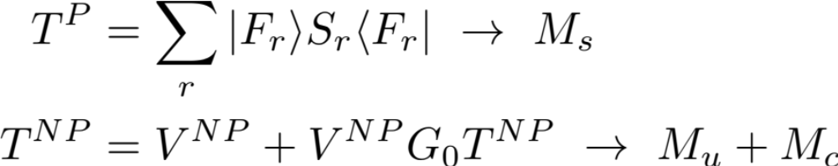
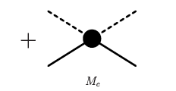
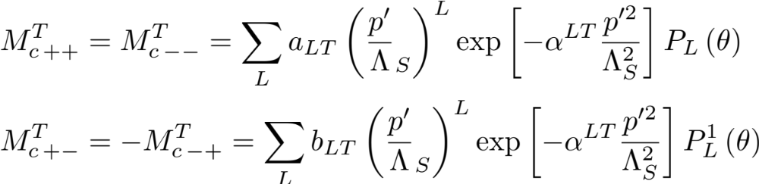
KN→KΞ : model
[Jackson, Oh, Haberzettl, K.N., PRC91(2015)065208]
a_{LT} , b_{LT} , α^{LT} = fit parameters
M_{c}
Λ_{S} ~ 1 GeV
(scale parameter)

Slide 14
KN → KΞ : hyperon resonances considered
Λ(1116) Σ(1193)
Λ(1405) Σ(1385)
Λ(1520)
the model parameters can be fixed from the relevant decay rates(PDG) and/or quark models and SU(3) symmetry considerations.
All 21 above-threshold S=-1 hyperon resonances listed in PDG:
except Λ(2350)9/2⁺ (results saturates after L > 3)

Slide 15
KN → KΞ : phenom. model for data prunning
For hard processes (p’^{2L}):

Slide 16
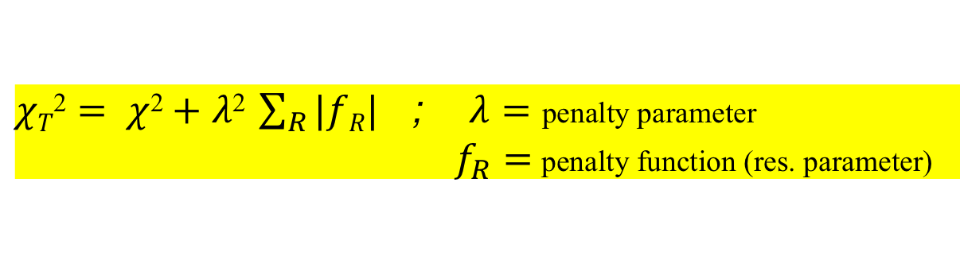

KN → KΞ : LASSO + BIC
LASSO :
$χT\text{2}= χ\text{2}+$ $λ\text{2} \sum_{R}{|fR|}$ ; $λ=$ penalty parameter
$f_{R}=$penalty function (res. parameter)
as a function of λ.
N_{RJ}
$f_{R}(J±)=M_{s}(\text{on}\text{−}\text{shell} \text{res}\text{.})$ $∝$
N_{RJ}
N_{RJ} = normalization constant
BIC : select the optimal value of λ by minimizing :
BIC = k ln(N) – 2 ln(L)
k = # of fit parameters
N = # of data points
L = likelihood
= -χ²/2 + … (for normal distribution)
(BIC)_{min} → lowest test error

Slide 17
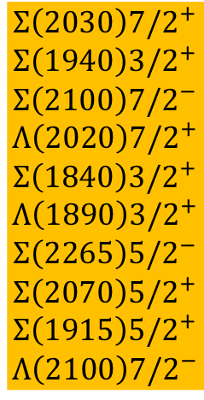
KN → KΞ : LASSO + BIC results
10 res. out of 21:
$$Σ\left(2030\right)7{/2}^{+}$$
$$Σ\left(1940\right)3{/2}^{+}$$
$$Σ\left(2100\right)7{/2}^{−}$$
$$Λ\left(2020\right)7{/2}^{+}$$
$$Σ\left(1840\right)3{/2}^{+}$$
$$Λ\left(1890\right)3{/2}^{+}$$
$$Σ\left(2265\right)5{/2}^{−}$$
$$Σ\left(2070\right)5{/2}^{+}$$
$$Σ\left(1915\right)5{/2}^{+}$$
$$Λ\left(2100\right)7{/2}^{−}$$
| f_{R} |

Slide 18
KN → KΞ : LASSO + BIC results

Slide 19
KN → KΞ : LASSO + BIC results

Slide 20
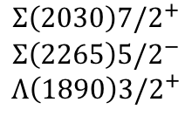
KN → KΞ : LASSO + BIC results
Jackson et al., PRC91 ’2015 :
(considering only 3- & 4-star resonances)
$$Σ\left(2030\right)7{/2}^{+}$$
$$Σ\left(2265\right)5{/2}^{−}$$
$$Λ\left(1890\right)3{/2}^{+}$$
(consistent with LASSO+BIC)

Slide 21
Summary & Outlook :
A blindfold determination of hyperon resonances based on the Least
Absolute Shrinkage Selection Operator (LASSO) method together with
the Bayesian Information Criterion (BIC) has been applied to
KN → KΞ to provide a model that describes the existing data with a
minimum number of hyperon resonances.
The approach works well even for relatively poor quality data. In
particular, it has identified 10 resonances (5 of them 1-star rated) to be significant out of all 21 above-threshold resonances listed in PDG.
We expect the LASSO+ITC method to become a standard tool in the determination of resonance spectra in hadron spectroscopy.

Slide 22
The End

