Slide 1
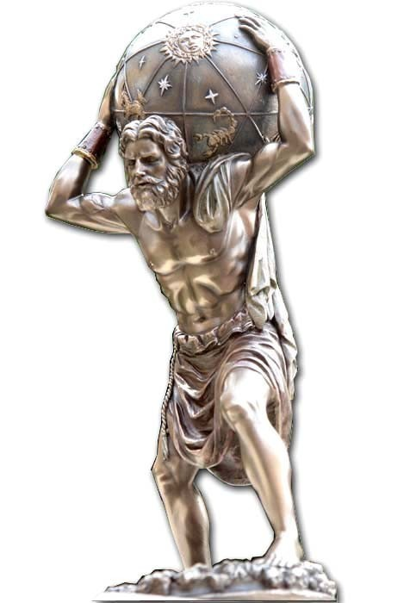
QCD:
Carrying Our Weight
Craig Roberts
Notes:
64 pages last time. Too long.

Slide 2
Collaborators: 2015-Present
Students, Postdocs, Profs.
Stan Brodsky (SLAC);
Volker Burkert (Jlab)
Lei Chang (Nankai U. ) ;
Xiao-Yun Chen (Nanjing Normal U.)
Bruno El-Bennich (São Paulo);
Tanja Horn (Catholic U. America)
Yu-Xin Liu (PKU);
Joannis Papavassiliou (U.Valencia)
M. Ali Paracha (NUST, Islamabad)
Jia-Lun Ping (Nanjing Normal U.)
Si-xue QIN (Chongqing U.);
Jose Rodriguez Quintero (U. Huelva) ;
Sebastian Schmidt (IAS-FZJ & JARA);
Peter Tandy (KSU);
Shaolong Wan (USTC) ;
Qing-Wu Wang (SICHUAN U)
Pei-Lin Yin (NJUPT)
Hong-Shi Zong (Nanjing U)
Jing CHEN (Peking U.)
Ya LU (Nanjing U.)
Yin-Zhen (Nanjing U.)
Chen CHEN (UNESP - São Paulo, USTC & IIT);
Zhu-Fang CUI (Nanjing U.) ;
J. Javier COBOS-MARTINEZ (U Michoácan);
Minghui DING (ANL, Nankai U.) ;
Fei GAO (Valencia, Peking U.) ;
L. Xiomara GUTIÉRREZ-GUERRERO (MCTP)
Bo-Lin LI (Nanjing U.)
Cédric MEZRAG (INFN-Roma) ;
Khépani RAYA (U. Huelva, U Michoácan);
Eduardo ROJAS (Antioquia U.)
Jorge SEGOVIA (IFAE&BIST, Barcelona);
Chao SHI (ANL, Nanjing U.)
Shu-Sheng XU (Nanjing U.)
Adnan Bashir (U Michoácan);
Daniele Binosi (ECT*)

Slide 3
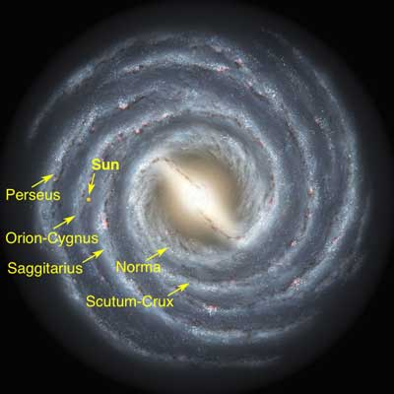
Emergent Phenomena in the Standard Model
Existence of the Universe as we know it depends critically on the following empirical facts:
Proton is massive, i.e. the mass-scale for strong interactions is vastly different to that of electromagnetism
Proton is absolutely stable, despite being a composite object constituted from three valence quarks
Pion is unnaturally light (not massless, but lepton-like mass), despite being a strongly interacting composite object built from a valence-quark and valence antiquark
Emergence: low-level rules producing high-level phenomena, with enormous apparent complexity

Slide 4

Strong Interactions in the
Standard Model
Only apparent scale in chromodynamics is mass of the quark field
Quark mass is said to be generated by Higgs boson.
In connection with everyday matter, that mass is 1/250th of the natural (empirical) scale for strong interactions,
viz. more-than two orders-of-magnitude smaller
Plainly, the Higgs-generated mass is very far removed from the natural scale for strongly-interacting matter
Nuclear physics mass-scale – 1 GeV – is an emergent feature of the Standard Model
  No amount of staring at L_{QCD} can reveal that scale
Contrast with quantum electrodynamics, e.g. spectrum of hydrogen levels measured in units of m_{e}, which appears in L_{QED}

Slide 5
Whence Mass?
Classical chromodynamics … non-Abelian local gauge theory
Remove the current mass … there’s no energy scale left
No dynamics in a scale-invariant theory; only kinematics … the theory looks the same at all length-scales … there can be no clumps of anything … hence bound-states are impossible.
Our Universe can’t exist
Higgs boson doesn’t solve this problem …
  normal matter is constituted from light-quarks
  the mass of protons and neutrons, the kernels of all visible matter, are 100-times larger than anything the Higgs can produce
Where did it all begin?
  … becomes … Where did it all come from?

Slide 6
Trace Anomaly
Classically, in a scale invariant theory
the energy-momentum tensor must be traceless: T_{μμ} ≡ 0
Classical chromodynamics is meaningless … must be quantised
Regularisation and renormalisation of (ultraviolet) divergences introduces a mass-scale
  … dimensional transmutation: mass-dimensionless quantities become dependent on a mass-scale, ζ
α → α(ζ) in QCD’s (massless) Lagrangian density, L(m=0)
  Under a scale transformation ζ → e^{σ} ζ, then α → σ αβ(α)
  L→ σ αβ(α) dL/dα
  ⇒ ∂_{μ}D_{μ} = δL/δσ = αβ(α) dL/dα = β(α) ¼G_{μν} G_{μν} = T_{ρρ} =: Θ₀
Straightforward, nonperturbative derivation, without need for diagrammatic analysis …
    Quantisation of renormalisable four-dimensional theory forces nonzero value for trace of energy-momentum tensor
QCD β function
Trace anomaly
Notes:
Alpha -> alpha(zeta) seems to be enough to generate M(zeta), which is large for zeta small.

Slide 7
Whence?
Classical chromodynamics … non-Abelian local gauge theory
Local gauge invariance; but there is no confinement without a mass-scale
  Three quarks can still be colour-singlet
  Colour rotations will keep them colour singlets
  But they need have no proximity to one another
  … proximity is meaningless in a scale-invariant theory
Whence mass … equivalent to whence a mass-scale … equivalent to whence a confinement scale
Understanding the origin of mass in QCD is quite likely inseparable from the task of understanding confinement.

Slide 8

Where is the mass?

Slide 9

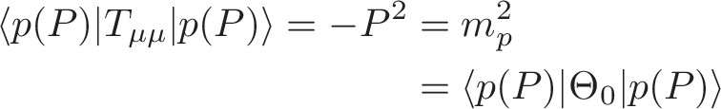
Trace Anomaly
Knowing that a trace anomaly exists does not deliver a great deal
… Indicates only that a mass-scale must exist
Can one compute and/or understand the magnitude of that scale?
One can certainly measure the magnitude … consider proton:
In the chiral limit the entirety of the proton’s mass is produced by the trace anomaly, Θ₀
… In QCD, Θ₀ measures the strength of gluon self-interactions
… so, from one perspective, m_{p} is completely generated by glue.

Slide 10

On the other hand …

Slide 11
Trace Anomaly
In the chiral limit
⇒
Does this mean that the scale anomaly vanishes trivially in the pion state, i.e. gluons contribute nothing to the pion mass?
Difficult way to obtain “zero”!
Easier to imagine that “zero” owes to cancellations between different operator contributions to the expectation value of Θ₀.
Of course, such precise cancellation should not be an accident.
    It could only arise naturally because of some symmetry and/or symmetry-breaking pattern.

Slide 12
Whence “1” and yet “0” ?
No statement of the question
“Whence the proton's mass?”
is complete without the additional clause
“Whence the absence of a pion mass?”
Natural visible-matter mass-scale must emerge simultaneously with apparent preservation of scale invariance in related systems
  Expectation value of Θ₀ in pion is always zero, irrespective of the size of the natural mass-scale for strong interactions = m_{p}

Slide 13

Ideas: Old & New

Slide 14
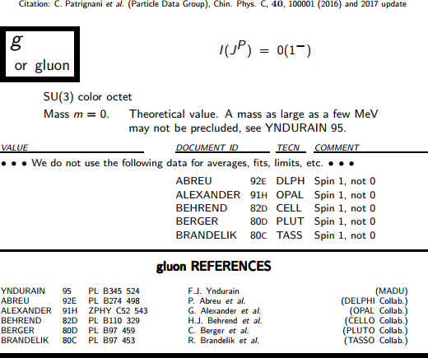
Particle Data Group

Slide 15
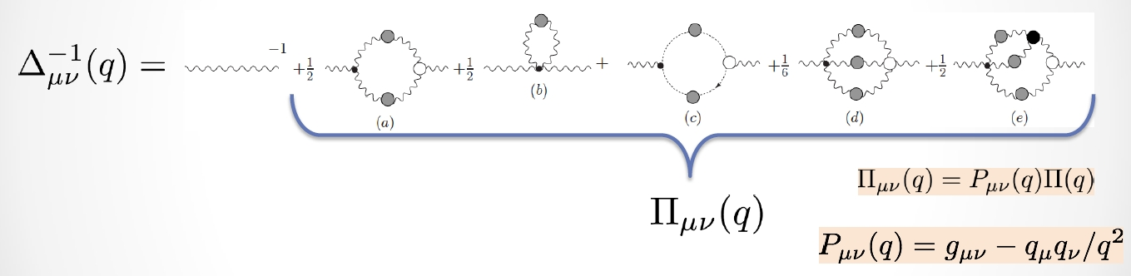
Gluon Gap Equation
Pinch Technique: Theory and Applications
Daniele Binosi & Joannis Papavassiliou
Phys. Rept. 479 (2009) 1-152

Slide 16


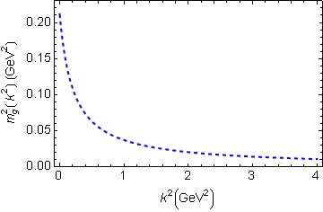
In QCD: Gluons become massive!
Bridging a gap between continuum-QCD and ab initio predictions of hadron observables, D. Binosi et al., arXiv:1412.4782 [nucl-th], Phys. Lett. B742 (2015) 183-188
Running gluon mass
Gluons are cannibals – a particle species whose members become massive by eating each other!
μ_{g} ≈ ½ m_{p}
Expression of trace anomaly:
Massless glue becomes massive
gluon mass-squared function
Power-law suppressed in ultraviolet, so invisible in perturbation theory
5%
Interaction model for the gap equation, S.-x.Qin et al., arXiv:1108.0603 [nucl-th], Phys. Rev. C 84 (2011) 042202(R) [5 pages]
Class A: Combining DSE, lQCD and pQCD analyses of QCD’s gauge sector

Slide 17


Massive Gauge Bosons!
Gauge boson cannibalism
… a new physics frontier … within the Standard Model
Asymptotic freedom means
… ultraviolet behaviour of QCD is controllable
Dynamically generated masses for gluons and quarks means that QCD dynamically generates its own infrared cutoffs
  Gluons and quarks with
  wavelength λ > 1/mass ≈ 0.5 fm
  decouple from the dynamics … Confinement?!
How does that affect observables?
  It will have an impact in
  any continuum study
  Possibly (probably?) plays a role in gluon saturation ...
  In fact, could be a harbinger of gluon saturation?

Slide 18
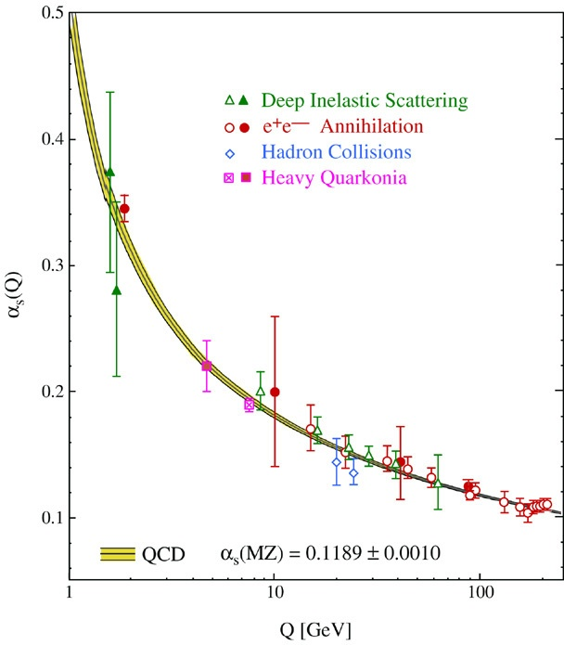
QCD’s Running Coupling
⇐
What’s happening
out here?!

Slide 19
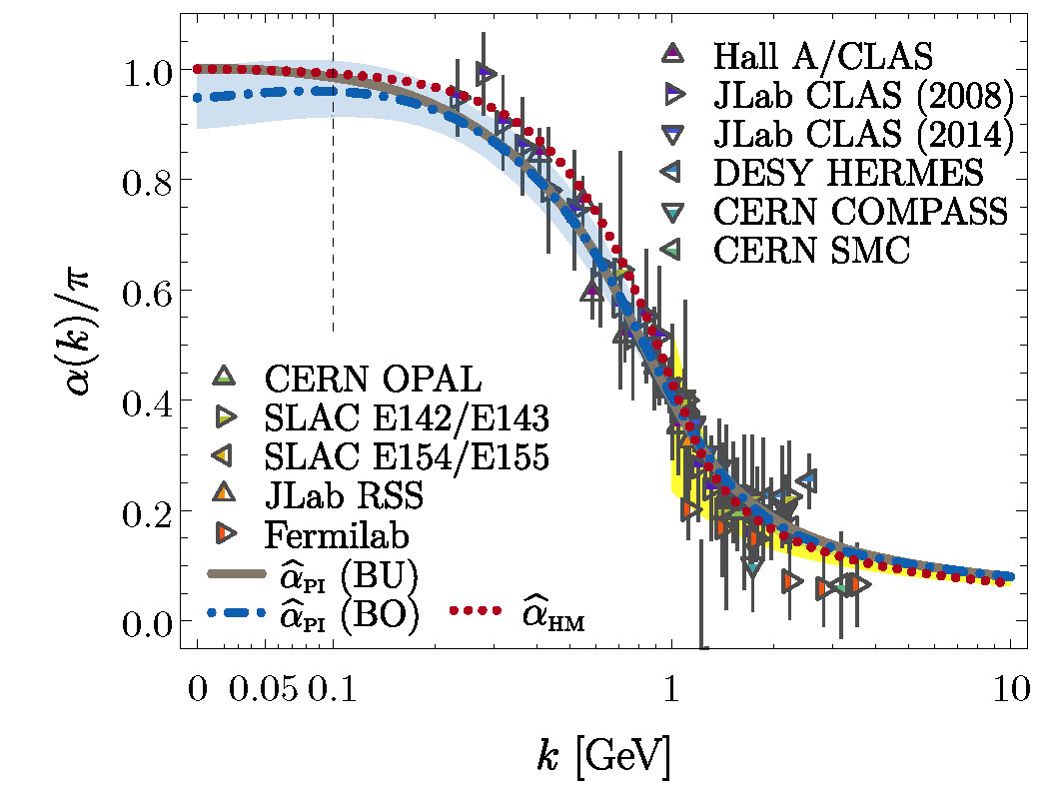
Process-independent effective-charge in QCD
Process independent strong running coupling
Binosi, Mezrag, Papavassiliou, Roberts, Rodriguez-Quintero
arXiv:1612.04835 [nucl-th], Phys. Rev. D 96 (2017) 054026/1-7
Modern continuum & lattice methods for analysing gauge sector enable
“Gell-Mann – Low”
  running charge to be defined in QCD
Combined continuum and lattice analysis of QCD’s gauge sector yields a parameter-free prediction
N.B. Qualitative change in α̂_{PI}(k) at k ≈ ½ m_{p}

Slide 20

QCD Effective Charge
Process independent strong running coupling
Binosi, Mezrag, Papavassiliou, Roberts, Rodriguez-Quintero
arXiv:1612.04835 [nucl-th], Phys. Rev. D 96 (2017) 054026/1-7
The QCD Running Coupling,
A. Deur, S. J. Brodsky and G. F. de Teramond,
Prog. Part. Nucl. Phys. 90 (2016) 1-74
Near precise agreement between process-independent
α̂_{PI} and α_{g1}
& α̂_{PI} ≈ α_{HM}
Perturbative domain:
difference = (1/20) α_{M̅S̅}²
Parameter-free prediction:
  Curve completely determined by results obtained for gluon & ghost two-point functions using continuum and lattice-regularised QCD.
Data = process dependent effective charge [Grunberg:1982fw]:
α_{g1}, defined via Bjorken Sum Rule

Slide 21
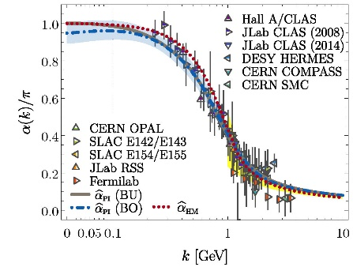
QCD Effective Charge
α̂_{PI} is a new type of effective charge
  direct analogue of the Gell-Mann–Low effective coupling in QED, i.e. completely determined by the gauge-boson two-point function.
α̂_{PI} is
  process-independent
  appears in every one of QCD’s dynamical equations of motion
  known to unify a vast array of observables
α̂_{PI} possesses an infrared-stable fixed-point
  Nonperturbative analysis demonstrating absence of a Landau pole in QCD
QCD is IR finite, owing to dynamical generation of gluon mass-scale, which also serves to eliminate the Gribov ambiguity
Asymptotic freedom ⇒ QCD is well-defined at UV momenta
QCD is therefore unique amongst known 4D quantum field theories
  Potentially, defined & internally consistent at all momenta

Slide 22
QCD Effective Charge
α̂_{PI} is a new type of effective charge
  direct analogue of the Gell-Mann–Low effective coupling in QED, i.e. completely determined by the gauge-boson two-point function.
α̂_{PI} is
  process-independent
  appears in every one of QCD’s dynamical equations of motion
  known to unify a vast array of observables
α̂_{PI} possesses an infrared-stable fixed-point
  Nonperturbative analysis demonstrating absence of a Landau pole in QCD
QCD is IR finite, owing to dynamical generation of gluon mass-scale, which also serves to eliminate the Gribov ambiguity
Asymptotic freedom ⇒ QCD is well-defined at UV momenta
QCD is therefore unique amongst known 4D quantum field theories
  Potentially, defined & internally consistent at all momenta
Conceivably, therefore,
QCD can serve as a basis
for theories that take physics
beyond the Standard Model

Slide 23
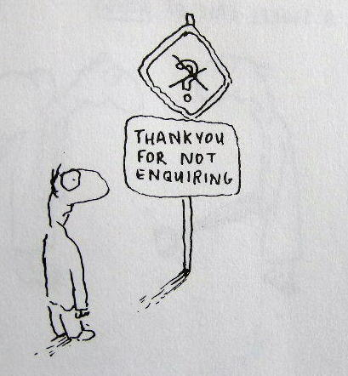
Enigma of Mass

Slide 24
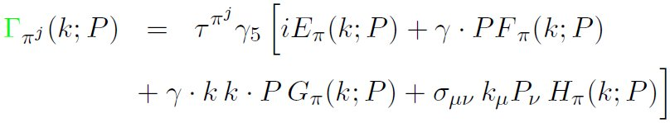

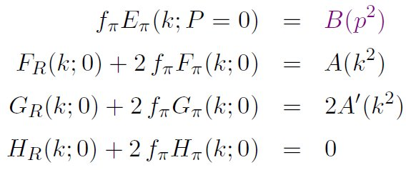
Pion’s Goldberger
-Treiman relation
Maris, Roberts and Tandy
nucl-th/9707003, Phys.Lett. B420 (1998) 267-273
Pion’s Bethe-Salpeter amplitude
Solution of the Bethe-Salpeter equation
Dressed-quark propagator
Axial-vector Ward-Takahashi identity entails
B(k²)
Owing to DCSB
& Exact in
Chiral QCD
Miracle: two body problem solved, almost completely, once solution of one body problem is known

Slide 25
The most fundamental expression of Goldstone’s Theorem and DCSB
Rudimentary version of this relation is apparent in Nambu’s Nobel Prize work
Model independent
Gauge independent
Scheme independent
f_{π} E_{π}(p²) = B(p²)

Slide 26
Pion exists if, and only if, mass is dynamically generated
Rudimentary version of this relation is apparent in Nambu’s Nobel Prize work
Model independent
Gauge independent
Scheme independent
f_{π} E_{π}(p²)⇔ B(p²)

Slide 27
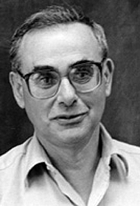
Enigma of mass
f_{π} E_{π}(p²) = B(p²)
This algebraic identity is why QCD’s pion is massless in the chiral limit
The quark level Goldberger-Treiman relation shows that DCSB has a very deep and far reaching impact on physics within the strong interaction sector of the Standard Model; viz.,
  Goldstone's theorem is fundamentally an expression of equivalence between the one-body problem and the two-body problem in the pseudoscalar channel.
This emphasises that Goldstone's theorem has a pointwise expression in QCD
Hence, pion properties are an almost direct measure of
the dressed-quark mass function.
Thus, enigmatically, the properties of the massless pion
are the cleanest expression of the mechanism that is
responsible for almost all the visible mass in the universe.

Slide 28
Whence “0” ?

Slide 29
Whence “0” ?
The answer is algebraic

Slide 30
Pion masslessness
Munczek, H. J., Phys. Rev. D 52 (1995) pp. 4736-4740
Bender, A., Roberts, C.D. and von Smekal, L., Phys. Lett. B 380 (1996) pp. 7-12
Maris, P. , Roberts, C.D. and Tandy, P.C., Phys. Lett. B 420 (1998) pp. 267-273
Binosi, Chang, Papavassiliou, Qin, Roberts, Phys. Rev. D 93 (2016) 096010/1-7
Obtain a coupled set of gap- and Bethe-Salpeter equations
  Bethe-Salpeter Kernel:
    valence-quarks with a momentum-dependent running mass produced by self-interacting gluons, which have given themselves a running mass
    Interactions of arbitrary but enumerable complexity involving these “basis vectors”
  Chiral limit:
    Algebraic proof
      at any & each finite order in symmetry-preserving construction of kernels for
        the gap (quark dressing)
        and Bethe-Salpeter (bound-state) equations,
      there is a precise cancellation between
        mass-generating effect of dressing the valence-quarks
        and attraction introduced by the scattering events
    Cancellation guarantees that
      simple system, which began massless,
      becomes a complex system, with
        a nontrivial bound-state wave function
        attached to a pole in the scattering matrix, which remains at P²=0 …
    Interacting, bound system remains massless
Quantum field theory statement:
In the pseudsocalar channel, the dynamically generated mass of the two fermions is precisely cancelled by the attractive interactions between them – iff –
f_{π} E_{π}(p²) = B(p²)
⇒ 2 M_{q} + U_{g} ≡ 0

Slide 31
Observing Mass

Slide 32
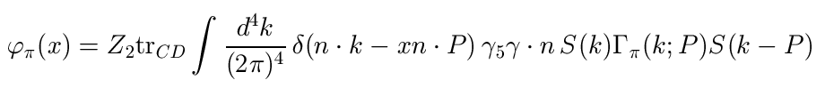
Pion’s valence-quark
Distribution Amplitude
Imaging dynamical chiral symmetry breaking: pion wave function on the light front, Lei Chang, et al., arXiv:1301.0324 [nucl-th], Phys. Rev. Lett. 110 (2013) 132001 (2013) [5 pages].
Methods have been developed that enable direct computation of the pion’s light-front wave function
φ_{π}(x) = twist-two parton distribution amplitude = projection of the pion’s Poincaré-covariant wave-function onto the light-front
Results have been obtained with the DCSB-improved DSE kernel, which unifies matter & gauge sectors
  ϕ_{π}(x) ∝ x^{α} (1-x)^{α}, with α≈0.5

Slide 33
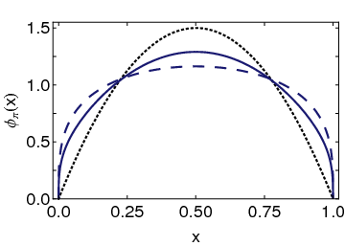
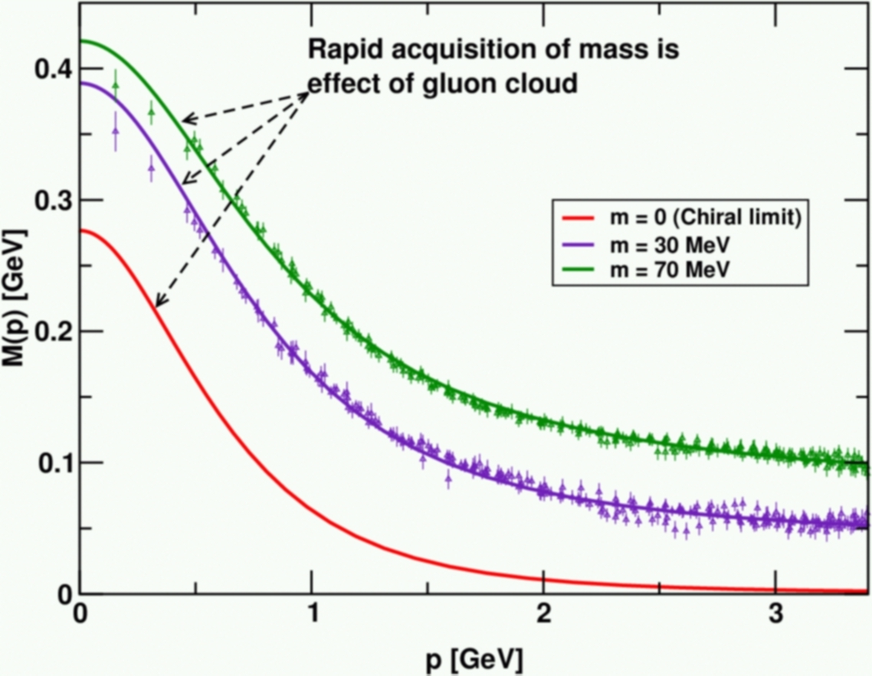
Pion’s valence-quark
Distribution Amplitude
Imaging dynamical chiral symmetry breaking: pion wave function on the light front, Lei Chang, et al., arXiv:1301.0324 [nucl-th], Phys. Rev. Lett. 110 (2013) 132001 (2013) [5 pages].
Continuum prediction:
marked broadening of φ_{π}(x), which owes to DCSB
Conformal QCD
DB
RL
Real-world PDAs are squat and fat
A theory that produces M(p)=constant
also produces φ(x)=constant

Slide 34
Leading-twist PDAs of
S-wave light-quark mesons
End of a long story (longer than 30 years war)
Continuum predictions that pion and kaon PDAs are broad, concave functions confirmed by simulations of lattice-regularised QCD
  Pion Distribution Amplitude from Lattice QCD, Jian-Hui Zhang et al., Phys.Rev. D95 (2017) 094514; 1702.00008
  Kaon Distribution Amplitude from Lattice QCD and the Flavor SU(3) Symmetry, Jiunn-Wei Chen et al., arXiv:1712.10025 [hep-ph]
  Pion and kaon valence-quark parton quasidistributions, S.-S. Xu, L. Chang et al. Phys. Rev. D97 (2018) 094014; arXiv:1802.09552 [nucl-th]
Continuum analyses predict that these properties characterise the leading-twist PDAs of all S-wave light-quark mesons
Many empirically verifiable predictions

Slide 35
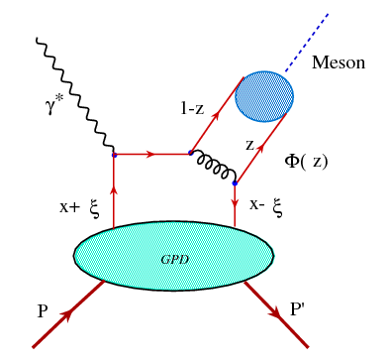

DVMP
Two nonperturbative quantities
  GPD of target
  ϕ_{M}, PDA of meson produced
Can’t extract GPD unless ϕ_{M} is known
Similar structure to elastic scattering formula
  v̅ = 1-z … Extracted result for GPD is very sensitive to endpoint behaviour of meson PDA
  Overlapping renormalisation/factorisation scales, must “communicate” under evolution because result should be scale-independent
D. Müller, et al.
Nuclear Physics
B 884 (2014) 438–546
We add that one usually assumes that the scheme (and framework) dependent meson DA is known, but even in the case of the pion DA rather different models were proposed [161–165,143,166,167] which, unfortunately, can be discriminated only partially by present experimental pion form factor [168–171] and pion-to-photon transition form factor [172–175] data and lattice results [176].

Slide 36
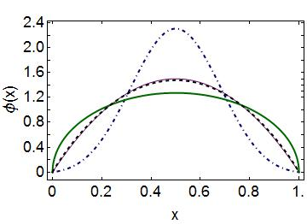
Emergent Mass vs. Higgs Mechanism
Parton distribution amplitudes of S-wave heavy-quarkonia
Minghui Ding, Fei Gao, Lei Chang, Yu-Xin Liu and Craig D. Roberts
arXiv:1511.04943 [nucl-th], Phys. Lett. B 753 (2016) pp. 330-335
When does Higgs mechanism begin to influence mass generation?
limit m_{quark}→ ∞
φ(x) → δ(x-½)
limit m_{quark} → 0
φ(x) ∼ (8/π) [x(1-x)]^{½}
Transition boundary lies just above m_{strange}
Comparison between distributions of light-quarks and those involving strange-quarks is good place to seek signals for strong-mass generation
conformal
c+c_{bar}: Higgs
(weak mass)
s+s_{bar}:
on the border
q+q_{bar}: Emergent
(strong mass)

Slide 37
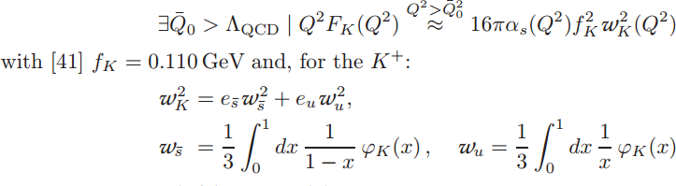
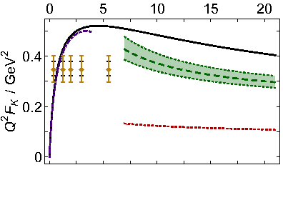
Kaon electromagnetic form factor
Exposing strangeness: projections for kaon electromagnetic form factors, Fei Gao, Lei Chang, Yu-Xin Liu, Craig D. Roberts and Peter C. Tandy, arXiv:1703.04875 [nucl-th], Phys. Rev. D 96 (2017) 034024
Solid black curve = modern DSE prediction
Hard-scattering formula
  Long-dashed green curve, with error band marking uncertainty in dilation of the PDA
Skewing is not the issue: 12%-15%, DSE- and lattice-QCD agree
It’s extent of the broadening that generates the uncertainty
JLab 12 can reach to the point at which VMD fails … as for the pion, can potentially validate general hard scattering formula
realistic PDA
conformal limit
Can an electron ion collider take us into the domain of scaling violation?!

Slide 38
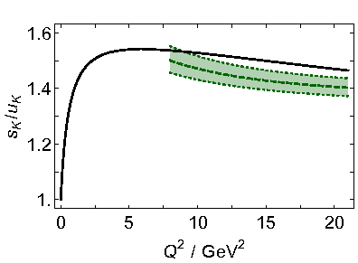
Kaon form factor
– flavour separation
Exposing strangeness: projections for kaon electromagnetic form factors, Fei Gao, Lei Chang, Yu-Xin Liu, Craig D. Roberts and Peter C. Tandy, arXiv:1703.04875 [nucl-th], Phys. Rev. D 96 (2017) 034024
Current conservation
F_{uss}(0) = F_{uus}(0)
Under evolution:
ϕ_{K} → 6 x (1-x) ⇒ ω_{s̅} → ω_{u} ⇒ Ratio → 1
Agreement between direct calculation and hard-scattering formula, using consistent PDA
Ratio never exceeds 1.5 and
Logarithmic approach to unity
Typical signal of DCSB-dominance in flavour-symmetry breaking:
  M_{s}(0) ∼ 1.25 M_{u}(0)
  but this scale difference becomes irrelevant under evolution
[ s̅ γ s u_{spectator} / u̅ γ u s_{spectator} ]² ≤ 1.5
DSE Prediction
Hard scattering formula, using DSE=lQCD predicted PDAs

Slide 39
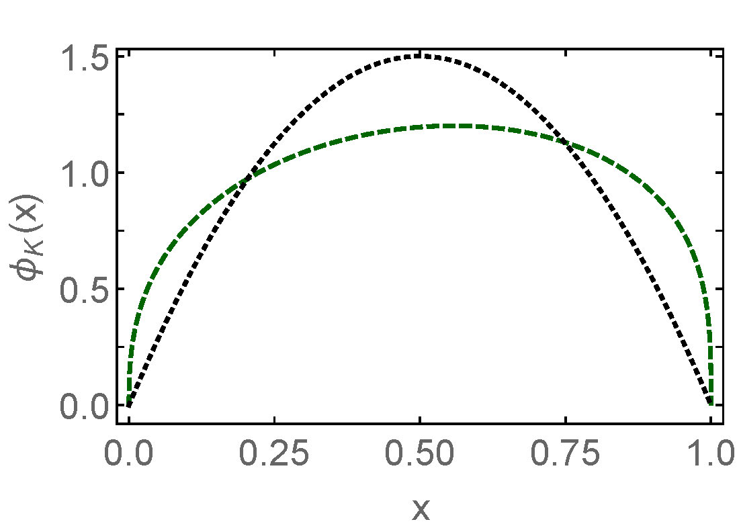
Isospin symmetry violation in charged-pion
Kaon PDA: m_{s}≠m_{u}
Plainly, when m_{d}≠m_{u} distortion in pion can’t be greater than that in kaon

Slide 40
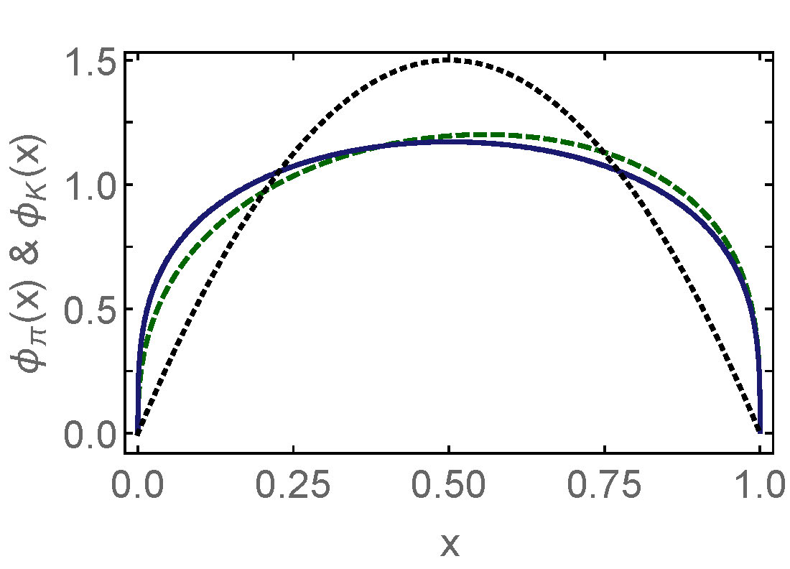
Isospin symmetry violation in charged pion
Kaon PDA: m_{s}≠m_{u}
Plainly, when m_{d}≠m_{u} distortion in pion can’t be greater than that in kaon
Pion PDA:
  Two blue curves plotted here
    M_{d}-M_{u} = 2 MeV
    M_{d}-M_{u} = 0 MeV
  Visually indistinguishable
  Such is the scale of charge symmetry breaking

Slide 41
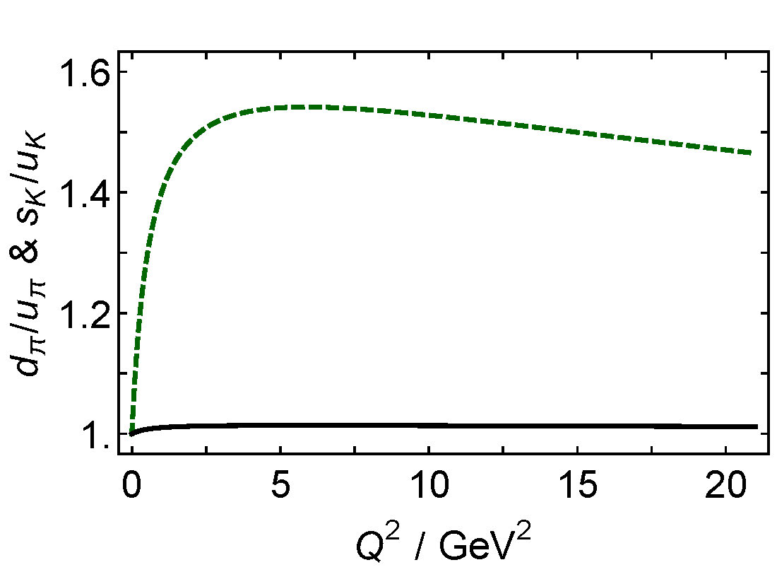
Isospin symmetry violation in charged pion
Kaon PDA: m_{s}≠m_{u}
Plainly, when m_{d}≠m_{u} distortion in pion can’t be greater than that in kaon
Pion PDA:
  Two blue curves plotted here
    M_{d}-M_{u} = 2 MeV
    M_{d}-M_{u} = 0 MeV
  Visually indistinguishable
  Such is the scale of charge symmetry breaking
π⁺ form factor: hard scattering formula with CSV-PDA
  1/40th of the effect in kaon
kaon
pion
Isospin symmetry violation in π⁺
  not more than 1.4%
  peaks at roughly 6 GeV²
  and falls to zero thereafter,
  in accordance with QCD
[d̅ γ d u_{spectator} / u̅ γ u s_{spectator} ]² ≤ 1.014

Slide 42
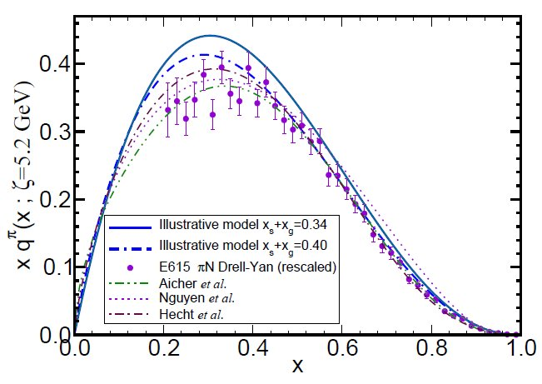
π & K Valence-quark Distribution Functions

Slide 43
π & K PDFs
Extant data on π & K PDFs (mesonic Drell-Yan) is old: 1980-1989
New data would be welcome:
  persistent doubts about the Bjorken-x ≃1 behaviour of the pion’s valence-quark PDF
  single modest-quality measurement of u^{K}(x)/u^{π}(x) cannot be considered definitive.
Approved experiment, using tagged DIS at JLab 12, should contribute to a resolution of pion question
  Similar technique may also serve for kaon and Jlab 12 experiment approved.
Future:
  new mesonic Drell-Yan measurements at modern facilities could yield valuable information on π and K PDFs (COMPASS),
  as could two-jet experiments at the large hadron collider;
  EIC would be capable of providing access to π and K PDFs through measurements of forward nucleon structure functions.
Gribov-Lipatov reciprocity (crossing symmetry) entails connection between PDFs and fragmentation functions on z ≃ 1 (z ≥ 0.75)
    D_{H/q}(z) ≈ z q^{H}(z)
  Reliable information on meson fragmentation functions is critical if the worldwide programme aimed at determining TMDs is to be successful

Slide 44
Pion’s Valence-Quark
Distribution Function
Owing to the validity of factorisation in QCD,
q^{π}(x) is directly measurable in πN Drell-Yan experiments
Experimental data on π & K PDFs obtained in mesonic Drell-Yan scattering from nucleons in heavy nuclei; but it’s old: 1980-1989
E615 @ FNAL (Conway:1989fs): leading-order analysis of πN Drell-Yan
q^{π}(x) ∼ (1-x)¹
Apparent disagreement with QCD.
Nevertheless (often) used to produce “modern” PDF fits

Slide 45

Valence-quark PDFs within mesons
Basic features of the pion valence-quark distribution function,
Lei Chang, Cédric Mezrag, et al.,
arXiv:1406:5450 [nucl-th], Phys. Lett. B 737 (2014)pp. 23–29
Valence-quark distribution functions in the kaon and pion,
Chen Chen, Lei Chang et al.
arXiv:1602.01502 [nucl-th], Phys. Rev. D93 (2016) 074021/1-11
Compute PDFs from imaginary part of virtual-photon – pion forward Compton scattering amplitude:
    γ π → γ π
Handbag diagram is insufficient. Doesn’t even preserve global symmetries. Exists a class of leading-twist corrections that remedies this defect ⇒
  Similar expressions for u_{V}^{K}(x), s_{V}^{K}(x)
Projection onto light-front
Partial derivative wrt relative momentum
Measurable quantities
Directly related to
dynamically generated quark masses
& bound-state wave functions

Slide 46


Valence-quark PDFs within mesons
Basic features of the pion valence-quark distribution function,
Lei Chang, Cédric Mezrag, et al.,
arXiv:1406:5450 [nucl-th], Phys. Lett. B 737 (2014)pp. 23–29
Valence-quark distribution functions in the kaon and pion,
Chen Chen, Lei Chang et al.
arXiv:1602.01502 [nucl-th], Phys. Rev. D93 (2016) 074021/1-11
Valence-quark PDFs satisfy, independent of any and all structural details:
Formulae provide algebraic proof that (hadronic scale ζ ≈ 0.5 GeV)
    q_{V}^{M}(x ≃ 1) ∝ (1-x)^{2n}
  in any theory with (1/k²)^{n} vector-boson exchange interaction

Slide 47
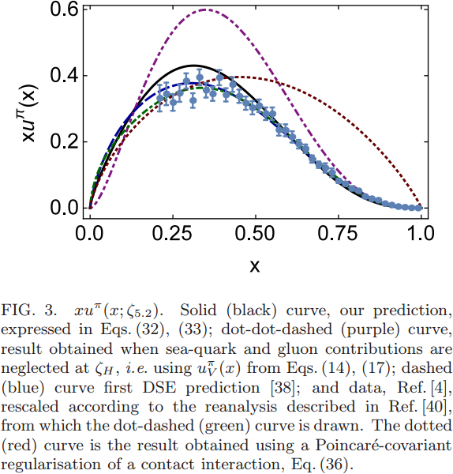
Pion PDF
DSE
2000 2016
Purple dot-dot-dash = prediction at ζ_{H}
Data = modern reappraisal of E615: NLO analysis plus soft-gluon resummation (ASV)
Solid black curve, prediction evolved to ζ=5.2GeV, the scale associated with the experiments
Blue dashed curve = first DSE prediction, in 2000 (ζ=5.2GeV)
Dotted red curve = result obtained with momentum-independent gluon exchange (contact interaction, ζ=5.2GeV)
CI: (1-x)^{1.0±0.1}
ζ=5.2GeV
QCD demands it
& phenomenology should respect that
DSE: (1-x)^{3.0±0.1}

Slide 48
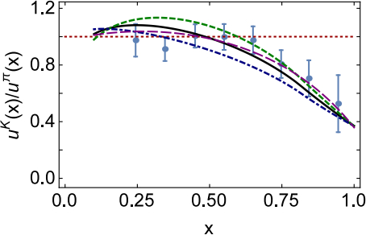

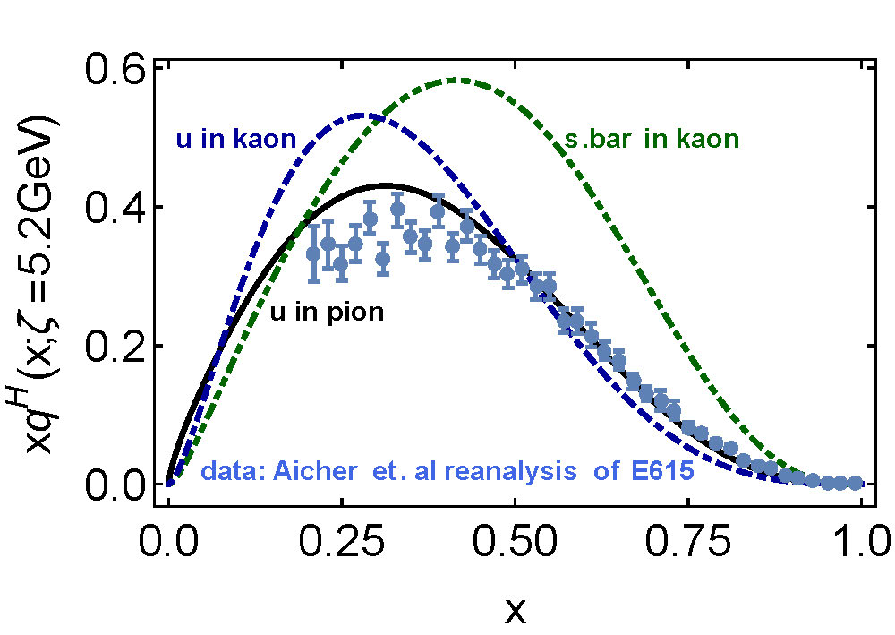
Kaon’s gluon content
0%
10%
〈x〉_{g}^{K}(ζ_{H}) = 0.05 ± 0.05
  ⇒ Valence quarks carry
  95% of kaon’s
  momentum at ζ_{H}
DGLAP-evolved to ζ₂
  Valence-quarks carry ⅔ of kaon’s light-front momentum
  Cf. Only ½ for the pion

Slide 49

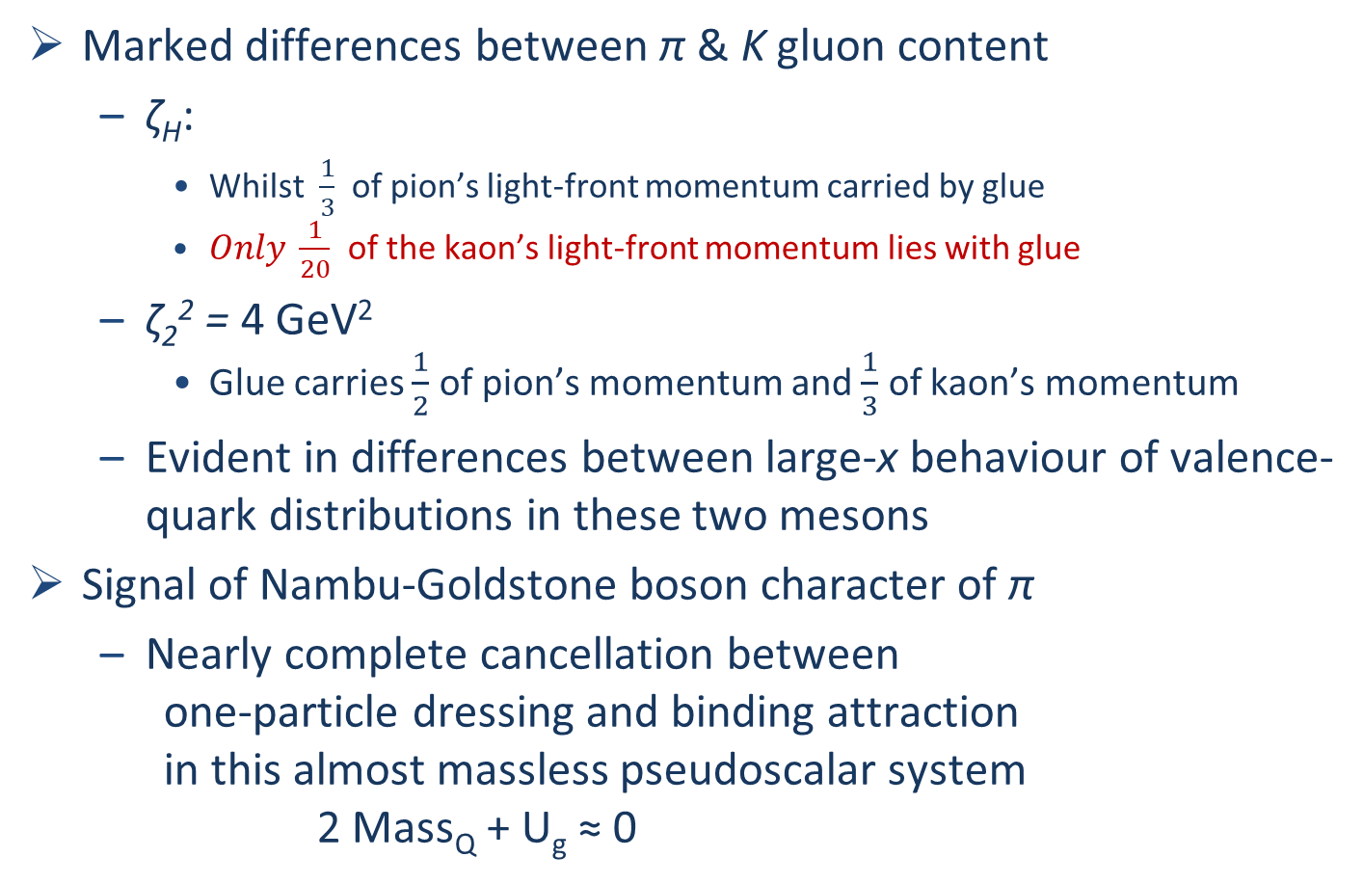
π & K PDFs
Valence-quark distribution functions in the kaon and pion,
Chen Chen, Lei Chang et al.
arXiv:1602.01502 [nucl-th], Phys. Rev. D93 (2016) 074021/1-11
Marked differences between π & K gluon content
  ζ_{H}:
    Whilst $\frac{1}{3}$ of pion’s light-front momentum carried by glue
    $Only \frac{1}{20}$ of the kaon’s light-front momentum lies with glue
  ζ₂² = 4 GeV²
    Glue carries $\frac{1}{2}$ of pion’s momentum and $\frac{1}{3}$ of kaon’s momentum
  Evident in differences between large-x behaviour of valence-quark distributions in these two mesons
Signal of Nambu-Goldstone boson character of π
  Nearly complete cancellation between
    one-particle dressing and binding attraction
    in this almost massless pseudoscalar system
    2 Mass_{Q} + U_{g} ≈ 0

Slide 50
π & K PDFs
Valence-quark distribution functions in the kaon and pion,
Chen Chen, Lei Chang et al.
arXiv:1602.01502 [nucl-th], Phys. Rev. D93 (2016) 074021/1-11
Existing textbook description of Goldstone’s theorem via pointlike modes is simplistic

Slide 51
π & K PDFs
Valence-quark distribution functions in the kaon and pion,
Chen Chen, Lei Chang et al.
arXiv:1602.01502 [nucl-th], Phys. Rev. D93 (2016) 074021/1-11
The appearance of Nambu-Goldstone modes in the Standard Model is far more interesting
  Nambu-Goldstone modes are nonpointlike!
  Intimately connected with origin of mass!
  Possibly/Probably(?) inseparable from expression of confinement!
Difference between gluon content of π & K is measurable … using well-designed EIC
Write a definitive new chapter in future textbooks on the Standard Model

Slide 52
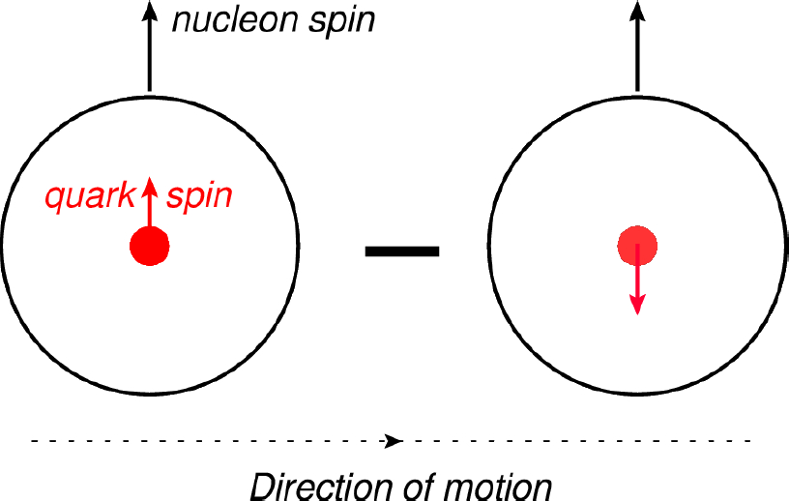
Proton’s Tensor Charge

Slide 53
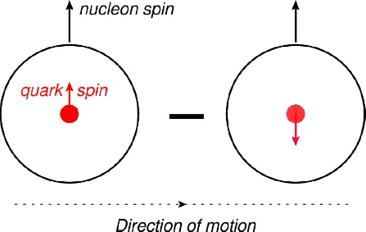

Tensor Charge and TMDs
New generation experiments aim to obtain data that can be used to determine the proton's transverse momentum dependent parton distribution functions (TMDs)
At leading-twist, three distinct TMDs are nonzero in the collinear limit, i.e. in the absence of parton transverse momentum within the target, k⊥ = 0:
  unpolarized = f₁ ,
  helicity = g_{1L} ,
  transversity = h_{1T} .
Proton’s tensor charges:
  measure any bias in quark transverse polarisation induced by a polarisation of the parent proton
Phenomenological extraction/inference from extant data on h_{1T}

Slide 54
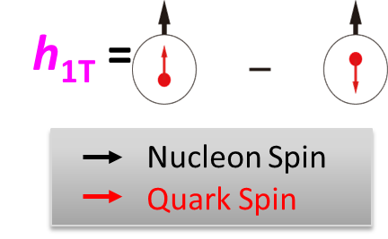

TMDs … Transversity
… Tensor Charge
Direction of motion
Intrinsic, defining property of the nucleon
… just as significant as axial-charge
… in non-relativistic limit it is axial charge
No gluon transversity distribution
Value of tensor charge places constraints on some extensions of the Standard Model <PRD85 (2012) 054512>
Current knowledge of transversity:
SIDIS @HERMES, COMPASS, JLab
Future SIDIS at JLab (SoLID), EIC, …

Slide 55
Proton Tensor Charges
Theoretical predictions:
Compute directly from matrix element
Used widely for Lattice-QCD analyses:
  [Bhattacharya:2015esa, Bhattacharya:2016zcn, Alexandrou:2017qyt, Bali:2014nma]
Continuum studies, too:
  Quark model [He:1994gz, Yamanaka:2013zoa]
  Diquark approximations to Faddeev equation [Hecht:2001ry, Pitschmann:2014jxa, Xu:2015kta]

Slide 56
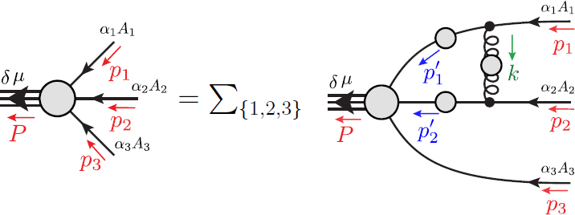
Baryons as a
3-valence-body problem

Slide 57
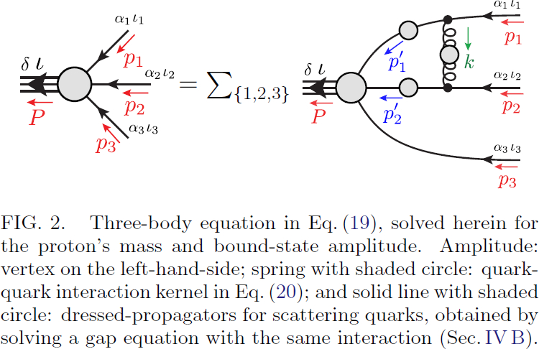


Proton Faddeev Amplitude
Proton tensor charges from a
Poincaré-covariant Faddeev Equation
Q.-W. Wang, S.-X. Qin, C. D. Roberts & S. M. Schmidt
arXiv:1806.01287 [nucl-th]
Using precisely same interaction as for mesons, solved for the nucleon, using symmetry-preserving RL-truncation of all relevant equations:
    Gap equations
    Bethe-Salpeter equations
    and Faddeev-equations
No diquark approximation to the quark-quark scattering kernel
Must solve for dressed-quark tensor charges, via tensor vertex.
  Only Q=0 required
  Renormalise at ζ₂ = 2 GeV
Natural size is now evident

Slide 58
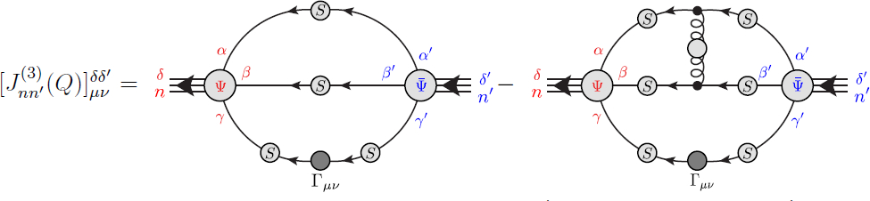
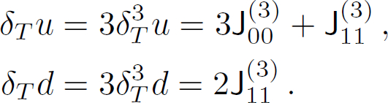
Proton’s Tensor Charges
Proton tensor charges from a
Poincaré-covariant Faddeev Equation
Q.-W. Wang, S.-X. Qin, C. D. Roberts & S. M. Schmidt
arXiv:1806.01287 [nucl-th]
Charges computed from the proton’s tensor current
  Symmetry-preserving form, consistent with Faddeev amplitude
Two isospin channels in Faddeev equation
and in current
  00 = kernel for isoscalar-scalar diquark
  11 = isovector-axial-vector diquark
Signal that
δ_{T}d ≈ 0 in models that
suppress axial-vector diquarks

Slide 59
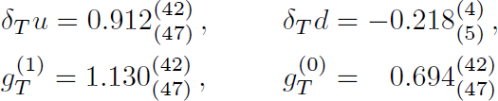
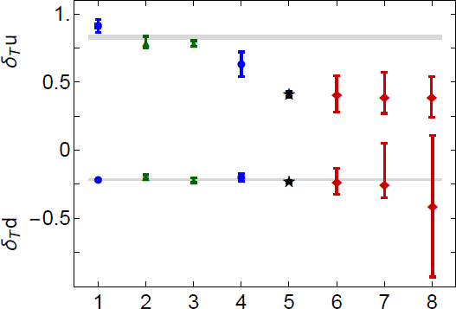
Proton’s Tensor Charges
Interaction kernel has one parameter, ω
  Fixed by requiring a good description of π and ρ properties
  Variation shows sensitivity to ± 10% changes in ω around the favoured value
δ_{T}u: Increasing tension between theory and phenomenology
δ_{T}d: Theory and Phenomenology agree
Theory average
This analysis
lQCD
Contact interaction DSE
SoLID precision
phenomenology

Slide 60

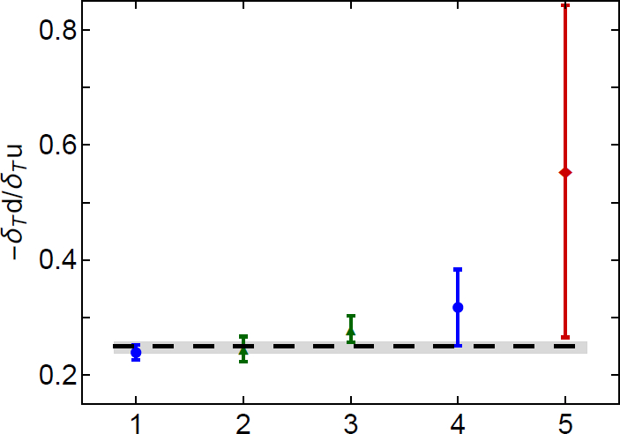
Proton’s Tensor Charges
Scale-invariant ratio
– δ_{T}d/δ_{T}u
Phenomenology [Ye:2016prn] produces ratio that is roughly twice as large
Using simple nonrelativistic quark model spin-flavour wave function this ratio is
– δ_{T}d/δ_{T}u = ¼
  Practically the same in MIT bag model
  But, in both cases, the individual tensor charges are measurably larger in magnitude
  Agreement accidental, like μ_{p}/μ_{n}
phenomenology
This analysis
lQCD
Contact interaction DSE

Slide 61
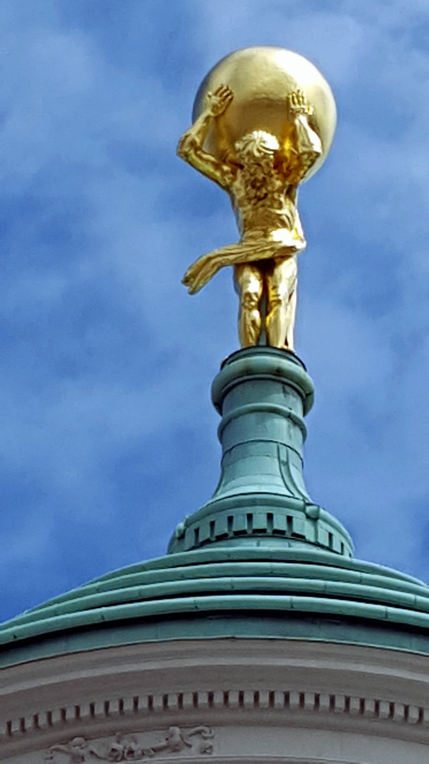
Epilogue

Slide 62
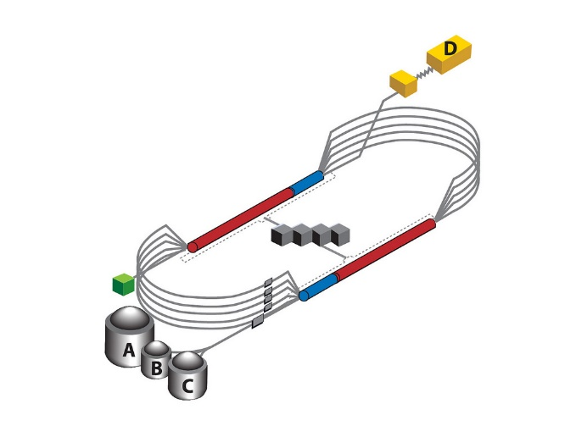

Epilogue
Challenge: Explain and Understand
the Origin and Distribution of the Vast Bulk of Visible Mass
Current Paradigm: Quantum Chromodynamics
QCD is plausibly a mathematically well-defined quantum field theory,
The only one we’ve ever produced
  Consequently, it is a worthwhile paradigm for developing Beyond-SM theories
Challenge is to reveal the content of strong-QCD
Tough Problem
Progress and Insights
being delivered by amalgam of
  Experiment
  Phenomenology
  Theory
Must continue into eras of

Slide 63
Epilogue
Challenge: Explain and Understand
the Origin and Distribution of the Vast Bulk of Visible Mass
Current Paradigm: Quantum Chromodynamics
QCD is plausibly a mathematically well-defined quantum field theory,
The only one we’ve ever produced
  Consequently, it is a worthwhile paradigm for developing Beyond-SM theories
Challenge is to reveal the content of strong-QCD
Tough Problem
Progress and Insights
being delivered by amalgam of
  Experiment
  Phenomenology
  Theory
Must continue into eras of
Thankyou

Slide 65
E615 Controversy
q^{π}(x) ∼ (1-x)¹
Numerous “explanations”
Nambu – Jona-Lasinio model, translationally invariant regularisaion
q^{π}(x) ∼ (1-x)⁰,
which becomes ≈1 after evolving from a low resolution scale
NJL models with a hard cutoff & also some duality arguments:
q^{π}(x) ∼ (1-x)¹
Relativistic constituent quark models:
q^{π}(x) ∼ (1-x)^{0…2}
depending on the form
of model wave function
Instanton-based models
q^{π}(x) ∼ (1-x)^{1…2}
Any power you might like in models possessing no connection with QCD.
What can be learnt from this?
Is QCD threatened?

Slide 66
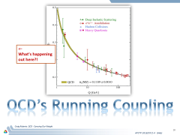
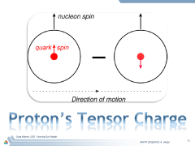

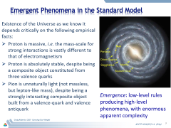
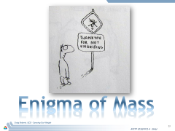
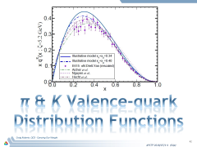
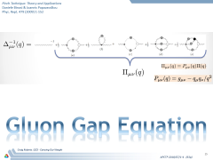
Contents
Tensor Charge

