Slide 1
Physics Perspectives
with
Positron Beams at Jefferson Lab
e⁺ @ Jlab 12 GeV & JLEIC
Eric Voutier for the JLab Positron Working Group
Institut de Physique Nucléaire, Orsay, France
Physics motivations
Polarized positrons @ JLab
Technological challenges
Conclusion
APCTP 2018
Pohang, July,1st-4th, 2018

Slide 2
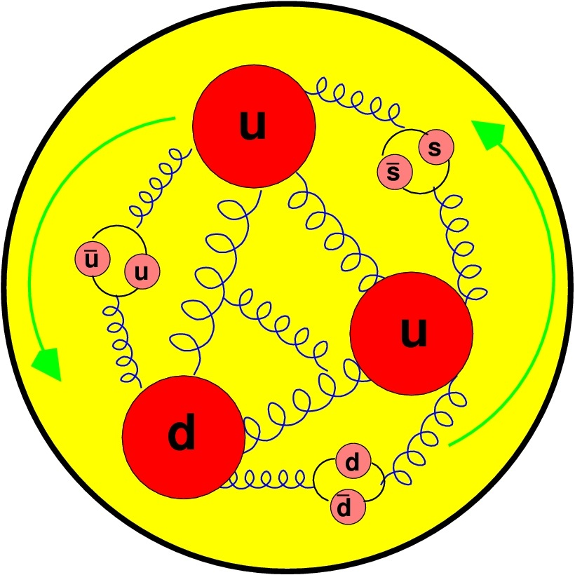
Physics Motivations
Two-photon physics
Generalized parton distributions
Neutral and charged DIS
Charm production
Pion and kaon structure
Charge conjugation violation
Dark photon
Right-handed W-bosons
Leptoquarks, leptogluons
Interference
Physics
Structure
Functions
Standard
Model Tests
Pohang, July 1st-4th, 2018
2/25

Slide 3

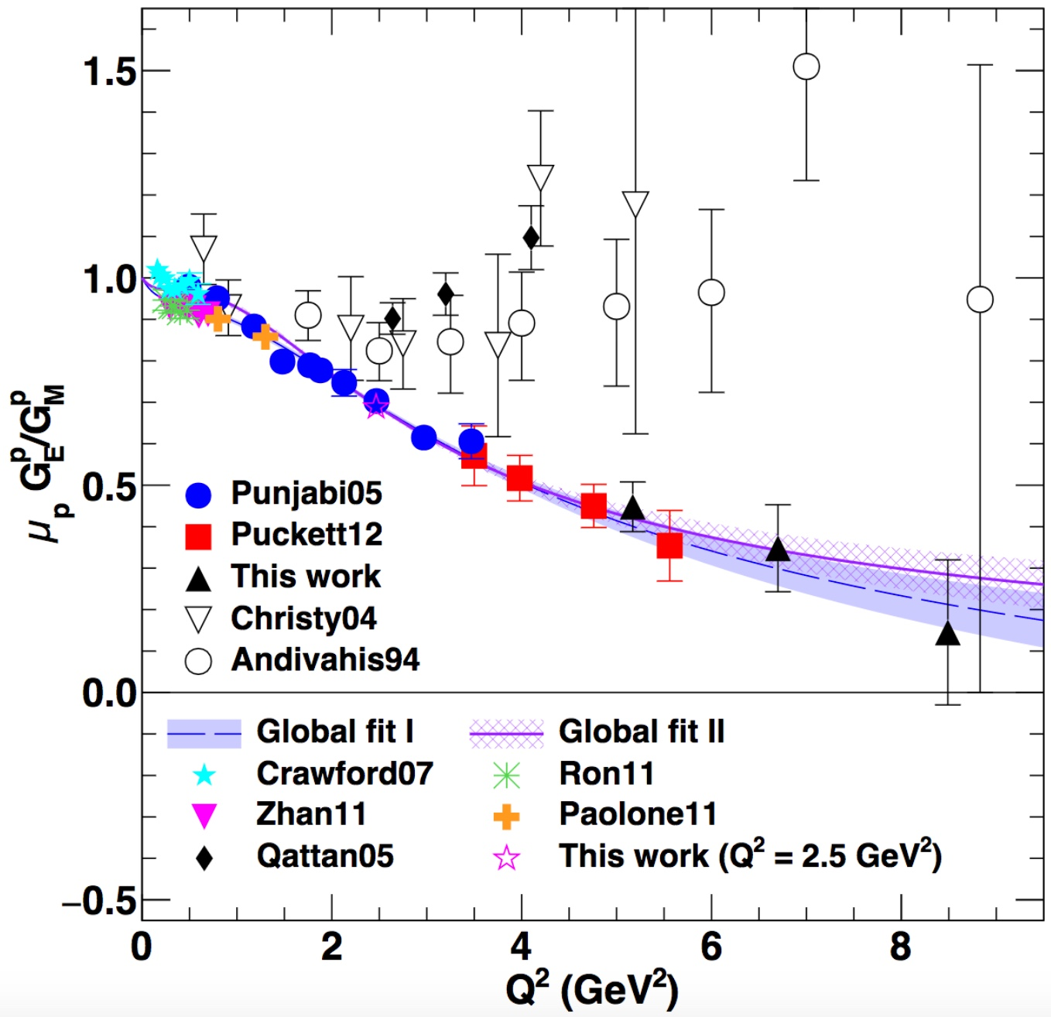
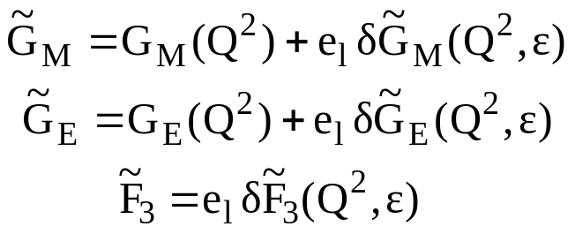
Electromagnetic form factors
Eric Voutier
Two Photons Physics
P.A.M. Guichon, M. Vanderhaeghen, PRL 91 (2003) 142303
Following the very first measurements of polarization transfer observables in electron elastic scattering, the validity of the 1γ exchange approximation of the electromagnetic interaction has been questioned.
A.J.R. Puckett et al. PRC 96 (2017) 055203
Within the 2γ exchange hypothesis, the electromagnetic structure of the nucleon may be parametrized by 3 generalized form factors, corresponding to 8 unknow quantities.
Q² (GeV²)
Pohang, July 1st-4th, 2018
3/25

Slide 4
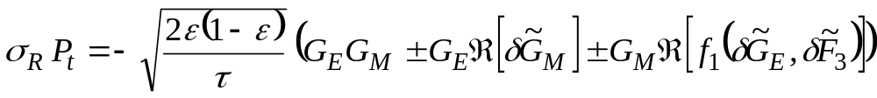

Electromagnetic form factors
Eric Voutier
Experimental Observables
M.P. Rekalo, E. Tomasi Gustafsson, NPA 742 (2004) 322 C. Carlson, M. Vanderhaeghen, ARNPS 57 (2007) 171
Unpolarized e± elastic scattering and polarization transfert observables off the nucleon involve up to 5 unknown quantities.
Cross Section
Polarization
Transfert
5 unknown contributions for 6 independent observables
Combining polarized electrons and positrons allows a model independent separation of the electromagnetic form factors of the nucleon.
Pohang, July 1st-4th, 2018
4/25

Slide 5
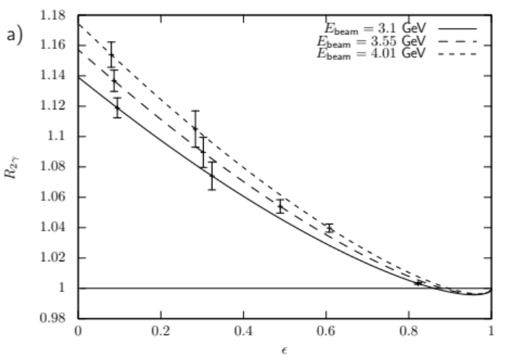
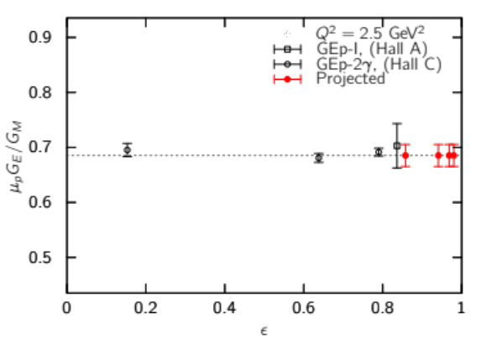
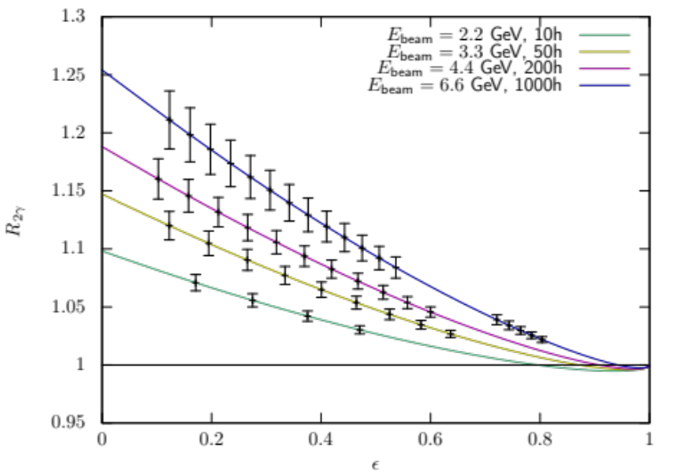
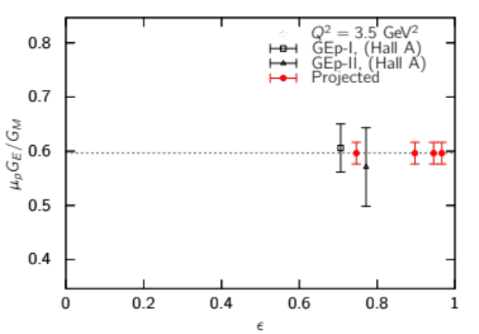
Electromagnetic form factors
Eric Voutier
LOI12-18-004
e+ @ JLab 12 GeV - J. Grames, E. Voutier et al.
J. Arrington, J. Bernauer, V. Burkert, A. Puckett, A. Schmidt et al.
A modified CLAS12 hosting an electromagnetic calorimeter in place of the Central Neutron Detector would allow to map out the 2γ-effects in the (Q²,ε) space.
e± polarization transfer measurements with SBS
Super-Rosenbluth measurements with e⁺ in Hall A/C
Pohang, July 1st-4th, 2018
5/25

Slide 6
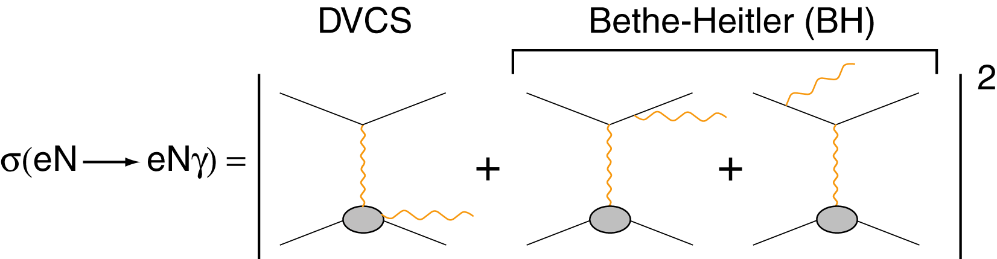




Generalized parton distributions
Eric Voutier
N(e,e′γN) Differential Cross Section
M. Diehl, CLAS12 European Workshop, Genova (2009)
Additional observables
Electron
observables
Electron & positron
observables
Polarized electrons and positrons allow to separate the
unknown amplitudes of the cross section for electro-production of photons.
Pohang, July 1st-4th, 2018
6/25

Slide 7
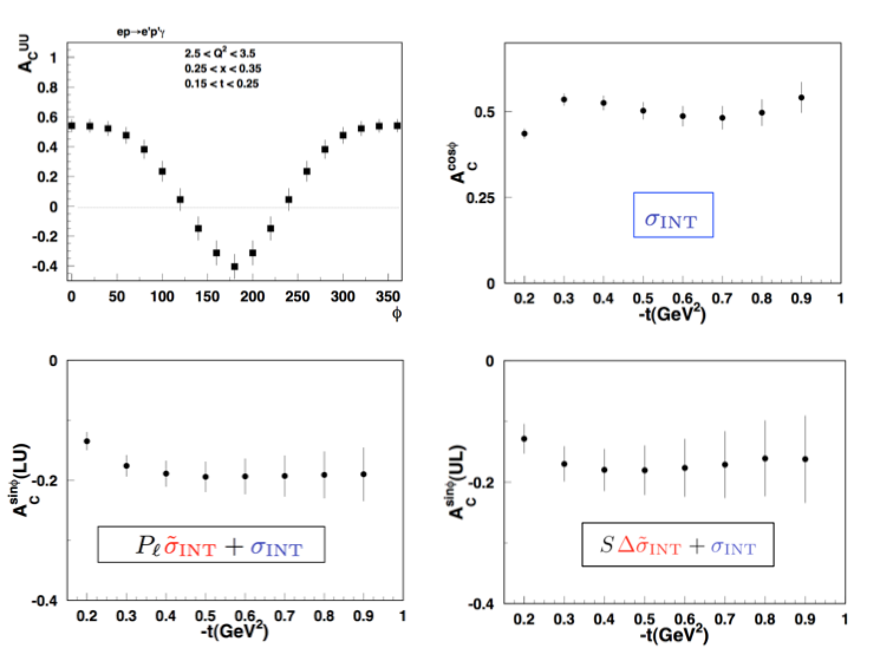
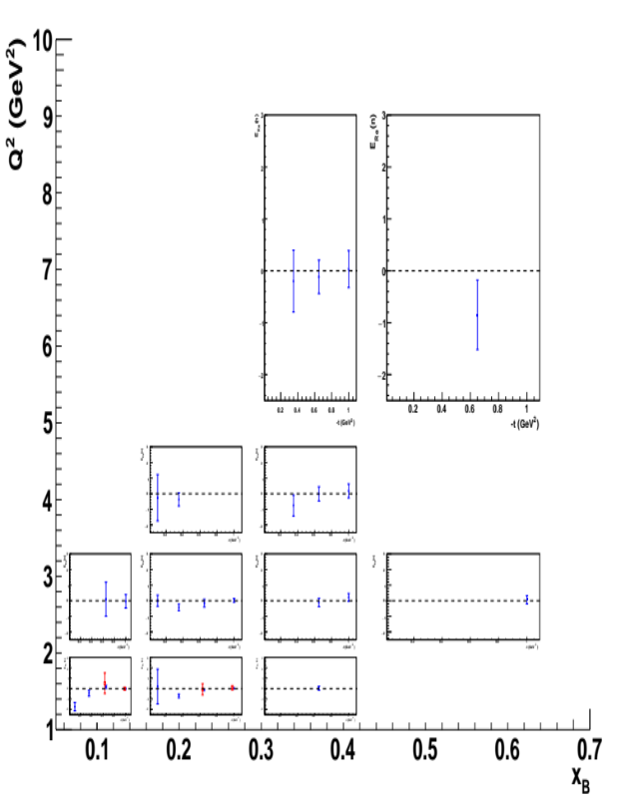
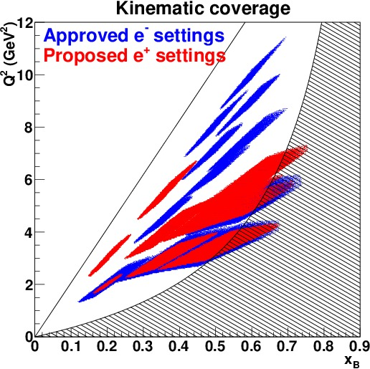
Generalized parton distributions
Eric Voutier
LOI12-18-004
e+ @ JLab 12 GeV - J. Grames, E. Voutier et al.
V. Burkert, L. Elouadrhiri, F.-X. Girod, C. Muñoz Camacho, S. Niccolai, E. Voutier et al.
It is proposed to measure polarized and unpolarized beam charge asymmetries off protons and neutrons (CLAS12), and unpolarized p-DVCS cross section with positrons (HMS+NPS).
e⁺ and e⁻ beams
e⁻ beam only
D-term
Re[E]
Pure DVCS
…
Pohang, July 1st-4th, 2018
7/25

Slide 8
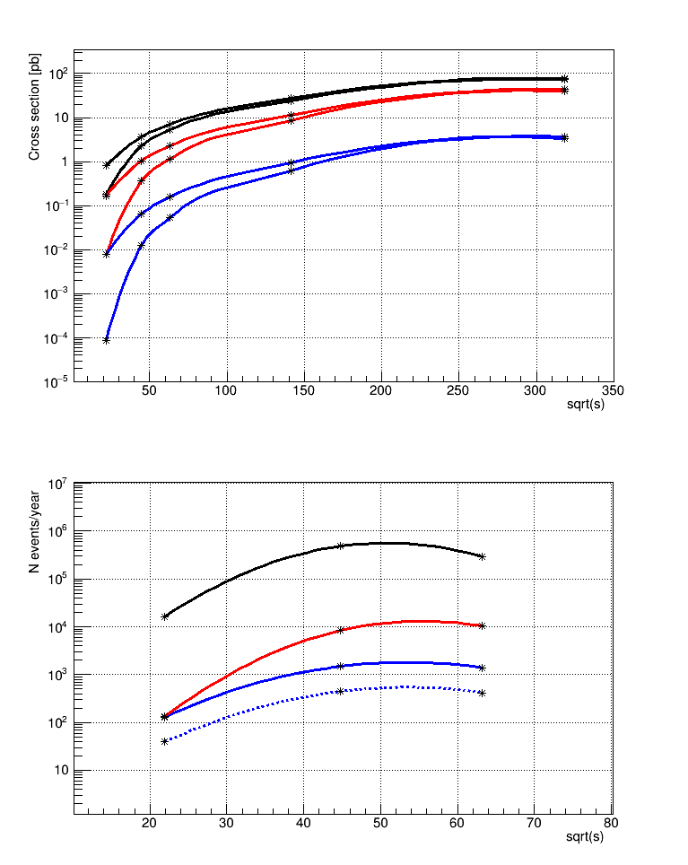
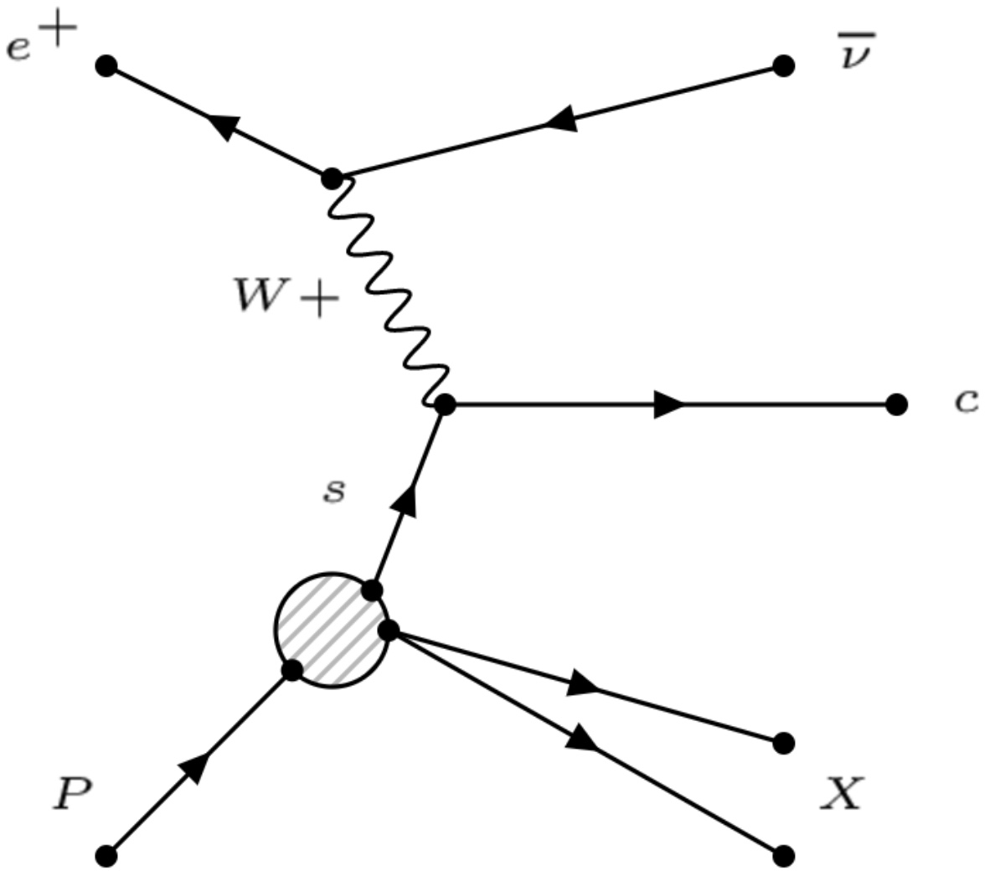
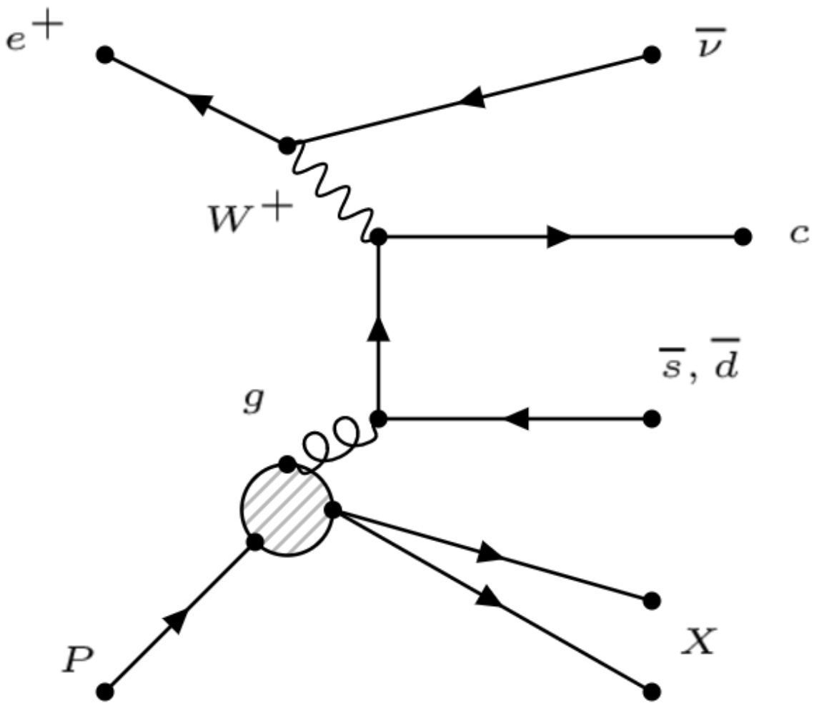

Charm production
Eric Voutier
Strangenes Tagging
The modest center-of-mass energy at the EIC can be compensated by the high luminosity and polarization degree of the lepton beam, to help for precise measurements of the small charge current cross section.
10
Q² > GeV²
100
CC e⁻p
CC e⁺p
Charm production via charge current exchange preferentially couples to the strange content of the nucleon.
The boson-gluon-fusion mechanism is a source of background, manageable with good PID and vertex reconstruction.
CC e⁺p (s->c)
EIC
$$e^{+}+p →\overline{υ_{e}}+c+X$$
$$e^{−}+p →υ_{e}+\overline{c}+X$$
An integrated luminosity of 10 fb⁻¹/year would provide ~1500 events/year.
Pohang, July 1st-4th, 2018
8/25

Slide 9
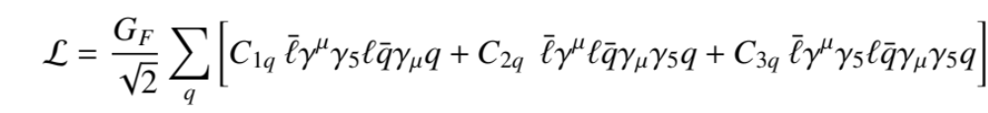
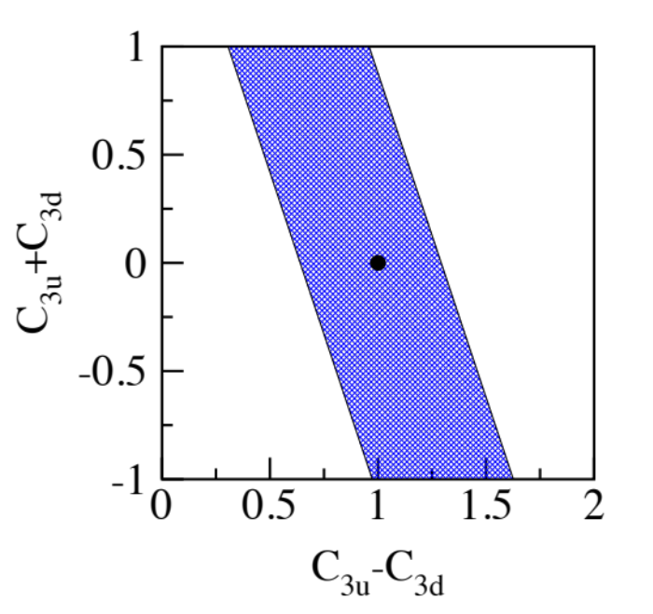



Charge conjugation violation
Eric Voutier
Weak Neutral Current Couplings
S.M. Berman, J.R. Primack , Phys. Rev. D 9 (1974) 2171 X. Zheng, JPos09, Newport News (2009)
The comparison of polarized electron an polarized positon scatterings provides access to the charge conjugation-violation coupling C_{3q} from the interference between the weak neutral and electromagnetic currents.
$$g_{A}^{e}g_{A}^{q}$$
$$A^{e_{L}^{−}−e_{R}^{+}}=\frac{dσ\left(e_{L}^{−}N\right)−dσ\left(e_{R}^{+}N\right)}{dσ\left(e_{L}^{−}N\right)+dσ\left(e_{R}^{+}N\right)}$$
The combination of C_{3q} couplings is poorly known; have only been measured at CERN using muon and anti-muon beams on a carbon target.
$$A_{p}^{e_{L}^{−}−e_{R}^{+}} = \left(\frac{3G_{F}Q^{2}}{2πα\sqrt{2}}\right) \frac{y\left(2−y\right)}{2} \frac{2C_{2u}u_{V}−C_{2d}d_{V}+2C_{3u}u_{V}−C_{3d}d_{V}}{4u+d}$$
0.81 (2C_{2u}-C_{2d}) + 2C_{3u}-C_{3d} = 1.53±0.45
$$A_{d}^{e_{L}^{−}−e_{R}^{+}} = \left(\frac{3G_{F}Q^{2}}{2πα\sqrt{2}}\right) \frac{y\left(2−y\right)}{2} \frac{2C_{2u}−C_{2d}+2C_{3u}−C_{3d}}{5}\frac{u_{V}+d_{V}}{u+\overline{u}+d+\overline{d}}$$
D. Wang et al. Phys. Rev. C 91 (2015) 045506
$A_{d}^{e_{L}^{−}−e_{R}^{+}}≈108 \frac{y\left(2−y\right)}{2} \left(2C_{3u}−C_{3d}\right) Q^{2}$ ppm
2C_{3u} – C_{3d} = 1.65 ± 0.45
There exists a unique opportunity for a polarized electron and positron beam at EIC to improve the C_{3q} knowledge.
C_{3q} are known only within 30%
Pohang, July 1st-4th, 2018
9/25

Slide 10
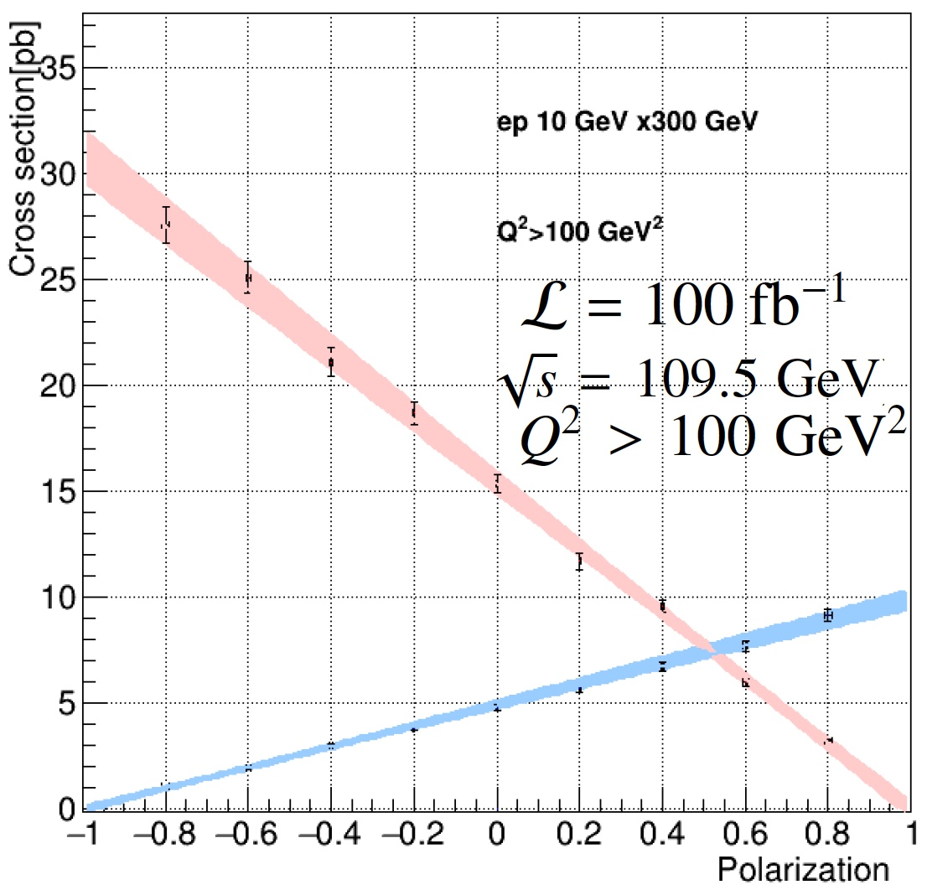


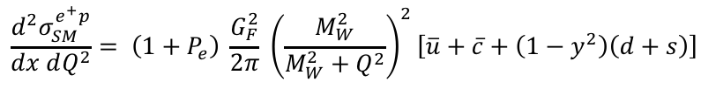
Right-handed W-bosons
Eric Voutier
Polarized Charge Current Cross Section
Y. Furletova, S. Mantry, JPos17, Newport News (2017)
The polarization dependence of the charge current cross section can be measured to potentially reveal deviations from the Standard Model prediction.
EIC projections
$$\frac{d^{2}σ_{SM}^{e^{+}p}}{dx dQ^{2}}= \left(1+P_{e}\right) \frac{G_{F}^{2}}{2π} {\left(\frac{M_{W}^{2}}{M_{W}^{2}+Q^{2}}\right)}^{2}\left[\overline{u}+\overline{c}+\left(1−y^{2}\right)\left(d+s\right)\right]$$
ΔP_{e}/P_{e}=1%
$$\frac{d^{2}σ_{SM}^{e^{−}p}}{dx dQ^{2}}= \left(1−P_{e}\right)\frac{G_{F}^{2}}{2π}{ \left(\frac{M_{W}^{2}}{M_{W}^{2}+Q^{2}}\right)}^{2}\left[u+c+\left(1−y^{2}\right)\left(\overline{d}+\overline{s}\right)\right]$$
$σ^{e^{±}p} \left(P_{e}=∓1\right)≠0 →$
Limit on the mass of
right-handed W-boson
Preliminary
95% confidence level upper bound
$σ^{e^{±}p} \left(P_{e}=−1\right)<0.0776 pb → M_{R}≥285 GeV$
(HERA limit in e⁺p is 208 GeV)
Pohang, July 1st-4th, 2018
10/25

Slide 11
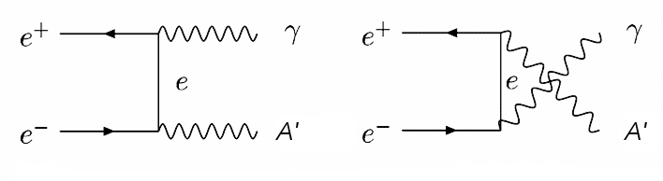
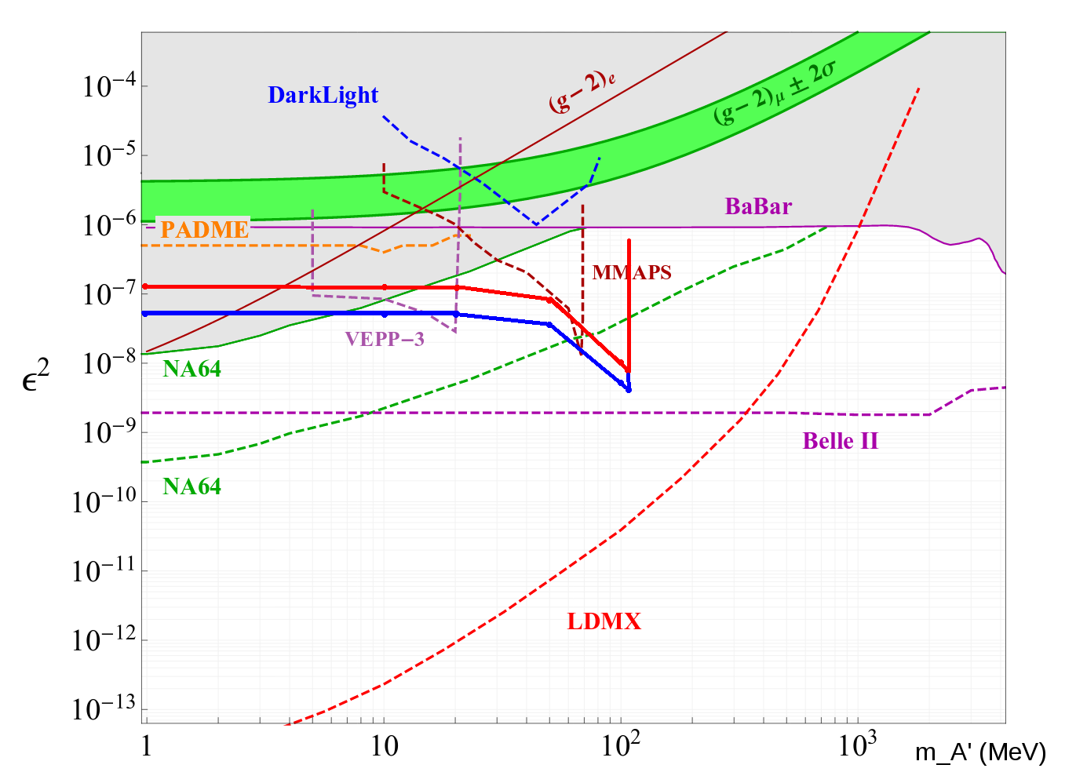
Search for dark photon
Eric Voutier
LOI12-18-004
e+ @ JLab 12 GeV - J. Grames, E. Voutier et al.
M. Battaglieri, A. Celentano, L. Marsicano et al.
The e⁺e⁻-annihilation offers an alternative way to probe the existence of a dark photon.
P. Valente, J. Alexander, JPos17, Newport News (2017)
L. Marsicano, JPos17, Newport News (2017)
In a PADME-like experiment looking at the photon spectra in the A’ invisible decay channel, a high energy positron beam
would extend in 180 days data taking
the A’ mass reach up to 100 MeV
and would improve by a
factor 10 the coupling strength sensitivity.
10 nA
100 nA
Pohang, July 1st-4th, 2018
11/25

Slide 12
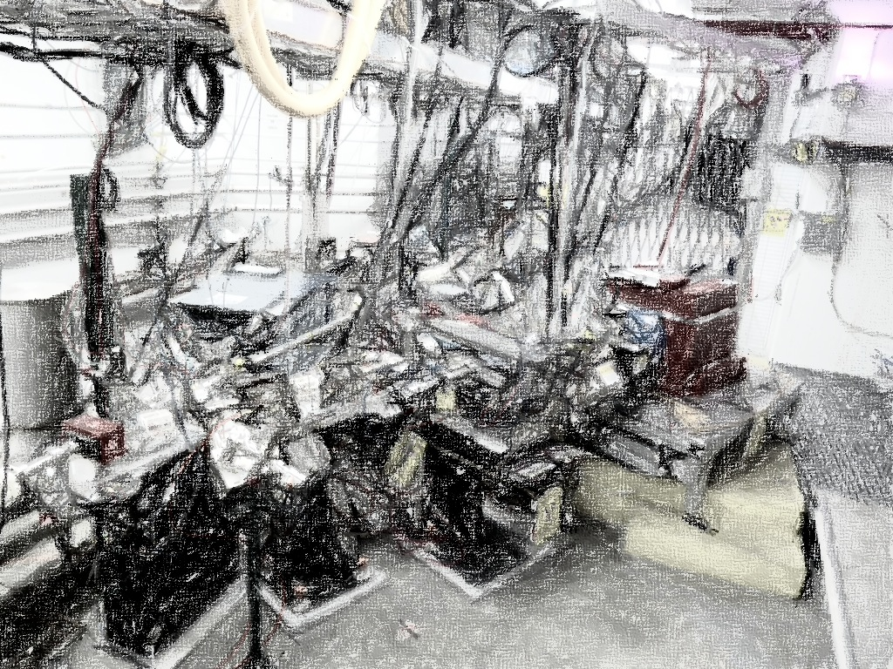
Polarized Positrons @ JLab
Positron polarization
JLab 12 GeV positron source
JLEIC positron source
Pohang, July 1st-4th, 2018
12/25

Slide 13
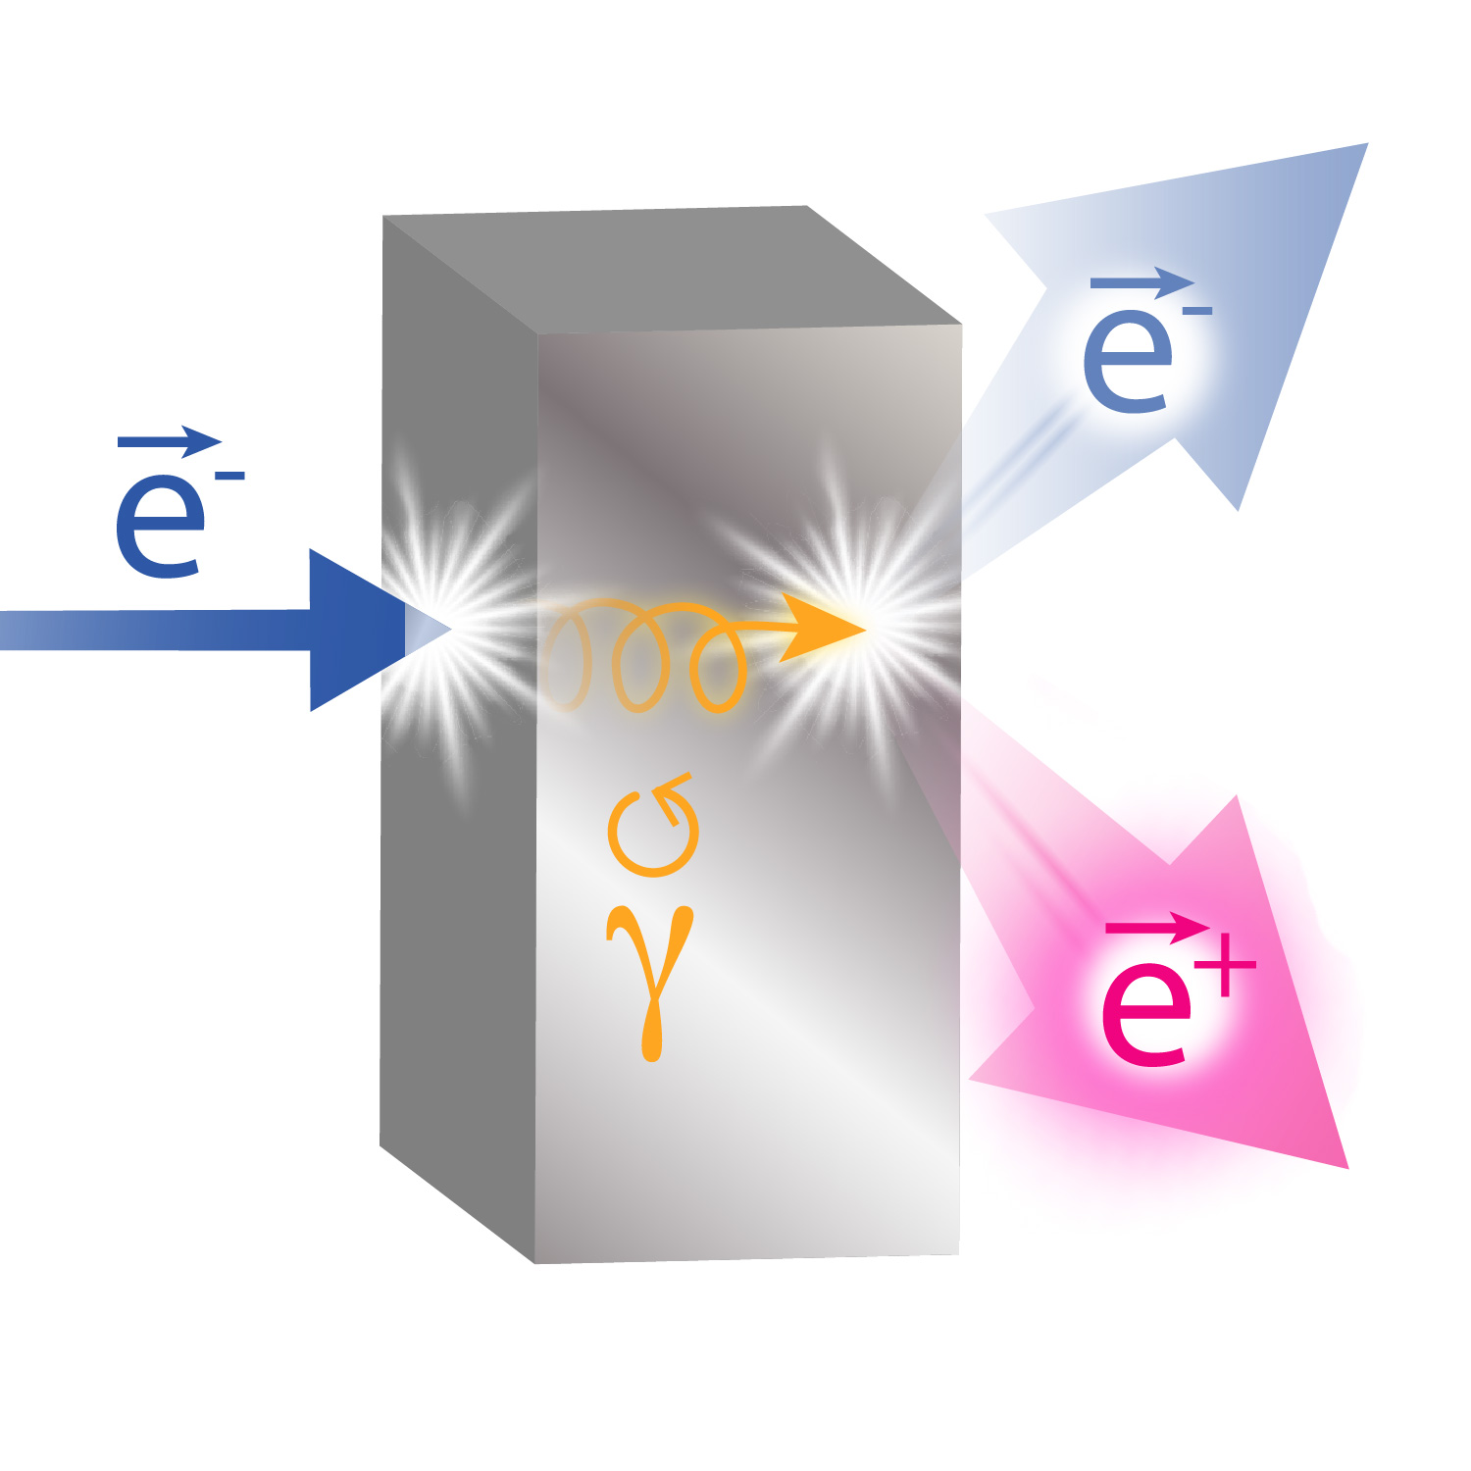
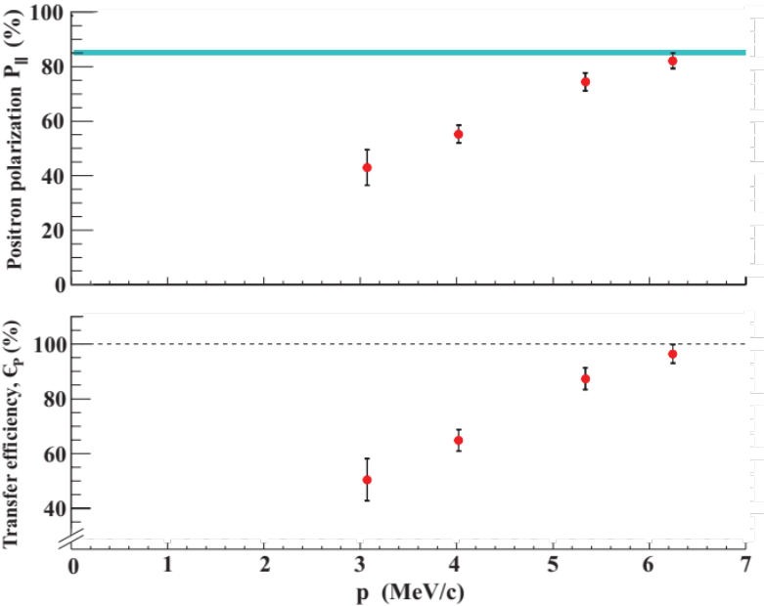
Positron polarization
Eric Voutier
PEPPo Technique
(PEPPo Collaboration) D. Abbott et al. , Phys. Rev. Lett. 116 (2016) 214801
PEPPo demonstrated efficient polarization transfer from 8.2 MeV/c electrons to positrons, expanding polarized positron capabilities from GeV to MeV accelerators.
e⁻ beam polarization
85.2 ± 0.6 ± 0.7 %
The PEPPo technique can optimaly achieve 75% electron polarization transfer.
Pohang, July 1st-4th, 2018
13/25

Slide 14
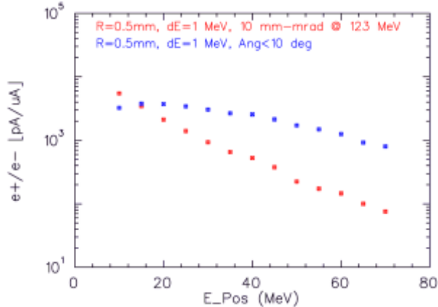
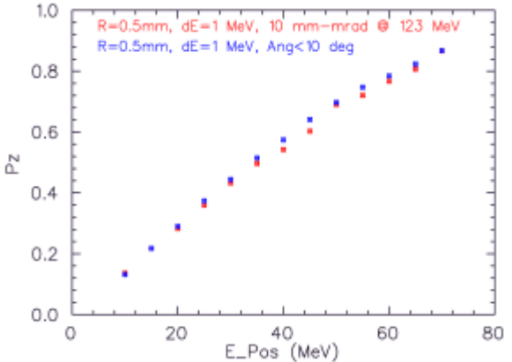
JLab 12 GeV positron source
Eric Voutier
LOI12-18-004
e+ @ JLab 12 GeV - J. Grames, E. Voutier et al.
L. Cardman et al. JPos17, Newport News (2017)
Positrons would be created at the CEBAF injector, using the 123 MeV electron beam.
5 MeV Dump
Synchrotron Light Monitor
Wien Filter
Chopper
Cryounit
Bunchlength
Cavity
Cryomodules
Buncher
Capture
Injection Chicane
Gun#2
PCup
FC#1
Prebuncher
Apertures
Wien Filter
E Select
Filter
Δφ Select
Selecting 60 MeV positrons maximizes the FoM (60%, 100 nA).
Selecting 6 MeV positrons maximizes the flux (> 1 μA).
Pohang, July 1st-4th, 2018
14/25

Slide 15
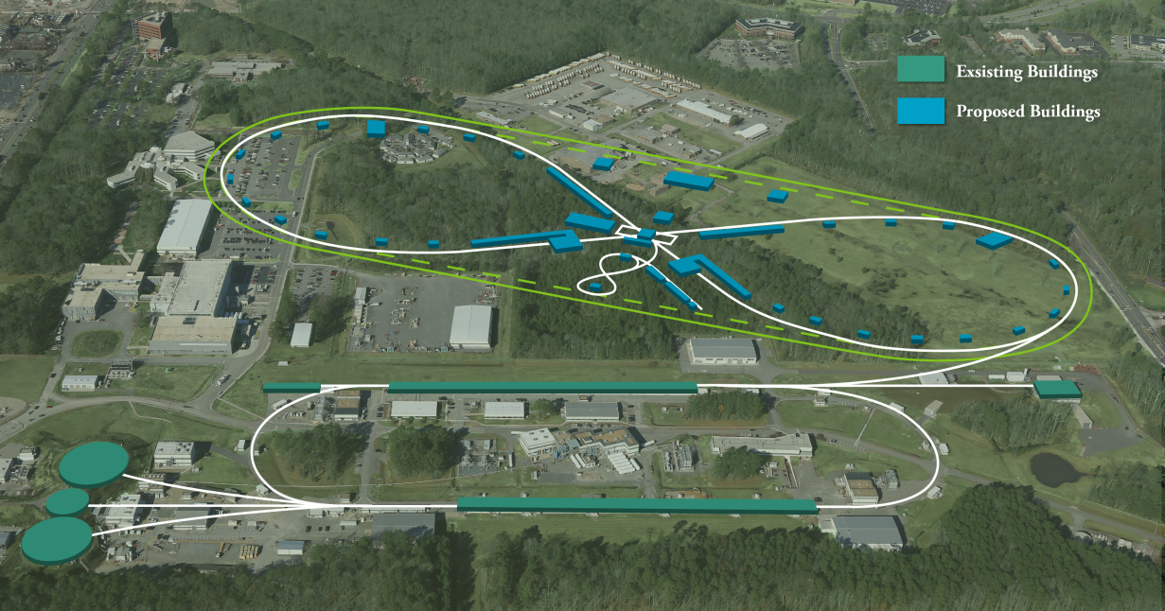
JLEIC positron source
Eric Voutier
Design Constraints
F. Lin et al. JPos17, Newport News (2017)
A possible design for a Positron-Ion-Collider (PIC) at JLEIC would involve a dedicated low energy polarized positron injector with specific pulse structure.
L ≧ 10³³ cm⁻².s⁻¹ P ≧ 40%
$$\vec{e^{+}}$$
17 MHz bunch train
of 60 bunches
1-2 pC
A low average current is required for injection into JLEIC with a reasonably short injection time (mn) and a reasonable polarization.
…
60 μs
20-85 ms
12-50 Hz, I_{ave} up to 6 nA
Pohang, July 1st-4th, 2018
15/25

Slide 16
JLEIC positron source
Eric Voutier
Positron Production Scheme
F. Lin et al. JPos17, Newport News (2017)
Positron Conversion/Collection Efficiency ~ 5 x 10⁻⁴
60% in polarization
Accumulator Ring (36m)
500-turn
phase-space painting
Bunch
Management
Polarized Electron
50 MeV Injector
Harmonic kicker
Extraction
to CEBAF
200 keV polarized e⁻
8 pC @ 748.5 MHz
~6mA
50 MeV polarized e⁻
4 nC bunches @ 748.5 MHz
~25 MeV Polarized e⁺
2 pC @ 17 MHz
50 MeV polarized e⁻
4 nC @ 17 MHz
High intensity polarized electron source
Management of beam power and material damage
Optimized collection system
Power on target
3.4 MW peak power
0.6 kW average
Pohang, July 1st-4th, 2018
16/25

Slide 17
Tecnological Challenges
Polarized electron source
Accumulator ring
Positron production
Positron capture
P3E initiative
Pohang, July 1st-4th, 2018
17/25

Slide 18
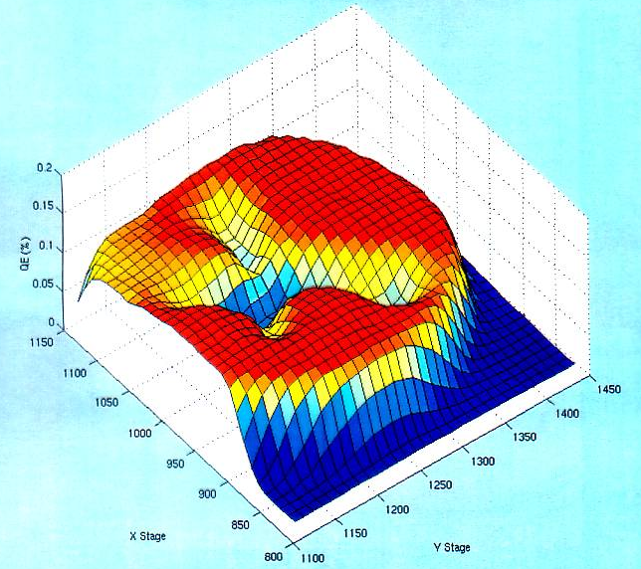
Polarized electron source
Eric Voutier
Photocathode R&D
The actual challenge of today’s spin polarized GaAs photoelectron guns technology is the extension of the charge lifetime from hundreds to thousands of Coulomb for uninterrupted operation at milli-Ampère beam current.
Electrons
OUT
Ions create QE trough to electrostatic center
Laser
IN
Gas
Minimizing ion production rate (higher photo-gun voltage, increased quantum efficiency…)
Minimizing ion damage effects (improved vacuum quality, larger spot size…)
Pohang, July 1st-4th, 2018
18/25

Slide 19
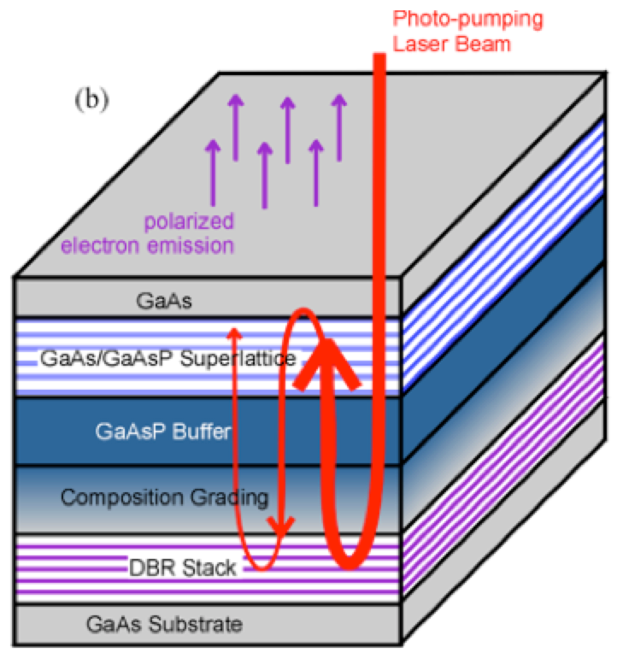
Polarized electron source
Eric Voutier
Quantum Efficiency
Current GaAs/GaAsP superlattice photocathodes in operation at CEBAF demonstrated high intensity together with high polarization.
Photocathode equiped with a Distributed Bragg Reflector demonstrated the ever measured highest QE & FoM.
W. Liu et al. Appl. Phys. Lett. 109 (2016) 252104
Cathode | Lab/Inc. | P (%) | QE (%) | FoM (P²xQE)
GaAS-GaASP | SLAC/SVTA | 86 | 1.20 | 0.89
AlInGaAs-AlGaAs | St. Petersburg | 92 | 0.85 | 0.72
GaAs-GaAsP | Nagoya | 92 | 1.60 | 1.35
GaAs-GaASP/DBR | JLab/SVTA |  | 6.40 | 4.52
J. Grames et al. PSTP 2017 (2017)
TJNAF
Pohang, July 1st-4th, 2018
19/25

Slide 20
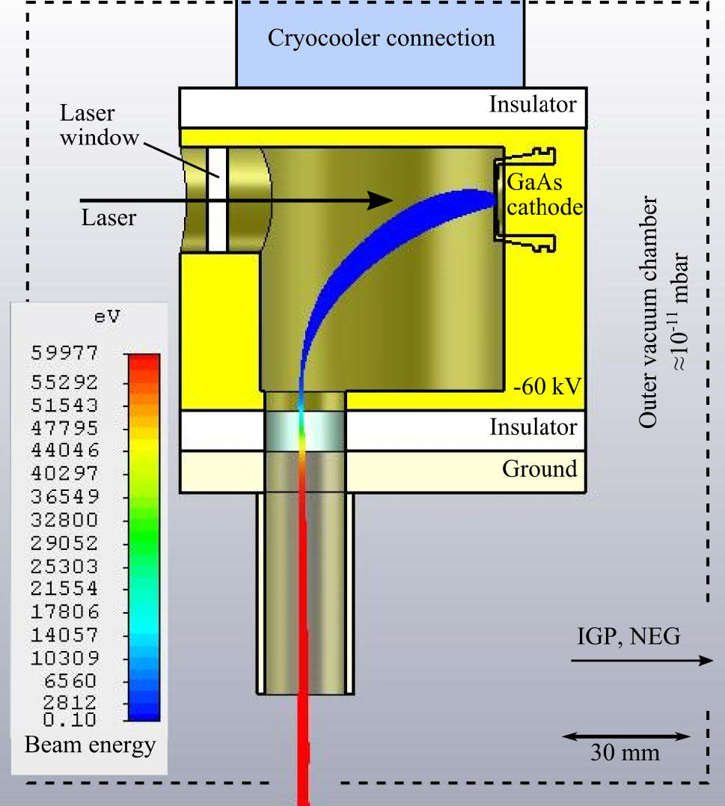
Polarized electron source
Eric Voutier
Vacuum Quality
S. Weih et al. JACoW IPAC (2017) TUPAB032
A photocathode placed in a cryogenic environment is expected to sustain higher laser power, and to much less suffer ion-back-bombardment effects because of better local vacuum condition from cryopumping at the cold surfaces.
A laser window prevents inner surfaces from outside contamination.
A bending electric field prevents ions produced by the extracted beam from traveling back to the cathode.
Would potentially provide 100 times higher beam currents.
TUD
Pohang, July 1st-4th, 2018
20/25

Slide 21
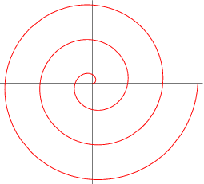
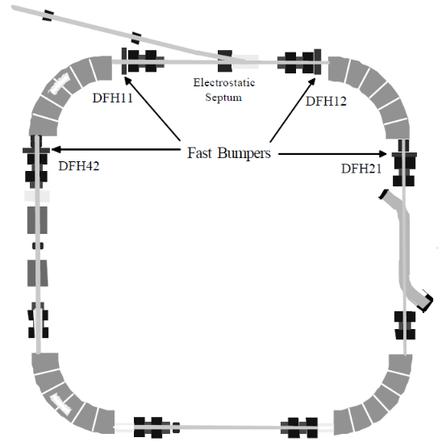
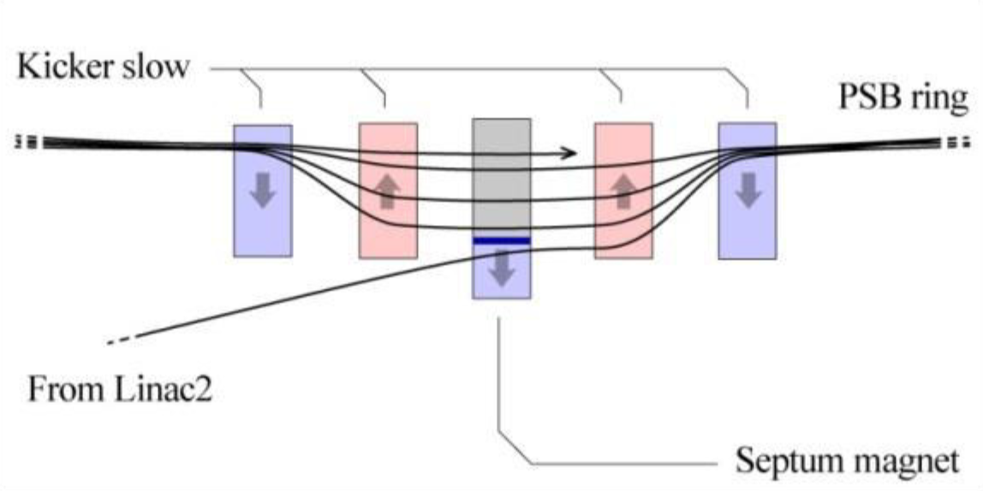
Accumulator ring
Eric Voutier
Multi-Turn Injection
x′
Septum thickness +
bunch width
The concept consists in an orbit bump near a septum which is then slowly reduced as beam being injected (phase-space painting).
The process can simultaneously occur in the longitudinal and vertical dimensions.
CERN’s LEIR has a design for 75-turn injection of Pb⁵⁴⁺. The plan is to push this number to a few hundred to a thousand thanks to low electron emittance.
x
Accumulator ring
Injected beam
Courtesy of Vasiliy Morozov
21/25
Pohang, July 1st-4th, 2018

Slide 22
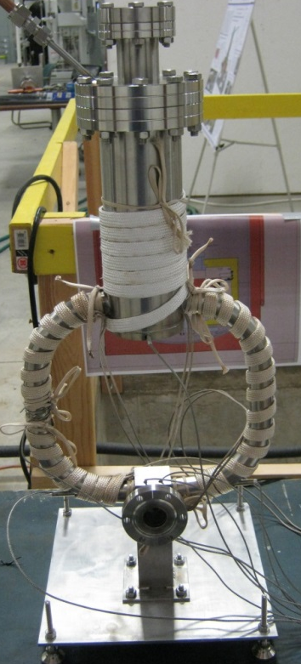
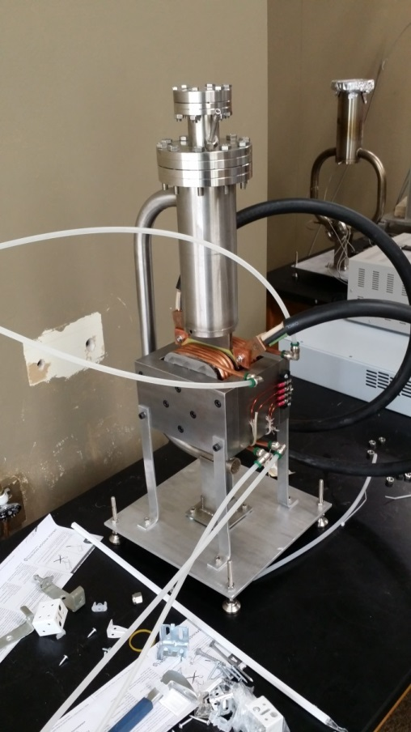
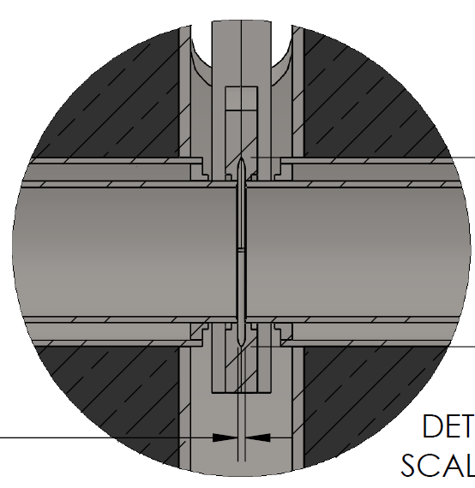

Positron production
Eric Voutier
High Power Target
Proposed high intensity polarized positron sources (ALTO, CEBAF, JLEIC, ILC…) represent challenging target issues with respect to beam power deposition and degradation of material through radiation exposure.
Liquid Metal Target
Lead-bismuth eutectic compound
C. Boulware et al. JPos17 (2017)
Stainless Steel Windows (0.25mm)
LBE (2mm)
Output (e⁻,e⁺,γ)
Input (e⁻)
  High Z = 82, 83
  Low melting point: 124°C
  High boiling point: 1670°C
  Natural circulation from density differential in warm/cold legs
  Possibility of mechanical and/or electromagnetic pumping to increase the flow
~10 kW power in CW
Pohang, July 1st-4th, 2018
22/25

Slide 23
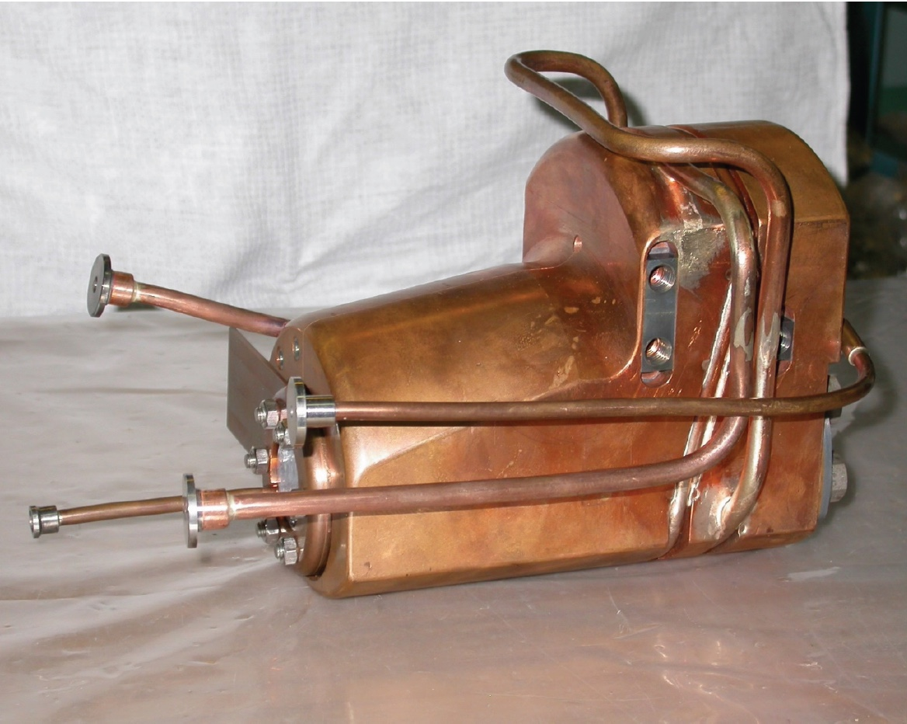
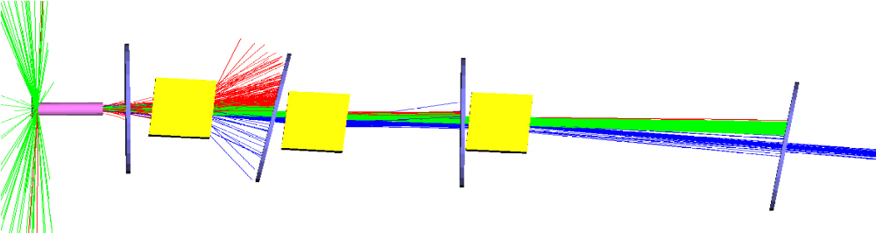
Positron capture
Eric Voutier
Positron Collection Concept
In comparison to unpolarized positron sources, the PEPPo technique requires the selection of a specific energy bite of the positron momentum spectra in order to optimize the figure-of-merit (P²I) of the beam.
Due to large emission angles, positron must be captured in an efficient matching system: Quarter Wave Transformer (QWT), Adiabatic Matching Device (AMD), Lithium Lenses, Plasma Lenses…
Additional emittance filters should also be considered to match CEBAF injection requirements.
VEPP-5
Flux concentrator
QWT Solenoid
Collimators
e⁻
e⁻
γ
126 MeV
e⁺
S. Golge, PhD Thesis, 2010 (ODU/JLab)
24 MeV
3x10⁻⁴ e⁺/e⁻
W target
Combined Function Magnet
(QD)
Pohang, July 1st-4th, 2018
23/25

Slide 24
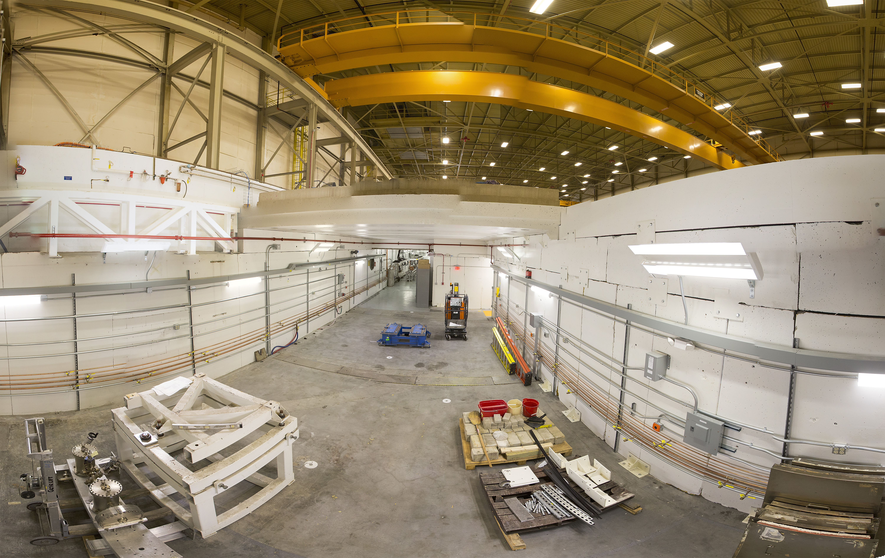
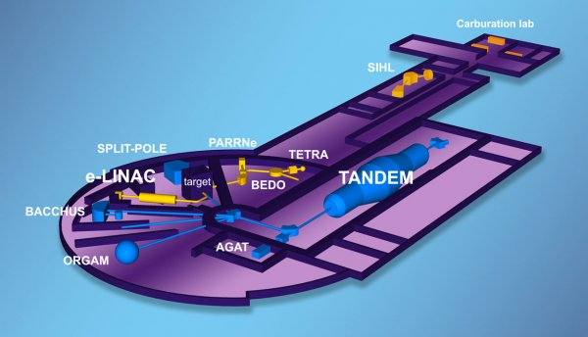
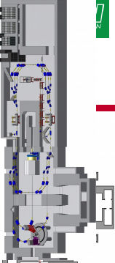
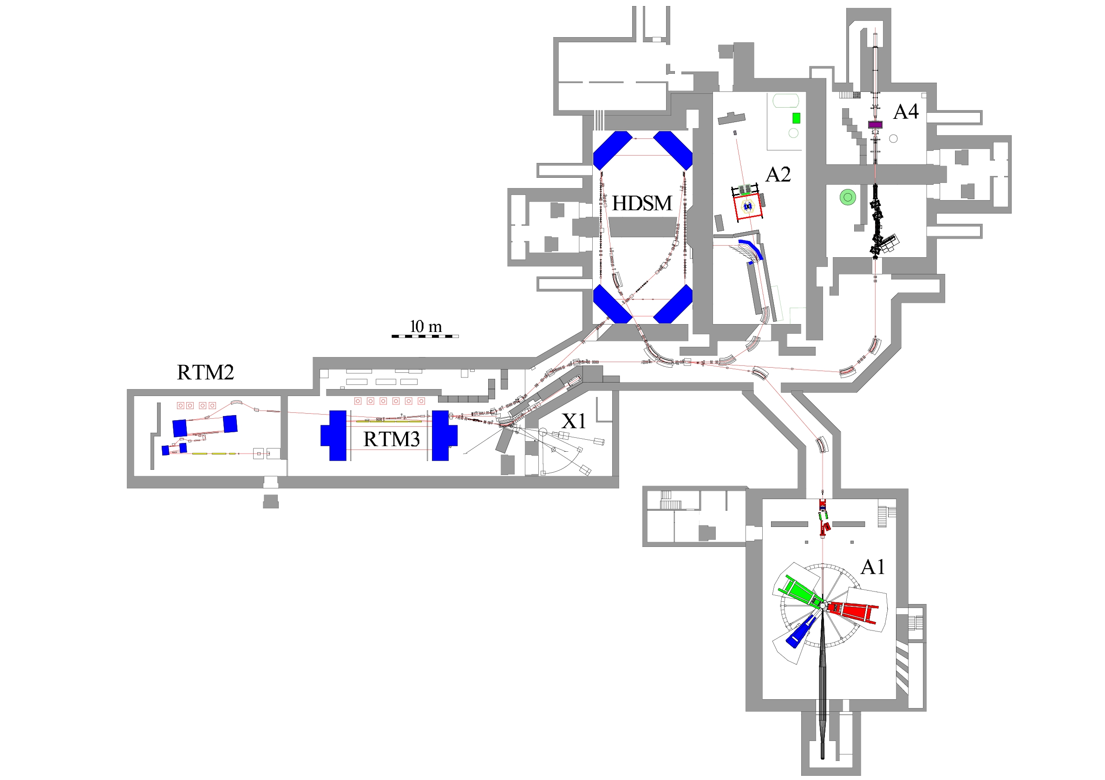
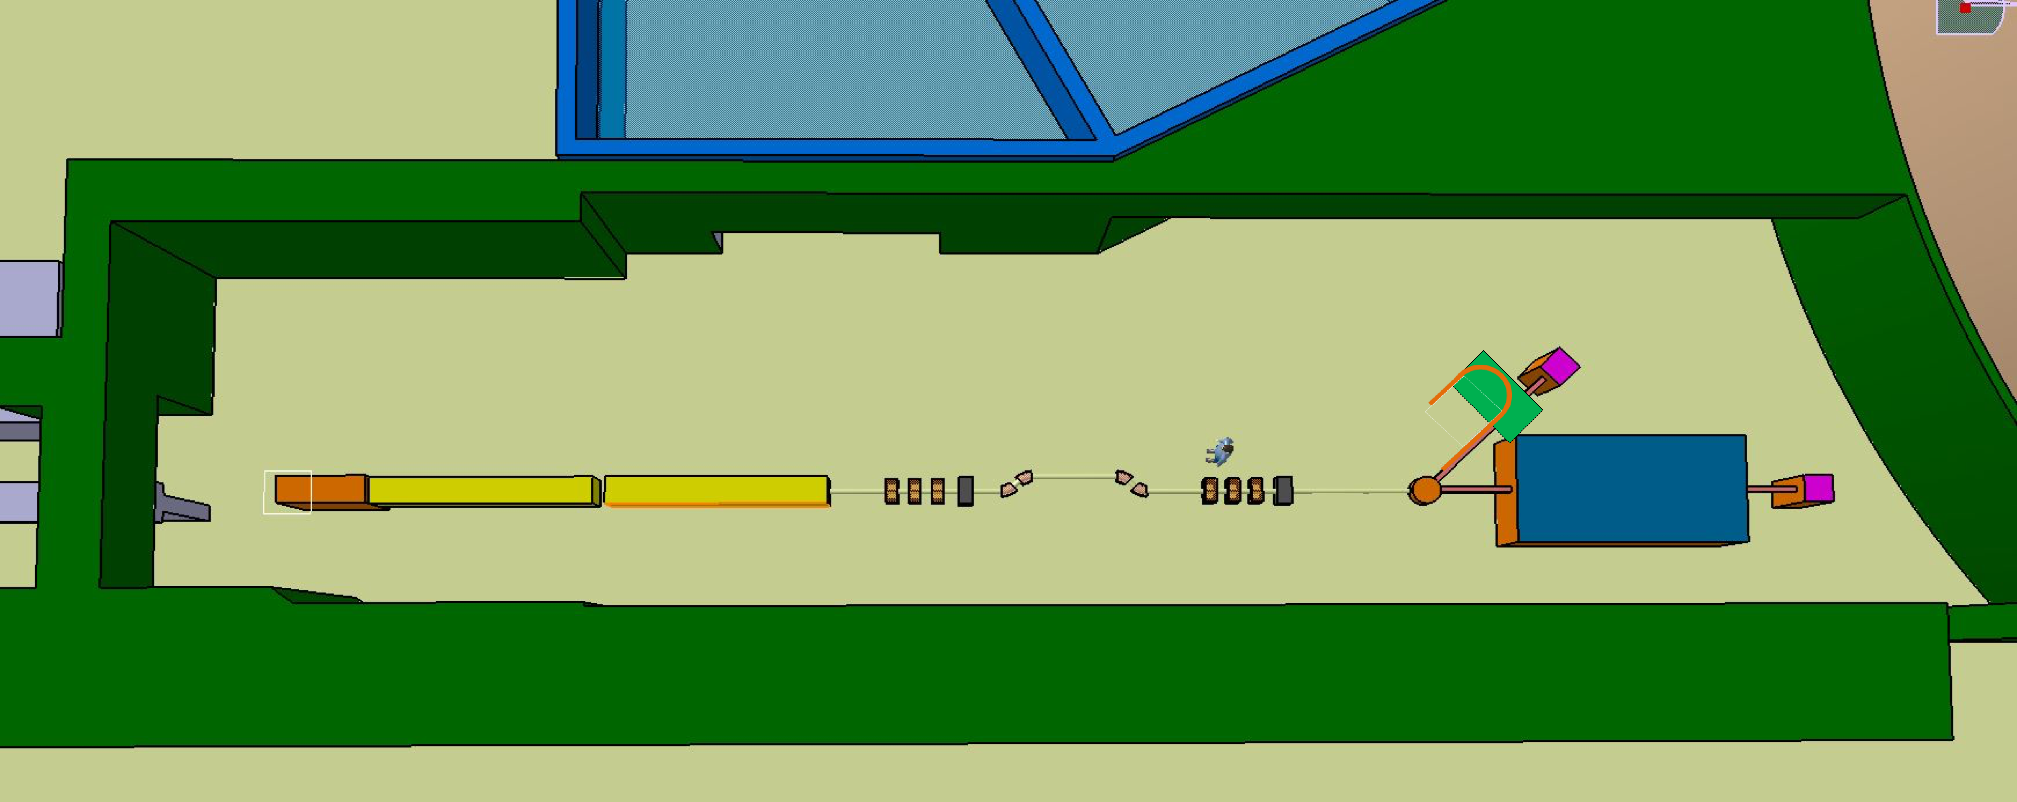
P3E initiative
Eric Voutier
Technical Concept Validation
K. Aulenbacher, N. Berger, I. Chaivoska, J. Enders, J. Grames, G. Moortgat-Pick, S. Riemann, E. Voutier et al.
Technical solutions for each component of the positron source must be experimentally evaluated and optimized.
ALTO @ IPN Orsay
10-50 MeV 100 Hz
IUTF @ JLab
5-10 MeV CW
PRAE @ LAL Orsay
30-140 MeV 50 Hz
MAMI @ JGU Mainz
1.6 GeV CW - 150 kW
The P3E (Polarized Electrons, Positrons, and Polarimetry) initiative, part of the STRONG-2020 proposal (H2020-INFRAIA-2018-2019 call), intends to address these issues .
Pohang, July 1st-4th, 2018
24/25

Slide 25
Conclusion
Eric Voutier
Summary
Polarized and unpolarized positron beams provide a unique opportunity
to enhance the physics reach of JLab and a future EIC.
Interferences, neutral and charged currents, test of the Standard Model…
Work is progressing to assess the quantitative impact of a polarized positron beam at JLab12 and EIC.
… JPos17 proceedings, LOI12-18-004, White Paper (2019), Coneptual Design Report (2020) …
The P3E european/US initiative has been proposed to evaluate/address some of the technical challenges of
polarized positron beams driven by high intensity polarized electron beams.
Please, consider contributing to this adventure !!
voutier@ipno.in2p3.fr grames@jlab.org Subscribe to pwg@jlab.org
Pohang, July 1st-4th, 2018
25/25

