Slide 1

3D Imaging in 12 GeV Era at Jefferson Lab
Harut Avakian (JLab)
July 2, 2018

Slide 2
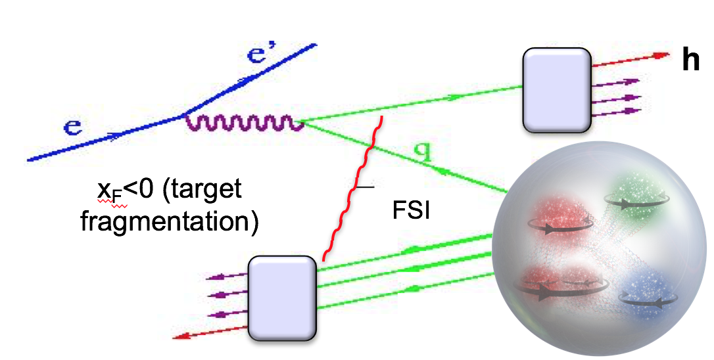
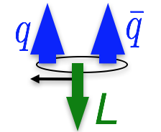
Outline
Introduction
Azimuthal distributions and Single Spin Asymmetries
Complementarity of SIDIS experiments
Experimental factors affecting extraction of SFs
The experiment
Efficiency and acceptance
Vector meson contributions
Radiative Corrections
Extraction and Validation Framework (EVA) for 3D PDFs
First preliminary SIDIS data from CLAS12
Summary
h
Notes:
Start with introduction of observables

Slide 3
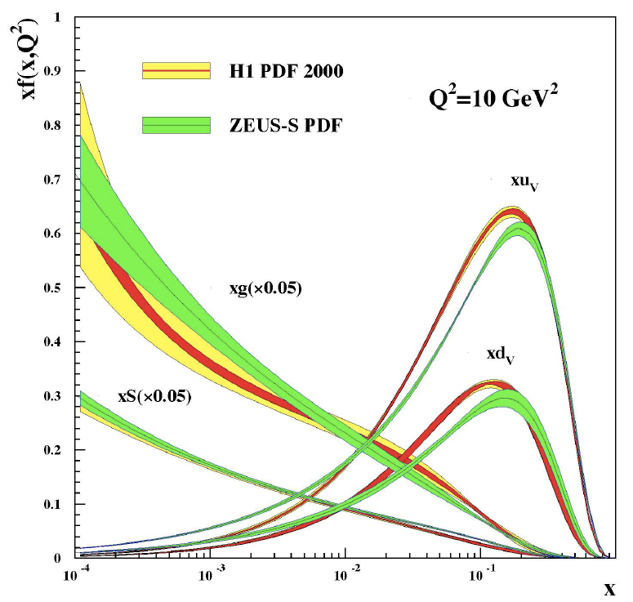
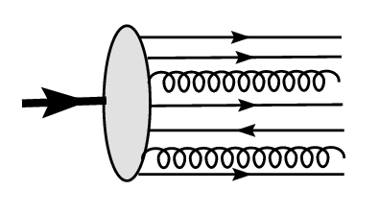
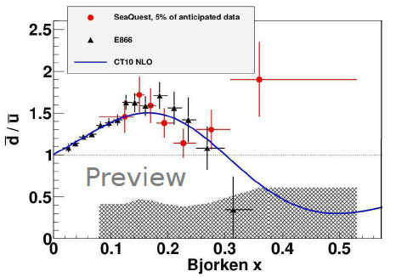
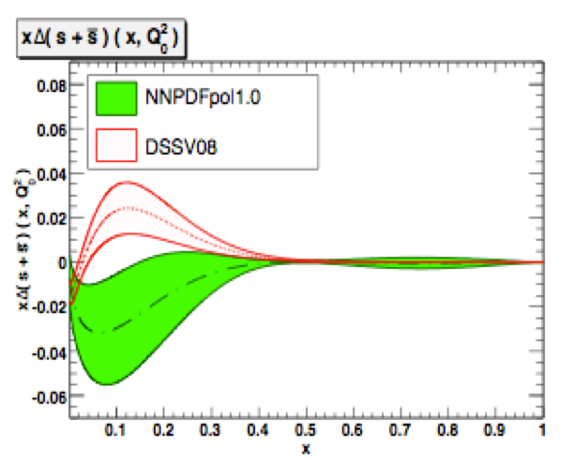
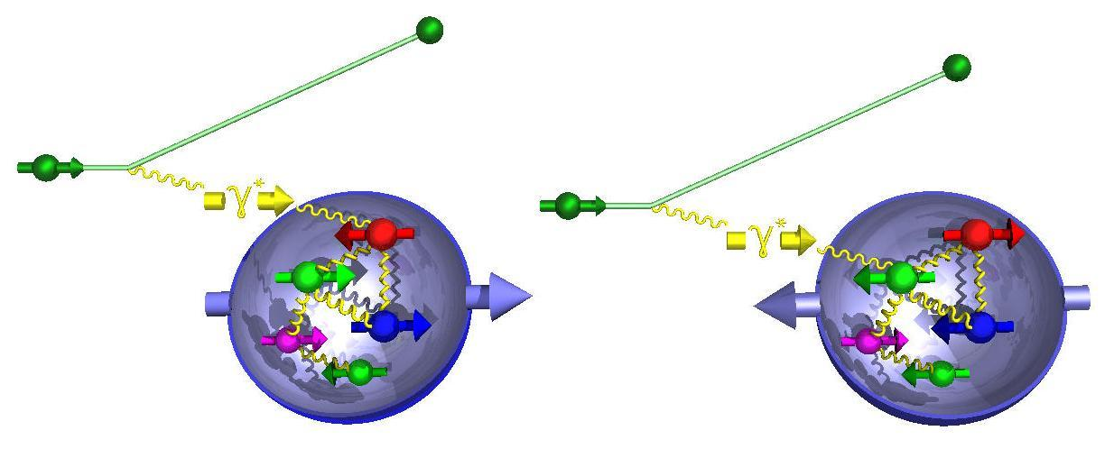
Parton Distribution Functions
In the frame with fast moving hadron, with “frozen” interactions study longitudinal momentum distributions
q(x) - Probability to find a quark with a fraction x of proton momentum P
For polarized case may be some tension between DIS and SIDIS in the range where non-perturbative sea is relevant (see W. Melnitchouk’ talk)
Notes:
One dimensional PDFs describing momentum distributions the fast moving hadron are under intensive studies for more than 30 years, mainly focusing on sums and differences of partonic distributions.
Some facilities involvd in electroproduction and pp scattering are listed here.

Slide 4
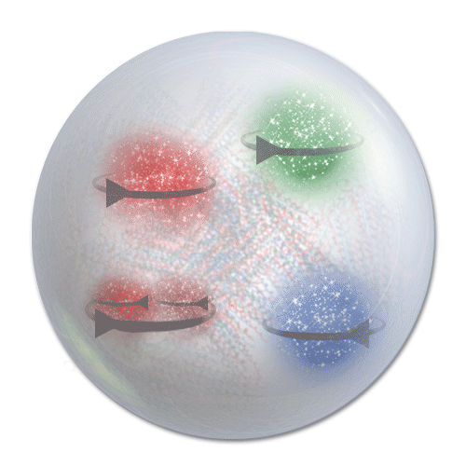
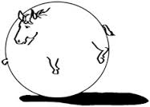
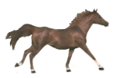
Proton structure from 1D to 3D
fast moving hadron
real life
spherical horse in vacuum
To understand better the dynamics we need to
  Study orbital motion, move from 1D to 3D
  Study interactions and correlations of spin, longitudinal and transverse degrees of freedom

Slide 5

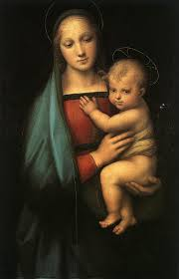
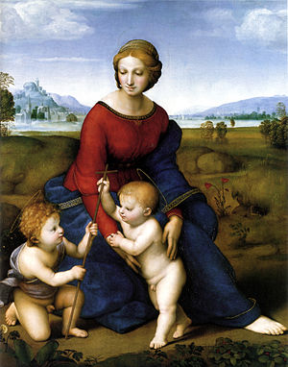
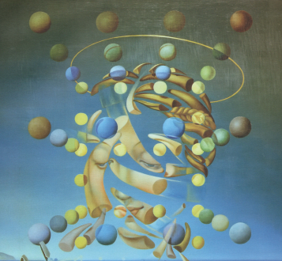
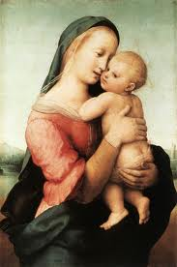
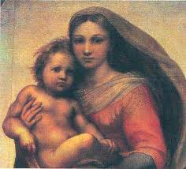
Fast moving frame
S. Dali (1954)
The Maximum Speed of Raphael's Madonna
Simplified picture may miss some relevant info
Notes:
"Salvador Dali's The Maximum Speed of Raphael's Madonna, 1954"

Slide 6

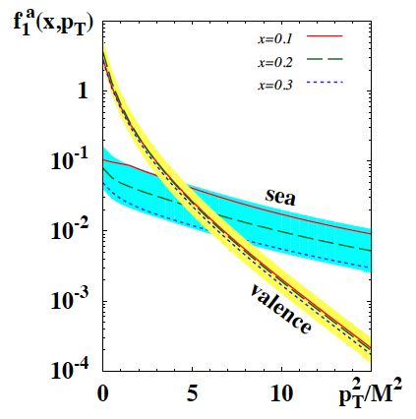


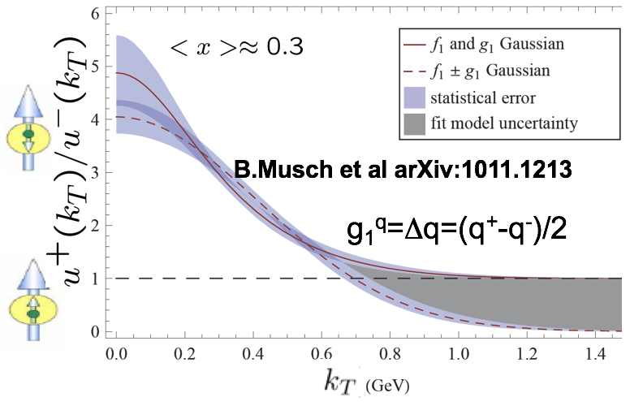
Features of partonic 3D non-perturbative distributions
Large flavor asymmetry of sea indicates non-perturbative sea plays a major
Predictions from dynamical models and lattice suggest that orbital structure of partonic distributions depend on flavor and spin.
P.Schweitzer et al. arXiv:1210.1267
Spin and momentum of struck quarks may be correlated with remnant
Correlations of spins of q-q-bars with nucleon and valence quark spin and transverse momentum should lead to observable effects
0 0.5 1.0

Slide 7
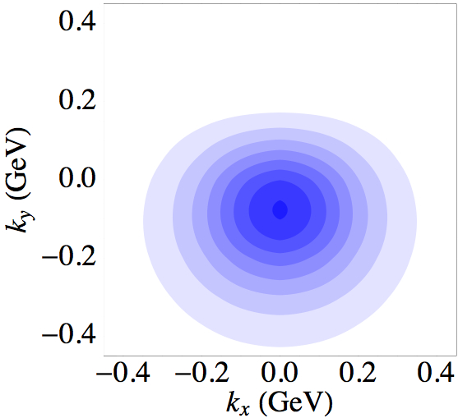

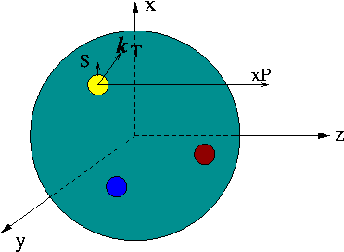
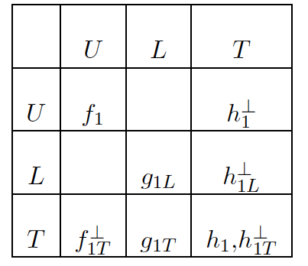
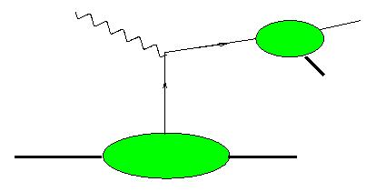
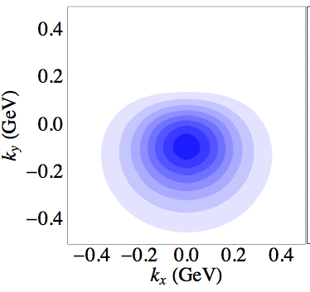
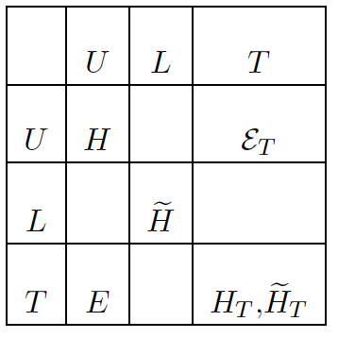
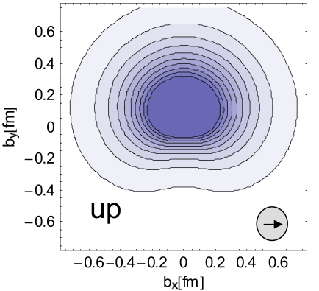
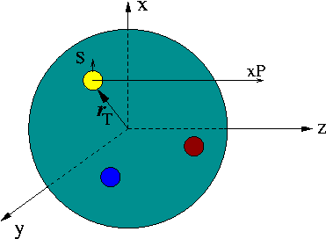
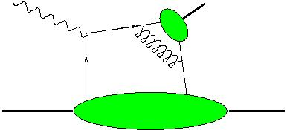
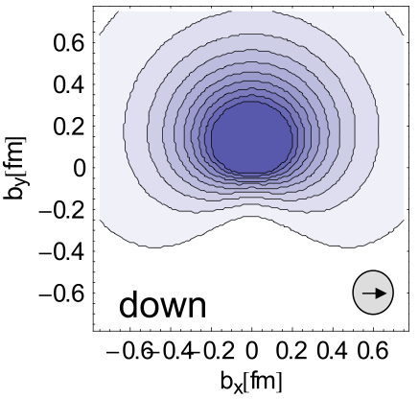
3D structure of the nucleon
Semi-Inclusive processes and transverse momentum distributions
up
h
Pasquini & Yuan
down
TMDs
Hard exclusive processes and spatial distributions of partons
γ,h
GPDs
The quark-gluon dynamics manifests itself in a set of non-perturbative functions describing all possible spin-spin and spin-orbit correlations
(QCDSF)
Notes:
Here is what we understand under the 3D structure of the nucleon. It is basicaly encoded in this two tables of functions describing transverse momentum and space distributions of quark with different polarizations in proton with different polarizations. GPDs and TMDs were already introduced as extensions of pdfs to transverse space, with teansverse momentum for TMDs and transverse coordinate for GPDs. Calculations of density distributions for transversely polarized quarks in an umpolarized proton are shown on the right column for TMDs and GPDs (bottom). You can see the polarizations of quarks pointing in the x-dircetion and shifts to up (positive y) for b_T and down for k_T(negative y). In both cases we have non perturbative pieces and hard scattering, with GPDs accesible in exclusive processes and TMDs in SIDIS.

Slide 8
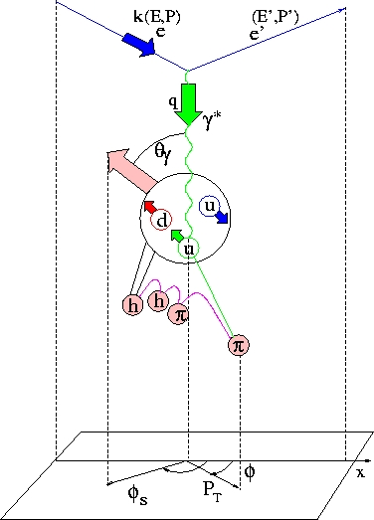
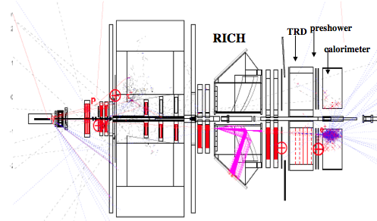


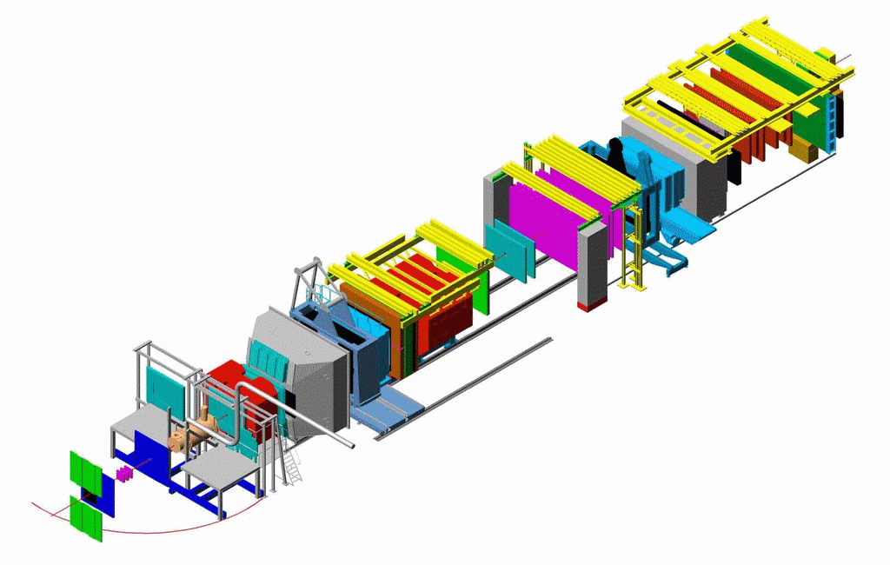



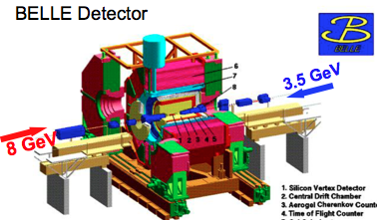

SIDIS kinematical plane and observables
y
x
z
Polarised Target
z
μ beam
EIC
corrections for the region of large kT~Q
beam polarization
target polarization

Slide 9
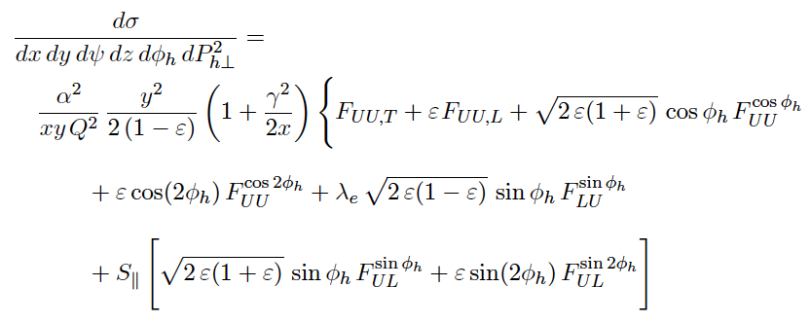
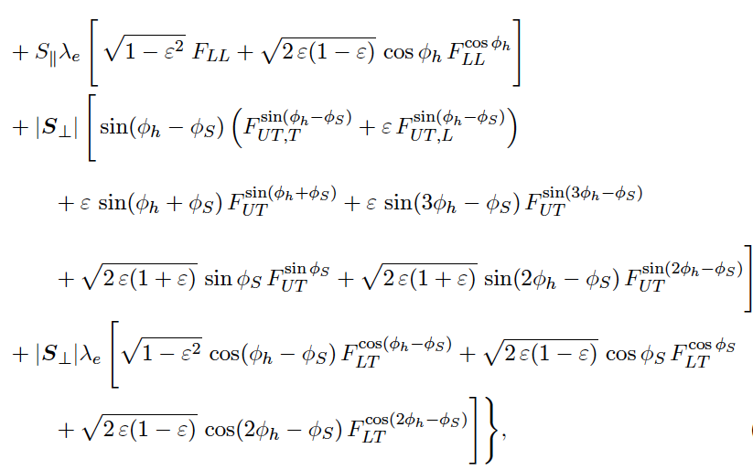
Nucleon structure & TMDs at leading twist
Extraction of leading twist TMDs limited to formalism accounting for only leading twists will require some mechanisms for controlling the systematics (measure and simulate background effects).
what
9

Slide 10
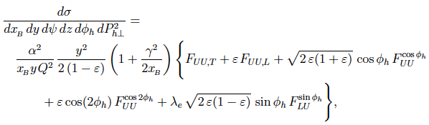
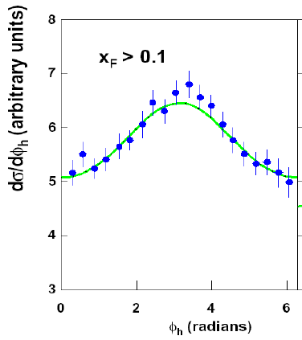
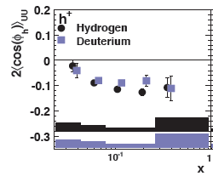
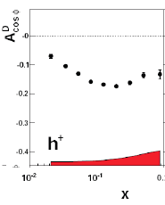

Higher twists in azimuthal distributions in SIDIS
HT
EMC (1987)
Large cosφ modulations observed by EMC were reproduced in electroproduction of hadrons in SIDIS with unpolarized targets at COMPASS and HERMES

Slide 11

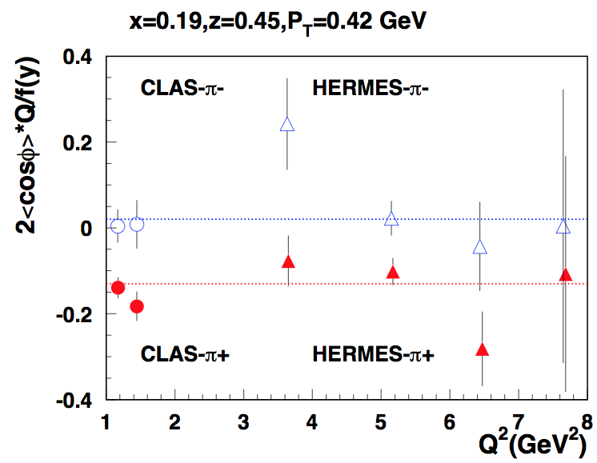
Comparing with HERMES
CLAS data consistent with HERMES (27.5 GeV)

Slide 12
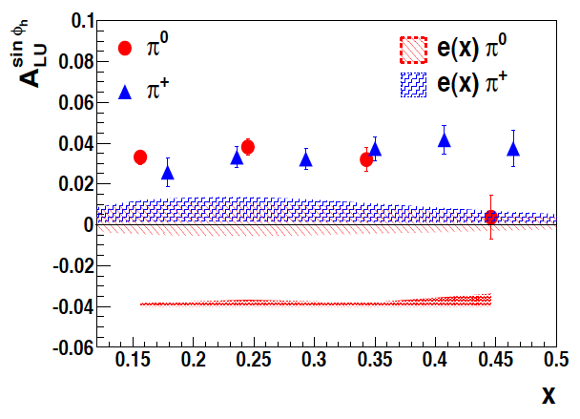
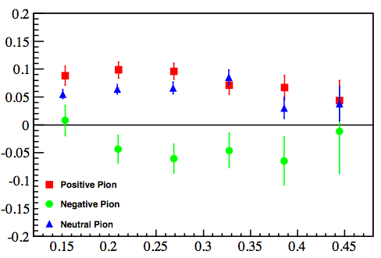
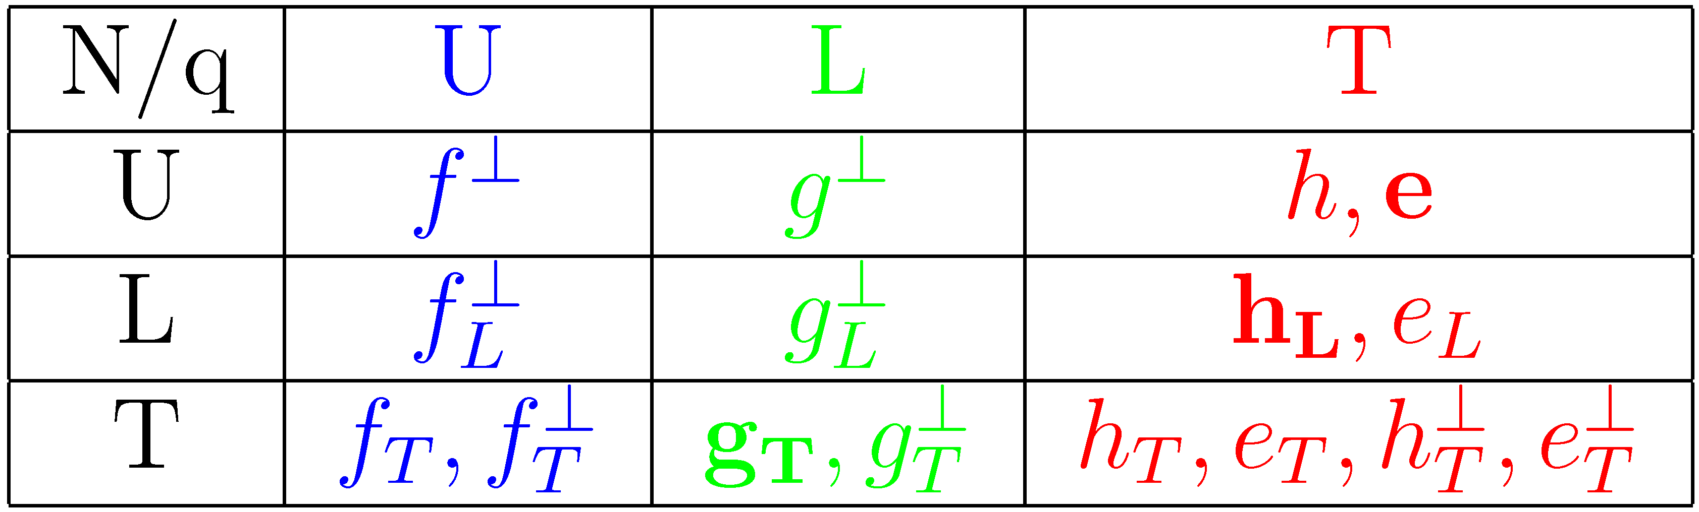
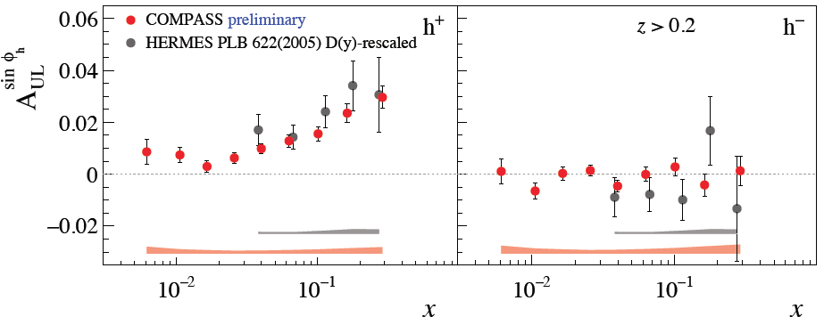
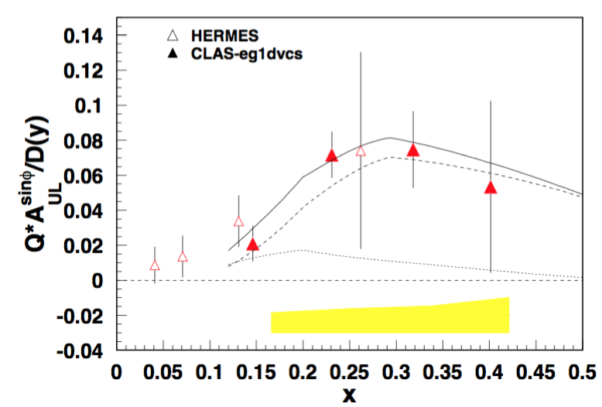
Quark-gluon correlations: flavor dependence
Higher Twist PDFs
roughly equal π⁺π⁰ SSA
π⁻ SSA much smaller, consistent with 0 or<0
CLAS/HERMES
arXiv:1709.10054
“collins” contribution
Significant longitudinal beam and target SSA measured at HERMES, JLab and COMPASS may be related to higher twist distribution functions
sinφ modulations for π⁺π⁰ consistent with dominance of Sivers mechanism
Subleading asymmetries comparable with leading ones (1/Q terms should be accounted)
Notes:
Lorenz invariant amplitudes

Slide 13
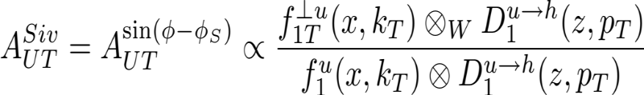
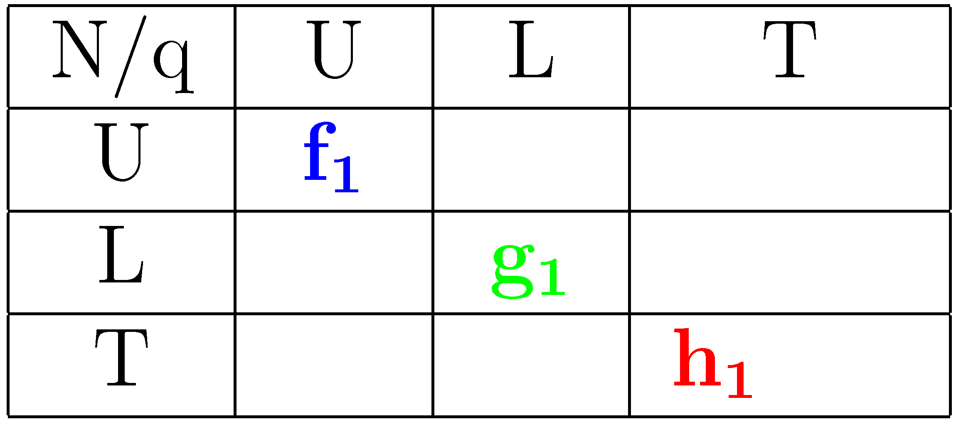
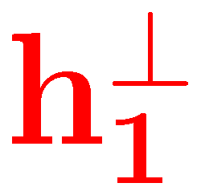


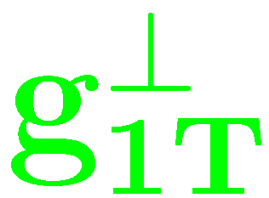

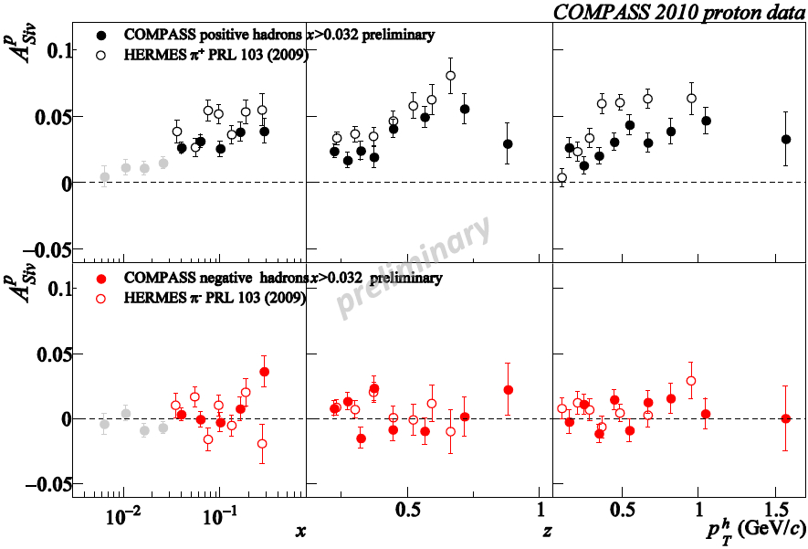
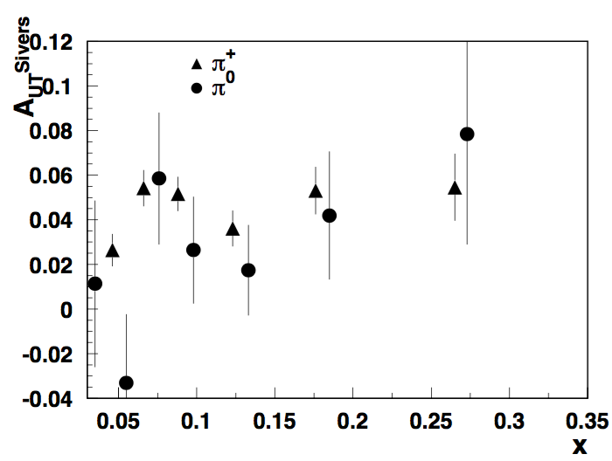
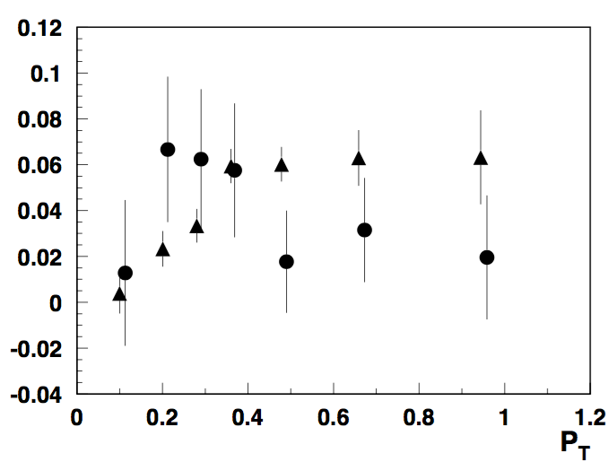
Sivers asymmetry: pions
π+/0, also K+ → Significant Sivers SSA increasing with x
K- and π- consistent with 0 ( contributions from different flavors cancel?).
Independent, high precision measurement in a wide Q² range is crucial
13
Notes:
A_{UT}^{Siv}=A_{UT}^{\sin(\phi-\phi_S)}\propto \frac{f_{1T}^{\perp u}(x,k_T)\otimes_W D_1^{u\rightarrow h}(z,p_T)}{f_1^{u}(x,k_T)\otimes D_1^{u\rightarrow h}(z,p_T)}

Slide 14



Multiplicities
COMPASS:1709.07374
Analysis of 1D may require understanding of 3D structure
Lower the beam energy, less phase space for high P_{T}
What is the origin of the tail?

Slide 15

High precision measurements of SIDIS Cross Section
Hall-A, E06-010 (He3)
pi+ results Φ_{h} (rad)
Precision measurements in a limited φ-range can be combined with CLAS data

Slide 16


Monte Carlo φ generated, reconstructed, and acceptance for π+ (lowest x-Q² bin)
P_{T} (GeV²)
2
CLAS at 6 GeV
(acceptance scale goes 0 – 0.5)
0.55
zoom
0.50
acceptance =
reconstructed
generated
0.45
corrected data =
data
acceptance
0.40
0.35
0.40
0.45
0.50
0.55
z

Slide 17









SIDIS at JLab12
π
Project Scope: completed
Complementary measurements with different targets
CLAS12
SOLID
E12-09-018
Combination of high resolution measurements from spectrometers combined with large acceptance data from CLAS12 and SOLID would allow to pin down all TMDs in the valence region
Notes:
Hall C requires three superconducting quadrupole magnets (Q1, Q2, and Q3), an HB dipole and a superconducting dipole magnet for the Super High Momentum Spectrometer (SHMS) to be installed within its Continuous Electron Beam Accelerator Facility (CEBAF).

Slide 18




C12-11-111
Aybat, Prokudin & Rogers
COMPASS
Large acceptance of CLAS12 allows studies of P_{T} and
Q²-dependence of SSAs in a wide kinematic range
Comparison of JLab12 data with HERMES, COMPASS (and EIC) will pin down the non-trivial Q² evolution of Sivers asymmetry.
HERMES
JLab12

Slide 19






A_{UT} studies at JLab
SOLID
CLAS12
E12-11-108
C12-11-111
Precision 4-d mapping of Collins target SSA using SoLID and CLAS12

Slide 20







Accessing transversity in dihadron production at JLab
Measurements with polarized protons
Measurements with polarized neutrons
CLAS12
SoLID
Bacchetta, Radici

Slide 21


Transversity from SoLID
Collins Asymmetries ~ Transversity (x) Collins Function
SoLID with trans polarized n & p → Precision extraction of u/d quark transversity
Collaborating with theory group (N. Sato, A. Prokudin, …) on impact study
Significant improvement, but need to quantify the systematics from modeling (underlying assumptions)
Collins Asymmetries
Significant improvement, but need to quantify the systematics from modeling (underlying assumptions)
Z. Ye et al., PLB (2017)
P_{T} vs. x for one (Q², z) bin
Total > 1400 data points

Slide 22





Extracting the average transverse momenta
Extraction very sensitive to input (replicas)
Most sensitive to parameters is the large P_{T} region
Multiplicity alone may not be enough to separate <k_{T}> from average <p_{T}>

Slide 23


Additional complications: Experiment can’t measure just 1 SF
I. Akushevich et al (LDRD-2018)
Due to radiative corrections, φ-dependence of x-section will get multiplicative R_{M} and additive R_{A} corrections, which could be calculated from the full Born (σ₀) cross section for the process of interest
Due to radiative corrections, φ-dependence of x-section will get more contributions
Some moments will modify
New moments may appear, which were suppressed before in the x-section
Simplest rad. correction
Correction to normalization
Correction to SSA
Correction to DSA
Simultaneous extraction of all moments is important also because of correlations!
Notes:
\sigma=\sigma_{UU}+\sigma_{UU}^{\cos\phi}cos\phi +S_T\sigma_{UT}^{\sin\phi_S}\sin\phi_S+....
F_{XY}^{h}(x,z,P_T) \rightarrow F_{XY}^{B,h}(x,z,P_T)\times R(x,z,P_T,\phi_h) +F_{XY}^{R,h}(\dots)
So far the analysis of the asymmetry or the ratio of the differences and the sums of yield for two spin orientation was perform assuming no cross contributions from different structure functions to specific
observable. The yield indeed is more complicated and as you can see the azimuthal structure for transverse target in addition to Collins and Sivers, has several other contributions.
In case there are no radiative corrections or acceptance effects all moments are orthogonal and separation of moments could be done using standard procedures (ex. weighting with corresponding moments or fitting with corresponding functions).
However, radiative effects change the original simplicity, introducing addition azimuthal dependence. One important consequence here is not as much the correction to extracted structure fiunction from itself, but the
contrubutions to observables from other structure functions which may be much bigger. An example of the contribution of sin\phi_S term to Collins and sivers asymmetries will be discussed later on.

Slide 24





TMD Extraction and Validation with SIDIS MC
SIDIS MC in 7D (10D) crucial for extraction chain
p┴
Theory
step-1
Provide a set of SF_{l}
For a given model/theory based on underlying non-perturbative input calculate SF_{l}
step-2 (for a given E_{beam},λ,Λ)
step-3 (detected for a given Detector configuration)
Output counts for a given energy and detector setup
Notes:
$\frac{d\sigma_{\lambda\Lambda}^{eN \rightarrow e^\prime h X}}{dxdQ^2 dz dP_{hT}^2 d\phi_h d\phi_l d\phi_s}$

Slide 25

N.Sato & UConn

Slide 26






EVA framework
TMD PDF/FF model input
simple Gaussian
no evolution
with evolution
small statistics
realistic MC
high statistics, better resolution
EVA Framework should allow
test the extraction procedures
Estimate systematic uncertainties from modeling
Evaluate the relevance of experimental uncertainties
…......

Slide 27




Candidate for CLAS12 first SIDIS publication: e’π⁰X
Extraction of e’π⁰X/ e'X ratio (ratio of semi-inclusive pi0 to inclusive electron) requires good control over the acceptance of photons
2
At large x, when sea contribution can be neglected the ratio e’π⁰X/ e'X should follow z-dependence of the fragmentation function (after integration over P_{T})

Slide 28
SUMMARY
Studies of azimuthal distributions of hadrons in SIDIS revealed complexity of the 3D nucleon structure, requiring new tools for multidimensional analysis
JLab12 will provide precision measurements of single and double spin asymmetries in pion and kaon SIDIS providing access to transverse momentum distributions of quarks in the valence region
For development of 3D PDF Extraction and VAlidation (EVA) framework (even for DIS) we need a collaboration of theorists, experimentalists and software experts to define the path to a flexible PDF extraction system with validation capabilities.
To proceed we need, well defined criteria, unified data presentation, and tools:
Define the data input (x-sections/multiplicities in φ-bins, for different helicity states)
Use MC to test extraction procedures
Test the systematics due to different assumptions in procedures for extraction of SFs and underlying 3D PDFs (“global fits”)

Slide 29
Support slides…

Slide 30


Slide 31




Slide 32




QCD: from testing to understanding
0h DIS
Testing stage:
pQCD predictions, observables in the kinematics where theory predictions are easier to get (higher energies, 1D picture, leading twist, current fragmentation, IMF)
parton distributions
hadronization
nucleon in 3D
strong interactions
&
quark gluon dynamics
evolution,
factorization
1h SIDIS/DVMP
quark-gluon correlations
Understanding stage:
non-perturbative QCD, strong interactions, observables in the kinematics where most of the data is available (all energies, quark-gluon correlations, orbital motion)
spectroscopy,
excited states
spin-orbit correlations
target fragmentationentanglement
2h SIDIS/DVMP
production in SIDIS provides access to correlations inaccessible in simple SIDIS (BEC,dihadron fragmentation , correlations of target and current regions, entanglement....)
Notes:
DIS proved to be a great tool in testing of the theory of strong interactions, which was a major focus in last decades. SIDIS, with detection of an additional hadron allowed first studies of of 3D structure, moving the main focus to understanding of strong interactions and quark gluon dynamics to address a number of puzzles accumulated in recent years. Detection of 2 hadrons, which is obviously more complicated provides access to even more details of quark gluon interactions Bose-Einstaein Correlations

Slide 33




Azimuthal moments and BM effect
Can we understand cos2φ and get precision measurement of multiplicities without sorting out cosφ ?
Radiative corrections may be significant for ep

Slide 34


Measuring SIDIS cross section: CLAS 5.5 GeV
Fit with
π+ and π-
Cross section in several bins drops faster than gauss
Simmetric behavior in cosφ indicates large BM contribution

Slide 35





Dihadron production
What is the origin of dihadrons?
What is a single hadron?
COMPASS: arXiv:1507.07593
R. Seidl et al. arXiv: 1706.08348
Matevosyan et al, arXiv:1312.4556

Slide 36

Studies of 1D PDFs
F. Aaron et al., JHEP 1001 (2010)
P. Jimenez-Delgado et al (2014), 1403.3355.
Strong model and parametrization dependence observed already for 1D PDFs
Positivity requirement may change significantly the PDF (need self consistent fits of polarized and unpolarized target data!!!)

Slide 37



Vector meson contributions vs dihadrons
Should we worry about pions/kaons coming from vector meson decays?
What about ρ+ and ρ-
What do we know about relevant observables for pions specifically coming from vector meson decays
What about SIDIS rhos (can we measure?)
What is radiative correction due to rho?
Vector meson as resonance in dihadron production?
COMPASS:1709.07374
π+π⁰
π+π−

Slide 38



Parton Distribution Functions
In the frame with fast moving hadron, with “frozen” interactions study longitudinal momentum distributions
q(x) - Probability to find a quark with a fraction x of proton momentum P
FNAL
h₁
P₁
P₁
P₂
Notes:
One dimensional PDFs describing momentum distributions the fast moving hadron are under intensive studies for more than 30 years, mainly focusing on sums and differences of partonic distributions.
Some facilities involvd in electroproduction and pp scattering are listed here.

Slide 39




Polarized PDFs
Ball et al arXiv:1303.7236
Parallel electron & quark spins
Anti-parallel electron & quark spins
errors due to parameterizations and model dependence may be compatible with statistical and systematic errors from experiments
may be some tension between DIS and SIDIS.
Notes:
NNPDF 1107.2652

Slide 40
Polarized PDFs
Ball et al arXiv:1303.7236
Parallel electron & quark spins
Anti-parallel electron & quark spins
errors due to parameterizations and model dependence may be compatible with statistical and systematic errors from experiments
may be some tension between DIS and SIDIS.
Notes:
NNPDF 1107.2652

Slide 41












Radiative SIDIS
Akushevich&Ilyichev in progress
additional photon can be described by three additional variables:
+…..
The phase space of the real photon:

Slide 42





From SIDIS to DIS
3D SIDIS
1D SIDIS
DIS

Slide 43
π0 SIDIS: advantages-I
1) suppression of higher-twist contributions at large hadron energy fraction (particularly important at JLab energies where small z events are contaminated by target fragmentation)
2) the absence of ρ0 production which complicates the interpretation of the charged single-pion data
3) the fragmentation functions for u and d quarks to π0 are
the same in first approximation
4) suppression of spin-dependent fragmentation for π0 s, due to the roughly equal magnitude and opposite sign of the Collins fragmentation functions for up and down

Slide 44
π0 SIDIS: advantages-II
5) longitudinal photon contribution, is suppressed in exclusive neutral pions production with respect to the transverse photon contribution, which is higher twist, suggesting that longitudinal photon contribution to SIDIS π0 will also be suppressed.
6) at large x , where the sea contribution is negligible, π0 multiplicities and double spin asymmetries will provide direct info on the fragmentation function of u and d -quarks to pπ0 .
7) π0 data has better uniformity and smaller variations of averages of P_{T} with x due to correlations between longitudinal and transverse momentum of quarks and hadrons
8) Particle ID (invariant mass of 2 photons) very different from charged pions

Slide 45

Multiplicities in SIDIS
For simple Gaussian distributions in k_{T} and p_{T}
For p0 at large x, when sea contribution can be neglected the ratio e’π⁰X/ e'X should follow z-dependence of the fragmentation function (after integration over P_{T})

Slide 46





From data to phenomenology: EBC
bin# | x | Q² | y | W | M_{X} | φ | z | P_{T} | λ | Λ | N(counts) | RC
1 ... N
For precision studies of TMDs we need x-sections/muliplicities in smallest possible bins in x,y,z,P_{T},φ for all hadrons and all relevant polarization states
Elementary Bins vs macroscopic bins
Pros: Cons:
can go to wider bins, 1)Requires huge
smaller bin centering corrections MC sample
3) smaller acceptance/radiative correcions.
4) can perform also Bessel weighting
5)Can re-calculate for any other kinematical variables (η,P_{T}/z,…)
…………………….
EBC: bin sizes limited by resolutions
P²_{T}(GeV²)
Q²(GeV²)
z
x

Slide 47


TMDs: Access Quark Orbital Angular Momentum
TMDs : Correlations of transverse motion with quark spin and orbital motion
Without OAM, off-diagonal TMDs=0,
no direct model-independent relation to the OAM in spin sum rule yet
In a large class of models, such as light-cone quark models
Pretzelosity: ΔL=2
SoLID with trans polarized n/p → quantitative knowledge of OAM
SoLID Projections: Pretzelosity
J.-P. Chen

Slide 48




Table Evolution
N/q
COMPASS-2017
Lattice
Boer-Mulders
Sivers
pretzelosity
Notes:
On the basis of good
R and L spinors the matrix M =[\Phi(x)^\gamma+]T
from light front correlation function

Slide 49
Experiment-Theory interaction
Theorist predicts effects and observables sensitive to them
Experimentalists submit a proposal and make measurement (~3-4 years)
Observables in form of a table bin# <average kin> | observable | <err>stat | <err>syst
Experiment measures “unexpected” effects
Theorist come up with possible interpretation
Description of data is necessary, but not sufficient!
What will be the most efficient format for the data (and metadata)?
Data required for certain analysis may require event by even info
How to store and preserve the data (for unbinned analysis)
Alternative to store full events (all tracks)
  Should provide easy access for theory)

Slide 50
12 GeV Approved Experiments by Physics Topics
Topic | Hall A | Hall B | Hall C | Hall D | Other | Total
Hadron spectra as probes of QCD | 0 | 3 | 1 | 3 | 0 | 7
Transverse structure of the hadrons | 5 | 4 | 3 | 1 | 0 | 13
Longitudinal structure of the hadrons | 2 | 3 | 6 | 0 | 0 | 11
3D structure of the hadrons | 5 | 9 | 7 | 0 | 0 | 21
Hadrons and cold nuclear matter | 7 | 3 | 7 | 0 | 1 | 18
Low-energy tests of the Standard Model and Fundamental Symmetries | 3 | 1 | 0 | 1 | 1 | 6
Total | 22 | 23 | 24 | 5 | 2 | 76
Total Experiments Completed | 2.5 | 1.1 | 0 | 0.4 | 0 | 4.0
Total Experiments Remaining | 19.5 | 21.9 | 24 | 4.6 | 2 | 72.0
JLab 2015 Science & Technology review closeout bullets:
develop an integrated picture of what measurements are necessary and will be conducted in determining the GPDs and TMDs
develop milestones for extraction of GPDs and TMDs from experiment

Slide 51

Identification of π⁰
Egmin>0.4 GeV
Egmin>0.7 GeV
Run4250
SIDIS-MC
Higher the minimum energy cut, less background
Background well described in the SIDIS MC

Slide 52
3D PDF Extraction and VAlidation (EVA) framework
SIDIS,DY,e+/e-)
experiments
Hard Scattering MC (GEANT, FASTMC,…)
EVA meetings at JLab to finalize goals and coordinate efforts
event selection
e’hX, e’hhX,..
Grid operations
QCD fundamentals
Library for Structure Function (SF) calculations
3D PDF and FF (models,
parametrizations)
Radiative
x-section
x-section calculations
SF calculations
Data Counts
(x-sections, multiplicities,….)
Defined set of assumptions
Defined set of assumptions
Extract 3D PDFs
extract
x-section
Extract SFs
Validation of extracted SFs or 3D PDFs (for a given set of assumptions)
Development of a reliable techniques for the extraction of 3D PDFs and fragmentation functions from the multidimensional experimental observables with controlled systematics requires close collaboration of experiment, theory and computing

Slide 53
Estimating systematics
Steps for Extraction and Validation procedure
make sure we can recover the underlying 3D PDFs (TMD/GPD…) PDF from generated for a given beam energy sample
make sure we can recover the underlying 3D PDFs (TMD/GPD…) from reconstructed for a given detector configuration sample
add radiative effects
add other SFs to see the effect of Cahn on extraction of the F_UU,T and check the extraction of cos and cos2 moments
3) add/eliminate evolution effects with HT effects and see if we can indeed separate them
4) add F_UU,L part and see the effect of disregarding it in the extraction.
....... big list of systematic checks....

Slide 54



Comparing different DIS models
filled symbols F₂/F₂ ^{CJ15}
open symbols F₂/F₂ ^{CJ15},^{LT}
reasonable agreement between F2 from empiric SLAC fit (Bosted) with CJ15 Jlab fit in most of the relevant kinematics
x

Slide 55

Candidate for first SIDIS publication: e’π⁰X
Extraction of e’π⁰X/ e'X ratio (ratio of semi-inclusive pi0 to inclusive electron) requires good control over the acceptance of photons
At large x, when sea contribution can be neglected the ratio e’π⁰X/ e'X should follow z-dependence of the fragmentation function (after integration over P_{T})

Slide 56

Standard input for SFs
(JavaScript Object Notation for a single hadron production eN->e‘X)
Table can be generated from any existing program for calculation of SFs for any given set of parameters, final state particles, target nucleon, polarization states in tiny bins.

Slide 57



Radiative DIS
Akushevich et al. http://www.jlab.org/RC/radgen/
For EVA tests a DIS generator developed which works with x-sections, SFs, grids, has radiative effects.
DIS cut (E’>2 GeV)
Radiative
DIS

Slide 58


Recovering generated input from reconstructed set
Step-II
40Mil generated events (200x200 bins)
line N. Sato
Acceptance can be defined using the weighted generator set
Both MCs after reconstruction recover the generated input in most of the kinematics.)

Slide 59


Extraction of DIS x-section and acceptance
Radiative corrections may be significant
acceptance
<x> <y> <Q²>
DIS output can be generated using input F₁,F₂ or F₂,F_{L} or directly x-sections
Tables can be used by theorists for extraction of underlying SFs

Slide 60
Suggested standard input for SFs:SIDIS Example
#!{
#! "model": "VGD_Fuu_01",
#! “description”: “Cahn contribution to cos”,
#! "reference": “M. Boglione, S. Melis & A. Prokudin Phys. Rev. D 84, 034033 2011",
#! "web-source": "http://aaa.html",
#! "formula": "$sf1=-2*d/b*a*a*(1-a)^p0*c^p1*(1-c)^p2*c*p3/p4*exp(-d*d/(p4+c*c*p3)/p4$",
#! "moment": “$A_{uu}\\cos\\phi$",
#! “lepton-polarization”: “0”,
#! “nucleon-polarization”: “0”,
#! "particle": "pi+",
#! "variables": ["AuuCos2","AuuCos2-Err"],
#! "axis": [
#! { "name": "a", "bins": 40, "min": 0.025, "max": 0.995, "scale":"arb" ,"description":"Bjorken x"}
#! { "name": "b", "bins": 40, "min": 20.00, "max": 4.70, "scale":"arb”, ”description":"Q^2"},
#! { "name": "c", "bins": 40, "min": 0.025, "max": 0.995, "scale":"lin", "description":”z,hadron frac. energy"},
#! { "name": "d", "bins": 40, "min": 0.00, "max": 2.00, ”scale":"lin", "description":”P_{T}, transverse momentum"}
#! ],
#! "parameters": [
#! {"name":"p0", "value": 1.0},
#! {"name":"p1", "value": 0.2},
#! {"name":"p2", "value": 0.1},
#! {"name":"p3", "value": 0.33, "description":”average k_T2”},
#! {"name":"p4", "value": 0.16, "description":”average pt_T2”}
#! ]
#! }
(JavaScript Object Notation for a single hadron production eN->e’hX)
2 more
variables
Multiple files for all relevant combinations of involved parameters
0 0 0 0 -0.01285 0.00200
0 0 0 1 -0.03736 0.00200
0 0 0 2 -0.05850 0.00200
0 0 0 3 -0.07459 0.00200
0 0 0 4 -0.08467 0.00200
.............
Table can be generated from any existing program for calculation of SFs for any given set of parameters, final state particles, target nucleon, polarization states.

Slide 61


A set of Structure Functions needed for x-section
Framework should handle any SF input

Slide 62
Standard output for data
{
"model": "Nobuo_Fuu_01"
"description": "F_uu,T"
"reference": "N. Sato et al"
"multiplicity":"Counts"
"Beam Energy": 10.600
"lepton-polarization": "0"
"nucleon-polarization": "0"
"particle": "pi+"
"variables":["Counts","acc","xav","qav","zav","ptav","yav","phav","pt/zav","eta"
"axis":[
{"name":"a","bins": 10,"min": 0.05, "max": 0.55, "scale":"lin","description":"x_bj"}
{"name":"b","bins": 7, "min": 1.00, "max": 8.0, "scale":"lin","description":"Q^2"}
{"name":"c","bins": 7, "min": 0.20, "max": 0.9, "scale":"lin","description":"z"}
{"name":"d","bins": 15,"min": 0.00, "max": 1.5, "scale":"lin","description":"PT"}
{"name":"e","bins": 36,"min": 0.0,"max": 360.0,"scale":"lin","description":"PHI"}
],
"parameters":[
]
}
1 1 1 4 0.999900E+02 0.0141 0.0994 1.0424 0.2636 0.0708 0.5271 0.5492 0.2686 -0.5311
1 1 1 1 5 0.110602E+03 0.0191 0.0937 1.0067 0.2710 0.0818 0.5404 0.8707 0.3000 -0.5052
…....
1 1 1 1 35 0.655700E+02 0.0090 0.0969 1.1218 0.2447 0.0310 0.5820 5.9564 0.1266 -0.5818
1 1 1 1 36 0.619600E+01 0.0012 0.0913 1.0703 0.2268 0.0029 0.5896 6.1982 0.0136 -0.5068
1 1 1 2 4 0.604000E+03 0.0311 0.0985 1.0670 0.2055 0.1918 0.5446 0.6019 0.9336 0.1294
1 1 1 2 7 0.911300E+03 0.0385 0.0927 1.2218 0.2506 0.1408 0.6631 1.1898 0.5642 -0.3208
Note: counts in φ are provided
Table may contain generated (for given beam energy) or reconstructed (for given detector configuration) event counts
Some bins miss due to phase space limitations and detector acceptance

Slide 63


Examples of data from SIDIS experiments
HERMES
COMPASS
http://hepdata.cedar.ac.uk/view/ins1278730
Experiment measures φ-dependence and performs fits to extract different moments
Need wide bins in kinematical variables to provide moments!

Slide 64


Evolution of the 3D structure physics

Slide 65


Additional complications: Experiment has limited acceptance
Limited kinematical coverage (acceptance) in particular at acceptance edges, large Q² and P_{T}
SIDIS@5.5 GeV
A_{LL}
DVCS@5.7GeV
Ignoring other variables (φ-in particular) doesn’t mean integrating over them
Experiment measures φ − counts involving also HT contributions !!!

Slide 66





CLAS at 5.5 GeV
(top row), (middle row), and (bottom row) vs P_{T} for π+ and π-
Q²
2
x
(high Q² bin of 0.2 < x < 0.3)

Slide 67

Тяжело в учении
--легко в бою
the more you sweat in times of peace the less you bleed in war
Monte Carlo simulation is crucial for understanding of systematics of all steps and assumptions used in extraction of complex 3D nucleon structure

Slide 68




Target fragmentation in SIDIS
P₁
Leading Twist
M. Anselmino, V. Barone and A. Kotzinian, Physics Letters B 713 (2012)
P₂
The beam–spin asymmetry appears, at leading twist and low transverse momenta, in the deep inelastic inclusive lepto-production of two hadrons, one in the target fragmentation region and one in the current fragmentation region.
Understanding of Target Fragmentation Region (TFR) is important for interpretation of the Current FR
Need a consistent theoretical description for TFR
Measure/model fracture functions
Notes:
{\cal{F}}_{LU}^{\sin(\phi_1-\phi_2)}=\frac{\mid\vec{P}_{1\perp}\vec{P}_{2\perp}\mid}{m_Nm_2} {\cal{C}}[w_5M_L^{\perp,h}D_1]

Slide 69




Sivers asymmetry: kaons vs pions
combined 2007 – 2010 results
π+
π-
K+
K-
preliminary
K+ at large x has larger Sivers SSA which may come from orbital effects in hadronization (higher twist effects)
K- and π- consistent with 0 indicating contributions from different flavors cancel.
Independent, high precision measurement in a wide Q² range is crucial
69
Notes:
A_{UT}^{Siv}=A_{UT}^{\sin(\phi-\phi_S)}\propto \frac{f_{1T}^{\perp u}(x,k_T)\otimes_W D_1^{u\rightarrow h}(z,p_T)}{f_1^{u}(x,k_T)\otimes D_1^{u\rightarrow h}(z,p_T)}

Slide 70

Additional complications: Experiment has limited energy
In F_{XY}^{h}(x,y,z,P_{T},φ) variables independent, while in real life even for 100% acceptance they are limited
P_{T}
Z

Slide 71

Radiative DIS
Akushevich et al. http://www.jlab.org/RC/radgen/
/group/gpd/sidis/inclusive-dis-rad/generate-dis
--rad 1 (table input, generated on flight)
DIS cut (E’>2 GeV)
with radiation
without radiation
Radiative correction become very significant for low energy scattered electron

Slide 72
Analysis of azimuthal moments in SIDIS/HEP
Data (contains N events with 4 vectors of reconstructed particles, N~1B)
MC +RC (contains M events with 4 vectors of generated and reconstructed particles, M~10-100N)
Define x-sections/normalized counts
Compare generated with reconstructed
Acceptance in “small” bins (counts in λ,Λ,x,y,[z,P_{T}][t], φ) defining reconstruction efficiency and material on path of leptons
Counts in “small” bins in
λ,Λ,x,y, [z,P_{T}][t],φ,RC corrected for detector acceptance and efficiency
Counts in a given bin corrected by rec.efficiency and radiative effects
Size of the bins dictated by the statistics allowing fits for extraction of azimuthal moments

Slide 73






Quark-gluon correlations
Force on the active quark right after scattering (Burkardt)
CLAS/HERMES
JLab-Hall-A
arXiv:1311.1866
Significant longitudinal target SSA measured at JLab and HERMES may be related to HT and color forces
Large transverse spin asymmetries observed in inclusive pion production (Hall-A, HERMES)
Models and lattice agree on a large e/f1 -> large beam SSA
Notes:
Lorenz invariant amplitudes

Slide 74
Questions to address
SIDIS and Hard Exclusive processes requiring multidimensional analysis, are a major challenge for experiment, theory, software extraction framework, claiming control of systematic uncertainties
At which step the experimental extraction should stop and theory extraction start?
How a detailed MC could help to understand better different contributions in the x-section of single or double pion production?
How the TMD/GPD libraries could be integrated into extraction process
How we deal with “real” data with finite beam energies and limited phase space?
Do we need “validation” of extracted TMDs and what that will include?

Slide 75
A_{UT} studies at JLab
SOLID
CLAS12
E12-11-108
C12-11-111
Precision 4-d mapping of Collins target SSA using SoLID and CLAS12

Slide 76
Event generators for SIDIS studies
Main classes of event generators:
a)Full event generators where sets of outgoing particles are produced in the interactions between two incoming particles and a complete event is generated
Applications: attempt to reproduce the raw data
understand background conditions
estimating rates of certain types of events
planning and optimizing detector performances,…
b) Specific event generators (single hadron, di-hadron,…) , where only the final state particles of interest are generated
Applications: providing fast tests of analysis procedures with relatively simple integration of different input models.
developing analysis frameworks.
1) Providing events with cross section
2) Phase space with realistic x-sections provided as weight factors
+unfolding measured data for acceptance and detector resolution effects

Slide 77


Comparing generated ouput with input
using x-section generator in x/y
reconstructed (from generated) output
generated input (filled symbols)
compare 3 bins in Q²
average values agree
Reconstructing SFs from generated input 1st check of the procedure

Slide 78



Additional complications: Experiment covers ranges described by different SFs
Boglione et al, Phys.Lett. B766 (2017) 245-253
Kinematics covers regions with different fractions from target and current fragmentation
JLab12
Understanding of the scale of ignored contributions (M/Q²,P_{T}/Q², Target/Current correlations,…) will define the limits on precision for other involved contributions (ex. evolution).
more CFR more TFR
CM
Breit
Multidimensional bins (x,y,z,P_{T},φ) are crucial for separation of different contributions

Slide 79

N.Sato & UConn

Slide 80

N.Sato & UConn

Slide 81






QED radiative corrections in SSA
Due to radiative corrections, φ-dependence of x-section will get more contributions
HERMES
using a simple approximation
we can get correction factors to moments (ex. for RC for )
we can get new moments
In reality contributions will me more complicated
Due to radiative corrections, φ-dependence of x-section will get more contributions
Some moments will modify
New moments may appear, which were suppressed before in the x-section
Notes:
\sigma=\sigma_{UU}+\sigma_{UU}^{\cos\phi}cos\phi +S_T\sigma_{UT}^{\sin\phi_S}\sin\phi_S+....
F_{XY}^{h}(x,z,P_T) \rightarrow F_{XY}^{B,h}(x,z,P_T)\times R(x,z,P_T,\phi_h) +F_{XY}^{R,h}(\dots)
So far the analysis of the asymmetry or the ratio of the differences and the sums of yield for two spin orientation was perform assuming no cross contributions from different structure functions to specific
observable. The yield indeed is more complicated and as you can see the azimuthal structure for transverse target in addition to Collins and Sivers, has several other contributions.
In case there are no radiative corrections or acceptance effects all moments are orthogonal and separation of moments could be done using standard procedures (ex. weighting with corresponding moments or fitting with corresponding functions).
However, radiative effects change the original simplicity, introducing addition azimuthal dependence. One important consequence here is not as much the correction to extracted structure fiunction from itself, but the
contrubutions to observables from other structure functions which may be much bigger. An example of the contribution of sin\phi_S term to Collins and sivers asymmetries will be discussed later on.

Slide 82



Radiative Corrections
- Radiative effects, such as the emission of a photon by the incoming or outgoing electron, can change all five SIDIS kinematic variables.
- Furthermore, exclusive events can enter into the SIDIS sample because of radiative effects (“exclusive tail”).
- HAPRAD 2.0 is used to do radiative corrections.
- For a given (obtained from a model), HAPRAD calculates . The correction factor is then:
- 3 different models were used to study model dependence.

Slide 83

Radiative Corrections
A^{cos h} _{UU} vs PTh
the high Q2 of 0:1 < x < 0:2
A^{cos2h} _{UU} vs PTh
Model for azimuthal moments after few iterations, roughly consistent with the input.

Slide 84


Bin Centering Corrections
v - 5-dimensional “volume" of the micro
bin at the center of the normal bin
V - the “volume” of the normal bin, - cross-section averaged over the “normal bin”
- cross-section at the micro-bin at the center of the normal bin
Bin centering corrections are approximated using a model based on the
results of the measurement. Using the model, the cross-section is calculated
In “micro-bins" (bins much smaller than the “normal bins” used for the final analysis.

Slide 85



Radiative DIS
Dedicated DIS generator with radgen (gemc input)
Eγ
θγ
Significant fraction of DIS radiative photons may be reconstructed
reconstructed photons

Slide 86

Systematics
electron cuts
pion cuts
φ*
Systematics from different factors considered uncorrelated
rad.corr

Slide 87




Additional complications(IV): Large higher twist structure functions
target mass corrections and HT SFs with strong dependence on flavor
CLAS PRELIMINARY 5.5 GeV
CLAS PRELIMINARY
presence of large corrections due to limited Q² make the estimate of systematics due to ignoring them important

Slide 88
Suggested standard input for SFs:Example (data)
#! {
#! "model": "Data",
#! “description”: “”,
#! "reference": "Exploring the Structure of the Proton via Semi-Inclusive Pion Production, Nathan Harrison",
#! "web-source": "https://www.jlab.org/Hall-B/general/thesis/Harrison_thesis.pdf",
#! "moment": “$A_{uu}\\cos\ 2\phi$",
#! “lepton-polarization”: “0”,
#! “nucleon-polarization”: “0”,
#! "particle": "pi+",
#! "variables": ["AuuCos2","AuuCos2-Err"],
#! "axis": [
#! { "name": "a", "bins": 5, "min": 0.01, "max": 0.60, "scale":"arb" ,"description":"Bjorken x"}
#! { "name": "b", "bins": 2, "min": 1.00, "max": 4.70, "scale":"arb”, ”description":"Q^2"},
#! { "name": "c", "bins": 18, "min": 0.00, "max": 0.90, "scale":"lin", "description":"hadron frac. energy"},
#! { "name": "d", "bins": 20, "min": 0.00, "max": 1.00, ”scale":"lin", "description":"transverse momentum"}
#! ]
#! }
0 0 1 0 -0.0162215 0.00242759
0 0 2 0 0.0264976 0.00306648
0 0 2 1 -0.000968785 0.00326021
0 0 2 2 -0.0183257 0.00427527
0 0 2 3 -0.00224623 0.00469542
0 0 3 0 0.04539 0.00433408
0 0 3 1 -0.00307352 0.00409825
0 0 3 2 -0.0403614 0.00503846
0 0 3 3 -0.034225 0.0061943
0 0 3 4 0.00820626 0.00610658
0 0 3 5 0.0013598 0.00762099
(JavaScript Object Notation for a single hadron production eN->e’hX)

Slide 89

Suggested standard input for SFs:SIDIS
(JavaScript Object Notation for a single hadron production eN->e’hX)
Advantages:
Table can be generated from any existing program for calculation of SFs for any given set of parameters, final state particles, target nucleon, polarization states.
Corresponding API will allow rebining, summing of tables with different ranges, web browsing, graphical presentation, integrations and other operations (will need API)

Slide 90

φ_{h} distributions – acceptance and radiative corrected with fit results (lowest x-Q² bin)
P_{T} (GeV²)
2
0.45
0.40
0.35
0.30
0.25
0.30
0.35
0.40
0.45
z

Slide 91




CLAS: e1f data set
- Two 0.4 GeV linear accelerators.
- Nine recirculation arcs for five loops around the track.
- Continuous, polarized electron beam up to 6 GeV delivered simultaneously to 3 experimental halls.
- High luminosity of 0.5 x 10³⁴ (cm² s)⁻¹
- E1-f run: 5.498 GeV electron beam with ~75% polarization (averaged over for this analysis); unpolarized liquid hydrogen target; about 2 billion events; broad and comparable kinematic range for two channels:
- Electromagnetic Calorimeter (EC) and Čerenkov Counter (CC) used in electron identification.
- Drift Chamber (DC) (3 regions) and time of flight Scintillators (SC) record position and timing information for each charged track.
- Torus magnet creates toroidal magnetic field which causes charged tracks to curve while preserving the φ_{lab} angle.

Slide 92
Standard output: CLAS e1f at 5.5 GeV
D. Riser
(JavaScript Object Notation used
for serializing and transmitting structured data)
#! {
#! "data-set": ["E1-F"],
#! "reference": "Exploring the Structure of the Proton via Semi-Inclusive Pion Production, Nathan Harrison",
#! "web-source": "https://www.jlab.org/Hall-B/general/thesis/Harrison_thesis.pdf",
#! "particle": "pi+",
#! “lepton-polarization”: “0”,
#! “nucleon-polarization”: “0”,
#! “target”: “hydrogen”,
#! “beam-energy”: “5.498 GeV”,
#! "variables": ["counts-corrected","stat-err","rad-corr"],
#! "axis": [
#! { "name": "a", "bins": 5, "min": 0.10, "max": 0.60, "scale":"arb", "description":"Bjorken x"},
#! { "name": "b", "bins": 1, "min": 1.00, "max": 4.70, "scale":"arb", "description":"Q^2"},
#! { "name": "c", "bins": 18, "min": 0.00, "max": 0.90, "scale":"lin", "description":"hadron frac. energy"},
#! { "name": "d", "bins": 20, "min": 0.00, "max": 1.00, "scale":"lin", "description":"transverse momentum"},
#! { "name": "e", "bins": 36, "min": -180.00, "max": 180.00, "scale":"lin", "description":"azimuthal angle"},
#! ]
#! }
0 0 15 2 0 0.153135 1.16888 0.772973 0.125044 -175 0.74663 3173.48 205.893 1.00537
0 0 15 2 1 0.153135 1.16888 0.772973 0.125044 -165 0.74663 3464.36 226.181 1.00307
0 0 15 2 2 0.153135 1.16888 0.772973 0.125044 -155 0.74663 3473.09 241.549 0.999228
0 0 15 2 3 0.153135 1.16888 0.772973 0.125044 -145 0.74663 3015.84 253.718 0.994561
0 0 15 2 4 0.153135 1.16888 0.772973 0.125044 -135 0.74663 4327.02 463.082 0.988254
Full 5-dimentional table (7 with helicities) allowing rebining, proper integrations over other variables, web browsing, graphical presentation,…
While keeping “human readable” the data will be machine readable (will need API)
Reducing the size of the bins (limited by resolution and MC statistics for acceptance extraction

Slide 93



Kinematic distributions
eπX evnts compared with eπX events from PYTHIA tuned to data (dashed)
Simple event generator should be “reasonable”

Slide 94







Dihadron production
C. Braun

Slide 95




Additional complications: limited phase space
M. Boglione, S. Melis & A. Prokudin Phys. Rev. D 84, 034033 2011
EVA tests: Cahn vs BM
generated
reconstracted
dashed line: full integration
solid: within kinematical limits
BM contribution seem to be less sensitive to phase space limitations
Need cross check.

Slide 96


Slide 97



Missing mass of pions in ep->e’πX
Δ⁺⁺
π-
π⁰
n
π+
Δ⁰
Large Delta(1232) contribution makes π- different (M_{x}>1.5 GeV applied)

Slide 98


Born, radiated, and exclusive tail cross-sections from HAPRAD (lowest x-Q² bin)
P_{T} (GeV²)
2
0.55
zoom
0.50
0.45
0.40
0.35
0.40
0.45
0.50
0.55
z

Slide 99


Clas12 resolutions
Angular and momentum resolutions define the EBC size

Slide 100

φ_{h} distributions - raw data (lowest x-Q² bin)
P_{T} (GeV²)
2
0.45
0.40
0.35
0.30
0.25
0.30
0.35
0.40
0.45
z

Slide 101



systematics
clas12 proposals

Slide 102





Boer-Mulders effect: kaons vs pions
L. Pappalardo
Effect much bigger for Kaons than for pions
Sign of K- is the same as for K+ (sign H₁┴ ^{fav} / H₁┴ ^{unfav} for π and K inconsistent)
Independent, high precision measurement at large x is crucial

Slide 103


Systematics

Slide 104














B2B hadron production in SIDIS: First measurements
M. Anselmino, V. Barone and A. Kotzinian, Physics Letters B 713 (2012)
CLAS PRELIMINARY
Significant asymmetries observed by CLAS at 6 GeV
Notes:
{\cal{F}}_{LU}^{\sin(\phi_1-\phi_2)}=\frac{\mid\vec{P}_{1\perp}\vec{P}_{2\perp}\mid}{m_Nm_2} {\cal{C}}[w_5M_L^{\perp,h}D_1]

Slide 105


A_{LU} comparing CLAS data sets e16 and e1f
e1f: weaker field, lower Q² and x
e16: higher field, higher average Q²
Asymmetries may change the sign in the exclusive limit
Asymmetries are large in the large x-region

Slide 106

Extracting the average transverse momenta
difference?

Slide 107


Suggested standard input for SFs:Example
(JavaScript Object Notation for a single hadron production eN->e’hX)
“reference: “M. Boglione, S. Melis & A. Prokudin Phys. Rev. D 84, 034033 2011”
“formula”
begin{align}
F_{UU} &= \sum_{q} \, e_q^2 \,\xbj \, f_1^{q}(\xbj)\,D_{h/q}(z_h)
\frac{e^{-\pth^2/\wpth}}{\pi\wpth}}, \\
\end{align} “
p1 p2

Slide 108

I.Akushevich

Slide 109







Extracting the moments
Moments mix in experimental azimuthal distributions
Simplest correction
Correction to normalization
Acceptance:
Correction to DSA
Moments/asymmetries:
Correction to SSA
Virtual photon angle:
Fake DSA cos
Simultaneous extraction of all moments is important also because of correlations!
Notes:
(1+\alpha\cos\phi)(1+A\cos\phi)\rightarrow 1+A\alpha/2
\frac{1+\beta\lambda\Lambda}{1+A\cos\phi)}\rightarrow 1-A\beta\lambda\Lambda\cos\phi
(1+\beta\lambda\Lambda+\gamma\lambda\Lambda\cos\phi)(1+A\cos\phi) \\\rightarrow 1+(\beta+\gamma A/2)\lambda\Lambda

Slide 110




MC (level-I) for CLAS12
SIDIS MC in 7D (x,y,z,φ,φ_{S},p_{T},λ,π)
p┴
P_{hT} = p┴ +z k_{T}
CLAS12 acceptance & resolutions
Events in CLAS12
Can achieve a reasonable agreement of kinematic distributions with realistic LUND simulation

Slide 111



MC(level-II) for CLAS12
SIDIS MC in 7D->9D
p┴
P_{hT} = p┴ +z k┴
Not trivial to realize in a self consistent way,
what we learn starting MC at quark level?

Slide 112




Partonic Transverse Motion at 11 GeV
input
input
Kinematical limits on transverse momentum size provided by the parton model transfer directly to the experimental observables
Average values of the transverse momentums are not constant!

Slide 113

Analysis of azimuthal moments in SIDIS/HEP
Data (contains N events with 4 vectors of reconstructed particles, N~1B)
MC +RC (contains M events with 4 vectors of generated and reconstructed particles, M~10-100N)
Define x-sections/normalized counts
Compare generated with reconstructed
Counts in “small” bins in
λ,Λ,x,y, [z,P_{T}][t],φ,RC corrected for detector acceptance and efficiency
Acceptance in “small” bins (counts in λ,Λ,x,y,[z,P_{T}][t], φ) defining reconstruction efficiency and material on path of leptons
data
MC gen, rec, acc
corrected data
Experimental input to phenomenology: x-sections, moments

Slide 114







SIDIS with Bessel weighting
p┴
P_{hT} = p┴ +z k_{T}
the formalism in b_{T}-space avoids convolutions
provides a model independent way to study kinematical dependences of TMD

Slide 115





BGMP: extraction of k_{T}-dependent PDFs
Need: project x-section onto Fourier mods in b_{T}-space to avoid convolution
Boer, Gamberg, Musch &Prokudin arXiv:1107.5294
eg1
acceptance
the formalism in b_{T}-space avoids convolutions
easier to perform a model independent analysis of TMDs
Widths extracted from eg1dvcs π⁰s consistent with eg1
Notes:
\int_0^{2\pi}d\phi_h\sin(\phi_h-\phi_S)\int_0^{\inf}d\bold{|P_{h\perp}|}\bold{|P_{h\perp}|}\frac{2J_1(\bold{|P_{h\perp}||b_T|})}{zM_h\bold{|b_T|}}\big[\frac{d\sigma}{dxdydzd\phi_h\bold{|P_{h\perp}|}d\bold{|P_{h\perp}|}}\big]
\sum_a e_a^2\tilde{f}_{1T}^{\perp (1)q}(x,z^2b_T^2)\tilde{D}_1^{q\rightarrow \pi}(z,b_T^2)
Finally about plans for extraction of actual TMDs out of measured azimuthal distribututions and asymmetries.
Here are bit more details on he the procedure with Bessel weighting proposed by Boer and col., which Patrizia introduced in previous talk.
We basically sum over all events the Bessel function of the product of P_T and given b_T in a given bin of x,Q^2, and z.
The additional factors in the weight are the kinematic factor from x-section and the reconstruction efficiency for a given event.
As predicted thisparticular sum should give us the product of fourier transforms of f1 and D1. The comparison on the left shows that we I
Indeed recover the generated distribution. The procedure requires a full range in P_T and the sensitivity to the maximum P_T
Is shown on the right plot. Points are for 3 P_T maxim cuts. There are still systematic effects in the extraction, but this particular study indicates that P_Tmax of ~1.5 will be enough.
The
To summarize precision measurement of azimuthal moments (cos2φ, cos2φ, sinφ) in semi-inclusive pion production in DIS with CLAS12 will allow to

Slide 116

Bessel method: sensitivity to cuts
P_{T} cuts affects the value of extraction and the shape of b_{T} dependence!
The correlation is direct consequence of the energy and momentum conservation when we account for intrinsic motion of the quarks
The correlation is not sensitive to the details of the models used for the extraction.

Slide 117



Accounting for nuclear effects
[hep-ph/0801.0434].
Under the “maximal two gluon approximation", the TMD quark distribution in a nucleus for leading twist
for higher twist
for simple Gaussian
The broadening width Δ_{2F} or the total average squared transverse momentum broadening,
is given by the quark transport parameter depending on the spatial nucleon number density
inside the nucleus and the gluon distribution function in a nucleon

Slide 118

Correlations between moments
Unpolarized cosφ (sets correspond to 0 and 0.1) , affects polarized sin2φ,cosφ moments

Slide 119





SIDIS with Bessel weighting
the data analysis can be performed in the b_{T}-space.
Notes:
f_1(x,k_T)=\frac{N}{\pi <k_T^2>}e^{-\frac{k_T^2}{<k_T^2>}}
\tilde{f}_1(b_T)=\frac{1}{2}<k_T^2>Ne^{-<k_T^2>b_T^2/4}

Slide 120




Lattice calculations and b_{T}-space
(PDFs in terms of Lorenz invariant amplitudes
Musch et al, arXiv:1011.1213)
c₂
σ₂

Slide 121




Quarks Intrinsic Motion in MC
New event generator based on M. Anselmino Phys. Rev. D, 71, 7, 2005 is developed (non zero hadrons mass approximation).
As an input user can give his preferable distribution and fragmentation functions.
Quark light-cone momentum fraction
Notes:
\frac{d \sigma}{ dx dy dz d p^2_{\perp} d k^2_{\perp} d \phi_l d \phi_h d \phi_k} = K(x,y) \times \left[ f_{1}(x,k_{\perp})D_1(z,p_{\perp}) + ... \right]

Slide 122




Kinematic correlations at finite Q²
From energy/momentum conservation
arXiv: 1106.6177
TMD-MC
x and k_{T} are not independent at low Q² even in factorized Gaussian approach!

Slide 123



Output of MC in terms of physics
Well known function for each event and its dependence
from shows clear peak and smaller sigma at low , where TMD
Factorization holds.

Slide 124

BGMP: extraction of k_{T}-dependent PDFs
Need: project x-section onto Fourier mods in b_{T}-space to avoid convolution
Boer, Gamberg, Musch &Prokudin arXiv:1107.5294
acceptance
the formalism in b_{T}-space avoids convolutions
→ easier to perform a model independent analysis of TMDs
P_{T} cuts affect not only on the value
of extraction also the shape of b_{T} dependence!
Notes:
\int_0^{2\pi}d\phi_h\sin(\phi_h-\phi_S)\int_0^{\inf}d\bold{|P_{h\perp}|}\bold{|P_{h\perp}|}\frac{2J_1(\bold{|P_{h\perp}||b_T|})}{zM_h\bold{|b_T|}}\big[\frac{d\sigma}{dxdydzd\phi_h\bold{|P_{h\perp}|}d\bold{|P_{h\perp}|}}\big]
\sum_a e_a^2\tilde{f}_{1T}^{\perp (1)q}(x,z^2b_T^2)\tilde{D}_1^{q\rightarrow \pi}(z,b_T^2)
Finally about plans for extraction of actual TMDs out of measured azimuthal distribututions and asymmetries.
Here are bit more details on he the procedure with Bessel weighting proposed by Boer and col., which Patrizia introduced in previous talk.
We basically sum over all events the Bessel function of the product of P_T and given b_T in a given bin of x,Q^2, and z.
The additional factors in the weight are the kinematic factor from x-section and the reconstruction efficiency for a given event.
As predicted thisparticular sum should give us the product of fourier transforms of f1 and D1. The comparison on the left shows that we I
Indeed recover the generated distribution. The procedure requires a full range in P_T and the sensitivity to the maximum P_T
Is shown on the right plot. Points are for 3 P_T maxim cuts. There are still systematic effects in the extraction, but this particular study indicates that P_Tmax of ~1.5 will be enough.
The
To summarize precision measurement of azimuthal moments (cos2φ, cos2φ, sinφ) in semi-inclusive pion production in DIS with CLAS12 will allow to

Slide 125

BGMP: extraction of k_{T}-dependent PDFs
Need: project x-section onto Fourier mods in b_{T}-space to avoid convolution
Boer, Gamberg, Musch &Prokudin arXiv:1107.5294
x=0.33
z=0.65
acceptance
generated
BGMP provides a model independent way to extract k_{T}-dependences of helicity distributions
requires wide range in hadron P_{T}
Notes:
\int_0^{2\pi}d\phi_h\sin\phi_h\int_0^{\inf}d\bold{|P_{h\perp}|}\bold{|P_{h\perp}|}\frac{2J_1(\bold{|P_{h\perp}||b_T|})}{zM_h\bold{|b_T|}}\big[\frac{d\sigma}{dxdydzd\phi_h\bold{|P_{h\perp}|}d\bold{|P_{h\perp}|}}\big]
\sum_a e_a^2\tilde{e}^{(1)a}(x,z^2b_T^2)\tilde{H}_1^{\perp(1)a}(z,b_T^2)+\dots
Finally about plans for extraction of actual TMDs out of measured azimuthal distribututions and asymmetries.
Here are bit more details on he the procedure with Bessel weighting proposed by Boer and col., which Patrizia introduced in previous talk.
We basically sum over all events the Bessel function of the product of P_T and given b_T in a given bin of x,Q^2, and z.
The additional factors in the weight are the kinematic factor from x-section and the reconstruction efficiency for a given event.
As predicted thisparticular sum should give us the product of fourier transforms of f1 and D1. The comparison on the left shows that we I
Indeed recover the generated distribution. The procedure requires a full range in P_T and the sensitivity to the maximum P_T
Is shown on the right plot. Points are for 3 P_T maxim cuts. There are still systematic effects in the extraction, but this particular study indicates that P_Tmax of ~1.5 will be enough.
The
To summarize precision measurement of azimuthal moments (cos2φ, cos2φ, sinφ) in semi-inclusive pion production in DIS with CLAS12 will allow to

Slide 126

BGMP: extraction of k_{T}-dependent TMDs
BGMP provides a model independent way to extract k_{T}-dependences of TMD
requires wide range in hadron P_{T}
Notes:
\int_0^{2\pi}d\phi_h\sin\phi_h\int_0^{\inf}d\bold{|P_{h\perp}|}\bold{|P_{h\perp}|}\frac{2J_1(\bold{|P_{h\perp}||b_T|})}{zM_h\bold{|b_T|}}\big[\frac{d\sigma}{dxdydzd\phi_h\bold{|P_{h\perp}|}d\bold{|P_{h\perp}|}}\big]
\sum_a e_a^2\tilde{e}^{(1)a}(x,z^2b_T^2)\tilde{H}_1^{\perp(1)a}(z,b_T^2)+\dots
Finally about plans for extraction of actual TMDs out of measured azimuthal distribututions and asymmetries.
Here are bit more details on he the procedure with Bessel weighting proposed by Boer and col., which Patrizia introduced in previous talk.
We basically sum over all events the Bessel function of the product of P_T and given b_T in a given bin of x,Q^2, and z.
The additional factors in the weight are the kinematic factor from x-section and the reconstruction efficiency for a given event.
As predicted thisparticular sum should give us the product of fourier transforms of f1 and D1. The comparison on the left shows that we I
Indeed recover the generated distribution. The procedure requires a full range in P_T and the sensitivity to the maximum P_T
Is shown on the right plot. Points are for 3 P_T maxim cuts. There are still systematic effects in the extraction, but this particular study indicates that P_Tmax of ~1.5 will be enough.
The
To summarize precision measurement of azimuthal moments (cos2φ, cos2φ, sinφ) in semi-inclusive pion production in DIS with CLAS12 will allow to

Slide 127
Why SoLID
JLab 6 GeV: precision measurements
high luminosity (10³⁹) but small acceptance (HRS/HMS: < 10 msr)
or large acceptance but low luminosity (CLAS6: 10³⁴)
JLab 12 GeV upgrade opens up a window of opportunities (DIS, SIDIS, Deep Exclusive Processes) to study valence quark (3-d) structure of the nucleon and other high impact physics (PVDIS, J/ψ, …)
High precision in multi-dimension or rare processes requires very high statistics → large acceptance and high luminosity
CLAS12: luminosity upgrade (one order of magnitude) to 10³⁵
To fully exploit the potential of 12 GeV, taking advantage of the latest technical (detectors, DAQ, simulations, …) development
→ SoLID: large acceptance detector can handle 10³⁷ luminosity (no baffles)
10³⁹ with baffles

Slide 128

Mapping Sivers Asymmetries with SoLID
Sivers Asymmetries ~ Sivers Function (x, k_{T}, Q²) (x) Fragmentation Function (z, p_{T},Q²)
Gauge Link/ QCD Final State Interaction
Transverse Imaging
QCD evolutions
SoLID: precision multi-d mapping
Collaborating with theory group:
impact study with new approach
Sivers Asymmetries
P_{T} vs. x for one (Q², z) bin
Total > 1400 data points
Liu, Sato,… on-going

Slide 129
TMDs: Access Quark Orbital Angular Momentum
TMDs : Correlations of transverse motion with quark spin and orbital motion
Without OAM, off-diagonal TMDs=0,
no direct model-independent relation to the OAM in spin sum rule yet
Sivers Function: QCD lensing effects
In a large class of models, such as light-cone quark models
Pretzelosity: ΔL=2 (L=0 and L=2 interference , L=1 and -1 interference)
Worm-Gear: ΔL=1 (L=0 and L=1 interference)
SoLID with trans polarized n/p → quantitative knowledge of OAM
SoLID Projections
Pretzelosity

Slide 130






Worm-gear Functions
g_{1T} ⁽¹⁾
g_{1T} =
h_{1L}⊥ =
S-P int.
Dominated by real part of interference
between L=0 (S) and L=1 (P) states
No GPD correspondence
Exploratory lattice QCD calculation:
Ph. Hägler et al, EPL 88, 61001 (2009)
TOT
P-D int.
Light-Cone CQM by B. Pasquini
B.P., Cazzaniga, Boffi, PRD78, 2008
Neutron Projections,

Slide 131


