Slide 1
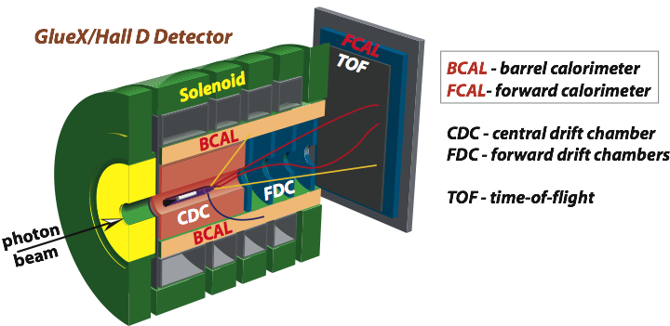

Prospects of Studying Hadrons in Nuclear
Matter with the GlueX Detector
A. Somov (Jefferson Lab)
The Nature of Hadron Mass and Quark-Gluon Confinement from JLab Experiments
in the 12-GeV Era, July 3 , 2018, Pohang, Korea
GlueX detector in Hall D
Proposed experiments using nuclear targets
- Study color transparency in photoproduction
- Study photoproduction of vector mesons off nuclei

Slide 2
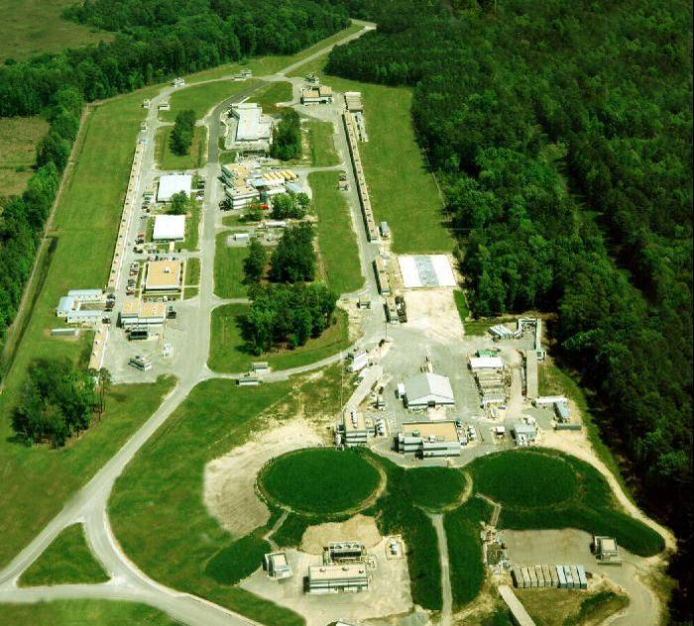
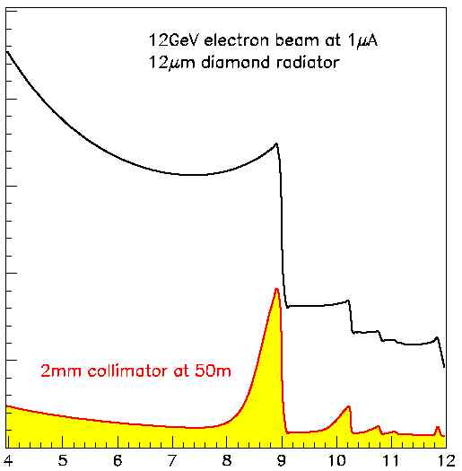
The GlueX Detector in Hall D at JLab
Photon beam produced by CEBAF
12 GeV electrons in a thin radiator via
bremsstrahlung process
Linear polarization of beam photons
Newly constructed experimental Hall D
with the GlueX detector
Hall D
Uncollimated photons
A
B
C
Collimated beam
photons
Photon beam energy (GeV)

Slide 3
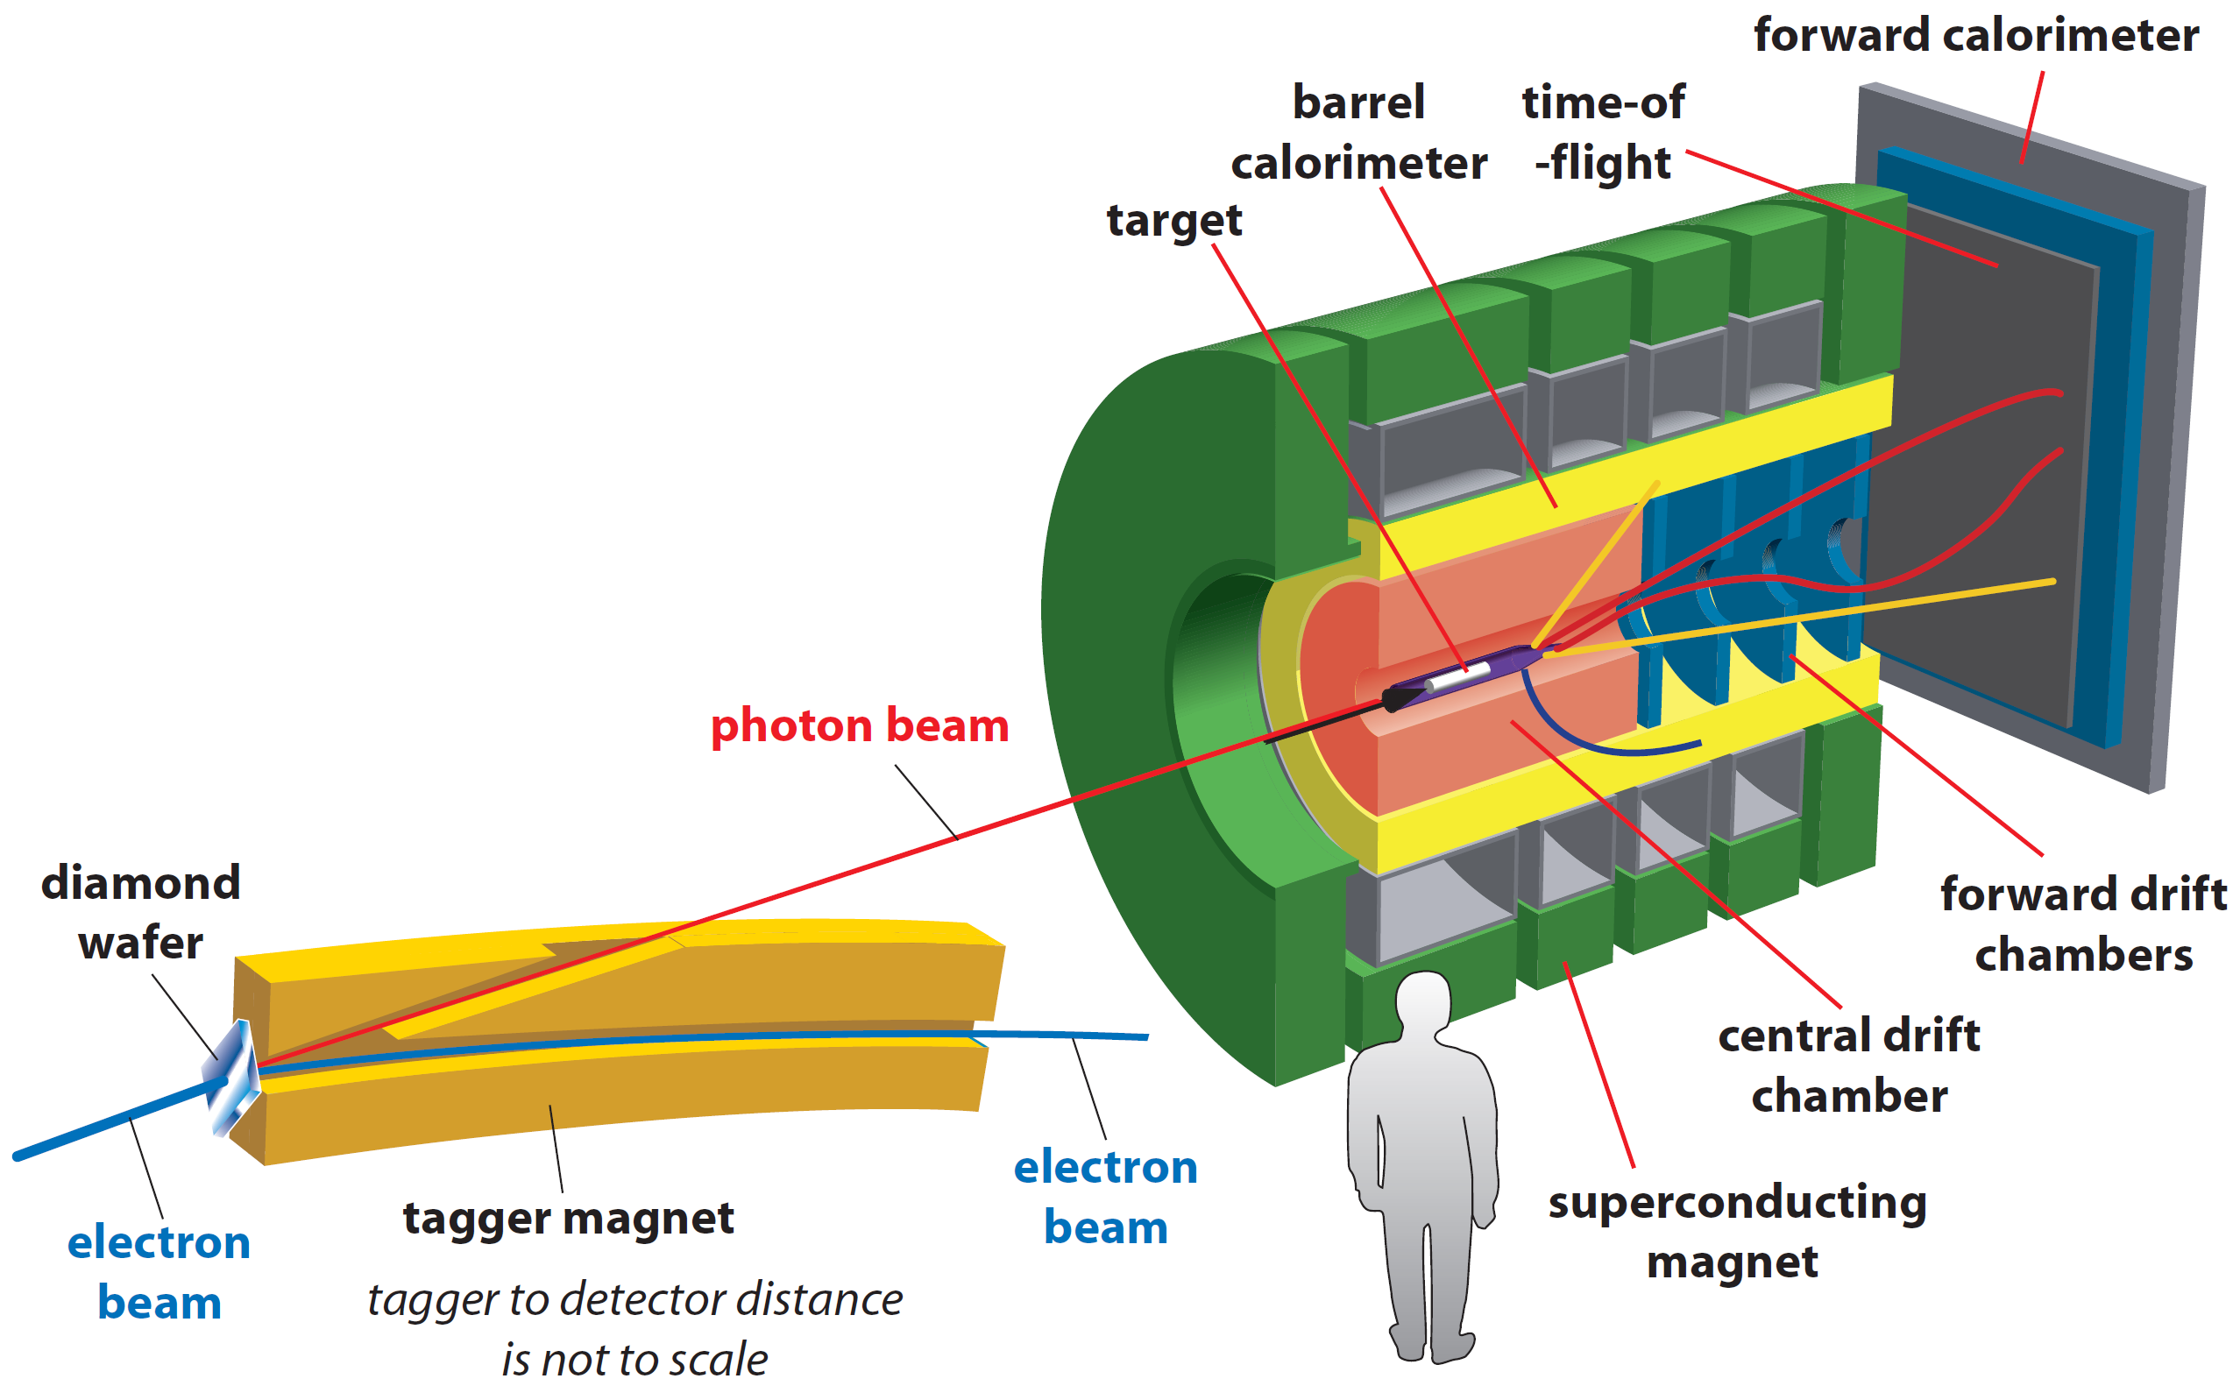
The GlueX Detector
• Optimized to detect multi-particle final states
• Hermetic, large/uniform acceptance for
charged and neutral particles, good energy
and momentum resolution
Tracks: σ_{p} / p ~ 2 – 5 %
Photons: σ_{E} / E = 6 % /√E ⊕ 1.6 %
Acceptance: 1° < θ < 120°
Target: liquid hydrogen
new PID (k/π)
Newly proposed experiments:
- install nuclear targets
- no modifications to the existing detector

Slide 4
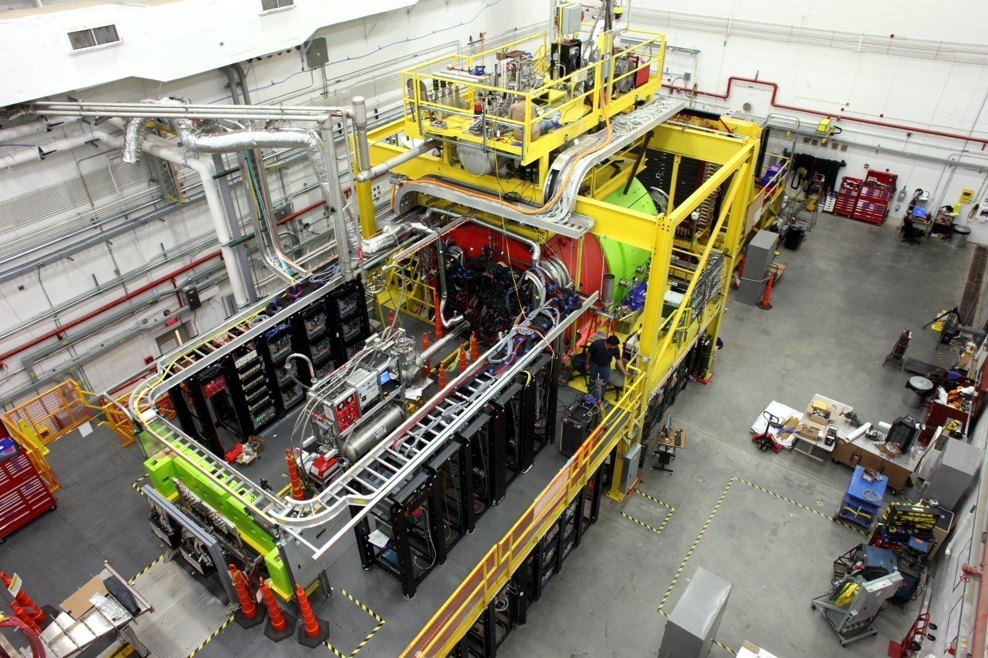
The GlueX Detector in Hall D
Beam Dump
Solenoid Magnet
Photon Beam

Slide 5
Approved Experiments in Hall D
Experiment | Name | Days | Condition | Target
E12-06-102 | Mapping the spectrum of light quark mesons and gluonic excitations with Linearly polarized photons | 120 |  | LH₂
E12-12-002 E12-13-003 | A study of meson and baryon decays to strange final states with GlueX in Hall D | 220 (200) | PID | LH₂
E12-10-011 | A precision measurement of the η radiative decay width via the Primakoff effect | 79 |  | LH₂ LHe₄
E12-13-008 | Measuring the charged pion polarizability in the γγ → π⁺π⁻ reaction | 25 |  | Sn
C12-14-004 | Eta decays with emphasis on rare neutral modes: The JLab Eta Factory experiment (JEF) |  | Upgrade Forward calorim. | LH₂
First physics run in Spring 2016
Took data in 2017 and 2018
(see talk by Elton Smith)

Slide 6
Physics Topics with Nuclear Targets
Workshop on nuclear photoproduction with GlueX, JLab, April 28 - 29, 2016
https://www.jlab.org/conferences/photoproduction16/
- motivated further theoretical studies
Photoproduction of vector mesons off nuclei S. Gevorkyan et al. Phys. Rev. C 93, (2016)
Color transparency A. Larionov and M. Strikman Phys.Lett. B, 760, 753 (2016)
Short range correlations
Study in-medium modification effects
Heavy meson photoproduction ( open charm, J/ψ )
Primakoff production
. . . . . .
Notes:
6

Slide 7
Hall D Physics Program: New Proposals
Proposal | Name | Target
PR12-17-007 | Probing QCD in the nuclear medium with real photons and nuclear targets at GlueX (Color Transparency and SRC) | A
PR12-17-010 PR12-18-001 | Production of vector mesons on nuclei with GlueX | A
Proposed experiments in Hall D using nuclear targets
Working group:
Gasparan (NCAT), L.Gan (UNCW), S. Gevorkyan (JINR),
I. Larin (UMAS), O. Hen (MIT), H. Gao (Duke), M. Patsyuk (MIT),
D. Dutta (MSS), L. Weinstein (ODU), E. Piasetzky (TAU), and
the GlueX Collaboration

Slide 8
Color Transparency
At high transfer momenta |t| photon couples to a qq configuration with a
small transverse size
The small-size configuration interacts less with the nuclear medium
(fundamental predictions of QCD)
Observables:
- Increase of the medium nuclear transparency T = σ _{A} / A ⋅σ _{N}
T
Color transparency
Glauber
|t|

Slide 9
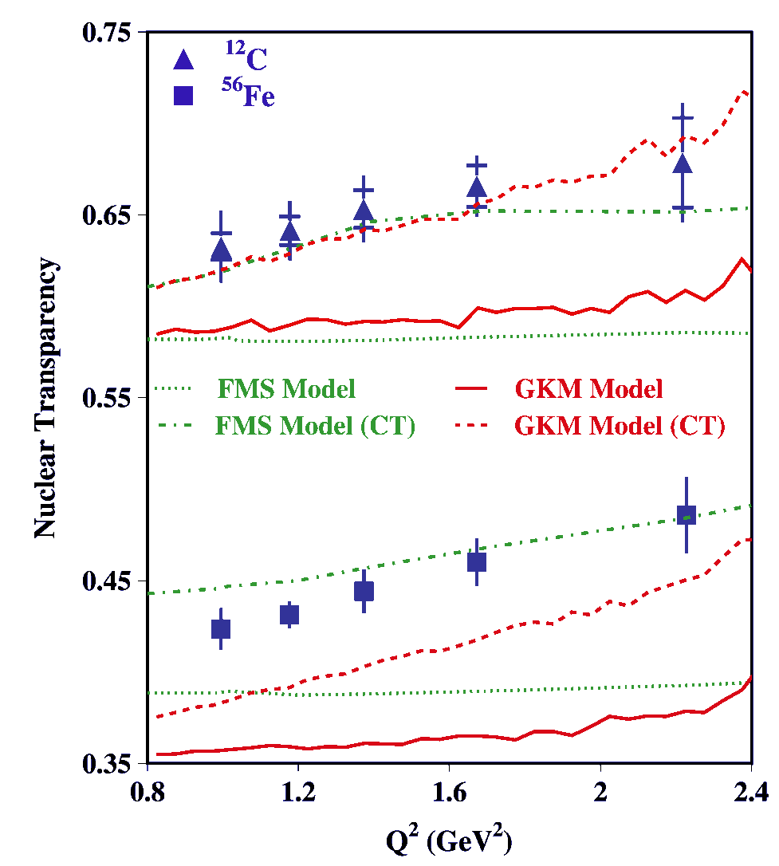
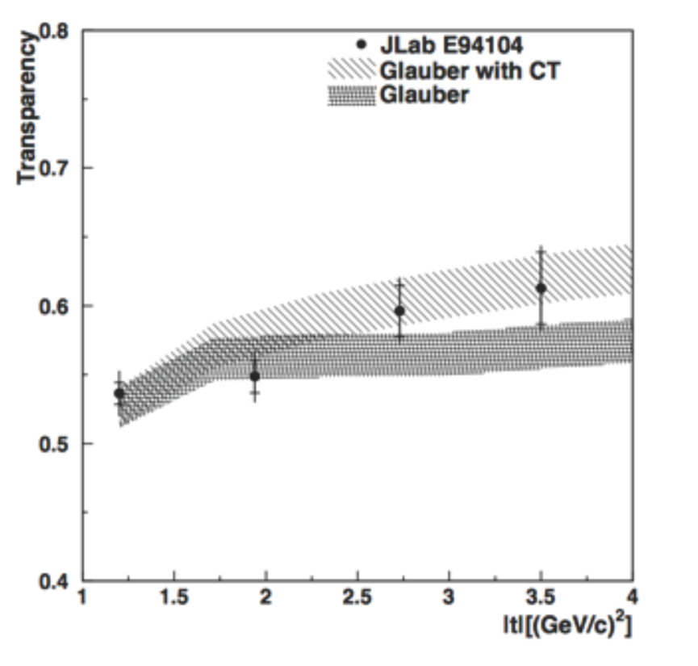
Example of Measurement of Color Transparency
γ + n → π ⁻ + p (⁴He target)
A (e,e′ ρ⁰)
D. Dutta et al., PRC 68, 021001 (2003)
L. El Fassi et al., PLB 712, 326 (2012)

Slide 10
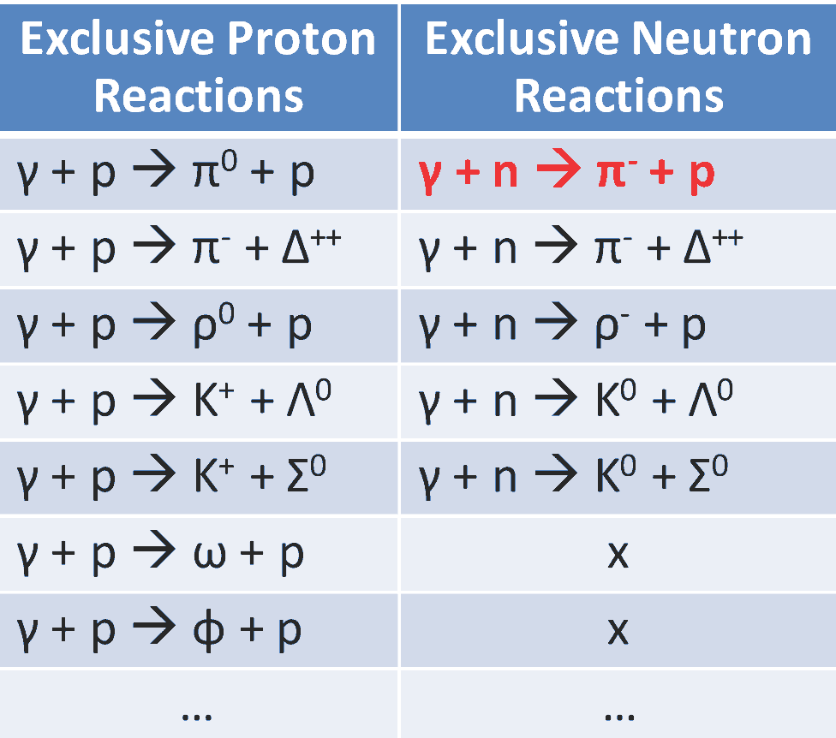
Proposed CT Measurements at GlueX
Measure nuclear transparency
using nuclear targets:
D, ⁴He, ¹²C, ⁴⁰C
Reconstruct several final states
Large range of |t _{max}|
from 3 GeV² to about 10 GeV²
- Previous measurement:
|t| < 3.5 GeV²

Slide 11
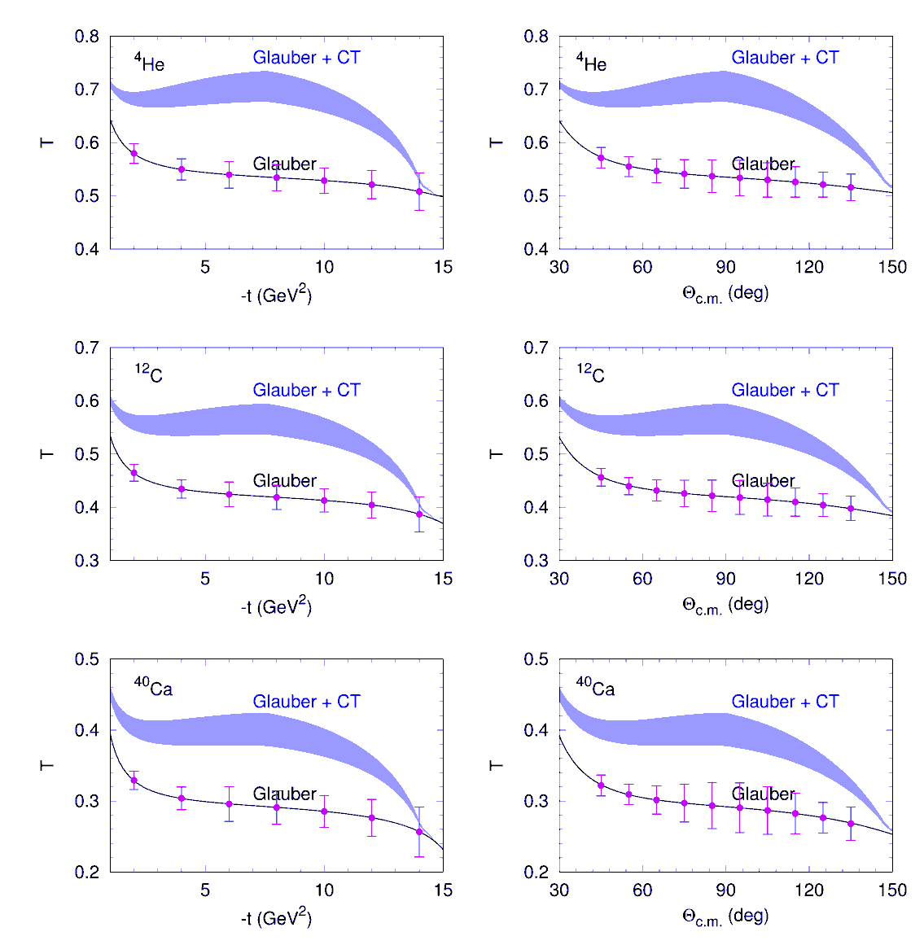
Expected Sensitivity
γ + n → π ⁻ + p
Theoretical calculations for GlueX
by A. Larionov and M. Strikman
Phys.Lett. B, 760, 753 (2016)
Number of reconstructed events
 | γ + n → π ⁻ + p | γ + n → ρ ⁻ + p
D | 13,600 | 57,000
⁴He | 13,000 | 54,000
¹²C | 7,400 | 31,000
⁴⁰Ca | 2,600 | 13,600
Smallest yield for γ + n → π ⁻ + p

Slide 12
Photoproduction of Vector Mesons on Nuclei
with GlueX
Proposed experiment PR12-18-001
Measure photoproduction cross sections of vector mesons ω, ρ, and φ
on C, Si, Sn and Pb targets in the energy range of 6 - 9 GeV with the
GlueX detector
Extract nuclear transparency at different energies
Extract spin density matrix elements
Extract cross section of longitudinally polarized omega mesons with
nuclei σ_{L} (ω N) with two methods
- nuclear transparency
- spin density matrix element ρ^{A}₀₀

Slide 13
Why is it Important ?
There are experimental indications that σ_{L} (VN) < σ_{T} (VN), but there
have been no direct measurements of σ_{L} (VN) so far. Measurements
of σ_{L} are important for the interpretation of the color transparency in
vector meson electroproduction and comparison between different
theoretical approaches
Disagreement between existing experimental data and theoretical
predictions for nuclear transparency
- observed weak beam-energy dependence of the nuclear
transparency in the previous experiments; contradicts theoretical
predictions

Slide 14
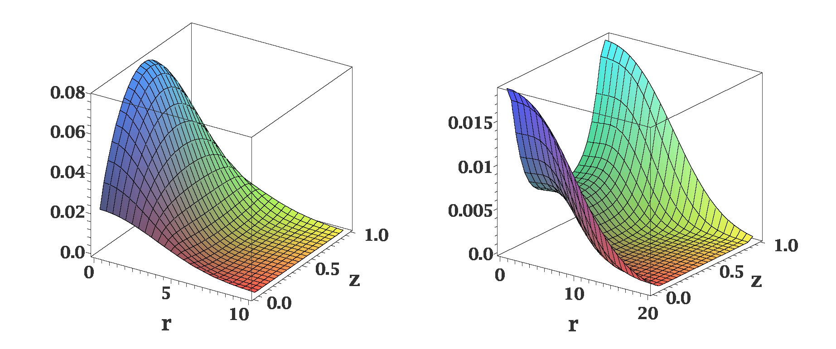
Distribution of Quarks in Vector Meson
Different distributions of quarks in the transversely and longitudinally polarized
mesons
ρ_{L}
ρ_{T}
In AdS/QCD (Brodsky & G.Teramond)
light-cone wave functions depend on
meson polarization
Light-cone wave functions for ρ mesons:
J.Forshaw and R.Sandapen
Phys.Rev. Lett. 109,081601,2012
Color dipole model of strong interaction
different cross sections for interactions of transversely and longitudinally
polarized mesons

Slide 15
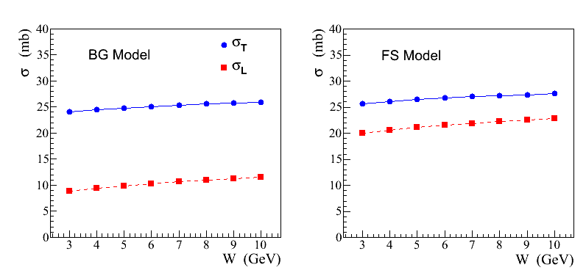
Recent Theoretical Calculations
S. Gevorkyan, paper in
preparation
σ_{L,T} (ρ N) cross sections predicted in a color dipole model using different
parameterizations of wave functions:
AdS / QCD holographic wave function (FS)
J.Forshaw and R. Sandopen,
Phys.Rev.Let. 109, 2012
Boosted Gaussian (BG) wave function
B.Kopeliovich et al., Phys.Rev. C65, 2002
FS model
BG model

Slide 16
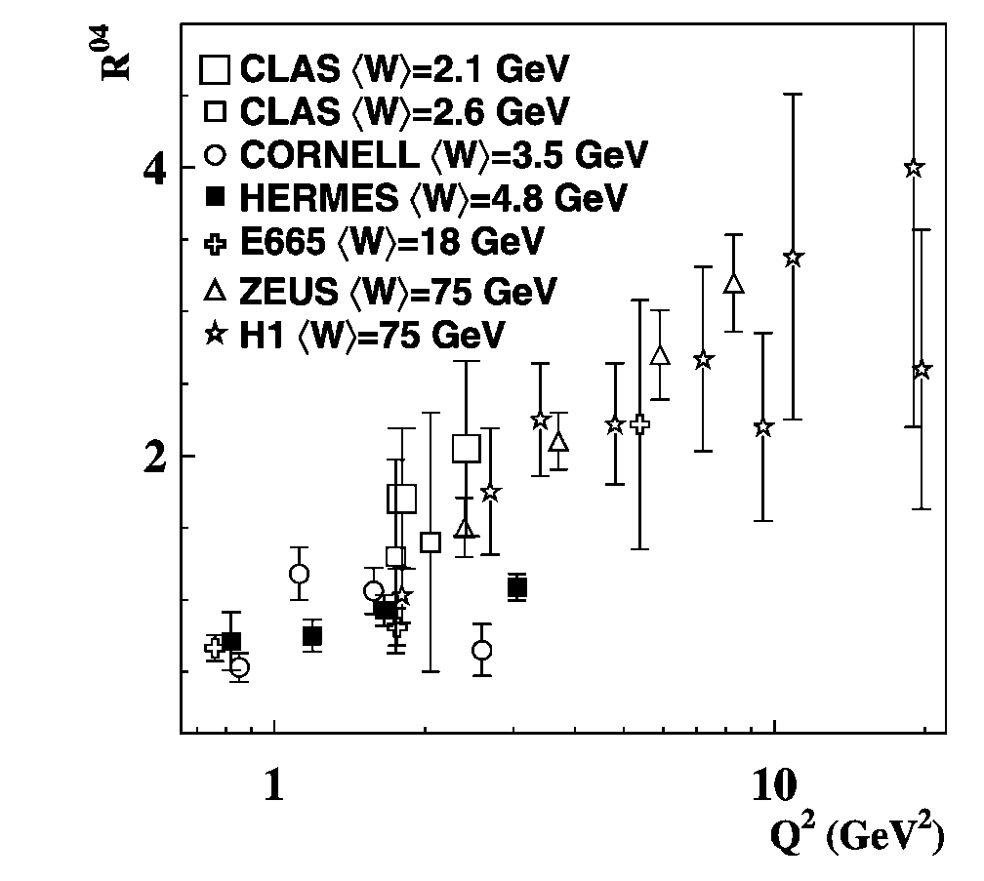
Impact of σ_{L,T} (VN) on Color Transparency
Q² dependence of the longitudinal-to-
transverse cross section ratio for ρ mesons
Larger fraction of longitudinally polarized ρ mesons produced at larger Q²

Slide 17
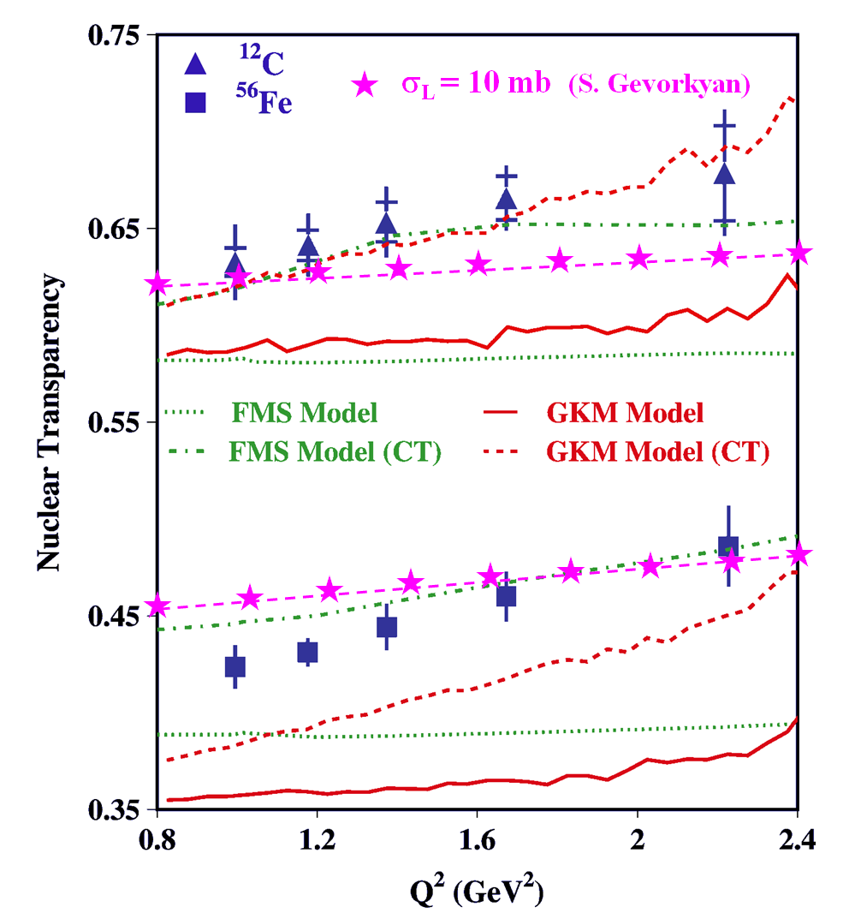
Impact of σ_{L,T} (VN) on Color Transparency
CT measurements at CLAS
Recent theoretical calculations
σ_{L} (VN) = 10 mb
Nuclear transparency depends on the polarization of the meson
- different absorption if σ_{L} (VN) ≠ σ _{T} (VN)
The Color Transparency effect is ‘screened ‘ if σ_{T} (VN) > σ_{L} (VN)

Slide 18
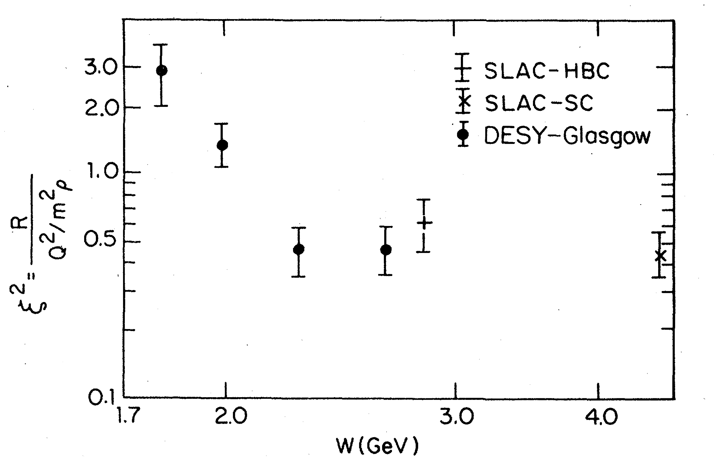
Polarization-Dependent Interactions: Experimental Observations
Hints from the electroproduction of vector mesons:
where
ρ mesons: ξ ~ 0.7 Nucl. Phys. B113, 53 (1976)
φ mesons: ξ² ~ 0.33 Phys. Rev. Let. 39, 516 (1977)
ξ²
W (GeV)
Similar observations of the polarization-dependent
interactions of deuterons with Carbon targer
- measured in Dubna and Juelich
Phys. Part. Nucl. Lett. 7, 27, 2010 Phys. Rev. Lett. 104, 2010
Measurements in the charge exchange process at Argonne:
π⁺ + Ne → ρ + Ne′
Nucl. Phys. B67, 333 (1973)
Propose to measure σ_{L} (VN) using photoproduction on nuclei

Slide 19
Coherent and Incoherent Production of ω Mesons
In the coherent γ + A → ω + A production at JLab energies the essential
contribution of pion exchange cancels out. From the absorption of ω’s one
can extract σ_{T} (ω N)
- it has been measured by several experiments (σ_{T} ~ 26 mb)
In the incoherent process γ + A → ω + A′ the cross section is given by
- N (0, σ_{L}) and N (E, σ_{T}) are absorptions of the longitudinally and transversely
polarized mesons predicted by theoretical models
- Sensitivity to σ_{L} through the absorption N (0, σ_{L})
- ρ₀₀ is the spin density matrix element measured in γ p → ω p reaction

Slide 20
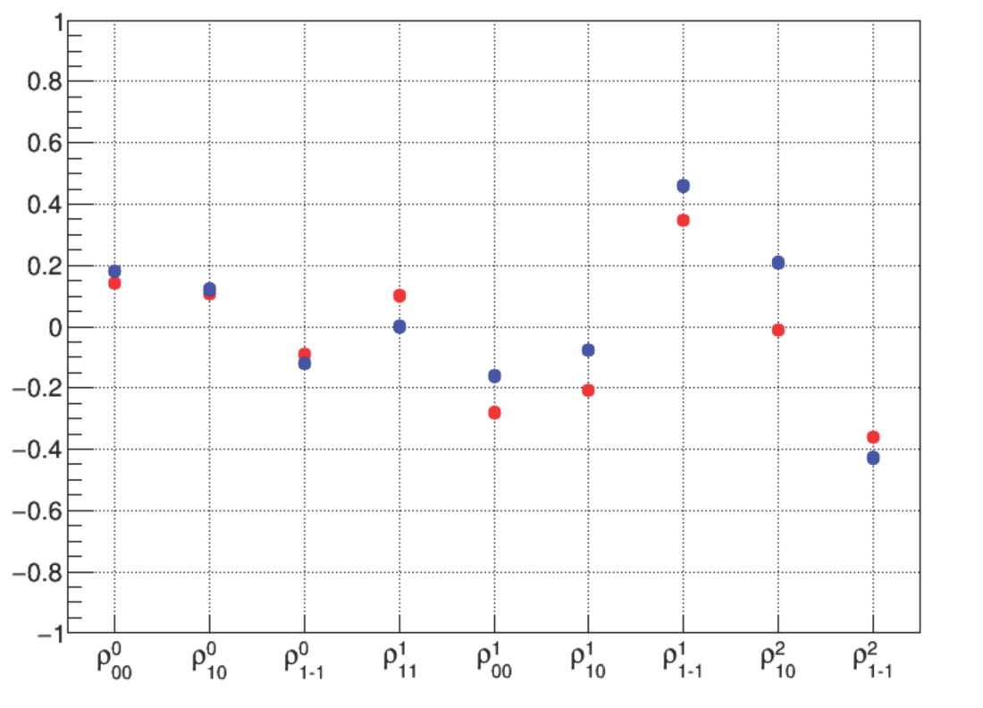
Why ω Mesons ?
Some fraction of ω mesons is longitudinally polarized at GlueX energies (9.3 GeV)
ρ₀₀ measured by SLAC is 0.2 ± 0.07
J.Ballam et al., Phys. Rev. D7, 3150 (1973)
Spin density matrix elements measured by
GlueX using a γp→ωp reaction
Preliminary GlueX results indicate
that ρ₀₀ is relatively large
GlueX preliminary
- measured in the energy range
8.4 – 9.1 GeV
- ρ₀₀ can be larger at smaller
energies (larger contribution
from pion exchange)
M. Staib, PhD tesis GlueX-doc-3357

Slide 21
How to Extract σ_{L} (ωN) ?
σ_{L} (ωN) can be extracted from the measurements of:
Method 1: Nuclear transparency ( A_{eff} )
Method 2: Spin density matrix element (ρ^{A}₀₀ )
Make use of the different absorption predicted for interactions of
longitudinally and transversely polarized mesons

Slide 22
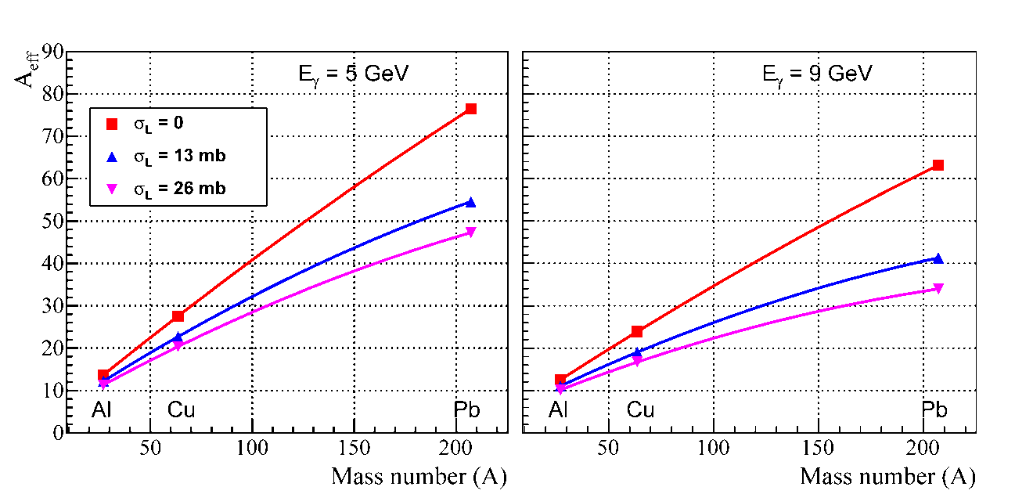
Extraction of σ_{L} (ωN): Method 1
Measure nuclear transparency A_{eff} for each nuclear target
A_{eff} depends on σ_{L} (see plot)
- N (0, σ_{L}) and N (E, σ_{T}) are predicted by theoretical models.
- N (E, σ_{T}) will be independently measured for ρ mesons
Predictions for A_{eff}
Calculations for GlueX
by S. Gevorkyan
Phys. Rev. C 93, 015203
(2016)

Slide 23
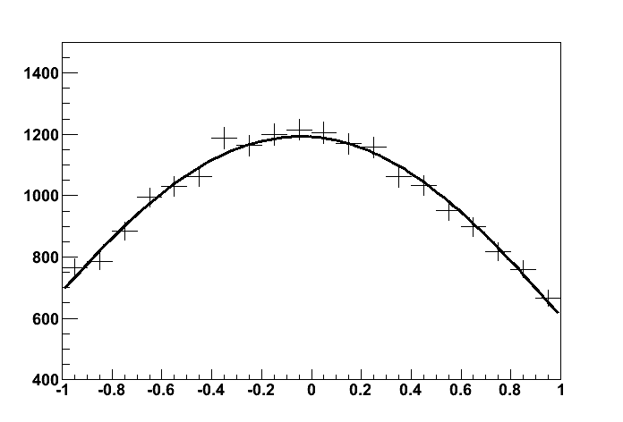
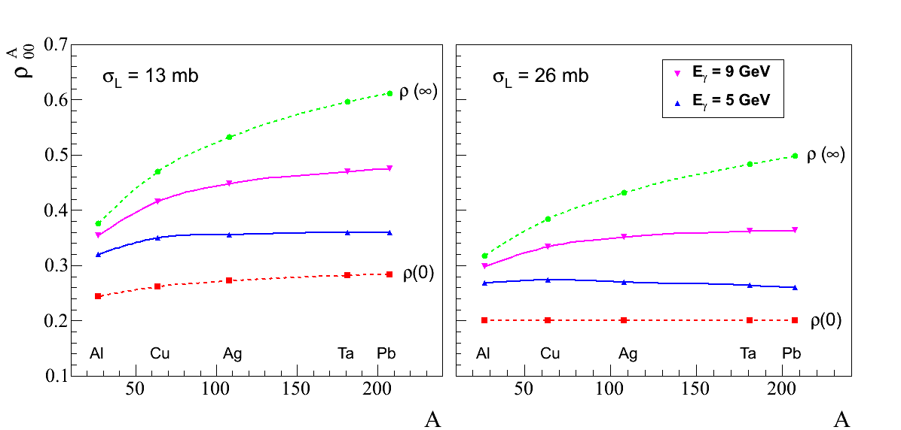
Extraction of σ_{L} (ωN): Method 2
Measure ρ^{A}₀₀ for each target from the
fit to the ω decay angular distribution
ρ^{A}₀₀ depends on σ_{L}
cos θ
- extract σ_{L}
Predictions for ρ^{A}₀₀
Phys. Rev. C 93, 015203 (2016)
Input value: ρ₀₀ = 0.2

Slide 24
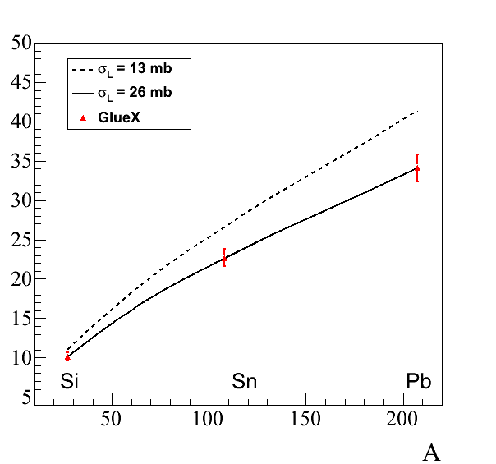
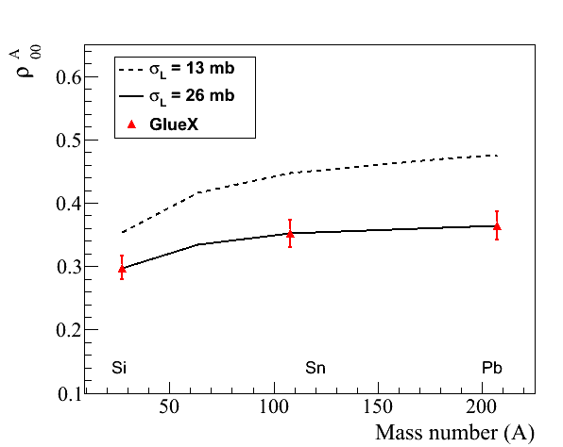
Projected Errors: A_{eff} and ρ^{A}₀₀
Projected errors on measurements of A_{eff} and ρ^{A}₀₀ for ω → π⁰ γ decays
(input values: σ_{T} = 26 mb, ρ₀₀ = 0.2)
A_{eff}
ρ^{A}₀₀
9 GeV
9 GeV

Slide 25
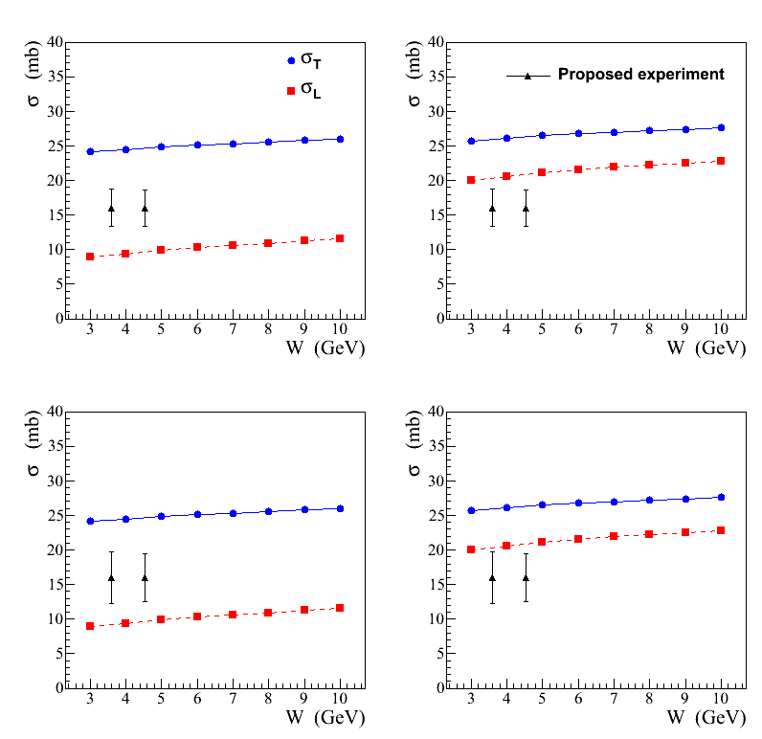
Projected Errors on σ_{L} (ωN)
FS model
BG model
ρ₀₀ = 0.2
σ_{L} extracted from the
measurement of A_{eff}
Combine measurements of A_{eff}
from two decay channels
ω → π⁰ γ and ω → π⁺ π⁻ π⁰
σ_{L} will be separately extracted
from the measuremnt of ρ^{A}₀₀
ρ₀₀ = 0.14

Slide 26
Energy Dependence of Nuclear Transparency

Slide 27
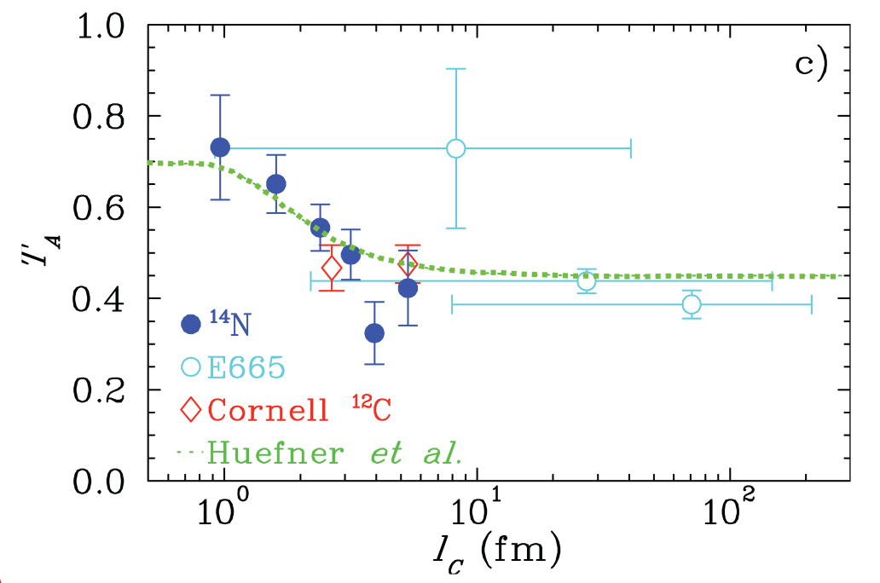
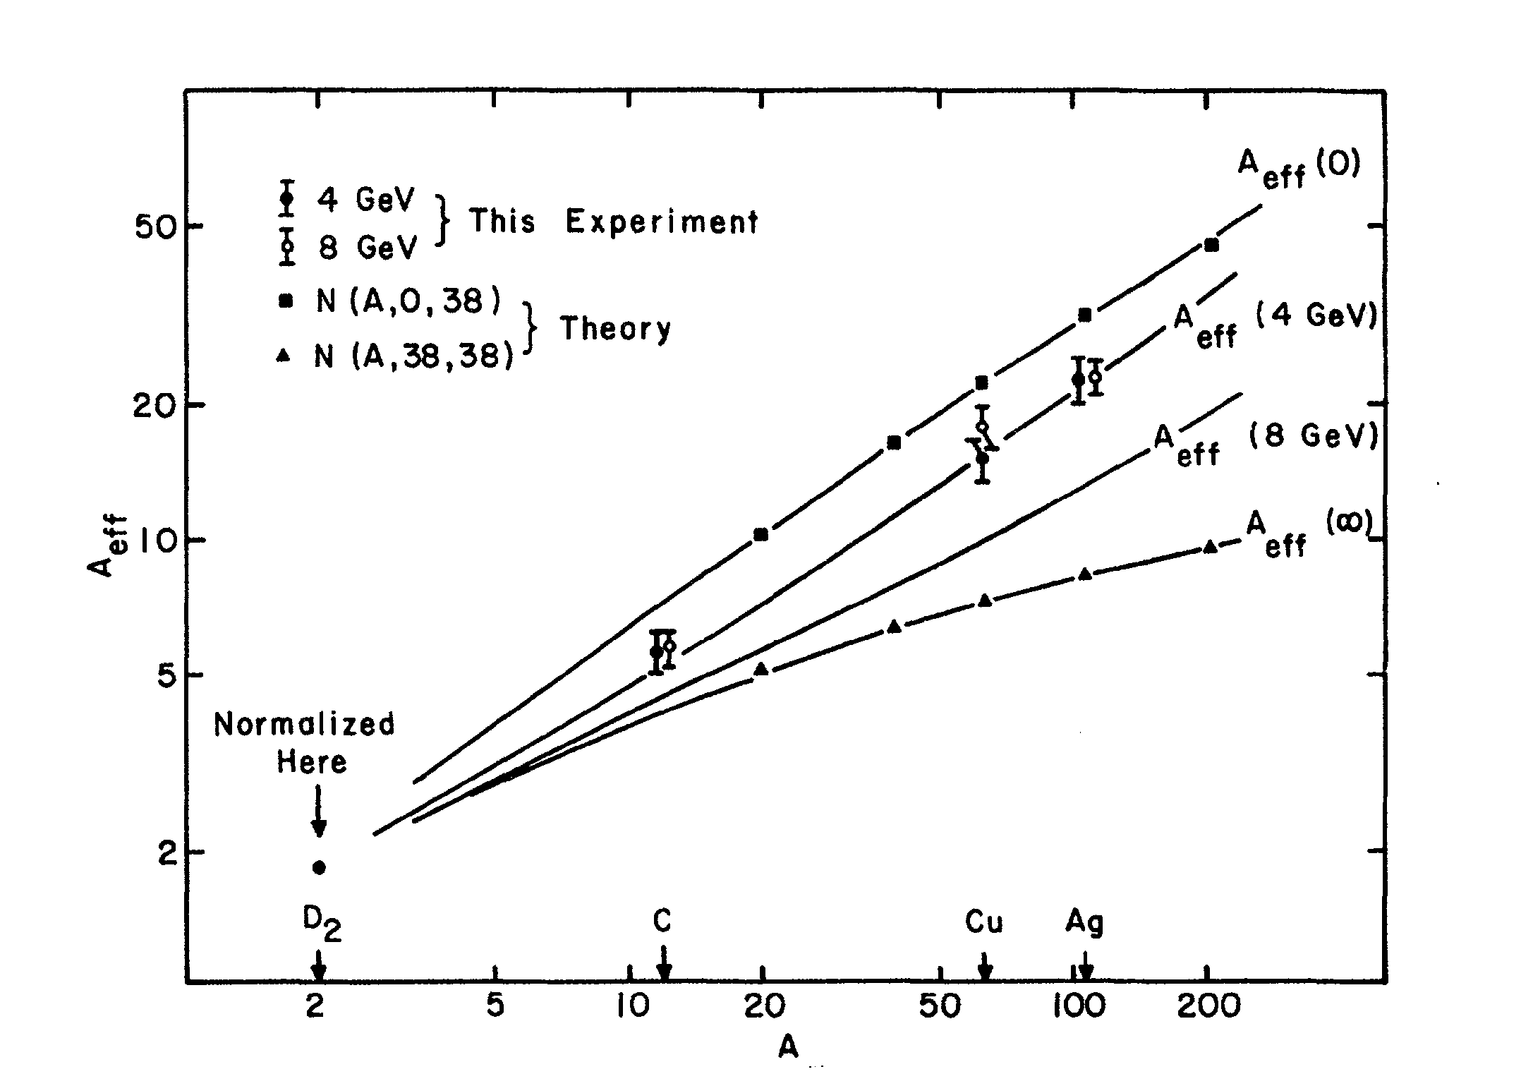
Energy Dependence of Nuclear Transparency
Energy dependence of the nuclear transparency due to the interference of amplitudes
in the production of mesons on nuclei
- dependence of the incoherent cross section on energy ν via the
coherence length
Predicted for both electroproduction and photoproduction
Measured in the electroptoduction
not observed in ρ photoproduction
A_{eff}
T_{A} = A_{eff} / A
G. McClellan, et al. Phys. Rev. Let. 23, 10, 1969

Slide 28
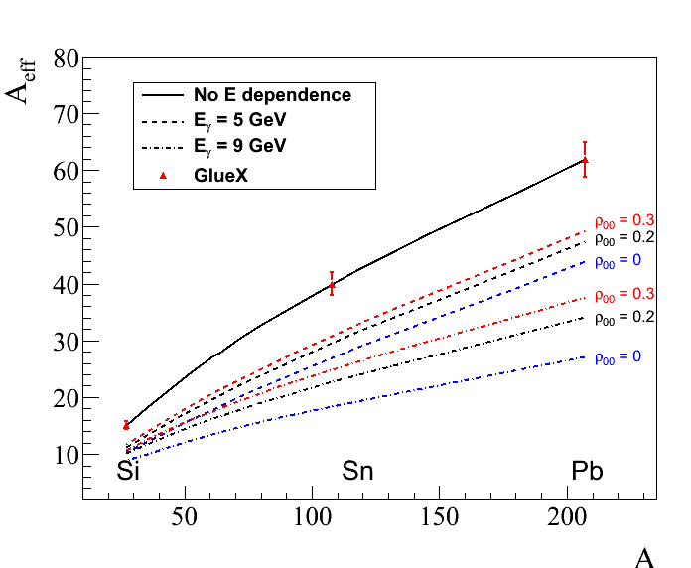
Energy Dependence Predicted for GlueX
Predicted energy dependence of the nuclear transparency for ω and ρ mesons
similar dependence for
ρ-mesons ( ρ₀₀ = 0 )
5 GeV
9 GeV

Slide 29
Summary
We are developing physics program to study photoproduction on nuclear targets
using the GlueX detector at JLab. Proposals of two experiments are being prepared
We propose to study nuclear transparency in photoproduction using different binary
reactions A(γ, NN). in the beam energy range 8–9 GeV. The data will be used
to probe the Color Transparency effect
Nuclear transparency will be measured for light mesons ρ, ω, and φ over a wide
energy range between 6 GeV and 12 GeV
- measurement will shed light on a long standing puzzle, a week beem energy
dependence of the nuclear transparency observed in precious experiments
For the first time, the total cross section of longitudinally polarized ω mesons on a
nucleon will be extracted from the two independent measurements of A_{eff} and ρ^{A}₀₀
- the knowlegde of σ_{L} (ωN) is important for many theoretical models
- provide information for understanding the color transparency in electroproduction
Several other physics topics can be worked out. We need feedback from theorists !

Slide 30
Backup Slides

Slide 31
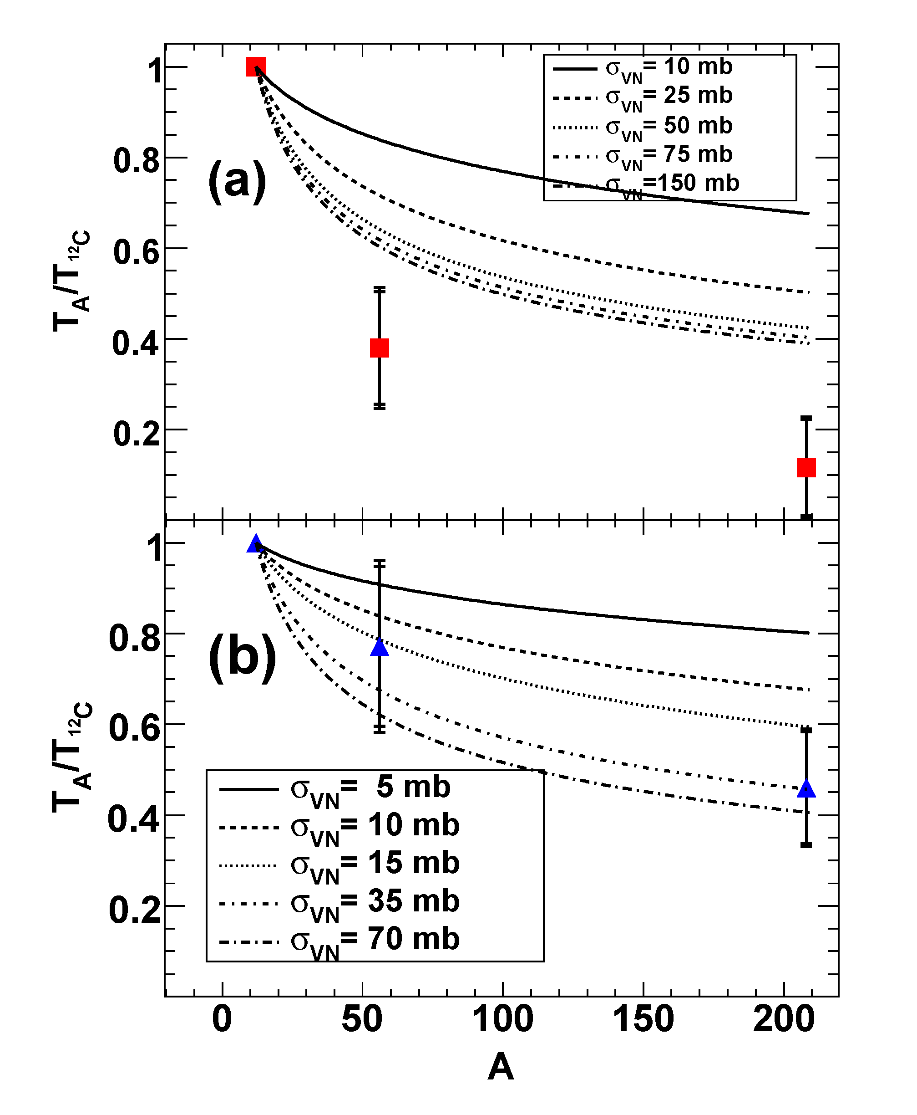
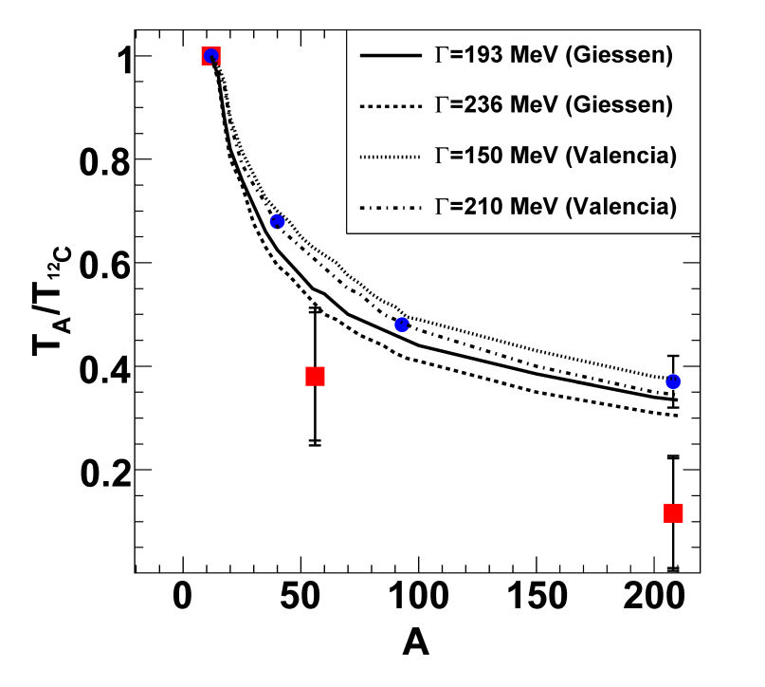
Nuclear Transparency Measured by CLAS E01-112
PRL 105, 112301 (2010)
ω mesons
φ mesons
Transparency T_{A} = σ_{A} / A σ_{N}
Large absorption observed for ω mesons
not consistent with CBELSA/TAPS results
- Interference between ω and ρ mesons
in the e⁺e⁻ decay mode (?)

Slide 32
Experimental Results on In-medium Modifications
S.Leupold, V. Metag, U. Mosel
Int. J. Mod. Phys. E 19 (2010)
Experimet | Beam GeV | P range GeV/c | ρ | ω | φ
Spring 8 | γ A 1.5 – 2.4 | p > 1 K⁺K⁻ final state |  |  | ΔΓ ~ 70 MeV p = 1.8 GeV/c
CBELSA/ TAPS | γ A 0.9 – 2.2 | p > 0 π⁰γ final state |  | ΔΓ ~ 130 MeV p = 1.1 GeV/c
CLAS E01-112 | γ A 0.6 – 3.8 | p > 0.8 e⁺e⁻ final state | Δm ~ 0 ΔΓ ~ 70 MeV p = 1.1 GeV/c
KEK-E325 | p A 12 | p > 0.6 e⁺e⁻ final state | Δm /m = -9 % ΔΓ ~ 0 | Δm /m = -9 % ΔΓ ~ 0 | Δm /m = -3.4 % ΔΓ / Γ = 3.6
GlueX | γ A 6 – 12 |  | ππ (e⁺e⁻) | π⁰γ, π⁺π⁻π⁰, (e⁺e⁻) | K⁺K⁻ (e⁺e⁻)

Slide 33
Medium Modifications of Mesons
Study modifications of meson properties by nuclear matter:
Spectroscopy of hadron line shapes
Attenuation measurements
Use vector mesons to study the mass distribution and medium absorption
(cτ = 1.3 fm, 23 fm, and 46 fm for ρ, ω, and φ)
In-medium modification measurements have been performed by several
experiments
- Experimental measurements are not completely understood
(more measurements are required)

Slide 34
GlueX Perspectives to Measure In-medium
Effects
Study medium modifications of light mesons ρ, ω, and φ
Reconstruct mesons in different final states
• study contribution from final state interactions
• small final state distortion in the dilepton final state
- small branching fractions of 10⁻⁴ – 10⁻⁵
- ρ - ω interference
- have to study GlueX reconstruction capabilities of dileptons
Study in-medium effects for different beam energies and meson
momenta

