Slide 1
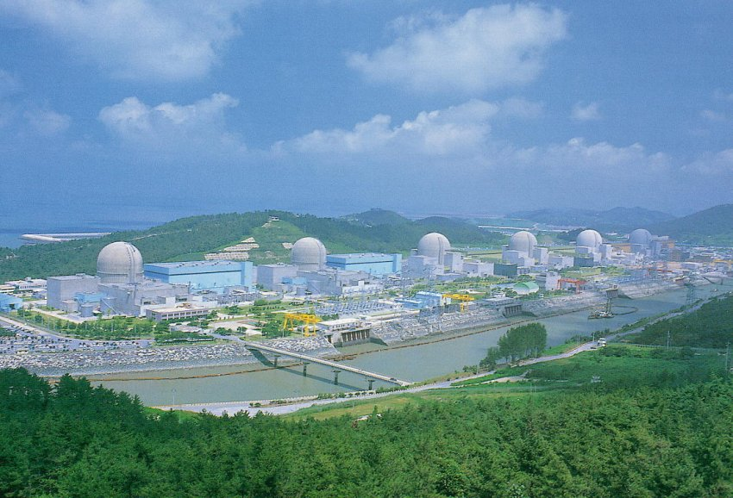
New Results from RENO
APCTP workshop on “The nature of hadron mass and quark-gluon confinement from Jlab Experiments”
APCTP at POSTECH, Pohang, July 3rd, 2018
Soo-Bong Kim (SNU)

Slide 2
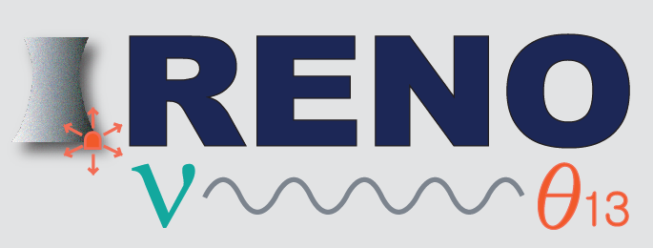
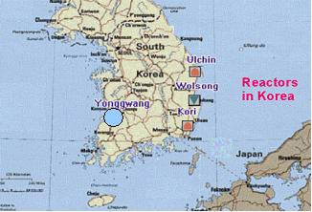
RENO Collaboration
Reactor Experiment for Neutrino Oscillation
(8 institutions and 40 physicists)
Chonnam National University
Dongshin University
GIST
KAIST
Kyungpook National University
Seoul National University
Seoyeong University
Sungkyunkwan University
Total cost : $10M
Start of project : 2006
The first experiment running with both near & far detectors from Aug. 2011
YongGwang (靈光) :
16.8 GW (6 reactors)

Slide 3
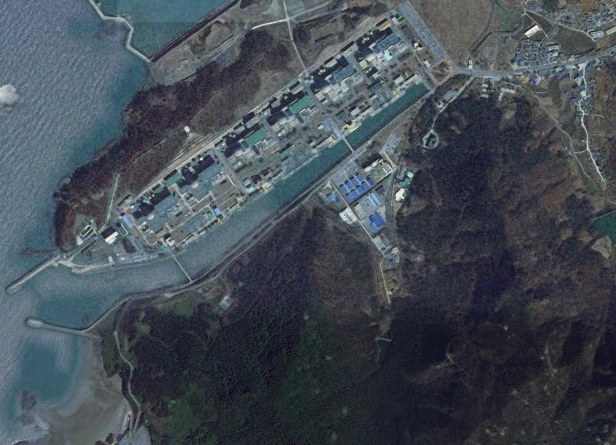

RENO Experimental Set-up
120 m.w.e.
Near Detector
294m
1383m
Far Detector
450 m.w.e.

Slide 4
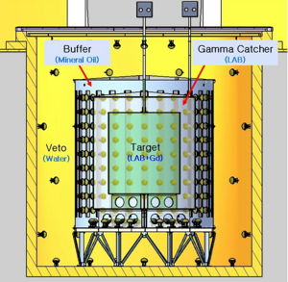
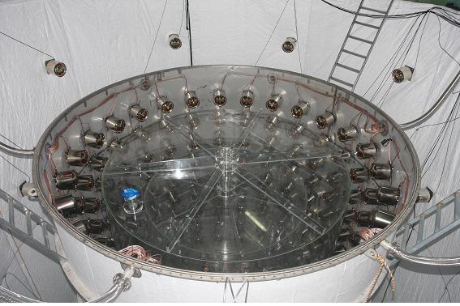
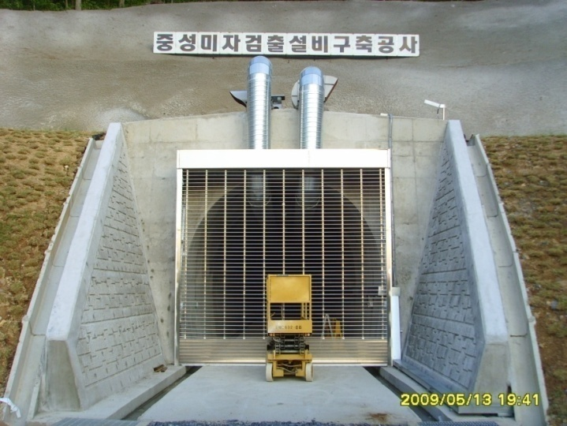
RENO Detector
354 ID +67 OD 10” PMTs
Target : 16.5 ton Gd-LS, R=1.4m, H=3.2m
Gamma Catcher : 30 ton LS, R=2.0m, H=4.4m
Buffer : 65 ton mineral oil, R=2.7m, H=5.8m
Veto : 350 ton water, R=4.2m, H=8.8m

Slide 5
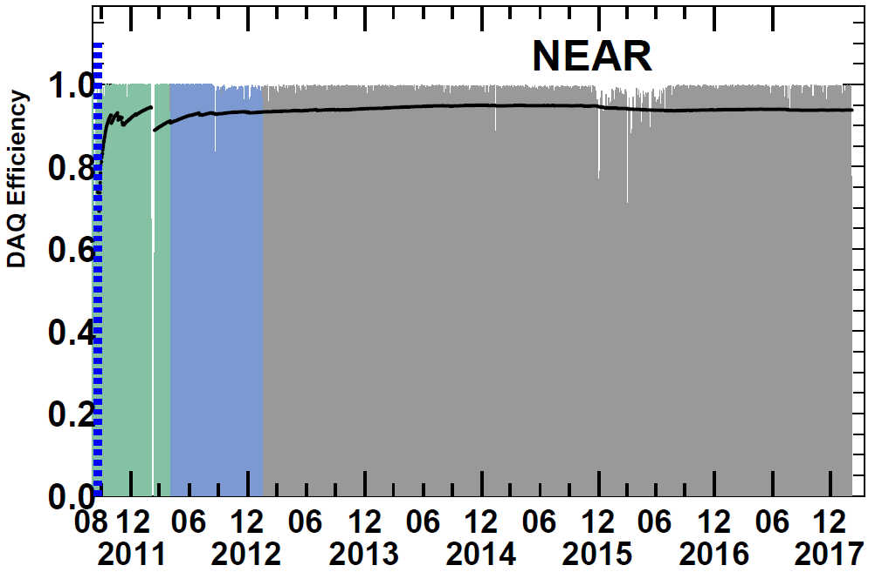
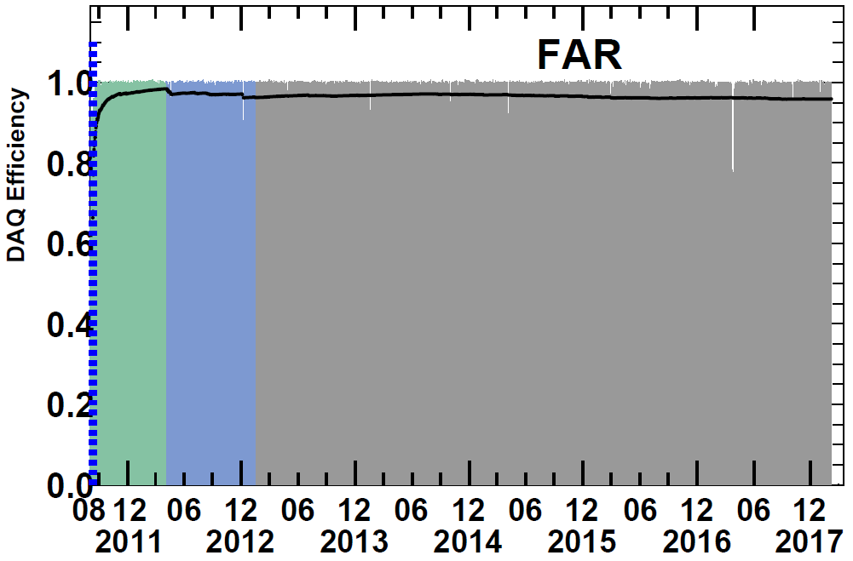
RENO Data-taking Status
Data taking began on Aug. 1, 2011 with both near and far detectors.
(DAQ efficiency : ~95%)
A
A (220 days) : First θ₁₃ result
[11 Aug, 2011~26 Mar, 2012]
PRL 108, 191802 (2012)
B
B (~500 days) : Recent results
Rate+shape analysis (θ₁₃ and |Δm_{ee}² |)
5 MeV excess
[11 Aug, 2011~21 Jan, 2013]
→ PRL 116, 211801 (2016)
accepted to PRD (arXiv:1610.04326)
Now
C (~2200 days) : New results
Rate+shape analysis (θ₁₃ and |Δm_{ee}² |)
Variation of reactor neutrino yield
5 MeV excess from ²³⁵U
[11 Aug, 2011~7 Feb, 2018]
→ (arXiv:1806.00248 & arXiv:1806.00574)
C (new results)

Slide 6
New RENO Results
■ Precise measurement of |Δm_{ee}² | and θ₁₃ using ~2200 days of data (Aug. 2011 – Feb 2018)
“Measurement of Reactor Antineutrino Oscillation Amplitude and Frequency at RENO” (arXiv:1806.00248)
■ Fuel-composition dependent reactor antineutrino yield →
“Fuel-composition dependent reactor antineutrino yield and spectrum at
RENO” (arXiv:1896.00574)
■ Measurement of absolute reactor neutrino flux and spectrum
■ Independent measurement of |Δm_{ee}² | and θ₁₃ with
delayed n-H signals
■ Results from a sterile neutrino search

Slide 7
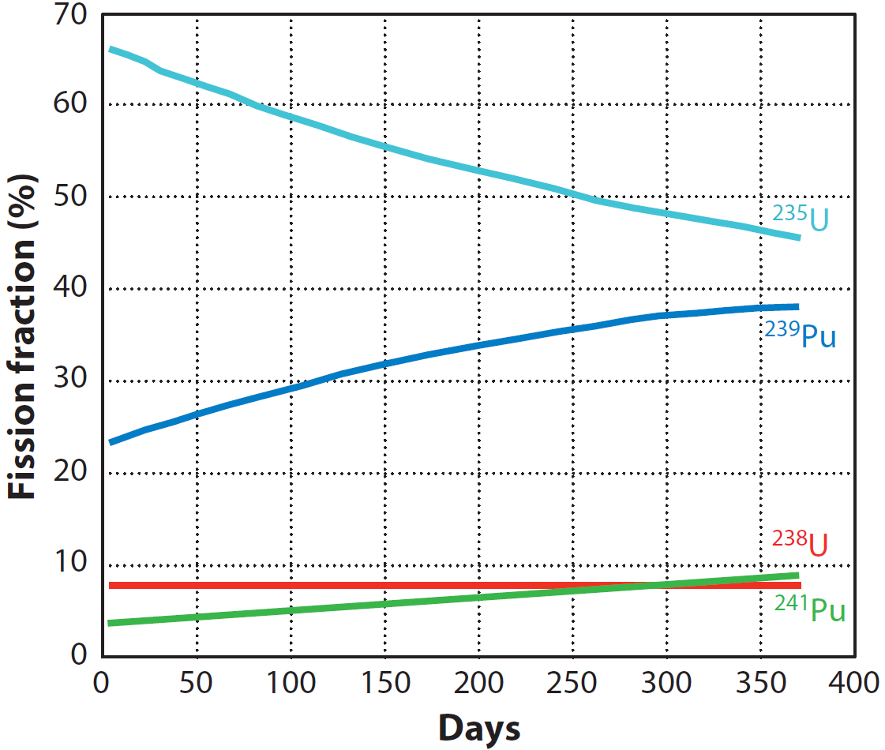
Reactor Fuel Isotope Fraction

Slide 8
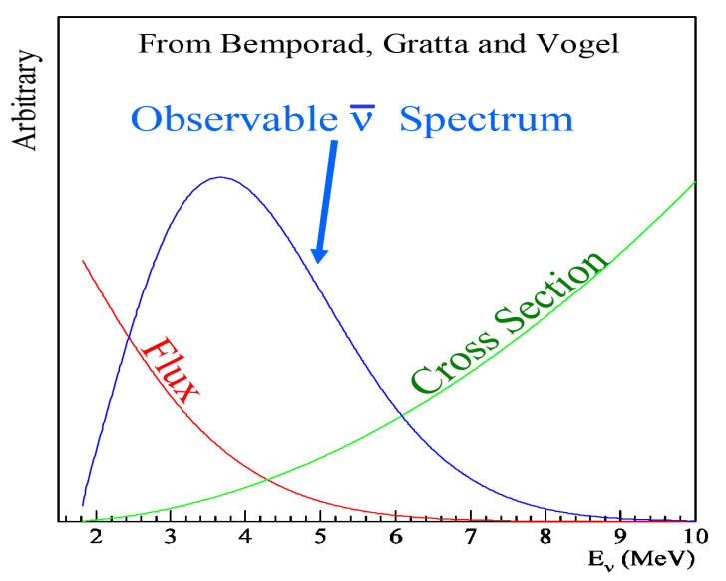
Observable Reactor Neutrino Spectrum

Slide 9

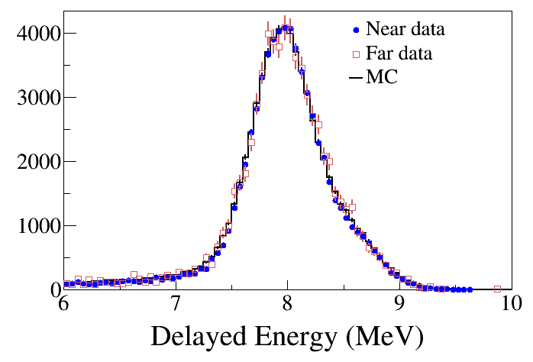
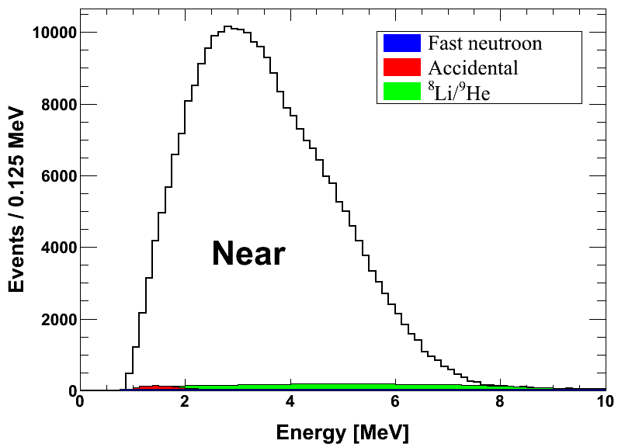
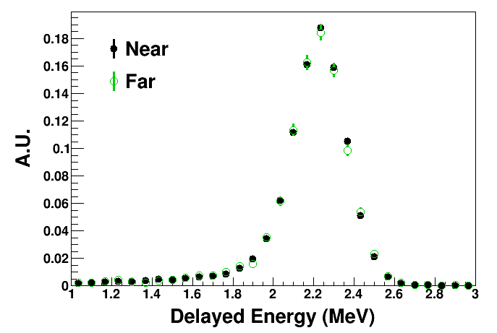
Coincidence of prompt and delayed signals
(prompt signal)
(delayed signal)
Delayed signal
Prompt signal
n-Gd IBD
~26 μs
8 MeV
~200 μs
n-H IBD
2.2 MeV

Slide 10
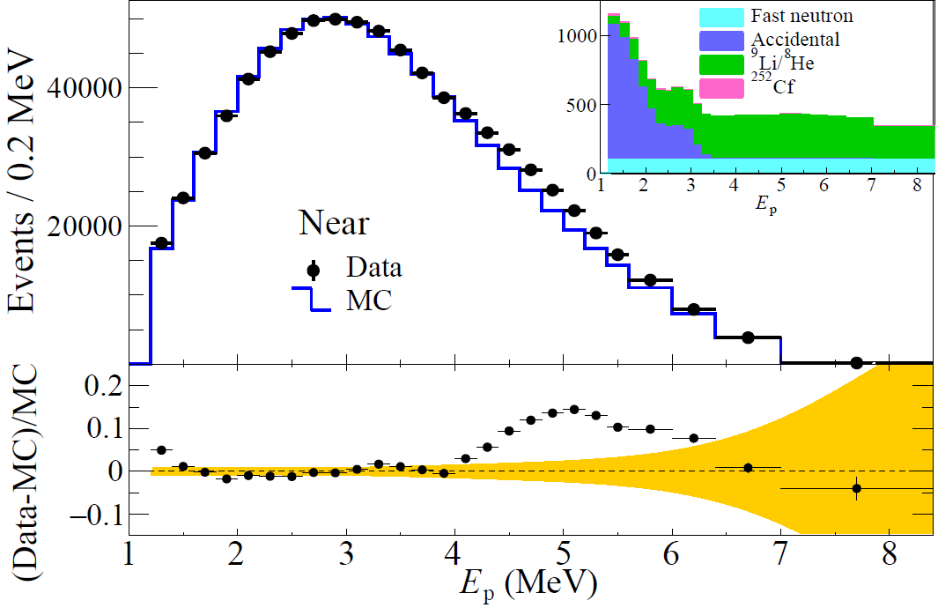
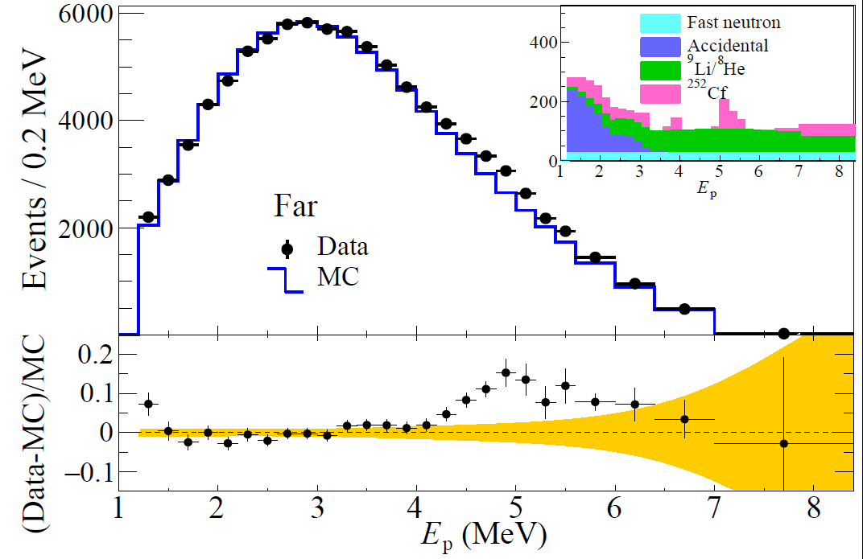
Measured Spectra of IBD Prompt Signal
Clear excess at 5 MeV (persistent from the first result)
~2.5%
~2.5%
Near Live time = 1807.88 days
# of IBD candidate = 850,666
# of background = 17,233 (2.0 %)
Far Live time = 2193.04 days
# of IBD candidate = 103,212
# of background = 4,879 (4.8 %)

Slide 11
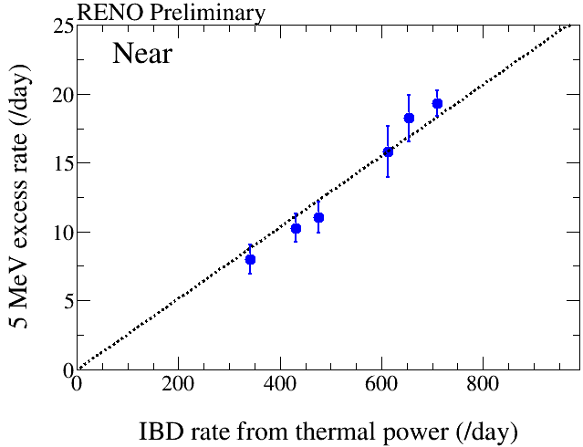
Correlation of 5 MeV Excess with Reactor Power
1400 days of data
5 MeV excess
has a clear
correlation
with reactor
thermal power !
two or three reactors are off
All the six reactors are on
The 5 MeV excess comes from reactors!

Slide 12
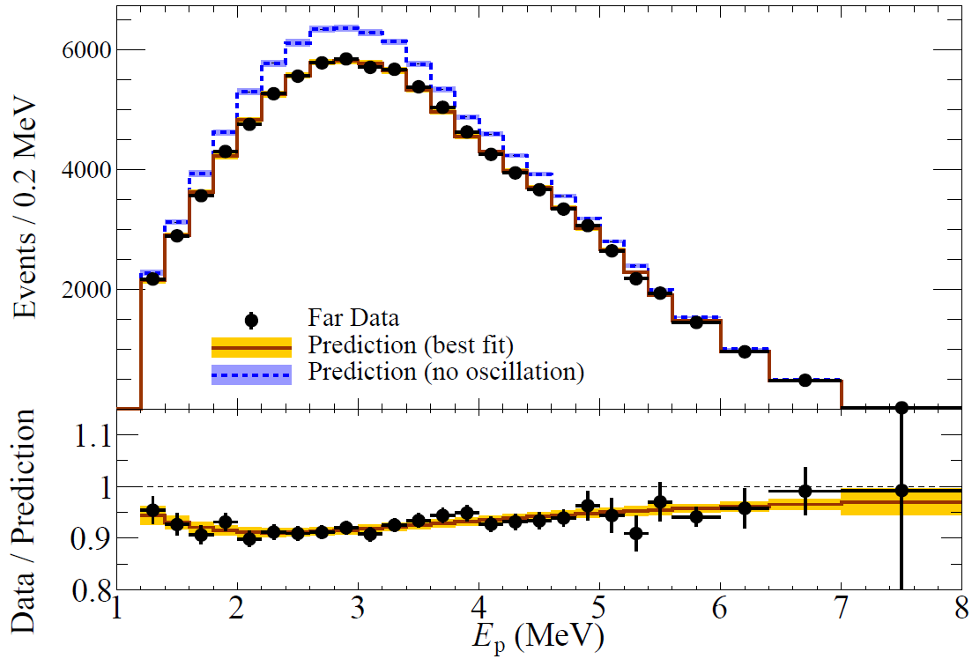
Far/Near Shape Analysis
Energy-dependent disappearance of reactor antineutrinos
sin²2θ₁₃ = 0.0896±0.0048(stat.)±0.0048(syst.)
(± 7.6%)
|△m_{ee}²| = 2.68±0.12(stat.)±0.07(syst.) (×10⁻³ eV²)
(± 5.2 %)

Slide 13
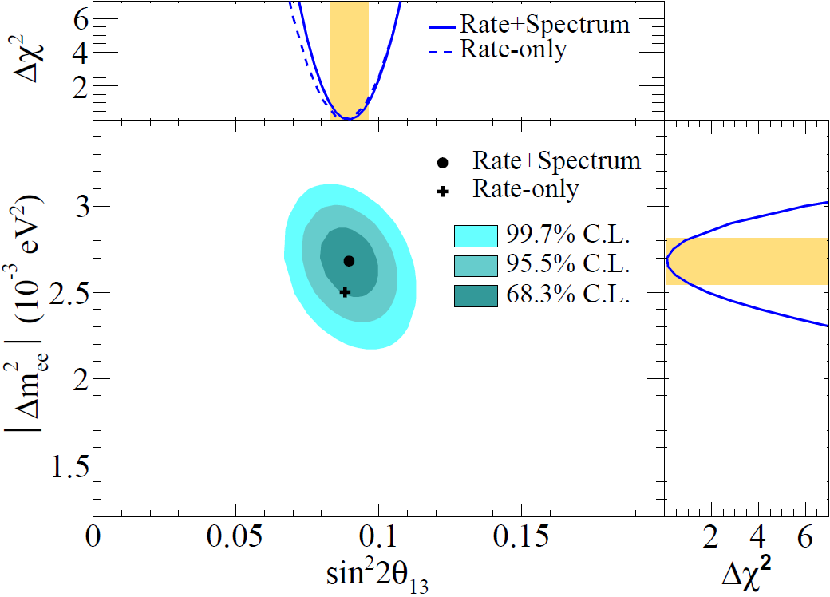
Results of θ₁₃ and |Δm²_{ee}|
sin²2θ₁₃ = 0.0896±0.0048(stat.)±0.0048(syst.)
|△m_{ee}²| = 2.68±0.12(stat.)±0.07(syst.) (×10⁻³ eV²)

Slide 14
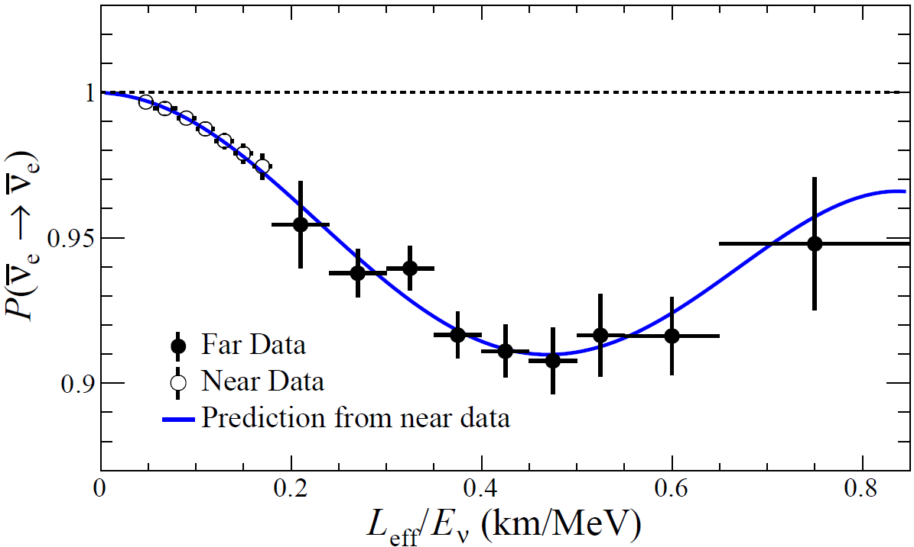
Observed L/E Dependent Oscillation

Slide 15
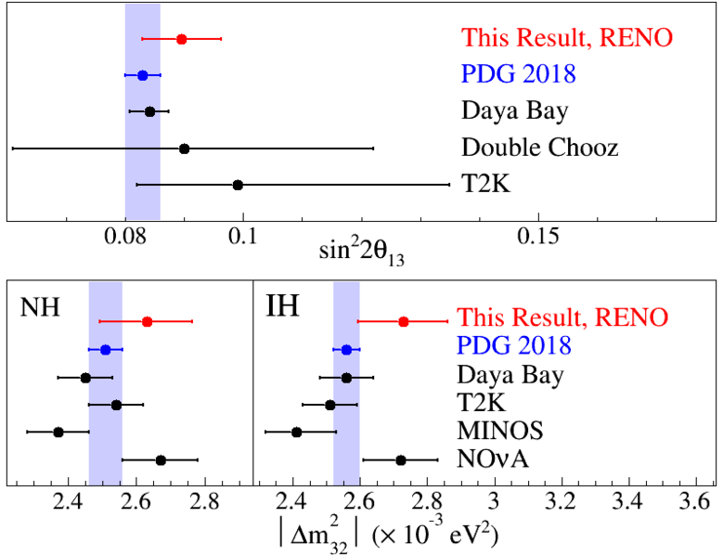
Comparison of θ₁₃ and |Δm²_{ee}|

Slide 16
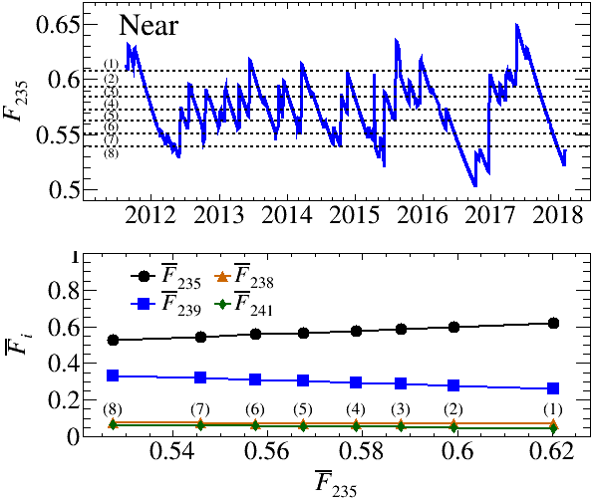
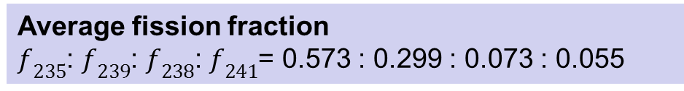
Evolution of Fuel Isotope Fraction
8 groups of near IBD samples with different ²³⁵U isotope fraction
Average fission fraction
$f_{235}$: $f_{239}$: $f_{238}$: $f_{241}$= 0.573 : 0.299 : 0.073 : 0.055

Slide 17
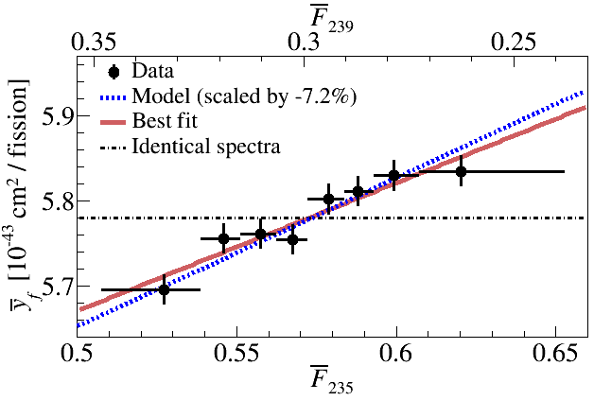
Fuel-Composition Dependent Reactor Neutrino Yield
Observation of fuel(energy)-dependent variation in IBD yield
→ 6.1σ rejection of identical reactor antineutrino spectra between 4 main fuel isotopes
IBD yield per fission
: energy spectrum
: time averaged fission fraction of isotope i

Slide 18
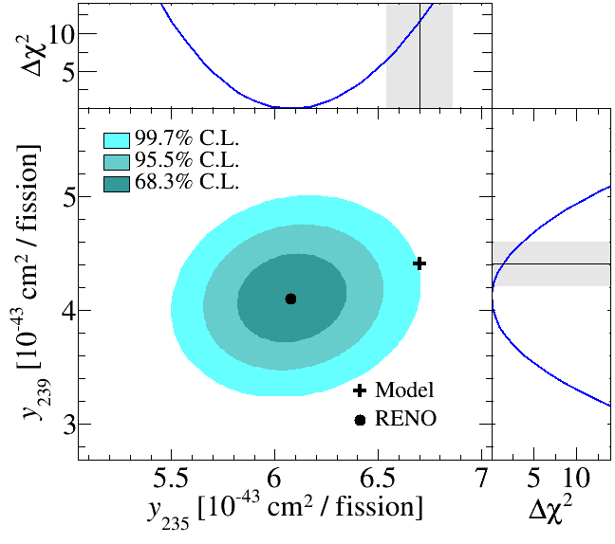
Reactor Antineutrino Yield per ²³⁵U vs. ²³⁹Pu Fission
The best-fit measured yields per fission of ²³⁵U (²³⁹Pu)
→ ²³⁵U: 3.5σ deficit relative to Huber-Mueller (H-M) prediction
²³⁹Pu: 1.2σ deficit

Slide 19
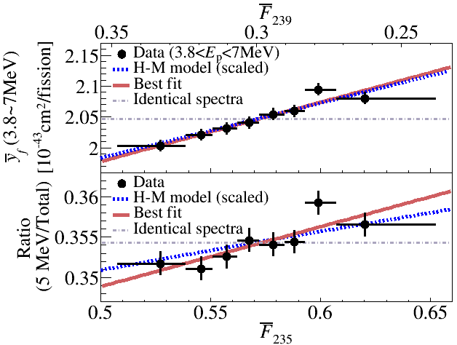
IBD Yield Variation of 5 MeV Excess Region
Ratio of IBD yield per fission between “5 MeV excess region” and “total” → Weak indication of enhanced yield in 5 MeV excess region due to ²³⁵U isotope fraction increase….

Slide 20
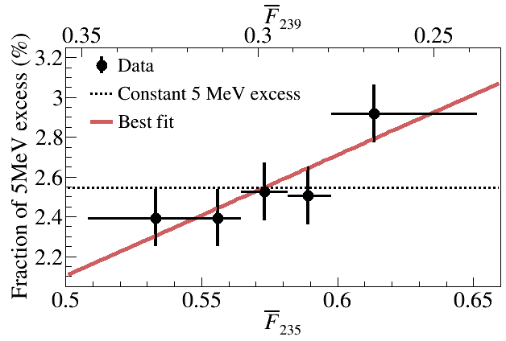
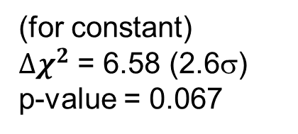
Correlation of 5 MeV excess with ²³⁵U isotope fraction
2.6σ indication of 5 MeV excess coming from ²³⁵U fuel isotope fission !!
(2.545 +-0.065) %
(for constant)
${∆χ}^{2}$ = 6.58 (2.6σ)
p-value = 0.067
(End
of reactor cycle)
(Beginning
of reactor cycle)

Slide 21
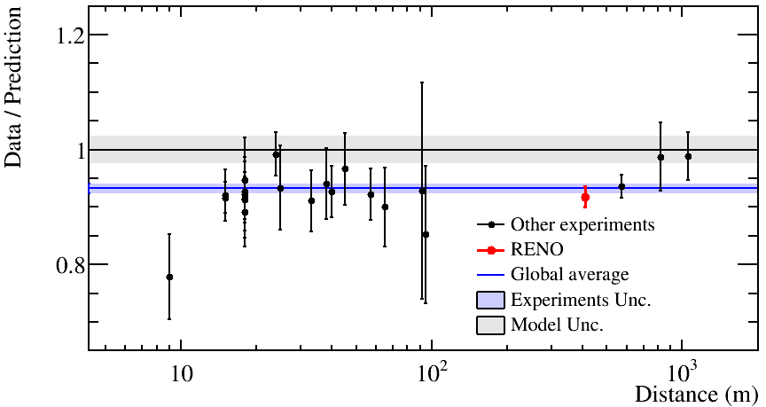
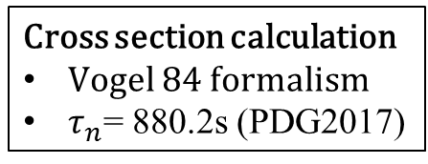
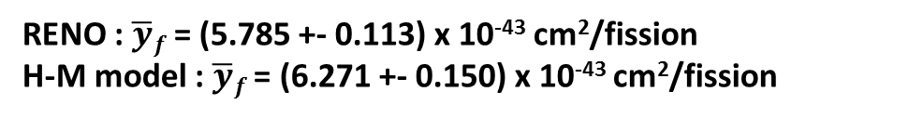
Measurement of Absolute Reactor Neutrino Flux
Cross section calculation
Vogel 84 formalism
$τ_{n}$= 880.2s (PDG2017)
Data / Prediction, RENO 2200 days at near (411 m)
0.924 +- 0.018 (for Huber + Mueller model) 0.965 +- 0.018 (for ILL + Vogel model)
RENO : $\overline{y}f$ = (5.785 +- 0.113) x 10⁻⁴³ cm²/fission
H-M model : $\overline{y}f$ = (6.271 +- 0.150) x 10⁻⁴³ cm²/fission
Deficit of observed reactor neutrino fluxes relative to the prediction (Huber + Mueller model) indicates an overestimated flux or possible oscillation to sterile neutrinos

Slide 22
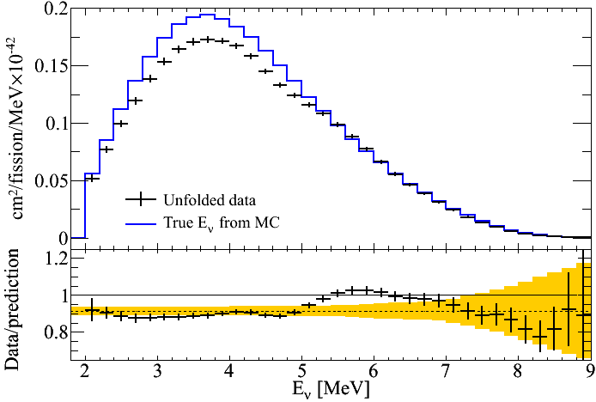
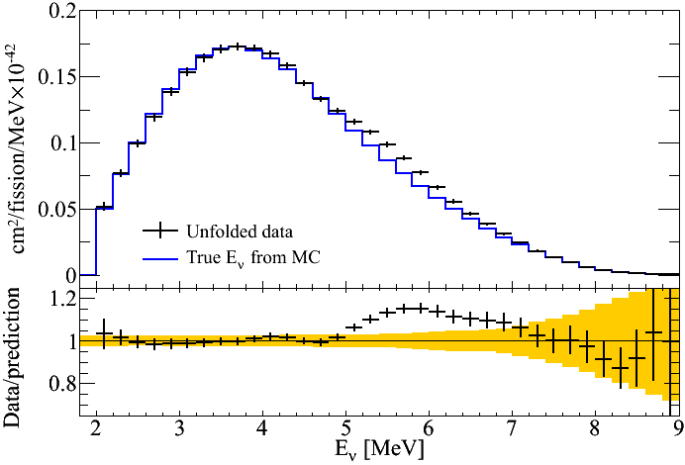
Unfolded Reactor Antineutrino Spectrum
Measured spectrum
vs. H-M prediction
Spectral comparison
* MC is normalized to data in the region excluding 3.6 < E_{p} < 6.6 MeV
Unfolding using iterative method in RooUnfold

Slide 23
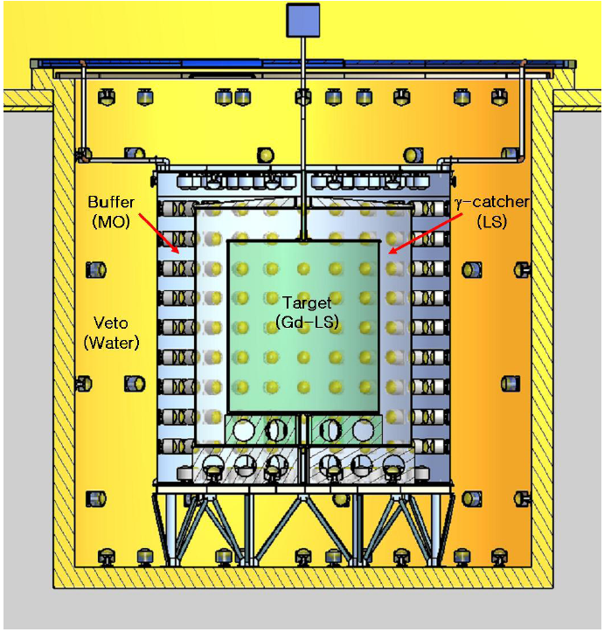
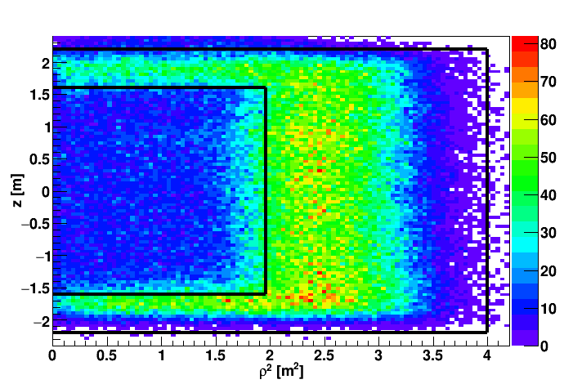
n-H IBD Analysis|
Motivation:
1. Independent measurement of θ₁₃ value.
2. Consistency and systematic check on reactor neutrinos.
n-H IBD Event Vertex Distribution
target
γ-catcher

Slide 24
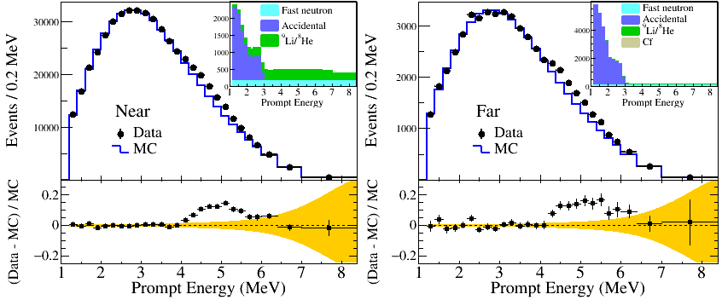
θ₁₃ Measurement with n-H
sin²2θ₁₃ = 0.085±0.008(stat.)±0.012(syst.)
Poster Presentation “Measurement of θ₁₃ in the reactor neutrino events with neutron captures on Hydrogen at RENO” by C. D. Shin (# 178)

Slide 25
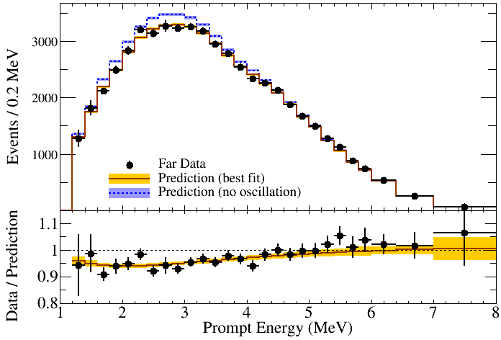
θ₁₃ and |Δm²_{ee}| Measurement with n-H
RENO Preliminary
sin²2θ₁₃ = 0.085±0.008(stat.)±0.012(syst.)

Slide 26
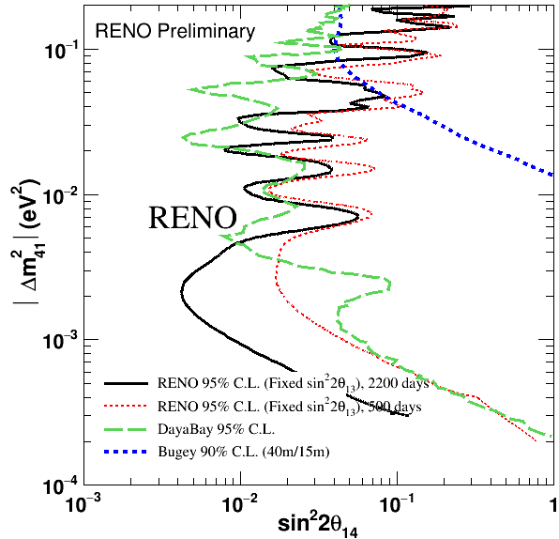
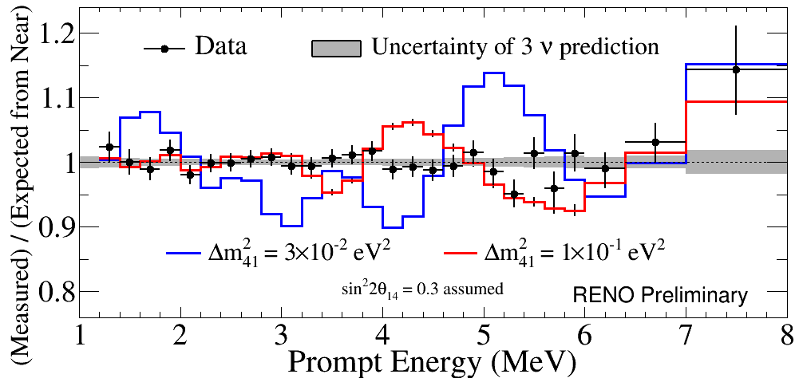
Light Sterile Neutrino Search Results
2200 days of RENO data
Consistent with standard 3-flavor
neutrino oscillation model
Able to set stringent limits in
the region |Δm₄₁²|< 10⁻² eV²

Slide 27
Summary
Observation of energy dependent disappearance of reactor neutrinos and improved measurement of and |Δm_{ee}² | and θ₁₃
7.6 % precision
5.2 % precision
First hint for correlation between 5 MeV excess and ²³⁵U fission fraction
Measured absolute reactor neutrino flux : R= 0.924±0.018 (H-M)
Measurement of |Δm_{ee}² | and θ₁₃ using n-H IBD analysis
Obtained an excluded region from a sterile neutrino search
additional 2~3 years of data taking under consideration to improve Δm_{ee}² accuracy

Slide 28
Thanks for your attention!

Slide 29
Backgrounds
Accidental coincidence between prompt and delayed signals
Fast neutrons produced by muons, from surrounding rocks and inside detector (n scattering : prompt, n capture : delayed)
Cosmogenic ⁹Li/⁸He β-n followers produced by cosmic muon spallation
Accidentals
Fast neutrons
⁹Li/⁸He β-n followers
μ
μ
μ
γ
p
n
n
⁹Li
e
Gd
Gd
n
Gd

