Slide 1

Towards Understanding the In-medium φ Meson with Finite Momentum
Philipp Gubler, JAEA
P. Gubler and K. Ohtani, Phys. Rev. D 90, 094002 (2014). H.J. Kim, P. Gubler and S.H. Lee, Phys. Lett. B 772, 194 (2017).
Talk at the APCTP Workshop
“The Nature of Hadron Mass and Quark-Gluon Confinement from JLab Experiments in the 12-GeV Era”
Pohang, South Korea
July 4, 2018

Slide 2




φ meson
m_{φ} = 1019 MeV
Γ_{φ} = 4.3 MeV

Slide 3
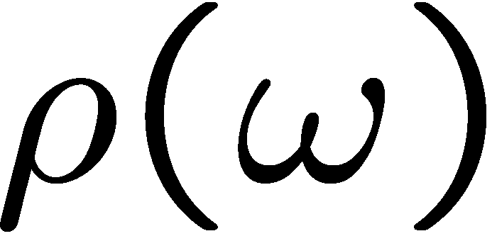
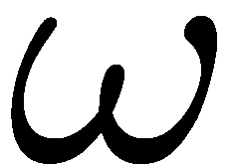
Introduction
Spectral functions at finite density
How is this complicated behavior related to the change of QCD condensates?
modification at finite density
coupling to nucleon resonances?
broadening?
mass/threshold shifts?

Slide 4
Motivation
In an actual experiment, the φ is (almost) always moving with non-zero velocity
e
p
φ
e
Non-negligible effect on the spectral function?
On mass shift?
E325 (KEK)
E16 (J-PARC)
On broadening?

Slide 5
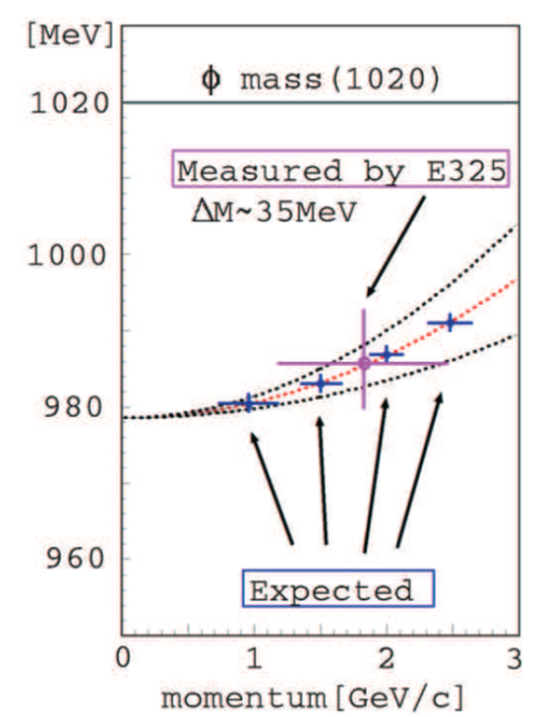
Motivation
Lorentz invariance is broken at finite density
Non-scalar condensates
QCD sum rules
Non-trivial dispersion relation?
Target of the E16 experiment at J-PARC

Slide 6
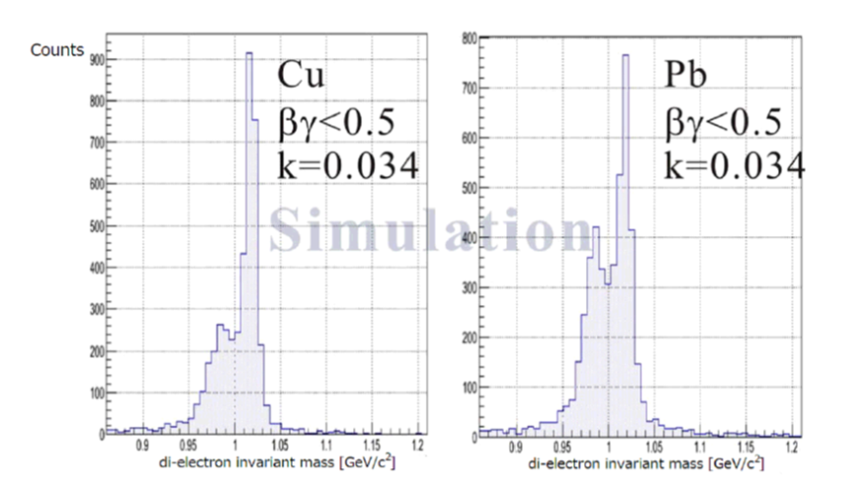
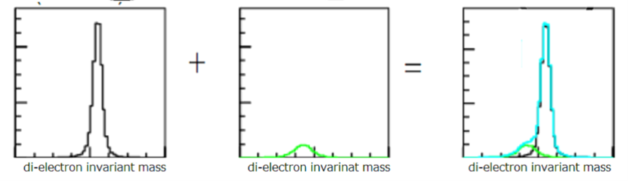
Experimental developments
The E325 Experiment (KEK)
Slowly moving φ mesons are produced in 12 GeV p+A reactions and are measured through di-leptons.
e
e
p
e
p
φ
φ
e
outside decay
inside decay
No effect (only vacuum)
Di-lepton spectrum reflects the modified φ-meson
Y. Morino et. al. (J-PARC E16 Collaboration), JPS Conf. Proc. 8, 022009 (2015).

Slide 7
Fitting Results
βγ<1.25 (Slow)
1.25<βγ<1.75
1.75<βγ (Fast)
Small Nucleus
Large Nucleus

Slide 8
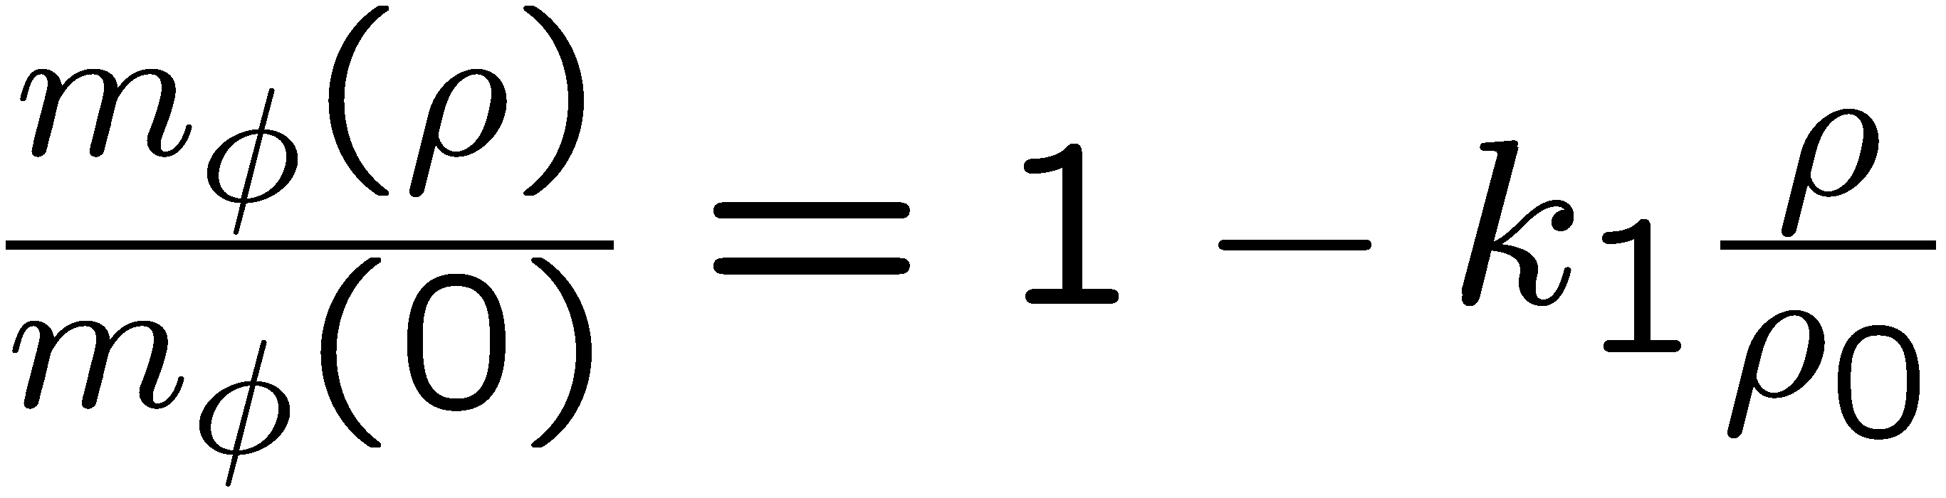
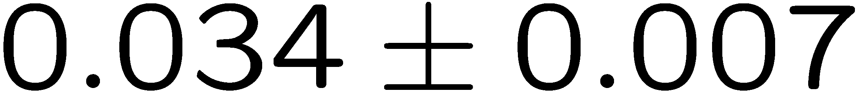
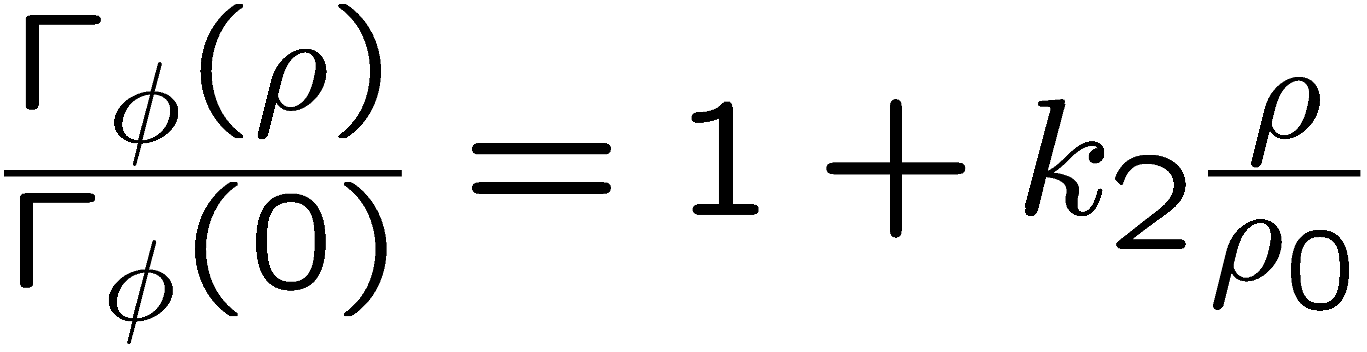
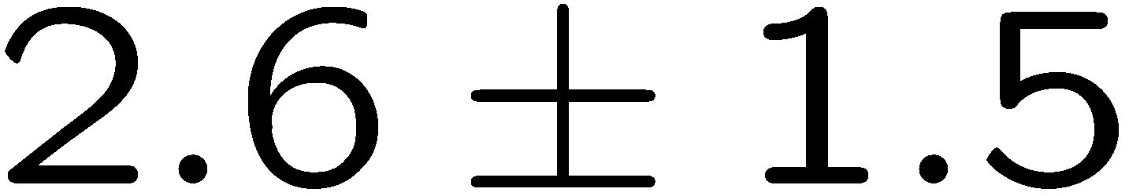
Experimental Conclusions
R. Muto et al, Phys. Rev. Lett. 98, 042501 (2007).
Pole mass:
35 MeV negative mass shift at normal nuclear matter density
Pole width:
Increased width to 15 MeV at normal nuclear matter density
Caution!
Fit to experimental data is performed with a simple Breit-Wigner parametrization
Too simple??

Slide 9
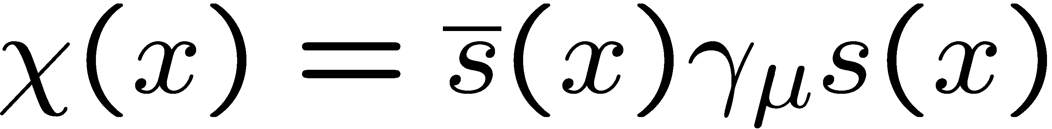
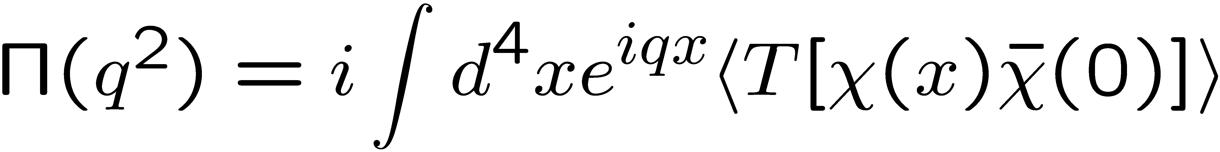
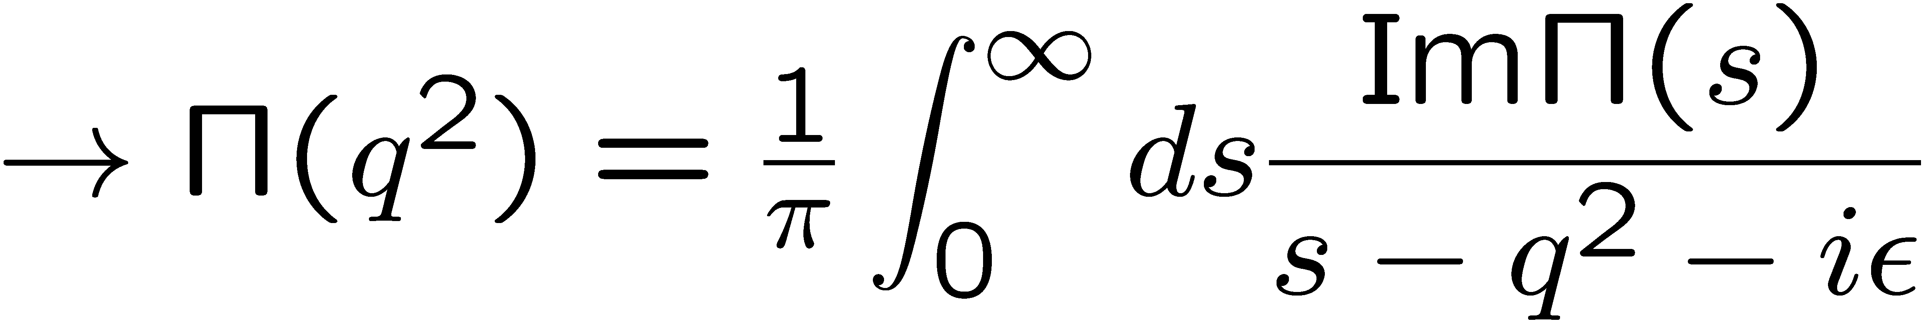
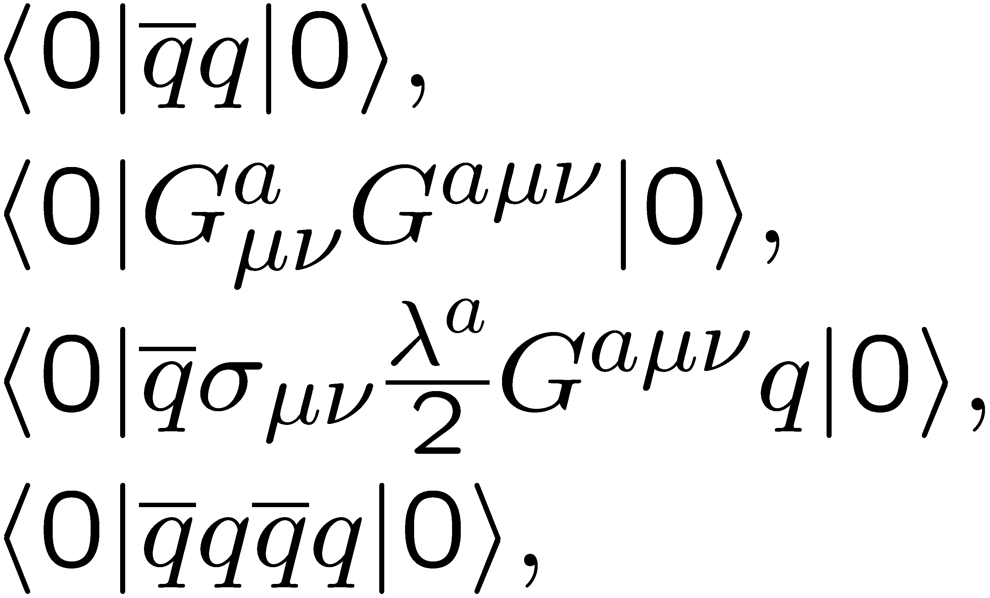
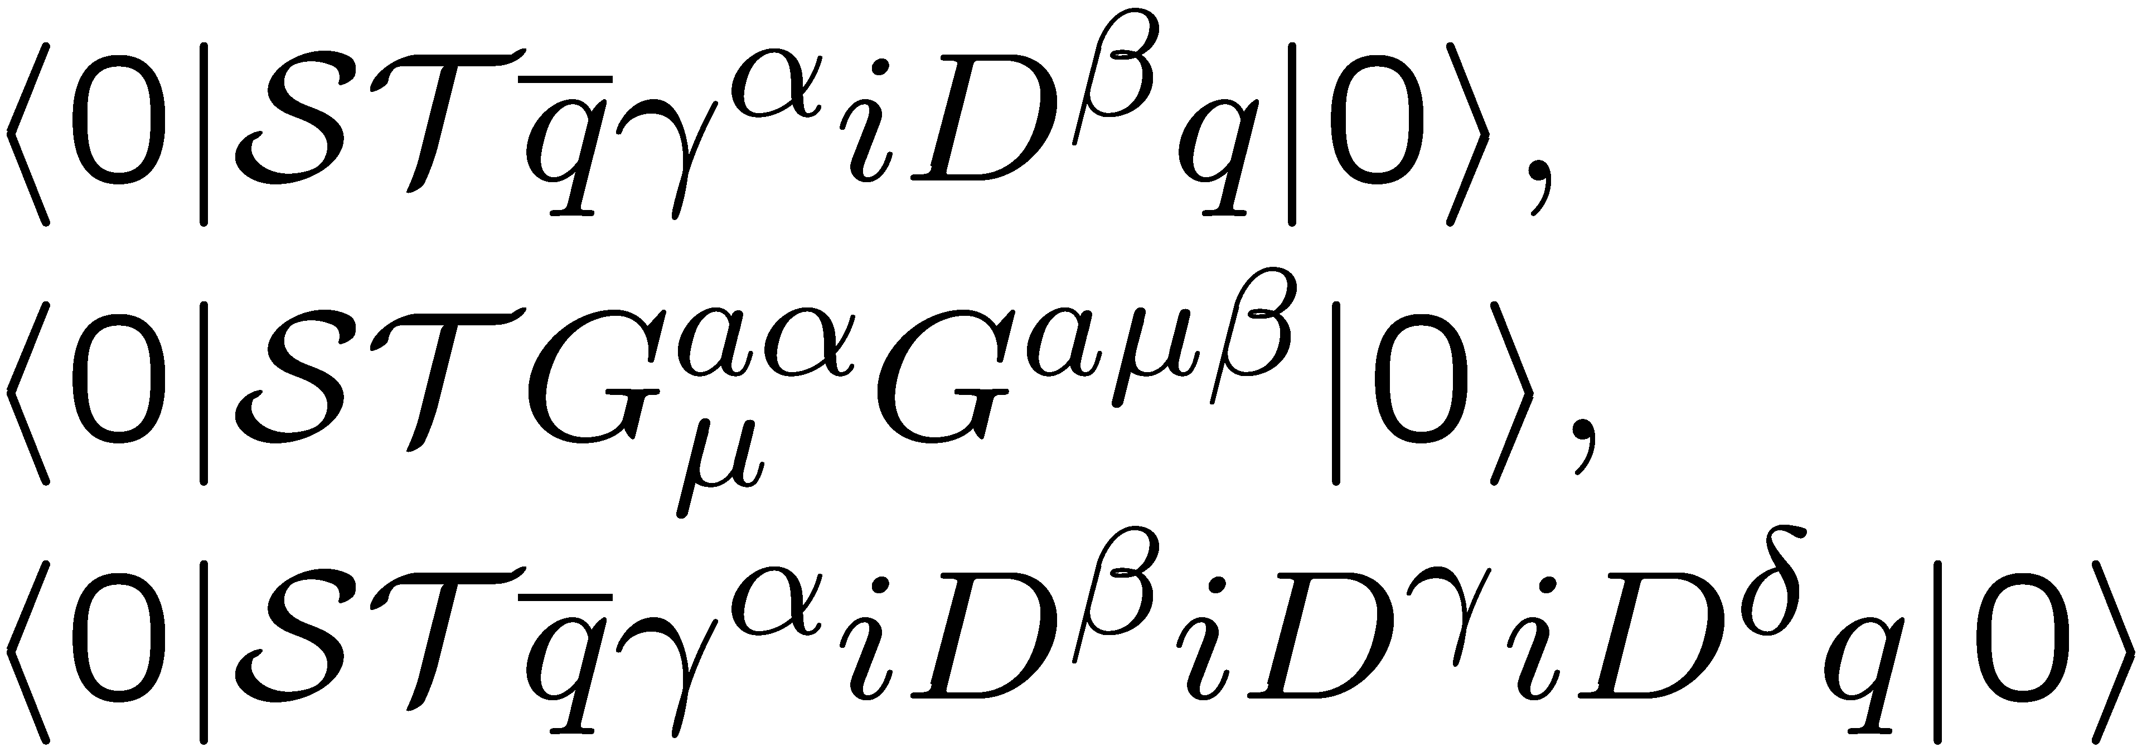
QCD sum rules
M.A. Shifman, A.I. Vainshtein and V.I. Zakharov, Nucl. Phys. B147, 385 (1979); B147, 448 (1979).
Makes use of the analytic properties of the correlation function:
spectral function
q²
scalar condensates:
trivial dispersion relation
non-scalar condensates:
non-trivial dispersion relation

Slide 10
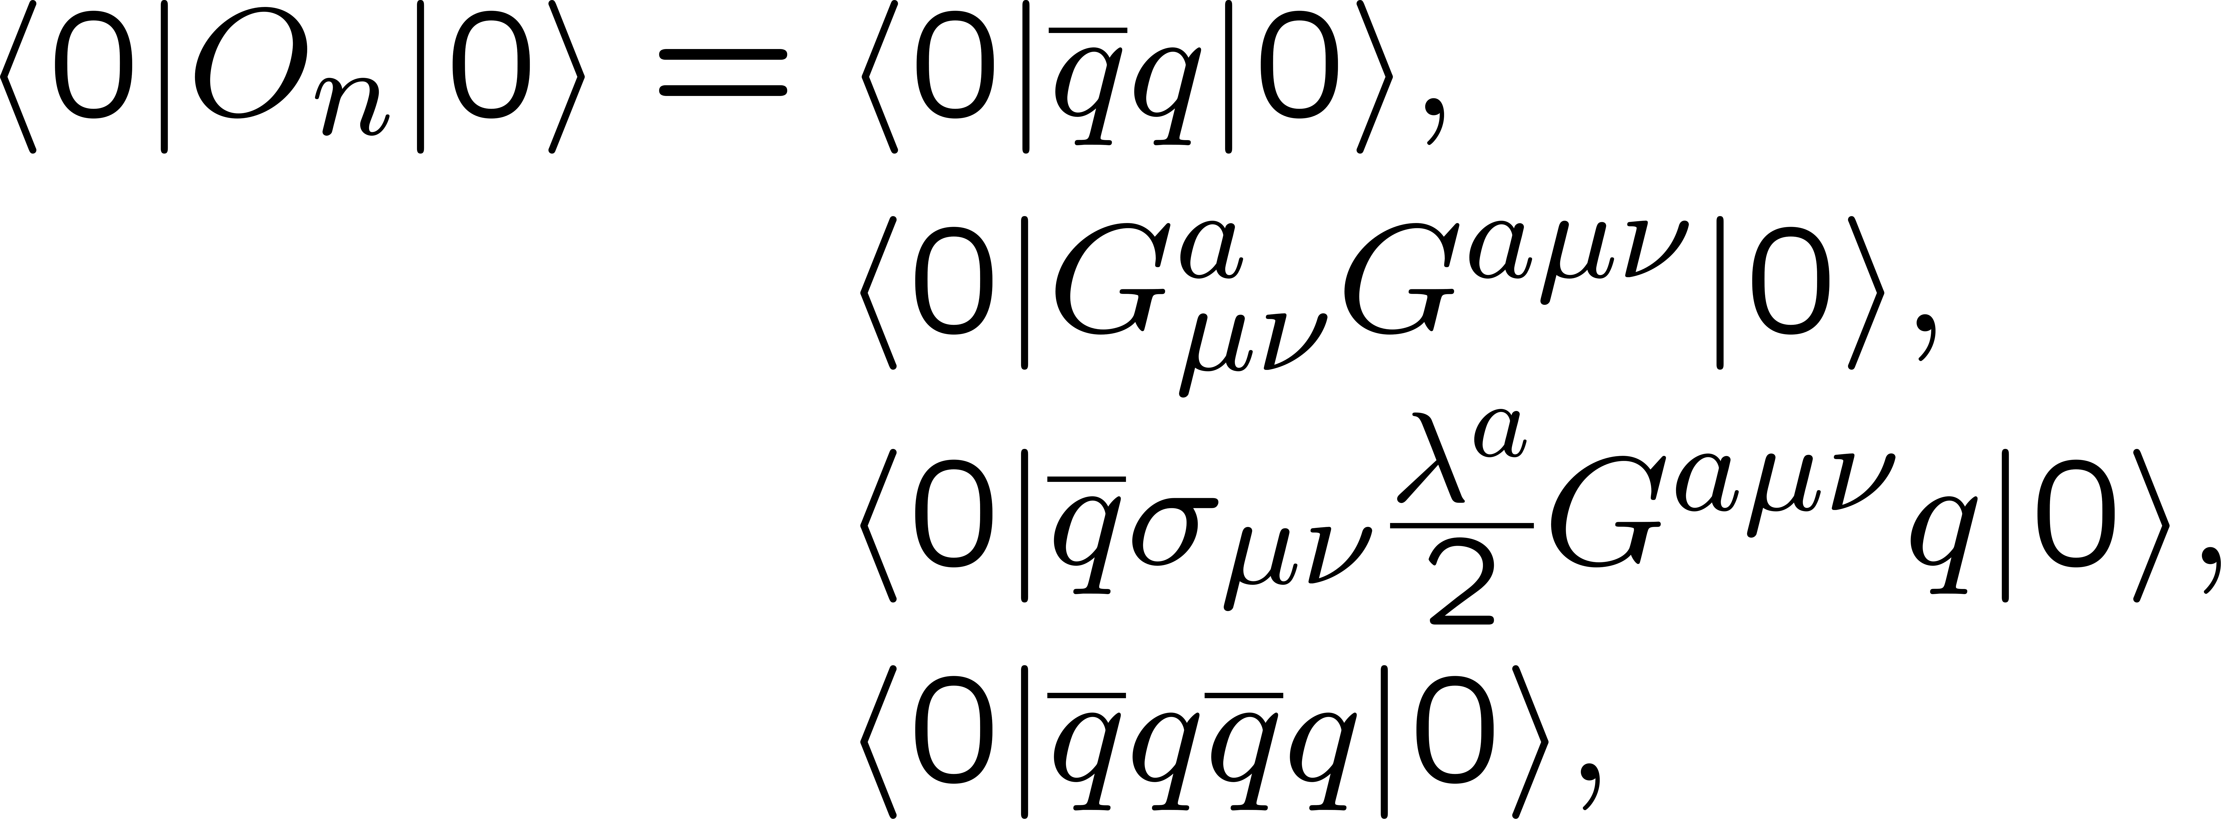
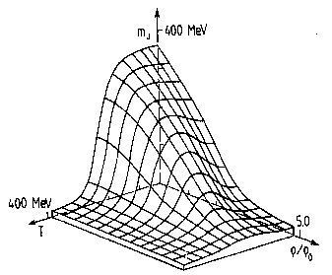
More on the operator product expansion (OPE)
non-perturbative condensates
perturbative Wilson coefficients
Change in hot or dense matter!

Slide 11
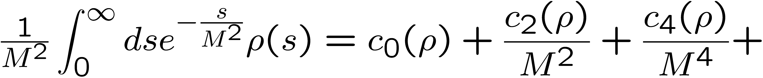
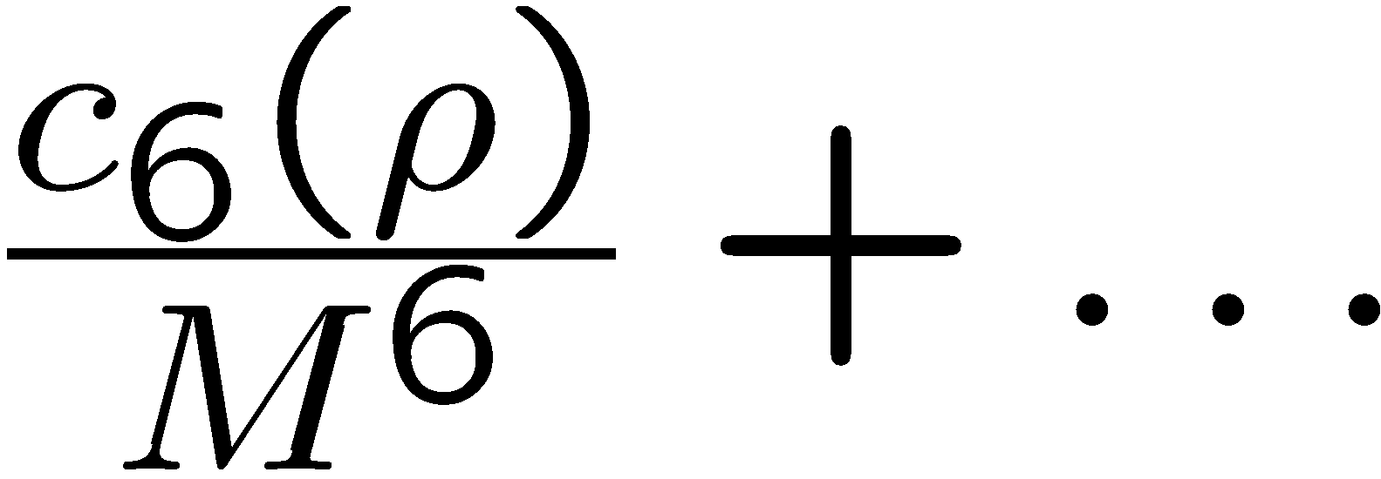
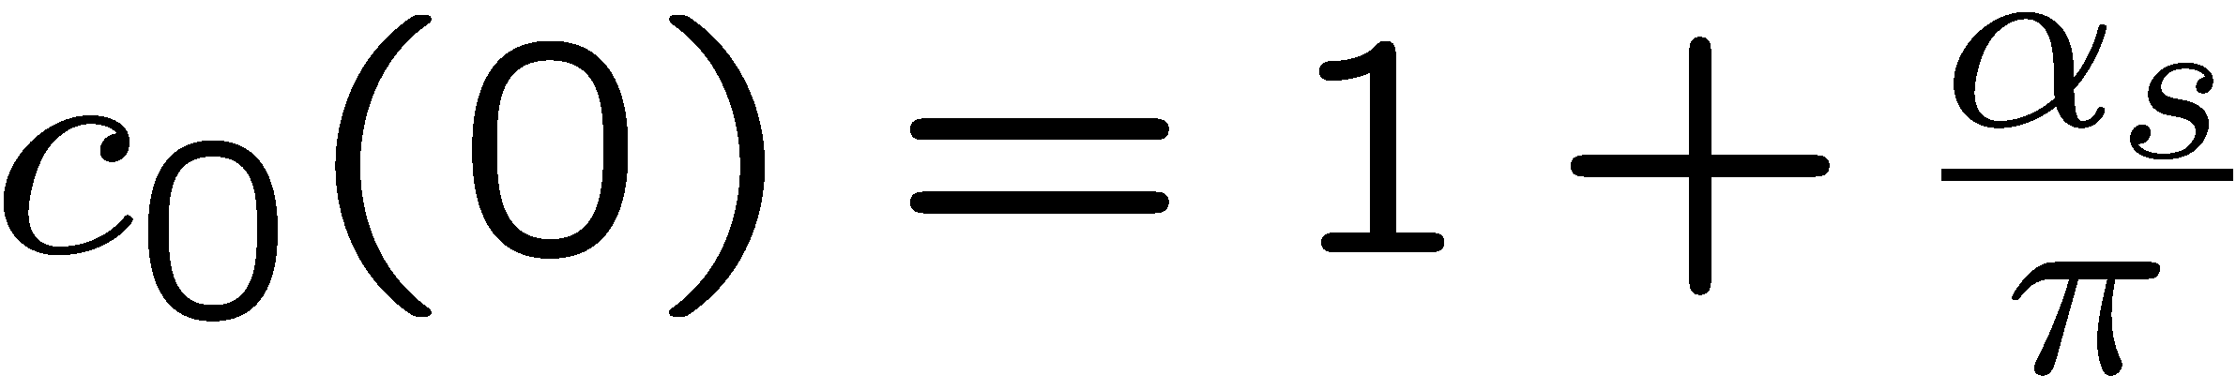
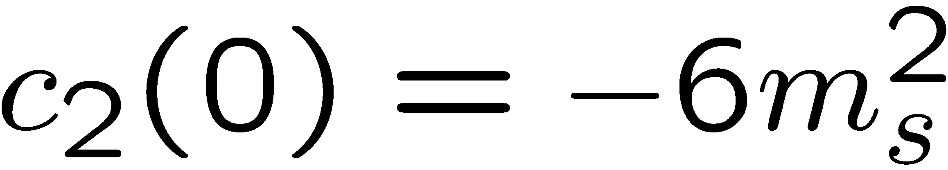
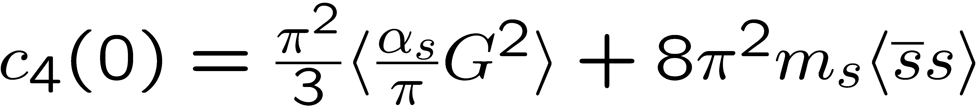
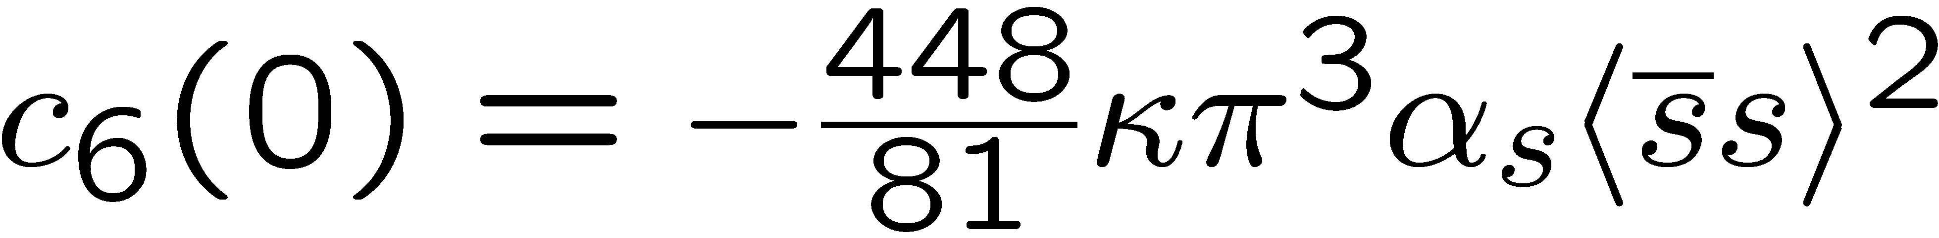
Structure of QCD sum rules for the phi meson
In Vacuum
Dim. 0:
Dim. 2:
Dim. 4:
Dim. 6:

Slide 12
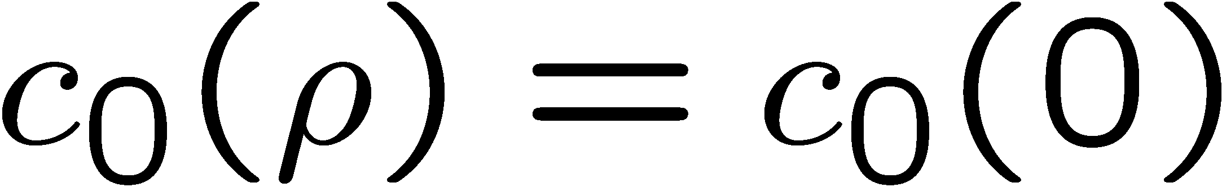
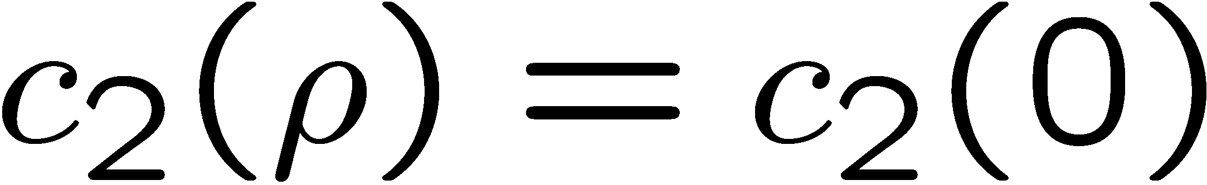
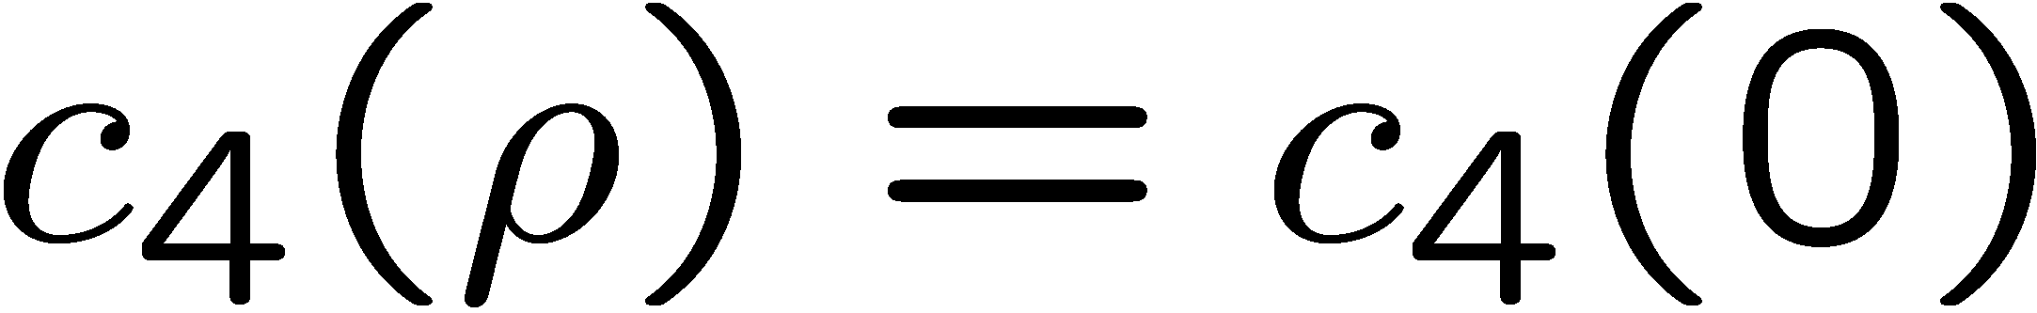
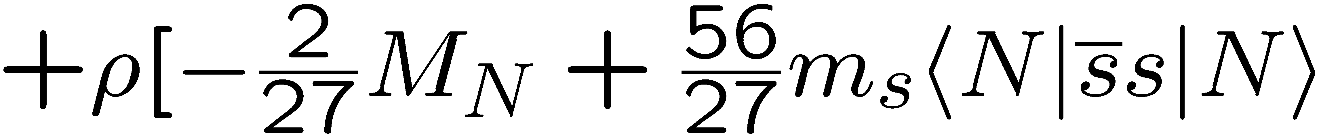
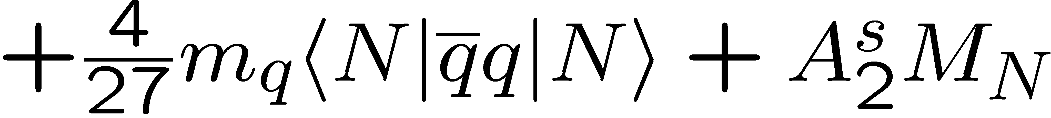
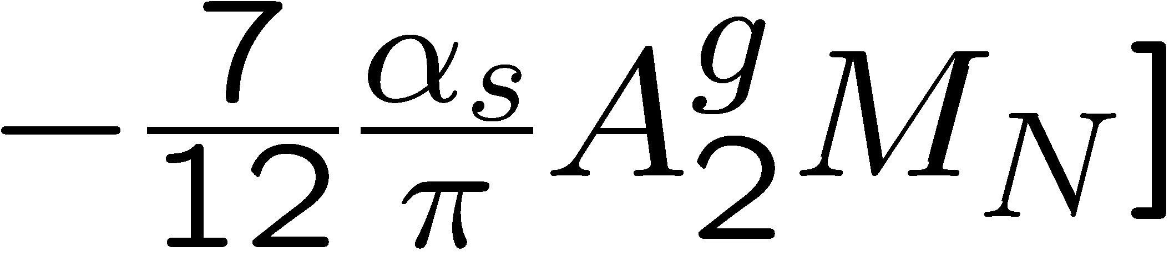
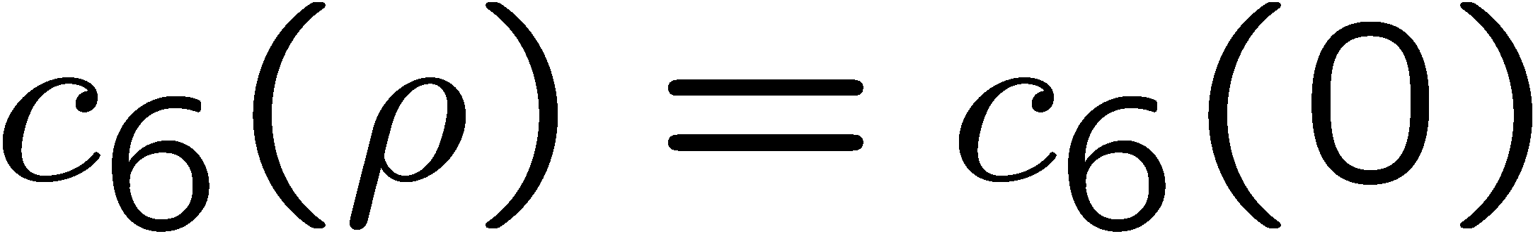
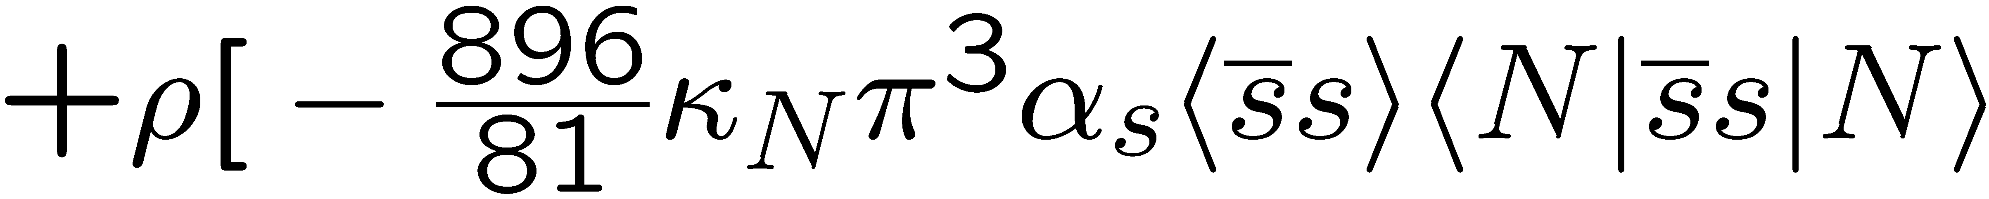
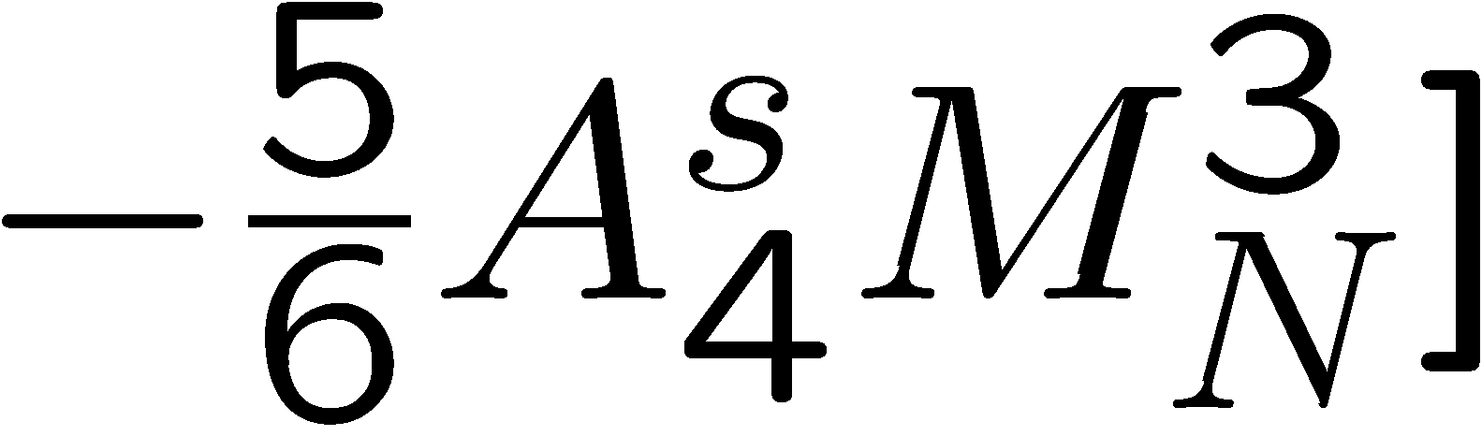
Structure of QCD sum rules for the phi meson
In Nuclear Matter
Dim. 0:
Dim. 2:
Dim. 4:
Dim. 6:

Slide 13
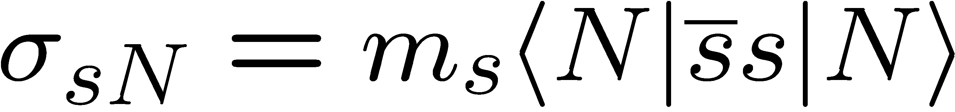
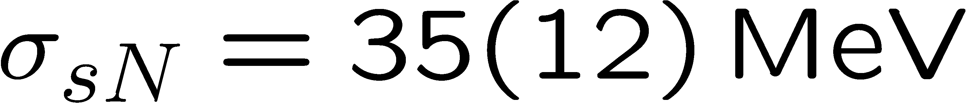
Recent results from lattice QCD
S. Durr et al. (BMW Collaboration), Phys. Rev. Lett. 116, 172001 (2016).
(Feynman-Hellmann)
Y.-B. Yang et al. (χQCD Collaboration), Phys. Rev. D 94, 054503 (2016).
(Direct)
A. Abdel-Rehim et al. (ETM Collaboration), Phys. Rev. Lett. 116, 252001 (2016).
(Direct)
G.S. Bali et al. (RQCD Collaboration), Phys. Rev. D 93, 094504 (2016).
(Direct)
N. Yamanaka et al. (JLQCD Collaboration), arXiv:1805.10507 [hep-lat].
(Direct)

Slide 14
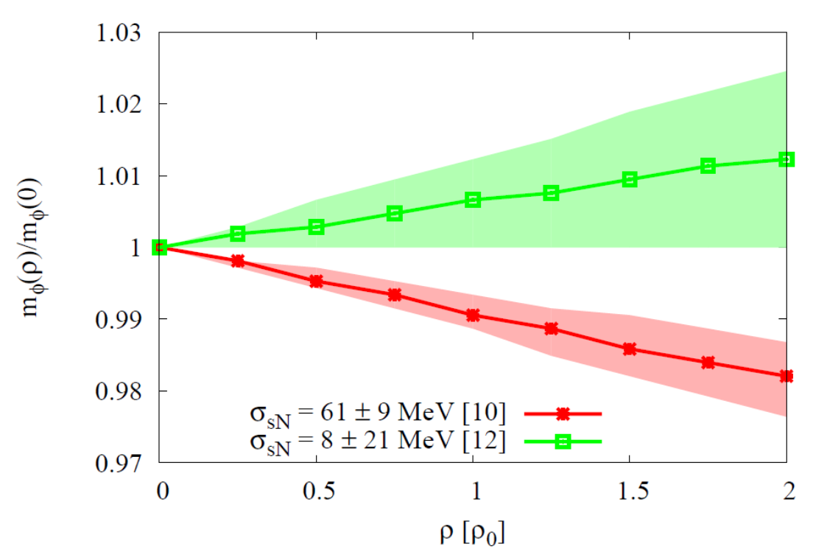
Results for the φ meson mass
Most important parameter, that
determines the behavior of the φ meson mass at finite density:
Strangeness content of the nucleon
P. Gubler and K. Ohtani, Phys. Rev. D 90, 094002 (2014).

Slide 15
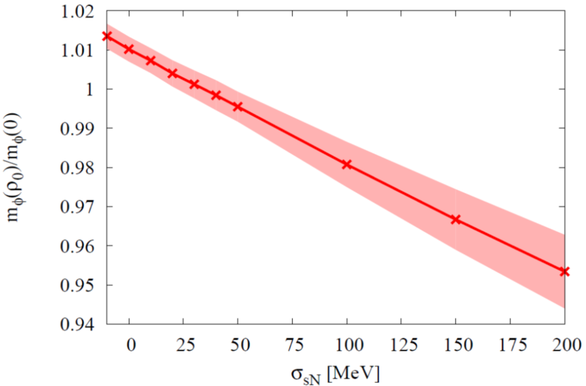
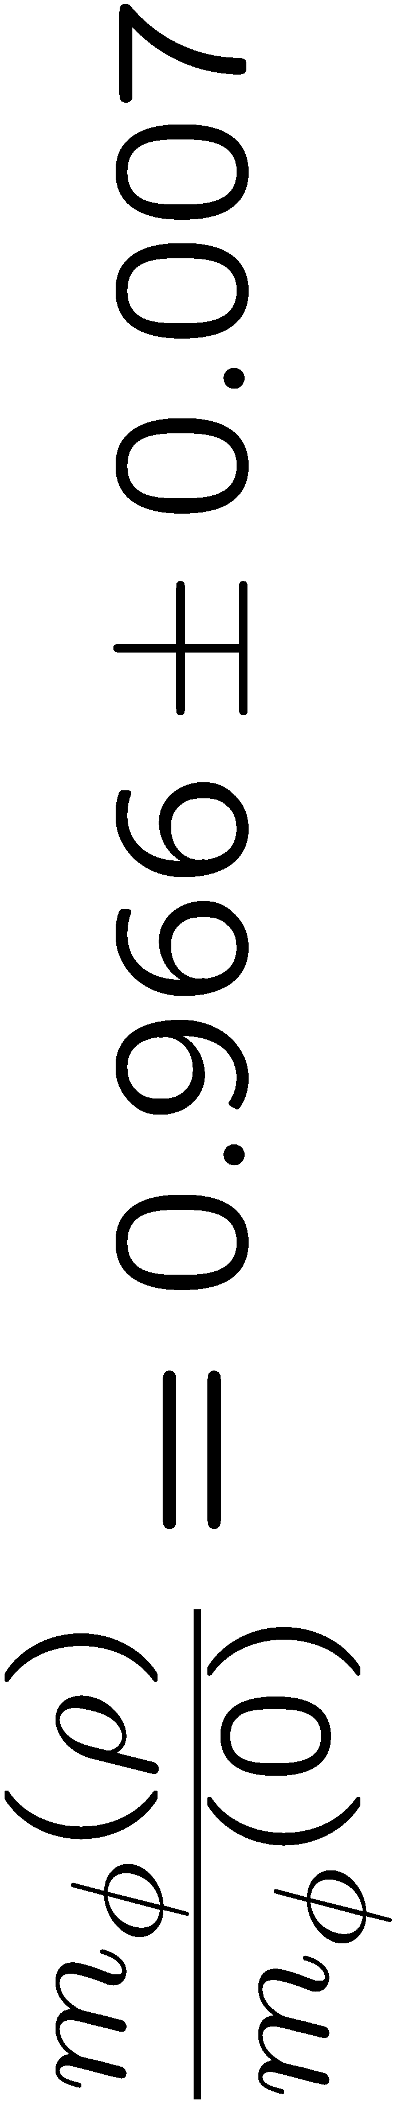
Compare Theory with Experiment
Sum Rules + Experiment
Not consistent?
Experiment
Lattice QCD

Slide 16
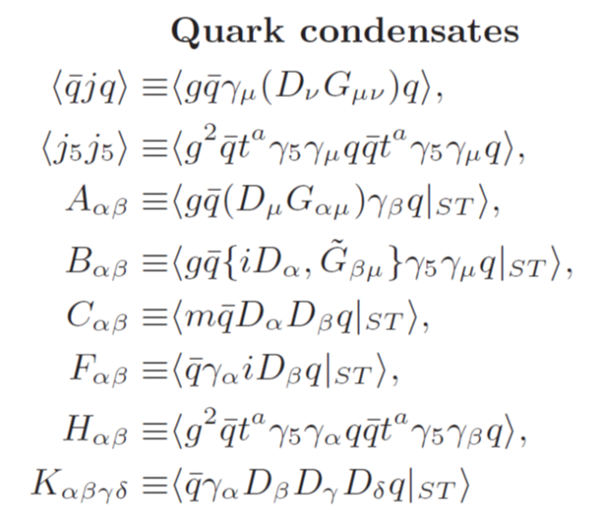
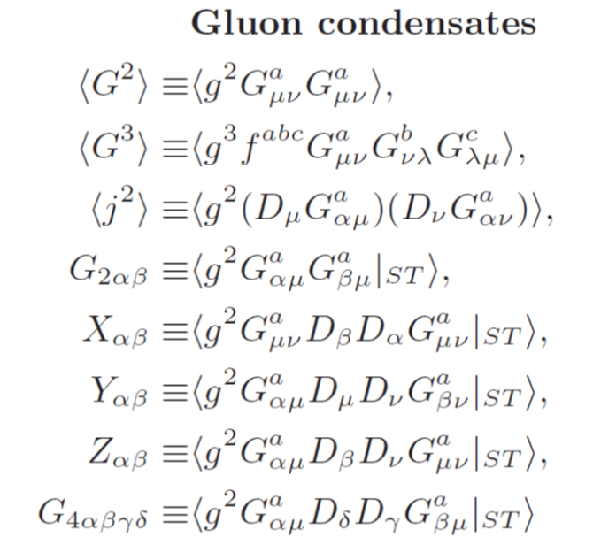
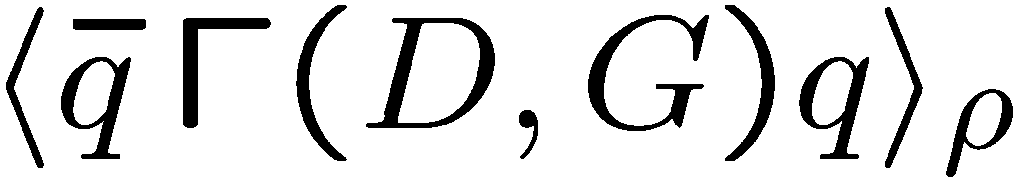

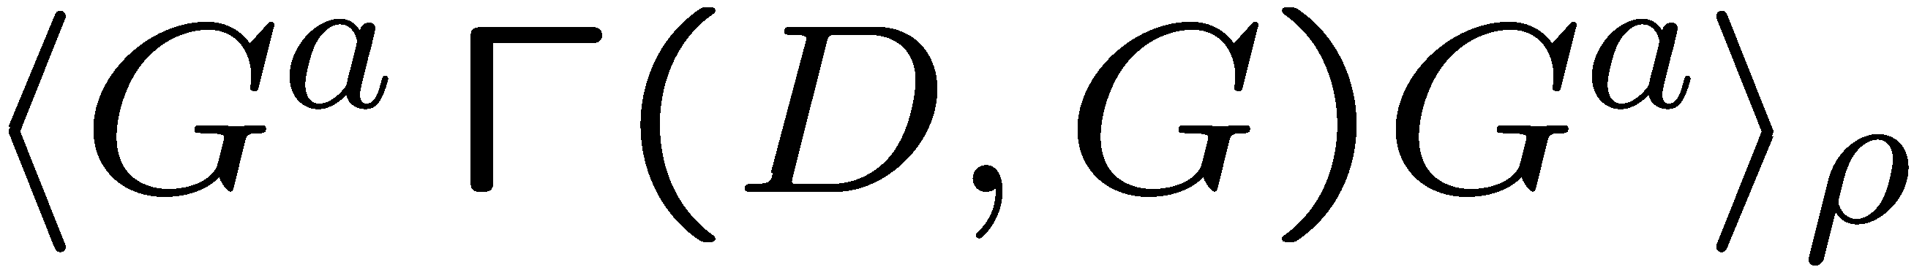
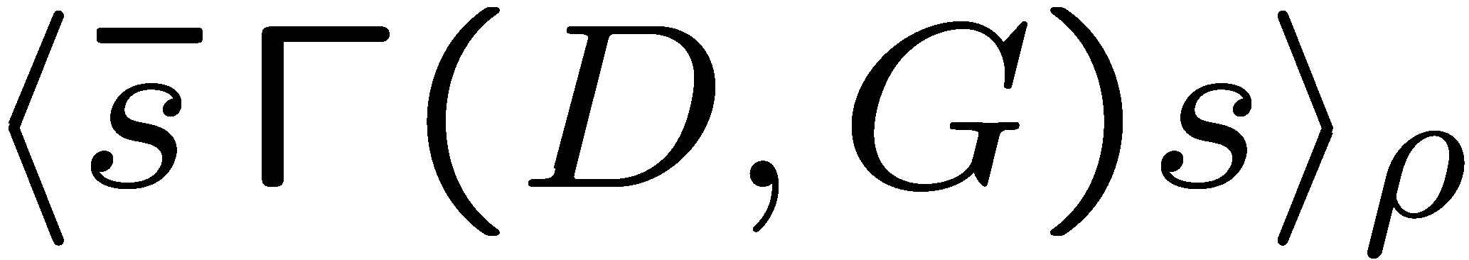
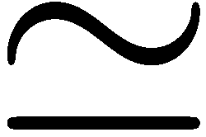
Condensates that appear in the vector channel
scalar
non-scalar
OPE not yet available
For ρ, ω:
For φ:

Slide 17
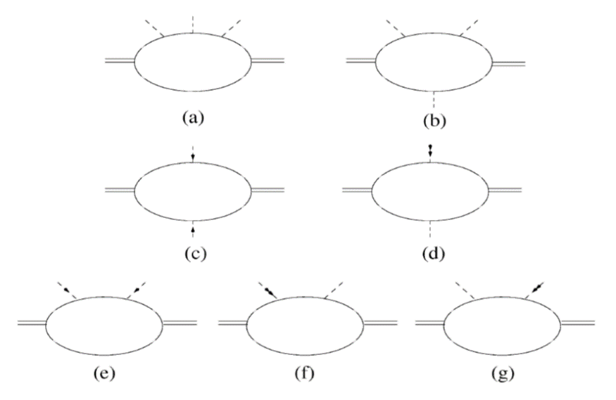
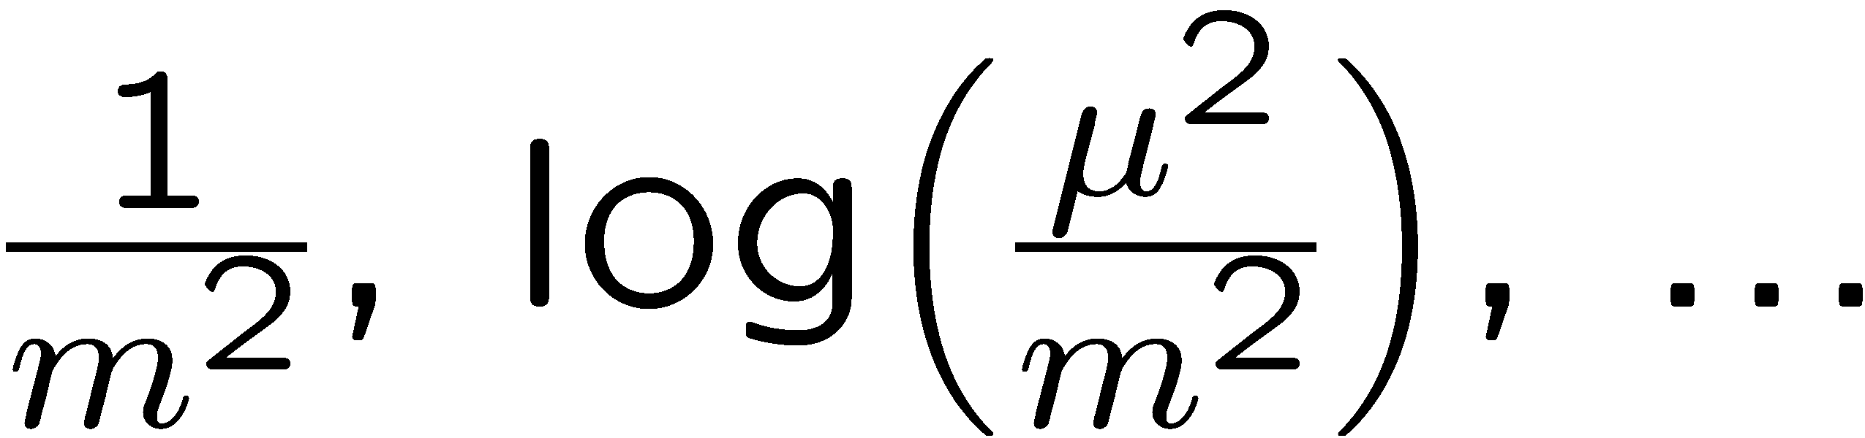
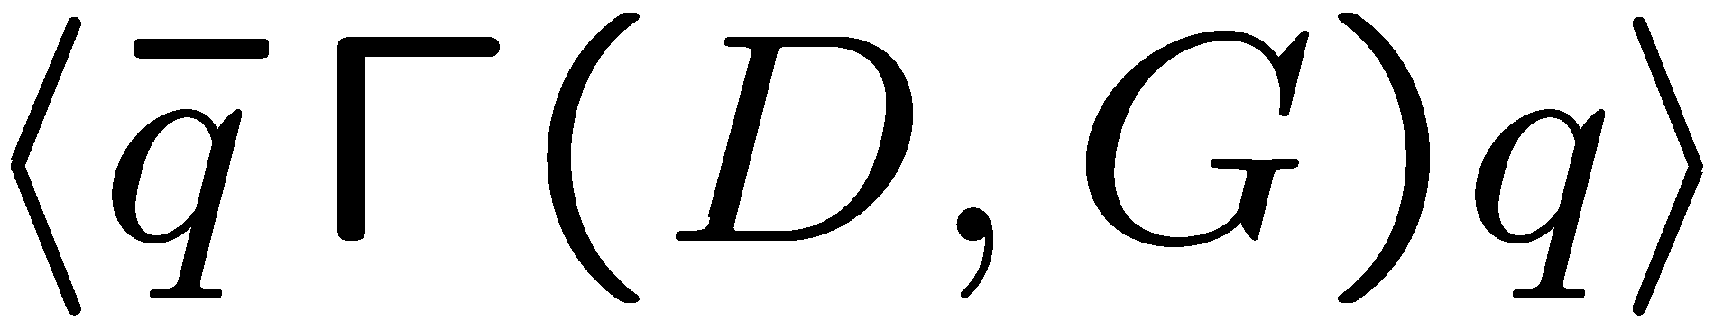
OPE calculation
Mass singularities in chiral limit!
Subtract corresponding quark condensate contribution
S. Kim and S.H. Lee, Nucl. Phys. 679, 517 (2001).
H.J. Kim, P. Gubler and S.H. Lee, Phys. Lett. B 772, 194 (2017).

Slide 18
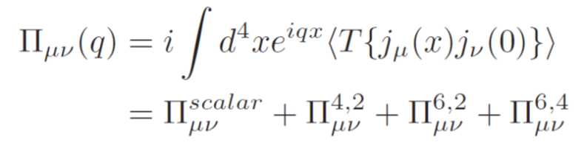
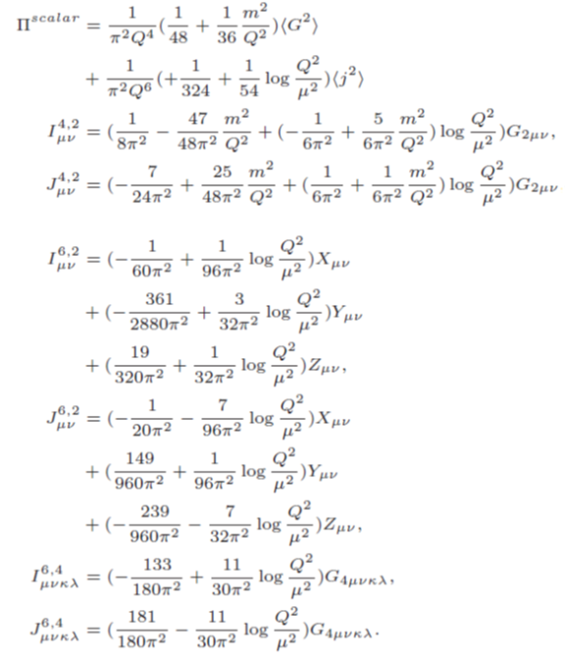
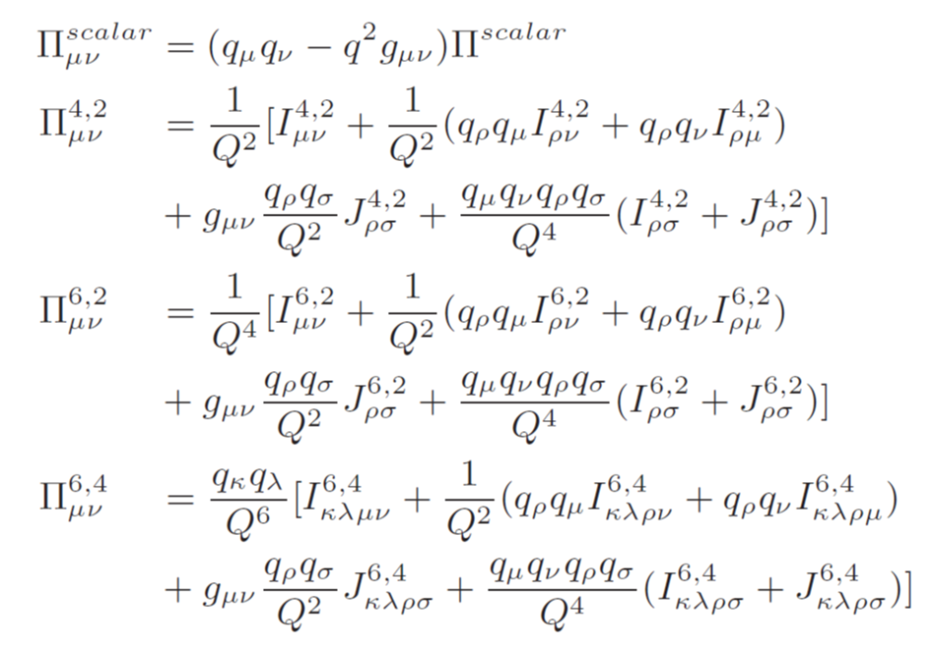
OPE result
H.J. Kim, P. Gubler and S.H. Lee, Phys. Lett. B 772, 194 (2017).

Slide 19
Next
Carry out numerical analysis and make predictions for the E16 experiment at J-PARC
?
What condensate is most important for determining the momentum dependence?
?

Slide 20
Summary and Conclusions
The φ-meson mass shift in nuclear matter constrains the strangeness content of the nucleon:
Most lattice calculations give a small σ_{sN}-value
  Increasing (or constant) φ-meson mass in nuclear matter??
One recent lattice calculates obtains a large σ_{sN}-value (σ_{sN} = 105 MeV)
  decreasing φ-meson mass in nuclear matter??
The E325 experiment at KEK measured a negative mass shift of -35 MeV at normal nuclear matter density
  a σ_{sN}-value of > 100 MeV??

Slide 21
Summary and Conclusions
We have computed the complete operator product expansion of non-scalar operators in the vector channel up to operator mass dimension 6.
Mass singularities completely cancel if the quark condensate contribution is properly treated
Important and non-trivial check of the calculation
Next goal:
Make predictions for non-trivial dispersion relation of the φ meson in nuclear matter

Slide 22
Backup slides

