Slide 1
Overview of
Nuclear Physics in Korea
Byungsik Hong
(Korea University)
Chair, Division of Nuclear Physics (DNP) of KPS

Slide 2
Big Questions in Nuclear & Particle Physics
What is the world made of?
  물질을 구성하는 가장 기본적인 단위는?
What holds the world together?
  이들 기본입자 사이의 힘은 무엇인가?
Where did we come from?
  그리고 우리 우주는 어떻게 형성되었나?
미시세계 ↔ 우주
The microscopic world and universe are not independent.

Slide 3
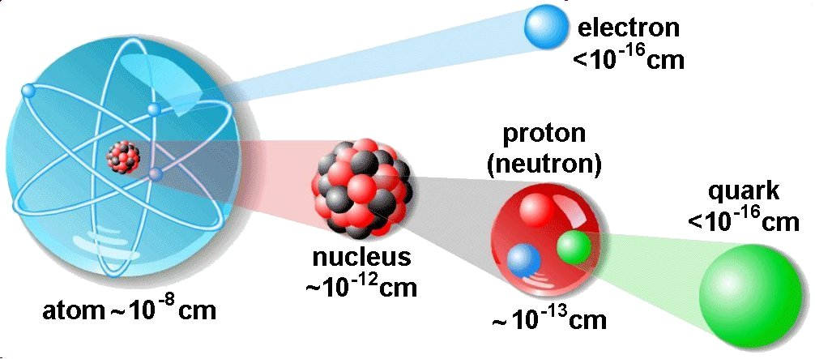
Structure of Matter
High-energy accelerators
Atom
Nucleus

Slide 4
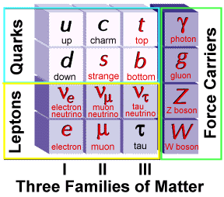
Elementary Particles
Why 3 generations?
No one really knows!
+ Antiparticles
+Higgs
(2012년)
=Standard Model
(표준모형)

Slide 5
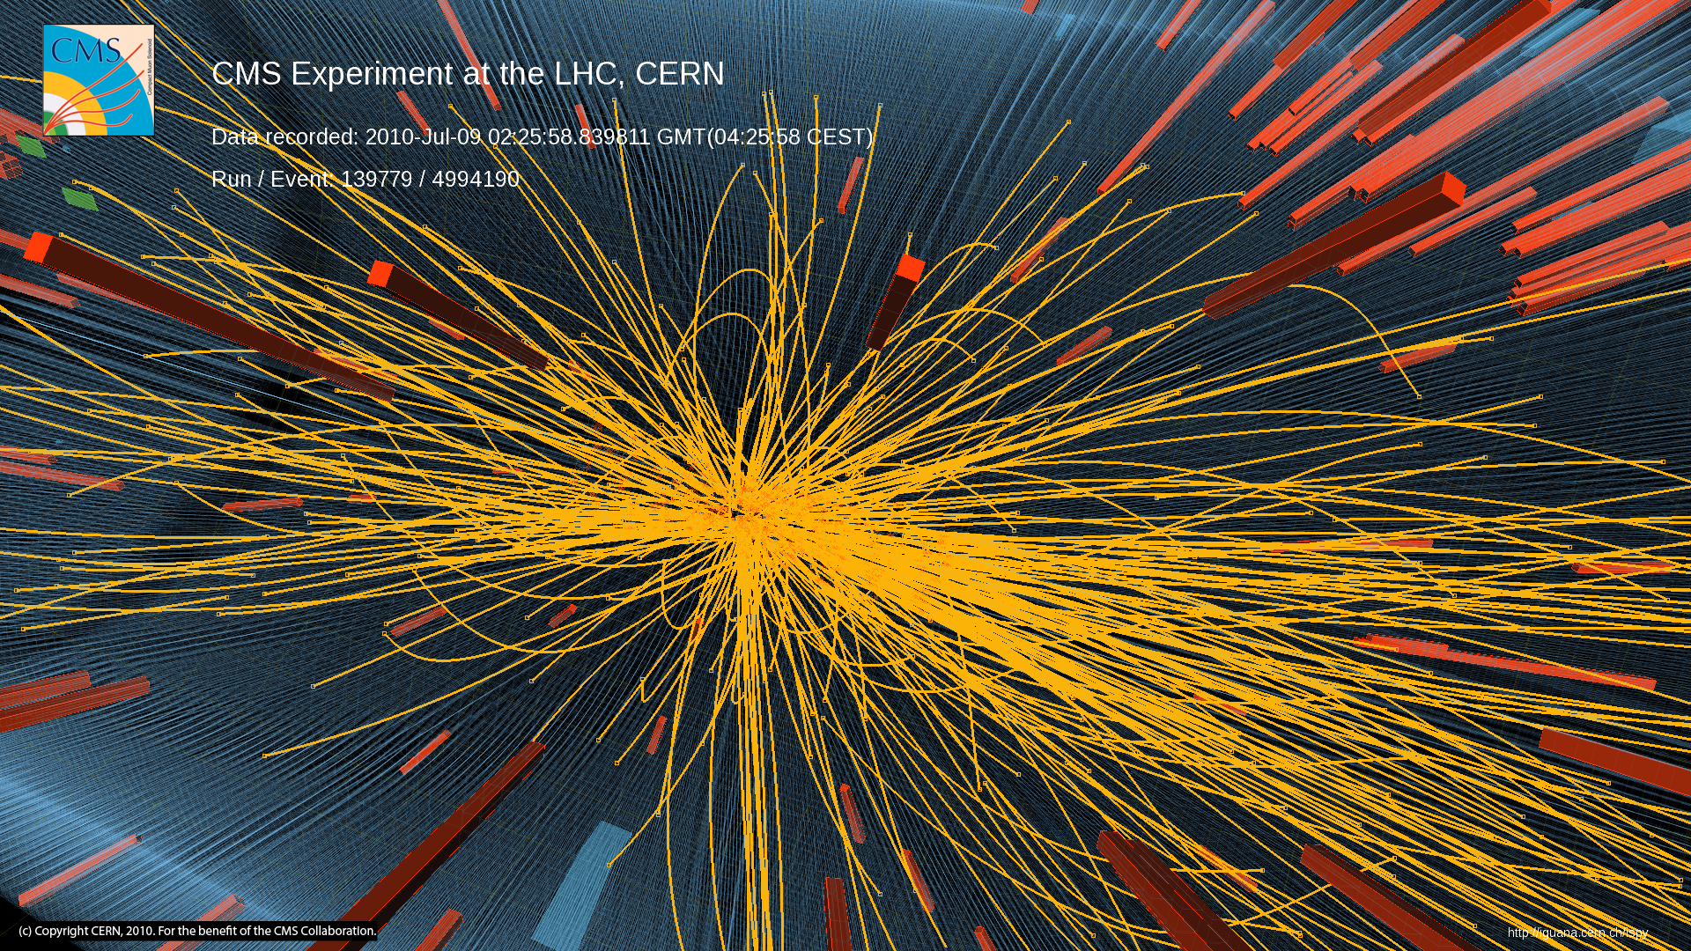
High-Multiplicity Event in pp

Slide 6
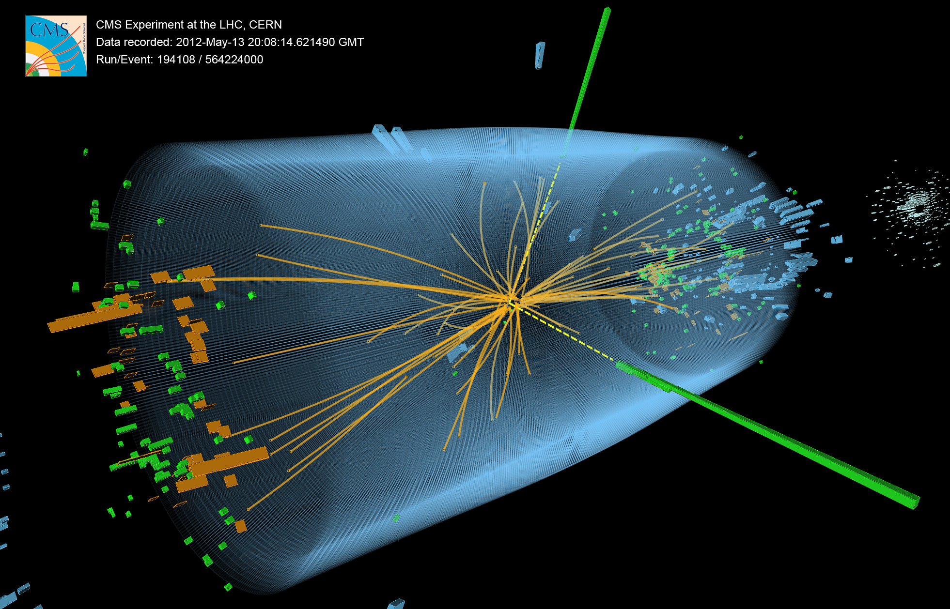
H ➔γγ
candidate

Slide 7
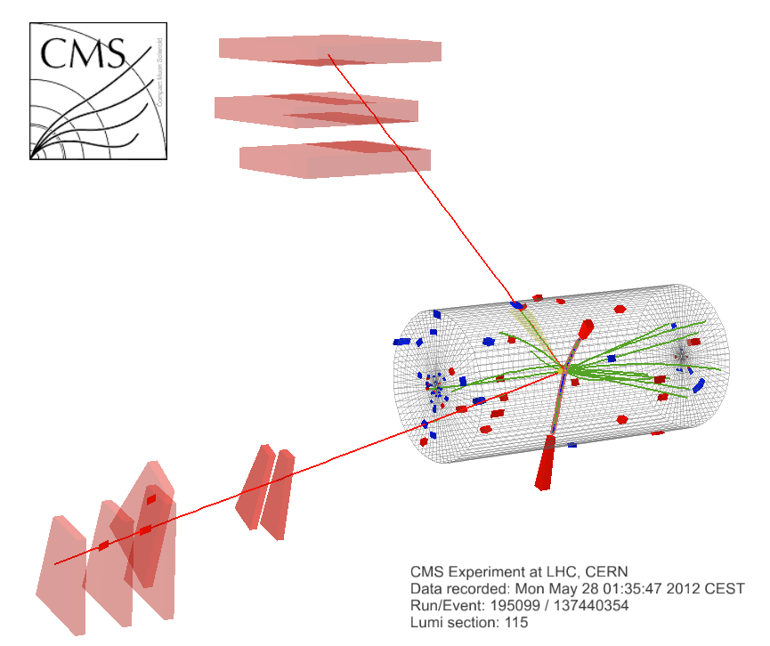
μ⁺(Z₁) p_{T} : 43 GeV
8 TeV DATA
4-lepton mass : 126.9 GeV
e⁻(Z₂) p_{T} : 10 GeV
μ⁻(Z₁) p_{T} : 24 GeV
e⁺(Z₂) p_{T} : 21 GeV

Slide 8
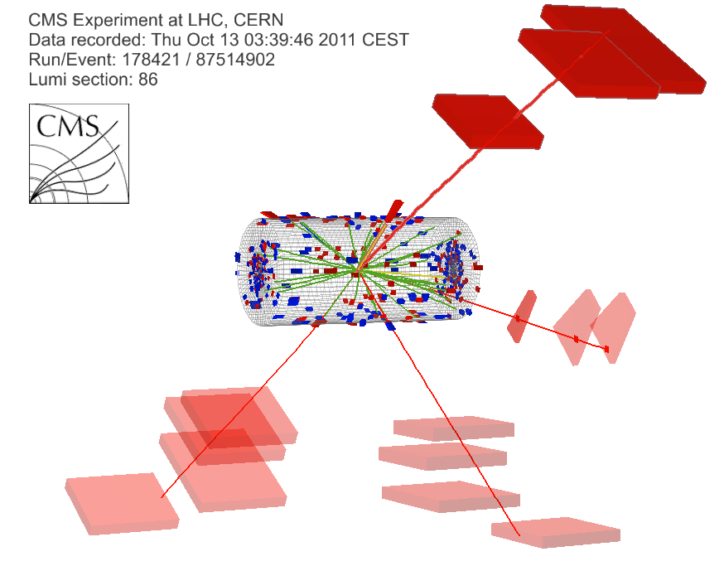
γ(Z₁)E_{T} : 8 GeV
μ⁻(Z₁) p_{T} : 28 GeV
7 TeV DATA
4μ+γ mass : 126.1 GeV
μ⁺(Z₂) p_{T} : 6 GeV
μ⁻(Z₂) p_{T} : 14 GeV
μ⁺(Z₁) p_{T} : 67 GeV

Slide 9
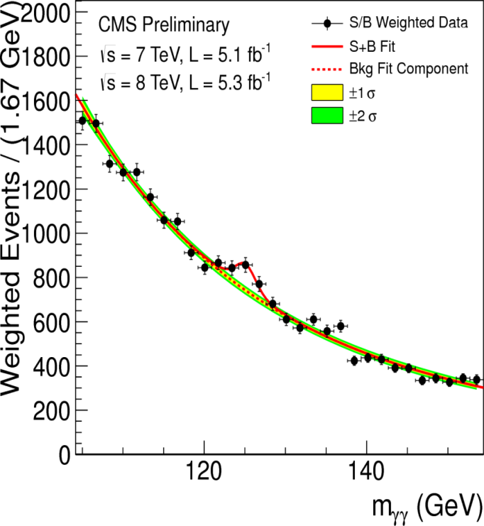
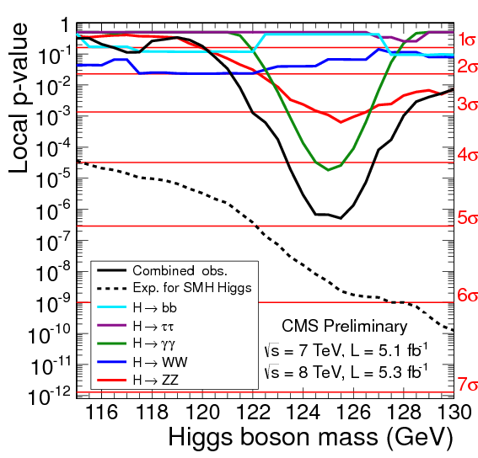

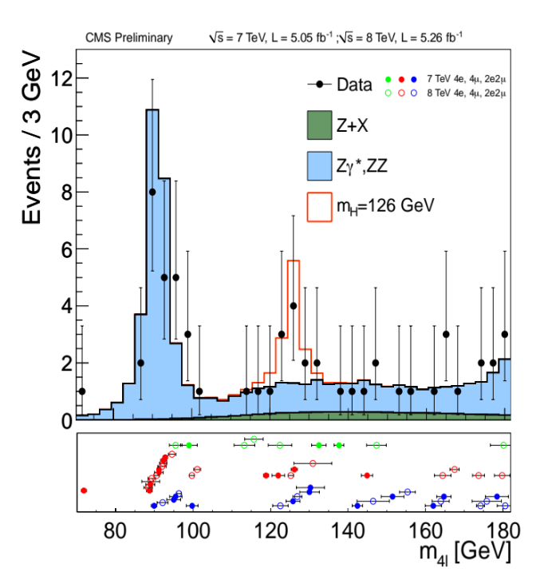
Discovery of Higgs
⇐ 2γ channels
4l channels ⇒

Slide 10
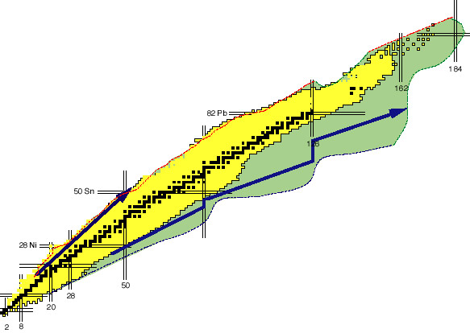
Structure of Matter (New Axis)
High-energy accelerators
Atom
Nucleus
Rare-isotope accelerators
About 10,000 species predicted theoretically

Slide 11
Nuclear Chart & Nuclear Physics
Stable Nuclei ≈ 300
Unstable nuclei observed so far ≈ 2700
Drip-lines (limit of existence)
by theoretical predictions ≈ 6000
Superheavy nuclei
r-process
(Novae & Supernovae)
s-process
(Red giants)
rp-process
Drip lines are determined by interplay among
  n-p symmetry
  Coulomb force
  Shell structure
  NN correlation
Z (양성자 수)
Terra incógnita
Neutron halo and skin
Reorganization of the nuclear shell structure
Deformation at drip lines
N (중성자 수)

Slide 12
Origin of Heavy Elements
Big Bang 이후
4분 후
헬륨핵 합성 시작
40분 후
H 75% + He 25% 로 구성
현 재
그렇다면 Au, Pb, U과 같은 무거운 원소들은 어떻게 생성 되었을까?
10억년 후
30만년 후
우주 배경복사 형성
수소핵이 핵융합을 일으키며 헬륨핵 으로 변환,
이러한 핵융합을 반복하며 Fe, Ni, Co 등의 안정된 원소생성
Q) 우주의 무거운 원소들은 어디서 왔을까?
?

Slide 13
Nova models in nuclear astrophysics
¹⁵O(α,γ)¹⁹Ne Reaction
²⁴Al
²⁵Al
Experimental requirements for direct measurement of σ
  Beam intensity (¹⁵O) > 10¹⁰ pps
  Target density (⁴He) > 10¹⁸/cm²
  Recoil det. efficiency > 40%
  >1 Count/hr
²¹Mg
²²Mg
²³Mg
²⁴Mg
²⁰Na
²¹Na
²²Na
²³Na
¹⁸Ne
¹⁹Ne
²⁰Ne
²¹Ne
²²Ne
Breakout paths to rp-process
(α, γ)
(α, γ)
¹⁷F
¹⁸F
¹⁹F
(α, p)
Stable
¹⁴O
¹⁵O
¹⁶O
¹⁷O
¹⁸O
Unstable
rp-process
Hot-CNO II
¹³N
¹⁴N
¹⁵N
CNO cycle : T₉ < 0.2
HCNO cycle: 0.2 < T₉ < 0.5
rp-process : T₉ > 0.5
Hot-CNO I
CNO cycle
¹²C
¹³C

Slide 14
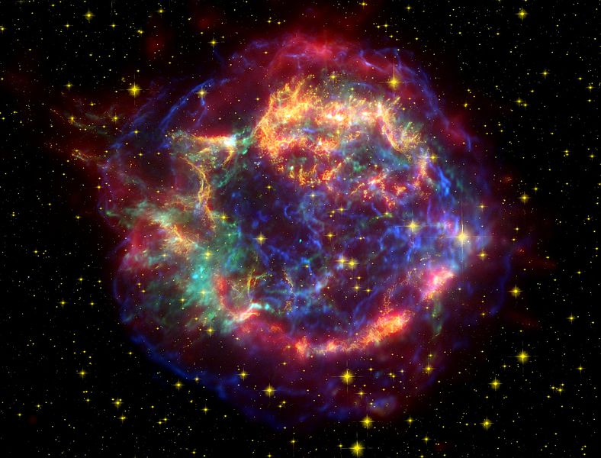
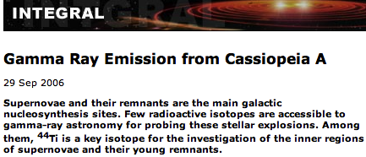
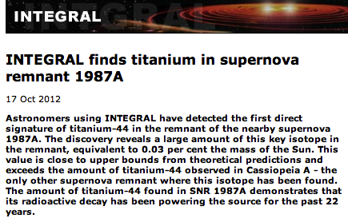
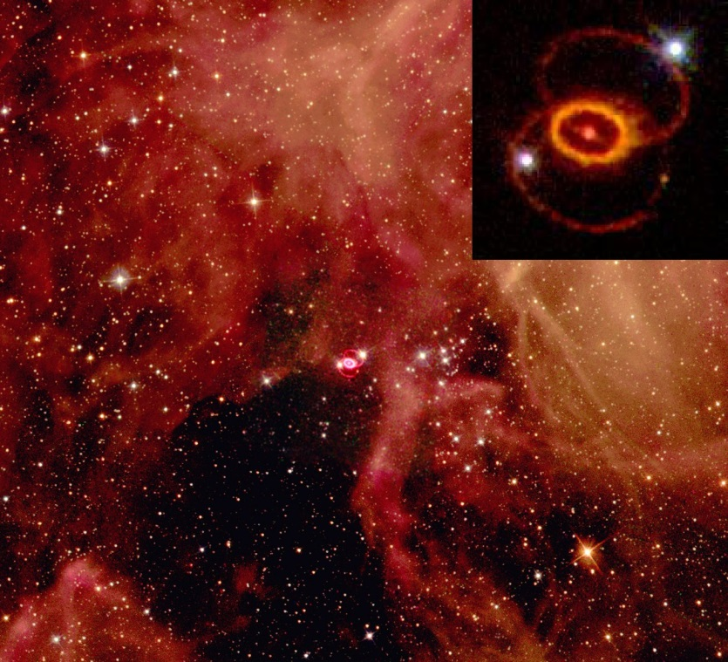
⁴⁴Ti(α,p)⁴⁷V Reaction

Slide 15
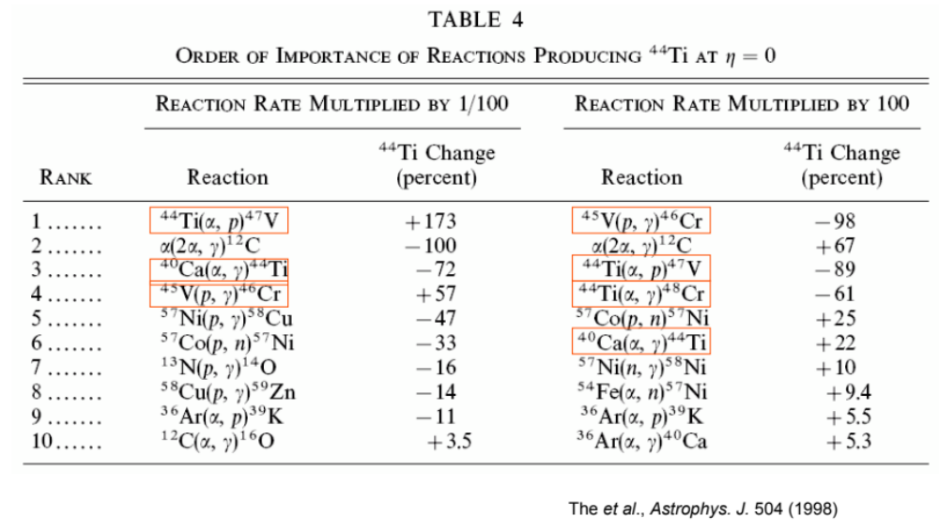
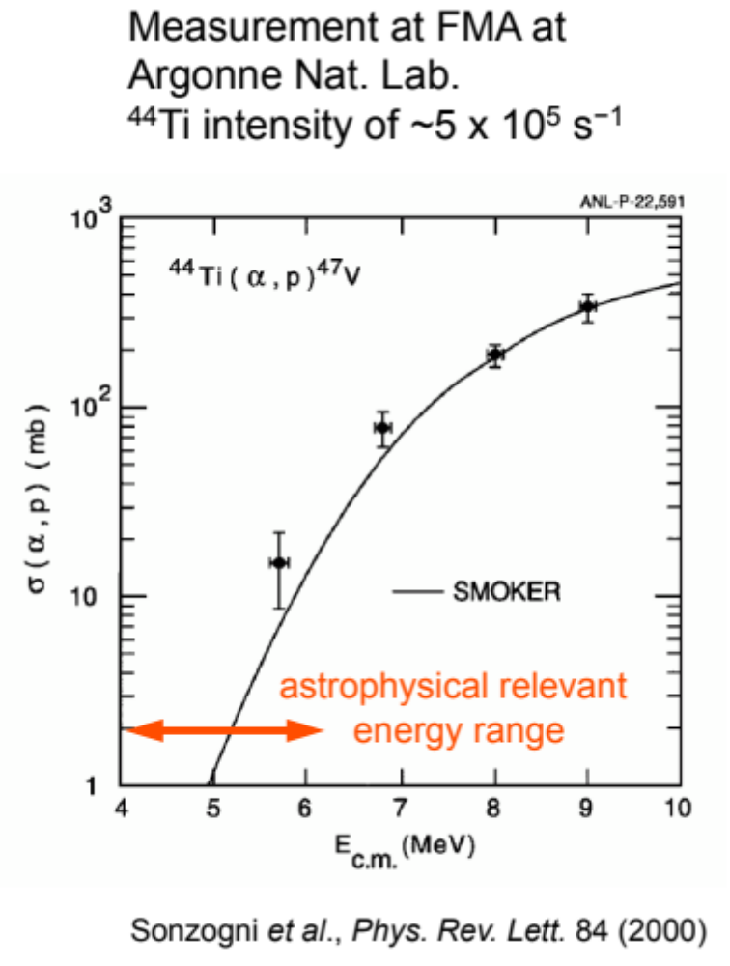
⁴⁴Ti(α,p)⁴⁷V Reaction
Presently, TRIUMF, CERN, CNS CRIB are working on this reaction.
At RISP, the direct measurement will be possible with an active target in the IF mode of KOBRA.

Slide 16
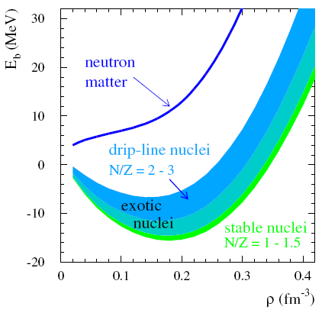
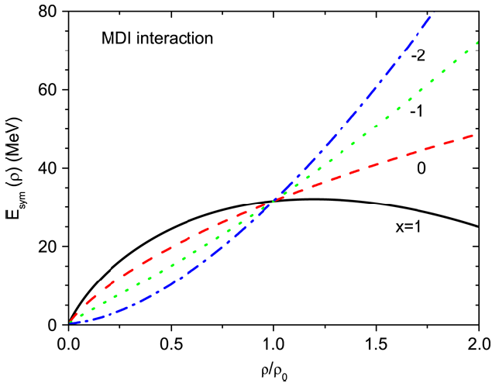

About Nuclear Matter: Equation of State (EOS) and Symmetry Energy
$E/A(ρ)$ (MeV)
Asy-stiff
핵 대칭에너지
E_{sym}
Asy-soft
ρ (fm⁻³)
L.W. Chen, C.M. Ko, B.A. Li,
Phys. Rev. Lett. 94, 032701 (2005)
CDR, FAIR (2001)

Slide 17
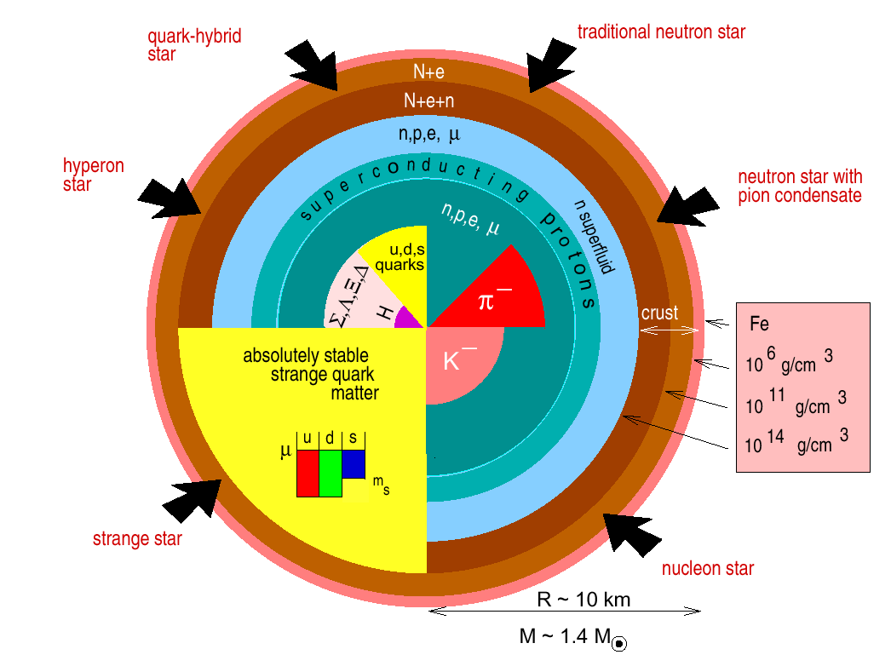
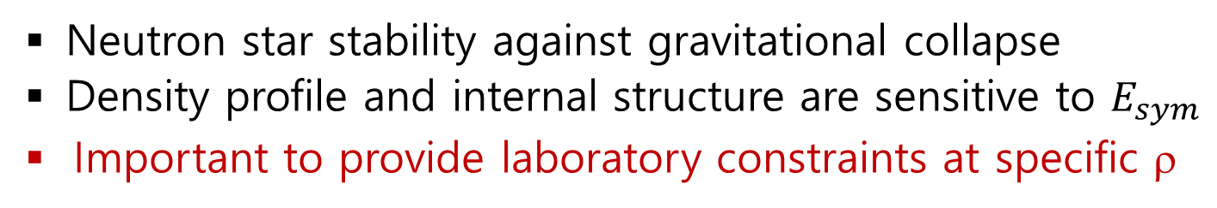
Symmetry Energy & Neutron Stars
Neutron star stability against gravitational collapse
Density profile and internal structure are sensitive to $E_{sym}$
Important to provide laboratory constraints at specific ρ
New axis for the phase of nuclear matter
Energy
np symmetric matter
np
asymmetry
axis
density

Slide 18
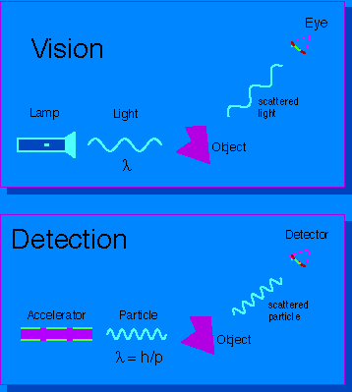
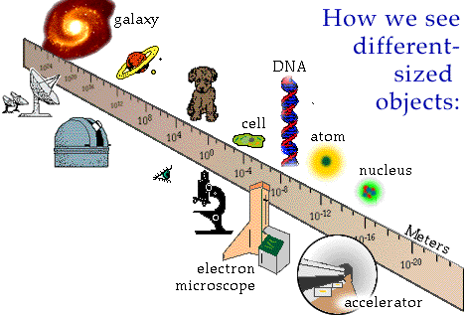
How do we measure?

Slide 19
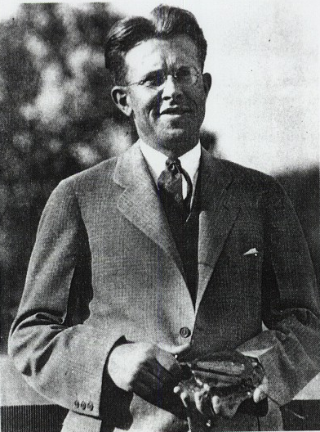
Accelerator
Accelerator is a kind of microscope that allows us to see small things.
1929
seen by
low-energy beam
(poorer resolution)
seen by
High-energy beam
(better resolution)
Ernest Lawrence
(1901-1958)

Slide 20
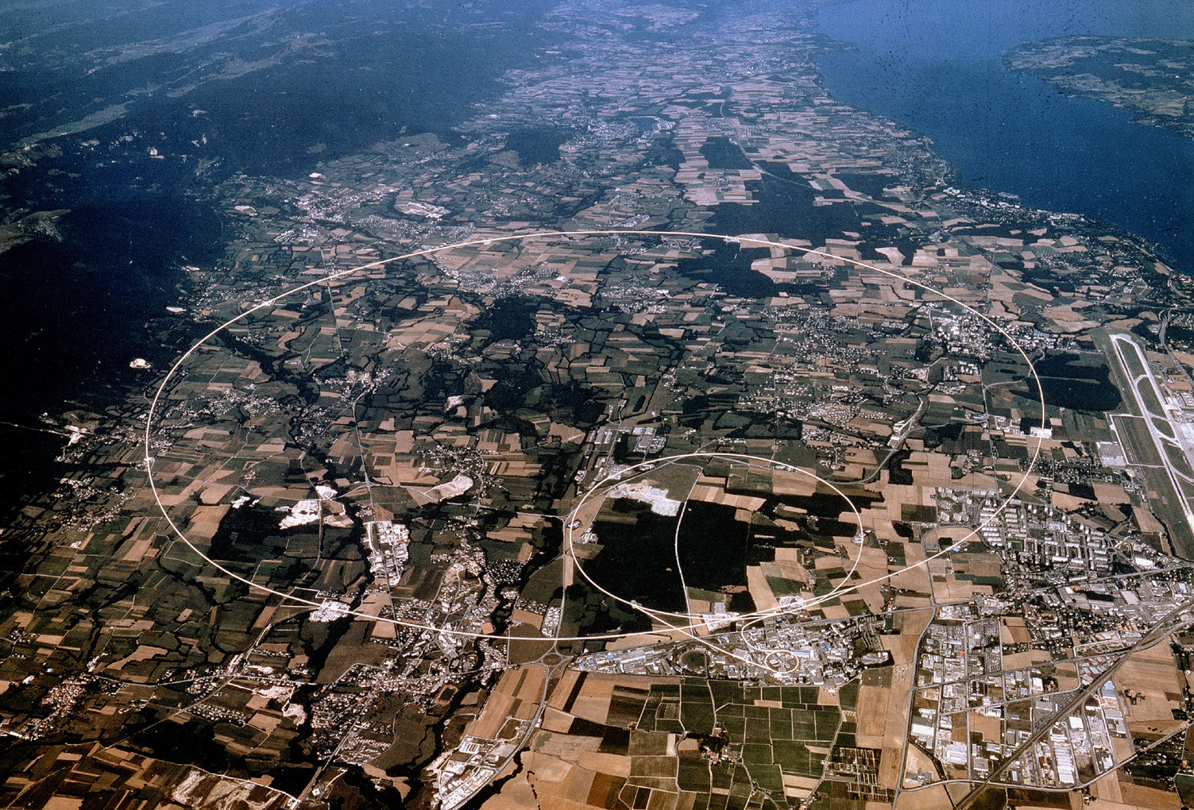
CERN: World’s Biggest Lab.

Slide 21
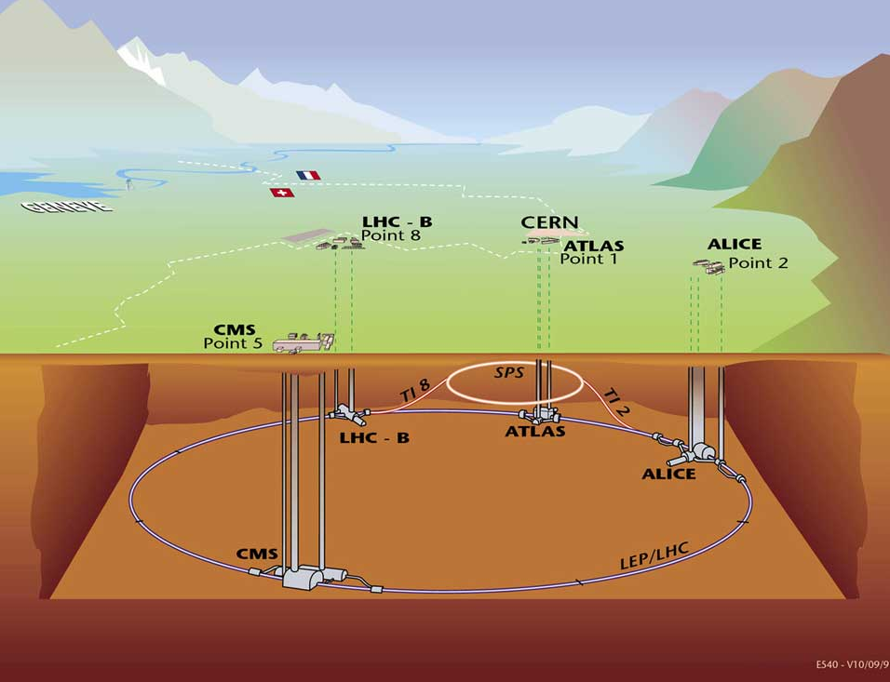
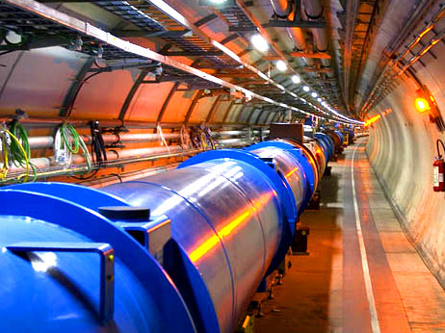
Large Hadron Collider (LHC)
27 km of 8 T magnets
100 m below surface

Slide 22
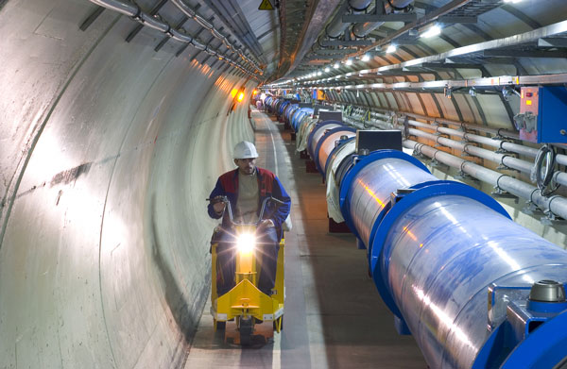
Large Hadron Collider (LHC)
Protons race around a 27 km circuit at 99.999999% of the speed of light,
crashing head on into each other 40,000,000 times a second.

Slide 23
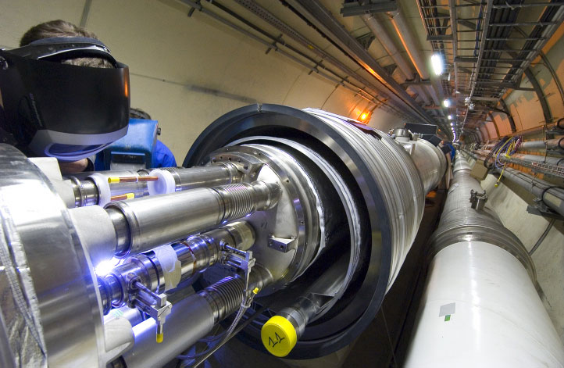
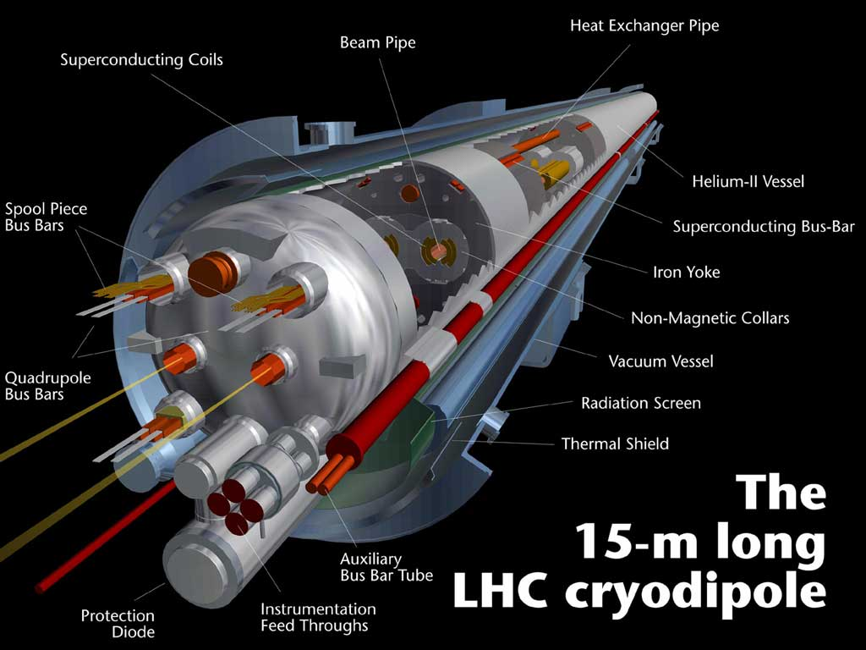
Large Hadron Collider (LHC)
In the emptiest space in our solar system …
Total 5,000 SC magnets including 1,296 dipoles
The beam pipe is evacuated to the same vacuum as interplanetary space.
The pressure (10⁻¹³ atm) is about 1/10th that of the surface of the moon.

Slide 24
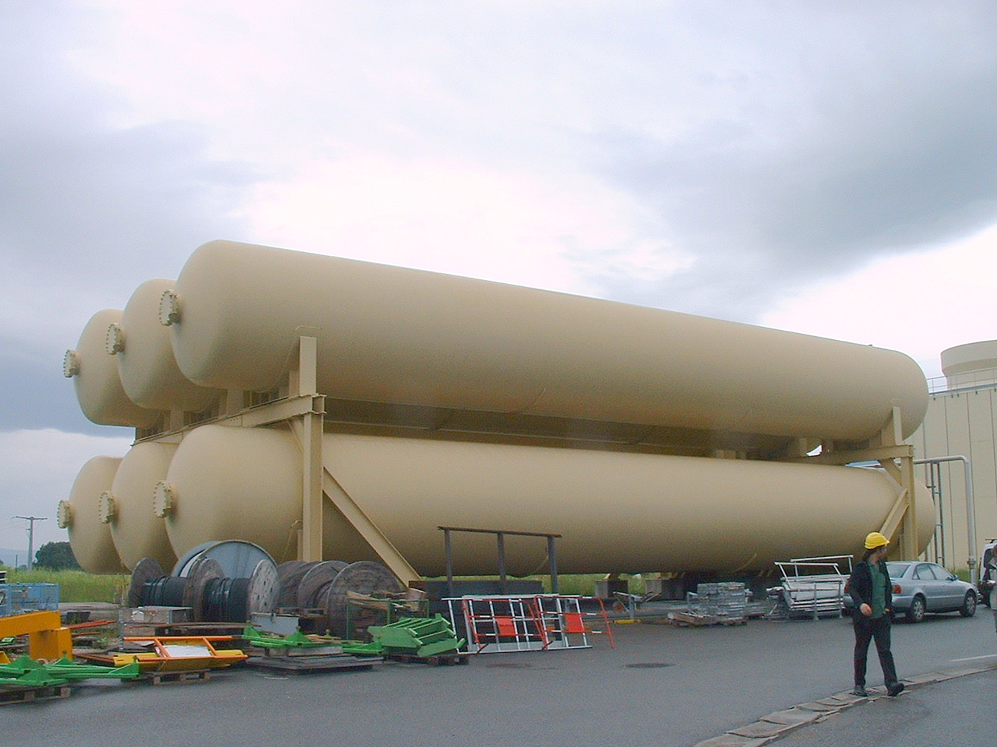
Large Hadron Collider (LHC)
In one of the coldest regions in the universe …
Superconducting, superfluid liquid He is maintained at -271.3º C or 1.9 K.
That is a little colder than interstellar space.

Slide 25
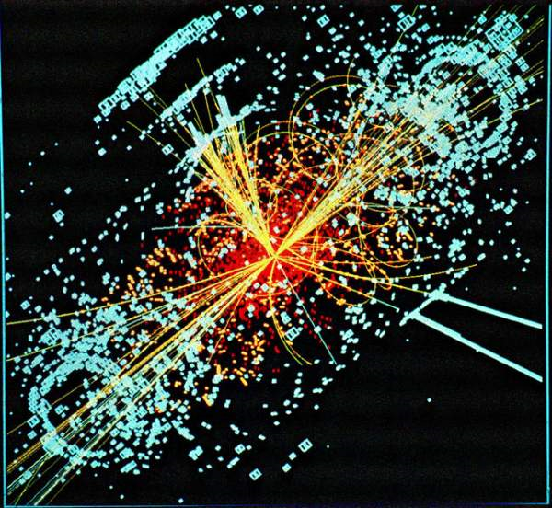
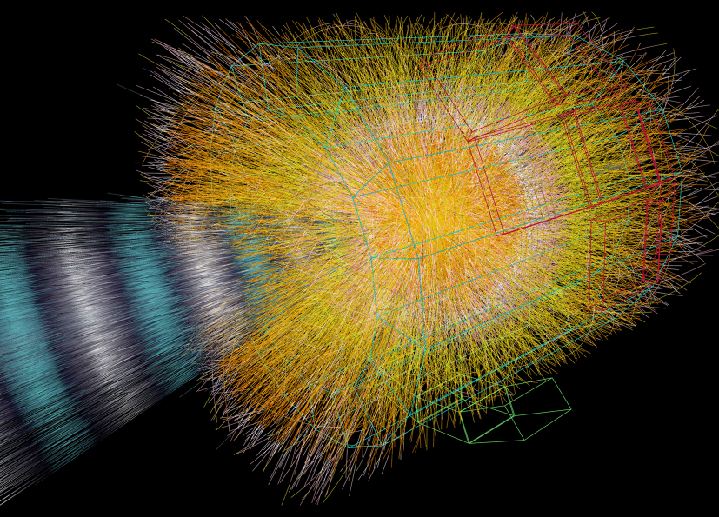
Large Hadron Collider (LHC)
Generating the hottest reactions in our galaxy …
Violent collisions corresponding to temperatures billion times higher than the core of the Sun will be produced.
That is roughly 160,000,000,000,000,000 degree in Celsius.
경
조
억
The counter rotating beams of protons, each carrying about the energy of a 400 ton train traveling at 150 km/h, are made to crash at the center of each experiment.

Slide 26
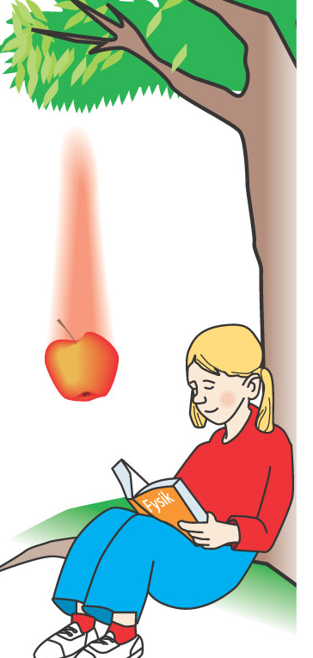
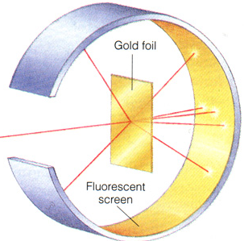
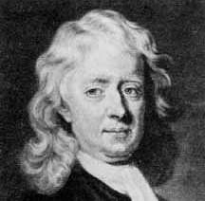
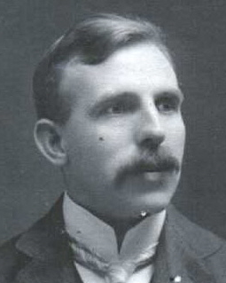
Old-fashioned Detector
Tool to measure something
Issac Newton
(1642 - 1727)
Ernest Rutherford
(1871 - 1937)
Eyes
Fluorescent (ZnS) Screen

Slide 27
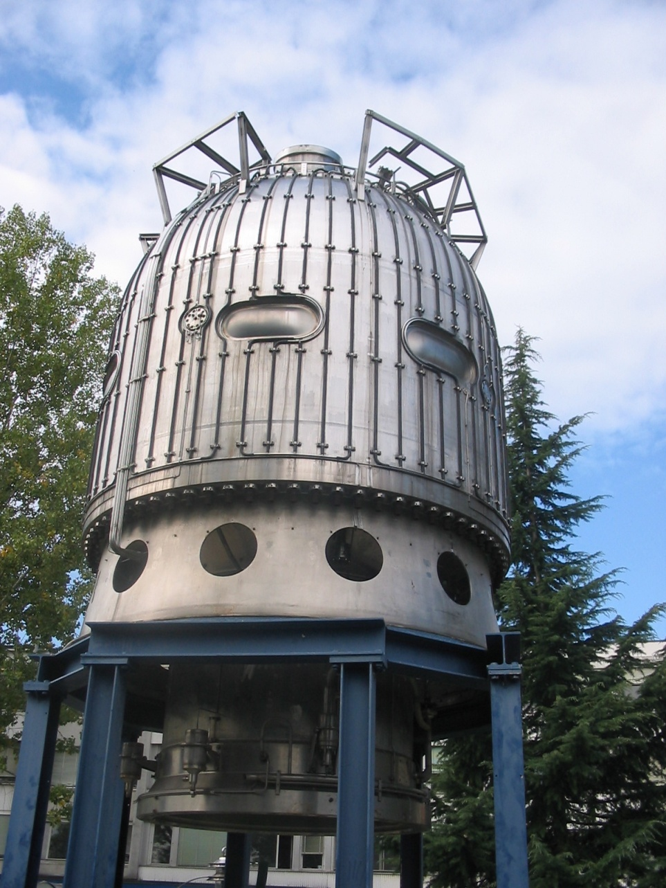
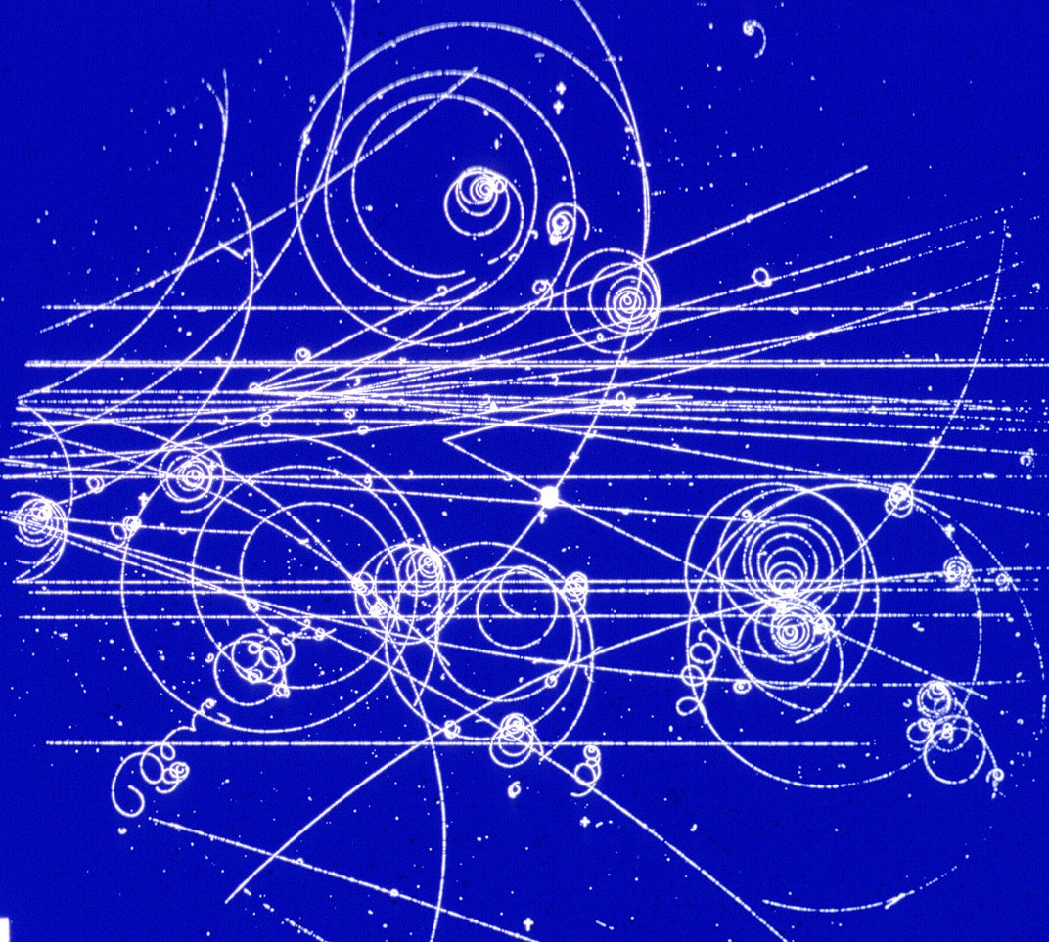
Old-fashioned Detector
Bubble Chamber
BEBC: Big European Bubble Chamber

Slide 28
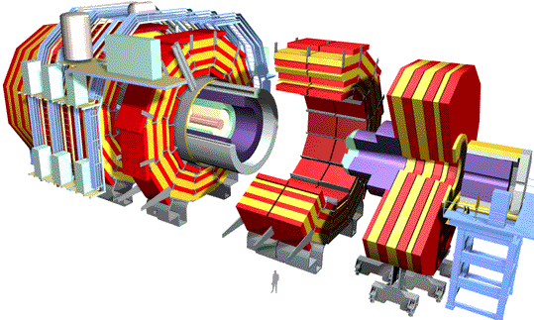
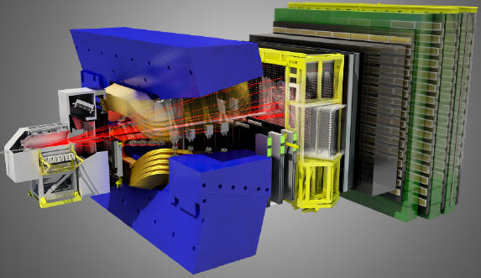
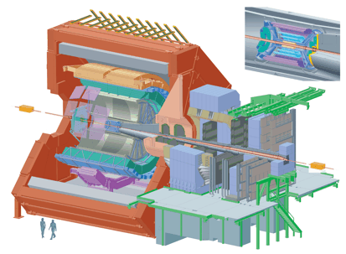
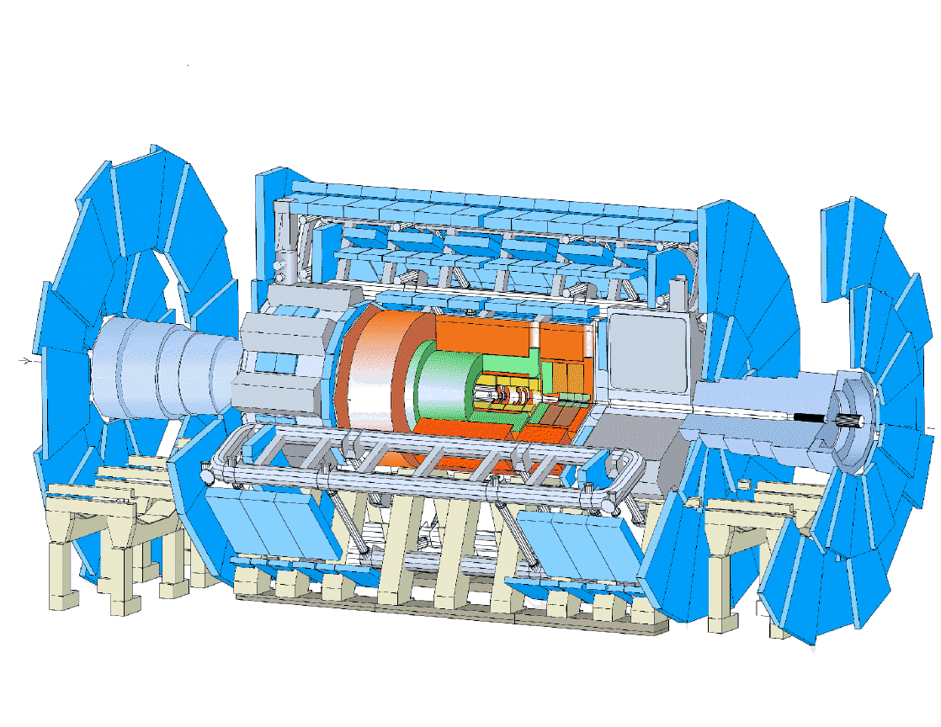
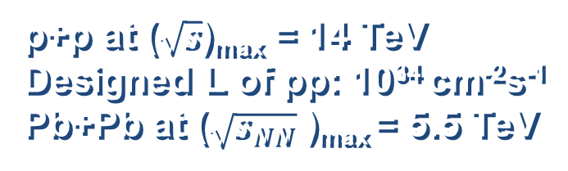
CMS
p+p at ($\sqrt{s}$)_{max} = 14 TeV
Designed L of pp: 10³⁴ cm⁻²s⁻¹
Pb+Pb at ($\sqrt{s_{NN}}$ )_{max} = 5.5 TeV
LHCb
ALICE
ATLAS

Slide 29

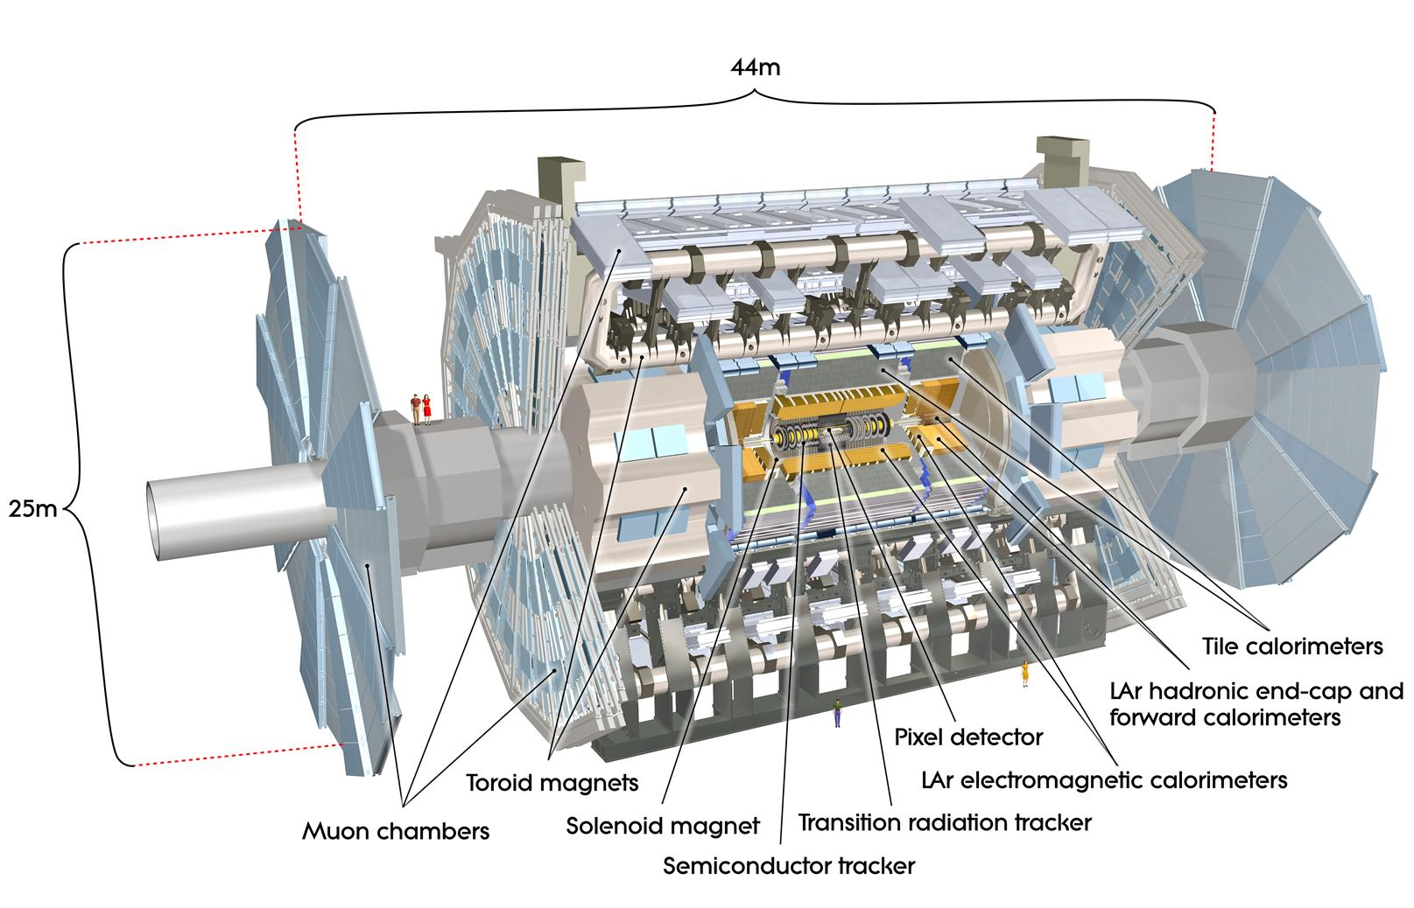
ATLAS Detector @ LHC
An Excellent Calorimetry
A large acceptance Inner Tracker
A hermetic Muon Spectrometer

Slide 30
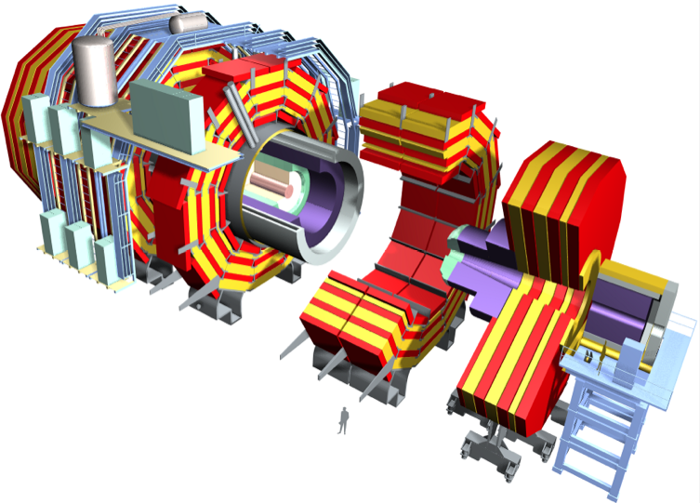
CMS Detector
Superconducting Coil (3.8 T)
CALORIMETERS
ECAL
HCAL
76k scintillating
PbWO₄ crystals
Plastic scintillator/
Brass sandwich
Steel YOKE
BSC
MB trigger
HF
TRACKER
MB trigger
Centrality in HI
Pixels (66M Ch.)
Silicon Microstrips (9.6M Ch.)
220 m² of silicon sensors
MUON ENDCAPS
Weight: 12,500 tons
Diameter: 15 m
Length: 22 m
MUON BARREL
Cathode Strip Chambers
Resistive Plate Chambers
Drift Tube Chambers
Resistive Plate Chambers

Slide 31
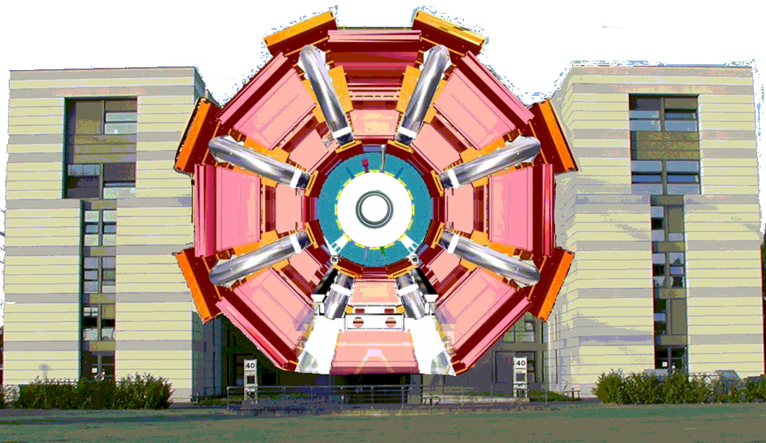
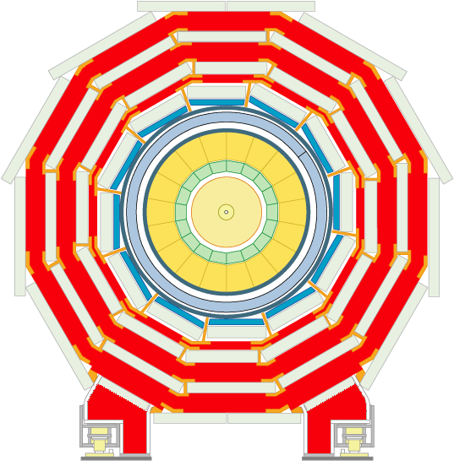
ATLAS vs. CMS
ATLAS (2 Tesla)
Six-story building
CMS (4 Tesla)
ATLAS is twice as big, but CMS is twice as heavy

Slide 32

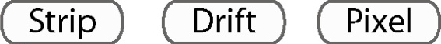



Size: 16ⅹ16ⅹ26 m³
Weight: 10,000 tons

Slide 33
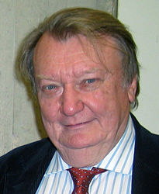
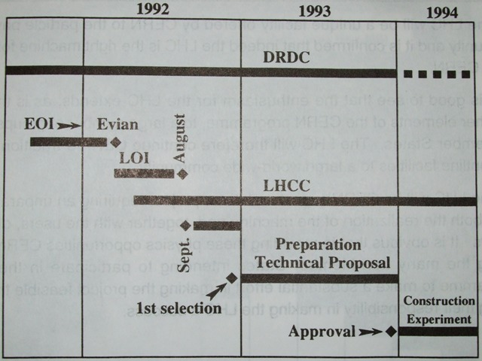
Brief History of LHC
First Concept: Evian Workshop in 1992
  Summary by C. Rubbia
Carlo Rubbia (1934 - )
Nobel prize in 1984 for the discovery of W & Z
Construction starts in ‘94
1st beam in ‘98
However,
In 1994, CERN Council approved the construction of LHC.
In 1996, experiments ATLAS and CMS were approved.

Slide 34




Aerial View of P5 for CMS in 1998
Gallo Roman Vestiges

Slide 35




Finishing P5 Cavern in Feb. 2005

Slide 36

Assembly on the Ground

Slide 37





Assembly in Underground Cave
~8 hours/100 m
Feb 2007
Last piece of CMS(YE-1) lowered in 22 Jan, 2008

Slide 38

Assembly Completed

Slide 39





Run History
Beam was extracted from SPS in TI2 on 14-15 June, 2008
Beam1 was injected in LHC on 8-11 August, 2008
First complete orbit on 10 September, 2008

Slide 40

Run History
Large helium leak in Sector 34 on 19 September, 2008 while magnets were being commissioned to 5 TeV
Helium escaped in the tunnel
Insulation vacuum broken
Beam vacuum broken
High resistivity of Cu stabilizer
splices in SC cable joint

Slide 41

Back in Business
SPS extraction test on 11-12 July, 2009
Beam circulation at 450 GeV in LHC on 20 Nov, 2009
First pp collision in LHC on 23 Nov, 2009
First physics paper from collisions by ALICE on 28 Nov, 2009
First stable physics fills available on 6 Dec, 2009
Each beam ramped to 1.18 TeV on 8 Dec, 2009
First stable pp collisions at 2.36 TeV on 14 Dec, 2009
End of the commissioning run of LHC on 16 Dec, 2009
  900 GeV: ~10 μb⁻¹,
  2.36 TeV : ~0.4 μb⁻¹ for each experiment
Physics run for pp at 7 TeV started on March, 2010
First run for Pb+Pb at $\sqrt{s_{NN}}$ = 2.76 TeV in Nov-Dec, 2010

Slide 42



Heavy-Ion Runs at LHC
  1st PbPb run @ $\sqrt{s_{NN}}$ = 2.76 TeV
  November-December 2010
  Recorded luminosity: 7.28 μb⁻¹
  2nd PbPb run
  @ $\sqrt{s_{NN}}$ = 2.76 TeV
  Nov.-Dec. 2011
  Recorded luminosity: 150 μb⁻¹
    About 20 times more statistics than 2010 during similar beamtime
2011
X20
2010

Slide 43

Typical PbPb Event

Slide 44



$Υ$(1S) Candidates in PbPb & pPb
[μ⁺μ⁻]
m 9.46 GeV/c²
p_{T} 0.06 GeV/c
y -0.33
[μ⁺]
p_{T} 4.74 GeV/c
η -0.39
[μ⁻]
p_{T} 4.70 GeV/c
η -0.28
PbPb
[μ⁺μ⁻]
m 9.45 GeV/c²
p_{T} 1.22 GeV/c
η -2.04
[μ⁺]
p_{T} 4.30 GeV/c
η -0.52
[μ⁻]
p_{T} 6.50 GeV/c
η -0.04
pPb
CMS DP-2013-001

Slide 45

μ⁻μ⁺ Invariant Mass Distribution
p_{T}^{μμ} > 6.5 GeV/c for |η| < 1.6
p_{T}^{μμ} > 3 GeV/c for 1.6 < |η| < 2.4

Slide 46




$Υ$(nS) Sequential Suppression
PRL 109, 222301 (2012), PbPb MinBias, $L_{int}$ = 150 μb⁻¹
$Υ$ states are suppressed sequentially
  $R_{AA}\left[Υ(3S)\right]<R_{AA}\left[Υ(2S)\right]<$ $R_{AA}\left[Υ(1S)\right]$
$Υ(2S)$ is suppressed even in the most peripheral bin.

Slide 47



Efforts in Korea
2003년: 국립핵과학연구소(NLNS) 최초 제안
DNP/KPS proposed NLNS for the first time.

Slide 48


Slide 49
Brief History of RISP
International Science-Business Belt (ISBB) plan (Jan. 2009)
Preliminary Design Report (Mar. 2009-Feb. 2010)
Conceptual Design Report (Mar. 2010-Feb. 2011)
Institute for Basic Science (IBS) established (Nov. 2011)
Rare Isotope Science Project (RISP) launched (Dec. 2011)
  Rare isotope accelerator complex is the representative facility of IBS
Baseline Design Summary (2012)
Technical Design Report (2012)
1st Amendment of the Master Plan (2013)
Civil Engineering and Construction Project (2014)
2nd Amendment of the Basis Plan (2015)
  2011- 2021 (14,445 KRW including 4,602 BKW for Acc. Facilities)

Slide 50
New RIB Facility RAON in Korea
ECR-IS
(10keV/u,12 pμA)
LEBT
Accelerator | Driver Linac |  | Post Acc. | Cyclotron
Particle | proton | U⁺⁷⁸ | RI beam | proton
Beam energy | 600 MeV | 200 MeV/u | 18.5 MeV/u | 70 MeV
Beam current | 660 μA | 8.3 pμA | - | 1 mA
Power on target | 400 kW | 400 kW | - | 70 kW
RFQ (300keV/u, 9.5 pμA)
MEBT
SCL1 (18.5MeV/u, 9.5 pμA)
Driver LINAC
Cyclotron
(p, 70 MeV, 1 mA)
Charge
Stripper
SCL2 (200MeV/u, 8.3 pμA for U⁺⁷⁸)
(600MeV, 660 μA for p)
μSR
Medical research
RFQ
HRMS
ISOL
Target
IF Target
IF system
SCL3 (18.5MeV/u)
MEBT
CB
RF
Cooler
Post Accelerator
Fragment Separator
ECR-IS
Atom/Ion
Trap
Low-Energy
Experimental
Area
ISOL system
High-Energy Experimental Area

Slide 51



RI Beam Production Methods
ISOL (Isotope Separator On-Line)
p on thick target (e.g. Uranium Carbide) → Target spallation or fission (low energy)
Current facilities: TRIUMP(ISAC), CERN(ISOLDE), GANIL(SPIRAL)
RI Ions
Reacceleration
Low-Energy
Experiments
IF (In-flight Fragmentation)
Stable heavy-ion beam on thin target → Projectile fragmentation (high energy)
Current facilities: RIKEN(RIBF), MSU(FRIB), GSI(FRS)/FAIR(Super FRS)
Stopped Beam Experiments (Traps)
Stopping
RI beam
High-Energy
Experiments

Slide 52

KOBRA
Stage 1
Korea Broad Acceptance
Recoil Spectrometer
and Apparatus
at low-energy experimental area
D1
D2
F1
F0
F2
W1
F3
High-performance spectrometer with detection system
Main experimental facility for nuclear science with low-energy beams up to 18.5 MeV/u
Stage 2
W2
F4
D3
F5

Slide 53


KOBRA & Low-Energy LAMPS
D1
D2
Photoabsorption Reactions
  ^{124,130,132}Sn+²⁰⁸Pb
  ^{68,70,72}Ni+²⁰⁸Pb
  ^{50,54,60}Ca+²⁰⁸Pb, etc.
Measurement: Excitation energy E* from kinematically complete measurement of all particles
F1
F0
F2
W1
F3
W2
D3
F4
F5
Low-energy LAMPS
GDR/PDR
Particle Emission
▼
Symmetry
Energy
▼
Neutron
Thickness
Si-CsI
Neutron Array

Slide 54

High-Energy LAMPS
Central and peripheral collisions
  ¹³²Sn+¹¹²Sn, ¹³²Sn+¹¹⁸Sn, ¹³²Sn+¹²⁴Sn
  ¹²⁴Sn+¹¹²Sn, ¹²⁴Sn+¹¹⁸Sn, ¹²⁴Sn+¹²⁴Sn
  ¹¹²Sn+¹¹²Sn, ¹¹²Sn+¹¹⁸Sn, ¹¹²Sn+¹²⁴Sn
  ¹⁰⁶Sn+¹¹²Sn, ¹⁰⁶Sn+¹¹⁸Sn, ¹⁰⁶Sn+¹²⁴Sn
  etc.

Slide 55


Applications
WWW
  Tim Berners-Lee invented WWW at CERN in 1989 for automatic information sharing among scientists all over the world
One in Globe and another one in CC

Slide 56


Applications
THE GRID
Amount of the LHC data
The detectors spew out analyzed data at 700 MB/sec.
That is ~30,000 Encyclopedia Britannicas every second !
That is 15,000,000 GB
(15 PB) per year:
20 km stack of average CDs per year.

Slide 57



Applications
Tumor therapy
Figures & pictures
from GSI, Germany

Slide 58
Summary
Nuclear physics is essential to understand the universe and fundamental interactions.
The large hadron collider (LHC) is exploring the high-temperature and high-density QCD matter in early universe.
The rare-isotope beam facility RAON is exploring the origin of elements & stability of matter from low to high densities.

Slide 59

방사광 가속기
http://www.particleadventure.org/history-universe.html
희귀 동위원소
중이온 가속기
RIBF, RAON
고에너지 가속기
(LHC, RHIC)

Slide 60
Summary
Nuclear physics is essential to understand the universe and fundamental interactions.
The large hadron collider (LHC) is exploring the high-temperature and high-density QCD matter in early universe.
The rare-isotope beam facility RAON is exploring the origin of elements & stability of matter from low to high densities.
Future of nuclear physics in Korea is quite promising for next decades.

