Slide 1

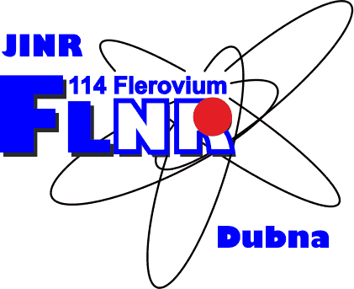
Production of neutron-rich heavy and superheavy nuclei in multinucleon transfer reactions
Alexander Karpov
Flerov Laboratory of Nuclear Reactions, JINR, Dubna, Russia
12 APCTP-BLTP JINR JW, 20-24 August 2018, Busan, Korea

Slide 2
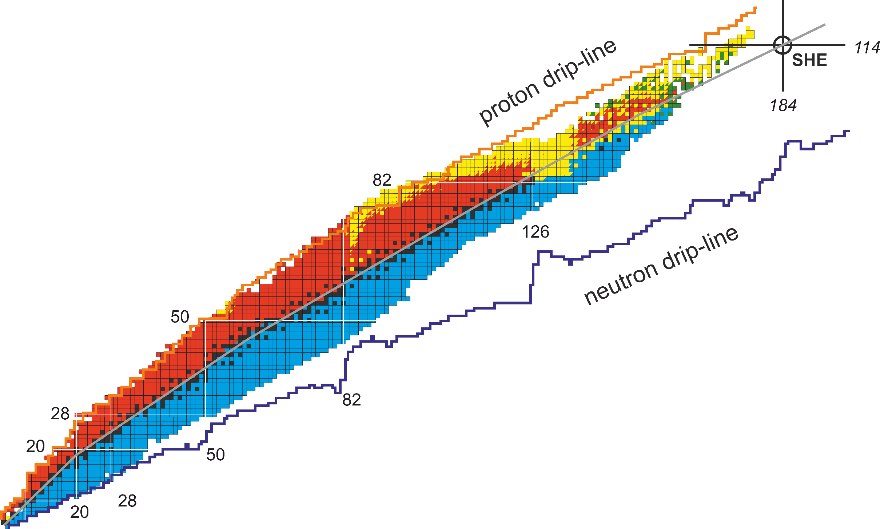
Motivation
Multi-nucleon transfer reactions are thought to be an efficient method of synthesis of new neutron-rich heavy and superheavy nuclei

Slide 3
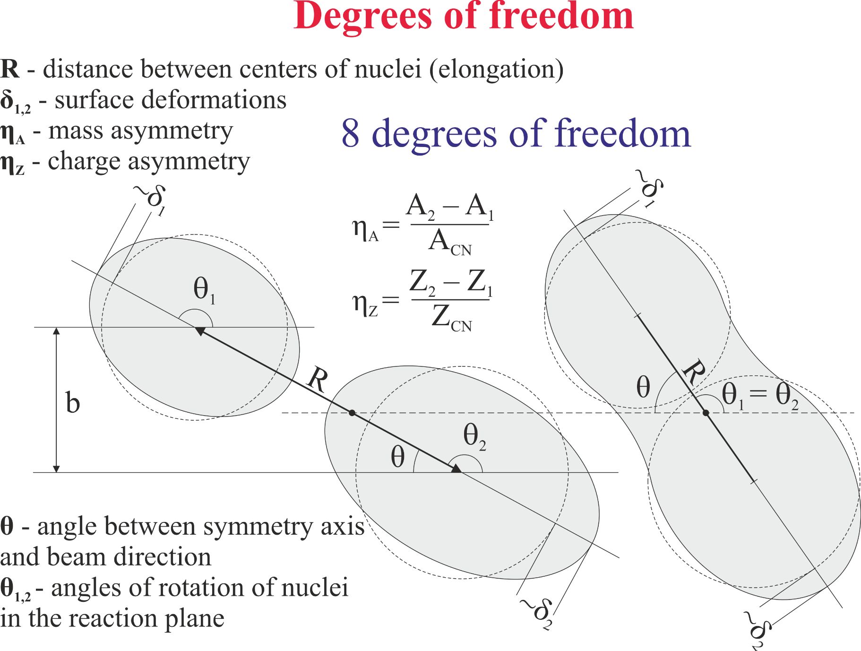
Model
A.V. Karpov and V.V. Saiko, Phys. Rev. C 96, 024618 (2017)

Slide 4
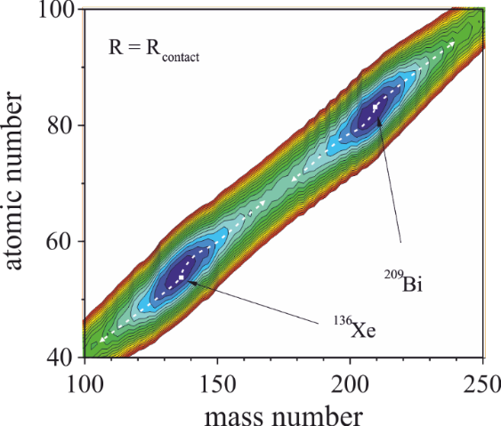
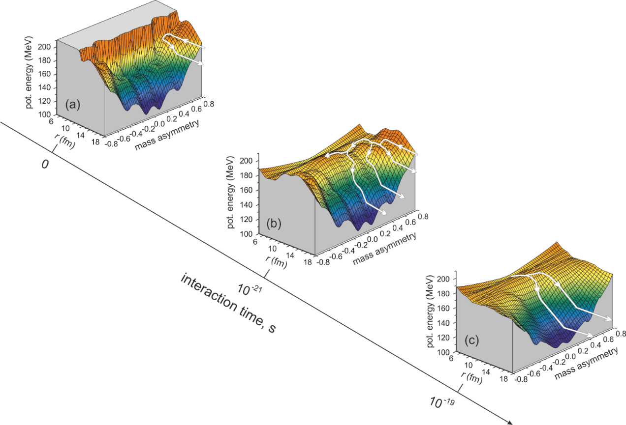
Potential energy
A.V. Karpov, EXON (2006)
V.I. Zagrebaev, A.V. Karpov, et al. PEPAN (2007)
Double-folding potential with Migdal forces
Two-center shell model

Slide 5
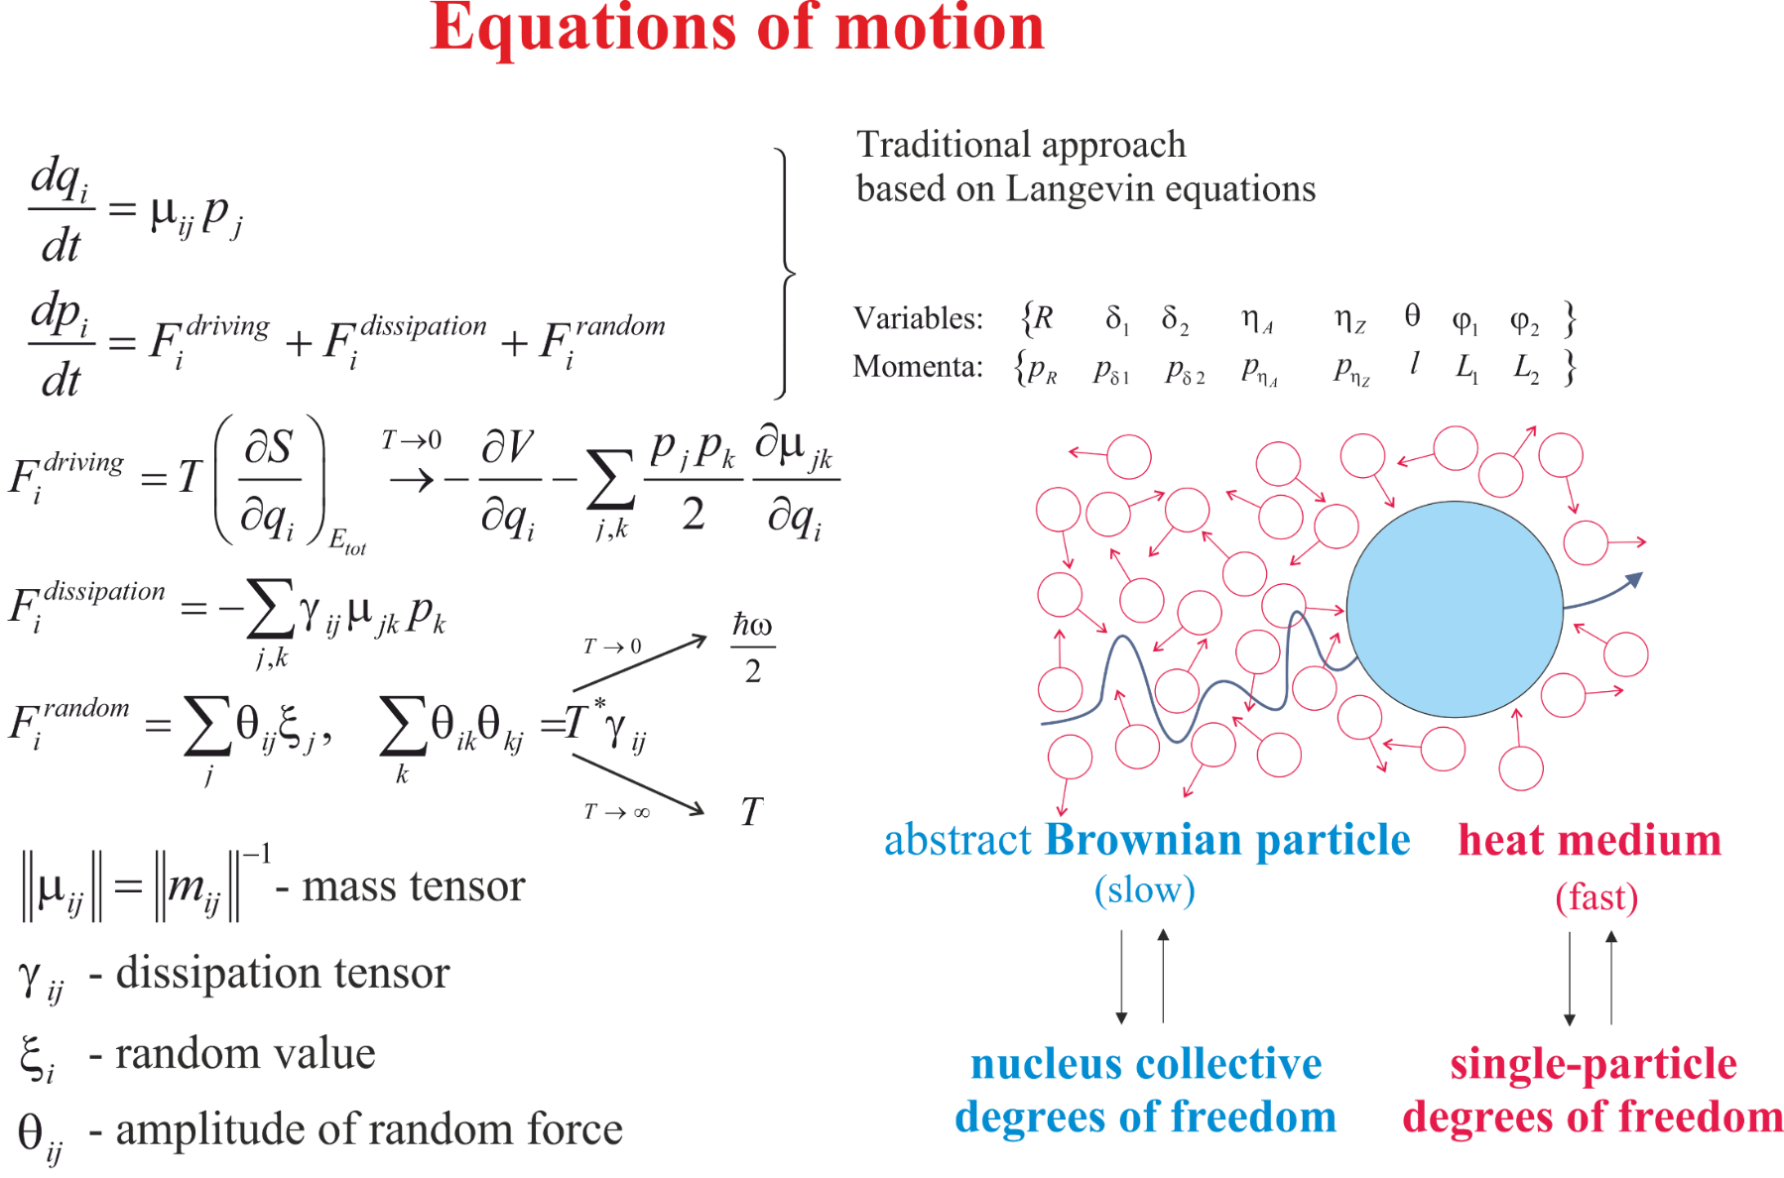

Slide 6
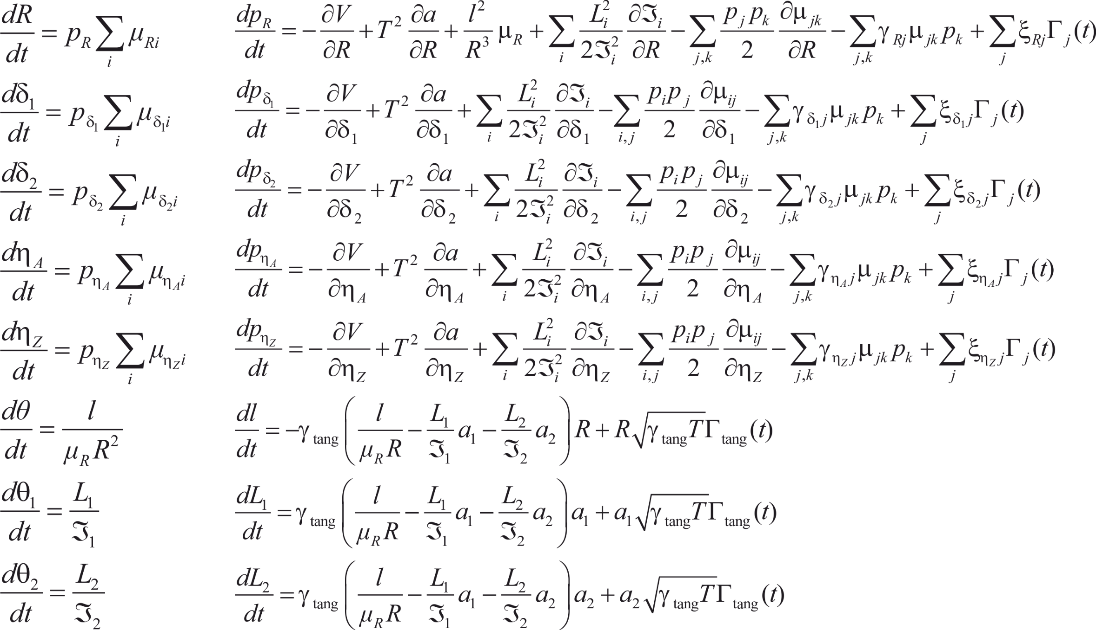
Equations of motion (R, δ₁, δ₂, η_{A}, η_{Z}, θ₁, θ₂, θ)

Slide 7
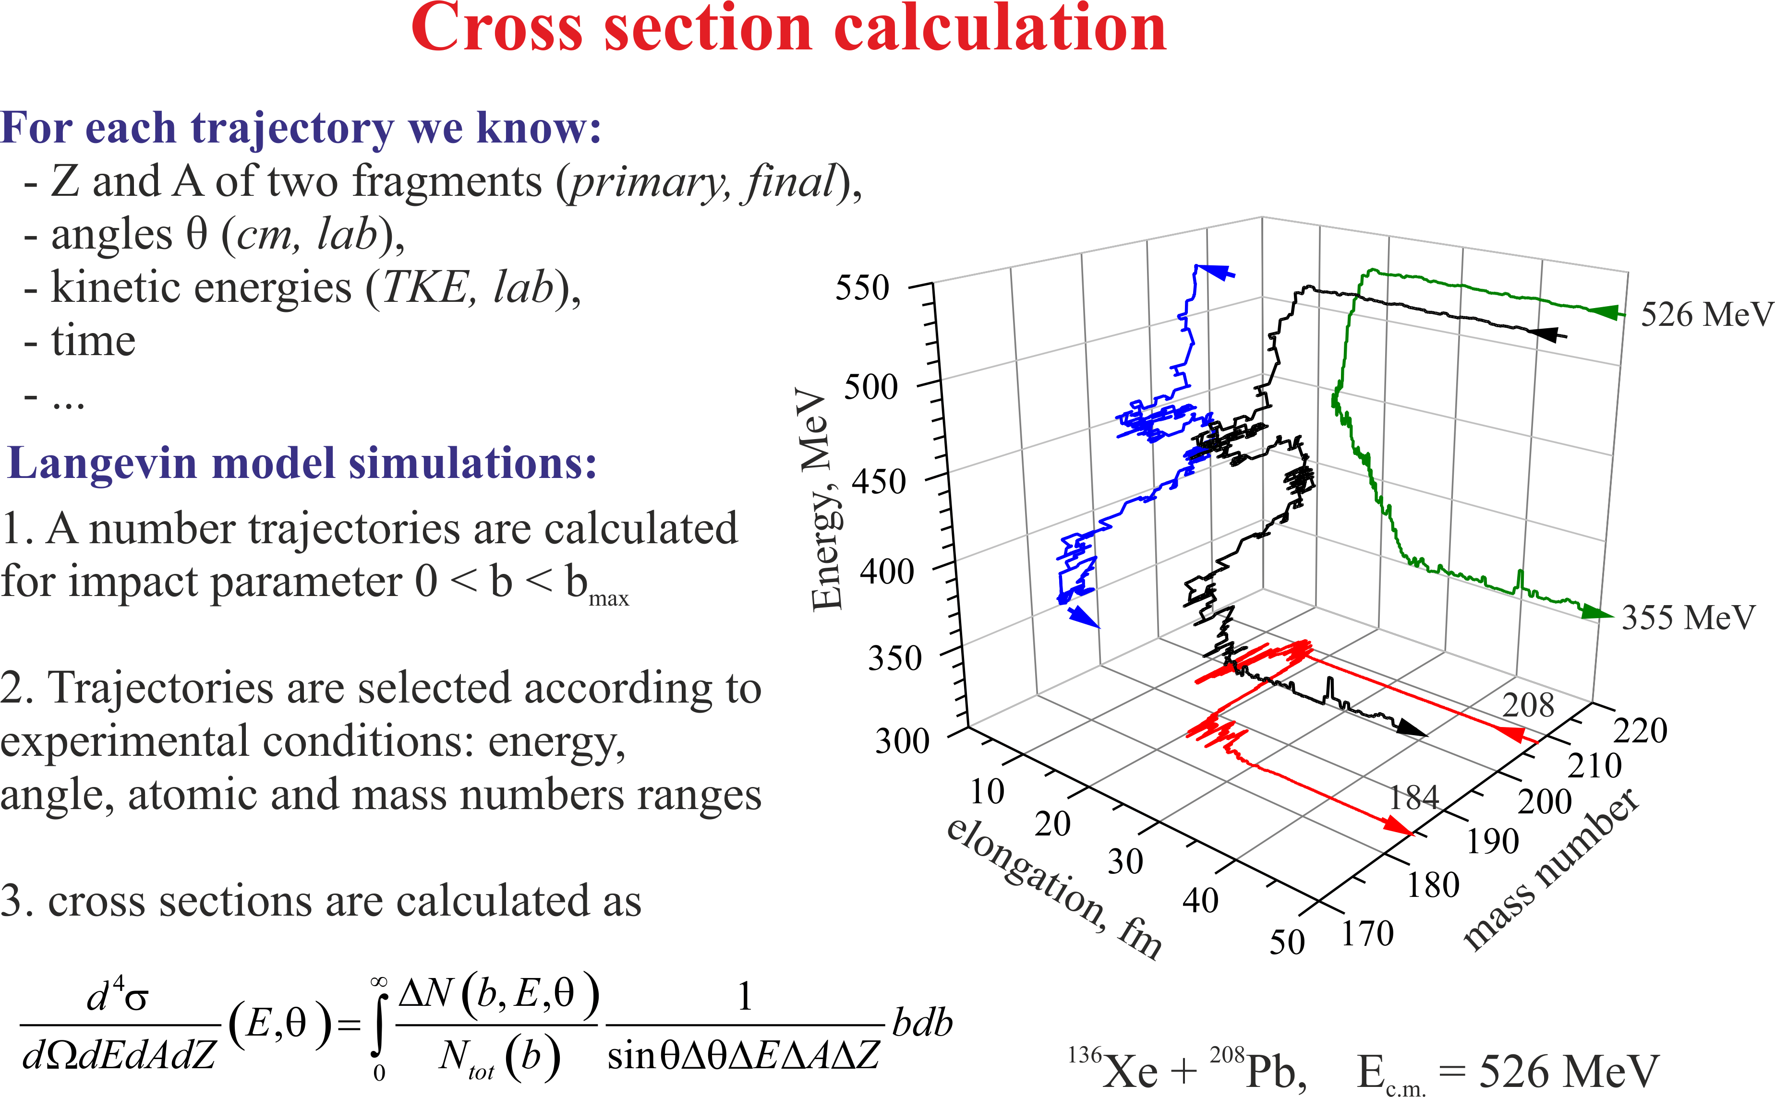

Slide 8
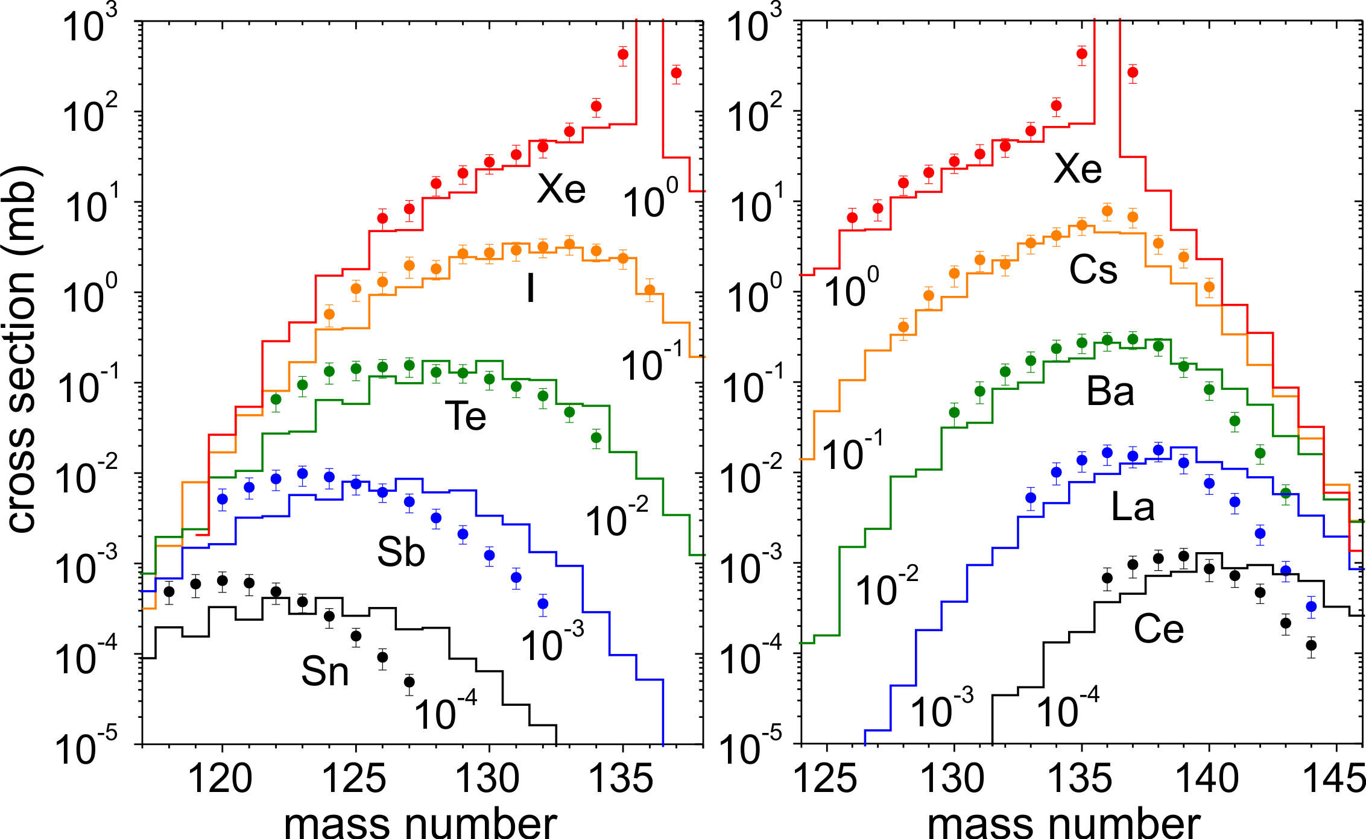
¹³⁶Xe+¹⁹⁸Pt @ 643 MeV
experiment: Y. X. Watanabe, et al., PRL (2015)

Slide 9
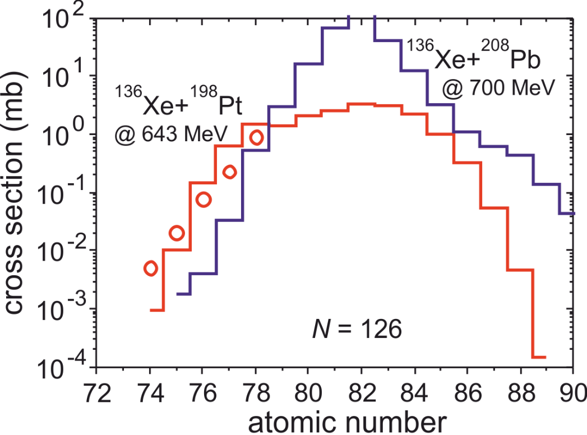
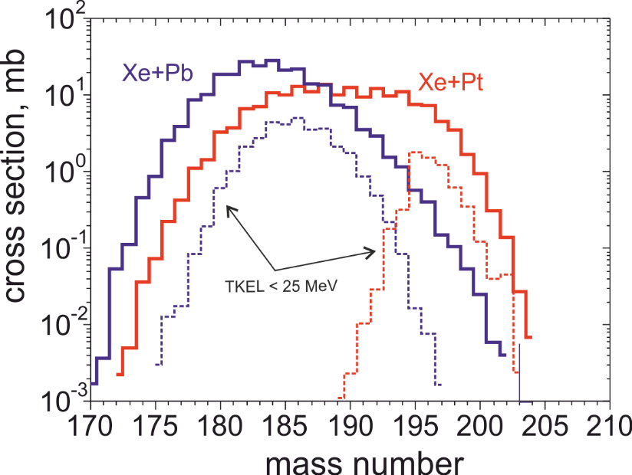
Production of N=126 nuclides
Optimal reaction
Os isotopes
experiment: Y. X. Watanabe, et al., PRL (2015)

Slide 10
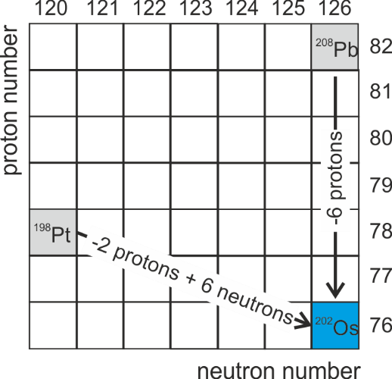
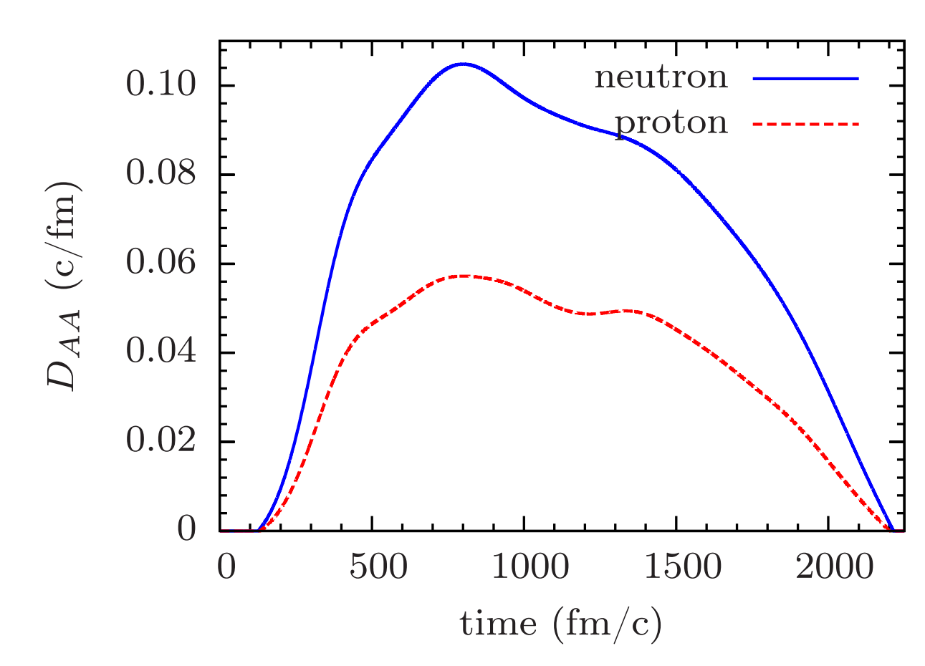
Production of N=126 nuclides
Optimal reaction
⁴⁸Ca+²³⁸U
¹³⁶Xe+²⁰⁸Pb: Q_{202Os}=-9.1 MeV
¹³⁶Xe+¹⁹⁸Pt: Q_{202Os}=-14.8 MeV
S. Ayik, B. Yilmaz, O. Yilmaz, A. S. Umar,
arXiv (2018)

Slide 11
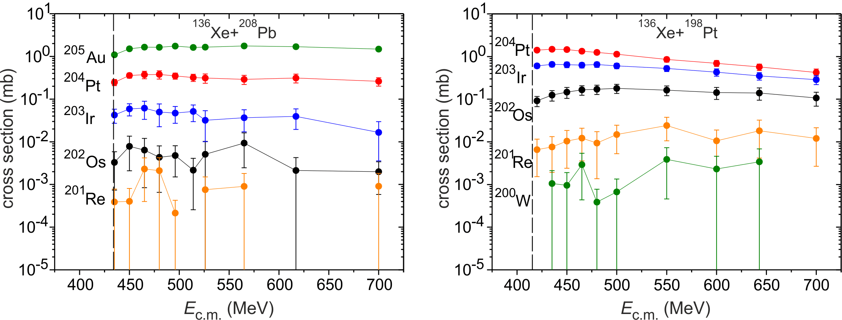
Production of N=126 nuclides
Optimal energy

Slide 12
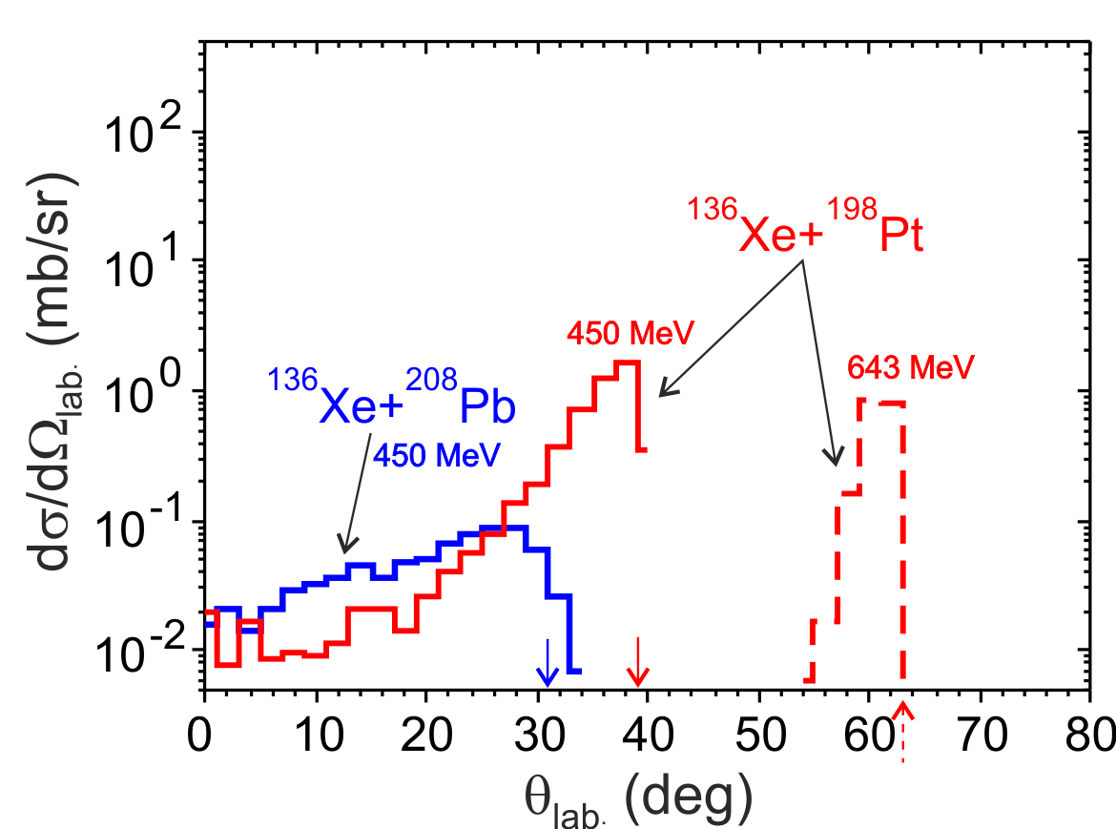
Production of N=126 nuclides
Detection angles

Slide 13
Production of neutron-rich Os-isotopes
10²
10¹
N=126
10⁰
last stable
¹³⁶Xe + ¹⁹⁸Pt
massive transfer
10⁻¹
last studied
10⁻²
Cross section, mb
10⁻³
last known
fragmentation of ²⁰⁸Pb
10⁻⁴
T. Kurtukian-Nieto et.al (2014)
10⁷
10⁻⁵
10⁻⁶
10⁻⁷
fragmentation of ²³⁸U
10⁻⁸
J. Kurcewicz et al.,(2012)
10⁻⁹
185
190
195
200
205
210
Mass number

Slide 14
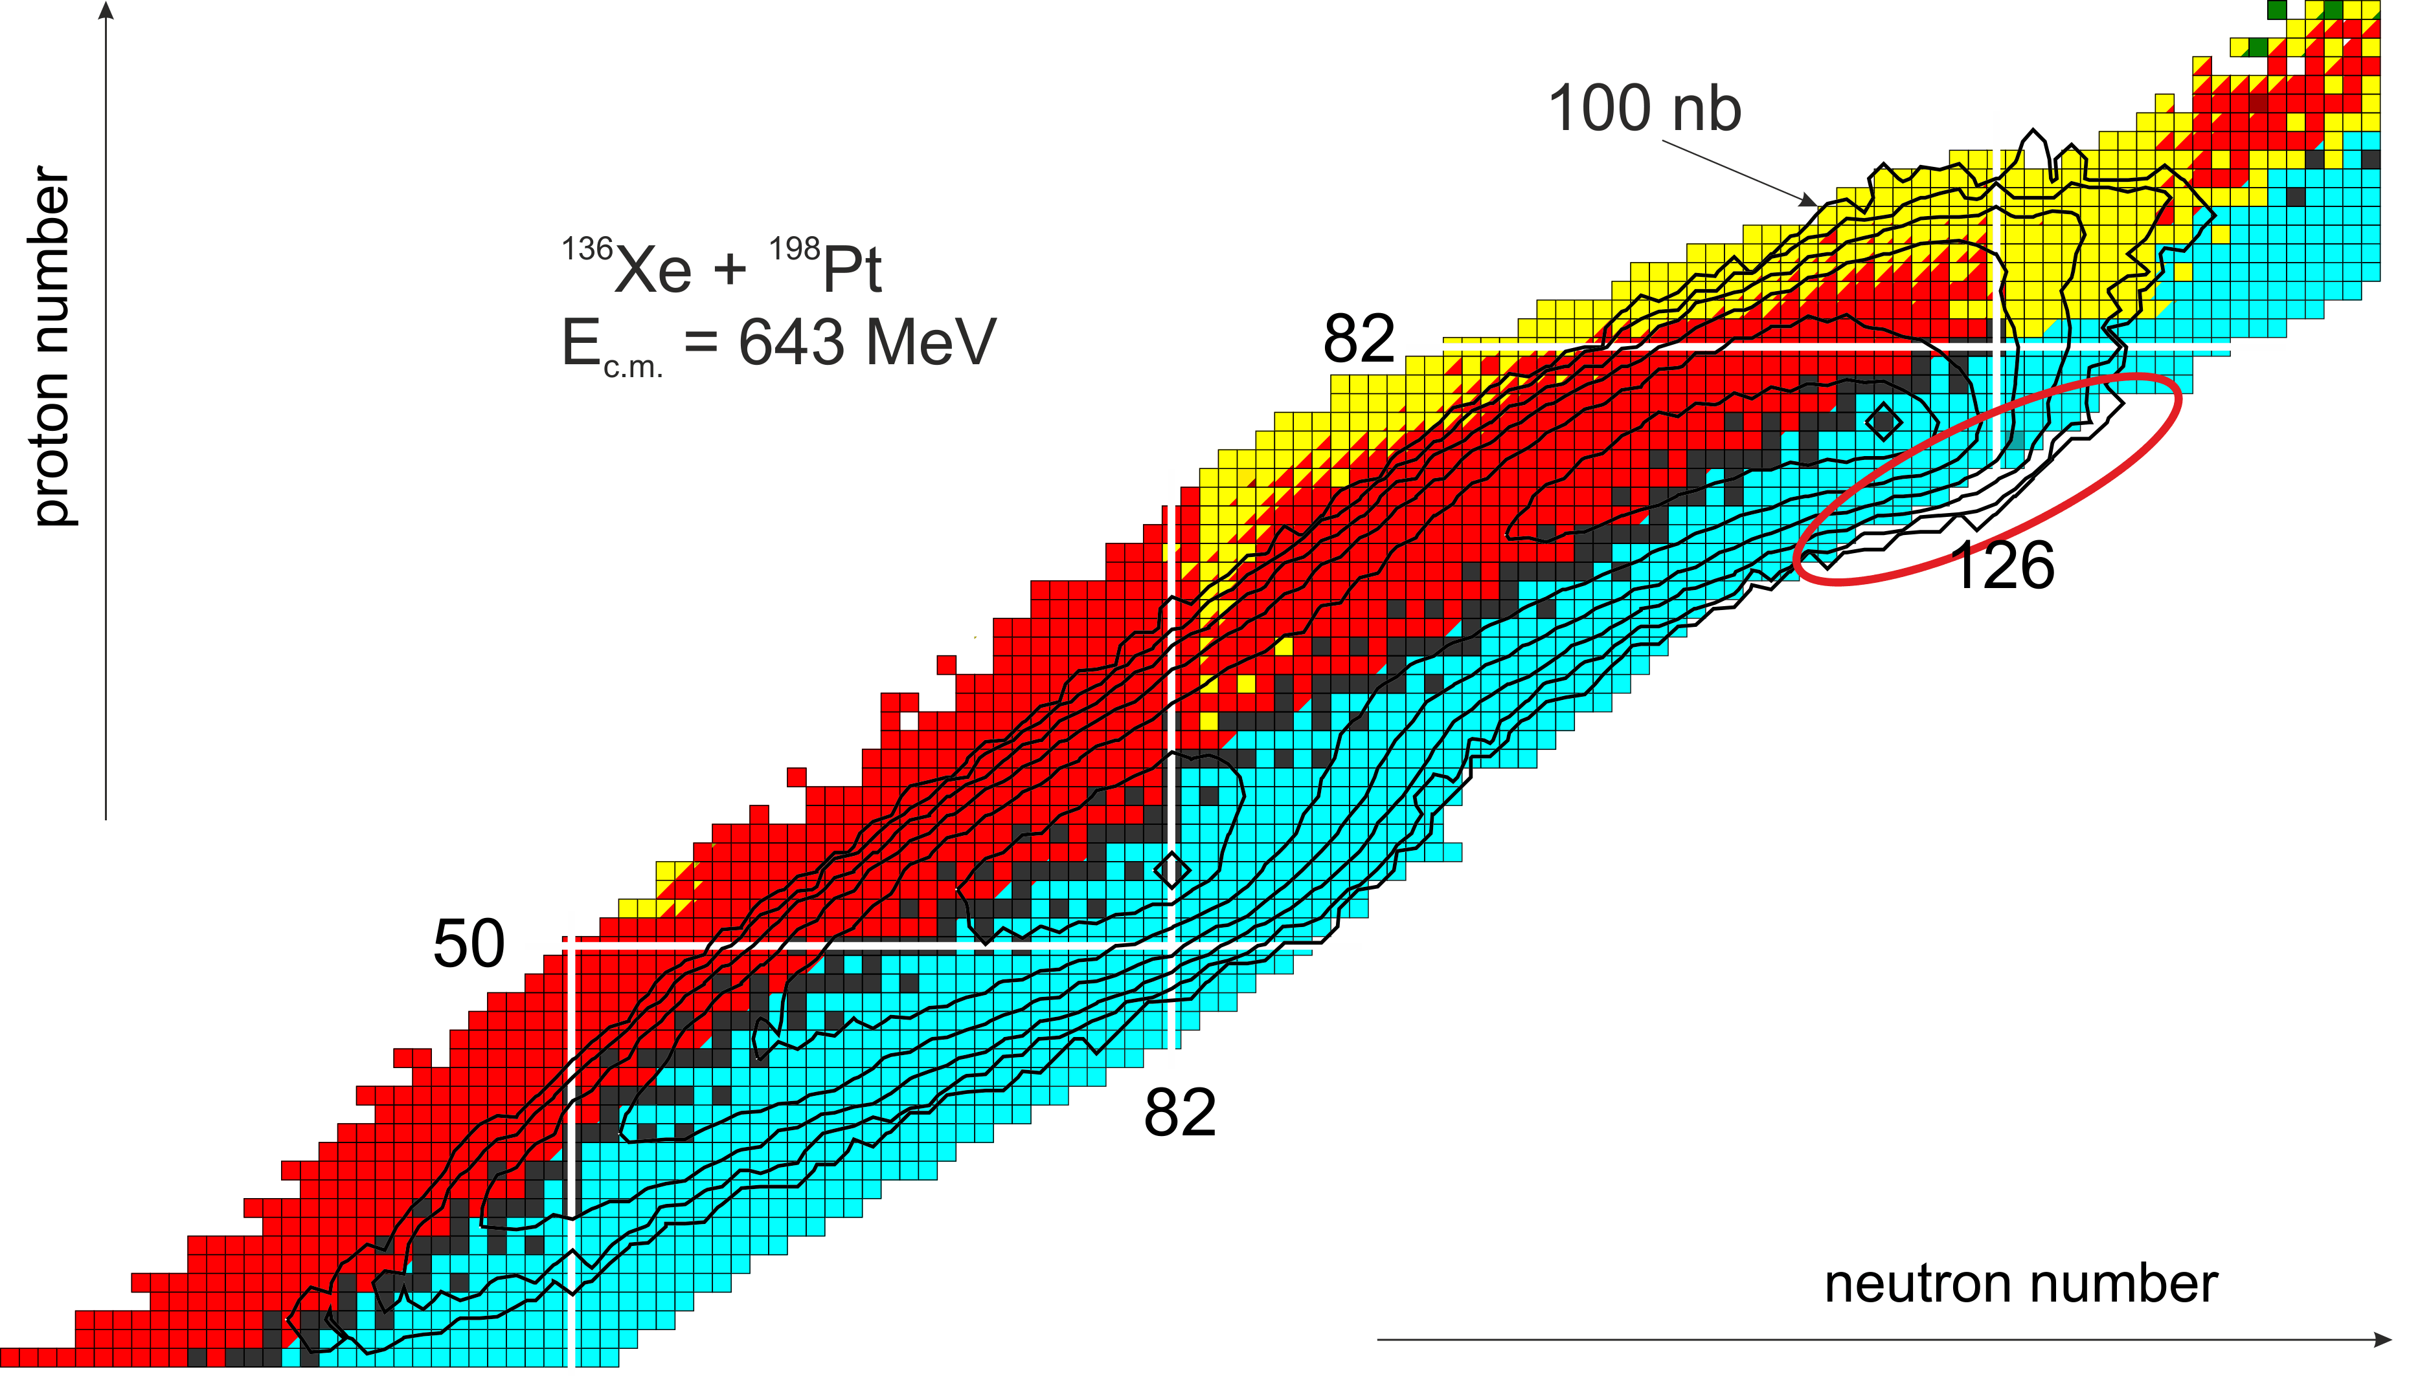
Production cross section

Slide 15
Production of neutron-rich heavy and SH nuclei in actinide-actinide collisions (U+smth.)
e.g. ²³⁸U+²⁴⁸Cm→²⁰⁸Pb*+²⁷⁸Sg*
Strong shell effects may lead to increased cross sections for formation of a Pb-like fragment as one of the reaction products and a heavy or SH fragment as another one

Slide 16
spherical nuclei at g.s.
Orientation effects in nucleus-nucleus collisions
statically deformed nuclei

Slide 17
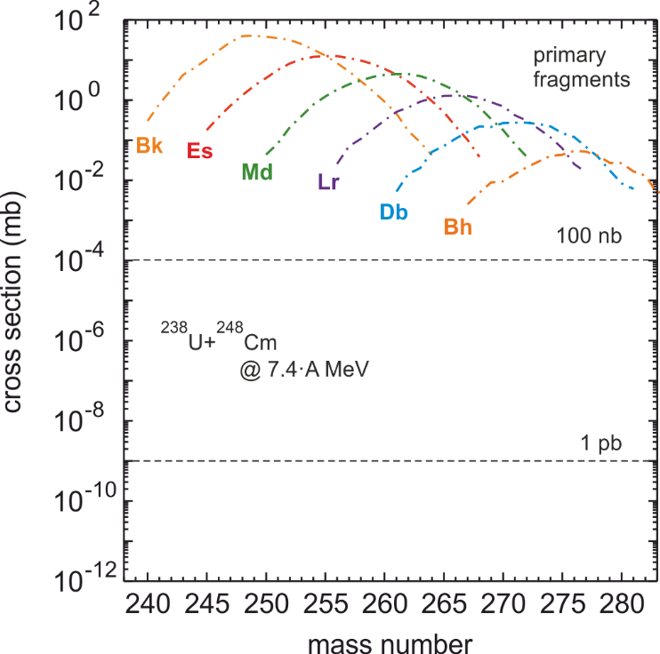
Collisions of actinides. A way to superheavies?
large production cross sections for
primary reaction products
²⁹⁸114* (double magic) can be produced with the cross section ~10-100 nb

Slide 18
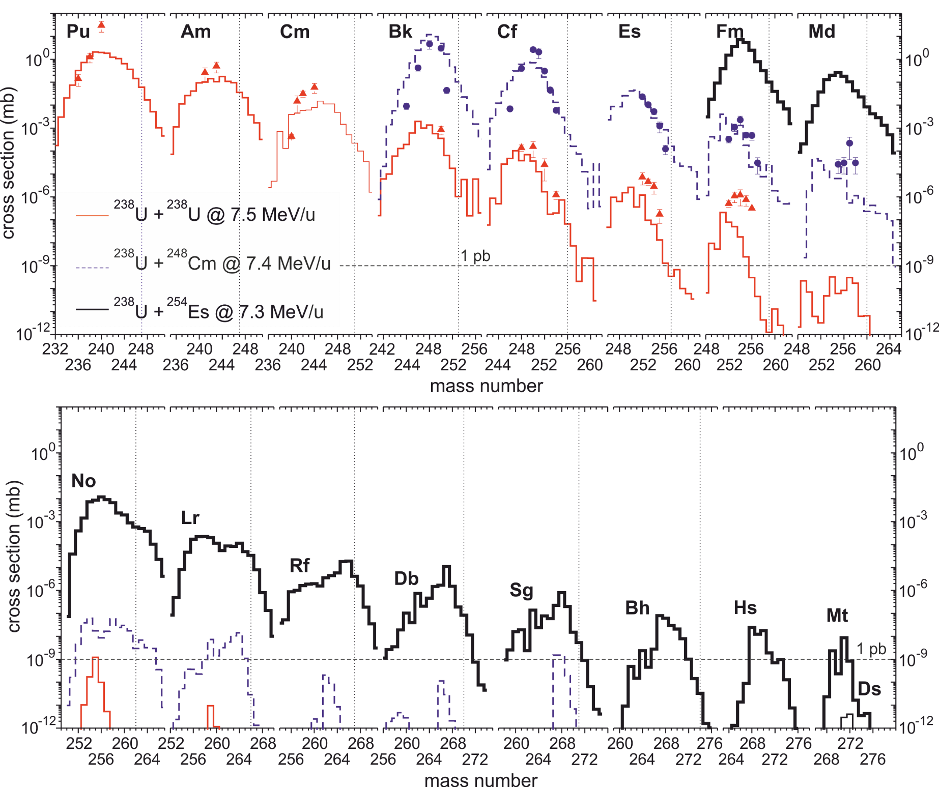
Collisions of actinides. A way to superheavies?
exp: M. Schädel et al.,
PRL (1978), (1982)

Slide 19
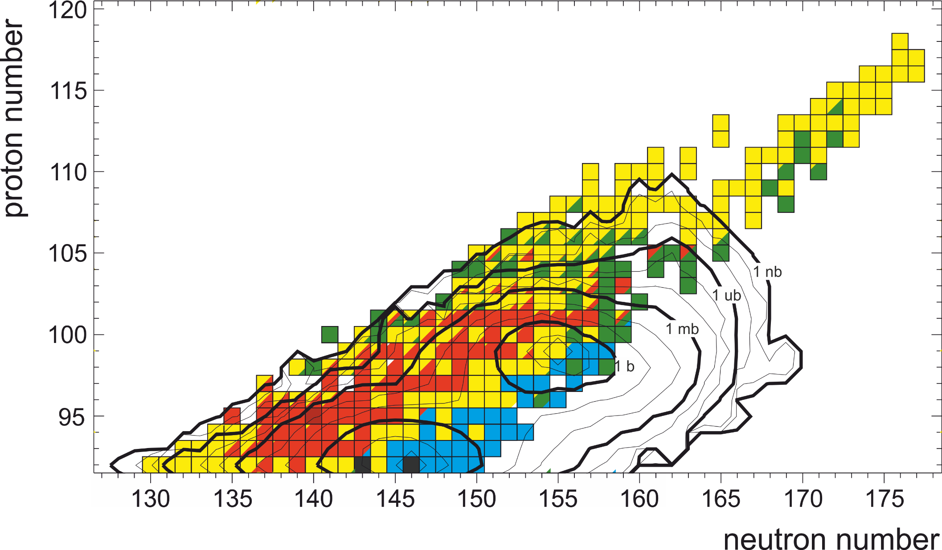
Collisions of actinides: ²³⁸U+²⁵⁴Es
²³⁸U+²⁵⁴Es @ 7.3 A∙MeV

Slide 20
Conclusions and Outlook
PRODUCTION OF NEUTRON-RICH HEAVY NUCLEI (N=126)
Large cross sections (>100 nb) for yet-unknown nuclei. Weak energy dependence of the production cross sections of neutron-rich nuclei, but strong sensitivity of the angular distributions to the collision energy.
PRODUCTION OF SH NUCLEI IN COLLISIONS OF ACTINIDES
Production cross sections drop down very quickly with increasing nucleon transfer due to small survival probabilities. One should use the heaviest available target (²⁵⁴Es, e.g.) to increase the production cross section of heaviest nuclei. There is a real chance to produce new isotopes of heavy actinides.
A.V. Karpov and V.V. Saiko, Phys. Rev. C 96, 024618 (2017)
Co-author: Vyacheslav Saiko

