Slide 1




The 12th BLTP-APCTP JINR Joint Workshop
Modern Problems in Nuclear and Elementary Particle Physics
August 20 - 24, 2018
Probing High Momentum Protons and Neutrons in Asymmetric Nuclei
Wooyoung KIM
Notes:
I-1

Slide 2

Short-Range Nucleon-Nucleon Correlations
Investigated with the Reaction
QE electron scattering experiments : mean-field theories can only partly describe the properties of nucleons bound in a nuclear system.
The depletion of the occupancy of various shells observed : a considerable fraction of the spectroscopic strength is located at large missing energy, caused by short-range nucleon-nucleon correlations.
A direct way to investigate SRC in nuclei is offered by the two-nucleon knockout reaction
.
Notes:
A-1

Slide 3
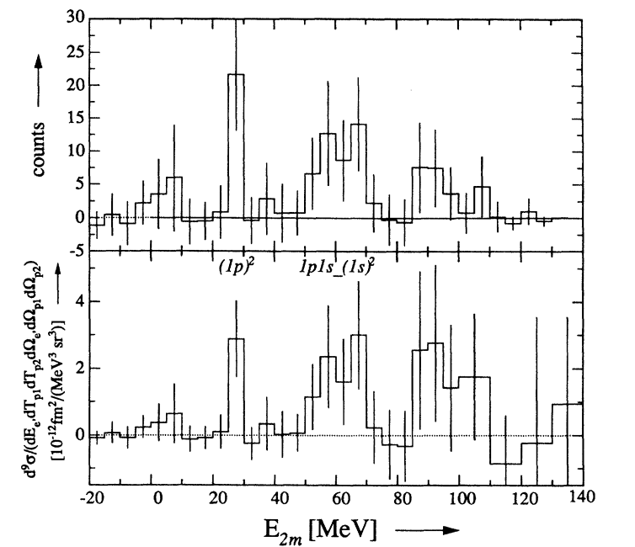

Measured Cross Section for the Knockout of a ${\left(1p\right)}^{2}$ Pair
Attributed to Short-range Nucleon-Nucleon Correlations.
Total number of triple coincidence as a ftn of double missing energy
Data corrected for radiative effects.
L.J.H.M Kester, W. KIM, et al. Phys. Rev. Lett 74, 10 (1995)
Notes:
A-2 (Delete Figure caption on image file.) Add main author and W. KIM Phys rev. 1995 (Below)

Slide 4
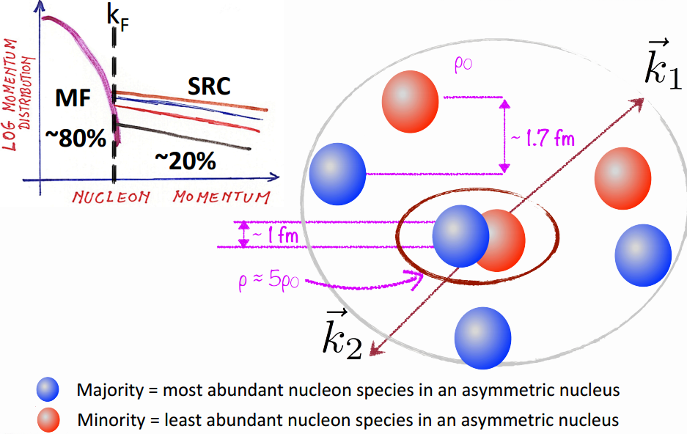
SRC-101
Notes:
Reynier Cruz Torres (Page 2)

Slide 5
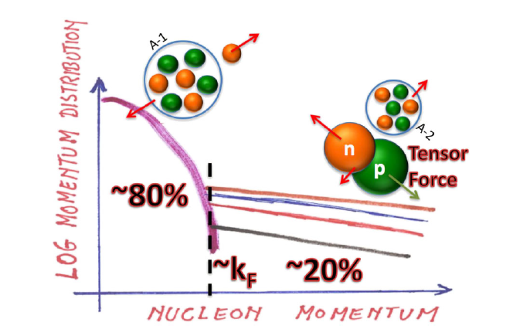
Dominant Features of the Nucleon Momentum Distribution in Nuclei
MF
SRC
O. Hen, G. Miler et al., Rev Mod. Phys. 89 (2017)
Notes:
I-3

Slide 6
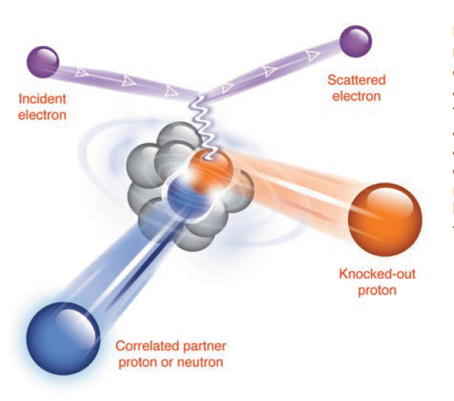
Probing Cold Dense Nuclear Matter
R. Subedi et al.. Hall A Science 320, 147 (2008)
The difference between the types of pairs:
due to the nature of the strong force
implications for understanding cold dense nuclear systems such as neutron stars.
Notes:
B-1

Slide 7

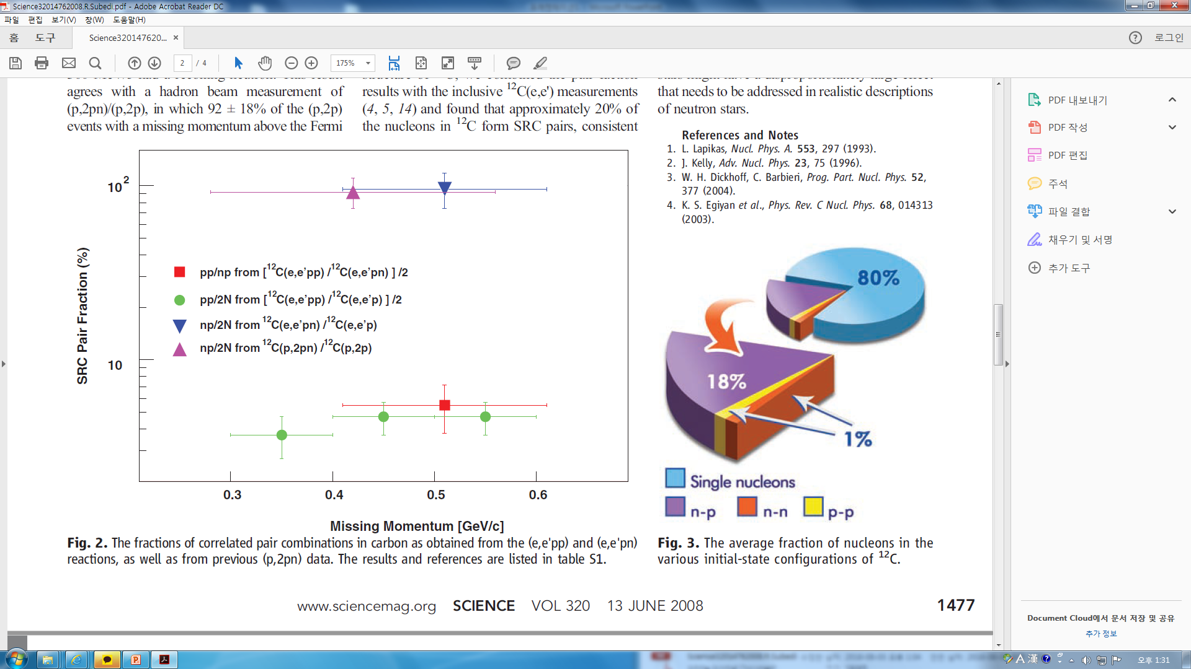
  Average Fraction of Nucleons in the Various Initial-State Configurations of
In , the n-p pairs are nearly 20 times as prevalent as p-p pairs and, by inference, n-n pairs.
Notes:
B-2

Slide 8
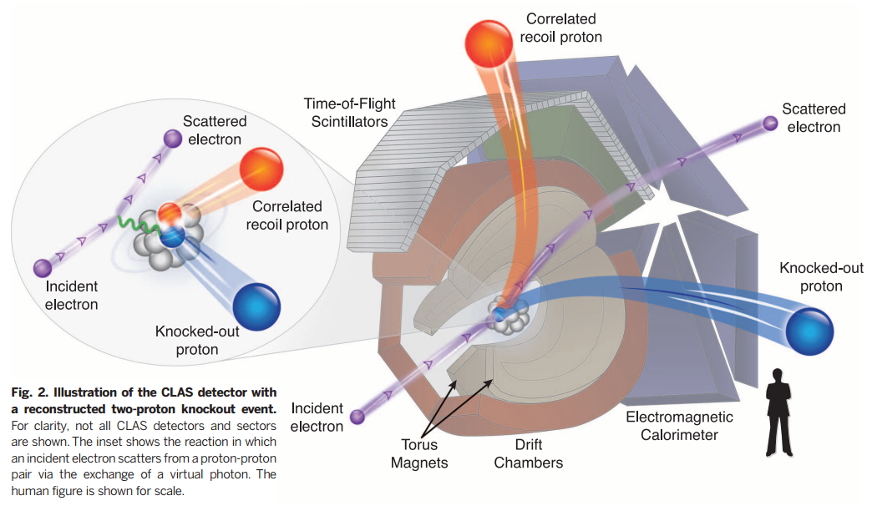
Momentum sharing in imbalanced Fermi systems
CLAS:
Nuclear Physics
Hadron Spectroscopy
Deep Process

Slide 9
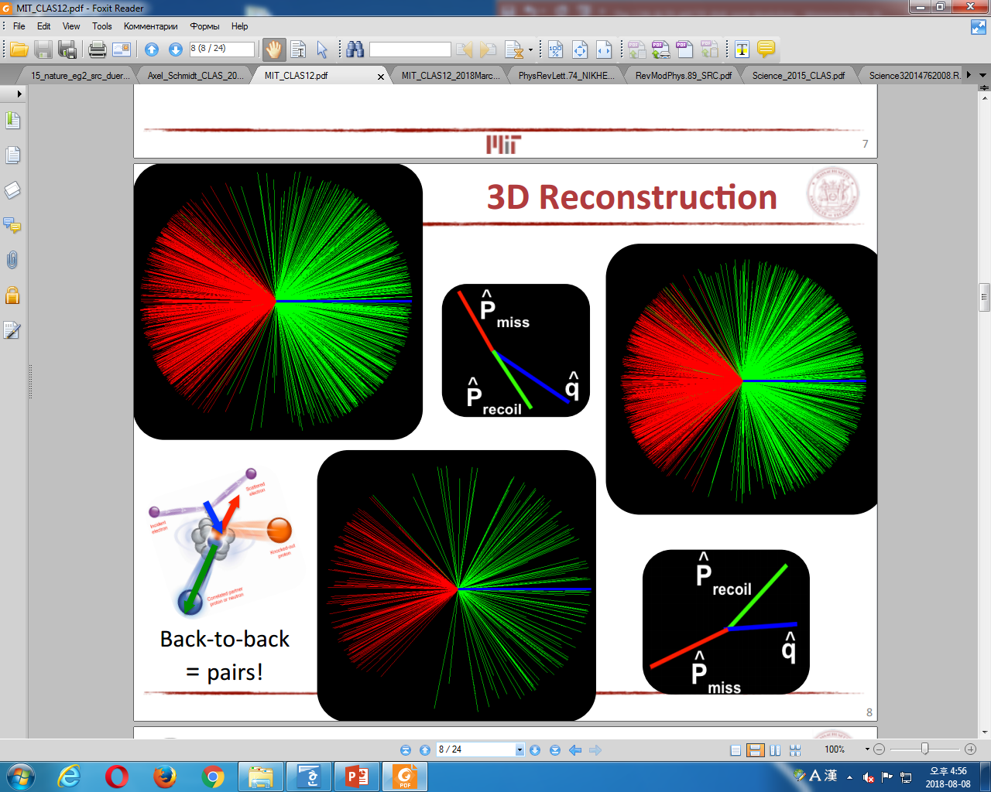
3D Reconstruction
Notes:
MIT copy slide 8

Slide 10
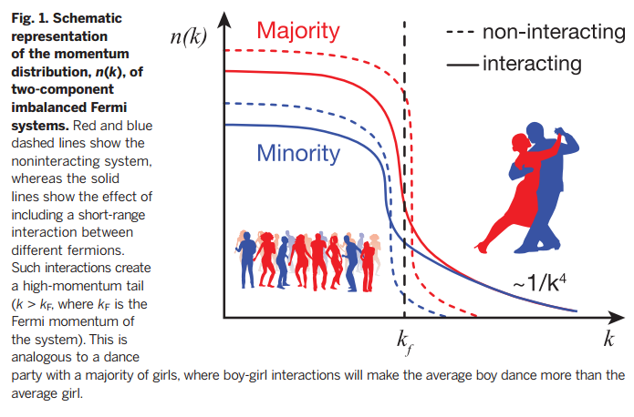
Momentum sharing in imbalanced Fermi systems

Slide 11
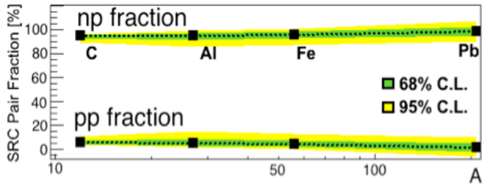
np-SRC pair dominance in heavy nuclei
O. Hen et al. (CLAS Collaboration),
Science 346, 614 (2014)
Notes:
MIT copy slide 9

Slide 12
np-SRC Pair Dominance in Heavy Nuclei
If the protons and neutrons did not interact, the Pauli exclusion principle would force the majority of fermions (n) to have a higher average momentum.
Even in heavy, neutron-rich nuclei, short-range interactions between the fermions form correlated high-momentum n-p pairs.
In neutron-rich nuclei, protons have a greater probability than neutrons to have momentum greater than the Fermi momentum
Implications ranging from nuclear few-body systems to neutron stars.

Slide 13
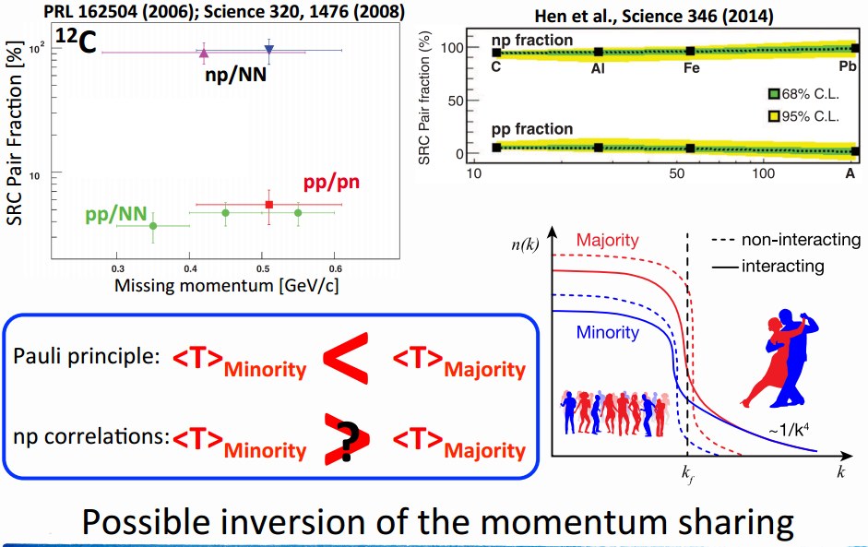
np-dominance and asymmetric nuclei
Notes:
Reynier Cruz Torres (Page 3)

Slide 14
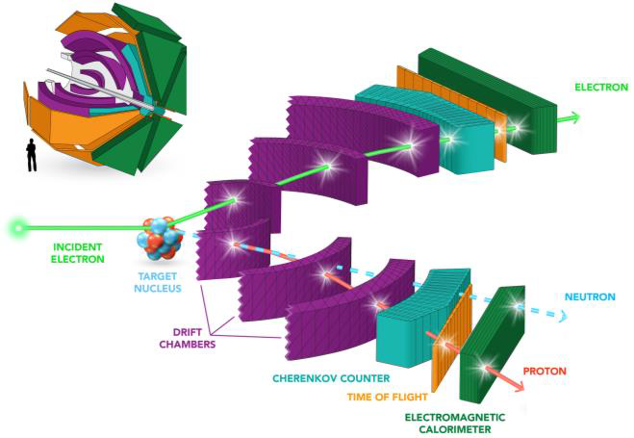
Probing High Momentum Protons and Neutrons in Asymmetric Nuclei
Notes:
D-1

Slide 15
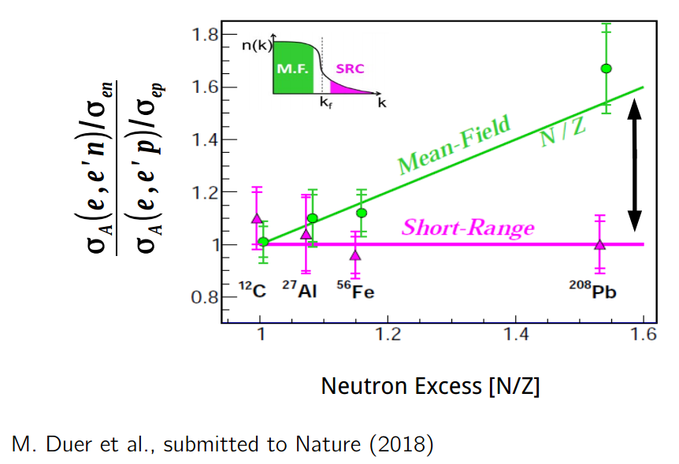
Short-range correlated pairs prefer to be np
Neutron correlation probability saturate in neutron-rich nuclei while proton probabilities grow
M. Duer et al.,(CLAS Collboration) Nature Aug. 30, 2018
Notes:
Reformat Text

Slide 16
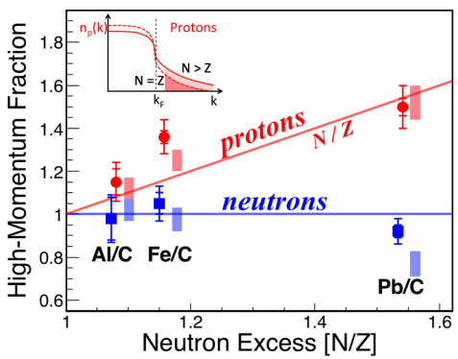
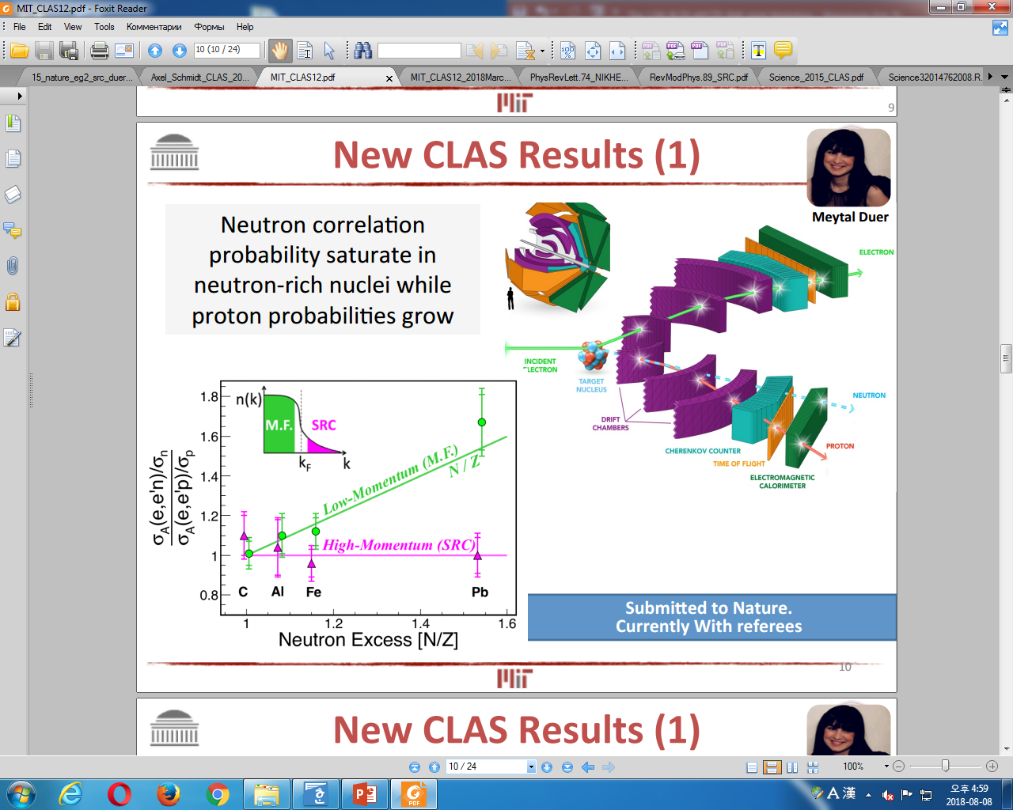
Minority Moves Faster than Majority
in Heavy Nuclei
Notes:
MIT Copy slide 11 + Modify in future (8-14)

Slide 17
Probing High Momentum Protons and Neutrons in Asymmetric Nuclei
This ‘high-momentum tail’ is predominantly due to close-proximity neutron-proton (np) pairs that interact via a strong short-range force.
The fraction of high-momentum protons increases dramatically with the neutron excess, while the fraction of high-momentum neutrons decreases slightly.
Protons move faster than neutrons in neutron-rich nuclei, an effect that we call momentum-sharing inversion.

Slide 18
Probing High Momentum Protons and Neutrons in Asymmetric Nuclei
Surprising, since in the nuclear shell model protons and neutrons obey Fermi statistics and independently fill energy shells.
Need to understand the nature of the high-momentum distribution in asymmetric nuclei to study systems such as neutron stars and the modification of the internal structure of nucleons bound in nuclei.

Slide 19
Back Up Slides

Slide 20
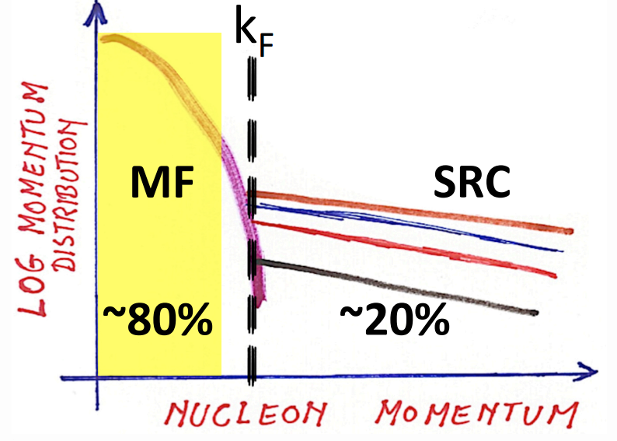
Identifying M.F. QE events
Notes:
Reynier Cruz Torres (Page 5)

Slide 21
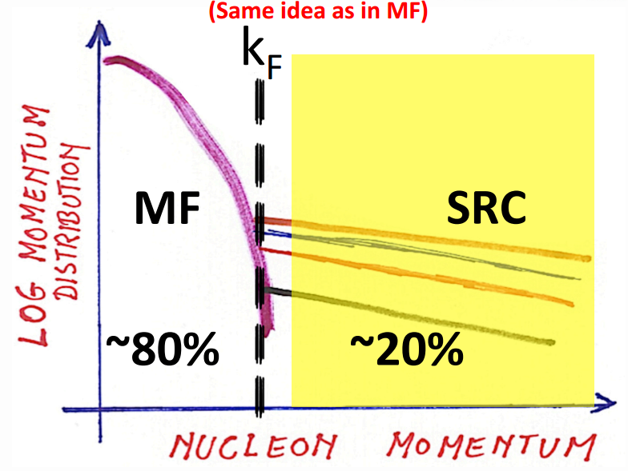
Identifying SRC QE events
Notes:
Reynier Cruz Torres (Page 12)

Slide 22

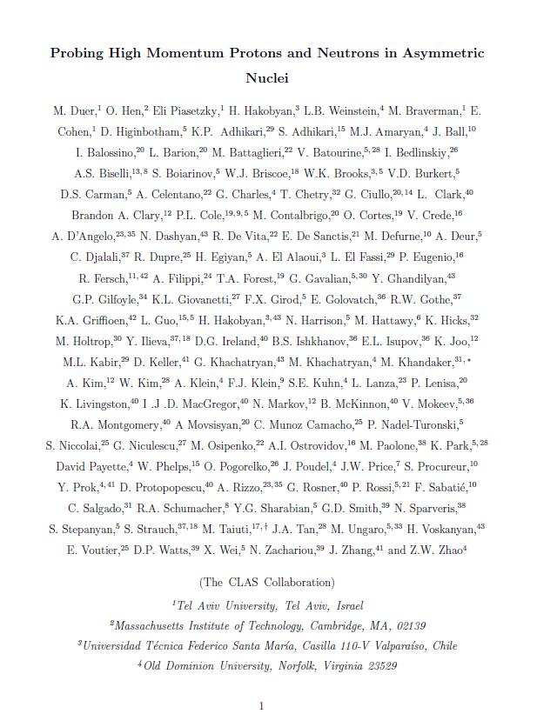

Introduction/SRC
SRC
Notes:
I-2

Slide 23
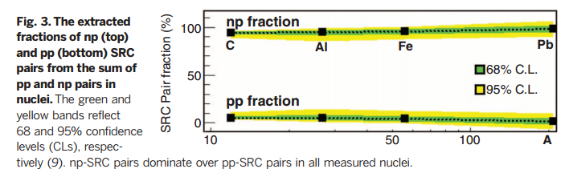
Momentum sharing in imbalanced Fermi systems (Fig. 3)

Slide 24
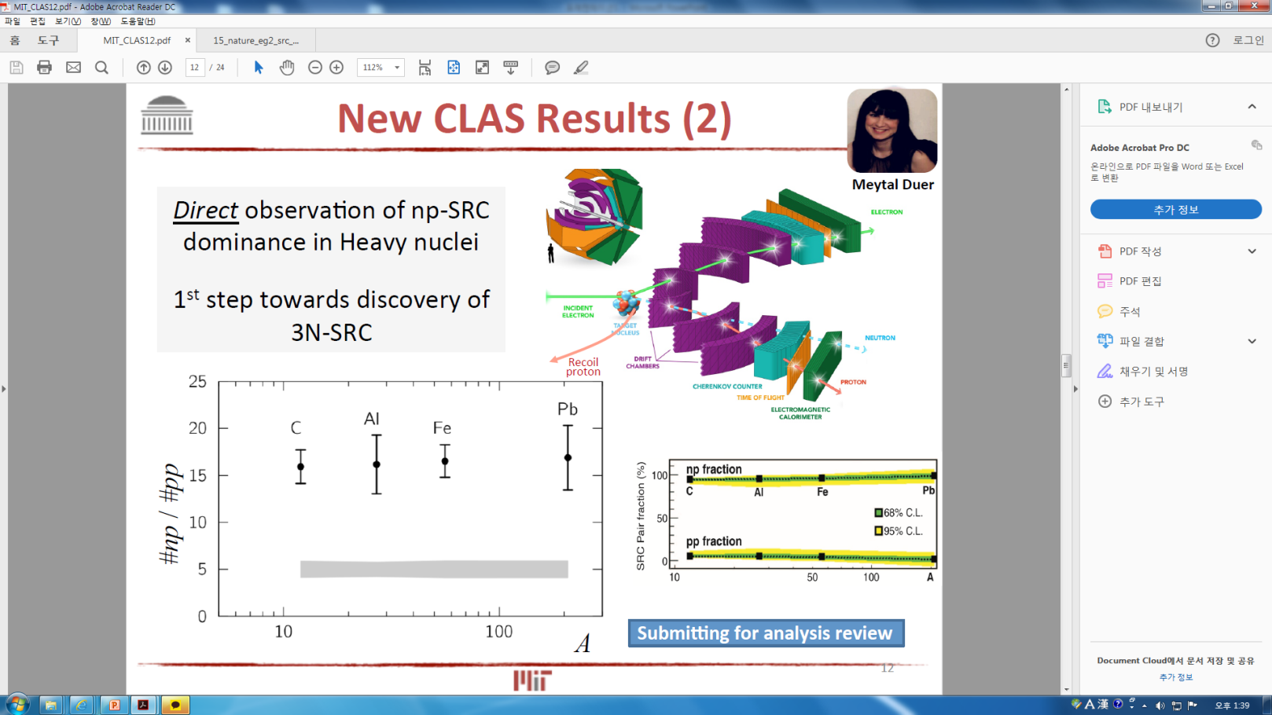

Short-range Correlated Pairs Prefer to be np
MIT PPT (Page 12)
Notes:
D-4

Slide 25
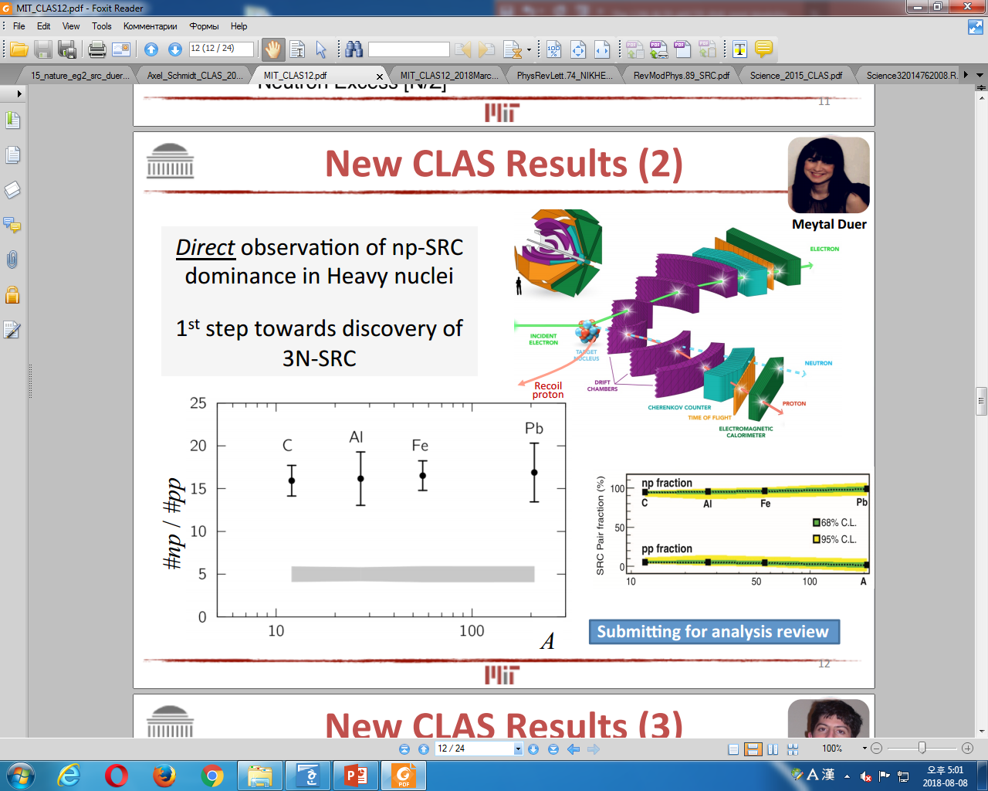
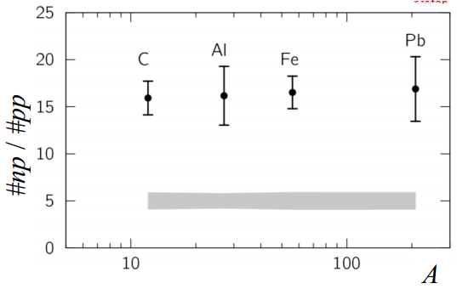
New CLAS Results (2)
Notes:
MIT copy slide 12

Slide 26
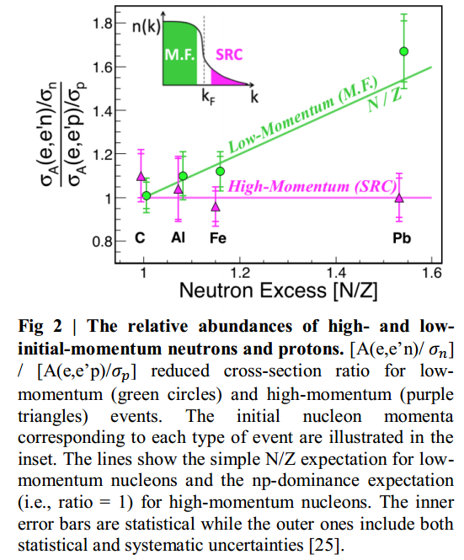
Probing High Momentum Protons and Neutrons in Asymmetric Nuclei (Fig. 2)

Slide 27
New CLAS Results (1)
Notes:
MIT Copy slide 10

Slide 28
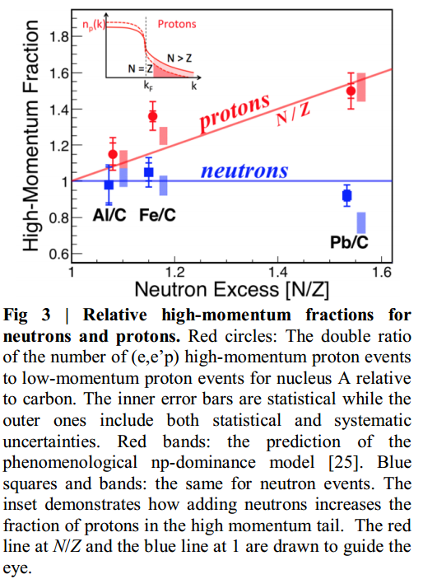
Probing High Momentum Protons and Neutrons in Asymmetric Nuclei (Fig. 3)

Slide 29
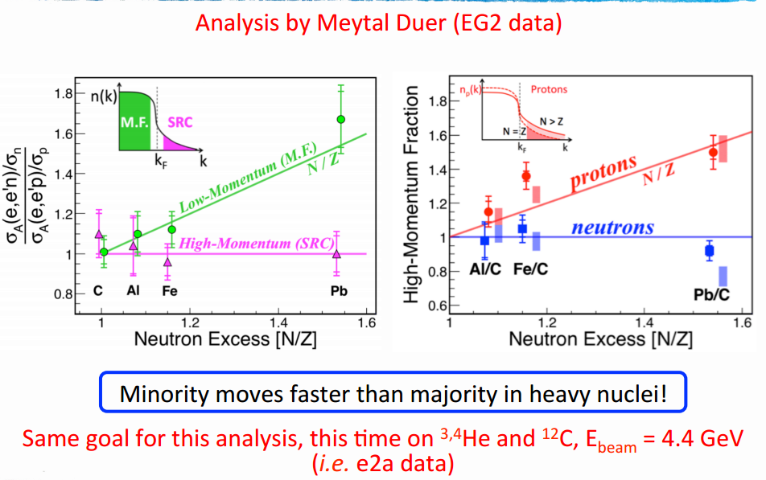
Results in Heavy Nuclei
Notes:
Reynier Cruz Torres (Page 4)

Slide 30
Electron scattering experiments demonstrate that about 20% of the nucleons in nuclei have momentum greater than the nuclear Fermi momentum, kF.
This ‘high-momentum tail’ is predominantly due to close-proximity neutron-proton (np) pairs that interact via a strong short-range force.

Slide 31
Measured protons and, for the first time, neutrons knocked out of medium to heavy nuclei by high-energy electrons.
The fraction of high-momentum protons increases dramatically with the neutron excess, while the fraction of high-momentum neutrons decreases slightly.
Protons move faster than neutrons in neutron-rich nuclei, an effect that we call momentum-sharing inversion.

Slide 32
Surprising, since in the nuclear shell model protons and neutrons obey Fermi statistics and independently fill energy shells.
Need to understand the nature of the high-momentum distribution in asymmetric nuclei to study systems such as neutron stars and the modification of the internal structure of nucleons bound in nuclei. In particular, the neutron excess in neutron stars should dramatically increase the average momentum of the protons, which could have significant implications for their cooling rate and equation of state.

