Slide 1
Toy Model for Nuclei
APCTP+BLTP Joint Workshop
Ghi Ryang Shin
Andong National University
Aug. 20, 2018

Slide 2
Warning !
Very simple Toy Model
Almost like the class project for Classical Mechanics
Have done by many people and well-known
Please Sit back and Relax

Slide 3
1. Motivation
I want to see the dynamics of N nucleon system with the nuclear potential
I do not care the relativity nor Quantum Mechanics at this moment so I will completely ignore those effects
Hope to find stable systems with internal motions
Hope to apply to low energy scattering, especially to RAON

Slide 4
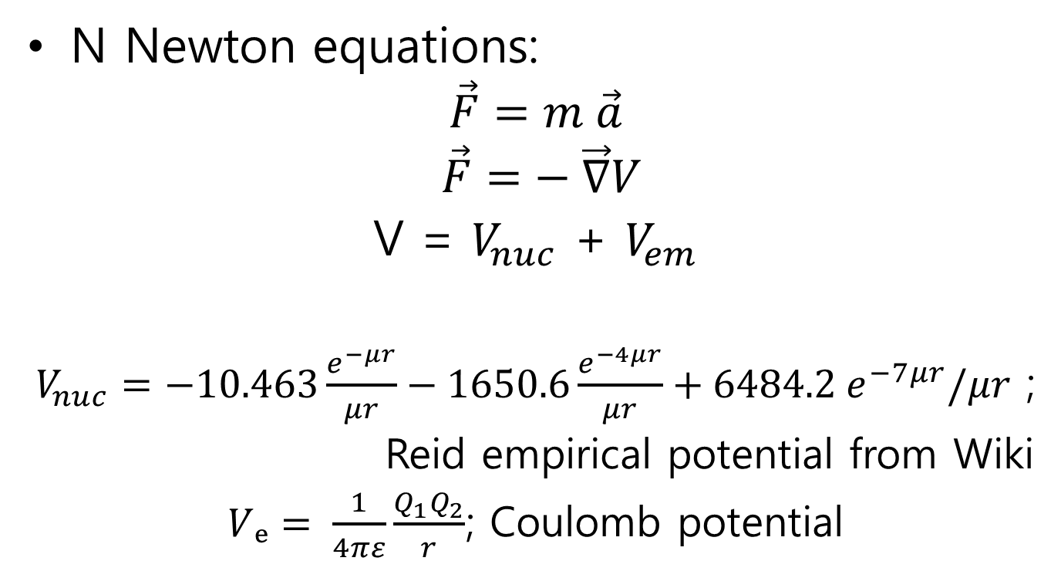
2. Equations of Motion
N Newton equations:
$$\vec{F}=m \vec{a}$$
$$\vec{F}=− \vec{∇}V$$
V = $V_{nuc}$ + $V_{em}$
$V_{nuc}=−10.463\frac{e^{−μr}}{μr}−1650.6\frac{e^{−4μr}}{μr}+6484.2 e^{−7μr}/μr$ ;
Reid empirical potential from Wiki
$Vₑ= \frac{1}{4πε}\frac{Q_{1}Q_{2}}{r}$; Coulomb potential

Slide 5
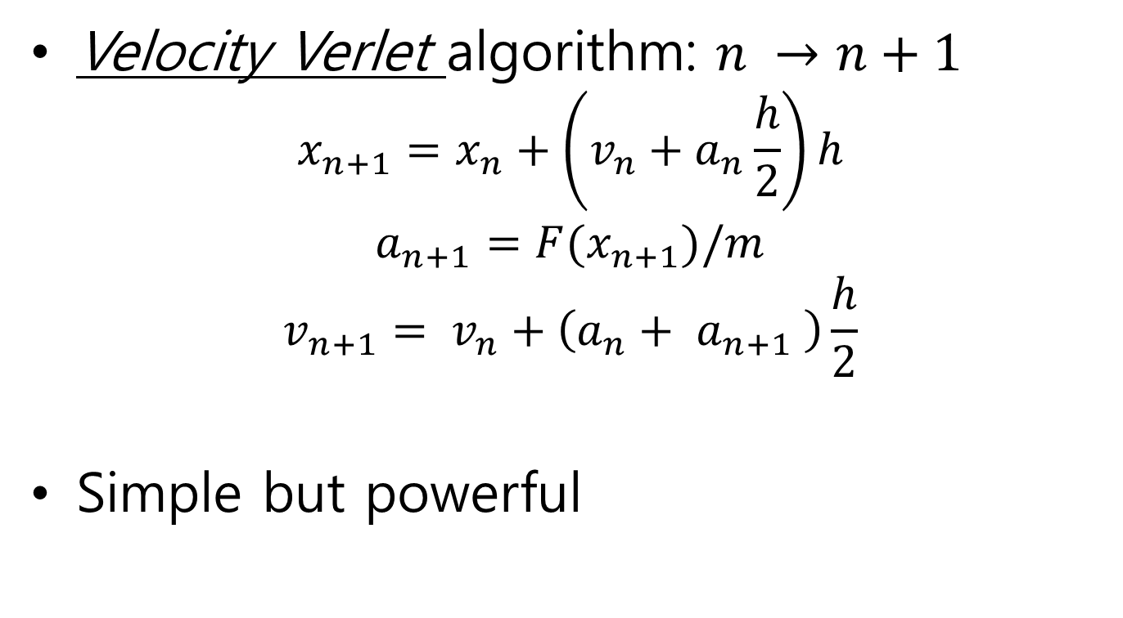
3. Integration(solving) Method
Velocity Verlet algorithm: $n →n+1$
$$x_{n+1}=x_{n}+\left(v_{n}+a_{n}\frac{h}{2}\right)h$$
$$a_{n+1}=F(x_{n+1})/m$$
$$v_{n+1}= v_{n}+\left(a_{n}+ a_{n+1} \right)\frac{h}{2}$$
Simple but powerful

Slide 6
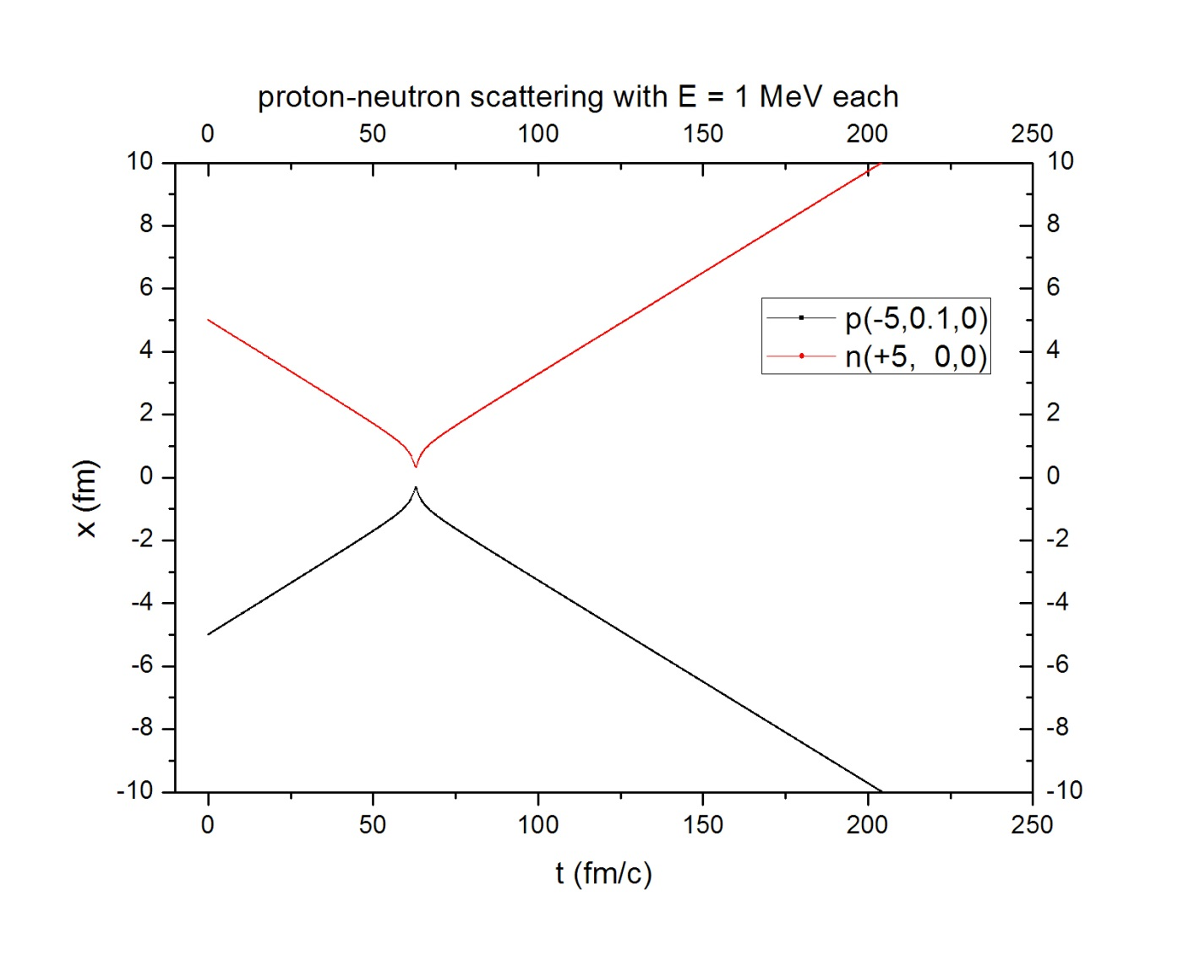
4. Some Results(NOT CONCLUSIONS)
1) Two nucleon scattering:

Slide 7
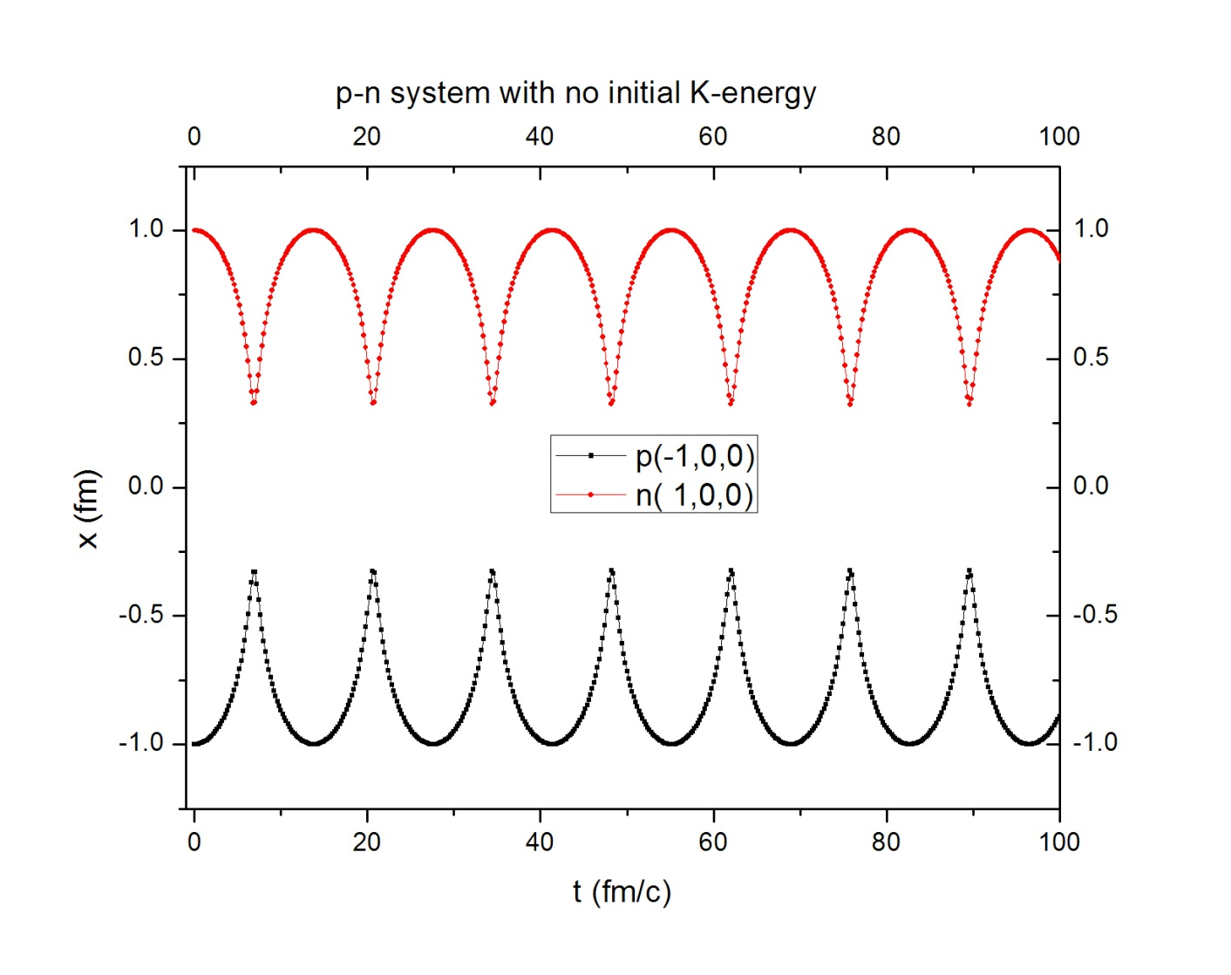
2) p-n system:

Slide 8
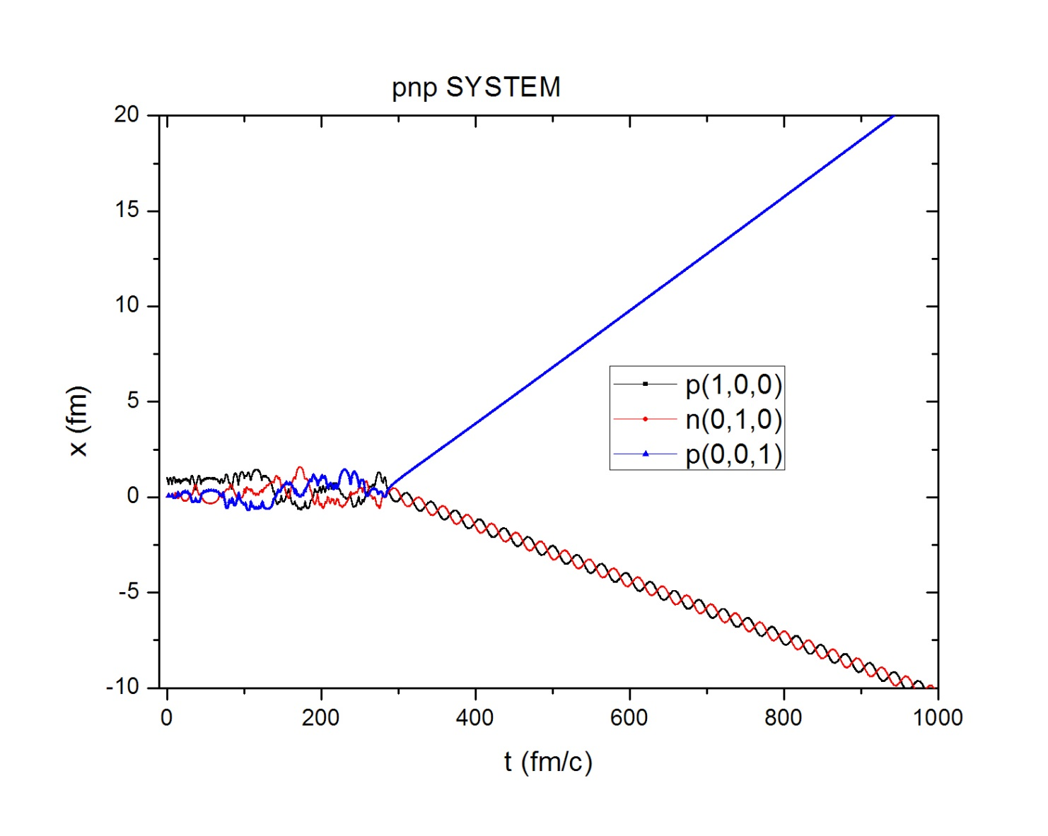
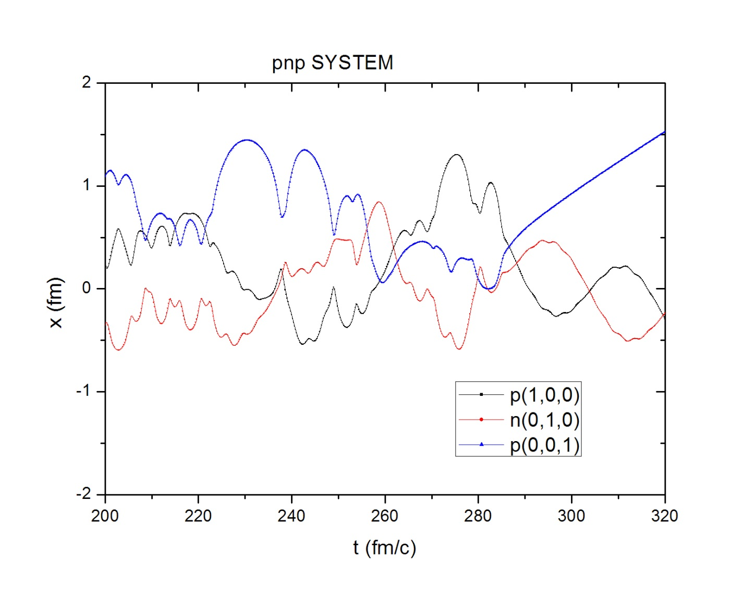
3) 2p-n system:

Slide 9
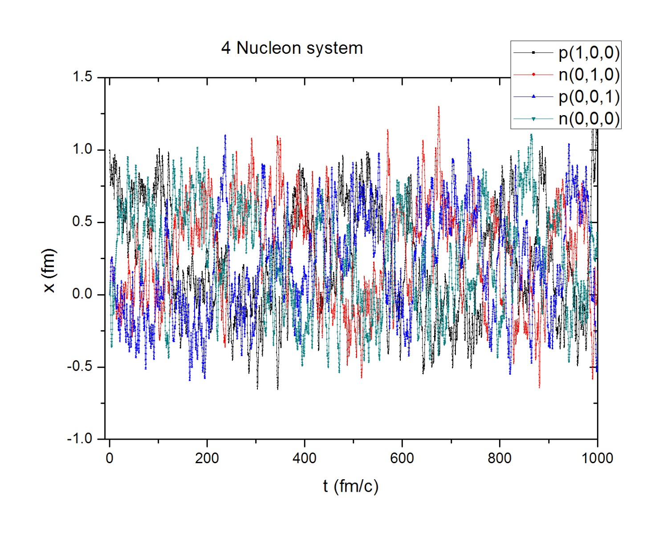
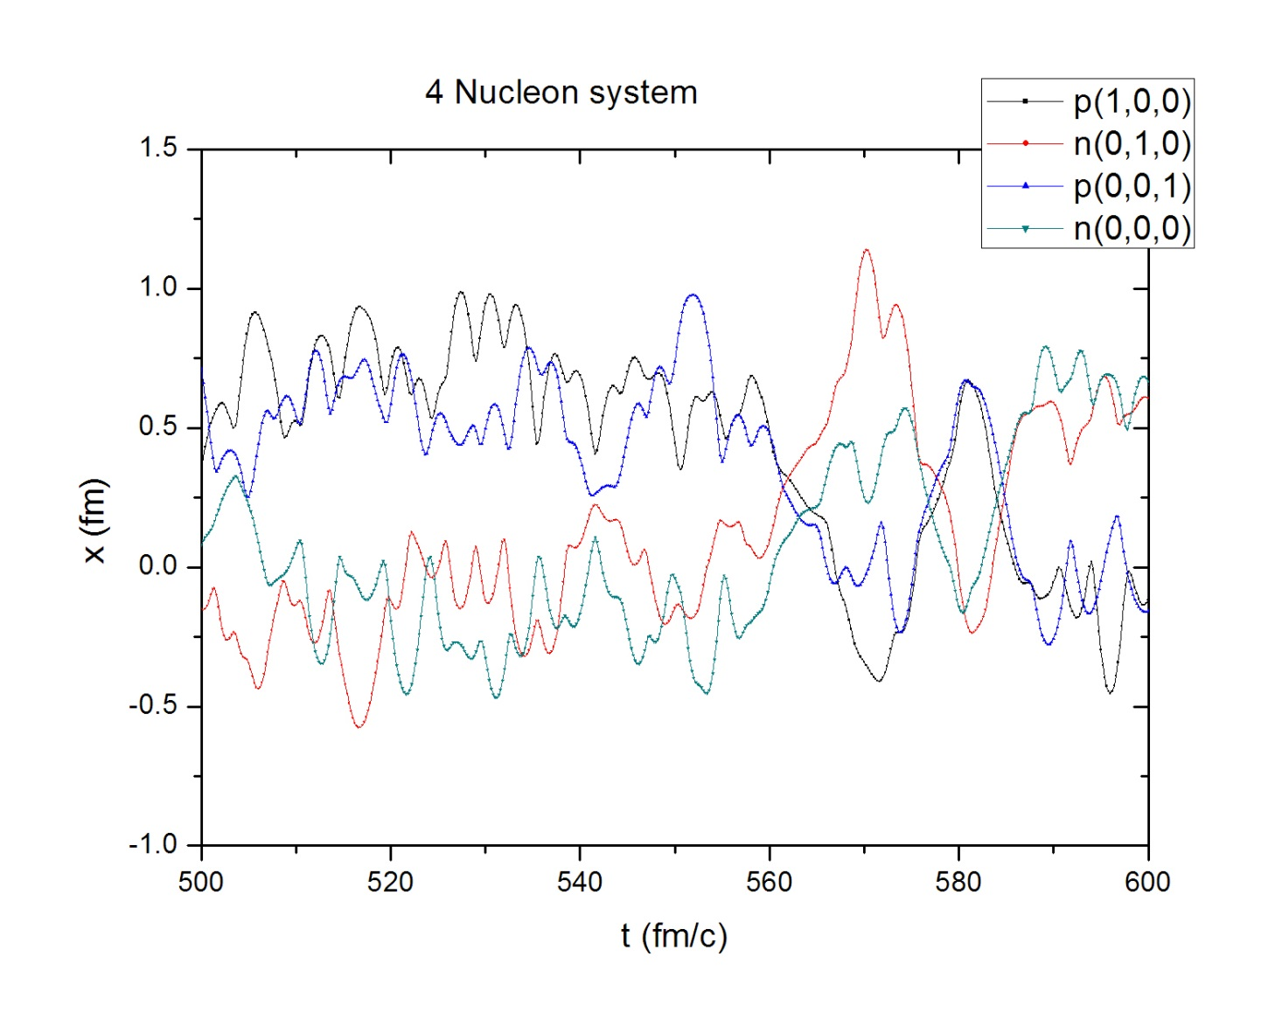
4) 2p+2n system:

Slide 10
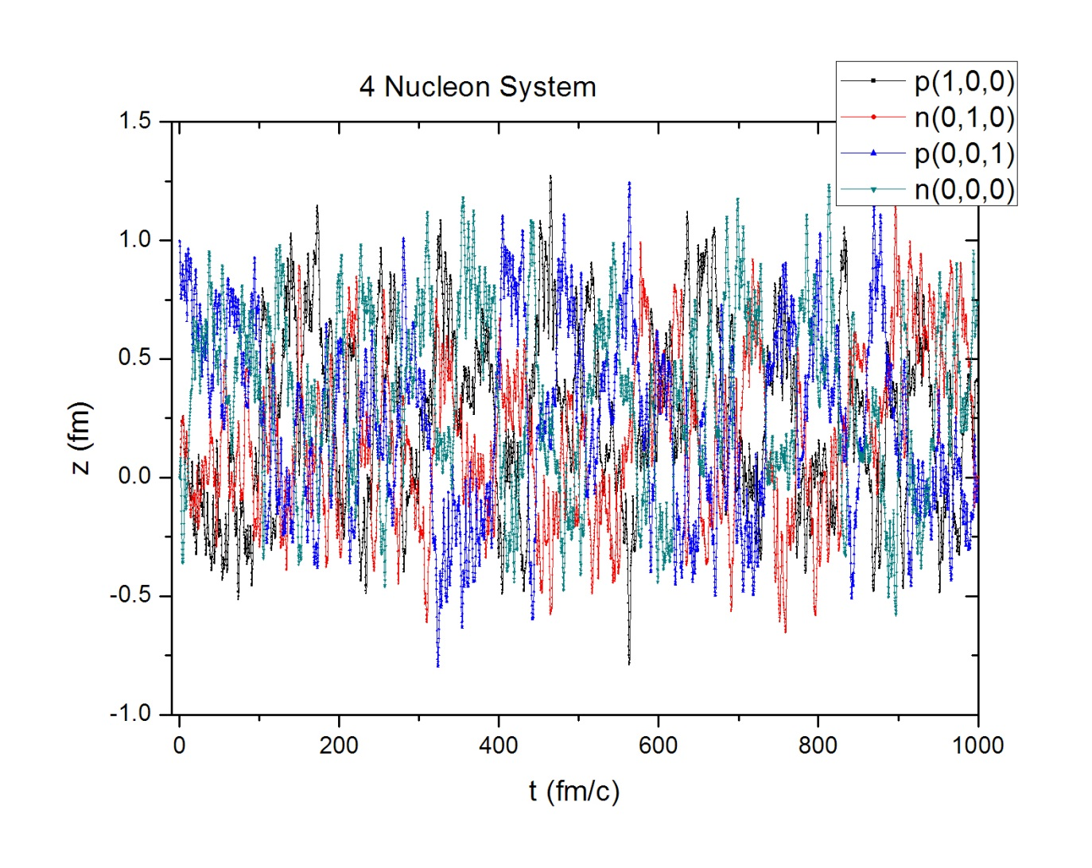
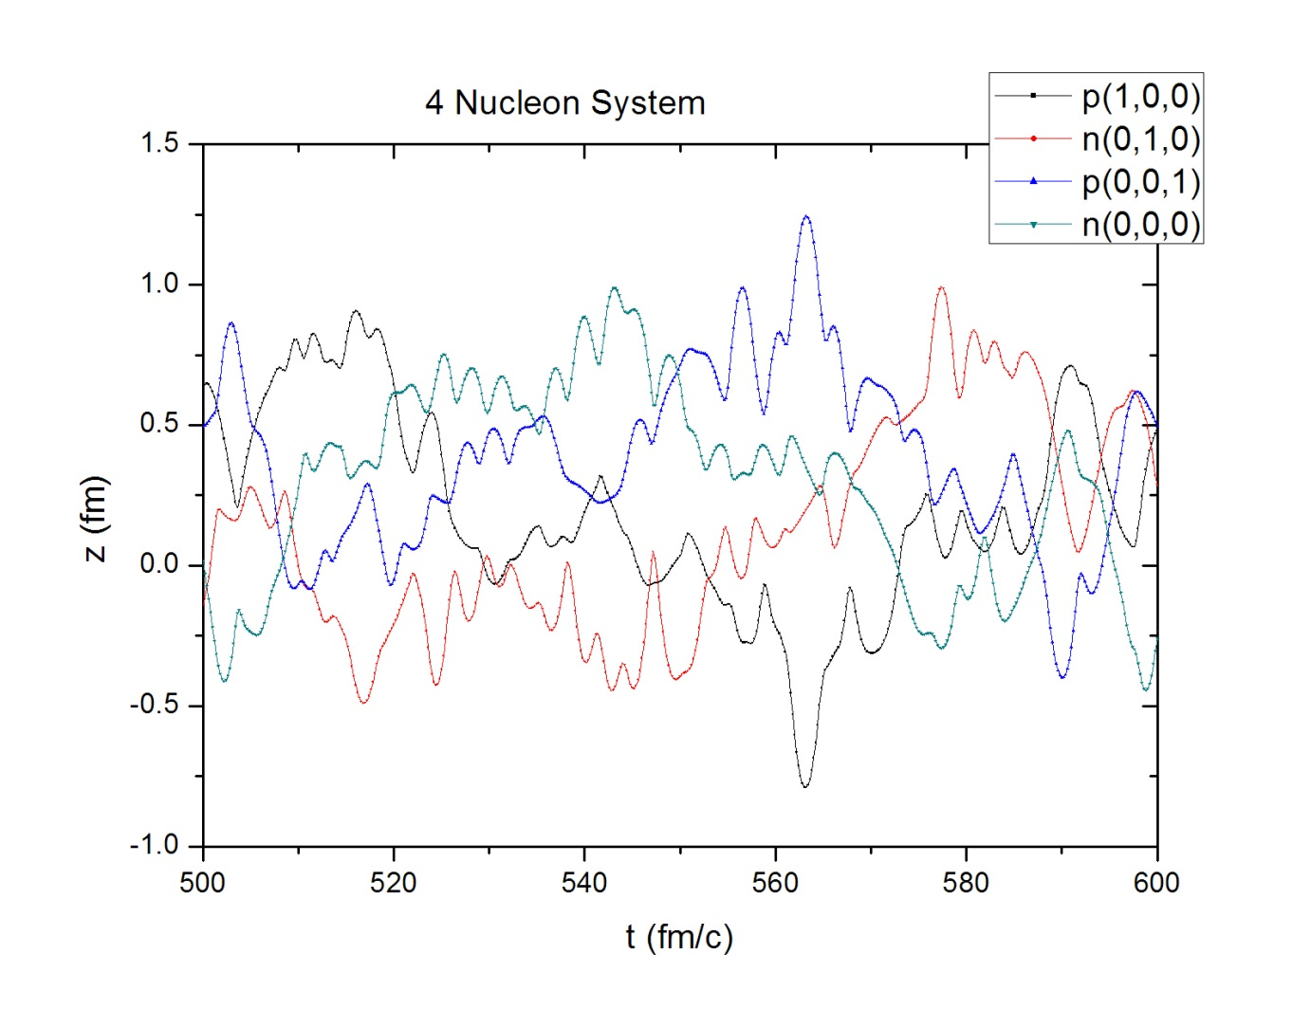

Slide 11
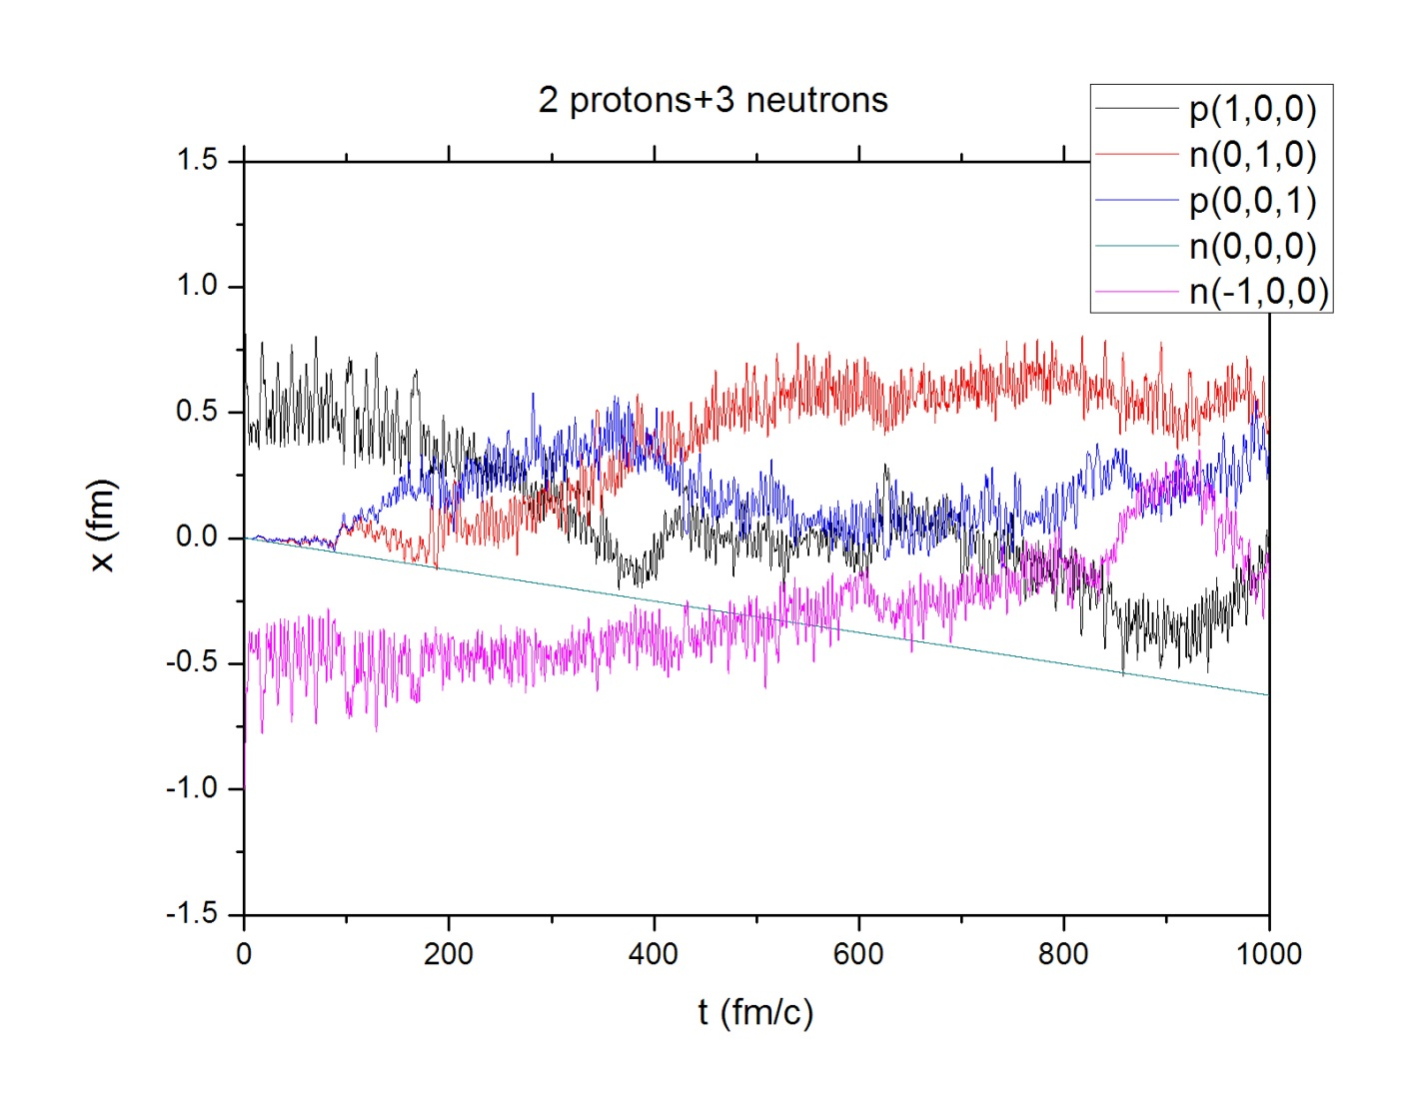
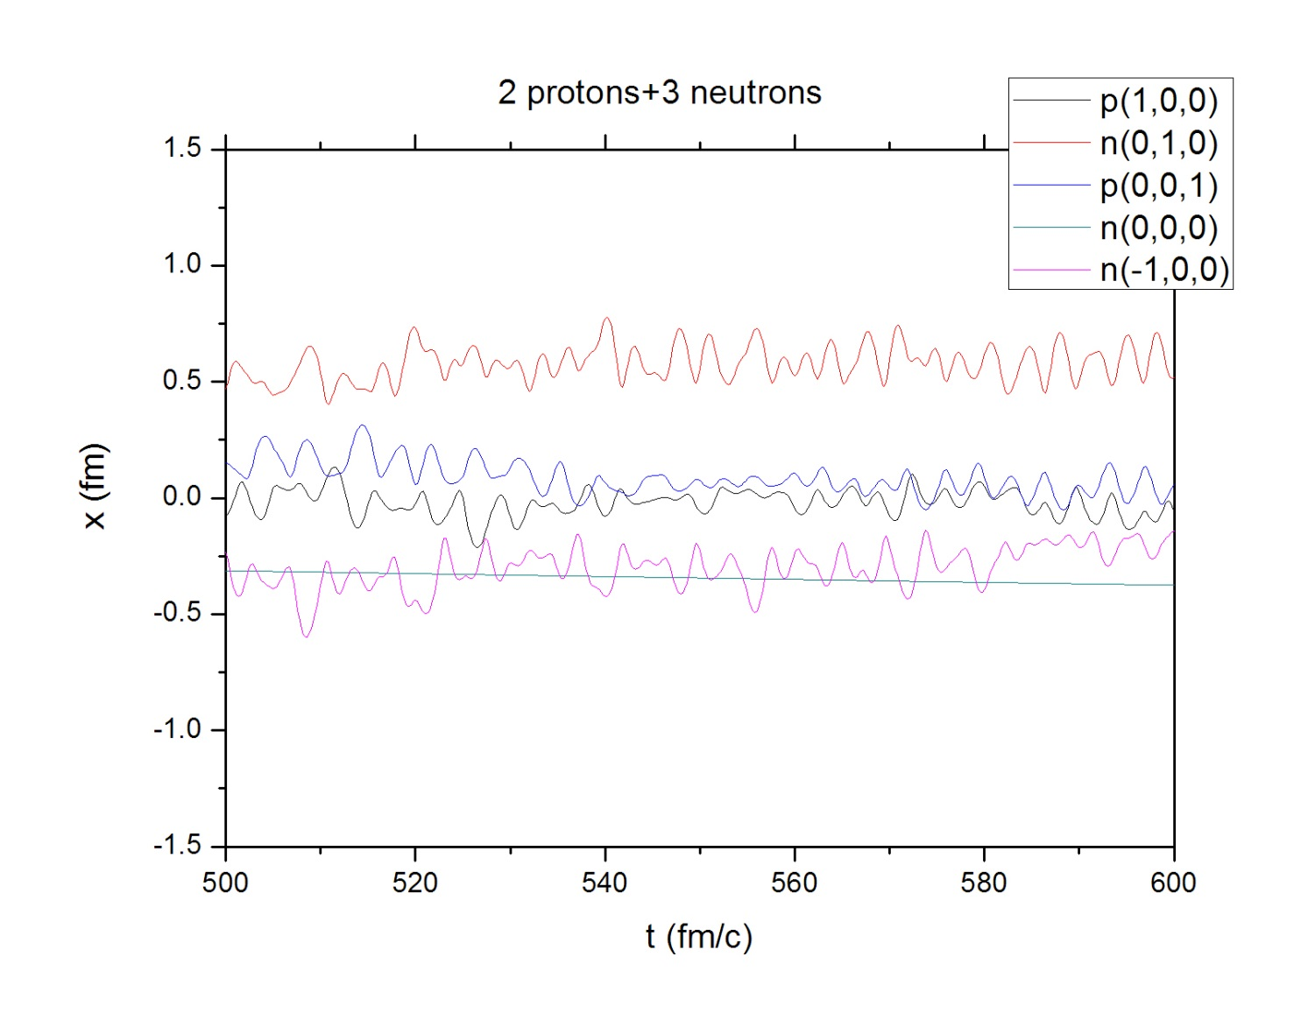
5) 2p+3n system:

Slide 12
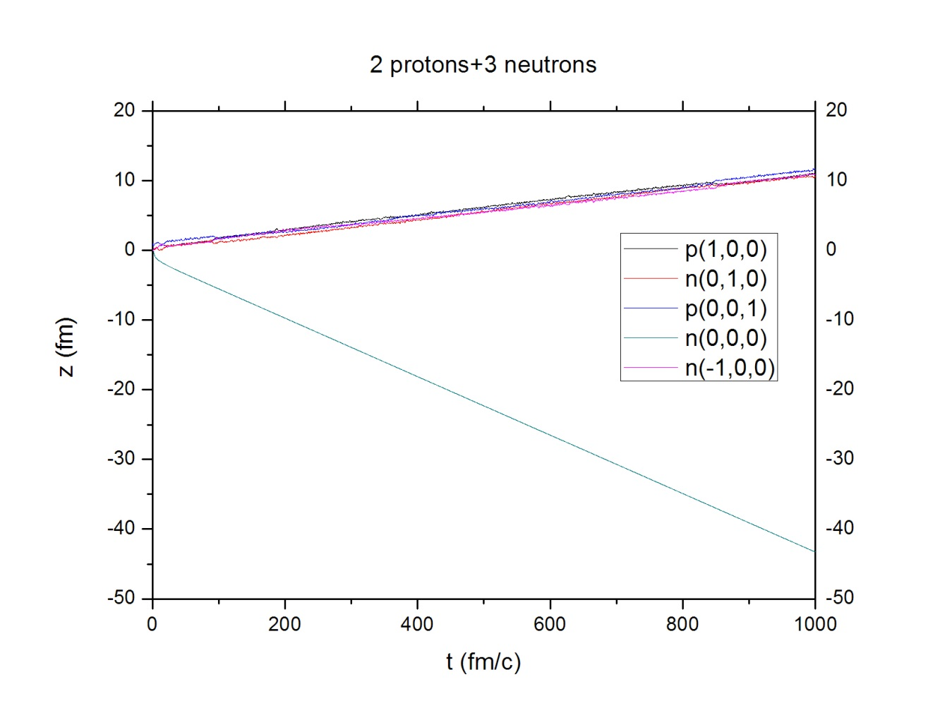
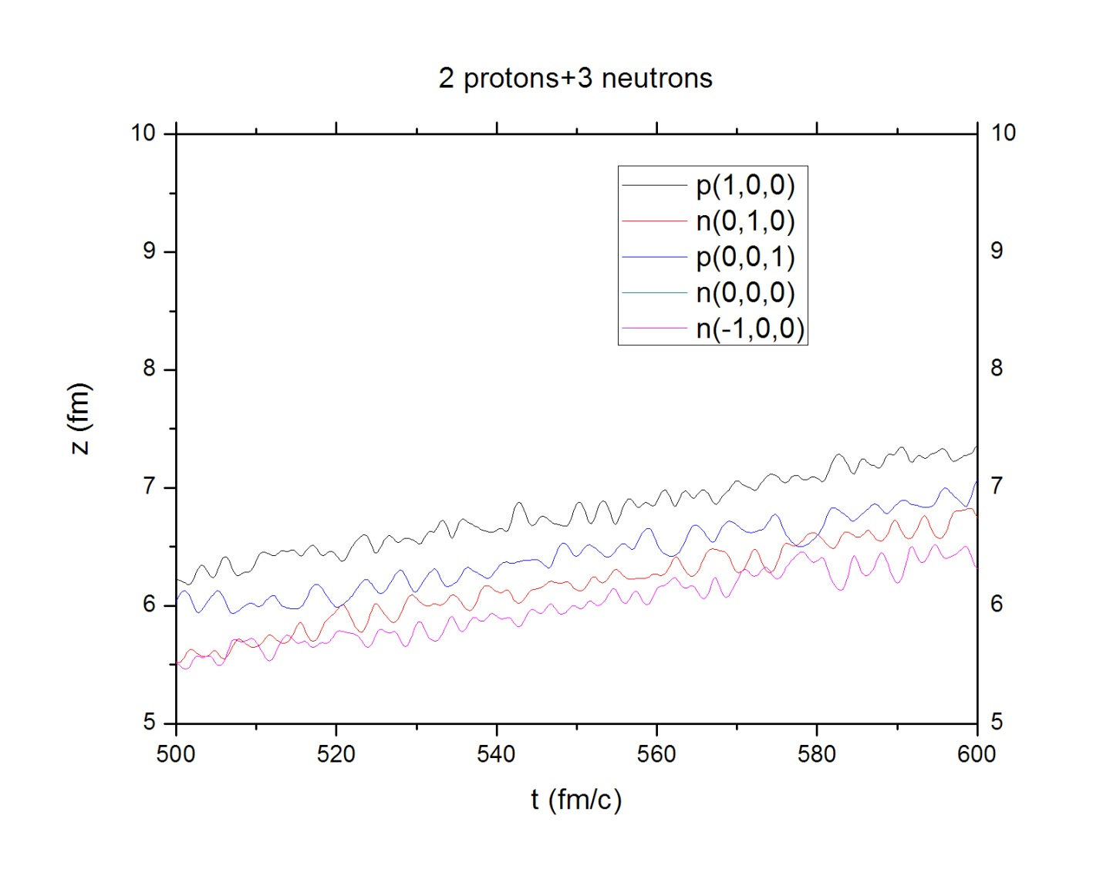

Slide 13
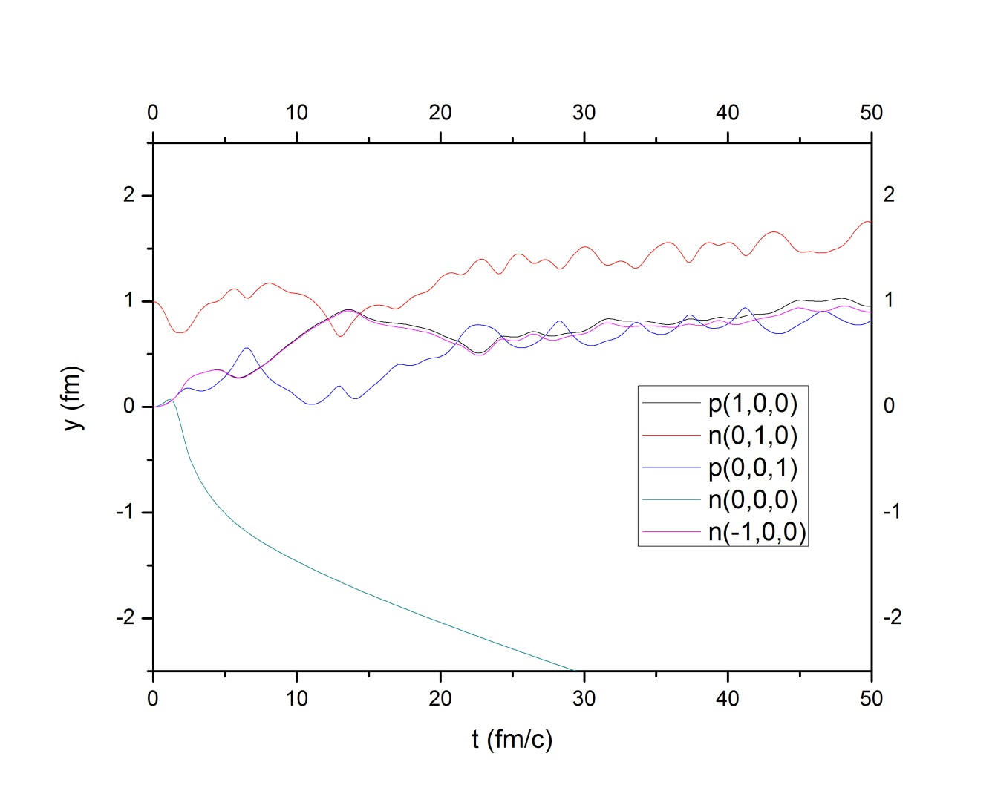

Slide 14
5. Remarks
May see some nucleons kicked out
May see stable states with internal motion
What if we bring another nucleon(s) into this system – classical scattering ? This will come soon
NEED more works on potentials
May need to use Wigner to expand to QM

Slide 15
Thank you for attention!

