Slide 1

Double Heavy Hadronic Spectrum from Supersymmetric LFHQCD
THE 12TH APCTP-BLTP JINR JOINT WORKSHOP ON
“Modern Problems in Nuclear and Elementary Particle Physics”
Liping Zou
Institute of Modern Physics, CAS
In collaboration with H. G. Dosch, M. Nielson, Pengming Zhang etc.
Phys.Rev. D98 (2018) 034002
arXiv:1801.00607

Slide 2
Supersymmetric Light Front Holographic QCD (SuSyLFHQCD)
QCD: Quantum chromodynamics
Holographic: The Quantum Field Theory in our 4-dimensional World is a hologram of a classical field theory in 5 dimensions: AdS/CFT correspondence
Light Front: We work in a Light front system
Supersymmetry : connects meson wave functions with baryon wave functions. It is the symmetry of SuSy Quantum Mechanics but not SuSy Quantum Field Theory.

Slide 3
Outline
AdS/CFT
HQCD and LFHQCD
Holographic QCD
Hard and Soft- wall model
Light Front HQCD
SuSyLFHQCD
A short introduction and examples
Applications to double-heavy hadrons
Conclusion

Slide 4
AdS/CFT
Maldacena conjecture
J. M. Maldacena, Int. J. Theor. Phys. 38, 1113 (1999)
Classical gravitational field theory in 5-dimensional Anti deSitter space (AdS₅)
conformal quantum field gauge theory with infinitely many colors in 4 dimensions
One can compute physical observables in a strongly coupled gauge theory in terms of
a weakly coupled classical gravity theory.
Unrealistic
i) QCD is not the scale invariant theory, one needs to break the conformal invariance.
A boundary condition in the extra dimension z in AdS_{d+1} breaks the conformal invariance and allows QCD mass scale and confinement.
ii) Infinitely many colors, all hadrons are stable.
indicates errors typically
To deal with real QCD in LFHQCD, we choose ”bottom-up” approach
Start from 4-d QFT and modify the 5-d classical gravity theory to obtain realistic features of hadron physics that cannot be seen from QCD Lagrangian.

Slide 5
HQCD
Scalar
By Fourier transformation and rescaling
we obtain the Schrodinger like equation from EoM
Solution for every value of M²
Bessel function of the first kind
No scale ! no bound states, no confinement…

Slide 6
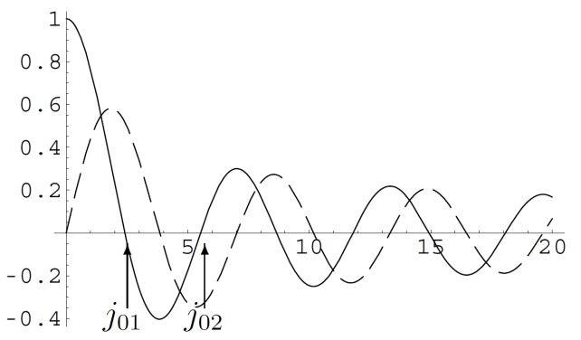
Hard wall model
Cutoff is set at
Duality only valid for
and demand
Zeros of the Bessel function
Yields discrete bound states, but no linear Regge trajectories.
Soft wall model
Modify the action by a for that purpose chosen, the Dilaton factor
which produce a smooth cutoff at large distances.
Solve Schrodinger equation and obtain Linear Regge trajectories
meson
baryon

Slide 7
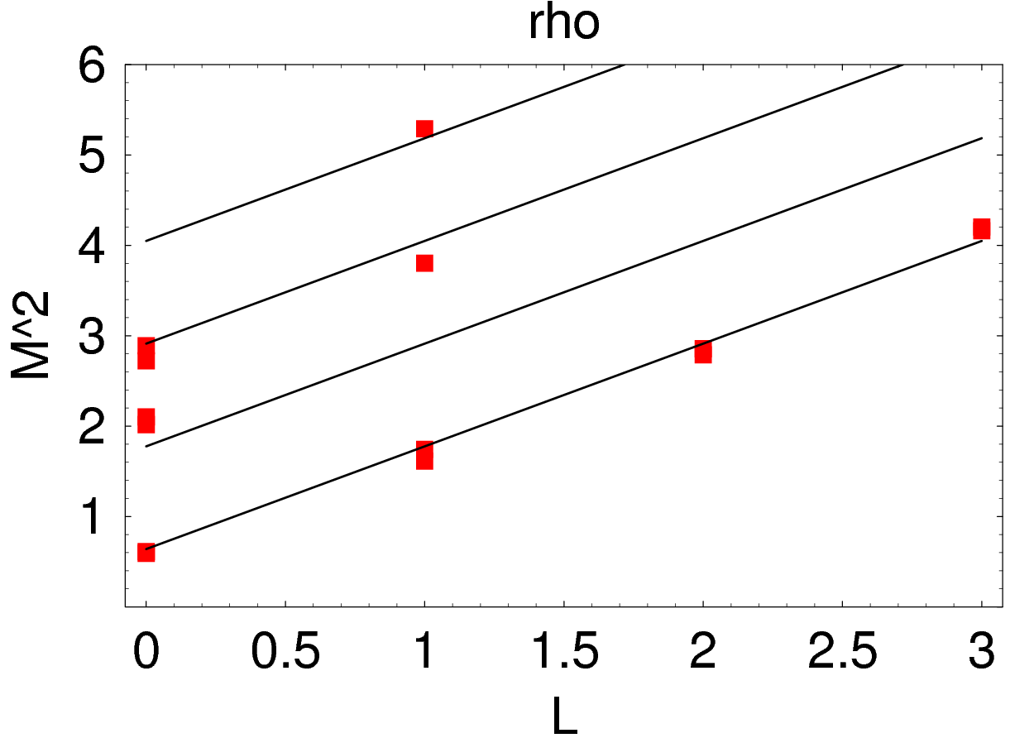
Light Front Holographic QCD
S. J. Brodsky et al. Phys. Rept. 584, 1(2015)
Soft wall model, with
Phenomenologically very successful
But
1. Modification of action “arbitrary”.
2. Completely different treatment of mesons and baryons, although structure very similar.
3. Spin..
Theoretical remedy for these ---SuSyLFHQCD

Slide 8
Supersymmetric Light Front Holographic QCD
Superconformal Quantum Mechanics (Not supersymmetric quantum filed theory )
i) Does not led to new particles(super partners of existing particles)
ii) The “Supersymmetry” relates the LF bound-state wave functions of mesons to baryons
(or to tetraquarks), in Hilbert space.
Simplest superconformal algebra: “4 Supercharges ”
Hamiltonian
Generator of special conformal Transformation
Light front Hamiltonian of Meson and Baryon without interaction
H. G. Dosch et al. PRD 91,045040(2015), PRD 91,085016(2015), PLB 759,171(2016)

Slide 9
Superconformal QM
E. Witen, Nucl. Phys. B 188, 513(1981)
S. Fbini et al. Nucl. Phys. B 245,17(1984)
To construct a new and general Hamiltonian G inside the superconformal algebra
One introduces of scale
Meson
Baryon
The interaction U for the meson with L_{M} and the baryon with L_{B} = L_{M}-1
is exactly the one we had introduced before “arbitrarily”.
Supersymmetry indicates NO arbitrary choice!
same λ for mesons and baryons in one family !

Slide 10
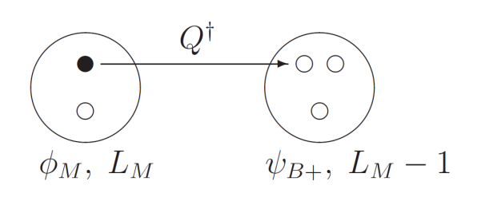
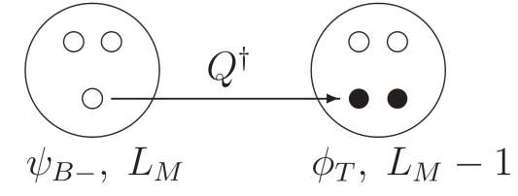
Up to now
q-->anti-diquark
Tetraquarks
Use baryon wave function with negative chirality
New doublet:
complete 4-supermultiplet
No partners for meson L=0
Meson
Spin contribution
Baryon
Quark masses correction
Tetraquarks

Slide 11
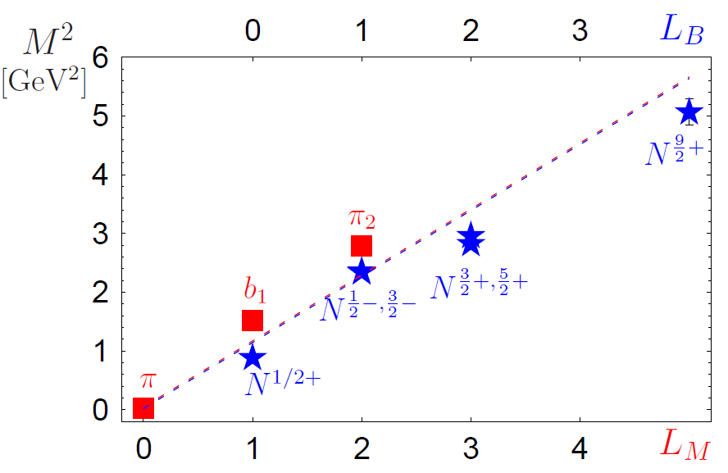
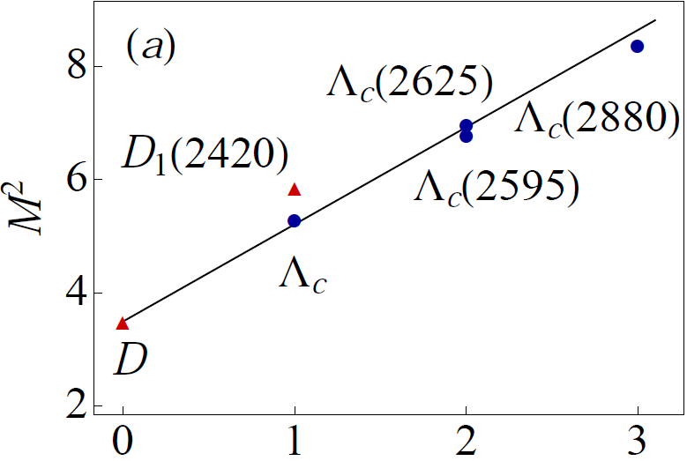
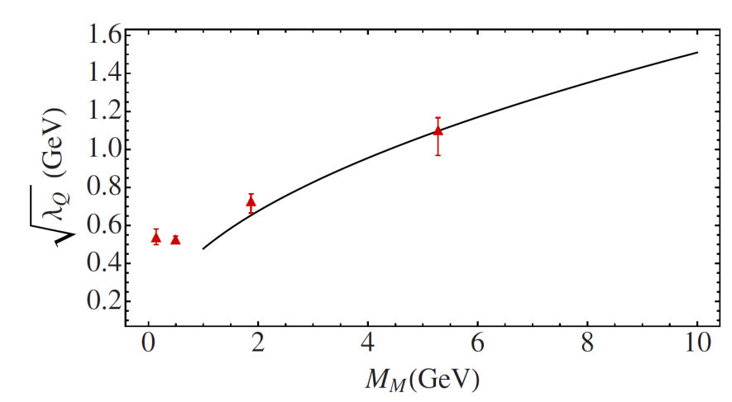
H. G. Dosch et al, Phys. Rev. D 92, 074010 (2015)
If conformal symmetry is broken by heavy quark masses,
supersymmetry survives
The trajectories are linear, but depends on heavy quark mass.
Can be predicted by implementing Heavy Quark Effective Symmetry on LFHQCD
H. G. Dosch et al, Phys. Rev. D 95, 034016 (2017)
L=0

Slide 12
The supersymmetric relation between mesons and baryons agree well with experimental measures across the entire hadron spectrum, including double heavy sector.
Even though the conformal symmetry is strongly broken by quark masses,
underlying dynamical supersymmetry still holds.

Slide 13
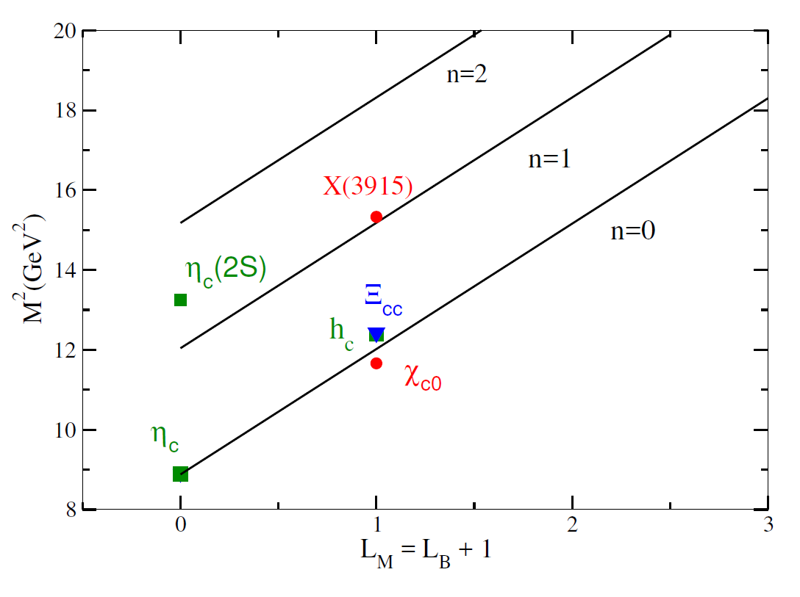
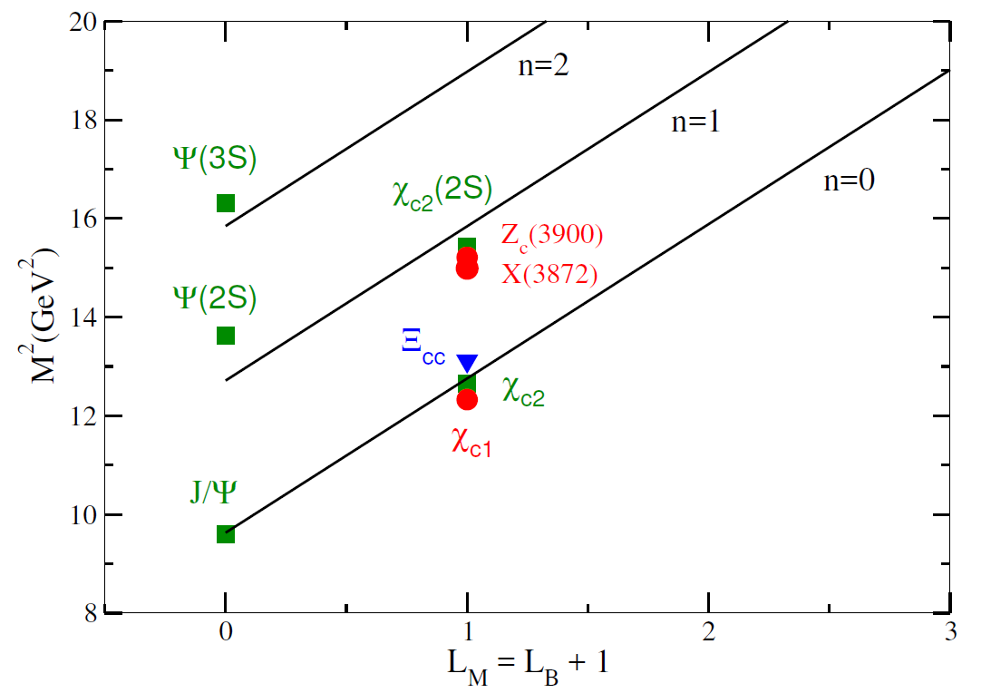
Double charm mesons (green squares), baryons (blue triangles)
tetraquarks (redcircles), solid lines(the fitting trajectories)
X(3872), Zc(3900)…
radial excitations are not so perfect
Our Regge trajectories agrees well with experimental data.
deviate from prediction
Colour-Coulomb effects become more important

Slide 14
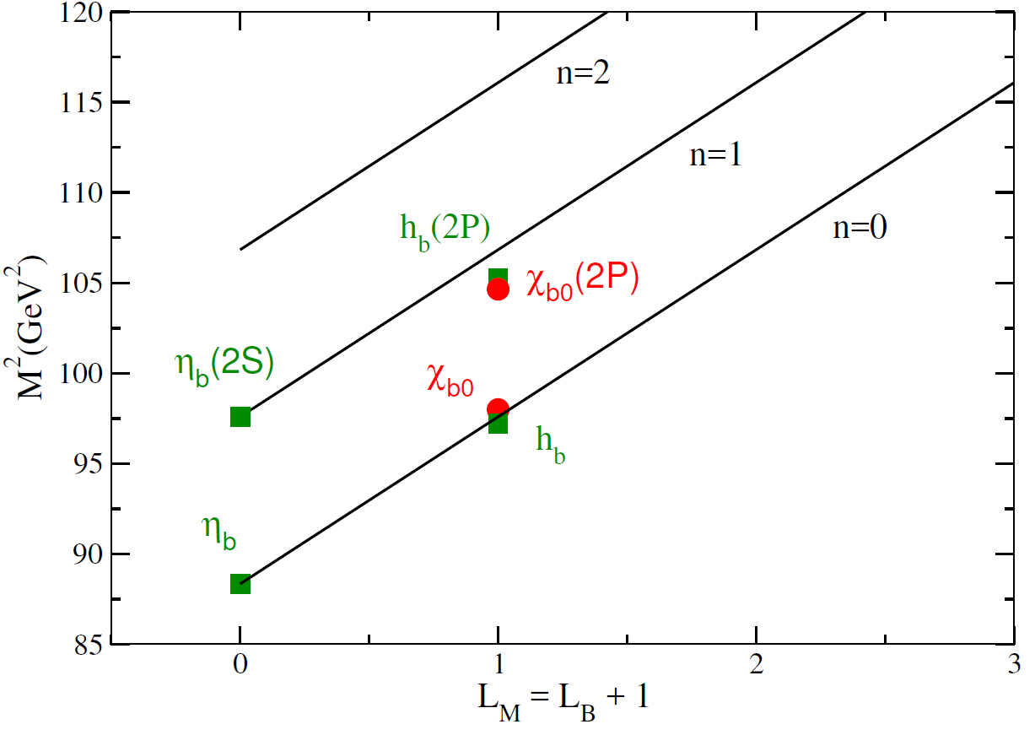
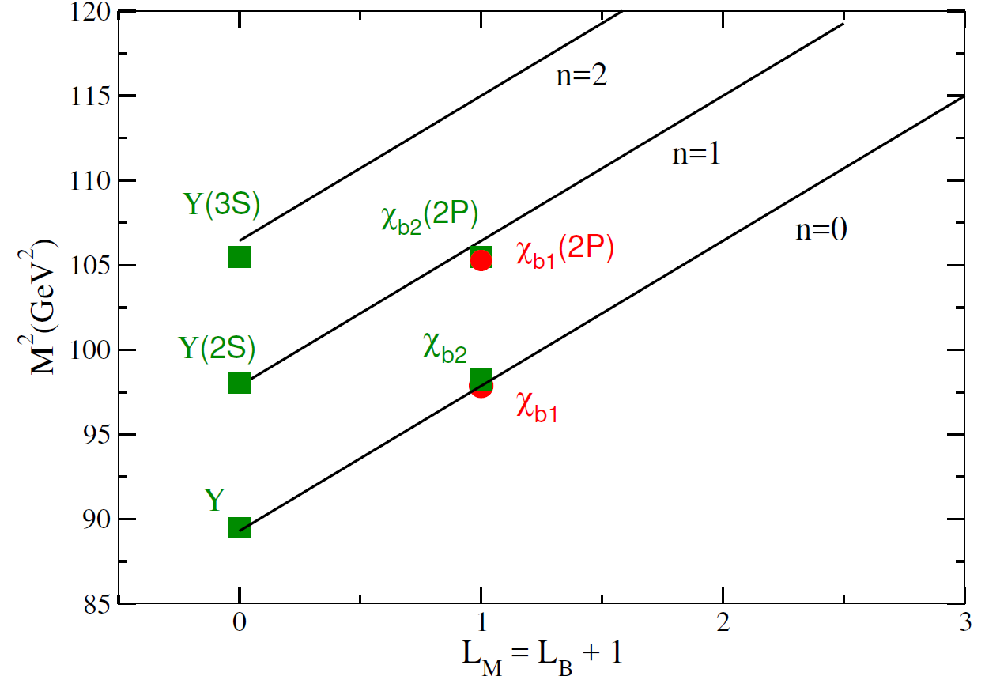
double-beauty hadrons—very good agreement
No experimental observation of double beauty baryons
Data are sparse, predicted linear trajectories cannot be fully tested,
But general behavior is really fantastic , and this is the beauty of the model.

Slide 15
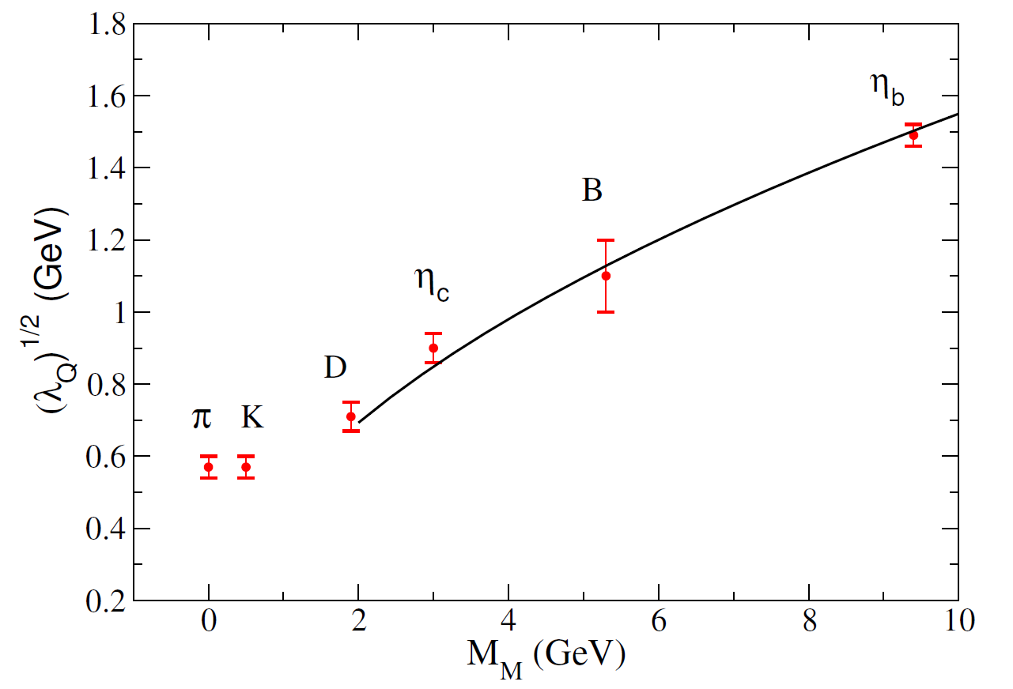
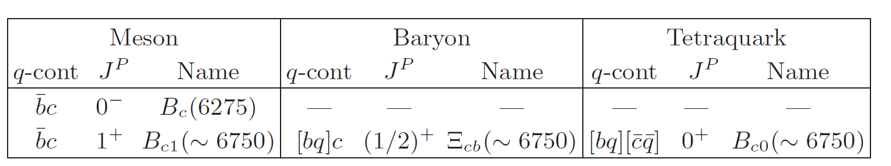
Heavy quark symmetry & SuSy LFHQCD
derived in the heavy quark limit works very well for all heavy states.
HQET is applicable only for states with only one heavy quark.
Universal behavior for all heavy states, including the double-heavy and the heavy-light states.
To predict higher excitations for Charmonium and bottomonium?

Slide 16
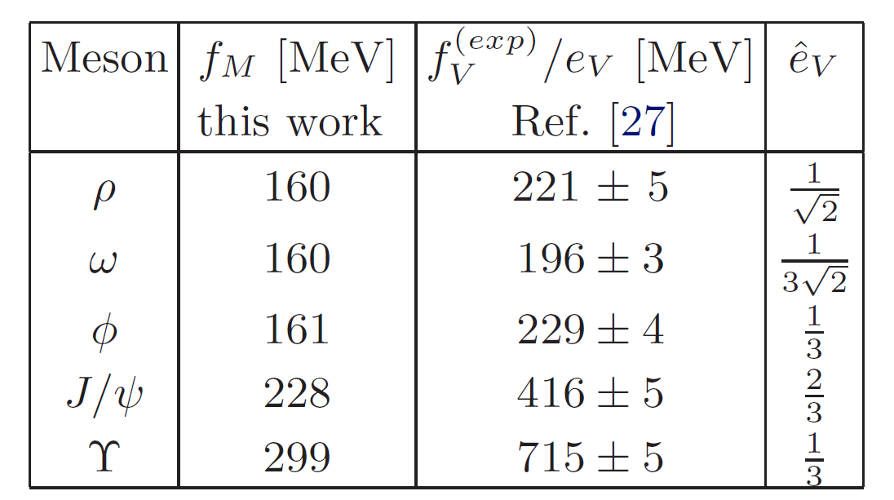
Decay constants and challenges
LFHQCD predicts an increase in the decay constant with the meson mass.
Eigenvalues are in good agreement with the experimental values,
but wave functions are too simple to convey all the complexity of the quarkonium states, even for light quark states.
With modifications
i) phenomenological longitudinal term
ii) helicity-dependent holographic wavefunction
iii) include dynamical spin effects

Slide 17
Conclusion
SuSyLFHQCD
i) Supersymmetric quantum mechanics
ii) Supersymmetry between light-front wave functions of mesons, baryons and tetraquarks.
ii) Conformal symmetry is strongly broken due to heavy quark masses, but the supersymmetry still holds.
The predicted Regge trajectories
agrees well with experimental data, even in double heavy quark system.
The Universal raw of scale parameter
allows us to predict new double heavy states
Challenges in describing decay constants

Slide 19
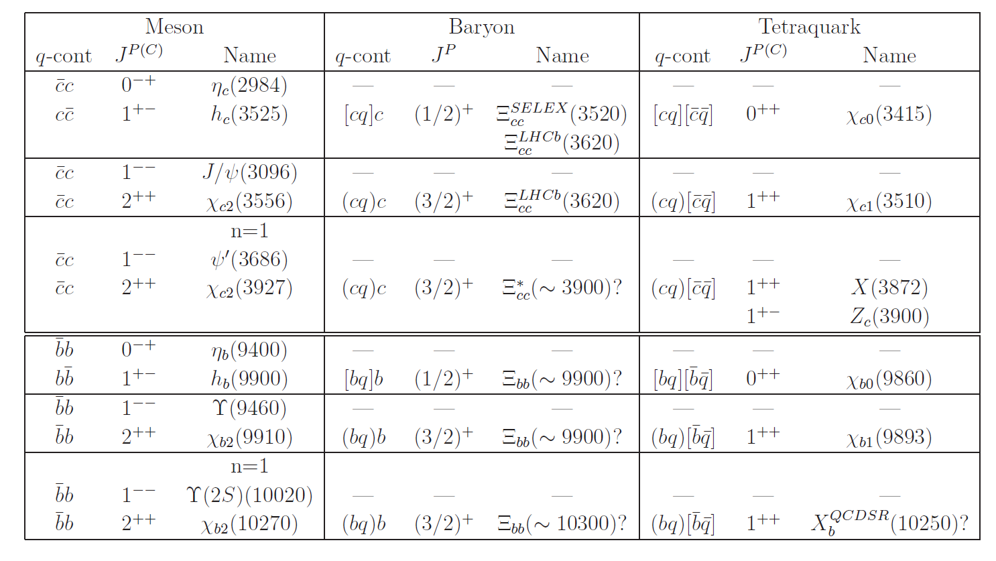
Backup
Double-heavy hadrons
Marina Nielsen and Stanley J. Brodsky, Phys.Rev. D97 (2018) no.11, 114001

Slide 20
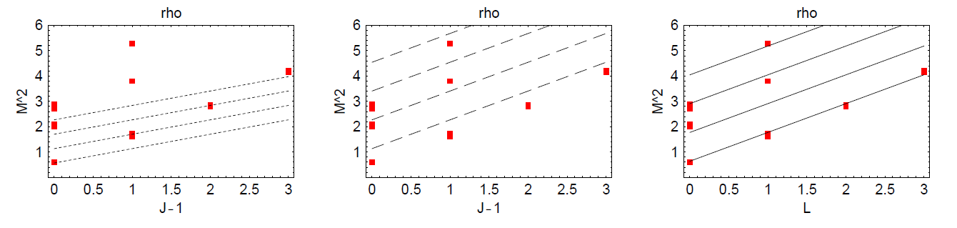
Rho trajectory
(a) and (b) from the conserved vector current J=1, L=1.
(c) the trajectories from LFHQCD, with J = 1, L = 0.
Vector propagator
conserved vector current
Digamma function with
poles at x=0,-1,-2...
LFHQCD
bound state poles in the propagator
trajectory

