Slide 1
Phase Transition of
Dense Skyrmion Matter
12th APCTP-BLTP Joint Workshop
2018. 8. 20-24, Busan
Byung-Yoon Park
(Chungnam Nat’l Univ.)
Collaboration with Won-Ki Paeng (AI/NLP Lab. Clunix)

Slide 2
Motivation
Strategy
Results
Discussions

Slide 3
1. What to know?

Slide 4
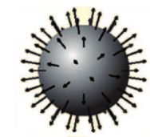
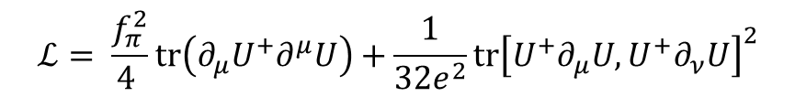
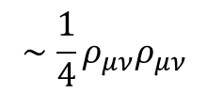
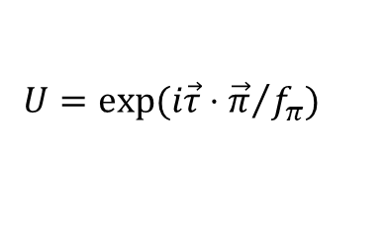
Skyrme Model & Dense Matter
$$ℒ= \frac{f_{π}^{2}}{4 }\text{tr}\left(∂_{μ}U^{+}∂^{μ}U\right)+\frac{1}{32e^{2}}\text{tr}{\left[U^{+}∂_{μ}U, U^{+}∂_{ν}U\right]}^{2}$$
$$∼\frac{1}{4}ρ_{μν}ρ_{μν}$$
$$U=exp⁡(i\vec{τ}⋅{\vec{π}}/{f_{π}})$$
Topological soliton
1. Strongly interacting objects
with a finite size
2. Non-perturbative treatment
of strong interactions
since 1961
3. No problem in constructing
dense matter
4. Unified approaches for mesons
and baryons

Slide 5
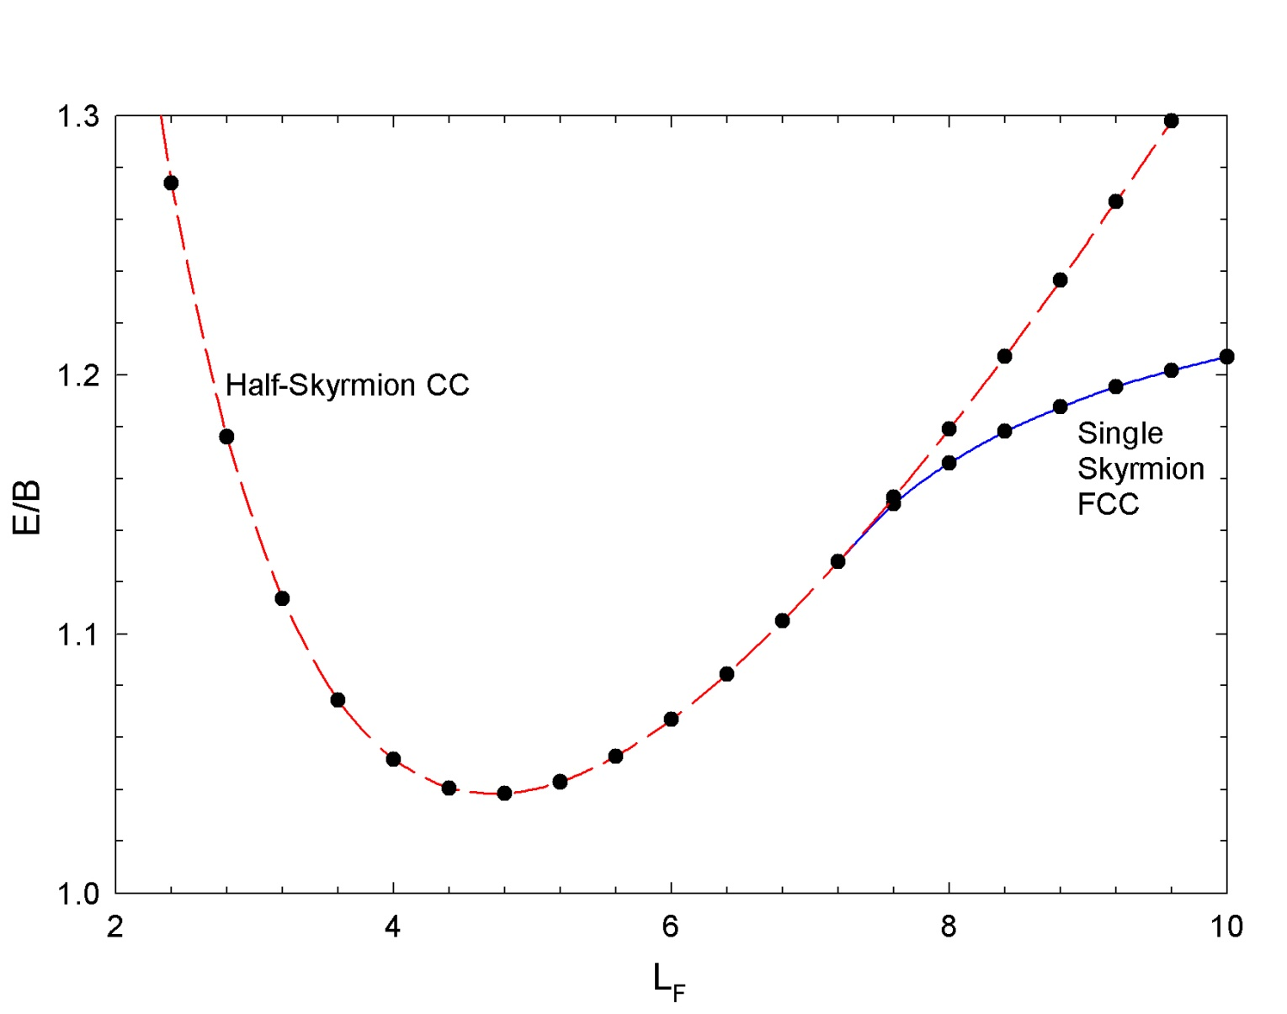
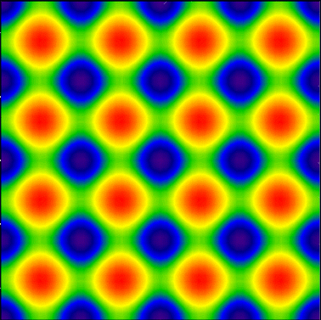
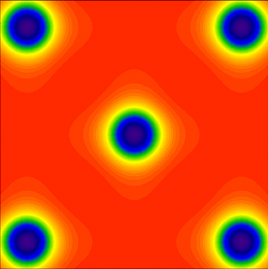
Skyrme Model & Dense Matter

Slide 6
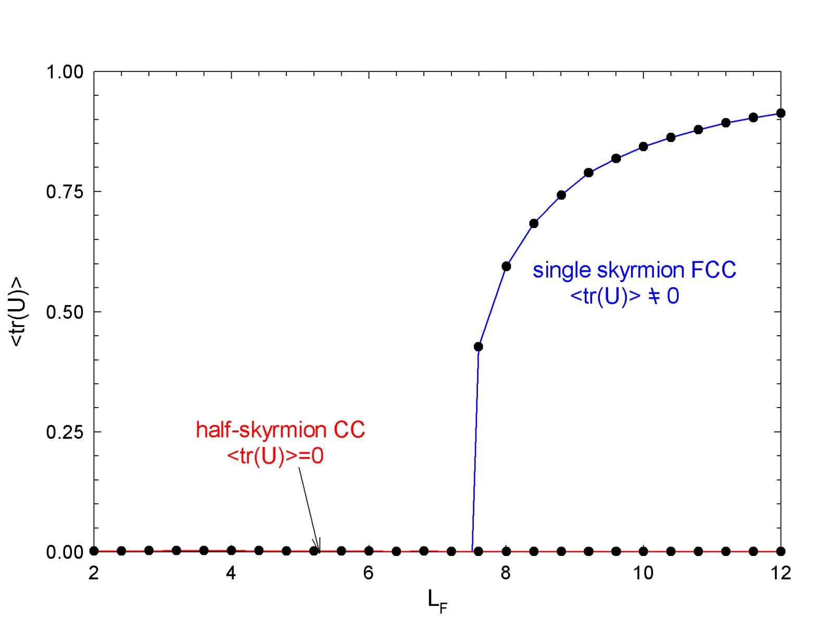
Skyrme Model & Dense Matter
?
BYP & V. Vento, in ‘Multifaceted Skyrmion’
eds. G. E. Brown & M. Rho, 2010

Slide 7
One more question,…
negative
pressure

Slide 8
One more question,…
negative
pressure
Is this genuine
phase transition?

Slide 9
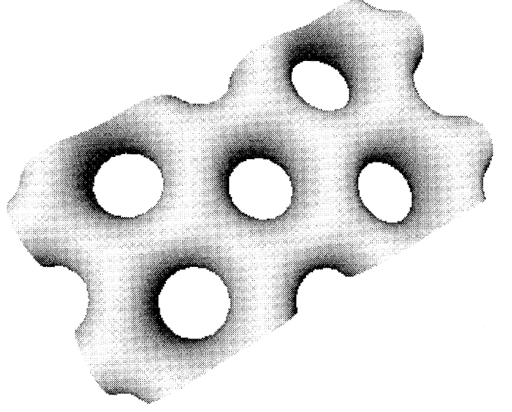
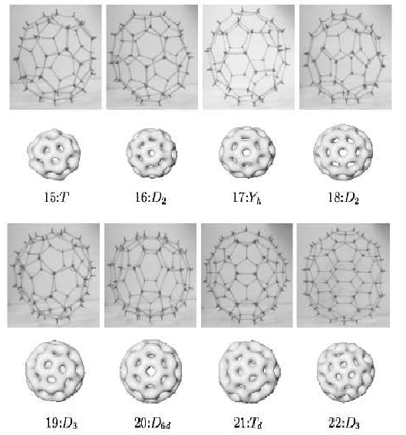
One more question,…
negative
pressure
R. Battye, P. Sutcliffe,
Phys. Lett. B416
(1998) 385
1.077
1.06

Slide 10
One more question,…
negative
pressure
Is this genuine
phase transition?

Slide 11
2. How to do?

Slide 12
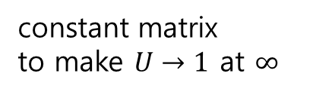

Atiyah-Manton Ansatz
time component of SU(2) gauge
potential for the instanton field
of charge N
constant
rotation
matrix
time-ordering
constant matrix
to make $U→1$ at $∞$

Slide 13



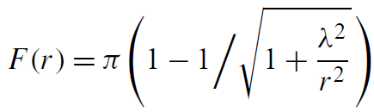
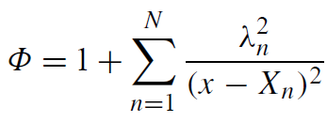



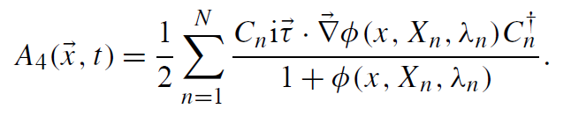
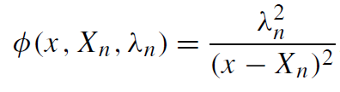
Multi-instanton solution
‘tHooft instanton
with
Modification
relative orientation
position

Slide 14
Skyrmion Sheet
3
2
1
0
1
2
3
Condition : all the neighboring skyrmions should have the relative orientation of maximum attraction

Slide 15
















FCC
$$z$$
$$0$$
$$0$$
$$z$$
$$0$$
$$0$$
$$x$$
$$y$$
$$y$$
$$x$$
$$0$$
$$0$$
$$y$$
$$z$$
$$0$$
$$0$$
(1,1,1) plane
$$x$$

Slide 16










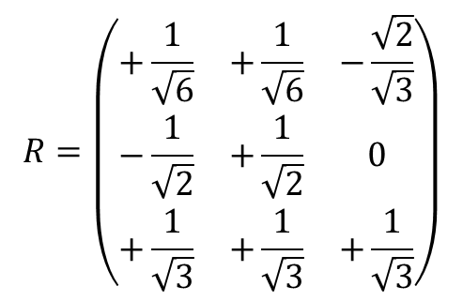
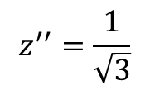







$$R=\left(\begin{matrix}+\frac{1}{\sqrt{6}} & +\frac{1}{\sqrt{6}} & −\frac{\sqrt{2}}{\sqrt{3}} \\ −\frac{1}{\sqrt{2}} & +\frac{1}{\sqrt{2}} & 0 \\ +\frac{1}{\sqrt{3}} & +\frac{1}{\sqrt{3}} & +\frac{1}{\sqrt{3}}\end{matrix}\right)$$
$$z,z′$$
$$z′′$$
$$π/4$$
$$0$$
$$0$$
$$z$$
$$\cos^{−1}{1/\sqrt{3}}$$
$$0$$
$$0$$
$$y′′$$
$$x$$
$$y^{′},y′′$$
$$0$$
$$y$$
$$y$$
$$x$$
$$0$$
$$0$$
$$y$$
$$x$$
$$z$$
$$0$$
$$0$$
$$z$$
$$x′′$$
$$x′$$
$$y$$
$$x$$
$$x′′$$
$$z^{′′}=\frac{1}{\sqrt{3}}$$
plane

Slide 17







$$R=\left(\begin{matrix}+\frac{1}{\sqrt{6}} & +\frac{1}{\sqrt{6}} & −\frac{\sqrt{2}}{\sqrt{3}} \\ −\frac{1}{\sqrt{2}} & +\frac{1}{\sqrt{2}} & 0 \\ +\frac{1}{\sqrt{3}} & +\frac{1}{\sqrt{3}} & +\frac{1}{\sqrt{3}}\end{matrix}\right)$$
$$z,z′$$
$$z′′$$
$$π/4$$
$$0$$
$$0$$
$$z$$
$$\cos^{−1}{1/\sqrt{3}}$$
$$0$$
$$0$$
$$y′′$$
$$x$$
$$y^{′},y′′$$
$$0$$
$$y$$
$$y$$
$${\hat{n}}_{x′}=(\frac{1}{\sqrt{6}},\frac{−1}{\sqrt{2}},\frac{1}{\sqrt{3}})$$
$$x$$
$$0$$
$$0$$
$$y$$
$$x′$$
$$z$$
$$0$$
$$0$$
$$z′$$
$$x′′$$
$$\left(\begin{matrix}+\frac{1}{\sqrt{6}} & +\frac{1}{\sqrt{6}} & −\frac{\sqrt{2}}{\sqrt{3}} \\ −\frac{1}{\sqrt{2}} & +\frac{1}{\sqrt{2}} & 0 \\ +\frac{1}{\sqrt{3}} & +\frac{1}{\sqrt{3}} & +\frac{1}{\sqrt{3}}\end{matrix}\right)\left(\begin{matrix}0 \\ 1 \\ 0\end{matrix}\right)=\left(\begin{matrix}\frac{1}{\sqrt{6}} \\ \frac{1}{\sqrt{2}} \\ \frac{1}{\sqrt{3}}\end{matrix}\right)$$
$$x′$$
$$y′$$
$${\hat{n}}_{z′}=(−\frac{\sqrt{2}}{\sqrt{3}},0,\frac{1}{\sqrt{3}})$$
$$x$$
$${\hat{n}}_{y′}=(\frac{1}{\sqrt{6}},\frac{1}{\sqrt{2}},\frac{1}{\sqrt{3}})$$
$$x′′$$
$$z^{′′}=\frac{1}{\sqrt{3}}$$
plane

Slide 18

Skyrmion Sheet
0
3
0
2
1
2
3
0
3
1
2
1
0
3
$$L$$
3
0

Slide 19
3. Results

Slide 20
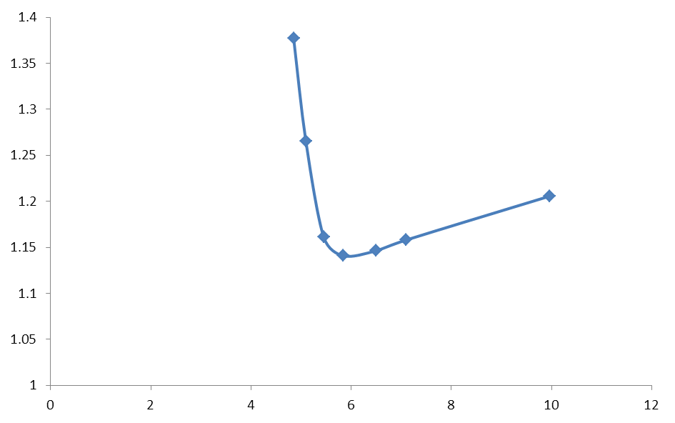
Skyrmion Sheet
1.14
5.9

Slide 21
Single Layer
1.14

Slide 22
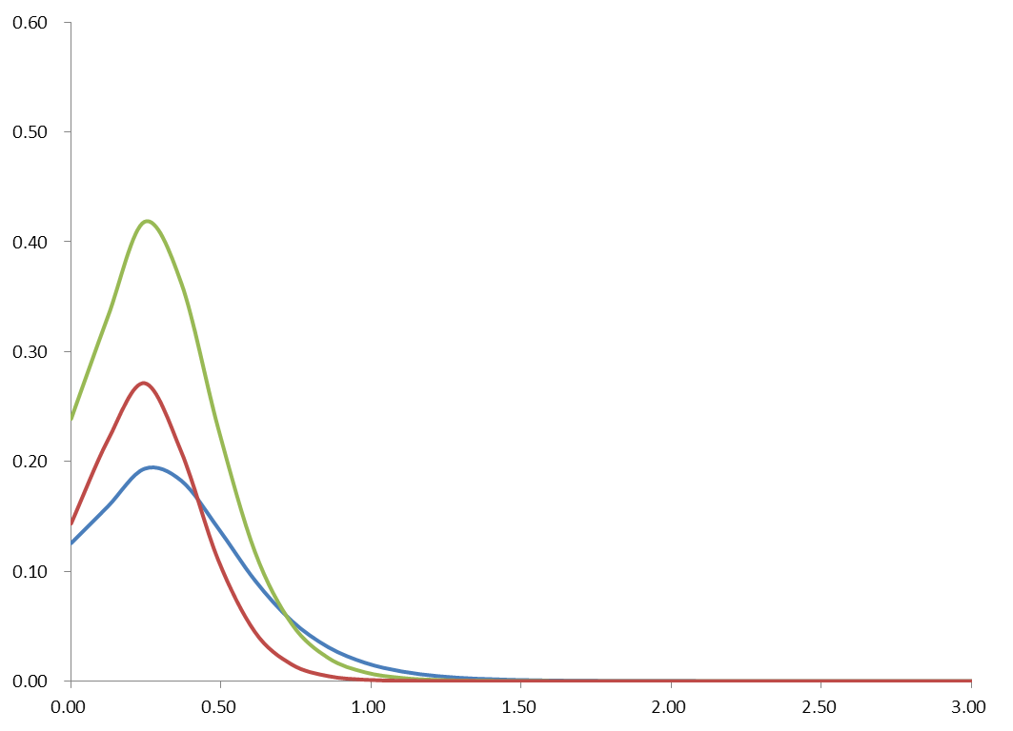




Single Layer
$$\iint{dxdy ρ_{B}(x,y,z)}$$
$$\iint{dxdy ℰ_{4}(x,y,z)}$$
$$\iint{dxdy ℰ_{2}(x,y,z)}$$
$$z$$

Slide 23
Half-skyrmion?
~

Slide 24
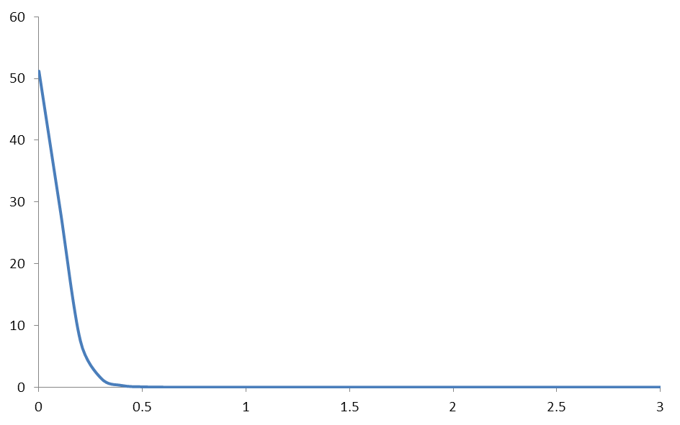
Single Layer
$$\iint{dxdy ρ_{B}(x,y,z)}$$
$$\iint{dxdy ℰ_{4}(x,y,z)}$$
$$\iint{dxdy ℰ_{2}(x,y,z)}$$
$$z$$

Slide 25

Double Layers
0
3
3
0
0
3
2
1
1
2
3
0
0
3
3
0
1
2
2
1
0
3
3
0
3
3
0
$$L_{z}=L/\sqrt{6}$$

Slide 26

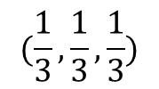



Double Layers
$$z$$
$$0$$
$$0$$
$$z$$
$$0$$
$$0$$
$$x$$
$$y$$
$$y$$
$$x$$
$$0$$
$$0$$
$$y$$
$$z$$
$$0$$
$$0$$
$$x$$
$$(\frac{1}{3},\frac{1}{3},\frac{1}{3})$$
(1,1,1) plane passing
$$y$$
$$x$$
(1,1,1) plane passing (0,0,0)

Slide 27
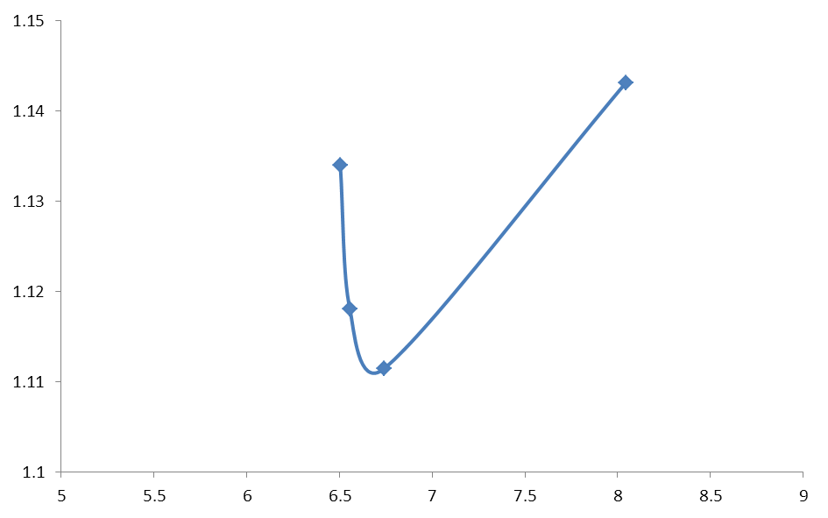
Double Layers
1.24
6 neighbors
1.14
3 more
neighbors
1.11
6.7

Slide 28
Double Layers

Slide 29
Double Layers

Slide 30
Double Layer

Slide 31
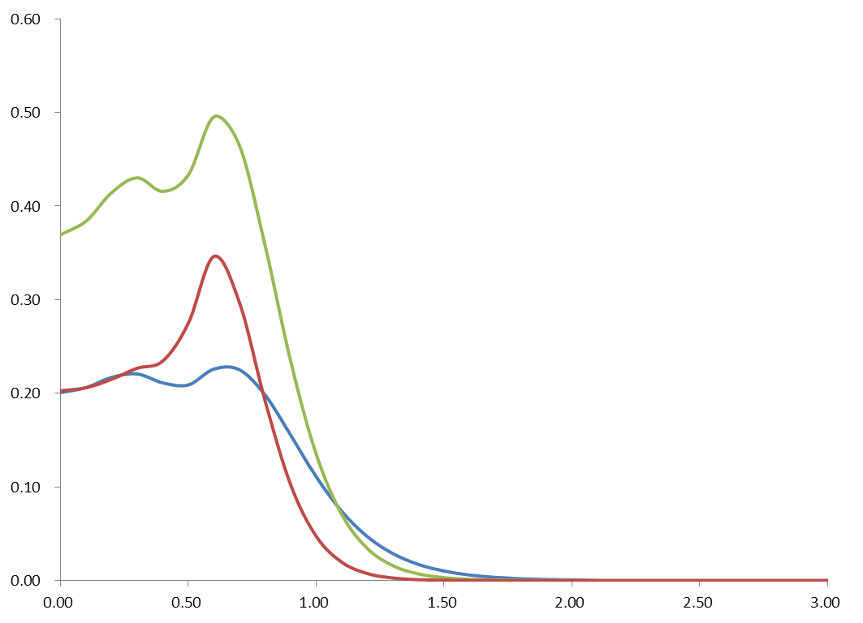



Double Layers
$$\iint{dxdy ρ_{B}(x,y,z)}$$
$$\iint{dxdy ℰ_{4}(x,y,z)}$$
$$\iint{dxdy ℰ_{2}(x,y,z)}$$

Slide 32
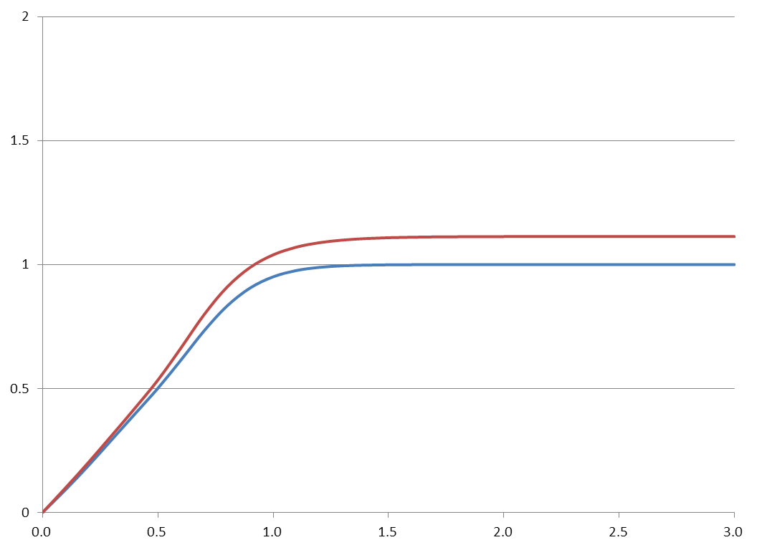
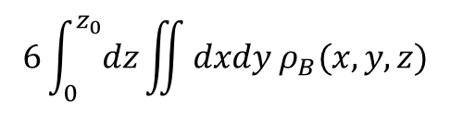
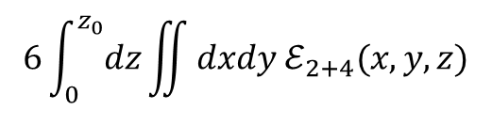
Double Layers
Single Layer
$$6\int_{0}^{z_{0}}{dz}\iint{dxdy ℰ_{2+4}(x,y,z)}$$
~1.14
x2
1.11
0.58
$$6\int_{0}^{z_{0}}{dz}\iint{dxdy ρ_{B}(x,y,z)}$$
0.53
x2
~1.06
Half-skyrmion CC

Slide 33
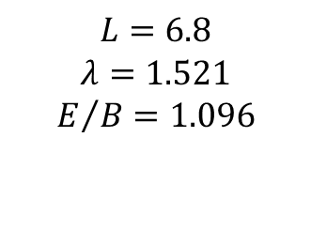
Triple layers
$$L=6.8$$
$$λ=1.521$$
$$E/B=1.096$$

Slide 34
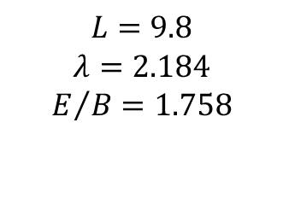
Triple layers
$$L=9.8$$
$$λ=2.184$$
$$E/B=1.758$$

Slide 35
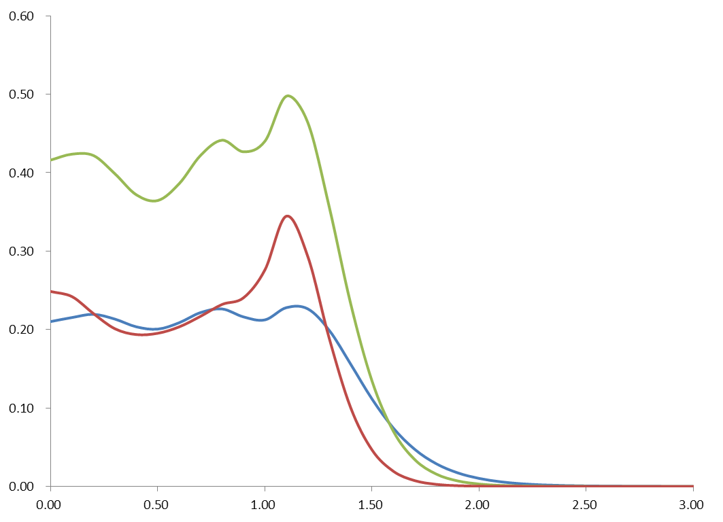
$$B(z)$$
$$E_{4}(z)$$
$$E_{2}(z)$$

Slide 36
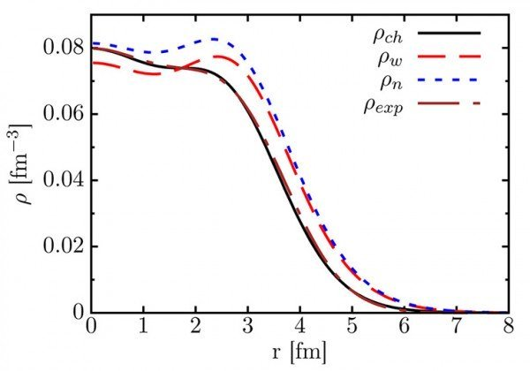
$$B(z)$$
$$E_{4}(z)$$
$$E_{2}(z)$$

Slide 37
$$B(z)$$
$$E_{4}(z)$$
$$E_{2}(z)$$

Slide 38
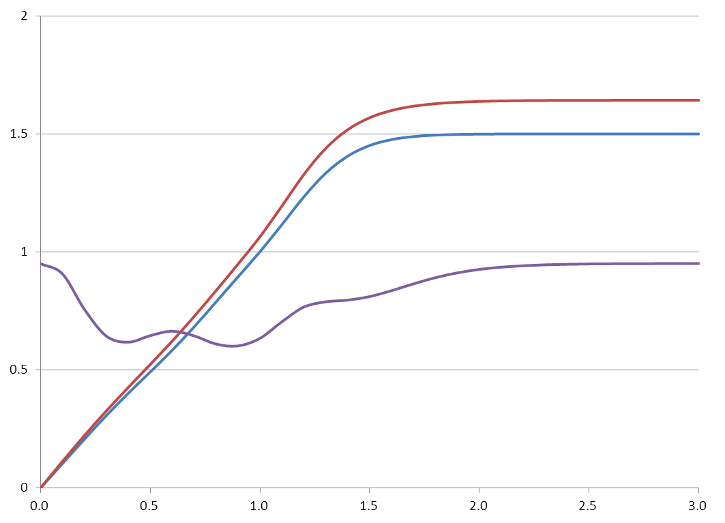


$$E$$
$E$= 0.58
$$B$$
1.10
$E$= 0.53
$$E/B$$
1.05
$E$=0.53
Weizsäcker's formula?
$$E_{B}=a_{V}A−a_{s}A^{2/3}$$

Slide 39


Sheet-Sheet Interaction
0
3
3
0
0
3
2
1
1
2
3
0
0
3
3
0
1
2
2
1
0
3
3
0
3
3
0
$$L_{z}=L/\sqrt{6}$$
$$α$$

Slide 40
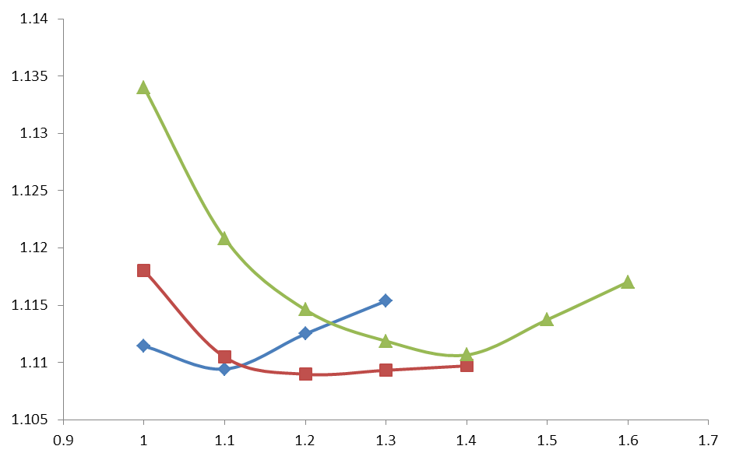




Sheet-Sheet Interaction
$${\tilde{λ}}^{2}=0.07$$
$${\tilde{λ}}^{2}=0.06$$
$${\tilde{λ}}^{2}=0.05$$
$$α$$
Local Minima

Slide 41
4. What we get to know?

Slide 42
$$B(z)$$
$$E_{4}(z)$$
$$E_{2}(z)$$

Slide 43
$$E$$
$E$= 0.58
$$B$$
1.10
$E$= 0.53
$$E/B$$
1.05
$E$=0.53
Weizsäcker's formula?
$$E_{B}=a_{V}A−a_{s}A^{2/3}$$

Slide 44
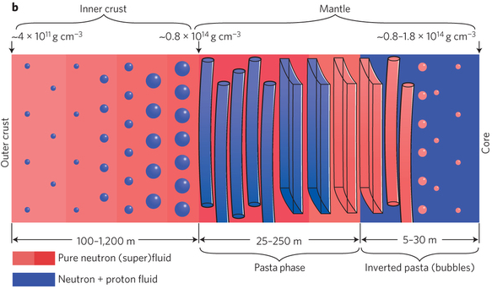
Dense Skyrmion Matter

Slide 45
감사합니다!

