Slide 1
Daejeon16 for light nuclei
Youngman Kim (IBS)
In collaboration with:
Ik Jae Shin (RISP, IBS)
J. Vary, P. Maris, Gianina Alina Negoita (Iowa State U.)
A. M. Shirokov (Moscow State U.)
I. Mazur, I. A. Mazur (Pacific National U.)
& more
Aug. 23, 2018, APCTP-BLTP, Busan

Slide 2
Ab initio NCSM
Daejeon 16
+ some isotopes
+ parity inversion in ¹¹Be
+ tetra neutron
+ artificial neural network
+ nucleon-alpha scattering

Slide 3
Ab initio No Core Shell Model
Ab initio: nuclei from first principles using fundamental interactions without uncontrolled approximations.
No core: all nucleons are active, no inert core.
Shell model: harmonic oscillator basis
Point nucleons

Slide 4
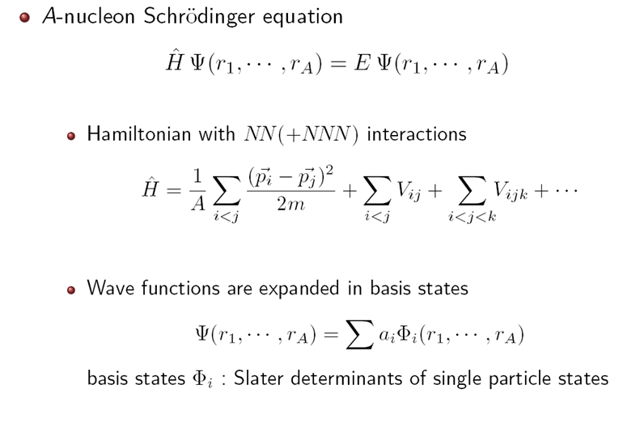

Slide 5
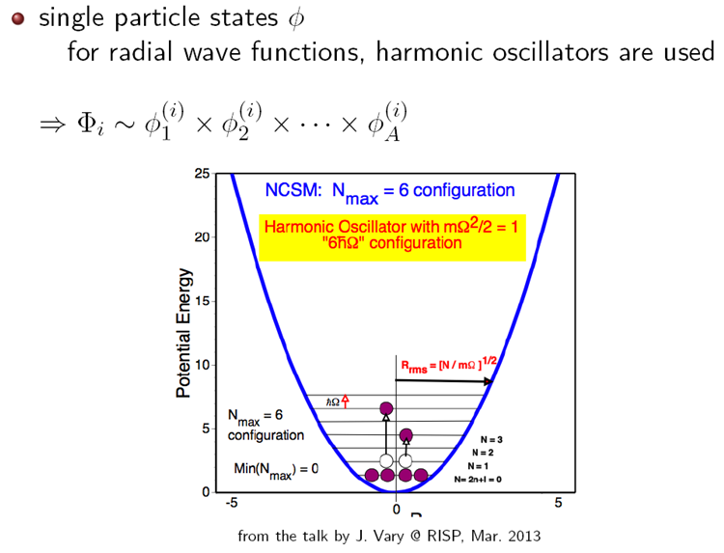

Slide 6
Ab initio structure and NN interaction
Unfortunately, the NN interaction at low energies needed for nuclear physics applications cannot be directly derived from QCD at the moment
Ab initio theory requires, of course, a realistic NN interaction accurately describing NN scattering data and deuteron properties
Nice to avoid NNN forces? Yes

Slide 7
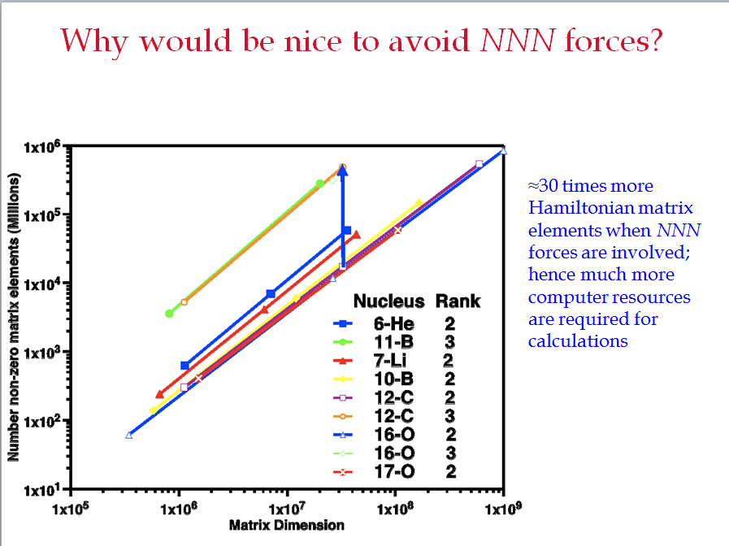
(Andrey Shirokov)

Slide 8
Example: ⁶Li
Ik Jae Shin, Y. Kim, P. Maris, J. P. Vary, C. Forssén, J. Rotureau, N. Michel, J .Phys. G44, 075103 (2017)

Slide 9
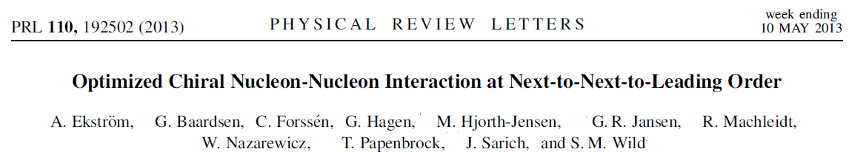
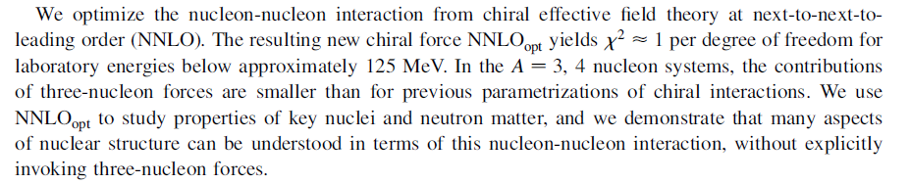

Slide 10
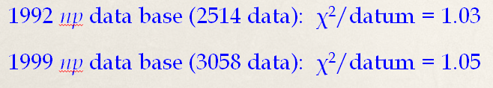
JISP (J-matrix Inverse Scattering Potential)
completely phenomenological
provides a good convergence of many-body calculations, eff. interaction is not needed
fitted to describe light nuclei: JISP6 up to A = 6, JISP16 up to A = 16
provides a high-quality description of NN data: chi²/datum = 1.03 up to E_{lab} = 350 MeV for the 1992 np data base (Andrey Shirokov)
A. M. Shirokov, A. I. Mazur, S. A. Zaytsev, J. P. Vary, T. A. Weber, Phys. Rev. C 70, 044005 (2004)
A. M. Shirokov, J. P. Vary, A. I. Mazur, S. A. Zaytsev, T. A. Weber, Phys. Lett. B 621, 96 (2005)
A. M. Shirokov, J. P. Vary, A. I. Mazur, T. A. Weber, Phys. Lett. B 644, 33 (2007)

Slide 11
Extrapolation methods
P. Maris, J. P. Vary and A. M. Shirokov, Phys. Rev. C 79, 014308 (2009),
C. Forssen, J. P. Vary, E. Caurier and P. Navratil, Phys. Rev. C 77, 024301 (2008),
S. A. Coon, M. I. Avetian, M. K. G. Kruse, U. van Kolck, P. Maris and J. P. Vary, Phys. Rev. C 86, 054002 (2012),
R. J. Furnstahl, G. Hagen and T. Papenbrock, Phys. Rev. C 86, 031301 (2012),
S. N. More, A. Ekstrm, R. J. Furnstahl, G. Hagen and T. Papenbrock, Phys. Rev. C 87, 044326 (2013),
…

Slide 12
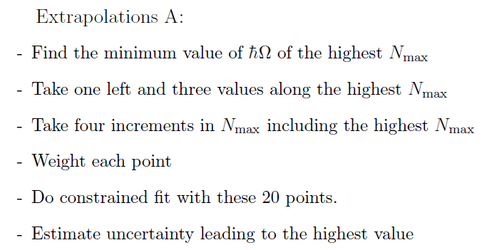
Extrapolating to the infinite matrix limit
“Extrapolations A & B”
P. Maris, J.P. Vary and A.M. Shirokov, Phys. Rev. C79, 014308 (2009)
P. Maris, A.M. Shirokov and J.P. Vary, Phys. Rev. C81, 021301(R) (2010)

Slide 13
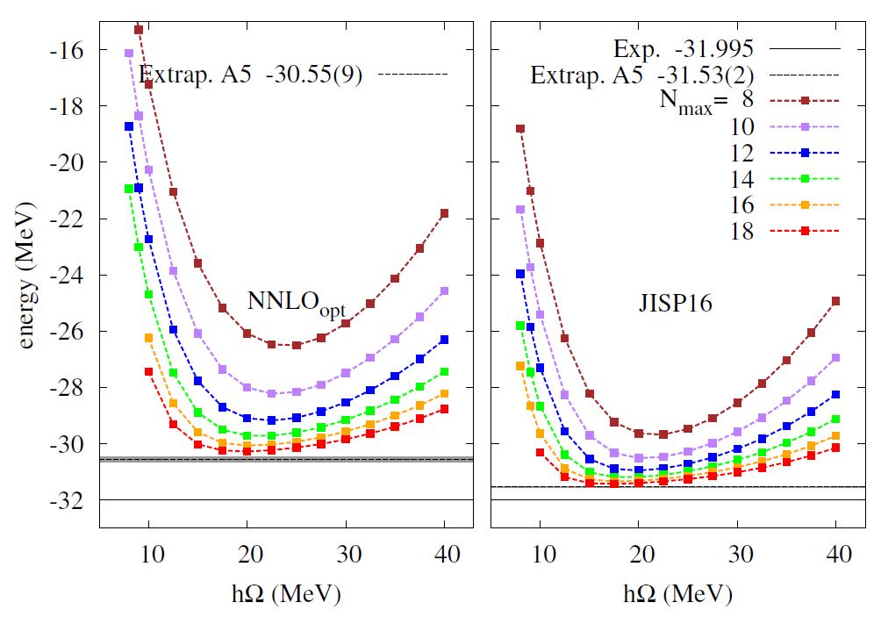
converge more slowly,
underbound by 1.44 MeV
,
underbound only by 0.46 MeV
⁶Li, Nmax=16; ~15,000 cores

Slide 14
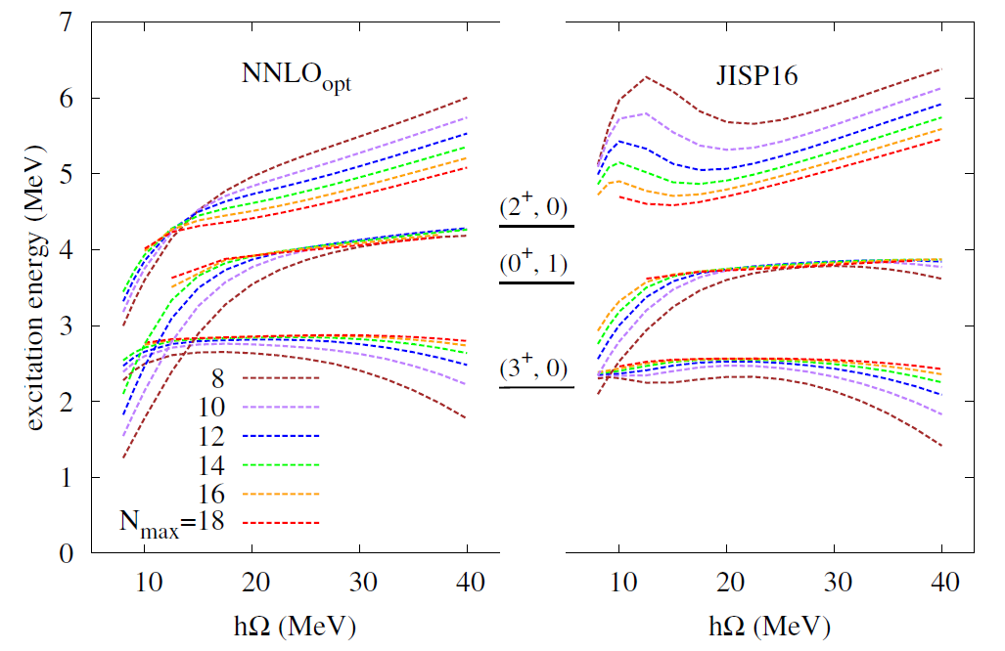
1.3 MeV
8.2 eV
24 keV
level ordering is ok with experiments

Slide 15
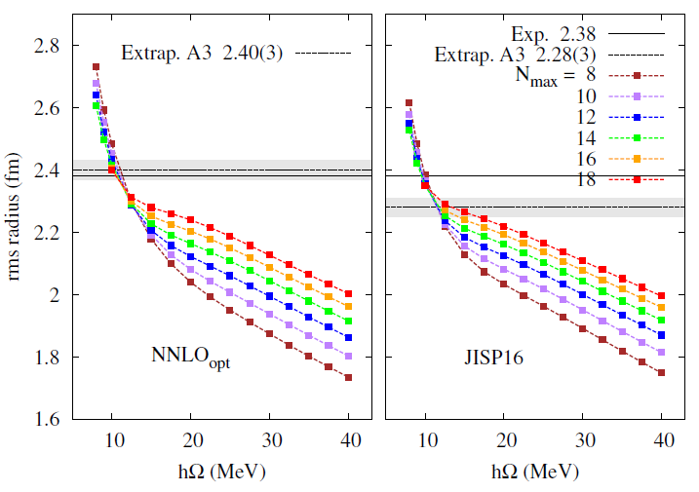


Slide 16
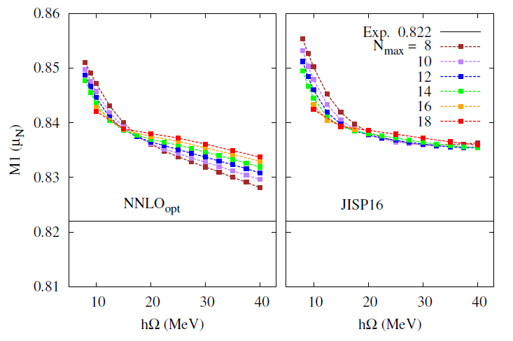
Both are within 2% of the experimental value

Slide 17
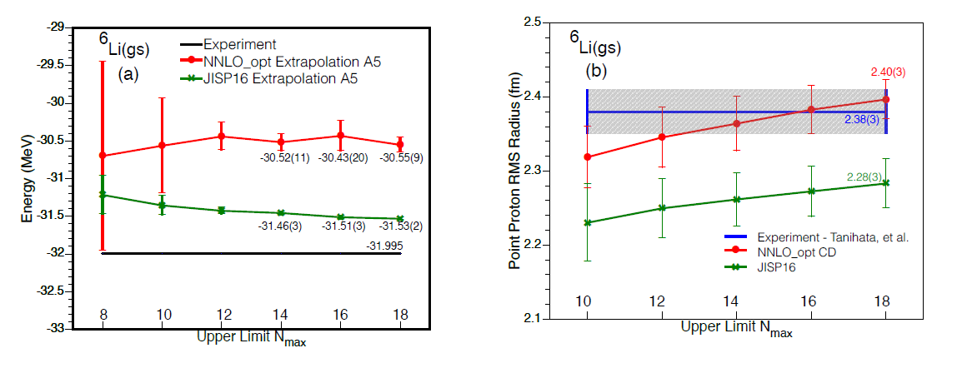

Slide 18
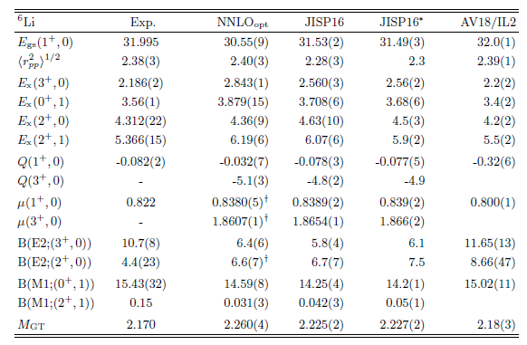

Slide 19
Daejeon 16
"N3LO NN interaction adjusted to light nuclei in ab exitu approach,"
A.M. Shirokov, I.J. Shin, Y. Kim, M. Sosonkina, P. Maris, J.P. Vary, PLB761 (2016) 87
Unfortunately, the NN interaction at low energies needed for nuclear physics applications cannot be directly derived from QCD at the moment
Ab initio theory (NCSM in our case) requires, of course, a realistic NN interaction accurately describing NN scattering data and deuteron properties
NNN requires a significant increase of computational resources, e.g. by a factor of 30 in the case of p-shell nuclei
Nice to avoid NNN forces? Yes

Slide 20
Daejeon 16
We use phase-equivalent transformations to adjust off-shell properties of similarity renormalization group evolved chiral effective field theory NN interaction (Idaho N3LO) to describe binding energies and spectra of light nuclei without NNN forces.
W. Polyzou and W. Glöckle theorem [Few-body Syst. 9, 97 (1990))]
H=T+V_{ij} ⇒ H’=T+V’_{ij}+V_{ijk}
where V_{ij} and V’_{ij} are phase-equivalent, H and H’ are isospectral.
Is it possible to transform as
H’=T+V’_{ij}+V_{ijk} ⇒ H=T+V_{ij}
with (approximately) isospectral H and H’ to minimize the need for the explicit introduction of three and higher body forces?
Assumption: our selected PETs are generating NNN forces which cancel the combined effect of the ‘intrinsic’ NNN interaction and the NNN force induced by the SRG transformation.

Slide 21
PET (phase equivalent transformation)
Assume unitary matrix [U] has only a finite matrix mixing of a few selected basis function. Then H and H’ have identical eigenvalues, and also asymptotic behavior of their eigenvector wave functions are same.
do not change scattering phase shifts and bound state energies of two-body system
but are supposed to modify two-body bound state observables such as the rms radius and electromagnetic moments
ex) JISP16 [A.M. Shirokov, J.P. Vary, A.I. Mazur and T.A. Weber, Phys. Lett. B 644 (2007) 33]

Slide 22
JISP16 vs Daejeon16
ISTP
(inverse scattering tridiagonal potential)
N3LO interaction
SRG
(similarity renormalization group)
SRG-evolved N3LO
PET (phase equivalent transformation)
JISP16
(J-matrix inverse scattering potential)
Daejeon16

Slide 23

PET angles (in degrees) defining the Daejeon16 NN interaction in various NN partial waves.
binding energies of ³H, ⁴He, ⁶Li, ⁸He, ¹⁰B, ¹²C, ¹⁶O
excitation energies of ⁶Li [(3⁺,0), (0⁺,1)], ¹⁰B[(1⁺,0)], ¹²C[(2⁺,0)]

Slide 24
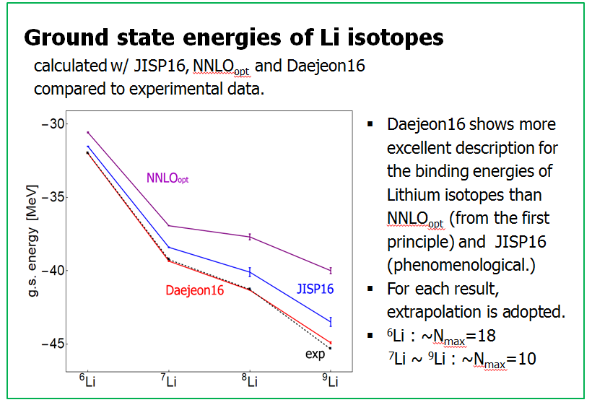

Slide 26
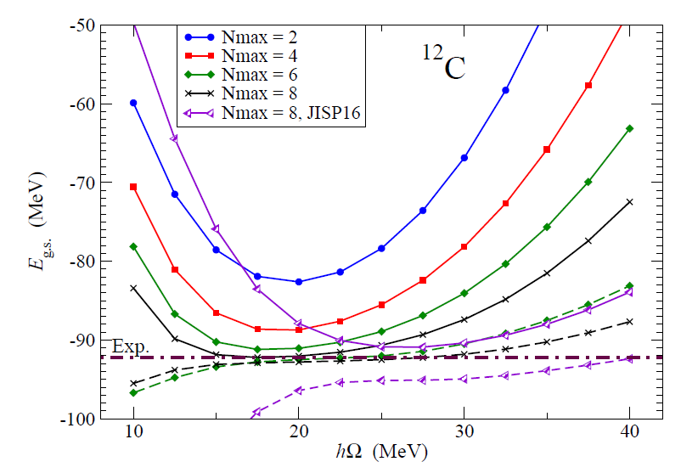
¹²C ground state energy in NCSM calculations obtained with Daejeon16 NN interaction

Slide 28
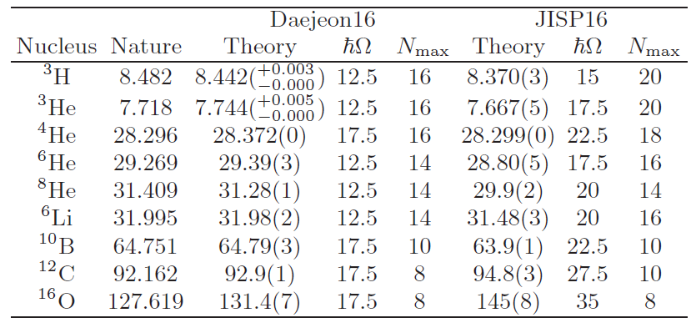
Binding energies (in MeV) of nuclei obtained with Daejeon16 NN interaction using Extrapolation B with estimated uncertainty of the extrapolation.

Slide 29
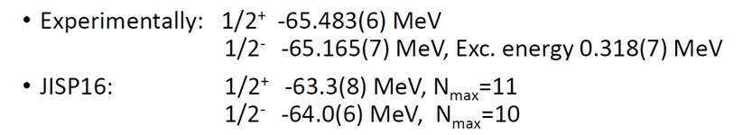
Parity Inversion in ¹¹Be

Slide 30
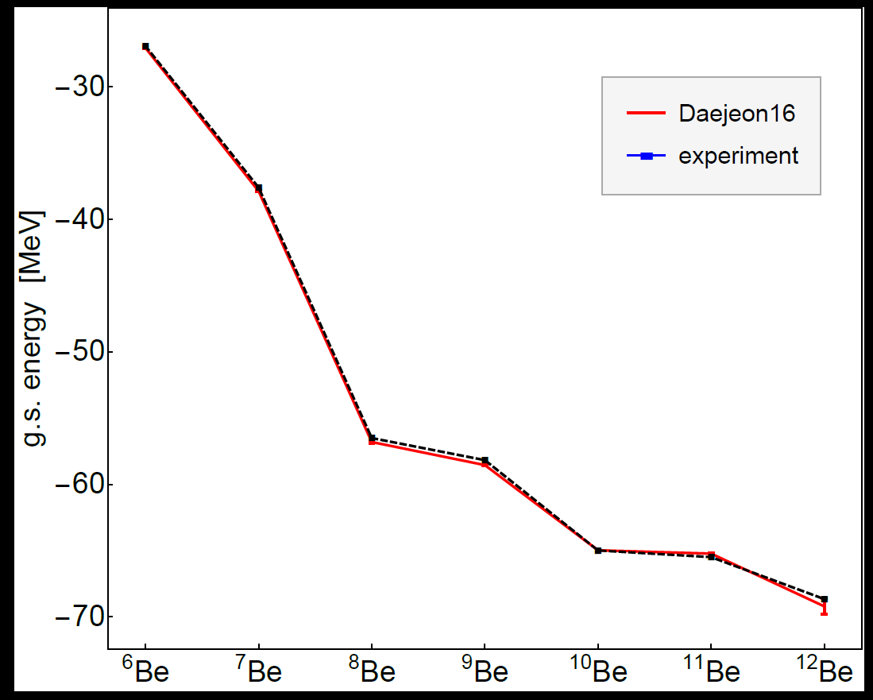

Slide 31
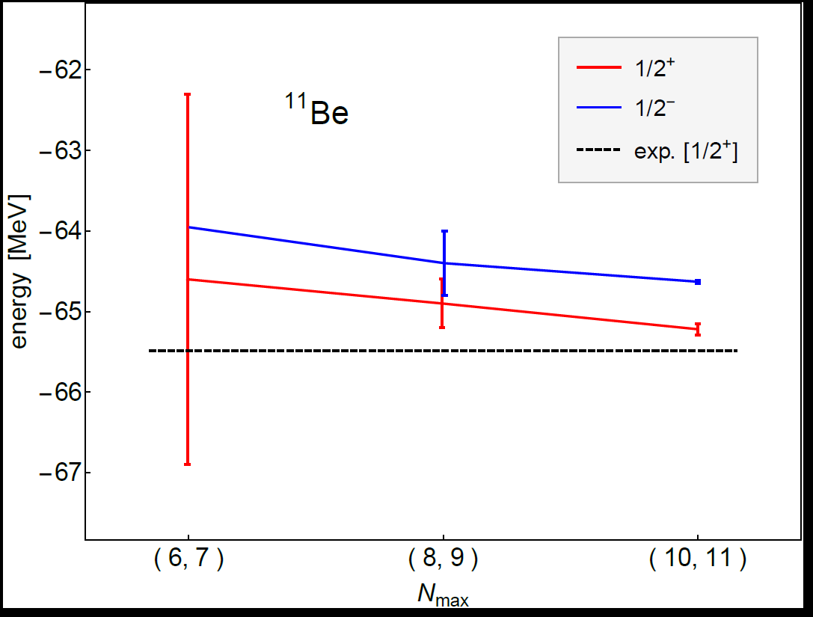


Slide 32
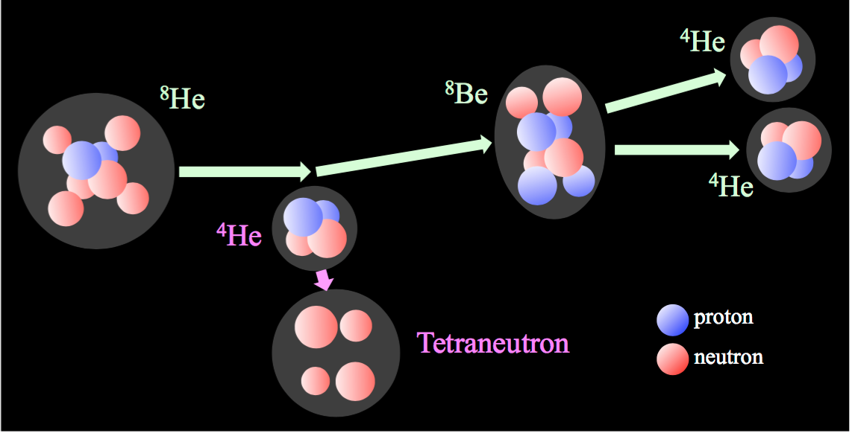
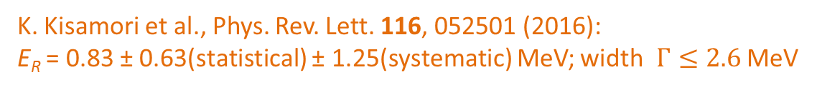
Tetra neutron
K. Kisamori et al., Phys. Rev. Lett. 116, 052501 (2016):
E_{R} = 0.83 ± 0.63(statistical) ± 1.25(systematic) MeV; width $Γ≤2.6$ MeV

Slide 33
JISP 16: E_{r}=0.8 MeV, Г=1.4
A.M. Shirokov, G. Papadimitriou, A.I. Mazur, I.A. Mazur, R. Roth, J.P. Vary. Phys. Rev. Lett. 117 (2016) 182502
Daejeon16: E_{r}=0.3 MeV, Г=0.7 MeV and E_{r}=0.8 MeV, Г=1.3 MeV

Slide 34
Deep Learning: A Tool for Computational Nuclear Physics
G. A. Negoita, et al., Proceedings of the Ninth International Conference on Computational Logics, Algebras, Programming, Tools, and Benchmarking COMPUTATION TOOLS 2018, [arXiv:1803.03215 [physics.comp-ph]].

Slide 35
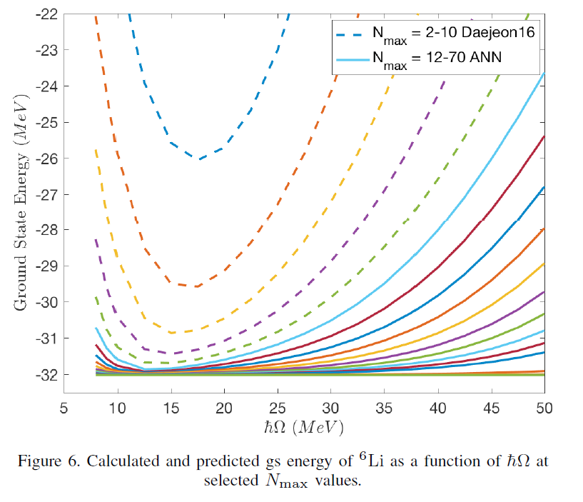

Slide 36
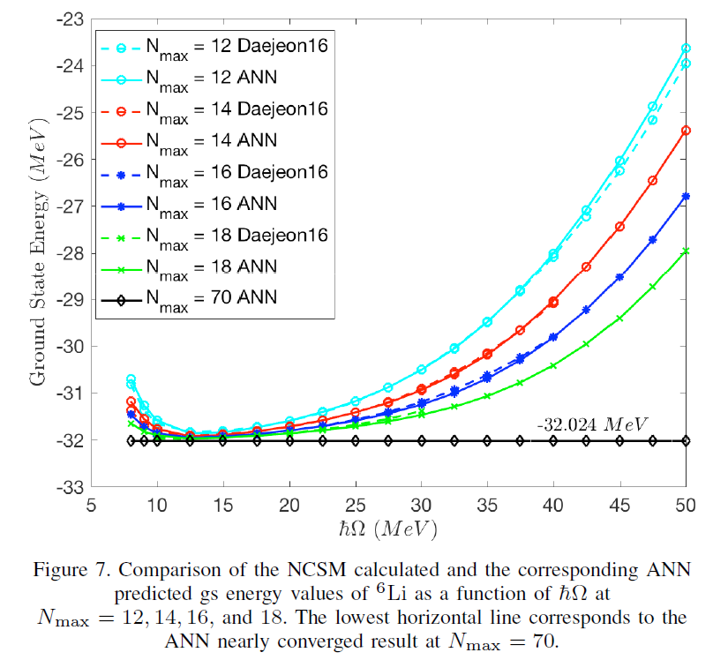

Slide 37
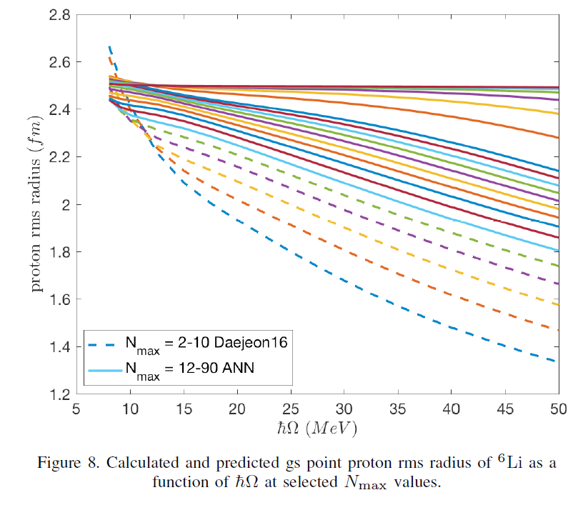

Slide 38
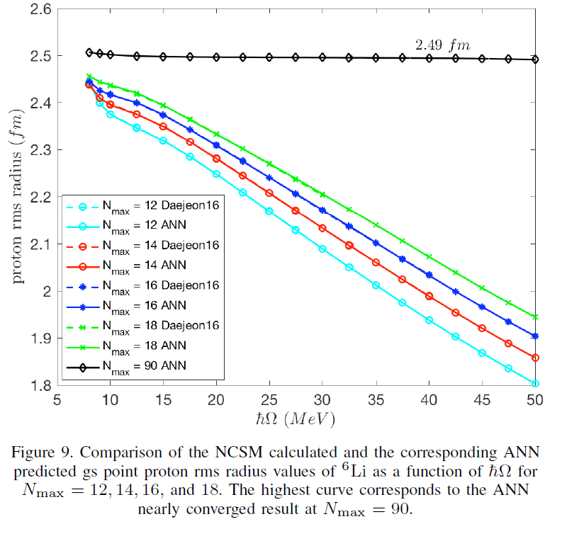

Slide 39
Nucleon-alpha Scattering and Resonances in ⁵He and ⁵Li with JISP16 and Daejeon16 NN interactions:
A.M. Shirokov, A.I. Mazur, I.A. Mazur, E.A. Mazur, I.J. Shin, Y. Kim, L.D. Blokhintsev, J.P. Vary, e-Print: arXiv:1808.03394 [nucl-th]

