Slide 1
Optimal quantum interference thermo- electric heat engine with edge states
Peter Samuelsson, Sara Kheradsoud, Björn Sothmann
APCTP-KIAS Workshop on Motors and Engines
June 2018
P. Samuelsson, S. Kheradsoud, B. Sothmann, Phys. Rev. Lett. 118, 256801 (2017) .

Slide 2
Outline
Thermoelectrics and edge state transport
Heat to electric energy conversion
Mesoscopic and nanoscale thermoelectrics
Edge state thermoelectrics
Coherent thermoelectrics
Coherence enhanced performance.
Optimal performance.
Double-slit interferometer.
Close-to-optimal edge state implementation
Mach Zehnder interferometer with side-coupled dot.
Transmission properties, power and efficiency.
Close-to-optimal performance.

Slide 3
Outline
Thermoelectrics and edge state transport
Heat to electric energy conversion
Mesoscopic and nanoscale thermoelectrics
Edge state thermoelectrics
Coherent thermoelectrics
Coherence enhanced performance.
Optimal performance.
Double-slit interferometer.
Close-to-optimal edge state implementation
Mach Zehnder interferometer with side-coupled dot.
Transmission properties, power and efficiency.
Close to optimal performance.

Slide 4
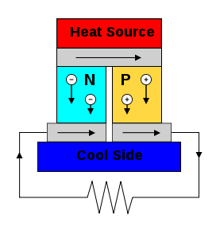
Heat to electric energy conversion
Thermoelectric heat engine
Semiconductor thermocouple
Grand idea: Conversion of waste heat to electric energy
Figure of merit
Heremans et al., Nat. Nano. 2013
Going nano
Hicks, Dresselhaus, PRB 1993
Low dimensionality
Size quantization
Strongly energy dependent transport

Slide 5
Nanoscale thermoelectric heat engines
Multi terminal heat engines
Roche et al., Nat. Comm. 2015
Properties
Separated heat and electric current flows
Rectification of fluctuations
Thierschmann et al., Nat. Nano. 2015

Slide 6
Edge state thermoelectrics
Edge state transport, integer quantum Hall effect
Classical
Quantum
Nernst effect
Three terminal heat engine
Sanchez, Sothmann, Jordan, PRL 2015
Sothmann, Sanchez, Jordan, EPL 2014

Slide 7
Outline
Thermoelectrics and edge state transport
Heat to electric energy conversion
Mesoscopic and nanoscale thermoelectrics
Edge state thermoelectrics
Coherent thermoelectrics
Coherence enhanced performance.
Optimal performance.
Double-slit interferometer.
Close-to-optimal edge state implementation
Mach Zehnder interferometer with side-coupled dot.
Transmission properties, power and efficiency.
Close-to-optimal performance.

Slide 8
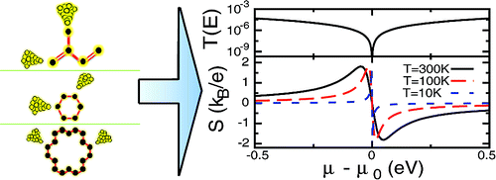
Coherence enhanced performance
Quantum dots/molecules
Mach-Zehnder interferometer
Rolleau et al. PRL 2008
Transport through two-level system
Heat engine proposal
Karlström et al, PRB 2011
Hofer, Sothmann, PRB 2015
Bergfield, Stafford, Nano Lett. 2009

Slide 9
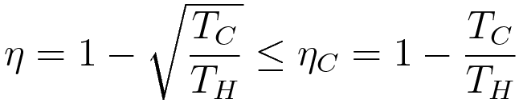
Optimal performance
Optimal transmission properties
Maximizing output power
Step function in energy
Efficiency
At maximum power
Curzon-Ahlborn limited
Whitney, PRL 2014
Q1: Can a purely interference based TE-heat engine be optimal?

Slide 10




Double slit interferometer
Generic interferometer
Scattering amplitude
Phase due to Aharanov-Bohm, ..
No individual TE-effect
Energy independent
Energy dependence
Scattering probability

Slide 11



Double slit interferometer
Conditions for optimal performance
Symmetric interferometer, .
Sharp phase jump for
Q1: Can a purely interference based TE-heat engine be optimal?
A1: Yes
Q2: Is there a possible experimental realization of such optimal engine (with edge states)?

Slide 12
Outline
Thermoelectrics and edge state transport
Heat to electric energy conversion
Mesoscopic and nanoscale thermoelectrics
Edge state thermoelectrics
Coherent thermoelectrics
Coherence enhanced performance.
Optimal performance.
Double-slit interferometer.
Close-to-optimal edge state implementation
Mach Zehnder interferometer with side-coupled dot.
Transmission properties, power and efficiency.
Close to optimal performance.

Slide 13





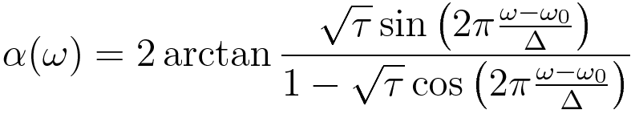
Mach-Zehnder with capacitor
Properties
Quantum point contacts
Mesoscopic capacitor
Contacts
Interferometer
Total transmission amplitude
Scattering phase at MC

Slide 14

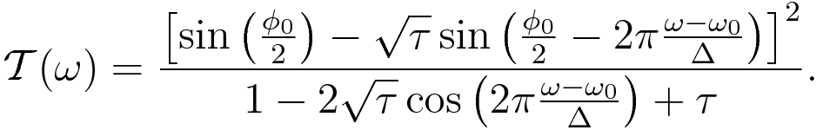

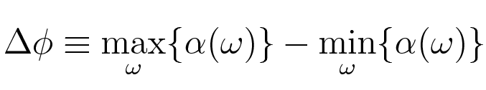


Transmission properties
Semitransparent splitters (symmetric condition),
Effective phase shift
for

Slide 15




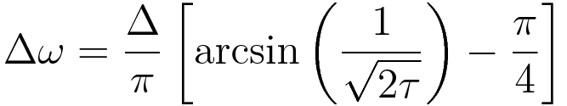
Transmission properties
Phase dependent symmetries
Filter analogy, ,
Ripple
Transition width, roll-off

Slide 16
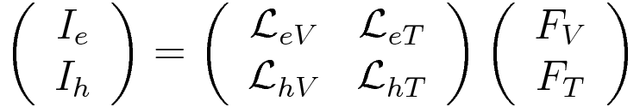




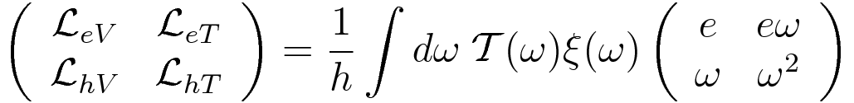
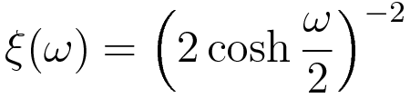
Thermoelectric scattering theory
Linear response theory (non-interacting), charge and heat currents
Butcher, 1990
Thermodynamic forces
where
Onsager matrix
where

Slide 17
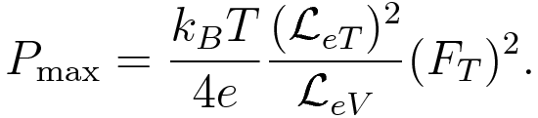
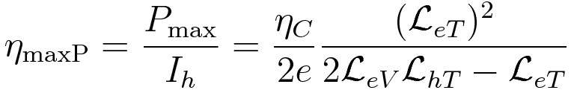
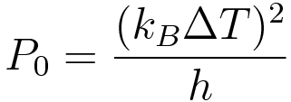
Power and efficiency
Maximum power generated, with respect to voltage
Efficiency at maximum power

Slide 18






Close-to-optimal performance
Optimal, single mode performance (step function transmission)
for
Numerical optimization
Optimizing over
Parameters
Values
90%
83%

Slide 19


Show-stoppers?
Dephasing
Asymmetry
Survives for moderate dephasing strength
Zero for complete dephasing.
Not very sensitive to arm length asymmetry

Slide 20
Conclusions
Interference-only thermoelectrics potentially optimal
Close-to-optimal performance in edge-state setup
Not very sensitive to dephasing and asymmetry
P. Samuelsson, S. Kheradsoud, B. Sothmann, Phys. Rev. Lett. In press.

