Slide 1
Overshooting and time delay in multi-feedback information engines
Chulan Kwon, Myongji University
Phys. Rev. E 95, 042103 (2017)
Europhys Lett. 117, 10011 (2017)
Contents
Introduction
Overshot Feedback: Trap Feedback
Time-delayed Feedback: Cold Damping
Summary and Future

Slide 2

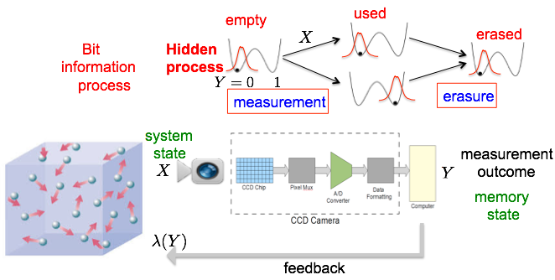
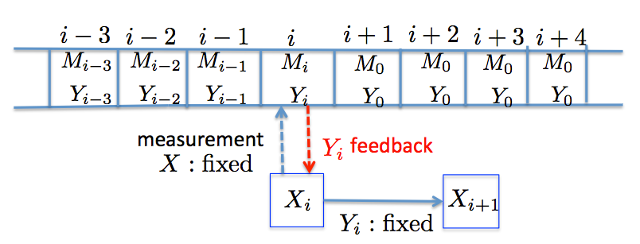
I. Introduction
Information process

Slide 3




I. Introduction
2. Post-measurement process
3. Shannon entropy and mutual information
Generalized second law
Sagawa et al, 2012
Landauer’s
erasure is not
needed. (Benett,1982)

Slide 4
I. Introduction
4. Overshooting
- feedback protocol for a special task based on measurement
- may not be efficient for the long-time duration from measurement
- resulting in low quality or failure of the task performance
- bad correlation between system and memory
—> the increase of mutual information
- caused by measurement error, long-duration between feedback steps,
time-delay in feedback process, large intensity of protocol, etc , which are
not avoidable in real experiments
anti-MI increase
MI decrease
new (bad) MI built-up

Slide 5



II. Overshot Feedback: Trap Feedback
Phys. Rev. E 95, 042103 (2017)
Task: reduction of mean-square-distance by repeated feedback
Expect
Solve
For only suitable values of
feedback is stable
and efficient

Slide 6

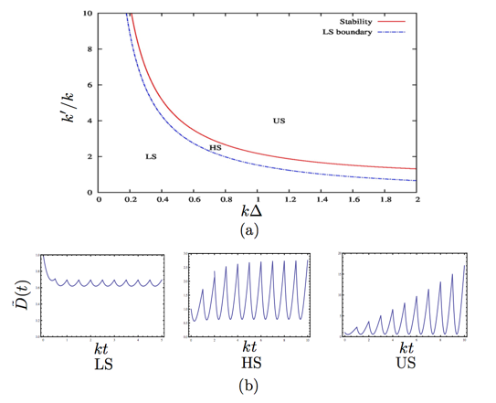
II. Overshot Feedback: Trap Feedback
Stability
where
Recursion is stable if

Slide 7
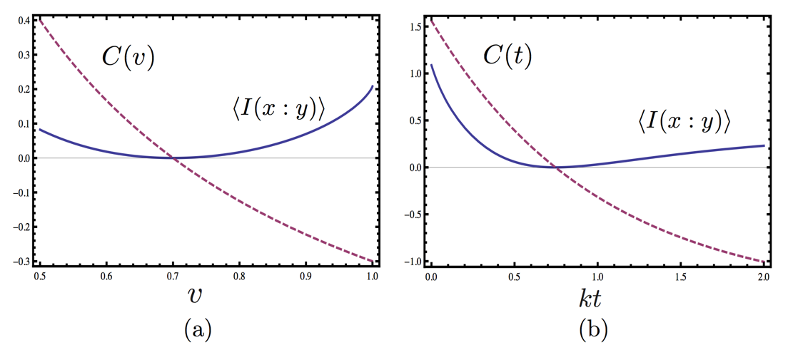
II. Overshot Feedback: Trap Feedback
Overshooting due to large
Correlation versus mutual information

Slide 8
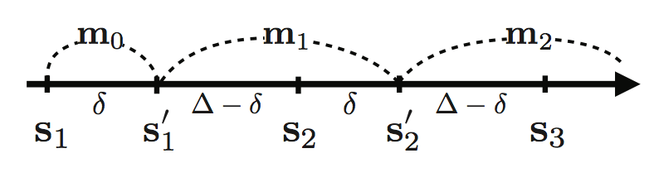
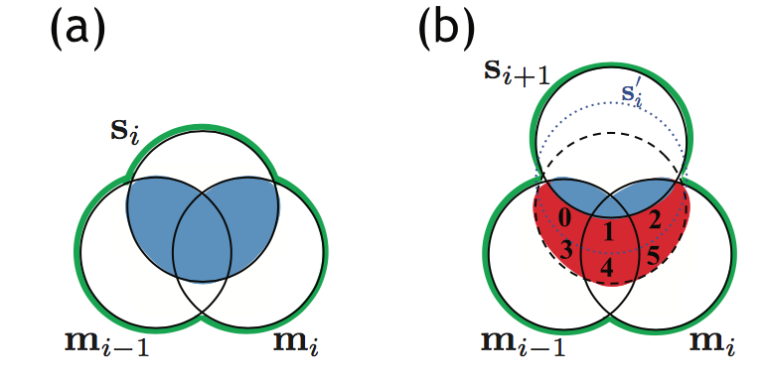

III. Time-delayed Feedback: Cold Damping
CK, J. Um, H. Park, EPL 117, 10011 (2017)
Three types of mutual information change
has the tightest positive bound.

Slide 9


III. Time-delayed Feedback: Cold Damping
Cold damping
Task: reduction of speed by repeated feedback
Path prob:
Linear recursion relation
Stability condition

Slide 10

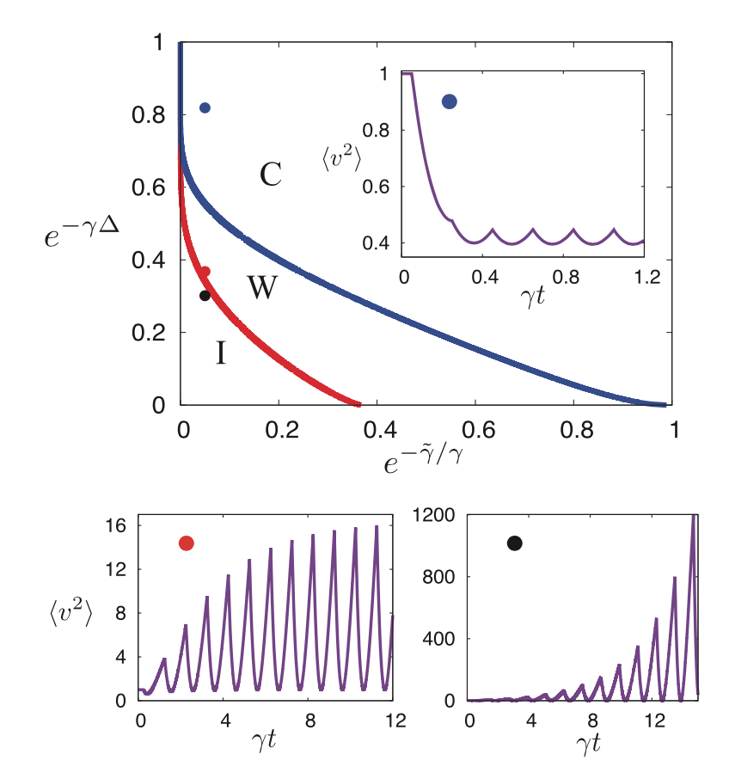
III. Time-delayed Feedback: Cold Damping

Slide 11
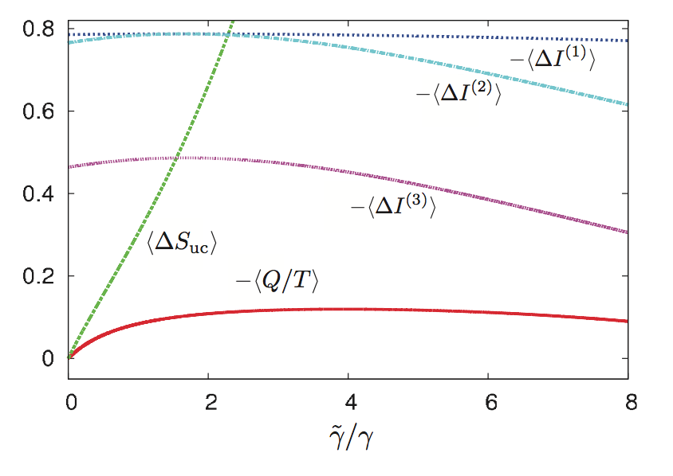
III. Time-delayed Feedback: Cold Damping
Total entropy production in a single interval for long feedback step

Slide 12
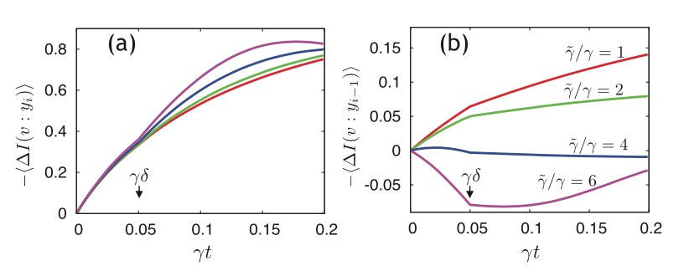
III. Time-delayed Feedback: Cold Damping
Overshooting for large t or large

Slide 13

IV. Summary and Future
Information and thermodynamic process of feedback via measurement is investigated.
Mutual information contributes to the entropy of the composite system of system and memory and measures the correlation between system and memory states.
Overshooting may appear when too large feedback parameters such as time interval, intensity of feedback protocol, measurement error are used.
Non-monotonous change of mutual information and anti-correlation appear as the onset of overshooting.
The trap feedback with the appearance of overshooting is studied .
Cold damping with time delay is studied.
A problem:
We need to find a different definition of entropy production having a finite positive bound.

