Slide 1
Statistics of an adiabatically driven quantum engine
himangshu prabal goswami,
Max-planck institute for the physics of complex systems,
APCTP-KIAS Workshop on "Motors and Engines"
JJune 27, 2018

Slide 2
Talk Outline:
Driven Systems
Geometric or Berry Phase (time-dependent Hamiltonians)
Quantum Heat Engine Model
Non driven Results
Driven Quantum Heat Engine Model
Machine Learning or artificial intelligence approach to statistics
Effects of Berry Phase on flux, II Law and efficiency
Conclusion

Slide 3
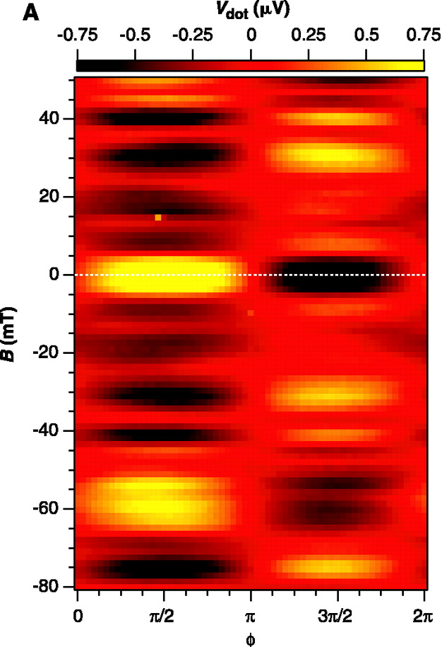
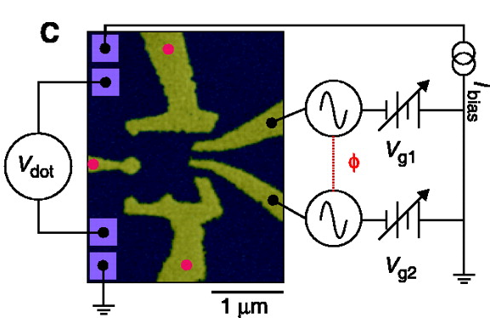
Motivation :Driving-induced electron pumping
QD
Source
V_{dot}
Drain
Negatively charged barriers
Zero magnetic field
External Driving via gates
I_{bias}
Switkes et al, Science (1999)

Slide 4
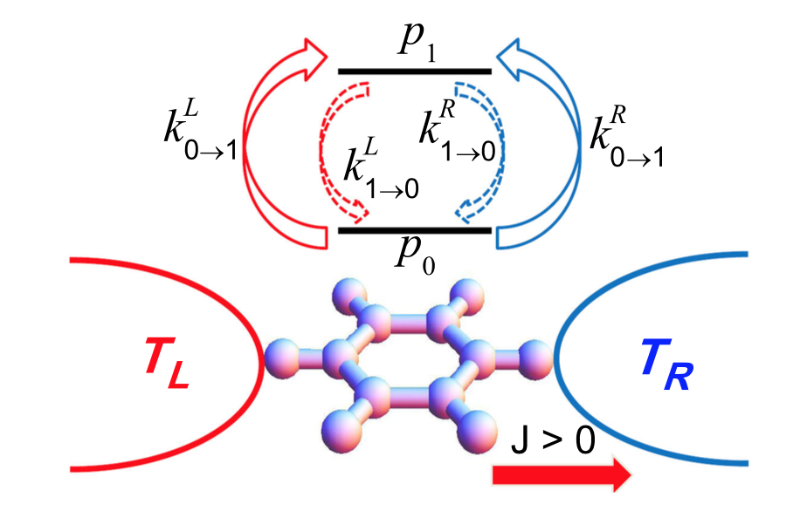
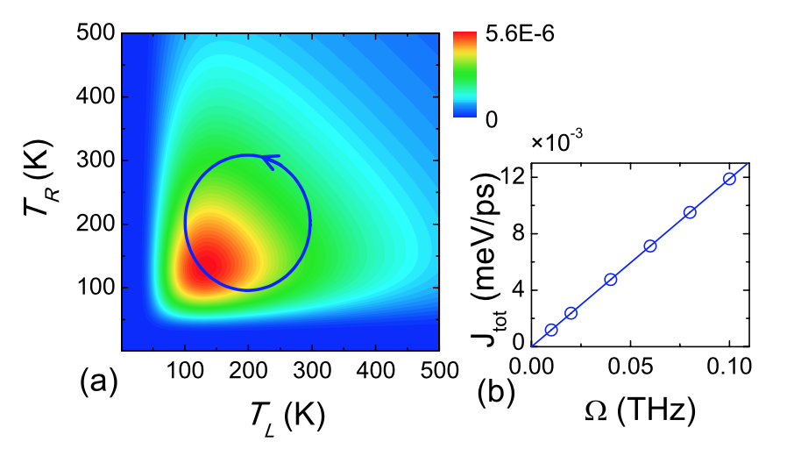

Motivation:Driving-induced heat pumping
Temperature is periodically modulated adiabatically.
External driving is much larger than internal relaxations
System is always in the steady state
Ren, Hanggi and Li, Phys. Rev. Lett (2010)

Slide 5

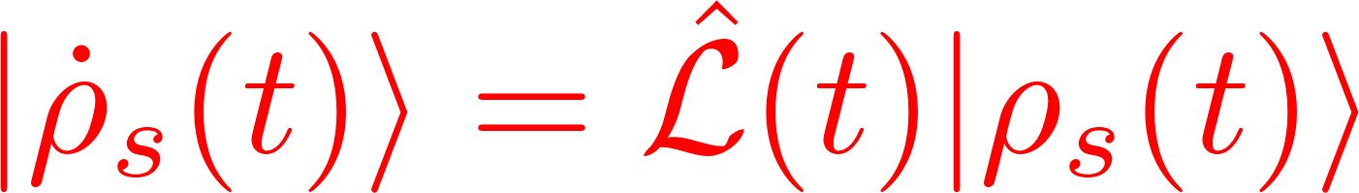
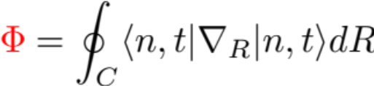

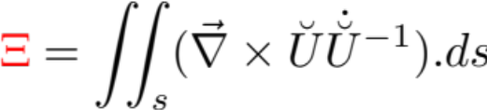
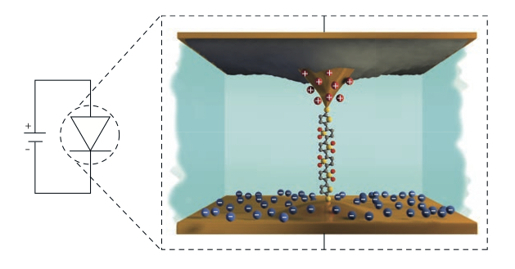
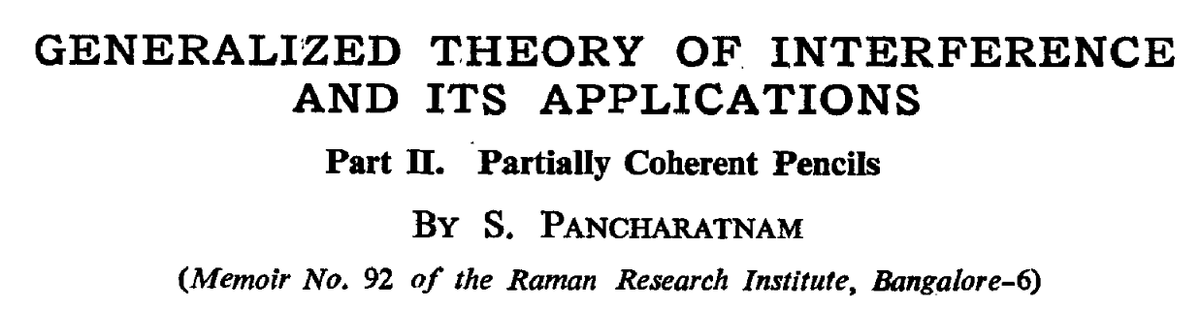
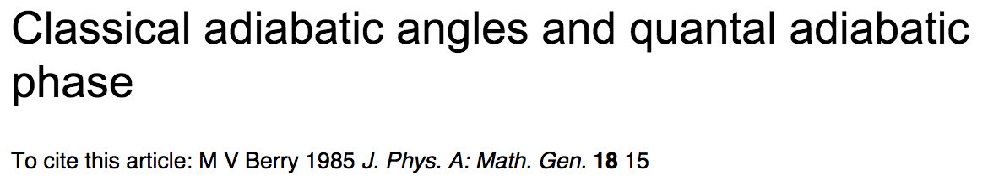
Geometric or Pancharatnam-Berry Phase
Periodic modulation of at least two parameters in adiabatic fashion in Hamiltonian”
ISOLATED Quantum System
NONequilibrium Quantum System
Reparametrization invariant
Gauge invariant
Proportional to area traced in parameter space
Analogous Equation to Schrodinger’s solution
Surface integral over Curl of eigensystem
Goswami and Harbola, Phys. Rev. B (2016)
Source Temperature, T_{h}
Connect reservoirs to time
varying thermostat
i.e
“DRIVEN DYNAMICS”
y_{t} =T_{h}(t)
Drain Temperature, T_{c}
x_{t} = T_{c}(t)
Notes:
Projection over the gradient of the eigenvector of H

Slide 6
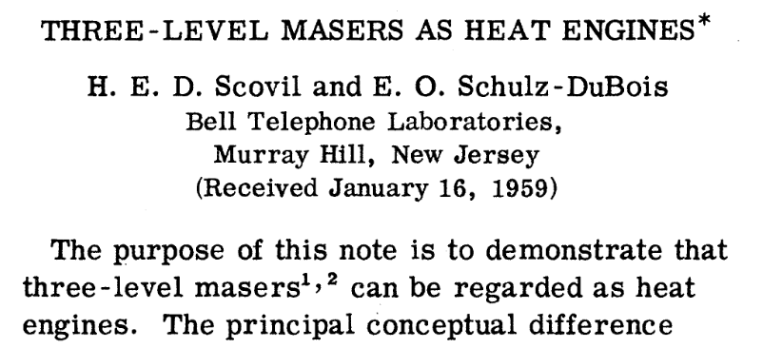
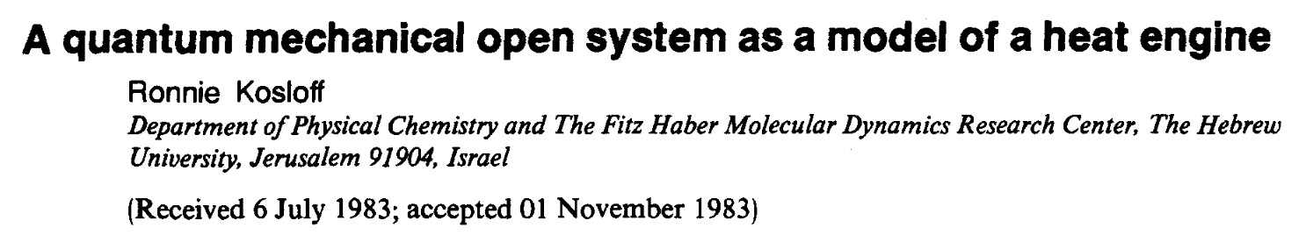
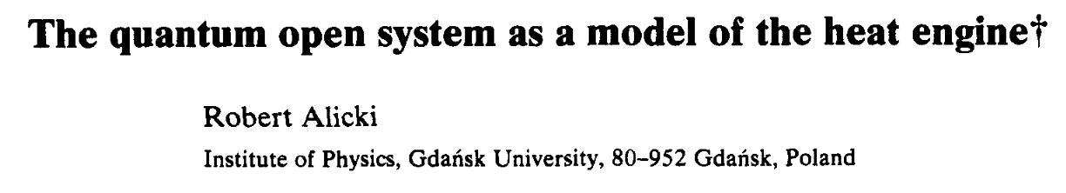
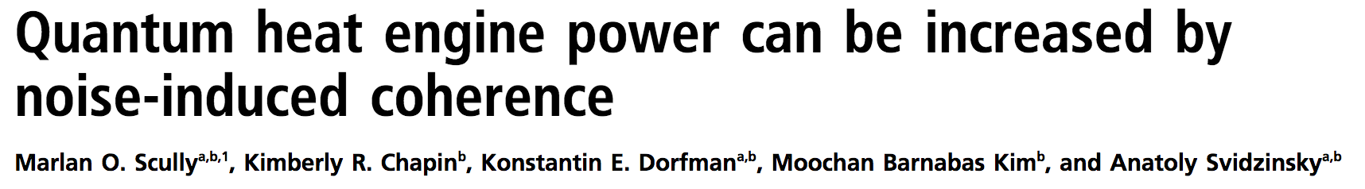
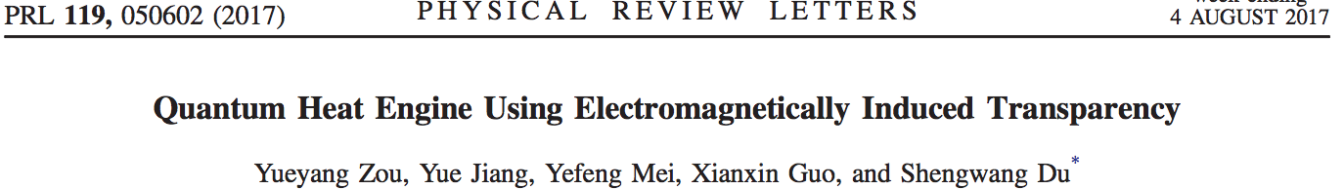
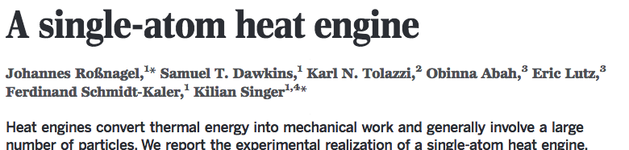



QUANTUM HEAT ENGINE
Hot Source
T_{h}
T_{c}
INTERESTED IN:
T_{h} => T_{h}(t)
T_{c} => T_{c}(t)
Quantized Levels
Giri and Goswami, Phys. Rev. E (2017)
Cold Drain

Slide 7
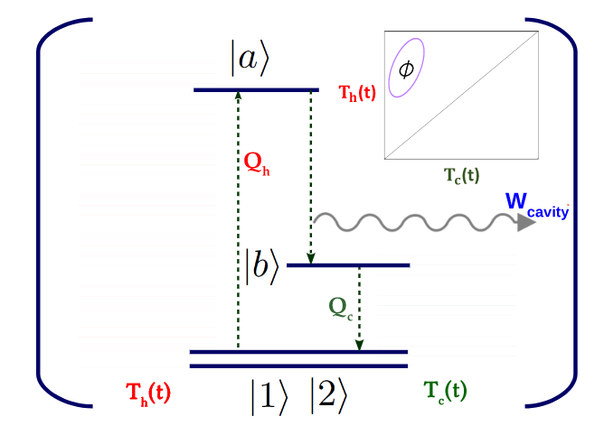
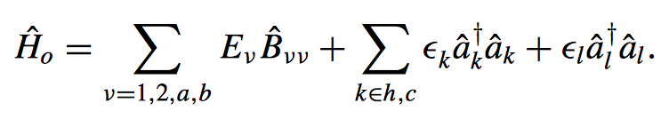
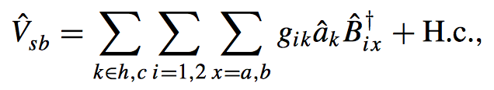
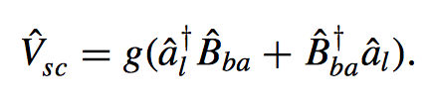

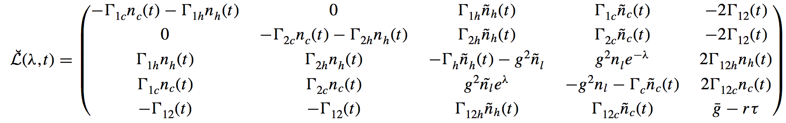
A driven Quantum Heat Engine Model
Hamiltonian
Full Counting Statistics Method
Coherence Measure parameters
Couplings
Driving dependent
Bose-Einstein Distributions
Notes:
Point out straight edge differences. Discuss Experimental evidence of QHE.

Slide 8
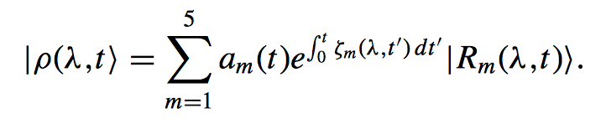
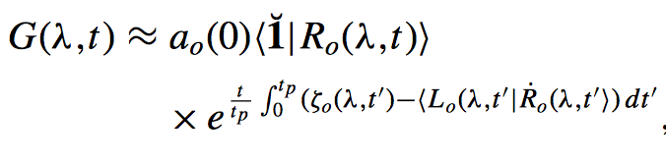
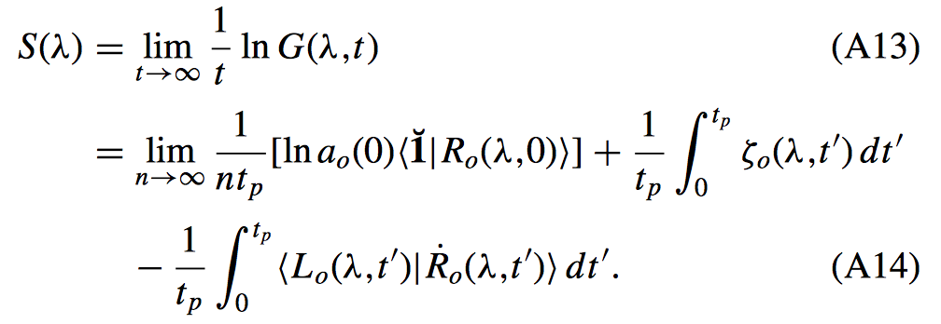
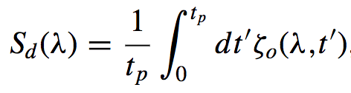

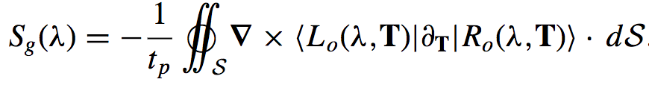
A driven Quantum Heat Engine Model
Generating Function:
Scaled Cumulant Generating Function:
Cavity Photon Flux, j
Dynamic
Geometric
Notes:
Point out straight edge differences. Discuss Experimental evidence of QHE.

Slide 9


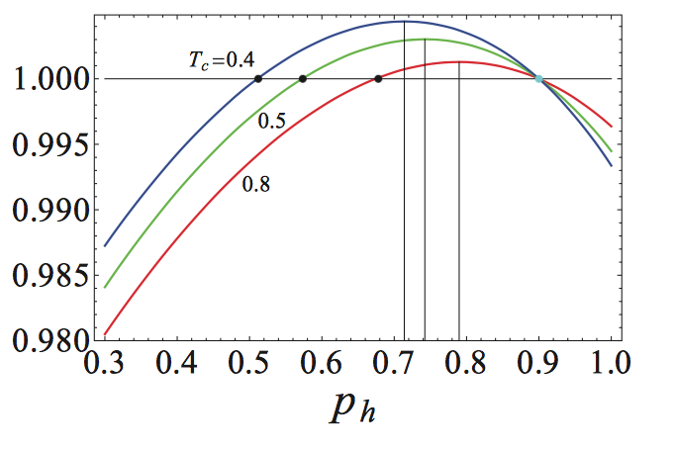
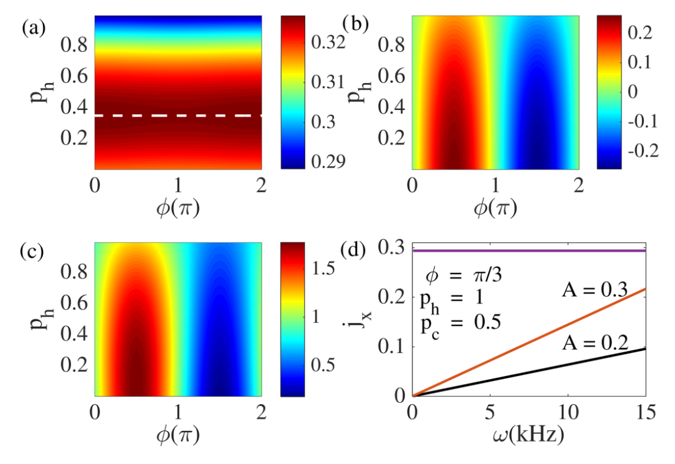
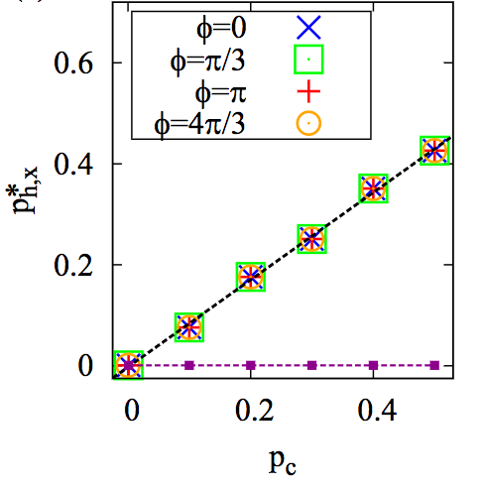
Effect on Flux
Maxima at 0 coherence
Minima at 0 coherence
Flux Optimization via
quantum coherence
is well known!
No Geometric optimal value
maxima
Linear increase of the Dynamic optimal value of hot coherence with cold coherence
Total flux
Geometric Effects nullify the effect of quantum coherences in optimizing the flux

Slide 10
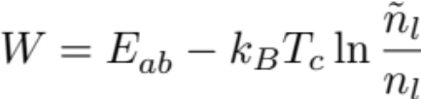
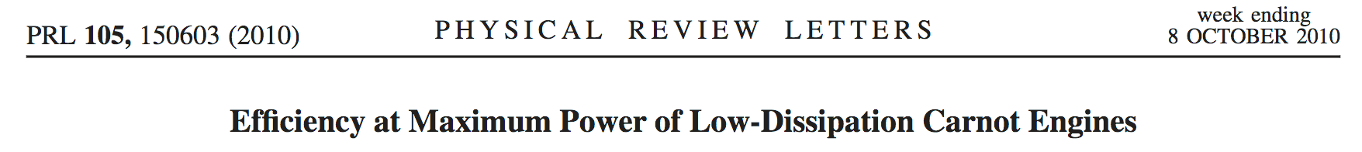
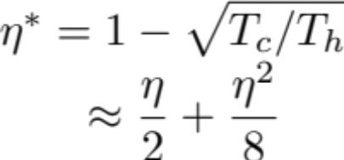
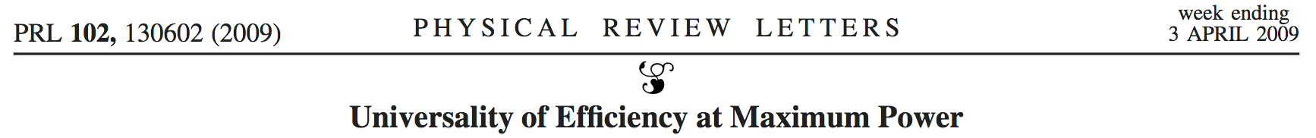
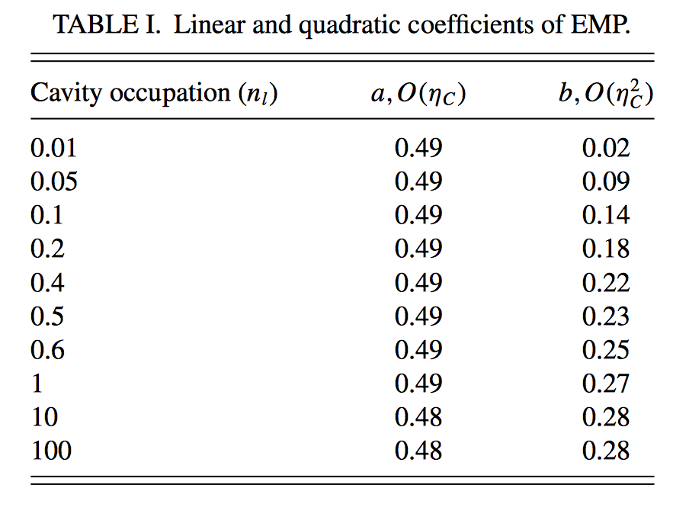
Universal Relationships in Efficiency at maximum Power
Power = j*W
EMP is the efficiency (W/(E_{a}- E₁)) when power is maximized with respect to system parameter: in this case, E_{a}
Curzon-Ahlborn EMP
(Carnot Efficiency)
Universal in all engines
Universal in left-right symmetric engines with low dissipation
For non-driven engine
Notes:
Discuss how to get geometric phase in QHE staring from Scovil-Dubois engine and then bring in the extra level to emphasize that you want to know coherence effects

Slide 11
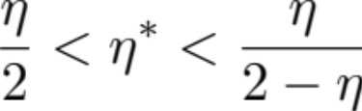
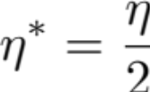
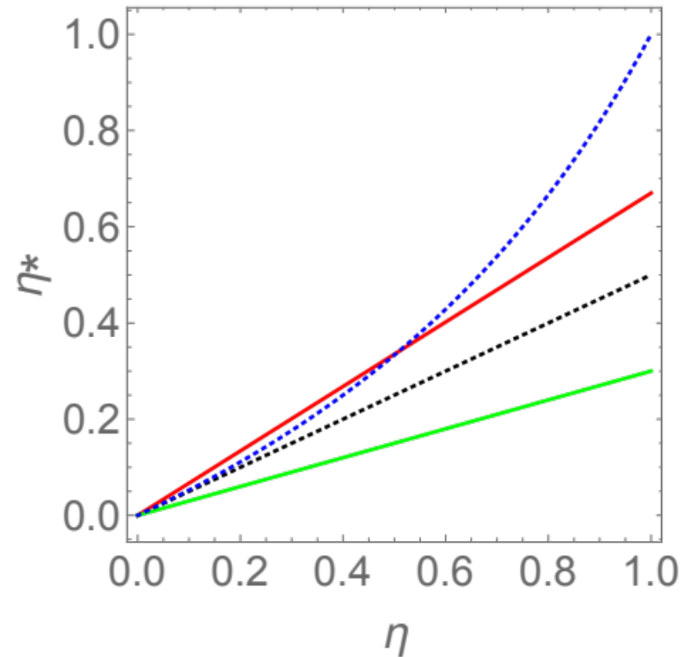
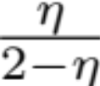
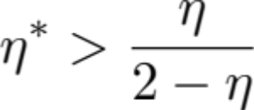
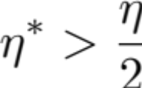


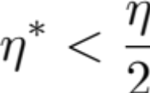

Universal Relationships in Efficiency at maximum Power
General Case:
Near Equilibrium:
Esposito et al
Violation of standard results
Recovered when phase difference is zero
Notes:
Discuss how to get geometric phase in QHE staring from Scovil-Dubois engine and then bring in the extra level to emphasize that you want to know coherence effects

Slide 12
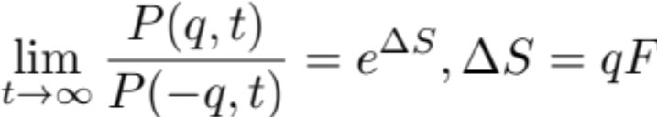
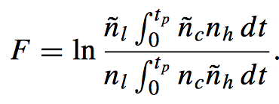
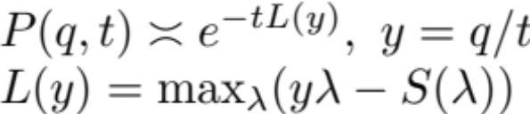

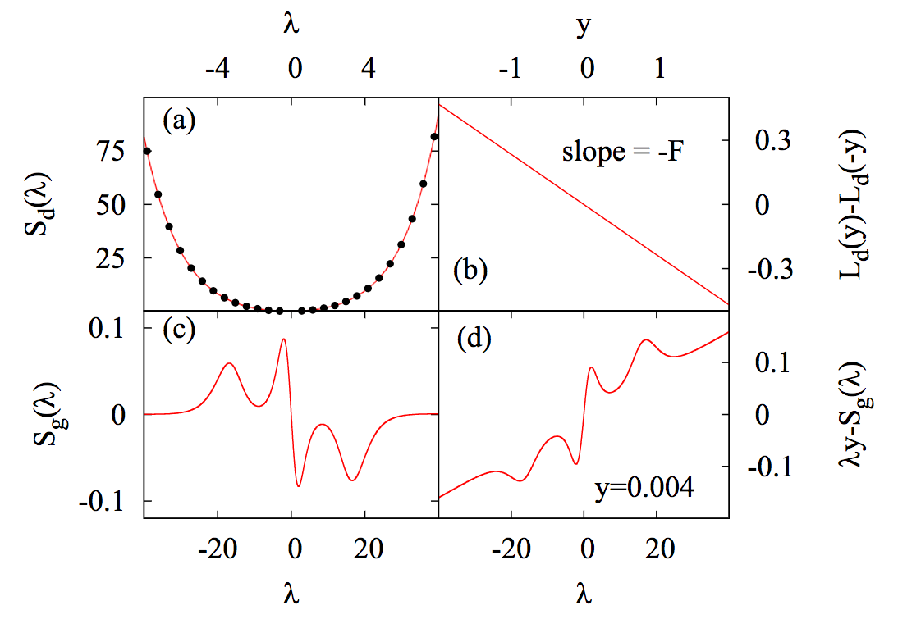
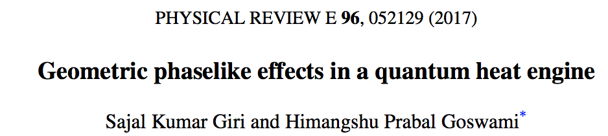
Impact on II Law
Fluctuation Theorem is the quantum analogue of II law of thermodynamics:
Campisi et al, Rev. Mod. Phys. (2011), Esposito et al, Rev. Mod. Phys. (2009)
For this model:
Non-driven case: Rahav et al, PRA (2012), Goswami and Harbola, PRA (2013)
Fluctuation Theorem comes from Large Deviation Theory:
Legendre Transform:
Reflected in a symmetry in the generating function :
Violates fluctuation theorem but not the II law
No symmetry with geometric contribution
Notes:
Show observations on how GP Kills flux optimazation.

Slide 13

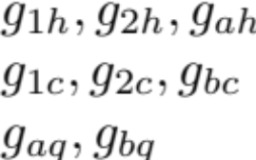

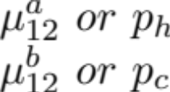

A different approach to statistics
Energies:
Hot Couplings:
Cold Couplings:
Cavity Couplings :
Hot Coherences:
Cold Coherence:
Driving parameters:
Reservoir Hamiltonian: Harmonic Oscillators
System Hamiltonian: Anharmonic Oscillator
Cavity Hamiltonian: Single Photonic mode.
Phase different driving protocol
Each set of parameters takes roughly 10 minutes to get a single value of an observable like variance
Very time consuming subsequent calculations.
Hence, “machine learning”
Notes:
Point out straight edge differences. Discuss Experimental evidence of QHE.

Slide 14




Machine Learning
“artificial intelligence via neural network algorithm”
Input vector
Output vector
Flux: mean
Variance
Skewness
PDF for
Net photon exchange between system and cavity
Layer Vectors
Neural Network: A network of vectors connected by weight matrices:
Artificial Intelligence: Error reduction by backpropagation via a Levenberg-Marquadt gradient descence and comparing predicted data with some known data.
Network becomes self aware of the relationship pattern between i/o via repetition

Slide 15
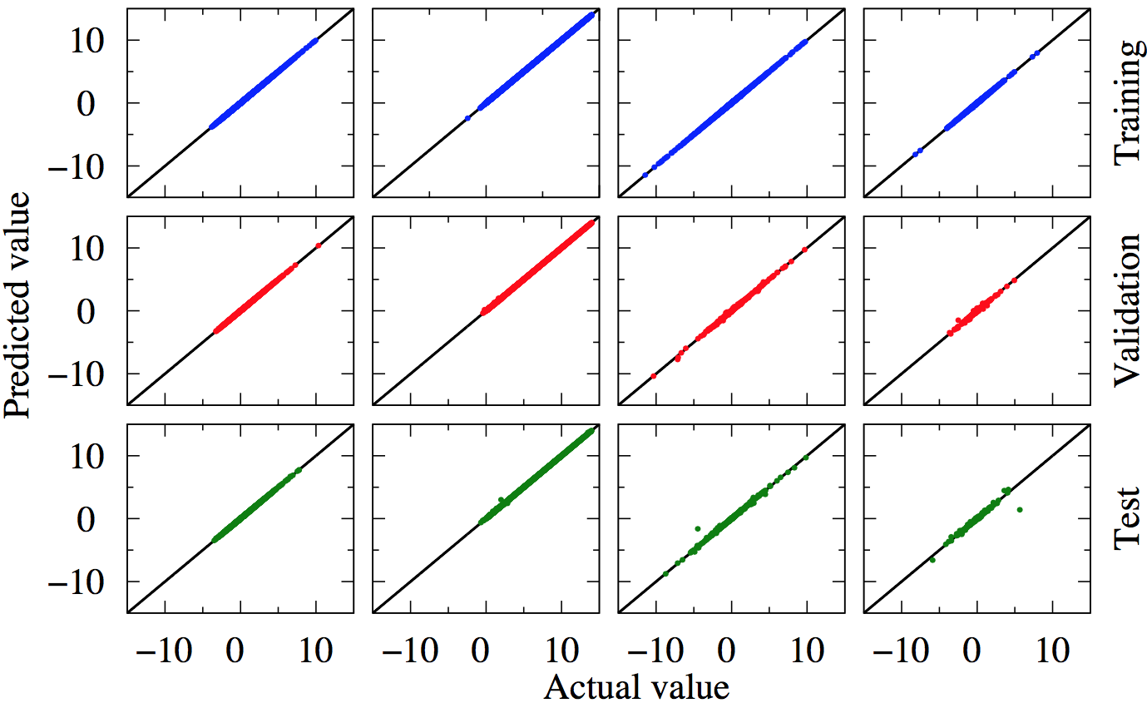


Artificial Intelligence Error visualization
Learning phase, estimates error and updates W matrices via comparison and backpropagation.
Application phase, uses previously calculated W matrices to gain intelligence!
Self aware phase!
Network has access to actual data only in training and validation phase.
Actual Data obtained from solving the QME combined with FCS method for 32200 random combination of input parameters.

Slide 16
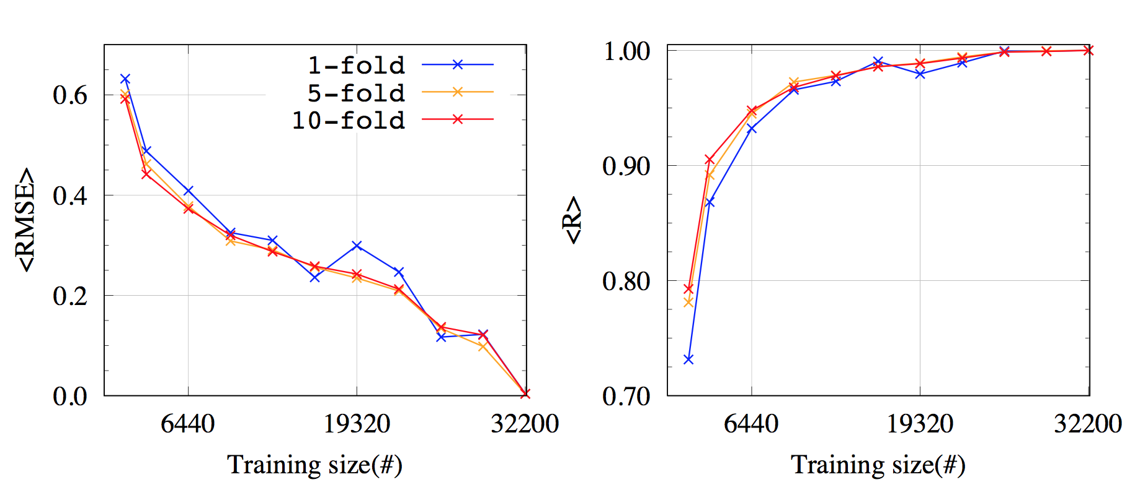
Artificial Intelligence Error visualization
Coefficient of prediction

Slide 17

Comparison

Slide 18

Photon Bunching and Antibunching

Slide 19


Interesting observation?

Slide 20


Concluding Remarks and Future
Quantum statistical thermodynamics can be studied via machine learning
Geometric Effects nullify the effect of quantum coherences in optimizing the flux.
With Geometric effects, some well established and standard nonequilibrium thermodynamic formulae do not hold.
Change of statistics possible from by tuning geometric components and coherences
Further Analysis of fluctuations…
Some sort of geometric entropy production?
Effect on universal oscillations of higher order cumulants...
Non-Markovian Effects
Notes:
Show observations on how GP Kills flux optimazation.

