Slide 1
Trade-off between efficiency and power of heat engines
Naoto Shiraishi (Keio University)
N. Shiraishi, K. Saito, and H. Tasaki, PRL 117, 190601 (2016).
N. Shiraishi, K Funo, and K. Saito, arXiv:1802.06554 (2018).
N. Shiraishi and K. Saito, arXiv:1806.09389 (today’s arXiv!)

Slide 2
Part I
Trade-off inequality between entropy production and heat flux

Slide 3
Background

Slide 4
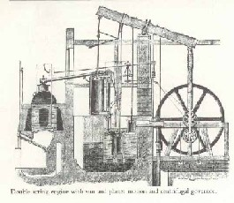
Efficiency and power: key quantities
Efficiency: How much heat is extracted as work.
Power: How much work is extracted per unit time.
What relation holds between efficiency and power?

Slide 5


What general properties we know?
Basic problem
Does a finite power engine attain Carnot efficiency?
Even such a simple problem has been open problem!
Thermodynamics
No restriction.
$$T_{1}$$
$$μ_{1}$$
$$T_{2}$$
$$μ_{2}$$
Liner irreversible thermodynamics
Not prohibited even in linear response regime when time-reversal symmetry is broken.
(G. Benenti, K. Saito, and G. Casati, PRL 106, 230602 (2011).)

Slide 6
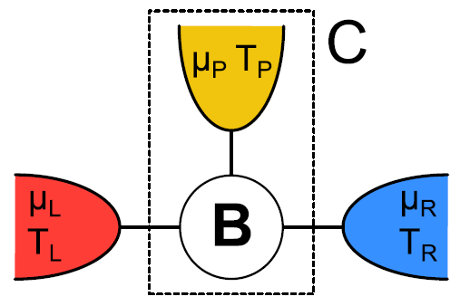
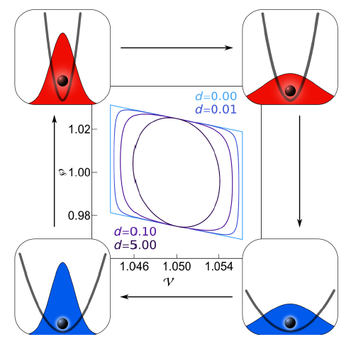
Concrete models (in linear regime)…
With magnetic field
K. Brandner, K. Saito, and U. Seifert, PRL 110, 070603 (2013).
V. Balachandran, G. Beneti, and G. Casati, PRB 87, 165419 (2013).
J. Stark, et.al. PRL 112, 140601 (2014).
B. Sothmann, R. Sanchez, and A. Jordan, EPL 107, 47003 (2014).
K. Yamamoto, et.al., PRB 94, 121402(R) (2016).
Time asymmetric operation
K. Brandner, K. Saito, and U. Seifert, PRX 5, 031019 (2015).
K. Proesmans and C. Van den Broeck, PRL 115, 090601 (2015).
Within these models in linear regime, Carnot efficiency implies zero power!

Slide 7
Present situation
General frameworks do not prohibit an engine at CE with finite power.
In analyses on concrete models in linear regime, all models do not attain CE with finite power.
General trade-off relation between power and efficiency has completely been missing.

Slide 8
Main result

Slide 9
Setup
Assumption
Dynamics of the engine is described by classical Markov process
Canonical distribution is invariant
Bath 1
Bath 2
Remarks
・Transient process → OK
・Broken time-reversal symmetry → OK
・Nonlinear regime → OK

Slide 10
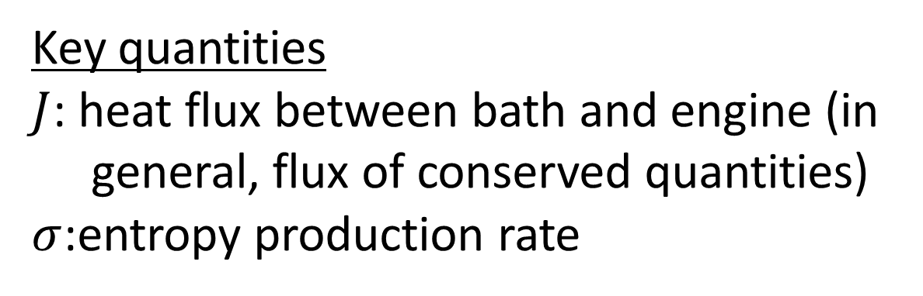

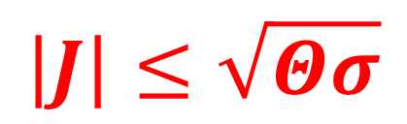
Main result (Inequality between heat flux entropy production)
Key quantities
$J$: heat flux between bath and engine (in general, flux of conserved quantities)
$σ$:entropy production rate
$$J$$
Then, the following relation holds (case of single bath)
$$\left|J\right|≤\sqrt{Θσ}$$
（$Θ$: coefficient depending on state defined later）
(N. Shiraishi, K. Saito, and H. Tasaki, PRL 117, 190601 (2016))

Slide 11
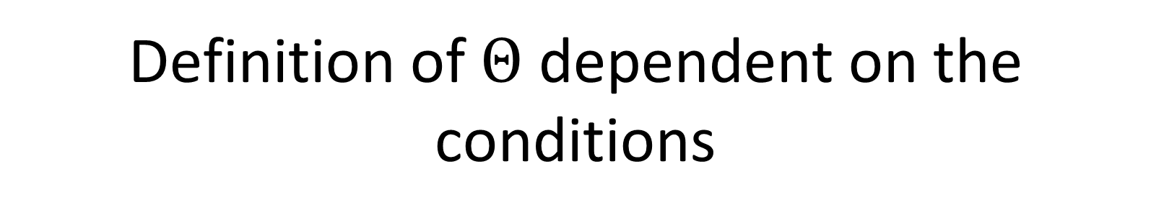
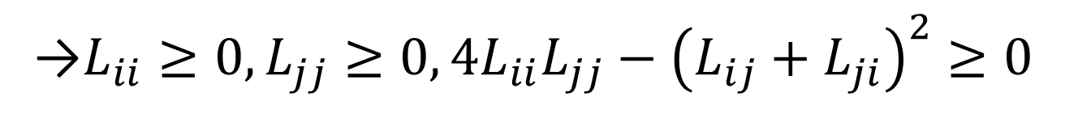
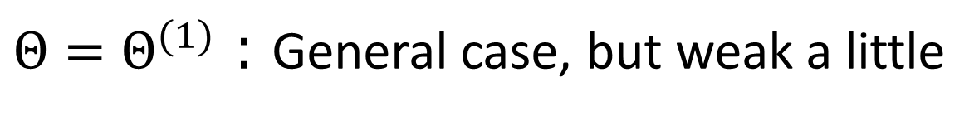
Definition of $Θ$ dependent on the conditions
$$\left|J\right|≤\sqrt{Θσ}$$
$Θ=Θ^{(1)}$：General case, but weak a little
(e.g., systems with thermal wall)
$Θ=Θ^{(2)}$：Case with detailed balance, but strong
(e.g., linear Langevin systems, discrete systems without magnetic field)

Slide 12
Power and efficiency (schematics)
Cyclic process with two baths
There must exist isothermal processes, and they possess inevitable dissipation.

Slide 13

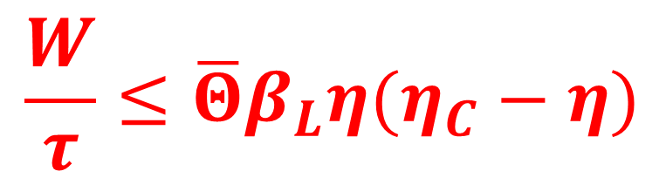

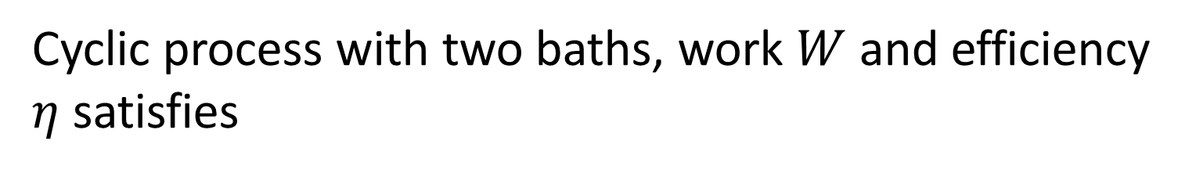

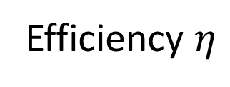
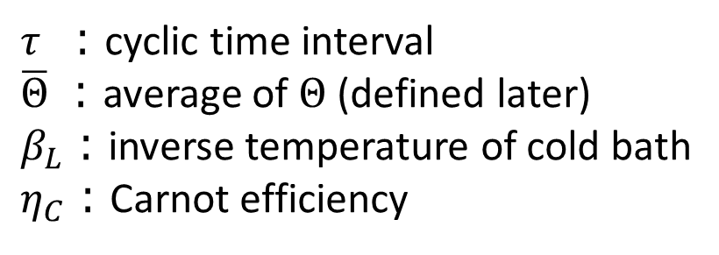
Main result (Inequality between power and efficiency)
Cyclic process with two baths, work $W$ and efficiency $η$ satisfies
$$\frac{W}{τ}≤\overline{Θ}β_{L}η(η_{C}−η)$$
$τ$ ：cyclic time interval
$\overline{Θ}$ ：average of $Θ$ (defined later)
$β_{L}$：inverse temperature of cold bath
$η_{C}$：Carnot efficiency
Power $\frac{W}{τ}$
$$0$$
$$η_{C}$$
Efficiency $η$
(N. Shiraishi, K. Saito, and H. Tasaki, PRL 117, 190601 (2016))

Slide 14
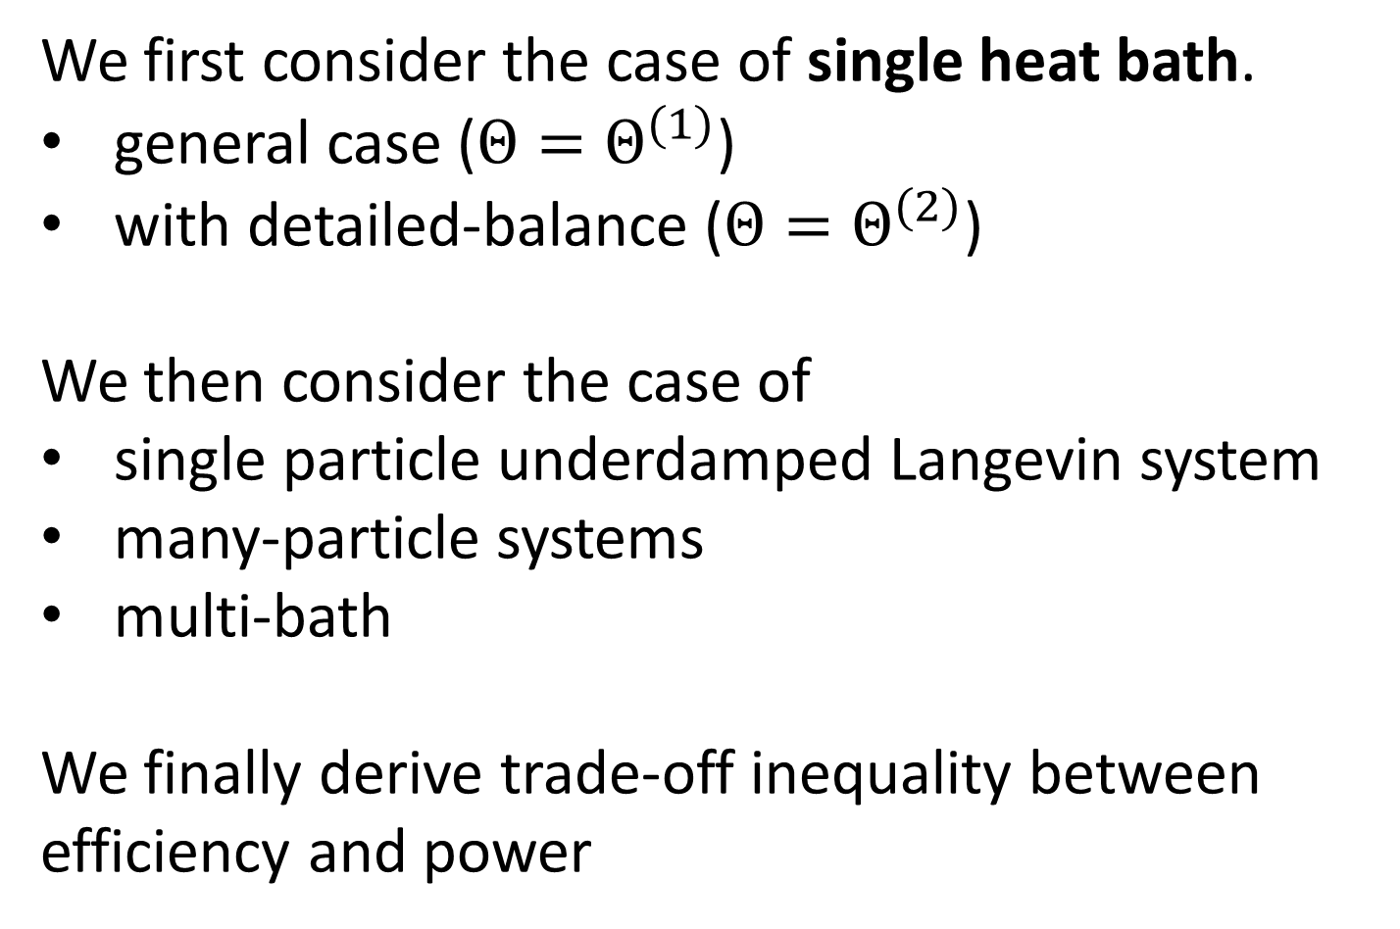
Outline of this part
We first consider the case of single heat bath.
general case ($Θ=Θ^{(1)}$)
with detailed-balance ($Θ=Θ^{(2)}$)
We then consider the case of
single particle underdamped Langevin system
many-particle systems
multi-bath
We finally derive trade-off inequality between efficiency and power

Slide 15
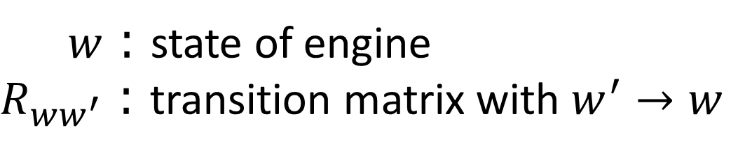

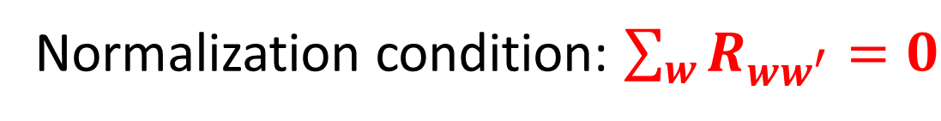
Dynamics
$$\frac{d}{dt}P_{w,t}=\sum_{w^{′}}{R_{ww^{′}}^{}P_{w^{′},t}^{}}$$
Master eq.
$w$：state of engine
$R_{ww^{′}}$：transition matrix with $w^{′}→w$
Normalization condition: $\sum_{w}{R_{ww^{′}}}=0$
We define dual matrix as ${\tilde{R}}_{ww^{′}}≔e^{−β\left(E_{w}−E_{w^{′}}\right)}R_{w^{′}w}$.

Slide 16
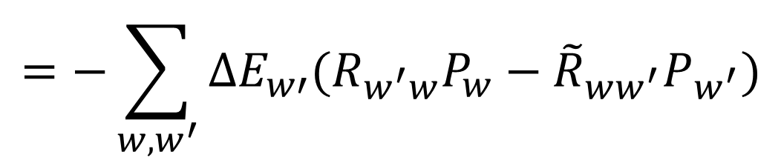
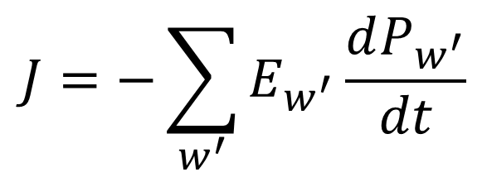
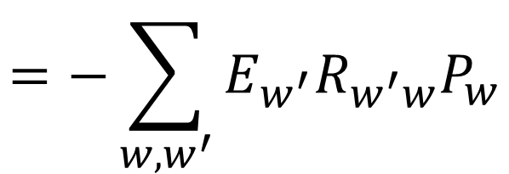
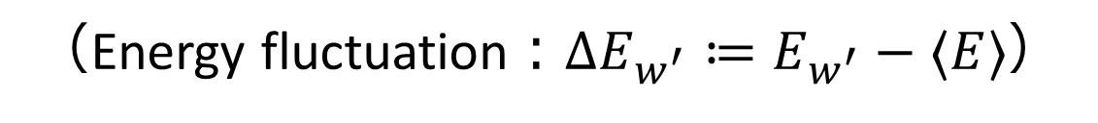
Definitions of key quantities
$$J=−\sum_{w^{′}}{E_{w^{′}}\frac{dP_{w^{′}}}{dt}}$$
Heat flux
$$=−\sum_{w,w^{′}}{E_{w^{′}}R_{w^{′}w}P_{w}}$$
$$=−\sum_{w,w^{′}}{{ΔE}_{w′}^{}(R_{w^{′}w}P_{w}−{\tilde{R}}_{ww^{′}}P_{w^{′}})}$$
（Energy fluctuation：$ΔE_{w^{′}}≔E_{w^{′}}−〈E〉$）

Slide 17
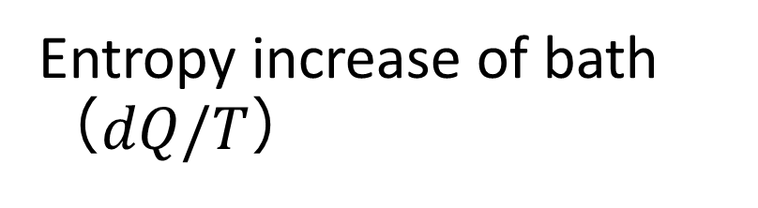
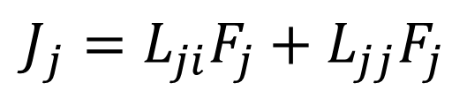
Definitions of key quantities
Entropy production rate
$$σ=−\sum_{w}{βE_{w}\frac{dP_{w}}{dt}}+\frac{d}{dt}\left(−\sum_{w}{P_{w}\ln{P_{w}}}\right)$$
Entropy increase of bath
（$dQ/T$）
(Shannon) entropy increase of system

Slide 18
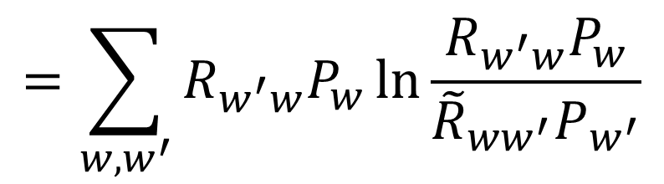
Definitions of key quantities
Entropy production rate
$$σ=−\sum_{w}{βE_{w}\frac{dP_{w}}{dt}}+\frac{d}{dt}\left(−\sum_{w}{P_{w}\ln{P_{w}}}\right)$$
$$=\sum_{w,w^{′}}{R_{w^{′}w}P_{w}\ln{\frac{R_{w^{′}w}P_{w}}{{\tilde{R}}_{ww^{′}}P_{w^{′}}}}}$$

Slide 19
Lemma: Inequality for relative entropy
For $\sum_{x}{p_{x}}=\sum_{x}{q_{x}}$, relative entropy satisfies
$$D\left(p_{x}| | q_{x}\right)≔\sum_{x}{p_{x}\ln{\frac{p_{x}}{q_{x}}}}$$
$$=\sum_{x}{p_{x}\ln{\frac{p_{x}}{q_{x}}}+q_{x}−p_{x}}$$
$$≥\sum_{x}{\frac{c_{0}{\left(p_{x}−q_{x}\right)}^{2}}{p_{x}+q_{x}}}$$
$\left(c_{0}=\frac{8}{9}\right)$

Slide 20
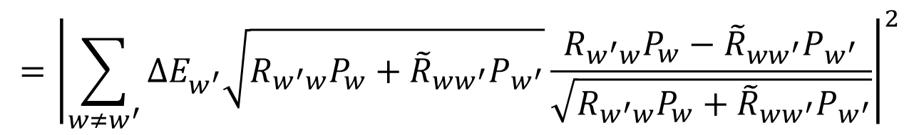
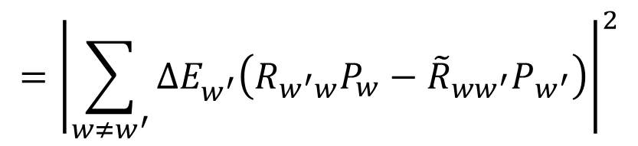

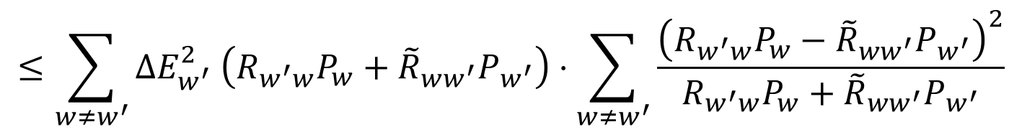
Derivation of main result
$${\left|J\right|}^{2}$$
$$={\left|\sum_{w≠w^{′}}{ΔE_{w^{′}}^{}\left(R_{w^{′}w}P_{w}−{\tilde{R}}_{ww^{′}}P_{w^{′}}\right)}\right|}^{2}$$
$$={\left|\sum_{w≠w^{′}}{ΔE_{w^{′}}^{}\sqrt{R_{w^{′}w}P_{w}+{\tilde{R}}_{ww^{′}}P_{w^{′}}}\frac{R_{w^{′}w}P_{w}−{\tilde{R}}_{ww^{′}}P_{w^{′}}}{\sqrt{R_{w^{′}w}P_{w}+{\tilde{R}}_{ww^{′}}P_{w^{′}}}}}\right|}^{2}$$
$$≤\sum_{w≠w^{′}}{ΔE_{w^{′}}^{2} \left(R_{w^{′}w}P_{w}+{\tilde{R}}_{ww^{′}}P_{w^{′}}\right)⋅\sum_{w≠w^{′}}{\frac{{\left(R_{w^{′}w}P_{w}−{\tilde{R}}_{ww^{′}}P_{w^{′}}\right)}^{2}}{R_{w^{′}w}P_{w}+{\tilde{R}}_{ww^{′}}P_{w^{′}}}}}$$
Schwarz inequality is used

Slide 21

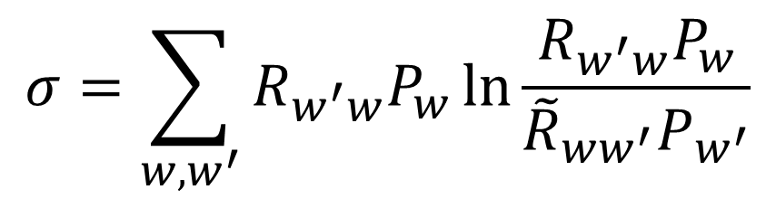
Derivation of main result
$${\left|J\right|}^{2}$$
$$={\left|\sum_{w≠w^{′}}{ΔE_{w^{′}}^{}\left(R_{w^{′}w}P_{w}−{\tilde{R}}_{ww^{′}}P_{w^{′}}\right)}\right|}^{2}$$
$$={\left|\sum_{w≠w^{′}}{ΔE_{w^{′}}^{}\sqrt{R_{w^{′}w}P_{w}+{\tilde{R}}_{ww^{′}}P_{w^{′}}}\frac{R_{w^{′}w}P_{w}−{\tilde{R}}_{ww^{′}}P_{w^{′}}}{\sqrt{R_{w^{′}w}P_{w}+{\tilde{R}}_{ww^{′}}P_{w^{′}}}}}\right|}^{2}$$
$$≤\sum_{w≠w^{′}}{ΔE_{w^{′}}^{2} \left(R_{w^{′}w}P_{w}+{\tilde{R}}_{ww^{′}}P_{w^{′}}\right)⋅\sum_{w≠w^{′}}{\frac{{\left(R_{w^{′}w}P_{w}−{\tilde{R}}_{ww^{′}}P_{w^{′}}\right)}^{2}}{R_{w^{′}w}P_{w}+{\tilde{R}}_{ww^{′}}P_{w^{′}}}}}$$
$$≤\frac{1}{c_{0}}\sum_{w≠w^{′}}{ΔE_{w^{′}}^{2} \left(R_{w^{′}w}P_{w}+{\tilde{R}}_{ww^{′}}P_{w^{′}}\right)}\sum_{w≠w^{′}}{R_{w^{′}w}P\left(w\right)\ln{\frac{R_{w^{′}w}P\left(w\right)}{{\tilde{R}}_{ww^{′}}P\left(w^{′}\right)}}}$$
$$=Θσ$$

Slide 22
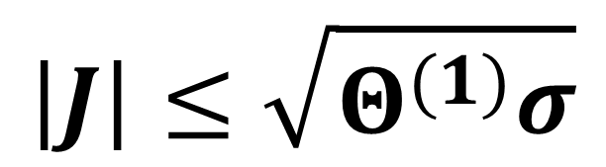
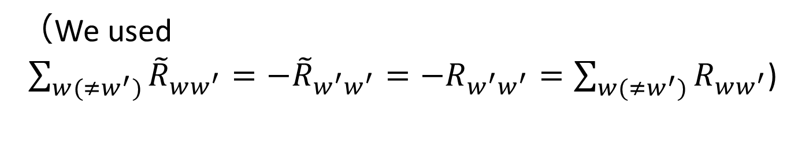
Inequality between heat flux and entropy production rate (general)
$$\left|J\right|≤\sqrt{Θ^{(1)}σ}$$
$Θ^{(1)}≔\frac{9}{8}\sum_{w≠w^{′}}{ΔE_{w^{′}}^{2} \left(R_{w^{′}w}P_{w}+R_{ww^{′}}P_{w^{′}}\right)}$
（We used
$\sum_{w(≠w^{′})}{{\tilde{R}}_{ww^{′}}}=−{\tilde{R}}_{{w_{}^{′}w}_{}^{′}}=−R_{{w_{}^{′}w}_{}^{′}}=\sum_{w(≠w^{′})}{R_{ww^{′}}}$)

Slide 23
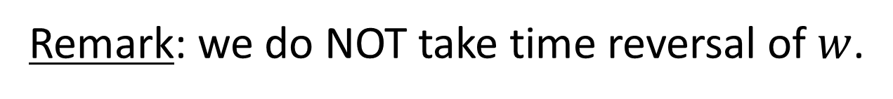
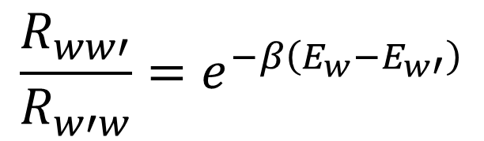

Case with detailed balance
Detailed balance
$$\frac{R_{ww′}^{}}{R_{w′w}^{}}=e^{−β\left(E_{w}−E_{w′}\right)}$$
Remark: we do NOT take time reversal of $w$.
This is different from
$$\frac{R_{ww′}^{}}{{R^{†}}_{w^{′∗}w^{∗}}^{}}=e^{−β\left(E_{w}−E_{w′}\right)}$$

Slide 24

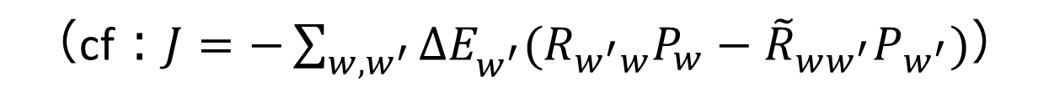
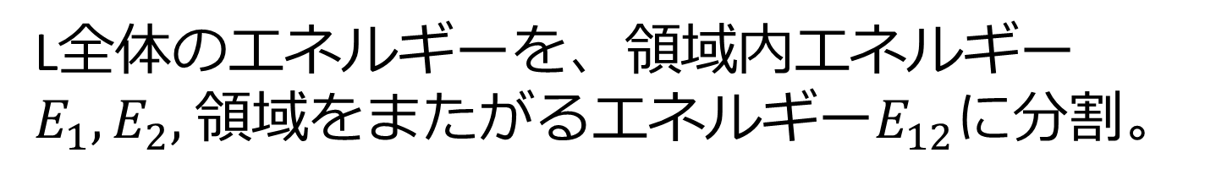
Rewrite $J$ and $σ$
In this case, ${\tilde{R}}_{ww^{′}}≔e^{−β\left(E_{w}−E_{w^{′}}\right)}R_{w^{′}w}=R_{ww^{′}}$
$$J=−\sum_{w,w^{′}}{E_{w′}^{}(R_{w^{′}w}P_{w}−R_{ww^{′}}P_{w^{′}})}$$
$$=−\frac{1}{2}\sum_{w,w^{′}}{(E_{w^{′}}^{}−E_{w})(R_{w^{′}w}P_{w}−R_{ww^{′}}P_{w^{′}})}$$
（cf：$J=−\sum_{w,w^{′}}{ΔE_{w^{′}}^{}(R_{w^{′}w}P_{w}−{\tilde{R}}_{ww^{′}}P_{w^{′}})}$）

Slide 25
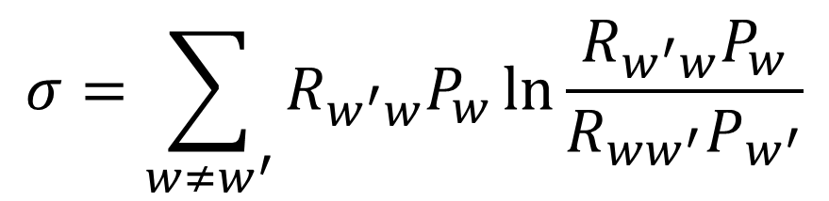
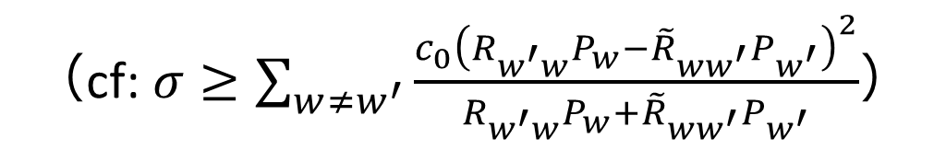
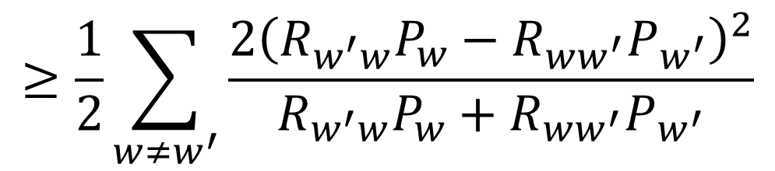
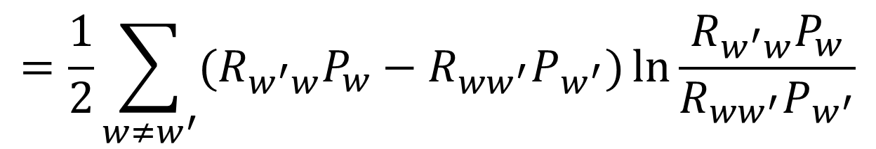
Rewrite $J$ and $σ$
$$σ=\sum_{w≠w^{′}}{R_{w^{′}w}P_{w}\ln{\frac{R_{w^{′}w}P_{w}}{R_{ww^{′}}P_{w^{′}}}}}$$
$$=\frac{1}{2}\sum_{w≠w^{′}}{(R_{w^{′}w}P_{w}−R_{ww^{′}}P_{w^{′}})\ln{\frac{R_{w^{′}w}P_{w}}{R_{ww^{′}}P_{w^{′}}}}}$$
$$≥\frac{1}{2}\sum_{w≠w^{′}}{\frac{{2\left(R_{w^{′}w}P_{w}−R_{ww^{′}}P_{w^{′}}\right)}^{2}}{R_{w^{′}w}P_{w}+R_{ww^{′}}P_{w^{′}}}}$$
（cf: $σ≥\sum_{w≠w^{′}}{\frac{{c_{0}\left(R_{w^{′}w}P_{w}−{\tilde{R}}_{ww^{′}}P_{w^{′}}\right)}^{2}}{R_{w^{′}w}P_{w}+{\tilde{R}}_{ww^{′}}P_{w^{′}}}}$）

Slide 26
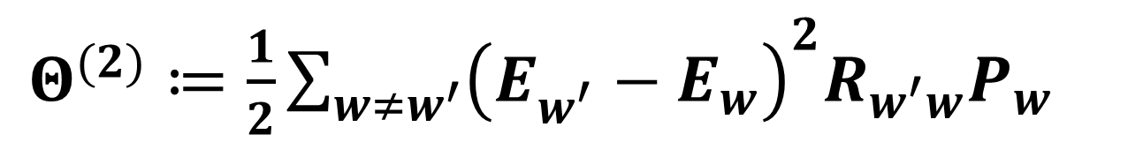
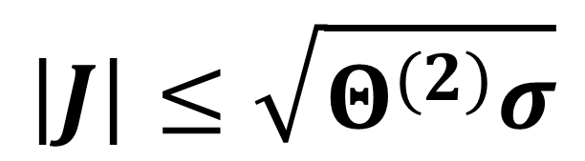
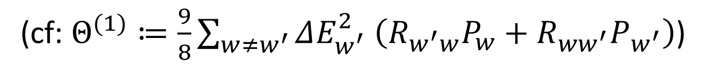
Inequality between heat flux and entropy production rate (strong)
$$\left|J\right|≤\sqrt{Θ^{(2)}σ}$$
$Θ^{(2)}≔\frac{1}{2}\sum_{w≠w^{′}}{{\left(E_{w^{′}}^{}−E_{w}\right)}^{2}R_{w^{′}w}P_{w}}$
(cf: $Θ^{(1)}≔\frac{9}{8}\sum_{w≠w^{′}}{ΔE_{w^{′}}^{2} \left(R_{w^{′}w}P_{w}+R_{ww^{′}}P_{w^{′}}\right)}$)

Slide 27
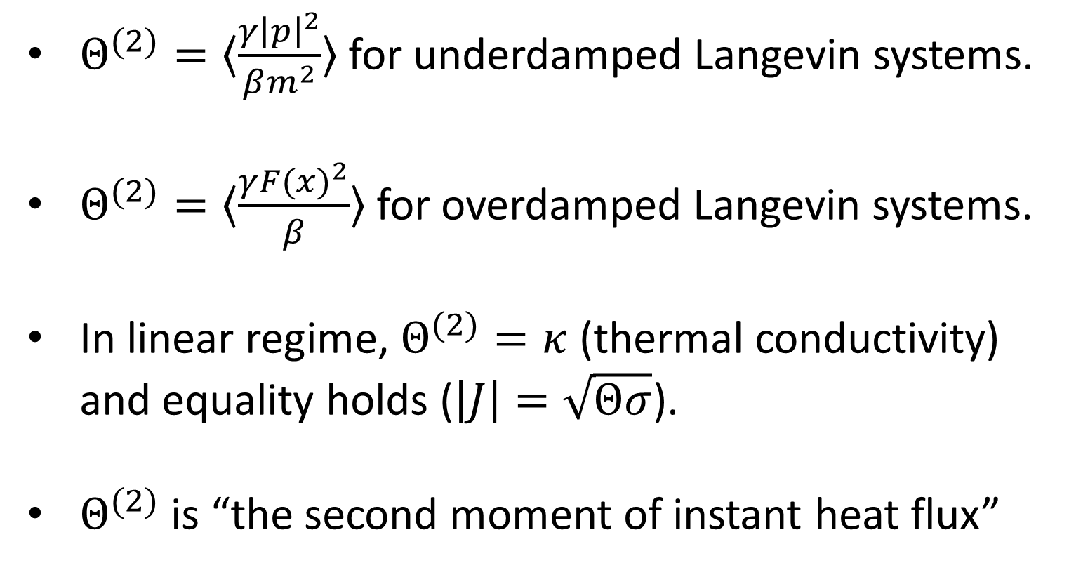

General properties of $Θ$
$Θ^{(2)}=〈\frac{γ{\left|p\right|}^{2}}{βm^{2}}〉$ for underdamped Langevin systems.
$Θ^{(2)}=〈\frac{γ{F(x)}^{2}}{β}〉$ for overdamped Langevin systems.
In linear regime, $Θ^{(2)}=κ$ (thermal conductivity) and equality holds ($\left|J\right|=\sqrt{Θσ}$).
$Θ^{(2)}$ is “the second moment of instant heat flux”

Slide 28
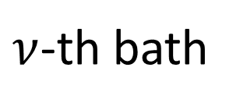
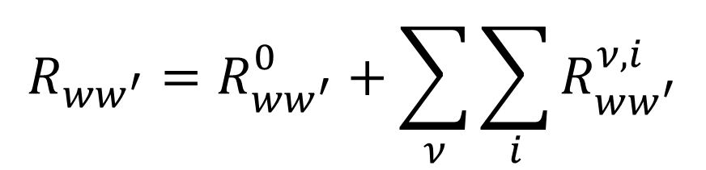
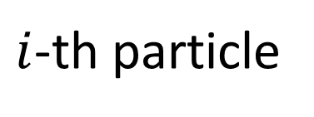
Application to many-body and multi-bath systems with Hamilton dynamics
Total transition rate is decomposed into
$$R_{ww^{′}}=R_{ww^{′}}^{0}+\sum_{ν}{\sum_{i}{R_{ww^{′}}^{ν,i}}}$$
Hamiltonian dynamics
label of particle
label of bath
$ν$-th bath
$i$-th particle

Slide 29
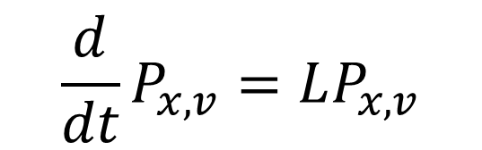
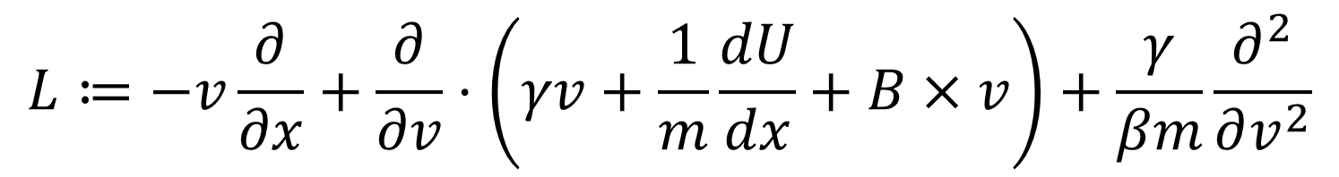
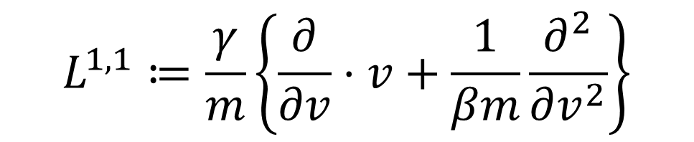
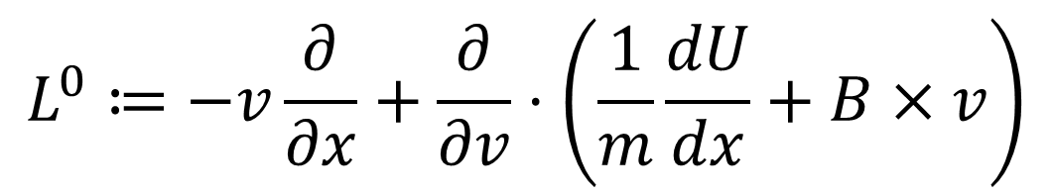
Hamilton and stochastic parts in underdamped Langevin system
$$\frac{d}{dt}P_{x,v}=LP_{x,v}$$
$$L≔−v\frac{∂}{∂x}+\frac{∂}{∂v}⋅\left(γv+\frac{1}{m}\frac{dU}{dx}+B×v\right)+\frac{γ}{βm}\frac{∂^{2}}{∂v^{2}}$$
$$L^{0}≔−v\frac{∂}{∂x}+\frac{∂}{∂v}⋅\left(\frac{1}{m}\frac{dU}{dx}+B×v\right)$$
$$L^{1,1}≔\frac{γ}{m}\left\{\frac{∂}{∂v}⋅v+\frac{1}{βm}\frac{∂^{2}}{∂v^{2}}\right\}$$

Slide 30
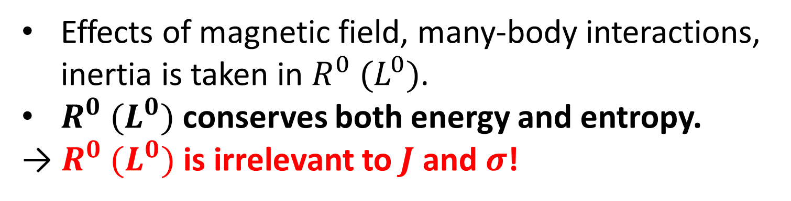



Properties of $R^{0} (L^{0})$ and $R^{ν,i} (L^{1,1})$
$$L^{0}≔−v\frac{∂}{∂x}+\frac{∂}{∂v}⋅\left(\frac{1}{m}\frac{dU}{dx}+B×v\right)$$
Effects of magnetic field, many-body interactions, inertia is taken in $R^{0} (L^{0})$.
$R^{0} (L^{0})$ conserves both energy and entropy.
→ $R^{0} (L^{0})$ is irrelevant to $J$ and $σ$!
$$L^{1,1}≔\frac{γ}{m}\left\{\frac{∂}{∂v}⋅v+\frac{1}{βm}\frac{∂^{2}}{∂v^{2}}\right\}$$
$R^{ν,i} (L^{1,1})$ acts only on velocity $v$, not position $x$.

Slide 31







Properties of $R^{ν,i} (L^{1,1})$ in linear Langevin systems
$$L^{1,1}≔\frac{γ}{m}\left\{\frac{∂}{∂v}⋅v+\frac{1}{βm}\frac{∂^{2}}{∂v^{2}}\right\}$$
For linear Langevin systems, corresponding transition rate $R_{v^{′}v}^{1,1}$ satisfies $R_{v^{′}v}^{1,1}=R_{−v^{′}−v}^{1,1}$ , which implies detailed balance.
This reflect spatial symmetry of noise!
$$−v$$
$$v$$
$$−v′$$
$$v′$$

Slide 32






$Θ$ in multi-particle case and thermodynamic limit
$$\left|J\right|=\sum_{i}{|J_{i}|}≤\sum_{i}{\sqrt{Θ_{i}σ_{i}}}$$
$i$-th particle
$$≤\sqrt{\left(\sum_{i}{Θ_{i}}\right)\left(\sum_{i}{σ_{i}}\right)}$$
$$=\sqrt{Θσ}$$
All of $J, σ, Θ≔\sum_{i}{Θ_{i}}$ are proportional to volume $V$
→$\left|J\right|≤\sqrt{Θσ}$ is meaningful even in $V→∞$.

Slide 33




Multi-bath case
In a similar manner, $Θ≔\sum_{ν}{Θ_{ν}}$ satisfies
$$\sum_{ν}{\left|J_{ν}\right|≤\sqrt{Θσ}}$$
$$J_{2}$$
$$J_{3}$$
$$J_{1}$$

Slide 34






Derivation of power-efficiency trade-off
Cyclic process with two baths
Bath H
$$Q_{H}$$
Thermodynamics leads to
$$W$$
$$ΔS=−β_{H}Q_{H}+β_{L}Q_{L}$$
$$Q_{L}$$
Bath L
$$η\left(η_{C}−η\right)=\frac{W}{Q_{H}}\frac{β_{L}Q_{L}−β_{H}Q_{H}}{β_{L}Q_{H}}$$
$$=\frac{WΔS}{β_{L}Q_{H}^{2}}$$

Slide 35





Time integration of inequality
General inequality $\sum_{ν}{\left|J_{ν}\right|≤\sqrt{Θσ}}$
By integrating with time, and using Schwarz inequality
$${\left(\int_{0}^{τ}{dt\sum_{ν}{\left|J_{ν}\right|}}\right)}^{2}≤{\left(\int_{0}^{τ}{dt\sqrt{Θσ}}\right)}^{2}$$
$$≤\left(\int_{0}^{τ}{dtΘ}\right)\left(\int_{0}^{τ}{dtσ}\right)=τ\overline{Θ}ΔS$$
（$\overline{Θ}≔\frac{1}{τ}\int_{0}^{τ}{dtΘ}$）
$Q_{H}=∫dtJ_{H}$ etc. leads to ${\left(Q_{H}+Q_{L}\right)}^{2}≤τ\overline{Θ}ΔS$

Slide 36




Derivation of power-efficiency trade-off
$$η\left(η_{C}−η\right)=\frac{WΔS}{β_{L}Q_{H}^{2}}$$
Bath H
$$Q_{H}$$
$$W$$
$$≥\frac{W}{β_{L}Q_{H}^{2}}\frac{{\left(Q_{H}+Q_{L}\right)}^{2}}{τ\overline{Θ}}$$
$$Q_{L}$$
Bath L
$$≥\frac{W}{β_{L}}\frac{1}{τ\overline{Θ}}$$
$$\frac{W}{τ}≤\overline{Θ}β_{L}η(η_{C}−η)$$

Slide 37
Quantum case and non-Markovian case
We can extend our result to quantum Markov process by considering microscopic origin of quantum Markov process.
Trade-off inequality between speed and efficiency for quantum non-Markovian system is derived with completely different approach (employing Lieb-Robinson bound and quantum information geometry)
(N. Shiraishi and H. Tajima, PRE 96, 022138 (2017))

Slide 38


Summary (of this part)
Trade-off between heat flux and entropy production rate is obtained:
Using this, power-efficiency trade-off is obtained:
As its corollary, we obtain no-go theorem of coexistence of finite power and Carnot efficiency.
$$\left|J\right|≤\sqrt{Θσ}$$
$$\frac{W}{τ}≤\overline{Θ}β_{L}η(η_{C}−η)$$

Slide 39
Part II
Speed limit for classical systems
N. Shiraishi, K Funo, and K. Saito, arXiv:1802.06554 (2018).

Slide 40
Speed limit: problem
Problem: Given Initial and final states (distributions).
How quick can we transform this state?
initial state
We can tune how to change the control parameters.
final state

Slide 41

Speed limit: known results
Quantum speed limit
$$\frac{ℒ\left(ρ_{i},ρ_{f}\right)}{ΔE/h}≤τ$$
Mandelstam-Tamm relation:
(L. Mandelstam and I. Tamm, J. Phys. (USSR) 9, 249 (1945))
Energy fluctuation bounds the speed of operation.
(Background: uncertainty relation)
What about classical systems?

Slide 42
Classical speed limits: some attempts
Some formal extensions to classical Hamiltonian/stochastic systems
S. Deffner, New J. Phys. 19, 103018 (2017), B. Shanahan, A. Chenu, N. Margolus, A. del Campo, Phys. Rev. Lett. 120, 070401 (2018), M. Okuyama and M. Ohzeki, Phys. Rev. Lett. 120, 070402 (2018), S. Ito, arXiv:1712.04311.
Physical picture/meaning is highly unclear!
Overdamped Langevin systems
K. Sekimoto and S.-i. Sasa, J. Phys. Soc. Jpn. 66, 3326 (1997).
E. Aurell, et.al., J. Stat. Phys. 147, 487 (2012).
Physical picture is clear.
But system is very specific!

Slide 43

Setting and goal of this part
System: general Markov process on discrete states with detailed-balance condition.
Initial and final distributions ($p$ and $p′$) are given.
What we want to obtain is…
$$\frac{ℒ{\left(p, p^{′}\right)}^{2}}{■▲}≤τ$$
established physical quantities

Slide 44



Main result
$$\frac{ℒ{\left(p,p^{′}\right)}^{2}}{2Σ〈A〉}≤τ$$
$ℒ\left(p,p^{′}\right)≔\sum_{w}{|p_{w}−p_{w}^{′} |}$ : total variation distance
$Σ$ : total entropy production
$〈A〉$: averaged dynamical activity $\int_{0}^{τ}{dtA(t)}$

Slide 45





What is dynamical activity?
Dynamical activity: How frequently jumps occur.
$$A(t)≔\sum_{w,w′}{R_{w^{′}w}p_{w}(t)}$$
Activity determines time-scale of dynamics.
Activity
cf) Current
$$+1$$
$$+1$$
$$+1$$
$$−1$$
Glassy dynamics:
J. P. Garrahan, et al., PRL 98, 195702 (2007).
Nonequilibrium steady state:
M. Baiesi, et al., PRL 103, 010602 (2009).

Slide 46

Physical meaning of our inequality
Length between initial and final states
$$\frac{ℒ{\left(p,p^{′}\right)}^{2}}{2Σ〈A〉}≤τ$$
Entropy production:
Cost of quick state transformation
Time-scale of dynamics (cf: Planck constant)

Slide 47





Derivation (instantaneous quantities)
$$\sum_{w}{\left|\frac{d}{dt}p_{w}\right|}$$
$$=\sum_{w}{\left|\sum_{w′(≠w)}{\left(R_{w^{′}w}P_{w}−R_{ww^{′}}P_{w^{′}}\right)}\right|}$$
$$≤\sum_{w}{\sqrt{\sum_{w′(≠w)}{\left(R_{w^{′}w}P_{w}+R_{ww^{′}}P_{w^{′}}\right)⋅\sum_{w′(≠w)}{\frac{{\left(R_{w^{′}w}P_{w}−R_{ww^{′}}P_{w^{′}}\right)}^{2}}{R_{w^{′}w}P_{w}+R_{ww^{′}}P_{w^{′}}}}}}}$$
$$≤\sqrt{\sum_{w′≠w}{\left(R_{w^{′}w}P_{w}+R_{ww^{′}}P_{w^{′}}\right)⋅\sum_{w′≠w}{\frac{{\left(R_{w^{′}w}P_{w}−R_{ww^{′}}P_{w^{′}}\right)}^{2}}{R_{w^{′}w}P_{w}+R_{ww^{′}}P_{w^{′}}}}}}$$
$$≤\sqrt{2Aσ}$$

Slide 48



Derivation (time integration)
$$ℒ\left(p_{i},p_{f}\right)≤\sum_{w}{\int_{0}^{τ}{dt\left|\frac{d}{dt}p_{w}\right|}}$$
$$≤\int_{0}^{τ}{dt\sqrt{2σA}}≤\sqrt{2τΣ〈A〉}$$
This is the desired result!
$$\frac{𝓛{\left(p,p^{′}\right)}^{2}}{2Σ〈A〉}≤τ$$

Slide 49



Fro systems without detailed-balance condition
Case with detailed-balance condition
$$\frac{ℒ{\left(p,p^{′}\right)}^{2}}{2Σ〈A〉}≤τ$$
Case without detailed-balance condition
$$\frac{c_{0}ℒ{\left(p,p^{′}\right)}^{2}}{2Σ_{HS}〈A〉}≤τ$$
$Σ_{HS}$: Hatano-Sasa entropy production
(Heat ${βQ}_{w→w^{′}}$ is replaced by excess heat $\ln{\frac{p_{w^{′}}^{ss}}{p_{w}^{ss}}}$)
(T. Hatano and S.-i. Sasa, Phys. Rev. Lett. 86, 3463 (2001))

Slide 50
Part III
Maximum efficiency for autonomous engines

Slide 51




Maximum efficiency of autonomous engines
Autonomous: stationary & not controlled externally.
Question: When autonomous engines attain the Carnot efficiency?
Feynman ratchet
Information engine
Thermoelectricity
(J. M. R. Parrondo & P. Espanol, Am. J. Phys. 64. 1125 (1996))
(K. Sekimoto, Physica D 205, 242 (2005), NS & T. Sagawa, PRE 91, 012130 (2015))
(G. D. Mahan and J. O. Sofo, PNAS 93, 7436 (1996))

Slide 52


What is general necessary condition to attain the Carnot efficiency?
Known results
In linear response regime ($ΔT, Δμ≅0$), tight-coupling condition (determinant of Onsager matrix =0) is necessary and sufficient condition.
What about general $ΔT, Δμ>0$ regime (nonlinear regime)?
Is there any relation between condition for linear regime and that for nonlinear regime?

Slide 53
Results
A kind of singularity is necessary to attain the Carnot efficiency in nonlinear regime.
This singularity condition provides different consequences between in small systems (finite size systems) and in macroscopic systems (systems in thermodynamic limit).
N. Shiraishi, Phys. Rev. E 92, 050101 (2015)
N. Shiraishi, Phys. Rev. E 95, 052128 (2017)

Slide 54



Classification
work extraction
particle bath ($μ_{1}$)
particle bath ($μ_{2}$)
particle current
single heat bath
We plot $(μ_{1},μ_{2})$ attaining the Carnot efficiency

Slide 55

Three classes in small and macroscopic engines
When $η_{Carnot}$ is attainable? | Only in linear regime | Within specific pair | Always
Required condition | - | Indifferentiable transition rate or free energy | Delta-function type transition rate
Small engine | × | × | 〇
Macro engine | 〇 | 〇 | 〇
N. Shiraishi, Phys. Rev. E 92, 050101 (2015), Phys. Rev. E 95, 052128 (2017)

Slide 56



Summary
Trade-off between heat flux and entropy production rate is obtained:
Using this, power-efficiency trade-off is obtained:
Entropy production also bounds the speed of state transformation
$$\left|J\right|≤\sqrt{Θσ}$$
$$\frac{W}{τ}≤\overline{Θ}β_{L}η(η_{C}−η)$$
$$\frac{𝓛{\left(p,p^{′}\right)}^{2}}{2Σ〈A〉}≤τ$$
END

Slide 58



Bound for non-Markovian engine
$$η≤η_{C}−\frac{{\left(Q_{L}\right)}^{2} }{8β_{L}Q_{H}j_{max}{\left(\frac{2vτ}{μ}+C\right)}^{D}}$$
$τ$：time-interval of a cycle
$v, μ, C$：constants came from Lieb-Robinson bound
$j_{max}$：maximum Fisher information per unit volume
$D$：spatial dimension
The slower process (large $τ$) have better efficiency.
The larger $Q_{L}$ implies worse efficiency.

Slide 60

Previous studies on power and efficiency
Endoreversible thermodynamics
F. L. Curzon and B. Ahlborn, Am. J. Phys. 43, 22 (1975).
P. Salamon and R. S. Berry, PRL 51, 1127 (1983).
B. Anderson, et.al., Acc. Chem. Res. 17, 266 (1984).
M. Esposito, et.al., PRL 105, 150603 (2010).
Overdamped Langevin system
K. Sekimoto and S.-i. Sasa, J. Phys. Soc. Jpn. 66, 3326 (1997).
E. Aurell, et.al., J. Stat. Phys. 147, 487 (2012).
Problems in these results
Model specific.
Most cases are in linear response regime.

Slide 61






Linear irreversible thermodynamics
$$T_{1}$$
$$μ_{1}$$
$$T_{2}$$
$$μ_{2}$$
Ex) Thermoelectric transport
$J_{i}$: heat flux $F_{i}$:temperature difference
$J_{j}$: particle flux $F_{j}$: chemical potential difference
Using Onsager matrix $L$,
$$J_{i}=L_{ii}F_{i}+L_{ij}F_{j}$$
$$J_{j}=L_{ji}F_{j}+L_{jj}F_{j}$$
$$\dot{S}=J_{i}F_{i}+J_{j}F_{j}$$
$≥0$ (second law)
→$L_{ii}≥0, L_{jj}≥0, 4L_{ii}L_{jj}−{\left(L_{ij}+L_{ji}\right)}^{2}≥0$

Slide 62




Difference between with and without time-reversal symmetry
$$\dot{S}=\frac{1}{L_{ii}}{\left(J_{i}+\frac{L_{ji}−L_{ij}}{2}X_{j}\right)}^{2}+\frac{4L_{ii}L_{jj}−{\left(L_{ij}+L_{ji}\right)}^{2}}{4L_{ii}}X_{j}^{2}$$
$$≥\frac{1}{L_{ii}}{\left(J_{i}+\frac{L_{ji}−L_{ij}}{2}X_{j}\right)}^{2}$$
Carnot efficiency⇔$\dot{S}=0$
$L_{ij}=L_{ji}$ (Time-reversal symmetry) $\dot{S}=0→J_{i}=0$
$L_{ij}≠L_{ji}$ (broken TRS) With proper $X_{j}$, $\dot{S}=0$ formally allow $J_{i}≠0$ (Finite power is not excluded)
(G. Benenti, K. Saito, and G. Casati, PRL 106, 230602 (2011))

Slide 63



Constraint in mesoscopic transport
Unitarity of scattering matrix says
$$L_{ii}L_{jj}+L_{ij}L_{ji}−L_{ij}^{2}−L_{ji}^{2}≥0$$
Carnot efficiency is achievable only when$x=1$ (no magnetic field)
Efficiency at maximum power may be larger than 1/2
K. Brandner, K. Saito, and U. Seifert, PRL 110, 070603 (2013).
V. Balachandran, G. Beneti, and G. Casati, PRB 87, 165419 (2013).

Slide 64


EMP is indeed larger than 1/2
Direct numerical calculation of AB effect.
V. Balachandran, G. Beneti, and G. Casati, PRB 87, 165419 (2013).

Slide 65

Onsager matrix in cyclic process
$J_{q}$：heat from hot bath/time
$J_{w}$：extracted work/time
$F_{q}≔β_{c}−β_{H}$
$F_{w}≔ΔH/T_{C}$
$$\dot{S}=J_{Q}F_{Q}+J_{w}F_{w}$$
$$ΔH$$
We define Onsager matrix by using them.
K. Brandner, K. Saito, and U. Seifert, PRX 5, 031019 (2015).

Slide 66





Inequality for relative entropy
$$=\sum_{x}{p_{x}\ln{\frac{p_{x}}{q_{x}}}+q_{x}−p_{x}}$$
$$D\left(p_{x}| | q_{x}\right)$$
$$≥\sum_{x}{\frac{c_{0}{\left(p_{x}−q_{x}\right)}^{2}}{p_{x}+q_{x}}}$$
$\left(c_{0}=\frac{8}{9}\right)$
We used a relation: $a\ln{\frac{a}{b}}+b−a≥\frac{c_{0}{\left(a−b\right)}^{2}}{a+b}$,
which is equivalent to $y\ln{y}+1−y≥\frac{c_{0}{\left(y−1\right)}^{2}}{y+1}$.

Slide 67

$J$ and $σ$ with detailed balance
$$σ=\sum_{w≠w^{′}}{R_{w^{′}w}P_{w}\ln{\frac{R_{w^{′}w}P_{w}}{R_{ww^{′}}P_{w^{′}}}}}$$
$$=\frac{1}{2}\sum_{w≠w^{′}}{(R_{w^{′}w}P_{w}−R_{ww^{′}}P_{w^{′}})\ln{\frac{R_{w^{′}w}P_{w}}{R_{ww^{′}}P_{w^{′}}}}}$$
$$≥\frac{1}{2}\sum_{w≠w^{′}}{\frac{{2\left(R_{w^{′}w}P_{w}−R_{ww^{′}}P_{w^{′}}\right)}^{2}}{R_{w^{′}w}P_{w}+R_{ww^{′}}P_{w^{′}}}}$$
（cf: $σ≥\sum_{w≠w^{′}}{\frac{{c_{0}\left(R_{w^{′}w}P_{w}−{\tilde{R}}_{ww^{′}}P_{w^{′}}\right)}^{2}}{R_{w^{′}w}P_{w}+{\tilde{R}}_{ww^{′}}P_{w^{′}}}}$）

Slide 68



Case of nonlinear Langevin equation
$$L^{1,1}≔\frac{γ(v)}{m}\left\{\frac{∂}{∂v}⋅v+\frac{1}{βm}\frac{∂^{2}}{∂v^{2}}\right\}$$
Desired relation is only $R_{v^{′}v}^{1,1}=R_{−v^{′}−v}^{1,1}$ (detailed-balance: DB)
If $γ\left(v\right)=γ(−v)$, DB is satisfied.
For one-dimensional systems, DB is satisfied.
For two or more dimensional systems, if rotation does not change energy, we can apply the above discussion to radial direction.

Slide 69



Upper bound of $Θ^{(1)}$
By putting $\left|R_{ww}\right|≤R_{max}$, we have
$$Θ^{(1)}≤\frac{1}{c_{0}}\left(\frac{d}{dt}〈ΔE^{2}〉+2R_{max}〈ΔE^{2}〉\right)$$

Slide 70


Discretization of transition rate
We set
$$P_{p→p±ε}≔\frac{γ}{βε^{2}}e^{−\frac{β}{4m}\left({\left(p±ε\right)}^{2}−p^{2}\right)}.$$
Then, in $ε→0$ limit, master equation becomes
$$\frac{d}{dt}P\left(p\right)=\frac{∂}{∂t}\left(\frac{γp}{m}P\left(p\right)\right)+\frac{γ}{β}\frac{∂^{2}}{∂p^{2}}P(p)$$
which is Kramers equation.

Slide 71



Discretization of transition rate
We set
$$P_{\left(x,p\right)→\left(x,p+ε\right)}≔\frac{1}{ε}F(x,p)$$
$$P_{\left(x,p\right)→\left(x+ε′,p\right)}≔\frac{1}{ε^{′}}\frac{p}{m}$$
Then, in $ε, ε′→0$ limit, master equation becomes
$$\frac{d}{dt}P\left(x,p\right)=−\frac{p}{m}\frac{∂}{∂x}P\left(x,p\right)−\frac{∂}{∂p} F\left(x,p\right)P(x,p)$$
which is Liouville equation.

Slide 72




The inequality is tight in linear regime
In $Δβ≪1$, Fourier law tells
$$β+Δβ$$
$J=κΔβ$ ➡ $σ=ΔβJ=J^{2}/κ$
$$β$$
（$κ$：thermal conductivity）
Fluctuation-dissipation like relation ${〈J^{2}〉}_{eq}=2κ$ says $Θ_{2}=κ$
Inequality $J^{2}≤Θ_{2}σ$ always becomes equality in the linear regime.

Slide 73


Thermoelectricity
$$T_{1}$$
$$μ_{1}$$
$$T_{2}$$
$$μ_{2}$$
$T_{1}>T_{2}, μ_{2}>μ_{1}$.
Heat current $J_{q}$, particle current $J_{n}$ flow along $1→2$
Efficiency is defined as $η_{C}=1−\frac{T_{2}}{T_{1}}≥η:=\frac{ΔμJ_{n}}{J_{q}−μ_{1}J_{n}}$
（$Δμ≔μ_{2}−μ_{1}$ We assumed $J_{q}−μ_{1}J_{n}>0$）

Slide 74


Inequality for heat and particle currents
In a similar manner, we have
$2J_{q}≤\sqrt{Θ_{q}σ}$
$2J_{n}≤\sqrt{Θ_{n}σ}$
Here $Θ_{q}$ takes $Θ^{1}$ or $Θ^{2}$, $Θ_{n}$ is
$$Θ_{n}≔\frac{9}{8}\sum_{w≠w^{′}}{ΔN_{w^{′}}^{2} \left(R_{w^{′}w}P_{w}+R_{ww^{′}}P_{w^{′}}\right)}$$

Slide 75



Power-efficiency trade-off in thermoelectricity
Using them, power and efficiency satisfy
$$ΔμJ_{n}≤\frac{Θ_{q}+{\left(μ_{1}\right)}^{2}Θ_{n}}{2}β_{2}η(η_{C}−η)$$
$$T_{1}$$
$$μ_{1}$$
$$T_{2}$$
$$μ_{2}$$

Slide 77



How to move the engine
closed process
equi-$μ$ process ($μ_{H}$)
equi-$μ$ process ($μ_{L}$)
closed process

Slide 78



State space of total system
$(X,ν)$ specifies the total state
$X∈\{A\sim D\}$
$ν$：particle number/ volume of A
$$ν=2/V$$
$$ν=1/V$$
This description applies to general engines
C
$$ν=0$$
B
D
A

Slide 79
Problem and approach
Goal: Derive conditions to attain Carnot efficiency.
Suppose that an engine attains the Carnot efficiency, and clarify what properties this engine should satisfy.
(Remark: Although explanation is on the autonomous Carnot engine, it applies to general engines)

Slide 80


Consequence from Carnot efficiency: 1
Equilibration condition: States attached to each particle bath are equilibrium distribution
Grand canonical distribution with $μ_{H}$
Grand canonical distribution with $μ_{L}$
Entropy production = 0 ⇔ partial entropy production = 0. Its equality condition implies above condition.

Slide 81
Consequence from Carnot efficiency: 2
Carnot efficiency implies zero power.
→We consider presence/absence of dissipation (particle leakage) under the condition that there is no probability flux between A-D, B-C.
B
C
A
D

Slide 82


Particle leakage between AD
$P_{D→A}(ν)$：particle number distribution ($ν≔n/V_{A}$) under the condition that $D→A$ occurs
A
D
For zero particle leakage, the following two condition is necessary.
Condition１：$P_{D→A}\left(ν\right)∝δ(ν−ν_{D→A}^{∗})$
Condition２：$ν_{D→A}^{∗}=ν_{A→D}^{∗}=ν^{∗}$

Slide 83

Necessary and sufficient condition for Carnot efficiency
■Condition for Carnot efficiency
Transitions between different particle baths satisfy
Transition occurs only a particular $ν=ν^{∗}$ (delta function type)
The $ν^{∗}$ for A→D and for D→A are the same
（Remark: This is also necessary for linear regime ）
What system satisfies the above conditions?

Slide 84

Difference between finite systems and macroscopic systems
Transition occurs only a particular $ν=ν^{∗}$ (delta function type)
The $ν^{∗}$ for A→D and for D→A are the same
Case of finite systems
1 is nontrivial condition. 1 directly implies 2 (because there is inverse process)
Case of macroscopic systems
1 is satisfied due to low of large numbers. 2 is nontrivial condition.

Slide 85


Case of finite systems
To make $P_{A→D}(ν)$ delta function…
set all transition rates zero except a particular $ν=ν^{∗}$!
$$ν$$
C
B
D
A

Slide 86



Consequence for finite systems
This condition is same for case of linear regime and case of finite $Δμ$!
In finite systems, if Carnot efficiency is attainable in linear regime, it is attainable with any chemical potential difference $Δμ$.

Slide 87


Case of thermodynamic limit
$P_{A→D}\left(ν\right)=P_{A→D;ν}P_{A}^{eq}(ν)$ has δ-function type peak
transition rate with $ν$
Equilibrium distribution at A
$$P_{A→D;ν}P_{A}^{eq}(ν)$$
$$ν$$
$$ν$$
$P_{D→A}\left(ν\right)∝e^{−βΔμ⋅Vν}P_{A→D} (ν)$ in general has different peak position!

Slide 88

What is condition for not changing the position of peak?
(1) $Δμ→0$ (linear regime)
$P_{D→A}\left(ν\right)∝e^{−βΔμ⋅Vν}P_{A→D} (ν)$ and $P_{A→D} (ν)$ have peaks at the same position.
If equilibration condition is satisfied, macroscopic engines attain the Carnot efficiency in linear regime!

Slide 89


What is condition for not changing the position of peak?
(2) set transition rates zero except $ν=ν^{∗}$
In this case, engines attain the Carnot efficiency with any $Δμ$.

Slide 90




What is condition for not changing the position of peak?
(3) Using indifferentiable point
Free energy or transition rate is indifferentiable
$$−\frac{∂}{∂ν}\ln{f\left(ν\right)}$$
$$f\left(ν\right)∝P_{A→D;ν}⋅e^{−βF_{A\left(ν\right)}}$$
$${βμ}_{H}$$
$${βμ}_{L}$$
(There indeed exists a model attaining the Carnot efficiency in this way)
$$ν$$
$$ν_{A→D}^{∗}=ν_{D→A}^{∗}$$

