Slide 1
Electronics for
Nuclear Physics
김상열
노티스

Slide 2
Why Electronics?
Detector + Electronics + Analysis = Physics
Detector + Electronics + = Development
+ Electronics + Analysis = Simulation
Detector + + Analysis = ????
* 매우 개인적인 의견임!!

Slide 3
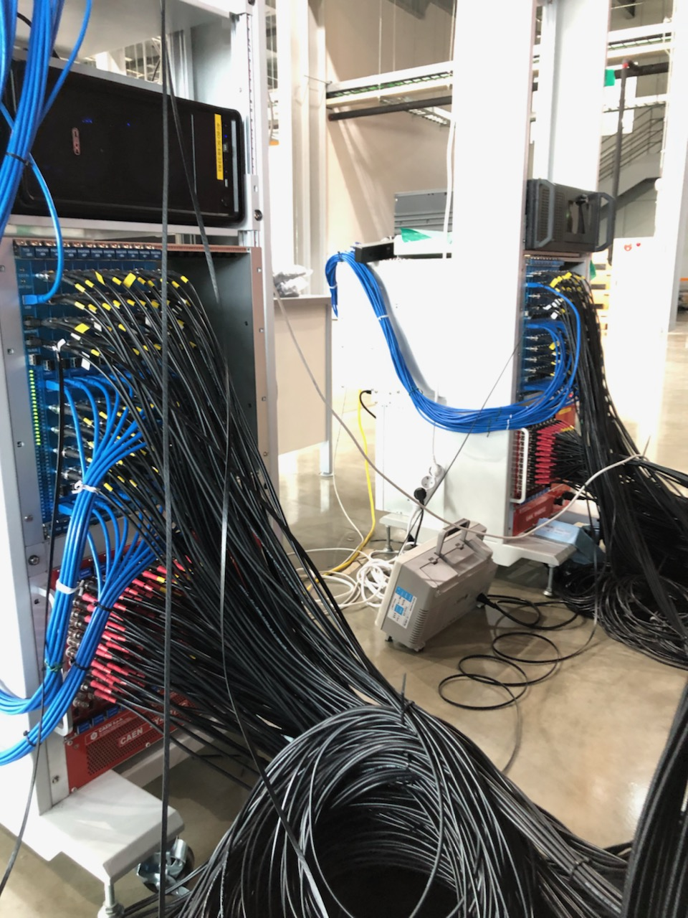
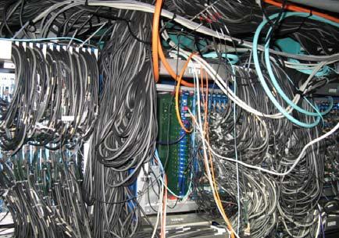
Some examples

Slide 4
Electronics for Nuclear physics experiment
Detector
Preamp
+ other
Analog circuits
Digitizer
Data Acquisition
Bias Voltage
Trigger
+ DSP
Power Supply

Slide 5
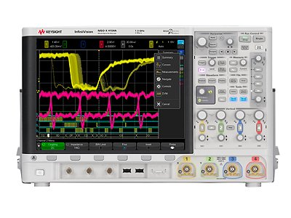
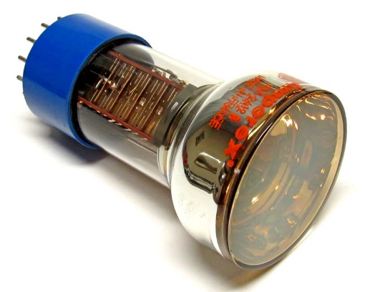
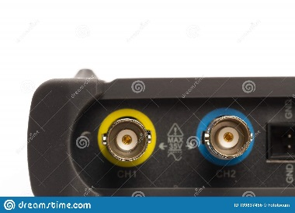
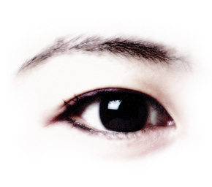
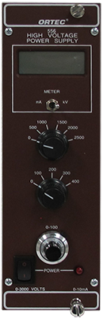
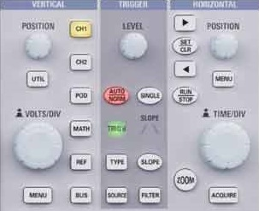
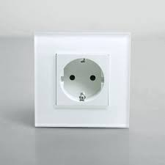
Frequently used example
50 ohm input impedance
Oscilloscope level trigger

Slide 6
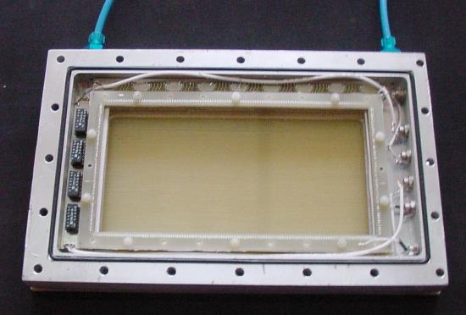
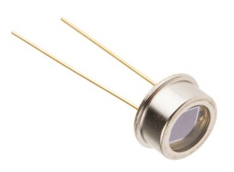
Signal from detector
PMT, SiPM… : gain ~ 10^6
-> ~ 10^10 electrons/MeV
= ~nC/MeV
Wire chamber, GEM… : gain ~ 10^2~3
-> ~ 10^6~7 electrons/MeV
= ~pC/MeV
Photodiode, Ion chamber… : gain ~ 1
-> ~ 10^3~5 electrons/MeV
= ~fC/MeV

Slide 7
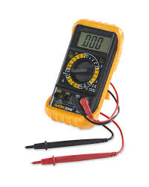


How to measure signal
Typical detector’s capacitance
= 10 ~ 1000 pF
and V = Q/C
~ nC/100 pF/MeV = 10 V/MeV
~ pC/100 pF/MeV = 10 mV/MeV
~ fC/10 pF/MeV = 100 uV/MeV

Slide 8
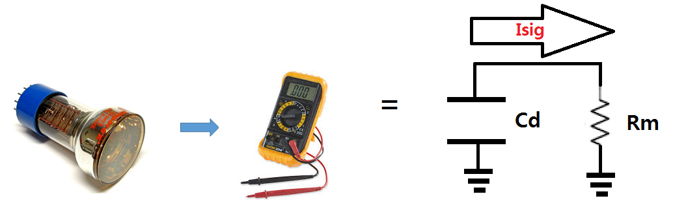
What we measure actually?
When Idet(detector current) is very fast,
Isig = Qdet x exp(-t/T) where T = Cd x Rm = 100 pF x 10 Mohm
= ~ ms -> very long!

Slide 9
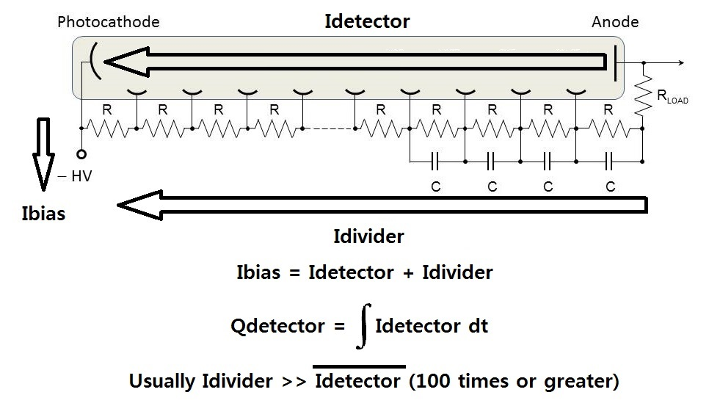
Where it comes from?

Slide 10

Bias voltage supplier should supply
If detector response time = ~ 10 ns
and count rate = ~ 100 kcps
PMT, SiPM… : nC/10 ns x 100 kcps/s
= 10 uA @ a few kV -> 1 mA @ kV
Wire chamber, GEM… : pC/10 ns x 100 kcps/s
= 1 uA @ kV(?)
Photodiode, Ion chamber… : fC/10 ns x 100 kcps/s
= ~1 nA @ a few ~ 100 V

Slide 11
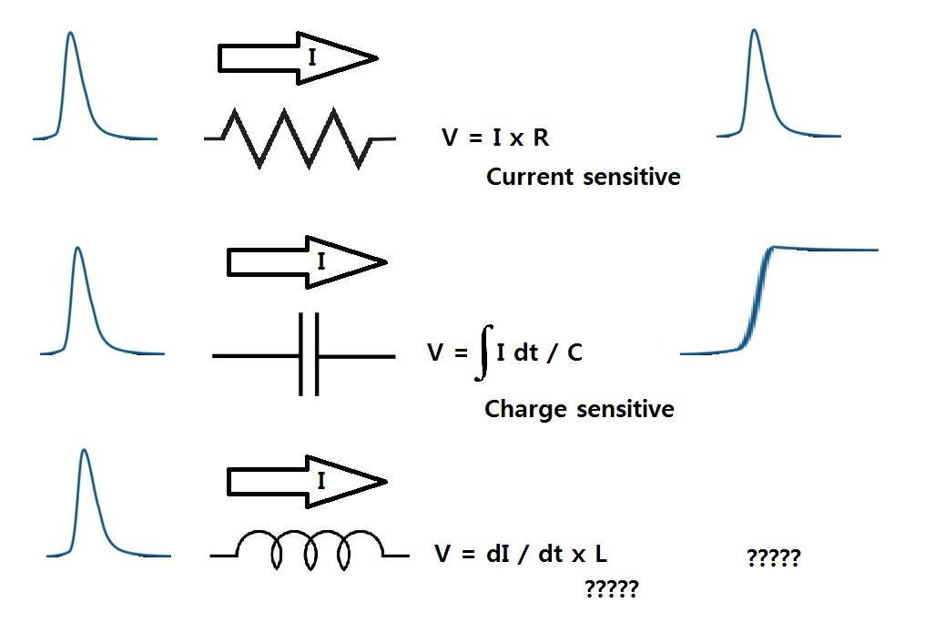
Preamplifier converts Idet to Voltage signal.

Slide 12
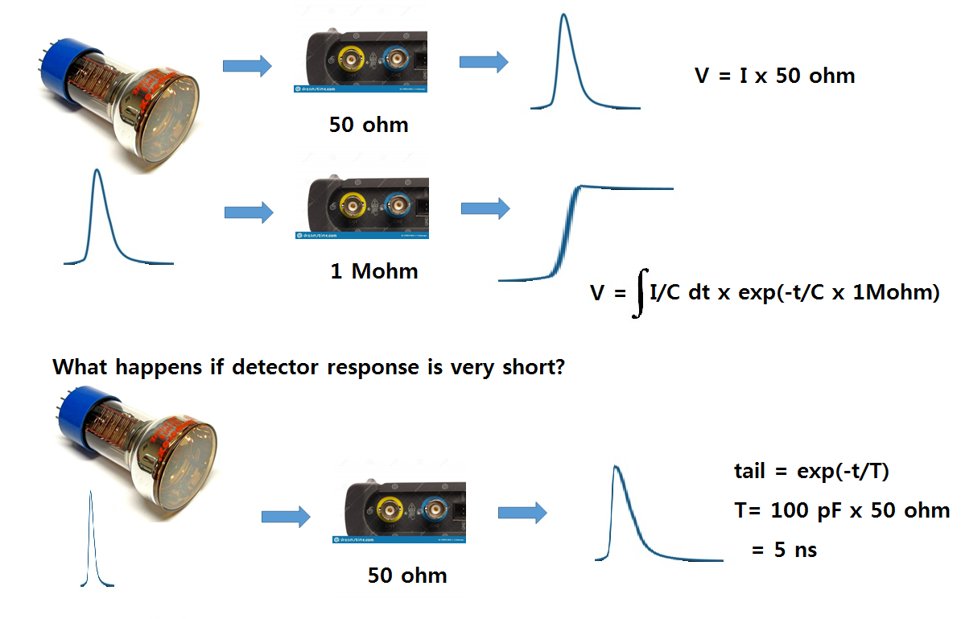
Take a look at PMT oscilloscope shot again

Slide 13
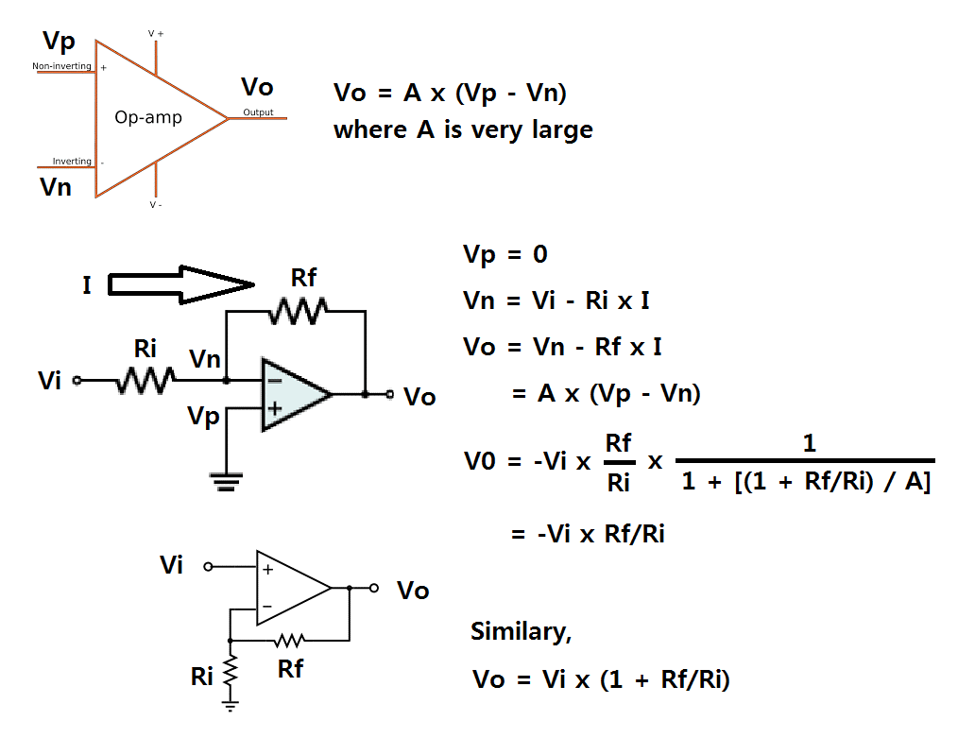
Opamp basics

Slide 14
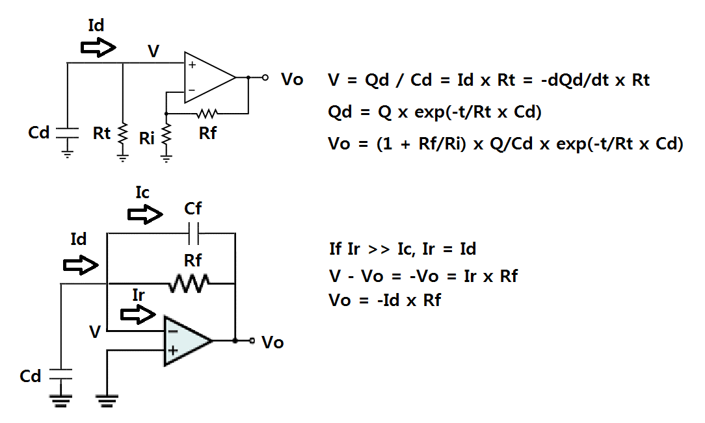
Current Sensitive Preamp

Slide 15
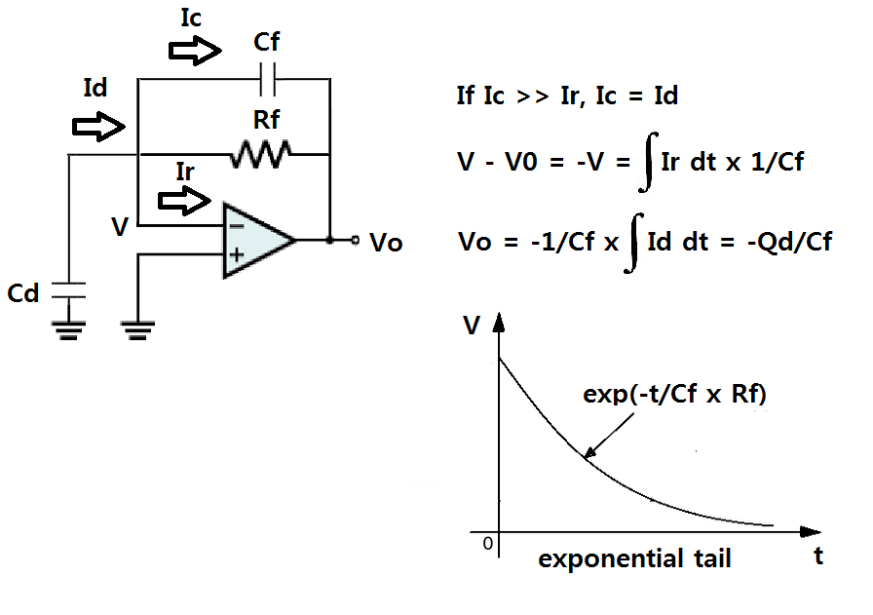
Charge Sensitive Preamp

Slide 16
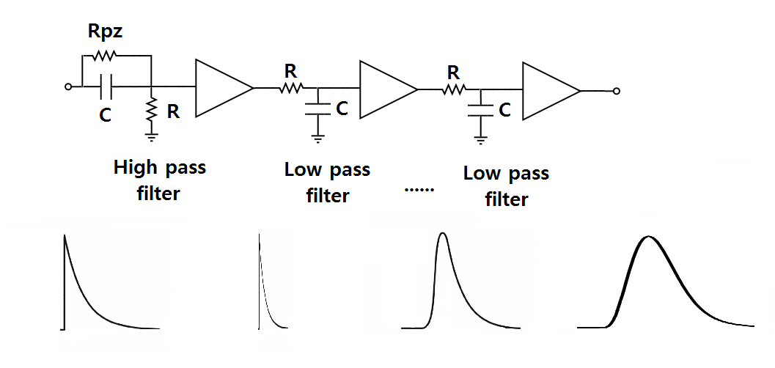
Shaping Amplifier

Slide 17
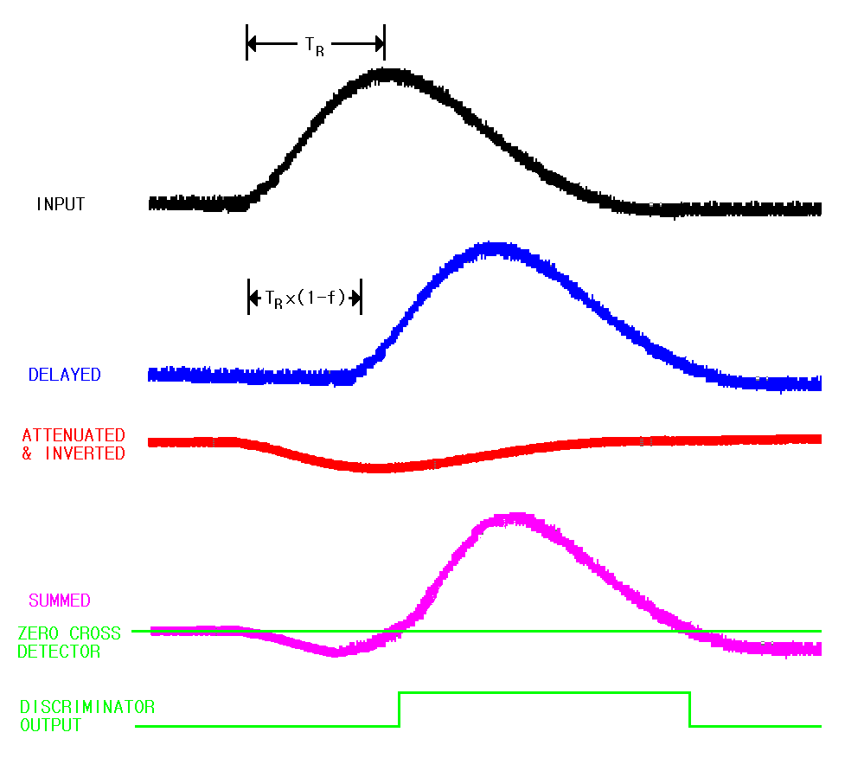
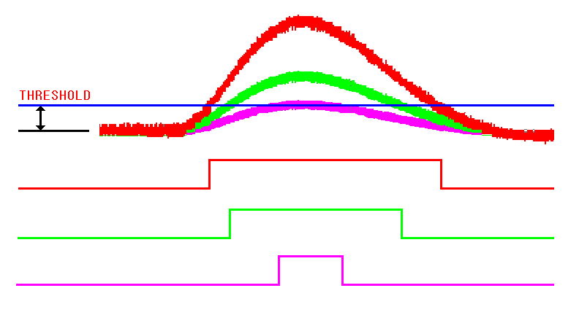
Discriminator
Leading edge discriminator
Constant fraction discriminator

Slide 18
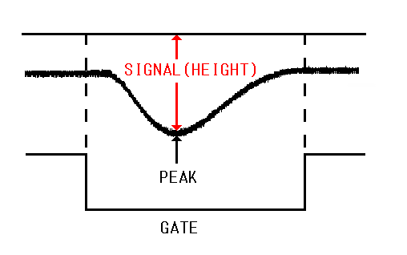
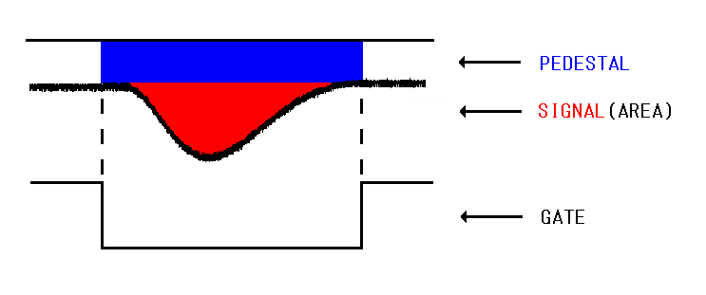
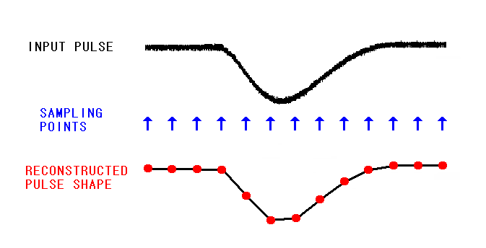
Analog to Digital Converter
Peak sensing ADC Charge sensing ADC
Flash ADC

Slide 19
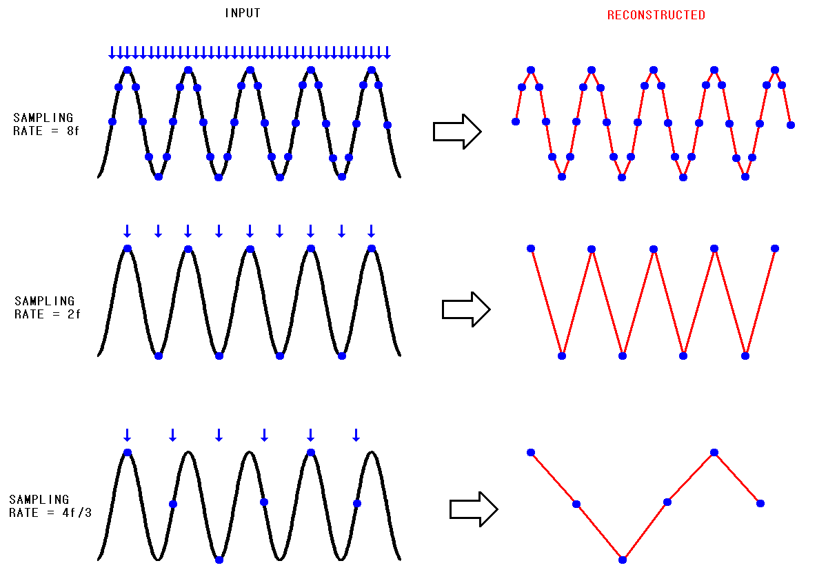
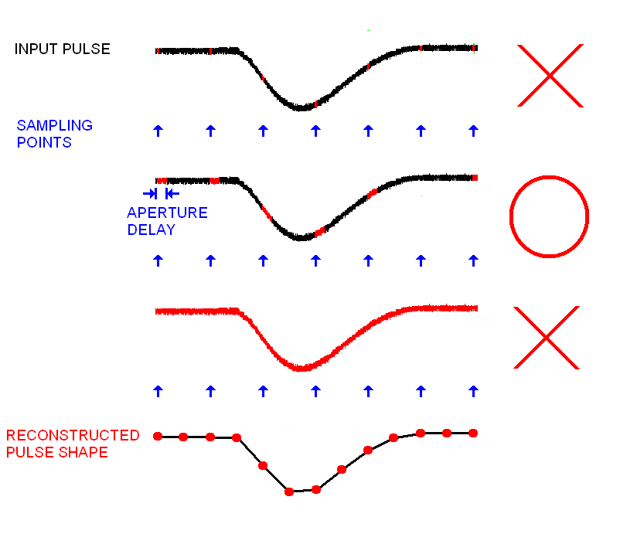
ADC sampling

Slide 20
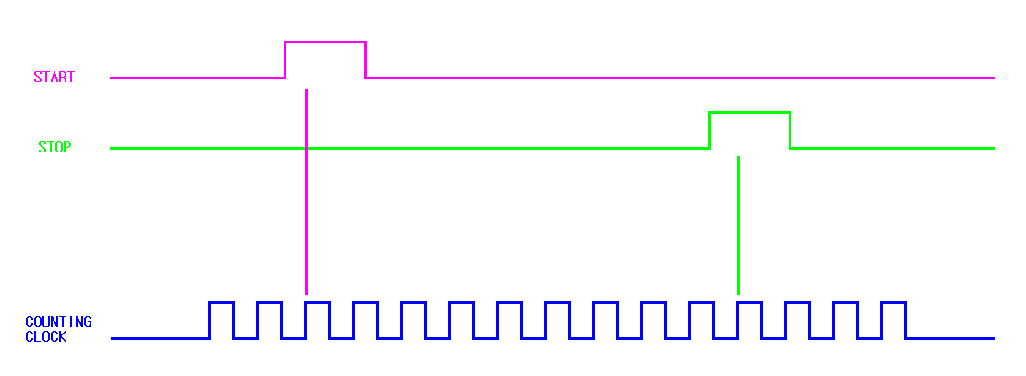
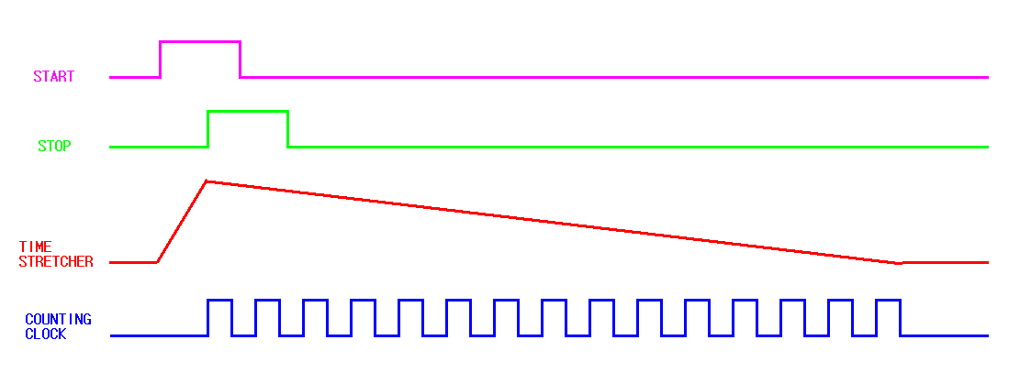
Time to Digital Converter
Direct counting
Resolution ~ 1 ns
Time stretching
Resolution ~ 10 ps

Slide 21
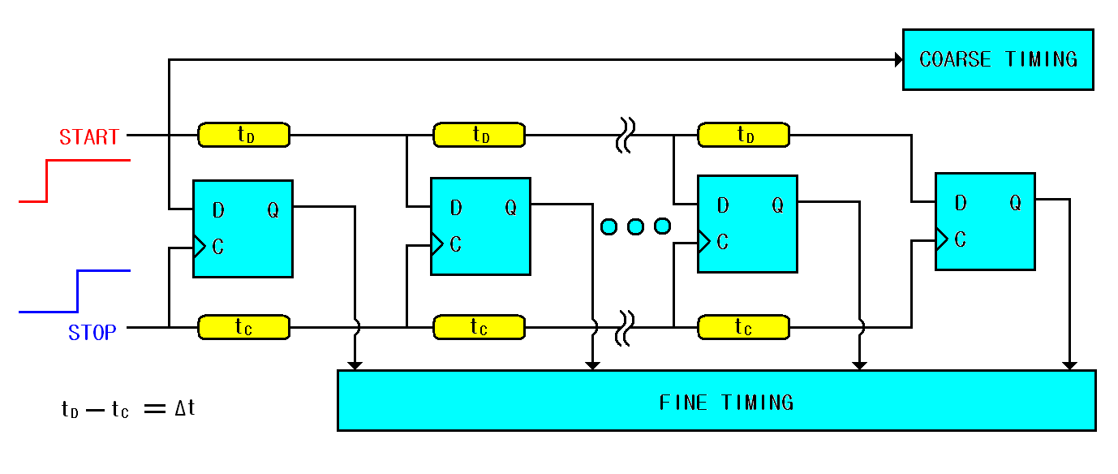
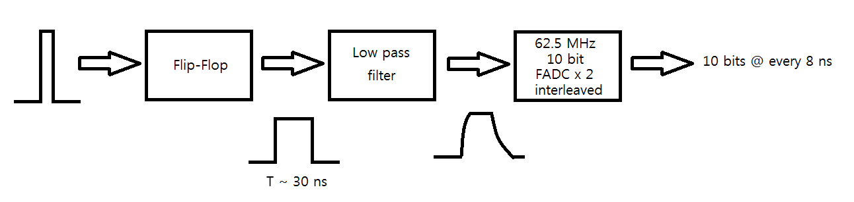
Time to Digital Converter
Time interpolation
Resolution ~ 10 ps
Multi-hit TDC
Pulse shaping TDC : resolution ~ 10 ps, multi-hit

Slide 22
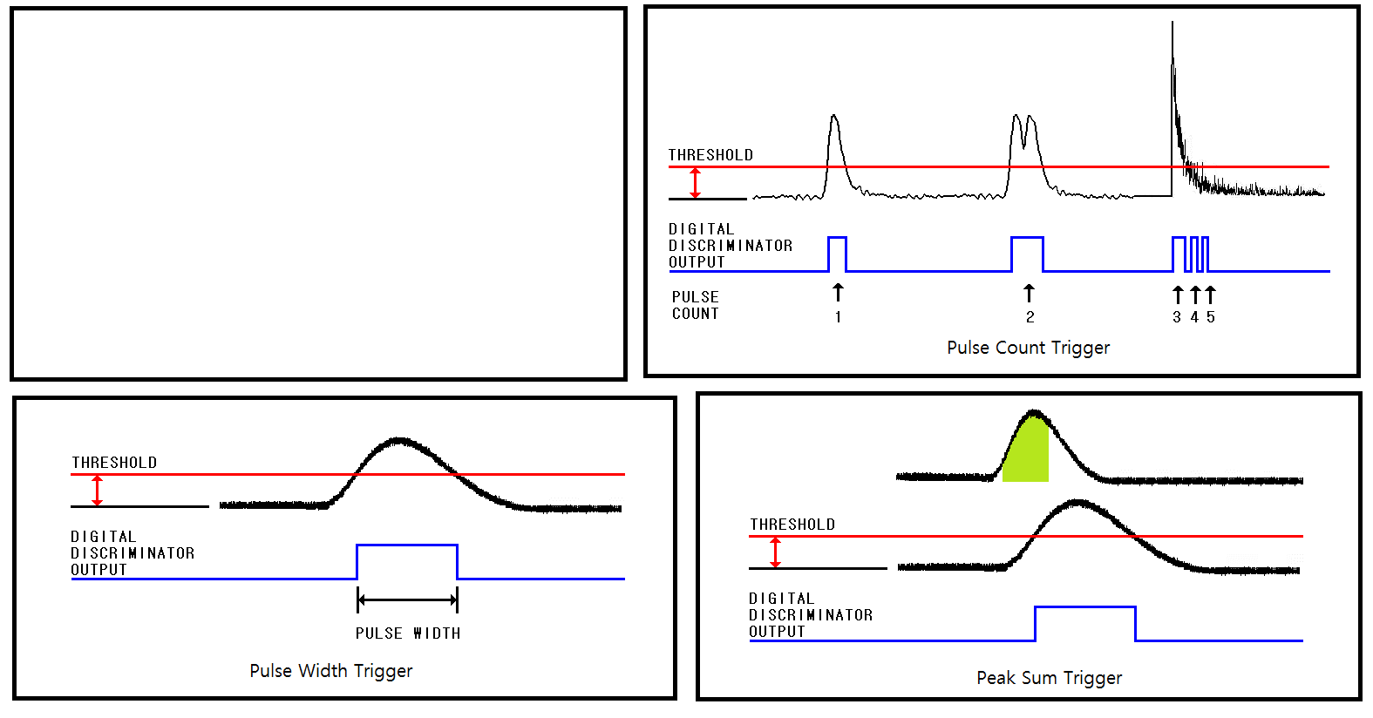
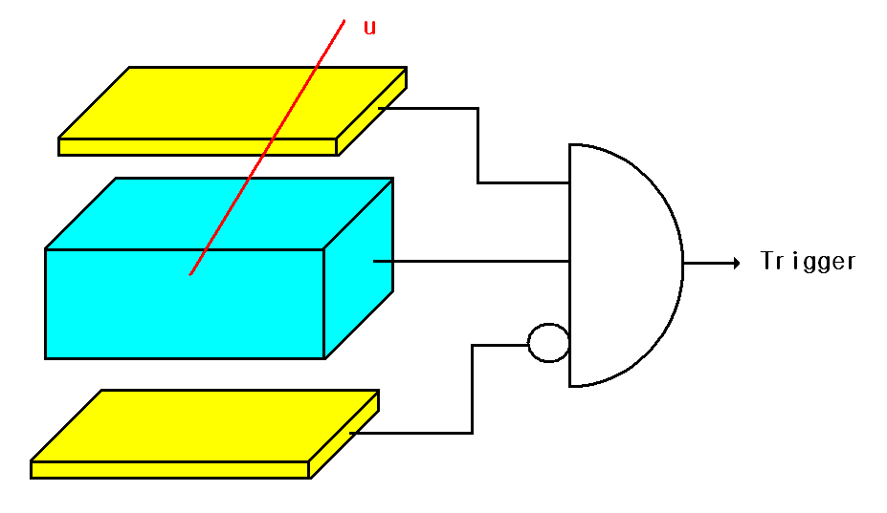
Trigger

Slide 23
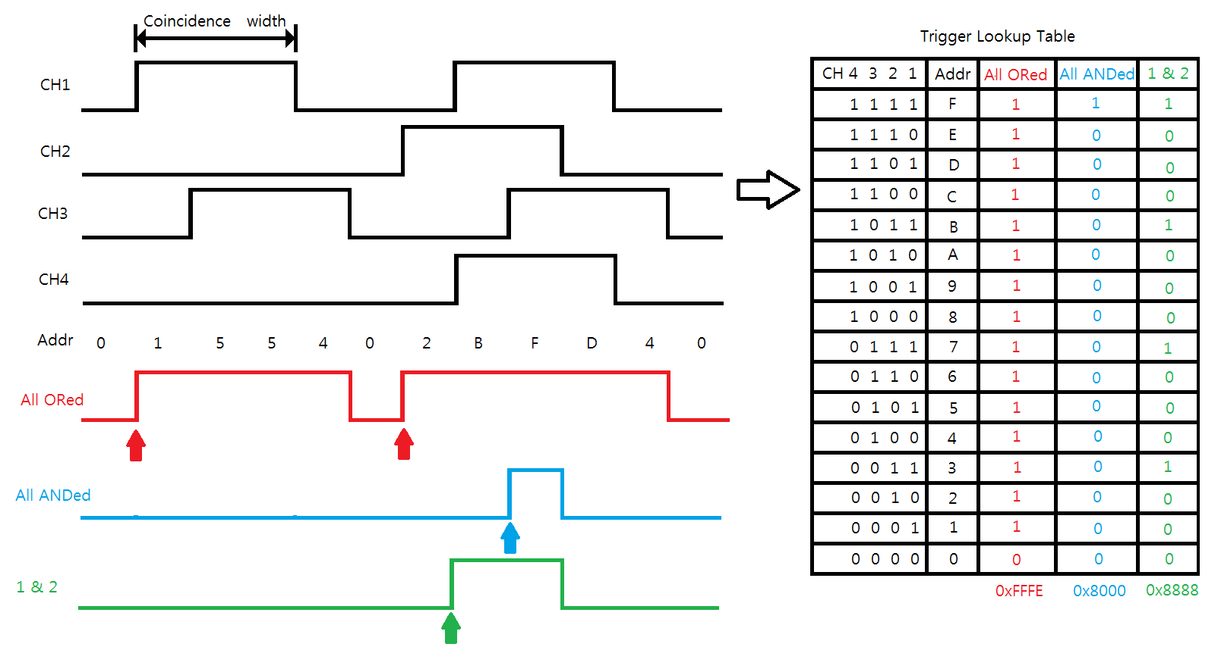
Trigger by combination

Slide 24
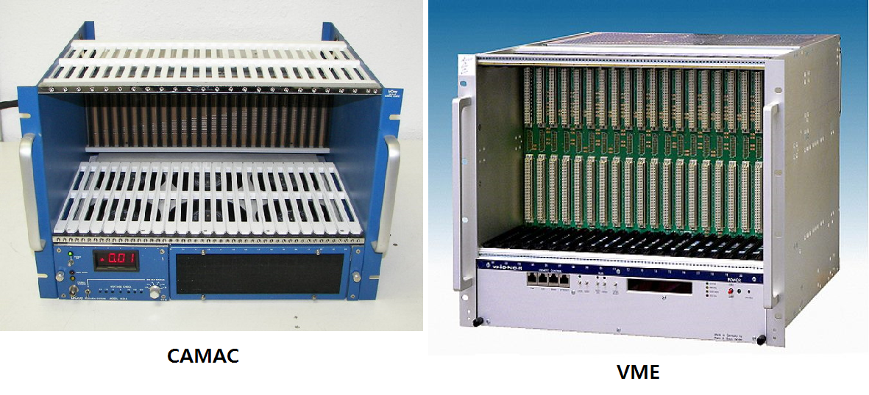
Data Acquisition
Standard DAQ

Slide 25
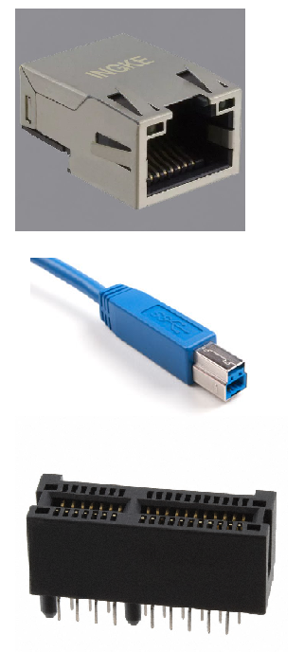
Data Acquisition
Ethernet : 125 MB/s max, ~30 MB/s typically
USB : 500 MB/s max, ~100 MB/s typically
PCI : 63 GB/s max, ~??? typically

Slide 26
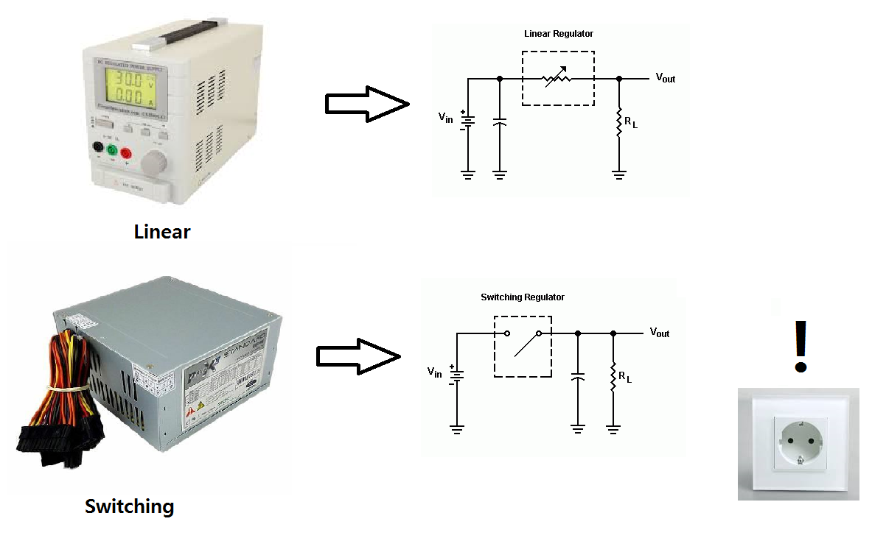
Power Supply

Slide 27
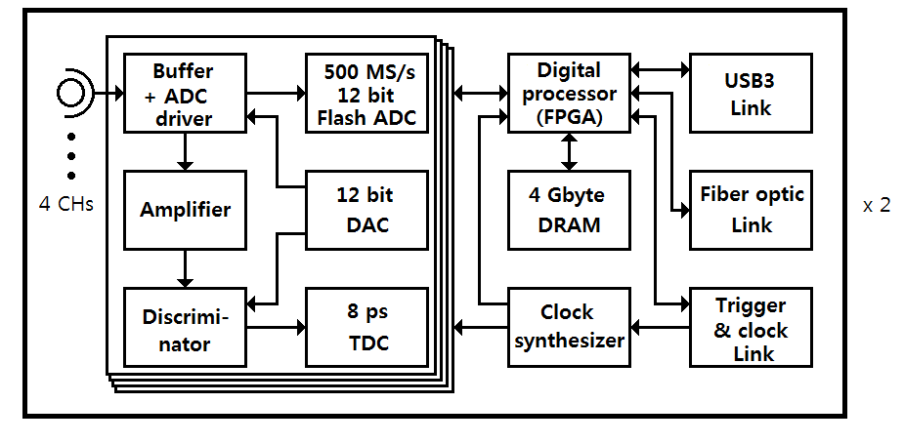
Example of electronics board

