Slide 1

Theory on Hadrons in nuclear medium
Su Houng Lee
Few words on Confinement, chiral symmetry breaking and UA(1) effect from the 80’s and 90’s
Few words on mass shift experiments
f₁(1285) and ω meson
K*, K1 meson
5. Conclusion

Slide 2

Understanding the mass of a composite object
electron
quark
gluon
Nucleus
quark
quark
proton
neutron
Nucleon
Quark < 5 %
The rest ??
QCD →
Mass of an Atom
Nucleon: 99.95 %
electron: 0.05 %
EM binding< 0.00001 %
Nucleus
Nucleons: 99%
Nuclear binding < 1 %
Confinement
U_{A}(1) breaking
χ-sym breaking
2

Slide 3
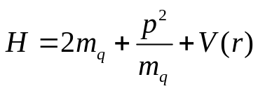
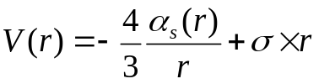



Constituent quark model: confinement vs chiral symmetry restoration
☞ Simple example for meson mass

Slide 4
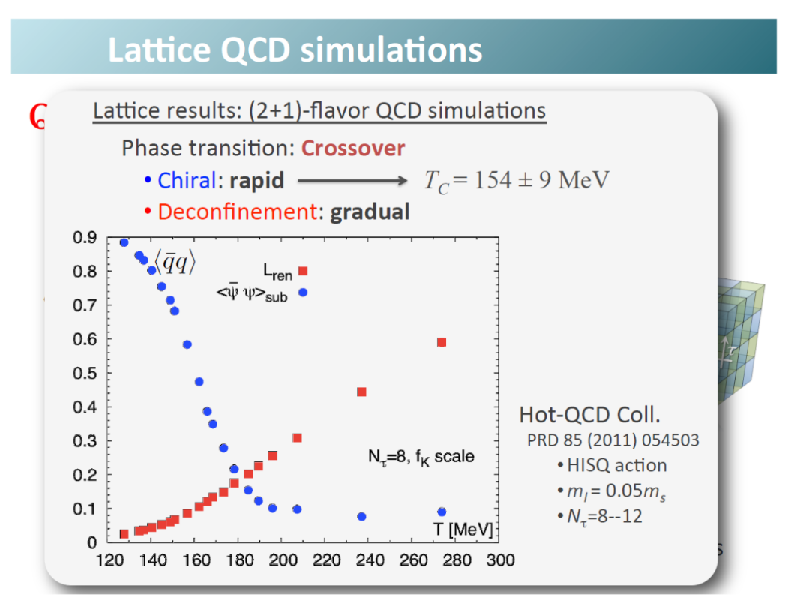
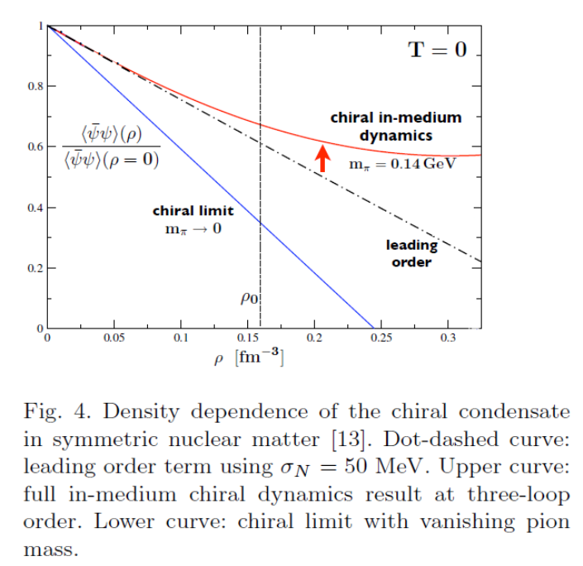
Chiral symmetry restoration at finite T and ρ
W. Weise
30% reduction in nuclear matter
→ What will happen to hadron masses : A bridge between QCD and experiment ?
Soft modes, scalar meson: Hatsuda, Kunihiro (85,87)
Pseudoscalar mesons: Bernard, Jaffe, Meissner (88), Klimt, Lutz, Vogel, Weise (90)
Brown-Rho: 91
4. Vector mesons: Hatsuda, Lee (92) ……
→ nuclear target provides a good environment to test effects of restoration

Slide 5
Few words on Confinement

Slide 6
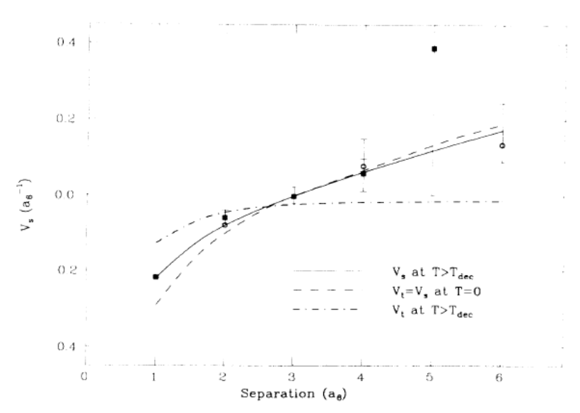





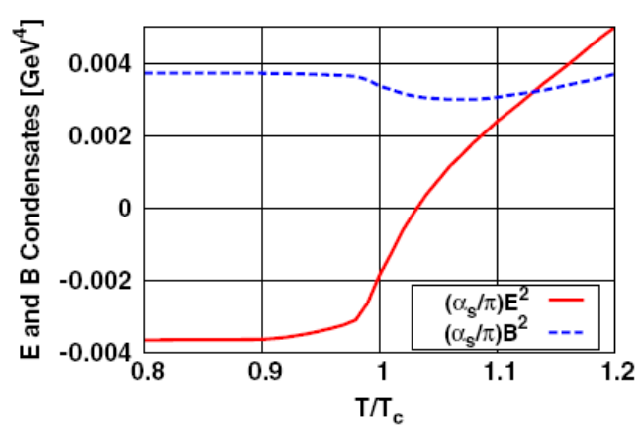
Confinement and Deconfinement at finite T
☞ Wilson Loops and potential
Manousakis, Polonyi PRL 1987
Time
T
R
Space
L
Space
☞ Local operators
Morita, SHLee PRL 2008, PRD 2009
OPE for Wilson lines: Shifman NPB73 (80)
Dosch, Simonov PLB339 (88)
W(S-T) = 1- <α/π E²> (ST)² +…
W(S-S) = 1- <α/π B²> (SS)² +…
<α/π B² >
<α/π E² >

Slide 7
Confinement and Deconfinement at finite T
☞ Wilson Loops and potential
Manousakis, Polonyi PRL 1987
Time
T
R
Space
L
Space
☞ Local operators
Morita, SHLee PRL 2008, PRD 2009
OPE for Wilson lines: Shifman NPB73 (80)
Dosch, Simonov PLB339 (88)
W(S-T) = 1- <α/π E²> (ST)² +…
W(S-S) = 1- <α/π B²> (SS)² +…
<α/π B² >
<α/π E² >
SHLee PRD40 (89):
Non-perturbative Gluon condensate above Tc

Slide 8
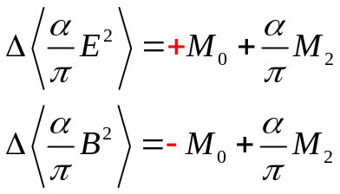
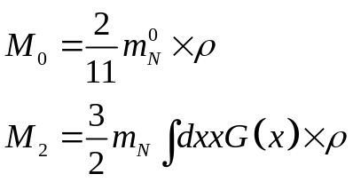
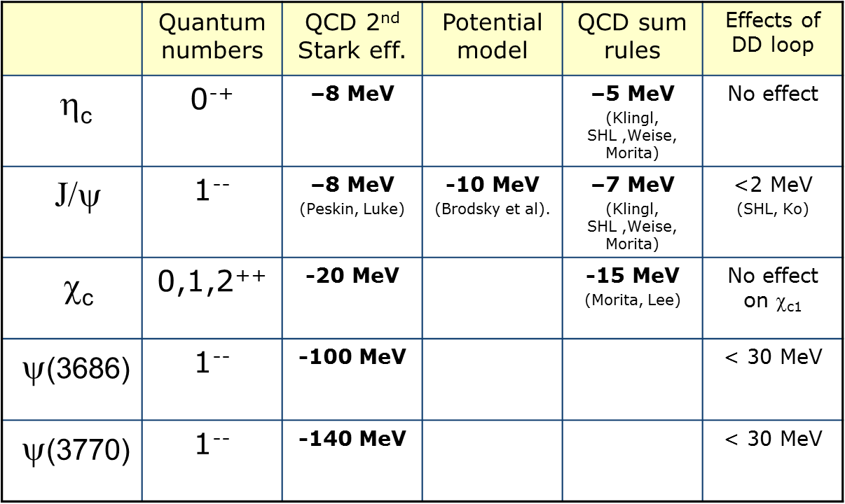
☞ Condensate change in nuclear matter
☞ Expected Mass shift of heavy quark system in nuclear matter
→ G. Wolf: Could be searched at PANDA at FAIR or future JPARC

Slide 9


Chiral symmetry and U_{A}(1)
Correlation function of chiral partners
U_{A}(1) breaking effects in Correlators
Cohen 96
Hatsuda, Lee 96

Slide 10





Chiral symmetry breaking (m→0) : order parameter
Quark condensate
☞
☞
Casher Banks formula: nontrivial zero mode ( λ =0) contribution

Slide 11
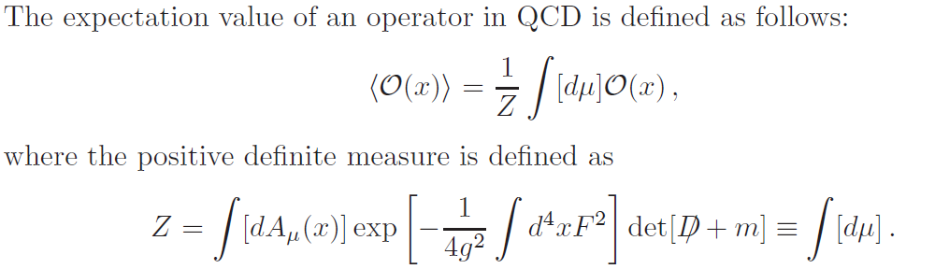
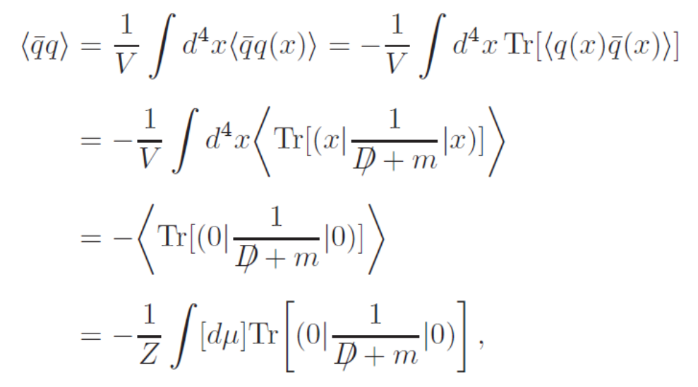
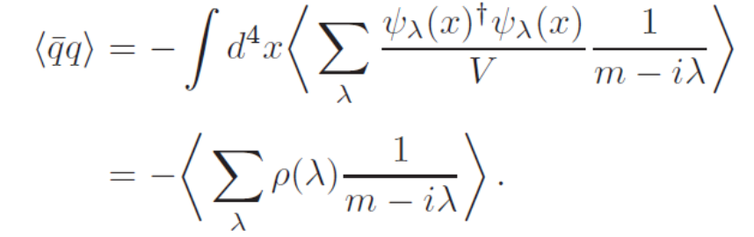
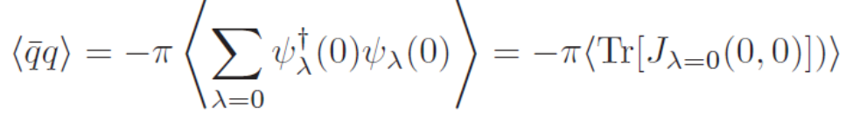
→ Casher Banks formula: nontrivial zero mode ( λ =0) contribution

Slide 12
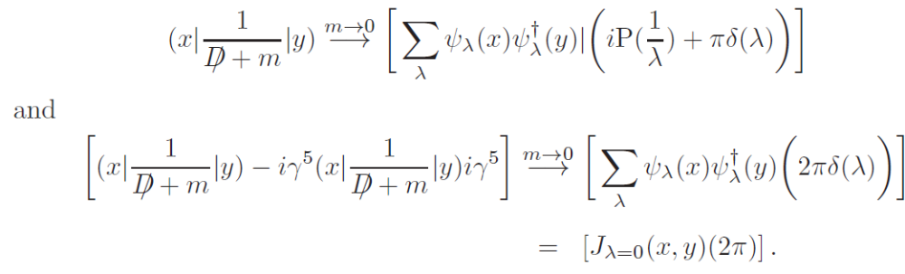
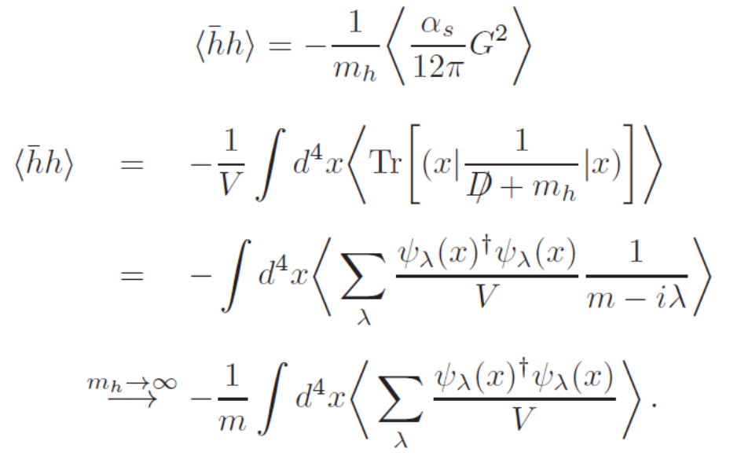
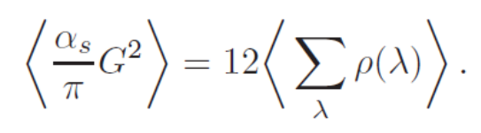
→ Useful identity
→ Gluon condensate

Slide 13








Other order parameters: V - A correlator + more
☞
Lee, S. Cho 2003

Slide 14


Other order parameters:
☞
Lee, S. Cho 2003
☞

Slide 15

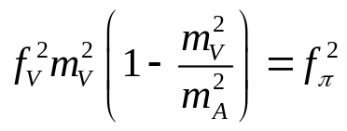

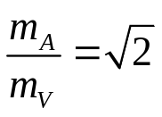



Hadron mass and chiral symmetry: Weinberg sum rule (1967)
☞
Pion contribution
→ Weinberg Sum rule
+ KSRF relation
→ trace part
→ Higher moments

Slide 16




Partial Chiral symmetry restoration in nuclear matter
☞ Nuclear Target experiments: provides a good environment to test effects of restoration
W. Weise
30% reduction in nuclear matter
→ Many previous work
Soft modes, scalar meson: Hatsuda, Kunihiro (85,87)
Pseudoscalar mesons: Bernard, Jaffe, Meissner (88), Klimt, Lutz, Vogel, Weise (90)
Brown-Rho: 91
4. Vector mesons: Hatsuda, Lee (92) …..

Slide 17
But ρ - a₁ masses are hard to observe
☞
Lee, S. Cho 2003
Very hard to observe

Slide 18




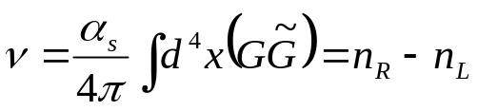






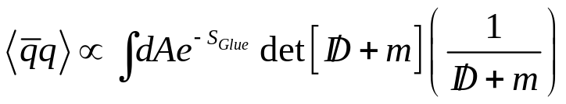

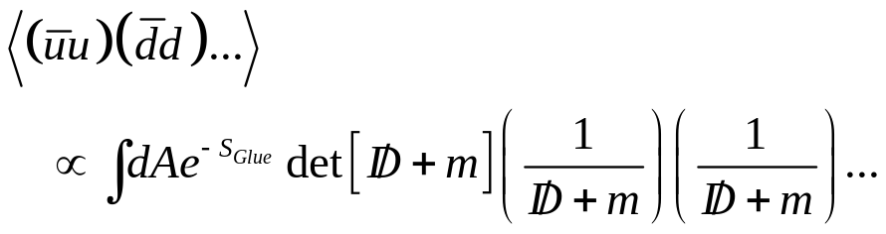

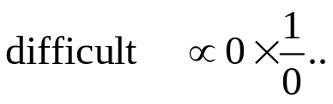
U_{A}(1) effect : effective order parameter (Lee, Hatsuda 96)
☞ Topologically trivial
☞ Topologically non-trivial
ν=0
ν=1

Slide 19




σ−η correlator : SU(2) case
☞
☞
‘t Hooft Interaction
☞
Quark picture
ν=1
ν=1
SU(3)

Slide 20





How can we observe restoration of chiral symmetry
can not be directly related to physical observable in a model independent way
could be considered
Whole spectrum not necessary
(Glozeman: Chiral symmetry is restored for excited states+ QCD duality)
Ground states that couple to each current can be compared
Both states should have small intrinsic width and experimentally observable

Slide 21
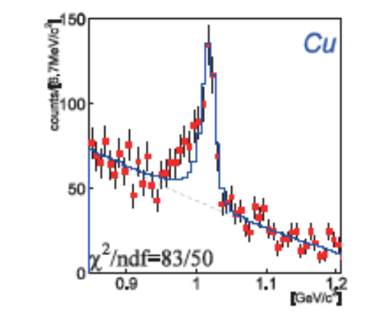
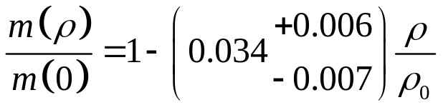
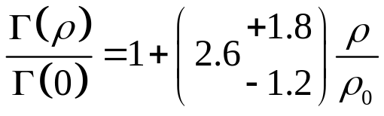
How can we observe mass shift – small width hadrons
KEK E325, J-PARC E16
Vacuum values | Mass | Width
φ | 1020 MeV | 4.266 MeV

Slide 22
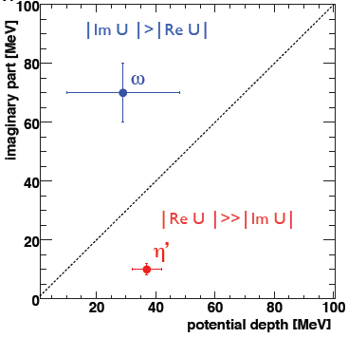


How can we observe mass shift – small width hadrons
CBELSA/TAPS coll (V. Metag, M. Nanova et al)
Vacuum values | Mass | Width
ω | 782.65 MeV | 8.49 MeV
η‘ | 957.78 MeV | 0.198 MeV

Slide 23
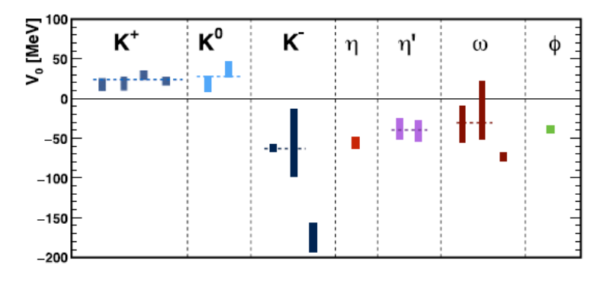
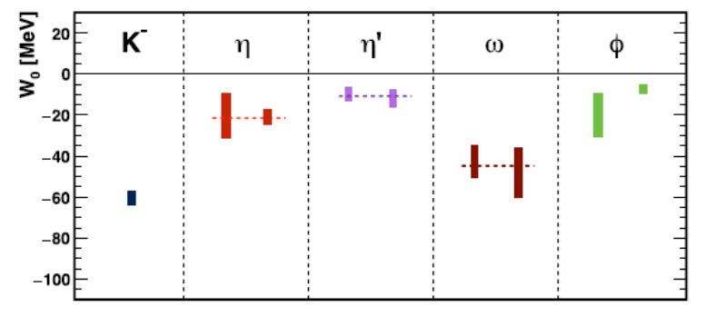
Summary by V. Metag (PPNP97 (2017)199)
☞
Downward mass shift
at nuclear matter
☞
Width increase
at nuclear matter
☞
Lesson from experiment
Look at small width hadrons (<100 MeV)
Can look at excitation energy
☞
Lesson from Theory
Look chiral partners

Slide 24
K* and K1 mesons
f₁(1285) and ω
K* and K₁

Slide 25







Light vector mesons – chiral partners ?
☞
J^{PC}=1⁻⁻ | Mass | Width | J^{PC}=1⁺⁺ | Mass | Width
ρ | 770 | 150. | a₁ | 1260 | 250-600
ω | 782 | 8.49 | f₁ | 1285 | 24.2
φ | 1020 | 4.266 | f₁ | 1420 | 54.9
K*(1⁻) | 892 | 50.3 | K₁(1⁺) | 1270 | 90
☞ Interpolating currents

Slide 26
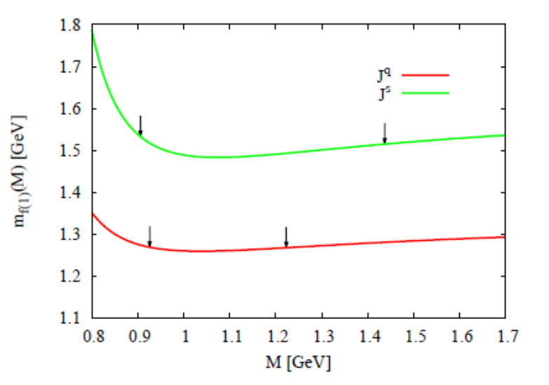


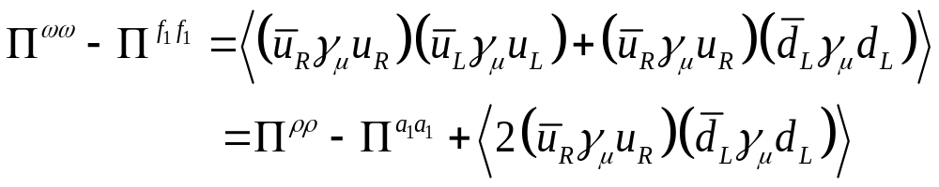

f1(1285) and f1(1420) sum rules (Gubler, Kunihiro, Lee, PLB767(2017)336)
☞ currents
☞ Chiral partner ?
Disconnected diagram

Slide 27
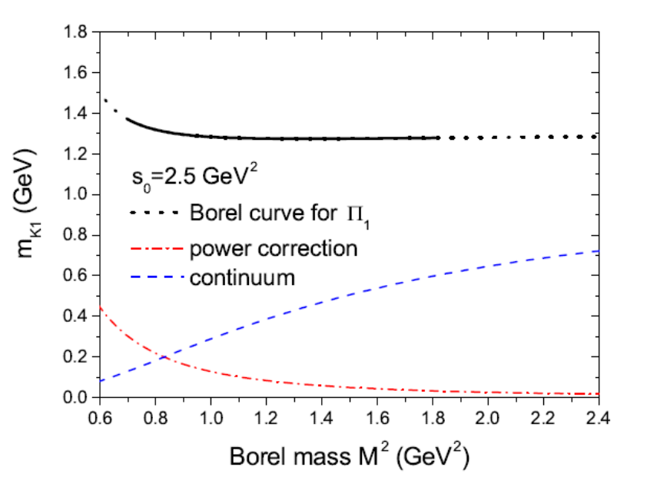

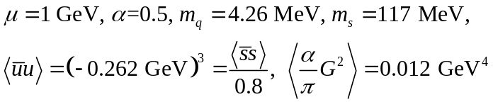


K* and K1 (Song, Hatsuda, Lee, PLB792 (2019) 160)
☞
J^{PC}=1⁻⁻ | Mass | Width | J^{PC}=1⁺⁺ | Mass | Width
ρ | 770 | 150. | a₁ | 1260 | 250-600
ω | 782 | 8.49 | f₁ | 1285 | 24.2
φ | 1020 | 4.266 | f₁ | 1420 | 54.9
K*(1⁻) | 892 | 50.3 | K₁(1⁺) | 1270 | 90
☞ (Κ∗,Κ₁ ) are chiral partners

Slide 28














Chiral Partner ?
☞ Chiral partner
Smaller mass splitting
☞ Distinct spectral density → can understand how chiral symmetry restoration is realized in nature

Slide 29

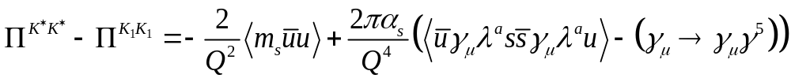




Weinberg type sum rule
☞
Correlation function differences are chiral order parameter
☞
Partial chiral symmetry restoration in nuclear medium
→ Medium effects at low density are taken into account through changes in the condensates

Slide 30

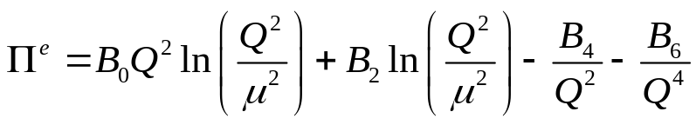

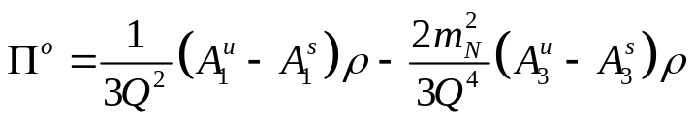
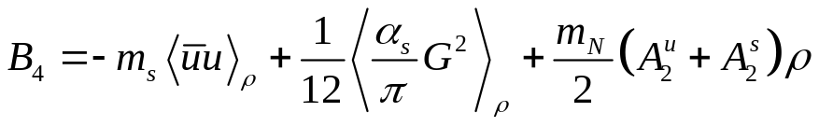

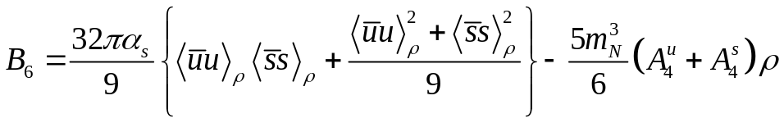

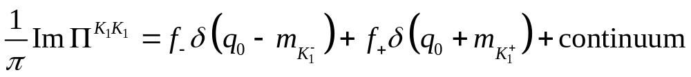
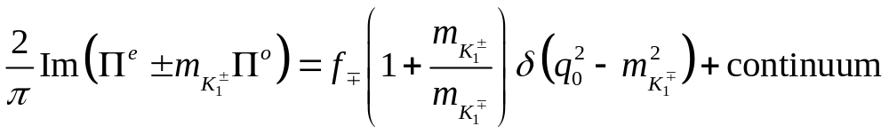
Additional input for individual sum rules
☞ OPE
☞ Spectral density

Slide 31

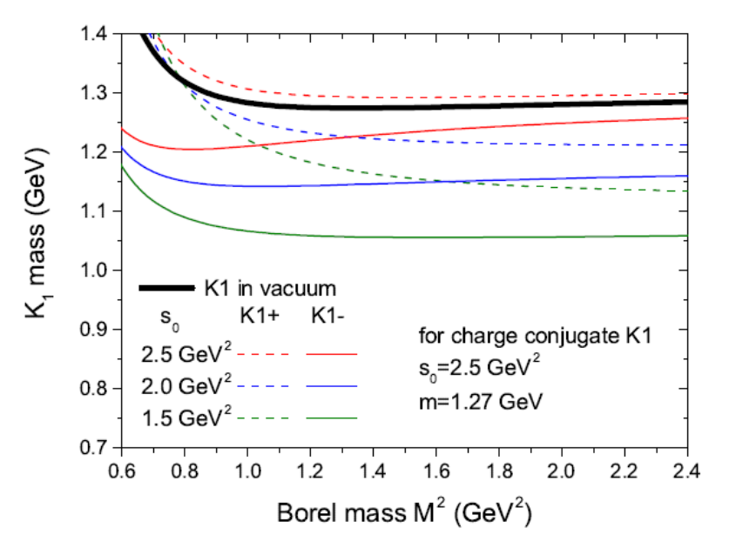





Expected mass shift from sum rules
☞ current
☞ Hence, mass shift at nuclear matter

Slide 32
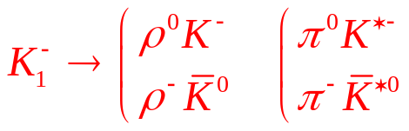



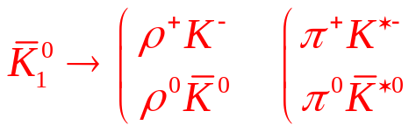

Possible future experiment
K1 (2GeV/c) excitation energy measurement at Jparc
Decay mode of K₁ (Γ=90MeV)
Decay mode | Fraction
K1(1270)→ K ρ | 42 %
K1(1270)→ K* π | 16 %
Kaon beam (2GeV)
Nuclear target

Slide 33
Summary
Chiral symmetry: Experience taught us to measure small width particles Γ<100 MeV
Theory tells us to look at chiral partners
K* K₁ are chiral partners could be done at J-PARC !! And possibly at other facilities
→ can link chiral symmetry restoration to mass generation in hadrons

Slide 34
Future of lattice QCD in Korea : I want to try
K*, K1 at finite T on the lattice
T dependence of Higher gluon operators : Gradient flow ?
Test
……?

