Slide 1
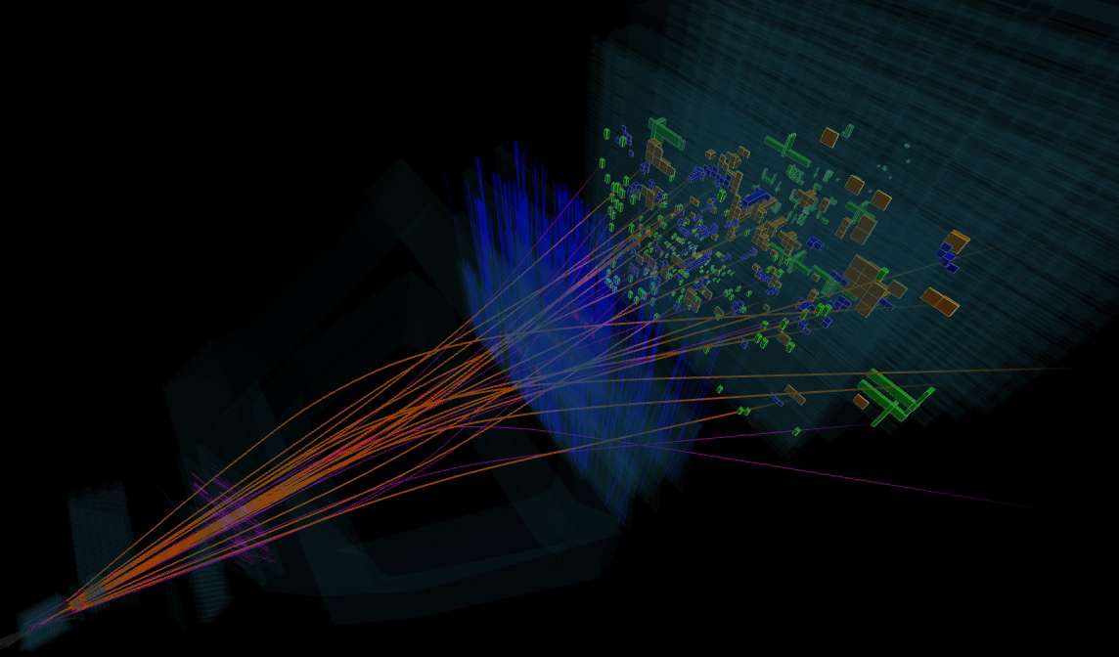

Light to Heavy baryons
Yang, Ghil-Seok
Soongsil
University
[Fig: http://lhcb-public.web.cern.ch/lhcb-public/ ]
Workshop on theoretical nuclear and hadron physics
November 13 (Fri), 2020 ~ November 14 (Sat), 2020
Notes:
First, I’d like to appreciate organizers for giving me a chance to present my work.
The title of this work is “isospin mass differences of singly heavy baryons”.
The speaker is Ghil-Seok, Yang, Soongsil University and
this work has been done with professor Kim, chairman of this session.

Slide 2










































































































Why positive ?
Motivation
$$0.220±0.013$$
$$0.01±0.15$$
($ddc$)
($udc$)
($uuc$)
($ddc$)
($udc$)
($uuc$)
Y
Y
Y
$$Λ_{c}^{+}$$
($udc$)
$$Σ_{c}^{0}$$
$$Σ_{c}^{+}$$
$$Σ_{c}^{++}$$
$$Σ_{c}^{∗0}$$
$$Σ_{c}^{∗+}$$
$$Σ_{c}^{∗++}$$
⅔
$$−0.9$$
⅔
$$?$$
$$?$$
⅔
$$?$$
$$0$$
½
$$≈183$$
-½
$$0$$
½
$$≈117$$
-½
½
$$≈120$$
-½
-1
1
-1
$$0$$
1
-⅓
$$T_{3}$$
-⅓
$$T_{3}$$
$$T_{3}$$
$$−0.8$$
($dsc$)
$$Ξ_{c}^{∗0}$$
-⅓
$$Ξ_{c}^{∗+}$$
$$Ξ_{c}^{0}$$
$$−2.98$$
$$Ξ_{c}^{+}$$
$$Ξ_{c}^{′0}$$
$$Ξ_{c}^{′+}$$
$$−0.8$$
($usc$)
($dsc$)
($usc$)
($dsc$)
($usc$)
$$≈124$$
$$≈128$$
$$Ω_{c}^{0}$$
$$−4/3$$
$$Ω_{c}^{∗0}$$
$$−4/3$$
($ssc$)
($ssc$)
[$\overline{3}$]=$D\left(0,1\right)$,
$$J= 1/2$$
twice ?
[$6$]=$D\left(2,0\right)$,
$$J= 1/2$$
[$6$]=$D\left(2,0\right)$,
$$J=3/2$$
Why negative ?
$$−5.06±0.18$$
$$−4.37±0.33$$
Y
Y
Y
?
?
$$Σ_{b}^{∗+}$$
$$Λ_{b}^{0}$$
($udb$)
$$Σ_{b}^{−}$$
$$Σ_{b}^{0}$$
$$Σ_{b}^{+}$$
$$Σ_{b}^{∗−}$$
$$Σ_{b}^{∗0}$$
⅔
($ddb$)
($uub$)
($uub$)
$$?$$
⅔
$$?$$
$$?$$
⅔
$$?$$
-½
½
$$≈174$$
-½
½
$$\sim 111(?)$$
-½
½
$$≈142(?)$$
-1
?
1
-1
$$0$$
?
1
$$0$$
$$T_{3}$$
$$0$$
$$T_{3}$$
$$T_{3}$$
-⅓
$$Ξ_{b}^{0}$$
-⅓
$$Ξ_{b}^{′0}$$
$$Ξ_{b}^{∗−}$$
-⅓
$$Ξ_{b}^{∗0}$$
$$Ξ_{b}^{−}$$
$$−5.9$$
($dsb$)
$$Ξ_{b}^{′−}$$
$$?$$
($usb$)
$$?$$
($usb$)
($usb$)
$$\sim 122(?)$$
?
$$≈ ?$$
($dsb$)
$$Ω_{b}^{−}$$
$$−4/3$$
$$Ω_{b}^{∗−}$$
$$−4/3$$
($ssb$)
($ssb$)
[$\overline{3}$]=$D\left(0,1\right)$,
$$J= 1/2$$
[$6$]=$D\left(2,0\right)$,
$$J= 1/2$$
[$6$]=$D\left(2,0\right)$,
$$J=3/2$$
Notes:
I’d like to start by the weight diagrams for singly heavy baryons, charmed and beauty baryons.
First triangle is antitriplet with three baryon states
and next two inverted triangles are sextet with six baryon states
When you look into the Particle Data Book,
Considering experimental uncertainties or unknow values of several heavy baryon masses,
you can see the equal-spacing structure for SU(3) flavor mass splittings.
You can also find such an equal-spacing feature in light baryons, for example, Decuplet baryons
because of the number of strange quark in Naive Quark Model.
Now, let’s check the isospin mass differences.
In the quark model, when you consider isospin mass differences betwen two heavy baryons with the same heavy quark,
You can say that it is nothing but the current quark mass difference between up and down quarks and you can forget about heavy quarks.
It means left one should be heavier than right one and this gives us the minus sign for isospin mass differences like this.
However, comparing the values of charmed and beauty baryons, this(beauty) one is twice of this(charm) one,
although, they have same quark components “us – ds”
We can find another surprising things when we look at the mass difference values for this cases.
As you see, the values of mass difference
for charmed Sigma ++ MINUS Sigma zero is unexpectated value, +0.220 MeV,
charmed Sigma ++ star MINUS Sigma zero star is also +0.01 MeV,
These positive numbers are unexpectated values.
Moreover, for the beauty baryons cases, the sign is opposite and magnitudes are also different.
This is motivation why I begin to study this topic.

Slide 3
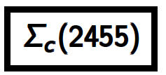

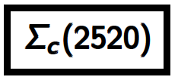

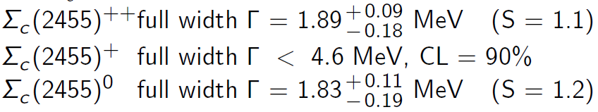
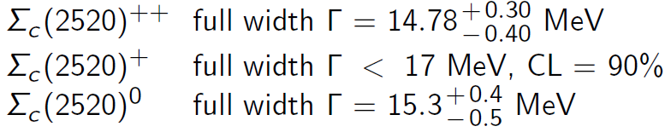
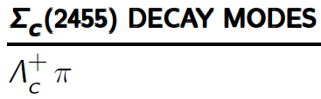
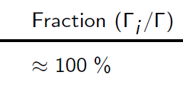
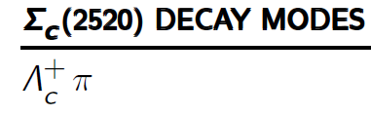
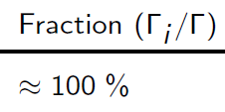
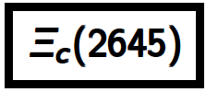





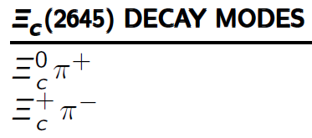


MOTIVATION 2
Strong Decay Widths

Slide 4
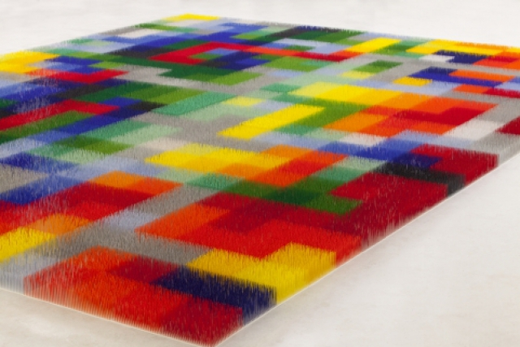
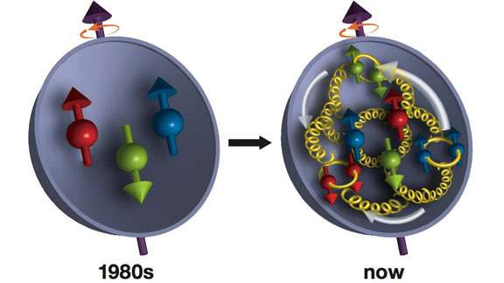
Theoretical framework: Chiral soliton model
Large $N_{c}$ arguments allows us to consider a classical pion mean field
(Witten): Relativistic Mean Field Approximation
Fig: https://phys.org/news/2017-03-proton.html
$$E$$
$$0$$
very large $N_{c}$ valence quarks
sea quarks
(pion mean fields)
The presence $N_{c}$ valence quarks creates the pion mean fields
and valence quarks are self-consistently bound by it in the large $N_{c}$ limit.
One can put $N_{c}$ to real-world value $3$ at the end of the calculation.
Notes:
Now let me briefly introduce the theoretical framework, chiral soliton model.
Chiral soliton model is based on the large Nc picture where the nucleon can be described as a soliton of the effective chiral Lagrangian.
This large Nc arguments allows us to consider a classical pion mean field which is created by Nc valence quarks.
Then valence quarks are self-consistently bound by it in the large $N_{c}$ limit.

Slide 5
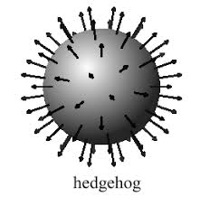
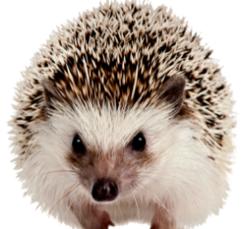
Theoretical framework: Chiral soliton model
: Effective and relativistic low energy theory
: Large $N_{c}$ limit : meson fields
→ Soliton (No quark degree of freedom)
: Quantizing SU(3) meson fields rotated in flavor and spin space
→ Collective Hamiltonian, model baryon states
Hedgehog Ansatz:
$$N(940,1/2^{+})$$
$$U_{0} =\left[\begin{matrix}e^{in⋅τ P\left(r\right)} & 0 \\ 0 & 1\end{matrix}\right]$$
$$K^{p}=0^{+}$$
$$E=0$$
$$K^{p}={1/2}^{+}$$
SU(2) Witten imbedding
into SU(3): SU(2) X U(1)
u,d
s
Notes:
Based on the principal idea of the pion mean-field approach suggested by Witten,
this pion mean field can be regarded as a soliton in large Nc limit.
For up and down quark sector, we employ pion mean field ....
and for strange quark, it has its own mean field separately.
After Quantizing SU(3) soliton by simultaneous flavor and spin rotations,...
we obtain collective hamiltonian and model baryon states

Slide 6



Theoretical framework: Chiral soliton model (Collective hamiltonian)
+
Y
Y
Y
Mass
Mass
( udd ) n
N
p ( uud )
( ddd )Δ⁻
Δ⁰
Δ
Δ⁺
Δ⁺⁺ ( uuu )
940
1
1
1232
-½
Λ
Λ
-3/2
-½
½
-3/2
1116
½
T₃
T₃
1385
1193
Σ⁻
Σ⁰
Σ⁰
Σ⁺
Σ^{*-}
Σ^{*0}
Σ*
Σ^{*+}
1318
-1
Ξ*
1533
-1
Ξ^{*-}
Ξ^{*0}
( dss)Ξ⁻
Ξ
Ξ⁰ ( uss )
Ω⁻
-2
Ω⁻( sss )
1673
Octet (8) : J ^{p} = 1/2 ⁺
Decuplet (10) : J ^{p} = 3/2 ⁺
SU(3) flavor symmetry breaking
+ Isospin symmetry breaking
Notes:
Collective Hamiltonian can be divided into two parts, symmetric and symmetry breaking contributions.
Symmetric one consists of classical soliton mass ...
and terms expressed by the moments of inertia of solion I1, and I2,
The contributions from SU(3) flavor and isospin symmetry breaking are expressed ...
by SU(3) Wigner rotation D-functions with current quark masses of strange and up and down.
α, β and γ are Dynamical model-parameters and Let me talk about those later.
So, from SU(3) flavor symmetry breaking effects, we can describe the multiplet
along the hypercharge axis for octet and decuplet baryons....
and...
From isospin symmetry breaking effect
We can describe all physical states for light baryons, octet and decuplet.

Slide 7
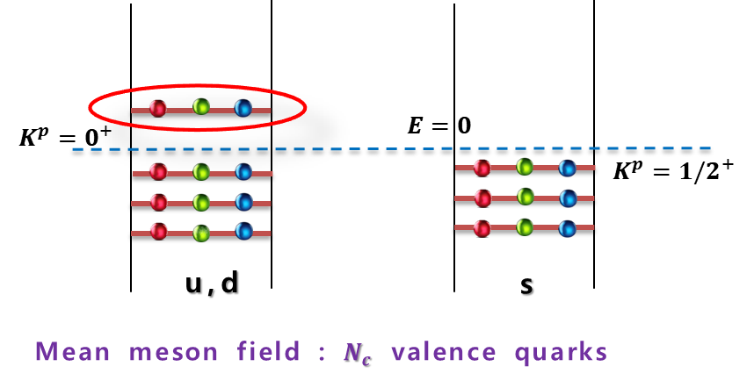





















Heavy quarks are too heavy !
$$Λ_{QCD}\left(210\sim 340 MeV\right) ≪ m_{c} \left(\sim 1.2 GeV\right)≪ m_{b}(\sim 4.5 GeV)$$
$$chiral symmetry$$
$$Λ_{QCD}$$
$$heavy Quark symmetry$$
$$m_{q}$$
$$1 MeV$$
$$10 MeV$$
$$100 MeV$$
$$1 GeV$$
$m_{q}$ expansion
$$u$$
$$d$$
$$s$$
$$c$$
$$b$$
${1/m}_{Q}$ expansion
[ M. Oka, Nucl.Phys A 914, 447 (2013) ]
light baryons ($qqq$)
Singly heavy baryons ($qqQ$)
$$K^{p}=0^{+}$$
$$E=0$$
$$K^{p}={1/2}^{+}$$
$c (b)$
u,d
s
Mean meson field : $N_{c}−1$ valence quarks
Notes:
However, for the heavy baryons,
we need to consider something more.
Because heavy quarks are too heavy,
then we don’t want to assume another symmetry like SU(4) in this mean-field approach.
So, If we take into account a heavy quark as a static color source,
we shall have the pion-mean field consisting of N_c -1 valence quarks.

Slide 8
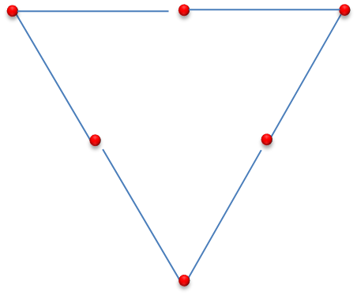
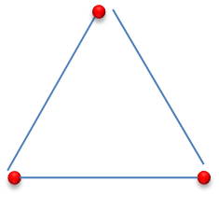











































$$d$$
$$u$$
$u, d, s$
$$d$$
$$u$$
$c, b$
$$s$$
$3⨂3$ $= \overline{3}⊕6$
$$s$$
$$⨂$$
$$[3]$$
$$[3]$$
$$=$$
$$Λ_{c}^{+}$$
($ddc$)
($udc$)
($uuc$)
($udc$)
$$Σ_{c}^{0}$$
$$Σ_{c}^{+}$$
$$Σ_{c}^{++}$$
$$Σ_{c}^{∗0}$$
$$Σ_{c}^{∗+}$$
$$Σ_{c}^{∗++}$$
$$⊕$$
($dsc$)
($usc$)
($dsc$)
$$Ξ_{c}^{′0}$$
$$Ξ_{c}^{′+}$$
($usc$)
$$Ξ_{c}^{∗0}$$
$$Ξ_{c}^{∗+}$$
$$Ξ_{c}^{0}$$
$$Ξ_{c}^{+}$$
$$Ω_{c}^{0}$$
($ssc$)
$$Ω_{c}^{∗0}$$
$$⊕$$
$$[ 6 ]$$
$$[ 6_{J=3/2} ]$$
$$[ \overline{3} ]$$
$$[ 6_{J=1/2} ]$$
Notes:
As you know, in a naive quark model,
a heavy baryon consists of a heavy quark and two light quarks.
Since a heavy quark is common component in the singly heavy baryons,
we can write down two light-quark combination as group representation 3 times 3.
After simply calculations with these weight diagrams,
we have two kinds of multiplets, antitriplet and sextet for the Nc-1 pion mean field.
In addition, when we consider the spin state of a heavy quark,
we have two sextet with spin one-half(1/2) and three-half(3/2).

Slide 9
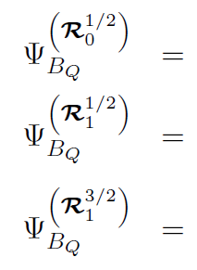









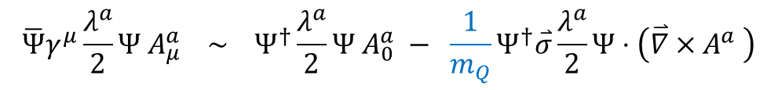



$$Y$$
$$E=0$$
$$Λ_{c}^{+} (udc)$$
⅔
$c (b)$
-½
½
$$0$$
$$T_{3}$$
u,d
s
$$Ξ_{c}^{0} (dsc)$$
-⅓
$$Ξ_{c}^{+} (usc)$$
Mean meson field : $N_{c}−1$ valence quarks
: $ψ$ from light baryons
$$For S_{z}=+1/2$$
$$\overline{Ψ}γ^{μ}\frac{λ^{a}}{2}Ψ{ A}_{μ}^{a} \sim Ψ^{†}\frac{λ^{a}}{2}Ψ{ A}_{0}^{a} − \frac{1}{m_{Q}}Ψ^{†}\overset{⃑}{σ}\frac{λ^{a}}{2}Ψ⋅\left(\overset{⃑}{∇}×A^{a} \right)$$
Heavy quark spin-flip is not taken into account : Heavy quark (spin) symmetry
Notes:
This is for the heavy baryon wavefunctions.
The complete wavefunction for a heavy baryon can be constructed by coupling the soliton wavefunction
to the heavy quark spinor such that the heavy baryon becomes a color singlet.
For this work, heavy quark spin-flip is not taken into account due to the heavy quark spin symmetry

Slide 10
SU(3) flavor mass splittings
of low-lying sinlgy heavy baryons
Phys.Rev.D 94 (2016) 071502 (Rapid comm.)
Phys.Rev.D 96 (2017) 094021

Slide 11

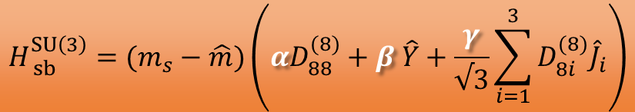


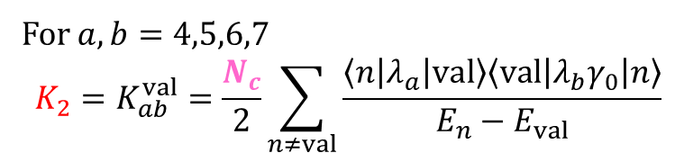
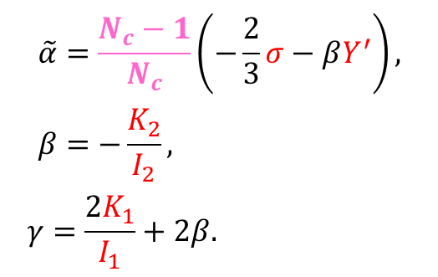


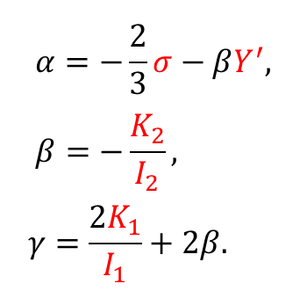



Recent results for heavy baryons in a chiral soliton model
  Mass splittings from SU(3) flavor symmetry breakings
Y
$$Λ_{c}^{+}$$
($udc$)
$$H_{ sb}^{SU\left(3\right)}=(m_{s}−\hat{m})\left(αD_{88}^{(8)}+β \hat{Y}+\frac{γ}{√3}\sum_{i=1}^{3}{D_{8i}^{(8)}{\hat{J}}_{i}}\right)$$
⅔
½
$$≈183$$
-½
$$0$$
$$T_{3}$$
where
$$Ξ_{c}^{0}$$
-⅓
$$Ξ_{c}^{+}$$
$$α=−\frac{2}{3}σ−βY^{′}, \\ β=−\frac{K_{2}}{I_{2}},$$
$$γ=\frac{2K_{1}}{I_{1}}+2β.$$
$$\tilde{α}=\frac{N_{c}−1}{N_{c}}\left(−\frac{2}{3}σ−βY^{′}\right), \\ β=−\frac{K_{2}}{I_{2}},$$
$$γ=\frac{2K_{1}}{I_{1}}+2β.$$
($dsc$)
($usc$)
[$\overline{3}$]=$D\left(0,1\right)$,
$$J= 1/2$$
For $a,b=4,5,6,7$
$$K_{2}=K_{ab}^{val}=\frac{N_{c}}{2}\sum_{n≠val}{\frac{\left\langle n\left|λ_{a}\right|val\right\rangle \left\langle val\left|λ_{b}γ_{0}\right|n\right\rangle }{E_{n}−E_{val}}}$$
Notes:
Now let me move on to the modification of pion mean field for the heavy baryons.
As we saw before, collective hamiltonian is composed of dynamic model parameters, α, β and γ.
These model parameters are expressed by moments of inertia of soliton in the order of Nc.
Thus α, β and γ should be modified ....
as like this for the singly heavy baryons consisting of Nc-1 valence quarks.

Slide 12
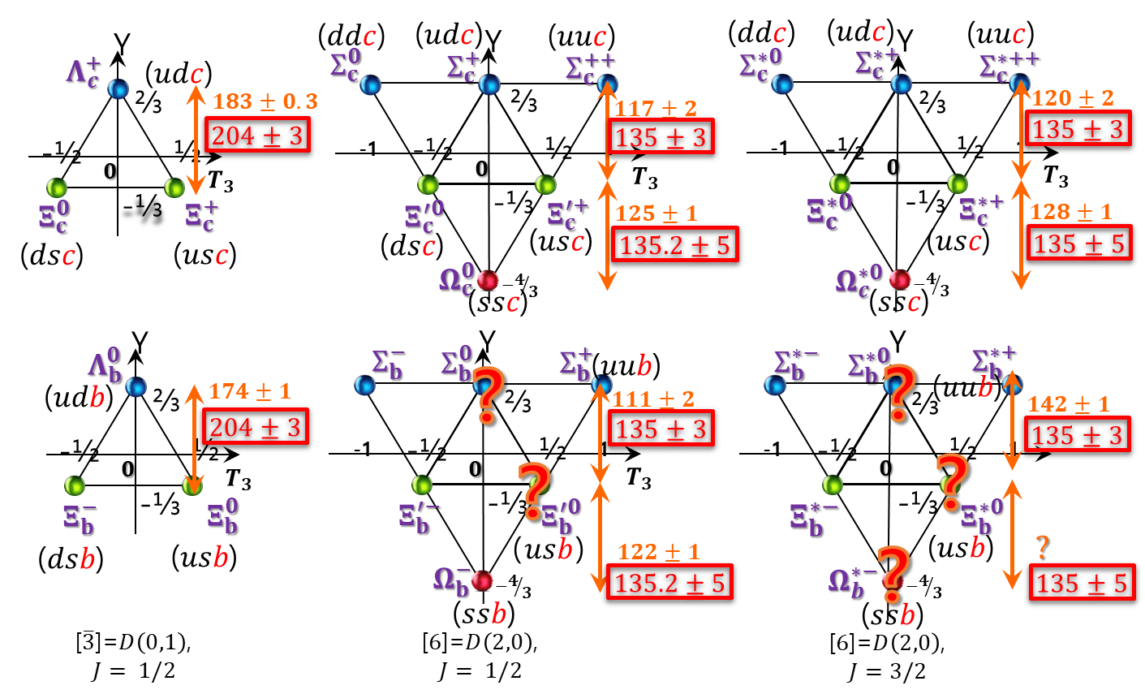
This results are from the soliton for the light baryons with a factor $\left(N_{c}−1\right)/N_{c}$
G.S Yang et al., Phys.Rev.D 94, 071502(R) (2016)
Notes:
And this is for numerical results for masses of singly charmed and beauty baryons.
This results are just from the soliton for the light baryons with a factor (Nc-1)/ Nc,
and we can see whole results are in good agreement with experimental data.

Slide 13
Strong decay widths
of low-lying sinlgy heavy baryons
Phys.Rev.D 96 (2017) 094021

Slide 14
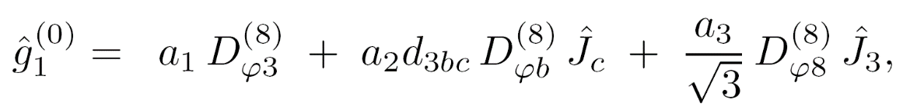
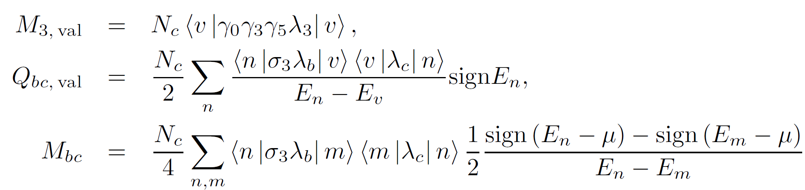


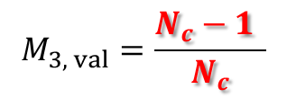

Recent results for heavy baryons in a chiral soliton model
  Strong decay widths of heavy baryons
$$= \left[M_{3}−\frac{2iQ_{12}}{I_{1}}\right]D_{X3}^{(8)} +\left[−\frac{4M_{44}}{I_{2}}\right]d_{pq3}D_{Xp}^{\left(8\right)}{\hat{J}}_{q} +\left[−\frac{2M_{83}}{I_{1}}\right]\frac{1}{\sqrt{3}}D_{X8}^{\left(8\right)}{\hat{J}}_{3} + ⋯$$
where
$$N_{c}−1$$
For heavy baryons
$$M_{3, val}=\frac{N_{c}−1 }{N_{c}}$$
from octet baryons
Notes:
And we have another results that can show successful Nc-1, modified pion-mean field for the heavy baryons.
In the same way as baryon masses, ....
dynamical model parameters a1, a2, a3 for strong decays can be modified by Nc-1.

Slide 15
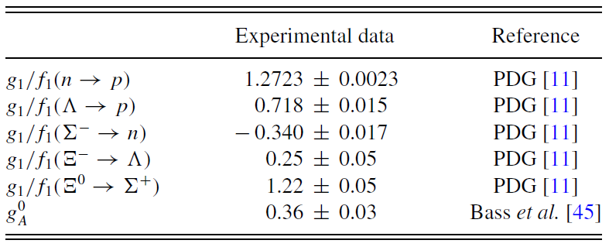
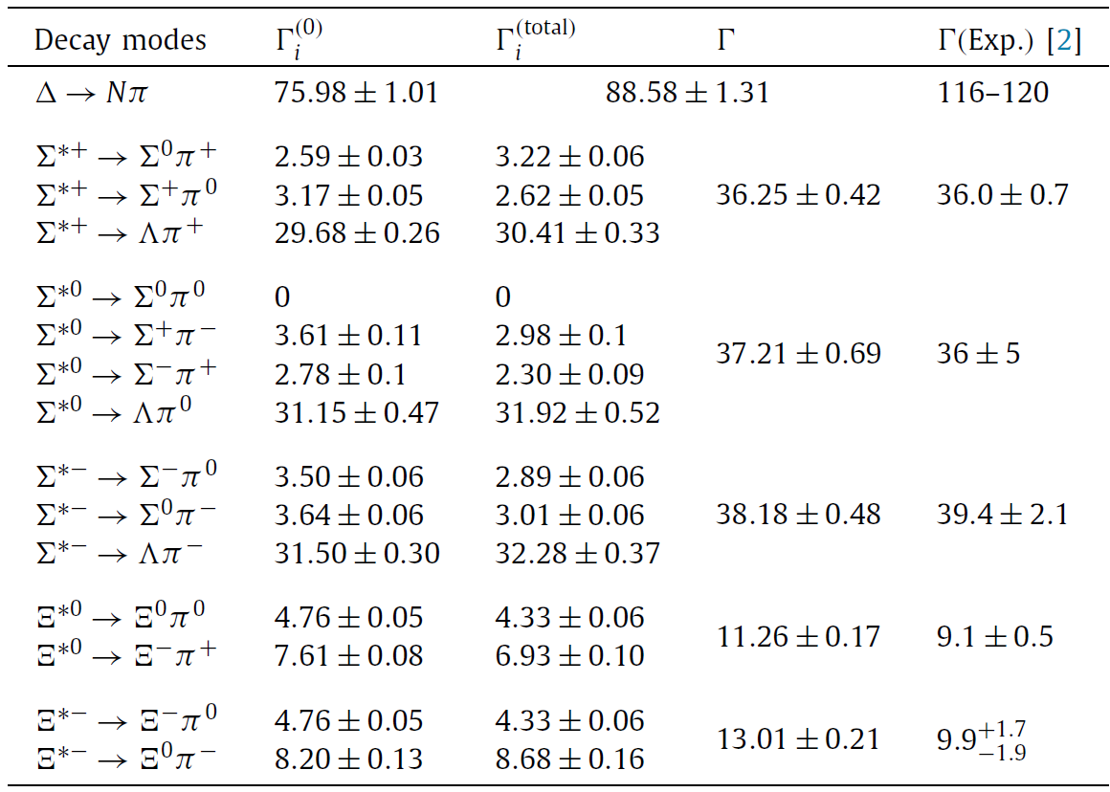
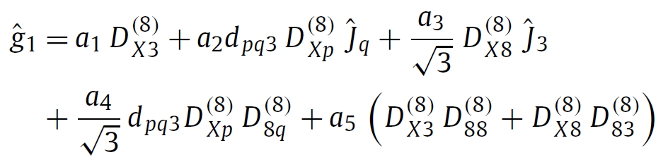

Theoretical Framework
Chiral soliton model & Mean field approach
$g_{1}/f_{1}\left(n→p\right)$ $=$ $−\frac{7}{30}a_{1}+\frac{7}{60}a_{2}+\frac{1}{60}a_{3}−\frac{11}{270}a_{4}−\frac{1}{9}a_{5}−\frac{1}{15}a_{6}+⋯$
Yang, et al. Rev. C 92 035206 (2015)
Yang, et al, Phys. Lett. B 785 434 (2018)

Slide 16
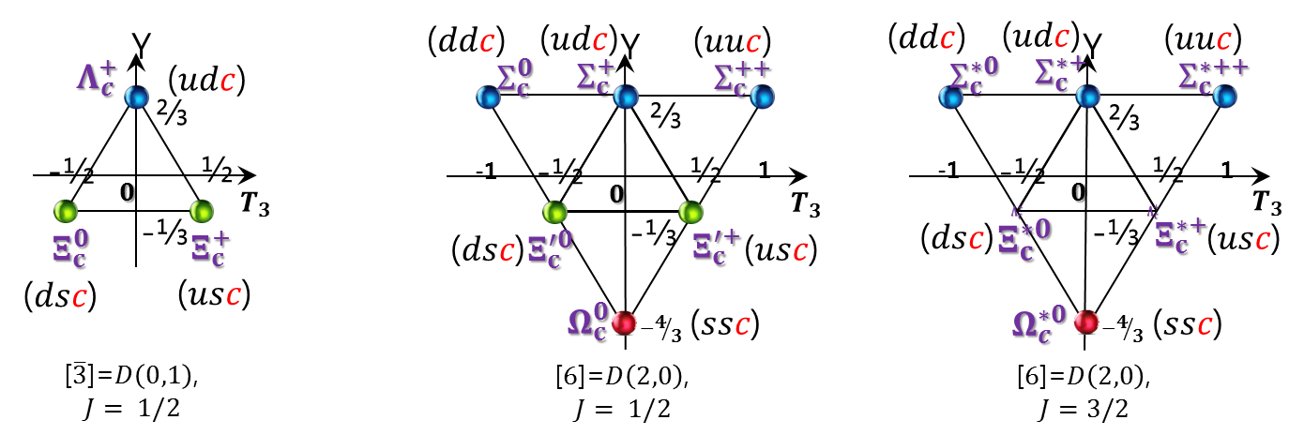
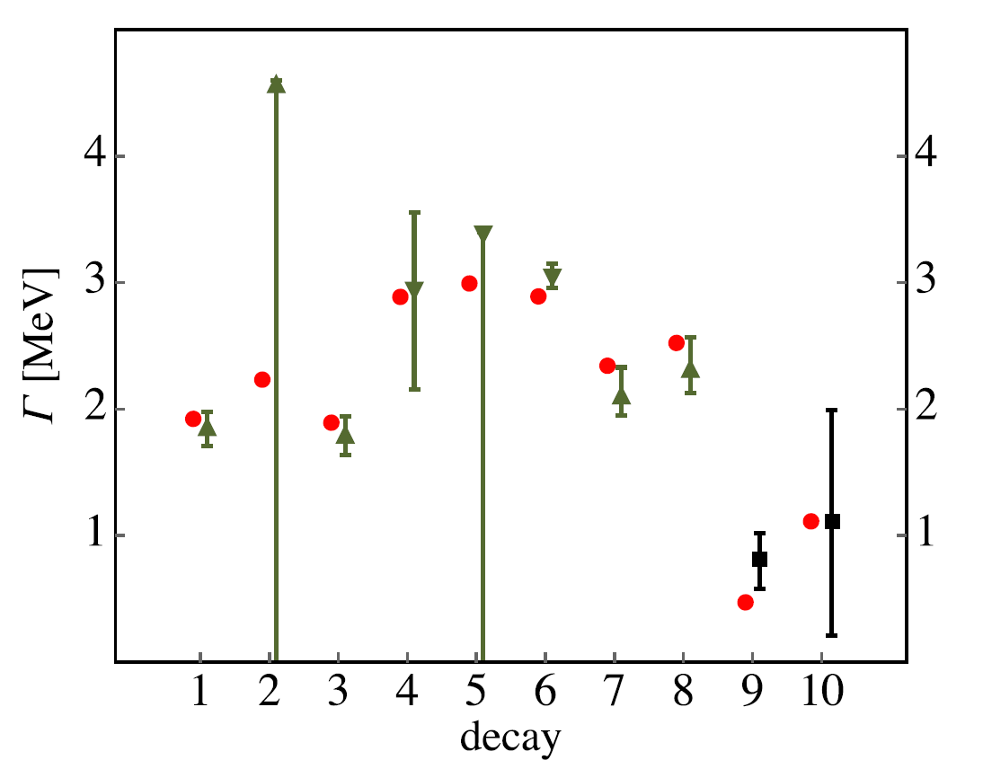
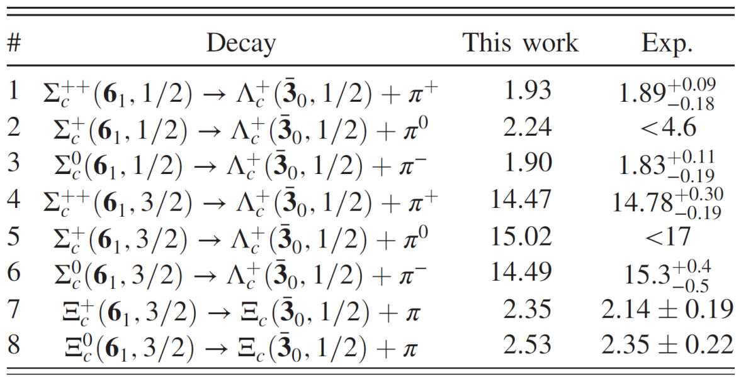
  Strong decay widths of charmed baryons
Yang, et al., Phys.Rev.D 96 (2017) 094021
Light quarks govern their structure of singly heavy baryons.
Notes:
We obtain the strong decay widths of charmed baryons.
In this picture, numbers on the horizental axis are the corresponding decay modes 1,2,3,4 and so on,
and vertical axis is about decay widths in unit of MeV.
The solid lines denote the experimental data with uncertainties and red spots are our prediction in this work.
As you see, the results are in very good agreement with experimental data.
From all these results, we can conclude that light quarks govern their structure of singly heavy baryons.

Slide 17
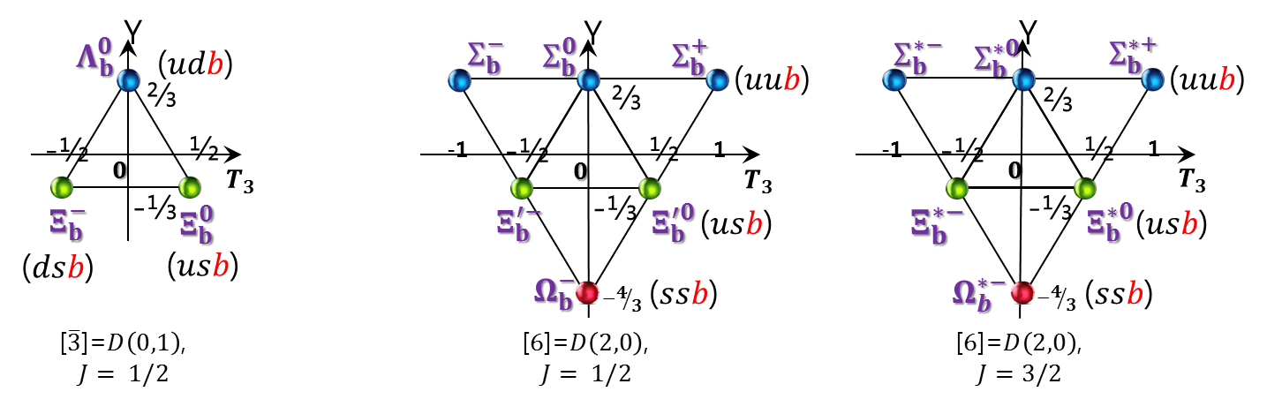
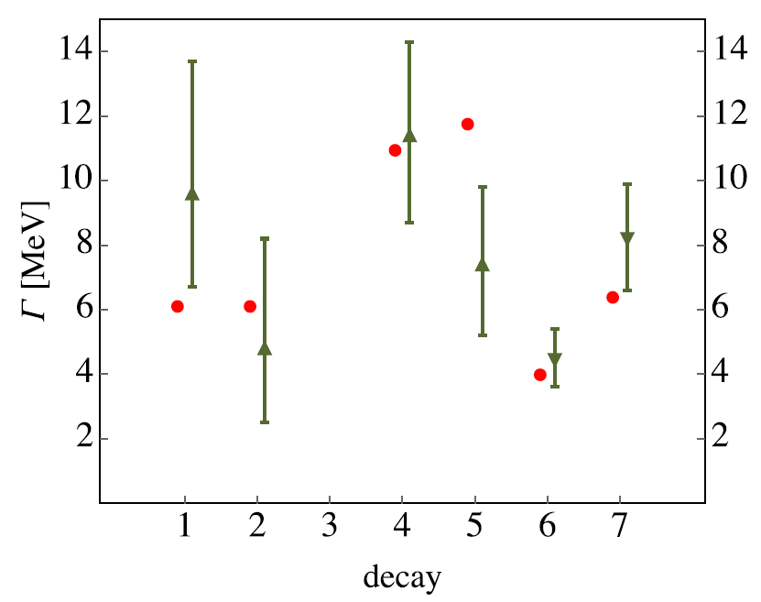
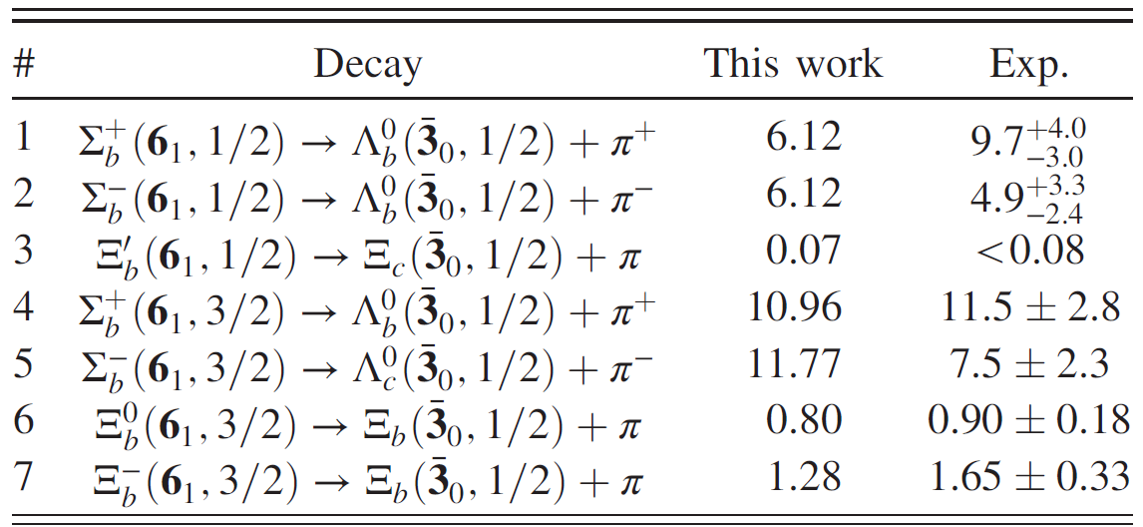
Results and Discussion
Strong Decay Widths of Bottom baryons
Light quarks govern their structure of singly heavy baryons.

Slide 18
Isospin mass differences
of low-lying singly heavy baryons
Phys.Lett.B 808 (2020) 135619

Slide 19
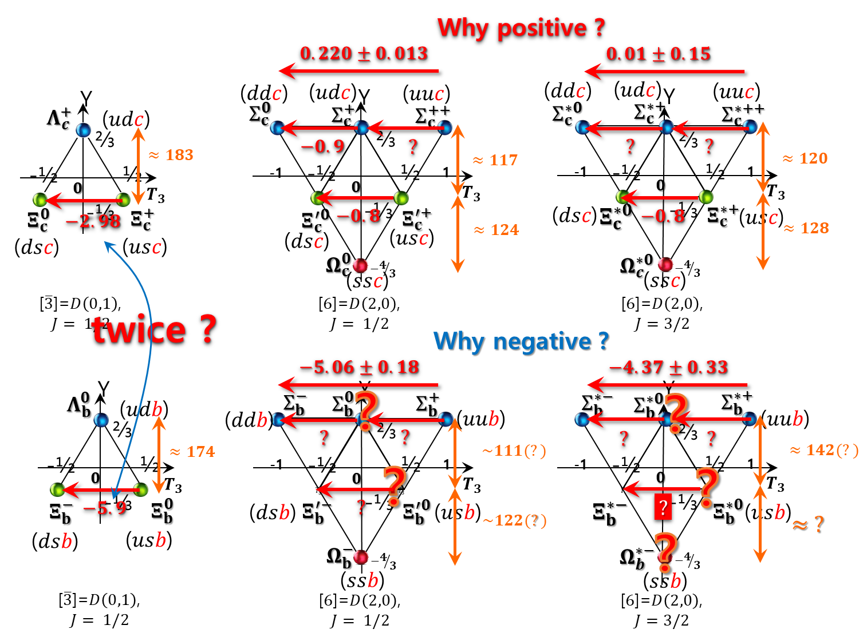
Motivation for isospin mass differences of singly heavy baryons
Notes:
Now let me remind you the motivation of this work
and talk about the isospin mass differences of singly heavy baryons

Slide 20
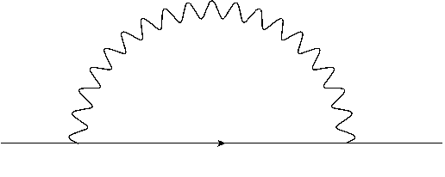
  Electromagnetic self-energy
EM mass corrections
k
B(p)
B(p)
Y
p
p - k
p
( udd ) n
1
p ( uud )
938.3
939.6
Electromagnetic (EM ) self-energy
-1
-½
Λ
½
1197
1
T₃
1189
EM [MeV] | Exp.
(p – n)_{EM} | 0.76±0.30
(Σ⁺ – Σ⁻)_{EM} | -0.17±0.30
(Ξ⁰ –Ξ⁻)_{EM} | -0.86±0.30
Σ⁻
Σ⁰
Σ⁺
1321
-1
1315
( dss)Ξ⁻
Ξ⁰ ( uss )
Gasser, Leutwyler, Phys.Rep 87, 77 “Quark Masses”
ΔM_{B} = M_{B1} – M_{B2} = (ΔM_{B} )_{H} + (ΔM_{B} )_{EM}
( p – n )_{exp}~ – 1.293 MeV
( p – n ) _{EM} ~0.76 MeV
Notes:
Basically, isospin symmetry-breaking effects are described by two contributions.
One is electromagnetic self-energy and ....
the other is hadronic contribution due to the current quark mass differences between up and down quarks.
but usually, people don’t take into account EM self-energy because they assume that magnitude is very small.
However, according to the analysis done by Gasser and Leutwyler in various studies,
then EM self-energy effects are Non-negligible, comparing with experimental data.

Slide 21
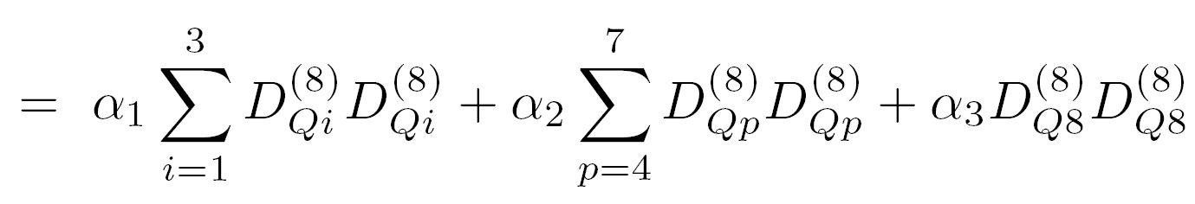
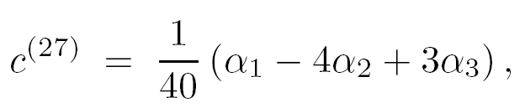

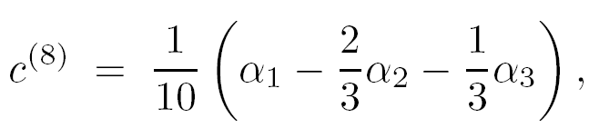

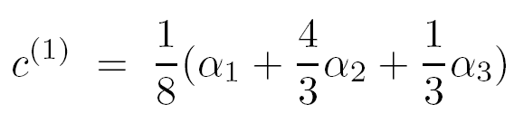
  Electromagnetic self-energy
In the ChSM,
It can be further reduced to
Because of Bose symmetry
G. S. Yang, et al., Phys. Lett. B 695, 214 (2011)
Notes:
In the chiral soliton model,
we can construct the operator for EM self-energy with two-points correlation functions,
It turns out that it was very successful for describing isospin mass differences of light baryons.

Slide 22
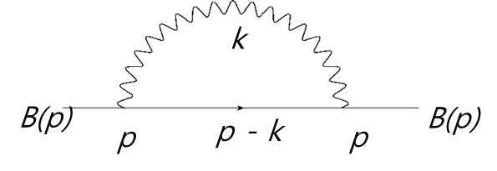











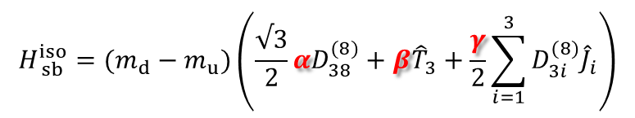
$ΔM_{B_{h}}^{total}=$ ${ΔM}_{sol}^{EM}+{ΔM}_{ sb}^{iso}+ΔM_{hf}+{ΔM}_{ sol−h}^{Coul}$
EM self-energy for a soliton
${ΔM}_{sol}^{EM}$ =
Hadronic contributions from $m_{d}$-$m_{u}$
$$h$$
$$H_{ sb}^{iso}=(m_{d}−m_{u})\left(\frac{√3}{2}αD_{38}^{(8)}+β{\hat{T}}_{3}+\frac{γ}{2}\sum_{i=1}^{3}{D_{3i}^{(8)}{\hat{J}}_{i}}\right)$$
$$q_{2}$$
${ΔM}_{ sb}^{iso}$ =
$$q_{1}$$
$$with N_{c}−1$$
Strong hyperfine interaction
for the light quarks inside a heavy baryon
$ΔM_{hf}$ =
$$δ^{hf}{ S}_{1}⋅S_{2}$$
Coulomb interaction
between a soliton and a heavy quark
${ΔM}_{ sol−h}^{Coul}$ =
$$α_{sol−h} {\hat{Q}}_{sol}{\hat{Q}}_{h}$$
Notes:
Then
we finally can write down all possible contributions
for the isospin mass differences of singly heavy baryons with 4 contributions.
First one is from EM self-energy for a soliton,
Second term is the hadronic contributions
Third one is strong hyperfine interaction for the light quarks inside a heavy baryon.
(Actually, this contribution corresponds to the arrangement of light quarks’ spins in a naive quark model.)
And the last one is the Coulomb interaction between a soliton and a heavy quark.
But you can find there are two additional parameters that we didn’t determine yet.

Slide 23
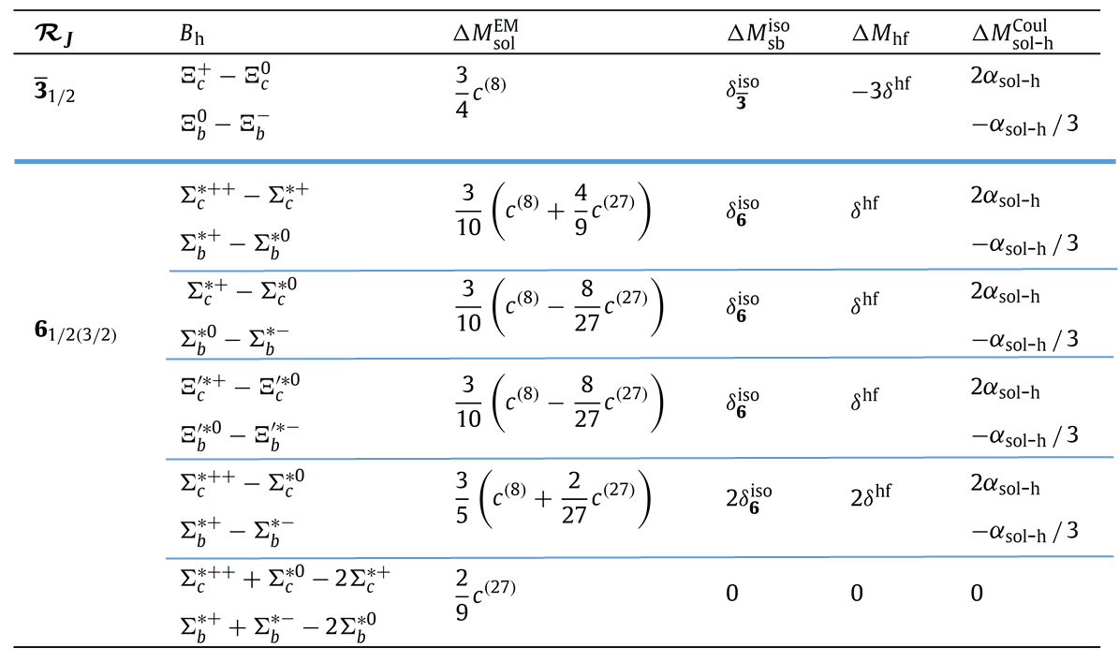

Slide 24
Notes:
These two parameters can be determined by two experimental values used as input.

Slide 25
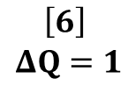

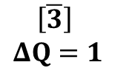

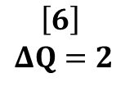




$ΔM_{B_{h}}^{total}=$
$${ΔM}_{sol}^{EM}+{ΔM}_{ sb}^{iso}+ΔM_{hf}+{ΔM}_{ sol−h}^{Coul}$$
$$\left[\overline{3}\right]$$
$$ΔQ=1$$
$${ΔM}_{sol}^{EM}$$
$${ΔM}_{ sb}^{iso}$$
$$ΔM_{hf}$$
$$\left[6\right]$$
$$ΔQ=1$$
$${ΔM}_{ sol−h}^{Coul}$$
$$\left[6\right]$$
$$ΔQ=2$$
$$\left[6\right]$$
$$∑Q=0$$
Notes:
Then we can see the final results for isospin mass differences of singly baryon baryons.
These 4 kind colored spots are for the EM, hadronic, hyperfine contributions about a soliton,
Only this one is for the interaction between a soliton and a heavy quark.
These baryons are antitriplet and thses are sextet baryons,...
and boxed baryons are beauty baryons.
Surprisingly, considering only the EM contributions, we can describe the experimental data for sextet charmed baryons,
When we look into the values carefully,
we can see that hyperfine interactions are around zero,
and blue and violet spots have almost same magnitudes with the opposite sign each other.
Then we obtain the final picture and all theoretical predictions are very good agreement with experimental data.

Slide 28
Studies in progress

Slide 29


($ddc$)
($udc$)
($uuc$)
($ddc$)
($udc$)
($uuc$)
Y
Y
Y
$$Λ_{c}^{+}$$
($udc$)
$$Σ_{c}^{0}$$
$$Σ_{c}^{+}$$
$$Σ_{c}^{++}$$
$$Σ_{c}^{∗0}$$
$$Σ_{c}^{∗+}$$
$$Σ_{c}^{∗++}$$
⅔
⅔
⅔
-½
$$0$$
½
-1
-½
$$0$$
½
1
-1
-½
½
1
-⅓
$$T_{3}$$
-⅓
$$T_{3}$$
$$0$$
$$T_{3}$$
$$Ξ_{c}^{0}$$
$$Ξ_{c}^{+}$$
$$Ξ_{c}^{′0}$$
$$Ξ_{c}^{′+}$$
($dsc$)
$$Ξ_{c}^{∗0}$$
-⅓
$$Ξ_{c}^{∗+}$$
($usc$)
($dsc$)
($usc$)
($dsc$)
($usc$)
$$Ω_{c}^{0}$$
$$−4/3$$
$$Ω_{c}^{∗0}$$
$$−4/3$$
($ssc$)
($ssc$)
[$\overline{3}$]=$D\left(0,1\right)$,
$$J= 1/2$$
[$6$]=$D\left(2,0\right)$,
$$J= 1/2$$
[$6$]=$D\left(2,0\right)$,
$$J=3/2$$

Slide 30

$$M_{B_{h}}^{total}={M_{0}+M}_{sol}^{EM}+M_{ sol}^{SU(3)}{+M}_{sol}^{Iso}+M_{hf}+M_{ sol−h}^{Coul}+\frac{2}{3}\frac{κ}{m_{h}}{\vec{S}}_{sol}⋅{\vec{S}}_{h}$$
The contributions from $m_{s}$-terms seem to be reduced by 7~8%

Slide 31
















Candidates:X(3872), Y(4140), Z(4430), ...
Y
Y
($ud\overline{Q}\overline{Q}$)
($dd\overline{Q}\overline{Q}$)
($ud\overline{Q}\overline{Q}$)
($ud\overline{Q}\overline{Q})$
⅔
⅔
⅔
⅔
$$0$$
$$0$$
$$0$$
$$0$$
½
½
½
-½
½
-½
-½
-1
-½
1
1
-1
1
-⅓
-1
-⅓
-⅓
-⅓
$$T_{3}$$
$$T_{3}$$
$$T_{3}$$
$$T_{3}$$
($ds\overline{Q}\overline{Q}$)
($us\overline{Q}\overline{Q}$)
($ds\overline{Q}\overline{Q}$)
($us\overline{Q}\overline{Q}$)
($ss\overline{Q}\overline{Q}$)
$$−4/3$$
$$−4/3$$
$$−4/3$$
[$\overline{3}$]=$D\left(0,1\right)$,
$$J=0$$
[$6$]=$D\left(2,0\right)$
[$6$]=$D\left(2,0\right)$,
$$J=1$$
[$6$]=$D\left(2,0\right)$,
$$J=2$$
$$J=0$$
Coulomb interaction
between a soliton and a heavy quark
${ΔM}_{ sol−h}^{Coul}$ =
$$α_{sol−h} {\hat{Q}}_{sol}{\hat{Q}}_{h}$$

Slide 32














Y
Y
$Ξ_{cc}^{+}$($dcc$)
⅓
$Ξ_{cc}^{++}$($ucc$)
$Ξ_{cc}^{+}$($dcc$)
⅓
$Ξ_{cc}^{++}$($ucc$)
$$0$$
$$0$$
-½
½
$$T_{3}$$
-½
½
$$T_{3}$$
-⅔
-⅔
$Ω_{cc}^{+}$($scc$)
$Ω_{cc}^{+}$($scc$)
[$3$]=$D\left(1,0\right)$,
$$J=1/2$$
[$3$]=$D\left(1,0\right)$,
$$J=3/2$$
Coulomb interaction
between a soliton and a heavy quark
${ΔM}_{ sol−h}^{Coul}$ =
$$α_{sol−h} {\hat{Q}}_{sol}{\hat{Q}}_{h}$$

Slide 33

Conclusion
Assuming that the valence quarks are bound by the pion mean fields,
we can regard the nucleon as a chiral soliton.
The present pion mean-field approach indeed explains consistently
both the SU(3) light baryons and the singly heavy baryons.
Dynamical parameters and flavor quantum numbers of the collective
operators and wave functions are modified by $N_{c}−1$ mean field
for the heavy baryons based on $N_{c}$ mean field for the light baryons
We have obtained excellent description of various physical observables
(Masses from isospin and SU(3) flavor symmetry breakings,
widths of strong and radiative decays, magnetic moments and transitions)
Contributions from isospin symmetry breaking for a soliton
are most significant to describe the isospin mass differences
of singly charmed and beauty baryons.
It is shown that light quarks govern their structure of singly heavy baryons.
Notes:
Now let me summarized.
Assuming that the valence quarks are bound by the pion mean fields,
we can regard the nucleon as a chiral soliton.
The present pion mean-field approach indeed explains consistently
both the SU(3) light baryons and the singly heavy baryons.
Dynamical parameters and flavor quantum numbers of the collective
operators and wave functions are modified by 𝑵_𝒄−𝟏 mean field
for the heavy baryons based on 𝑵_𝒄 mean field for the light baryons
We have obtained excellent description of various physical observables
(Masses from isospin and SU(3) flavor symmetry breakings,
widths of strong and radiative decays, magnetic moments and transitions)
Contributions from isospin symmetry breaking for a soliton
are most significant to describe the isospin mass differences
of singly charmed and beauty baryons.
It is shown that light quarks govern their structure of singly heavy baryons.

Slide 34

Collective Hamiltonian
+
where
In-medium modified model variables
$$M_{cl}^{∗}, I_{1}^{∗}, I_{2}^{∗}, K_{1}^{∗}, K_{2}^{∗}$$
Ex)

Slide 35









In-medium modified model variables
$$M_{cl}^{∗} , { I}_{1}^{∗} ,I_{2}^{∗}{ , K}_{1}^{∗} , { K}_{2}^{∗}$$
$$(λ,δ,δ_{i})$$
$$(λ,δ,δ_{i})$$
$$(λ,δ,δ_{i})$$
$$(λ,δ,δ_{i})$$
$$(λ,δ,δ_{i})$$
Mass energy per baryon
Mass energy per baryon
Binding energy per baryon
$$ε$$
Where $δ=\frac{N−Z}{A}, δ_{i}=\frac{S_{i}}{A}, λ=ρ/ρ_{0}$
$M_{1,2,3}=mass of hyperons$
$(Λ,Σ,Ξ,…,Ω…)$

Slide 36



+
where
$$\frac{K_{1,2}^{∗}}{I_{1,2}^{∗}}=\frac{K_{1,2}}{I_{1,2}}\left[1+f\left(λ\right)δ\right]$$
$$\frac{K_{1,2}^{∗}}{I_{1,2}^{∗}}=\frac{K_{1,2}}{I_{1,2}}\left[1+f_{i}\left(λ\right)δ_{i}\right]$$

Slide 37



$$\frac{K_{1,2}^{∗}}{I_{1,2}^{∗}}=\frac{K_{1,2}}{I_{1,2}}\left[1+f\left(λ\right)δ\right]$$
$$\frac{K_{1,2}^{∗}}{I_{1,2}^{∗}}=\frac{K_{1,2}}{I_{1,2}}\left[1+f_{i}\left(λ\right)δ_{i}\right]$$
In the saturation density of nuclear matter

Slide 38


Slide 39





Neutron / baryonic star in a modified SU(3) chiral soliton model
$$ε$$
Preliminary
For simple test, we take $δ=0 (N=Z)$
$δ=0, …$
$δ_{i}=?$
$K_{0}∼240 MeV ?$

Slide 40


