Slide 1
Effect of Tensor Force in Nuclear Structure
Eun Ja Ha¹
in collaboration with
Myung-Ki Cheoun¹ and Hiroyuki Sagawa²
Origin of Matter and Evolution of Galaxy (OMEG) Institute, Soongsil University, Seoul, Korea
RIKEN and University of Aizu, Japan
Workshop on theoretical nuclear & hadron physics, Nov. 13-14, 2020, PKNU, Busan

Slide 2
Contents
1. The effect of tensor force in the ground state of nuclei
: submitted to PRC
2. The effect of tensor force in Gamow-Teller transition
: on-going work

Slide 3
The effect of tensor force in the ground state of nuclei

Slide 4
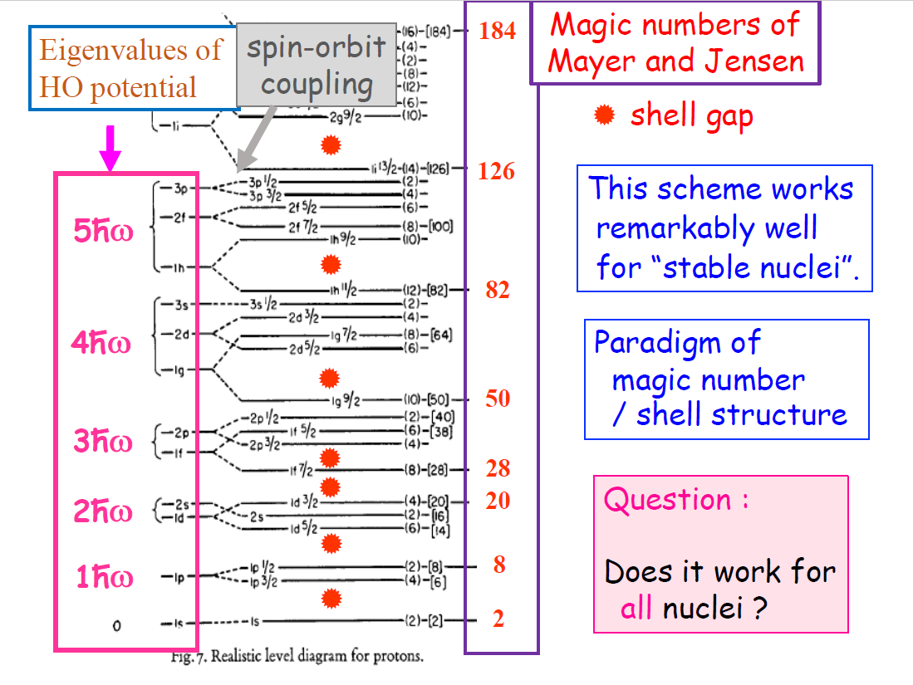
Magic numbers are the same for all nuclei?
From Takaharu Otsuka’s talk

Slide 5
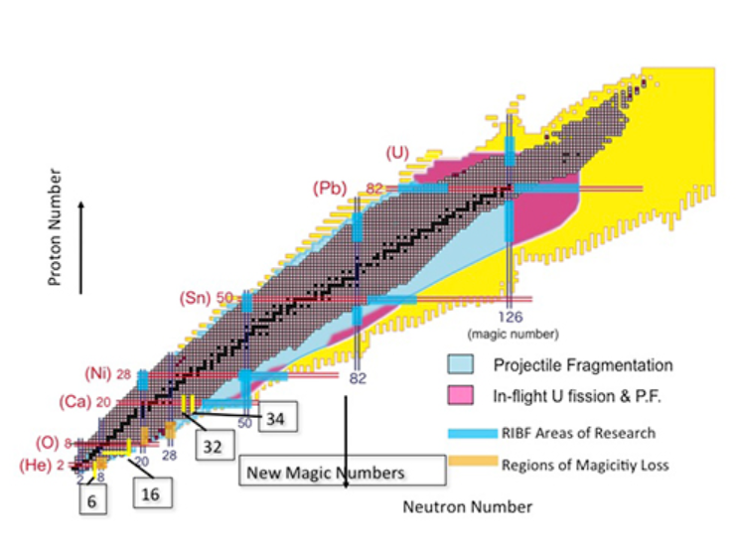
‘Magic numbers’ disappear and expand area of nuclear deformation.
P. Doornenbal et al. PRL 111,212502(2013)
⁵⁴Ca
⁴²Si
²⁴O
“Measuring the evolution of nuclear shells helps us understand the underlying forces inside the nucleus, that play also an important role in the nucleosynthesis”
Notes:
KOBRA :비교적 낮 은, 핵자당 20 MeV 이하의 희귀동위원소 A<80

Slide 6
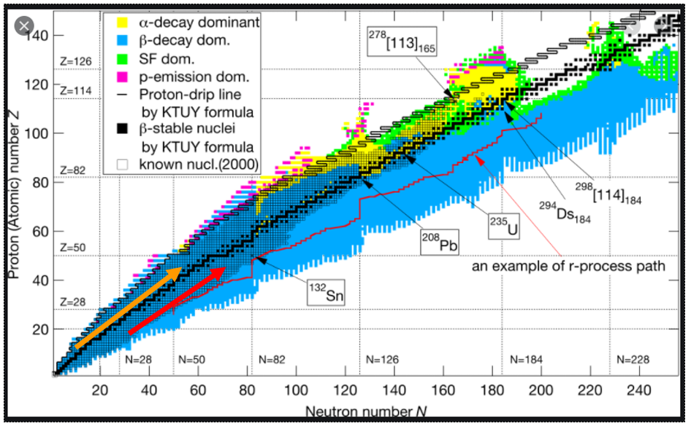
Area of interest : N=Z or N > Z nuclei
For N=Z nuclei, np pairing is more dominant than the like-pairing(nn- & pp-pairing).

Slide 7
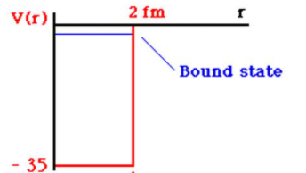

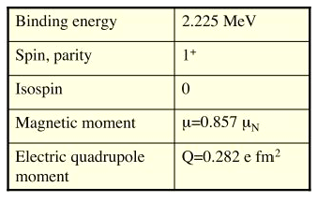

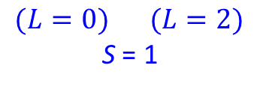
Tensor force : first evidence from the deuteron.
^{2S+1} L _{J}
$$(L=0) (L=2)$$
S = 1
Tensor force(TF) mixes two states.
Without TF deuteron is unbound.

Slide 8
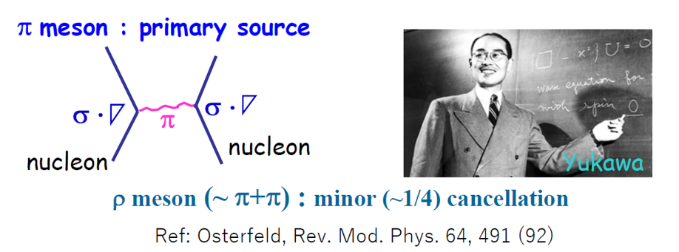
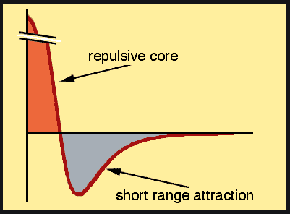


Tensor force (TF)
: Non-central force (S=1)
$$\hat{V}T=V_{T}\left(r\right)\hat{S}12$$
$$\hat{S}12=3\frac{(σ_{1}∙r)(σ_{2}∙r)}{r^{2}} − \left(σ_{1}∙σ_{2}\right)$$
:Tensor operator
Origin of TF :
Tensor attraction 80% of entire attraction
From Otsuka’s talk

Slide 9
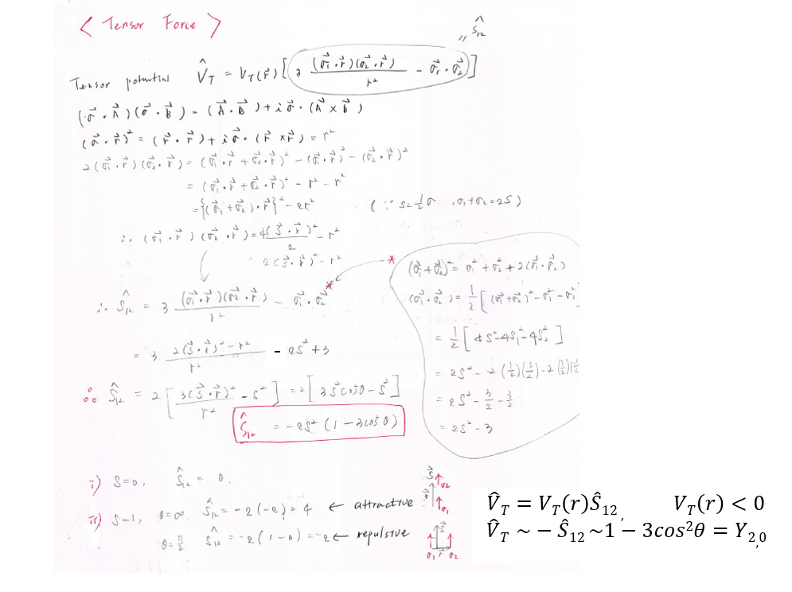

Slide 10
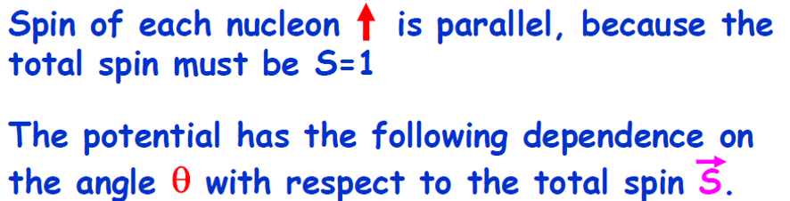
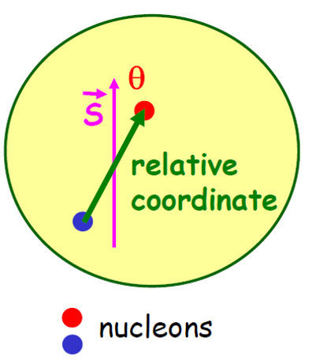
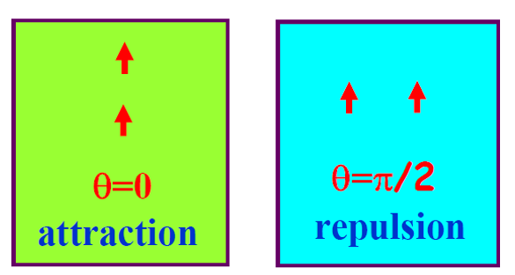
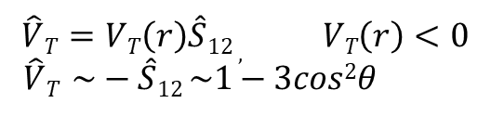
How does the tensor force work ?
$$\hat{S}12=3\frac{(σ_{1}∙r)(σ_{2}∙r)}{r^{2}} − \left(σ_{1}∙σ_{2}\right)=−2S^{2}\left(1−3cos2θ\right) \sim Y_{2,0}$$
contribute only to S=1 states.
$$\hat{V}T=VT\left(r\right)\hat{S}12 , VT\left(r\right)<0$$
$\hat{V}T \sim −\hat{S}12 \sim 1−3cos2θ$
: Tensor force
From Otsuka’s talk

Slide 11
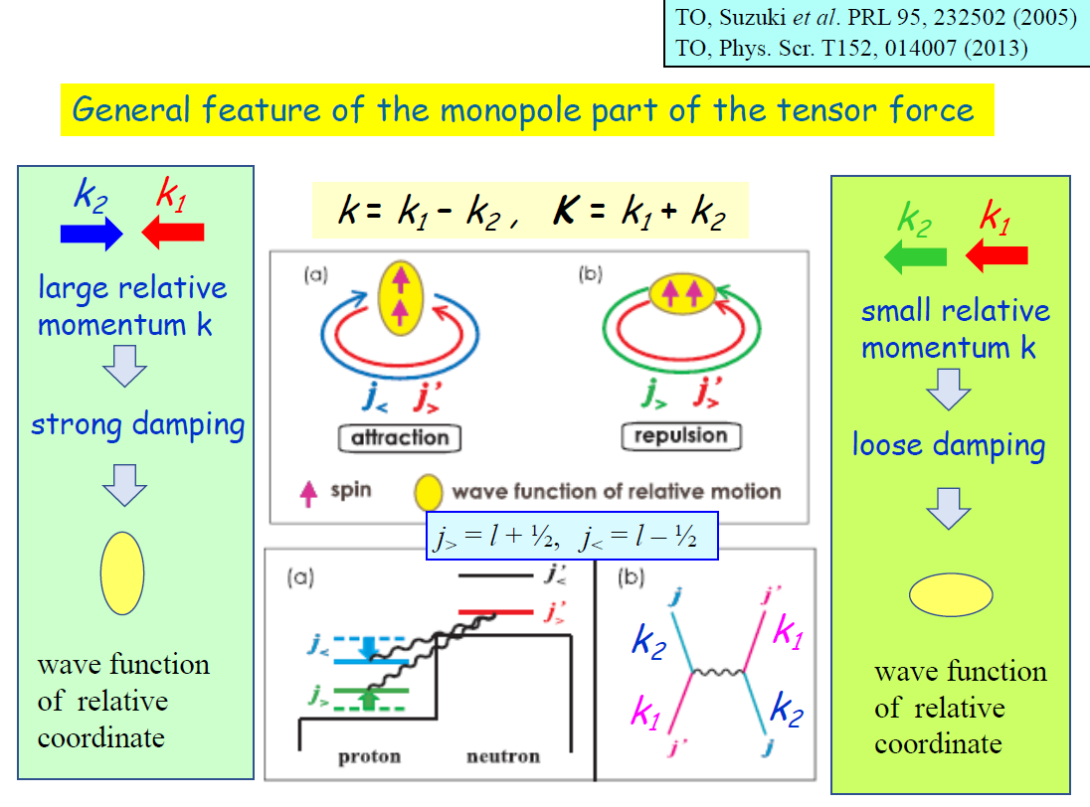
Tensor force in nuclei
Notes:
TF is important to the binding of nuclei.

Slide 12
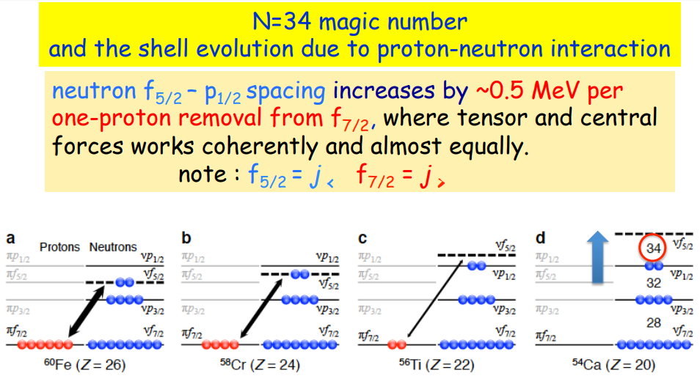
New magic number from ⁵⁴Ca (N=34)!
D. Steppenbeck et al. Nature 502,207(2013)
⁷⁰Zn³⁰⁺ ions at 345MeV by BigRIPS
From Otsuka’s talk

Slide 13
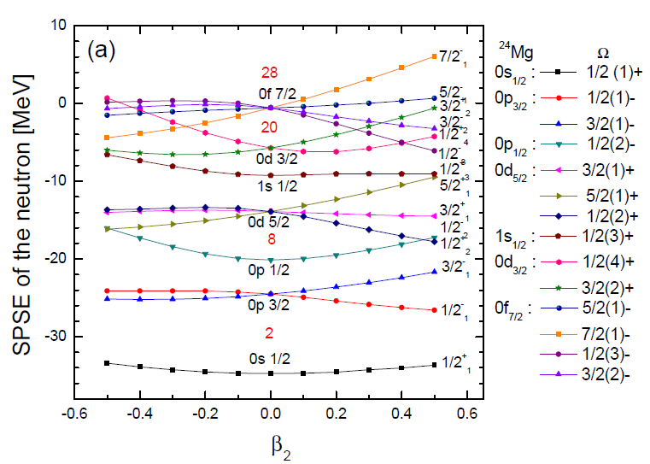
2-4.연구 결과 1
Change in shell structure, disappearance of “magic number 20”
E. Ha et al. PRC97(2018)
³²Mg
14

Slide 14
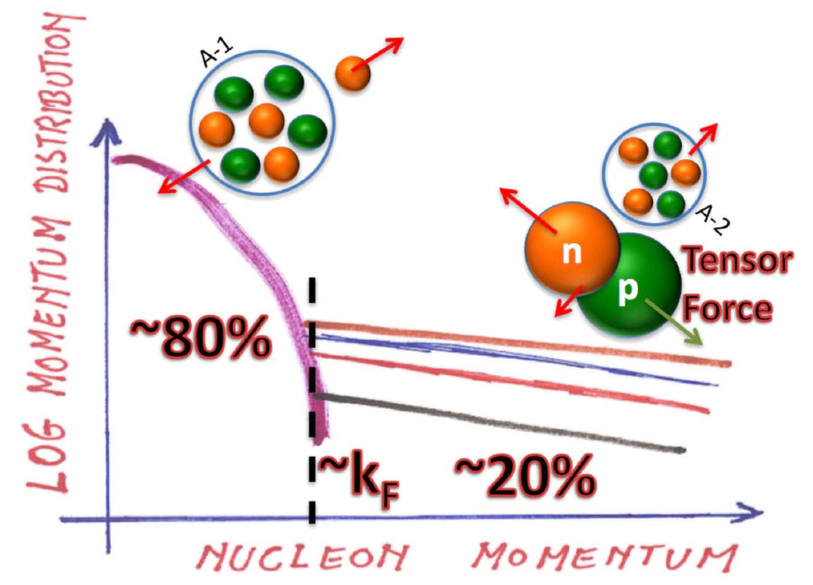
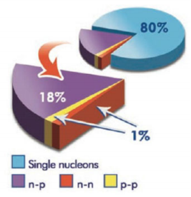


Short-range correlation(SRC) pairs in nuclei
Or Hen et al., Rev. Mod. Phys. 89, 045002 (2017).
R. Subedi et al., SCIENCE. 320,13 (2008).
¹²C$(e,e^{′}pN)$
$K_{F}≅250$ MeV/c
High-momentum tail from tensor force at k > k_{F} in N=Z and N > Z nuclei.
Mean field : two-body interaction ➔ one-body interaction
But two-body interaction still remain at the short range region.
In order to consider the residual interaction, we introduce the pairing correlations.

Slide 15
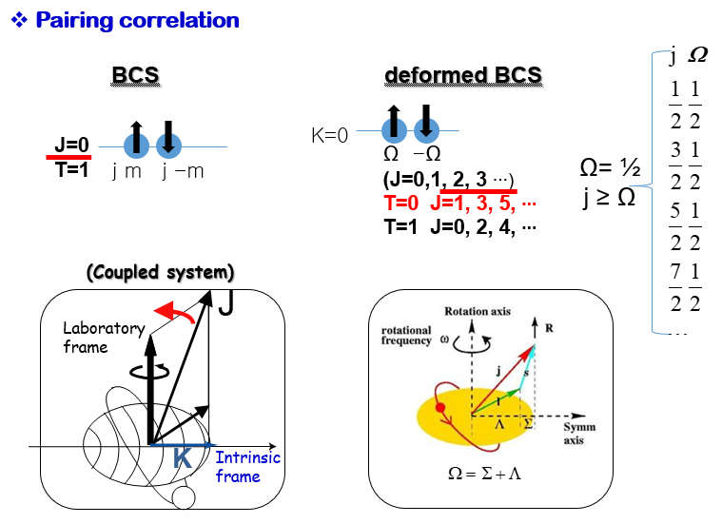
Two nucleon coupling
- This use a deformed Nilsson single particle basis.
The rotational symmetry can be restored by the angular momentum projection
technique.

Slide 16
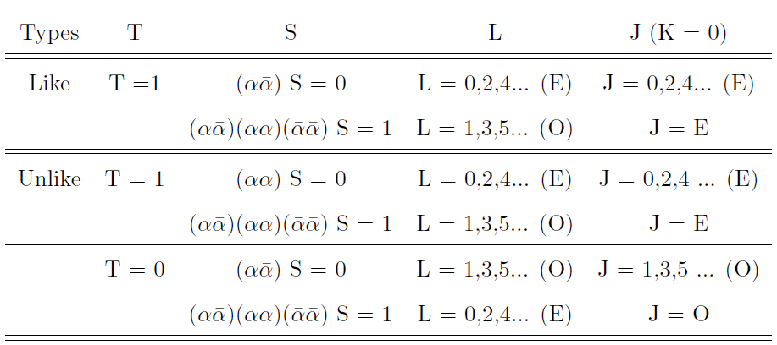



Pairing scheme
T=1 (Isovector(IV), isospin- triplet), T=0 (Isoscalar(IS), isospin- singlet)
TF
^{2S+1} L _{J}
TF
³S_{1,}³D₁
In deformed formalism !
blue: repulsive,
red: attractive
Notes:
Deuteron G.S. 3S1=96%, 3D1=4%

Slide 17
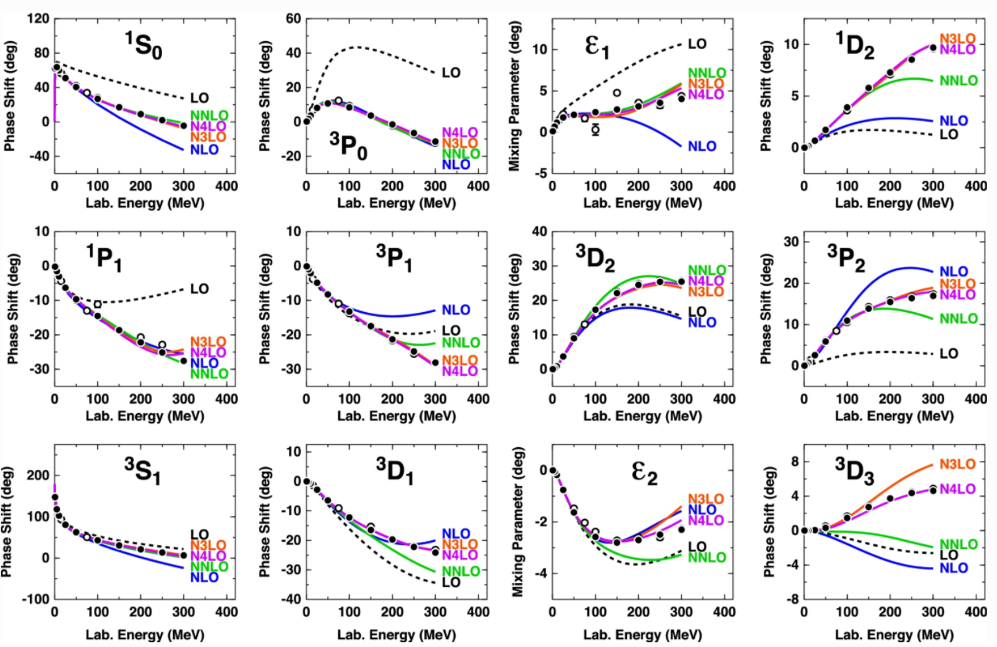
Nucleon-Nucleon Scattering Phase Shifts

Slide 18
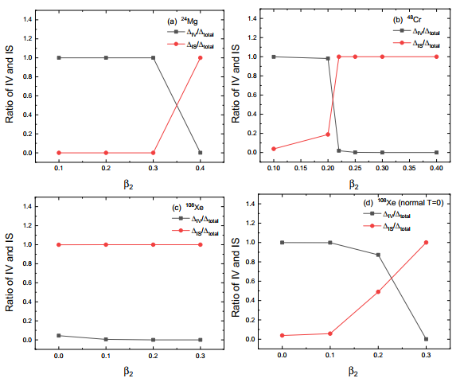
Coexistence of IV and IS pairing in N=Z nuclei
Ha et al. PRC99,064304 (2019)
enhanced T=0
enhanced T=0
enhanced T=0
normal T=0

Slide 19
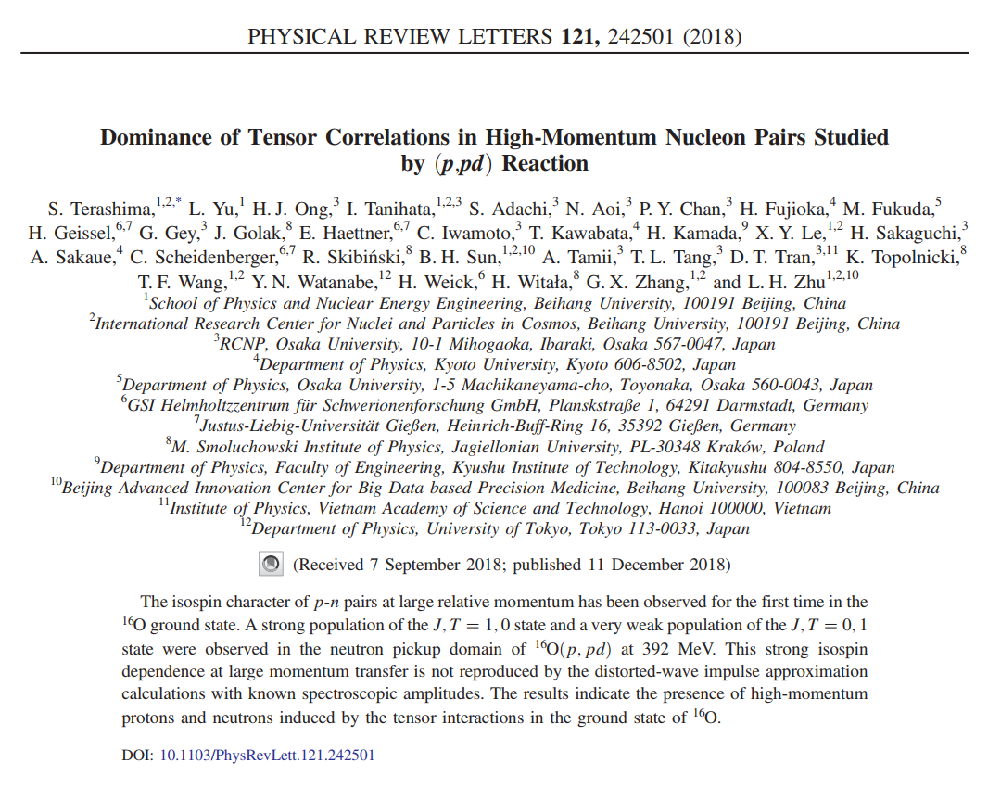
Deuteron structure in nucleus?

Slide 20
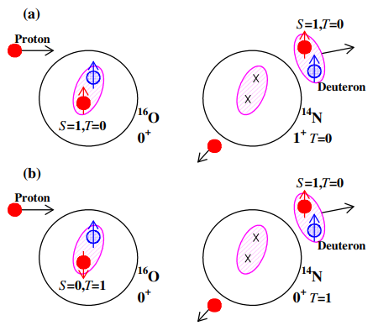


Dominance of tensor correlations in high-momentum n-p pairs
$$16O\left(p,pd\right) at 392MeV$$
S.Terashima, et al. PRL 121 (2018)
$$√$$
Tensor force
(non-central)
3.95MeV
1
Central force
2.31MeV
S=1,T=0 channel in the cross section is dominant.
The high-momentum n-p pairs(S=1,T=0) due to tensor force has been observed in the ¹⁶O ground state.
Notes:
Fermi momentum k_F= 250 MeV/c, (e,e’d) reaction

Slide 21
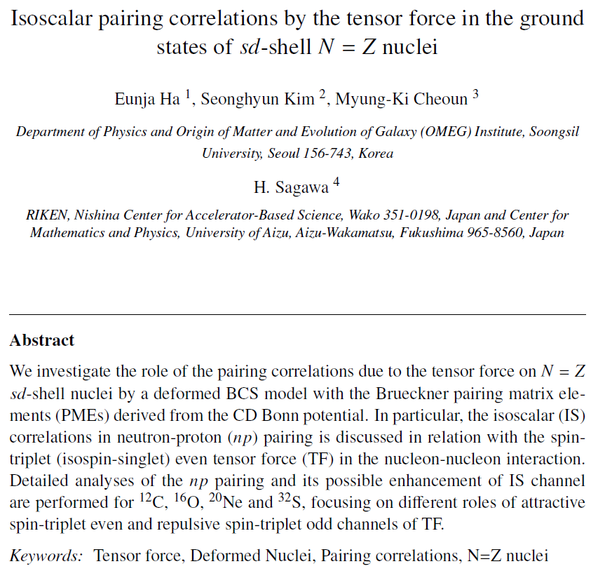
TF in the ground states.
Ha et al. submitted to PRC

Slide 22
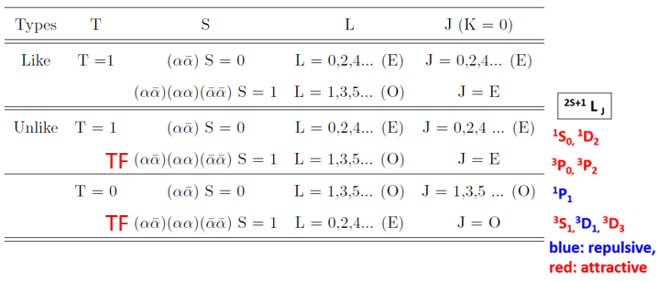

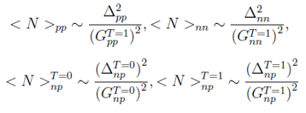
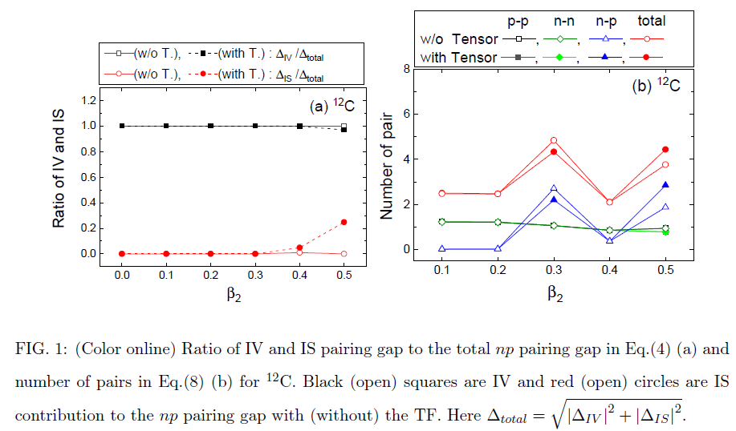

¹²C
$$3P1$$
tensor force effect !!!
# of nn & pp pairs are rarely by the TF, while that of np pairs changes at certain deformation.
TF increases (decreases) the PMEs of the T=0 np channel by its attractive (repulsive) property around $β2\sim 0.5$(0.3)
TF is sensitive on the deformation and may break the IV dominance of the np pairing.

Slide 23
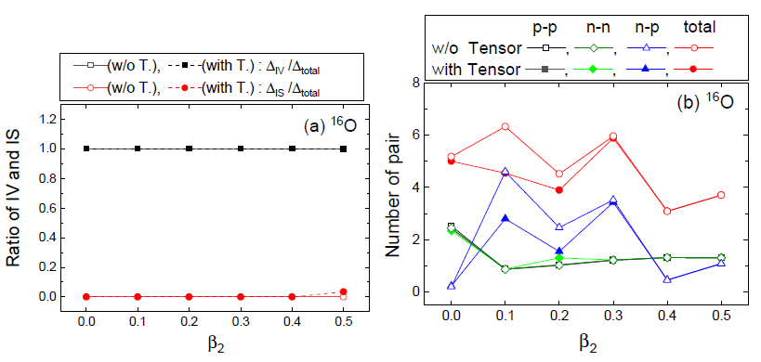
¹⁶O
$$3P1$$

Slide 24
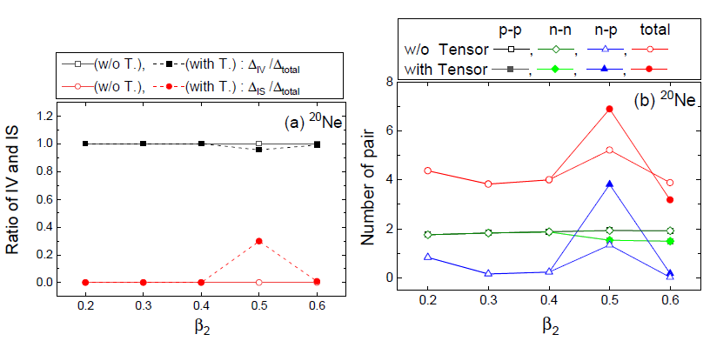
²⁰Ne

Slide 25
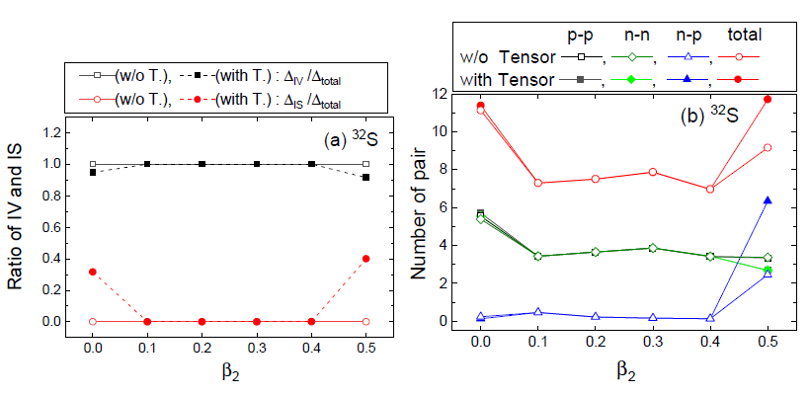
³²S
For ³²S, $β2\sim 0.5$, both T=1 and 0 attractive increase the #, the T=0 attractive TF increase more the # of np.
For $β2\sim 0.$ region, the IV force (w/o TF case) does not produce the #, because the strongest ¹S₀ may not work. The IS TF(with TF case) becomes significant but compete with attractive and repulsive force.

Slide 26
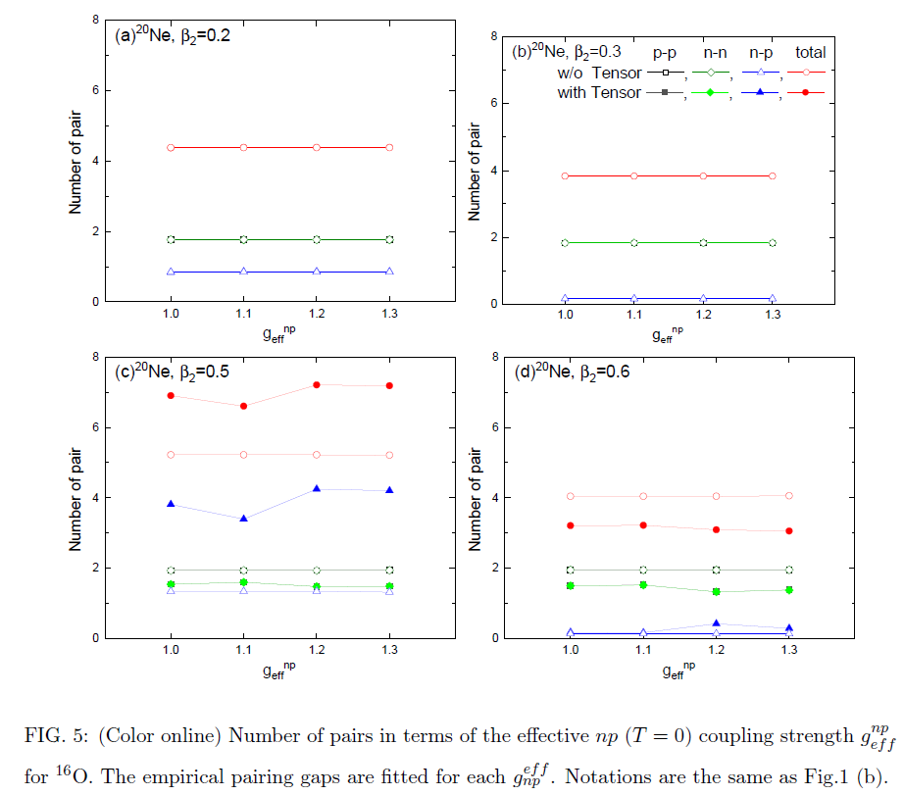
Effect of IS enhancement(or IV quenching)
The increased # of the np pair was saturated even for the increase of the IS enhancement.
However, detailed features of the TF effect depends on the deformation for each nucleus.

Slide 27
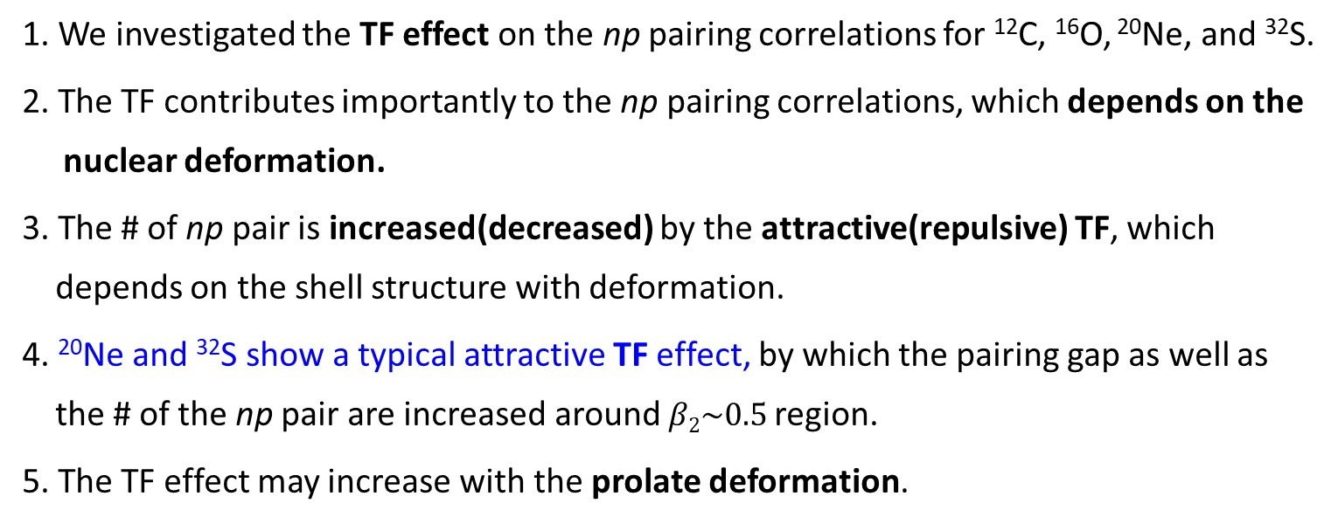
Summary 1
1. We investigated the TF effect on the np pairing correlations for ¹²C, ¹⁶O, ²⁰Ne, and ³²S.
2. The TF contributes importantly to the np pairing correlations, which depends on the
nuclear deformation.
3. The # of np pair is increased(decreased) by the attractive(repulsive) TF, which
depends on the shell structure with deformation.
4. ²⁰Ne and ³²S show a typical attractive TF effect, by which the pairing gap as well as
the # of the np pair are increased around $β2\sim 0.5$region.
5. The TF effect may increase with the prolate deformation.

Slide 28
The effect of tensor force
in Gamow-Teller Transition

Slide 29
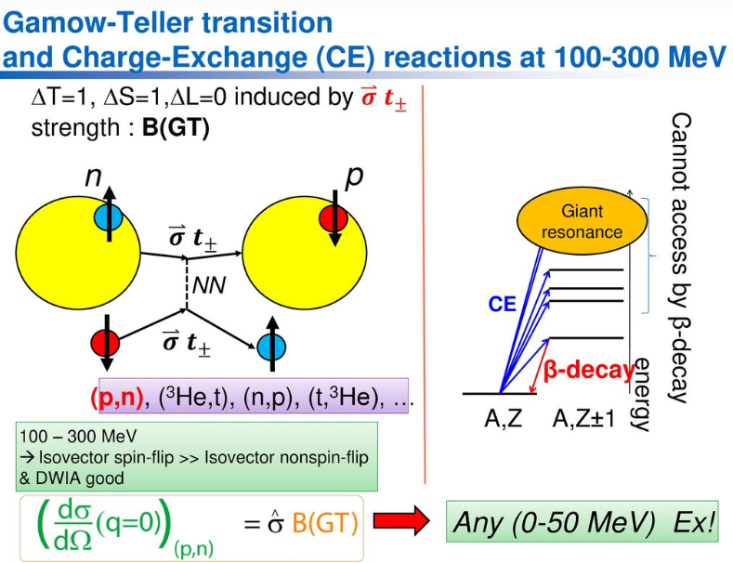
From M. Sasano’s talk
Notes:
(p,n) reaction in inverse kinematics. Tritium=3H

Slide 30
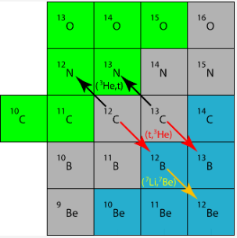
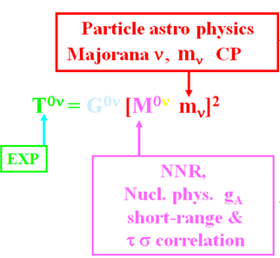
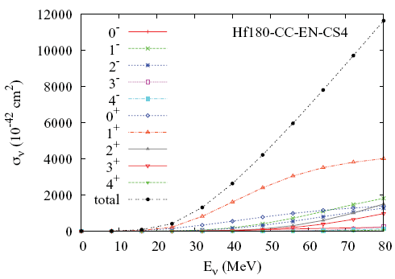
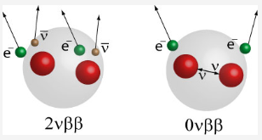
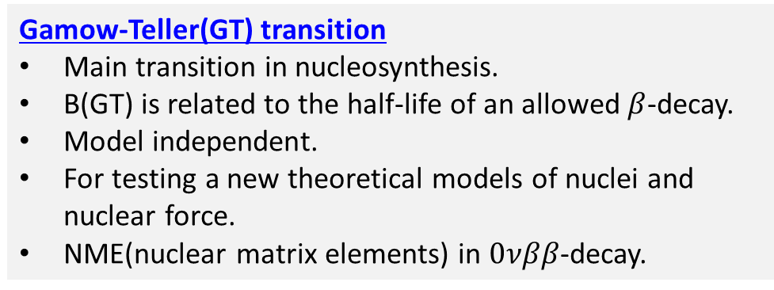
Charge-exchange(CE) reaction
CE reaction is very useful to study for the spin-isospin response of nuclei.
Gamow-Teller(GT) transition
Main transition in nucleosynthesis.
B(GT) is related to the half-life of an allowed $β$-decay.
Model independent.
For testing a new theoretical models of nuclei and nuclear force.
NME(nuclear matrix elements) in $0νββ$-decay.
CHEOUN,HA,..PRC 82(2010)
Notes:
In 0vbb-decay, v is majorana particle, determine v mass Exp. 150Nd

Slide 31
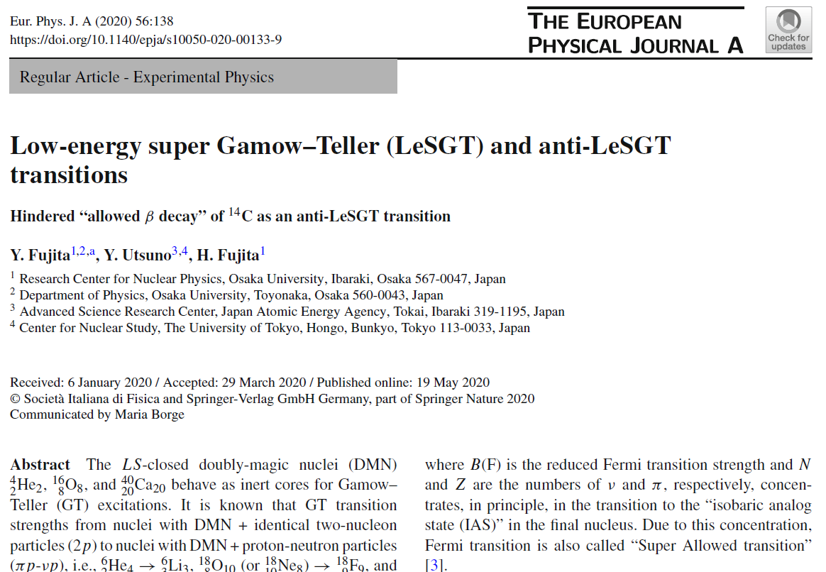

Slide 32
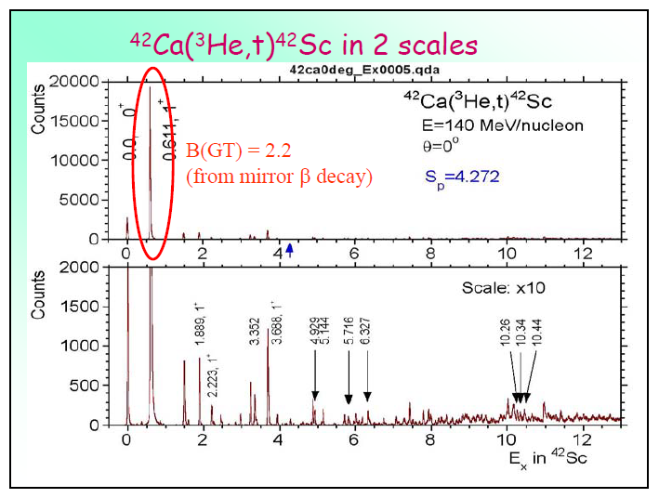
Low-energy super GT state(LeSGT) in N=Z+2 nuclei
LeSGT : 80% of the total B(GT) strength is concentrated in the excitation of the 0.611MeV state.
From Y. Fujita’s talk

Slide 33
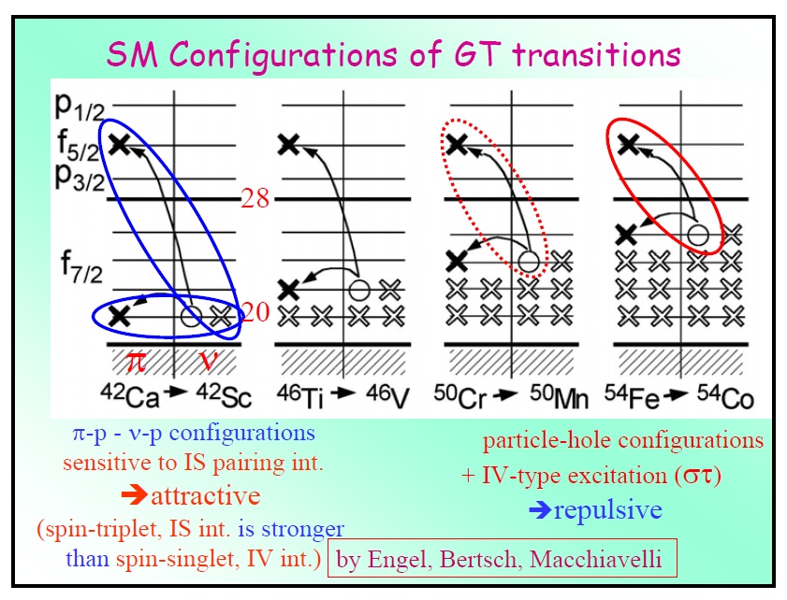
IS (T=0) pairing can play important roles !

Slide 34
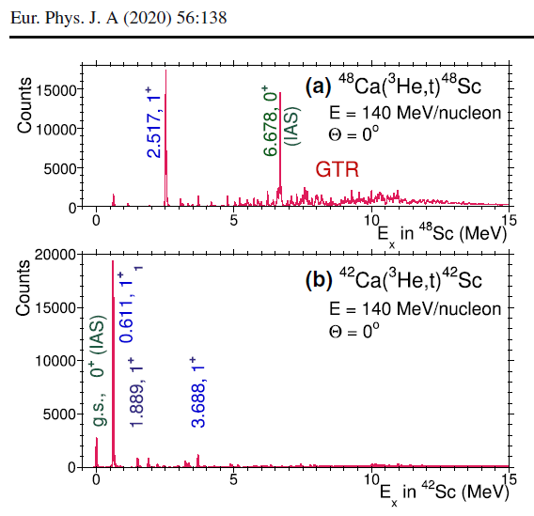
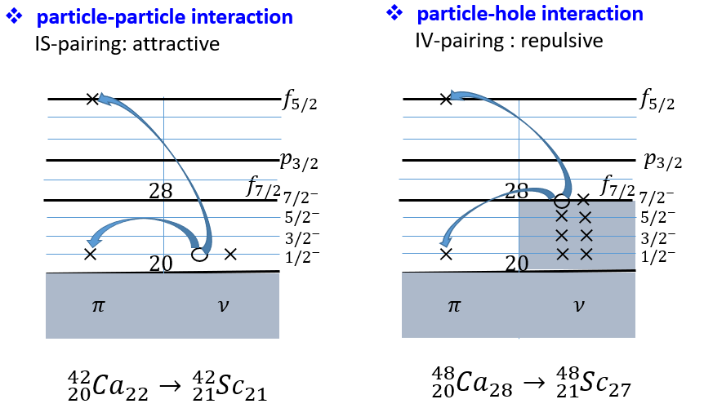
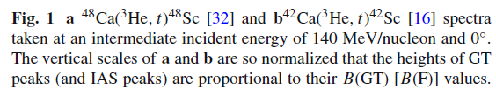
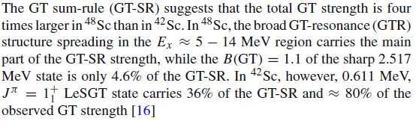
4.6% of GT-SR
36% of GT-SR

Slide 35
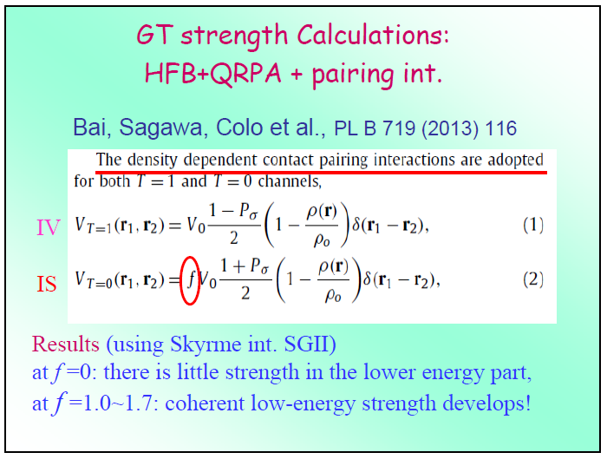

Slide 36
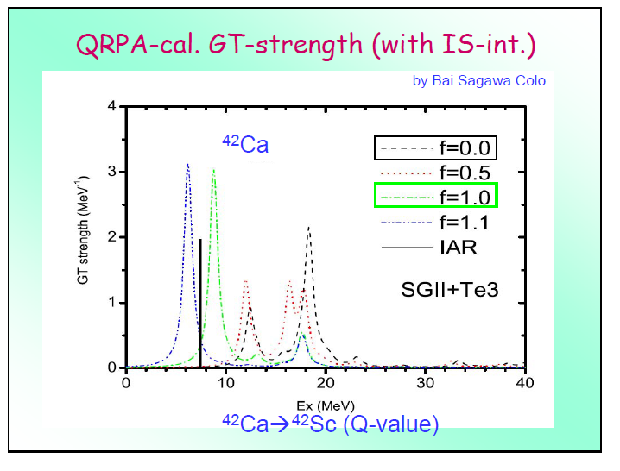
Low-energy super GT state(LeSGT)

Slide 37
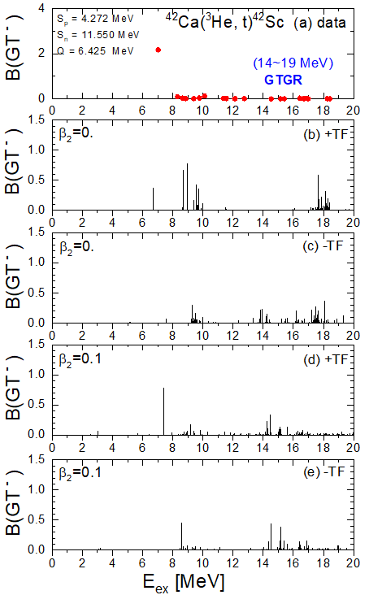
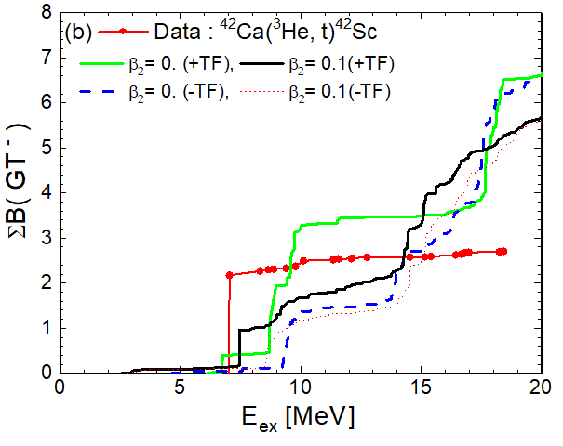




Role of TF in GT states
$\frac{gpp}{gph}=1.7$ : ⁴²Ca,
$\frac{gph}{gpp}=1.64$ : ⁴⁸Ca
 | $$β2(E2)$$ | $β2(FRDM$) | $β2(RMF$)
⁴²Ca | 0.245 | 0. | 0.
⁴⁸Ca | 0.104 | 0. | 0.
Tensor force & Deformation ?
$$√$$

Slide 38





Role of TF in GT states
$\left({\frac{7}{2}}_{1}^{−},{\frac{7}{2}}_{1}^{−}\right),\left({\frac{5}{2}}_{1}^{−},{\frac{5}{2}}_{1}^{−}\right),\left({\frac{3}{2}}_{2}^{−},{\frac{3}{2}}_{2}^{−}\right)$, $\left({\frac{1}{2}}_{3}^{−},{\frac{1}{2}}_{3}^{−}\right)from (f_{\frac{7}{2}} ,f_{\frac{7}{2}})$
$$\left({\frac{1}{2}}_{3}^{+},{\frac{1}{2}}_{3}^{+}\right)from (d_{\frac{3}{2}} ,d_{\frac{3}{2}})$$
$\left({\frac{1}{2}}_{3}^{−},{\frac{1}{2}}_{3}^{−}\right)from (f_{\frac{7}{2}} ,f_{\frac{7}{2}})$
$$\left({\frac{3}{2}}_{2}^{+},{\frac{5}{2}}_{1}^{+}\right)from (d_{\frac{3}{2}} ,d_{\frac{5}{2}})$$
$$√$$
$$\left({\frac{1}{2}}_{3}^{−},{\frac{1}{2}}_{3}^{−}\right),\left({\frac{1}{2}}_{3}^{−},{\frac{3}{2}}_{2}^{−}\right)from (f_{\frac{7}{2}} ,f_{\frac{7}{2}})$$
$$\left({\frac{1}{2}}_{4}^{−},{\frac{3}{2}}_{2}^{−}\right)from (f_{\frac{5}{2}} ,f_{\frac{7}{2}})$$

Slide 39






Role of TF in GT states
$\left({\frac{7}{2}}_{1}^{−},{\frac{7}{2}}_{1}^{−}\right),\left({\frac{5}{2}}_{1}^{−},{\frac{5}{2}}_{1}^{−}\right),\left({\frac{3}{2}}_{2}^{−},{\frac{3}{2}}_{2}^{−}\right)$, $\left({\frac{1}{2}}_{3}^{−},{\frac{1}{2}}_{3}^{−}\right)from (f_{\frac{7}{2}} ,f_{\frac{7}{2}})$
$$\left({\frac{1}{2}}_{3}^{+},{\frac{1}{2}}_{3}^{+}\right)from (d_{\frac{3}{2}} ,d_{\frac{3}{2}})$$
$\left({\frac{1}{2}}_{3}^{−},{\frac{1}{2}}_{3}^{−}\right)from (f_{\frac{7}{2}} ,f_{\frac{7}{2}})$
$$\left({\frac{3}{2}}_{2}^{+},{\frac{5}{2}}_{1}^{+}\right)from (d_{\frac{3}{2}} ,d_{\frac{5}{2}})$$
$$√$$
$$√$$
$$√$$

Slide 40





Role of TF in GT states
$\frac{gph}{gpp}=1.64$ : ⁴⁸Ca
$$\left({\frac{3}{2}}_{2}^{−},{\frac{1}{2}}_{3}^{−}\right),\left({\frac{1}{2}}_{3}^{−},{\frac{1}{2}}_{3}^{−}\right)from (f_{\frac{7}{2}} ,f_{\frac{7}{2}})$$
$\left({\frac{7}{2}}_{1}^{−},{\frac{7}{2}}_{1}^{−}\right),\left({\frac{5}{2}}_{1}^{−},{\frac{5}{2}}_{1}^{−}\right),\left({\frac{3}{2}}_{1}^{−},{\frac{3}{2}}_{1}^{−}\right)$ $from (f_{\frac{7}{2}} ,f_{\frac{7}{2}})$
$$\left({\frac{1}{2}}_{3}^{−},{\frac{1}{2}}_{5}^{−}\right)from (f_{\frac{7}{2}} ,f_{\frac{5}{2}})$$
$$√$$

Slide 41


Role of TF in GT states
$$√$$

Slide 42

Summary 2
1. We investigated the TF effect for Gamow-Teller transition in ⁴²Ca and ⁴⁸Ca.
2. Tensor force plays an important role in producing the low-energy GT peak.
3. The effect of TF is larger at $β2=0$ than at deformed region.
4. LeSGT(low energy super Gamow-Teller) is well reproduced because there are
many configurations of GT transition that contribute to increase the TF in
deformation case.

Slide 43
Thank you for your attention!

Slide 44
2-2.연구개요
Back Up

Slide 45


Slide 46



Role of TF in GT states
Tensor force & Deformation ?
$$√$$

Slide 47



Role of TF in GT states
$$\left({\frac{1}{2}}_{2}^{+},{\frac{1}{2}}_{3}^{+}\right)from (d_{\frac{5}{2}} ,d_{\frac{3}{2}})$$
$$√$$

Slide 48




































particle-particle interaction
IS-pairing: attractive
particle-hole interaction
IV-pairing : repulsive
$$×$$
$$f_{5/2}$$
$$×$$
$$f_{5/2}$$
$$p_{3/2}$$
$$p_{3/2}$$
$$28$$
$$f_{7/2}$$
$$28$$
$$f_{7/2}$$
$${7/2}^{−}$$
$$×$$
$${7/2}^{−}$$
$${5/2}^{−}$$
$$×$$
$$×$$
$${5/2}^{−}$$
$${3/2}^{−}$$
$$×$$
$$×$$
$${3/2}^{−}$$
$$×$$
$$20$$
$$×$$
$${ 1/2}^{−}$$
$$×$$
$$20$$
$$×$$
$$×$$
$${ 1/2}^{−}$$
$$π$$
$$ν$$
$$π$$
$$ν$$
$${{}_{20}^{42}{Ca}}_{22}→{{}_{21}^{42}{Sc}}_{21}$$
$${{}_{20}^{48}{Ca}}_{28}→{{}_{21}^{48}{Sc}}_{27}$$

Slide 49



Nucleon-Nucleon Scattering Phase Shifts
IV(isovector), IS(isoscalar)
pp & nn ^{2S+1} L _{J}
IV T=1 (S) | S =0 (A) L =even(S) J = L ¹S_{0,} ¹D₂ | S =1 (S) L =odd(A) J = Even ³P_{0,} ³P_{1,} ³P₂
np
IV T=1 (S) | S =0 (A) L =even(S) J = L ¹S_{0,} ¹D₂ | S =1 (S) L =odd(A) J = Even ³P_{0,} ³P_{1,} ³P₂
IS T=0 (A) | S =0 (A) L =odd(A) J = L ¹P₁ | S =1 (S) L =even(S) J = Odd ³S_{1,} ³D_{1,} ³D_{2,} ³D₃
blue: repulsive, red: attractive

Slide 50

Six parameters in empirical formula

Slide 51

Isobaric analogue state (IAS)

Slide 52

Motivations
Formalism
Results
Summary
M1 spin transition data shows the IV quenching for the N = Z sd-shell nuclei.
: IS T = 0 pairing by the tensor force well-known in deuteron structure may
become more significant even inside nuclei.
According to a study on the relationship between nuclear deformation and np-pairing correlation, the IV and IS pairing may have a large coexistence and the deformation can cause the quenching of the IV np-pairing.
H. Matsubara, et al. PRL 115 (2015)
Danilo Gambacurta, et al. PRC 91 (2015)

Slide 53


Slide 54


Motivations
Formalism
Results
Summary
Why np-pairing is important?
Production of the high-lying GT state
Occupation probability of ⁵⁶Ni
With np-pairing
W/O np-pairing
ʎ_{n}
ʎ_{p}
a
$$×$$
a
p n
The transition by nucleons below the Fermi orbit can be allowed.
The high-lying GT states can be produced.
The np-pairing makes the smearing of Fermi surface.
Notes:
If we switch on np pairing nucleons gather on the Fermi surface.

Slide 55


Slide 56


Slide 57


$J_{στ}$ : volume integral of the effective interaction $V_{στ}$at momentum transfer $q≈0.$
$K(ω)$: kinematic factor.
$ω:$total energy transfer.
$N_{στ}$ : distortion factor.
$σ(0)$ : unit cross section for the GT transition at $q=ω=0.$

Slide 58

RPA
In a weak perturbing external filed, the response of system is related to
the 2-body Green’s function.
RPA provides an approximation scheme to calculate the 2-body Green’s function.
In dielectric function e(k,w) describes the dielectric response to the plan-wave
Electric field E(w,k)exp^i(kr-wt).
The contribution to the dielectric function from the total potential is assumed to
average out, so that only the potential at wave vector k contribute.

