Slide 1
Hysteric Magnetoconductance
Based on JHEP 07 (2019) 158 (1902.10929) and 2008.xxxxx
Quantum Matter and Quantum Information with Holography
August 23 (Sun), 2020 ~ August 31 (Mon), 2020
Kyung Kiu Kim (Sejong University)
With Keun-Young Kim(GIST), Yunseok Seo(GIST) and Sang-Jin Sin(Hanyang Univ.)

Slide 2
Contents
Motivation
Experimental Data : Crossover and Hysteric Phase Transition of TI
A holographic model showing Spontaneous Magnetization
Magnetic Impurity
Conductivity formula
Our Data and Experimental Data
Summary

Slide 3
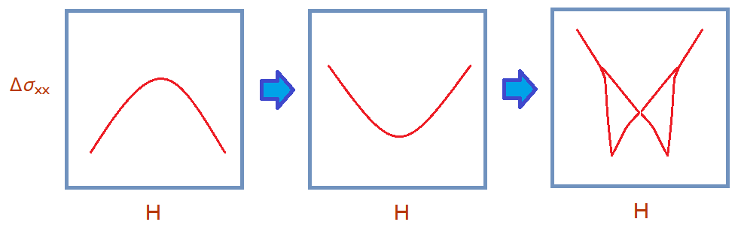
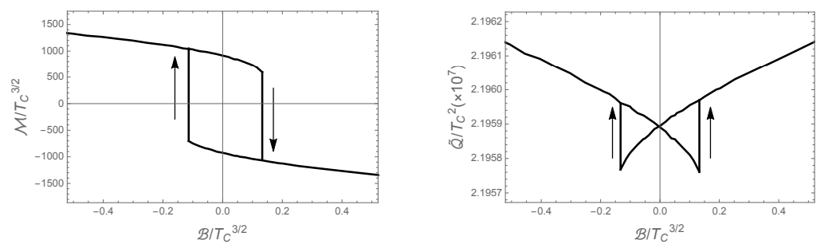
Motivation
Interesting phase transition discovered in Topological Insulators.
- Current on surfaces and DC transport (WAL => WL => Hysteresis )
Our previous work for spontaneous Magnetization
How can we describe this phase transition?

Slide 4
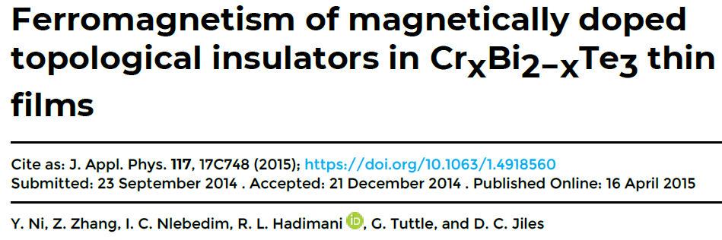
Recent data in Topological Insulator
Doping Magnetic impurity to control TR symmetry.
WAL -> WL -> Hysteric Phase

Slide 5
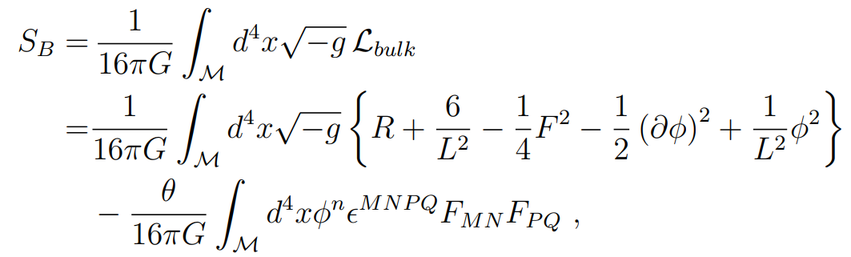
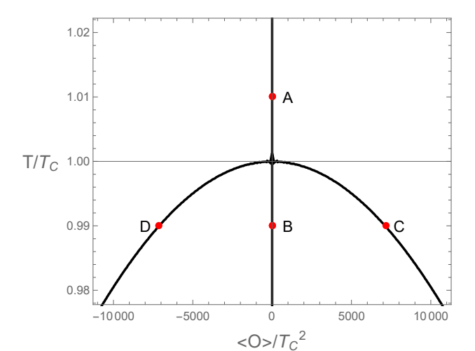
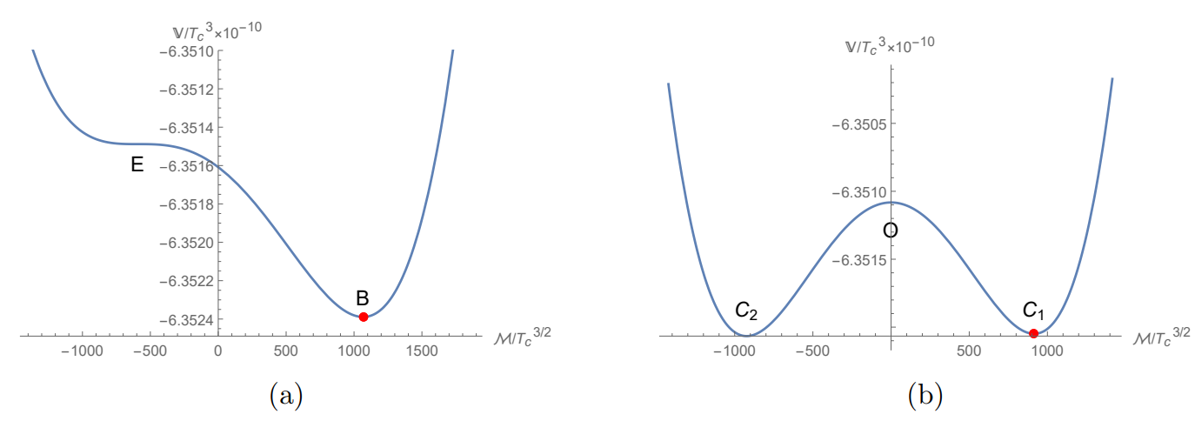
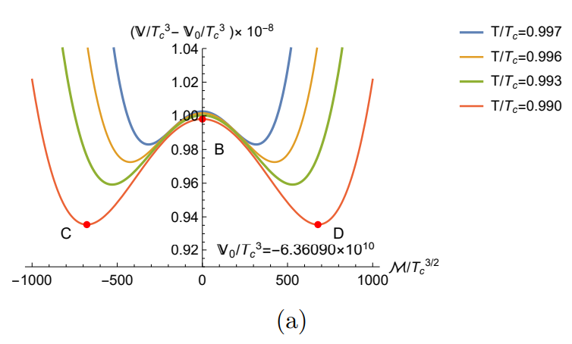
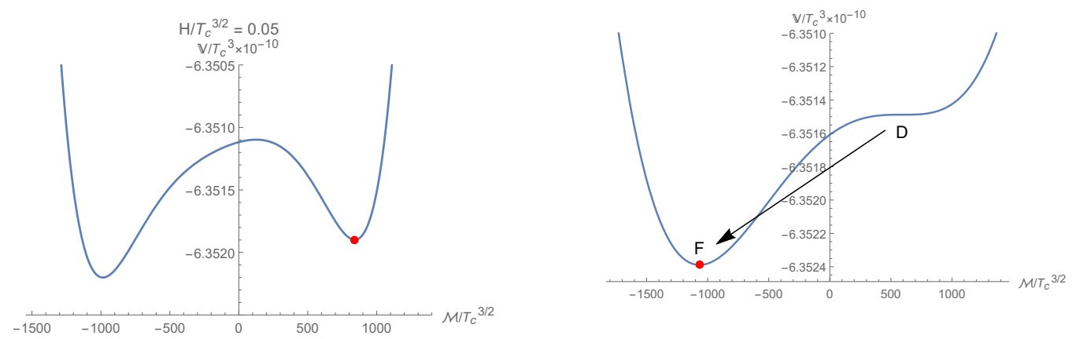
Previous Work : Holographic Bi-stable model
Model

Slide 6
Previous work
Hysteresis Curves for Magnetization and Charge Density

Slide 7
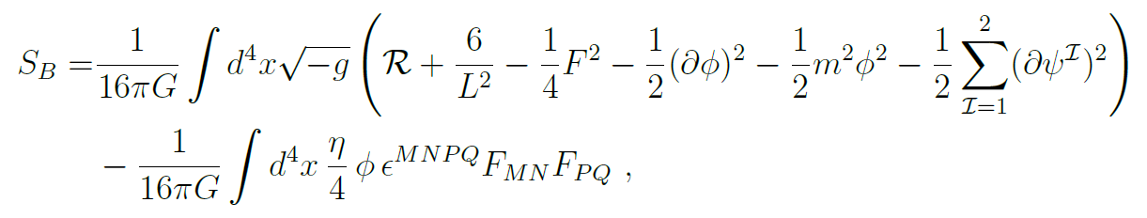
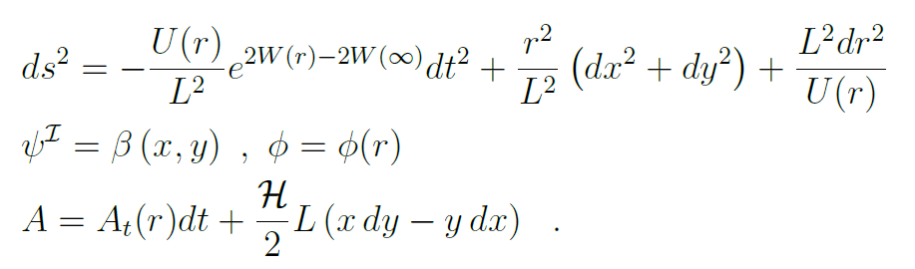
Addition of impurity
An extension to the previous model
Adding an axion field

Slide 8
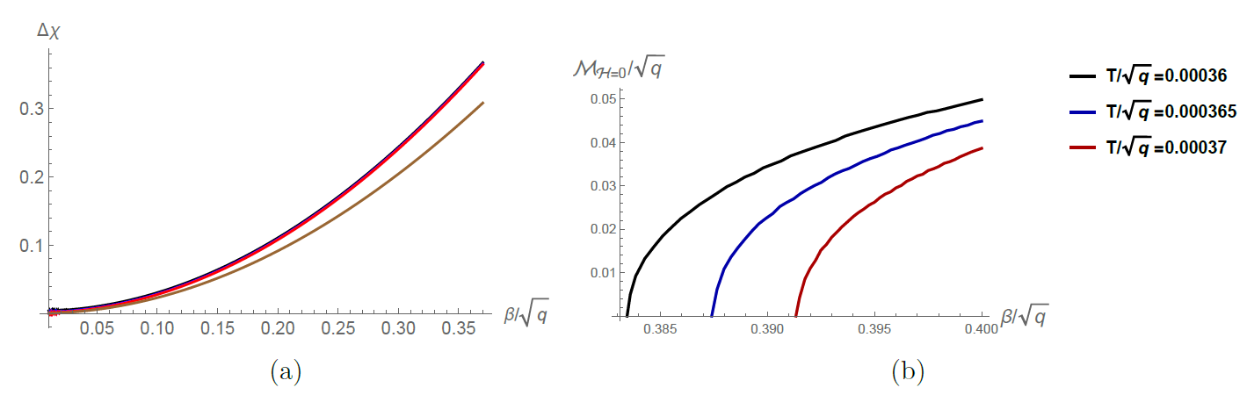
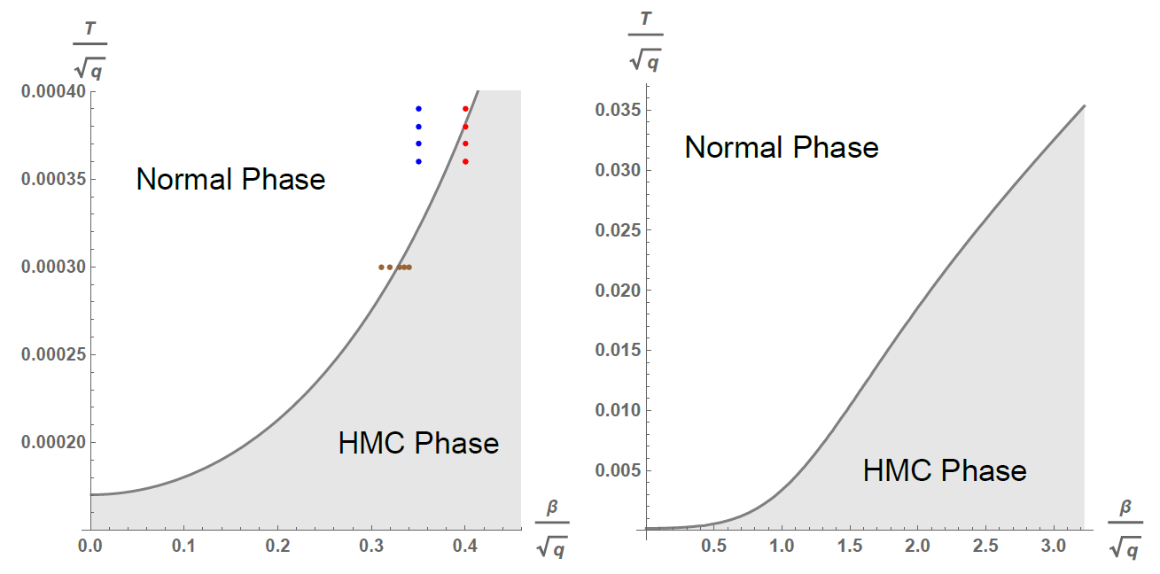
Is this a magnetic impurity?
Susceptibility and Magnetization without the other sources.
In fact, this axion plays a role of the magnetic impurity
Phase diagram

Slide 9
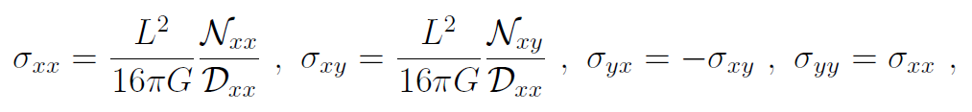
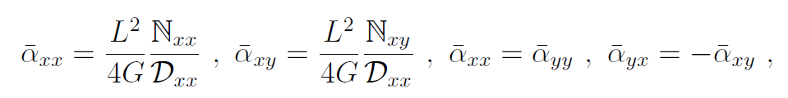
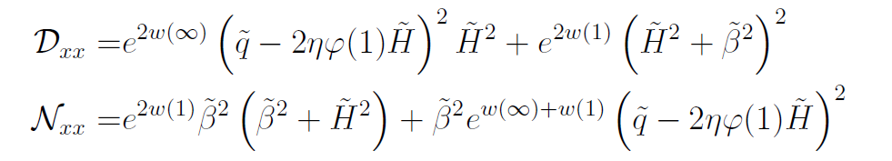
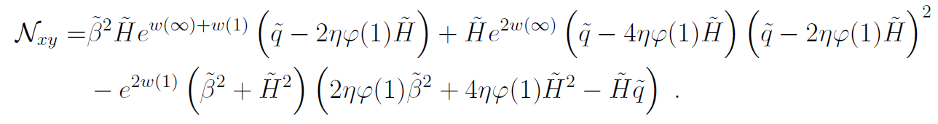
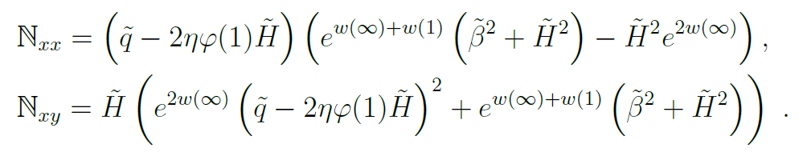

Conductivity formulas
DC transport

Slide 10
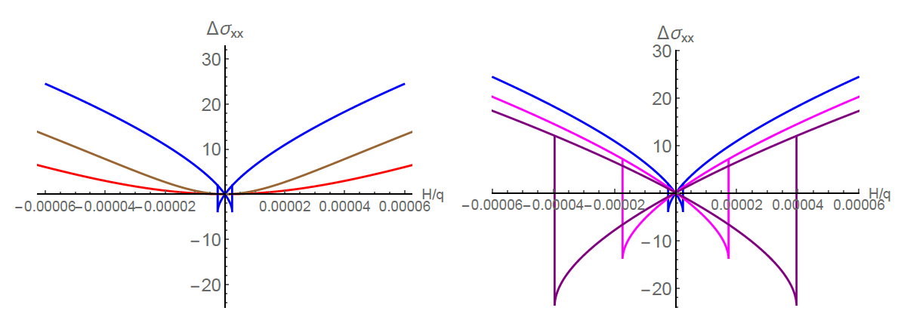
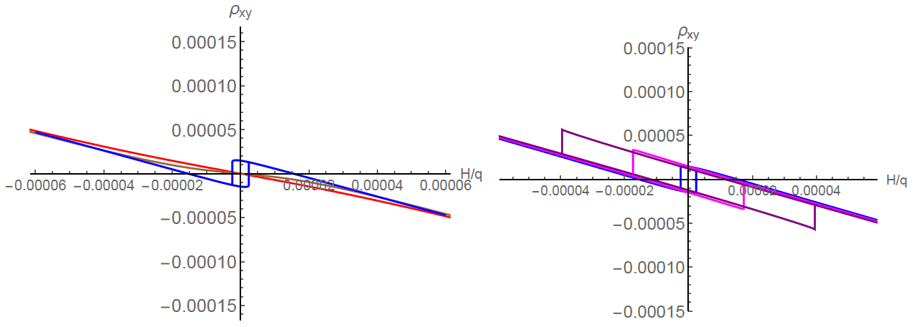
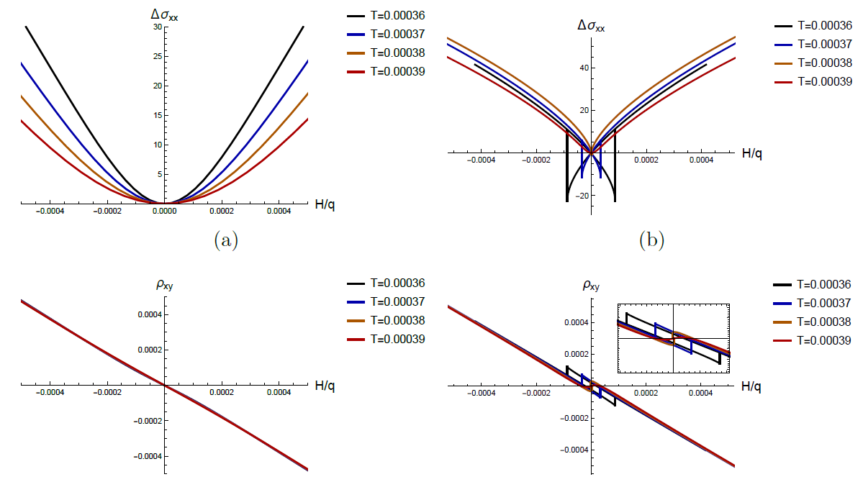
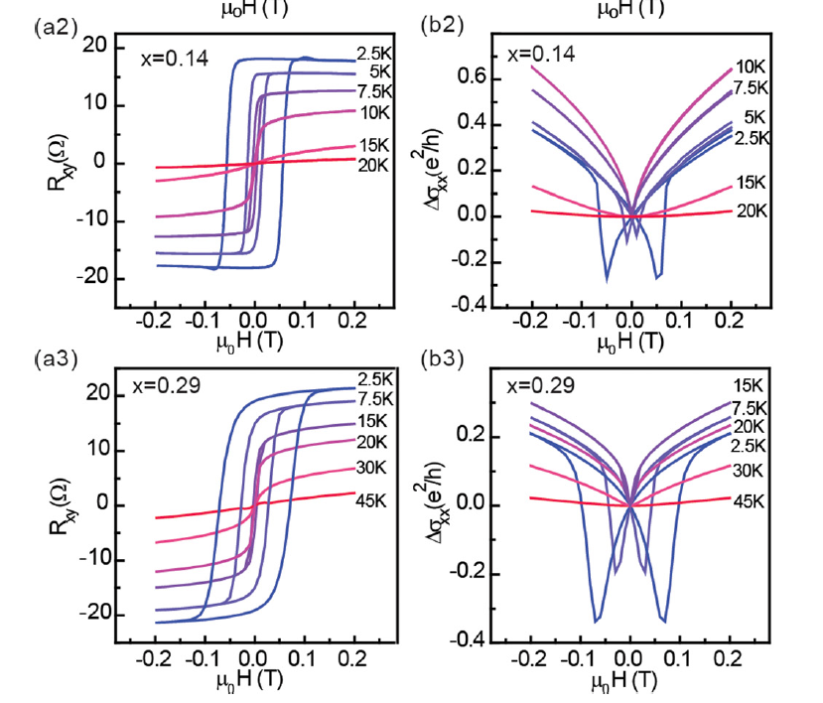
Our data and Experimental data

Slide 11
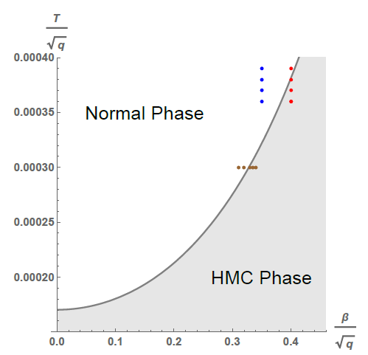
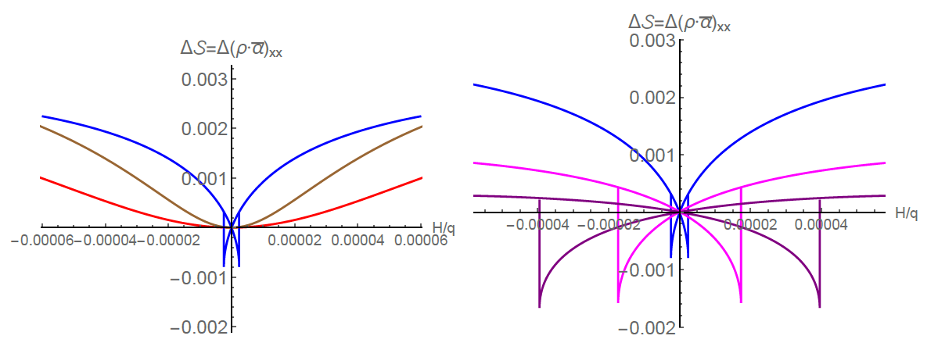
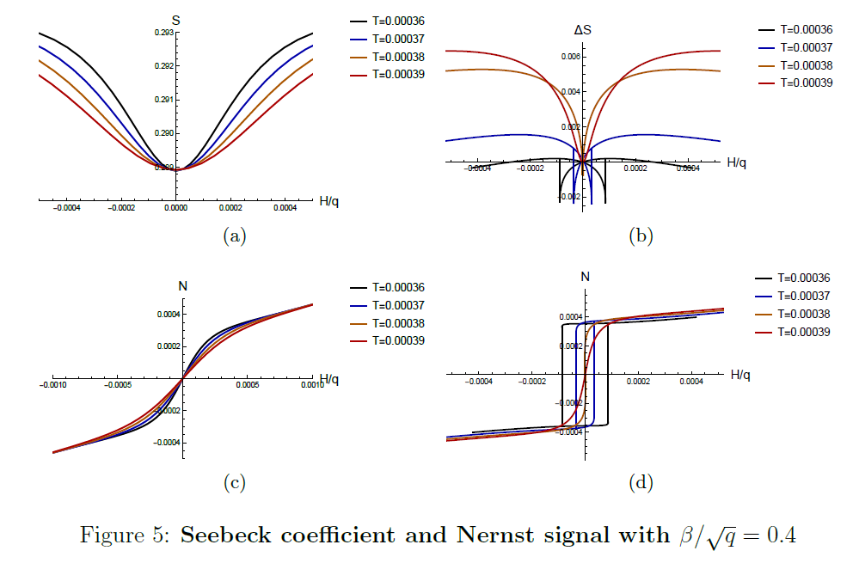
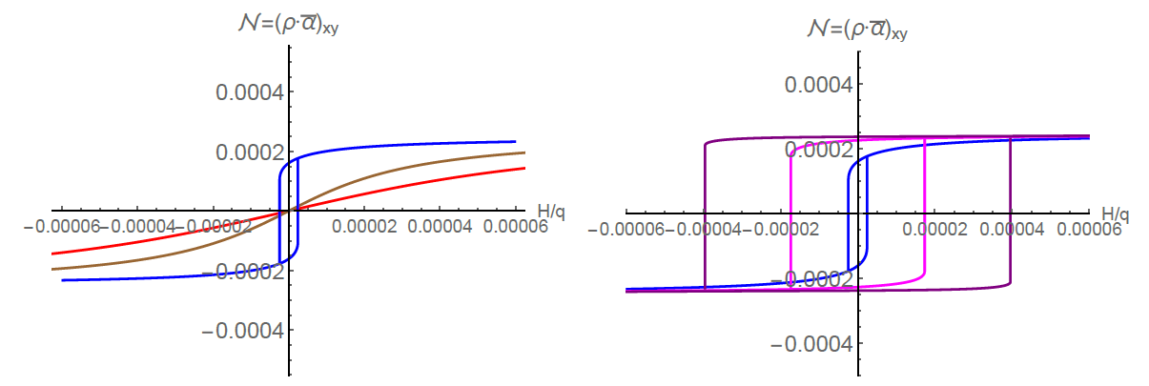

Seebeck coefficient and Nernst signal :
No experimental data

Slide 12
Summary
We constructed Hysteric Magnetoconductance Phase induced by magnetic impurity using a holographic approach.
We derived Holographic conductivity formulas for the hysteric phase.
We showed that the axion field can be regarded as a magnetic impurity.
We computed hysteric Seebeck coefficient and Nernst signal which can be observed in experiment near future.

