Slide 1
Deep learning: Extrapolation tool for ab initio nuclear theory
Youngman Kim (IBS)
2020 on-line NPS school, June 22, 2020

Slide 2
Mostly in collaboration with:
For ab initio NCSM, etc
Ik Jae Shin (RISP, IBS)
J. Vary, P. Maris, Gianina Alina Negoita (Iowa State U.)
A. M. Shirokov (Moscow State U.)
A. I. Mazur, I. A. Mazur (Pacific National U.)
N. A. Smirnova, CENBG (CNRS/IN2P3 – U. de Bordeaux)

Slide 3
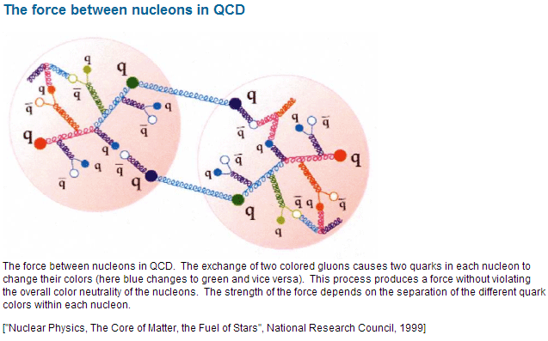

Slide 4
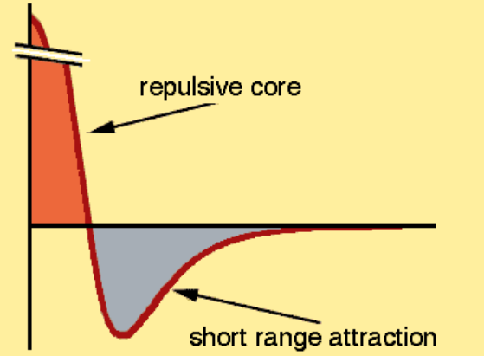



p
d
u
p
d
d
u
u
d
u
n
p
n
u
d
u
p
n
π
d
d
u
n
p
π
u
d
d
n
p
d
u
n
u
n
d
n

Slide 5
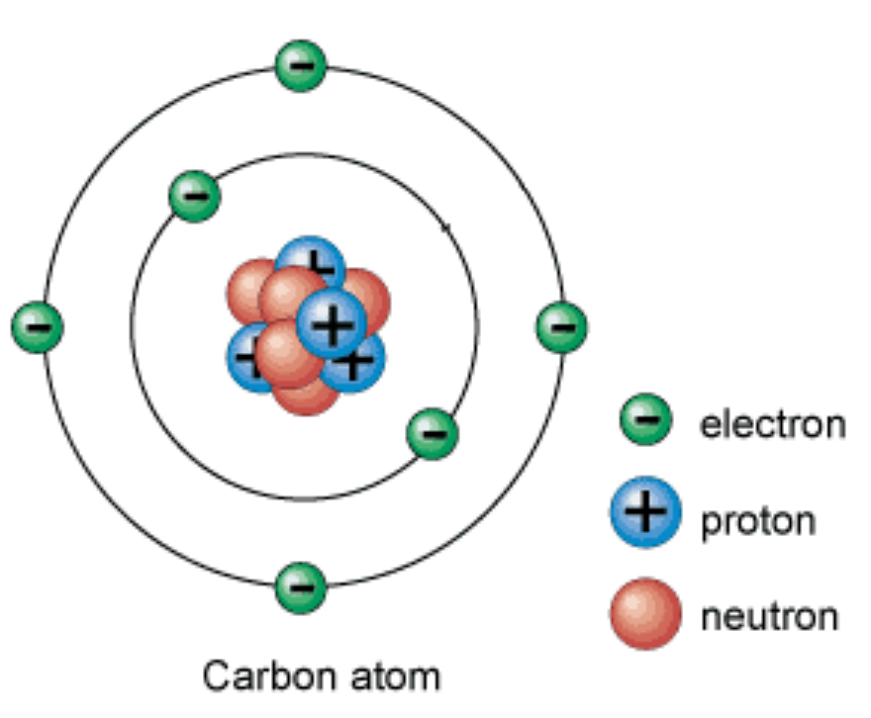
Clusters of levels → shell structure

Slide 6


Inert core
Interacting SM
HF

Slide 7
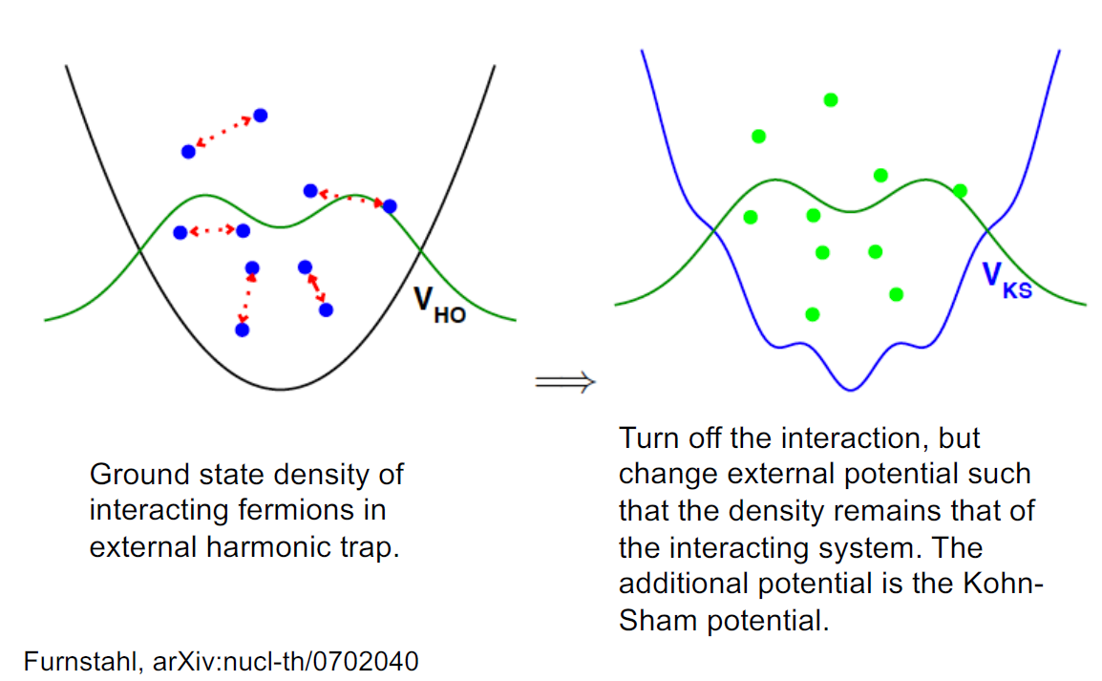

Slide 8
Ab initio NCSM
Daejeon 16 NN interaction
+ parity inversion in ¹¹Be
+ microscopic effective shell-model interactions
+ artificial neural network

Slide 9
Ab initio No Core Shell Model
Ab initio: nuclei from first principles using fundamental interactions without uncontrolled approximations.
No core: all nucleons are active, no inert core.
Shell model: harmonic oscillator basis
Point nucleons

Slide 10
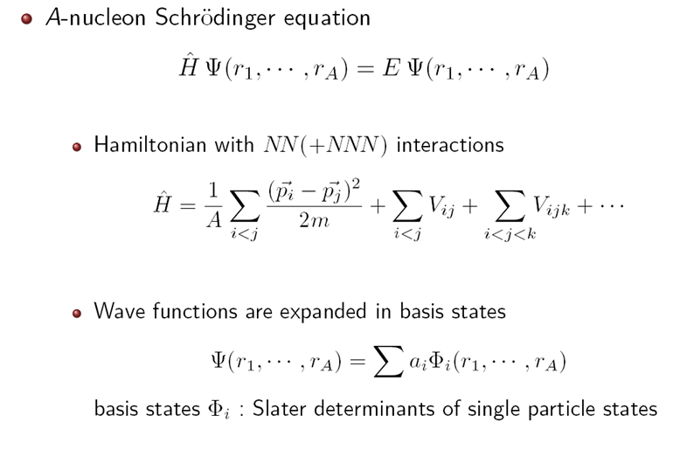

Slide 11
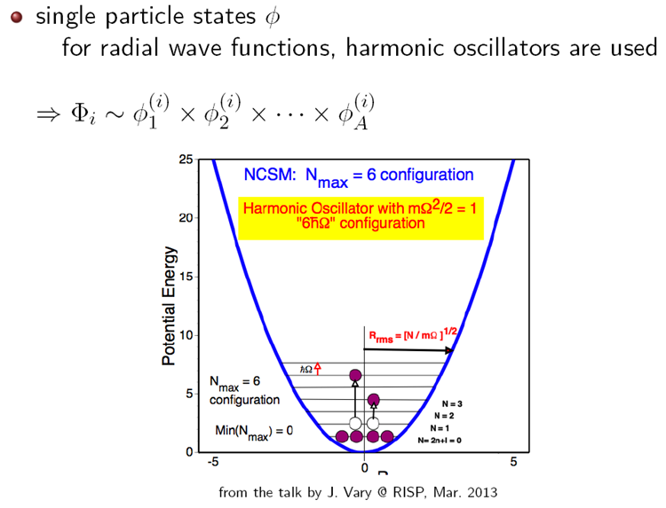

Slide 12
Ab initio structure and NN interaction
Unfortunately, the NN interaction at low energies needed for nuclear physics applications cannot be directly derived from QCD at the moment
Ab initio theory requires, of course, a realistic NN interaction accurately describing NN scattering data and deuteron properties
Nice to avoid NNN forces? Yes

Slide 13
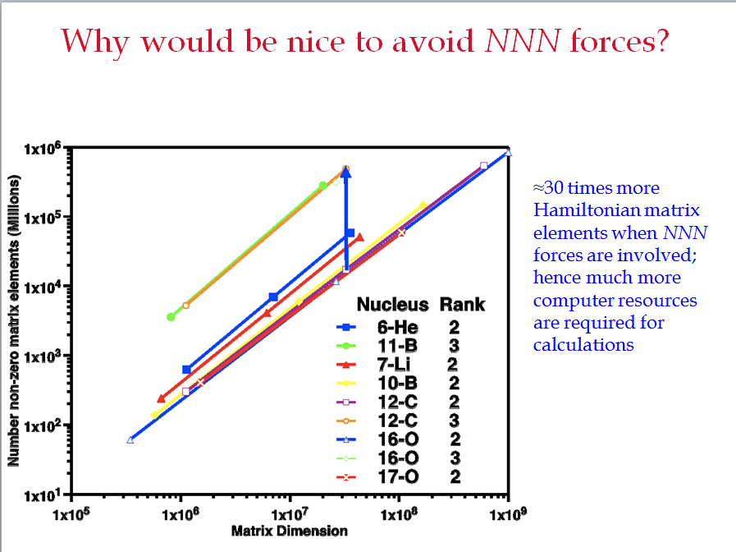
(Andrey Shirokov)

Slide 14
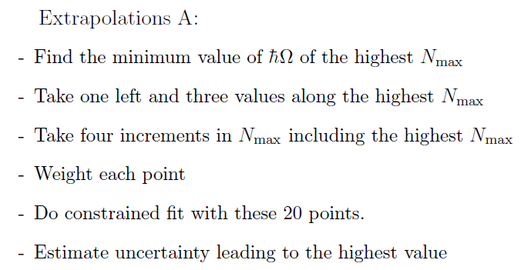
Extrapolating to the infinite matrix limit
“Extrapolations A & B”
P. Maris, J.P. Vary and A.M. Shirokov, Phys. Rev. C79, 014308 (2009)
P. Maris, A.M. Shirokov and J.P. Vary, Phys. Rev. C81, 021301(R) (2010)

Slide 15
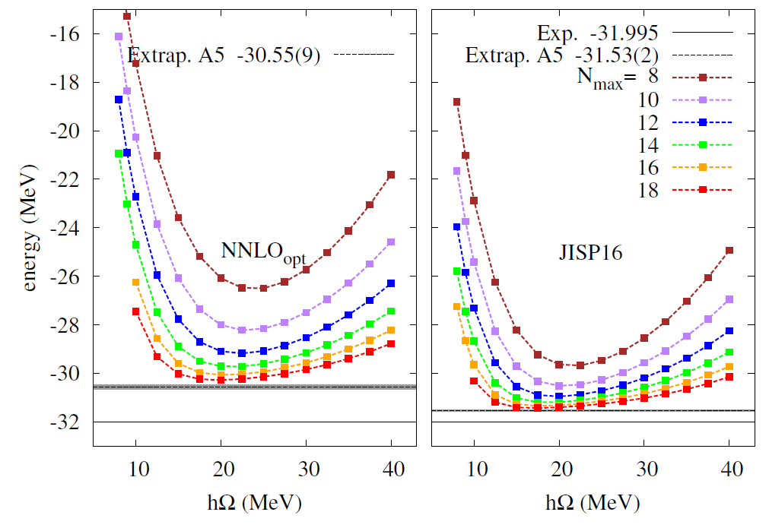
Ik Jae Shin, YK, P. Maris, J. P. Vary, C. Forssén et al, J. Phys.G 44 (2017) 7, 075103

Slide 16
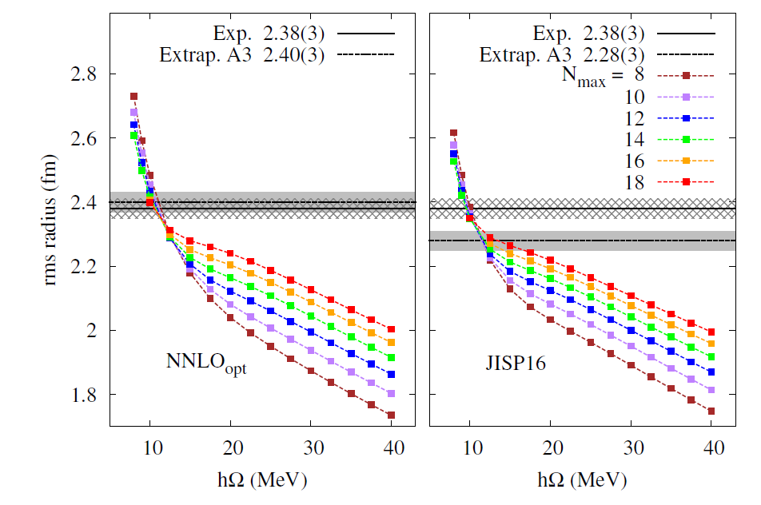

Point-proton mean-square radius is the mean expectation value of the square of the position vector of the individual protons:

Slide 17
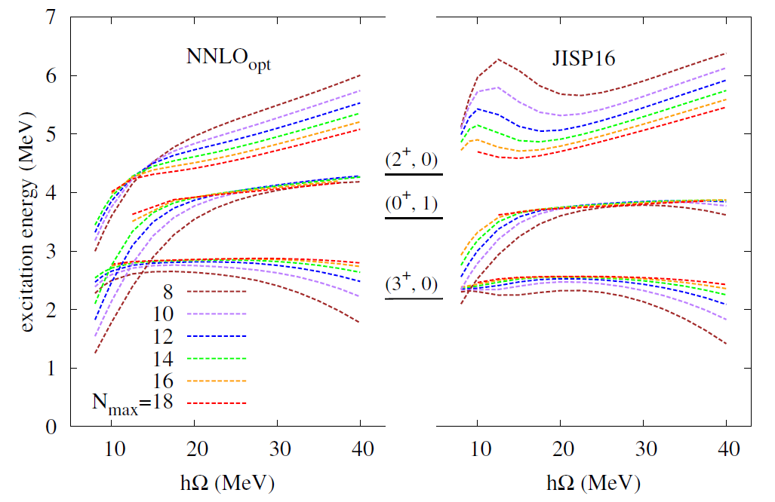
1.3 MeV
8.2 eV
24 keV
level ordering is ok with experiments

Slide 18
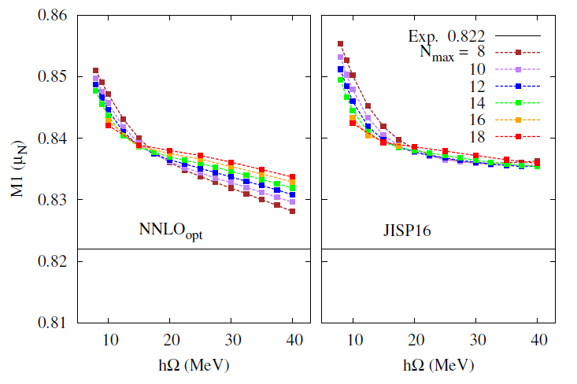
Both are within 2% of the experimental value

Slide 19
Daejeon 16
"N3LO NN interaction adjusted to light nuclei in ab exitu approach,"
A.M. Shirokov, I.J. Shin, Y. Kim, M. Sosonkina, P. Maris, J.P. Vary, PLB761 (2016) 87
Unfortunately, the NN interaction at low energies needed for nuclear physics applications cannot be directly derived from QCD at the moment
Ab initio theory (NCSM in our case) requires, of course, a realistic NN interaction accurately describing NN scattering data and deuteron properties
NNN requires a significant increase of computational resources, e.g. by a factor of 30 in the case of p-shell nuclei
Nice to avoid NNN forces? Yes

Slide 20
We use phase-equivalent transformations to adjust off-shell properties of similarity renormalization group evolved chiral effective field theory NN interaction (Idaho N3LO) to describe binding energies and spectra of light nuclei without NNN forces.
W. Polyzou and W. Glöckle theorem [Few-body Syst. 9, 97 (1990))]
H=T+V_{ij} ⇒ H’=T+V’_{ij}+V_{ijk}
where V_{ij} and V’_{ij} are phase-equivalent, H and H’ are isospectral.
Is it possible to transform as
H’=T+V’_{ij}+V_{ijk} ⇒ H=T+V_{ij}
with (approximately) isospectral H and H’ to minimize the need for the explicit introduction of three and higher body forces?

Slide 21
PET (phase equivalent transformation)
Assume unitary matrix [U] has only a finite matrix mixing of a few selected basis function. Then H and H’ have identical eigenvalues, and also asymptotic behavior of their eigenvector wave functions are same.
do not change scattering phase shifts and bound state energies of two-body system
but are supposed to modify two-body bound state observables such as the rms radius and electromagnetic moments
ex) JISP16 [A.M. Shirokov, J.P. Vary, A.I. Mazur and T.A. Weber, Phys. Lett. B 644 (2007) 33]

Slide 22
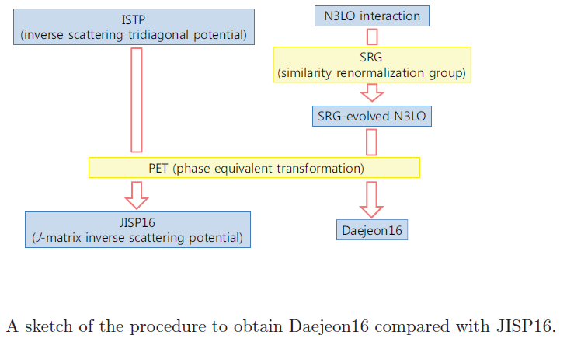
JISP16 vs Daejeon16

Slide 23

PET angles (in degrees) defining the Daejeon16 NN interaction in various NN partial waves.
binding energies of ³H, ⁴He, ⁶Li, ⁸He, ¹⁰B, ¹²C, ¹⁶O
excitation energies of ⁶Li [(3⁺,0), (0⁺,1)], ¹⁰B[(1⁺,0)], ¹²C[(2⁺,0)]

Slide 24
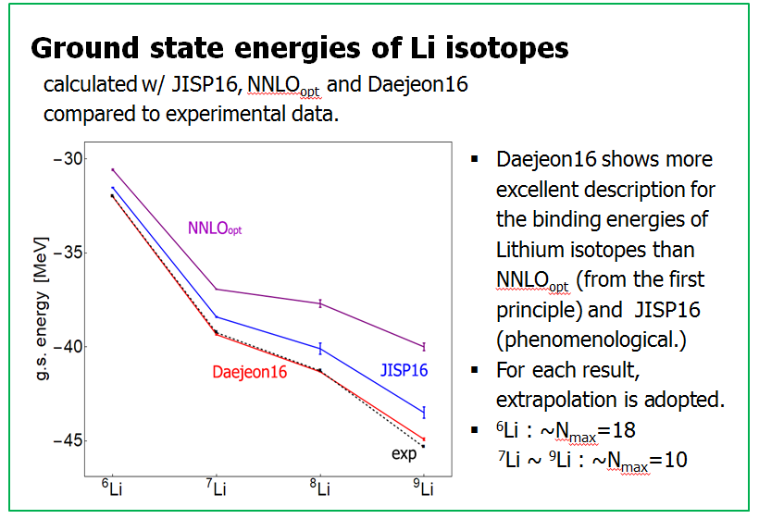

Slide 25
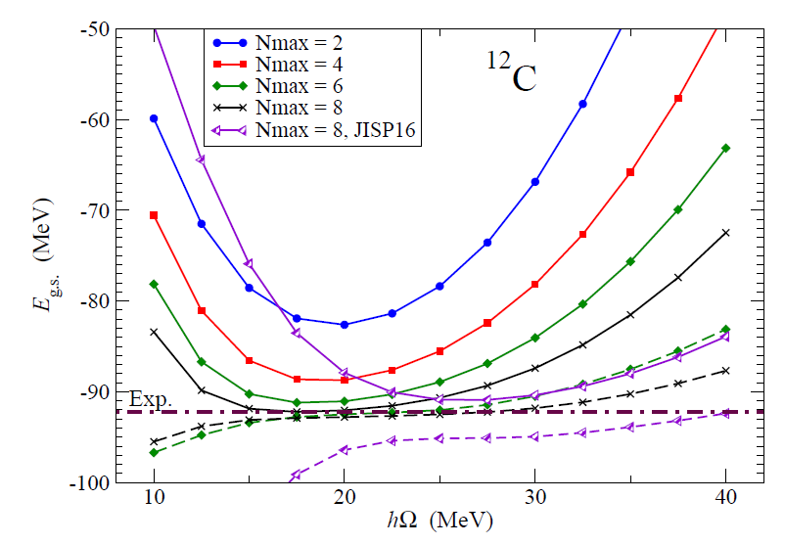
¹²C ground state energy in NCSM calculations obtained with Daejeon16 NN interaction

Slide 27
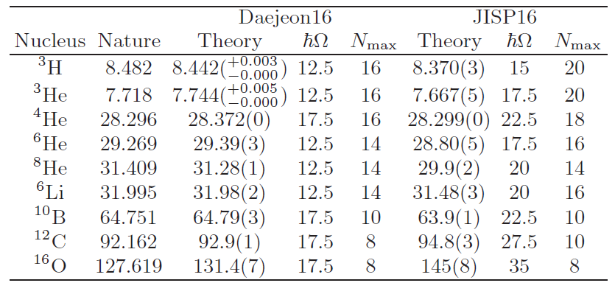
Binding energies (in MeV) of nuclei obtained with Daejeon16 NN interaction using Extrapolation B with estimated uncertainty of the extrapolation.

Slide 28
Parity Inversion in ¹¹Be
opposite to the expectation from the conventional shell model!

Slide 29
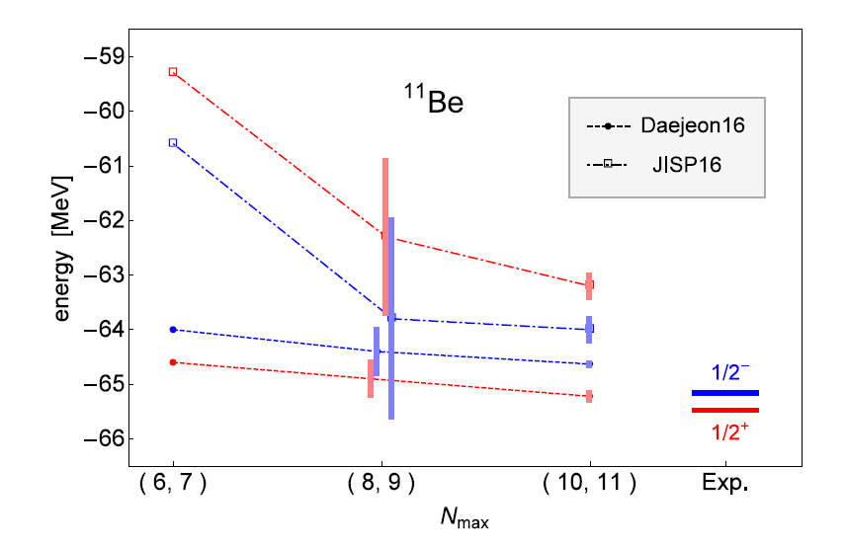
Interaction matters!
Y. Kim, I. J. Shin, A. M. Shirokov, M. Sosonkina, P. Marise and J. P. Vary, arXiv:1910.04367 [nucl-th]

Slide 30
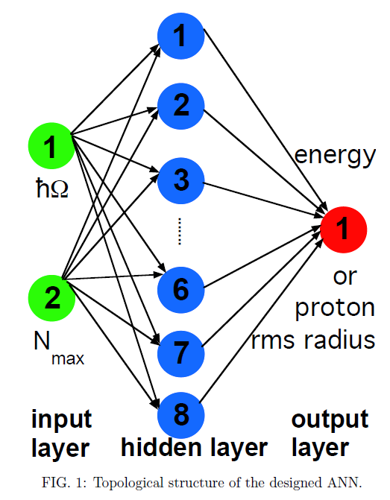
Deep learning: Extrapolation tool for ab initio nuclear theory
N_{max}= 2, 4, …, 10
for ANN training
and testing
Gianina Alina Negoita, et al.,
Phys. Rev. C99, 054308 (2019);
e-Print: 1803.03215 [physics.comp-ph]

Slide 31
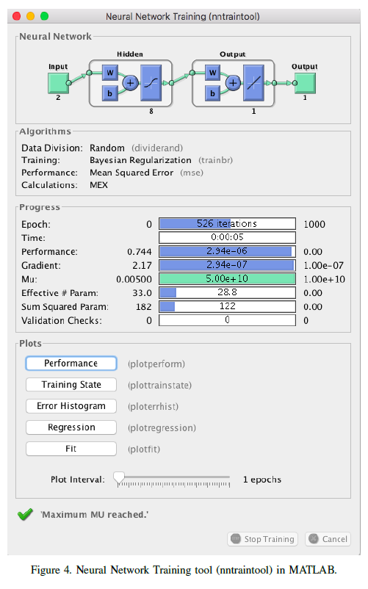

Slide 32
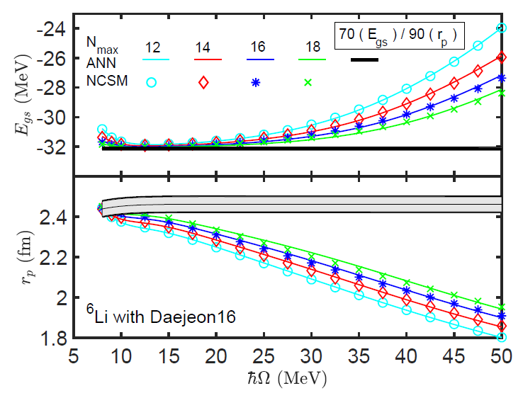

Slide 33
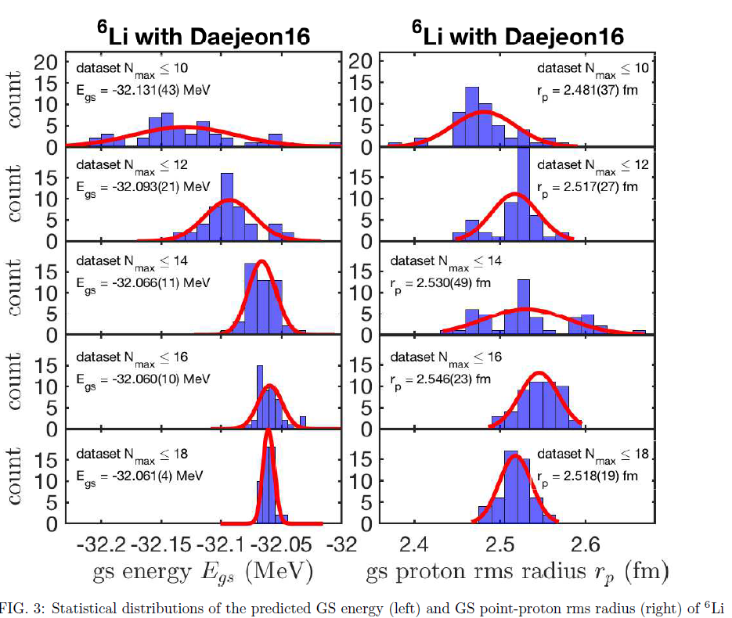

Slide 34
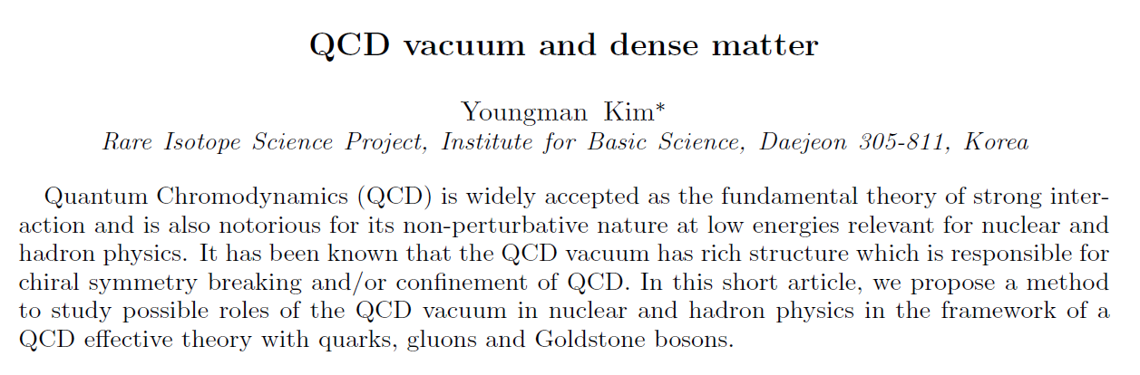
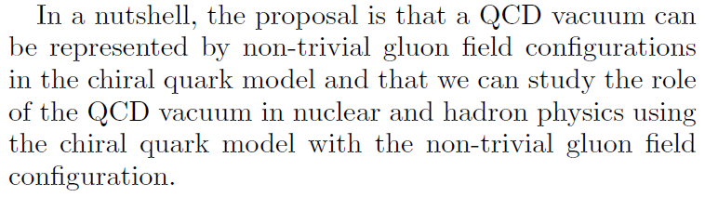
Addendum:
Y. Kim, AAPPS Bulletin Vol.30 No.2 (202

Slide 35
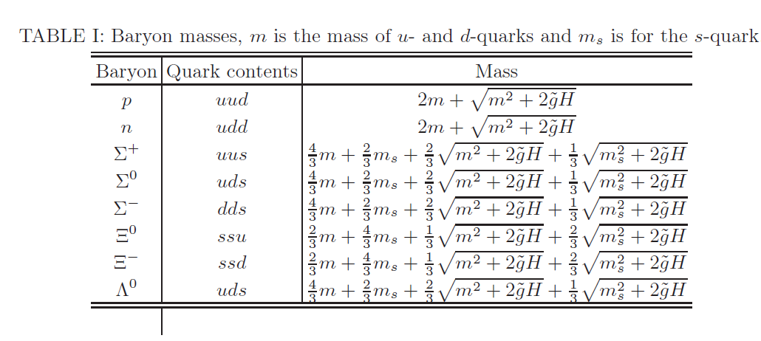
M. Harada, YK, H. K. Lee and I. A. Mazur, “QCD vacuum and baryon masses” in preparation

Slide 36
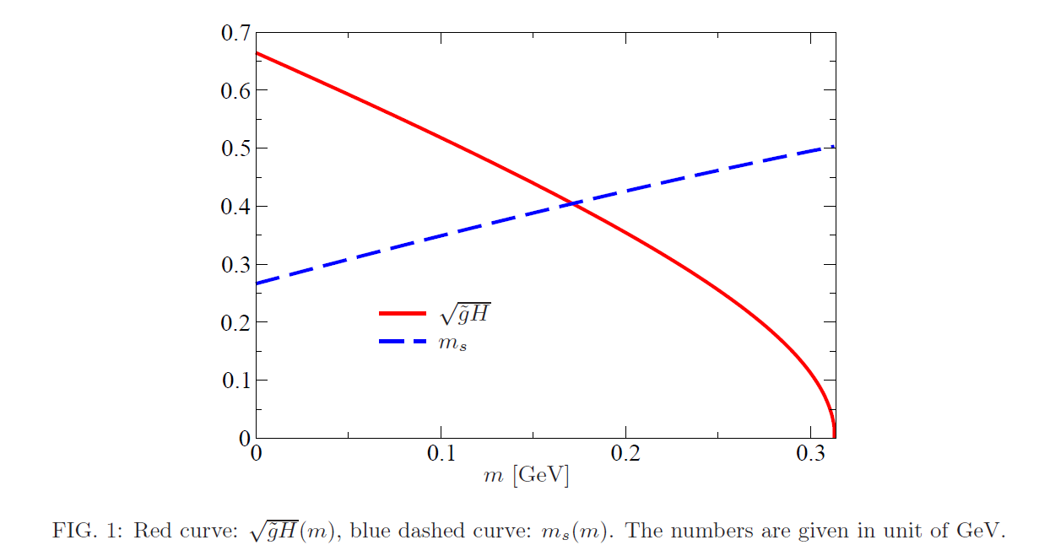
Ab initio nuclear theory (+ deep learning) may reveal remnants of QCD in
finite nuclei???!!!

