Slide 1
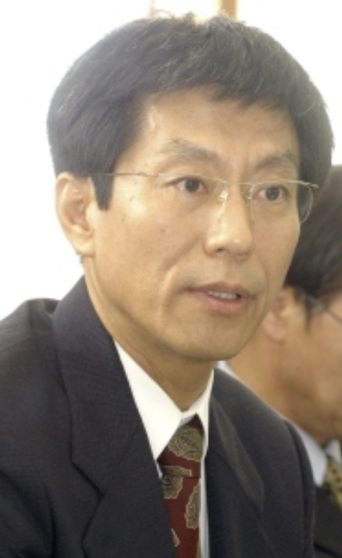
2020/02/26, Sogang University
Retirement Conference of Prof. Chaiho Rim
Broadening the
Research interests
with
Hyeong-Chan Kim
(Korea National University of Transportation)

Slide 2
When I meet C. Rim, I was quite conservative in work:
General Relativity, Black hole, particle detector model, Non-perturbative quantum field theory…
C Rim introduced me a Wicked way in physics!
The noncommutative field theory!

Slide 3
Physical Properties in a Kappa-Minkowski Spacetime
Hyeong-Chan Kim
(Yonsei University, Republic of Korea)
In collaboration with C. Rim and J. H. Yee
세종 대학교 Feb. 4, 2008

Slide 4
Spacetime Noncommutativity?
0
Now I am magician. I will make the space noncommute!

Slide 5

Space-time Non-commutativity
Path 1
Path 2

Slide 6
Spacetime Noncommutativity?
0

Slide 7
Space-time Non-commutativity
Setup equation?
Left .Down . Right . Up = Elevator
The basic equation of space-time non-commutativity comes from this relation. Left → Exp(ix), Down → Exp(i y), Elevator → Exp(i q)
Taking infinitesimal limit, we have
[x , y]= i q

Slide 8
Uncertainty?
D
D
D
0
Man ponders shadow, or shadow ponders itself?

Slide 9
Space-time Non-commutativity
The distance from start to destination is uncertain:
L,L + Elevator ; L is the distance without using
elevator
This is the same as that of the uncertainty of coordinates:
D x = < x > - <x> ~ Elevator
2
2
2
2
This provides the relation between the non-commutativity and uncertainty of space-time coordinates.

Slide 10
Introduction to noncommutativity
Space noncommutativity
Setup an equation?
Left .Down . Right . Up = Elevator
The basic equation of space-time non-commutativity comes from this relation. Left → Exp(ix), Down → Exp(i y), Elevator → Exp(i q)
Taking infinitesimal limit, we have the relation:
[x , y]= i q
If the height of the stair increases as the distance in y,
we may have
[x , y]= i y

Slide 11
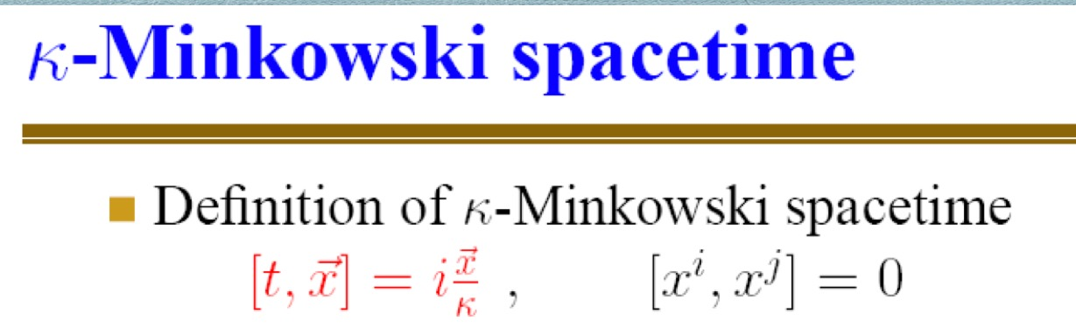

Slide 12
After that, I am working on
Holographic dark energy,
Scalar field dark matter,
Gravity theory beyond general relativity,
Anisotropic matter and its applications,
Even Wormholes,
Thanks to C Rim, I succeeded to extend my research boundary very much!

Slide 13

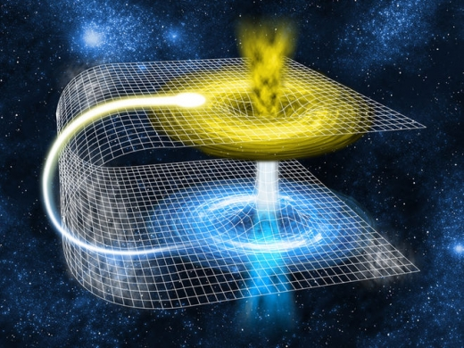



Temperatures for Closed and wormhole spacetimes
2020년 2월 26일
ER=EPR
1992-11
1999-22
2010-40
2018-115
2019-134
2020-16
Modified gravity
https://www.space.com/20881-wormholes.html
arXiv:1905.10050[JCAP09(2019)001] HC, Y Lee
arXiv:1911.00425 HC
KNUT. Hyeong-Chan Kim

Slide 14



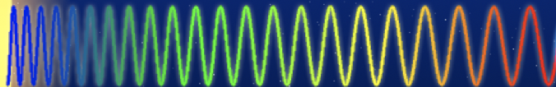
Zeroth law of thermodynamics in the presence of gravity
0th law is the transitive relation
between systems in thermal equilibrium.
In the presence of gravity
The local temperature of a macroscopic system is position dependent
because of the gravitational redshift and the gravitational potential energy
of self-gravitating system.
Consider a small system of radiation `A’
A
Asymptotic
temperature
T₁
T₂

Slide 15

Spacetimes with closed space and wormholes?
No asymptotic geometry
to define asymptotic temperature!
Many asymptotic geometries
A
T(x)
T(y)
S_3 geometry
Local temperature is different.
Red-shift factor is different.
The asymptotic temperatures are not well-defined!

Slide 16


Other problems in the asymptotic temperature
The formula defining the asymptotic temperature depends on two points. Therefore, it is a bi-local quantity.
The formula is explicitly dependent on the coordinate choice.
For a small system `A’, the asymptotic temperature cannot be defined from the first law of thermodynamics except for a few cases.
Position, coordinates independent definition of temperature?
From the definition of the asymptotic temperature
Where x, y are points inside a system in thermal equilibrium.

Slide 17
Local Temperature?
Which physical situation does the local temperature describe?
To answer this, let us consider a small system `A’ in thermal equilibrium
which is immersed in a star.
Define thermodynamic temperature as
A
We will show that the thermodynamic temperature is different from the local and the asymptotic temperatures.
To show this, let us set the system to be spherically symmetric.

Slide 18

Entropy of a system in a star
Thickness =
A
Metric inside the system `A’:
Entropy of `A’:

Slide 19
Variation of the Entropy of a system in a star
Variation of the entropy:
Assume
Volume integral of the energy density:
Gravitational potential energy:

Slide 20
Local temperature and thermodynamic temperature
Variation of the entropy with
Here, if the absorbed heat still remain around r_{c}
as the case that the thermometer is located at the same position
with the system `A’.
The local temperature becomes:
Thermodynamic
temperature:

Slide 21
Properties of the thermodynamic temperature
neither the local temperature nor the asymptotic temperature.
The thermodynamic temperature is
not larger than the local temperature.
The same as the asymptotic temperature at the surface of the star.
In the presence of a
coordinate singularity,
Local temperature is finite → The thermodynamic temperature = 0.
The thermodynamic temperature is finite → Local temperature= .
However, the present relation is coordinates dependent!

Slide 22
Coordinates independent relation
Thermodynamic temperature and asymptotic temperature:
Define generalized temperature:
Now, we find that the generalized temperature is
position & coordinates independent once
the surface of interaction is given.

Slide 23
Application 1: Photon star of radius r*
Spherically symmetric star:
The generalized temperature:
The thermodynamic temperature inside the star:

Slide 24
Application 2: Closed space
Black holes in S(3) space:
I.Cho, H.K, PRD95, (2017)
Let a system `A’ of its generalized temperature is located at .
The thermodynamic temperature of a system `B’ in equilibrium with `A’ is
Vanishes at the equator.
Local temperature:
Diverges at the event horizon.

Slide 25
Application 3: Spacetime with a wormhole
Even though the asymptotic temperatures are different,
A
M_{u}
T(x)
T(y)
M_{l}
In equilibrium situation, the generalized temperature is the same at all points.

Slide 26
Summary and Discussions
It is important to broaden the research area in the postdoc time.
I have introduced a generalized and a thermodynamic temperature which may play roles in a generalized situations.
Examples were shown.

Slide 27
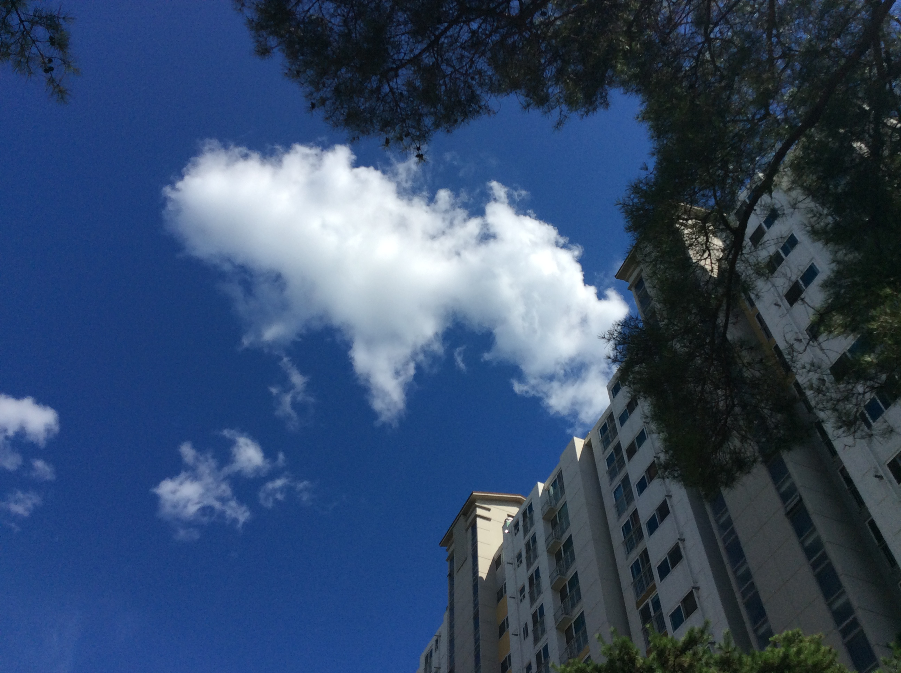

Thanks you very much.
임채호 교수님, 정년 축하합니다.
정년 후에도 좋은 일, 행복한 일 많기를 바랍니다.

