Slide 1
Introduction to Fusion and Quasifission Reactions
Kyungil Kim
Rare Isotope Science Project, Institute for Basic Science
Nuclear Physics School, June 22nd , 2021

Slide 2
Outline
Day 1. Overview
Day 2. Di-Nuclear System (DNS) Model 1
Day 3. DNS Model 2
Day 4. Adiabatic Model & Applications

Slide 3
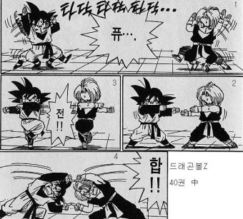

Fusion?

Slide 4
영화 속의 퓨전
안타깝게도 우리는 이렇게 멋지지는 않습니다.
(스포 주의! 10년 넘은 영화지만….)

Slide 5

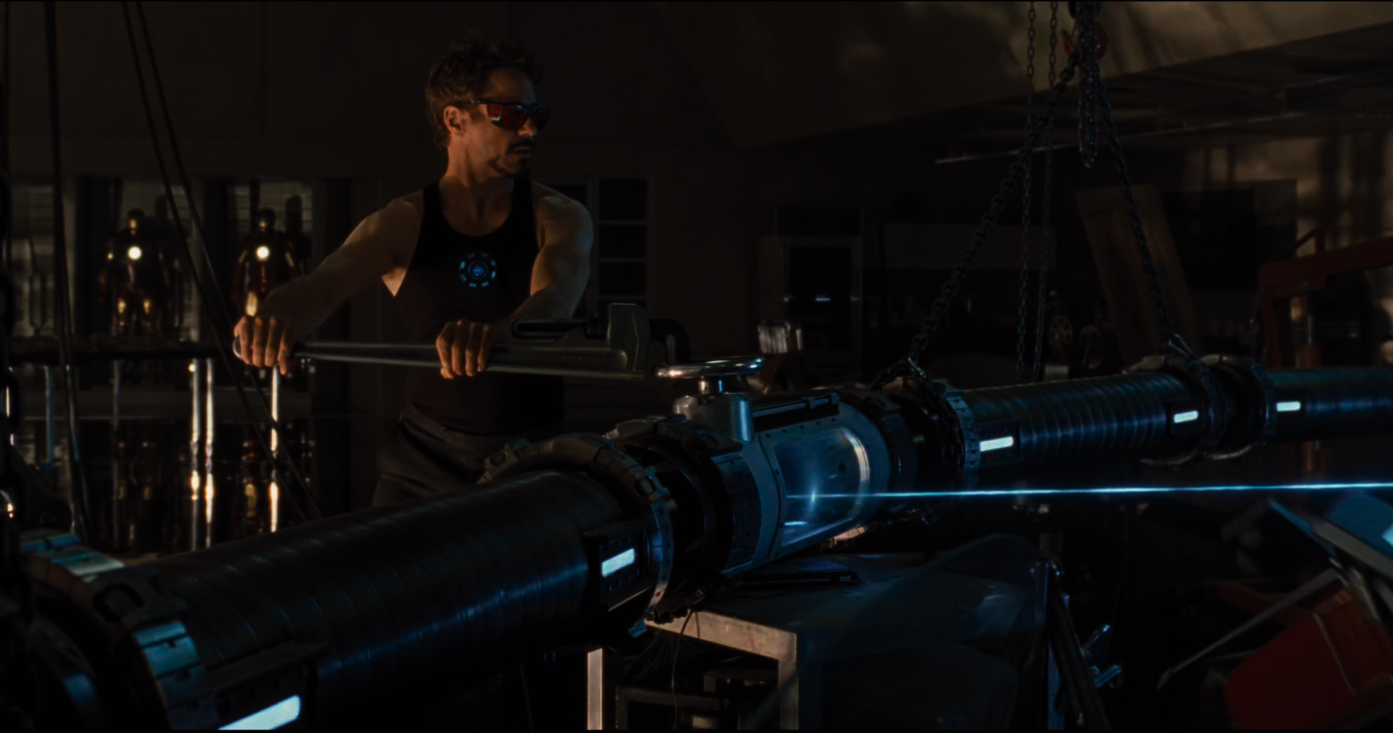
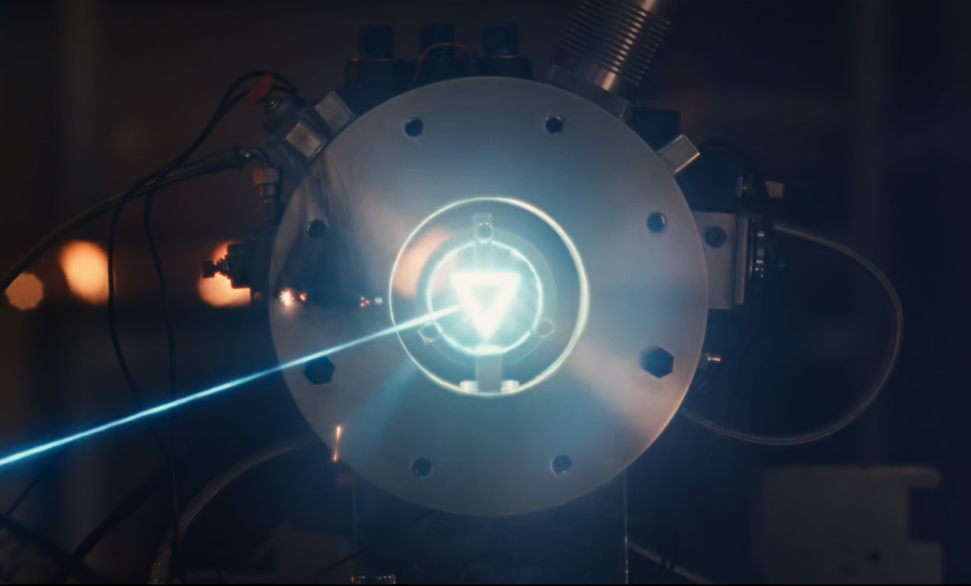
영화 <아이언맨2> 중에서
돌아가신 아버지에게서 가르침을 얻은 토니 스타크는 새로운 물질을 합성하는 법을 알아내고,
뭔가 뚝딱뚝딱 만들어서 빔을 쏘아대더니,
새로운 물질을 짜잔~! 만들어 냅니다.
영화 <아이언맨2> 중에서.

Slide 6

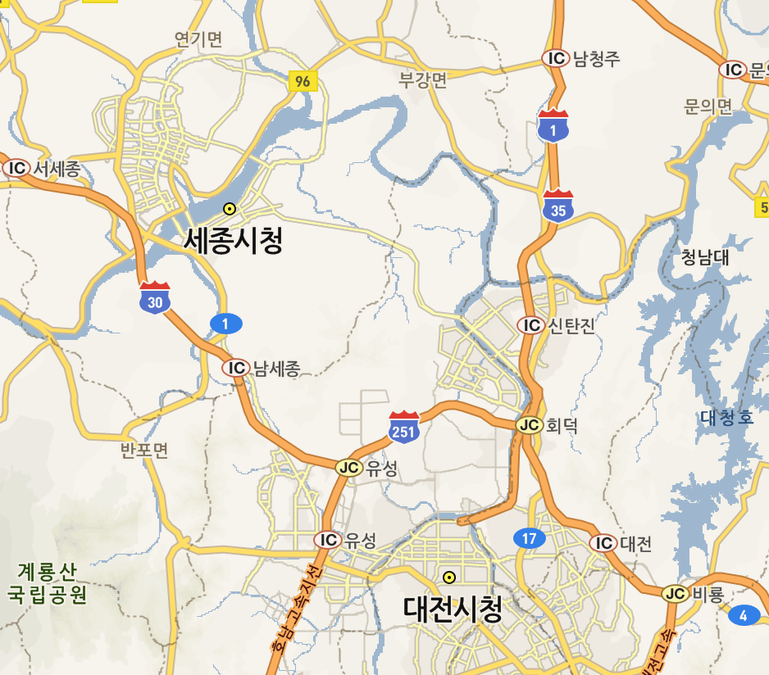
RAON (라온)
신동지구

Slide 7
중이온 가속기?
RAON (Rare isotope Accelerator complex for ON-line experiments)
중이온 가속기
중이온 : 무거운 핵을 의미. 가장 가벼운 수소 원자 (양성자)부터 가장 무거운 우라늄까지 가속이 가능.
가속기 : 이러한 원자 핵을 ~200 MeV/n

Slide 8
새로운 핵의 합성

Slide 9
Name of Elements
Element | Derived from
₄₅Rh (Rhodium) | Rose
₉₆Cm (Curium) | Curie
₁₀₂No (Nobelium) | Nobel
₁₁₄Fl (Flerovium) | Flyorov
₃₂Ge (Germanium) | Germany
₈₄Po (Polonium) | Poland
₈₇Fr (Francium) | France
₉₅Am (Americium) | America
₇₂Hf (hafnium) | Copenhagen (Hafnia)
₉₈Cf (Californium) | California
₁₁₆Lv (Livermorium) | Livermore
? | ?

Slide 10
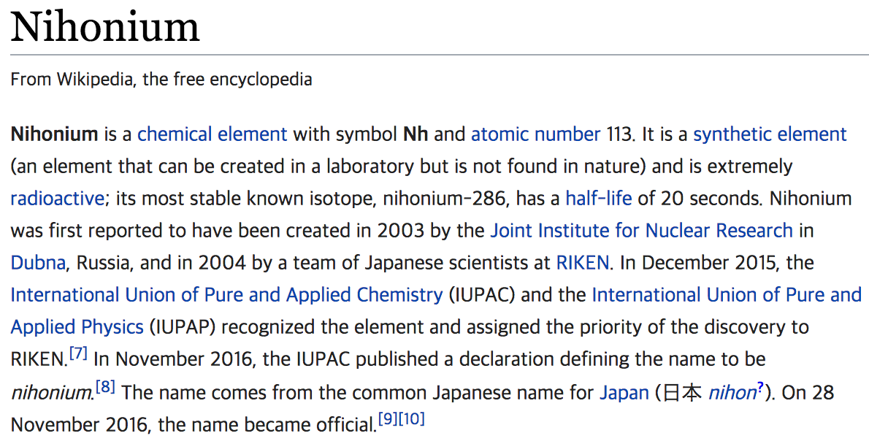
Koreanium?
Koreanium???

Slide 11
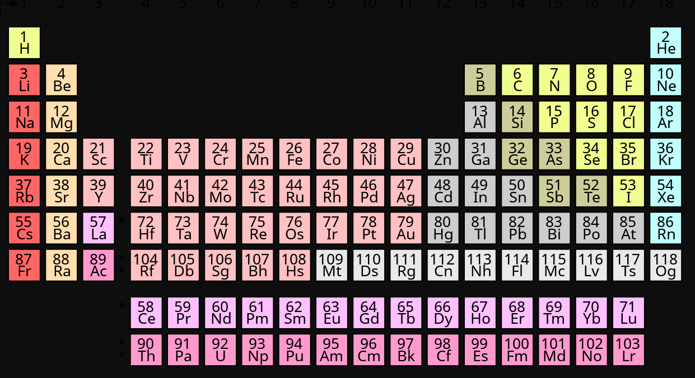
주기율표에 원소가 늘어났어요.
원자 번호는 몇 번까지 가능할까요?
?
2012년
114번 : Flerovium (플레로븀, Fl)
116번 : Livermorium (리버모륨, Lv)
2016년
113번 : Nihonium (니호늄, Nh)
115번 : Moscovium (모스코븀, Mc)
117번 : Tennessine (테네신, Ts)
118번 : Oganesson (오가네손, Og)

Slide 12
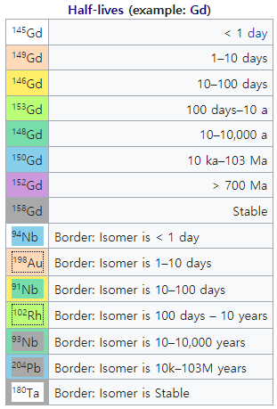
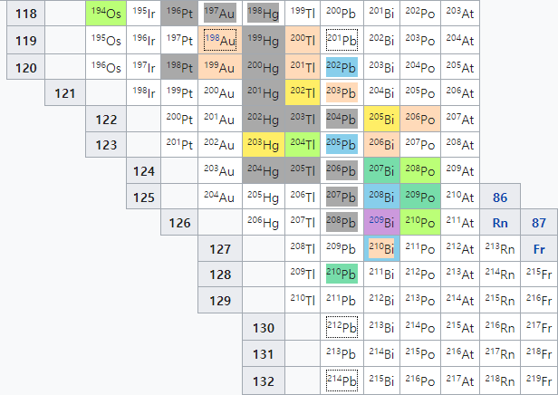
Heaviest Element in Nature?
From Wiki.

Slide 13
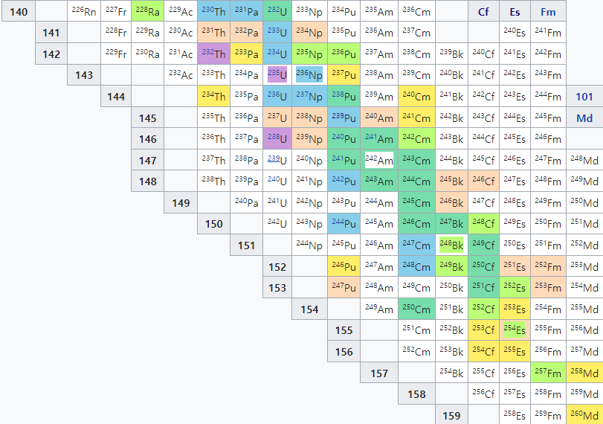
Heaviest Element in Nature?
From Wiki.

Slide 14
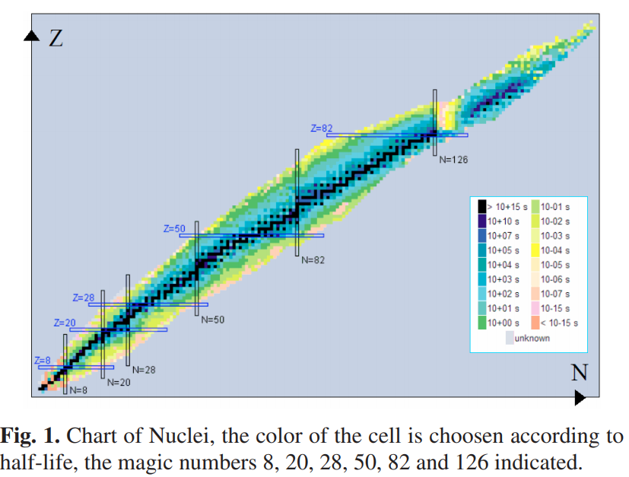
Super Heavy Element Synthesis
?
Stability island?
  Various prediction from many theoretical models
<Super heavy element (SHE) synthesis>
Very small cross section
  less than pb (pb for Z=116,118)
Sensitive to the beam energy
Limited beam-target combination
  neutron deficient SHE
NNDC Chart of Nuclides
One of good beam and target nuclei candidates for Z=120,122 would be ⁵⁰Ti and ⁵⁴Cr beams and Cf target.
  Are there other possibilities? ( ex. Isotope beam, …)

Slide 15
핵의 합성 과정
+
+

Slide 16
핵의 합성 과정
준분열 반응
(Quasi-fission)
99% !!

Slide 17
핵의 합성 과정
증발
(Evaporation)
핵분열
(Nuclear Fission)
99% !!
< 1%

Slide 18
새로운 핵의 합성
합성이 성공할 확률?
산란 단면적 단위 : b(barn) = 10⁻²⁸ m²
합성 단면적의 일반적인 크기 ~ 1 pb
= 10⁻¹² b
-> 세계 최고 시설에서 최고의 컨디션으로 실험한다면 하루에 한 개 정도가 만들어질 확률.

Slide 19
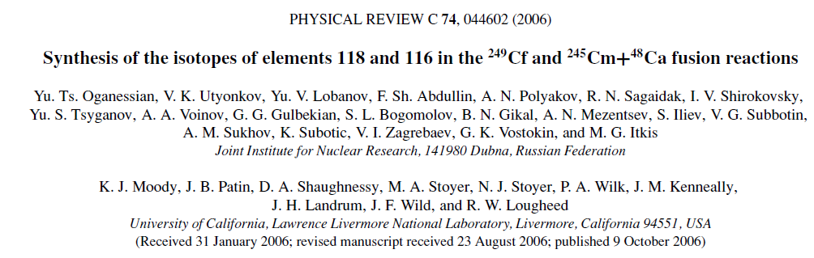
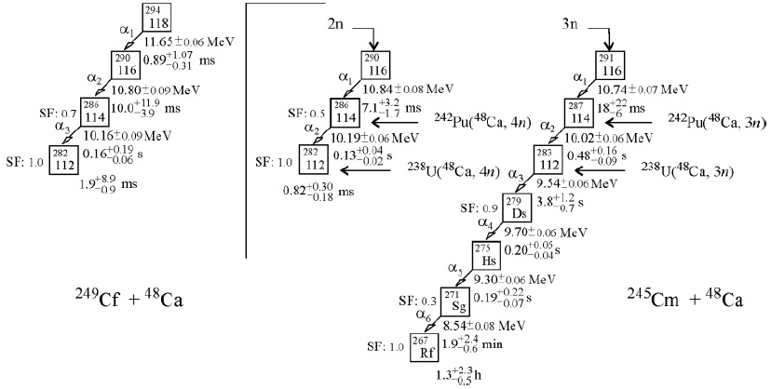
45일동안 3개 만들어짐?
Projectile
ex)⁴⁸Ca
A few MeV/n
ex)²⁴⁹Cf, ²⁴⁵Cm
Target
3 events for 1080h(~45 days)
3 events for 1000h

Slide 20
Schematic View of the Fusion Process
Inelastic b>b_{c}
scattering
Projectile
Quasi-fission
A few MeV/n
Target
Capture
b<b_{c}
Compound Nucleus
Fast-fission
L_{B}<L<L_{cap}
Fission (Fusion-fission)
Competition!
p
Compound Nucleus
n
Evaporation
Fusion 0<L<L_{B}
α

Slide 21
Diabatic and Adiabatic Models
Adiabatic Approach
Diabatic Approach (DNS model)

Slide 22

Evaporation Residue Cross-section

Slide 23

Liquid Drop Model
+
n
Attraction by nuclear force
Repulsion by Coulomb force
+
n
n
n
n
+
+
Mass of a nucleus in the liquid drop model

Slide 24

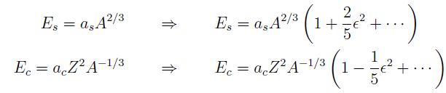
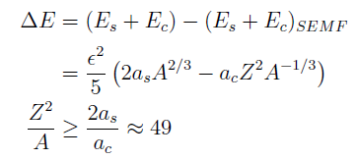
Liquid Drop Model
R
b
a
Surface and Coulomb energy change
In many approaches, a next magic number of proton is predicted in the range of Z=113~126.
Z≥116, A≥270

Slide 25

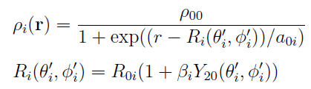
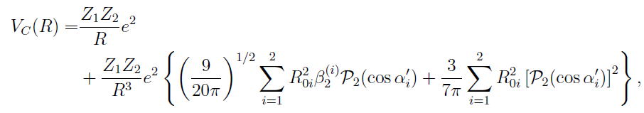
Nucleus Nucleus Potential
<Nuclear force>
Migdal force
Attraction
by nuclear force
Repulsion
by Coulomb force
<Coulomb force>

Slide 26
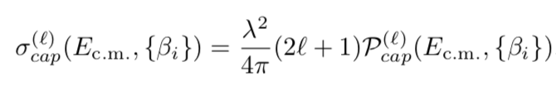
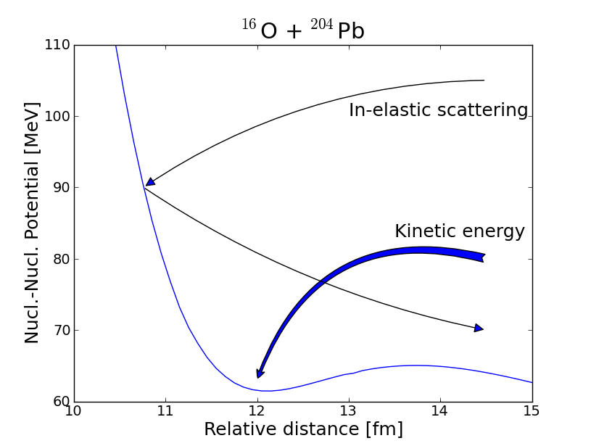
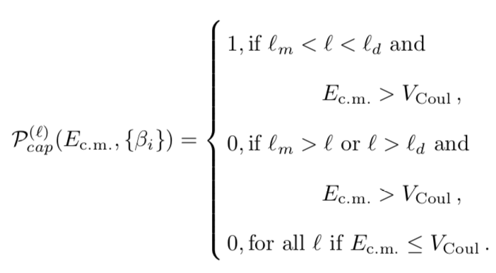
Di-Nuclear System (DNS) Model - Capture
<Capture cross section>
Kinetic energy dissipation by friction

Slide 27




Nucleus Nucleus Potential
<Nucleus-Nucleus potential>
Migdal force

Slide 28
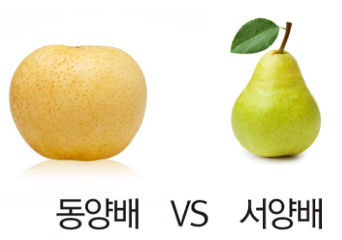
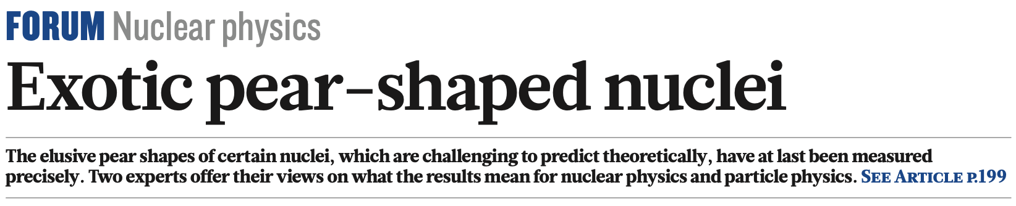
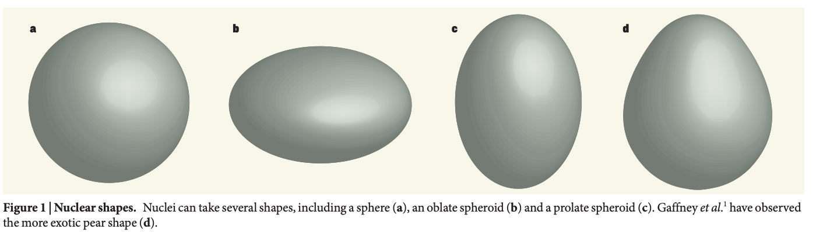
Nuclear Deformation

Slide 29
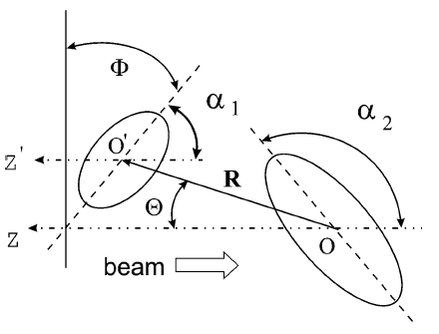


Deformation and Orientation
R₁ > R₂
V_{c}(R₁) < V_{c}(R₂)
R₁
R₂

Slide 30
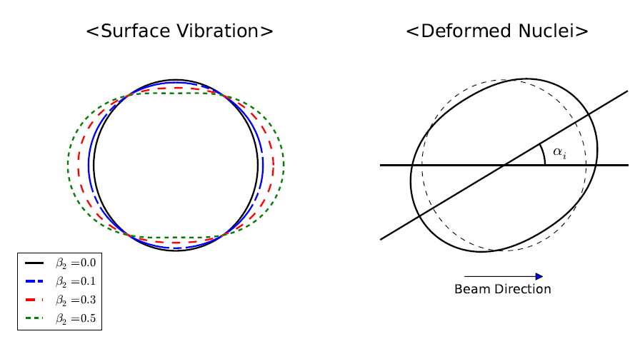
Vibration and Deformation
Ex)
Nucleus | β₂ | β₃ | β₂* | β₃*
⁴⁰Ar | 0.0 | 0.0 | 0.284 | 0.26
¹⁸⁰Hf | 0.279 | 0.0 | 0.274 | 0.07

Slide 31
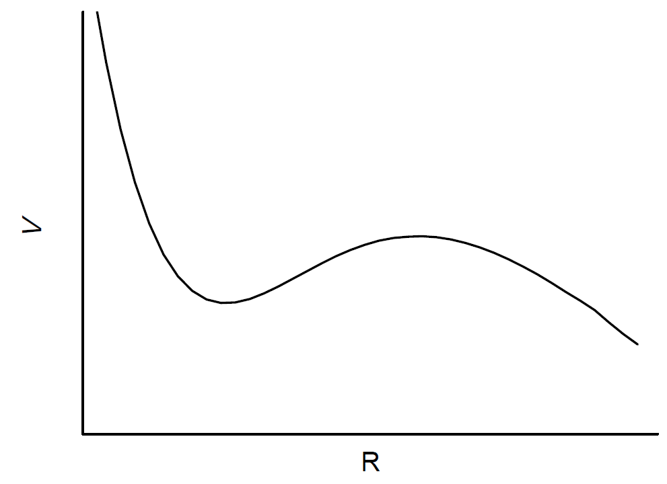
Capture
Kinetic energy : a few MeV/n
Kinetic energy loss by friction
B_{qf}
<Potential pocket>

Slide 32
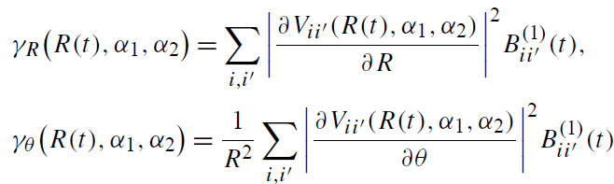




Friction
<Friction coefficient>
V_{T}
g_{PT}
V_{P}
<target>
<Equation of motion>
<projectile>

Slide 33
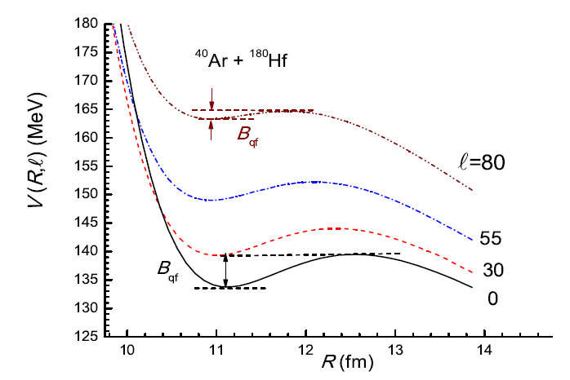


Rotation
<Rotation>

Slide 34
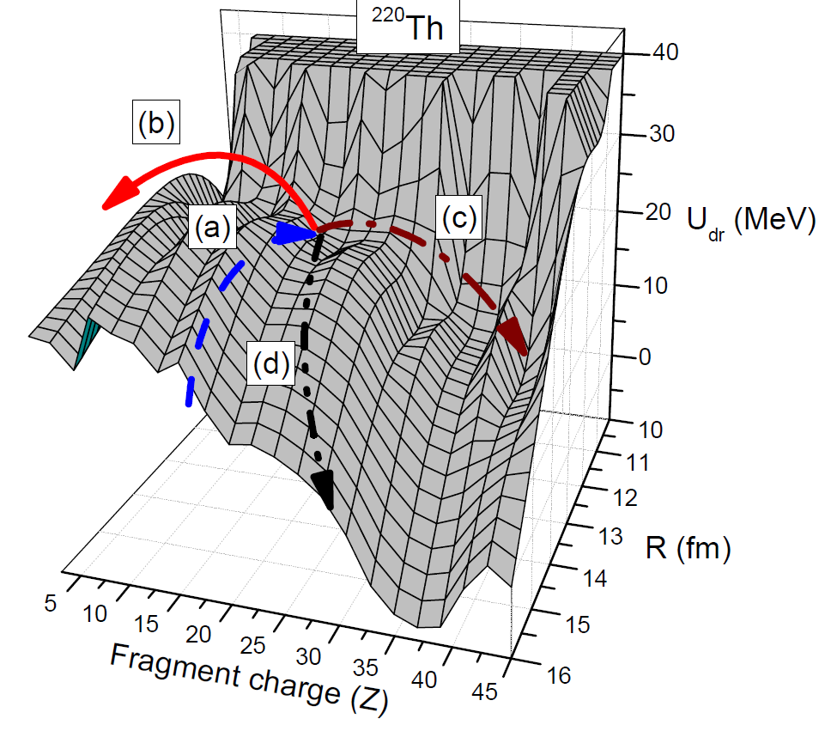

DNS Model - Fusion
<Driving potential>
Entrance channel
Fusion
Charge symmetric DNS
Quasi fission
<Fusion cross section>

Slide 35
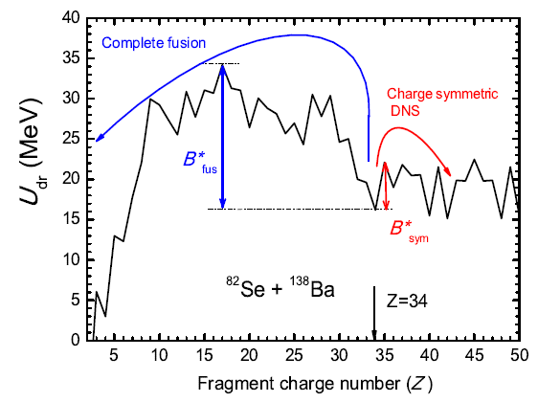

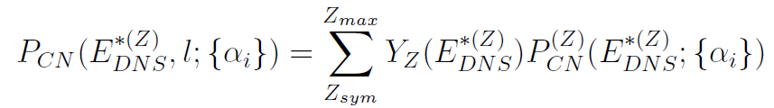


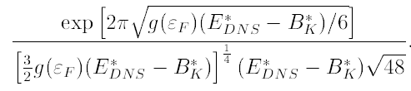
Fusion Cross-section
Cross-section for evaporation residues
Fusion cross-section
Probability for formation of compound nucleus
Level density

Slide 36
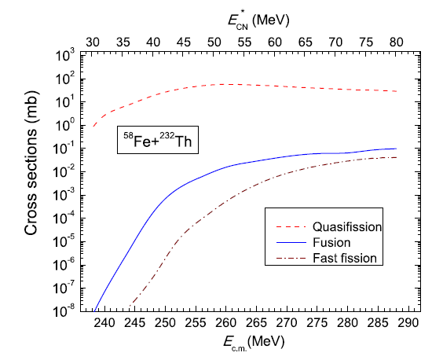
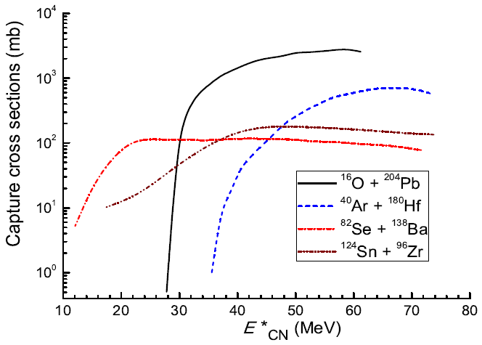
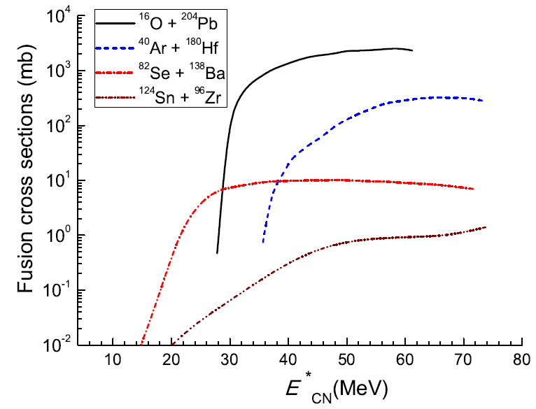
Hindrance by Quasifission
Almost every event become a quasi-fission in superheavy element synthesis.
~10 times
~1000 times

Slide 37
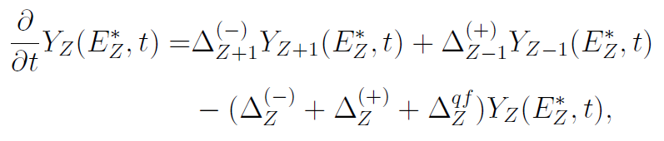
Multi-nucleon Transfer
Evolution of the DNS by nucleon transfer
Y_{Z-1}
Y_{Z}
Y_{Z+1}

Slide 38

DNS Model – DNS Evolution
<Master equation>
V_{T}
g_{PT}
V_{P}
<target>
<Transition rate>
<projectile>
<Matrix element>

Slide 39
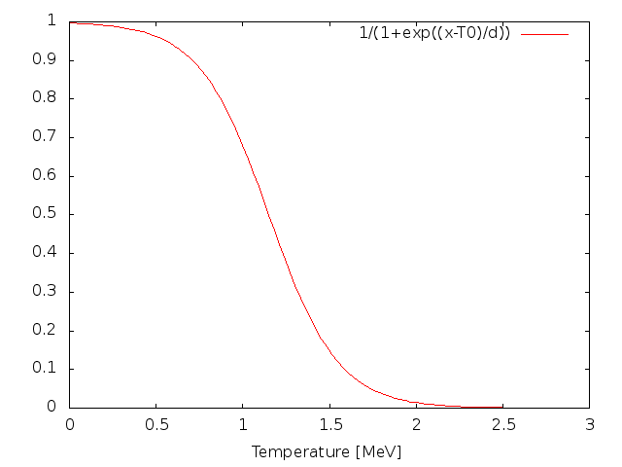


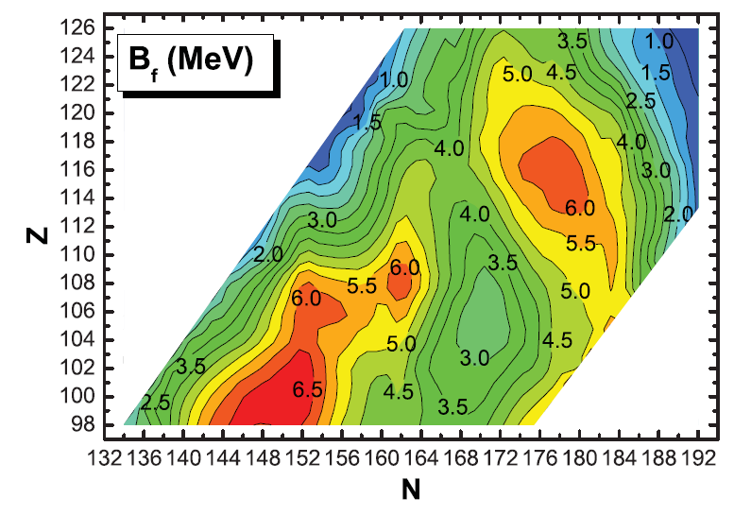
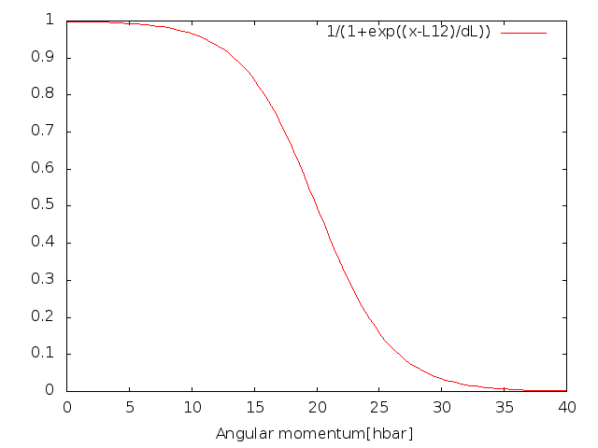
Fast Fission
<Temperature and angular momentum dependence of fission barrier>
Kowal, et al. PRC82 (2010) 014303

Slide 40


Survival Probability
Cross-section for evaporation residues
+ …
Width of fission is much larger than width of neutron emission for heavy mass system.
The survival probability of additional one neutron evaporation is very small.
W_{sur}^{1n} >> W_{sur}^{2n}

Slide 41
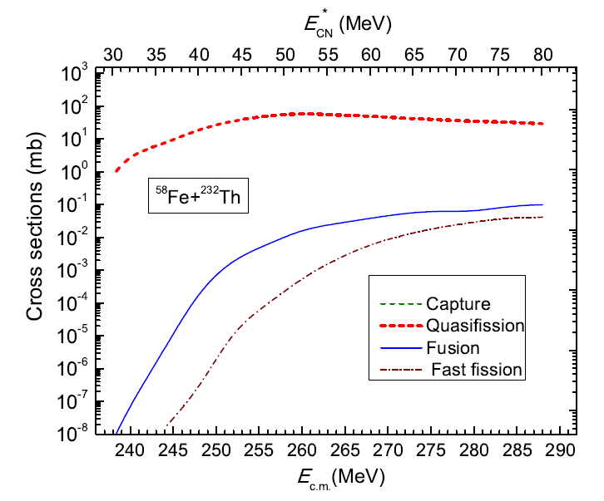
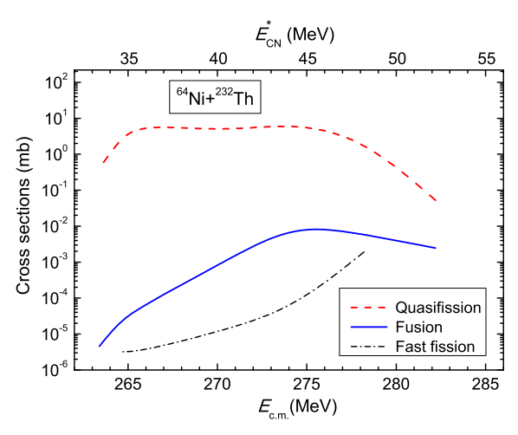
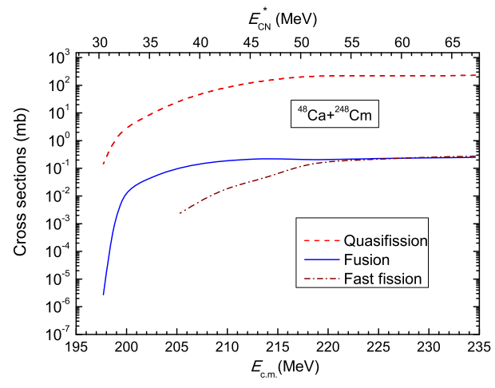
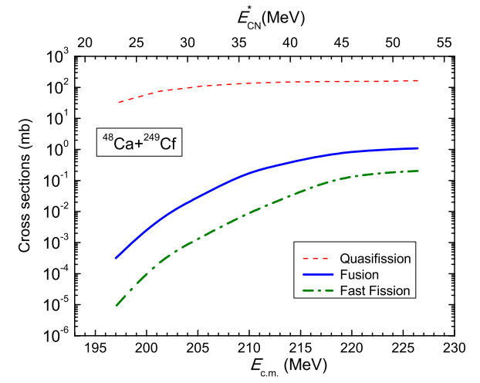
Th 표적을 이용한 핵 합성 연구
<Z=116,118 synthesis with Th target>
Ref.) A.Nasirov, KIK, et al. EPJ A 49 (2013) 147

Slide 42
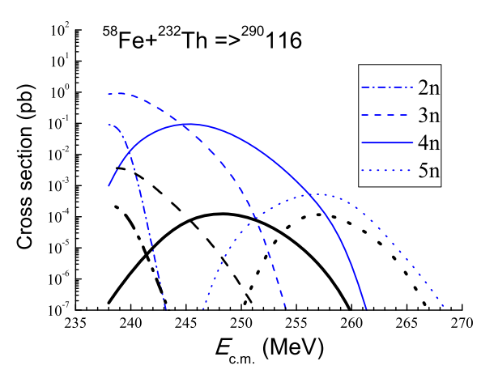
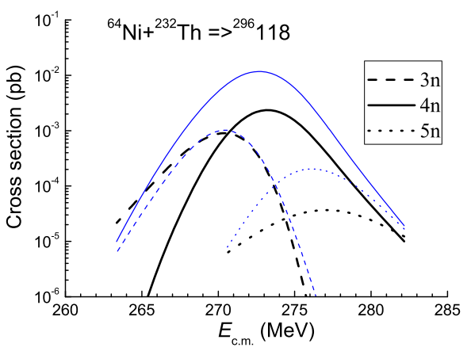
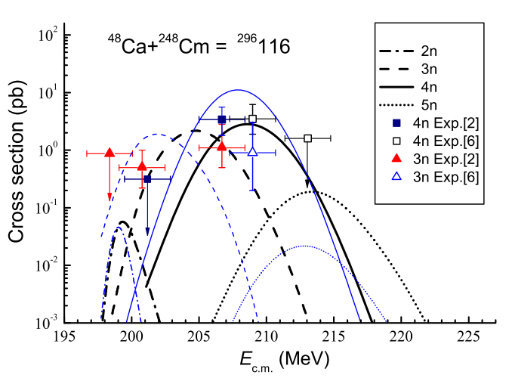
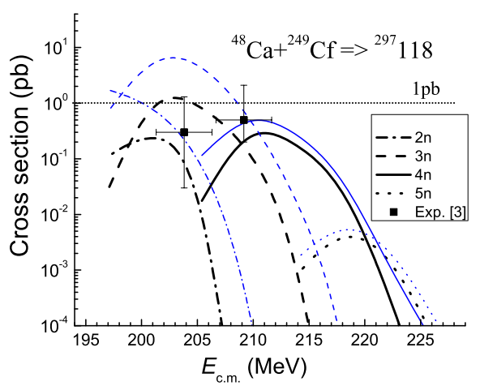
Th 표적을 이용한 핵 합성 연구
<Z=116,118 synthesis with Th target>
Fusion-evaporation cross sections with Th target are ~fb.
Fusion-evaporation cross sections are ~pb.
Ref.) A.Nasirov, KIK, et al. EPJ A 49 (2013) 147

Slide 43
How Select Beam and Target?
Ex.) If we want to synthesize Th (Z=90),
  Possible beam-target combination,
    O (Z=8) + Pb (Z=82)
    Ar (Z=18) + Hf (Z=72)
    Se (Z=34) + Ba (Z=56)
    Sn (Z=50) + Zr (Z=40)
  Coulomb Force
    O (Z=8) + Pb (Z=82) -> Z₁Z₂ = 656
    Ar (Z=18) + Hf (Z=72) -> 1296
    Se (Z=34) + Ba (Z=56) -> 1904
    Sn (Z=50) + Zr (Z=40) -> 2000
More symmetric!
More repulsion!

Slide 44
How Select Beam and Target?
Ex.) If we want to synthesize Th (Z=90),
  Nuclear Force
    O (Z=8) + Pb (Z=82) -> r₁+r₂ = 1.2 * (A₁^{1/3} + A₂^{1/3}) = 7.613
    Ar (Z=18) + Hf (Z=72) -> 8.137
    Se (Z=34) + Ba (Z=56) -> 8.479
    Sn (Z=50) + Zr (Z=40) -> 8.525
Easy to touch!
Migdal force

Slide 45

Hot and Cold Fusion
²²⁰Th*
Cold Fusion
  Relatively mass symmetric entrance channel
  Excitation energy: 10~20 MeV
  (1~2n ER)
  Typical target : Pb, Bi
  (near doubly magic nuclei)
Hot fusion
  Relatively mass asymmetric entrance channel
  Excitation energy:30~40 MeV
  (3~4n ER)

Slide 46
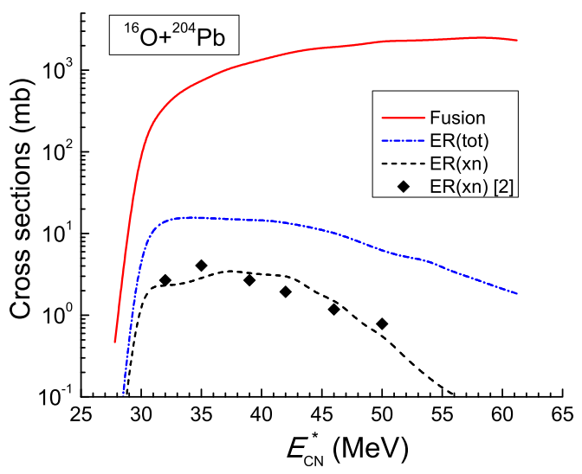
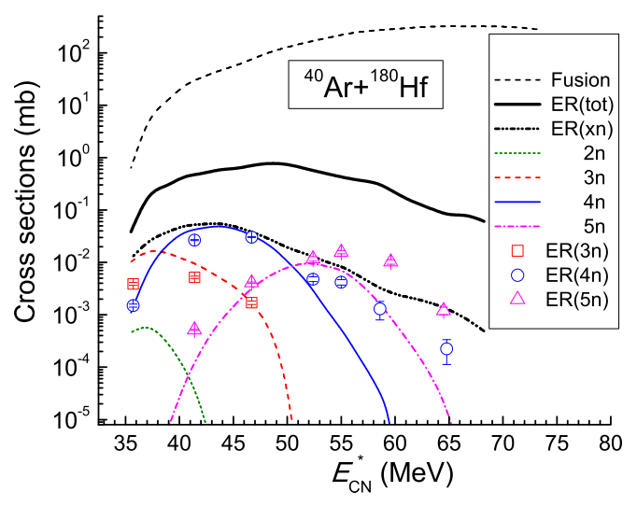
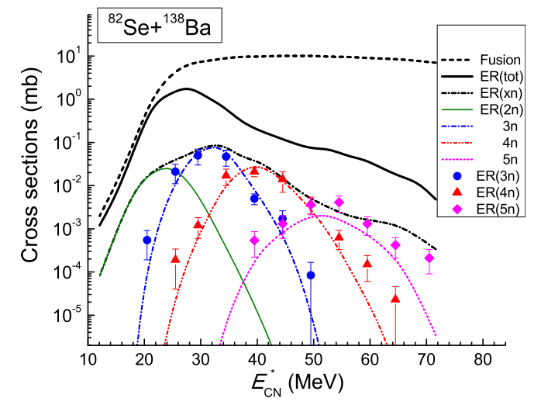
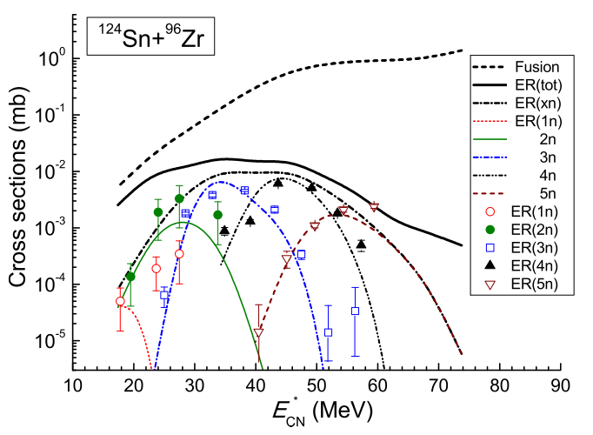
다양한 빔-표적 조합
<Synthesis of ²²⁰Th>
Hot fusion
Cold fusion
Ref.) KIK et al. PRC 91 (2015) 064608

Slide 47

Stability Island?
N=Z
Stability island?

Slide 48

Target
From Wikipedia

Slide 49
Heaviest Element in Nature?
From Wiki.

Slide 50
Experimental Results – Synthesis of Cf
Ref.) J.Khuyagbaatar, et al. PRC 86 (2012) 064602

Slide 51



Results – Synthesis of Cf
<Driving potential>
<DNS evolution>
<Fusion probability>
Different initial N/Z ratios of two system give different mass and charge distributions of di-nuclear systems during the fusion process.

Slide 52


Results – Synthesis of Cf

