Slide 1
Introduction to Fusion and Quasifission Reactions
Kyungil Kim
Rare Isotope Science Project, Institute for Basic Science
Nuclear Physics School, June 23rd , 2021

Slide 2
Outline
Day 1. Overview
Day 2. Di-Nuclear System (DNS) Model 1
Day 3. DNS Model 2
Day 4. Adiabatic Model & Applications

Slide 3
Schematic View of the Fusion Process
Inelastic b>b_{c}
scattering
Projectile
Quasi-fission
A few MeV/n
Target
Capture
b<b_{c}
Compound Nucleus
Fast-fission
L_{B}<L<L_{cap}
Fission (Fusion-fission)
Competition!
p
Compound Nucleus
n
Evaporation
Fusion 0<L<L_{B}
α

Slide 4

Evaporation Residue Cross-section

Slide 5
Units
σ [mb]
R=1.2 A^{1/3} [fm]
E_{lab} [MeV]
10 mb=10⁻³⁰ m²=1 fm²

Slide 6
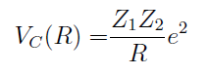
Beam Energy
¹⁶O (Z=8)
R=1.2 A^{1/3} [fm]
²⁰⁴Pb (Z=82)
e²=1.44 MeV fm
    O (Z=8) + Pb (Z=82) -> Z₁Z₂ = 656 E_{coul}= 124.1 MeV
    Ar (Z=18) + Hf (Z=72) -> 1296 = 229.4 MeV
    Se (Z=34) + Ba (Z=56) -> 1904 = 323.4 MeV
    Sn (Z=50) + Zr (Z=40) -> 2000 = 337.8 MeV
    O (Z=8) + Pb (Z=82) -> r₁+r₂ = 1.2 * (A₁^{1/3} + A₂^{1/3}) = 7.613
    Ar (Z=18) + Hf (Z=72) -> 8.137
    Se (Z=34) + Ba (Z=56) -> 8.479
    Sn (Z=50) + Zr (Z=40) -> 8.525

Slide 7
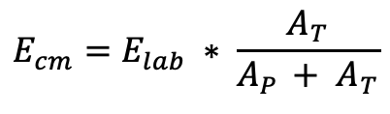
Beam Energy
¹⁶O (Z=8)
R=1.2 A^{1/3} [fm]
²⁰⁴Pb (Z=82)
e²=1.44 MeV fm
$$E_{cm}=E_{lab} ∗ \frac{A_{T}}{A_{P }+ A_{T}}$$
    ¹⁶O (Z=8) + ²⁰⁴Pb (Z=82) E_{coul}= 124.1 MeV E_{lab}= 133.3 MeV
    ⁴⁰Ar (Z=18) + ¹⁸⁰Hf (Z=72) = 229.4 MeV = 280.4 MeV
    ⁸²Se (Z=34) + ¹³⁸Ba (Z=56) = 323.4 MeV = 515.6 MeV
    ¹²⁴Sn (Z=50) + ⁹⁶Zr (Z=40) = 337.8 MeV = 774.1 MeV

Slide 8

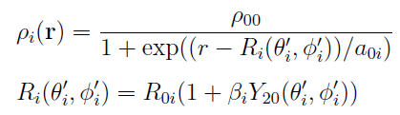
Nucleus Nucleus Potential
<Nuclear force>
Migdal force
C₀=300 MeV, F_{in}=0.09, F_{ex}=-2.59

Slide 9




Nucleus Nucleus Potential
<Nucleus-Nucleus potential>
Migdal force

Slide 10
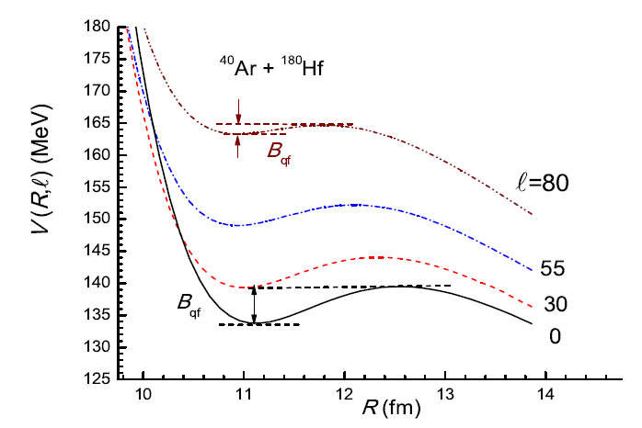


Rotation
<Rotation>

Slide 11
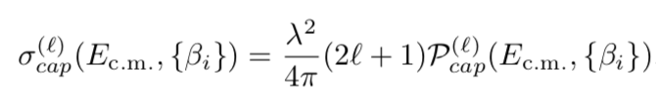
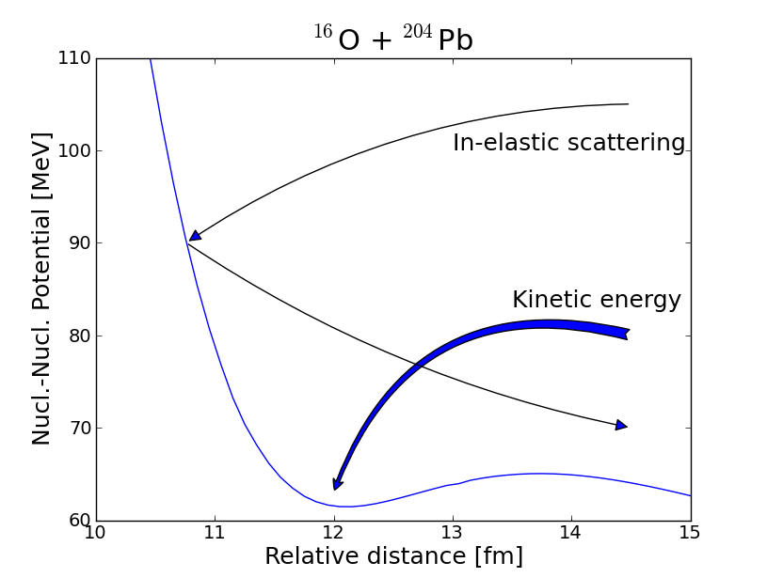
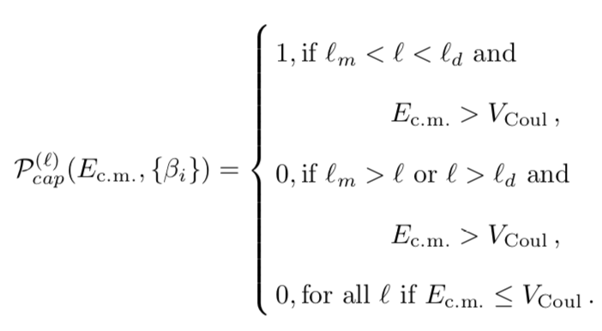
Di-Nuclear System (DNS) Model - Capture
<Capture cross section>
Kinetic energy dissipation by friction

Slide 12
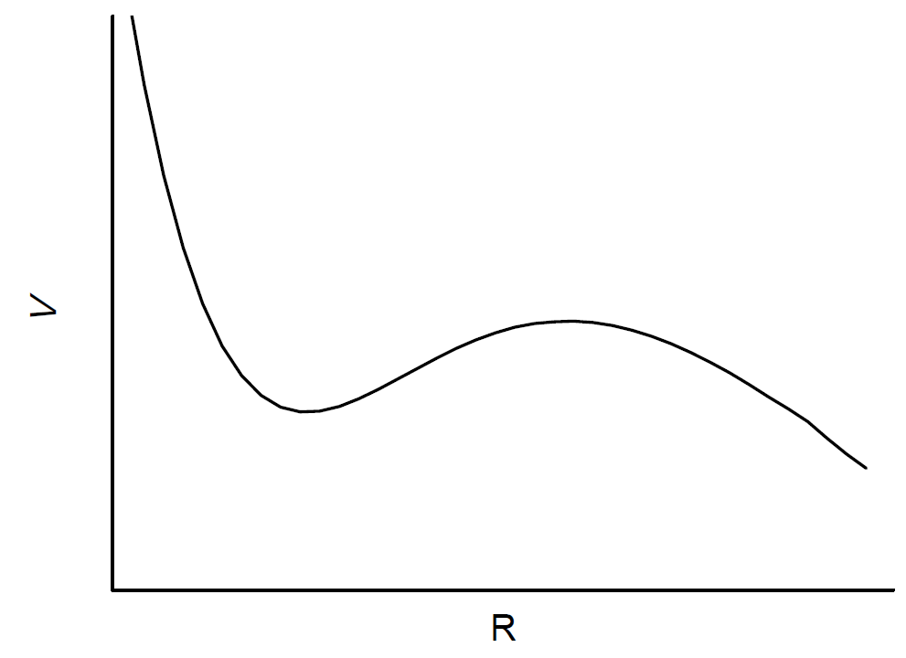
Capture
Kinetic energy : a few MeV/n
Kinetic energy loss by friction
B_{qf}
<Potential pocket>

Slide 13
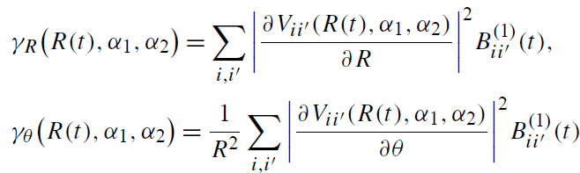




Friction
<Friction coefficient>
V_{T}
g_{PT}
V_{P}
<target>
<Equation of motion>
<projectile>

Slide 14
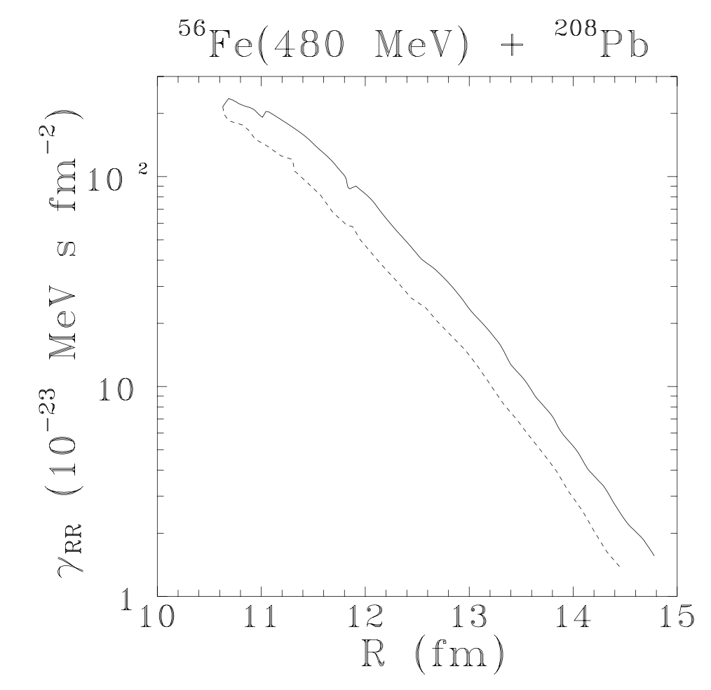
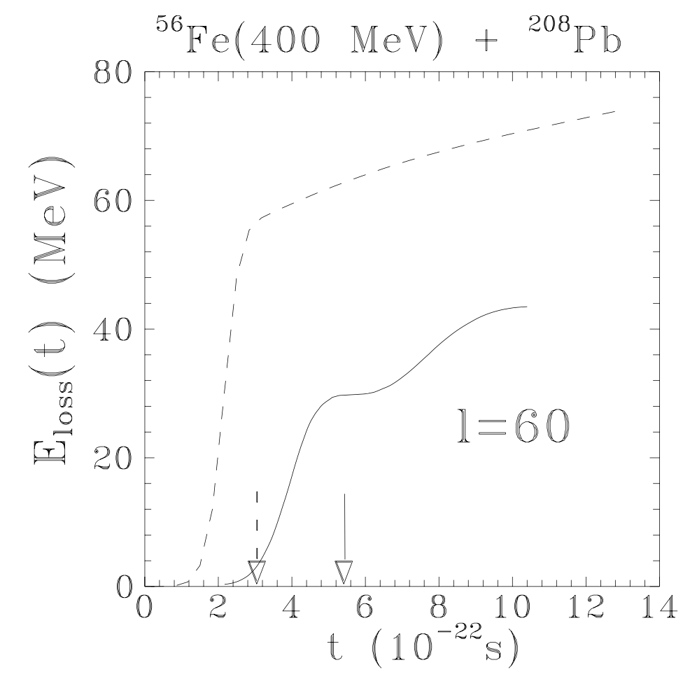
Friction

Slide 15

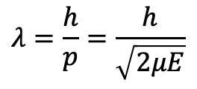

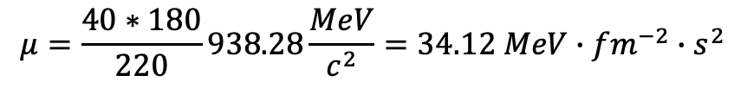
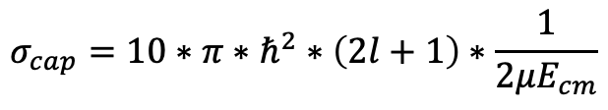
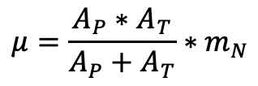
Capture Cross-section
de Broglie wavelength
$$λ=\frac{h}{p}=\frac{h}{\sqrt{2μE}}$$
$$μ=\frac{A_{P}∗A_{T}}{A_{P}+A_{T}}∗m_{N}$$
$$σ_{cap}=10∗π∗ℏ^{2}∗\left(2l+1\right)∗\frac{1}{2μE_{cm}}$$
$ℏ=6.58∗{10}^{−22}$ MeV s
c=30*10²² fm/s
Ex.) ⁴⁰Ar+¹⁸⁰Hf, E_{cm}=250 MeV, l=10
$$μ=\frac{40∗180}{220}938.28\frac{MeV}{c^{2}}=34.12 MeV∙{fm}^{−2}∙s^{2}$$
$$σ_{cap}=1.673 mb$$

Slide 16
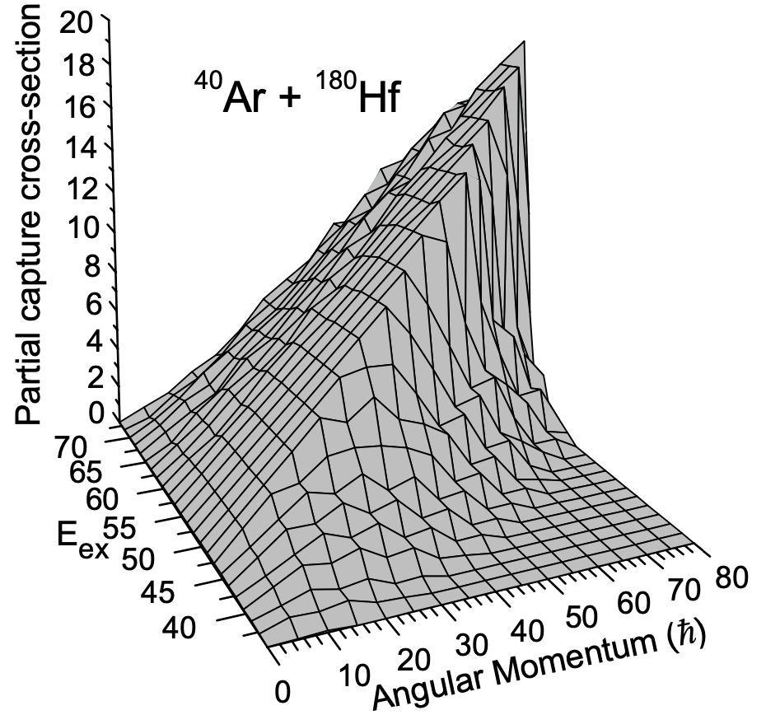
Ar+Hf

Slide 17
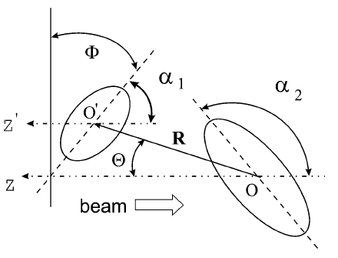


Deformation and Orientation
R₁ > R₂
V_{c}(R₁) < V_{c}(R₂)
R₁
R₂

Slide 18
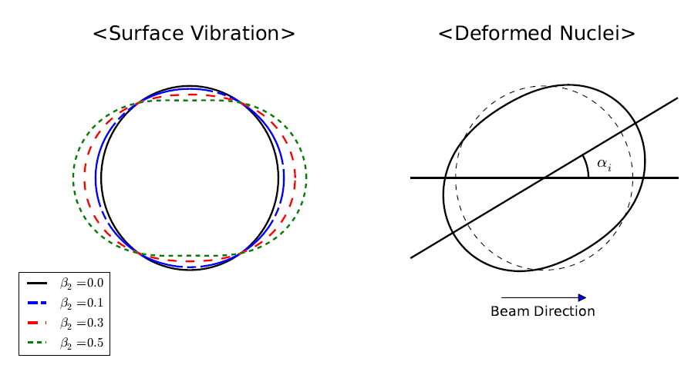
Vibration and Deformation
Ex)
Nucleus | β₂ | β₃ | β₂* | β₃*
⁴⁰Ar | 0.0 | 0.0 | 0.284 | 0.26
¹⁸⁰Hf | 0.279 | 0.0 | 0.274 | 0.07

Slide 19
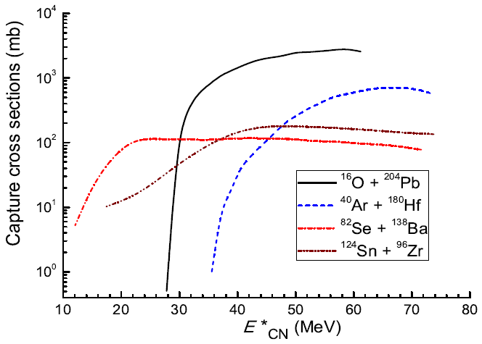
Capture Cross-section
²²⁰Th*

