Slide 1
Introduction to Fusion and Quasifission Reactions
Kyungil Kim
Rare Isotope Science Project, Institute for Basic Science
Nuclear Physics School, June 24th , 2021

Slide 2
Outline
Day 1. Overview
Day 2. Di-Nuclear System (DNS) Model 1
Day 3. DNS Model 2
Day 4. Adiabatic Model & Applications

Slide 3
Schematic View of the Fusion Process
Inelastic b>b_{c}
scattering
Projectile
Quasi-fission
A few MeV/n
Target
Capture
b<b_{c}
Compound Nucleus
Fast-fission
L_{B}<L<L_{cap}
Fission (Fusion-fission)
Competition!
p
Compound Nucleus
n
Evaporation
Fusion 0<L<L_{B}
α

Slide 4

Evaporation Residue Cross-section

Slide 5
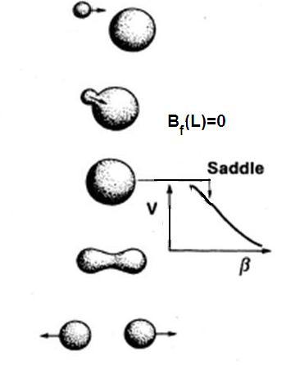
Fusion in DNS Model
Fast Fission
From Slide of Prof. A.K.Nasirov

Slide 6
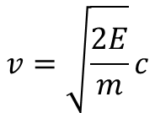



Time in Fusion Process
    O (Z=8) + Pb (Z=82) -> r₁+r₂ = 1.2 * (A₁^{1/3} + A₂^{1/3}) = 7.613
    Ar (Z=18) + Hf (Z=72) -> 8.137
    Se (Z=34) + Ba (Z=56) -> 8.479
    Sn (Z=50) + Zr (Z=40) -> 8.525
E_{lab} [MeV]
    ¹⁶O (Z=8) + ²⁰⁴Pb (Z=82) E_{coul}= 124.1 MeV E_{lab}= 133.3 MeV
    ⁴⁰Ar (Z=18) + ¹⁸⁰Hf (Z=72) = 229.4 MeV = 280.4 MeV
    ⁸²Se (Z=34) + ¹³⁸Ba (Z=56) = 323.4 MeV = 515.6 MeV
    ¹²⁴Sn (Z=50) + ⁹⁶Zr (Z=40) = 337.8 MeV = 774.1 MeV
$$v=\sqrt{\frac{2E}{m}}c$$
$$E \left[MeV\right]=\frac{1}{2}m \left[\frac{MeV}{c^{2}}\right]v^{2}$$
Ex.) ⁴⁰Ar+¹⁸⁰Hf, E_{cm}=250 MeV, m_{N}=940 MeV
$$v=0.115c=0.346∗{10}^{8}m/s$$
$$v=1fm/\left(2.89∗{10}^{−23}\right)s$$

Slide 7

Thermal Equilibrium
Capture process
  ~10⁻²²s -> Non-equilibrium physics
Competition between fusion and quasifission
  >10⁻²¹s -> Equilibrium interpretation
    Statistical method! -> Level density

Slide 8
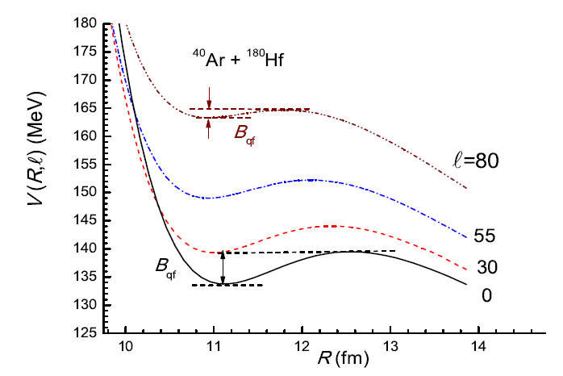
NN Potential

Slide 9
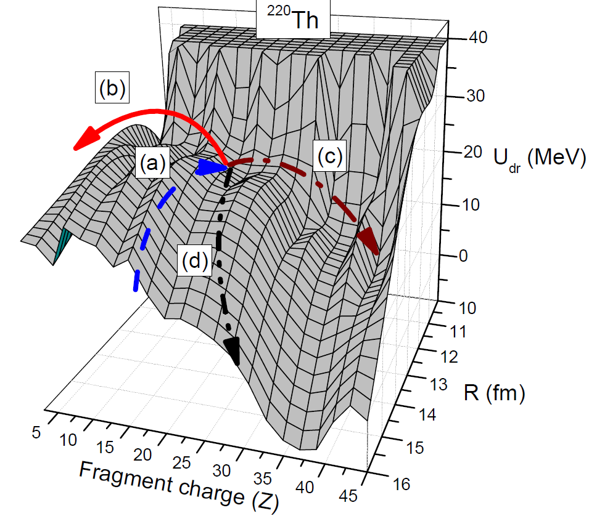
Driving Potential
Entrance channel
Fusion
Charge symmetric DNS
Quasi fission
<DNS>
Z
Z’

Slide 10

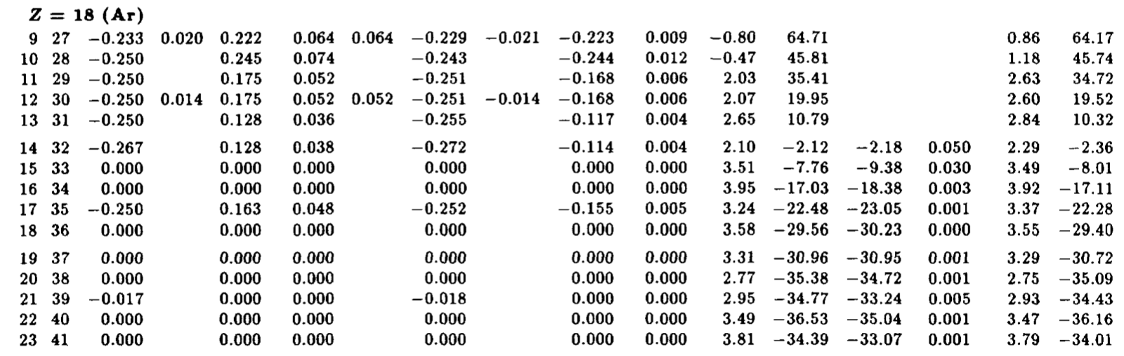
Mass Excess
1 atomic mass unit = ¹²C mass / 12 = 931.494 MeV / c²
⁴⁰Ar mass = 40 atomic mass unit + mass excess of ⁴⁰Ar
B₁+B₂-B_{CN} = M₁+M₂-M_{CN} = mass excess of (1+2-CN) = Q value

Slide 11
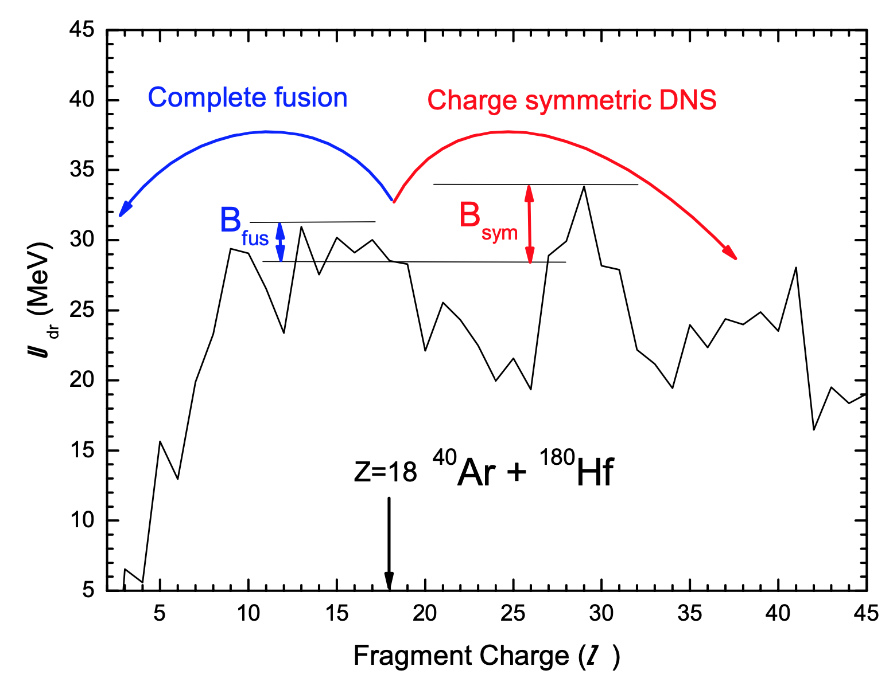

DNS Model - Fusion
<Driving potential>
Entrance channel
Fusion
Charge symmetric DNS
Quasi fission
<Fusion cross section>

Slide 12

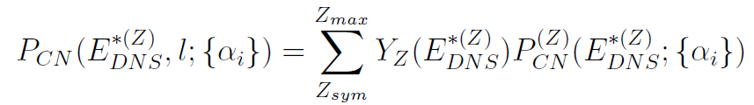


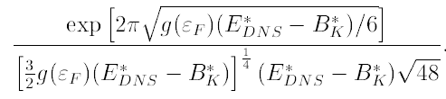
Fusion Cross-section
Cross-section for evaporation residues
Fusion cross-section
Probability for formation of compound nucleus
Level density

Slide 13
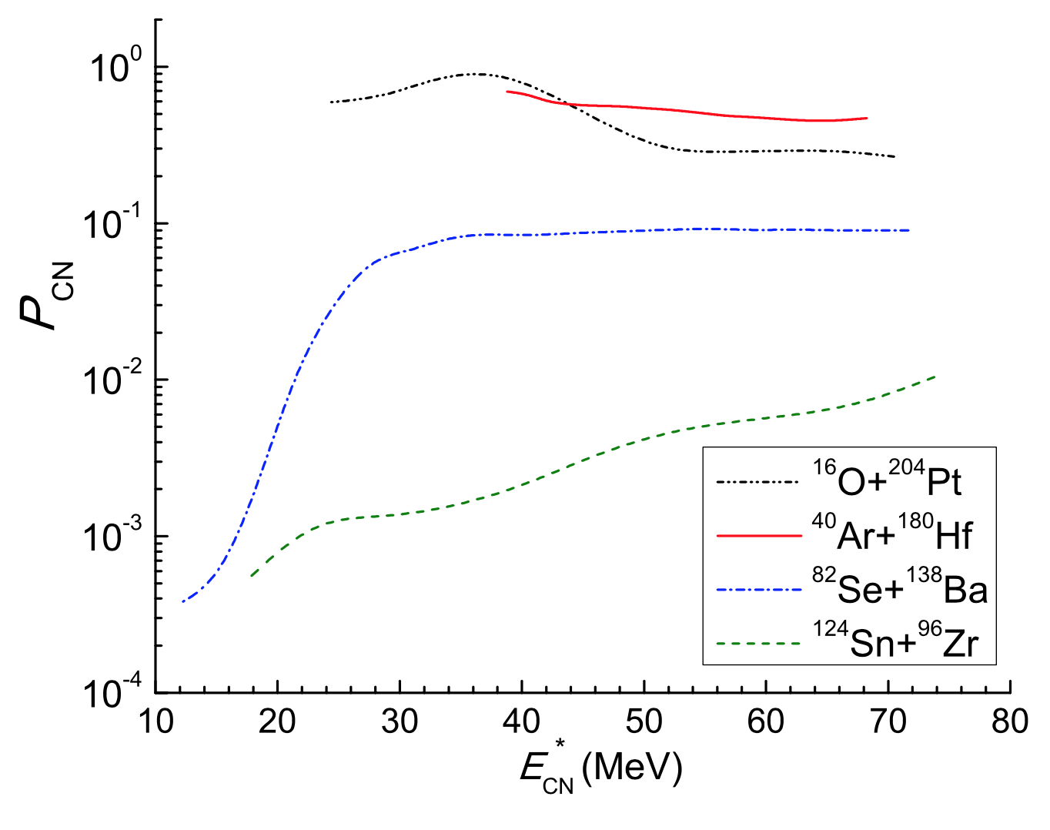
P_{CN}

Slide 14
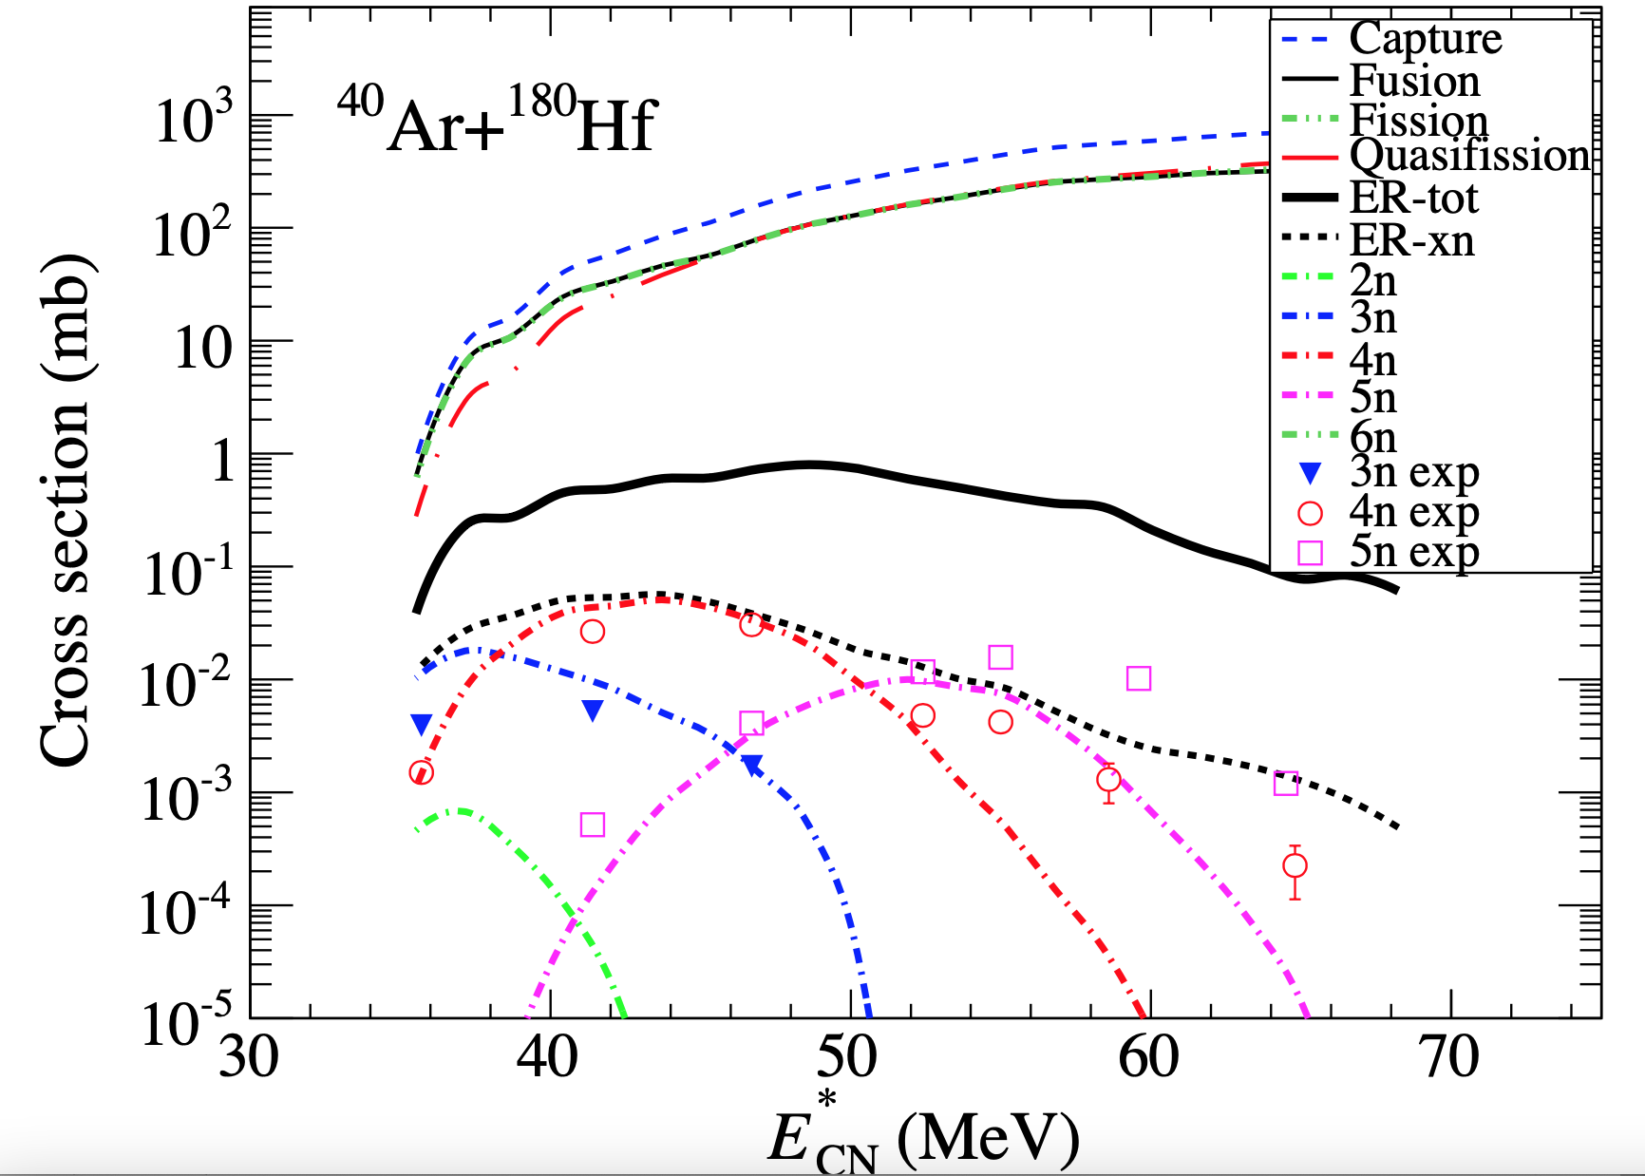
Ar+Hf

Slide 15
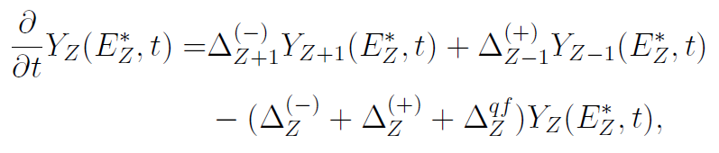
Multi-nucleon Transfer
Evolution of the DNS by nucleon transfer
Y_{Z-1}
Y_{Z}
Y_{Z+1}

Slide 16

DNS Model – DNS Evolution
<Master equation>
V_{T}
g_{PT}
V_{P}
<target>
<Transition rate>
<projectile>
<Matrix element>

Slide 17
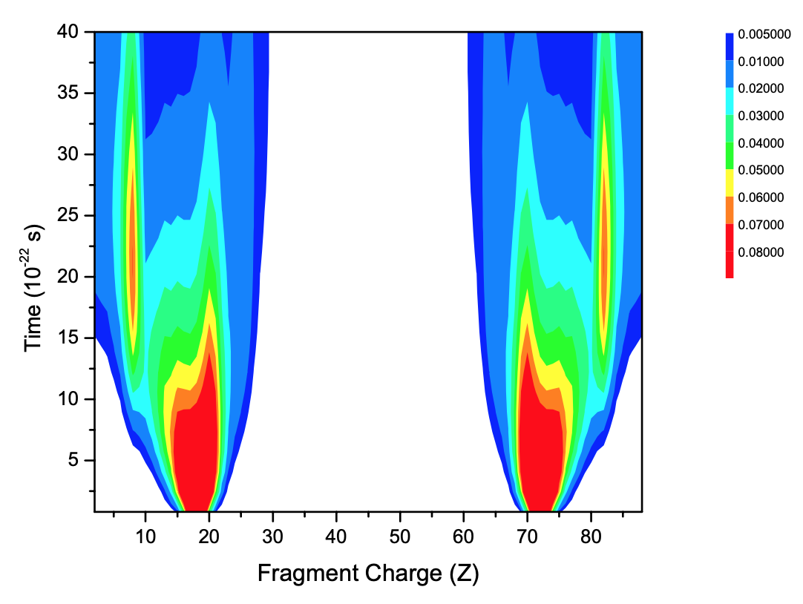
DNS Evolution of Ar+Hf

Slide 18
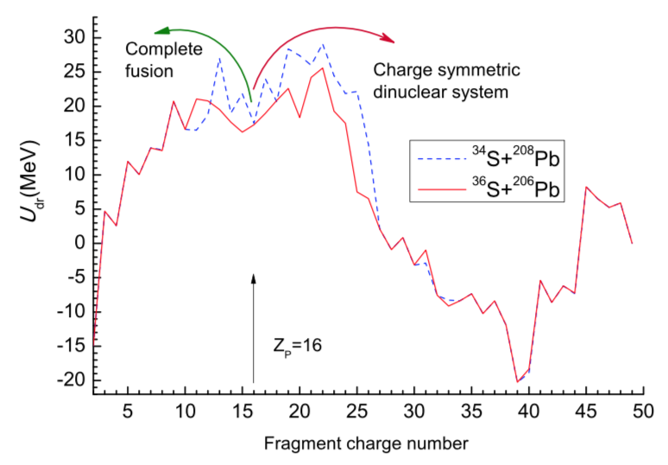
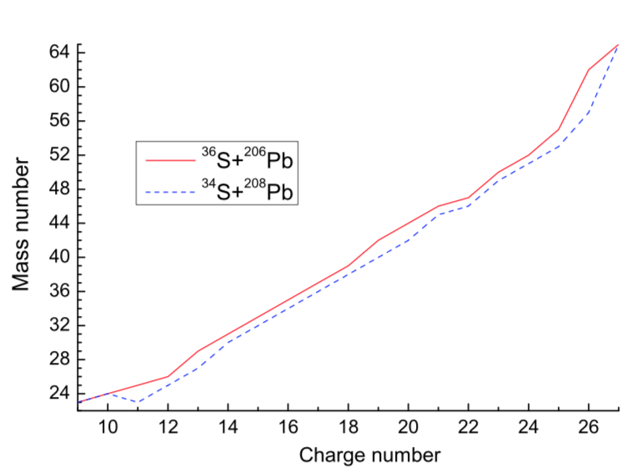
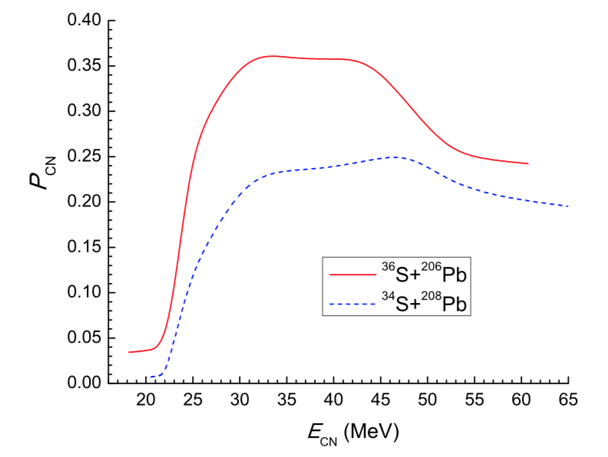
Results – Synthesis of Cf
<Driving potential>
<DNS evolution>
<Fusion probability>
Different initial N/Z ratios of two system give different mass and charge distributions of di-nuclear systems during the fusion process.

Slide 19


Survival Probability
Cross-section for evaporation residues
+ …
Width of fission is much larger than width of neutron emission for heavy mass system.
The survival probability of additional one neutron evaporation is very small.
W_{sur}^{1n} >> W_{sur}^{2n}

