Slide 1
Dynamical coupled-channels approach to meson-production reactions in the nucleon resonance region
Hiroyuki Kamano
(KEK)
2016 2nd HaPhy meeting “Hadron productions: Theory and Experiment”
APCTP, Pohang, Korea, November 25-26, 2016

Slide 2
Outline
PART I:
Background & motivation for spectroscopic
study of N* & Δ* baryon resonances
PART II:
Recent results from ANL-Osaka Dynamical
Coupled-Channels (DCC) analysis

Slide 3
PART I
Background & motivation for spectroscopic
study of N* & Δ* baryon resonances

Slide 4
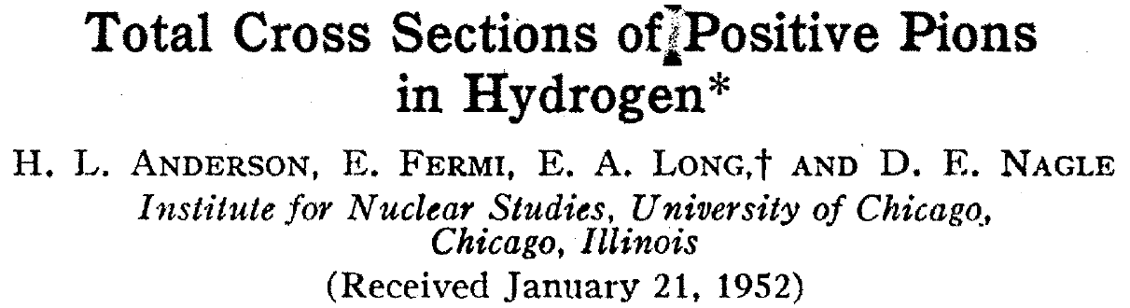
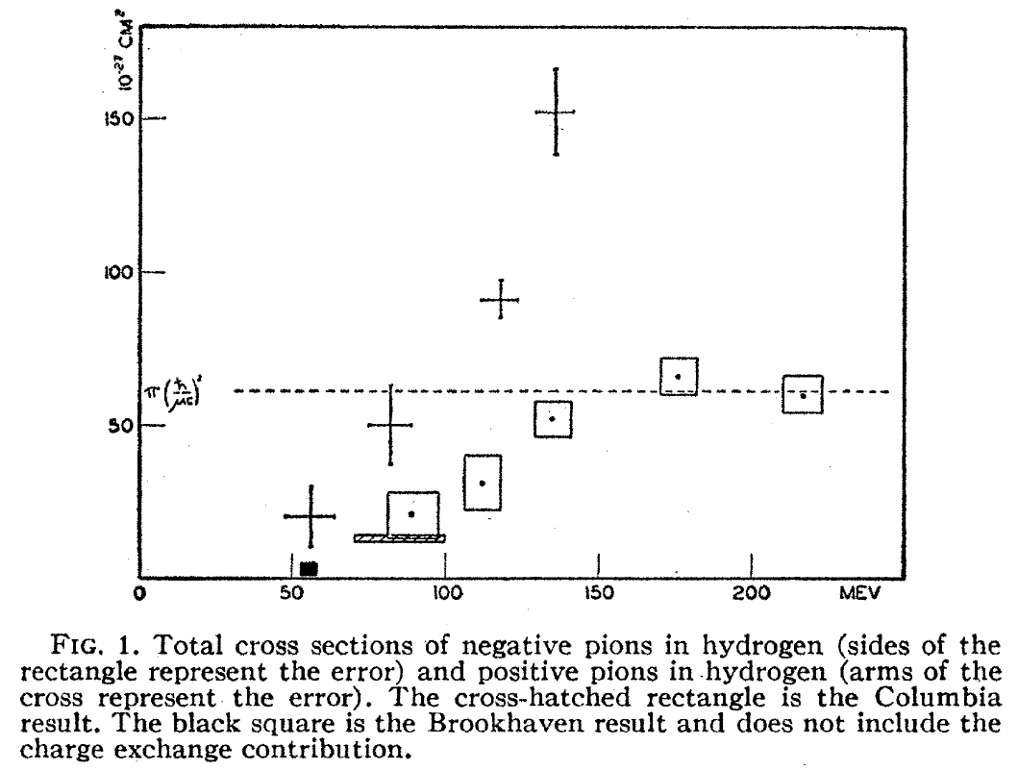
Introduction: N* & Δ* spectroscopy
Discovery of the Δ baryon (1952)
Behavior of the π⁺ p & π⁻ p
cross sections implies
the existence of a new
baryon with isospin 3/2 !!
π⁺ p total
π⁻ p total

Slide 5
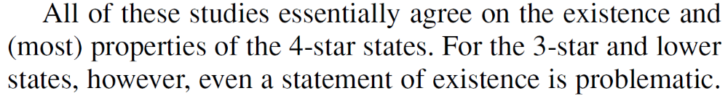
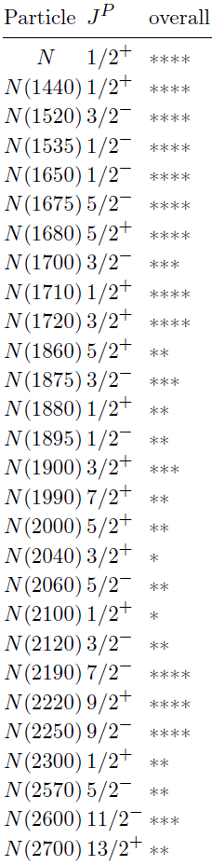
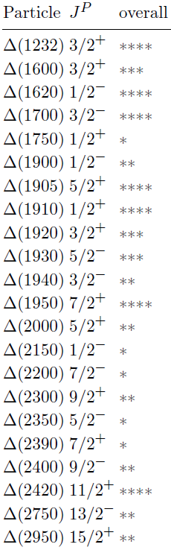
Introduction: N* & Δ* spectroscopy
N*
Δ*
?
Arndt, Briscoe, Strakovsky, Workman PRC74(2006)045205
?
?
?
N* & Δ* spectroscopy remains as
central issue in the hadron physics !!
Mass, width, spin, parity …?
quark-gluon structure (form factors)?
How produced in reaction processes?
...
?
?
?
baryon
PDG(2016):
http://pdg.lbl.gov
?
meson
3-quark state
multiquark state
“molecule-like” state

Slide 6
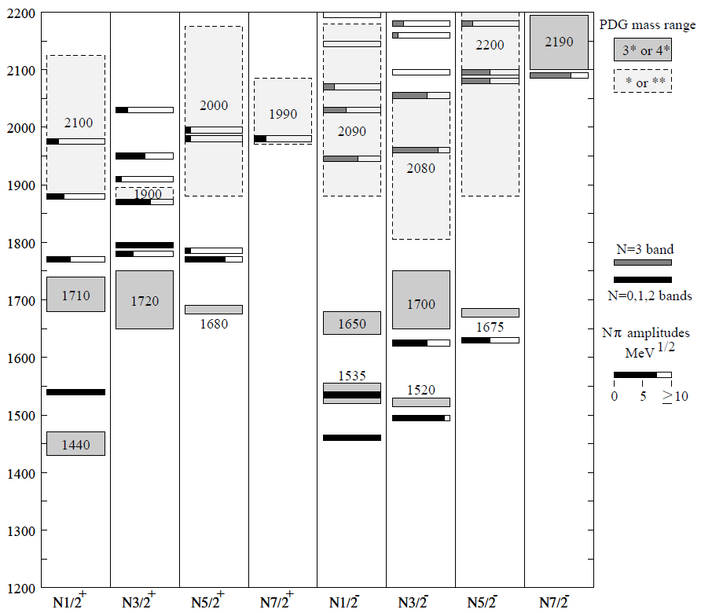
Static hadron models and reaction dynamics
Various static hadron models have been proposed to calculate
hadron spectrum and form factors.
In reality, excited hadrons are “unstable” and can exist
only as resonance states in hadron reactions.
Constituent quark models, Dyson-Schwinger Eq. approaches, soliton models,...
Excited hadrons are treated as stable particles.
u
u
d
What is the role of reaction dynamics in interpreting
the hadron spectrum, structures, and dynamical origins ??
Constituent quark model
PDG
CQM results
N* baryon spectrum
Capstick, Roberts, Prog. Part. Nucl. Phys 45(2000)S241

Slide 7
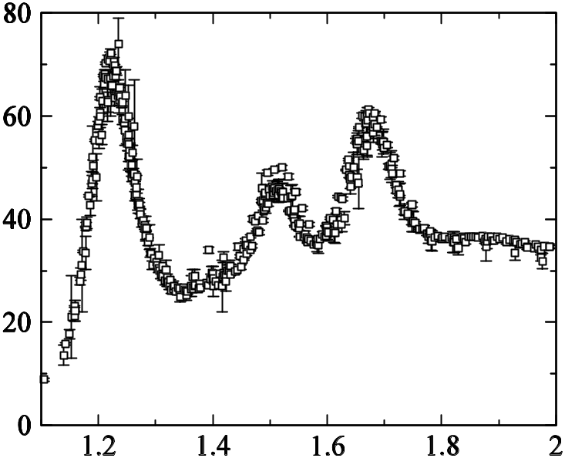
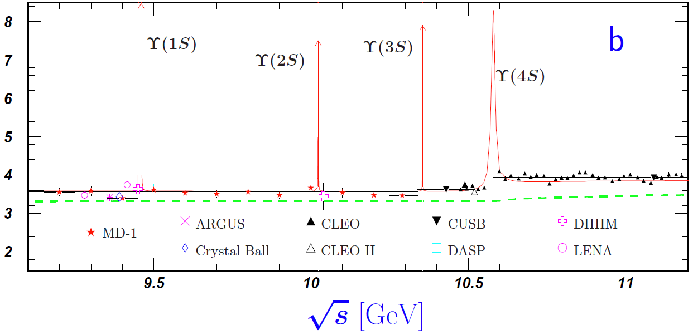
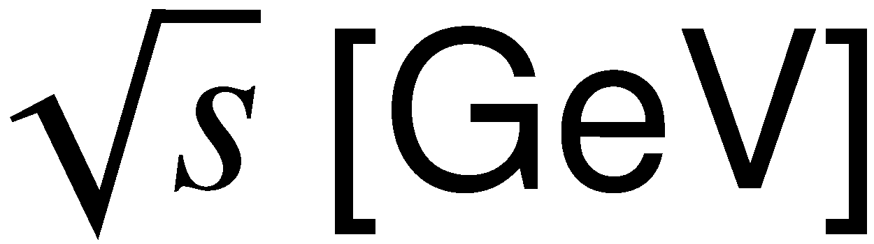
Light-quark hadron spectroscopy :
Physics of broad & overlapping resonances
N* : 1440, 1520, 1535, 1650, 1675, 1680, ...
Δ : 1600, 1620, 1700, 1750, 1900, …
Δ (1232)
~ 20 resonances
Width: a few hundred MeV.
Resonances are highly overlapping
in energy except Δ(1232).
Width: ~10 keV to ~10 MeV
Each resonance peak is clearly separated.

Slide 8
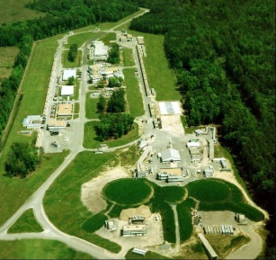
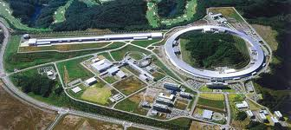

Cooperative efforts between experiments and theoretical analyses
Experiments
Theoretical analyses
with coupled-channels framework
ANL-Osaka
Argonne-Pittsburgh
Bonn-Gatchina
Carnegie-Mellon-Berkeley
Dubna-Mainz-Taipei
EBAC
Giessen
GWU/VPI
Juelich-Bonn
Karlsruhe-Helsinki
KSU
Zagreb
…
Since late 90s
e.g.) Meson photoproductions
γ
πN
ηN
ππN
KΛ
KΣ
ωN
…
.
.
N
.
N*, Δ*
ELPH, ELSA, GRAAL, JLab,
MAMI, SPring-8, ...
Multichannel unitary condition:

Slide 9
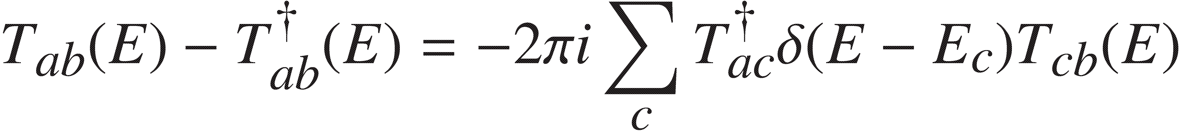
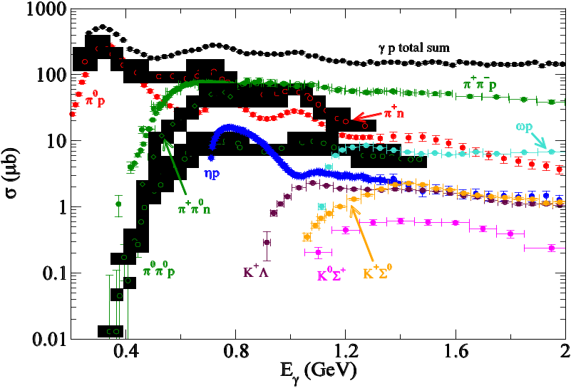
Why multichannel unitarity is so important ??
1) Ensures conservation of probabilities
in multichannel reaction processes
2) Defines proper analytic structure
(branch points, cuts,…) of scattering
amplitudes in the complex energy
plane, as required by scattering theory
Key essential to
simultaneous analysis
of various inelastic reactions.
increasing predictivity of
constructed reaction models
Crucial for extracting resonances
“correctly”, and avoiding
WRONG resonance signals !!
[e.g., Ceci et al, PRC84(2011)015205]
Im(W)
e.g.) N*, Δ case
πN
ππN
ηN
Re(W)
πΔ
×
(exclusive) γp reaction total cross sections
resonance
pole

Slide 10
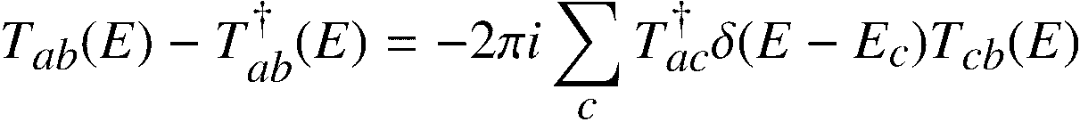
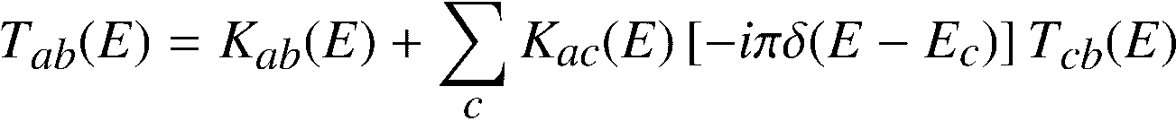
Approaches for coupled-channels analysis
Multichannel unitary condition:
Heitler equation:
K-matrix: must be hermitian for real E.
(on-shell) K-matrix approach:
Dynamical-model approach:
Heitler equation can be solved algebraically.
Argonne-Pittsburgh, Bonn-Gatchina, Carnegie Mellon-Berkely,
GWU/VPI, Karlsruhe-Helsinki, KSU, ...
Heitler equation becomes identical to Lippmann-Schwinger integral equation.
Potential V is derived from a model Hamiltonian.
off-shell rescattering effect
ANL-Osaka, Dubna-Mainz-Taipei, Juelich-Bonn,...

Slide 11


Why dynamical coupled-channels approach??
 | (on-shell) K-matrix | Dynamical model
Numerical cost | Cheap - solve on-shell algebraic eq. (Analysis can be done quickly on PC.) | (Very) Expensive - solve off-shell integral eq. (Supercomputers are needed.)
Data fitting | Efficient - K(E) can be parametrized as one likes | Not so efficient - Form of V is severely constrained by theoretical input (model Hamiltonian)
To understand the physics of reaction dynamics behind
formation, structure, etc. of hadron resonances, one needs:
Modeling reaction processes appropriately with a model Hamiltonian.
(➔ not a simple “pole + polynomial” parametrization, etc.)
Solving proper quantum scattering equation (LS eq.) in which
off-shell rescattering effects are also appropriately contained.
This can be achieved only by using the dynamical-model approach !!

Slide 12
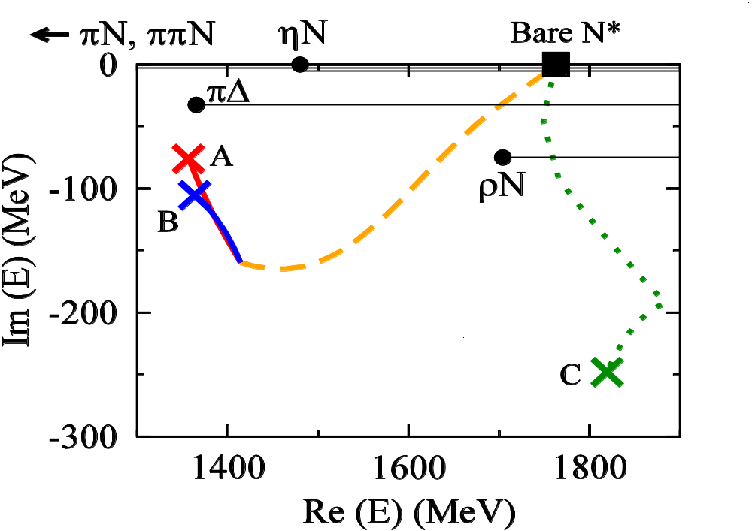
Dynamical origin of P₁₁ N* resonances
(nontrivial feature of multichannel reaction dynamics)
Would be related to a baryon state
in static hadron models excluding
meson-baryon continuums
Move of poles by
“gradually”
strengthening
channel couplings
Turn on
πΔ coupling
Double-pole structure of
the Roper resonance
[Arndt 1985, Cutkosky 1990
Arndt 2006, Doring 2009
Suzuki 2010, Kamano 2010]
Corresponding to
N(1710)1/2⁺
Suzuki, Julia-Diaz, HK, Lee, Matsuyama, Sato, PRL104 042302 (2010)

Slide 13
PART II
Recent results from ANL-Osaka DCC analysis

Slide 14






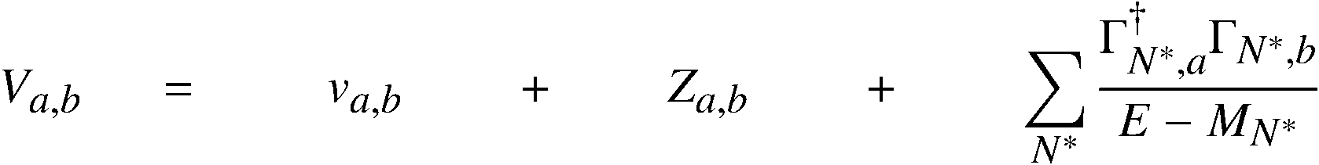
Dynamical coupled-channels (DCC) model for meson production reactions
For details see Matsuyama, Sato, Lee, Phys. Rep. 439(2007)193
HK, Nakamura, Lee, Sato, PRC(2013)035209
Partial-wave (LSJ) amplitudes of a → b reaction:
Reaction channels:
Transition Potentials:
t-channel
contact
s-channel
u-channel
π, ρ, σ, ω,..
Physical N*s will be a “mixture” of the two pictures:
N
N, Δ, ...
coupled-channels
effect
off-shell
effect
π
Δ
π
Exchange potentials
ρ, σ
baryon
meson cloud
π
N
N
Δ
Δ
Meson-Baryon Green functions
π
Summing up all possible transitions between reaction channels !!
(➔ satisfies multichannel two- and three-body unitarity)
Momentum integral takes into account off-shell rescattering effects
in the intermediate processes.
Would be related with hadron states of the static hadron models (quark models, DSE, etc.) excluding meson-baryon continuums.
meson
core
Z-diagrams
Stable channels
Quasi 2-body channels
e.g.）πN scattering
N*_{bare}
Bare N* states
π
Δ
π
N
π
N
η
N
N
K
Λ
π
…
＝
V
＋
＋
＋
Δ
Δ
ρ, σ
ρ, σ
π
π
π
π
N
N
Exchange potentials
Z-diagrams
bare N* states

Slide 15
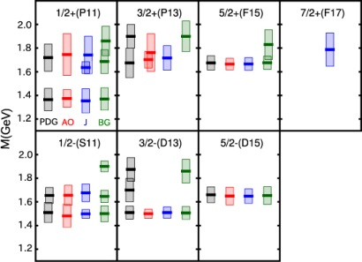
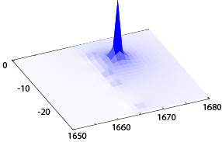
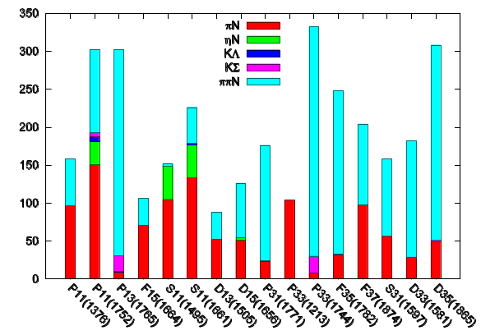



Strategy for N* and Δ* spectroscopy
1) Construct a model by making
χ²-fit of the world data of
meson production reactions.
2) Search poles of scattering
amplitudes by analytic continuation
to a complex energy plane.
3) Extract resonance parameters
defined by poles.
Latest published model (8-channel):
Made simultaneous analysis of
- πN → πN(SAID amp) (W < 2.3 GeV)
- πp → ηN, KΛ, KΣ (W < 2.1 GeV)
- γp → πN, ηN, KΛ, KΣ (W < 2.1 GeV)
- γ ‘n’ → πN (W < 2 GeV)
➔~27,000 data points of both
dσ/dΩ & spin-pol. obs.
Mass spectrum
HK, Nakamura, Lee, Sato, PRC88(2013)035209
[updated in PRC94(2016)015201 ]
|T|
Branch
point
physical
sheet
unphysical
sheet
Region our model can cover
Im(W)
Re(W)
Partial decay widths
Cut rotated from
real W axis
Pole position → (complex) resonance
mass
Residues → coupling strengths
between resonance
and meson-baryon
channel
γp total cross sections in N* region
Use supercomputers to accomplish
coupled-channels analyses:

Slide 16
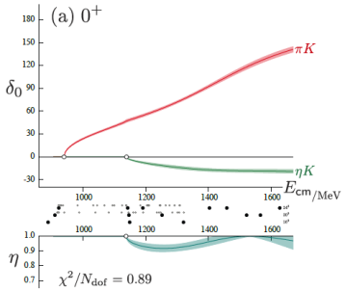
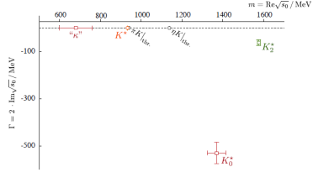
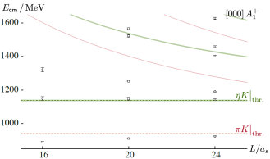

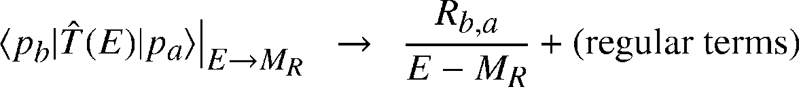
Baryon resonances as poles of scattering amplitudes
There are attempts to link real energy spectrum of
QCD in the finite volume to resonance pole masses.
PROPER definition of
Hadron resonance masses (complex) ➔ Pole positions of scattering amplitudes
in the lower-half of complex-W plane
Transition amplitudes between ➔ ~ Residues^{1/2} at the pole
resonance and scattering states
QCD spectrum
in finite volume
Phase shifts & inelasticity
(Luescher’s formula)
Extracted resonance
poles
(K-matrix analysis)
Dudek et al, PRL113(2014)182001
(see also an approach based on the HAL QCD method:
Inoue et al., NPA881(2012)881; Ikeda et al., arXiv:1602.03465)
Residue at the pole
~
Resonance theory based on Gamow vectors:
[G. Gamow (1928), R. E. Peierls (1959), …]
“Quantum resonance state is an (complex-)energy eigenstate of
the FULL Hamiltonian of the underlying theory solved under the
Purely Outgoing Boundary Condition (POBC).”
Branch point
(channel threshold)
W = M_{R}
unphysical
sheet
physical
sheet
Im(W)
cut
Resonance pole position
( Im(M_{R}) < 0 )
Energy eigenvalue = pole energy
Transition matrix elements between ~ Residues^{1/2} at the pole
resonance and scattering states
Re(W)

Slide 17
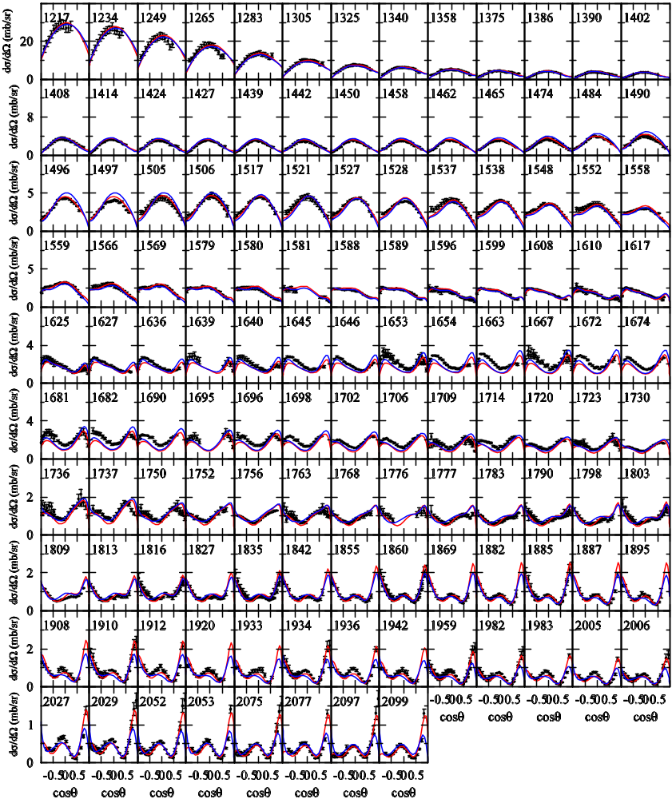
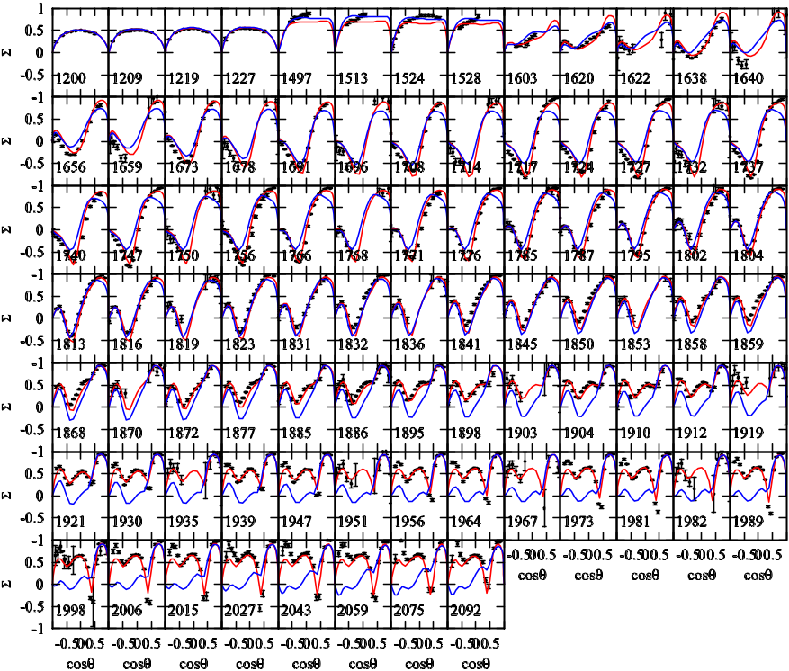
ANL-Osaka DCC approach to N* and Δ*
HK, Nakamura, Lee, Sato, PRC88(2013)035209; 94(2016)015201
γp → π⁰p
dσ/dΩ for W < 2.1 GeV
Σ for W < 2.1 GeV
Red: Updated model [PRC94(2016)015201]
Blue: Original model [PRC88(2013)035209]

Slide 18
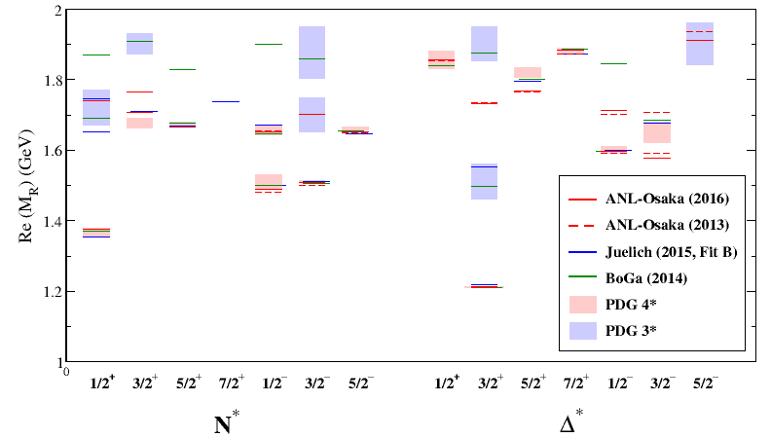
Extracted N* & Δ* mass spectrum
(pole mass M_{R})
πN→ππN data would provide
crucial information on establishing
Roper-like Δ resonance !!
Partial decay widths
J-PARC E45 experiment
[Sako, Hicks et al.]
N* & Δ* below Re(M_{R}) ~ 1.7 GeV
have been established (with one exception).

Slide 19
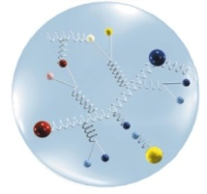
Electromagnetic transition form factors: quantitative understanding of N* & Δ* structure
virtual γ
q
(q² = －Q² <0)
Q²: corresponds
to “resolution”
N
N*, Δ*
N-N* e.m. transition form factor
“dressed”-quark core
obscured by dense meson clouds
“Partons”
How effective d.o.f.s of baryon
constituents changes with Q² ??
？
Q²：small
(low “resolution”)
Q²：large
(high “resolution”)

Slide 20
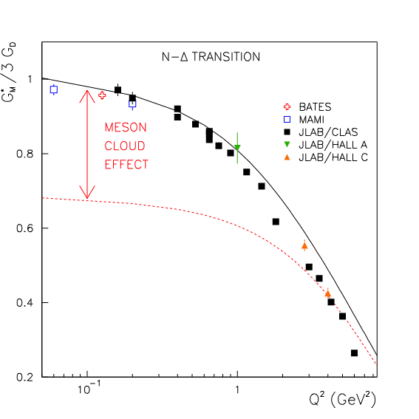
Role of reaction dynamics in form factors:
Meson-cloud effect
N-N* e.m. transition form factor
Re[G_{M}(Q²)] for γ N → Δ (1232) M1 transition
virtual γ
(q² = －Q² <0)
Most of the available static
hadron models INDEED give
G_{M}(Q²) close to the “Bare”
form factor !!
q
Q²: corresponds
to “resolution”
N
N*, Δ*
=
Bare
meson cloud
+
Full dressed
Bare
Q² increases
“bare” state
(core composed of
“dressed” quarks)
Meson cloud
Julia-Diaz, Lee, Sato, Smith, PRC75 015205 (2007)

Slide 21
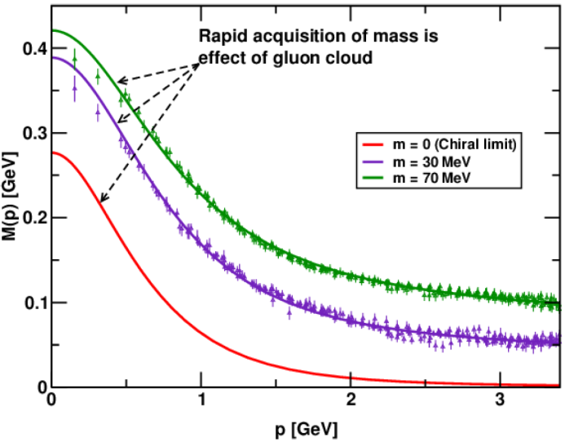
N* program at CLAS12:
Find evidence of “dressed quarks” inside N*
See, e.g., INT workshop “Spectrum and Structure of Excited Nucleon from Exclusive Electroproduction”, Nov. 14-18, 2016
http://www.int.washington.edu/PROGRAMS/16-62w/
“dressed”-quark core
obscured by dense meson clouds
Meson clouds become small;
“dressed”-quark core dominates
“Partons”
“dressed”-quark
with “running” mass
Q²：small
(low “resolution”)
Q²：large
(high “resolution”)
Running dressed quark mass
“constituent” quark
“current” quark
Curves: a model based on
Dyson-Schwinger
equations (Landau gauge)
Points: Lattice QCD
Will be studied as
a main N* program at
CLAS12@JLab
(E12-09-003, E12-06-108A)
e.g.) Cloet, Roberts,
Prog.Part.Nucl.Phys.77(2014)1

Slide 22
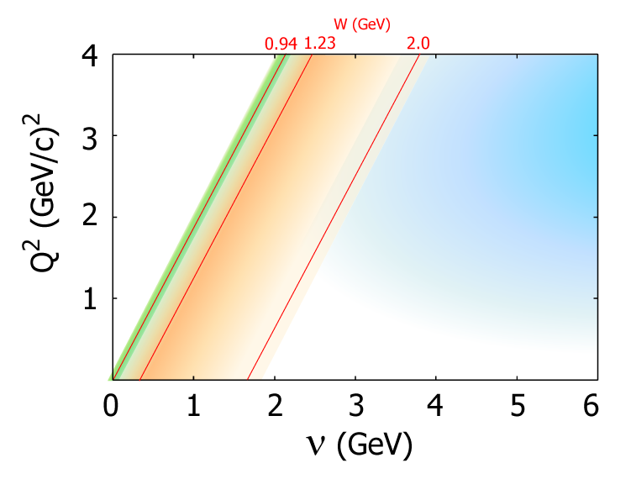
E.M. transition form factors:
Critical input to neutrino physics
Neutrino-induced meson production reaction:
l-, ν
ν
W⁺, Z⁰
N
V - A
N*, Δ*
Neutrino collaboration@J-PARC Branch, KEK Theory Center
Vector part of the weak current matrix elements can be precisely
determined with exclusive electroproduction data !!
- Data for BOTH proton & deuteron (“neutron”) targets are required
to make isospin decomposition of vector current.
http://nuint.kek.jp/index_e.html
QE
GOAL:
Construct a unified model
comprehensively describing
neutrino-nucleon/nucleus reactions
over QE, RES, and DIS regions !!
Quasi elastic
region
DIS
Deep inelastic
scattering
region
RES
Resonance
region
Key to precise determination of leptonic CP violation & neutrino
mass hierarchy from next-generation neutrino-oscillation expt.
at T2K and DUNE etc.
[see. e.g., Alvarez-Ruso et al., New J. Phys. 16(2014)075015]
A review article for the neutrino collaboration
(to be published in Rep. Prog. Phys.):
Nakamura et al., arXiv:1610.01464
DCC model for neutrino-nucleon reactions:
Nakamura, HK, Sato, PRC92(2015)025205
CP phase & mass
hierarchy studies
with atmospheric exp.
T2K (long-baseline exp.)

Slide 23
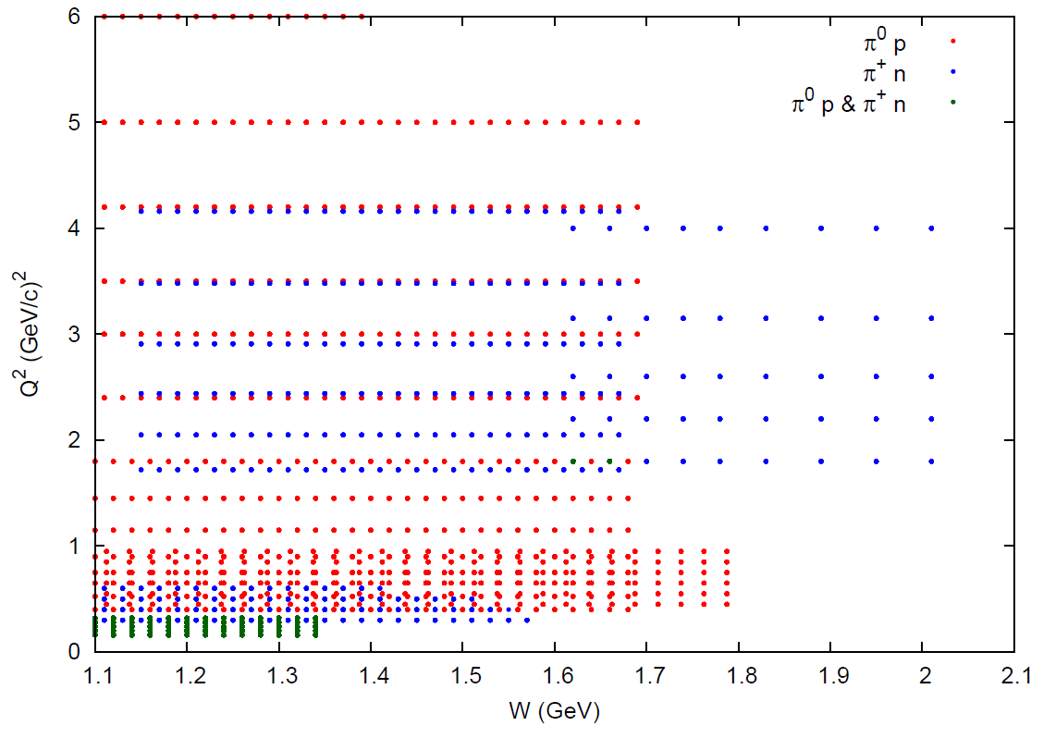
Analysis of electroproduction reactions:
Determining N-N* e.m. transition form factors
Meson electroproductions:
e’
N-N* e.m. transition
form factor
e
^{γ*}
N
N*, Δ*
e.m. transition form factor:
Database for 1π electroproduction@CLAS6
(Q² < 6 GeV²)
(W,Q²) region in
the current analysis
(Q² < 6 GeV², W < 1.7 GeV)
γ∗
+
=
N
N*, Δ*
+ K⁺Λ, K⁺ Σ⁰,
ππN
electro-
production
data
Bare
Meson cloud
(W,Q²) region in the early
analysis:
Julia-Diaz, HK, Lee, Matsuyama,
Sato, Suzuki, PRC80(2009)025207
Varies model parameters included only in the “bare” transition form factors.
(Other parameters are fixed with the values obtained in πN & γN analysis.)

Slide 24

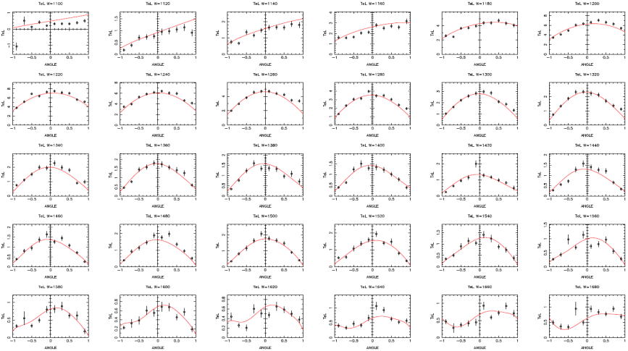
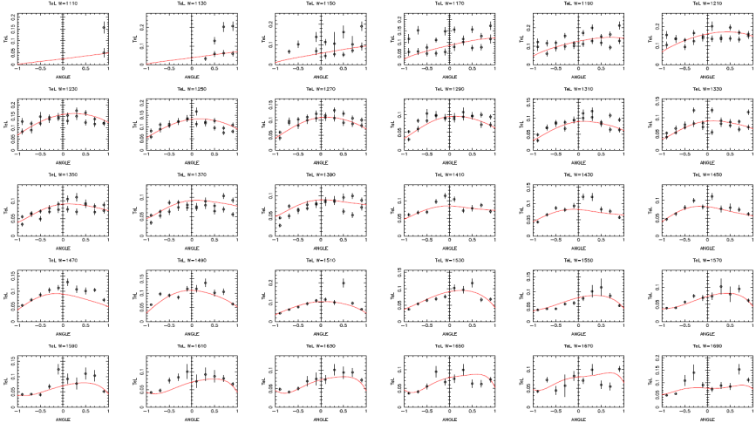
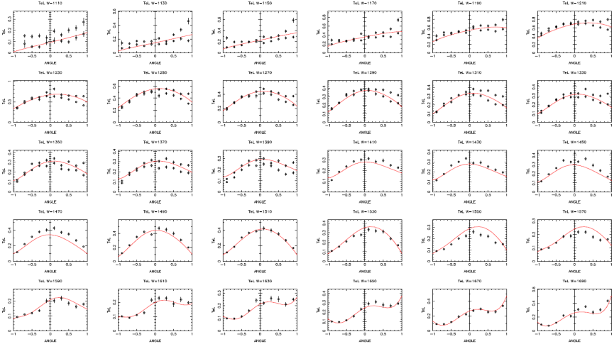
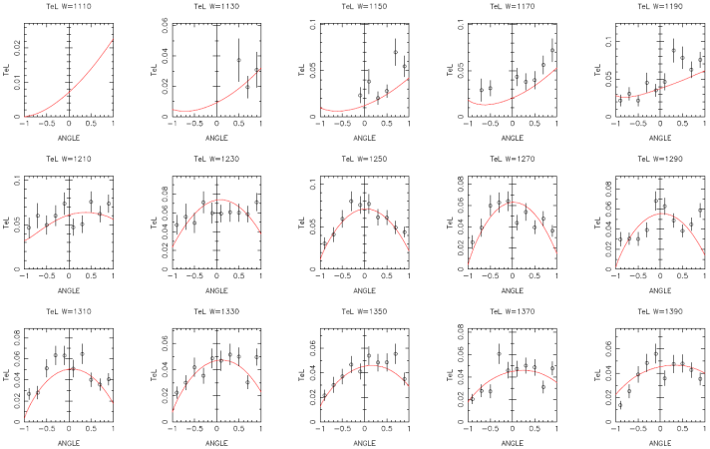
Analysis of electroproduction reactions:
Determining N-N* e.m. transition form factors
σ_{T}+εσ_{L} for ep → eπ⁰p
Data for structure functions are obtained
with the help of K. Joo and L. C. Smith.
Q² = 1.15 GeV², 1.10 < W < 1.69 GeV
Q² = 5.0 GeV², 1.11 < W < 1.69 GeV
PRELIMINARY
PRELIMINARY
Q² = 3.0 GeV², 1.11 < W < 1.69 GeV
Q² = 6.0 GeV², 1.11 < W < 1.39 GeV
PRELIMINARY
PRELIMINARY
cosθ
cosθ

Slide 25
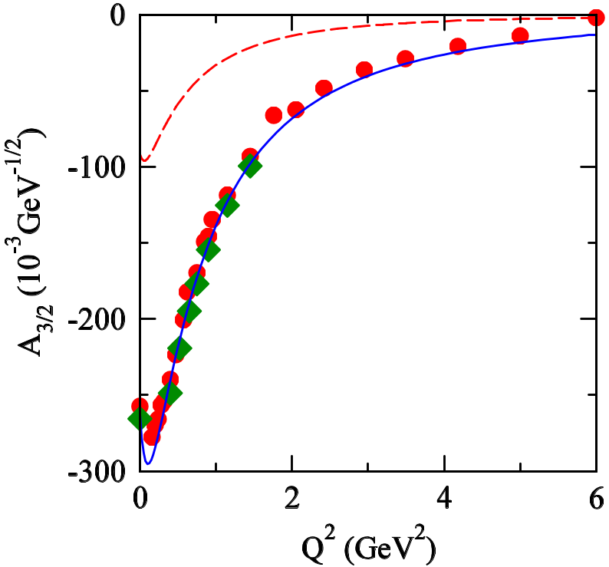
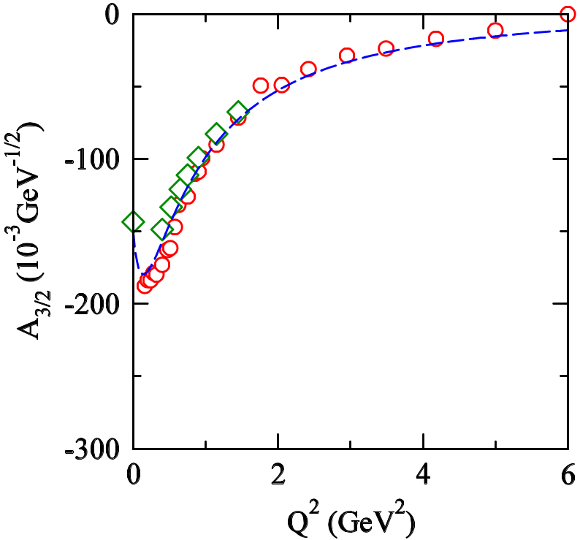
Extracted e.m. transition form factors
N → Δ(1232)3/2⁺ transition form factor A_{3/2}
[evaluated at Δ pole mass: M_{R} = 1210 –i 50 MeV]
meson cloud (current)
PRELIMINARY
PRELIMINARY
π
－
N
Full
πN-loop
Current = πN, ππN, ηN, KΛ, KΣ; 2 bare states in P33
JLMS = πN, ππN, ηN; 2 bare states in P33
[PRC80(2009)025207; 82(2010)045206]
Sato-Lee = πN; 1 bare state in P33
[PRC63(2001)055201; 75(2007)015205]

Slide 26
Summary
N* & Δ* spectroscopy as physics of broad & overlapping resonances
Cooperative efforts between experiments and theoretical analyses with
coupled-channels framework are indispensable to establishing the spectrum.
Reaction dynamics is a crucial part of understanding the spectrum, dynamical origin,
and structure, ... of N* & Δ*.
Dynamical coupled-channels approach is a suitable one to study
the role of reaction dynamics.
➔ Multichannel reaction dynamics in the origin of P₁₁ N* resonances.
➔ Meson-cloud effect on the transition form factors.
Major topics in N* & Δ* spectroscopy
Establishing high-mass N* & Δ* resonances [Re(M_{R}) > 1.7 GeV]
Determining Q² dependence of electromagnetic transition form factors
for well-established low-lying N* & Δ* resonances.
➔ “(over-)complete” experiments for photoproduction reactions (CLAS6, ELSA, MAMI,...)
➔ Measurements of electroproduction reactions over wide Q² range (CLAS6, CLAS12)
Electroproduction analysis & extension of our DCC model are underway !!

Slide 27
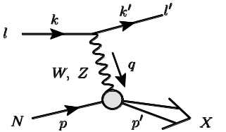

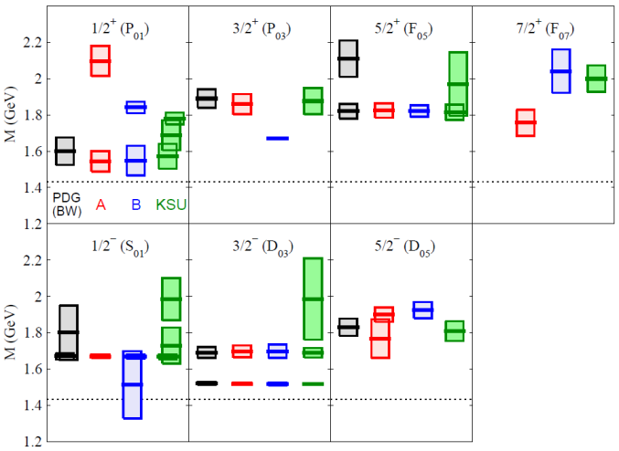

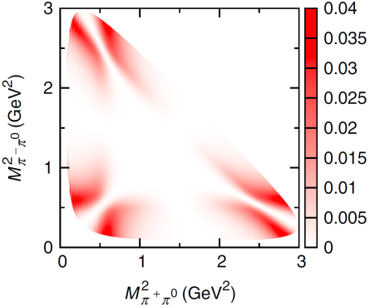
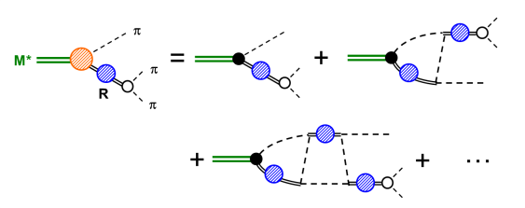
Summary 2
N* & Δ* spectroscopy
Neutrino reactions
- Early analyses of πN & γN reactions:
PRC76(2007)065201; 77(2008)045205; 78(2008)025204
PRC79(2009)025206; 80(2009)065203; 81(2010)065207
PRL104(2010)042302
- Latest analysis of πN & γN reactions:
PRC88(2013)035209; 88(2013)045203; 94(2016)015201
- Electroproduction analysis & Form factor extraction:
PRC80(2009)025207; 82(2010)045206
- Calculation in Q² = 0 limit:
PRD86(2012)097503
- Full DCC-model calculation up to W = 2 GeV, Q² = 3 GeV²:
PRD92(2015)074024
QE
Quasi elastic
scattering
region
DIS
Deep inelastic
scattering
region
RES
Resonance
region
Atmospheric
exp.
Collaboration@J-PARC Branch,
KEK Theory Center [arXiv:1303.6032]
http://j-parc-th.kek.jp/html/English/e-index.html
T2K
ANL-Osaka
DCC approach
- Λ*, Σ* resonance extractions via analysis of K⁻p & K⁻d reactions:
PRC90(2014)065204; 92(2015)025205; arXiv:1608.03470
- Formulation of 3-body unitary model for decays of mesons:
PRD84(2011)114019
- Application to γp → M*N → (3π)N:
PRD86(2012)114012
Λ* & Σ* spectroscopy
Meson spectroscopy

Slide 28
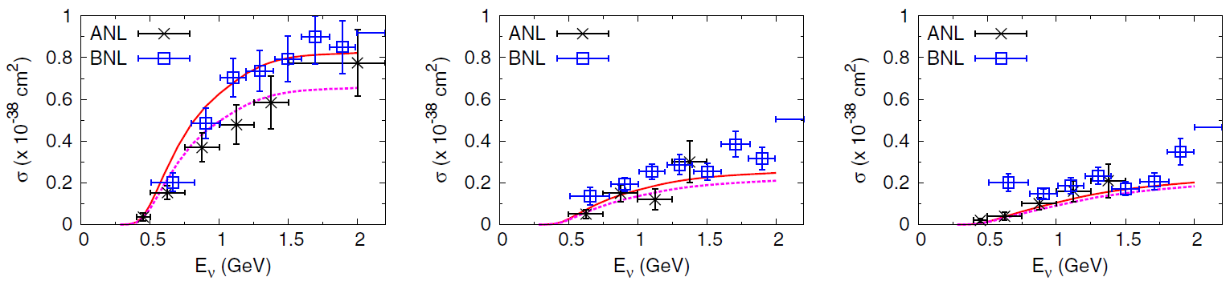
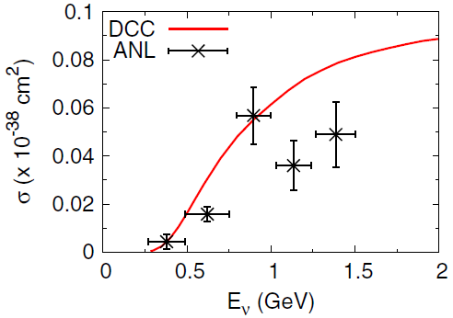
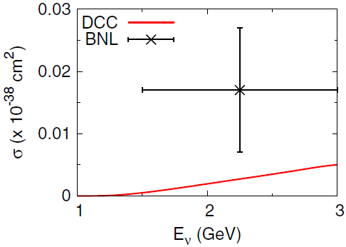
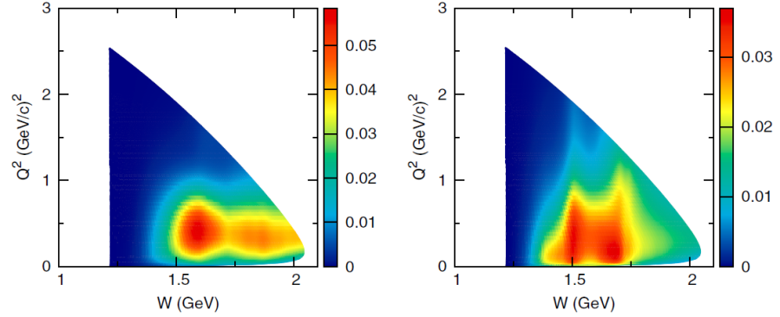
Predicted results for neutrino-induced reactions
Nakamura, HK, Sato, arXiv:1506.03403; to appear in PRD
The first-time full coupled-channels calculation of
ν-nucleon reactions beyond the Δ(1232) region !!
Single pion production:
ν p → μ⁻ π⁺ p
ν n → μ⁻ π⁰ p
ν n → μ⁻ π⁺ n
ν n → ν π⁻ p
Double pion production:
KΛ production:
dσ/dWdQ² at Eν = 2 GeV
ν n → μ⁻ K⁺ Λ
ν p → μ⁻ π⁺ π⁰ p
ν n → μ⁻ π⁺ π⁻ p

Slide 29
Back up

Slide 30

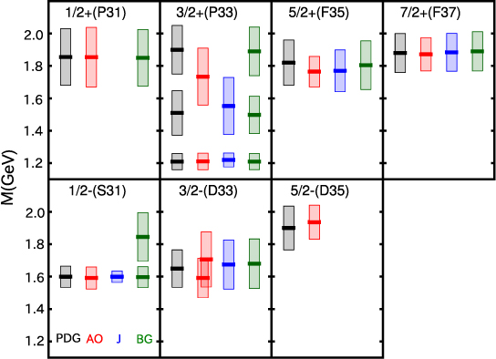
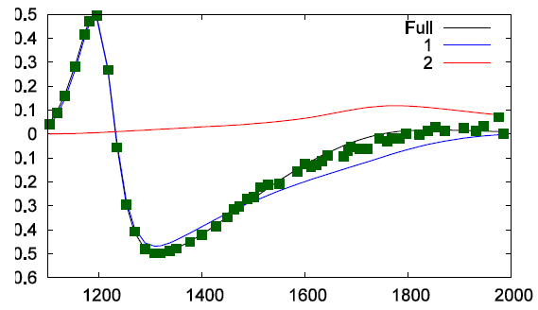
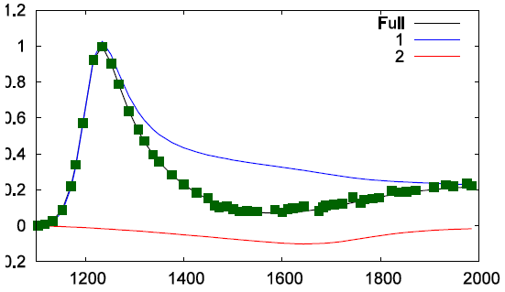
Comparison of N* & Δ* spectrum
between multichannel analyses
HK, Nakamura, Lee, Sato, PRC88 (2013) 035209
Existence and mass spectrum are now well
established for most low-lying resonances !!
(➔ Next task: establish high-mass resonances)
-2Im(M_{R})
(“width”)
M_{R} : Resonance
pole mass
(complex)
Re(M_{R})
J^{P}(L_{2I 2J})
“N” resonance (I=1/2)
J^{P}(L_{2I 2J})
“Δ” resonance (I=3/2)
πN → πN P33 (I=3/2, J^{P}=3/2⁺) amp.
Re
Im
### NOTE: Presented only N* and Δ* with -2Im(M_{R}) < 400 MeV ###
PDG: 4* & 3* states assigned by PDG2012
AO : ANL-Osaka
J : Juelich [EPJA49(2013)44]
BG : Bonn-Gatchina [EPJA48(2012)5]

Slide 31
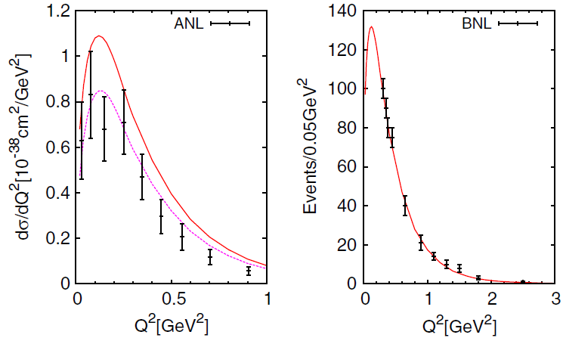

Predicted results for neutrino-induced reactions
Nakamura, HK, Sato, arXiv:1506.03403; to appear in PRD
The first-time full coupled-channels calculation of
ν-nucleon reactions beyond the Δ(1232) region !!
Single pion production:
ν p → μ⁻ π⁺ p
ν n → μ⁻ π⁰ p
ν n → μ⁻ π⁺ n
ν n → ν π⁻ p
dσ/dQ² for ν p → μ⁻ π⁺ p
(flux averaged for Eν)
d²σ/dWdQ² at Eν = 2 GeV
ν p → μ⁻ π⁺ p
ν n → μ⁻ π⁰ p + μ⁻ π⁺ n

Slide 32

Predicted results for neutrino-induced reactions
Nakamura, HK, Sato, arXiv:1506.03403; to appear in PRD
Double pion production:
ν p → μ⁻ π⁺ π⁰ p
ν p → μ⁻ π⁺ π⁺ n
ν n → μ⁻ π⁺ π⁻ p
dσ/dWdQ² at Eν = 2 GeV
ν p → μ⁻ π⁺ π⁰ p
ν n → μ⁻ π⁺ π⁻ p
KΛ production:
ν n → μ⁻ K⁺ Λ

Slide 33


