Slide 1
Review on quantum criticality in metals and beyond
Ki-Seok Kim (POSTECH)

Slide 2
Why is the nature of quantum criticality involved with a Fermi surface difficult to understand?
The reason is that we should solve strongly coupled field theories near quantum criticality involved with a Fermi surface.

Slide 3
Contents
Symmetry breaking quantum criticality in the Landau’s Fermi-liquid state: Hertz-Moriya-Millis theory and beyond (Fermi-surface problems)
Mott quantum criticality from the Landau’s Fermi-liquid state: Emergent localized magnetic moments and effective Kondo vs. RKKY interactions (Beyond Fermi-surface problems)
Heavy-fermion quantum criticality in a heavy-fermion Fermi-liquid state: Symmetry breaking quantum criticality + Mott quantum criticality (Beyond Fermi-surface problems)
Emergent hydrodynamics near Mott & heavy-fermion quantum criticality and AdS/CFT duality conjecture

Slide 4



Landau’s Fermi-liquid theory I: Thermodynamics
$$=exp\left[−βF_{FL}\left\{δn\left(\vec{p},\vec{r},t\right)\right\}\right]$$

Slide 5
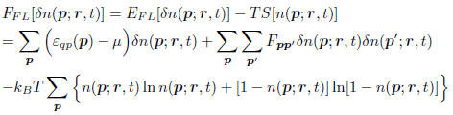
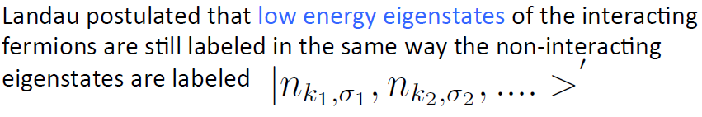

$$Emergent local U_{\vec{p}}\left(1\right) symmetry$$

Slide 6
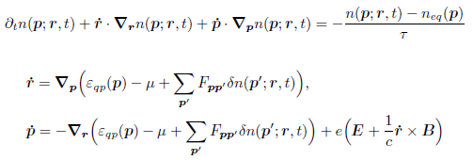

Landau’s Fermi-liquid theory II: Near equilibrium
$$cf. For a Weyl metal state→Berry curvature \& Chiral anomaly$$

Slide 7
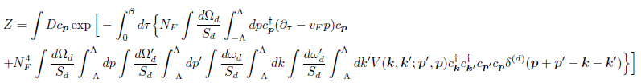


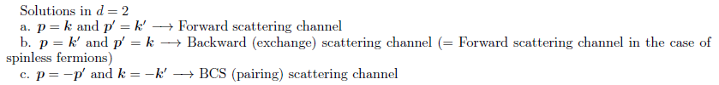

Landau’s Fermi-liquid fixed point
$$Scaling analysis in the tree level$$
$$Momentum in the transverse$$
$$\left(angular\right) direction is dimensionless.$$
$$Only Forward, backward, and BCS scattering are marginal,$$
$$and other scattering channels are all irrelevant in the low−energy limit.$$

Slide 8
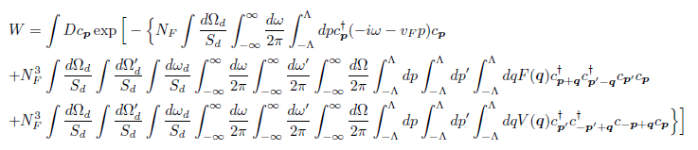

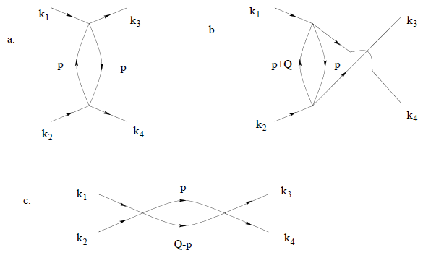
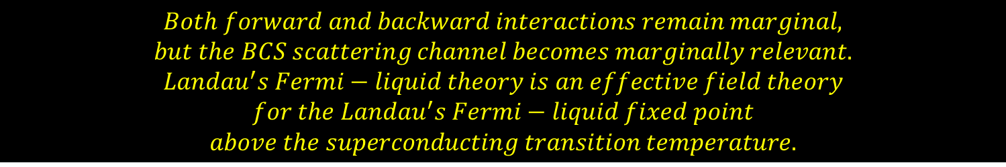
$$Both forward and backward interactions remain marginal,$$
$$but the BCS scattering channel becomes marginally relevant.$$
$$Landau^{′}s Fermi−liquid theory is an effective field theory$$
$$for the Landau^{′}s Fermi−liquid fixed point$$
$$above the superconducting transition temperature.$$

Slide 9
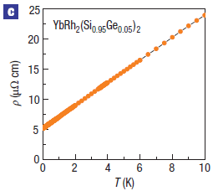
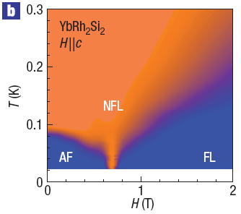
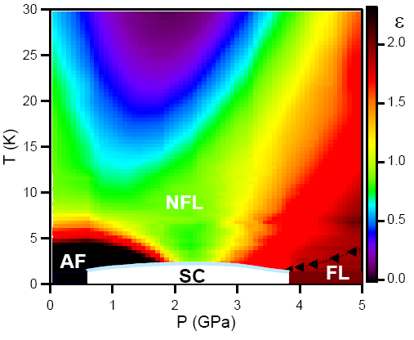
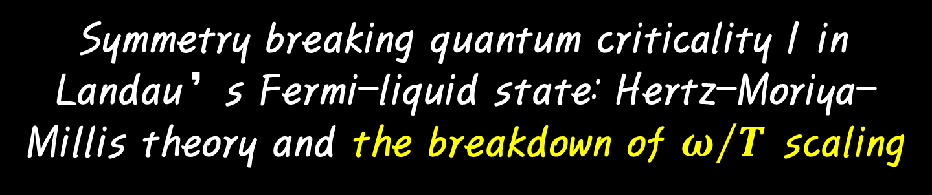
Symmetry breaking quantum criticality I in Landau’s Fermi-liquid state: Hertz-Moriya-Millis theory and the breakdown of $ω/T$ scaling

Slide 10
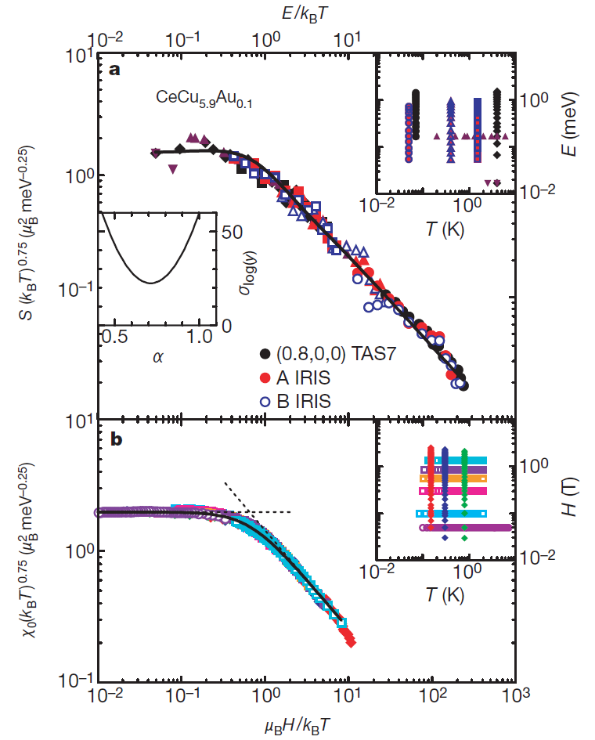
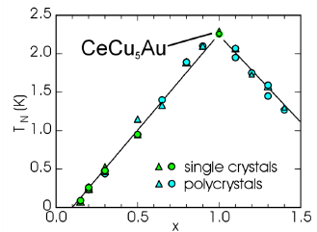

The unsolved problem
How can we understand the emergence of the 𝝎∕𝑻 scaling near quantum criticality?

Slide 11

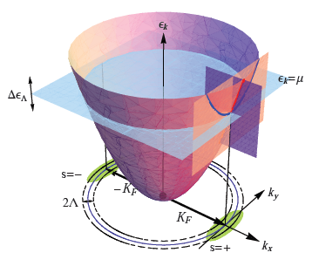







Hertz-Moriya-Millis effective field theory for symmetry breaking quantum criticality in metals
$$Self−consistent RPA analysis$$
$$3$$
$$z=3$$

Slide 12
Argument for justification of the patch construction I
At the Landau’s Fermi-liquid fixed point: The transverse (angular) momentum is dimensionless, and only the longitudinal momentum is dimensionful.
At the Hertz-Moriya-Millis fixed point (a quantum critical point): Both the transverse and longitudinal momenta are dimensionful, which scale in a different way.

Slide 13
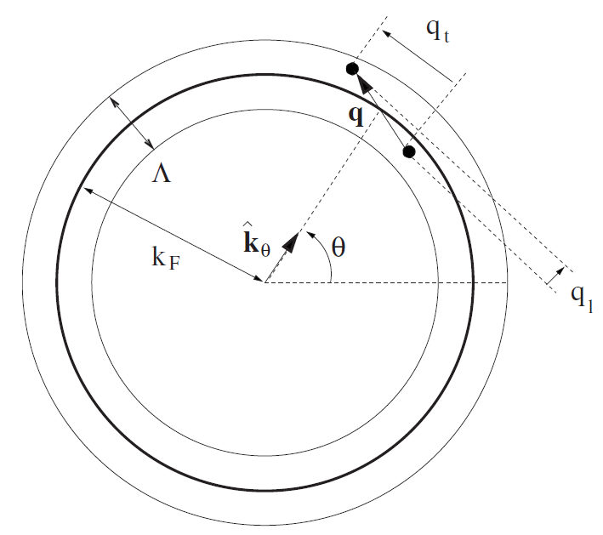
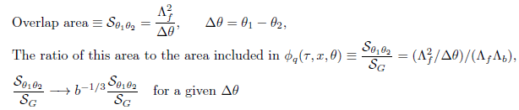
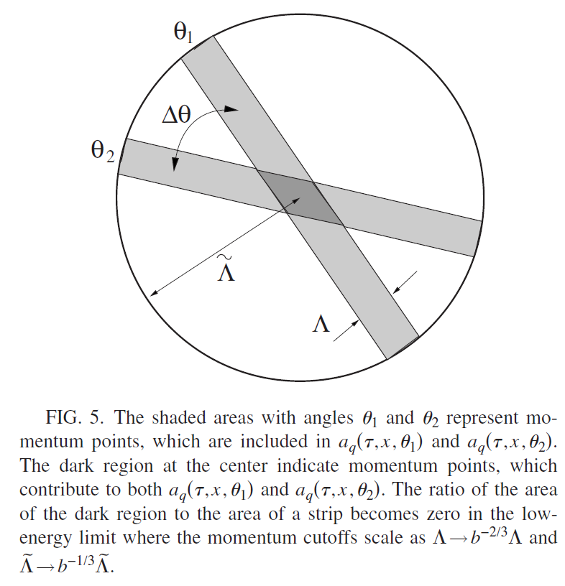
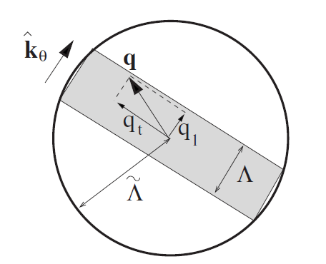

Argument for justification of the patch construction II
$$Emergent locality in momentum space$$
$$near HMM quantum criticality$$
Phys. Rev. B 78, 085129 (2008)

Slide 14
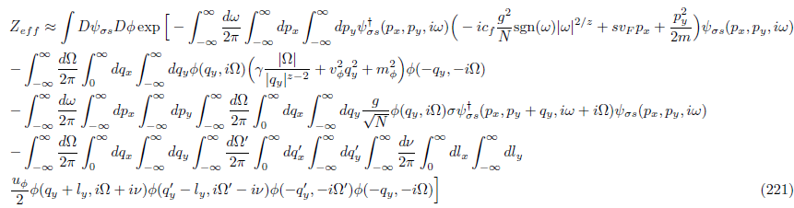
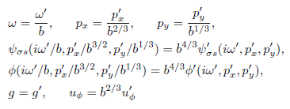

$$z=3$$
Hertz-Moriya-Millis theory is an effective fixed-point theory
for quantum criticality as the Landau’s Fermi-liquid theory for metals.

Slide 15





Scaling theory from the Hertz-Moriya-Millis theory

Slide 16
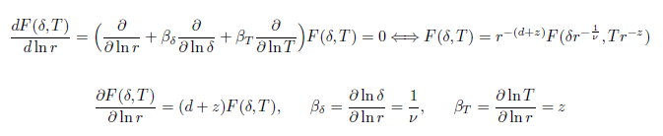

Slide 17
Grüneisen (1877~1949) ratio

Slide 18
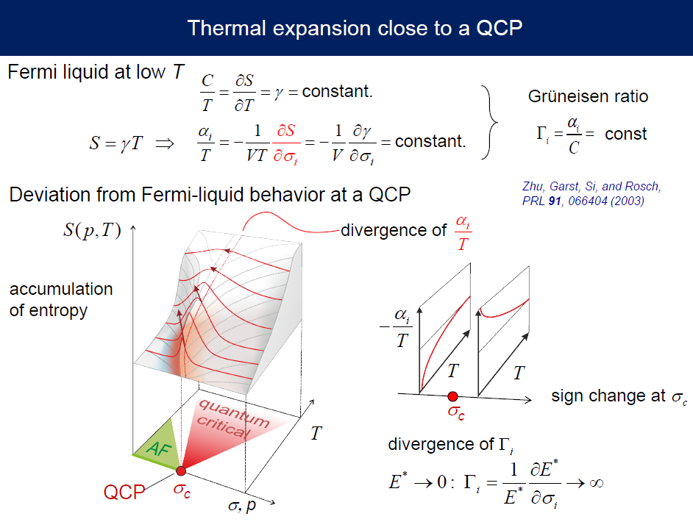
$$H. v. Lohneysen, APCTP lecture on heavy−fermion quantum criticality (2016)$$

Slide 19
Divergence of Grüneisen ratio at any quantum critical points
Spin
Density
wave
Fermi liquid

Slide 20
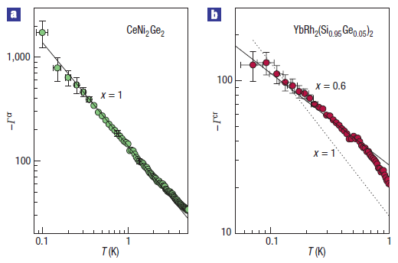


Thermodynamics : Grüneisen ratio
$$ν=\frac{1}{2}\& z=2$$
$$ν=\frac{1}{2}\& z=3$$

Slide 21
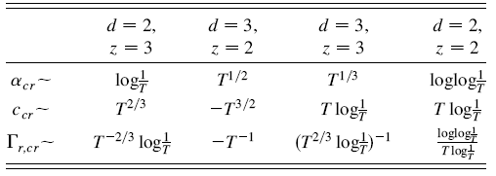
Thermodynamics
at quantum critical points
Spin
density
wave
Spin
density
wave
Ferromagnetic
Kondo breakdown
Ferromagnetic
Kondo breakdown

Slide 22
The role of dangerously irrelevant operators in thermodynamics

Slide 23
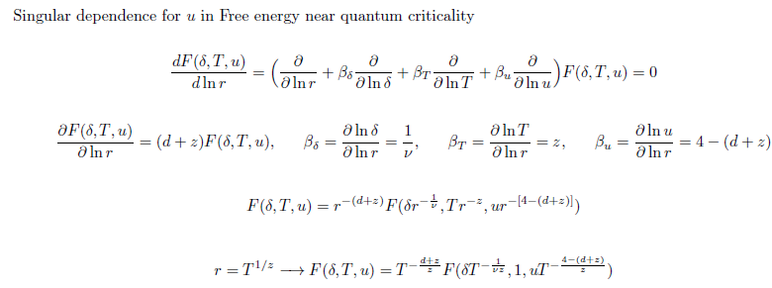

Slide 24
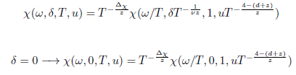

The breakdown of $ω/T$ scaling

Slide 25
Symmetry breaking quantum criticality II in Landau’s Fermi-liquid state: Beyond the Hertz-Moriya-Millis theory
The self-consistent RPA or Eliashberg or non-crossing approximation or large-N limit turns out to be unstable, making this fixed-point quantum critical theory unreliable. On the other hand, the Landau’s Fermi-liquid fixed point remains stable even beyond the 1/N approximation, and the Landau’s Fermi-liquid theory does.

Slide 26
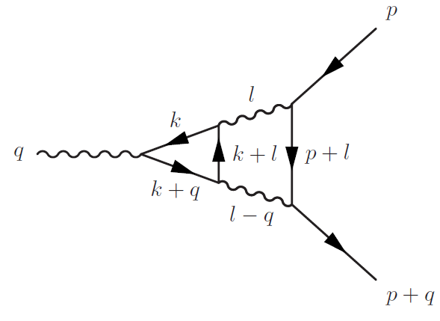
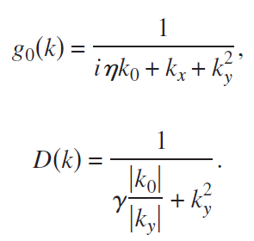
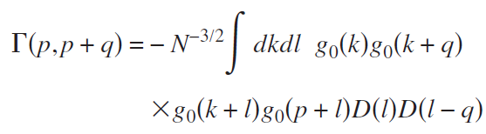
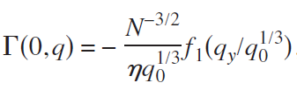
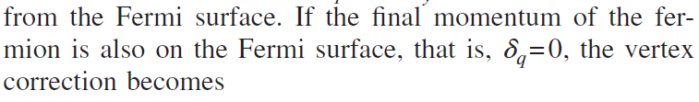

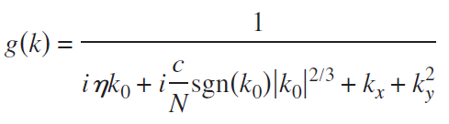

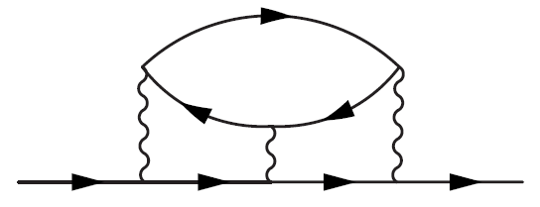

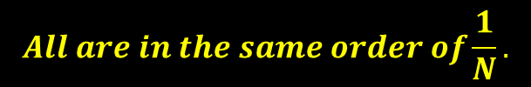
S.-S. Lee, Phys. Rev. B 80, 165102 (2009)
$$All are in the same order of\frac{1}{N}.$$

Slide 27


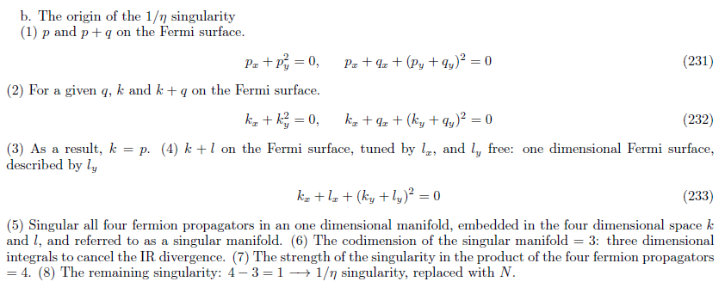
S.-S. Lee, Phys. Rev. B 80, 165102 (2009)

Slide 28
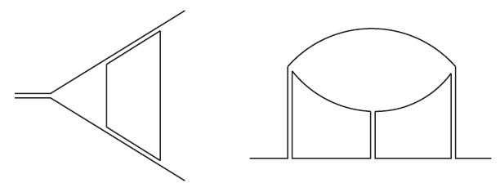
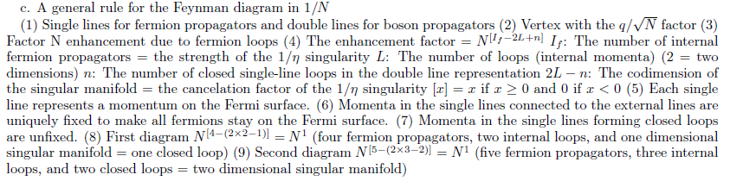
S.-S. Lee, Phys. Rev. B 80, 165102 (2009)

Slide 29
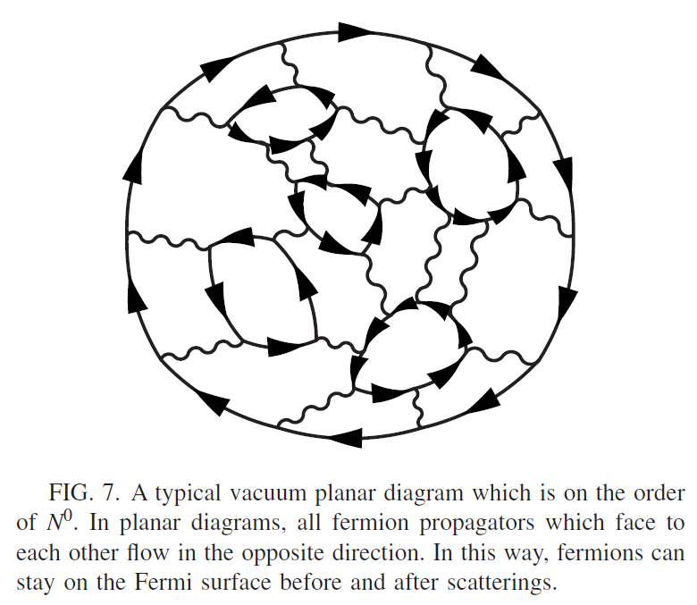
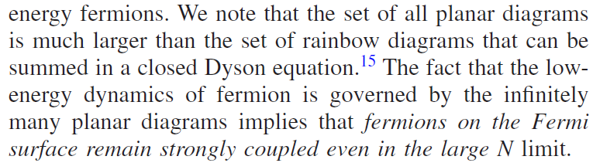
S.-S. Lee, Phys. Rev. B 80, 165102 (2009)

Slide 30
1. Softness of a Fermi surface = Too many soft modes from Fermi-surface fluctuations = Huge Landau damping of order parameter fluctuations (HMM theory)
2. How to reduce the effective number of Fermi-surface excitations ?
3. Graphenization = Continuation from a pseudo-gapped Fermi surface to a genuine Fermi surface = Dimensional regularization of a Fermi-surface problem (S.-S. Lee)
4. We start from a different fixed point instead of the HMM fixed point.
The origin of the failure of the large-N approximation

Slide 31
Beyond Fermi-surface problems

Slide 32
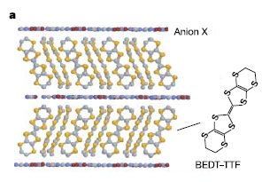
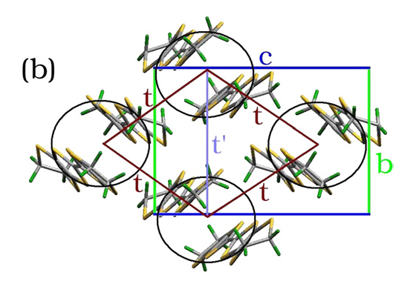

Mott quantum criticality from the Landau’s Fermi-liquid state
Kappa-class organic salts

Slide 33
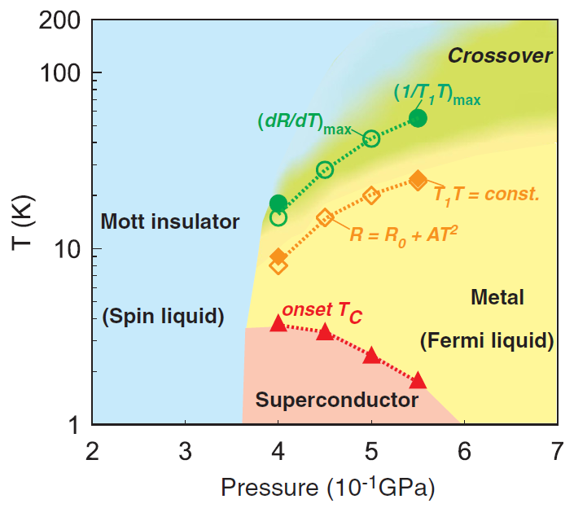

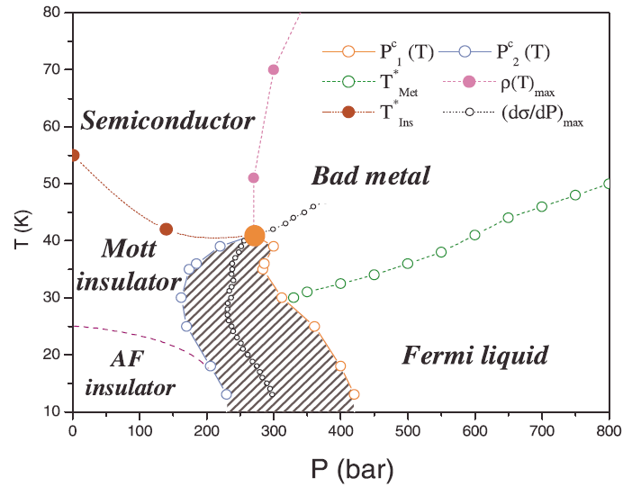
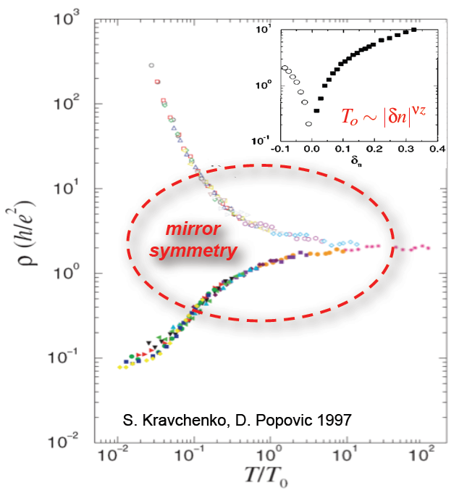
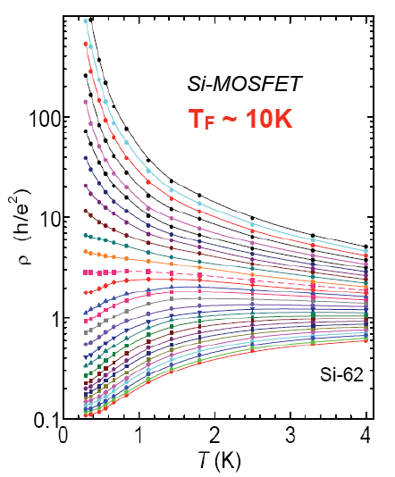
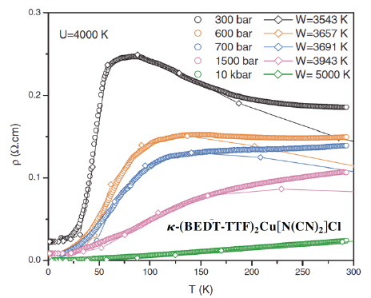

(Mott) metal-insulator transitions
(Mott) metal-insulator transitions
at high temperatures

Slide 34
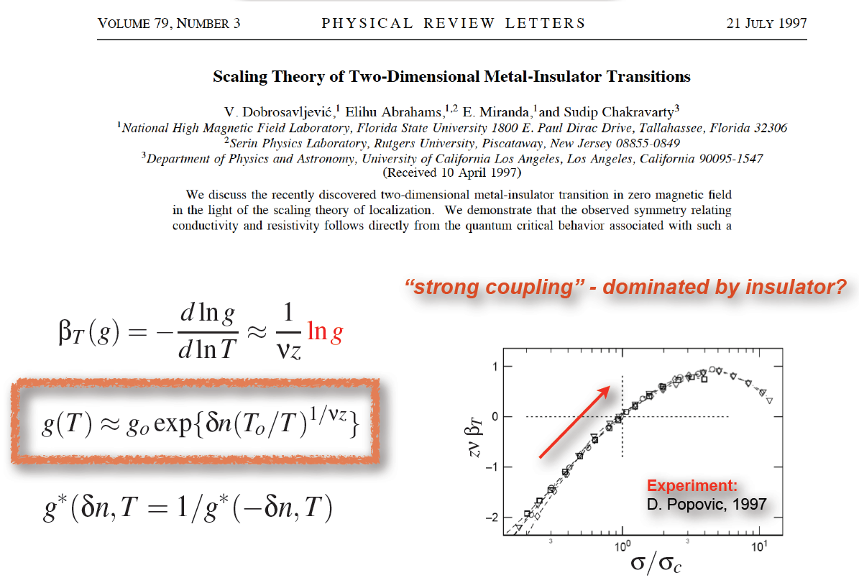

$$)$$
)
$$\text{Vladimir} \text{Dobrosavljevic}\text{, }\text{KPS} \text{spring} \text{meeting}\text{ 2015}$$

Slide 35

Emergence of localized magnetic moments & their ultimate fate: Competition between the Kondo effect and the RKKY interaction
A view point and an ultimate question within that view point: An emergent effective Kondo lattice model in the vicinity of a metal-insulator Mott transition
$$cf. Spin susceptibility at high temperatures$$
$in a Fermi liquid state$ ➔ Curie behavior

Slide 36
I. Emergent local moments are screened by the Kondo effect, resulting in Landau’s Fermi-liquid state.
Kondo-effect driven Mott transition: Dynamical mean-field theory (DMFT) approach

Slide 37



$$\text{Vladimir} \text{Dobrosavljevic}\text{, }\text{KPS} \text{spring} \text{meeting}\text{ 2015}$$

Slide 38

$$\text{Vladimir} \text{Dobrosavljevic}\text{, }\text{KPS} \text{spring} \text{meeting}\text{ 2015}$$

Slide 39



$$Kanoda^{′}s group 2014 \& 2015$$

Slide 40






$$ρ=e^{{±\left(\frac{T}{T_{0}}\right)}^{1/{zν}}}$$
$$Kanoda^{′}s group 2014 \& 2015$$
$$\text{Vladimir} \text{Dobrosavljevic}\text{,}$$
$$\text{KPS} \text{spring} \text{meeting}\text{ 2015}$$

Slide 41
RKKY-interaction driven Mott transition:
Spin-liquid physics (Gauge theory) approach
II. Emergent local moments are screened by the RKKY interaction, resulting in a spin-liquid phase.

Slide 42


$κ−BEDT$: Emergence of localized magnetic moments, Mott quantum criticality, spin-liquid physics, & superconductivity

Slide 43





$$(2003)$$

Slide 44







Effective theory: U(1) spin liquid with a spinon Fermi surface
$$SLMI$$
$$FL$$
$$AFMI$$
Phys. Rev. Lett. 95, 036403 (2005)
Phys. Rev. B 70, 035114 (2004)

Slide 45
How to understand the crossover behavior from the local-moment Mott quantum criticality of the DMFT description at high temperatures to the spin-liquid Mott transition of the gauge theory approach at low temperatures?

Slide 46

Heavy-fermion quantum criticality in a heavy-fermion Fermi-liquid state

Slide 47


The unsolved problem in heavy-fermion quantum criticality

Slide 48

$$H. v. Lohneysen, APCTP lecture on heavy−fermion quantum criticality (2016)$$

Slide 49

$$H. v. Lohneysen, APCTP lecture on heavy−fermion quantum criticality (2016)$$

Slide 50

Possible interaction vertices
in heavy-fermion systems

Slide 51
Kondo effect

Slide 52

$$H. v. Lohneysen, APCTP lecture on heavy−fermion quantum criticality (2016)$$

Slide 53

$$H. v. Lohneysen, APCTP lecture on heavy−fermion quantum criticality (2016)$$

Slide 54

$$H. v. Lohneysen, APCTP lecture on heavy−fermion quantum criticality (2016)$$

Slide 55

$$H. v. Lohneysen, APCTP lecture on heavy−fermion quantum criticality (2016)$$

Slide 56

$$H. v. Lohneysen, APCTP lecture on heavy−fermion quantum criticality (2016)$$

Slide 57




$$T_{HFL}^{}$$
$$T_{FS}^{}$$
$${T_{K}^{}}^{SI}$$

Slide 58

$$H. v. Lohneysen, APCTP lecture on heavy−fermion quantum criticality (2016)$$

Slide 59


Possible interaction vertices
in heavy-fermion systems

Slide 60

Doniach’s Phase Diagram (1978)
Fermi
liquid
Anti-ferro

Slide 61


Putting quantum criticality into Mott transition
Spin-density-wave (Itinerant) vs. Kondo breakdown (Localized)
“Hertz-Moriya-Millis”
“Mott transition” involved

Slide 62

$$H. v. Lohneysen, APCTP lecture on heavy−fermion quantum criticality (2016)$$

Slide 63


Quantum critical normal state in CeRhIn5 : Fermi surface reconstruction and divergence of effective mass
A review paper : G. Knebel, D. Aoki,
and J. Flouquet, arXiv:0911.5223v1

Slide 64


Fermi surface reconstruction
Quasi two dimensional Fermi surface sheets
H. Shishido, R. Settai, H. Harima, & Y. Onuki, JPSJ 74, 1103 (2005)

Slide 65



Evolution of Fermi surfaces
across quantum criticality
NATURE |
VOL 432 | 16 DECEMBER 2004|

Slide 66



PNAS ∣ August 17, 2010 ∣
vol. 107 ∣ no. 33 ∣ 14547

Slide 67



Kondo breakdown (localized) scenario : An orbital selective Mott transition

Slide 68




Novel metallic state
NATURE PHYSICS | VOL 5 | 465 | JULY 2009

Slide 69




$$H. v. Lohneysen, APCTP lecture on heavy−fermion quantum criticality (2016)$$

Slide 70






Novel metallic state
$$"Mott"$$
NATURE PHYSICS | VOL 5 | 465 | JULY 2009
$$"Mott−$$
$$Hertz−$$
$$Moriya−$$
$$Millis"$$
$$"Mott−$$
$$Hertz−$$
$$Moriya−$$
$$Millis"$$
$$"Hertz−$$
$$Moriya−$$
$$Millis"$$
$$"Hertz−$$
$$Moriya−$$
$$Millis"$$
$$"Mott"$$

Slide 71
How to describe strong inelastic scattering between emergent localized magnetic moments and itinerant electrons?
Emergent hydrodynamics?

Slide 72



Hydrodynamics in “metals” ?
Strong inelastic scattering ➔ Fast thermalization ➔ Effective (approximate) hydrodynamics: $AdS_{d+2}$ classical dual field theory (Role of the conformal symmetry ?)

Slide 73
Hydrodynamic transport phenomena are quite difficult to realize in metals. However, ……

Slide 74





Hydrodynamics in the Dirac fluid ?: Realization of the $AdS_{d+2}$ semi-classical field theory ?

Slide 75
Summary
Symmetry breaking quantum criticality in the Landau’s Fermi-liquid state: Hertz-Moriya-Millis theory and beyond
Mott quantum criticality from the Landau’s Fermi-liquid state: Emergent localized magnetic moments and effective Kondo vs. RKKY interactions
Heavy-fermion quantum criticality in a heavy-fermion Fermi-liquid state: Symmetry breaking quantum criticality + Mott quantum criticality
Emergent hydrodynamics near Mott quantum criticality and AdS/CFT duality conjecture

