Slide 1
Equation of State
and Unruh temperature
Hyeong-Chan Kim
(KNUT)
International workshop on String theory and cosmology
Hanyang University, Seoul, Korea,
Aug. 17, 2016.
Newtonian gravity:
arXiv:1608.03409 , H.K., Gungwon Kang (KISTI),
General relativity:
To appear soon, H.K., Chueng Ji (NCSU).

Slide 2

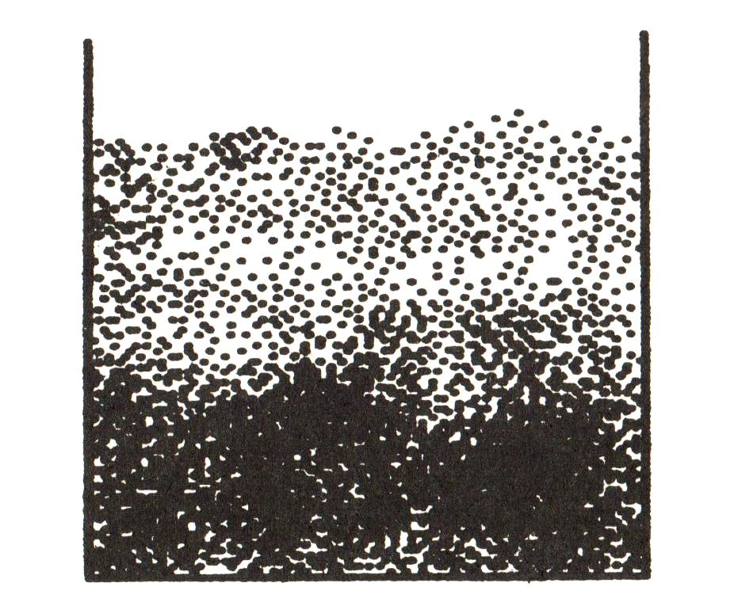
Statistical description in a gravity
Statistical description requires :
g
g
g
is possible??
is impossible. Local description in terms of pressure and density is
inappropriate.
A strong gravity restricts the region of space where the statistical
description is possible.

Slide 3
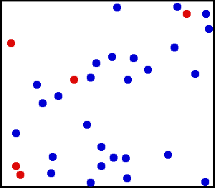
Two EoSs we are interested in:
EoS 1:
(Ideal gas)
An additional constraint: Adiabaticity
EoS 2:
Polytropic EoS

Slide 4



Brief summary of the particles in the presence of a gravity
v
T, N, V
P(z)
The density and pressure are
position dependent.
Kinetic energy:
Therefore, the avarage speed
of a particle is independent of
its height.
g
v
For the time being, we assume the volume contains
statistically enough number of particles.

Slide 5
Q: It appears genuine that strong gravity affects on the distributions of matters.
Then, how is the Equation of State?

Slide 6







Statistics (Summary)
Basic principle:
The number of particles in unit phase volume is proportional to
Partition function:
Total energy and entropy:
Heat Capacity:
Number of ptls (normalized):

Slide 7

Ideal Gas in Constant Newtonian Gravity
N-particle system in a box:
One particle Hamitonian:
One particle partition function:
Landsberg, et. al. (1994).
Order parameter for gravity:
Ratio btw the grav. Potential energy to the thermal kinetic energy.

Slide 8

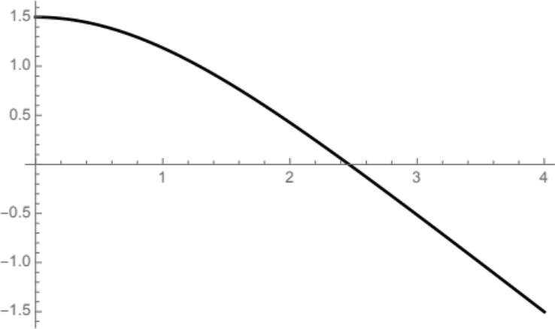
Ideal Gas in Constant Gravity
Internal energy:
U_{N} /Nk_{B}T
X
Gravitational potential energy:

Slide 9
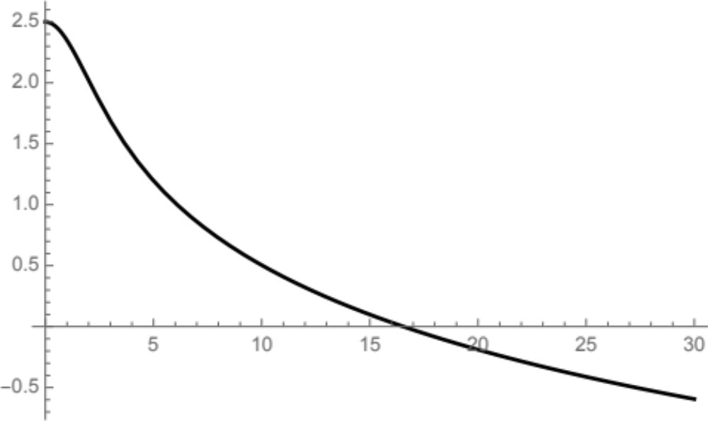

Ideal Gas in Constant Gravity
Entropy:
✗
(X dep part of S_{N})/Nk_{B}
Ordering effect of gravity
X
Entropy takes negative values for large gravity.

Slide 10
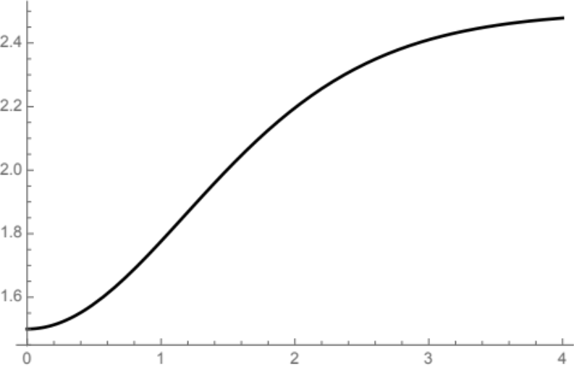

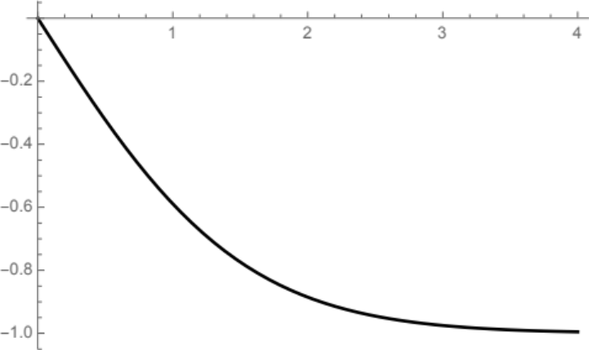

Heat Capacities:
Heat capacity for constant gravity:
C_{V}/Nk_{B}
Monatomic gas
X
Gravity capacity for constant T:
X
G_{T}/M

Slide 11


EoS 1 in Constant Gravity
Distribution of particles is position dependent:
However, local and the averaged values satisfy the ideal gas law.

Slide 12




The new EoS 2 in the adiabatic case
First law:
The energy is dependent on both of the temperature and gravity:
Adiabaticity:
We get,
EoS appears to be factorized. However,
contains thermodynamic variables.

Slide 13


The new EoS 2: Limiting behaviors
Weak gravity limit:
The correction is second order.
Therefore, one can ignore this correction in the small size limit of the system.
Therefore, the gravity effects on EoS is
negligible if the system size is small.
Strong gravity (macroscopic system) limit:
shows noticeable difference even in the non-relativistic,
Newtonian regime:

Slide 14

An application of the modified EoS
Density
increases.
Gravity
decreases.
Strong gravity limit holds.
Weak gravity limit holds.
N
N
N
N
The pressure (and density)
changes very fast.
Therefore, this strong gravity
regime is thin.
N
N
N
N
Therefore, for most stars in astrophysics, the
gravity effects on EoS is ignorable.

Slide 15
Then, when can we observe the gravity effect?
A: Only when the macroscopic effects are unavoidable.
Macroscopic: size > kinetic energy/gravitational force
Every cases are beyond
the scope of
the classical Newtonian theory.
System is being kept in thermal equilibrium compulsory.
The (self) gravity (or curvature) increases equally or faster than the
inverse of system size. (e.g., Palatini f(R) gravity near the star surface.
This is impossible in GR.)
The size of the system is forced to be macroscopic.
Ex) The de Broglie wavelength of the particles is very large
(light, slowly moving particles e.g., the scalar dark matter).
→ Require quantum mechanical treatment.
Near an event horizon where the gravity diverges.
→ Require general relativistic treatment.

Slide 16
Relativistic Case

Slide 17
Equation of State in General Relativity
General Covariance:
Freely falling frame = locally flat
EoS in freely falling frame = EoS in flat ST
Scalar quantity
Density, pressure, temperature are scalar quantities.
Therefore, their values in other frame must be the same as
those in the freely falling frame.

Slide 18



Generalization: Ideal Gas in Constant Gravity
Particle in a box (Rindler spacetime):
One particle Hamiltonian:
g
Rindler horizon
Momentum space increases at z=0.
Four vector:

Slide 19


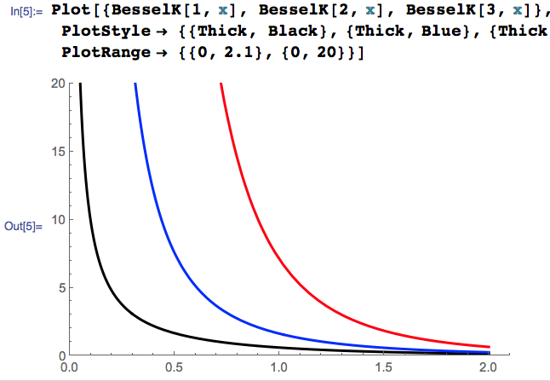

Generalization: Ideal Gas in Constant Gravity
N-particle system in a box (Canonical ensemble):
Temperature at z=0
Partition function:
Gravity dependence:

Slide 20
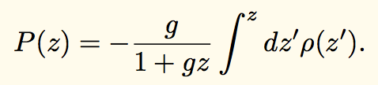
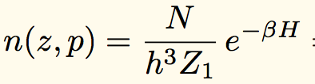
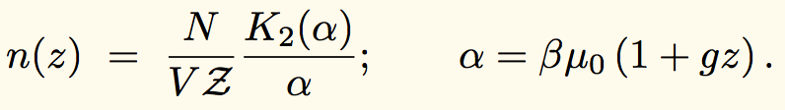
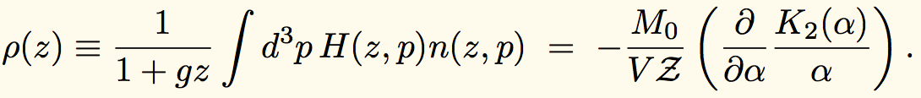
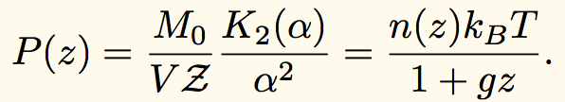

Continuity Equation:
The Continuity Equation→ Pressure
The number and energy densities:
Inserting this equation to
Ideal gas law is satisfied locally
(not globally) by local temperature.

Slide 21
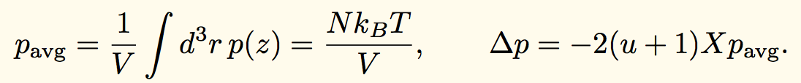
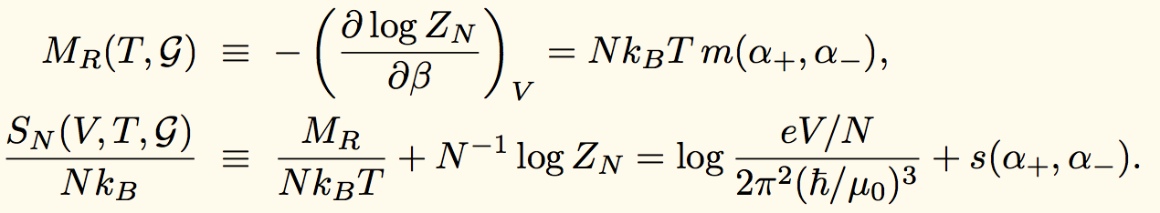
Total energy and Entropy:
Define pressure in Rindler space:
Ideal gas law is satisfied on the whole system if one
define an average pressure for Rindler space.
The total energy and entropy in Rindler frame:

Slide 22
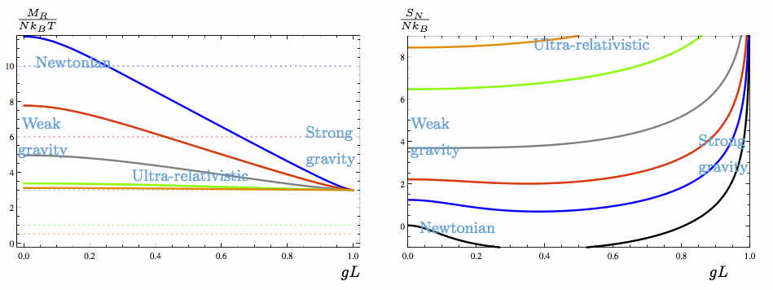
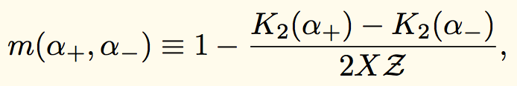

Total energy and Entropy
In the strong gravity region, physical quantities appear to have some
universality.

Slide 23
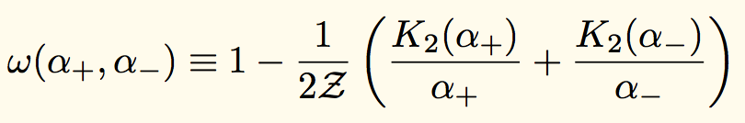
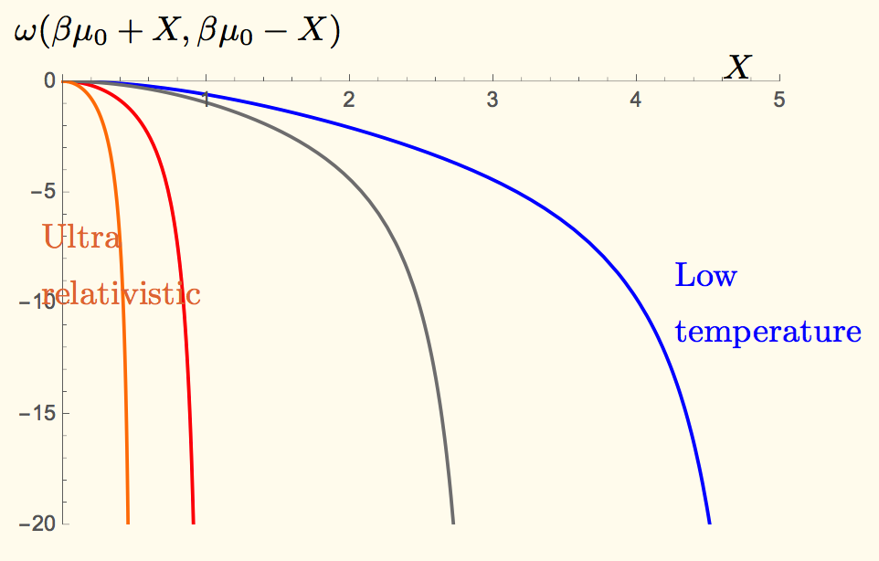
Gravitational potential:
Gravitational potential Energy:

Slide 24
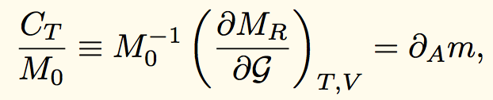
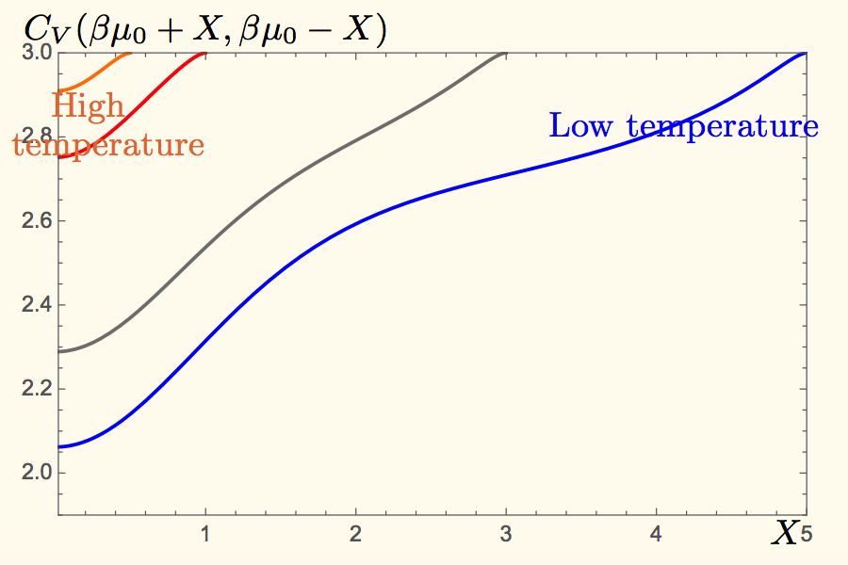
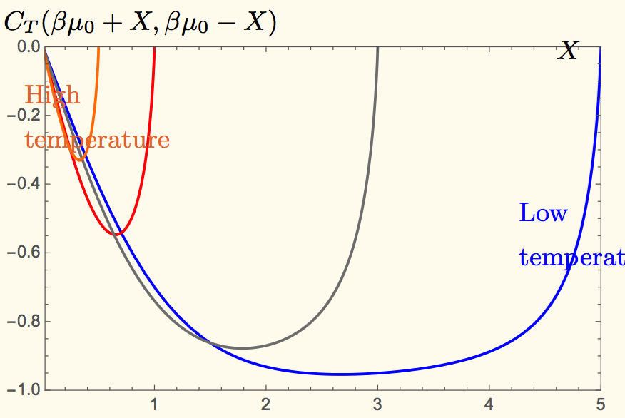
Heat Capacities:
Heat Capacities for constant volume, gravity and
for constant volume, temperature:

Slide 25

Strong gravity regime:
Parameterize the distance from the event horizon as
Radiation?
Area
proportionality

Slide 26



Thermodynamic first law
Differentiating the definition of entropy:
From the functional form of the partition function:
Combining the two, we get the first law:
Gravitational
potential energy

Slide 27




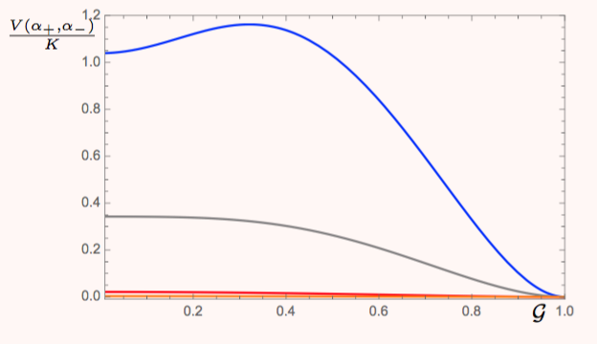

Equation of state for an adiabatic system
From the first law with dS=0,
From the definition of Heat capacities:
Combining the two, we get:
Integrating:
Universal feature?
5
3

Slide 28






Newtonian gravity limit:
Reproduce the Newtonian result.
Strong gravity limit:
Unruh temperature?
At present, we cannot determine the dimensionless part.

Slide 29

Conclusion
Newtonian gravity:
 | Locally | Macroscopically
 | Kept | kept
 | kept | modified
Rindler spacetime:
EoS in the strong gravity limit appears to determine the temperature of the system to be that of the Unruh temperature.

Slide 30
Future plan
1) System around a blackhole horizon
2) Quantum mechanical effect?
3) Self gravitating system?
4) Relation to blackhole thermodynamics?
5) Dynamical system?
5) Etc…

Slide 31
Thanks, All Participants.

