Slide 1

A hairy BH in ${AdS}_{3}$
International Workshop for String theory and Cosmology 2016
August 17 (Wed), 2016 ~ August 19 (Fri), 2016
Hanyang University, Seoul Korea
Kyung Kiu Kim (Yonsei Univ.)
In collaboration with
Byoungjoon Ahn, Seungjoon Hyun,, Sang-A Park and Sang-Heon Yi (Yonsei Univ.)

Slide 2
Outline
Motivation
A hairy BH in the bulk point of view
A hairy BH in the boundary point of view
On-shell action
Summary

Slide 3
Motivation
There are many kinds of hairy black holes in AdS.
AdS/CFT provides dual meanings to such solutions in the dual field theories.
These hairy solutions can be related to some phase transitions or sourced physics in the dual field theories.
Recently there have been developments in hairy black hole solution and the Smarr relation of time dependent black holes.
Since the low dimensional physics can be solved or understood easily in some case, we are interested in AdS_3 black holes.
The AdS_3 black holes are dual to thermal states of 1+1 dimensional field theory which has many integrable structures.

Slide 4
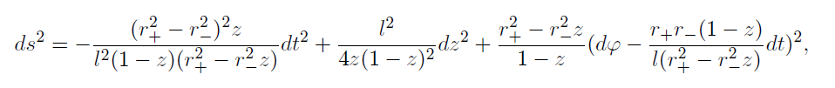
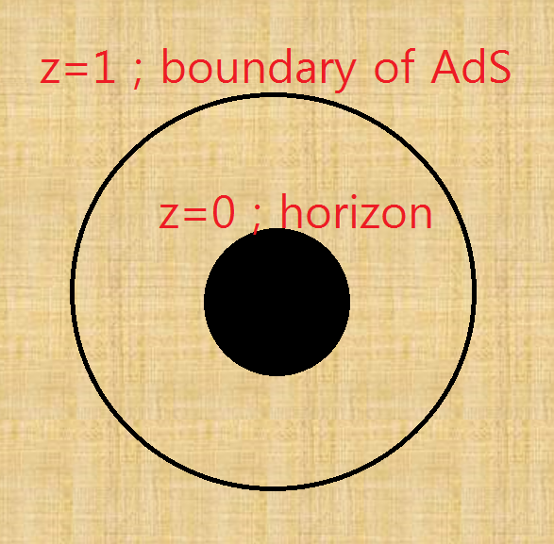
A hairy BH in the bulk point of view
The rotating BTZ black hole

Slide 5
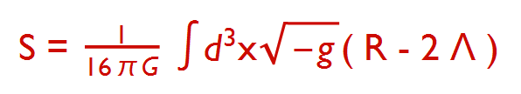

The Action of the system
We would like to add a matter to make a hairy configuration.
This system was studied in
Our work is strongly based on this paper.

Slide 6


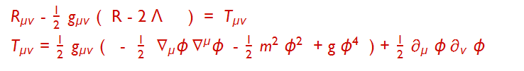
What kind of hairs can exist?
VS
Let us consider mass of hairs?

Slide 7
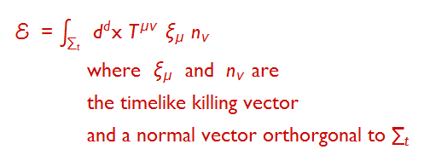
Normalizable mode?
Normalizable hair, Normalizable mode,
Normalizable Energy !
The normalizability depends on the asymptotic behavior of the scalar field.

Slide 8

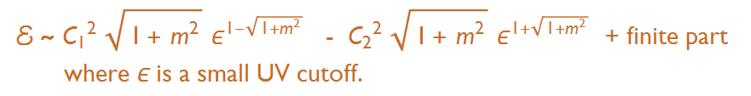
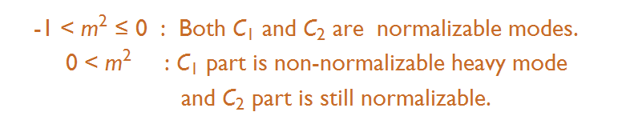

Asymptotic solution of the scalar field
Then the energy or mass of the hair becomes
We are not interested in too heavy hairy configurations.

Slide 9



If the scalar mass is between -1 and 0, A hairy BH is possible for all the modes.
When do the hairy configurations appear?
In order to see this, we need to investigate the instability of the Rotating BTZ.
Instability of a black hole? Quasi-normal mode!
Quasi normal mode of the scalar :
Linear fluctuation in the BTZ background
Ansatz for the scalar field

Slide 10
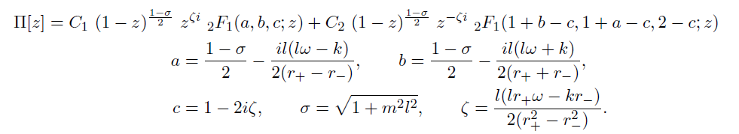


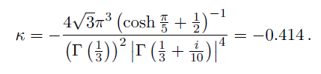
This equation admits a general solution.
By ingoing boundary condition at the horizon z=0, C_1 = 0.
How do we require boundary condition near the boundary of AdS space z = 1.
For convenience, we take the mass square as- 8/9.
This is a solution of a linear equation, so overall size can be absorbed by a scaling. Let us fix the ratio of A and B

Slide 11
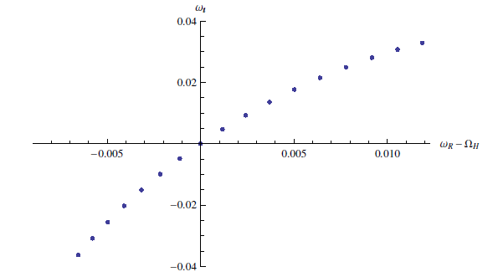

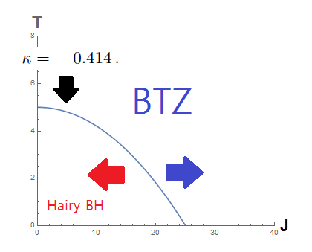
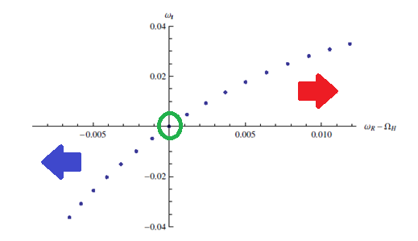
Frequencies satisfying the boundary conditions are as follows:
Angular velocity, Angular momentum, Temperature and Mass

Slide 12
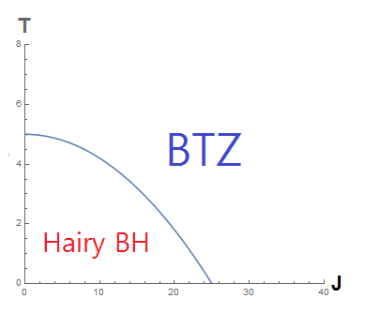
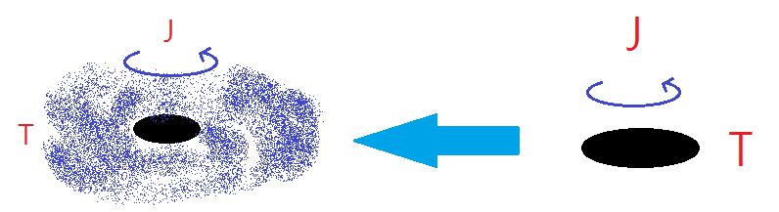
Real Phase diagram ?
If it is a right phase diagram,
There is a phase transition
betwee BTZ and Hairy BH.
In low temperature and Small Angular momentum, a rotating BTZ BH changes to a hairy BH.

Slide 13
In order to conclude the existence of this phase transition, we have to compare the free energy.
The phase transition in the micro-canonical ensemble was studied in the paper by Iizuka et al.
We will try to understand the phase transition by comparing Euclidean on-shell action. This is the main part of this work.

Slide 14


A hairy BH in the boundary point of view
Before calculating the on-shell action, let us explain how this transition can be depicted through AdS/CFT correspondence.
AdS/CFT can be expressed by following equivalence of two partition functions.
In some limit( large N with fixed coupling or classical gravity limit )
This equivalence changes into
Indentifying these sources is one of important parts in this correspondence.

Slide 15
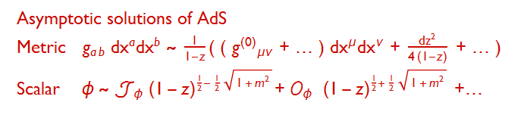

The source is non-normalizable mode in the gravity theory and the source of an operator(Chiral primary) in CFT
In this model, we have two bulk fields.
Each field has one non-normalizable mode.
The source in the field theory can be identified as

Slide 16

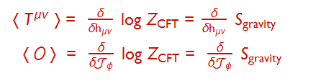
These sources denote the metric and a source of a scalar operator.
They appear in the field theory side.
The VEV of operators are given by

Slide 17
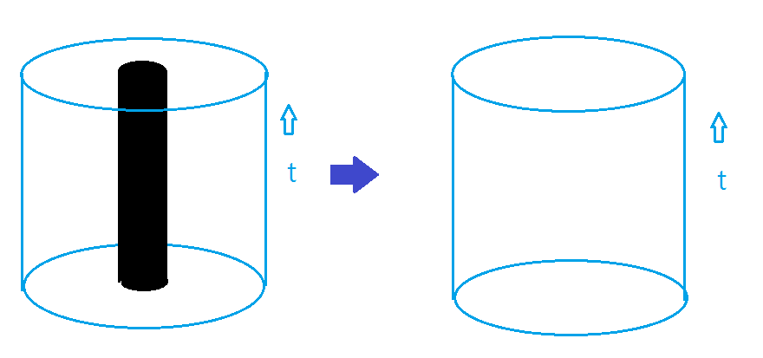
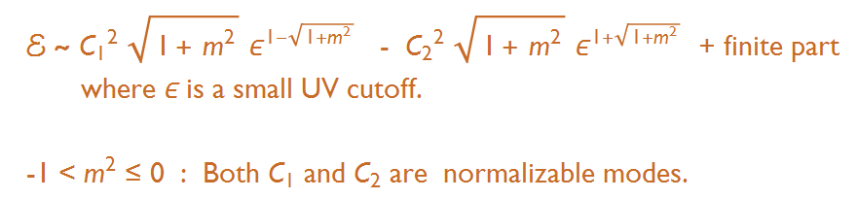
So far so good. Let me come back to the specific problem.
AdS_3 is dual to a CFT in R X S^1 .
There is one difference. The case under consideration doesn’t have any non-naormalizable mode.

Slide 18
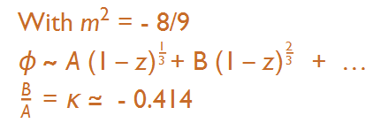
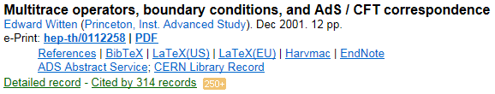
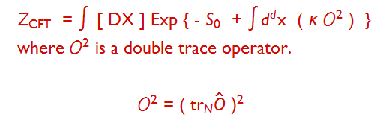
Both modes are normalizable.
What is the interpretation by AdS/CFT .
Multi-trace deformation !
In the large N limit, a nontrivial effect remains in the gravity theory.

Slide 19
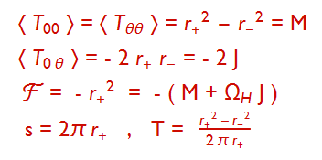
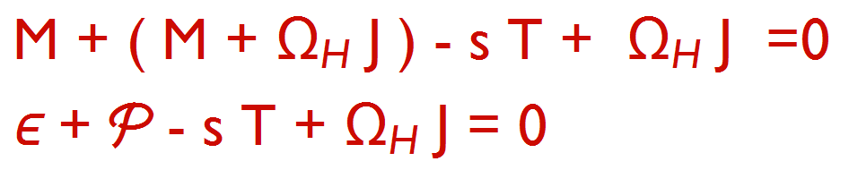
Boundary physical quantities for the rotating BTZ ;
Thermodynamic relation

Slide 20
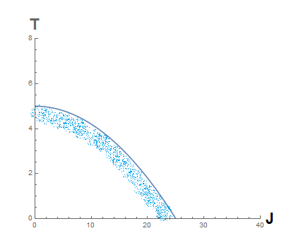
We would like to compute the on-shell action for the hairy BH and compare it to the on-shell action of the BTZ at the same angular momentum and temperature

Slide 21

In Iizuka et al, they obtain a perturbative solution up to ε^4 to see the phase transition.
We will consider the solution up to ε^2 to get the on-shell action.
Let us start with the following metric ansatz.
Then the perturbative metric and scalar field are given in the following form.
Where the coordinate y is given by

Slide 22


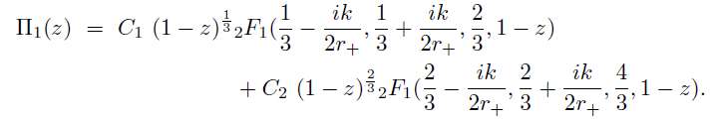


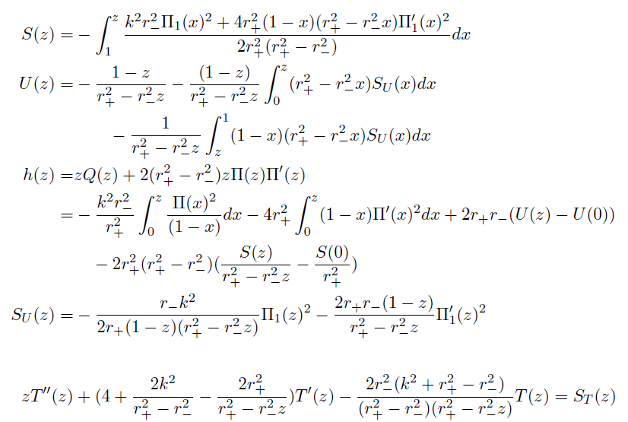
Up to ε^2 we have an analytic expression

Slide 23

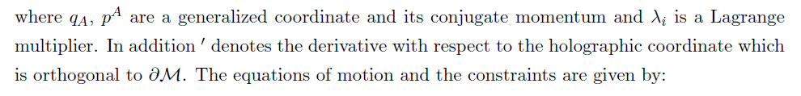

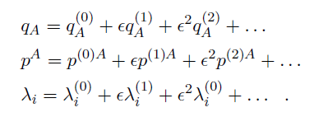
On-shell action
General expansion including counter term
Let us start with a general action
Expand the fields

Slide 24
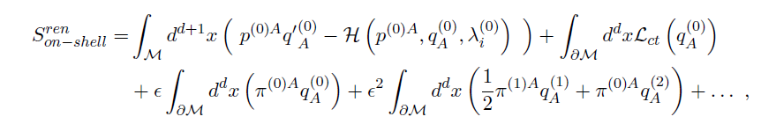
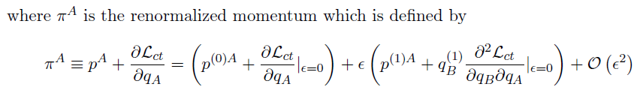
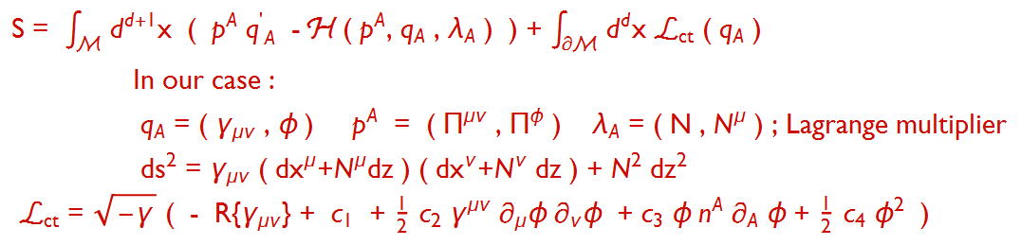
By using perturbative eoms, the on-shell action is given in the following form :
Back to our case

Slide 25
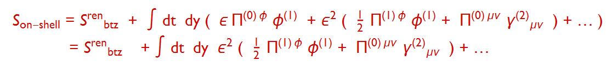



Plugging the fields, we can get
To get more explicit value we have compute the renormalized momenta.

Slide 26
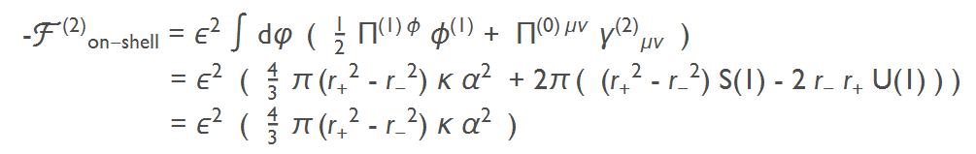

The final on-shell action is
by the boundary conditions

Slide 27
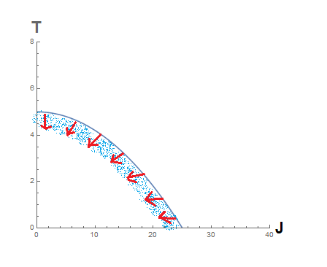
Comparison to the on-shell action of the BTZ
We found that the free energy of the hairy black hole is smaller than the free energy of the BTZ inside of the marginal stability curve.
Therefore, the second order phase transition occurs small angular momentum and low temperature region.

Slide 28

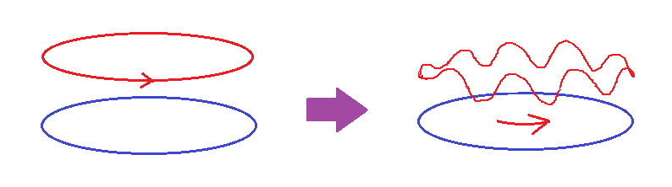
Interpretation in the boundary theory :
There is a deformed CFT on S^1 by a double trace operator.
The normal state has a momentum flow. The flow is steady. No fluctuation in the spatial coordinate.
In low T and small J , the steady momentum flow changes to a lumpy flow.

Slide 29
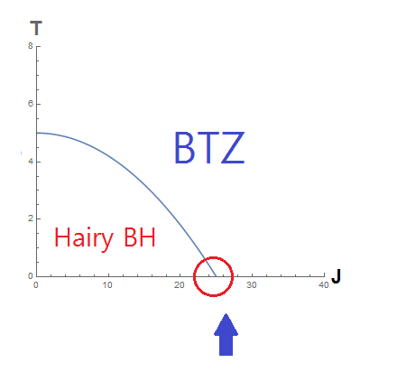
Most interesting point is the zero temperature.
This is a quantum phase transition.
Even the normal state is a superfluid state because the gravity dual is the extremal BTZ.
Thus the phase transition describes a transition between superfluid phases.

Slide 30
Summary and ongoing direction
The rotating BTZ with a scalar field could have instabilities.
With some generalized boundary condition, there exists hairy configurations with finite energies.
This bulk physics is dual to a phase transition under the double trace deformation.
We calculated the on-shell action of the hairy configuration.
By comparison of free energies, we show that there is a second order phase transition
We will investigate the zero-temp. phase transition and the Smarr relation of the hairy BHs.
We are finding non-perturbative numerical solutions sitting on inside the phase diagram .

Slide 31
Thank you for the attention !

