Slide 1
Origin of Hawking radiation and firewalls
W. Kim, Aug. 19, 2016, Sogang Univ.
<2016 international workshop for string theory and cosmology at Hanyang Univ>
Based on arXiv:1604.00465
arXiv:1508.00312

Slide 2
[1] History
[2] Issue
[3] Resolution
[4] Conclusion

Slide 3
[1] History
Hawking radiation(1975)
Boundary conditions on the past and the future horizons
(1)Boulware state (2) Israel-Hartle-Hawking state
(3)Unruh state: evaporating black holes and Hawking radiation
Information loss problem in the Unruh state
Pure state(nonthermal) turns into mixed states (thermal)
Violation of unitary evolution in quantum mechanics
Hawking radiation plays a role of information carrier, then the problem can be solved.
Black hole complementarity
Observer dependent descriptions : free-fall or fixed observers
Susskind, Thorlacius and Uglum, Phys. Rev. D 48, 3743 (1993); Stephens, `t Hooft and Whiting, Class. Quant. Grav. 11, 621 (1994).

Slide 4
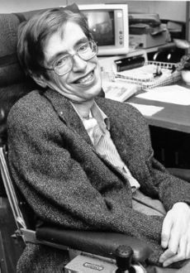
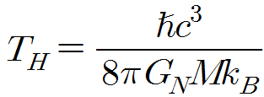
Quantum black holes
Hawking, S.W. (Aug. 1975) Particle creation by black holes. 《Communications in Mathematical Physics》 43 (3): 199–220.

Slide 5
History of information loss problem
Evaporation of black hole: loss of information
But QM requires that information be preserved.
Hawking claims information loss.
“God sometimes throws a dice where it can’t be seen.”
Preskill: conservation of information even in BH
Susskind and t’ Hooft: black hole complementarity
After all, Hawking agreed his fault(2004).
******************finished 1stwar*****************
******************2nd war*********************
Polchinski: AMPS claims firewall puzzle (2013)
Black hole complementarity is not enough.
Preskill: back to the 40 years ago

Slide 6
Black hole complementarity and firewalls
Inertial frame: nothing happens at the horizon!
Fixed frame:
something happens
at the horizon!
But firewalls even in the inertial frame!!!!

Slide 7

$$→$$
Black hole complementarity may be not enough
Note that the most important thing to be distinguished from the conventional puzzles is that it appears at a macroscopic distance. →( turns into microscopic problem eventually: see conclusion)
In an evaporating black hole, the freely falling observer encounters some quanta of super-Planckian frequency at the horizon after the Page time when the entropy of the black hole has emitted half of its initial Bekenstein-Hawking entropy, which violates the equivalence principle.

Slide 8
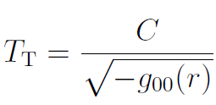

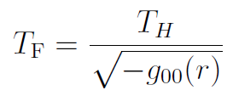

Qualitatively,
Tolman temperature(HH state)
Alice(free-fall)
Fiducial temperature
Bob(fixed)
Observations
They are the same!!!( We have used them more than 40 years!)
[ex] 1+1 dimensions
It is ill-defined near the horizon because of the negative energy density.

Slide 9
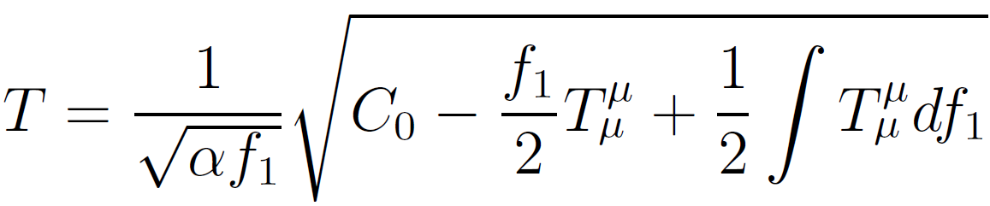
Resolution(HH state)
Conventional assumptions by Tolman
Perfect fluid
Covariant conservation of energy momentum tensor
Traceless stress tensor!
arXiv:1508.00312
Perfect fluid
Covariant conservation of energy momentum tensor
Trace of stress tensor=Trace anomaly (Hawking radiation)

Slide 10

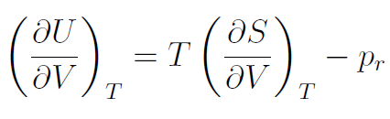

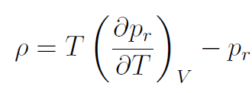
Appendix: detail thermodynamic expressions
First law
Maxwell relation
Temperature independence of conformal anomaly

Slide 11
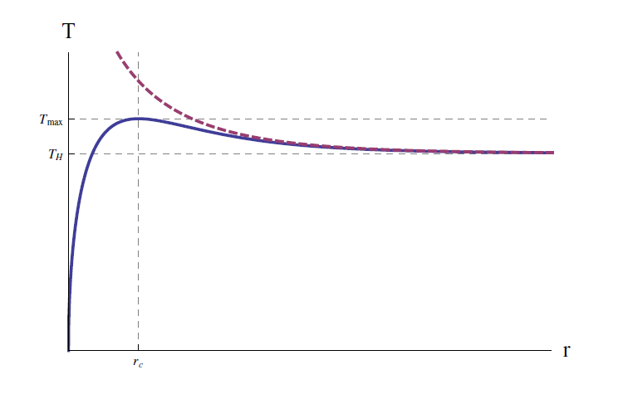
Tolman vs. Effective Tolman

Slide 12



Conclusion of [1]
There are no firewalls in the Israel-Hartle-Hawking state.
So, the Tolman temperature should be written as the effective Tolman temperature.
In addition, the Stefan-Boltzmann law should be written as the effective Stefan- Boltzmann law as
Consequently, the free fall temperature is not the same as the fiducial temperature in the presence of the Hawking radiation.
Gim and Kim (2015)

Slide 13



[2] Issue
Hawking: blueshifted infinite radiation at the horizon is Hawking radiation (via pair creation at the horizon) → pair creations?
Unruh: no outgoing positive radiation at the horizon→ no firewall?
Gim, Kim: quantal Tolman temperature whose peak is ∽3M)
How to generalize to Unruh state?
Giddings: near horizon quantum atmosphere is the source of Hawking radiation → no firewalls?

Slide 14
Explicit questions
Hawking: pair creations, infinite blueshift at the horizon
AMPS: firewalls from monogamy principle
Unruh: no radiation at the horizon
Giddings: no firewalls, but macroscopic quantum atmosphere
Questions: Where is the origin of the Hawking radiation?
What is the origin of the firewall?

Slide 15
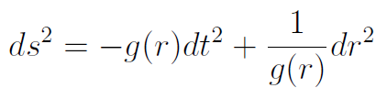








Basic calculations
Metric
Hawking temperature
Trace anomaly
Free-fall energy density and flux from covariant conservation law

Slide 16






Free-fall frame
Energy density and Flux
Boulware state
Israel-Hartle-Hawking state
Unruh state

Slide 17


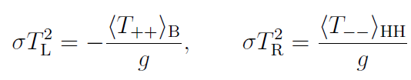


Stefan-Boltzmann law in Unruh state
Giddings(2016) : from the conservation law
New definitions (Kim 2016)
Recall the definitions of various vacuum states

Slide 18


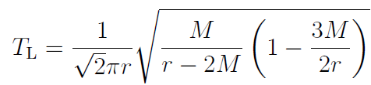
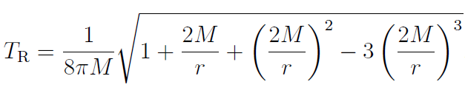
Tolman temperature in the Unruh state
Schwarzschild black hole:
Firewall
Hawking radiation

Slide 19
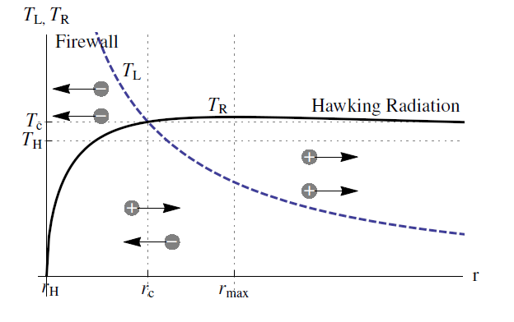
[3] Resolution

Slide 20


[4]Conclusions and Further directions
AMPS’ firewall comes from the positive outgoing flux. However, firewall exists in the form of the divergent negative ingoing flux, which gives the divergent positive temperature without violation of quantum monogamy principle.
As claimed by Unruh, there is no positive outgoing flux at the horizon. However, the firewall comes from the negative influx rather than the outgoing positive flux.
(cf: Giddings seems to believe that the firewall does not exist.)
Hawking’s calculation is right, but interpretation about the source of Hawking radiation should be changed as not pair creations but Casimir effect.

Slide 21
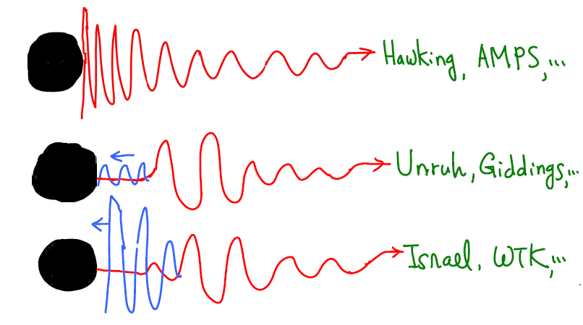
Graphic summary

Slide 22






The remaining problem is how to make the divergence at the horizon finite.
Yes. It is Quantum Gravity!
Superficially macroscopic but microscopic problem!
Further directions:

