Slide 1
Holographic Entanglement Entropy of Anisotropic Minimal Surfaces in LLM Geometries
Mini-workshop on “ Gauge theory and Supergravity
APCTP, Postech, July 25 (Mon), 2016 ~ July 29 (Fri), 2016
Based on arXiv:1605.00849 Phys.Lett. B759 (2016) 395
Collaboration with Chanju Kim, O-Kab Kwon
And
Phys.Rev. D90 (2014) 4, 046006 ,
Phys.Rev. D90 (2014) 12, 126003
(with O. Kwon, C. Park and H. Shin.)
Kyung Kiu Kim
(Yonsei University)

Slide 2
Contents
Entanglement Entropy
Holographic Entanglement Entropy
(Ryu-Takayanagi formula)
1+1 d case(Mass-deformation for 1+1 d by cutting)
C theorem in 1+1d
F theorem in 2+1d
Renormalized entanglement entropy for F
LLM geometry and mass deformed ABJM
REE near UV
Summary

Slide 3



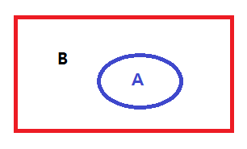


Entanglement Entropy
Quantity measuring spatial entanglement of a state
A state can be written in the form of
where A and B are basis wave functions of Hilbert spaces and . They are defined in the regions A and B, respectively.
Definition

Slide 4
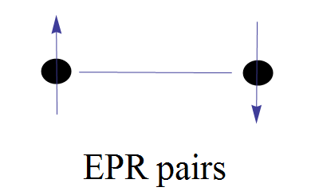
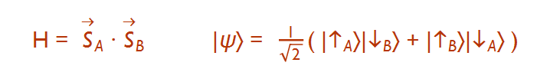

A simple example : two points and two spins
Let us consider ground state ( The ground state is not necessary. )
Maximum entanglement entropy
Minimum entanglement entropy with a trivial Hamiltonian

Slide 5
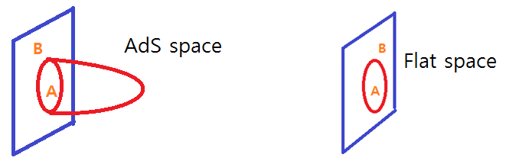
Holographic Entanglement Entropy(Ryu-Takayanagi Formula)
Area of minimal surface in AdS = Entanglement entropy of CFT
Boundary of A : entangling surface
Agreements with CFTs in 2d 3d 4d ….

Slide 6


From field theories
(2 dimensions and higher dimensions)
Minimal surfaces have same structure of these UV divergences.

Slide 7


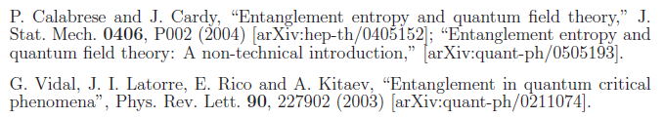
1+1 d case
From field theory 94’
Minimal surface(geodesic) in AdS3
Mass deformation
C. Holzhey, F. Larsen and F. Wilczek,

Slide 8
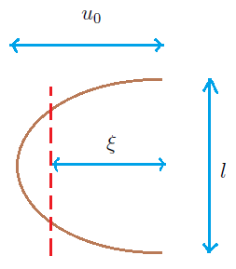



HEE for mass deformed case

Slide 9
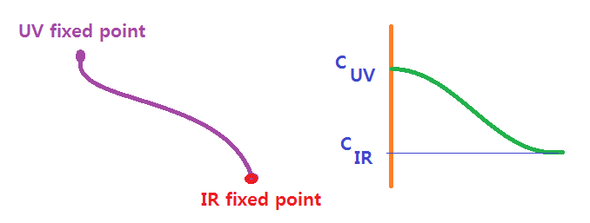
C theorem in 1+1 d
Decreasing c function under RG flow
Zamolodchikov 86, Cardy 88, Komargodski-Schwimmer 11 for even dimension ( Tr( T ) )
Is there a 3 dimensional version?
F-theorem in 2+1 d
F = - log Z : free energy decreases ?

Slide 10

F theorem
(Jafferis-Klebanov-Pufu-Safdi 11, Myers-Sinha 10 ) F_UV > F_IR
For CFT_3 [Casini-Huerta-Myers 11 ]

Slide 11

Renormalized entanglement entropy for F
Liu-Mezei 12
We follow this prescription.
The goal of this work is to show that F can be a c function by controlling mass deformation.
UV -> IR : The mass becomes bigger
CFT -> massive theory
We will take the ABJM theory as a probe theory.

Slide 12
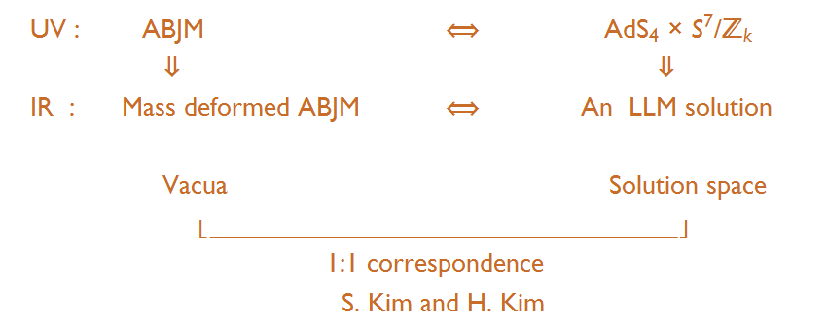
Correspondence between LLM and mABJM

Slide 13
LLM geometry for the mass-deformed ABJM theory
The dual geometries are given by solutions of the 11 dimensional super gravity with an appropriate ansatz using the bubbling geometry technique.
Ignoring the Z_k modding, the M2 brane world-volume theory has SO(8) R symmetry.
By the mass deformation, this R-symmetry is broken to SO(4)XSO(4).
So the metric has two S3 spheres and the 4-form field strength also contains the S3 volume forms .

Slide 14
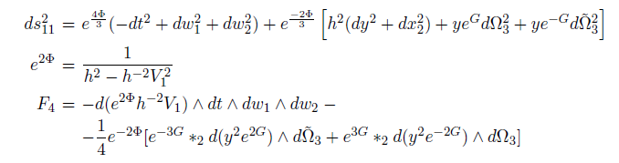
The 11 dimensional killing spinor has a structure roughly
- ( two S3 Killing spinor) X ( B : spinor in the other space)
Using this B, one can construct spinor bilinears
~ B (Gamma Matrices) B
This construction gives (pseudo) scalars, (pseudo) vector, 2 forms, 3 forms, …, and so on, which are part of the metric and the field strength.
Finally, one can obtain following solution.

Slide 15
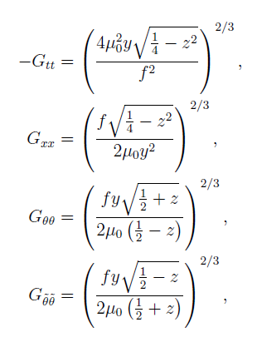

Considering Z_k modding of the Ansatz give the solution we will consider as follows.

Slide 16
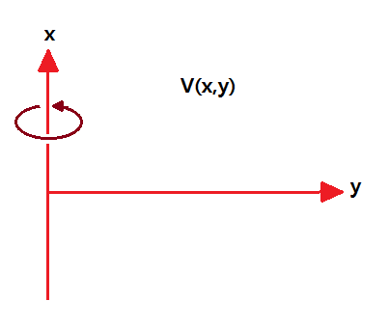
Thus the z(x,y) and V(x,y) determine the geometry and the field strength.
By Susy and the equation of motion, z(x,y) and V(x,y) are related to each other. They are not independent.
The equation for V(x,y) is nothing but the Laplace equation in the cylindrical coordinates.

Slide 17
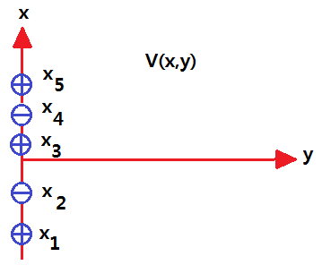
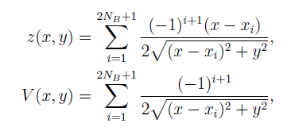
So V(x,y) is given by the scalar potential produced by charges sitting on y=0 line.
To make the asymptotic geometry AdS4, the sum of the charges should be 1.

Slide 18
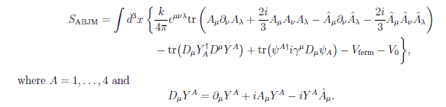



Lagrangian of mABJM

Slide 19


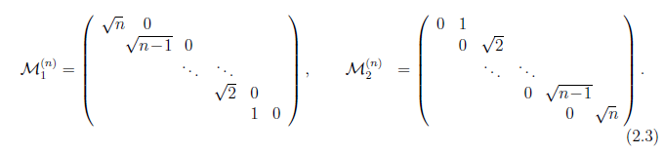
Discrete vacua for the mass-deformed ABJM theory
There are infinite number of discrete vacua encoded by VEV of the scalar field.
GRVV( Gomis et al 08) matrix

Slide 20
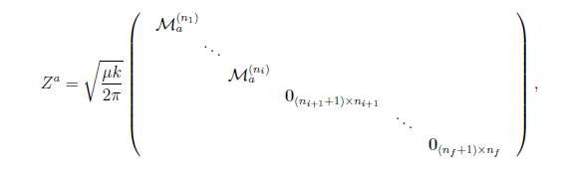
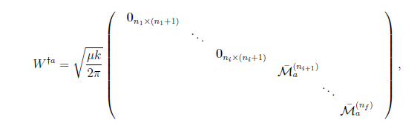

Vacuum solutions

Slide 21

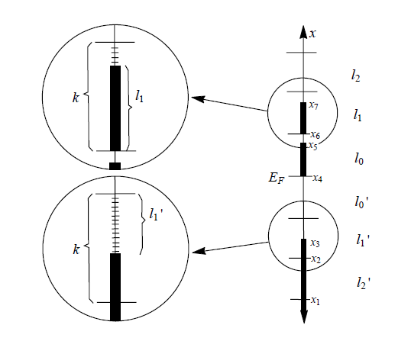
For supersymmetric vacua
( S. Kim H. Kim and S. Cheon)
This gives a constraint for x_i s.
Matching with gravity solution
N_n = l_n

Slide 22
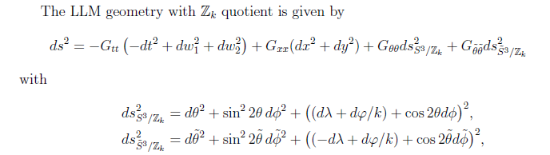

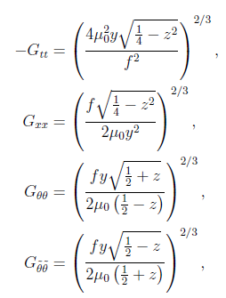


Holographic entanglement entropy for the Strip case.
To consider the minimal surface,
The induced metric is given by

Slide 23
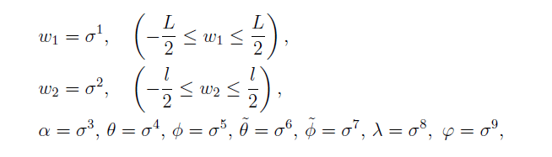

Isotropic Approximation
We are considering target space map for the strip as follows.
To avoid Partial differential equation, we take into account
This is valid, when the minimal surface is far from the droplets and the charge distribution is close to symmetric configuration(Isotropic approx.).
Since our interest is behavior near UV fixed point and symmetric charge distribution so far.

Slide 24

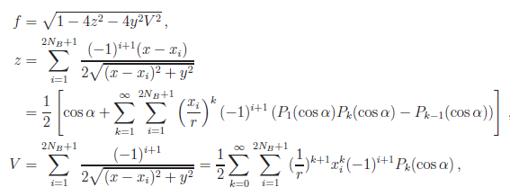
Isotropic Approximation
Asymptotic expansion of minimal surface

Slide 25
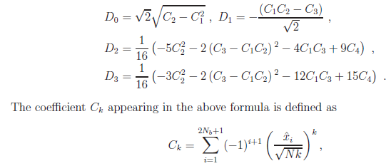
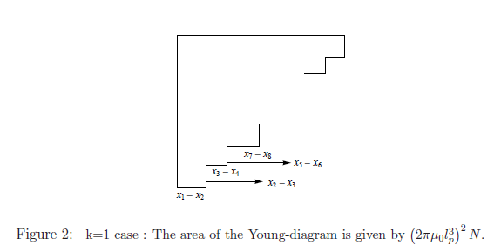

Slide 26
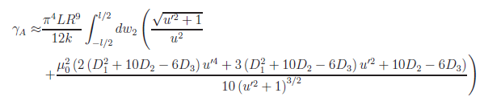
Isotropic Approximation
Minimal surface up to the quadratic order

Slide 27
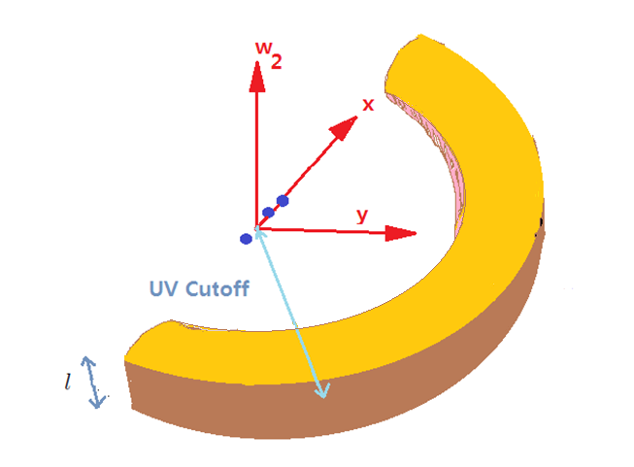
The minimal surface (strip)

Slide 28

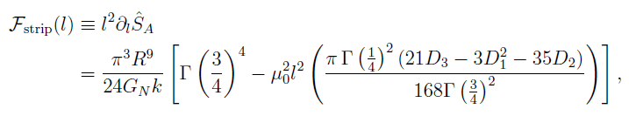

Isotropic Approximation
The minimal surface, the holographic entanglement for the strip case.
The renormalized entanglement entropy is

Slide 29
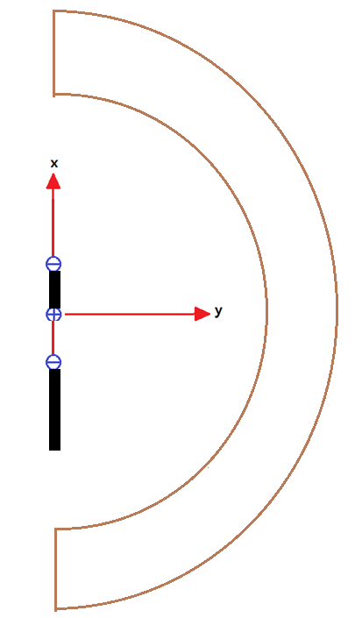


For symmetric droplet case.
So the free energy( c function )

Slide 30


HEE for the Disk case (Isotropic Approximation)
The target space map is given by
The minimal surface Lagrangian is
In the small mass approximation

Slide 31
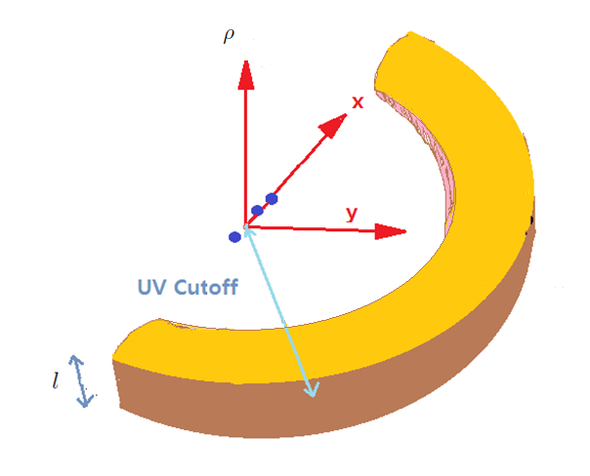

Slide 32


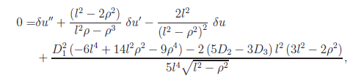
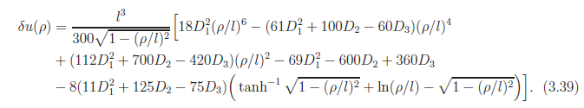
Isotropic Approximation

Slide 33
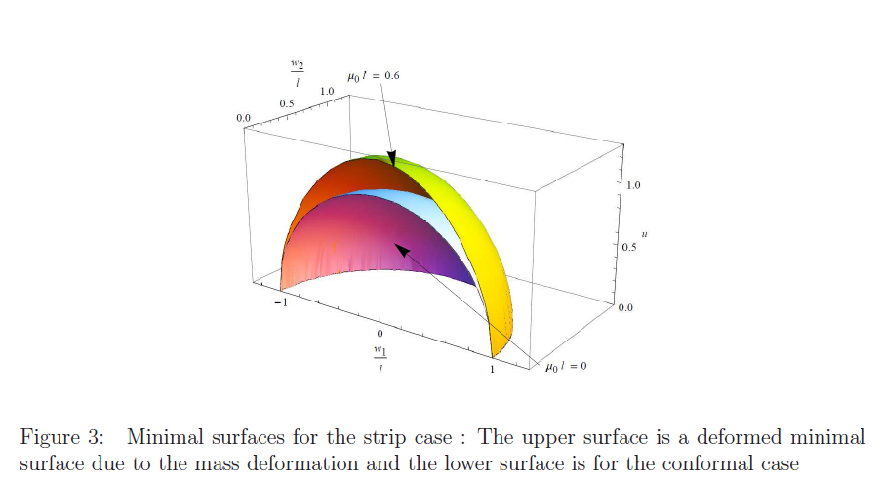
Because of the AdS metric factor, the minimal surface has a counter-intuitive shape as follows.

Slide 34



For general droplets, the holographic entanglement entropy is given by
For k= 1 and the symmetric droplet case,
The entanglement entropy is

Slide 35
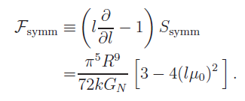

Isotropic Approximation
The c-function is
For general case

Slide 36


Isotropic Approximation
For the symmetric case, the c-function or the partition function shows the monotonic decreasing behavior.
For general droplets, it is not guaranteed to have decreasing behavior. We need to investigate the validity of our approximation and the modification of the coefficient.
?

Slide 37
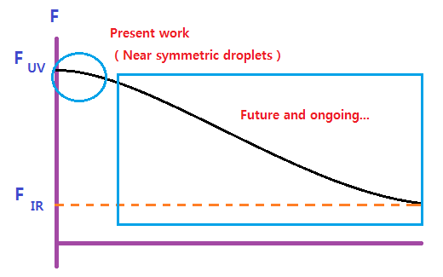
F theorem is valid near UV fixed point for symmetric configuration.
It’s not true for general configurations.
- We found that the increasing behaviors also appear
Thus REE is a good choice as a c function for the symmetric droplet.

Slide 38
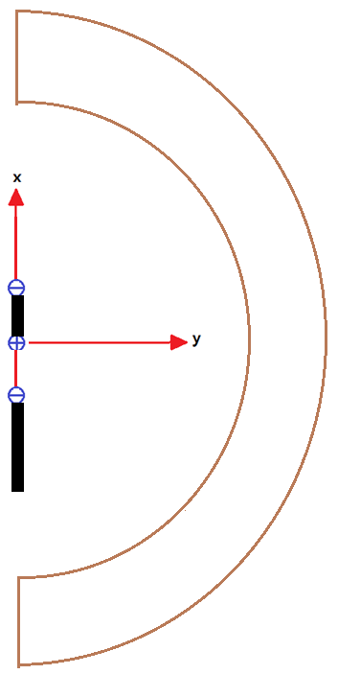
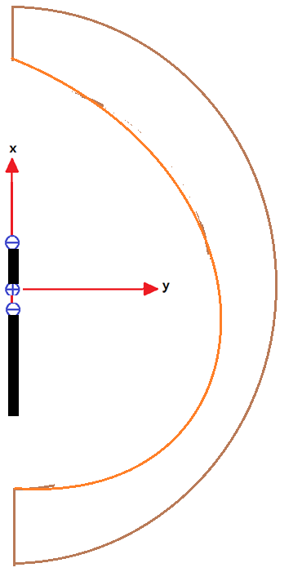
Anisotropic surface from PDE
The PDE effect
We have ignored the distorted effect from the asymmetric configuration of the droplets.

Slide 39




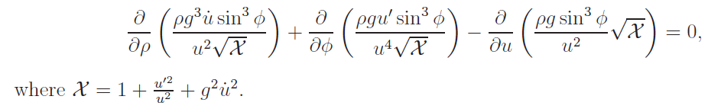
Anisotropic surface
We arrive at a PDE

Slide 40
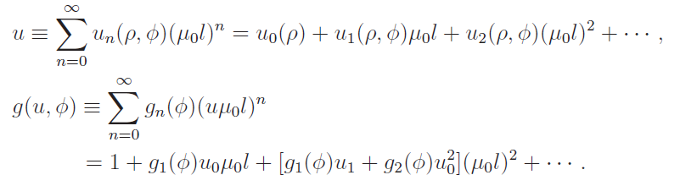

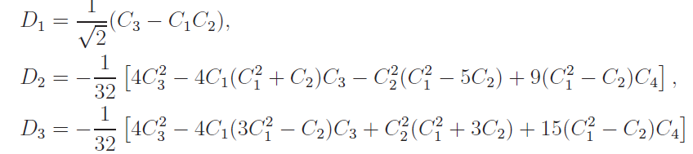

Slide 41


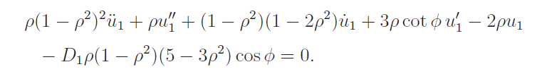

0th order : Isotropic
1st order : Anisotropic but does not contribute to EE

Slide 42
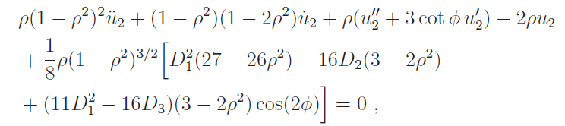
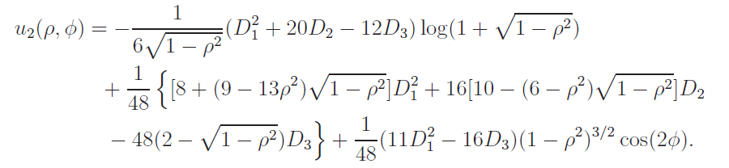
2nd order : the leading contribution to EE from anisotropic surface.

Slide 43
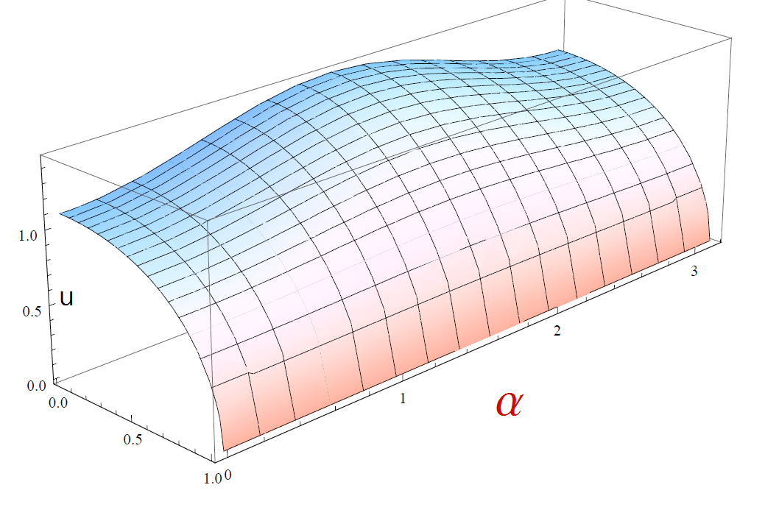
A minimal surfaces

Slide 44



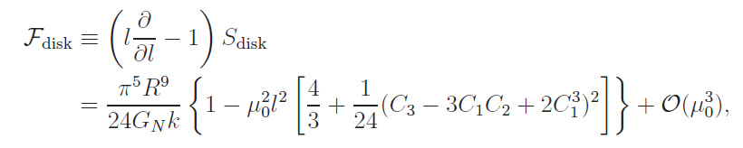
HEE for the general droplet
Renormalized EE and Complete square

Slide 45
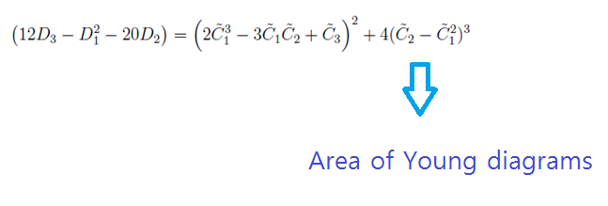
Observation
1.HEE does not depend on Scaling of the Young diagrams except for the overall factor.
2. The quadratic contribution is always negative!

Slide 46
3. The general result is consistent with the previous isotropic approximation for the symmetric droplets.

Slide 47
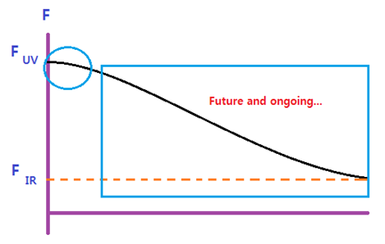
F theorem is valid near UV fixed point for all the vacuum configurations .
REE is a good choice for a c function.
PDE effect? Now OK!

Slide 48
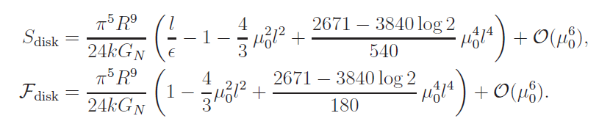
4th order
Symmetric case ( Square Y diagram )
It is also possible to calculate the general droplets.

Slide 49
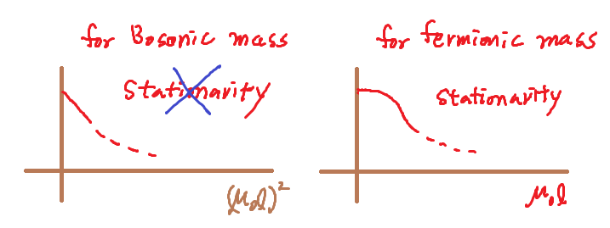
Stationarity
Since we deal with the supersymmetric deformation, we conclude that the REE or C function is stationary.

Slide 50
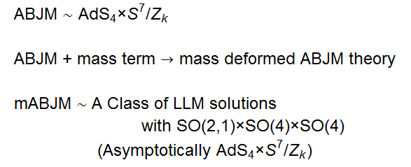
Summary and Discussion

Slide 51
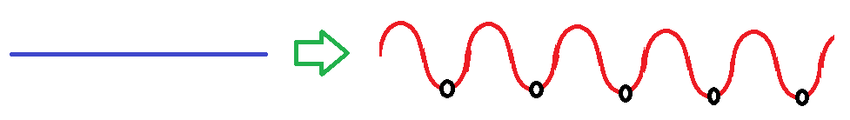

Summary and Discussion
Vacuum structure
Continuous Vacua Discrete Vacua
Entanglement Entropy ?

Slide 52



An infinite number of entanglement entropies
We consider all the entanglement entropies corresponding to all the vacua through a holographic approach(Ryu-Takayanagi Formula).
For small mass deformation
This result should correspond to the corresponding field theory calculation with small mass perturbation.

Slide 53
The droplet configuration determines all the LLM geometry.
The droplet pictures can be related to Yong diagrams.
HEE depends only on the shape of the Young diagram except for the overall factor.
All the REE corresponding to vacua of mABJM show monotonically decreasing behavior near UV fixed point.
Since the mABJM has much of supersymmetry and our result is given in small mass perturbation, we speculate that our result can be checked by a field theory calculation.

Slide 54
Thank You!

