Slide 1
Massive M2-brane theory
and the LLM geometry
O-Kab Kwon
(Sungkyunkwan University)
In collaboration with Dongmin Jang,
Yoonbai Kim, Driba Tolla
arXiv:1608.xxxxx
APCTP mini workshop
July 25 - 29, 2016

Slide 2
Outline
Introduction and motivation
LLM geometry and dual relation
KK reduction
Holography
Summary

Slide 3

Introduction and Motivation
AdS/CFT correspondence: d-dim. CFT is dual to string/M-theory
on with compact
Maldacena’s conjecture:
1. N=4 SYM in 4-dim for all is dual to
full quantum IIB string theory on
2. ‘t Hooft limit of N=4 SYM is dual to classical
type IIB string theory on
➔ 1/N expansion: planar limit
Perturbation for
String loop expansion

Slide 4
Introduction and Motivation
3. large ‘t Hooft coupling limit of N=4 SYM is dual to
supergravity on
finite

Slide 5
Introduction and Motivation
3. large ‘t Hooft coupling limit of N=4 SYM is dual to
supergravity on
To test Maldacena’s conjecture, large N is necessary.
Gauge/gravity duality is still valid for finite N?
Is there some example to see the duality for finite N?
finite

Slide 6




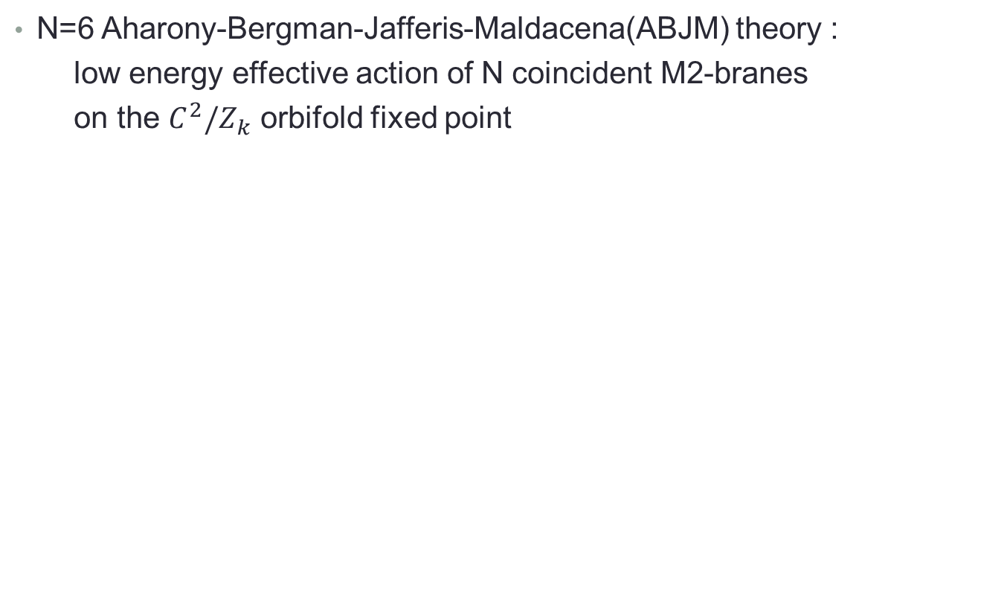
N=6 Aharony-Bergman-Jafferis-Maldacena(ABJM) theory :
low energy effective action of N coincident M2-branes
on the $C^{2}/Z_{k}$ orbifold fixed point
dual gravity(large N)
M-theory on
N =6 ABJM
dual gravity(large N)
IIA theory on
Still large N is necessary!!

Slide 7
Introduction and Motivation
Deformation: breakdown of conformal symmetry?
It was extended to deformed CFT’s and string/M-theory on
asymptotic ➔ gauge/gravity duality for non-CFT
Deformed CFT’s:
- considering vacua where the conformal symmetry
is spontanteously broken
- adding new terms in the action
➔ dual geometry becomes asymptotic

Slide 8
Introduction and Motivation
Deformed CFT’s with high supersymmetries
- considering vacua where the conformal symmetry
is spontanteously broken
ex) Coulomb branch of the N=4 SYM in d=4
[Kraus-Larsen-Trivedi]
➔ dual to near horizon limit of the solution
for multi-centered D3-branes in IIB SUGRA
➔ asymptotically
➔ Kaluza-Klein reduction
➔ Holographic renormalization method [Skenderis-Taylor 2006]

Slide 9
Introduction and Motivation
- adding new terms in the action
ex) ABJM + mass terms = mass-deformed ABJM (mABJM)
[Hosomichi-Lee-Lee-Lee-Park, GRVV, 2008]
➔ dual to the LLM geometry with SO(2,1)XSO(4)XSO(4) isometry
➔ asymptotically

Slide 10
Introduction and Motivation
- adding new terms in the action
ex) ABJM + mass terms = mass-deformed ABJM (mABJM)
[Hosomichi-Lee-Lee-Lee-Park, GRVV, 2008]
➔ dual to the LLM geometry with SO(2,1)XSO(4)XSO(4) isometry
➔ asymptotically
Known results :
- LLM geometry can be dual to the massive M2-brane theory
[Lin-Lunin-Maldacena, 2004]
- one-to-one correspondence between vacua of the mABJM theory
and the LLM geometry [Cheon-Kim-Kim 2011]

Slide 11
Introduction and Motivation
Correspondence between vacua of QFT and BPS solutions in gravity
is not enough.
How can we show the correspondence
using a method of the gauge/gravity duality
quantitatively in both sides?

Slide 12
Introduction and Motivation
Correspondence between vacua of QFT and BPS solutions in gravity
is not enough.
The underlying principles of holography were constructed
by GKP and Witten:
: gauge invariant operator in CFT
: boundary value of a gauge invariant gravity field
= source field which couples to in CFT

Slide 13

Introduction and Motivation
d=3 CFT(ABJM) is dual to the d=11 SUGRA on
KK reduction on
d=4 gravity for fluctuations

Slide 14
Introduction and Motivation
d=3 CFT(ABJM) is dual to the d=11 SUGRA on
+ relevant
deformation
KK reduction on
mass-deformed ABJM
d=4 gravity for fluctuations

Slide 15
Results
chiral primary operator
Field theory side
Gravity side

Slide 16
Introduction and Motivation
UV fixed point
CFT
(ABJM)
RG flow for a relevant deformation:
(massive deformation)
IR fixed point

Slide 17
Vacua of mABJM
N=6 Aharony-Bergman-Jafferis-Maldacena(ABJM) theory :
low energy effective action of N coincident M2-branes
on the $C^{2}/Z_{k}$ orbifold fixed point
dual gravity(large N)
M-theory on
N =6 ABJM
dual gravity(large N)
IIA theory on
SUSY preserving
mass deformation
N =6 mABJM
[Hosomichi et al 08]
[Gomis et al 08]

Slide 18
Vacua of mABJM
N=6 Aharony-Bergman-Jafferis-Maldacena(ABJM) theory :
low energy effective action of N coincident M2-branes
on the $C^{2}/Z_{k}$ orbifold fixed point
dual gravity(large N)
M-theory on
N =6 ABJM
dual gravity(large N)
IIA theory on
SUSY preserving
mass deformation
N =6 mABJM
Effective action of M2-branes
in the presence of the transverse
self-dual 4-form flux
[Hosomichi et al 08]
[Gomis et al 08]

Slide 19
One interesting property of the mABJM theory
Discrete vacua!!
[Gomis et al 08]
Too many vacua than expected
Select SUSY vacua from the classical vacua
[Kim-Kim 10]
Dual to the LLM geometry

Slide 20

Vacua of the mABJM theory
Original ABJM theory ➔ SU(4) global symmetry
Mass-deformation: SU(4) → SU(2)XSU(2)XU(1)
Two gauge fields
Matter fields are in the bifundamental representation

Slide 21

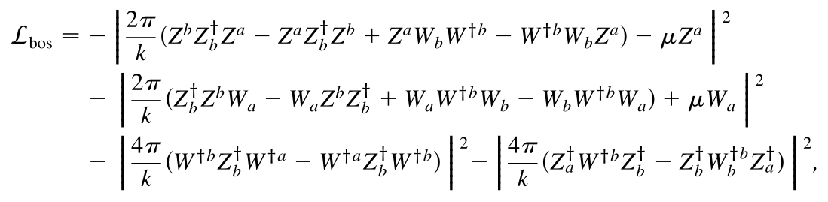

Classical supersymmetric vacuum equation

Slide 22

Classical supersymmetric vacuum equation

Slide 23


mABJM theory and SUSY vacuum solution
Classical vacuum solution
        ↓
Discrete vacuum solutions (GRVV matrix)

Slide 24
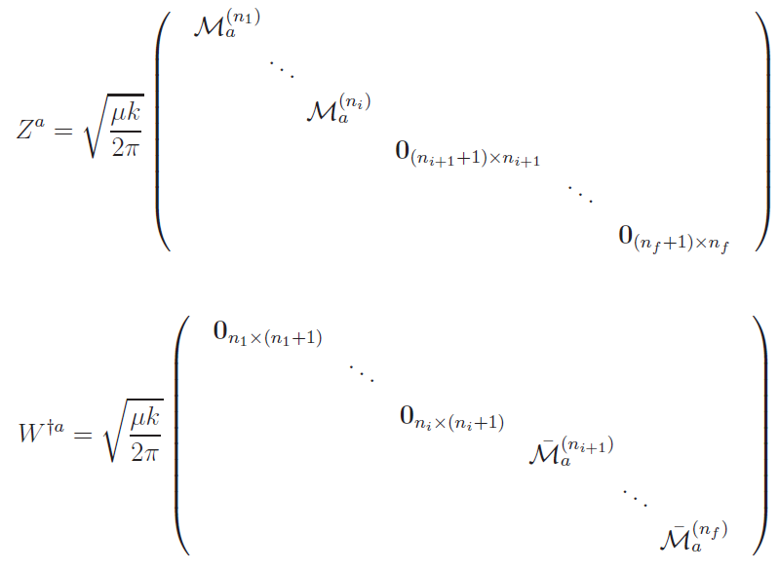
GRVV matrices
Block-diagonal N X N matrices

Slide 25




Constraint:
Condition for supersymmetric vacua:
[Kim-Kim 10]

Slide 26
Block-diagonal N X N matrices

Slide 27
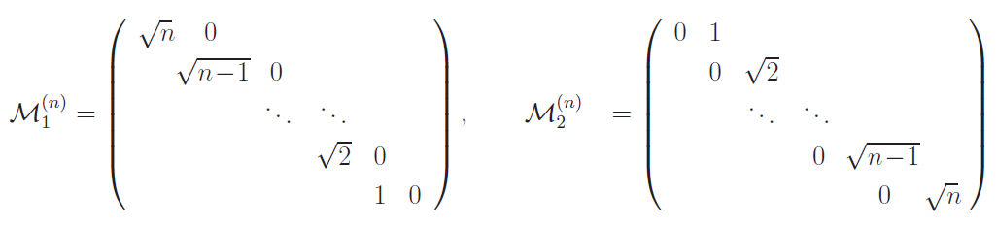

Slide 28
Constraint:
Condition for supersymmetric vacua:
[Kim-Kim 10]

Slide 29

Vacua are classified by

Slide 30
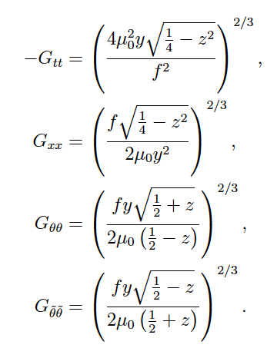

LLM geometry
Half-BPS solutions with SO(2,1)XSO(4)XSO(4) isometry
in 11-dimensional supergravity [04, Lin-Lunin-Maldacena]

Slide 31
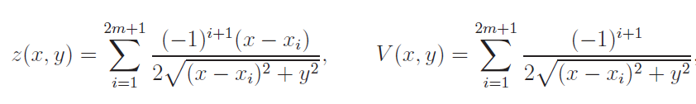
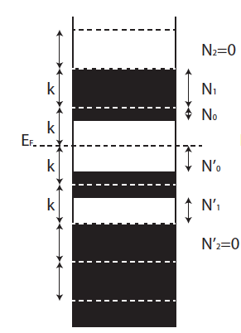
This solution is completely determined by two functions:
Vacuum is identified by the occupation numbers :
[Cheon-Kim-Kim 2011]

Slide 32


LLM geometry and dual relation
SUSY vacua of the mABJM with
[Hosomichi et al 08]
[Gomis et al 08]
(GRVV matrices)
one-to-one correspondence
[Cheon-Kim-Kim 11]
LLM bubbling geometry
with quotient in 11d SUGRA
[Bena-Warner; Lin-Lunin-Maldacena 04]

Slide 33
LLM geometry and dual relation
Half-BPS solutions with SO(2,1)XSO(4)XSO(4) isometry
in 11-dimensional supergravity [04, Lin-Lunin-Maldacena]

Slide 34
LLM geometry and dual relation
This solution is completely determined by two functions:
➔
white strip
black strip

Slide 35
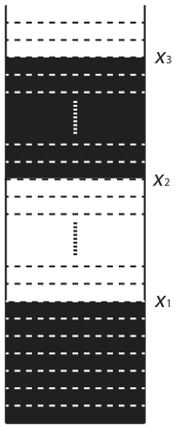

Asymptotic space
Symmetric LLM geometry
Mass effects
become large
Mass effects
become small

Slide 36
Asymptotic space
Symmetric LLM geometry
IR region
UV region

Slide 37
Asymptotic space
Symmetric LLM geometry
IR region
UV region

