Slide 1
Towards causal-patch physics in dS/CFT
Yasha Neiman
Okinawa Institute of Science and Technology
17xx.soon, 1509.05890, 1502.06685,
1502.04106, 1409.6753, 1406.3291, 1312.7842
[with Lucas Hackl, Illan Halpern]
ICGAC13-IK15
Ewha Women’s University
July 6, 2017

Slide 2

Plan of the talk
Intro to Higher-spin dS/CFT
Folding de Sitter space in half
Observer-dependent quantum mechanics
Massless holography in dS4/Z2
Higher-spin gravity on fixed geometry
Bulk and CFT from twistor space
Outlook

Slide 3
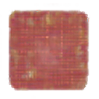
Plan of the talk
Intro to Higher-spin dS/CFT
Folding de Sitter space in half
Observer-dependent quantum mechanics
Massless holography in dS4/Z2
Higher-spin gravity on fixed geometry
Bulk and CFT from twistor space
Outlook

Slide 4

Quantum Gravity in 1997-98
AdS/CFT: first (by my standards) working models of quantum gravity.
Positive Λ: all such models observationally falsified.
Contact with experiment at cosmological scales. Through holography, quantum gravity is not just about the Planck length!

Slide 5

The significance of Λ
Anti-de Sitter (Λ < 0):
r=∞ is a physical place:
Can get there and back within finite time.
Can prepare and measure states at r=∞.
Outcomes calculated by CFT.
r=0
r=∞

Slide 6


The significance of Λ
De Sitter (Λ > 0):
Cosmological horizon around every observer.
r=∞ causally inaccessible, unphysical.
Must tackle quantum gravity inside a finite region!
t=+∞
r=rH
r=0
Causal
patch
r=rH
t=-∞

Slide 7
The big question
AdS/CFT reconciles G≠0, ℏ≠0.
Retreat to r=∞ avoids many hard questions of quantum spacetime.
Now, must reconcile G≠0, ℏ≠0, Λ>0!
Must venture into the bulk.
Quantum spacetime head-on?

Slide 8


dS/CFT: a conservative strategy
Apply AdS wisdom to Λ>0.
Use t=±∞ instead of r=∞.
Take largest, simplest finite region: causal patch of cosmological observer.
Patch is anchored by lightcones to t=±∞:
retaining some connection to the boundary.
t=+∞
r=rH
Causal
patch
r=rH
t=-∞

Slide 9
dS/CFT:
Conceptual difficulties
Find dictionary between t=±∞ and causal patch.
CFT lives on spacelike boundary. Time must emerge holographically.
How to handle the two boundaries?
t=+∞
r=rH
Causal
patch
r=rH
t=-∞

Slide 10

dS/CFT:
Technical difficulties
String theory not understood in dS ➔ no model.
No unitary SUSY in de Sitter.
Excited string modes ➔ massive bulk fields
➔ complex conformal weights in CFT.

Slide 11
dS/CFT:
History in a nutshell
2001-2004: Many ideas proposed for the conceptual issues, with no reference model.
String community “gives up”, settles on a solid but insufficient picture. [Maldacena, 2001]

Slide 12
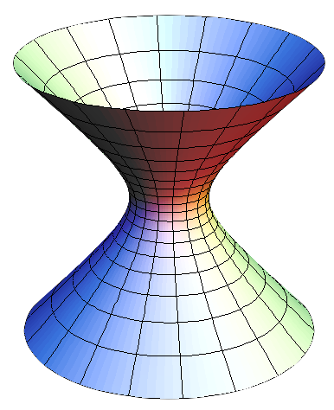
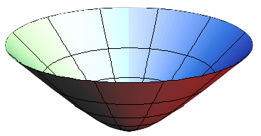
Maldacena’s interpretation
dS ↔︎ Euclidean AdS
t=∞ ↔︎ r=∞
ZCFT [sources] = Path integral in Euclidean AdS [fields at r=∞]
= Hartle-Hawking ΨH.H. in dS [fields at t=∞]

Slide 13

dS/CFT:
History in a nutshell
2001-2004: Many ideas proposed for the conceptual issues, with no reference model.
String community “gives up”, settles on a solid but insufficient picture. [Maldacena, 2001]
2011: A working model.
[Anninos, Hartman, Strominger]

Slide 14
The higher-spin model
4d Bulk: Vasiliev’s Higher Spin gravity
3d Boundary: N free massless scalars
Simplest AdS/CFT [Klebanov & Polyakov, 2001]
Survives in dS.
Bulk has ∞ many massless fields
➔ non-local, no GR limit.
However: d=4, Λ>0!

Slide 15
Higher-spin gravity
One massless field of each spin (0,1,2,3,4,…)
∞-dim gauge symmetry.
“The opposite of SUGRA”: spacetime symmetries extended in a bosonic direction.
Close relation to twistor theory.
Unbroken ∞-dim symmetry ➔ free CFT dual.

Slide 16
The Vasiliev field equations
Like GR - Non-perturbative, diff-invariant.
No action principle or quantization, except through holography.

Slide 17
Goals and attitude
Study HS gravity as a working model of holography with G≠0, ℏ≠0, Λ>0.
Recover physics in a de Sitter causal patch.
Shamelessly use unrealistic features of HS theory.
Concrete goal: obtain finite-dimensional Hilbert space in de Sitter, in accordance with BH entropy.

Slide 18
Plan of the talk
Intro to Higher-spin dS/CFT
Folding de Sitter space in half
Observer-dependent quantum mechanics
Massless holography in dS4/Z2
Higher-spin gravity on fixed geometry
Bulk and CFT from twistor space
Outlook

Slide 19

dS4 embedded in R^{1,4}
O(1,4) symmetry
Bulk isometries
Boundary
conformal group

Slide 20

de Sitter space is twice too big
Two boundaries at t=±∞.
Every observer sees half of space.
Only expanding patch is relevant for cosmology.

Slide 21

Schrodinger’s
“Elliptic de Sitter” dS4/Z2
Bulk:
Boundary:
Folding in half
in space and time.
O(1,4) symmetry preserved.

Slide 22


The promise of dS4/Z2
[Parikh, Savonije, Verlinde, 2002]
Each observer sees
all of space.
Clasically, same information on the boundary and inside
a causal patch!
However, boundary is still unobservable.
Still need a dictionary!
pfinal
pinitial
pinitial
pfinal

Slide 23
Plan of the talk
Intro to Higher-spin dS/CFT
Folding de Sitter space in half
Observer-dependent quantum mechanics
Massless holography in dS4/Z2
Higher-spin gravity on fixed geometry
Bulk and CFT from twistor space
Outlook

Slide 24
Causality in dS4/Z2
Spacetime not time-orientable.
However, no closed timelike curves.
An observer’s patch
is orientable, based on ordering of her worldline endpoints.
pfinal
pinitial
pinitial
pfinal

Slide 25
Observer-dependent quantum mechanics
Quantum mechanics requires time orientation
for sign of [x,p].
Exists only separately for each observer!
pfinal
pinitial
pinitial
pfinal

Slide 26
Horizon complementarity
[’t Hooft, 1985; Susskind et al, 1993]
Proposed solution to black hole information.
No states of entire Universe,
only of observable patches.
Hilbert spaces seen by different observers are secretly isomorphic - same quantum info.
A vague idea. Explicit realization?

Slide 27
Quantum field theory in dS/Z2
The geometry “forces” complementarity.
Classically, same information for all observers.
Quantum mechanically, have a prescription for translating info between observers.
[Halpern, YN, 2015; Hackl, YN, 2016]

Slide 28

Translation between observers
Unify the world-pictures of different observers through a global “meta” structure.
Hermitian operators in observer’s picture
Antipodally symmetric wavefunctions in global dS
[Halpern, YN, 2015; Hackl, YN, 2016]

Slide 29
Quantum field theory in dS/Z2
Observers agree on physics wherever they agree on time orientation.
However, disagree on entanglement across horizons.
Nevertheless, no obvious paradoxes.
Generalized complementarity?
[Halpern, YN, 2015; Hackl, YN, 2016]

Slide 30
Plan of the talk
Intro to Higher-spin dS/CFT
Folding de Sitter space in half
Observer-dependent quantum mechanics
Massless holography in dS4/Z2
Higher-spin gravity on fixed geometry
Bulk and CFT from twistor space
Outlook

Slide 31
Holographic dictionary for free fields in dS4/Z2
Express the operator algebra in a causal patch in terms of boundary fields.
Use only the CFT partition function. No bulk calculations!
pfinal
pinitial
pinitial
pfinal

Slide 32

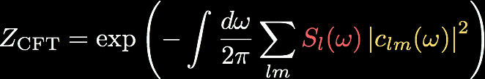
Solution
(scalar field example)
Boundary field modes:
CFT partition function:
Causal-patch operator algebra:

Slide 33
What went into this result?
R×O(3) symmetry of the causal patch.
Linearity of the free field equations.
Masslessness:
Massless fields have a special relation between boundary data at ∞ and the dS/Z2 topology.
[YN, 2014]

Slide 34
Prospects for full higher-spin gravity
Good:
dS/Z2 holography likes massless fields.
HS theory has only massless fields.
Scary:
What to do without the pure dS geometry?
How to handle the complicated bulk interactions?
What do horizons mean in HS theory, anyway?

Slide 35
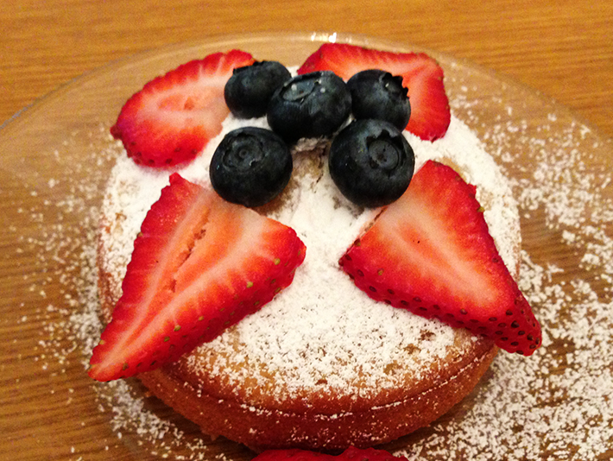
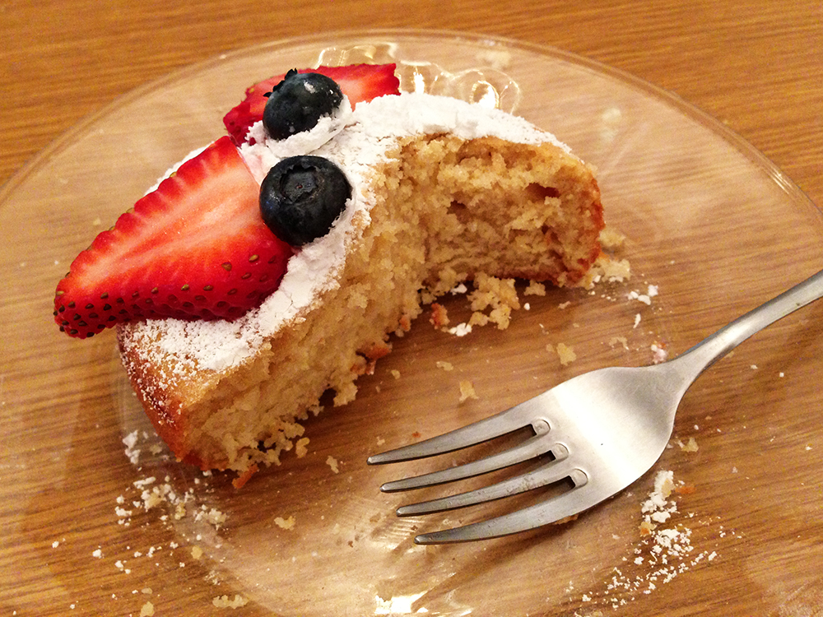
Cause for hope:
Higher spins are magic.
=

Slide 36

Prospects for full higher-spin gravity
Good:
dS/Z2 holography likes massless fields.
HS theory has only massless fields.
Scary:
What to do without the pure dS geometry?
How to handle the complicated bulk interactions?
What do horizons mean in HS theory, anyway?

Slide 37
Plan of the talk
Intro to Higher-spin dS/CFT
Folding de Sitter space in half
Observer-dependent quantum mechanics
Massless holography in dS4/Z2
Higher-spin gravity on fixed geometry
Bulk and CFT from twistor space
Outlook

Slide 38
Vasiliev’s field equations are “Unfolded”
Equations written in terms of “Master Fields”.
Contain not only fields of every spin,
but also Taylor series of derivatives.
The whole solution encoded at every point!

Slide 39
Different symmetry structure
Since fields go together with derivatives, HS gauge group includes internal translations, separate from diffeomorphisms.
The spin-2 field is tied to “internal” translations, Diffeomorphisms not essential to the dynamics!

Slide 40

The diff-invariant
Vasiliev field equations
“Gravitational”. Interesting to study.

Slide 41

Vasiliev field equations on fixed (A)dS geometry
“Non-gravitational”. Feasible to study.
[YN, 2015]

Slide 42
Prospects for full higher-spin gravity
Good:
dS/Z2 holography likes massless fields.
HS theory has only massless fields.
Scary:
What to do without the pure dS geometry?
How to handle the complicated bulk interactions?
What do horizons mean in HS theory, anyway?

Slide 43
Prospects for full higher-spin gravity
Good:
dS/Z2 holography likes massless fields.
HS theory has only massless fields.
Scary:
What to do without the pure dS geometry?
How to handle the complicated bulk interactions?
What do horizons mean in HS theory, anyway?

Slide 44
Plan of the talk
Intro to Higher-spin dS/CFT
Folding de Sitter space in half
Observer-dependent quantum mechanics
Massless holography in dS4/Z2
Higher-spin gravity on fixed geometry
Bulk and CFT from twistor space
Outlook

Slide 45
Do we need the non-linear Vasiliev equations?
We just want the “on-shell action” as a (non-linear) functional of boundary data.
Can always write it as a functional of linearized bulk solution.
Tightly constrained by HS symmetry.
[Colombo, Sundell; Didenko, Skvortsov, 2012]

Slide 46
Exploit the free CFT
Bulk HS theory: interacting m=0 fields.
Boundary CFT: free m=0 fields.
n-point functions encode bulk interactions!
The CFT can be used to solve the bulk indirectly.
Only useful if bulk and CFT are expressed on common footing.

Slide 47
Taking the fight to twistor space
Twistors:
Spinors of the spacetime symmetry group.
Nonlocal, “maximally lightlike” shapes.
Ideal for describing free massless fields.
In 4d, the Penrose transform translates between twistor space and free massless fields.

Slide 48




Taking the fight to twistor space
Twistor Space
Penrose
transform
New
Linearized
HS theory
in 4d
Free CFT
in 3d

Slide 49




Penrose transfom:
Bulk ↔︎ Twistor space
Twistor
function
Fields and their
derivatives
at point x
Higher-spin
algebra

Slide 50


Boundary ↔︎ Twistor space
CFT action with sources:
Transform into twistor space:
Partition function:

Slide 51
Taking the fight to twistor space
Twistor Space
Penrose
transform
New
Linearized
HS theory
in 4d
Free CFT
in 3d

Slide 52
Prospects for full higher-spin gravity
Good:
dS/Z2 holography likes massless fields.
HS theory has only massless fields.
Scary:
What to do without the pure dS geometry?
How to handle the complicated bulk interactions?
What do horizons mean in HS theory, anyway?

Slide 53

Goals and attitude
Study HS gravity as a working model of holography with G≠0, ℏ≠0, Λ>0.
Recover physics in a de Sitter causal patch.
Shamelessly use unrealistic features of HS theory.
Concrete goal: obtain finite-dimensional Hilbert space in de Sitter, in accordance with BH entropy.

Slide 54
Plan of the talk
Intro to Higher-spin dS/CFT
Folding de Sitter space in half
Observer-dependent quantum mechanics
Massless holography in dS4/Z2
Higher-spin gravity on fixed geometry
Bulk and CFT from twistor space
Outlook

Slide 55
Outlook
Translate the free-field dS/Z2 holography into the language of higher-spin theory.
Hope that the magic continues, and that the full non-linear result will follow.
Obtain the first working model of quantum
sort-of-gravity inside a cosmological horizon.
Finite-dim. Hilbert space?
Expected side benefit: a more explicit quantization of higher-spin theory.

Slide 56
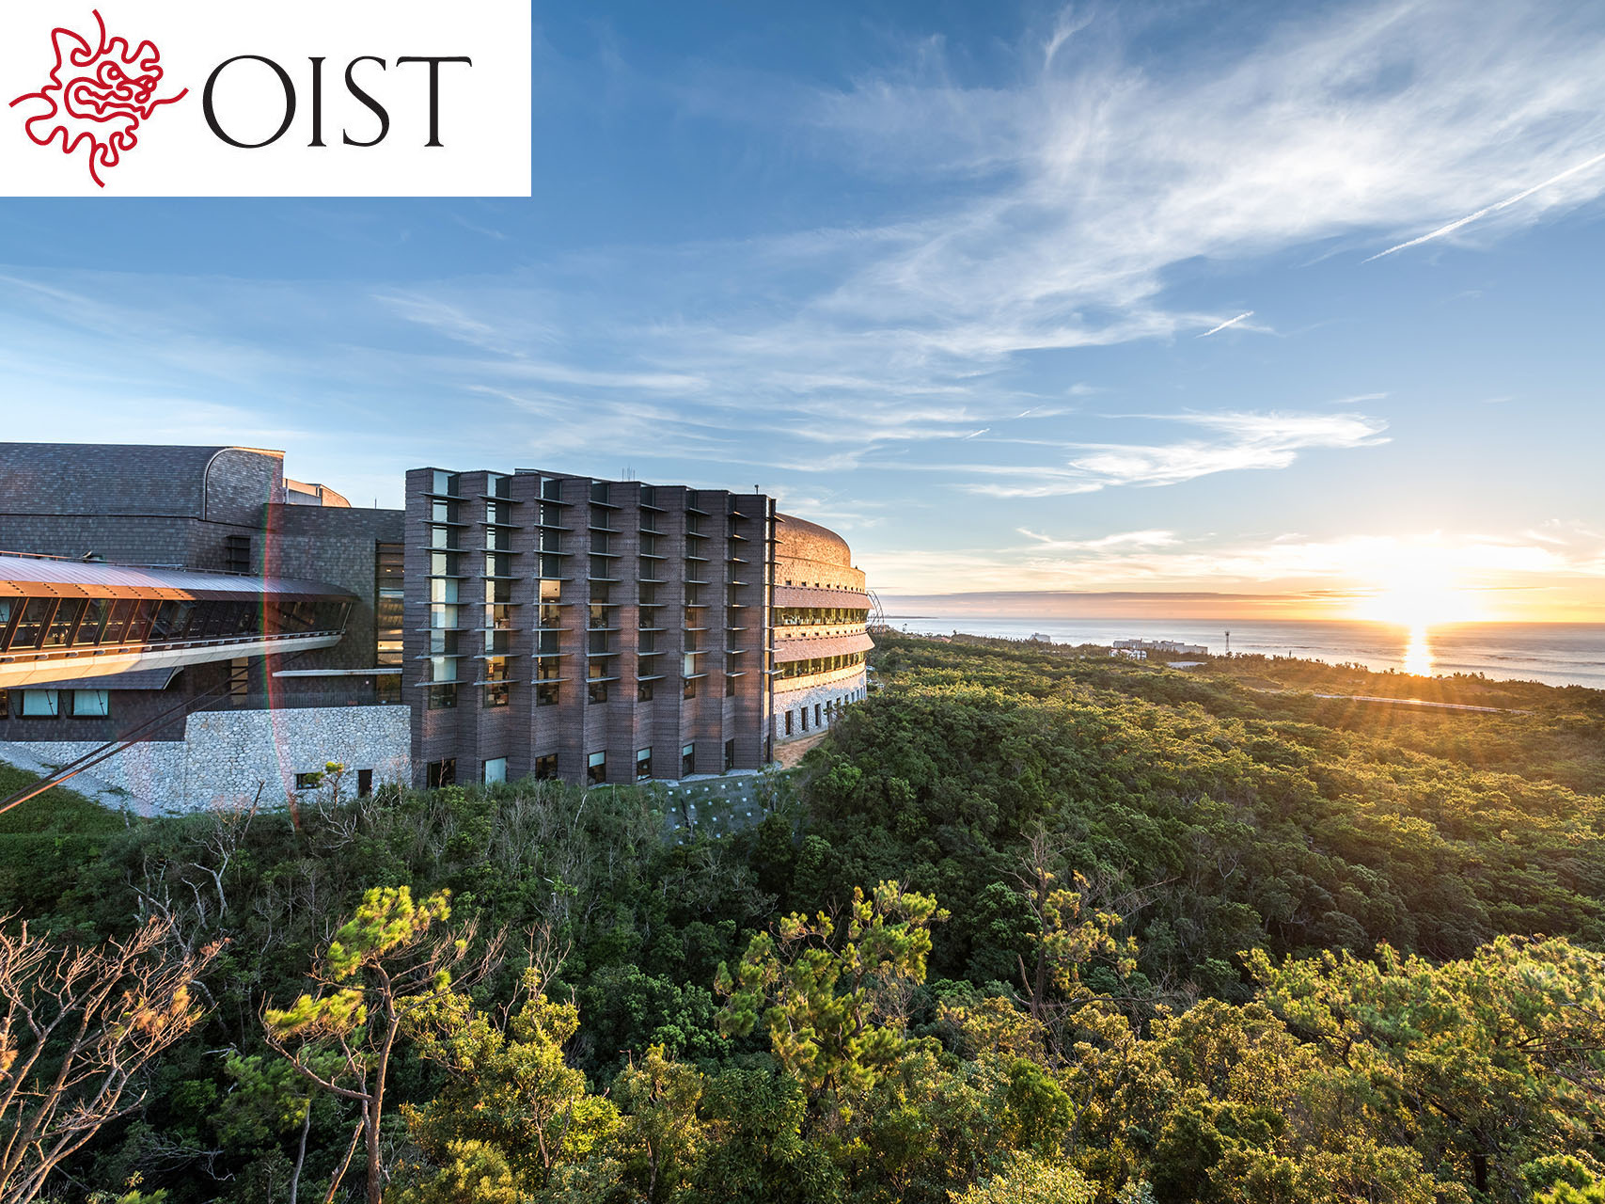

Slide 57



Clifford algebra:
O(1,4) symmetry generated by:
Reflection (CPT):
“Square root” representation:
Spinors!
Higher-spin algebra:
O(1,4) symmetry generated by:
Reflection (CPT):
“Square root” representation:
Penrose transform!

Slide 58

“Square root representation”
made manifest via boundary bilocal:
where
The same bilocal transforms the CFT
into twistor space:

