Slide 1
The revival of General Relativity at Princeton.
Dieter Brill
University of Maryland

Slide 2
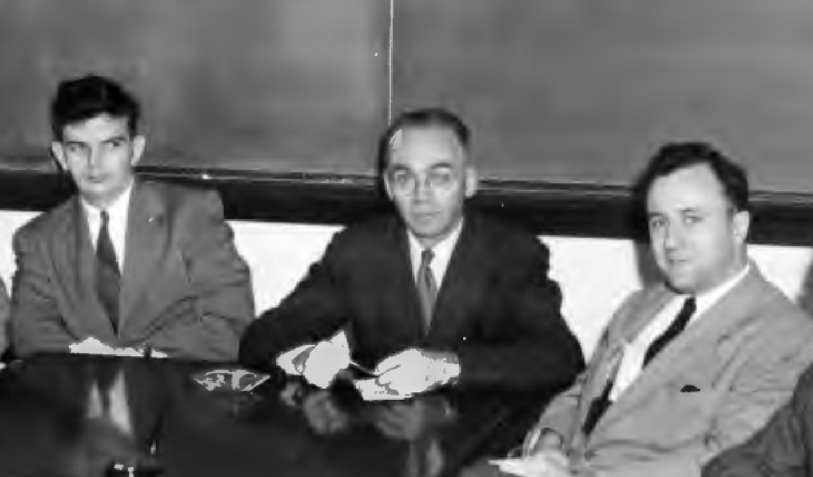
Dicke Bleakney Wheeler about 1950

Slide 3
3 decades after its discovery General Relativity was a sterile, neglected part of Physics
Revival in 1950’s led by Wheeler’s “Daring Conservatism” inherited from Bohr
His judgment and courage, his daring conservatism, carried him to
wonderful conclusions of a kind that free invention has not strength to
reach, nor conviction to maintain.
Some people think Wheeler's gotten crazy in his later years, but he's always been crazy.
R. Feynman as reported by K Thorne
This was a view that John used to justify some of his outrageous work like wormholes and geons and whatnot.
Charles Misner
Daring Conservatism struck many colleagues as odd but somehow irresistible.
In the execution no one comes close to Wheeler of the 1950’s.
He came to fundamental physics from nuclear physics.
His task -- the union of “five particles and four modes of energy transmission”
He first attacked fields in a series of 6 papers (two unwritten) he named a critique of classical field theory. We take this as the Daring Conservatism program.

Slide 4
Daring conservatism may be said to proceed by
Wheeler’s first Moral Principle
Never make a calculation until you know the answer
… and be daring in choosing and then getting that answer.
In the years preceding his GR work his answer for the basic constituents of nature was: electrons and positrons. Fields are unnecessary because Action takes place at a Distance between point charges – Wheeler-Feynman electrodynamics. It does not need the concept of electromagnetic field and its infinities.
Other elementary particles would then have to be bound states of electrons and positrons, a kind of higher-order positronium. A start in this direction was made in Wheeler’s study of Polyelectrons. He asked suggestive questions connecting them to mesons.

Slide 5
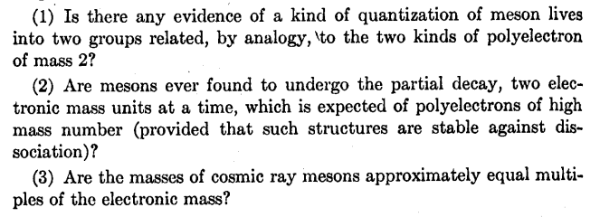
And he asked Bohr:
The other problem, about which I am very anxious to get your opinion, is the question: is it possible to exclude a picture of elementary particle [meson and nucleon] constitution based entirely on positive and negative electrons?
Here’s how the scheme was supposed to work:

Slide 6
Are all elementary particles and fields explained via electrons?
Object | Reference | Method
Electron/Positron | Pair Theory (1930’s) | Basic constituent
Meson | Polyelectrons (1946) | QM electrostatic bound state “The properties of polyelectrons suggest … questions about … cosmic ray mesons”
nucleon | Letter to Bohr (1950) | QM bound state due to radiative EM forces “It does not seem impossible …”
EM field | Wheeler-Feynman (1945/9) | Action at a Distance between point charges
Gravity | Problems and Prospects in Elementary Particle Research (1945) | Eliminate Space and Time “Just as [for E&M]… we should be able in principle to dispense with the[se] concepts”

Slide 7
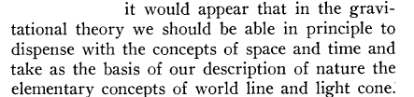
Action at a distance also for gravity:
Wheeler 1945, 1949
And for Mach’s Principle,
inertia here arises from mass there
on which Wheeler’s 1952 course was based. It makes the single mass Schwarzschild solution senseless
Geometry cannot be part of physics in some regions and not part of physics in others
and implies that the universe be closed. Recorded in his class and research notebook.
If you would learn, teach!

Slide 8
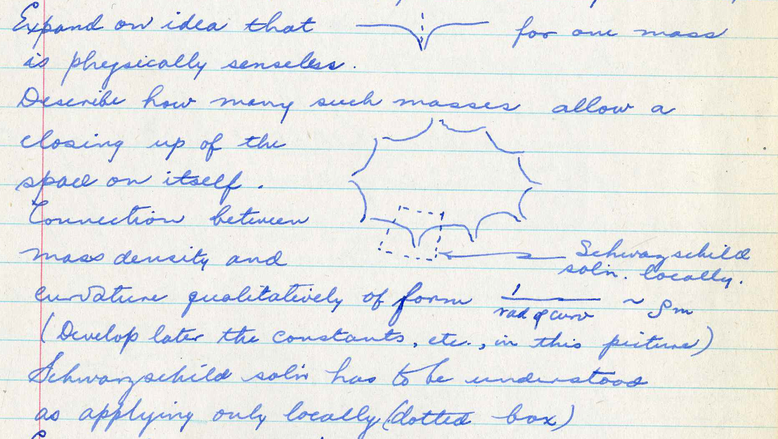

Slide 9
The page following testifies to Wheeler's strong commitment to his conception of Mach's principle (transcribed from Notebook):
Question raised (in class) whether mass density enough to permit open or closed universe, in view of expansion rate?
Answer: Conclude from above that closure comes first; density knowledge too poor to permit proof of contradiction; closure so fundamental to whole Mach idea that in present state of knowledge think of density value having to yield precedence to Mach principle.
The notebooks show efforts to describe spacetime, in a complementary way, by , worldlines, lightcones and their "liaisons"
But spacetime and fields remain, and the vision changes from fields as subsidiary to particles to particles (classical bodies) made from fields. This vision, and Daring Conservatism itself, is revealed to the world on January 29, 1954 in the 12th Richtmyer lecture of the APS.
People still thought Wheeler was crazy, but this time they listened – the ideas fresh and sufficiently well-defined to work with (if only to refute).

Slide 10
12th Richtmyer lecture
I propose that we should raise at the head of our enterprise the flag of daring conservatism
Conservatism built on five most fundamental concepts
Three massless fields -- electromagnetism, gravity, neutrino
One principle – quantum
and electron theory
Examples of free inventions to be rejected
Cosmological constant
Meson theory – proliferation of fields
Unified Field Theory – “no accelerator would work”
Challenges to the daring
Gravitational collapse
What is the distinction of principle, if any, between the final stages of collapse of a star
and the steps in the decay of a meson?
Kugelblitz – ball of light -- later called geon
How different is a particle from a kind of hurricane in the fields of zero rest mass?
In what points of principle., if any, do [smallest mass geons] differ from elementary particles?
Feynman quantization of gravity
Find neutrino field in GR action functional – (-g)^{½}
Electrons as a special kind of disturbance in the electromagnetic field and in other fields of zero rest mass.

Slide 11
The GEON Paper
(Part 6 of the critique of classical field theory, 1955)
Less than 8 months after the Richtmyer lecture the first results of calculations on geons were published
Geons are soliton-like long-lived concentrations of zero restmass field energy
Visualized as beams of radiation (light) bent into circles by the gravity of these beams
Non-singular solutions of coupled gravity and field equations
They have a non-zero total mass-energy, hence “mass without mass”, momentum, intrinsic angular momentum – properties of a classical body
Spherical thin-shell geons are truly spherical and static only in a “geometrical optics” approximation
In a wave description energy can leak to infinity through the gravitational barrier, the geon loses mass and decays – but linearly, in finite time
The mass of a thin-shell geon determines its radius and the red shift from its interior (similarity law)
The analysis for the proper approximate form of the field equations is involved and takes many notebook pages. Here is the beginning of it,

Slide 12
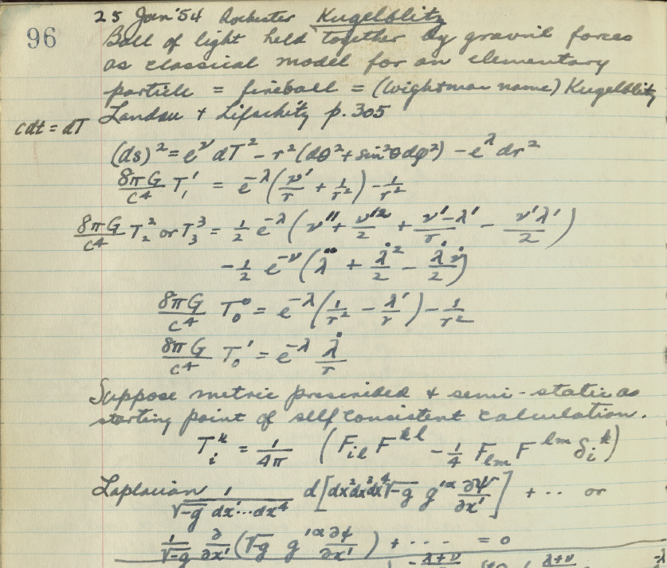

Slide 13
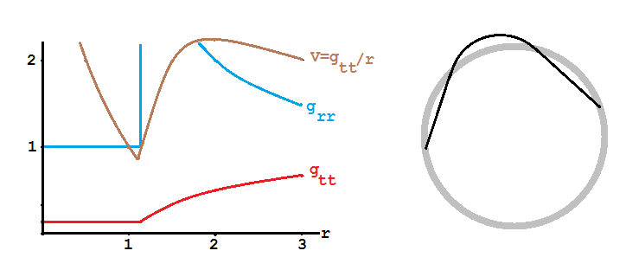
Result: 3 coupled ODE’s (for g_{tt}, g_{rr} and the field strength) that were solved numerically and yielded the red shift factor g_{tt}^{½}(0) = 0.33 ≈ 1/3 and a geon radius 9M/8.
Once the structure qualitatively known (flat inside, Schwarzschild outside) these results can be found from the single equation R = 0, valid for any zero restmass field. Integration over the thin active region where R has δ-function singularities yields an algebraic equation between the inner and outer metric parameters.
Also in geon paper: charge without charge, Feynman quantization

Slide 14
Part 6 of the critique: Geometry
Very conservative: classical theory is rewritten, unchanged
Very daring: electromagnetism is eliminated, many different topologies are admitted
Method: The “footprints” that EM fields leaves on geometry are as good as EM fields themselves for expressing the content of Maxwell’s equations.
“Real” charges can be replaced by flux through wormhole mouths, like “real masses” are replaced by geons or wormholes
Einstein-Maxwell equations are replaced by very different-looking Rainich-Riemann equations for the spacetime geometry only – geometrodynamics
They have the same content and solution geometries as Einstein-Maxwell.
Though harder and less practical to solve and interpret, they achieve in terms of pure geometry
Gravitation without gravitation (as Einstein did)
E&M without E&M
Charge without charge (wormholes)
Mass without mass (geons)
These are the main results of daring conservatism of the 1950’s.
On the practical side the paper gives the uniquely appropriate mathematics (differential forms) for treating electromagnetism in general manifolds.

Slide 15
What became of Daring Conservatism?
It became more commonplace, less conservative. Some of the questions of the 50’s became tremendously fruitful (and mainstream), others fell by the wayside.
Wheeler was wrong about cosmological constant and closed universe
Gravitational collapse led to black holes, their transformations, entropy, radiation
Kugelblitz-geon was found to be unstable to a collective mode. Wheeler considered it as a resonance on the way to gravitational collapse. Generalized, the concept is still used
Quantization of gravity is not (yet?) achieved. Sum over all topologies led Wheeler to the idea of a foam-like structure of spacetime
Neutrinos – no uniquely right proposal for spin without spin
Elementary particles: geometrodynamics only available indicator of what goes on at small distances; one must have some perspective on what happens at 10⁻³³ cm before one can find the rationale of quarks and particles
Action-at-a-Distance spacetime was still considered to motivate a rethinking of the meaning of space and time
E&M without E&M found to fail for certain configurations (null fields). “If it came true, it was not much of a dream”.
Charge without charge and other topologies – one of the most fruitful ideas to come out of the geometrodynamics program.
Wheeler’s question about entropy of a system falling into a black hold led to black hole entropy; a similar question about nucleon conservation led to Wheeler’s very little reported δ-ray free invention

Slide 16
Overall, Wheeler lifted General Relativity from the margins of physics to one of the hottest research topics it is today

